Slide 1
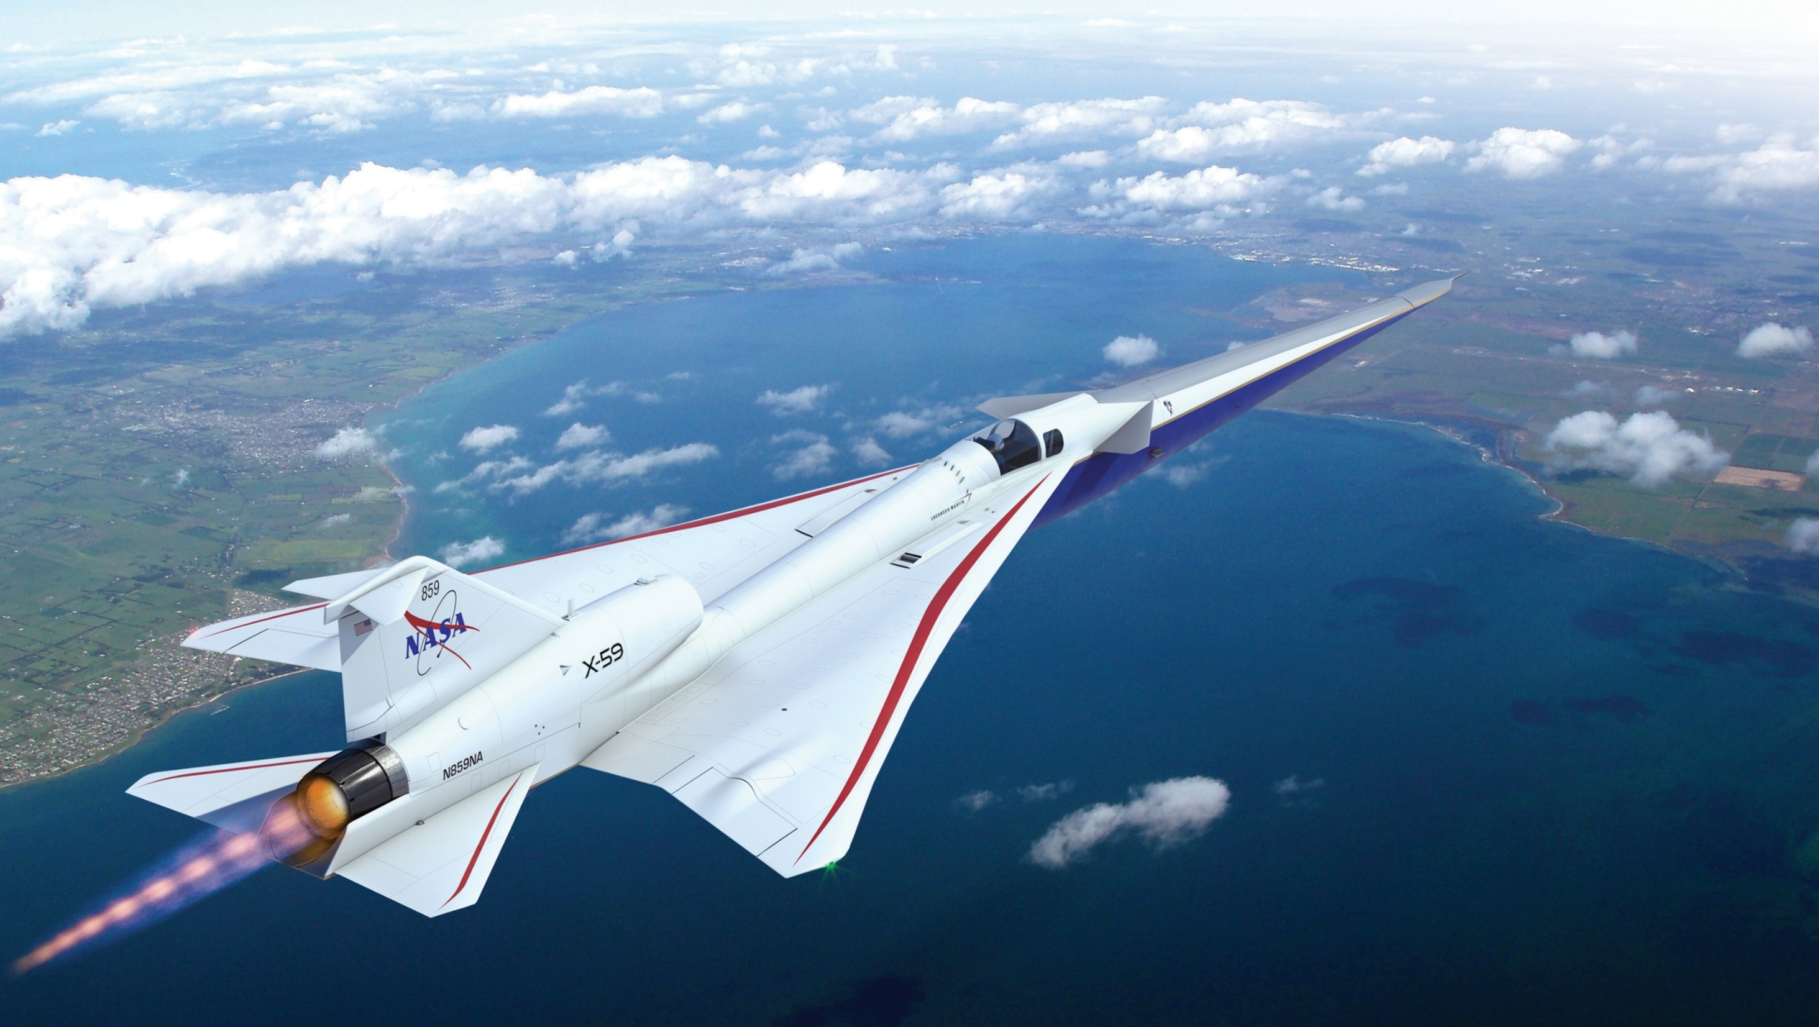
NASA and Quesst Mission Overview
Aaron Vaughn
NASA Langley Research Center
University of Nebraska-Lincoln
American Society of Mechanical Engineers
November 8, 2022
Notes:
Hi I’m Aaron Vaughn from NASA Langley Research Center and today I’ll be providing some information about acoustics at NASA and share a brief overview of the Quesst Mission.
I’d also like to acknowledge several others at NASA who have contributed to this presentation including the members of NASA’s community test planning and execution teams, and our branch heads Ran Cabell and Mike Doty

Slide 2
Outline
My background
Opportunities at NASA
  Acoustics at NASA Langley
  Opportunities for students and graduates
NASA Quesst Mission
  Background: civil supersonic transportation prohibition
  X-59 low-boom aircraft
  Mission phases
  Current status
  Challenges
Notes:
First, I’ll give a little about my background. Then I’ll provide some information about what acoustics research is going on at NASA Langley and potential opportunities at NASA. Finally, I’ll talk about the Quesst mission that I’m currently supporting, whose goal is to help enable the future of commercial supersonic flight.

Slide 3

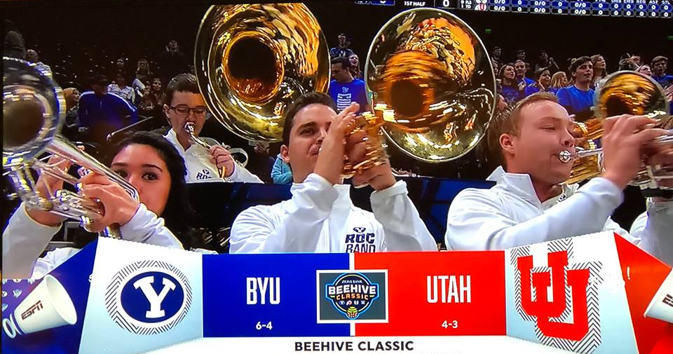
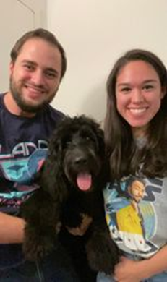
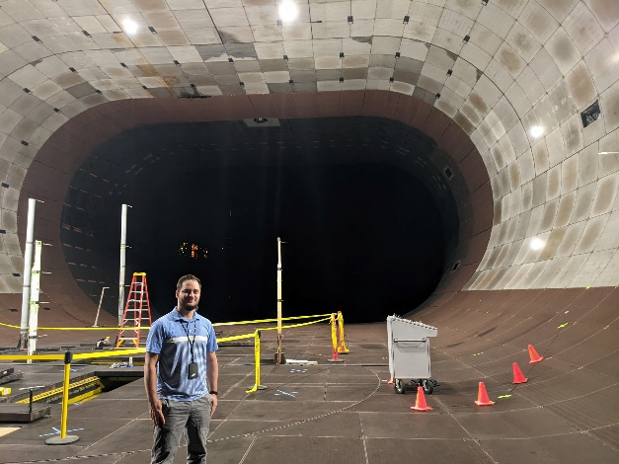
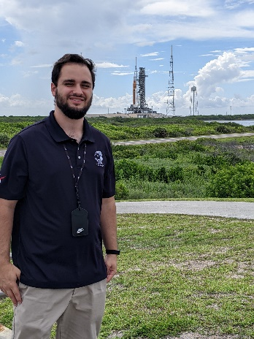
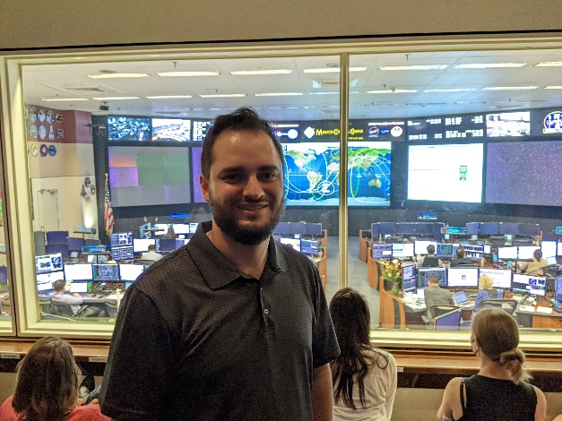
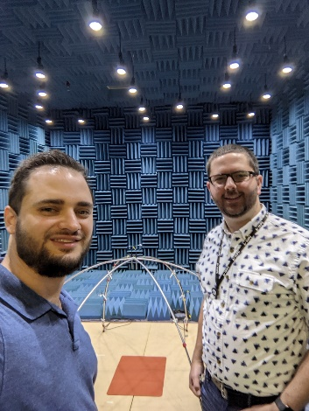
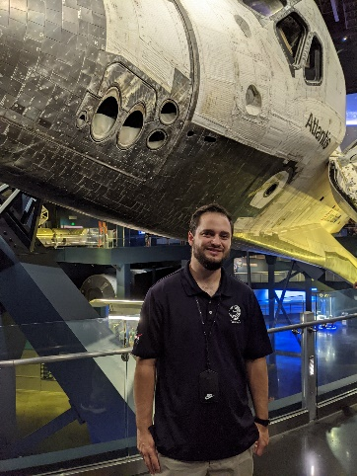
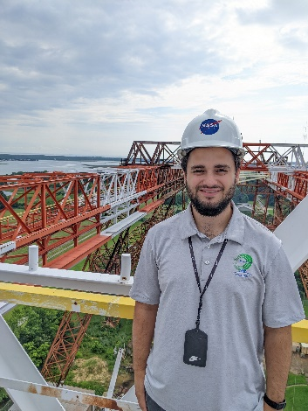
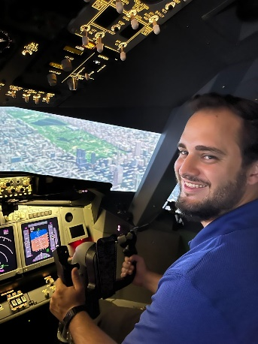
About Me
Originally from New Mexico and Utah
M.S. in Physics from Brigham Young University, Aug. 2020
  Jet noise research – physical characterization of jet crackle
Research Aerospace Engineer
  Structural Acoustics Branch, NASA Langley Research Center, Hampton, VA
  Sonic boom research
Early career leadership development program
  NASA FIRST (Foundations of Influence, Relationships, Success, and Teamwork)
  Learn about NASA, myself, and teamwork
Notes:
A little background about myself–
I’m originally from New Mexico and Utah. I attended Brigham Young University in Provo, Utah for my undergrad and graduate degrees in physics. I was involved in jet noise research under Dr. Kent Gee as both an undergrad and grad student and wrote a Master’s thesis on the physical characterization of jet crackle. I also participated in the BYU marching and pep bands, where I met my wife who I married in the Salt Lake Temple, and we have a dog named Lando.
I joined NASA after graduating in 2020. My job title is Research Aerospace Engineer and I do acoustics research with sonic booms in the structural acoustics branch at NASA Langley.
Since joining NASA, I’ve been fortunate enough to participate in an early career leadership program titled NASA FIRST, which stands for Foundations of Influence, Relationships, Success, and Teamwork. This program focuses on development through understanding NASA as an Agency, greater awareness of self, and the importance of team dynamics. I’ve had the opportunity to visit other NASA centers and see amazing facilities far beyond what my day-to-day job is involved with such as the 40’x80’ wind tunnel at Ames Research Center, the SLS rocket at Kennedy Space Center, the Flight Control Center at Johnson Space Center, to name a few.
I am excited today to share with you all a bit about what goes on at NASA.

Slide 4
Outline
My background
Opportunities at NASA
  Acoustics at NASA Langley
  Opportunities for students and graduates
NASA Quesst Mission
  Background: civil supersonic transportation prohibition
  X-59 low-boom aircraft
  Mission phases
  Current status
  Challenges
Notes:
Alright enough about me. Let’s move on to Acoustics at NASA

Slide 5
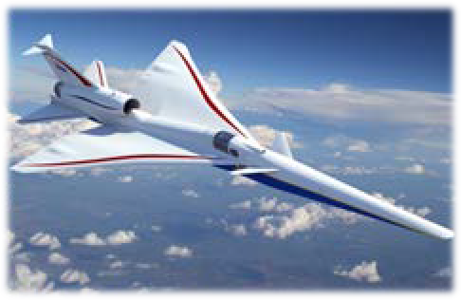
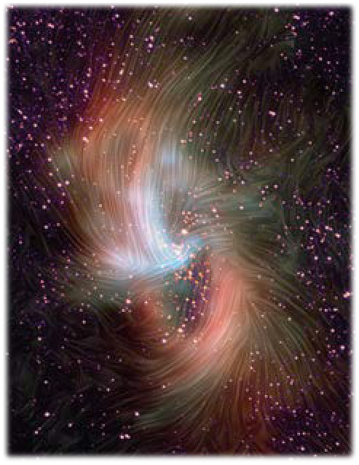
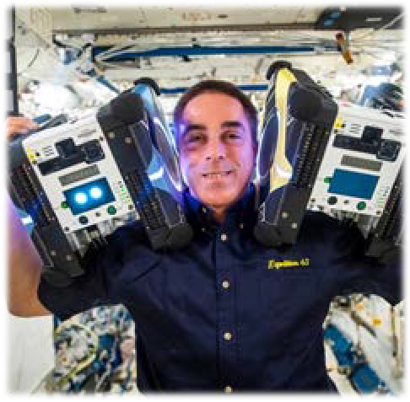
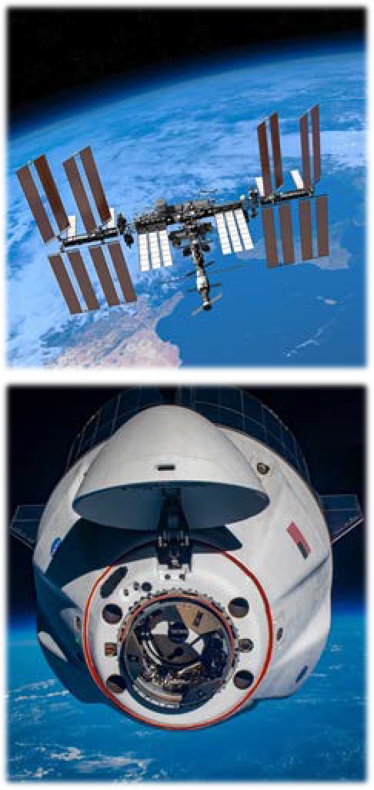
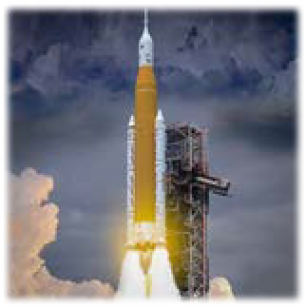
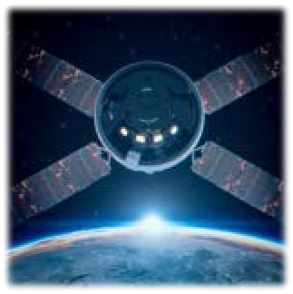
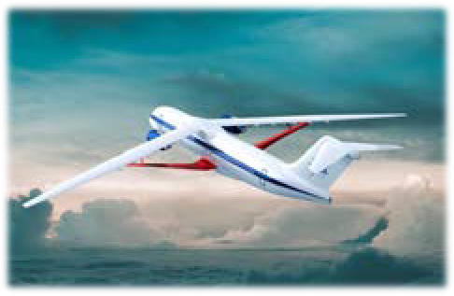
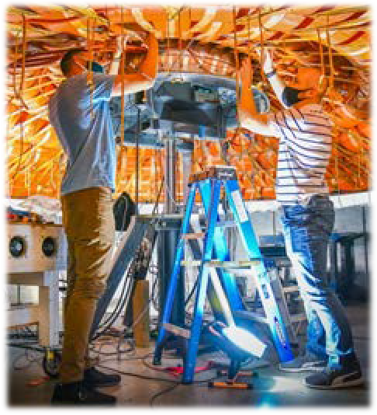
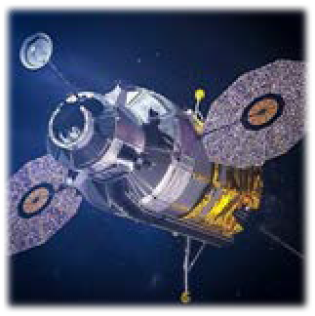
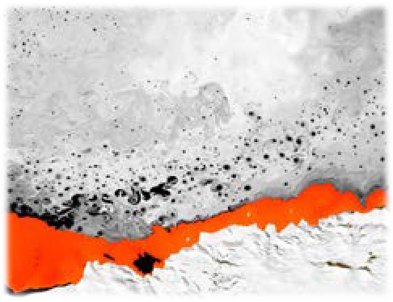

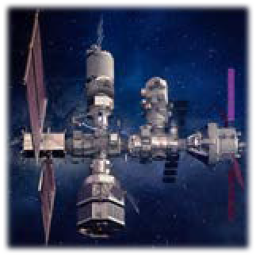
NASA Mission Directorates
Aeronautics Research
Science
Space Technology
Space Operations
Exploration Systems Development
Transform Aviation through R&D
Understand the Sun, Earth, and Universe
Develop and transfer revolutionary technologies
Launch and Space Operations
Moon to Mars Exploration
Adapted from ntrs.nasa.gov/citations/20220013091
Notes:
NASA stands for the National Aeronautics and Space Administration and is divided into 5 Mission directorates. Aeronautics which seeks to transform aviation through research and development, Science that seeks to understand the sun, Earth, and universe, Space Technology that deals with developing and transferring revolutionary technologies, Space Operations that handles launch and near-Earth space operations, and Exploration Systems Development that encompasses Moon to Mars and deep space exploration.
Now NASA is of course typically associated with space research, and I know what you’re thinking – there is not a whole lot of sound in space. But the aeronautics research mission directorate focuses on several acoustics related projects here on earth for terrestrial aviation.

Slide 6
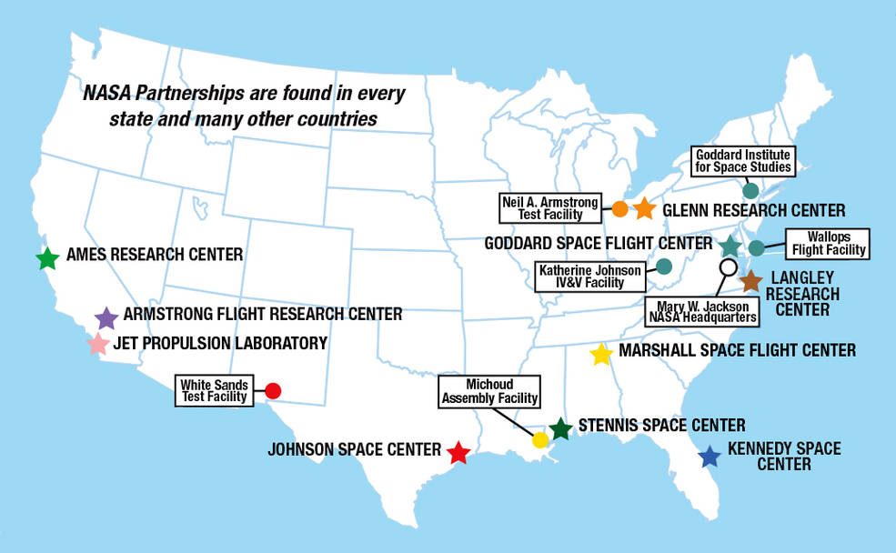
Notes:
NASA has many research, spaceflight and assembly facilities all across the country, and NASA Langley is in Hampton, VA.
Much of the work is done with teams spanning multiple locations. On my team, we also regularly work with NASA employees from Armstrong and Ames in California as well as some from NASA Glenn in Ohio. NASA also supports contractors who work all over the globe.

Slide 7
Acoustics at NASA Langley
Structural Acoustics Branch
  stab.larc.nasa.gov
Aeroacoustics Branch
  aab.larc.nasa.gov
Notes:
NASA Langley has two acoustics branches with slightly different expertise. I work in the Structural Acoustics Branch, and our sister branch is the Aeroacoustics Branch. Their websites are listed here in case you want to dive into additional detail on any of the topics I will outline on the next slide.

Slide 8
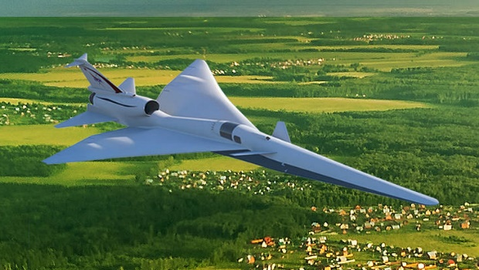
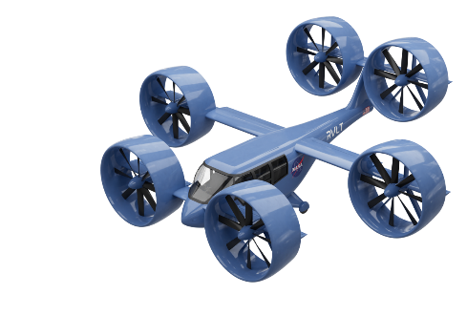
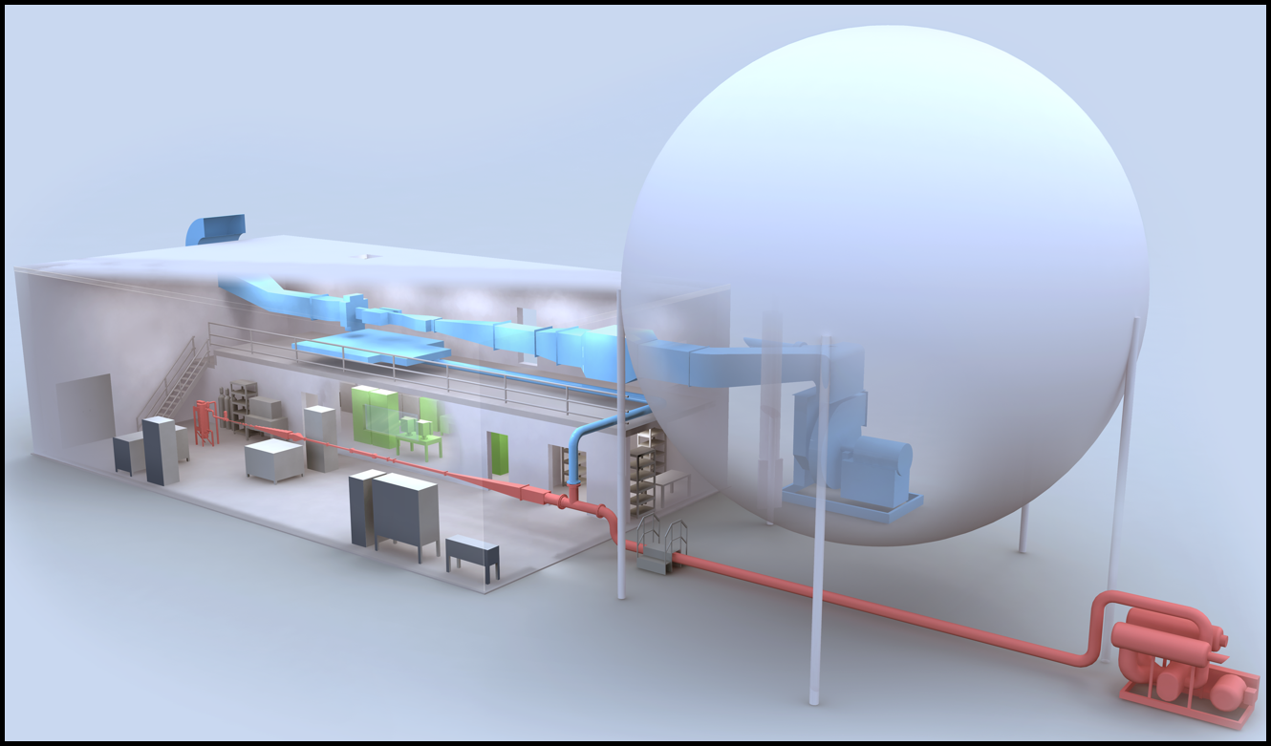
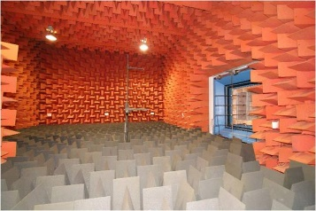
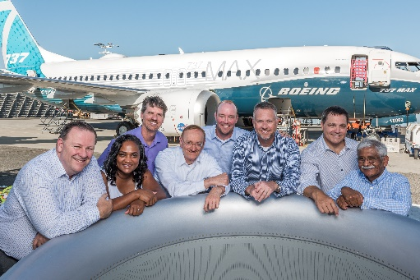
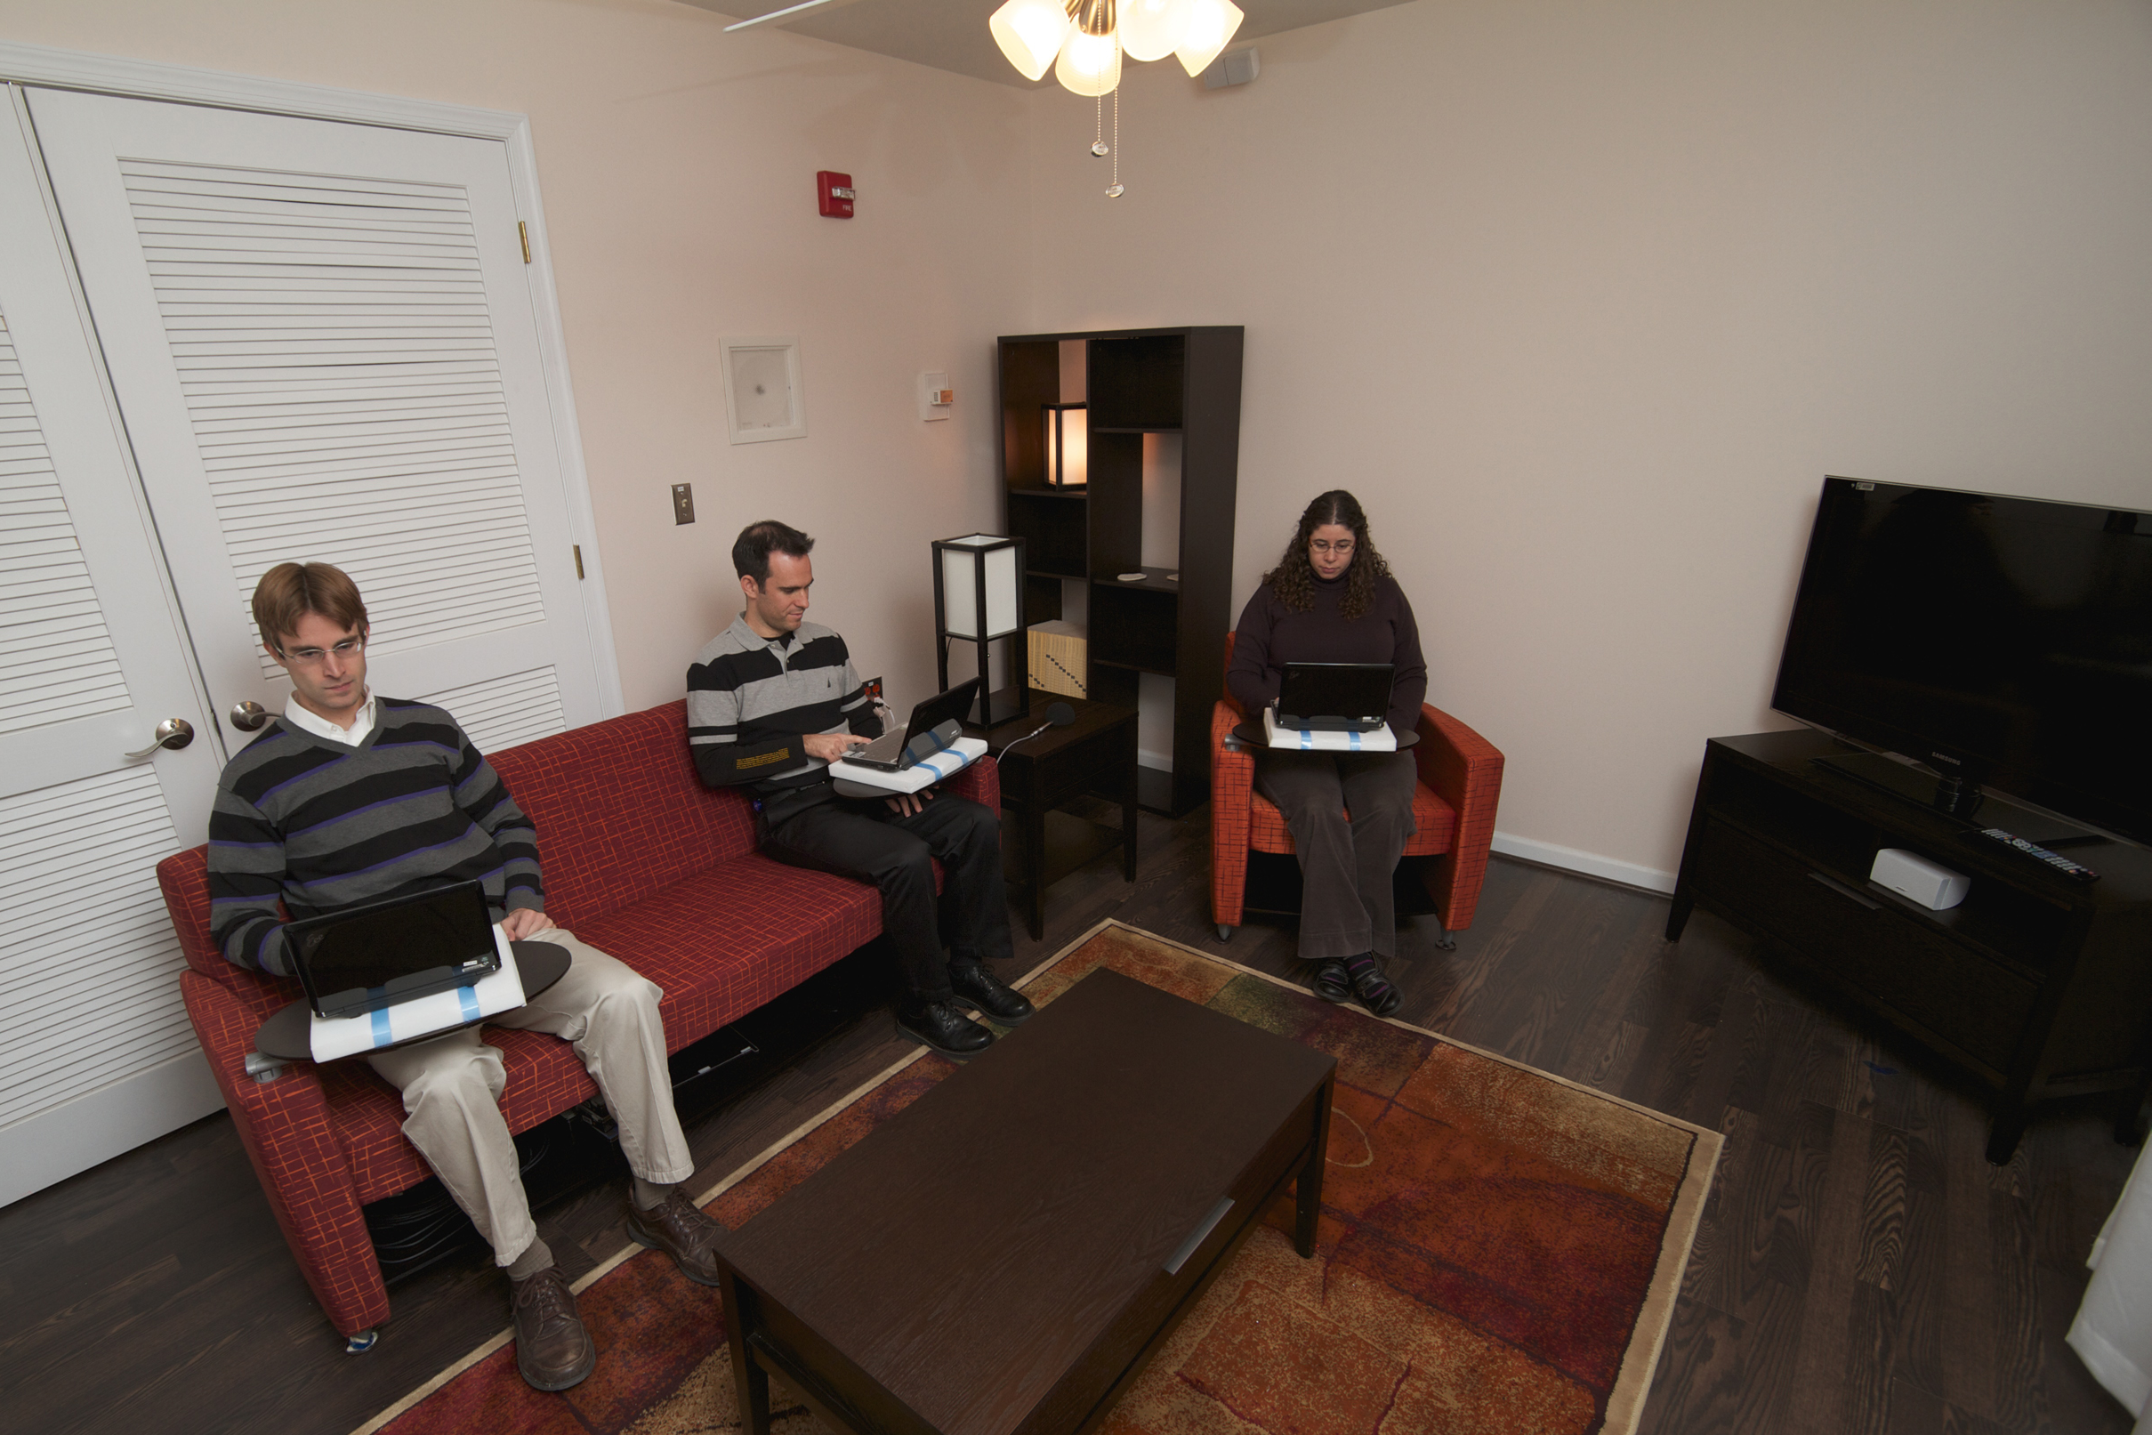
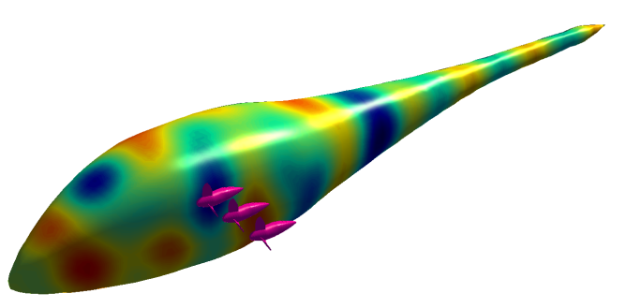
Structural Acoustics Branch
  stab.larc.nasa.gov
Understand and mitigate the impact of noise on people and structures
Auralization
Realistic aircraft sounds from predictions or measurements
Major Facilities Used
SALT (anechoic chamber, reverberant chamber)
Liner Technology Facility
Psychoacoustics
Human response to sound;
community response to aviation noise
Noise Control Technologies
Acoustic Liners
Active noise control
Adaptive structures
Sound/structure Interactions
Exterior Effects Room
Interior Effects Room
Notes:
[take time, point out figures]
The structural acoustics branch aims to understand and mitigate the impact of noise on people and structures. There are four main categories of research expertise in our branch – psychoacoustics, auralization, sound/structure interaction, and noise control.
For psychoacoustics, we research human perception of sound and community noise. Two of our branch’s facilities support this. The exterior effects room is a multiseat psychoacoustics laboratory where aircraft or other sounds is played over an array of loudspeakers. The emerging topic of urban air mobility or small personal rotorcraft and the noise they generate is of particular interest to our branch, and a lot research is being done in that area.
The interior effects room is an interesting lab space that looks just like a home living room but is instrumented with 52 subwoofers in order to accurately recreate the sound from supersonic aircraft.
The auralization team creates realistic aircraft sounds from predictions and measurements, which are often played back in the exterior effects room for psychoacoustics studies.
Our noise control technologies team supports several projects. The Liner Technology Facility is used to test the noise reduction qualities of jet engine acoustic liners in laboratory conditions. The noise reduction research has influenced products that are currently flying today. Others in the branch support active noise control, adaptive structures, and effects of sound on structures such the effect of rotor noise on aircraft bodies.

Slide 9
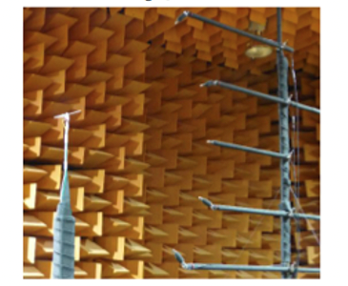
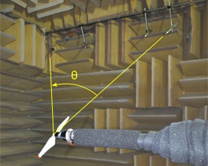
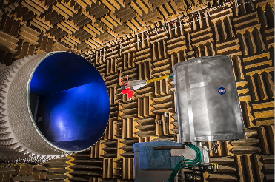
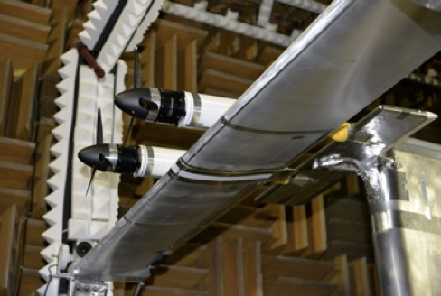
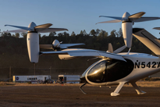
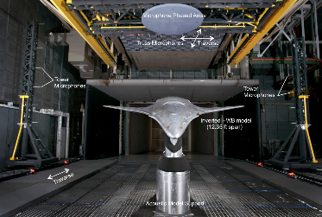
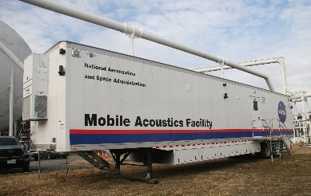
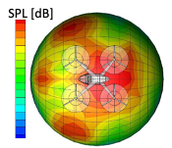
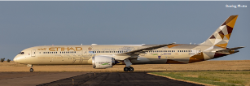
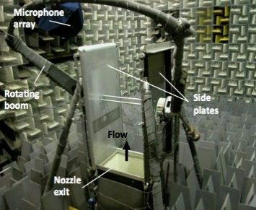
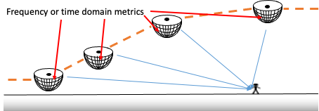
Aeroacoustics Branch
  aab.larc.nasa.gov
Understand and accurately predict the noise from any air vehicle configuration.
Define and demonstrate concepts for air vehicle noise reduction.
Major Facilities Used
Subsystem Level Measurements
Full Vehicle Measurements
Small Hover Anechoic Chamber
Low Speed Aeroacoustic Wind Tunnel
Source Noise Experiments
14x22 Acoustic Mode
Mobile Acoustics Facility
System Noise
Propulsion-Airframe Aeroacoustics
Quiet Flow Facility
Source Noise Predictions
Notes:
[make sure it conveys more than just propellor noise]
The aeroacoustics branch aims to understand and accurately predict the noise from any air vehicle configuration as well as to define and demonstrate concepts for air vehicle noise reduction.
Six of their expertise areas are source noise experiments, subsystem measurements, full vehicle measurements, source predictions, system noise, and propulsion-airframe acoustics.
Researchers work in several wind tunnels measuring noise from various propellers at the subsystem level, but they also get to take the mobile acoustics facility out to the field and measure noise from vehicle flyovers. From these and other prediction tools they create accurate directional source noise predictions for use in determining noise at the ground.
Between the two branches there is a lot of amazing work being accomplished, and perhaps something that catches your interest.

Slide 10
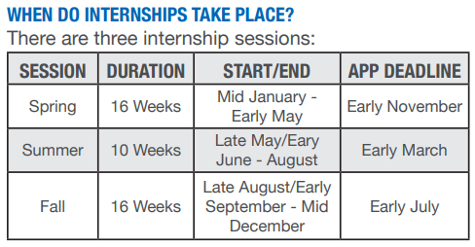
NASA Opportunities for Students and Graduates
intern.nasa.gov
  Internships
  Fellowships
    2021: $50k (M.S.) or $55k (PhD) per year
  Pathways Program
    Minimum 16 weeks on-site at NASA
usajobs.gov
  Employment
    2022: Starting at $66k for M.S. and $80k for PhD + annual bonus. Support for work-life balance:
      13 days paid time off + 10 federal holidays, 13 days paid sick leave, 12 weeks paid parental leave
      Health & life insurance, up to 5% matching retirement contribution plus pension
    Flexible work hours, telework arrangements, and conference travel support may also be possible
NASA Advanced Degree Program
  Covers tuition and books to complete Master’s and PhD programs after being hired
Notes:
There are many opportunities for students and graduates at NASA. The primary channels are through the intern.nasa.gov website and the federal job website, usajobs.gov.
NASA internships are available in three separate sessions each year. The spring session’s deadline is quickly approaching the first week of November, so check that out soon if you’re interested.
The intern.nasa.gov also has information on available fellowships, which in 2021 paid out about 50k per year to M.S. students and about 55k per year to PhD students.
“Pathways Interns typically follow a cooperative education model, where you’ll alternate between working at NASA and going to school until you graduate. The biggest opportunity that comes to Pathways Interns is the chance to be noncompetitively converted to a full-time position after you complete your initial Pathways appointment. This gives you the chance to transition directly into a full-time job without having to reapply.”
There may be some upcoming openings in both the acoustics branches at NASA Langley, so be on the lookout for a call for applicants. Here are some details regarding employment at NASA and the included benefits. Starting salaries for fresh MS students is 66k and the starting salary for PhD is 80k. 13 days paid time off plus the 10 federal holidays. 13 paid sick days. Recently the parental leave program was overhauled to allow 12 weeks paid time off for both parents. You get access to the federal insurance rates, up to 5% matched retirement contributions as well as an additional life-long pension. We have flexible work hours and telework arrangements, and you may also be supported to travel to conferences.
Also, after being hired and working for 1 year you are eligible to apply for the NASA Advanced Degree Program, which pays tuition and books toward MS and PhD degrees.

Slide 11
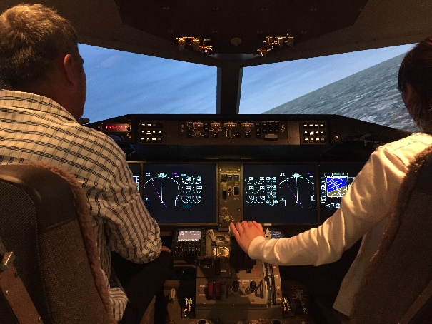
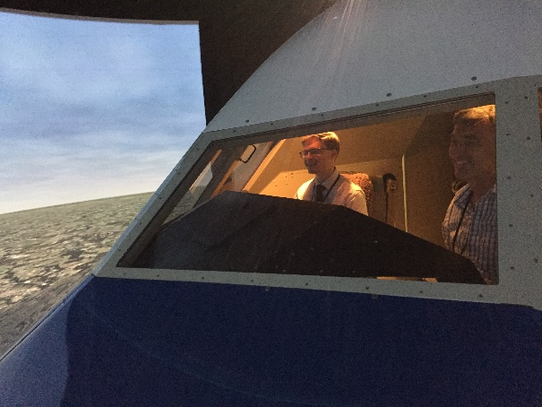
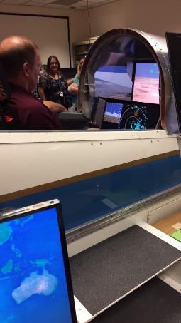
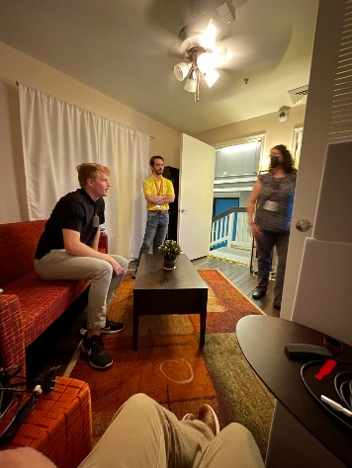
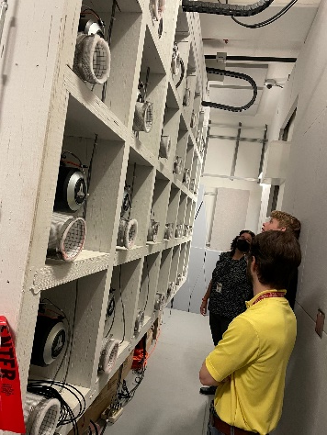
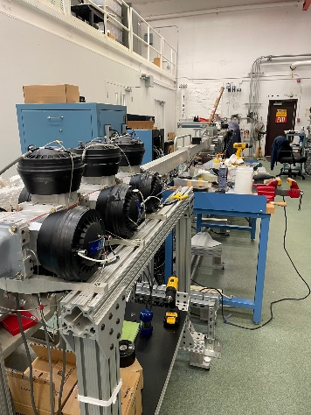
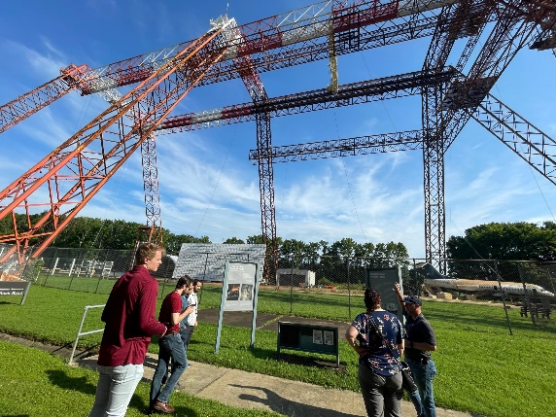
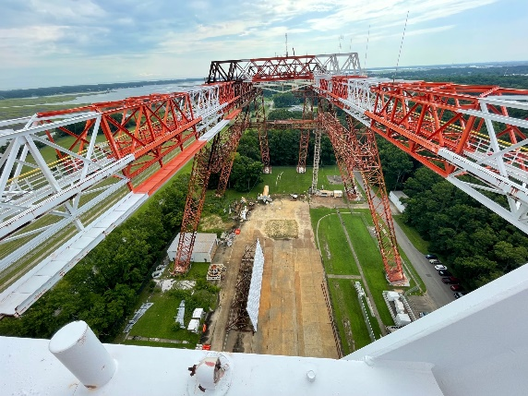
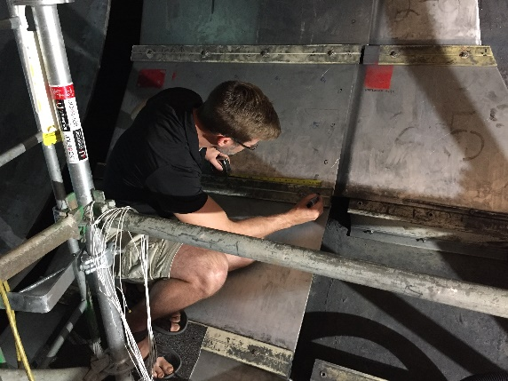








What do opportunities at NASA Langley look like?
Virtual or Hybrid
Notes:
Beyond the acoustic branches at NASA Langley, there are many unique facilities and experiences to be had across NASA. There are collection of flight simulators. There is the towering gantry facility where the apollo astronauts trained and is now used for crash testing of air and spacecraft. There are many wind tunnels of varying size and speed. There are opportunities both virtual or hybrid that may be of interest to you, so be sure to be plugged into opportunities via interns.nasa.gov or usajobs.gov

Slide 12
Outline
My background
Opportunities at NASA
  Acoustics at NASA Langley
  Opportunities for students and graduates
NASA Quesst Mission
  Background: civil supersonic transportation prohibition
  X-59 low-boom aircraft
  Mission phases
  Current status
  Challenges
Notes:
Now we’ll transition to focus on the NASA Quesst Mission

Slide 13







Supersonic Flight and Sonic Boom: A Brief History
1947 First supersonic flight
Sonic boom a novelty
1950s Rapid development of supersonic military aircraft
Noise and damage concerns
1960s Supersonic commercial aircraft proposed
Community studies determine sonic boom exposure level is unacceptable
1973 US federal ban, international limits
1976 – 2003 Concorde commercial service
Supersonic operations only over the ocean
2003 DARPA-NASA Shaped Sonic Boom Demonstration
First flight demonstration of sonic boom “shaping” theory
2018 – 2026 NASA Quesst mission First flight demonstration of low noise supersonic design
    Community studies to gauge public reaction
Bell X-1
F-100
XB-70
Concorde
SSBD
X-59
Notes:
Supersonic flight has been around since Chuck Yeager broke the sound barrier in the Bell X-1 in 1947.
As one NASA pilot likes to say, “we broke the sound barrier 75 years ago and have been working to fix it ever since.”
Through the 1950s supersonic military aircraft rapidly developed which gave rise to noise concerns.
In the 1960s supersonic commercial aircraft were proposed, potentially cutting flight times in half, and several major community studies were conducted to test their potential noise impact. In these studies, an aircraft flies supersonically and produces a sonic booms over the community. After a period of time, people in the community provide their response via social surveys. The results revealed that conventional sonic booms were too loud to be acceptable.
And in 1973 overland commercial supersonic flight was banned.
There were, however, commercial supersonic aircraft from 1976—2003, the Concorde, which flew passengers supersonically over water but had to slow down over land.
In 2003, the Shaped Sonic Boom Demonstration, or SSBD, showed that if you change the geometry of the supersonic object, you can minimize the shock wave, or sonic boom, that reaches the ground.
Building on this “shaped-boom” technology, the present NASA Quesst mission is developing the X-59 aircraft, which will be used to collect community response data to these quieter sonic booms or as we like to call them, “sonic thumps.”
X-59 what is special about it? Shaped-sonic boom. Here or on next slides. Use 2003 test to setup the importance of X-59
Presently, NASA’s Quesst mission is building a low noise supersonic experimental aircraft, the X-59, to enable survey data collection from the public on reactions to low noise supersonic overflight and.

Slide 14

How large is the noise exposure region from a supersonic overflight?
Notes:
So why are sonic booms such an issue for supersonic aircraft? Well, when an object travels faster than the speed of sound, the sound waves bunch up and form a shock wave. This shock wave is called a Mach cone as it is in the shape of a cone with the point at the supersonic object. For a supersonic aircraft, when this shock wave reaches the ground, it is perceived as a “sonic boom.” The width of the Mach cone’s intersection with the ground is referred to as a carpet (denoted by the yellow lines in the figure), which can be 20 to 50 miles wide depending on altitude and weather. As the aircraft flies hundreds or thousands of miles while dragging a 50-mile-wide carpet is why supersonic flight can cause many people on the ground to experience a disruptive sonic boom.

Slide 15

The vision for commercial supersonic flight
Overland Flight Restrictions based on unacceptable sonic boom noise are viewed as the main barrier to this vision
An emerging potential market has generated renewed interest in civil supersonic aircraft
Evidenced by the appearance of several commercial programs despite lack of standards for en route noise or landing and takeoff noise
National Research and Policy agencies play a central role in developing the data needed for the regulation change that is essential to enabling this new market
The vision of the Supersonics Community is a future where fast air travel is available for a broad spectrum of the traveling public
Future supersonic aircraft will not only be able to fly overland without creating an “unacceptable situation” but compared to Concorde and SST will be efficient, affordable, and environmentally responsible
Credit: Lockheed Martin
15
Notes:
Our vision for the future is fast air travel that is broadly available to the traveling public, potentially cutting flight times in half and allowing us to connect across the US and around the world with speed and efficiency. There are a handful of companies seeking to make this a reality, however, the biggest roadblock is the restriction on overland supersonic flight. Therefore, there is a need for research agencies like NASA to gather data to inform and policy agencies like FAA to develop new regulations to enable the future of commercial supersonic flight.

Slide 16

Overcoming the barrier to overland flight
The Quesst mission is specifically planned to generate key data for success in NASA’s commitment to support development of en route certification standards based on acceptable sound levels
New environmental standards are needed to open the market to supersonic flight
An en route noise standard is the biggest challenge
  Requires proof of new design approaches
  Must replace current prohibitions
  No relevant data exists to define limits
    Community data from large, diverse population is a requirement
  Standard must be accepted internationally
16
Notes:
One key to overcoming the barrier is the development of appropriate noise level standards.
The goal is to move away from the current speed limit, which prohibits any supersonic flight, to establishing an actual noise limit.
A regulation with a noise limit requires data to inform it.

Slide 17


Community Survey Data to a Dose-Response Curve
How much did the sonic boom bother, disturb, or annoy you?
Fit Statistical Model
1 2 3 4 5
Convert to binary annoyance response
Participant ID | Boom Number | Dose (Noise Level) | Survey Response
1000 | 1 | 70 | 0
1000 | 2 | 81 | 1
1000 | 3 | 74 | 0
1001 | 1 | 72 | 0
1001 | 2 | 78 | 0
Notes:
Here’s an example of the kind of data we’d need to inform regulators. In this table, we have participants who are responding to booms with a given dose, or noise level, and a survey response. In this case, the dose is the measured noise level of the sonic boom, and the survey response is the annoyance response on a 5-point scale. This data is collected from many participants and many booms and then combined through a statistical model to produce a dose-response curve that describes the community annoyance relative to the noise level of the sonic booms.
The Quesst Mission is intended to generate and provide data like this to regulators for the development of the noise standard.

Slide 18



What is the NASA Quesst Mission?
Phase 1 – Aircraft Development
In progress (2018-23)
  Design, fabricate a quiet supersonic research aircraft
  Prove performance in test range flights
  Prove safety for flights in normal airspace
Systematic Approach Leading to Community Testing
Phase 2 – Acoustic Validation
Preparation in progress (2018-23), Execution 2023-24
  Prove the acoustic characteristics match design targets
  Detailed in-flight and ground measurements in test range
Phase 3 – Community Response Testing
Preparation in progress (2019-23), Execution 2024-27
Conduct community tests
  Select communities
  Outreach and engagement (including STEM)
  Obtain necessary approval
  Plan surveys and recruit participants
  Collect ground measurements
Notes:
NASA’s Quesst mission culminates in the collection of public survey data on reactions to low noise supersonic overflight. It’s divided into 3 phases.
Phase 1 is aircraft development of the X-59, which is currently underway. Lockeed Martin is leading the build in Palmdale, California. Phase 1 includes the design, fabrication, and ground test of the X-59. When ready, the aircraft will undergo a series of envelope expansion flights to prove the airplane is ready and safe to fly.
After that we’ll stay in the test ranges to conduct the acoustic validation, which is Phase 2. Here we’ll be proving that the acoustic signature of the airplane matches what we set out to design. We’ll conduct detailed inflight and ground measurements of the airplane’s signature in preparation for community testing.
Phase 3 is execution of the community response tests and data analysis. That phase will be executed over 2-3 years staring in 2024 and will consist of several month-long flight tests over different communities in the US and possibly abroad.

Slide 19

The X-59 Aircraft
Key requirements drive X-59 design
The acoustic signal of the X-plane must effectively replicate that of future larger supersonic commercial aircraft.
The X-plane must conduct community overflight tests using normal commercial aircraft flight maneuvers.
Design Parameters
Length: 99’ 7”
Span: 29’ 6”
Speed: Mach 1.4 (925 mph)
Altitude: 55,000 ft
Design Features
New, unique airframe design with acoustic signature shaping
Many components from existing aircraft to reduce cost
Payload capacity: single pilot/flight test instrumentation
Notes:
The X-59 aircraft design is driven by the idea of meeting a set of requirements to accomplish the mission. The acoustic signal must replicate a future, larger aircraft, and we must be able to operate the airplane using normal flight maneuvers that would be expected for commercial supersonic aircraft.
Some design features include the unique airframe design, including a long nose, to accomplish the “shaped-boom” design, which reduces the conventional sonic boom to a “sonic thump.” It also uses many components from existing aircraft to reduce cost. It’s a research aircraft, so the payload is just a single pilot plus flight test instrumentation.

Slide 20



X-59 Aircraft Development Status
Lockheed Martin is the lead for manufacturing
  Major airframe components mated
  Systems installation and checkout in progress
    NASA supplied systems delivered
    Engine delivered
Ground testing in Texas
First flight in 2023
GE F414 engine
Simulator with External Vision System (XVS)
Manufacturing progress at Lockheed-Martin
Notes:
Here are some images of the airplane in fabrication. Some systems are supplied by NASA such as the External Vision System, which enables forward vision without a forward-facing canopy window, as the aircraft has the long nose to help with the “boom-shaping.” The airplane is powered by an existing fighter aircraft engine. The aircraft underwent ground testing in TX in the spring and is back in California for the finishing touches. The target for its first flight is in 2023.

Slide 21


Just how quiet will the NASA X-59 be?
PL (dB)
W. Doebler and J. Rathsam, Proc. Mtgs. Acoustics 36, 040005 2019.
21
Notes:
Psychoacoustic research on sonic booms has shown that the Perceived Level, or PL, decibel scale correlates well with human perception of impulsive sonic booms. This is different than other decibel scales that work well for continuous noise such as A-weighted sound level.
To put PL values in context, the conventional sonic booms from Concorde or other traditional loud sonic-boom-generating aircraft were on the order of 105 dB Perceived Level, which is comparable to nearby thunder or a car door slam from inside the car. These types of sounds can be very startling when you are not expecting them.
By contrast, X-59’s sonic thump is designed to be 75 dB, which is comparable to distant thunder, or a car door slam from across the street.

Slide 22





Scaling up the NASA community surveys from lab-scale to national-scale
Human response and annoyance, particularly indoors, is the key concern.
Quiet Supersonic Flights 2018
Galveston, Texas
Laboratory Tests
Small Community Test
Large Community Test
Tests of increasing complexity have provided preparation and confidence
Ready to take the next step with flight testing over very large communities
Notes:
Similar to the Space side of NASA where rockets undergo design iterations, test firings, and several other steps before space launches, we have undergone several steps in preparing for our future community tests. NASA conducted laboratory psychoacoustic tests with the Interior Effects Room built in 2007-09, performed small community test near Edwards Air Force Base in California in 2011, and piloted a risk reduction community noise survey test in a larger community in Galveston, Texas in 2018. These earlier tests have prepared NASA to take the next step with flight tests over very large communities.

Slide 23


Dose-Response Curves from Past NASA Tests
Large Community Test
Small Community Test
J. Lee, et al. J. Acoustical Soc. Am., 147:2222, 2020.
Notes:
This plot shows sample dose response curves resulting from previous NASA community tests. Now the objective of these community tests were not to resolve a representative dose-response curve to inform regulators but for preparing and reducing risk for the Quesst mission.
We see that the x-axis shows noise dose in terms of Perceived Level (PL) in decibels, and the y-axis shows percent of highly annoyed responses.
There’s a high degree of scatter in the data, which is typical of social survey data.
As a matter of practicality, the sonic boom community tests have all been “panel surveys,” in which a panel of survey participants responds multiple times. It simply is not practical to recruit a member of the public and then only request a single response, especially when responses are needed promptly after each overflight. A consequence of having panel studies is the need for statistical models that account for the correlation among multiple observations from the same person.
The Quesst mission goal is to produce an accurate and precise dose-response curve that is representative of the nation.

Slide 24



Exposure Design and Estimation – Key Challenges
Noise dose estimation challenges:
  Measuring over a large area
  Combining measured and predicted levels
  Estimating meteorological condition
  Automating acoustic data acquisition (and transmission)
  Acquiring acoustic data with low signal-to-noise ratio (sonic boom loudness relative to ambient noise)
  Acoustic sensor placement to minimize measurement error
Strategies to address challenges include:
  Development and testing of rapid, automated methods of exposure estimation based on acoustic and meteorological sensor data
  Hardware/software testing and validation of remote operation and robustness during Phase 2
Notes:
There are a handful of challenges in collecting accurate noise dose values, which impact the horizontal axis of the dose-response curve, including
Measuring over a large area
Combining measured and predicted levels
Estimating meteorological condition
Automating acoustic data acquisition (and transmission) – as we will have many unmonitored systems deployed in the field
Acquiring acoustic data with low signal-to-noise ratio (sonic boom loudness relative to ambient noise)
Acoustic sensor placement to minimize measurement error
Some strategies to address this include:
Development and testing of rapid, automated methods of exposure estimation based on acoustic and meteorological sensor data
Hardware/software testing and validation of remote operation and robustness during Phase 2

Slide 25

Survey Design and Analysis – Key Challenges
Survey design challenges:
  Representative sample from few community studies
  Instantaneous survey collection
  Location information
  Statistical analysis to handle collected data
  Avoiding bias
Strategies to address challenges include:
  Testing/validation of survey methods and instruments through small-scale studies
  Testing of automated processing methods to achieve target levels of usable/valid survey data
Notes:
There are a handful of challenges in the survey design as well, which impacts the vertical axis of the dose-response curve, including
Representative sample from few community studies – we only have 5 communities that we can test
Instantaneous survey collection – we want to collect responses after each aircraft overflight
Location information – location required to assign a dose value
Statistical analysis to handle collected data – Same group of participants responding over the course of weeks requires a different method than many other community noise surveys that often just have 1 response over a longer period of time
Avoiding bias – We don’t want people to never say they’re annoyed because they want commercial supersonic flight, we need honest answers to accurately model representative annoyance
Some mitigation strategies to address these challenges include:
Testing/validation of survey methods and instruments through small-scale studies
Testing of automated processing methods to achieve target levels of usable/valid survey data

Slide 26
Summary
Quesst Mission
  The X-59 will soon be flying over several US communities
  Noise dose and perceptual response data will be collected to inform potential new supersonic aircraft noise certification standards
  We are in the planning stage and are working to solve several testing challenges
Many opportunities for students and graduates at NASA – be sure to apply!
  intern.nasa.gov
  usajobs.gov
Notes:
In summary
Quesst Mission
The X-59 will soon be flying over several US communities
Noise dose and perceptual response data will be collected to inform potential new supersonic aircraft noise certification standards
We are in the planning stage and are working to solve several testing challenges
Many opportunities for students and graduates at NASA – be sure to apply!
intern.nasa.gov
usajobs.gov

Slide 27
nasa.gov/quesst
aaron.b.vaughn@nasa.gov

