Slide 1
Towards Assurance for Safety-Critical, Machine Learning-enabled Aviation Systems
Dr. Natasha A. Neogi and Dr. Sarah M. Lehman
NASA Langley Research Center (LaRC)
November 17, 2022

Slide 2
Agenda
Introduction
  Motivation
  Application
Testing for Neural Networks
  Applying Software Testing to Neural Networks
  Neural Network Coverage Testing
Surprise Adequacy Testing Metric for Neural Networks
Augmenting Surprise Adequacy: The Delta Hypothesis
Discussion and Closing Remarks

Slide 3
Agenda
Introduction
Testing for Neural Networks
Surprise Adequacy Testing Metric for Neural Networks
Augmenting Surprise Adequacy: The Delta Hypothesis
Discussion and Closing Remarks
Learning-enabled systems are becoming ubiquitous in domains that historically generate large amounts of data. However, deployment in safety-critical applications requires guarantees on behavior.
What might be a path forward? Examining domains with risk tolerant profiles and hazard rich environments…

Slide 4
Motivation
Systems with machine learning enabled components are proliferating into a variety of domains
  Search engines, hospitality and tourism, personal assistants, education (mixed reality textbooks), product recommendations, entertainment and video games, etc.
However, they are unable to be employed in safety-critical systems due to the inability to assure them
  Lack of predictability: Neural networks (i.e., same network or different network) trained on the same data may yield different answers for the same input
  Opacity to human users: Decision logic of neural network may not be readily apparent to humans (e.g., users, designers, developers, etc.)
  Brittleness: Susceptible to minor perturbations that can result in undesirable outcomes (e.g., handling edge cases without reverting to human intervention, etc.)
Deploying these systems in risk tolerant applications may be a point of entry to gain data on their performance in hazard rich environments
Notes:
Practical real-world conditions (lighting, etc) result in small perturbations to image that lead to large deviations in output.

Slide 5

System Wide Safety Overview and Technical Challenge #5
Safety Demonstrator Series
Operational demonstration of and recommendations for requirements and standards necessary to monitor, assess, and mitigate risks to assure safety in disaster-oriented operations.
Operational Safety (Thrust 5)
TC-1: Predictive Terminal Area Risk Assessment
TC-2: IASMS SFC Development for Emerging Operations
TC-5: Safety Demonstrator Series for Operational IASMS
Current Day
Near Future
Transformed NAS
TC-4: Complex Autonomous Systems
Assurance
TC-3: V&V for Commercial Operations
Design Safety (Thrust 6)

Slide 6








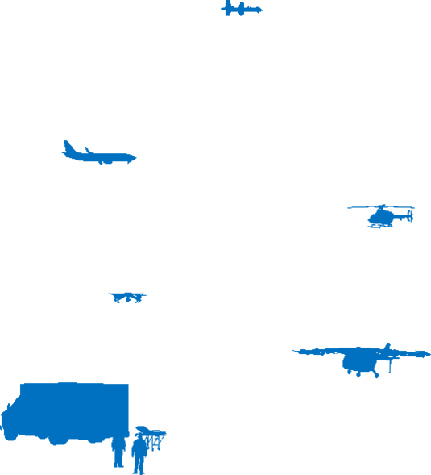
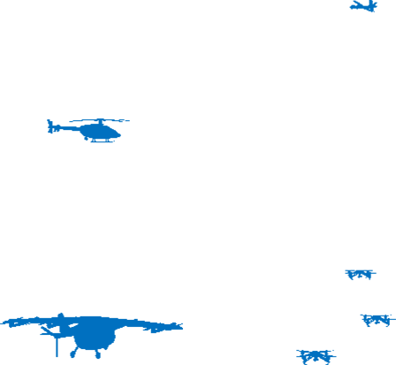
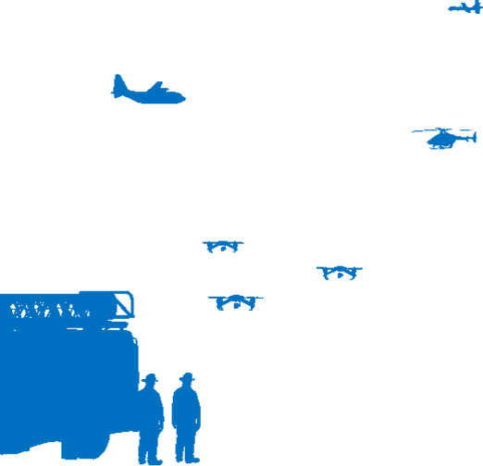


Scheduled Progression
SD-1 (FY 25)
SD-2 (FY 27)
SD-3 (FY 28)
SD-4 (FY 30)
Wildfire Fighting
Hurricane Relief and Recovery
Emergency Medical
Urban Disaster Relief
HIGH
MED
LOW
LOW
Rural and partially evacuated area
Partially evacuated area
Urban area
Urban area
LOW-MODERATE
MODERATE
MODERATE
HIGH
Intensive HMI and lack of commercial flights
Numerous agencies coordinating multiple
relief efforts
Regularly scheduled commercial flights
- - - - -
LOW-MODERATE
MODERATE-HIGH
MODERATE
HIGH
Unknown location of fire; poor visibility
Unknown state of terrain; poor infrastructure
All weather operations
- - - - -
Environment:
Low Visibility, Smoke...
Environment:
Low Visibility, RF/EMF Hazards, Poor Weather…
Environment:
Urban Airspace, RF/EMF Hazards…
Environment:
Degraded Infrastructure, RF/EMF Hazards…
Vehicle & Mission:
sUAS, mid-size UAS/
Short Range
Vehicle & Mission:
sUAS, mid-size UAS, large UAS/
Multiple Days
Vehicle & Mission:
sUAS, mid-size UAS, large UAS/
Long Range
Vehicle & Mission:
sUAS, mid-size UAS, large UAS/
Multiple Days
Human Role:
High
Human Role:
Medium
Human Role:
Low
Human Role:
Multiple Simultaneous HMI paradigms
Risk Tolerance
Complexity
Uncertainty

Slide 7

Notes:
Close this video with a segue way into testing.

Slide 8
Agenda
Introduction
Testing for Neural Networks
Surprise Adequacy Testing Metric for Neural Networks
Augmenting Surprise Adequacy: The Delta Hypothesis
Discussion and Closing Remarks
So, we’ve demonstrated that machine learning-enabled systems in safety-critical applications require assurance and SWS TC5 is helping us get there.
But exactly HOW is this being accomplished? There are many possibilities, but today we will focus on forensic testing of neural networks…

Slide 9
A Quick Refresher on Testing
WHY perform testing?
What is the GOAL of testing?
To VERIFY that the product has been built according to stakeholder requirements
To VALIDATE that the product actually meets stakeholder needs (regardless of what the requirements say)
To INTEGRATE the product into a larger system
To uncover undesirable system behavior and reduce runtime errors
 | Specification | Implementation
1 | Correct | Missing
2 | Correct | Incomplete or incorrect
3 | Incomplete or incorrect | Correct
4 | Missing | Missing
Arising From

Slide 10
A Quick Refresher on Testing
What ACTIVITIES does testing include?
How are testing efforts ORGANIZED?
Checking EXTERNAL product behaviors (“black box”)
Checking INTERNAL product behaviors (“white box”)
Checking NON-FUNCTIONAL product behaviors
“Does my software produce the correct output for this input?”
“Does my software follow the correct algorithmic steps to produce its output?”
“Is my software usable, reliable, performant, etc.?”
Test Suite
As many combinations of inputs, outputs, and behaviors as possible have been exercised
Test Case
Test Case
Goals after executing
Test Case
Test Case
As many latent bugs, issues, problems, etc. as possible have been identified
Test Case
Test Case

Slide 11

The Problem of Testing Machine Learning-enabled Systems
PROBLEM:
Traditional testing approaches developed for DETERMINISTIC software systems do not translate directly to NON-DETERMINISTIC software systems, such as machine learning-enabled systems.
 | Deterministic / Traditional | Non-deterministic / ML-enabled
PURPOSE | To automate known processes | To provide answers to questions / problems with no readily apparent answer
BEHAVIOR | Inherited from manually written code | Learned by observing patterns in large data sets
LOGIC | Knowable; can be written out as a flowchart or series of algorithmic steps | Obscure; not easily or directly understandable
IN OTHER WORDS:
Testing machine learning-enabled systems is difficult because there is NO OBVIOUS LINK between undesirable system behavior and the faulty component which caused it.
Biased / incomplete data set
Insufficient model training
Incomplete specification
Logical errors in “wrapper” code

Slide 12
The Problem of Testing Machine Learning-enabled Systems
Many kinds of testing approaches have been adapted to machine learning-enabled systems, including but not limited to:
Metamorphic testing: [11] [16]
Identifying relationships / properties of input-output pairs, generating new inputs from known “good” inputs, and seeing if the properties hold for the outputs for those modified inputs
Differential testing: [3] [4]
Supplying an input to different instances of the same model (or mutated versions of the input to the same model), and observing differences in internal processing until output changes
Black Box
White Box
Combinatorial testing: [17] [18]
Limiting testing efforts to combinations of factors / parameters that are most likely to contribute to failures
Property-based testing: [19]
Defining custom properties (e.g., “robustness”, “safety”, etc.) and designing tests to maximize these properties
Time / Money Saving
Open Ended

Slide 13

The Problem of Testing Machine Learning-enabled Systems
Our focus: coverage testing
However, coverage testing does not directly translate when neural nets are involved!
FOCUS:
Discrete, quantifiable aspect of software under test (e.g., lines of code, logical branches, etc.)
GOAL:
Execute all instances of target metric (aspect) by end of test suite
INTUITION:
If all “physical” aspects of code have been exercised, then there is nowhere left for bugs to hide.
Foundational intuition does not hold when behavior is data-driven rather than code-driven!
From a software perspective, a neural network is just a series of mathematical transformations
Connect to camera
Extract latest frame
Convert to usable format
Feed to neural network
Respond to result
Easy to execute all “physical” aspects of the code and still have latent issues thanks to cascading results [13]
“WRAPPER” CODE
Notes:
Careful of making the assumption / inferring that full coverage testing is enough on its own for safety assurance, even for “traditional” systems. (e.g., infinite state space systems)
Coverage testing is a BEDROCK, but NOT THE ONLY THING … also leveraging formal methods and other approaches

Slide 14

Primer on Neural Network Coverage Testing
Closest analogue for traditional coverage testing is to use neurons inside the network
Neuron
Code execution is binary… either a line of code (logical branch, etc.) was executed or it wasn’t. Neuron executions are different.
Input
Processing Function
Activation Function
Output
All neurons are “executed” for all inputs, but the amount that each NEURAL output contributes to the final NETWORK output is unclear.
Image Classification
0.025
0.046
0.789
…
0.001
The image is an instance of Class #3

Slide 15
Primer on Neural Network Coverage Testing
How do you determine which neurons are “covered”?
METRIC | APPROACH | GOAL (END OF TEST SUITE) | INTUITION
Deep Neuron Coverage (DNC) [13] | Only consider those neurons which have outputs (“activations”) above a given threshold | “Activate” 100% of neurons in network | Replicate traditional structural coverage testing
K-Multisection Neuron Coverage (KMNC) [10] | Consider the full range of possible activation values observed over test suite; split range into “k” subsections | Maximize the number of activation subsections covered by each neuron | Want to include coverage for full range of possible activations, not just the high ones
Neuron Boundary Coverage (NBC) [10] | Only consider those neurons whose activation is ABOVE or BELOW a given threshold | Maximize percentage of network neurons which surpass boundary thresholds | Network behavior should be characterized by both active and inactive neurons
Strong Neuron Activation Coverage (SNAC) [10] | Only consider those neurons whose activation is above a VERY HIGH threshold | “Strongly activate” as many neurons in network as possible | “Hyperactive” neurons with the very highest activation values contribute most to network output
Top-K Neuron Coverage (TKNC) [10] | Only consider those neurons which have produced the top “k” activation values in a given layer | Maximize percentage of neurons which qualify in “top-K” for the corresponding layer | Neural activity should be considered within the context of the enclosing layer, rather than the network at large

Slide 16
Primer on Neural Network Coverage Testing
Impact of neuron coverage / extensions
  Neuron coverage (NC) has exploded in popularity, formed the foundation of many research efforts
  DeepXplore [13] used NC to guide generation of test inputs; found thousands of errors in state-of-the-art neural networks trained on real world data sets
  DeepTest [14] proposed set of transformations to generate test inputs / increase NC; applied concepts to autonomous driving scenarios and demonstrated that retraining networks with NC-increasing inputs could increase overall prediction accuracy
Limitations / criticisms of neuron coverage
  Primary focus is on a test set; no way to judge the quality of a single input (e.g., are inputs which activate more neurons “better” than others) [6]
  Generalized NC is not strongly / positively correlated with defect detection, does not guarantee naturalness of generated inputs [1] [2] [5]
  Prioritizing selection / generation of NC-increasing test inputs can actually make it harder to build an effective test suite [5]

Slide 17
Agenda
Introduction
Testing for Neural Networks
Surprise Adequacy Testing Metric for Neural Networks
Augmenting Surprise Adequacy: The Delta Hypothesis
Discussion and Closing Remarks
Neuron coverage testing is a nice start, but doesn’t tell the whole story …

Slide 18
Primer on Surprise Adequacy
Presented by Kim et al in 2019 [6] as a spiritual successor to (and critique of) neuron coverage:
ORIGINAL NEURON COVERAGE:
SURPRISE ADEQUACY:
INTUITION:
Patterns of neuron activations can be used to characterize how a neural network processes a class of inputs.
INTUITION:
Characterization of a neural network’s internal processing is a function, not only of its activations, but also of its training data.
SOURCE OF ERROR:
Neurons exerting previously unseen influence during the processing of a given input
SOURCE OF ERROR:
Inputs which are too dissimilar to the network’s training data set (e.g., “surprising”)
THEREFORE:
Fully exploring the internal runtime state of the neural network should, in theory, exercise the full spectrum of neural network behaviors.
THEREFORE:
Effective test metrics should take not only a neural network’s internal runtime state into account, but also the data set on which the network was trained.

Slide 19
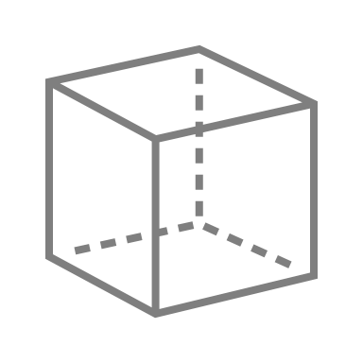
Primer on Surprise Adequacy
Uses activations, but in a different way:
Instead of taking all activations that meet some conditions:
Take ALL activations in a target LAYER, regardless of value:
Assemble the values as a vector (“trace”) and treat it as a point in N-dimensional space!
The choice of which layer(s) to use is flexible.
Typically, the last hidden layer is used, as this represents the culmination of the neural network’s internal processing.
Number of neurons in target layer determines dimensions in embedding space.

Slide 20



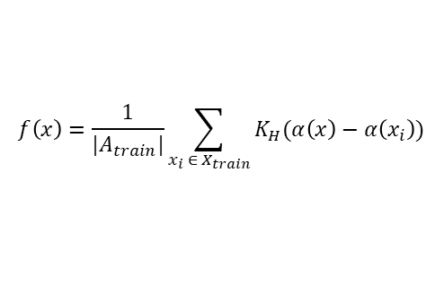








Primer on Surprise Adequacy
Compare traces of new inputs against known traces of training data set to determine how “surprising” (e.g., different, novel, suspicious, etc.) the new input is
Likelihood-based Surprise Adequacy (LSA)
Distance-based Surprise Adequacy (DSA)
Surprise Coverage (SC)
Predicted
Class
KDE of
Per-Class
AT Subset
$$x_{a}$$
0
U
$$x$$
b₀
b₁
…
b_{n}
$$x$$
Next Nearest
Class
$$x_{b}$$
Test Suite Surprise Scores
How likely is the input to belong to the predicted class based on the probability density of that class?
How likely is the new input to belong to the predicted class based on its Euclidean proximity to the predicted, other classes?
INTUITION: By covering the range of possible inputs from very un-surprising to very surprising, you will exercise the range of possible behaviors.
$$f\left(x\right)=\frac{1}{|A_{train}|}\sum_{x_{i} ∈{ X}_{train}}{K_{H}(α\left(x\right)−α\left(x_{i}\right))}$$
$$dist_{a}=|\left|α\left(x\right)−α\left(x_{a}\right)\right||$$
$$SC\left(x\right)=\frac{\left|\left\{b_{i}\right|∃x ∈X :SA\left(x\right) ∈ (U∙\frac{i−1}{n}, U∙\frac{i}{n})\}\right|}{n}$$
$$dist_{b}=|\left|α\left(x_{a}\right)−α\left(x_{b}\right)\right||$$
$$LSA\left(x\right)=−log⁡(f\left(x\right))$$
$$DSA\left(x\right)= \frac{dist_{a}}{dist_{b}}$$
NOTE: efficacy heavily dependent on selections of “n” and “U”

Slide 21
Primer on Surprise Adequacy
Impact of SA
  Inputs with higher SA scores are harder for neural networks to classify correctly
  Adversarial inputs typically earn higher SA scores than known good inputs
  Retraining networks with high-SA samples can improve edge case performance
SA extensions and refinements
  Original paper addressed image classification problems; has since been expanded into include regression [8] and NLP problem spaces [7] [9]
  Performance enhancements, efficiency boosts, decreased processing latency [12]
  Use of nearest neighborhoods instead of individual neighbors [15]

Slide 22
Agenda
Introduction
Testing for Neural Networks
Surprise Adequacy Testing Metric for Neural Networks
Augmenting Surprise Adequacy: The Delta Hypothesis
Discussion and Closing Remarks
Is it enough to have only a single numerical score of how surprising or novel an input is compared to the test set? No, it is not …

Slide 23
Delta Hypothesis
Can Surprise Adequacy scores TRULY represent the range of inputs your system may encounter?
ALEATORIC UNCERTAINTY:
Uncertainty that arises due to inherent randomness of the universe (e.g., a coin flip)
EPISTEMIC UNCERTAINTY:
Uncertainty that arises due to a lack of knowledge of the operating domain
Goal of testing is to reduce epistemic uncertainty / put safeguards around sources of aleatoric uncertainty.
IRREDUCIBLE:
Aleatoric uncertainty CANNOT be reduced by the addition of more information.
REDUCIBLE:
Epistemic uncertainty CAN be reduced by learning more, adding more information.
If the only certainty is uncertainty, how do we distinguish between errors that arise as a result of a LESS-THAN-PERFECT MODEL vs. LEAVING THE MODEL’S OPERATIONAL DOMAIN?
KNOWN UNKNOWN:
Recognized but poorly understood phenomena
UNKNOWN UNKNOWN:
No prior knowledge; cannot be anticipated

Slide 24


Delta Hypothesis
Neural networks have no inherent way to reflect when they are leaving their operational domain, and SA metrics alone do not address this
KEY LIMITATION: It is not enough to know THAT an input is surprising; we also need to know WHY it is surprising!
Input earns a high SA score
Is it because it’s an outlier of known classes…
…or because it’s completely outside the training set?
Focus of SA and similar metrics
CRITICAL for safety-critical systems!
Surprise scores are simply arbitrary numeric values
No context other than “lower is better”
Cut-off between acceptable and concerning surprise scores is also arbitrary

Slide 25
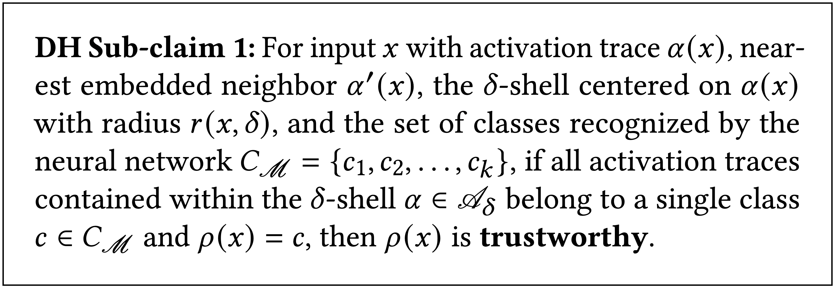
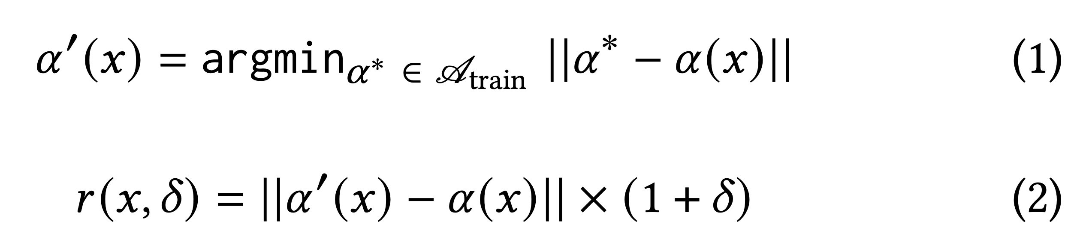
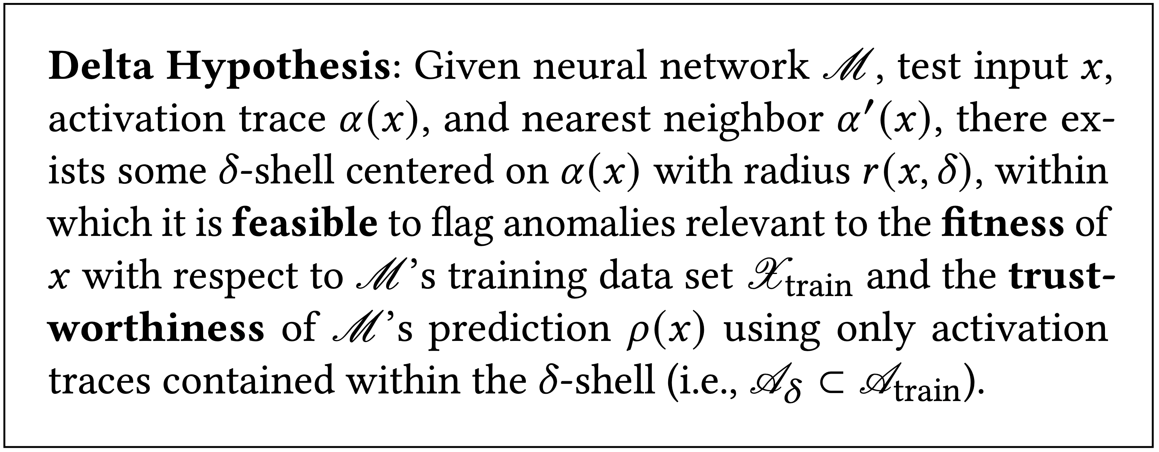
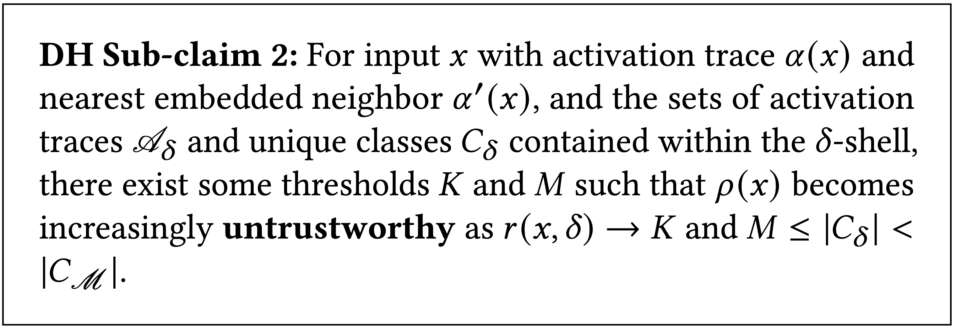
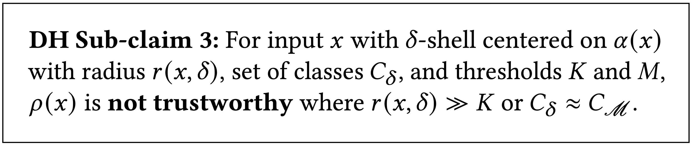
Delta Hypothesis
TRANSLATION:
The likelihood that the input belongs to the predicted class is HIGHEST when all training points in the Delta Shell also belong to that class.
TRANSLATION:
The set of training data points that are nearest to the input in space will contribute the most to understanding the neural network’s prediction for that input.
TRANSLATION:
The likelihood that the input belongs to the predicted class DECREASES as the size of the Delta Shell and count of represented classes approach some thresholds.
E.g., instead of using only the nearest points in the predicted and next nearest classes to calculate surprise, consider the number and designation of ALL points within some additional distance (𝜹) past the single nearest neighbor (“Delta Shell”).
TRANSLATION:
The likelihood that the input belongs to the predicted class is LOWEST when the size of the Delta Shell and count of represented classes greatly exceed their thresholds.

Slide 26
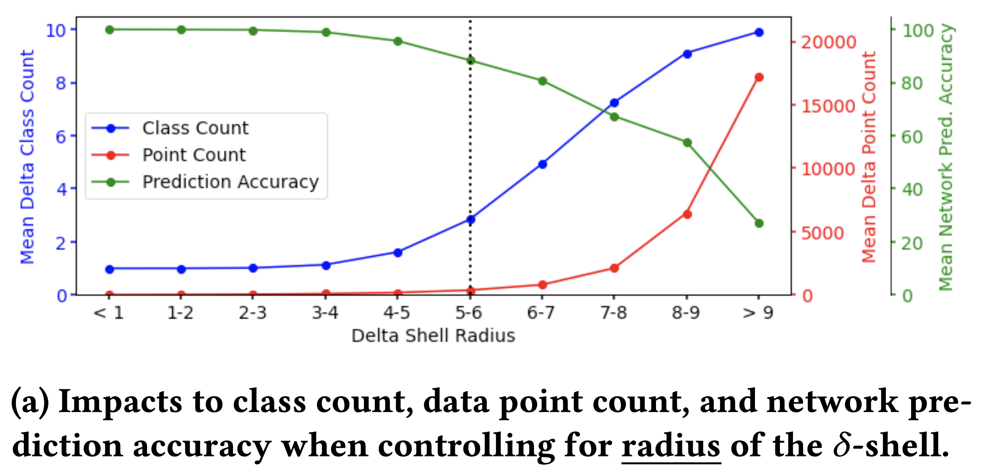
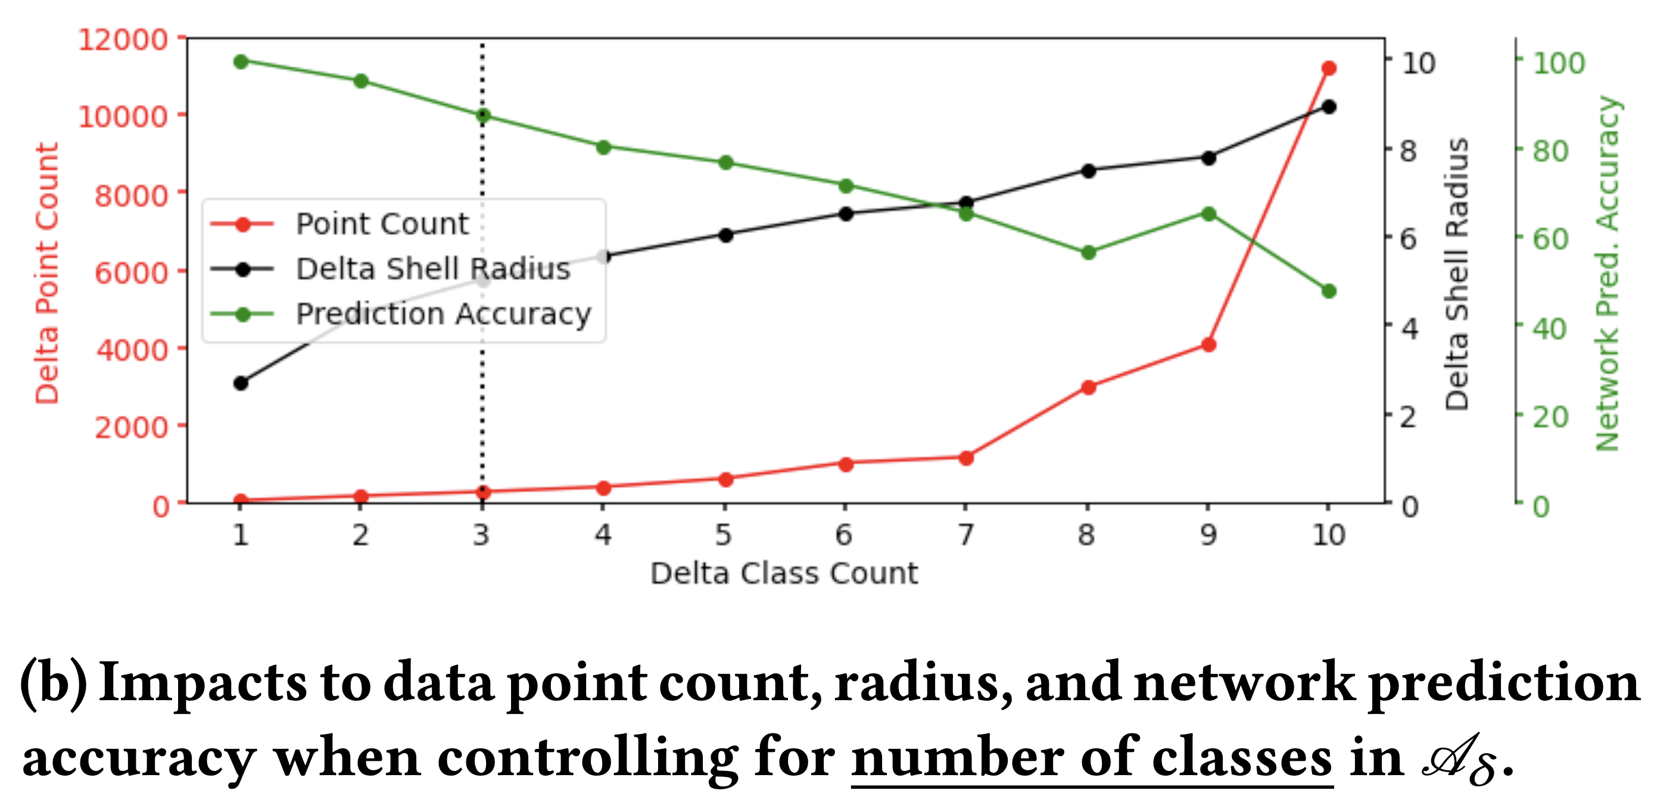
Delta Hypothesis
We observed that neural network prediction accuracy DEGRADES as:
Distance from the input to its nearest neighbors in
the training set INCREASES
The number of unique classes represented by training points in the input’s immediate vicinity INCREASES
The overall number of training points within the
input’s immediate vicinity INCREASES
THEREFORE, WE SHOULD BE ABLE TO:
Use the distance to nearest neighbor, count of unique classes, and overall point count within the immediate vicinity to FLAG potentially suspicious inputs

Slide 27
Delta Hypothesis
How can SA benefit from additional information, such as that provided by the Delta Hypothesis?
CHARACTERISTICS | LIMITATIONS
SA produces a single numeric “score” indicating surprise | No greater context for, explanation of the numeric score
DSA (the most popular variant) only considers nearest neighbors from predicted, next nearest classes | Does not account for (volume of) presence from other classes (e.g., Class A has a closer neighbor, but Class B has more points in the vicinity)
SA assumes a (more or less) correct prediction for the current input | No sanity checking for completely incorrect predictions; compounds limitation of only considering predicted, next nearest class neighbors when calculating surprise
SA claims to help identify samples that lie on the decision boundary between two candidate classes | Assumes that all samples fall within the distribution of known classes; has no accommodation for “noise” images (e.g., like you would find in a live video feed)
EXPECTED BENEFITS:
Improved understanding of topological space surrounding input by considering ALL points, classes
Topological characteristics used to “sanity check” neural network’s prediction
Ability to better distinguish between intra-class variants and “noise” images
Stay tuned for our upcoming paper!

Slide 28
Agenda
Introduction
Testing for Neural Networks
Surprise Adequacy Testing Metric for Neural Networks
Augmenting Surprise Adequacy: The Delta Hypothesis
Discussion and Closing Remarks
And now for some thoughts…

Slide 29
Closing Thoughts
While testing can never guarantee the absence of errors, it can illuminate factors in the neural network’s embedding and its training set that can be a potential predictor of undesirable or surprising outputs
  Meant to be considered as a part of a suite of tools in tackling assurance for these systems
Surprise adequacy helps quantify the similarity of an input to a neural network’s training data
  Significant subjectivity is linked to discretization of metric space, potentially leading to a degree of arbitrariness
A single metric may not be sufficient to capture all the modes of fragility or brittleness inherent in a neural network
  Overabundance of data must be avoided in time-critical decision making (i.e., information for information’s sake may not be the best way forward)
  Need to monitor for leading indicators that progress into extremely undesirable outcomes
Augmenting surprise adequacy with further information may yield valuable insight
  Topological characteristics can be used to “sanity check” neural network’s prediction
Delta Hypothesis paper currently under consideration for ICSE SEIP ‘23

Slide 30
Closing Thoughts
Potential path forward by introducing learning enabled systems in highly risk tolerant missions with hazard rich environments
  Learning enabled systems often have poorly specified requirements and implicit assumptions and biases inherent to their operational environments
Systems will have to be monitored to see when processing a given input constitutes a departure from the operational domain
  Inputs can be in distribution, marginally out of distribution, or no longer in within the acceptable set of inputs
Managing uncertainty in learning systems is difficult but necessary for the eventual verification and validation of learning systems in real, open-world settings
  Aleatoric uncertainty can be studied and measured, but not reduced
  Epistemic uncertainty can be reduced through further research about the system
Managing the ‘unknown unknowns’ or unexpected inputs will still likely dominate the discussion of safety in the aviation industry going forward

Slide 31
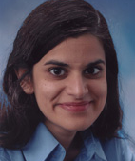

Thank you! Questions?
Natasha A. Neogi
natasha.a.neogi@nasa.gov
Sarah M. Lehman
sarah.lehman@nasa.gov

Slide 32
References
Chen et al. “Deep Neural Network Test Coverage: How Far Are We?” in arXiv preprint arXiv:2010.04946, 2020.
Dong et al. “There is Limited Correlation Between Coverage and Robustness for Deep Neural Networks” in arXiv preprint arXiv:1911.05904, 2019.
Guo et al. “DLFuzz: Differential Fuzzing Testing of Deep Learning Systems” in Proceedings of the 26th Joint Meeting on European Software Engineering Conference and Symposium on the Foundations of Software Engineering, ESEC / FSE ‘18, 2018. ACM.
Guo et al. “Coverage Guided Differential Adversarial Testing of Deep Learning Systems” in IEEE Transactions on Network Science and Engineering, Volume 8, Number 2, April-June 2021.
Harel-Canada et al. “Is Neuron Coverage a Meaningful Measure for Testing Deep Neural Networks?” in Proceedings of the 28th Joint European Software Engineering Conference and Symposium on the Foundations of Software Engineering, ESEC / FSE ‘20, 2020. ACM.
Kim et al. “Guiding Deep Learning System Testing Using Surprise Adequacy” in Proceedings of the 41st International Conference on Software Engineering, ICSE ‘19, 2019. IEEE / ACM.
Kim et al. “Evaluating Surprise Adequacy for Question Answering” in Proceedings of the 42nd International Conference on Software Engineering Workshops, ICSE-W ‘20, 2020. IEEE / ACM.
Kim et al. “Reducing DNN Labelling Cost using Surprise Adequacy: An Industrial Case Study for Autonomous Driving” in Proceedings of the 28th Joint European Software Engineering Conference and Symposium on the Foundations of Software Engineering, ESEC / FSE ‘20, 2020. ACM.
Kim et al. “Multimodal Surprise Adequacy Analysis of Inputs for Natural Language Processing DNN Models” in Proceedings of the 2021 International Conference on Automation of Software Testing, AST ‘21, 2021. IEEE / ACM.
Ma et al. “DeepGauge: Comprehensive and Multi-Granularity Testing Criteria for Gauging the Robustness of Deep Learning Systems” in Proceedings of the 33rd ACM / IEEE International Conference on Automated Software Engineering, 2018.
Ma et al. “DeepMutation: Mutation Testing of Deep Learning Systems” in Proceedings of the 29th International Symposium on Software Reliability Engineering, ISSRE ‘18, 2018. IEEE.
Ouyang et al. “Improved Surprise Adequacy Tools for Corner Case Data Description and Detection” in Applied Sciences, Volume 11, Number 15, 2021.
Pei et al. “DeepXplore: Automated Whitebox Testing of Deep Learning Systems” in Proceedings of the 26th Symposium on Operating Systems Principles, SOSP ‘17, pages 1-18, New York, NY, USA, 2017. ACM.
Tian et al. “DeepTest: Automated Testing of Deep Neural Network-Driven Autonomous Cars” in Proceedings of the 40th International Conference on Software Engineering, ICSE ’18, pages 303-314, 2018. ACM.
Weiss et al. “A Review and Refinement of Surprise Adequacy” in Proceedings of the 3rd International Workshop on Deep Learning for Testing and Testing for Deep Learning, DeepTest ‘21, 2021. IEEE / ACM.
Zhou, Zhi Quan and Liqun Sun. "Metamorphic testing of driverless cars." Communications of the ACM 62.3 (2019): 61-67.
Kuhn, D. Richard, et al. "Combinatorial methods for explainable AI." 2020 IEEE International Conference on Software Testing, Verification and Validation Workshops (ICSTW). IEEE, 2020.
Ma, Lei, et al. "Combinatorial testing for deep learning systems." arXiv preprint arXiv:1806.07723 (2018).
Pei, Kexin, et al. "Towards practical verification of machine learning: The case of computer vision systems." arXiv preprint arXiv:1712.01785 (2017).

Slide 33
References
Damien Busatto-Gaston, Debraj Chakraborty, Shibashis Guha, Guillermo A. Perez & Jean-Francois Raskin (2021): Safe Learning for Near-Optimal Scheduling. In: Quantitative Evaluation of Systems: 18th International Conference, QEST 2021, Paris, France, August 23–27, 2021, Proceedings, Springer-Verlag, Berlin, Heidelberg, p. 235–254, doi:10.1007/978-3-030-85172-9_13.
Giorgio C Buttazzo, Marko Bertogna & Gang Yao (2012): Limited preemptive scheduling for real-time systems. a survey. IEEE transactions on Industrial Informatics 9(1), pp. 3–15, doi:10.1109/TII.2012.2188805.
Gilles Geeraerts, Shibashis Guha & Jean-Fran.ois Raskin (2018): Safe and Optimal Scheduling for Hard and Soft Tasks. In: 38th IARCS Annual Conference on Foundations of Software Technology and Theoretical Computer Science (FSTTCS 2018), Leibniz International Proceedings in Informatics (LIPIcs) 122, pp. 36:1–36:22, doi:10.4230/LIPIcs.FSTTCS.2018.36.
Martin L. Puterman (1994): Markov Decision Processes: Discrete Stochastic Dynamic Programming, 1st edition. John Wiley & Sons, Inc., USA, doi:10.1002/9780470316887.
Marco Spuri & Giorgio C. Buttazzo (2004): Scheduling aperiodic tasks in dynamic priority systems. Real-Time Systems 10, pp. 179–210, doi:10.1007/BF00360340.
Natasha Neogi, Surya Murthy, and Suda Bharadwaj, “Scheduling for Urban Air Mobility using Safe Learning”, Fourth Workshop on Formal Methods for Autonomous Systems, International Conference on Software Engineering and Formal Methods (SEFM) 2022, Berlin, Germany, September 26-27, 2022.

Slide 34
Backups

Slide 35
Certification, Operational Approval, Hazard Analysis, and Risk
Primary aim of aircraft certification (Part 21 etc.) is to provide assurance of safety by: (1) assuring that items perform their intended (safe) functions under any foreseeable operating condition, and (2) assuring that unintended functions are improbable.
Concept of Operations + Vehicle System
Risk from Novel Concepts (e.g., Autonomy…)→
Safety Argument
OpHA
PHA, FHA, etc.
Hazards
Hazard Mitigations
Safety Objectives
Severity
Likelihood
Risk
Notes:
Certification under Part 21 means: either type certification under 21.1X (grab all the other relevant parts like Part 23, 33, etc for your design), Restricted type (21.25) or Special Class 21.17b (which cannot be used in conjunction with production certificate).
Assurance of safety means not only having a safe system, but being able to communicate (to regulator) why it is safe.
You need to have standardized and repeatable engineering processes in place in order to demonstrate you have met certification requirements (e.g., your type certification basis). If you don’t have repeatable engineering practice, you must implement this or you will be dead in water.
Intended functions must be specified correctly, under FORSEEABLE operating conditions. Grand Challenge will help us SCOPE OUT FORSEEABLE OPERATING CONDITIONS (as currently we don’t know what we don’t know). Demonstrating lack of unintended functionality is difficult.
Steps forward to demonstrate system safety from first principles:
Operational Hazard Assessment (using ConOps + vehicle system/platform)
Vehicle specific hazards (e.g., PHA, FHA etc.) are then aggregated
Controllability, maneuverability, etc.
Set of hazards to be mitigated (airworthiness, operational, training…)
Evaluate with respect to severity, likelihood…RISK
Operational and environmental assumptions
Helps develop requirements for each hazard resulting in desired level of mitigation
Can use available regulation for conventional hazards
Can modify available regulation to fit similar hazards in new context
Can abstract groups of requirements
o Novel hazards and/or assurance techniques will require the use of novel mechanism for certification: Safety Arguments!!!

Slide 36
Safety Argumentation
Demonstrate satisfaction of safety objectives
Justify acceptability of safety based on product-specific and targeted evidence
(Potentially) justify the determination of objectives and the selection of artifacts
A system safety claim may be thought of as a proposition over variables:
This
system
This environment
These criteria
deployed
in
meets
A safety assurance case provides
Decomposed, traceable, integrated, organized support for this proposition

Slide 37
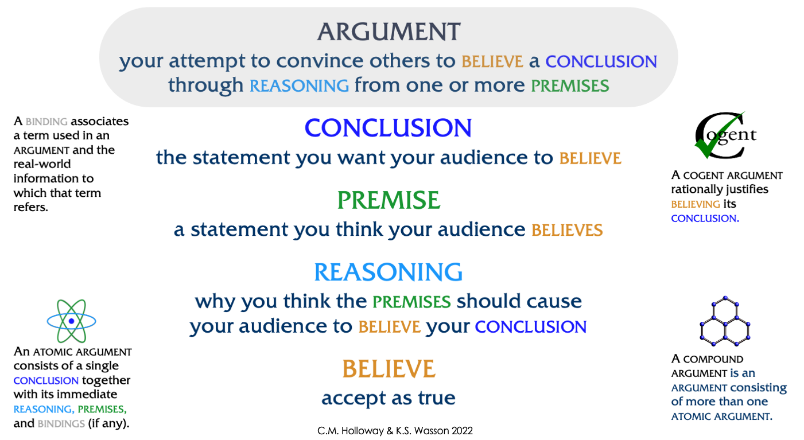
Argument Terminology

Slide 38
Overarching Properties and Overarching Properties Related Arguments
The Overarching Properties (OPs) encapsulate the essential properties that should be satisfied by any entity (software, hardware, or system) for which approval is sought
  The OPs are a novel expression of time-honored principles
  The property labels (Intent, Correctness, Innocuity) do not affect the meaning of the properties in any way; they are included only for convenience of reference
  The meaning of the properties is fully defined by the three property statements and eight definitions
Overarching Properties Related Arguments (OPRAs) are intended to provide a way (but not the only way) to demonstrate and assess whether an entity possess the OPs
  A NASA-sponsored series of case studies is ongoing to assess the efficacy of OPRAs
  Other cases studies and pilot projects are also being conducted
Papers and presentations available at https://bit.ly/opfoundations
Notes:
LaRC Annex 7 / FAA.TO 005, Umbrella Interagency Agreement, NASA Number IA—1407 / FAA Number DTFAWA-14-C-00019
Work being done with the FAA’s Chief Scientist and Technical Advisor (CSTA) George Romanski, Aircraft Computer Software, Barbara Lindberg (Oversees software and digital systems research portfolio)
Defined Intended Functions are correct and complete wrt desired system behavior
Implementation is correct wrt defined intended function under foreseeable operating conditions
All of the implementation is either required by the defined intended function, or is without unacceptable safety impact
Basis for WG is Basis is work by EU research project called Re-Engineering and Streamlining the Standards for Avionics Certification (RESSAC)
Use of the Goal-Structuring Notation (GSN) for expressing arguments

Slide 39
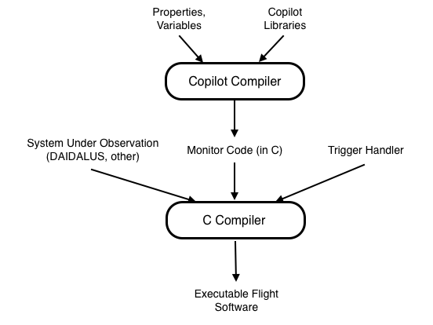
Run Time Verification: Copilot DSL Runtime Monitors
Runtime verification (RV) involves monitors that observe the behavior of a system and detects if it is inconsistent with a given specification
  Monitored system - system under observation (SUO)
Specification is written in a decidable logic or appropriate abstract notation
  Regular languages, Linear temporal logic (LTL) , Metric temporal logic (MTL)
When a monitor detects that a property is violated, it may raise an alarm or steer the system into a safe mode of operation
RV frameworks synthesize monitors from specs
Copilot is a Haskell-based embedded Domain Specific Language (DSL) that synthesize monitors for real-time embedded systems
  Generates Misra-like C monitors
  Constant time, constant memory
  Minimum instrumentation of SUO source code
  Samples system under observation
    Can miss state changes if not sampled

Slide 40
Safety Argumentation
Demonstrate satisfaction of safety objectives derived from hazard analysis
Justify acceptability of safety based on product-specific and targeted evidence
(Potentially) justify the determination of objectives and the selection of evidence
“Safety Case is a structured argument, supported by a body of evidence, that provides a compelling, comprehensible and valid case that the system is safe for a given application in a given operating environment.” –UK MOD
A Safety Claim is a Proposition over variables:
This
system
This environment
These criteria
deployed
in
meets
Safety Assurance Case:
Decomposed, traceable, integrated, organized support for this proposition

Slide 41
Streamlining Assurance and Certification Processes
Overarching Properties (OPs) encapsulate the essential properties that should be satisfied by any entity (software, hardware, or system) for which approval is sought
  Intent, Correctness, and Innocuity
Overarching Properties Working Group (OPWG) is currently working to “identify and justify evaluation Criteria that will facilitate producing sufficient evidence that the Overarching Properties are satisfied”
  Creating format and requirements of OP descriptions
  Providing current uses of argument-based approaches to assurance (safety cases)
  Lexicography, lexicology, grammar, and style of written materials
  Assisting in modifying the scope document to facilitate agreement between certification authorities
Work to be done after completion of Criteria draft includes
  Writing supplementary materials to help industry and authorities understand the Overarching Properties
  Conducting evaluation of the sufficiency of the OPs relative to currently recognized standards
Notes:
LaRC Annex 7 / FAA.TO 005, Umbrella Interagency Agreement, NASA Number IA—1407 / FAA Number DTFAWA-14-C-00019
Work being done with the FAA’s Chief Scientist and Technical Advisor (CSTA) George Romanski, Aircraft Computer Software, Barbara Lindberg (Oversees software and digital systems research portfolio)
Defined Intended Functions are correct and complete wrt desired system behavior
Implementation is correct wrt defined intended function under foreseeable operating conditions
All of the implementation is either required by the defined intended function, or is without unacceptable safety impact
Basis for WG is Basis is work by EU research project called Re-Engineering and Streamlining the Standards for Avionics Certification (RESSAC)
Use of the Goal-Structuring Notation (GSN) for expressing arguments

Slide 42
Literature Review
Gilles Geeraerts et al. (2018) | Damien Busatto-Gaston et al. (2021)
Define a scheduler for preemptible¹ tasks and jobs and outlines how to build a finite MDP that accurately represents the system | The authors discuss a safe sampling algorithm and prove that sample complexity is proportional to the size of the domain of the distribution.
Outline a method for finding a safe and optimal scheduler for the MDP model. | Show that Monte-Carlo Tree Search (MCTS) can be used to solve preemptible¹ scheduling systems with large state-spaces (e.g. 10²⁰)
¹Preemptible jobs can be interrupted and resumed. Non-Preemptible jobs must be completed before a new job can be started (Buttazzo et al. (2012))
The MDP model, sampling algorithm, and MCTS used by these authors served as a foundation for our approach

Slide 43
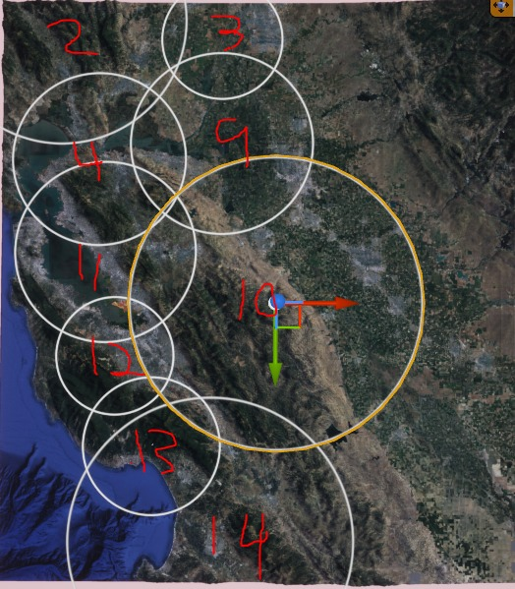
Example: UAM Scheduling System
Goal: Model requests across a finite set of vertihubs
Routes: Route between two vertihubs. Used to generate requests (Ci, Di, Ai)
Requests: Specific occurrence of travel on the route
Elements of Request:
  Ci : The completion time of the request
  Di : The deadline for the request (Hard or Soft)
  Ai : The inter-arrival time for a new request on the same route
Ex. ({3: 0.5, 4: 0.5}, 7, {8: 1.0})
Ci ≤ Di < Ai
Image Source: Google Earth (2022)

Slide 44
Handling Aleatoric Uncertainty Using Safe Learning
Research Project
Notes:
”We’ve talked about safety arguments by which you demonstrate to a regulator how you have managed uncertainty in your system, and thus made it safe … now we will talk about specific research efforts by which sources of aleatoric and epistemic uncertainty may be tamed …”

Slide 45
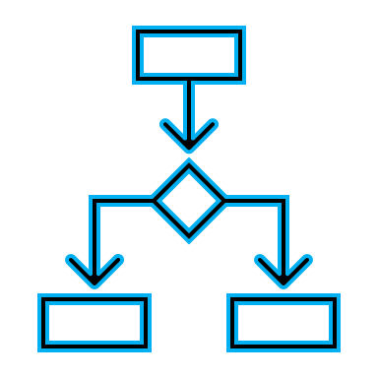

Research Approach
OUR GOAL
To find a safe (optimal) policy over a learned (MDP) system
Learn and Construct a Markov Decision Process (MDP) model of the system
Use existing MDP-solving algorithms to find the optimal (scheduler) policy
Neogi, N., Murthy, S., and S. Bharadwaj, “Scheduling for Urban Air Mobility using Safe Learning”, Fourth Workshop on Formal Methods for Autonomous Systems (FMAS), International Conference on Software Engineering and Formal Methods (SEFM) 2022, Berlin, Germany, September 26-27, 2022.

Slide 46
Problem Statement and Background
Goal: Model requests across a finite set of vertihubs
Routes: Route between two vertihubs. Used to generate requests (Ci, Di, Ai)
Requests: Specific occurrence of travel on the route
Elements of Request:
  Ci : The completion time of the request
  Di : The deadline for the request (Hard or Soft)
  Ai : The inter-arrival time for a new request on the same route
Ex. ({3: 0.5, 4: 0.5}, 7, {8: 1.0})
Ci ≤ Di < Ai
Gilles Geeraerts et al. (2018) define a scheduler for preemptible tasks and jobs and outlines how to build a finite MDP that accurately represents the system
  Outline a method for finding a safe and optimal scheduler for the MDP model.
Damien Busatto-Gaston et al. (2021) discuss a safe sampling algorithm and prove that sample complexity is proportional to the size of the domain of the distribution.
  Show that Monte-Carlo Tree Search (MCTS) can be used to solve preemptible¹ scheduling systems with large state-spaces (e.g. 10²⁰)
The MDP model, sampling algorithm, and MCTS used by these authors served as a foundation for our approach

Slide 47
UAM Scheduler to MDP
MDP is widely-used way to model semi-random decision-making processes
Many currently existing learning algorithms work well with MDPs
MDP | UAM Scheduler
Set of states: S | All reachable request configurations
Set of actions: A | Set of requests an agent can work on
Probability function: P(s, a, s’) | Dependent on the completion and inter-arrival probability distributions
Reward function: R(s, a, s’) | Penalize missed deadlines

Slide 48
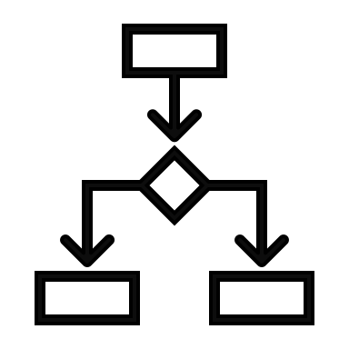



5-Step Process for a Safe Pseudo-Optimal Policy Over Learned MDP
CONSTRUCTION of the MDP model
PRUNING states and actions
SAMPLING probability distributions
LEARNING by creating an estimate MDP
SOLVING the MDP for an optimal policy

Slide 49
Constructed MDP (Non-preemptible UAM scheduling)
{3: 0.5, 4: 0.5}, 7, {8: 1.0}
{2: 1.0}, 3, {4: 1.0}
0, p = 0.5
S1
None
{0: 1.0}, 4, {5: 1.0}
{2: 1.0}, 3, {1: 1.0}
1
{3: 0.5, 4: 0.5}, 6, {7: 1.0}
{2: 1.0}, 2, {3: 1.0}
{3: 0.5, 4: 0.5}, 5, {6: 1.0}
{0: 1.0}, 1, {2: 1.0}
S2
0, p = 0.5
S4
Repeat None
0, 1, None
S3
0
{3: 0.5, 4: 0.5}, 4, {5: 1.0}
{2: 1.0}, 0, {1: 1.0}
C = -10
0, p = 0.5
0, p = 0.5
{0: 1.0}, 3, {4: 1.0}
{2: 1.0}, 3, {4: 1.0}
{0: 1.0}, 1, {3: 1.0}
{2: 1.0}, 2, {3: 1.0}
{0: 1.0}, 0, {1: 1.0}
{2: 1.0}, 2, {2: 1.0}
Repeat None
S5
1
1
1
{3: 0.5, 4: 0.5}, 1, {2: 1.0}
{2: 1.0}, 0, {2: 1.0}
C = -10
{0: 1.0}, 0, {1: 1.0}
{0: 1.0}, 0, {1: 1.0}
{0: 1.0}, 0, {1: 1.0}
{1: 1.0}, 0, {1: 1.0}
C = -10
{0: 1.0}, 1, {2: 1.0}
{0: 1.0}, 1, {2: 1.0}
0, 1, None
0, 1, None
0, 1, None
0, 1, None
Terminal
C = -10000
0, 1, None
{0: 1.0}, 0, {1: 1.0}
{0: 1.0}, 0, {1: 1.0}

Slide 50
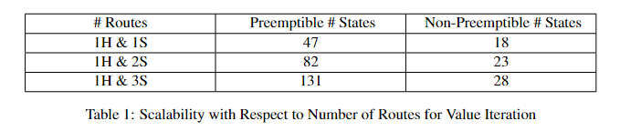
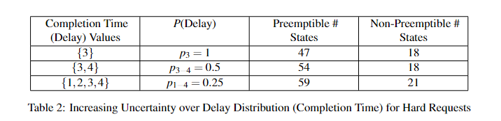
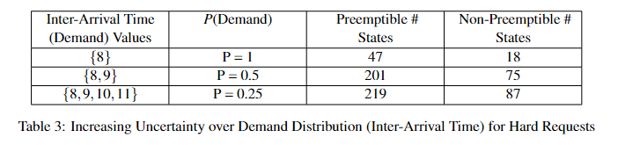
MDP Construction and Scalability
The size of the MDP state space depends on the number of requests and the complexity of the completion time and inter-arrival time distributions

Slide 51
Pruning the MDP
Key Question: How to avoid entering the terminal state while sampling
Solution: Prune the MDP to remove terminal states and actions that lead to the terminal state
{3: 0.5, 4: 0.5}, 7, {8: 1.0}
{2: 1.0}, 3, {4: 1.0}
0, p = 0.5
S1
None
{0: 1.0}, 4, {5: 1.0}
{2: 1.0}, 0, {1: 1.0}
C = -10
1
{3: 0.5, 4: 0.5}, 6, {7: 1.0}
{2: 1.0}, 2, {3: 1.0}
{3: 0.5, 4: 0.5}, 5, {6: 1.0}
{0: 1.0}, 1, {2: 1.0}
S2
0, p = 0.5
S3
S4
Repeat None
0, 1, None
0
{3: 0.5, 4: 0.5}, 4, {5: 1.0}
{2: 1.0}, 0, {1: 1.0}
C = -10
0, p = 0.5
0, p = 0.5
{0: 1.0}, 3, {4: 1.0}
{2: 1.0}, 3, {4: 1.0}
C = -10
{0: 1.0}, 1, {3: 1.0}
{2: 1.0}, 2, {3: 1.0}
{0: 1.0}, 0, {1: 1.0}
{2: 1.0}, 2, {2: 1.0}
S8
S5
1
1
1
{0: 1.0}, 0, {1: 1.0}
{0: 1.0}, 0, {1: 1.0}
{0: 1.0}, 0, {1: 1.0}
{1: 1.0}, 0, {1: 1.0}
C = -10
{0: 1.0}, 1, {2: 1.0}
{0: 1.0}, 1, {2: 1.0}
0, p = 0.5
0, p = 0.5
S6
0, 1, None
0, 1, None
0, 1, None
0, 1, None
{0: 1.0}, 0, {1: 1.0}
{0: 1.0}, 0, {1: 1.0}
{0: 1.0}, 0, {1: 1.0}
{2: 1.0}, 0, {1: 1.0}
C = -10
{0: 1.0}, 1, {2: 1.0}
{2: 1.0}, 1, {2: 1.0}
S7
S9
S10

Slide 52
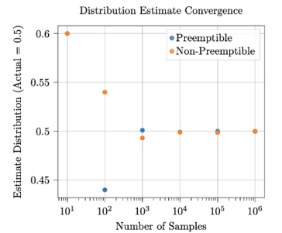
Sampling Algorithm
Steps through MDP
Counts computation time and inter-arrival time
One can observe how the MDP converges on the actual value as the number of samples increases
Figure: Delay Distribution for Priority Route with Completion Time = {1,2}

Slide 53




Learning the Safe (Pruned) MDP
{3: 0.5, 4: 0.5}, 7, {8: 1.0}
{2: 1.0}, 3, {4: 1.0}
0, p $≈$0.5
S1
None
{0: 1.0}, 4, {5: 1.0}
{2: 1.0}, 0, {1: 1.0}
C = -10
1
{3: 0.5, 4: 0.5}, 6, {7: 1.0}
{2: 1.0}, 2, {3: 1.0}
{3: 0.5, 4: 0.5}, 5, {6: 1.0}
{0: 1.0}, 1, {2: 1.0}
S2
0, p $≈$0.5
S3
S4
Repeat None
0, 1, None
0
{3: 0.5, 4: 0.5}, 4, {5: 1.0}
{2: 1.0}, 0, {1: 1.0}
C = -10
0, p $≈$0.5
0, p $≈$0.5
{0: 1.0}, 3, {4: 1.0}
{2: 1.0}, 3, {4: 1.0}
C = -10
{0: 1.0}, 1, {3: 1.0}
{2: 1.0}, 2, {3: 1.0}
{0: 1.0}, 0, {1: 1.0}
{2: 1.0}, 2, {2: 1.0}
S8
S5
1
1
1
{0: 1.0}, 0, {1: 1.0}
{0: 1.0}, 0, {1: 1.0}
{0: 1.0}, 0, {1: 1.0}
{1: 1.0}, 0, {1: 1.0}
C = -10
{0: 1.0}, 1, {2: 1.0}
{0: 1.0}, 1, {2: 1.0}
0, p $≈$0.5
0, p $≈$0.5
S6
0, 1, None
0, 1, None
0, 1, None
0, 1, None
{0: 1.0}, 0, {1: 1.0}
{0: 1.0}, 0, {1: 1.0}
{0: 1.0}, 0, {1: 1.0}
{2: 1.0}, 0, {1: 1.0}
C = -10
{0: 1.0}, 1, {2: 1.0}
{2: 1.0}, 1, {2: 1.0}
S7
S9
S10

Slide 54
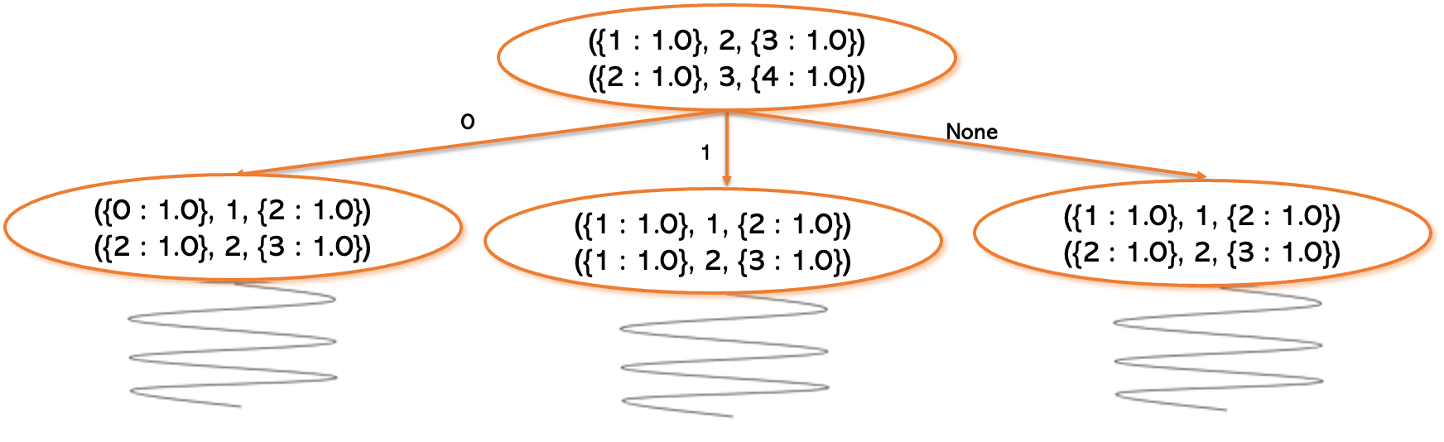
Solving: Value Iteration & MCTS
The value iteration algorithm is used to estimate the discounted future rewards for all states in an MDP.
The algorithm iteratively updates the values of each state until the discounted future reward converges.
The run time of value iteration is proportional to the size of the state space, which causes the runtime to increase drastically as the number of requests increases.
MCTS is a Finite Horizon Simulation.
Returns estimated optimal action for a given state
Since the estimation does not occur for every state, using MCTS greatly reduces run time
There exist several options for simulation step policies: Random Action vs Earliest Deadline First

Slide 55
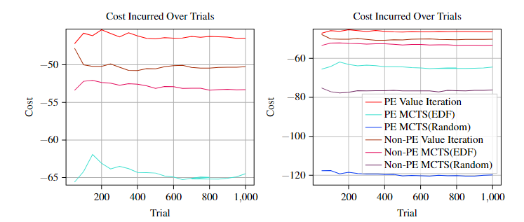
Solving: Policy Comparison
Value Iteration performed better than MCTS in all cases.
EDF MCTS performed better than Random MCTS.
Since the non-preemptible scheduler is less flexible than the preemptible, its optimal policy accrues a larger cost over time.
For MCTS, the non-preemptible scheduler performed better because it was able to step further into the future compared to the preemptible scheduler.
PE Value Iteration
Non-PE Value Iteration
Non-PE MCTS (EDF)
PE MCTS (EDF)

Slide 56
Safe Learning over MDPs
If you can model your system as an MDP (e.g., Scheduling, Path Planning, etc.) you can solve for an optimal (or pseudo-optimal) policy.
Further Goals
Expanding the scheduling framework to multi-agent systems
Introducing additional constraints to improve the accuracy of the model
You can learn a safe MDP of a system by pruning unsafe states from the model, sampling the probability distributions of the pruned model, and creating a learned (estimated) MDP.
The estimate MDP can then be used to identify the near-optimal policy that minimizes the average cost (i.e., minimizing missed soft deadlines) while guaranteeing no unsafe states are entered (i.e., no missed hard deadlines) .
Approach is scalable in terms of states (e.g., number of routes) and actions (e.g., size of both computation and inter-arrival distributions)

