Slide 1

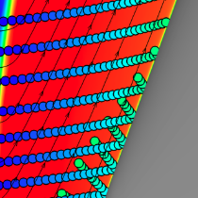
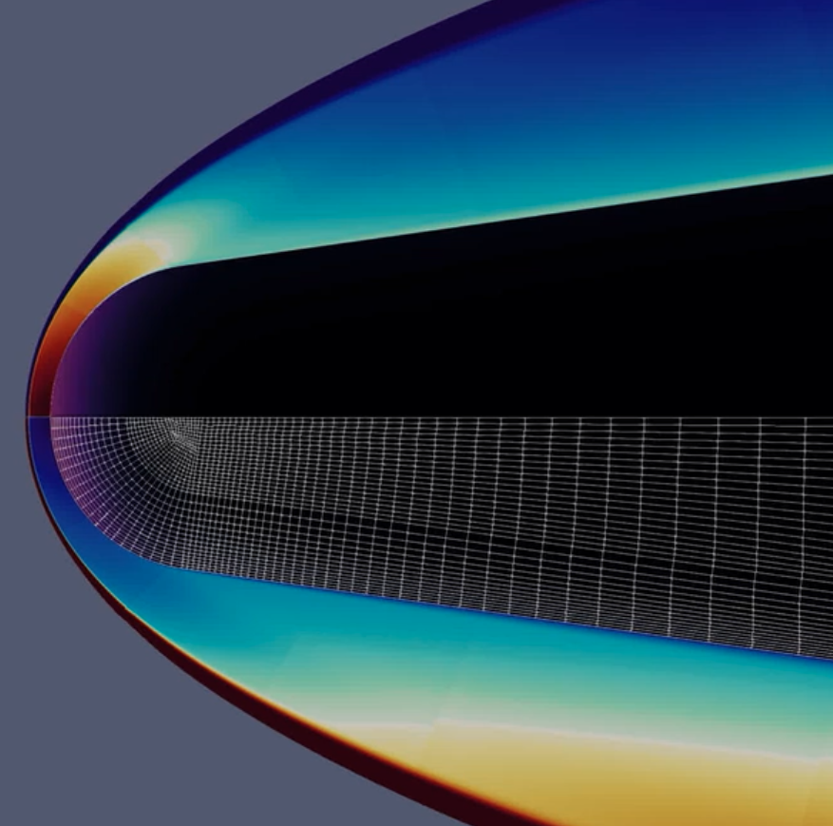
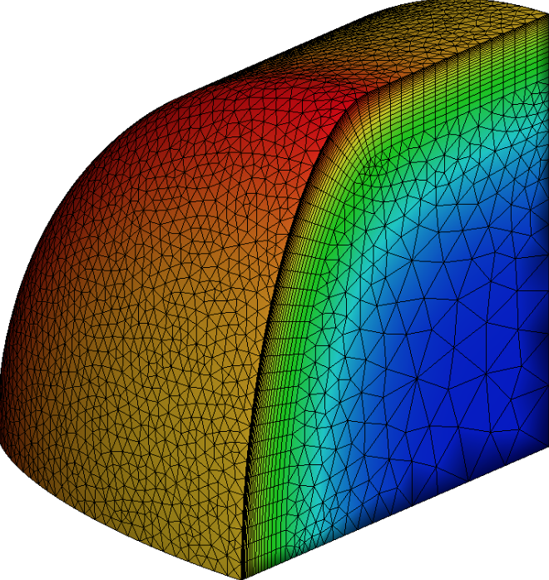
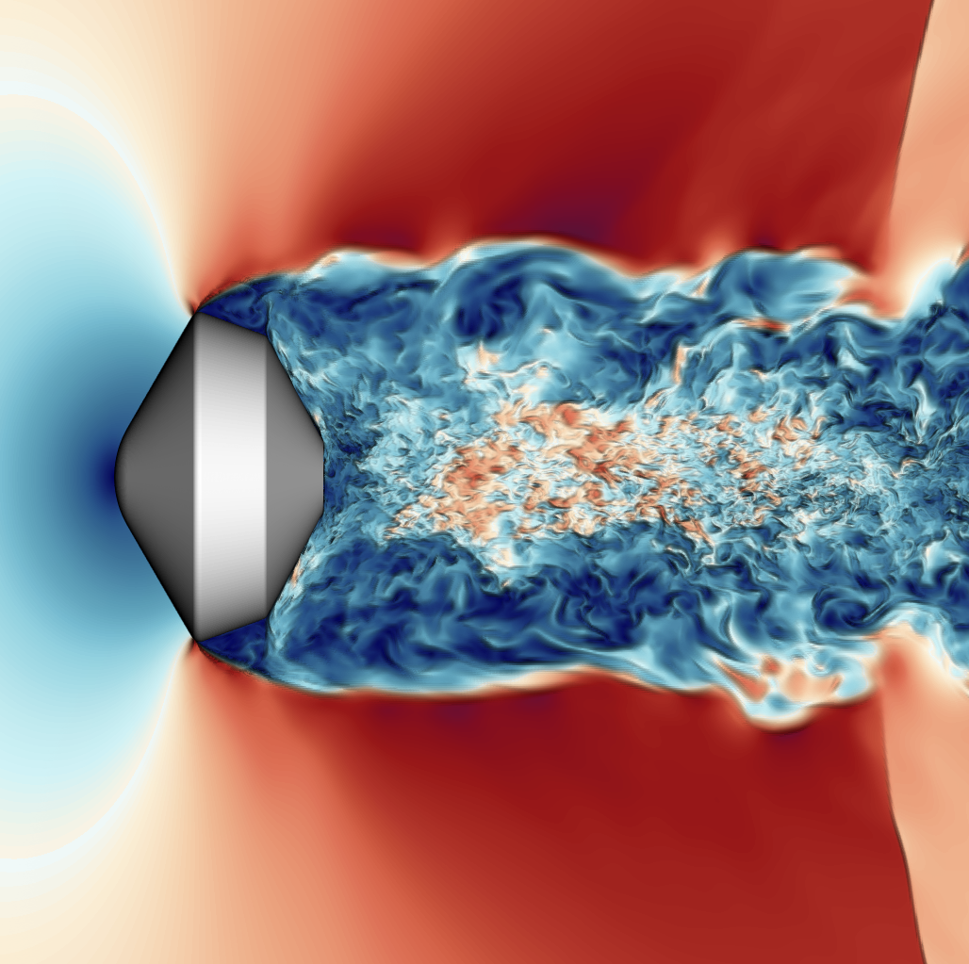
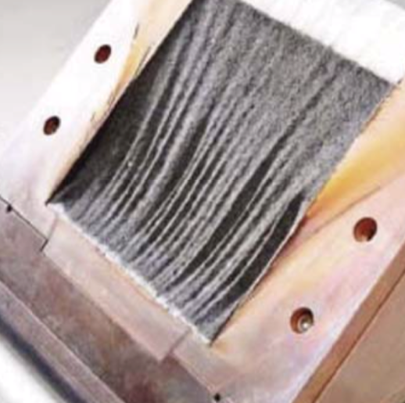
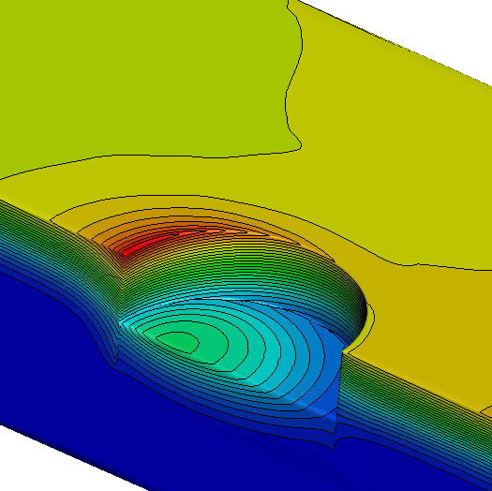
Material Response Simulations of Dragonfly Capsule using Icarus
Joseph Schulz, Georgios Bellas-Chatzigeorgis, Olivia Schroeder, Joseph Brock, Eric Stern, and Grant Palmer

Slide 2
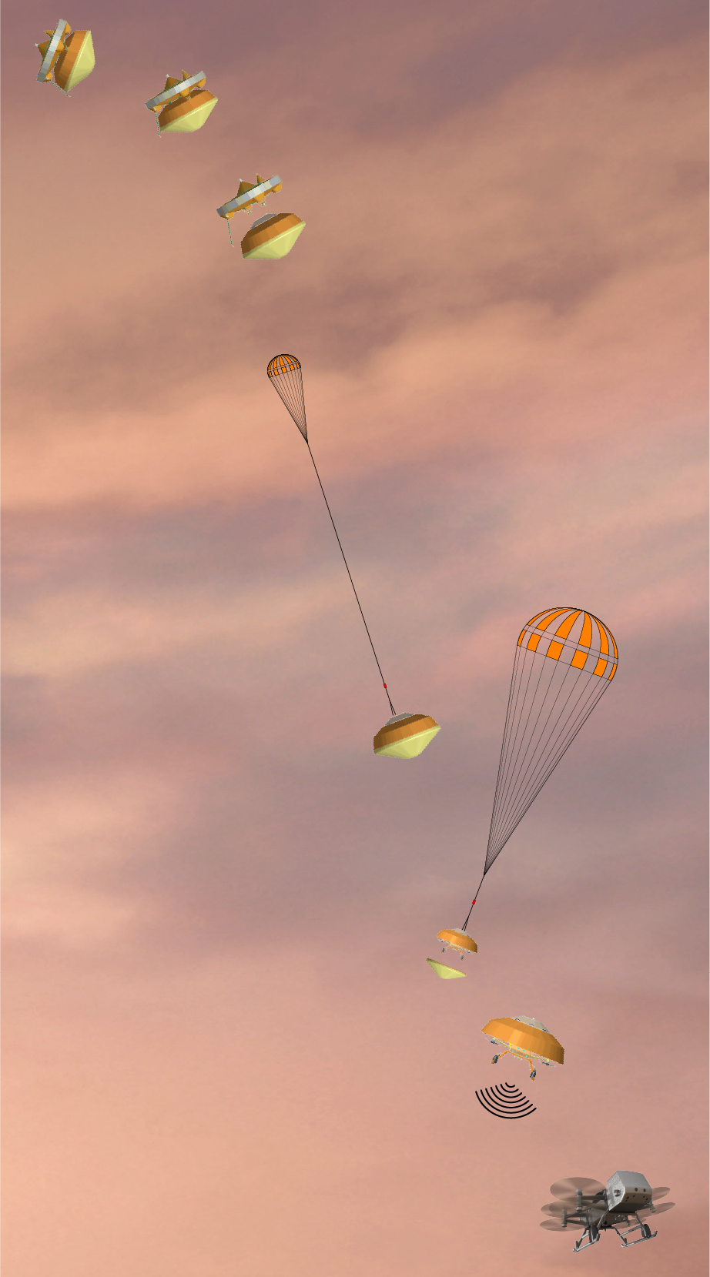
Dragonfly Entry Aerosciences Measurements (DrEAM)
Success of MEDLI and MEDLI2 instrumentation for MSL and Mars2020 motivates the opportunity to learn about our entry systems
Dragonfly + DrEAM
  Engineering Science Investigation (ESI) requirement for New Frontiers / Discovery class missions to incorporate EDL instrumentation
Titan
  Surface atmospheric pressure = 1.45 atm
  4.3x density of Earth’s atmosphere at sea level
  94.3% nitrogen, 5.6% methane and 0.1% hydrogen
Mission Timeline
2019 | 2020 | 2021 | 2022 | 2023 | 2024 | 2025 | 2026 | 2027 | 2028 | 2029 | 2030 | 2031 | 2032 | 2033 | 2034 | 2035
selection
launch
arrival
Image Credits: John Hopkins APL

Slide 3
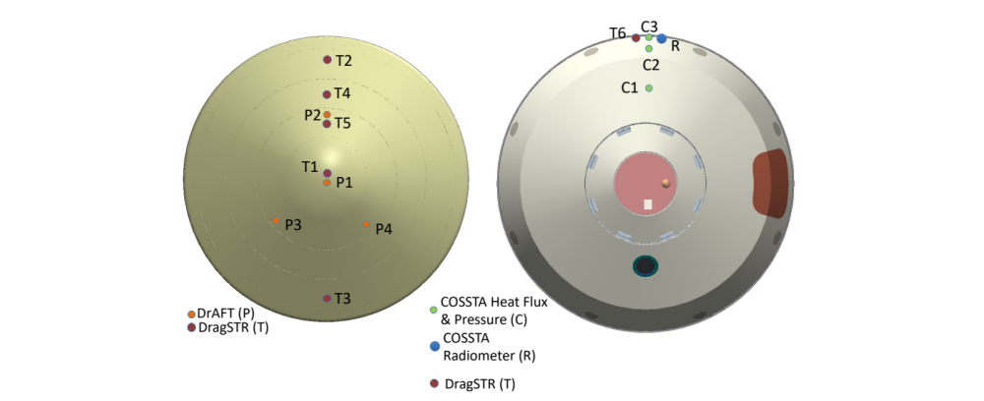
DrEAM : Instrumentation and Science Objectives
Preliminary Sensor Layout
Forebody aerothermal environment
  Transition to turbulence?
TPS response in non-oxidizing environment
  Recession?
Convective cooling during descent
  Impact on TPS bondline
Methane abundance in Titan’s upper atmosphere
Aftbody CN radiative heating from violet and red bands
  Impact of TPS design
Atmospheric density and winds
Vehicle orientation and dynamics
Heritage from ExoMars Schiaparelli / MEDLI / MEDLI2
DragSTR : Dragonfly Sensors for Thermal Reconstruction
DrAFT : Dragonfly Atmospheric Flight Transducers
COSSTA : COmbined Sensor System for Titan Atmosphere
[1] IPPW 2022, Brandis et al. Overview of the Dragonfly Entry Aerosciences Measurements (DrEAM) Suite.

Slide 4
Reconstructing DrEAM data
Aerothermal data reconstruction
  Pressure transducers + in-depth thermocouple measurements to infer environment using inverse analysis
  Lessons learned and tools developed from previous missions
Radiation is sensitive to concentration of CH₄
  Uncertainty in upper atmosphere is 0.9 - 2.2%
  High concentration of CN (1-2% mole fraction) in wake
What can we do to gain confidence in accuracy of reconstructions?
How do we handle or bound uncertainty?
Demonstration, assessment, and model development of Icarus for applications related to Dragonfly

Slide 5
Objectives
Use Icarus for
  one-dimensional analysis of the material stack-up at select points on the heatshield to predict the in-depth temperatures, i.e., simulate thermocouple (TC) measurements
    Perform a Monte-Carlo analysis to assess the optimal TC depth
  three-dimensional simulations of Dragonfly heatshield
    Decoupled US3D / Icarus
    Fully-coupled simulations using Ares plugin
Thursday morning: Olivia Schroder will give a talk about the development of Ares for multi-physics coupling in US3D
Several posters on CFD / Material response coupling
- Coupling CFD and Material Response for Analysis of Mars Entry : John Thornton, Dinesh Prabhu, Jeremie Meurisse, Arnaud Borner, Josh Monk, Brett Cruden

Slide 6
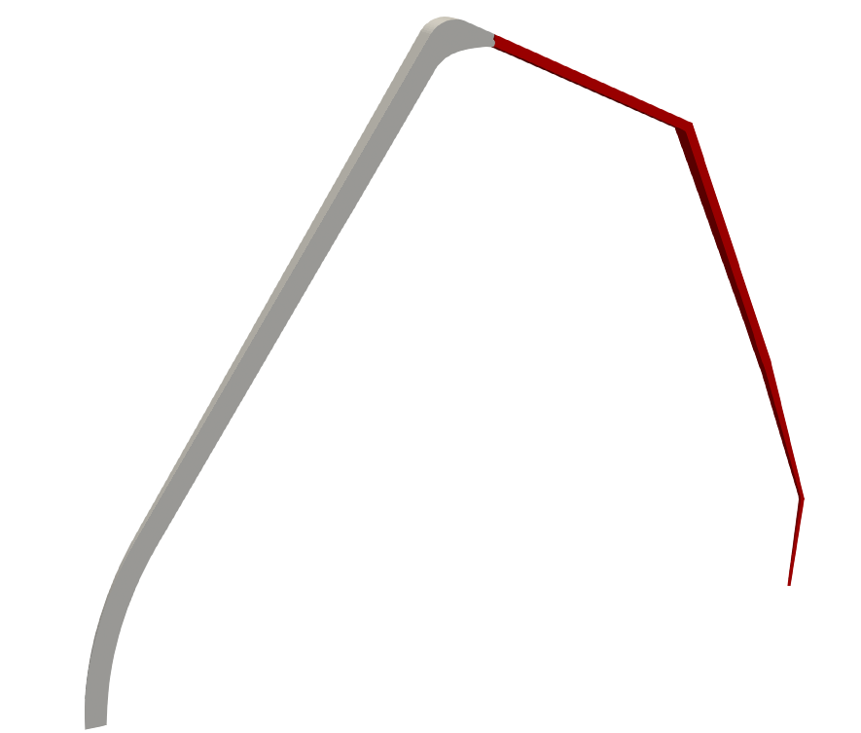



Dragonfly Thermal Protection System
Aft-shoulder
Heatshield material stackup
Material response simulations
  Pyrolysis
  Darcy’s law for convective transport
Titan Environment
  94.3% nitrogen – expect little recession and is currently neglected
Boundary conditions – solve the surface mass / energy balance
PICA
Aluminum Honeycomb
Fore-shoulder
NOTE: This presentation focuses only on the heatshield
$$p_{s} :$$
specified surface pressure
$$T_{s} :$$
$$q_{s}+αq_{rad}−σε\left(T^{4}−T_{∞}^{4}\right)−q_{cond}=0$$
Stagnation point

Slide 7
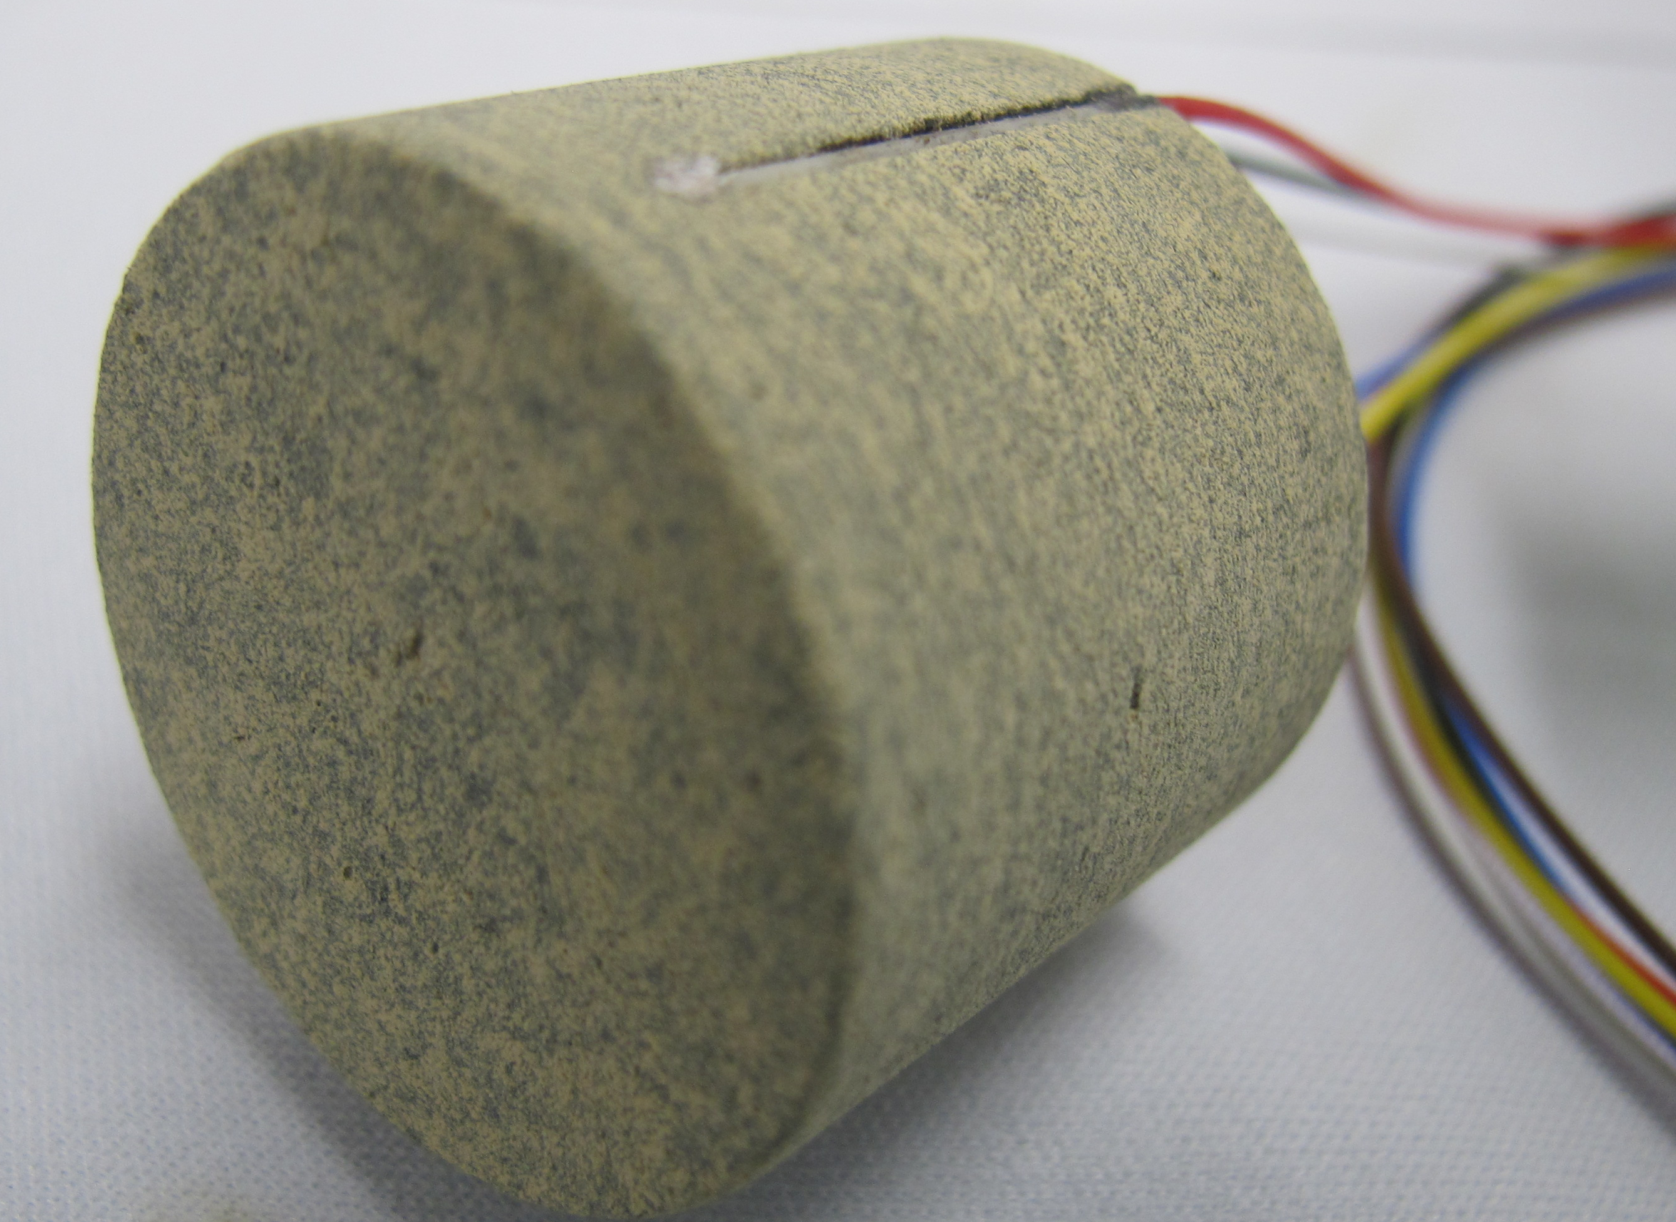
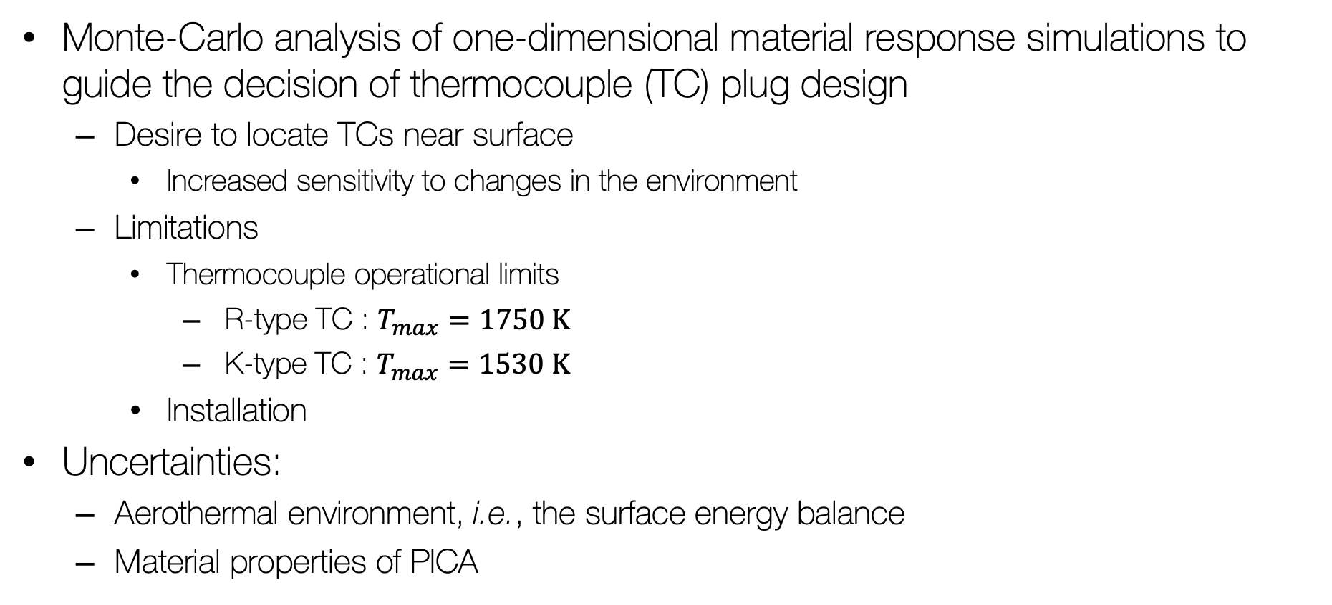
DragSTR Plug Design
Monte-Carlo analysis of one-dimensional material response simulations to guide the decision of thermocouple (TC) plug design
  Desire to locate TCs near surface
    Increased sensitivity to changes in the environment
  Limitations
    Thermocouple operational limits
      R-type TC : $T_{max}=1750 \text{K}$
      K-type TC : $T_{max}=1530 \text{K}$
    Installation
Uncertainties:
  Aerothermal environment, i.e., the surface energy balance
  Material properties of PICA
DragSTR Plug
Each plug contains 1-3 TCs and is flush-mounted

Slide 8
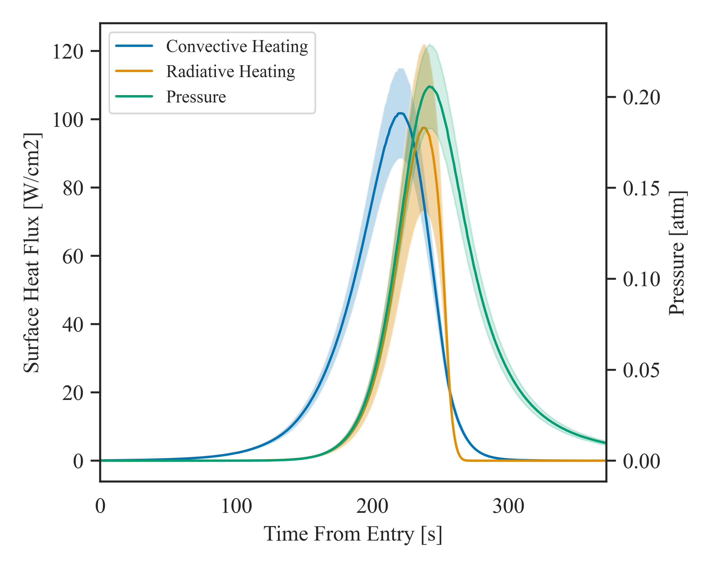
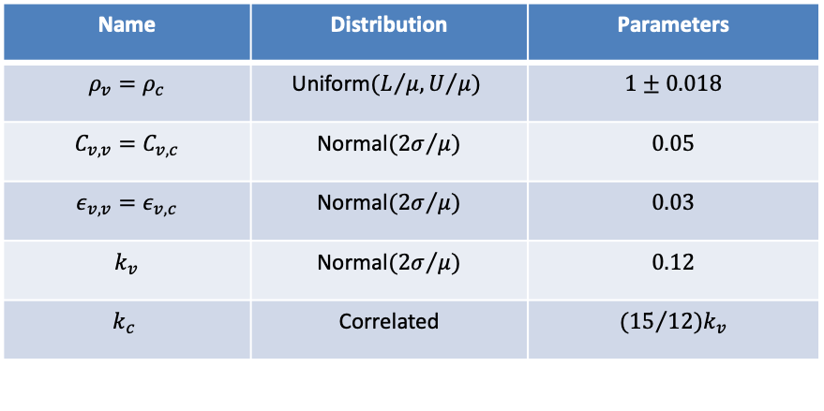
Monte-Carlo Analysis
Surface quantities at stagnation point
Uniform sampling between the nominal and margined environments
  Convective / radiative heating and pressure
PICA property uncertainties
  Adopted from study conducted for the MEDLI2 flight reconstruction
Name | Distribution | Parameters
$$ρ_{v}=ρ_{c}$$ | $$\text{Uniform}(L/{μ, U/{μ)}}$$ | $$1±0.018$$
$$C_{v,v}=C_{v,c}$$ | $$\text{Normal}({2σ}/{μ)}$$ | $$0.05$$
$$ε_{v,v}=ε_{v,c}$$ | $$\text{Normal}({2σ}/{μ)}$$ | $$0.03$$
$$k_{v}$$ | $$\text{Normal}({2σ}/{μ)}$$ | $$0.12$$
$$k_{c}$$ | $$\text{Correlated}$$ | $${(15}/{12)k_{v}}$$
Mean values of surface environment variables (solid lines) with shaded regions delineating the bounds of the uniform distribution
[H. Alpert et al. AIAA Paper 2022-0550]

Slide 9
Black-box Uncertainty Analysis
uqdriver
EFT1 / Artemis
Design of Experiments
problem = UQ(config=‘input.yml’)
problem.setup()
Case Generator : runner
Step 1
INHEAT:CHAR
case_list.xlsx
DrEAM
Step 2
SEB
Case Generator : icarusPy
Backends
DAKOTA
SALib
Numpy/Pandas
icarus
results.pkl
Analysis
problem.evaluate()
df = problem.analyze()
Saltelli, A., Ratto, M., Andres, T., Campolongo, F., Cariboni, J., Gatelli, D., Saisana, M., Tarantola, S. “Global Sensitivity Analysis : The Primer”, 2008
DAKOTA Package
SALib : Sensitivity Analysis Library in Python

Slide 10
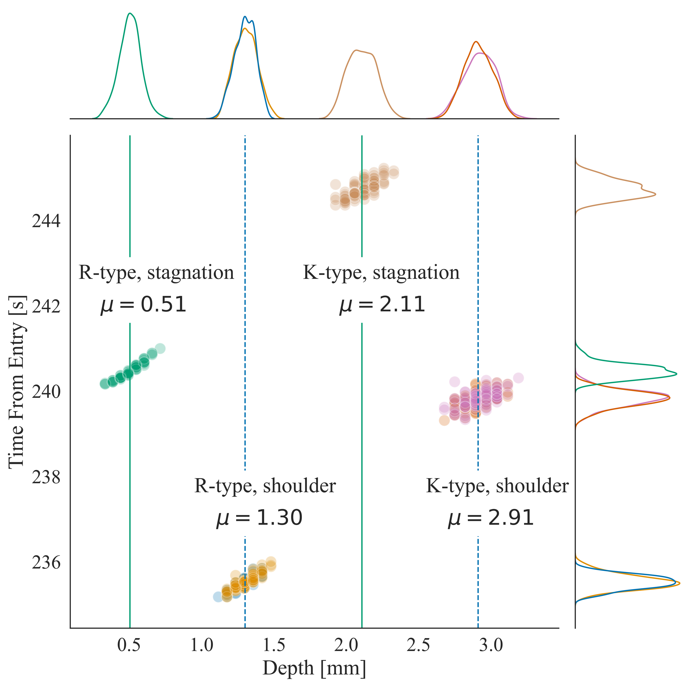
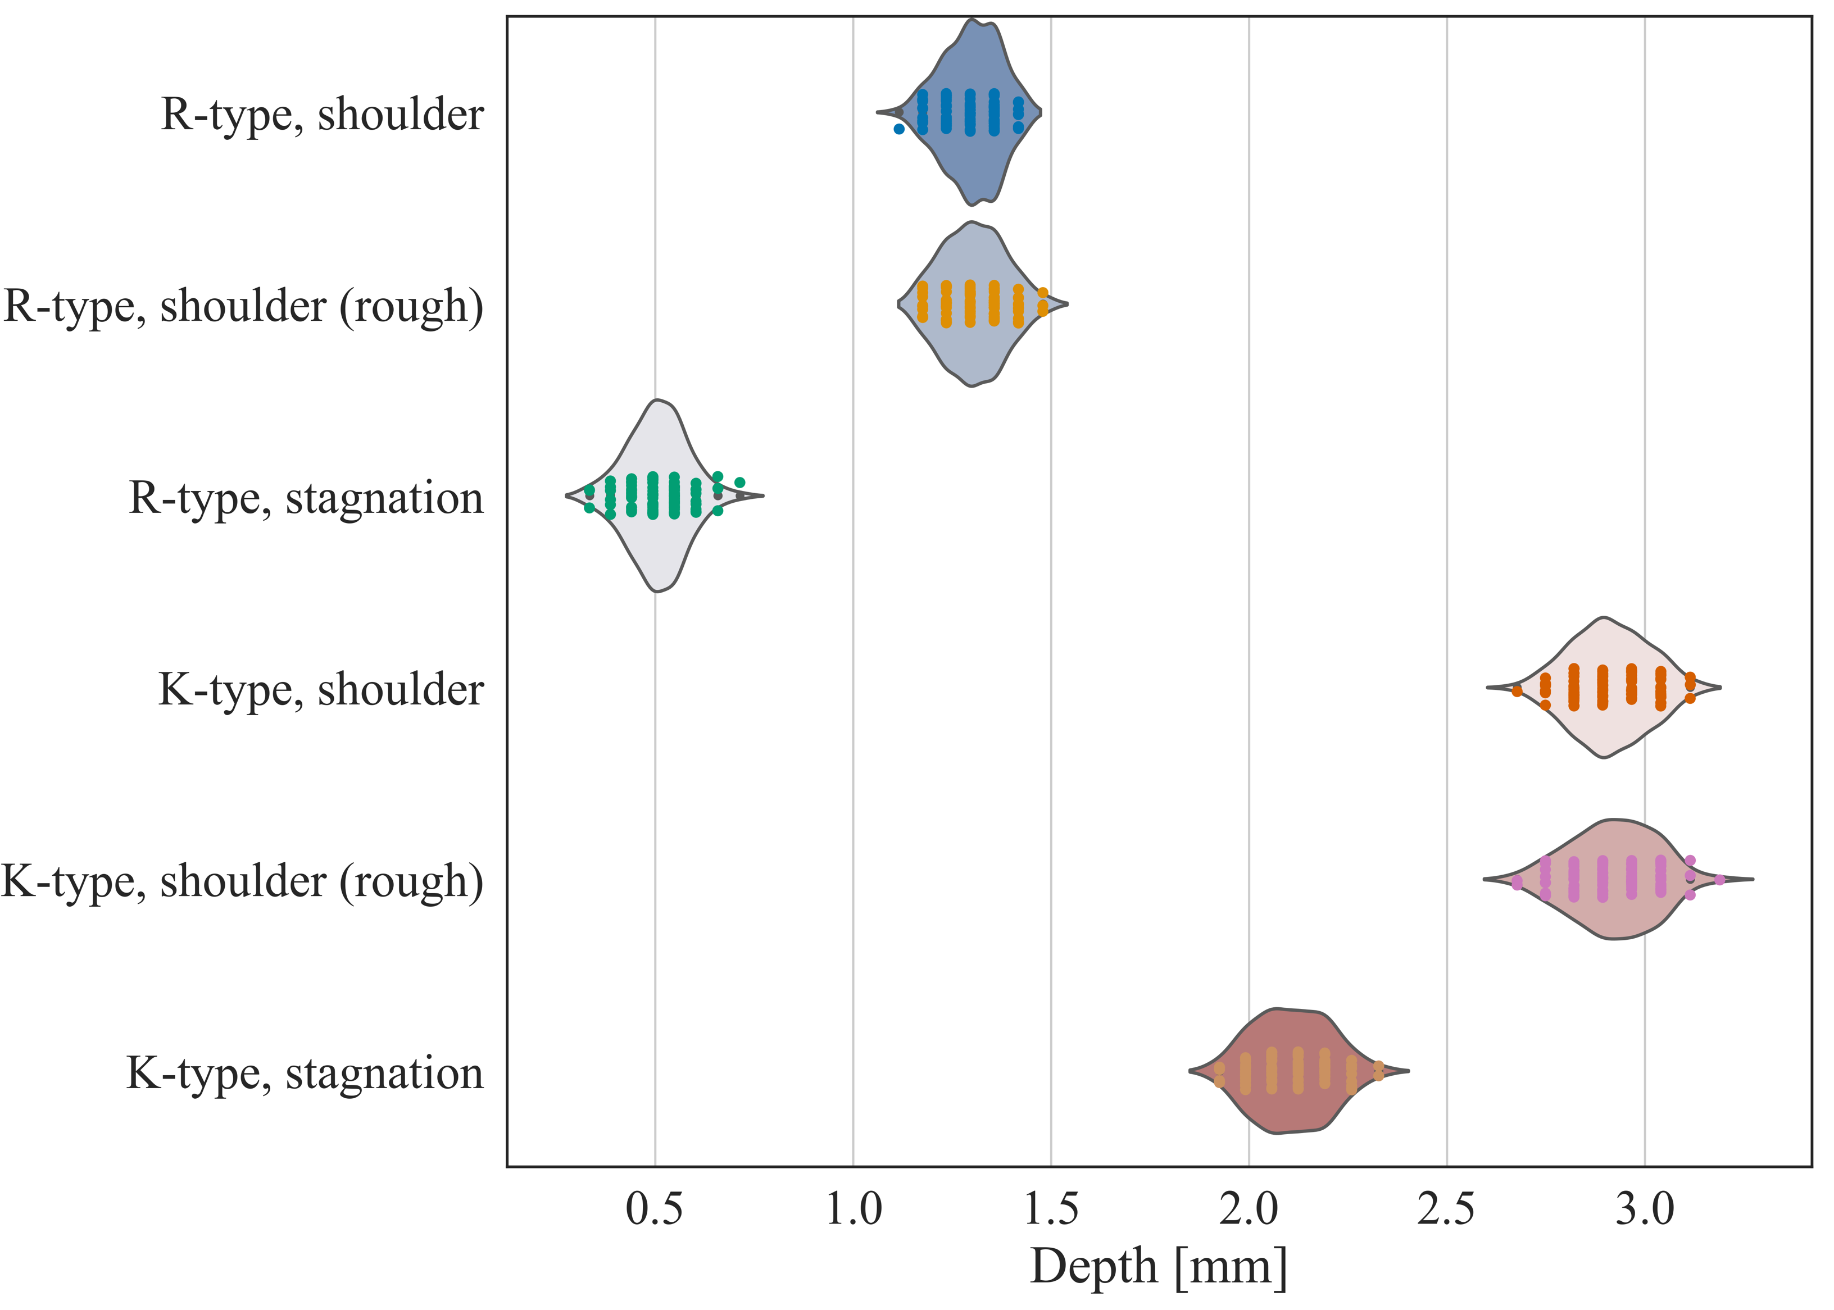
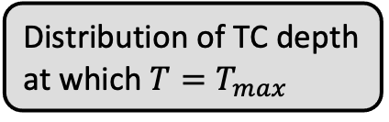
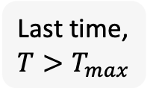
Results of Monte-Carlo Study
Distribution of TC depth at which $T=T_{max}$
Last time, $T>T_{max}$
R-type TC : $T_{max}=1750 K$ K-type TC : $T_{max}=1530 K$

Slide 11
Multi-dimensional Simulations
Two different approaches
  Construct a database of flow / radiation solutions of the best-estimated trajectory and interpolate to spatial and time-varying profiles
  Use Ares, a plug-in to US3D, to couple the material and flow simulations
    Inputs are freestream conditions of the trajectory
    Icarus only solves the radiative and conductive heat fluxes, all convective and chemical fluxes handled by Ares/US3D
$$q_{s}^{DPLR}\left(x,t\right)+αq_{R}^{DPLR}\left(x,t\right)−σε\left(T^{4}−T_{∞}^{4}\right)−q_{cond}=0$$

Slide 12
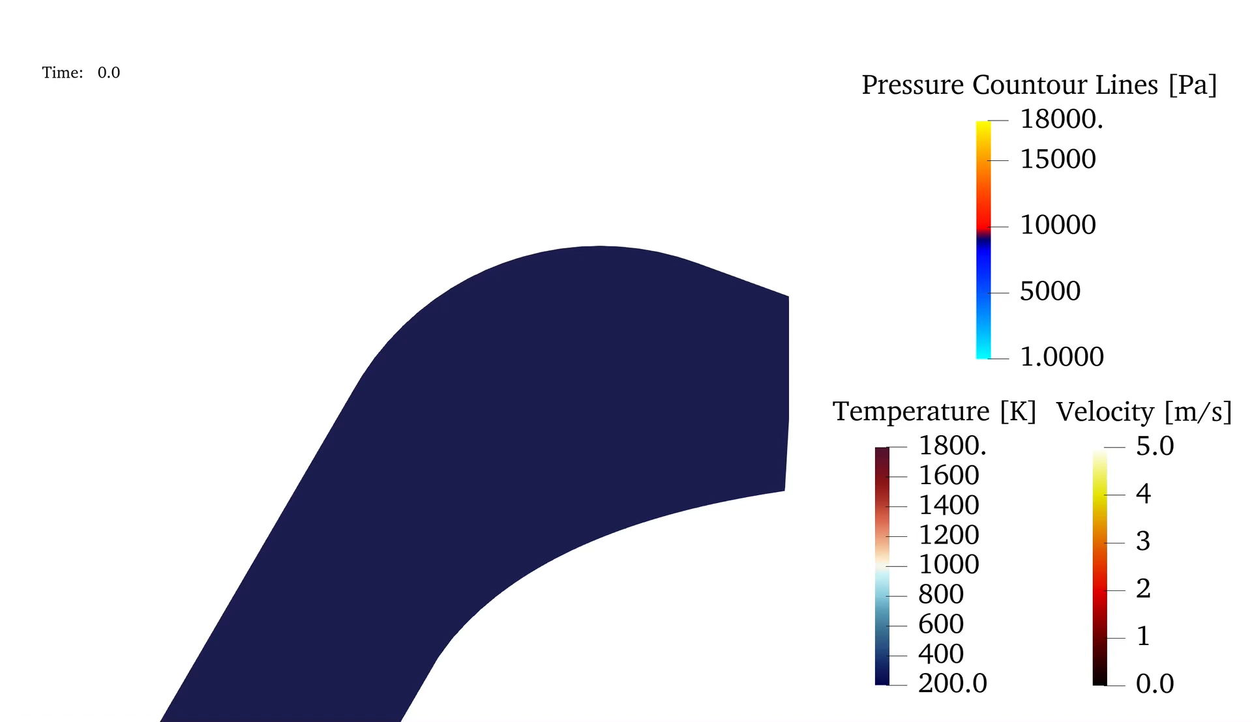
Three-dimensional Material Response
99.5 Char Percentage
Decoupled material response
Surface environments
  Interpolated using the same environments as the 1-D analysis
Objective is to account for any multi-dimensional affects, particularly at the shoulder
3D mesh shows much faster raise of the in-depth temperature
Suspect the solution is not grid independent
  Coarser than usual mesh chosen to help facilitate debugging of coupled simulations

Slide 13

Why coupling?
Animation of temperature response of an ablating Iso-Q
General Motivations
Improve modeling of gas surface interaction
Can flow coupling improve recession predictions near the shoulder?
Affect of pyrolysis gas products in flow
Dragonfly / DrEAM
Flow + Radiation + Material to improve out understanding of model sensitivities and uncertainties
Better environment reconstructions?
Will this enable better predictions of the freestream CH4?
Milos, F.S. and Chen, Y.-K. “Ablation and Thermal Response Property Model Validation for Phenolic Impregnated Carbon Ablator”, AIAA-2009-262

Slide 14
Ares
Time-scale of coupling between flow and material set by user
  Number of iterations to re-converge CFD versus the increment of physical time the material sees a given environment
  From “traditional” one-way to tightly-coupled simulations
Very active development – key contributions from Olivia Schroeder and Joe Brock
  Surface recession & mesh motion for ablating problems
  Gas-surface interaction models
  No requirement of “face-matched” US3D and Icarus geometry
  Software development – MPI, solution restart, data visualization, etc.
  Radiation solver available as a US3D plug-in, but not yet linked
  Pyrolysis gas products blown into the boundary layer are neglected

Slide 15
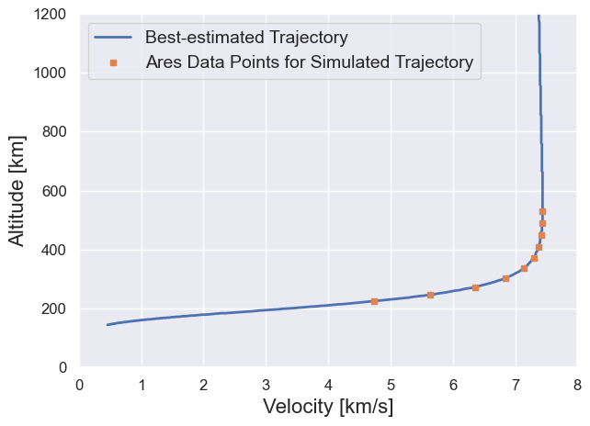
Ares
50 seconds of trajectory through peak heating simulated
US3D solution
  Mesh tailored for peak heating
  No mesh adaption during transient
Tight-coupling between US3D and Icarus during first 5 seconds of trajectory
Every 1000 fluid iterations, solid updated 0.25 seconds

Slide 16
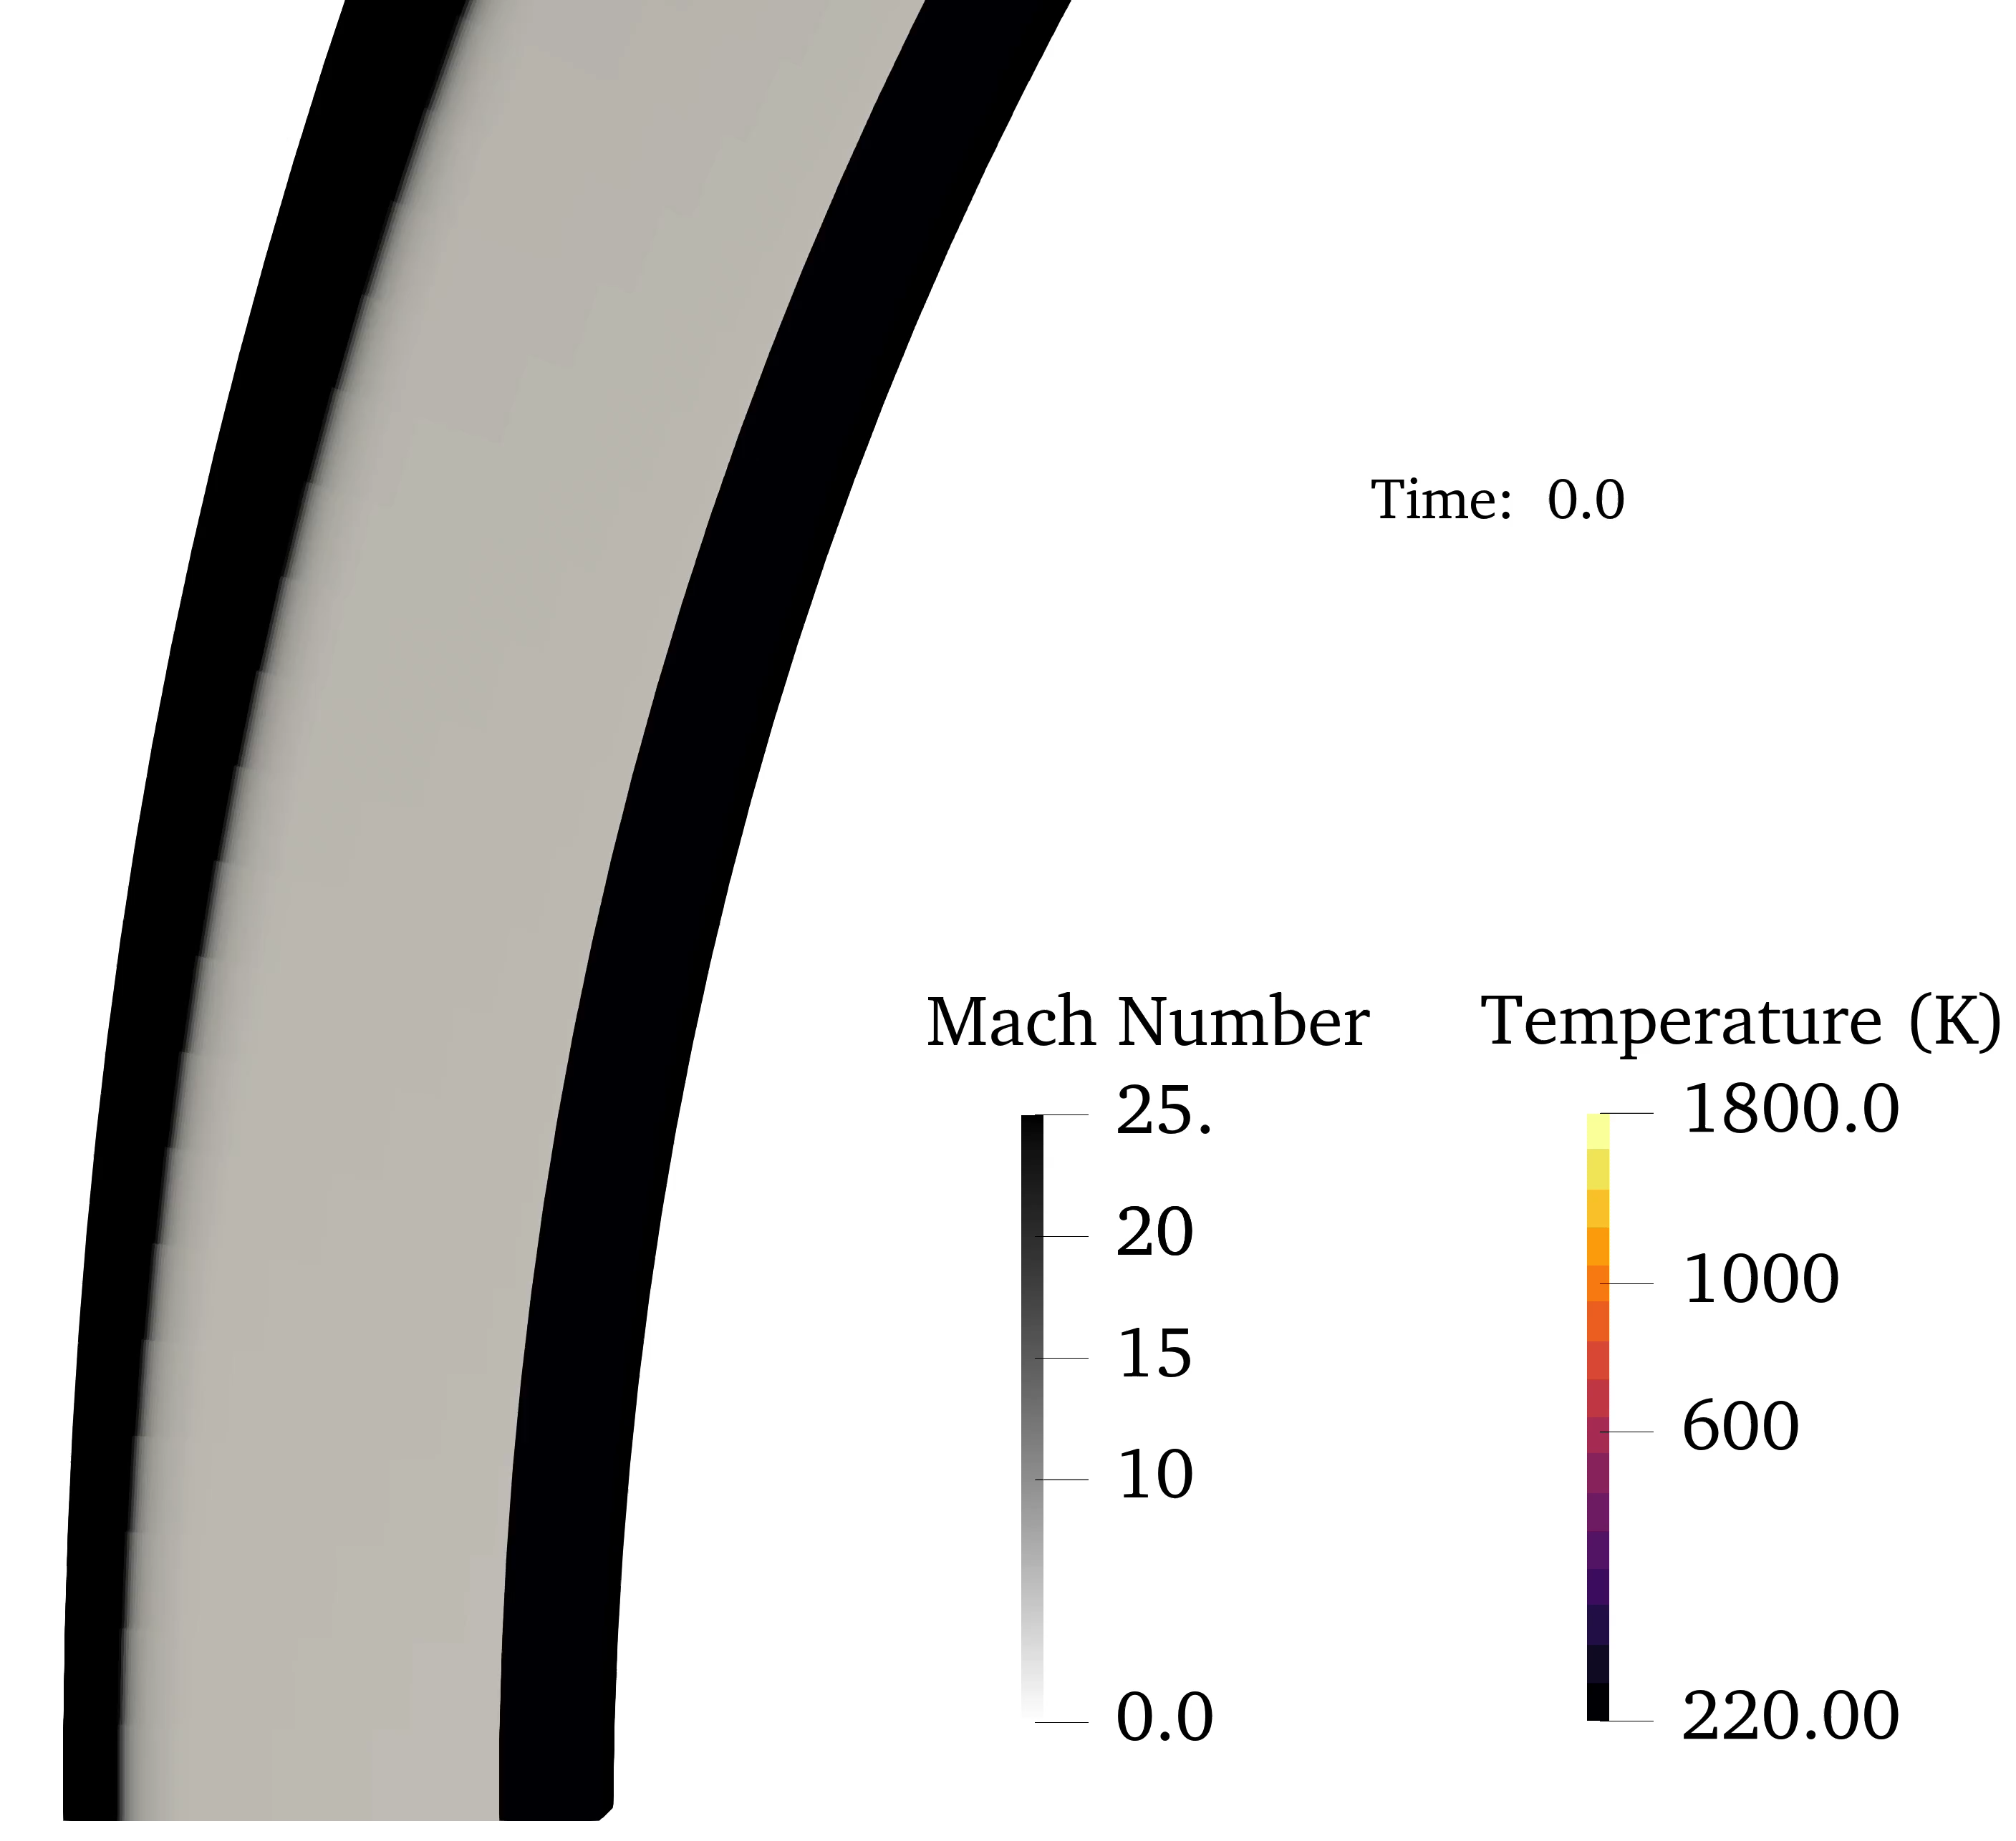
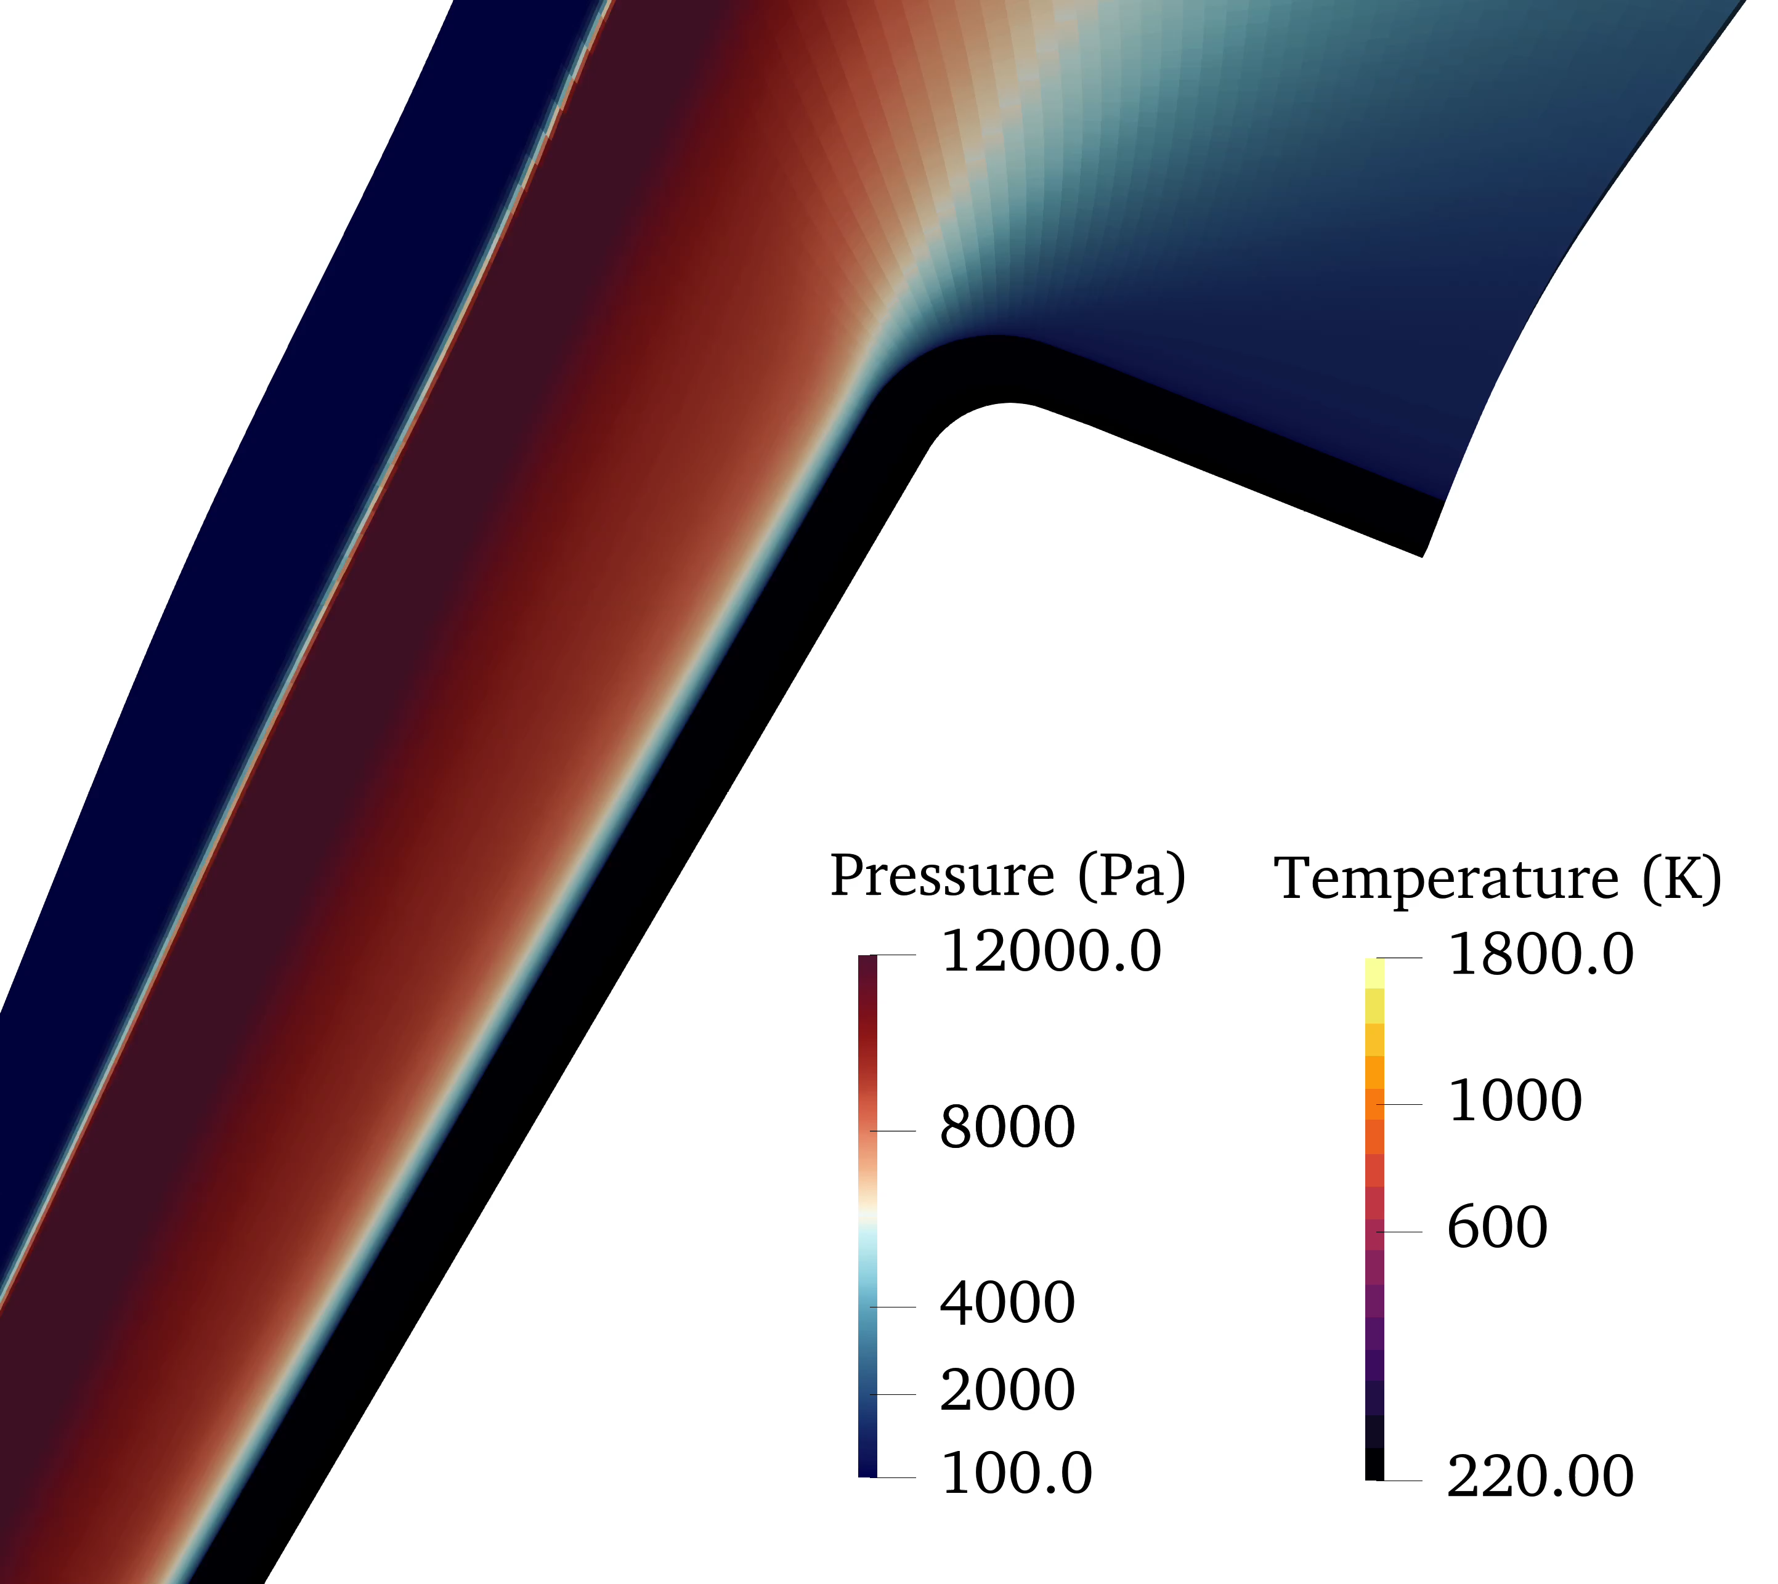
Ares

Slide 17
Conclusions
Monte-Carlo analysis using one-dimensional material stack-up simulations
  Demonstrated ability within Icarus to perform uncertainty quantification using a set of icaruspy and uqdriver
  Provide guidance in determining the optimal TC depth
Multi-dimensional modeling
  Very promising demonstration of the fluid-material coupled simulations of Dragonfly heatshield
  Near-term goals
    Include the backshell and wake flow into the simulation
    Add the radiative heating solutions
    Inclusion on gas surface interaction physics

Slide 18
Thank You!
Questions??
Special thanks to NASA’s Entry Science Modeling project for their support and the entire Icarus development team.
The author is supported through NNA15BB15C contract between NASA Ames Research Center and AMA, Inc.

Slide 19
Backup Slides

Slide 20

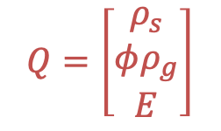
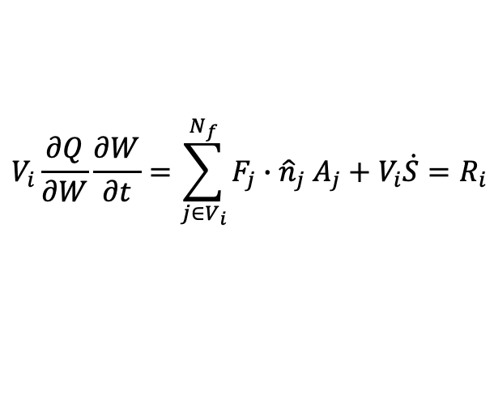
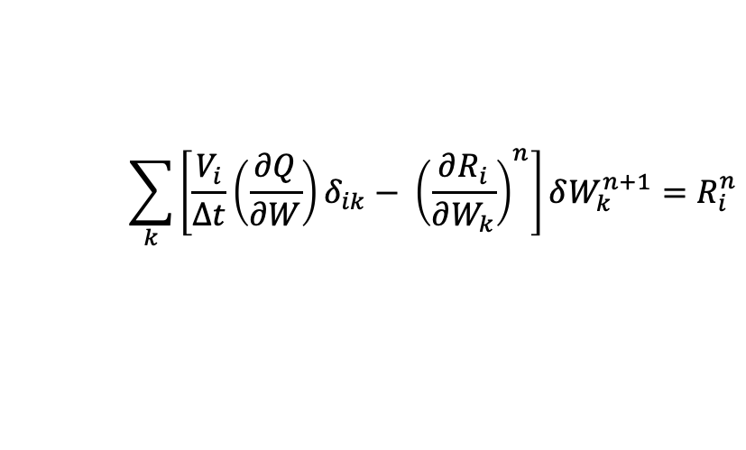
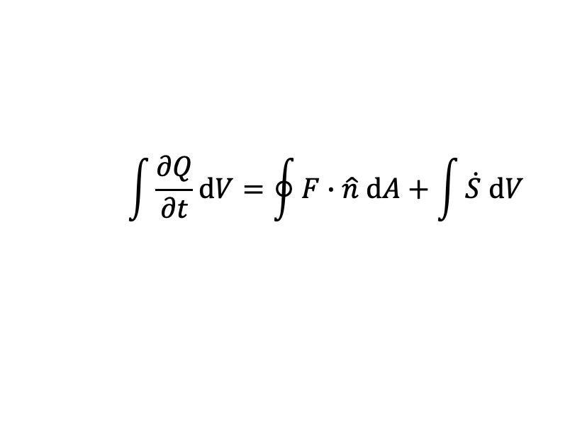
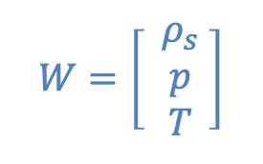
Icarus
Equations solved in conservative form using the finite-volume method in parallel for systems containing multiple materials
Finite-volume formulation
Processor boundaries
$$\int{\frac{∂Q}{∂t}\text{d}V}=\oint{F∙\hat{n} \text{d}A+\int{\dot{S} \text{d}V}}$$
Heatshield
$$Q=\left[\begin{matrix}ρ_{s} \\ φρ_{g} \\ E\end{matrix}\right]$$
$$W=\left[\begin{matrix}{ ρ}_{s} \\ p \\ T\end{matrix} \right]$$
Conservatives:
Primitives:
Facesheet
Implicit Euler – Primitives
$$V_{i}\frac{∂Q}{∂W}\frac{∂W}{∂t}=\sum_{j∈V_{i}}^{N_{f}}{F_{j}∙{\hat{n}}_{j} A_{j}+V_{i}\dot{S}=R_{i}}$$
Structure
$$\sum_{k}{\left[\frac{V_{i}}{Δt}\left(\frac{∂Q}{∂W}\right)δ_{ik}− {\left(\frac{∂R_{i}}{∂W_{k}}\right)}^{n}\right]δW_{k}^{n+1}}=R_{i}^{n}$$
Figure : Toy simulation of Dragonfly “tooth”

Slide 21
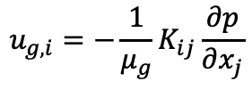
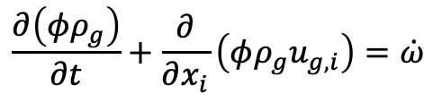
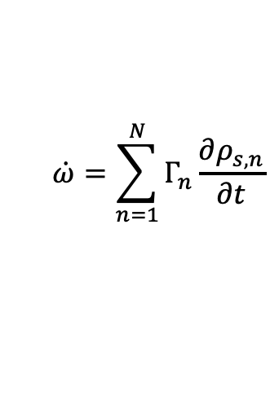
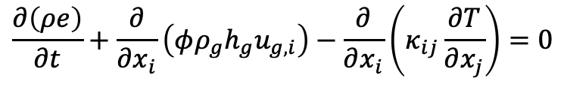
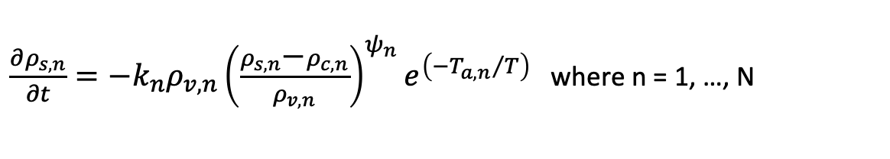



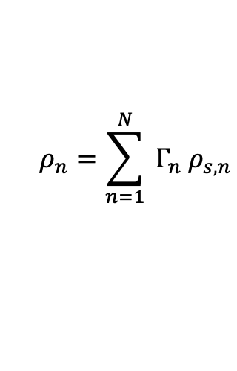

Governing Equations of Icarus
${\frac{∂ρ_{s,n}}{∂t}=−k_{n}ρ_{v,n}\left(\frac{ρ_{s,n}\text{−}ρ_{c,n}}{ρ_{v,n}}\right)}^{ψ_{n}}e^{\left(−{T_{a,n}}/T\right)}$ where n = 1, …, N
Material thermodynamic and transport properties are computed as mixture-averages of the Virgin and Char values
For example, solid enthalpy
Thermal conductivity and permeability are orthotropic properties, i.e., Rank-2 tensors
Momentum equation reduced via Darcy’s Law
  Pyrolysis gas transport fluxes are weakly non-linear
Pyrolysis gas products are assumed to be in equilibrium with the material
  Pyrolysis gas mixture properties calculated using tabulated thermal equilibrium quantities computed using Mutation++
$$ρ_{n}=\sum_{n=1}^{N}{{{ Γ}_{n} ρ}_{s,n}}$$
$$Γ_{n}=$$
pseudo-volume fraction of component
$$φ=$$
porosity
Conservation of Mass
$$h_{s}=Y_{v}h_{s,v}+\left(1−Y_{v}\right)h_{s,c}$$
$$\frac{∂\left({φρ}_{g}\right)}{∂t}+\frac{∂}{∂x_{i}}\left(φρ_{g}u_{g,i}\right)=\dot{ω}$$
$$\dot{ω}=\sum_{n=1}^{N}{Γ_{n}\frac{∂ρ_{s,n}}{∂t}}$$
convective transport of pyrolysis gases
Darcy’s Law:
$$u_{g,i}=−\frac{1}{μ_{g}}K_{ij}\frac{∂p}{∂x_{j}}$$
$$\frac{∂\left(ρe\right)}{∂t}+\frac{∂}{∂x_{i}}\left(φρ_{g}h_{g}u_{g,i}\right)−\frac{∂}{∂x_{i}}\left(κ_{ij}\frac{∂T}{∂x_{j}}\right)=0$$
Conservation of Energy
$$ρ=φρ_{g}+ρ_{s}$$
Heat conduction

Slide 22
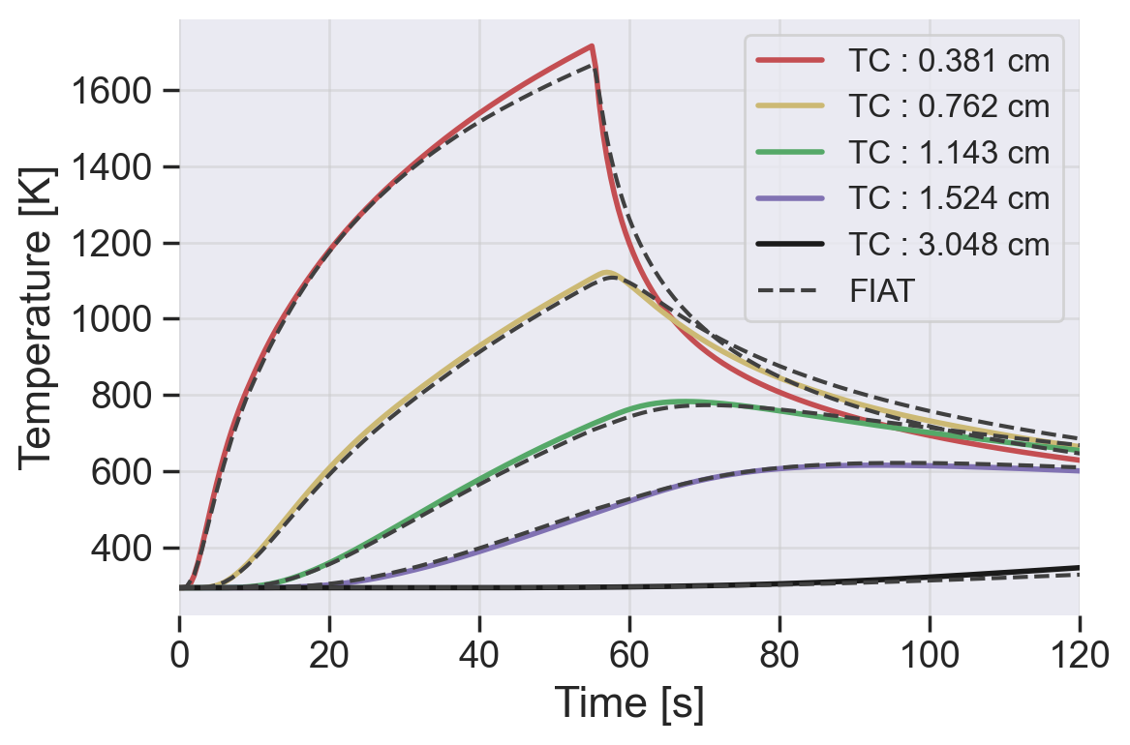
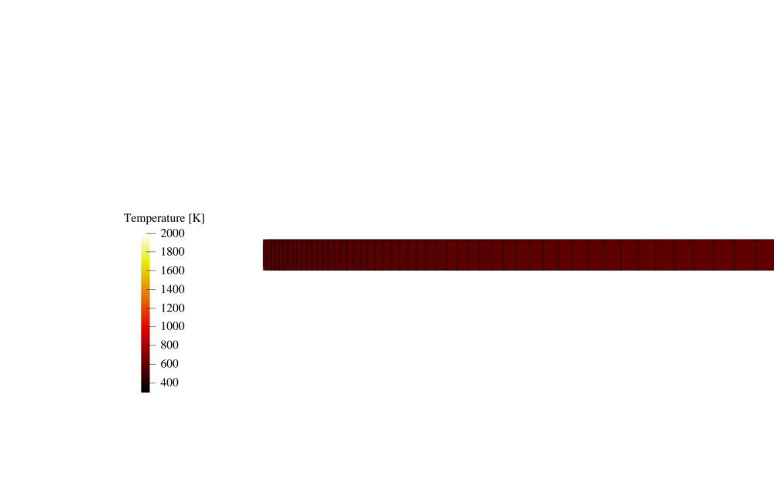
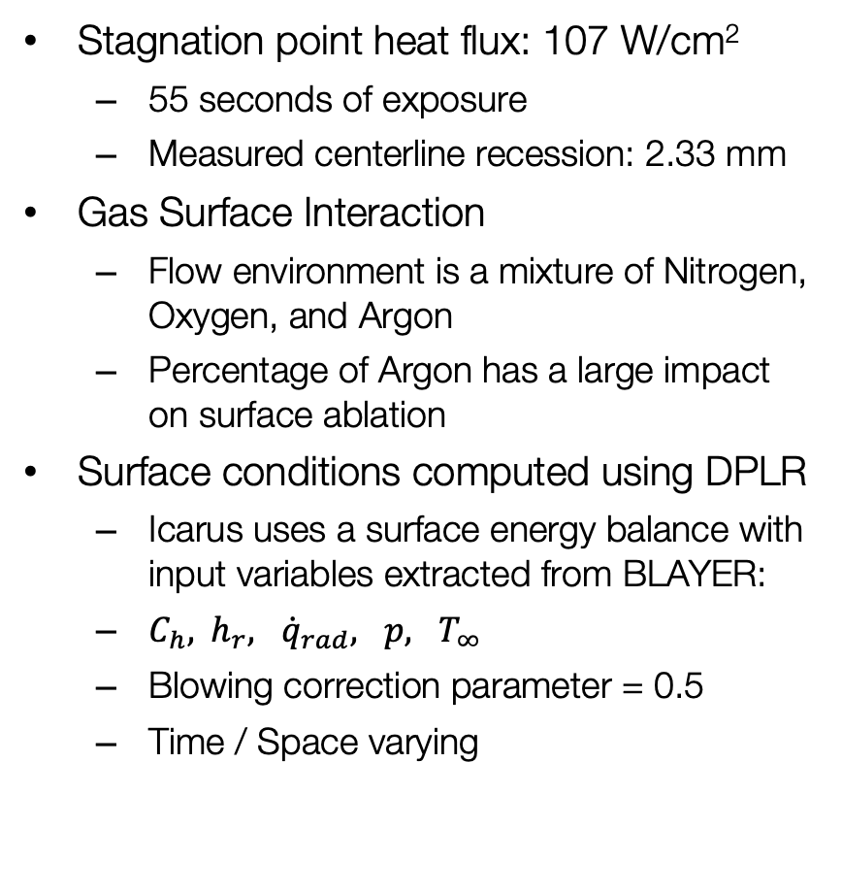
AHF Arcjet : PICA Validation Test
Stagnation point heat flux: 107 W/cm²
  55 seconds of exposure
  Measured centerline recession: 2.33 mm
Gas Surface Interaction
  Flow environment is a mixture of Nitrogen, Oxygen, and Argon
  Percentage of Argon has a large impact on surface ablation
Surface conditions computed using DPLR
  Icarus uses a surface energy balance with input variables extracted from BLAYER:
  $C_{h},{ h}_{r}, {\dot{q}}_{rad}, p, T_{∞}$
  Blowing correction parameter = 0.5
  Time / Space varying
Milos, F.S. and Chen, Y.-K. “Ablation and Thermal Response Property Model Validation for Phenolic Impregnated Carbon Ablator”, AIAA-2009-262
One-dimensional Simulations
2.22 mm
30 s
10 s

Slide 23
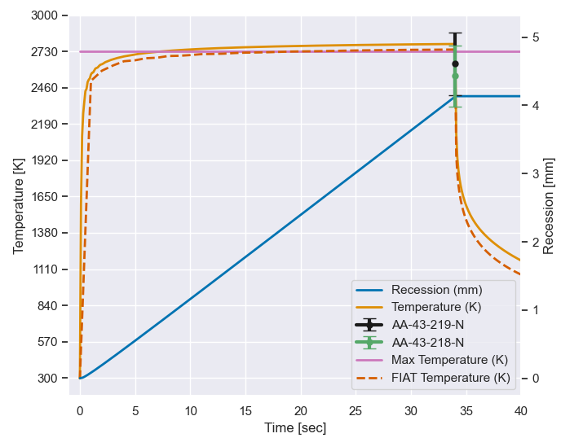
Why coupling?
Extensive test campaigns have been conducted to validate the PICA material response model
Milos, F.S. and Chen, Y.-K. “Ablation and Thermal Response Property Model Validation for Phenolic Impregnated Carbon Ablator”, AIAA-2009-262
Stagnation Point

Slide 24
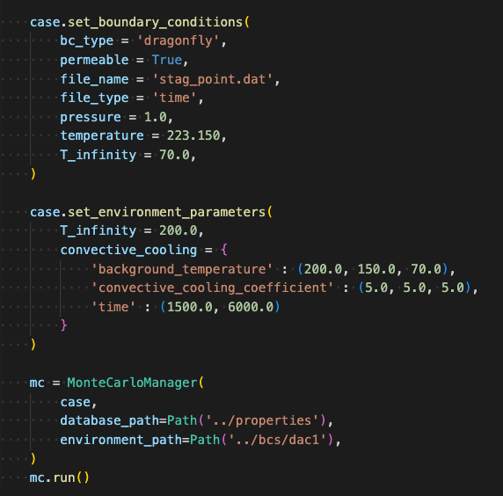
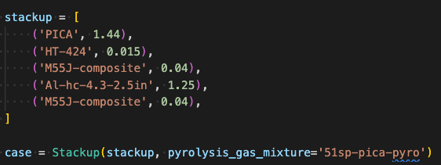
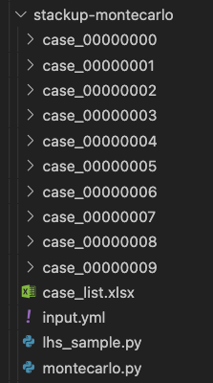
icarusPy used for Case Management
Running 1-D material stack-up with Icarus
Customize BCs
Customize environment
Case directories cropped out
Path to trajectory data
(stag_point.csv)
Defines uncertain variables
Sample generation
UQ runner

Slide 25
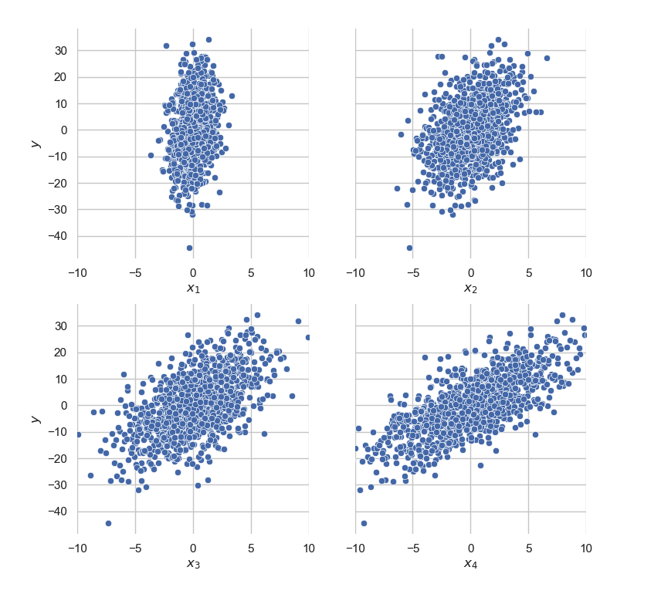



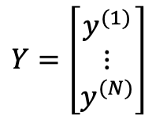
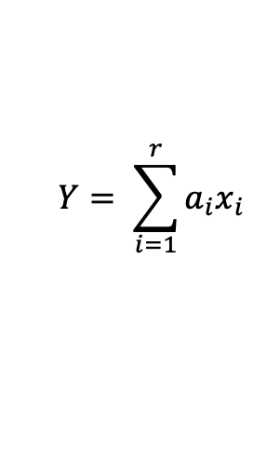

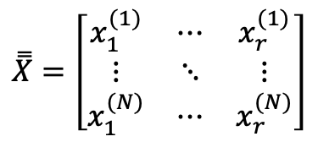



Example Case
$$Y= \sum_{i=1}^{r}{a_{i}x_{i}}$$
Input factors:
$$X=\left(a_{1},a_{2},…, {a_{r}, x}_{1},x_{2},…,x_{r}\right)$$
$$a_{i}$$
Assume are fixed (inactive)
Input variables are independent and distributed normally with zero mean
linear_model.yml
$$x_{i}\sim N\left(0, σ_{x_{i}}\right) i=1,2,…,r$$
x1: &x1
name: x1
distribution: normal
mean: 0.0
standard_deviation: 1.0
(x2,x3,x4) definitions omitted
variables:
- *x1
- *x2
- *x3
- *x4
sampling:
method: lhs
backend: SALib
method_args:
samples: 1000
Let , with
$$r=4$$
$$σ_{x}=(1,2,3,4)$$
$$a=(2,2,2,2)$$
from uqdriver.main import UQ
problem = UQ(
config='linear_model.yml',
model=LinearModel(weights=[2,2,2,2]),
)
problem.setup()
problem.evaluate()
df = problem.analyze()
$$N=1000$$
Scatterplot:
$$\overset{̿}{X}=\left[\begin{matrix}x_{1}^{(1)} & ⋯ & x_{r}^{(1)} \\ ⋮ & ⋱ & ⋮ \\ x_{1}^{(N)} & ⋯ & x_{r}^{(N)}\end{matrix}\right]$$
$$Y=\left[\begin{matrix}y^{(1)} \\ ⋮ \\ y^{(N)}\end{matrix}\right]$$

Slide 26
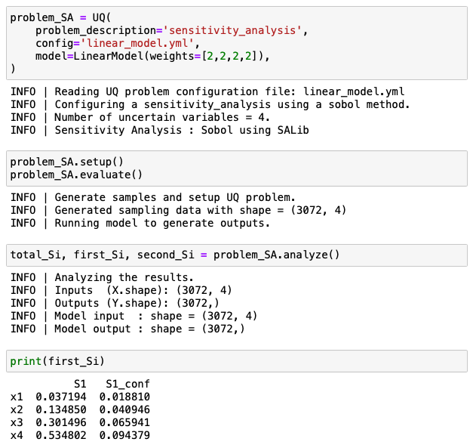
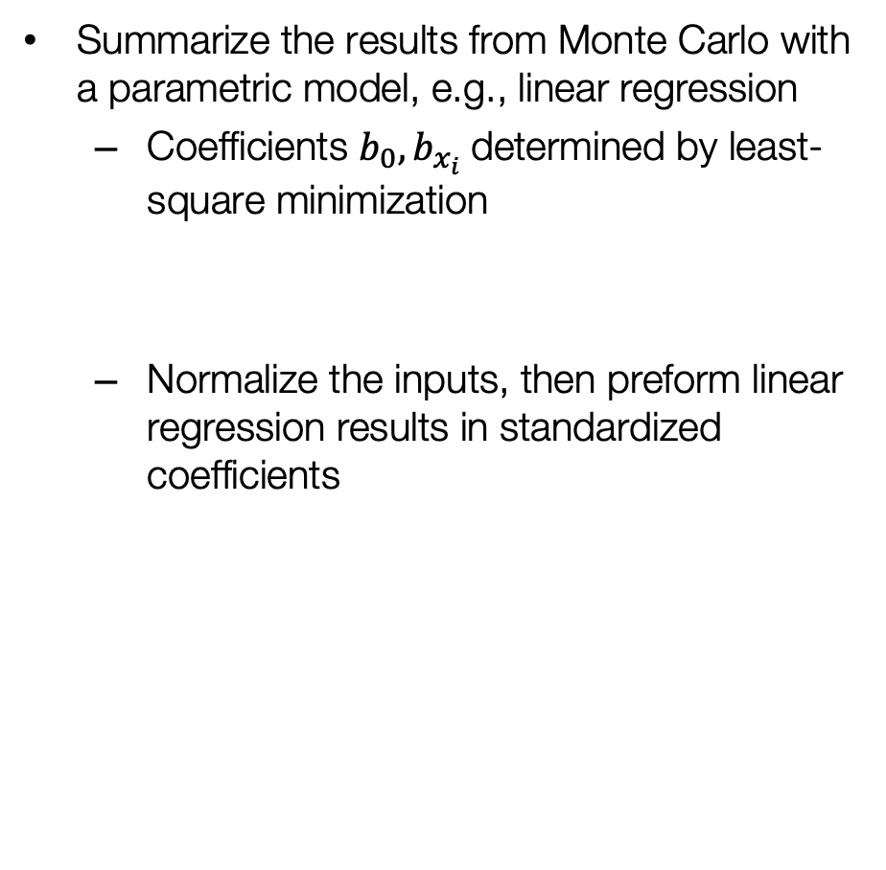
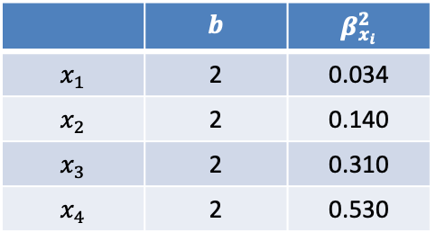
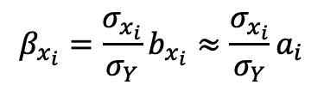
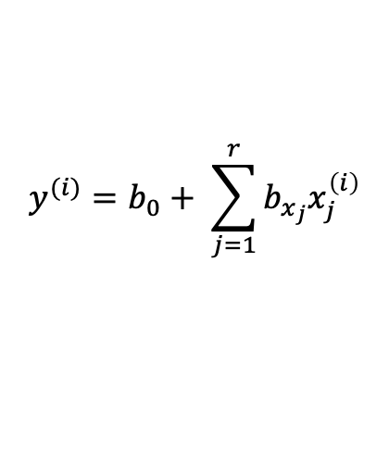
Example
Summarize the results from Monte Carlo with a parametric model, e.g., linear regression
  Coefficients $b_{0},b_{x_{i}}$determined by least-square minimization
  Normalize the inputs, then preform linear regression results in standardized coefficients
$$y^{(i)}=b_{0}+ \sum_{j=1}^{r}{b_{x_{j}}x_{j}^{\left(i\right)}}$$
$$β_{x_{i}}=\frac{σ_{x_{i}}}{σ_{Y}}b_{x_{i}}≈{\frac{σ_{x_{i}}}{σ_{Y}}a}_{i}$$
 | $$b$$ | $$β_{x_{i}}^{2}$$
$$x_{1}$$ | 2 | 0.034
$$x_{2}$$ | 2 | 0.140
$$x_{3}$$ | 2 | 0.310
$$x_{4}$$ | 2 | 0.530
import statsmodels.api as sm
from scipy.stats.mstats import zscore
lr = sm.OLS(zscore(y), zscore(X)).fit()
lr.summary()

