Slide 1
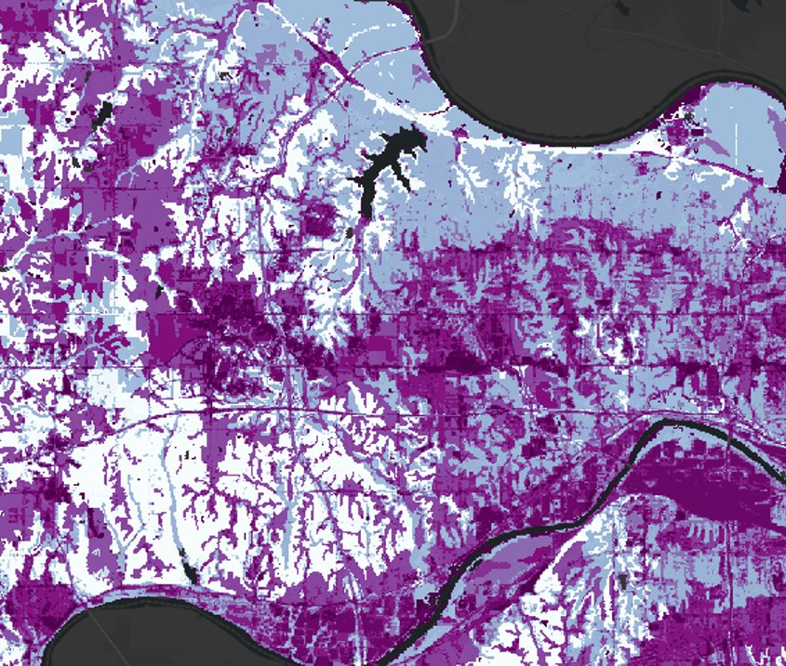
Kansas City
Disasters II
Analyzing Precipitation and Land Cover Data to Refine the Assessment of Urban Flood Vulnerability
Nora Carmody
Dain Kim
Kameron Lloyd
Ruby Nagelberg
Massachusetts – Boston | Fall 2022
Notes:
Speaker Notes:
Nora: We’re the Kansas City Disasters II team from the Boston node and our project analyzes precipitation and land cover data to refine the assessment of urban flood vulnerability in Wyandotte County.
------------------------------Image Information Below ------------------------------

Slide 2
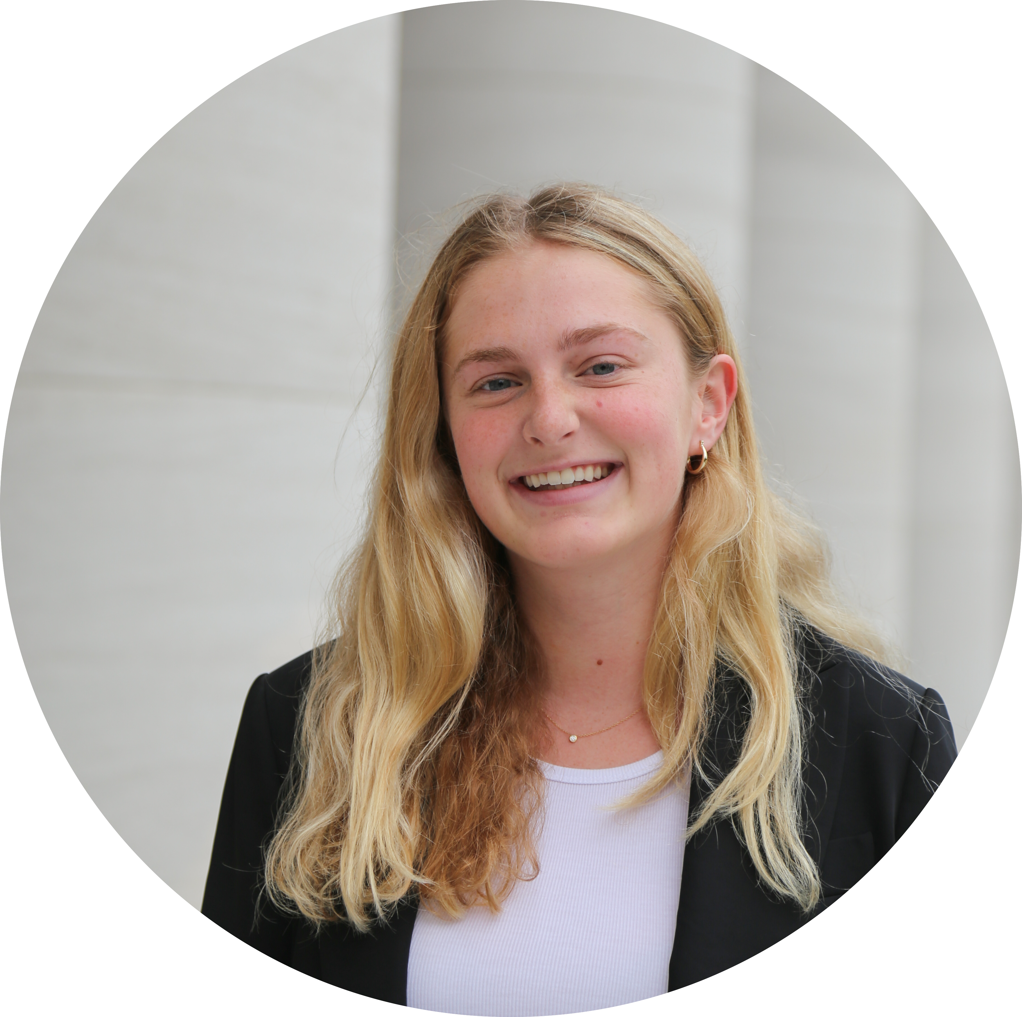
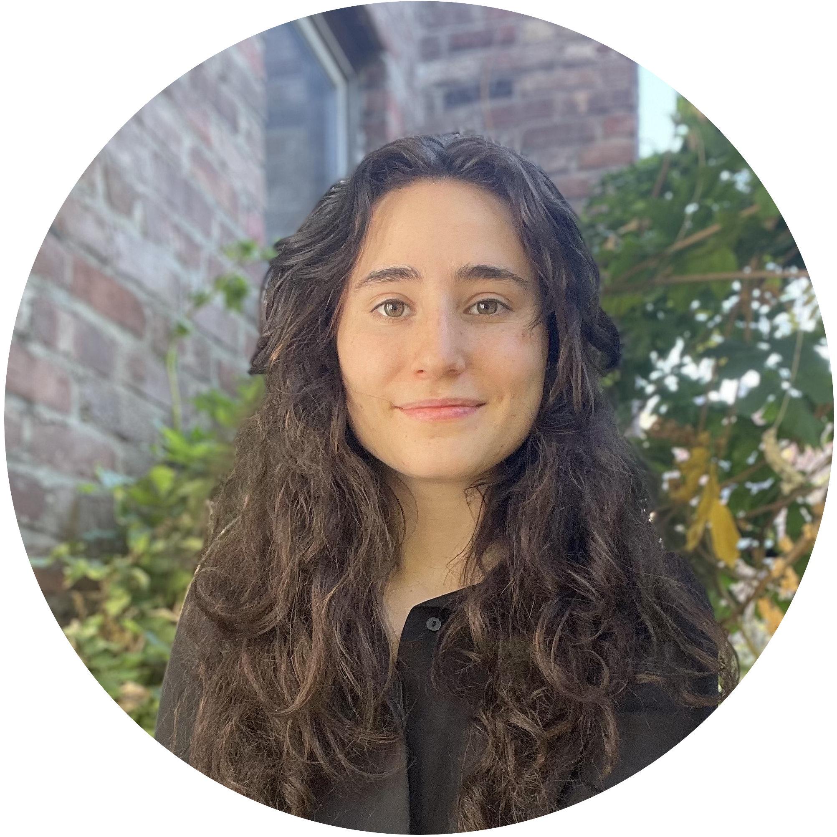
OVERVIEW: The Team
Nora Carmody
Dain Kim
Kameron Lloyd
Ruby Nagelberg
Notes:
Speaker Notes:
Nora: The team members include myself, Nora Carmody, Dain Kim, Kameron Lloyd, and Ruby Nagelberg
------------------------------Image Information Below ------------------------------
Image Credits: DEVELOPers

Slide 3
OVERVIEW: The Partners
Groundwork Northeast Revitalization Group
Groundwork USA
A national network of local organizations
Devoted to regenerating and improving urban space
Mitigating environmental, economic, and social inequalities within marginalized communities
Lawrence Hoffman
Jalisa Gilmore
A Groundwork USA trust
Mission to sustain and revitalize the community
Rooted in principles of equity, community cohesion, institutional transparency, and environmental justice
Rev. Adrianne Showalter-Matlock
Notes:
Speaker Notes:
Kameron: Our team partnered with both Groundwork USA and Groundwork Northeast Revitalization Group (NRG), supporting their Climate Safe Neighborhood's Project. Prior to our work, NRG had relied on community accounts of water contamination. While still essential, community input has met limitation in terms of eliciting adequate action from policymakers to address these environmental inequities and has added difficulty in identifying specific strategic points of intervention based on the landscape. In this project we built capacity to integrate NASA Earth observations in order to examine the inequitable distribution of ecosystem services affecting water quality and complement lived experiences shared by affected communities.

Slide 4
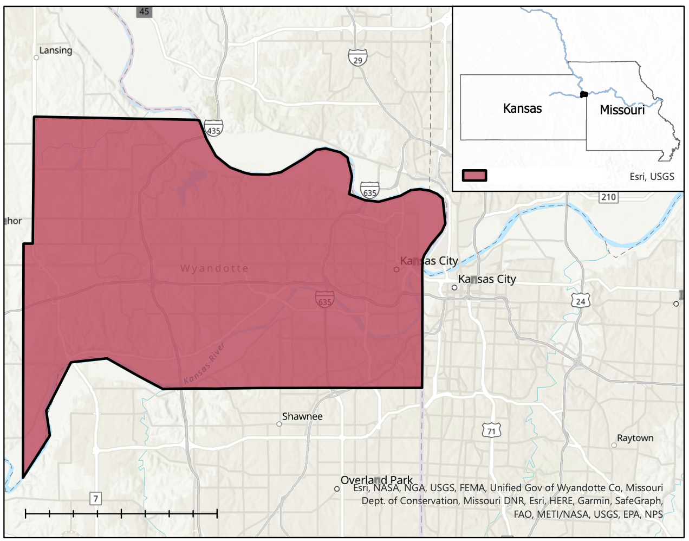
OVERVIEW: The Study Area
Study Area: Wyandotte County, Kansas
Study Period: secret January 2000 – December 2020
Average Annual Precipitation: 2000-2020
Land cover change scenarios: 2001, 2011, 2019
Precipitation change scenarios: 2012, 2016, 2019
Kansas
Kansas
Missouri
Wyandotte County
0
2.5
5
10 Miles
Notes:
Speaker Notes:
: The study area includes all of Wyandotte County, Kansas, and our research includes over 20 years of data. We used GPM IMERG precipitation data from January 2000 – December 2020 to determine high, low and average precipitation years in Wyandotte County. And we used NLCD landcover data for 2001, 2011, and 2019 to examine the effects of land cover change on stormwater retention.
------------------------------Image Information Below ------------------------------

Slide 5
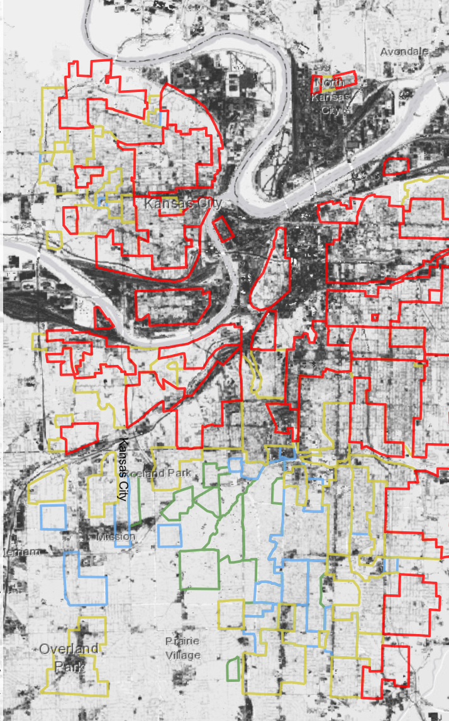
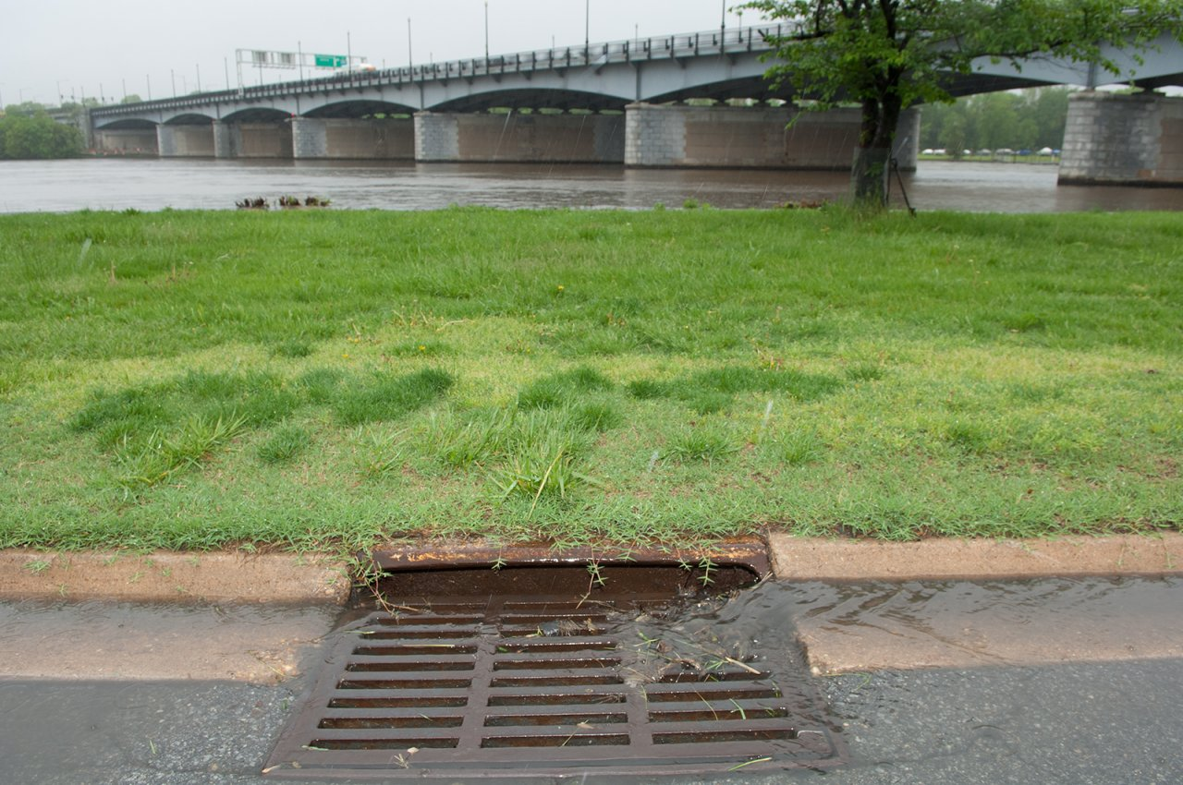
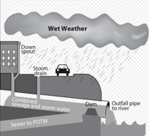
OVERVIEW: Community Concerns
Combined Sewer Overflows (CSOs)
Polluted Runoff
Impervious surfaces in disinvested neighborhoods
Image Credit: EPA, Groundwork Northeast Revitalization Group
Notes:
Speaker Notes:
:Why are we examining precipitation and land cover data for Wyandotte County? During rainfall events in Wyandotte County, runoff picks up an array of pollutants that percolate into groundwater or runoff into waterways. During severe flood events, the combined sewer system also often overflows leading to untreated storm and wastewater discharging into nearby streams, rivers, and other waterbodies. At these high levels, contaminants from stormwater runoff and combined sewer overflows can present a range of human health effects as well as threaten aquatic ecosystems. Due to rapid urbanization and the discriminatory practice of redlining, marginalized communities in Wyandotte County are located in areas lacking ecosystem services such as natural stormwater management which protects people and infrastructure from this runoff and associated pollution.
------------------------------Image Information Below ------------------------------
Image #1 Credit: U.S. EPA
Image #1 Source: https://www.epa.gov/sourcewaterprotection/urbanization-and-stormwater-runoff
Image #2 Credit: U. S. EPA
Image #2 Source: https://commons.wikimedia.org/wiki/File:CSO_diagram_US_EPA.svg
Image #3 Credit: Groundwork Northeast Revitalization Group
Image #3 Source: https://www.northeastkck.org/climate-safe-kck

Slide 6
OVERVIEW: Ecosystem services
Water Purification
Water Retention
Image Credit: Timofei Rostilov, Carbon Design
Notes:
Speaker Notes:
Ruby: Our project assessed the ability of the land to provide two ecosystem services essential for proper stormwater management: water purification and water retention. Water purification occurs when water infiltrates into the ground and soil filters contaminants out of the stormwater, keeping pollutants from reaching surface and groundwater. Water retention is the process in which soil stores water during storm events, decreasing runoff volume. When high levels of impervious surfaces disrupt the hydrological cycle and inhibit these essential ecosystem services, more stormwater becomes runoff which pollutes nearby receiving waters. We used water retention values and avoided pollutant load values to assess the ability of the land to provide these ecosystem services.
------------------------------Icon Information Below ------------------------------
“Soil, moisture, field icon” by Carbon Design is licensed under CC BY 4.0. Retrieved from https://www.iconfinder.com/search?q=soil&price=free.
and "Drinking, filter, purification icon" by Timofei Rostilov is licensed under CC BY 4.0. Retrieved from
https://www.iconfinder.com/search?q=water+filter&price=free

Slide 7
OBJECTIVES
1
2
3
4
Identify areas with low rates of stormwater retention
Examine inequitable distribution of ecosystem services affecting water quality
Explore implications of land cover variance on socio-economically vulnerable populations
Identify points of intervention for green infrastructure projects
Notes:
Speaker Notes:
Ruby: As a part two of a two term project our main objectives were to build on the last term's quantitative analysis of runoff during severe storm events by including an investigation of longer term retention ratios using annual precipitation measures to examine water quality concerns associated with runoff.
We hoped to visualize the areas with poor retention capabilities as well as areas with intersectional socioeconomic vulnerabilities to identify areas that would most benefit from green infrastructure initiatives.
------------------------------Image Information Below ------------------------------
Graphic inspired by KCI Disasters DEVELOP Team, created by KCII Disasters DEVELOP Team

Slide 8
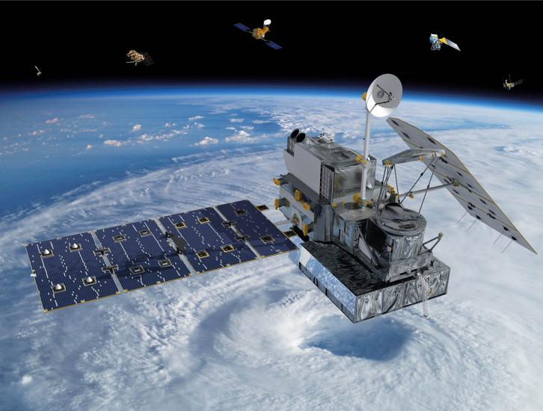
METHODS: NASA EO & Data Acquisition
Ancillary Data
USGS National Land Cover Database (NLCD)
USDA Soil Survey Database
Runoff coefficients
National Stormwater Quality Database
US Census Bureau Block Group Data
Global Precipitation Measurement
Integrated Multi-satellitE Retrievals
(GPM IMERG)
Image Credit: NASA
Notes:
Speaker Notes:
Ruby: Our satellite data comes from NASA's Global Precipitation Measurement, Integrated Multi-Satellite Retrievals. We acquired this data to produce annual precipitation raster layers that we inputted into the inVEST Stormwater Retention model. We also acquired US Geological Survey National Landcover data, US Department of Agriculture Soil Survey data, runoff coefficients by land use and permeability class, and stormwater quality data from the National Stormwater Quality Database, all as inputs for the InVEST model. To analyze the model outputs, we additionally acquired US Census Bureau data to examine socioeconomic vulnerabilities in Wyandotte County.
------------------------------Image Information Below ------------------------------
Image Credit: NASA
Image Source: https://gpm.nasa.gov/sites/default/files/styles/article_top_tablet/public/2018-09/GPM-space-default.jpg?itok=Z88LSRS2

Slide 9
METHODS: InVEST Stormwater Retention Model
Annual Precipitation Raster
Land Use Raster
Biophysical Table
Soil Group Classification Raster
InVEST Urban Stormwater Retention Model
Stormwater Retention Volume
Stormwater Retention Ratio
Avoided Pollutant Load
Notes:
Speaker Notes:
We used the InVEST Stormwater Retention Model to identify the areas of Kansas City where soils are retaining stormwater and its associated pollutants, thereby mitigating disastrous effects on water quality, and where impervious landcover types are preventing this ecosystem service.
To run the InVEST model we used an annual precipitation raster, a land use raster, a biophysical table summarizing the runoff coefficients and total pollutant loads for each land cover type, and a soil group raster. After gathering all the input layers, we generated information about stormwater retention volume, stormwater retention ratios, and avoided pollutant load for our study area.
------------------------------Image Information Below ------------------------------
Graphic inspired by KCI Disasters DEVELOP Team, created by KCII Disasters DEVELOP Team

Slide 10
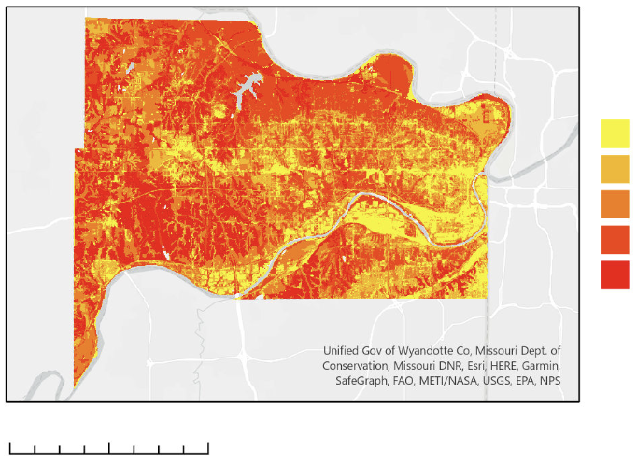
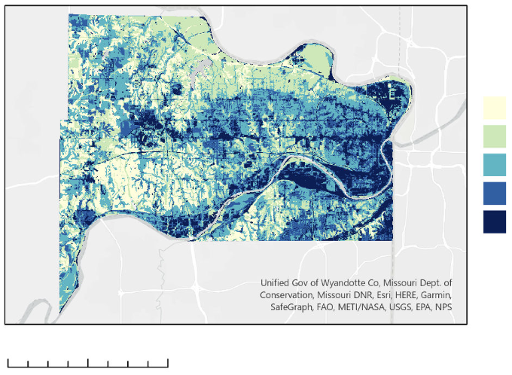
RESULTS: InVEST Outputs - Retention/Runoff
2020 Retention Ratios
2020 Runoff Ratios
0 - .11
.301 - .388
.111-.178
.389 - .607
.179 - .307
.608 - .808
.308 - .508
.809 - .887
.509 - .7
.888 - 1
0 2.5 5 10 Miles
0 2.5 5 10 Miles
Notes:
Speaker Notes:
After running the model for the most recent year we had precipitation data for – 2020 – we saw a low ratio of stormwater being retained in the soil and a larger ratio becoming runoff in Northeast Wyandotte.

Slide 11
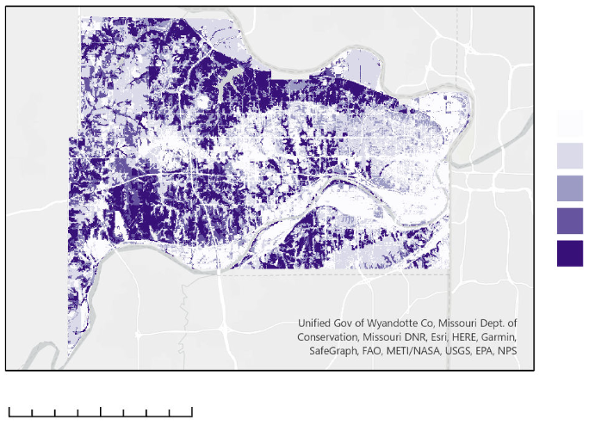
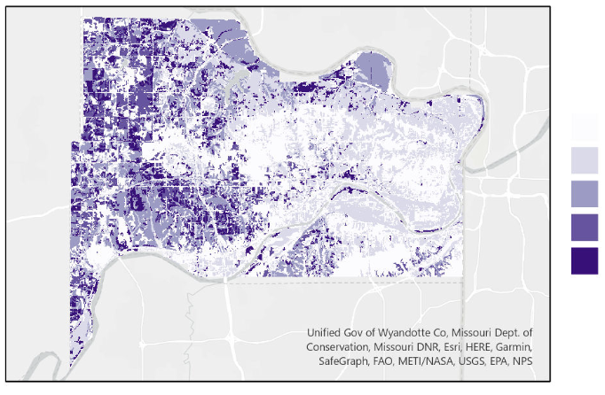
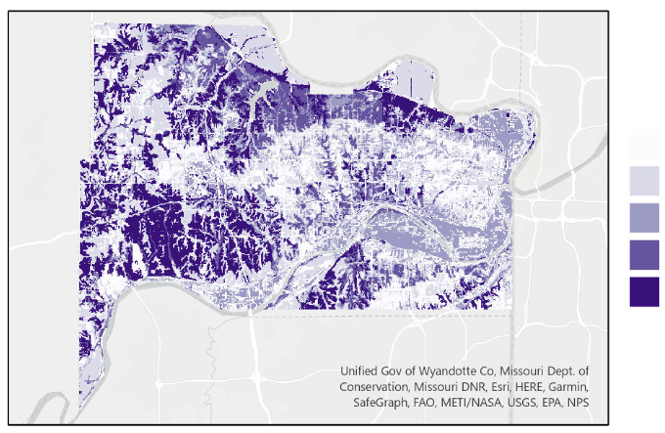
RESULTS: InVEST Outputs – Avoided Pollutants
2020 Avoided Total Suspended Solids
2020 Avoided Phosphorus
.001 - .019 Mg/L
0 - .00011 Mg/L
.02 - .05 Mg/L
.00012 - .0002 Mg/L
.051 - .079 Mg/L
.00022 - .0003 Mg/L
.08 - .162 Mg/L
.00031 - .0005 Mg/L
.163 - .397 Mg/L
.00051 - .0012 Mg/L
0 2.5 5 10 Miles
2020 Avoided Nitrogen
0 - .0007 Mg/L
.0008 - .0013 Mg/L
.0014 - .00196 Mg/L
.00197 - .00232 Mg/L
.000233 - .0051 Mg/ L
Notes:
Speaker Notes:
The model also produced avoided pollutant values demonstrating the ability of the land to catch pollutants before release to surface and groundwater. From these outputs we calculated that Groundwork KCK service area in Northeast Wyandotte had 2.5 times less avoided total suspended soils, 1.9 times less avoided nitrogen, and 1.4 times less avoided phosphorus, compared to the county as a whole. This suggests higher water quality concerns in the area as these pollutants can end up in runoff that contaminates nearby waterways instead of being held by the soil.
------------------------------Image Information Below ------------------------------

Slide 12
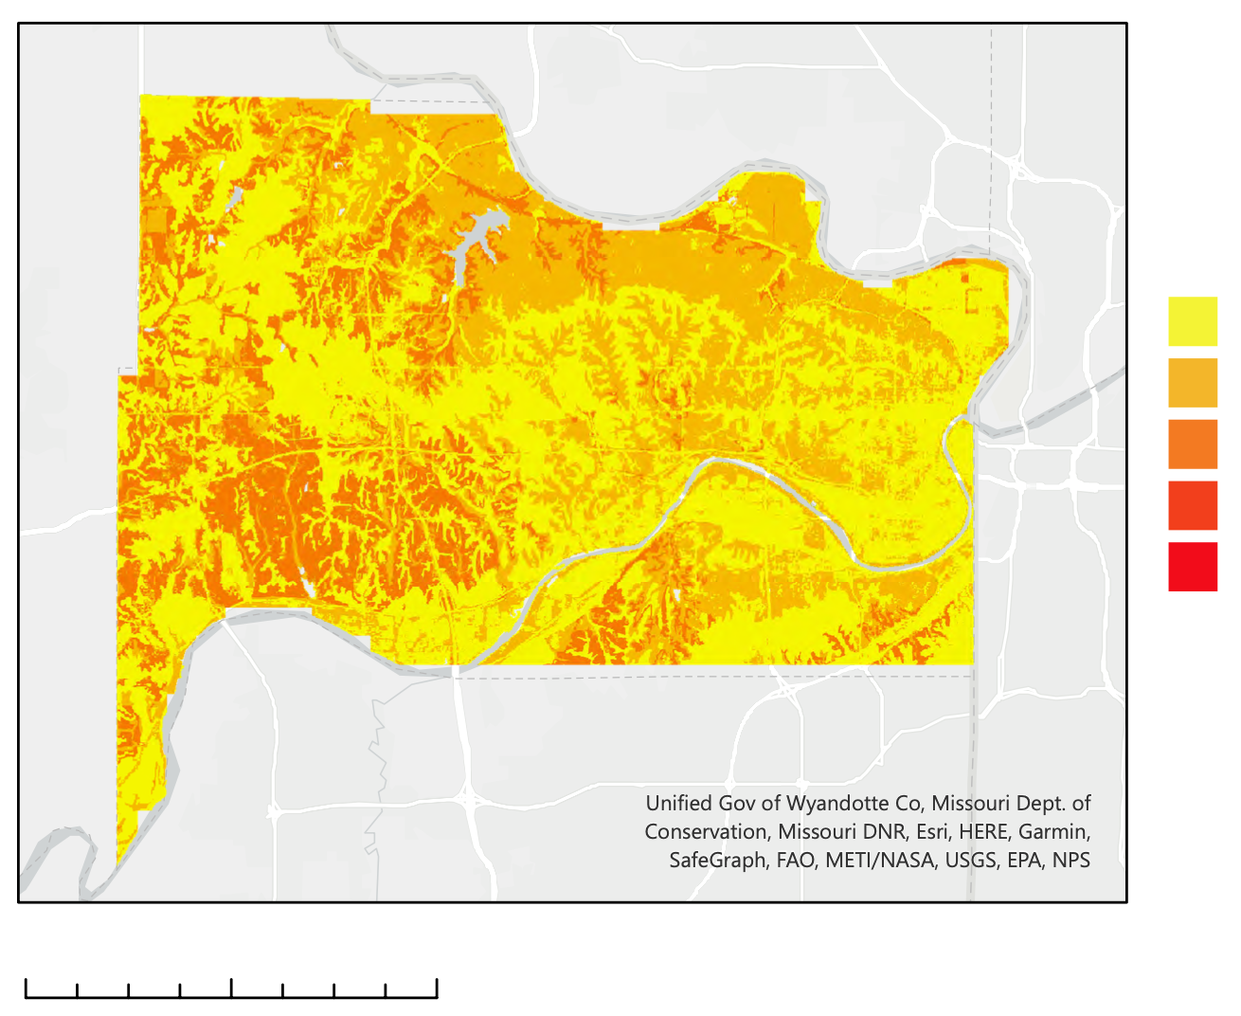
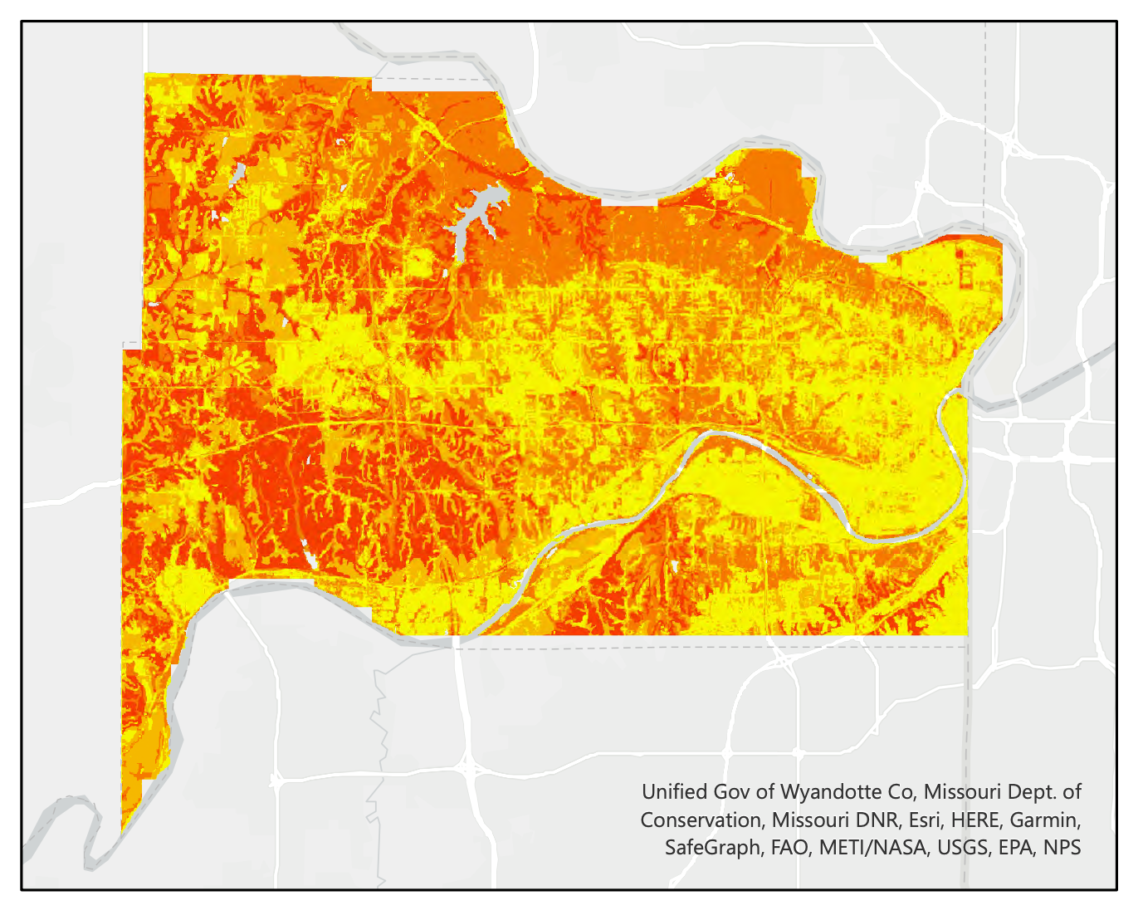
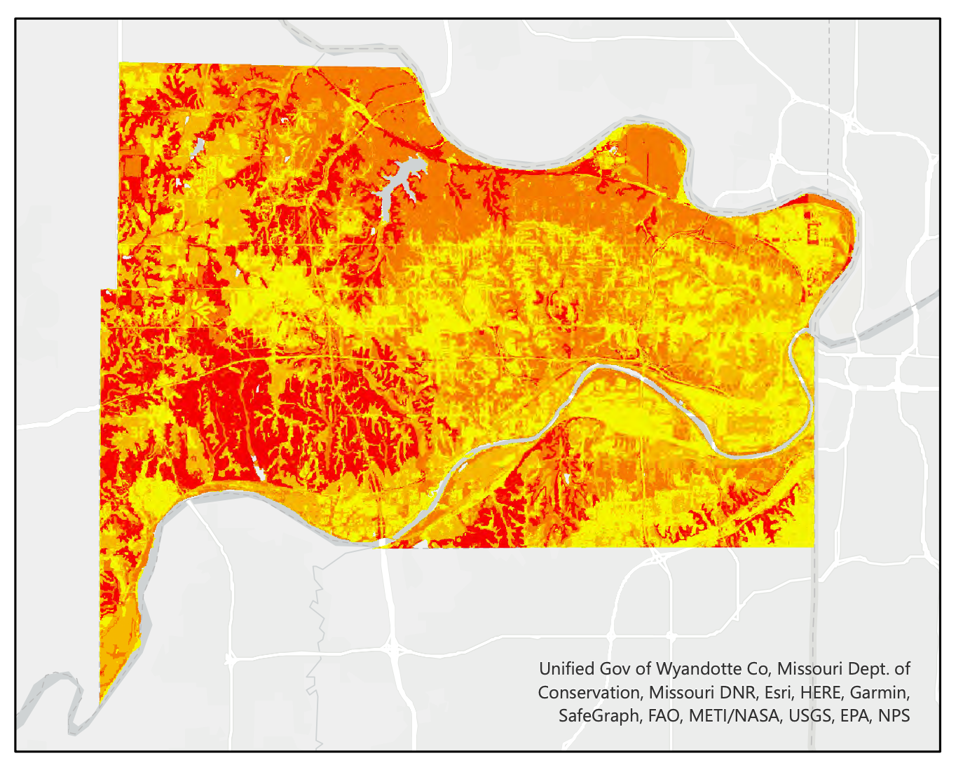
RESULTS: Precipitation Change
Stormwater Retention Volume in Low, Medium, and High Precipitation Scenarios
2012: Low Precipitation
2016: Medium Precipitation
2019: High Precipitation
0 5 10 Miles
Square meters per year
0.001 - 0.238
0.239 - 0.476
0.477 - 0.715
0.716 - 0.953
0.954 - 1.191
Notes:
Speaker Notes:
: By running the stormwater retention model for a high, medium, and low annual precipitation scenario while keeping the land cover and soil group classifications constant, we determined that annual precipitation has no effect on the retention ratio outputs due to limitations of the model. However, the high annual precipitation scenario had a higher retention volume than the medium and low annual precipitation layers respectively- highlighting the importance of retention capability in high precipitation years as larger volumes of water are stored rather than released as runoff.
------------------------------Image Information Below ------------------------------

Slide 13
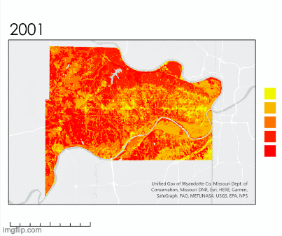
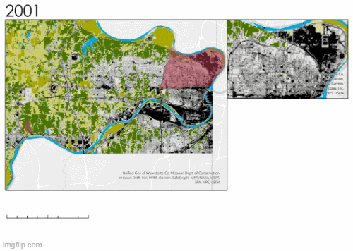
RESULTS: Land Cover Change
Land Cover Classification
Retention Ratios
0 - .11
.111 - .178
Open water
.179 - .307
Developed open land
.308 - .508
Developed low intensity
.509 - .7
Developed medium intensity
Developed high intensity
Barren land
0 2.5 5 10 Miles
Wooded
Grassland
0 2.5 5 10 Miles
Pasture
Cultivated crops
Wetlands
Notes:
Speaker Notes:
: We repeated this process to asses the effects of landcover change on stormwater retention. By running the model three times using a 2001, 2011, and 2019 land cover dataset respectively while keeping the annual precipitation raster constant. We determined that Wyandotte County has increased their impervious surface cover by 3% since 2001. While a relatively small change, we did see visible decrease in stormwater retention capabilities across the county as a result.
------------------------------Image Information Below ------------------------------

Slide 14
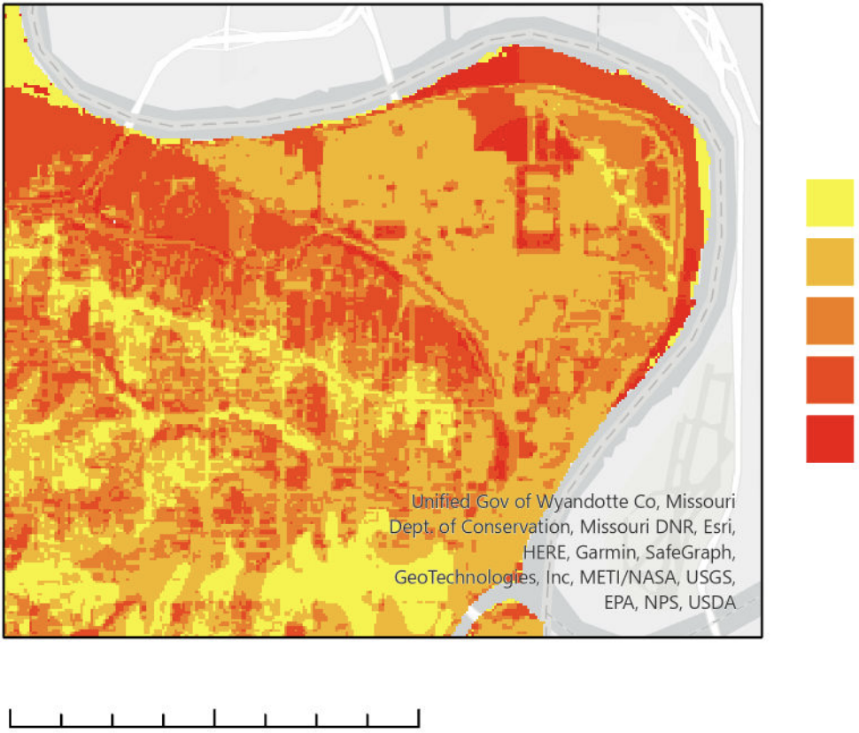
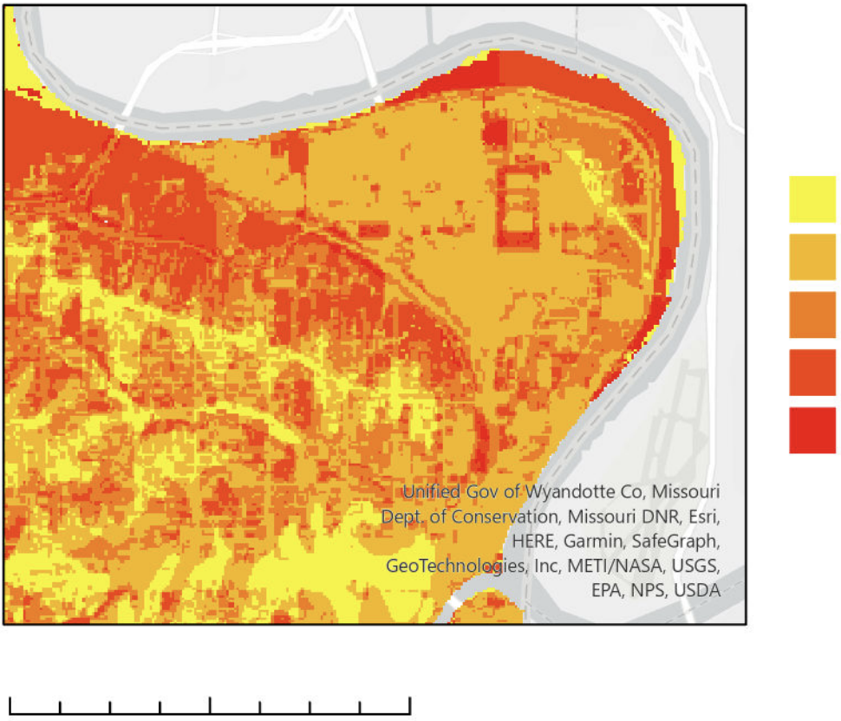
RESULTS: Land Cover Change
2001 Northeast Wyandotte Retention Ratios
2019 Land Cover Northeast Wyandotte Retention Ratios
0 - .11
0 - .11
.111 - .178
.111 - .178
.179 - .307
.179 - .307
.308 - .508
.308 - .508
.509 - .7
.509 - .7
0 2.5 5 10 Miles
0 2.5 5 10 Miles
Notes:
Speaker Notes:
:Looking specifically at Groundwork's service area in Kansas City, we were able to identify an area in the Northeast of this region that has experienced a decrease in stormwater retention capability between 2001 and 2019, a possible focus for future Groundwork projects.

Slide 15
METHODS: Green Infrastructure Analysis
% Non-White Population
Median Income
% No High School Diploma
Census Block Group
Principal Component Analysis
Social Vulnerability Index/Rank
Stormwater Retention Ratio
Notes:
Speaker Notes: Using three social and demographic factors from the Census Bureau – median income, % non-white population, and % no high school diploma per block – we created a Social Vulnerability Index. We ran principal component analysis on the three socioeconomic variables for all blocks, and chose the first principal component (PC1) to be the index to represent the social vulnerability. We then compared this social vulnerability index to stormwater retention ratios to determine census blocks that might benefit most from green infrastructure projects.
The PC1 value was scaled to ____ Dain comment: match the common understanding (?) Idk essentially to make it more interpretable for ppl (but without messing up the meaningful info it contains)
------------------------------Image Information Below ------------------------------
Graphic inspired by KCI Disasters DEVELOP Team, created by KCII Disasters DEVELOP Team

Slide 16
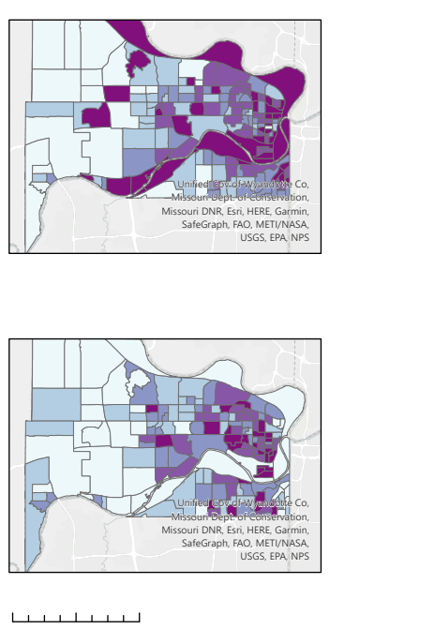
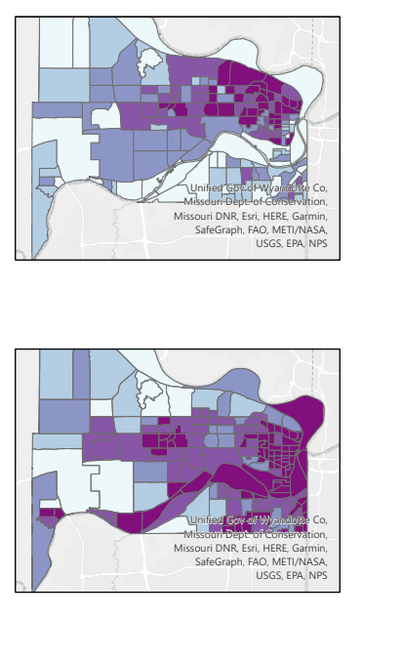
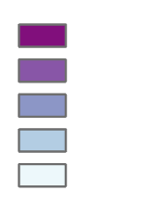
RESULTS: Socioeconomic Implications
Median Household Income (U.S. dollars)
Percent Minority Populations
0 – 25,000
0 - 9
26,000 – 42,000
9.1 - 25
43,000 – 53,000
26 - 49
54,000 – 73,000
50 - 65
74,000 – 150,000
66 - 100
Percent without high school diploma
Average Retention Ratio
0 - 3
.001 - .211
3.1 - 8
.212 - .284
8.1 - 14
.285 - .365
15 - 21
.366 - .404
22 - 20
.405 - .47
0 5 10 Miles
Notes:
Speaker Notes:
: By comparing the results of the stormwater retention model with US Census data, we determined that communities in East Wyandotte experience the most intersecting socio-economic vulnerabilities as well as low retention and high runoff. These are largely communities of color that experience poor stormwater retention, low median annual incomes, and have significant portions of their population without a high school diploma.
------------------------------Image Information Below ------------------------------

Slide 17
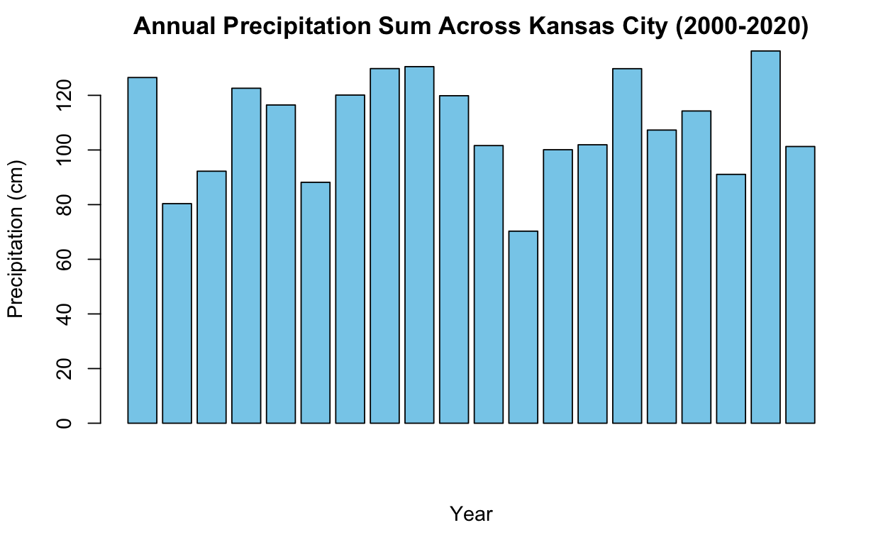
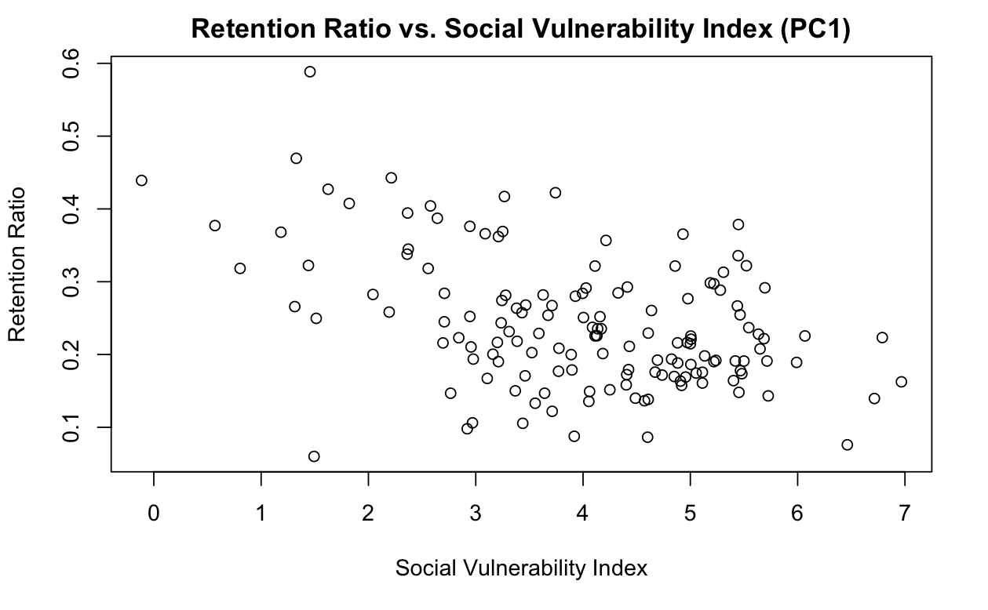
RESULTS: Additional Plots
Notes:
(May include in an earlier slide – just wanted to get approved through export control in case)

Slide 18
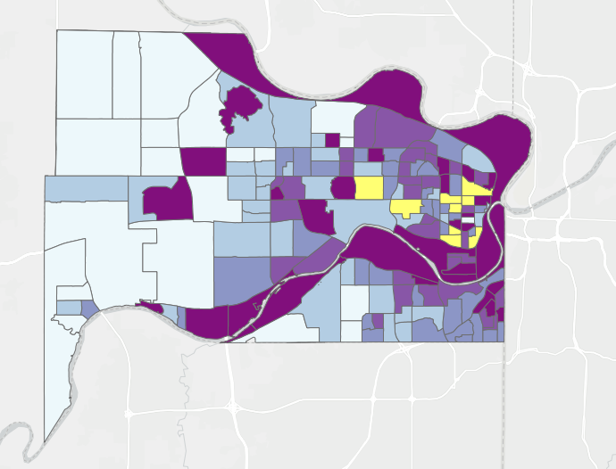
RESULTS: Green Infrastructure
10 census blocks that make the best Green Infrastructure candidates
Placeholder: Figure Title
0 5 10 Miles
Notes:
Speaker Notes:
: By performing PCA analysis of the existing vulnerabilities in Wyandotte County, we were able to identify 10 census blocks that would make the best candidates for Green Infrastructure initiatives based on median household income, percent minority population, and percent without a high school diploma. This process involved comparing these 3 vulnerability factors to stormwater retention. The factors that correlated more to stormwater retention were then weighted as most important in determining the vulnerability index. All social vulnerabilities and their weights were then combined to produce one vulnerability score. The census blocks with darker symbology are therefore correlated to higher social vulnerabilities. Finally, the census blocks with the 10 most vulnerable populations were highlighted using yellow. These census blocks would make the best candidates for Green Infrastructure initiatives.
------------------------------Image Information Below ------------------------------

Slide 19
RESULTS: Limitations
Land cover classifications, soil groups, and over simplified spatial variability
Coarse precipitation data and non-site-specific biophysical values
Broad outputs concerning stormwater pollutants and location
Notes:
Speaker Notes:
:While our study produced meaningful results, we still met limitations.
First, the InVEST model is highly simplified and only considers 11 land cover classifications and four soil groups. This simplifies the spatial variability that exists in Wyandotte County.
Second, the precipitation data that was used as a model input was rather coarse and the data used in the biophysical table was found in literature. This limits the quality of our data analysis.
Finally, the model itself is limited in what it can tell us about water quality since it models stormwater retention as an ecosystem service rather than measuring the direct amount of pollutant that ends up in each body of water.
------------------------------Image Information Below ------------------------------
Clipart Credit: Microsoft Office 365/PowerPoint

Slide 20
CONCLUSIONS
As impervious land cover has increased from 2001 to 2019, stormwater retention has decreased
Stormwater retention is poor in areas of high socioeconomic vulnerability suggesting runoff and water quality concerns in these areas
Green infrastructure initiatives would be the most effective in census blocks highlighted in yellow
0 5 10 Miles
Best Green Infrastructure Candidates
Notes:
Speaker Notes: placeholder
In this study, we determined that as Wyandotte County becomes more urbanized, impervious surface cover is increasing leading to lower stormwater retention across the county but especially in the Northeast. Low stormwater retention is especially problematic in these neighborhoods due to high impervious surface cover, socio-economic vulnerabilities, and combined sewer overflow events that compound pollution deposited directly from stormwater runoff. The neighborhoods highlighted above are the neighborhoods that we've identified as being highly vulnerable to the adverse effects of water quality concerns related to runoff and CSO's and are excellent candidates for green infrastructure initiatives.
------------------------------Image Information Below ------------------------------

Slide 21
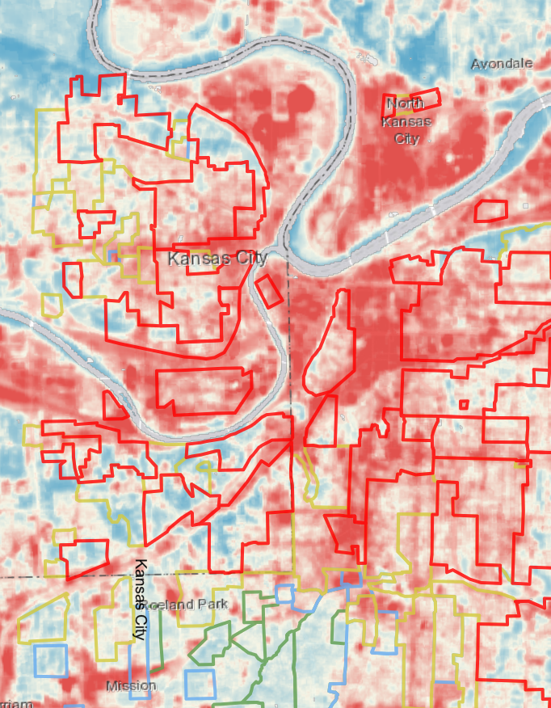
CONCLUSIONS: Further Work
Create an environmental vulnerability index using urban flood risk data and stormwater retention data + urban heat disparities, air pollution measurements, and socioeconomic factors
Use a more complex model like the EPA's Stormwater Management Model to analyze the effect of green infrastructure on stormwater retention & water quality
Image Credit: Groundwork Northeast Revitalization Group, EPA
Notes:
Speaker Notes:
: While our study produced meaningful results about stormwater retention in Wyandotte, there is still further work to be done. We recommend taking the direction of creating an environmental vulnerability index including other environmental hazards to show cumulative impact or using the EPA's Stormwater Management model to further analyze the effect of green infrastructure on retention, taking into account the layout of the built sewer infrastructure as well as natural stormwater management services provided by the land.
------------------------------Image Information Below ------------------------------
Image #1 Credit: Groundwork Northeast Revitalization Group
Image #1 Source: https://images.squarespace-cdn.com/content/v1/59a59cc3bebafbcf1a20862f/f45a0c50-d6c2-488a-84ef-858b8545e5f6/Transparency2.png?format=500w
Image #2 Credit: EPA
Image #2 Source: https://www.epa.gov/sites/default/files/2016-10/swmm.png

Slide 22
The team would like to thank the following people for their contributions to this project:
Fellow
Tyler Pantle, DEVELOP MA – Boston
Science Advisor
Dr. Kenton Ross, NASA Langley Research Center
Previous Contributors
M. René Castillo
Hadwynne Gross
Eric Sjöstedt
Raychell Velez
Project Partners
Groundwork USA
Jalisa Gilmore
Lawrence Hoffman
Groundwork NRG
Reverend Adrianne (Adri) Showalter-Matlock
Notes:
Speaker Notes:
Nora: Finally, we would like to extend our gratitude to all who helped make this project possible. Thank you for a wonderful term, it has been a pleasure working with you.

