Slide 1
Gatlinburg & Beatty
Wildfires
Evaluating the Role of Soil Moisture in Determining Vegetation Health, Fuel Loads, and Wildfires in the Gatlinburg and Beatty Fires
Kelli Roberts
William Hadley
Daniel Littleton
North Carolina – NCEI | Fall 2022
Notes:
Speaker Notes:
Hi all! Thank you for joining our presentation on the results of our NASA DEVELOP term at the NC - NCEI Node. Over the past ten weeks, we studied environmental conditions in the lead-up to two wildfire events that took place in Oregon and eastern Tennessee.
I am Kelli Roberts, the project’s team lead, and I’ll pass it over to Will and Dan to introduce themselves.

Slide 2






Overview
Methods
Gathering, processing, and analyzing data
Introduction
Introduction
Methods
Conclusions
Background, community concerns, and project partners
Objectives
Results
Conclusions
Major takeaways, limitations, and future work
Objectives
Results
Supporting understanding of fire dynamics using Earth observations
Findings and end products
Notes:
Creator: Kathryn
Presenter:
Back up Presenter:
Speaker Notes
In this presentation, we will offer background on the fire events, outline our objectives, describe the methodology we used to compare the behavior of environmental variables prior to both wildfires, and share the results of those comparisons. We will conclude by describing some of the limitations of our research as well as further work that can build on this study.
-------------------------------------------------------------------------------
Slide template inspired by the Fall 2021 MSFC St. Joseph Peninsula Disasters Team’s presentation
Image Credit: Microsoft PowerPoint icons

Slide 3
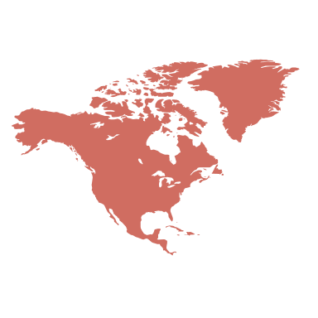
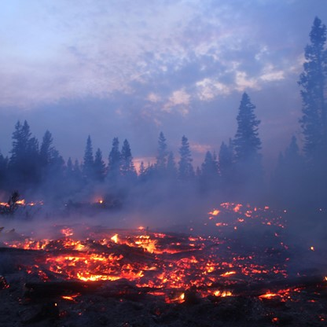
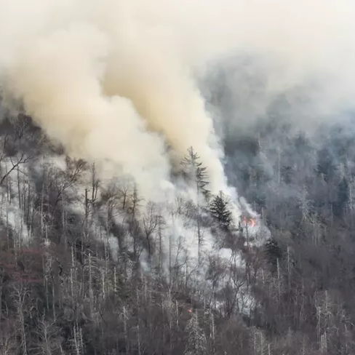

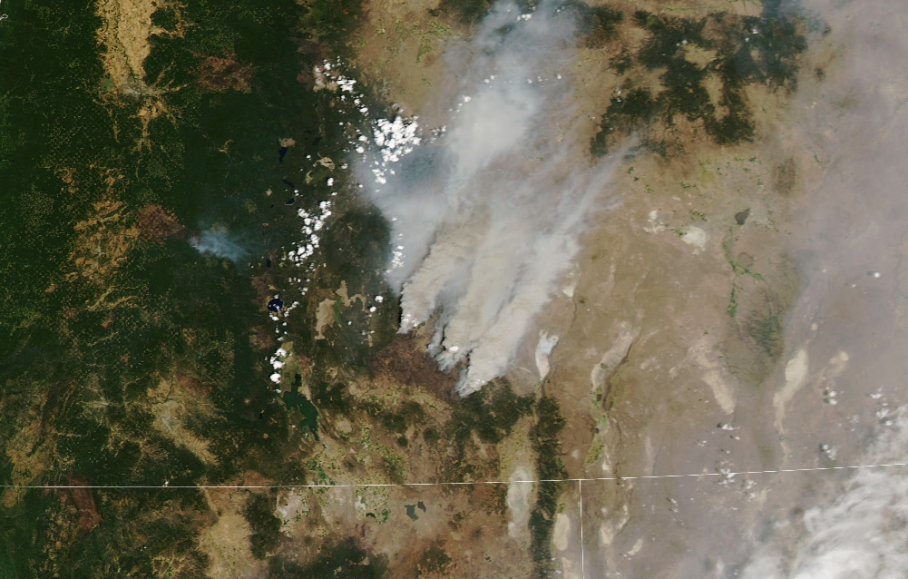
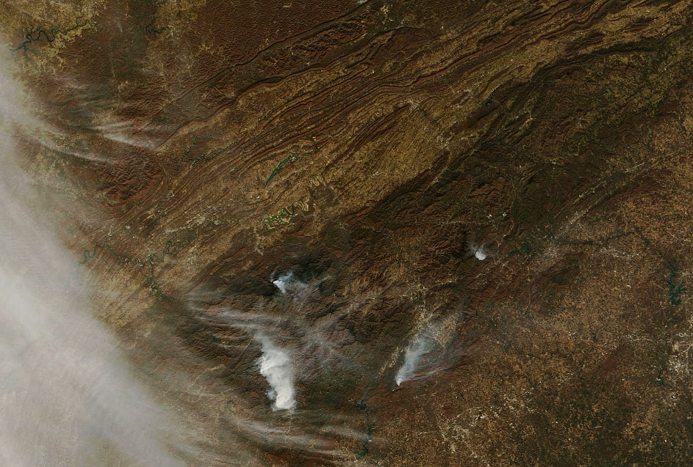
Introduction
Bend
Gatlinburg
0
50
km
Image credit: Warren Bielenberg, Joshua Stevens,
Lauren Dauphin, and U.S. Forest Service – Pacific Northwest Region
0
50
km
Notes:
Creator: Kathryn
Presenter:
Back up Presenter:
Speaker Notes
In this project, we studied two wildfire events, one that occurred in the eastern United States and another that took place on the West Coast of the country.
PLAY ANIMATION 1
The Chimney Tops 2 Fire began on November 23rd, 2016 on the Chimney Tops mountain in the central Great Smoky Mountains National Park. Prior to fire ignition, the southeastern United States was experiencing exceptional drought conditions. The fire burned 11,000 acres before it was extinguished on November 28th; the greater 2016 Smoky Mountains wildfire complex claimed 14 lives.
This true color image, which was captured by the Moderate Resolution Imaging Spectroradiometer (MODIS) on NASA’s Terra satellite, depicts smoke from several fires burning in the area on November 27, 2016.
PLAY ANIMATION 2
The Bootleg Fire occurred between July 6th and August 15th, 2021 near Beatty, Oregon and burned over 400,000 acres, making it the second largest fire in the United States in 2021. The fire was so extreme that it created weather phenomena in the surrounding area in contrast with typical fire events in which local weather conditions determine how fires evolve and behave.
This true color image was captured by Terra MODIS on July 18th, 2021. At this point less than two weeks after the fire ignited, it already burned 1,209 square kilometers.
------------------------------Image Information Below------------------------------
Chimney Tops 2 Fire Map:
Image Credit: Joshua Stevens, NASA Earth Observatory
Image Source: https://earthobservatory.nasa.gov/images/89195/fires-continue-to-rage-in-the-southeast, NASA Earth Observatory materials are freely available for re-publication or re-use
Chimney Tops 2 Fire Image:
Image Credit: Warren Bielenberg, National Park Service
Image Source: “Chimney Tops 2 Fire” via NPS (https://www.nps.gov/grsm/learn/chimney-tops-2-fire.htm) is part of the Public Domain
Bootleg Fire Map:
Image Credit: Lauren Dauphin, NASA Earth Observatory
Image Source: https://earthobservatory.nasa.gov/images/148602/oregon-smothered-with-smoke, NASA Earth Observatory materials are freely available for re-publication or re-use
Bootleg Fire Image:
Image Credit: U.S. Forest Service – Pacific Northwest Region
Image Source: “Bootleg Fire burned area Fremont-Winema National Forest Oregon 080421” via Flickr (https://www.flickr.com/photos/forestservicenw/52290532026/in/album-72157719551550368/) is part of the Public Domain
North America Map:
Microsoft PowerPoint shapes and icons

Slide 4
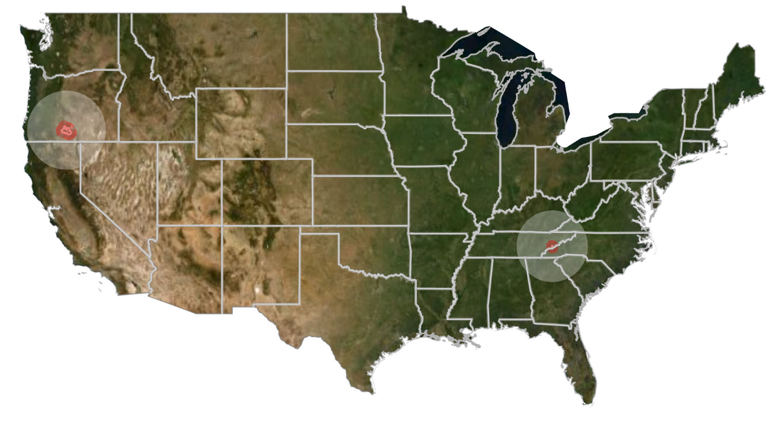
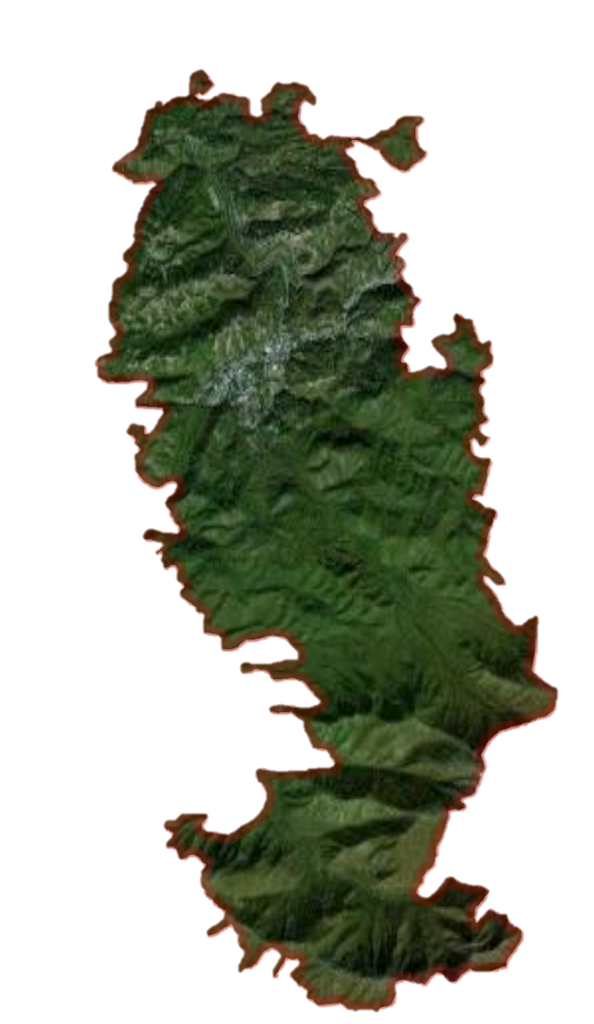

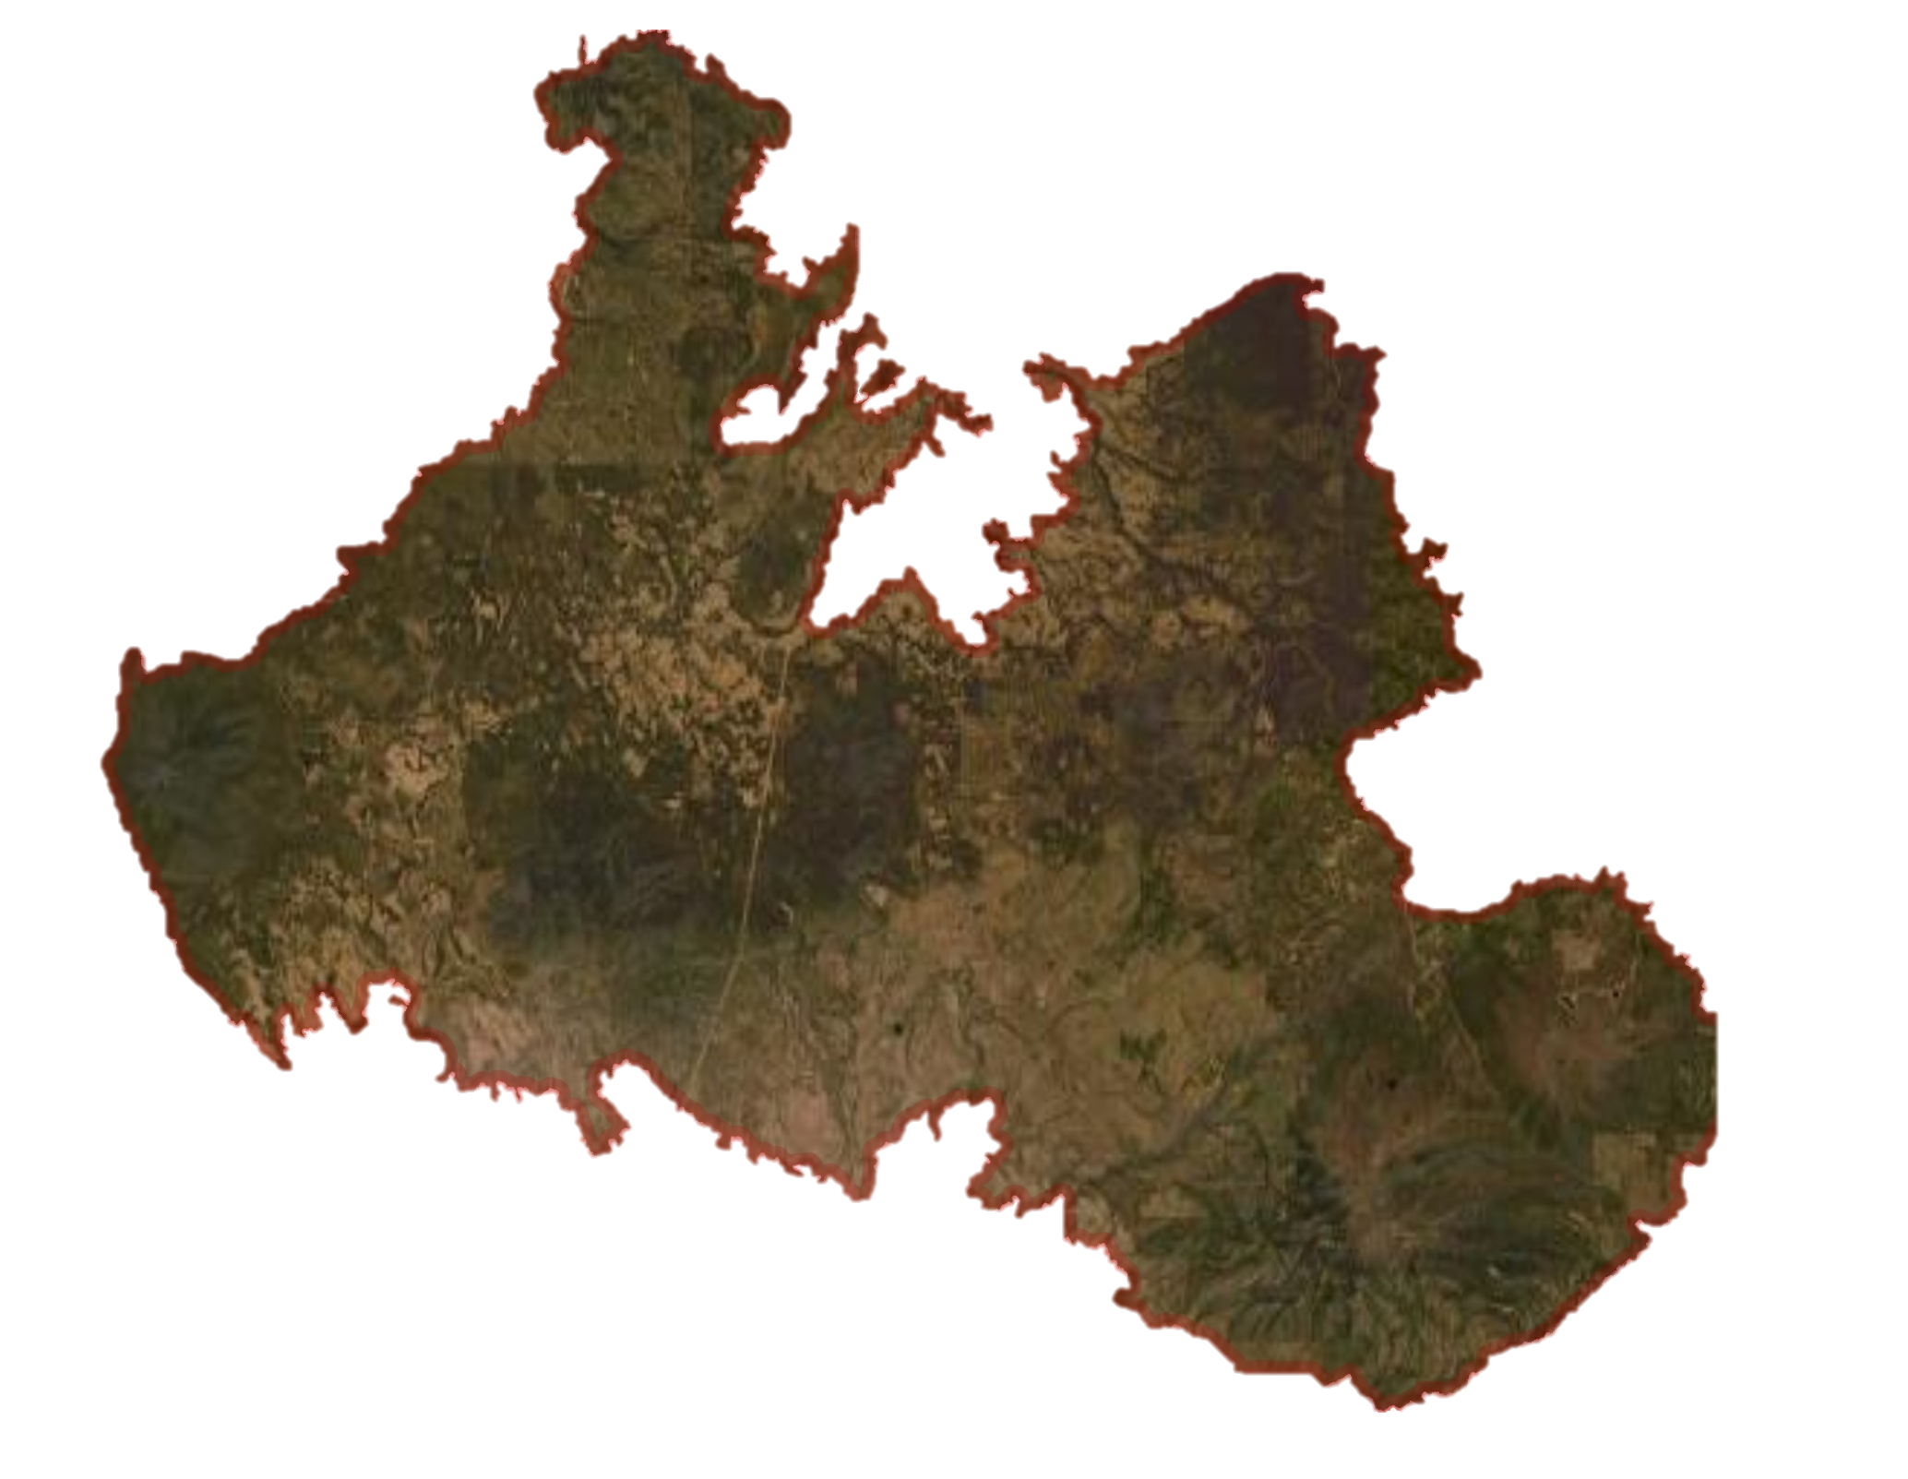
Study Area
N
0
500
1000
km
0
2.5
5
km
0
5
10
km
Chimney Tops 2
Fire
Bootleg Fire
Study Period:
May – November 2016
Study Period:
January – July 2021
Basemap credit: Aerogrid, AEX, Airbus, CGIAR, CNES/Airbus DS, DigitalGlobe, Earthstar Geographics, Esri, Getmapping, Geodatastyrelsen, GeoEye, GIS, GSA, IGN, IGP, NASA, NCEAS, NGA, NLS, NMA, OS, swisstopo, USDA, USGS
Notes:
Creator: Kathryn
Presenter:
Back up Presenter:
Speaker Notes
To capture patterns in environmental conditions in the regions where these fires occurred, the study area analyzed in this project was extended to the area within a 250 km radius of both fire footprints. Our study periods consisted of the six months preceding each fire event. The team also looked at seasonal trends up to a decade preceding each fire as a point of comparison for analysis.
----------------------------Image Credits------------------------
Basemap credit: Aerogrid, AEX, Airbus, CGIAR, CNES/Airbus DS, DigitalGlobe, Earthstar Geographics, Esri, Getmapping, Geodatastyrelsen, GeoEye, GIS, GSA, IGN, IGP, NASA, NCEAS, NGA, NLS, NMA, OS, swisstopo, USDA, USGS

Slide 5
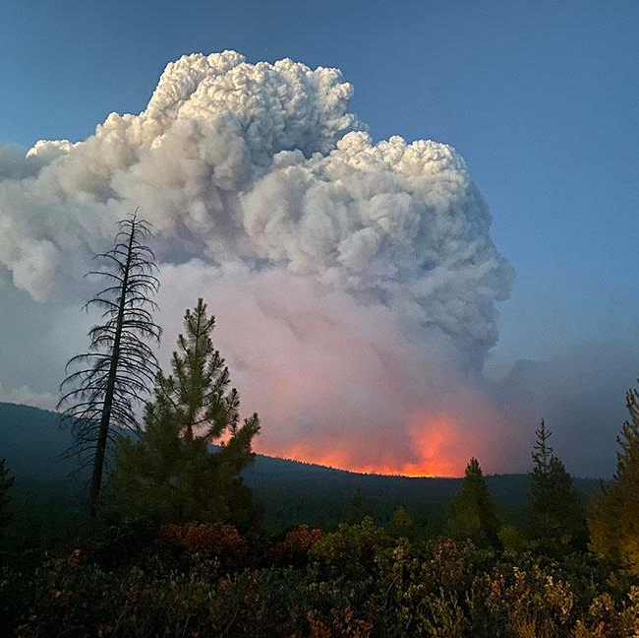


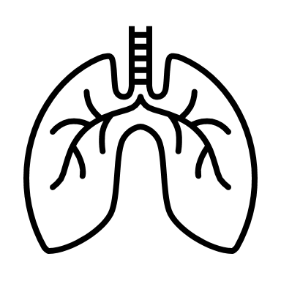

Community Concerns
Fire damage threatens national forests, biodiversity, and historic ecosystems
Increased risks of loss of life, air quality concerns, and property damage
Historically, Indigenous communities are disproportionately impacted by drought conditions. Wildfires compromise protected land, cultural sites, and resources
Credit: U.S. Forest Service, Freemont-Winema National Forest
Notes:
Creator: Kelli
Presenter:
Back up Presenter:
Speaker Notes
Wildfires have shifted from a seasonal phenomenon to a consistent threat as a consequence of climate change, raising constant concerns in areas vulnerable to fire damage.
Fires threaten national forests, biodiversity, and historic ecosystems. Loss of life post-fire, both human and endangered wildlife populations occurs due to ecosystem and air quality damage.
Additionally, Indigenous communities are disproportionately impacted by drought conditions. Wildfires compromise protected land, cultural sites, and resources such as waterways, hunting and fishing areas.
----------------------------Image Credits------------------------
Bootleg Fire Image:
Image Credit: Fremont-Winema National Forest, US Forest Service and National Interagency Fire Center
Image Source: “Bootleg Fire” via Flickr (https://www.flickr.com/photos/nifc/51300053645/) is part of the Public Domain
Icons: PowerPoint Icons

Slide 6



Objectives
Produce a spatially-averaged time-series of vegetation health
Analyze soil moisture conditions preceding both fire events
Assess the relationship among vegetation health, soil moisture conditions, and fuel load six months prior to both fire events
Notes:
Creator: Kelli
Presenter:
Back up Presenter:
Speaker Notes
The team produced a spatially-averaged time series using two vegetation indices and the Keetch-Byram Drought Index (KBDI).
Then, soil moisture conditions preceding each fire were analyzed through three standardization methods.
Finally, an assessment of the relationship between vegetation health, soil moisture, and fuel load was conducted to determine correlations in the six months leading up to both fire events.
------------------------------Image Information Below------------------------------
Icons: PowerPoint SmartArt + Icons

Slide 7


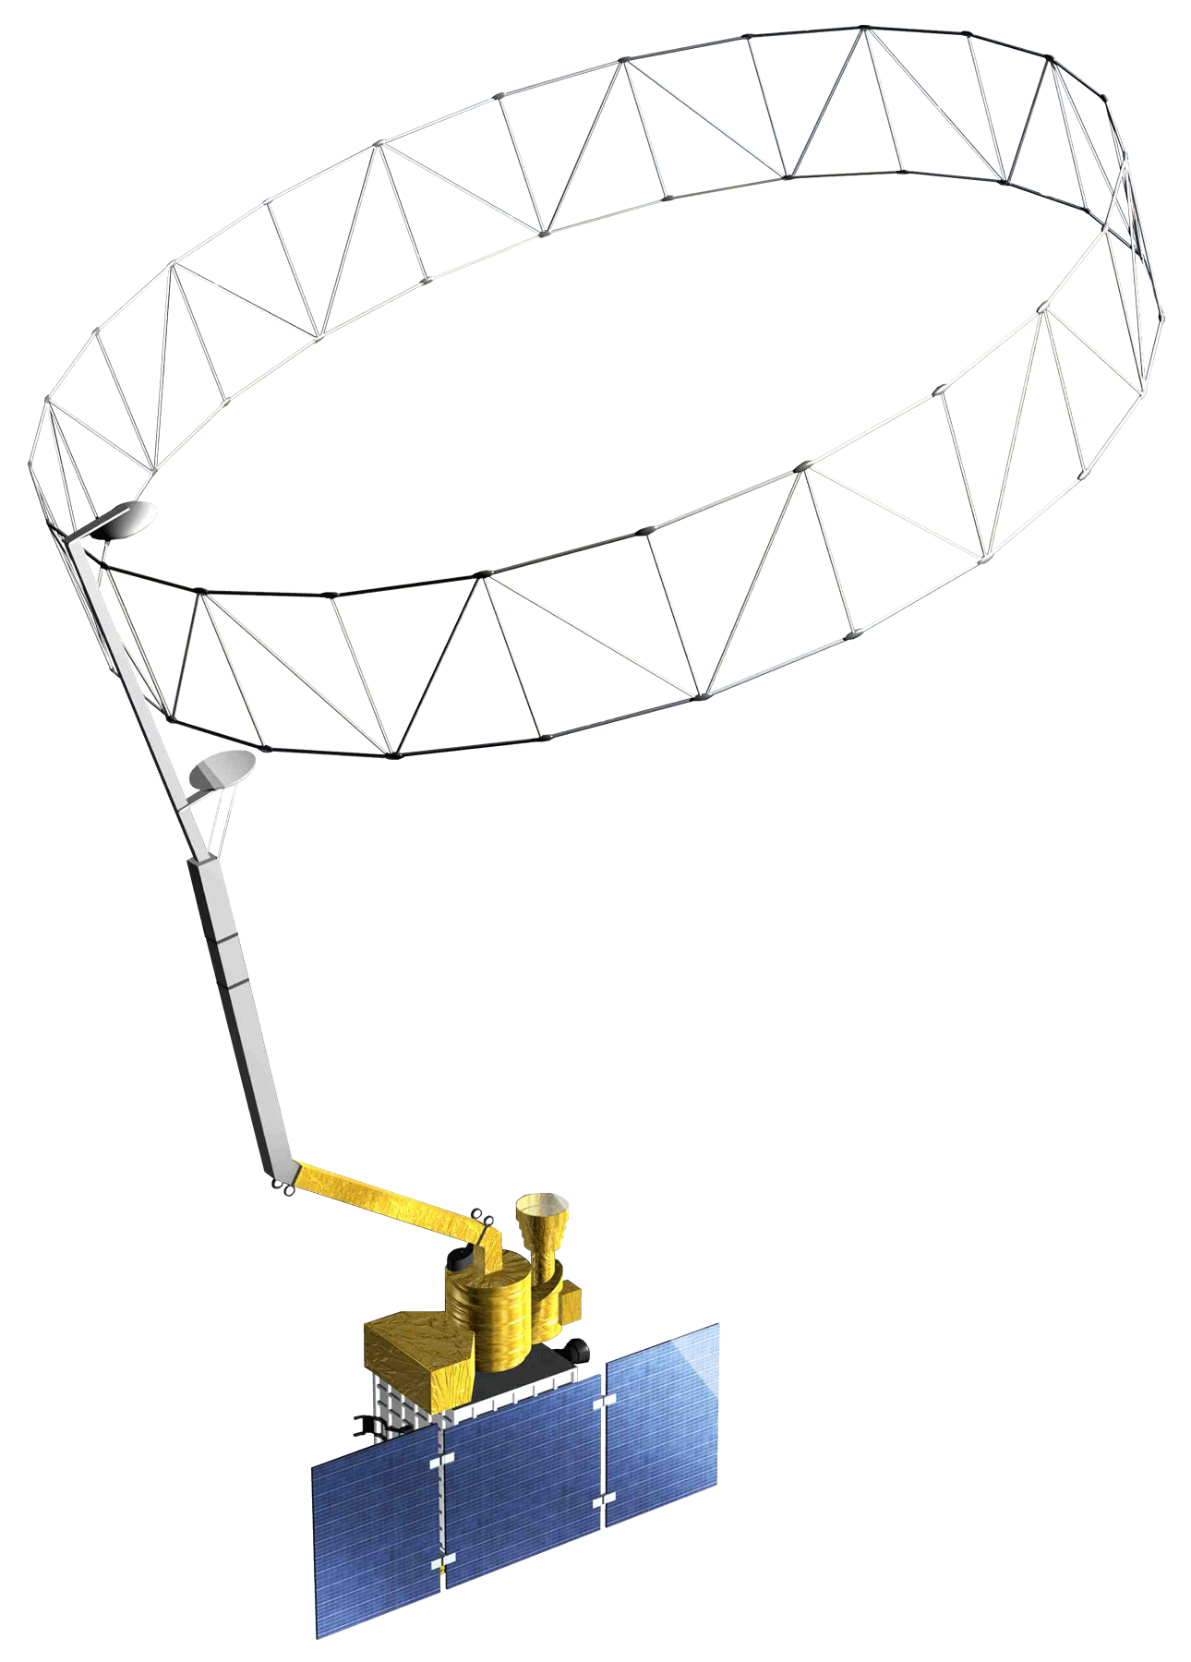
Methodology
– Earth Observations
Terra MODIS
SMAP
Image credit: NASA
Notes:
Creator: Kathryn
Presenter:
Back up Presenter:
Speaker Notes
For this project, we utilized data collected by NASA’s Terra MODIS (Moderate Resolution Imaging Spectroradiometer) to calculate two vegetation indices—NDVI and EVI. These vegetation calculations were used in combination with United States Forest Service Wildland Fire Assessment System Keetch Byram Drought Index (KBDI) to visualize vegetation health across both study areas prior to fire ignition.
We also utilized the European Space Agency Climate Change Initiative Soil Moisture dataset to analyze antecedent soil moisture conditions. This dataset is constructed—in part—using data captured by NASA's Soil Moisture Active Passive (SMAP) satellite.
------------------------------Image Information Below------------------------------
Background Image:
Image credit: NASA
Image Source: https://www.nasa.gov/content/earth-day-image-gallery-celebrating-earths-beauty
Landsat 8 Satellite OLI/TIRS Sensor Image:
Image credit: NASA
Image Source: DEVELOPedia
Terra MODIS Image:
Image credit: NASA
Image Source: DEVELOPedia
SMAP Image:
Image credit: NASA
Image Source: DEVELOPedia

Slide 8
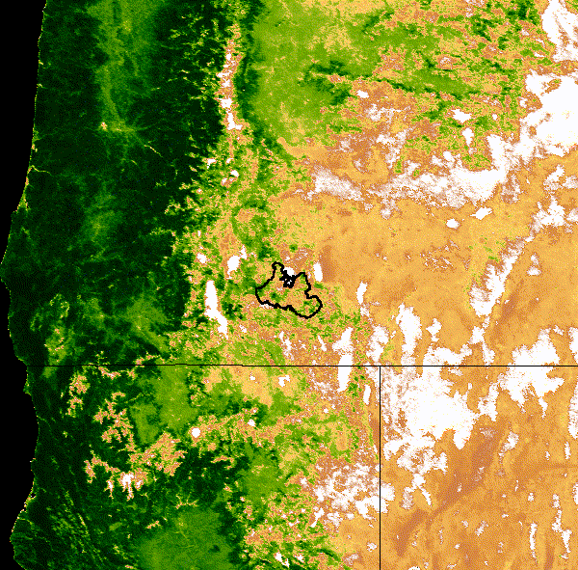
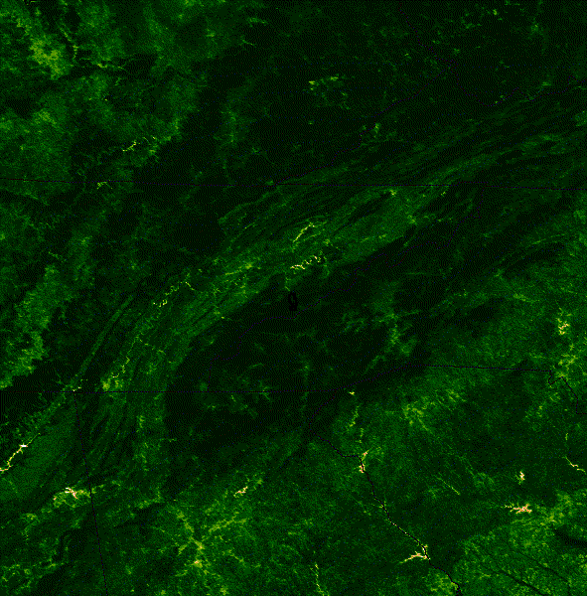
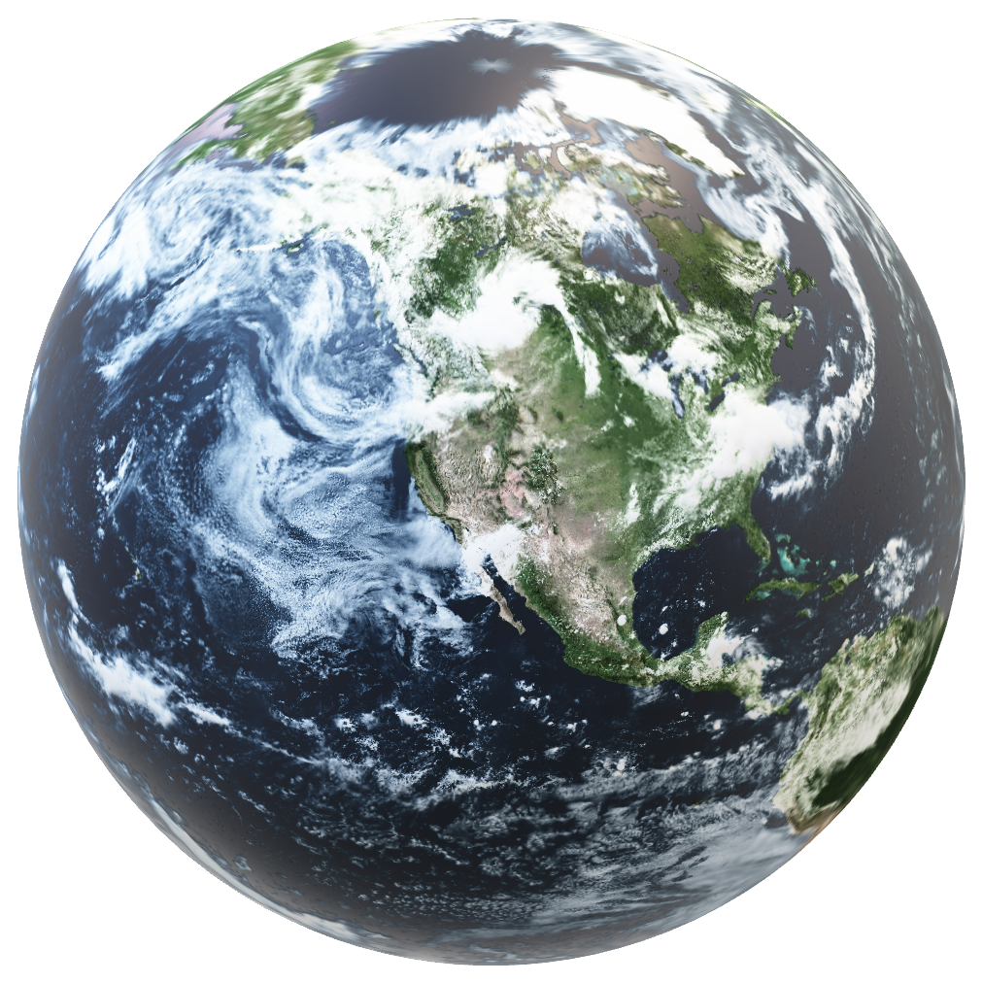
Methodology
– Vegetation Indices
Terra MODIS
Fire Footprint
Image credits: NASA
Notes:
Creator: Kathryn
Presenter:
Back up Presenter:
Speaker Notes
The team calculated normalized difference vegetation index (NDVI) and enhanced vegetation index (EDVI) using surface reflectance data collected by the MODIS sensor aboard NASA’s Terra satellite.
NDVI, the difference between near-infrared (which vegetation strongly reflects) and red light (which vegetation absorbs), is used to quantify plant productivity.
Kike NDVI, Enhanced Vegetation Index measures plant greenness but is more sensitive to variation in heavily vegetated areas and reduces background noise collected in imagery.
The visualizations depicted on the screen are animations of NDVI calculations that were constructed using imagery collected by Terra MODIS.
----------------------------Image Credits------------------------
Animations:
Image credit: NASA
Image Source: Visualizations created using Terra MODIS data in Google Earth Engine (https://developers.google.com/earth-engine/datasets/catalog/MODIS_061_MOD13A2), dataset provided by NASA LP DAAC at the USGS EROS Center

Slide 9
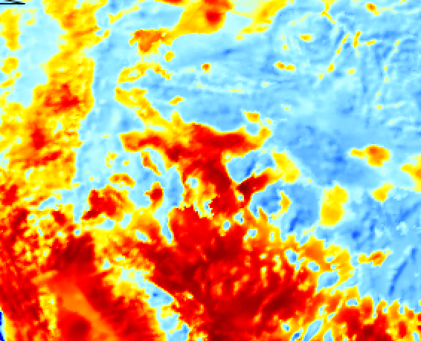
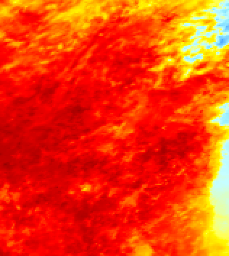
Methodology
Keetch-Byram Drought Index (KBDI) at Fire Onset
Bootleg
Chimney Tops 2
Notes:
Creator: Kelli
Presenter:
Back up Presenter:
Speaker Notes
The Keetch-Byram Brought Index, or KBDI, was developed to assess the potential for forest fire development in the southeastern United States. This index evaluates wildfire risk through evapotranspiration and precipitation measurements that capture soil moisture deficiencies.
Although the two fires were located on opposite sides of the country 5 years apart, KBDI shows a similarly strong drought on the day of fire ignition in both study areas.
The index visualizes drought using a gradient of blue, yellow, and red. The blue areas indicate areas with conditions that do not contribute much to fire intensity. The yellow represents areas that are beginning to contribute to fire intensity and the red areas show where drought conditions that actively contribute to fire intensity are present.
The bootleg fires does indicate a higher drought condition, but this is typical for the West and highlights the unusual conditions in the East that led up to the Chimney Tops 2 fires due to the similarity in this index.
------------------------------Image Information Below ------------------------------

Slide 10
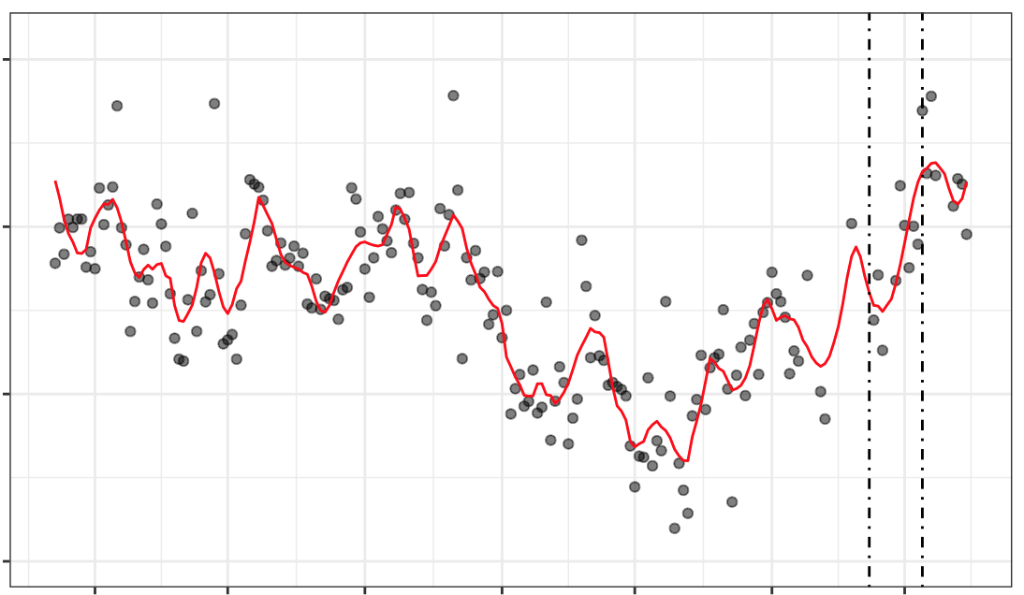
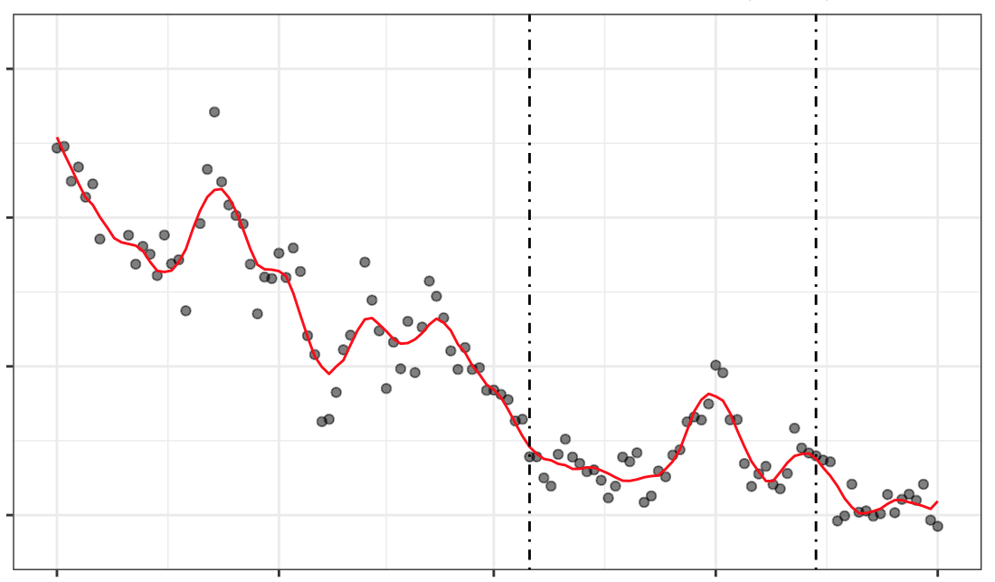


Results
– Volumetric Soil Moisture (30-year) (VSM)
Chimney Tops 2
Bootleg
0.32
0.25
Fire Ignition
Fire Ignition
Fire Containment
0.28
0.20
m³ water / m³ soil
0.24
0.15
Fire Containment
0.10
0.20
Jun 1
Jul 1
Aug 1
Sep 1
Oct 1
Nov 1
Dec 1
May 1
Jun 1
Jul 1
Aug 1
Sep 1
Date
Date
2016
2021
Fire Ignition Date
Fire Ignition Date
Nov 27
July 6
Notes:
Creator: Will
Presenter:
Back up Presenter:
Speaker Notes
Displayed here are average volumetric soil moisture measurements—one of the three standardization approaches used to analyze antecedent soil moisture conditions in the months before the Chimney Tops 2 and Bootleg Fires—for each study area.
Average volumetric soil moisture is a calculation is of the fraction of soil volume that is occupied by water. This is the initial dataset generated by SMAP prior to any standardization method.

Slide 11
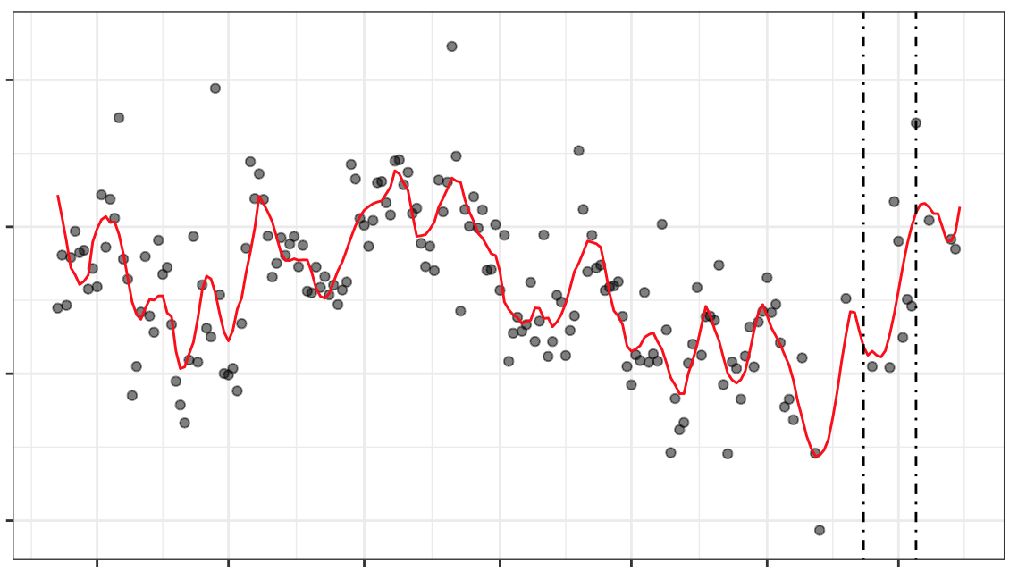
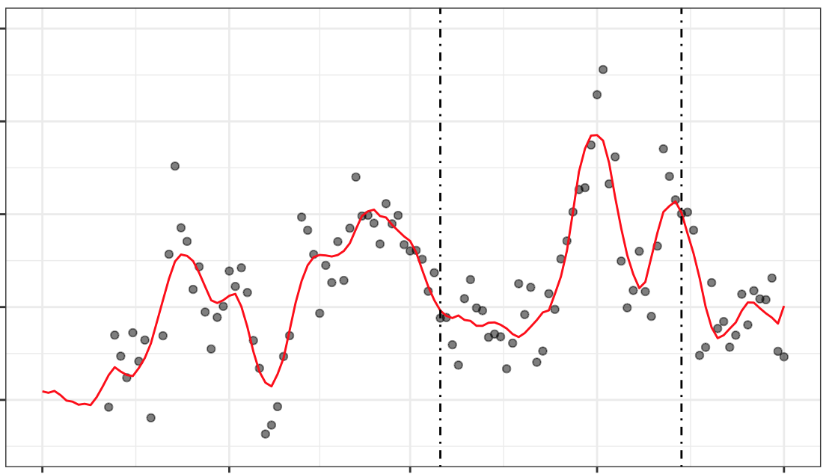
Results
– Seasonal Anomalies in Soil Moisture (SMA)
Chimney Tops 2
Bootleg
1.0
1.0
Fire Ignition
Fire Ignition
0.5
Fire Containment
Fire Ignition
0
0.0
Standard Deviation from Seasonal Average
-0.5
-1.0
Fire Containment
-1.0
-2.0
Jun 1
Jul 1
Aug 1
Sep 1
Oct 1
Nov 1
Dec 1
May 1
Jun 1
Jul 1
Aug 1
Sep 1
Date
Date
2016
2021
Fire Ignition Date
Fire Ignition Date
Nov 27
July 6
Notes:
Creator:
Presenter:
Back up Presenter:
Speaker Notes
Displayed here is the standardized soil moisture seasonal anomalies in the months before the Chimney Tops 2 and Bootleg Fires.
Standardized soil moisture seasonal anomalies—one of the three soil moisture standardization methods—measure the degree to which soil moisture conditions in 2016 differed from the average conditions at corresponding time of year.
----------------------------Image Credits------------------------
Image Credit:

Slide 12
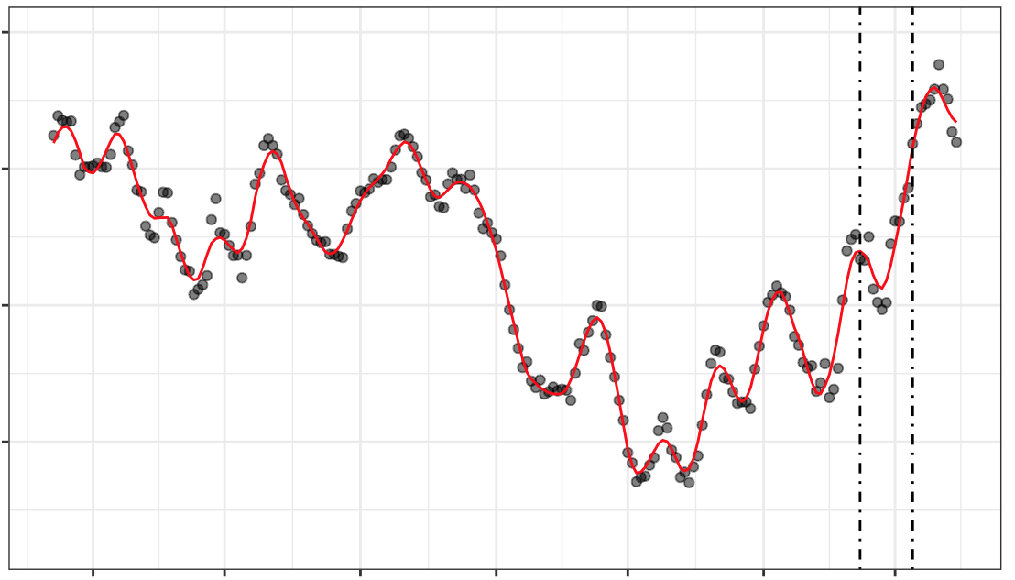
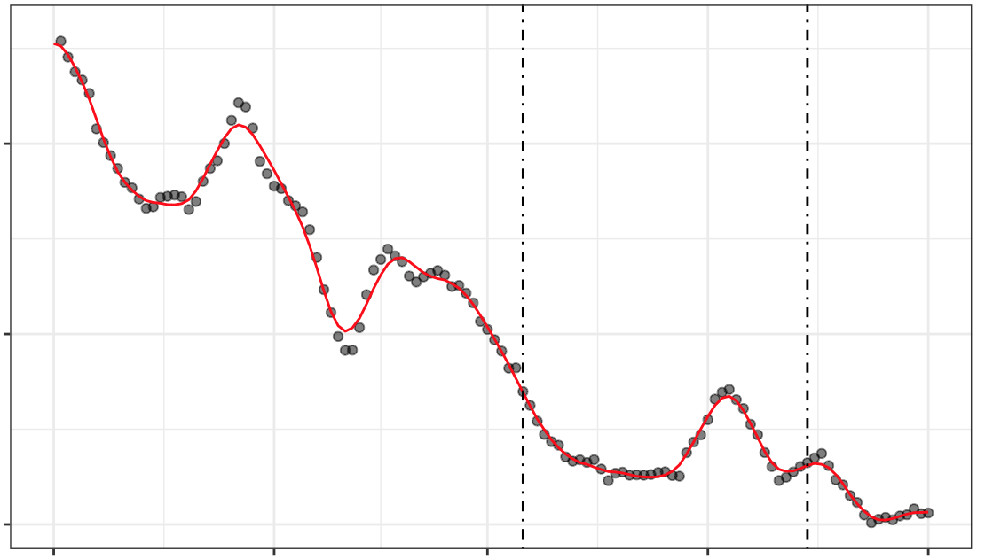
Results
– Fraction of Available Water (FAW)
Chimney Tops 2
Bootleg
1.5
Fire Ignition
Fire Ignition
1.0
Fire Containment
1.3
m³ water / m³ soil
1.1
0.5
Fire Containment
0.9
0.0
Jun 1
Jul 1
Aug 1
Sep 1
Oct 1
Nov 1
Dec 1
May 1
Jun 1
Jul 1
Aug 1
Sep 1
Date
Date
2016
2021
Fire Ignition Date
Fire Ignition Date
Nov 27
July 6
Notes:
Creator:
Presenter:
Back up Presenter:
Speaker Notes
Displayed here is the fraction of available water (FAW) in the months before the Chimney Tops 2 and Bootleg Fires.
The fraction of available water represents the amount of water in the soil that is accessible by plants, between the wilting point and field capacity.
----------------------------Image Credits------------------------
Image Credit:

Slide 13
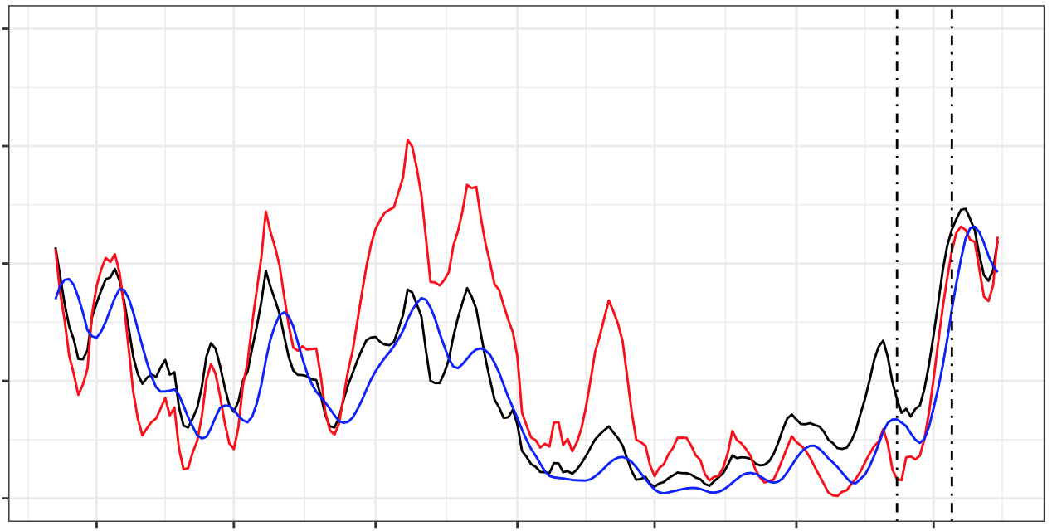
Results
– Chimney Tops 2 30-Year Soil Moisture Percentile
1.00
Fire Ignition
Fire Containment
0.75
0.50
Percentile
0.25
SMA
FAW
VSM
0.00
Jun 1
Jul 1
Aug 1
Sep 1
Oct 1
Nov 1
Dec 1
Date
Notes:
Creator: Will
Presenter:
Back up Presenter:
Speaker Notes
Comparing these standardization approaches demonstrates the complex nature of fire climatology. Overall, the trend of both the FAW and VSM show seasonal similarities in soil moisture percentiles several months prior to the Chimney Tops 2 fire event.
Generally, all three variables are indicative of drought conditions in the lead-up to the fire, but these time series also give an examples of how the different standardization approaches can lead to different results. In November, the volumetric soil moisture began to rise in the surrounding area, but not a fast as typically occurs during the recharge period of winter, meaning that the soil moisture anomalies remained low.
Finally, as is visible to the around the time of fire containment, soil moisture measurements are responsive to precipitation events, as this sharp rise in moisture coincides with the arrival of the rains which helped bring an end to the fire.

Slide 14
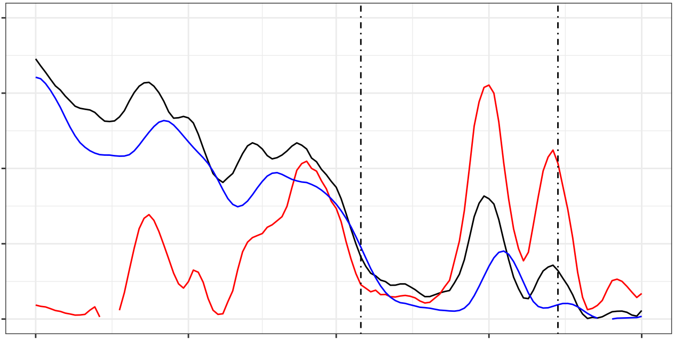
Results
– Bootleg 30-Year Soil Moisture Percentile
1.00
Fire Ignition
Fire Containment
0.75
0.50
Percentile
0.25
SMA
FAW
VSM
0.00
May 1
Jun 1
Jul 1
Aug 1
Sep 1
Date
Notes:
Creator: Will
Presenter:
Back up Presenter:
Speaker Notes
Now, moving on to the results of the Bootleg fire. This graph shows, once again, similar trends between the FAW and the VSM in the several months leading up to the fire event. The SMA trends with much more variability in this analysis than the Chimney Tops 2 fire in the East, with seasonal patterns differing widely for most months shown here.
This difference is explained by the overall drier conditions in the West, especially during the summer. The spikes that occur in soil moisture anomaly during the fire, for example, show the soil becoming wetter than average, but starting from such an arid baseline, this does not represent a great change.

Slide 15
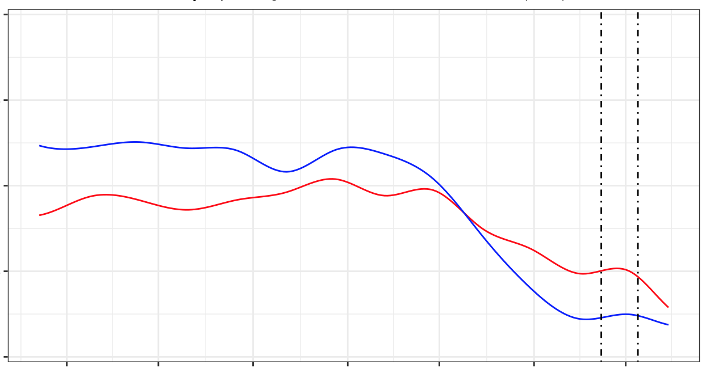
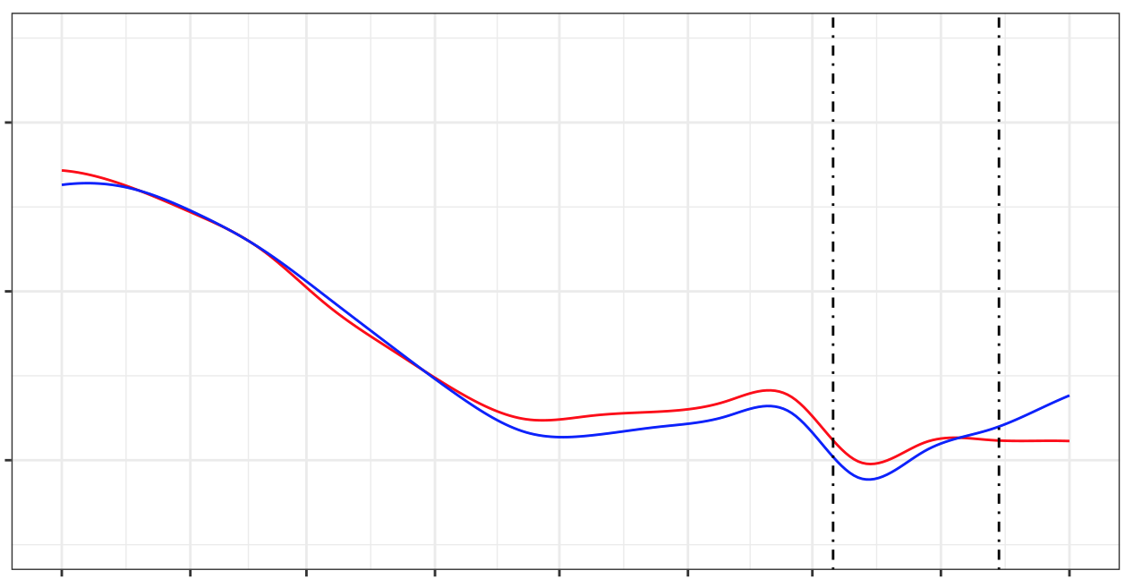
Results
– Seasonal Anomalies in Vegetation Indices
Chimney Tops 2
Bootleg
0.8
Fire Ignition
Fire Ignition
1
0.4
Fire Containment
Fire Containment
Standard Deviation from
Seasonal Average
0.0
0
-0.4
-1
-0.8
Jun 1
Jul 1
Aug 1
Sep 1
Oct 1
Nov 1
Dec 1
Jan 1
Feb 1
Mar 1
Apr 1
May 1
Jun 1
Jul 1
Aug 1
Sep 1
Date
Date
EVI
NDVI
2016
2021
Fire Ignition Date
Fire Ignition Date
Nov 27
July 6
Notes:
Creator:
Presenter:
Back up Presenter:
Speaker Notes
Our vegetation analysis show seasonal trends in NDVI and EVI several months before each fire event. Since vegetation serves as the fuel of wildfires, these indices' deviations from seasonal averages indicates how much dryer live vegetation is from normal, and therefore how much more likely it is to easily burn.
For Chimney Tops 2, the values were both far below the standard deviation before the fire onset in late November. Likewise for Bootleg, vegetation conditions deviated from the seasonal average around early spring and remained low throughout months immediately prior to the fire.
Not only do these measurements broadly indicate the drought conditions present in the lead up to these fires, but they also broadly mirror the soil moisture conditions shown on previous slides, demonstrating the potential to use soil moisture in monitoring fire risk.
----------------------------Image Credits------------------------
Image Credit:

Slide 16
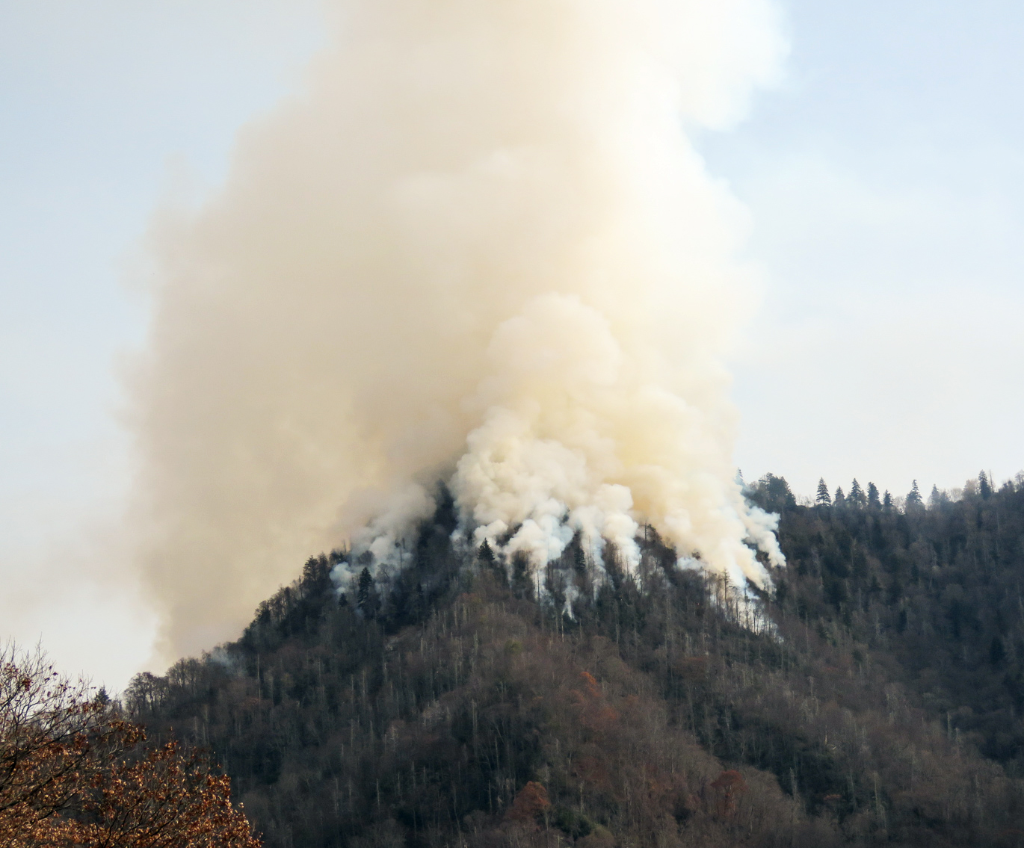

Conclusions
May 2016 – November 2016
All soil moisture standardization methods presented drought signal approximately 3 months prior to fire.
January 2021 – July 2021
Variability among soil moisture standardization methods reflects fire regime of the Western US.
Overall
Remotely sensed soil moisture data mirror fuel conditions as measured by vegetation indices, indicating its utility in measuring regional wildfire potential.
Image Credit: National Park Service
Notes:
Creator:
Presenter:
Back up Presenter:
Speaker Notes
In the three months prior to the ignition of the Chimney Tops 2 Fire, all three standardized soil moisture identified drought signals in the surrounding region.
In antecedent conditions prior to the Bootleg Fire, the three standardized approaches captured variation in soil moisture. These variations are due, in part, to the climate and fire regimes present in the western United States.
In summary, these approaches are similar to trends in vegetation indices over the same time period, demonstrating the utility of soil moisture and vegetation metrics to identify wildfire risk.
----------------------------Image Credits------------------------
Chimney Tops 2 Fire Image:
Image Credit: Warren Bielenberg, National Park Service
Image Source: “Chimney Tops 2 fire in Great Smoky Mountains National Park” via USGS. (https://www.usgs.gov/media/images/chimney-tops-2-fire-great-smoky-mountains-national-park) is part of the Public Domain

Slide 17
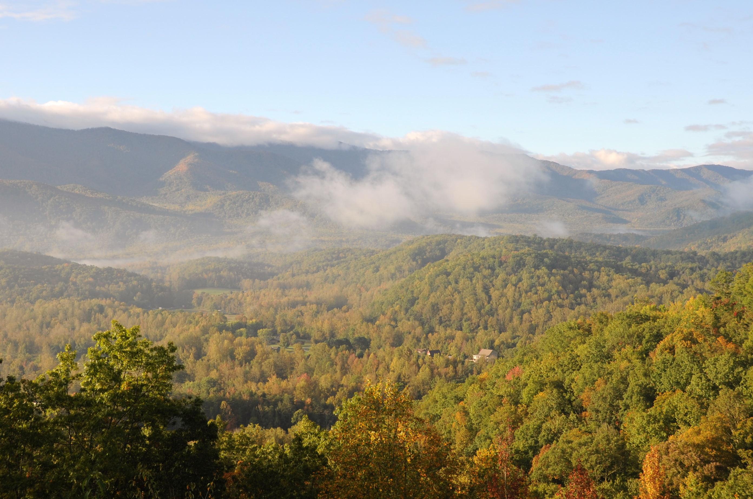
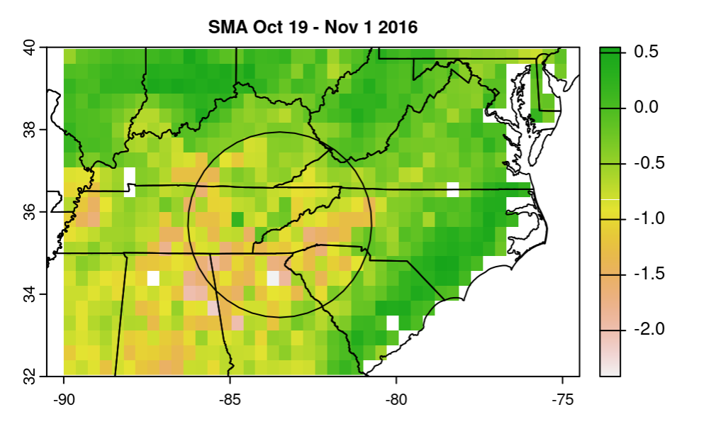

Errors and Uncertainties
Cloud cover in the Great Smoky Mountains
KDBI not commonly used in western United States
Seasonality of vegetation indices
FAW values outside of expected range
Resolution of remote sensing imagery
Image credit: Carl Wycoff,
Emily Carlin
Notes:
Creator: Kathryn
Presenter:
Back up Presenter:
Speaker Notes
PLAY ANIMATION 1
A primary limitation of this study is the high prevalence of cloud cover over the Great Smoky Mountains, which limit the capacity of remote sensing technologies to consistently capture conditions on the ground in the area around the Chimney Tops 2 Fire.
PLAY ANIMATION 2
The size of the Chimney Tops 2 Fire is a limitation of this study as this fire includes a small number of remotely-sensed images within its footprint.
PLAY ANIMATION 3
The Chimney Tops 2 Fire occurred in late November after the leafing season concluded, so vegetation indices were unable to consistently measure trends in vegetation greenness in the weeks prior to the fire event.
PLAY ANIMATION 4
A limitation of this study is the varied use of drought indices across the United States. The KBDI index used in our study was developed using data gathered from forest ecosystems in the southeastern United States and therefore, does not fully align with the patterns in the western United States.
PLAY ANIMATION 5
Additionally, FAW values were outside of the typical range. Usually, FAW is measured on a scale ranging from zero to one, with values closest to one indicating the wettest areas. This scaling discrepancy may be attributed to the way in which FAW was calculated during the analyses, and future work could recalculate these measurements.
------------------------------Image Information Below ------------------------------
Smoky Mountain Clouds Image:
Image Credit: Carl Wycoff
Image Source: “The Great Smoky Mountains.” via Flickr. (https://www.flickr.com/photos/carlwwycoff/4055575126), listed under Attribution 2.0 Generic (CC BY 2.0) license
Fall Leaves Image:
Image Credit: Emily Carlin
Image Source: “Fall Leaves” via Flickr. (https://www.flickr.com/photos/emiline220/8289152185/), listed under Attribution-NoDerivs 2.0 Generic (CC BY-ND 2.0) license
Pixel Image
Created by Will

Slide 18
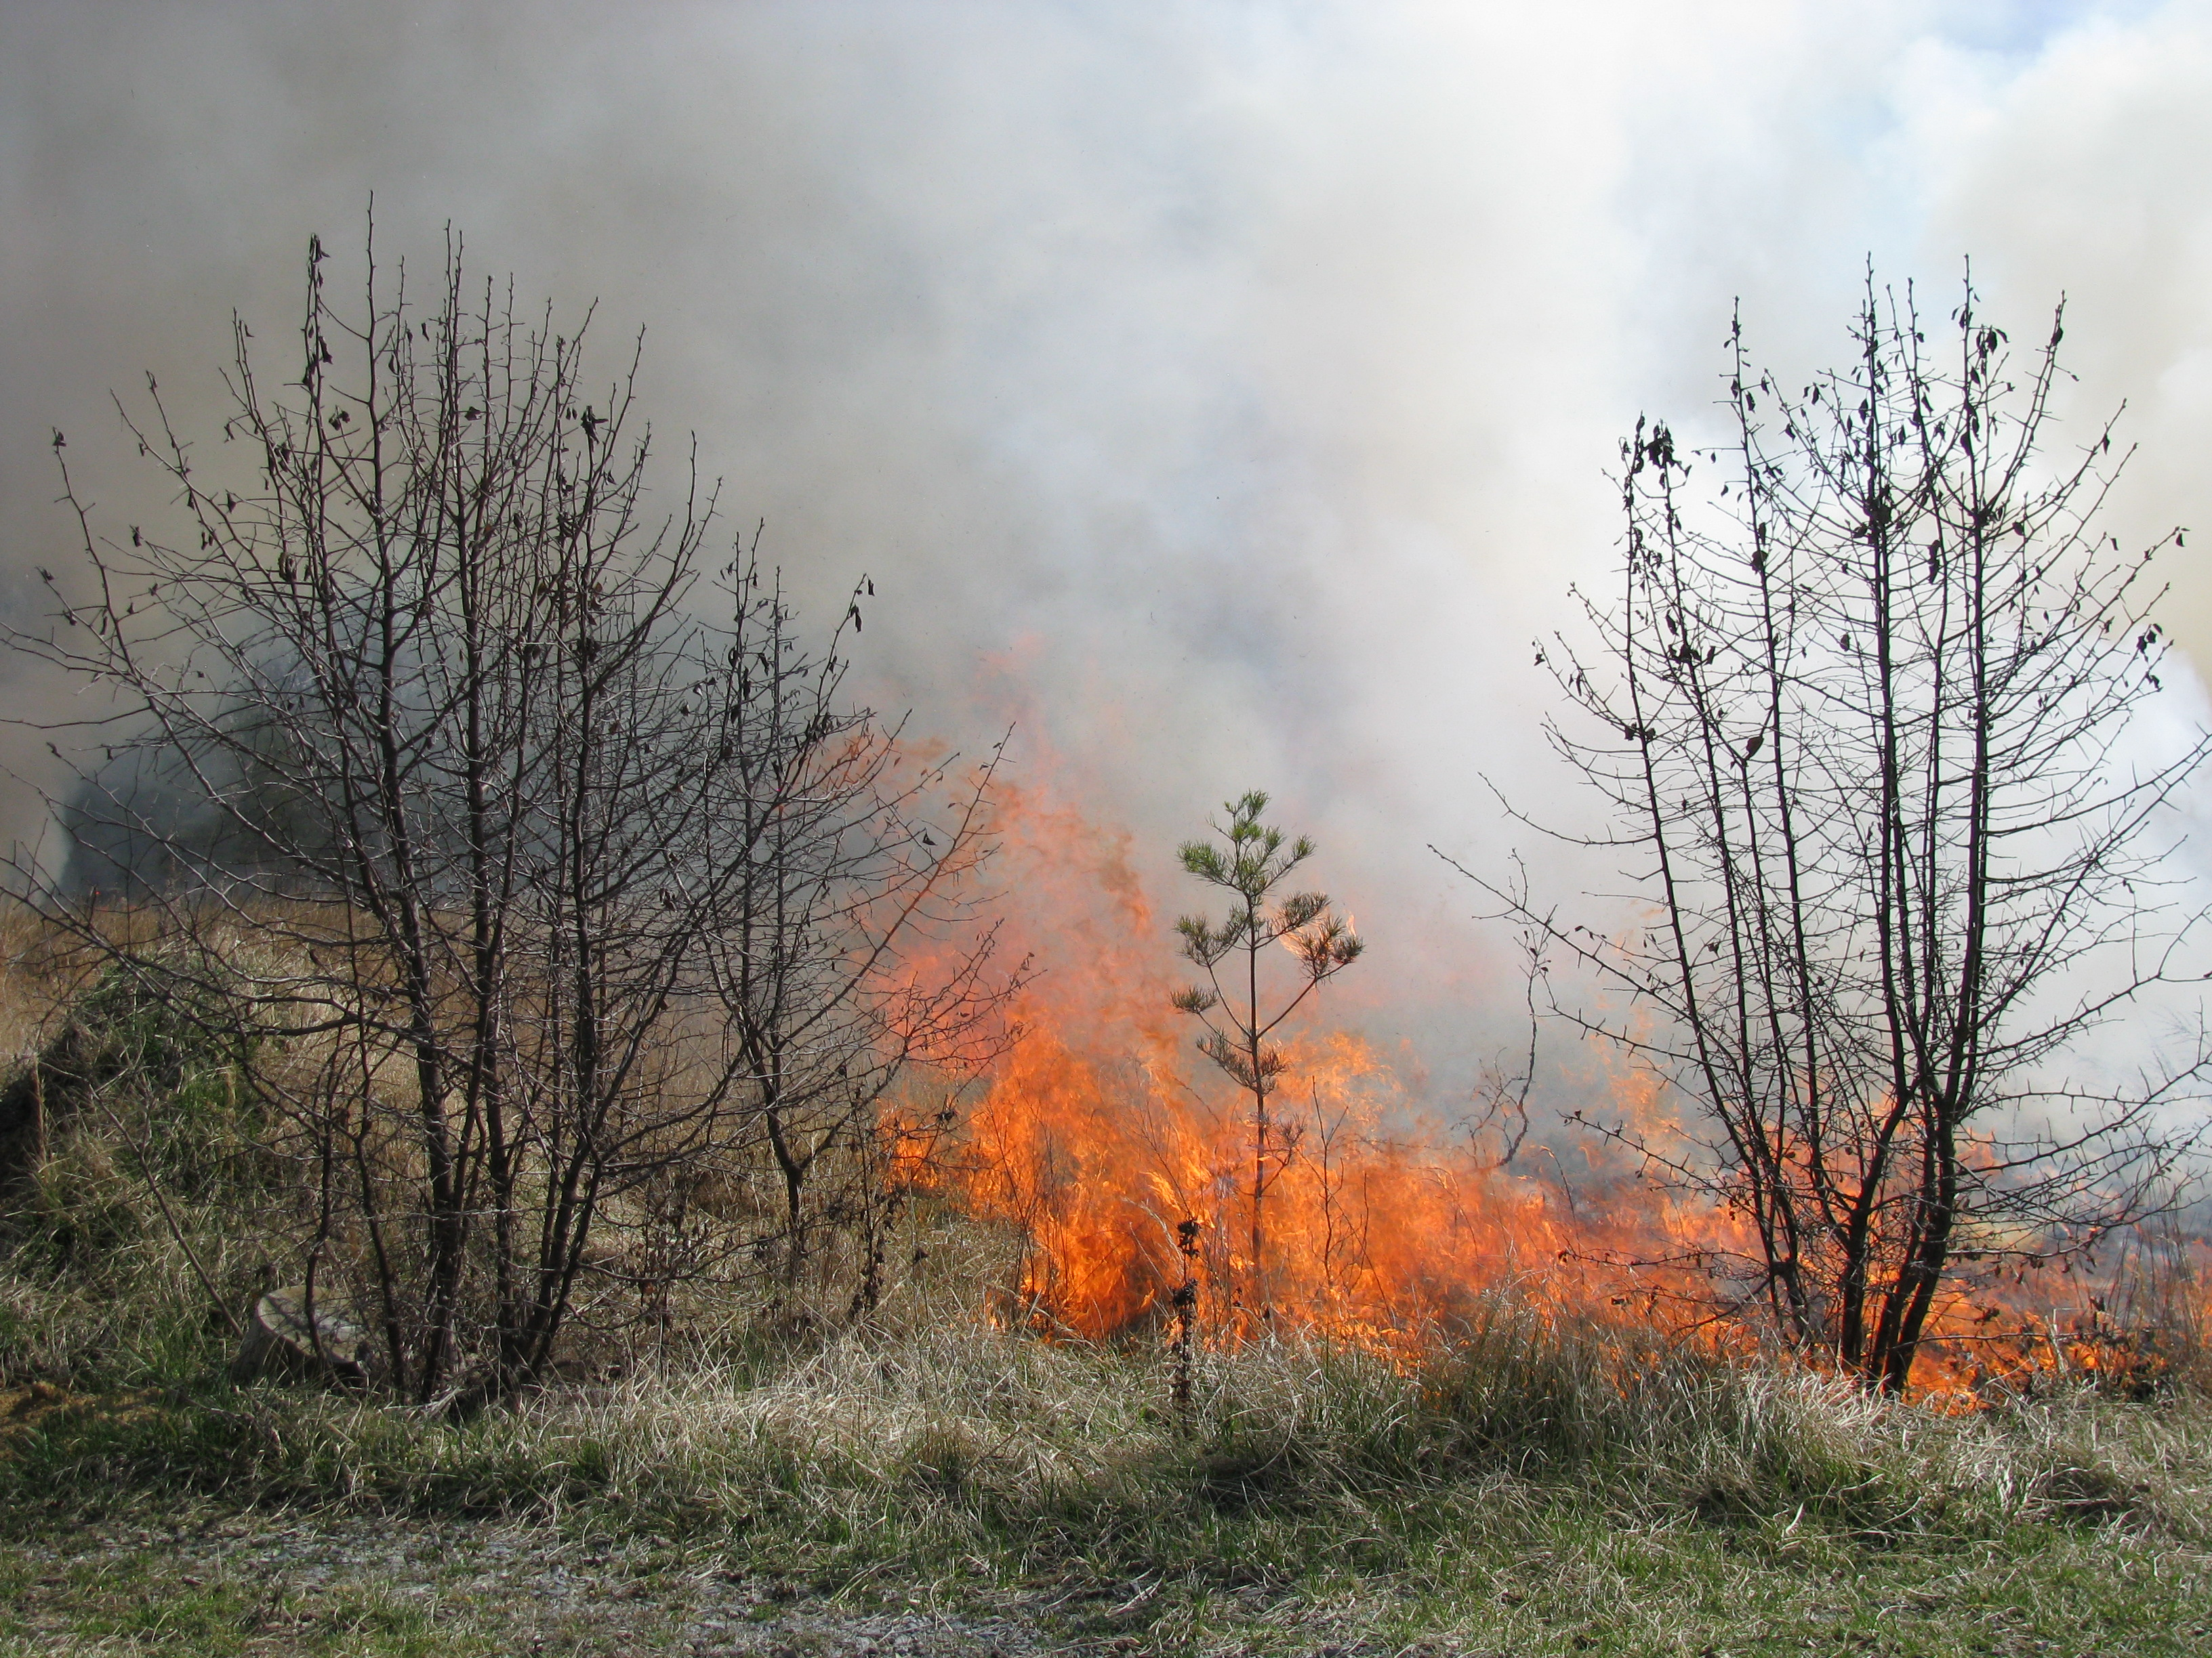
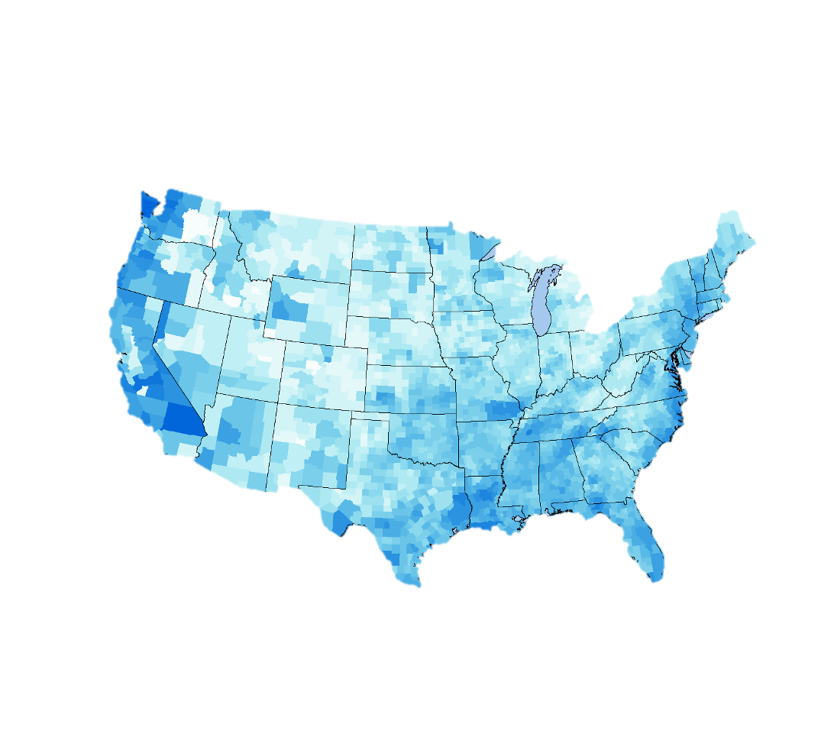



Future Work
Fuel load maps
Expanding fire analyses to other ecosystems
Integrating other vegetation indices
National assessment of major wildfires
Image credit: Metric Maps and U.S. Fish and Wildlife Service
Notes:
Creator: Kathryn
Presenter:
Back up Presenter:
Speaker Notes
Future work can expand on the research conducted in this study to examine how the behavior of environmental conditions influence wildfire development.
PLAY ANIMATION 1
Project partners are interested in conducting a national assessment of major wildfire occurrences across all states and Puerto Rico to provide additional context on metrics such wildfire frequency, median acreage burned, and annual and seasonal variations at a state-by-state level.
PLAY ANIMATION 2
Additional vegetation indices such as Evaporative Stress Index (ESI), Vegetation Drought Response Index (VegDRI), and Vegetation Health Index (VHI), could be incorporated into future investigations of vegetation health prior to fire events.
PLAY ANIMATION 3
Future work could expand these analysis to include grassland fires, soil fires, or timber fires to examine fuel loads across varied fire types.
PLAY ANIMATION 4
Finally, it was found to be infeasible to produce fuel load maps within the scope of this project. Future projects could expand on the timeseries constructed in this project to map fuel loads spatially across the study areas.
------------------------------Image Information Below ------------------------------
US Precipitation Map:
Image Credit: Metric Maps
Image Source: “Record 1 day precipitation by USA county 1979 - 2011.” via Wikipedia. (https://commons.wikimedia.org/wiki/File:Record_1_day_precipitation_by_USA_county_1979_-_2011.png) listed under a Creative Commons Attribution-Share Alike 4.0 International
Grassland Fire Image:
Image Credit: U.S. Fish and Wildlife Service
Image Source: “Controlled Burn Maintains Grassland” via Flickr. (https://www.flickr.com/photos/usfwsnortheast/6941238660), part of the Public Domain

Slide 19



DEVELOP Node Leadership
Kathryn Caruso – Fellow
Science Advisors
Ronnie Leeper
Molly Woloszyn
Project Partners
Dr. Timothy Brown
Marina Skumanich
Britt Parker
Dr. Sheila Saia
Corey Davis
Dr. Tyson Ochsner
Notes:
Creator: Will
Presenter:
Back up Presenter:
Speaker Notes
The team is grateful to everyone who contributed to this project.

