Slide 1

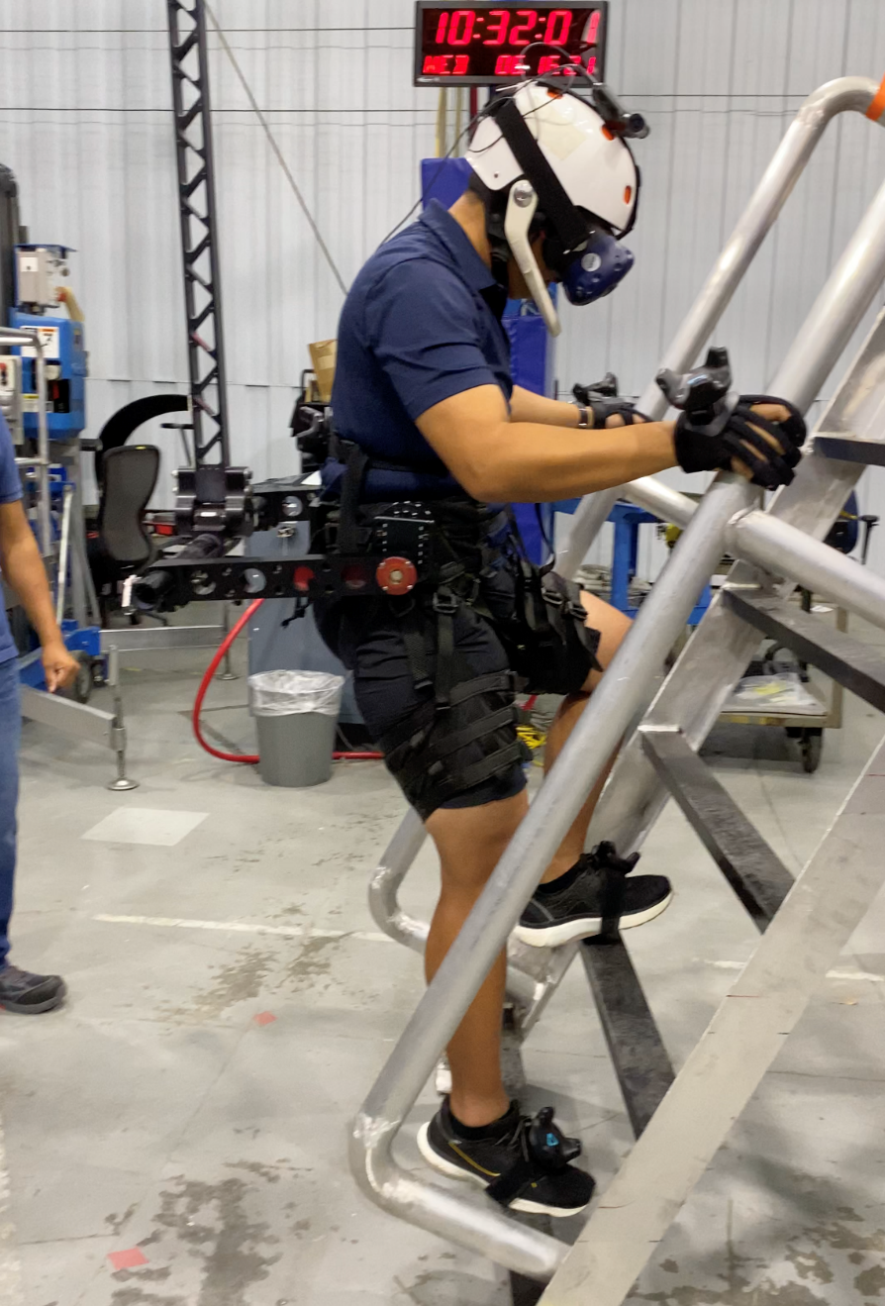
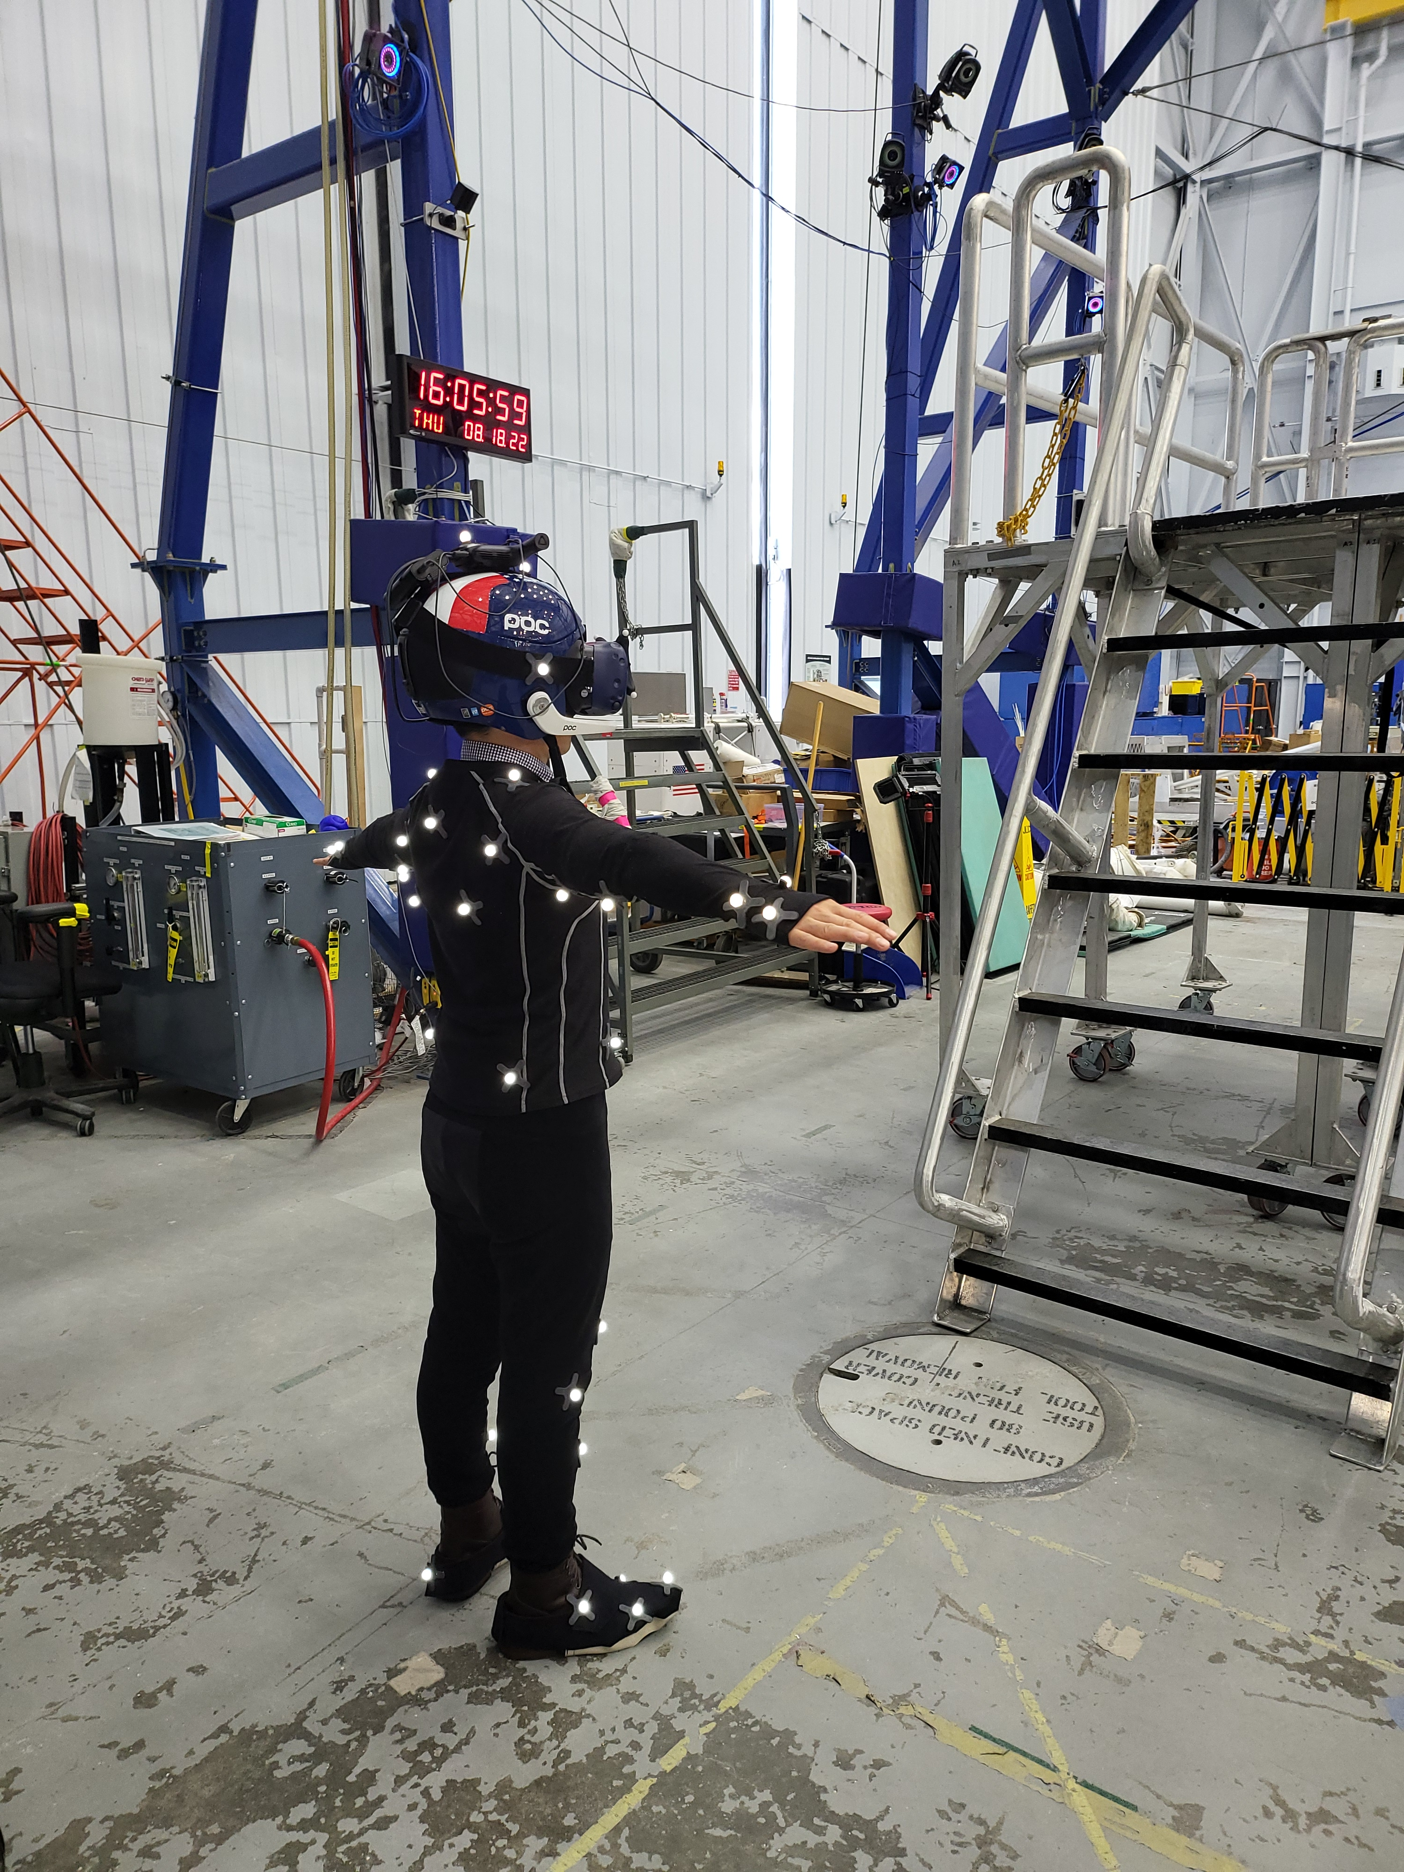
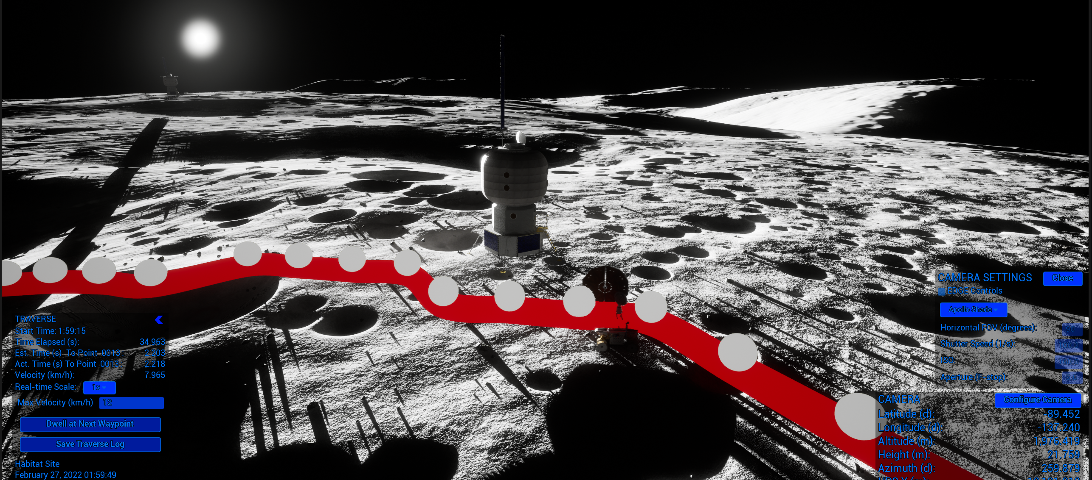
Lunar Surface Mixed Reality and ARGOS Trainer
CIF-1
Principal Investigator(s): Lee Bingham, Eddie Paddock
Technology Taxonomy Area (TX): 07.3.3: Training, 11.3.4: Simulation-based Training Decision Support Systems
TRL: Start 6 / Current 7
FY22 IRAD PROJECT Overview
This Artemis focused Mixed Reality (MR) and ARGOS project extends the current VR/ARGOS CIF project to enhance and add VR/MR capabilities to support analysis, training and risk reduction for lunar surface EVA operations in the extreme South Pole lunar environment. This third year focused on establishing a functional trainer for crew that supports the ingress/egress of a lander as well as surface tasks such as sample collection and tool deployment and operation. Completed enhancements include improving hand tracking, the addition of supporting mixed reality surface operations, and the implementation of a higher fidelity body tracking capability through a motion capture system.
INNOVATION
This project provides a digital representation of the lunar south pole for risk reduction, training and engineering design evaluation. This digital environment is combined with a human-rated gravity off-load system and a mockup of the lander porch and ladder to simulate an initial egress from a lander to the lunar surface. The fusion of physical objects with a higher fidelity virtual representation creates an immersive experience at a lower cost than constructing an entire physical environment.
Outcome
In Year 3 (FY”22) of the project, we successfully completed 7 human-in-the-loops tests in ARGOS with test subjects from CX, engineering, and subject matter experts and integrated the Optitrack motion capture system.
  Updated body tracking calibration capability, user interface (UI), and procedures to improve and streamline calibration
  Performed several successful human-in-the-loop ARGOS tests
  Installed Optitrack motion capture system at the ARGOS facility
  Integrated Optitrack system into the Lunar Surface Mixed Reality simulation
  Updated lander mockup calibration with improved UI and calibration points
  Updated simulation per CX test subject feedback
Infusion Space / Earth
This capability has applications for analysis and con-ops of lunar vehicle design concepts of the porch, ladder, or additional egress or offloading mechanisms.
Potential evaluation of artificial lighting designs to aid in EVA ops or navigation within the extreme environment of the lunar south pole.
The Lunar Site Analysis, Design, and Planning team for Artemis Base Camp Lunar Architecture Team is leveraging the visualization capabilities of this simulation for sync point products and traverse planning, analysis and visualization through a derived application, the Digital Lunar Exploration Sites Unreal Simulation Tool (DUST).
Human-in-the-loop testing of the Lunar Surface Mixed Reality and ARGOS Trainer
PARTNERSHIPS / collaborations
This work has been developed in collaboration with the EVA Management Office (XX), the EVA, Robotics and Crew Systems (CX) to help develop potential training requirements, and Josh Sooknanan with ER’s Dynamic System Test Branch (ER5) to provide ARGOS testing support.
Future Work
This work will continue as a project in support of EHP through an ITA to improve the visual fidelity and include additional capability within the simulation. A full-body motion capture system will be used to improve tracking fidelity and provide an expandable workspace for use in the larger AXES system. Collaboration with CX will continue to refine the procedures and capabilities for use as a training tool for crew. Continued input from the Astromaterials and Research Exploration Science (ARES) group will help improve the visual fidelity and accuracy of the lunar environment. Human-in-the-loop engineering test runs within ARGOS will be used to refine performance of the Mixed Reality interface with the mockup platform and establish procedures for training.
2022 JSC Technology Showcase MSC# 27038, 27251, 27233
DAA# ___________

