Slide 1
Shoshone River
Water Resources
Assessing Sediment Inputs into the Shoshone River in Wyoming to Determine Areas for Protections and Restoration Practices
Robyn Holmes (Project Lead)
Cassie Ferrante
Nelson Lemnyuy
Will Campbell
Pop-Up Project | Fall 2022
Notes:
Hello everyone, and welcome to the Shoshone River Water Resources presentation. This project, centered around sediment inputs into the Shoshone River, was completed during the Fall 2022 term with Robyn Holmes as the Team Lead, Cassie Ferrante, Nelson Lemnyuy, and Will Campbell.

Slide 2
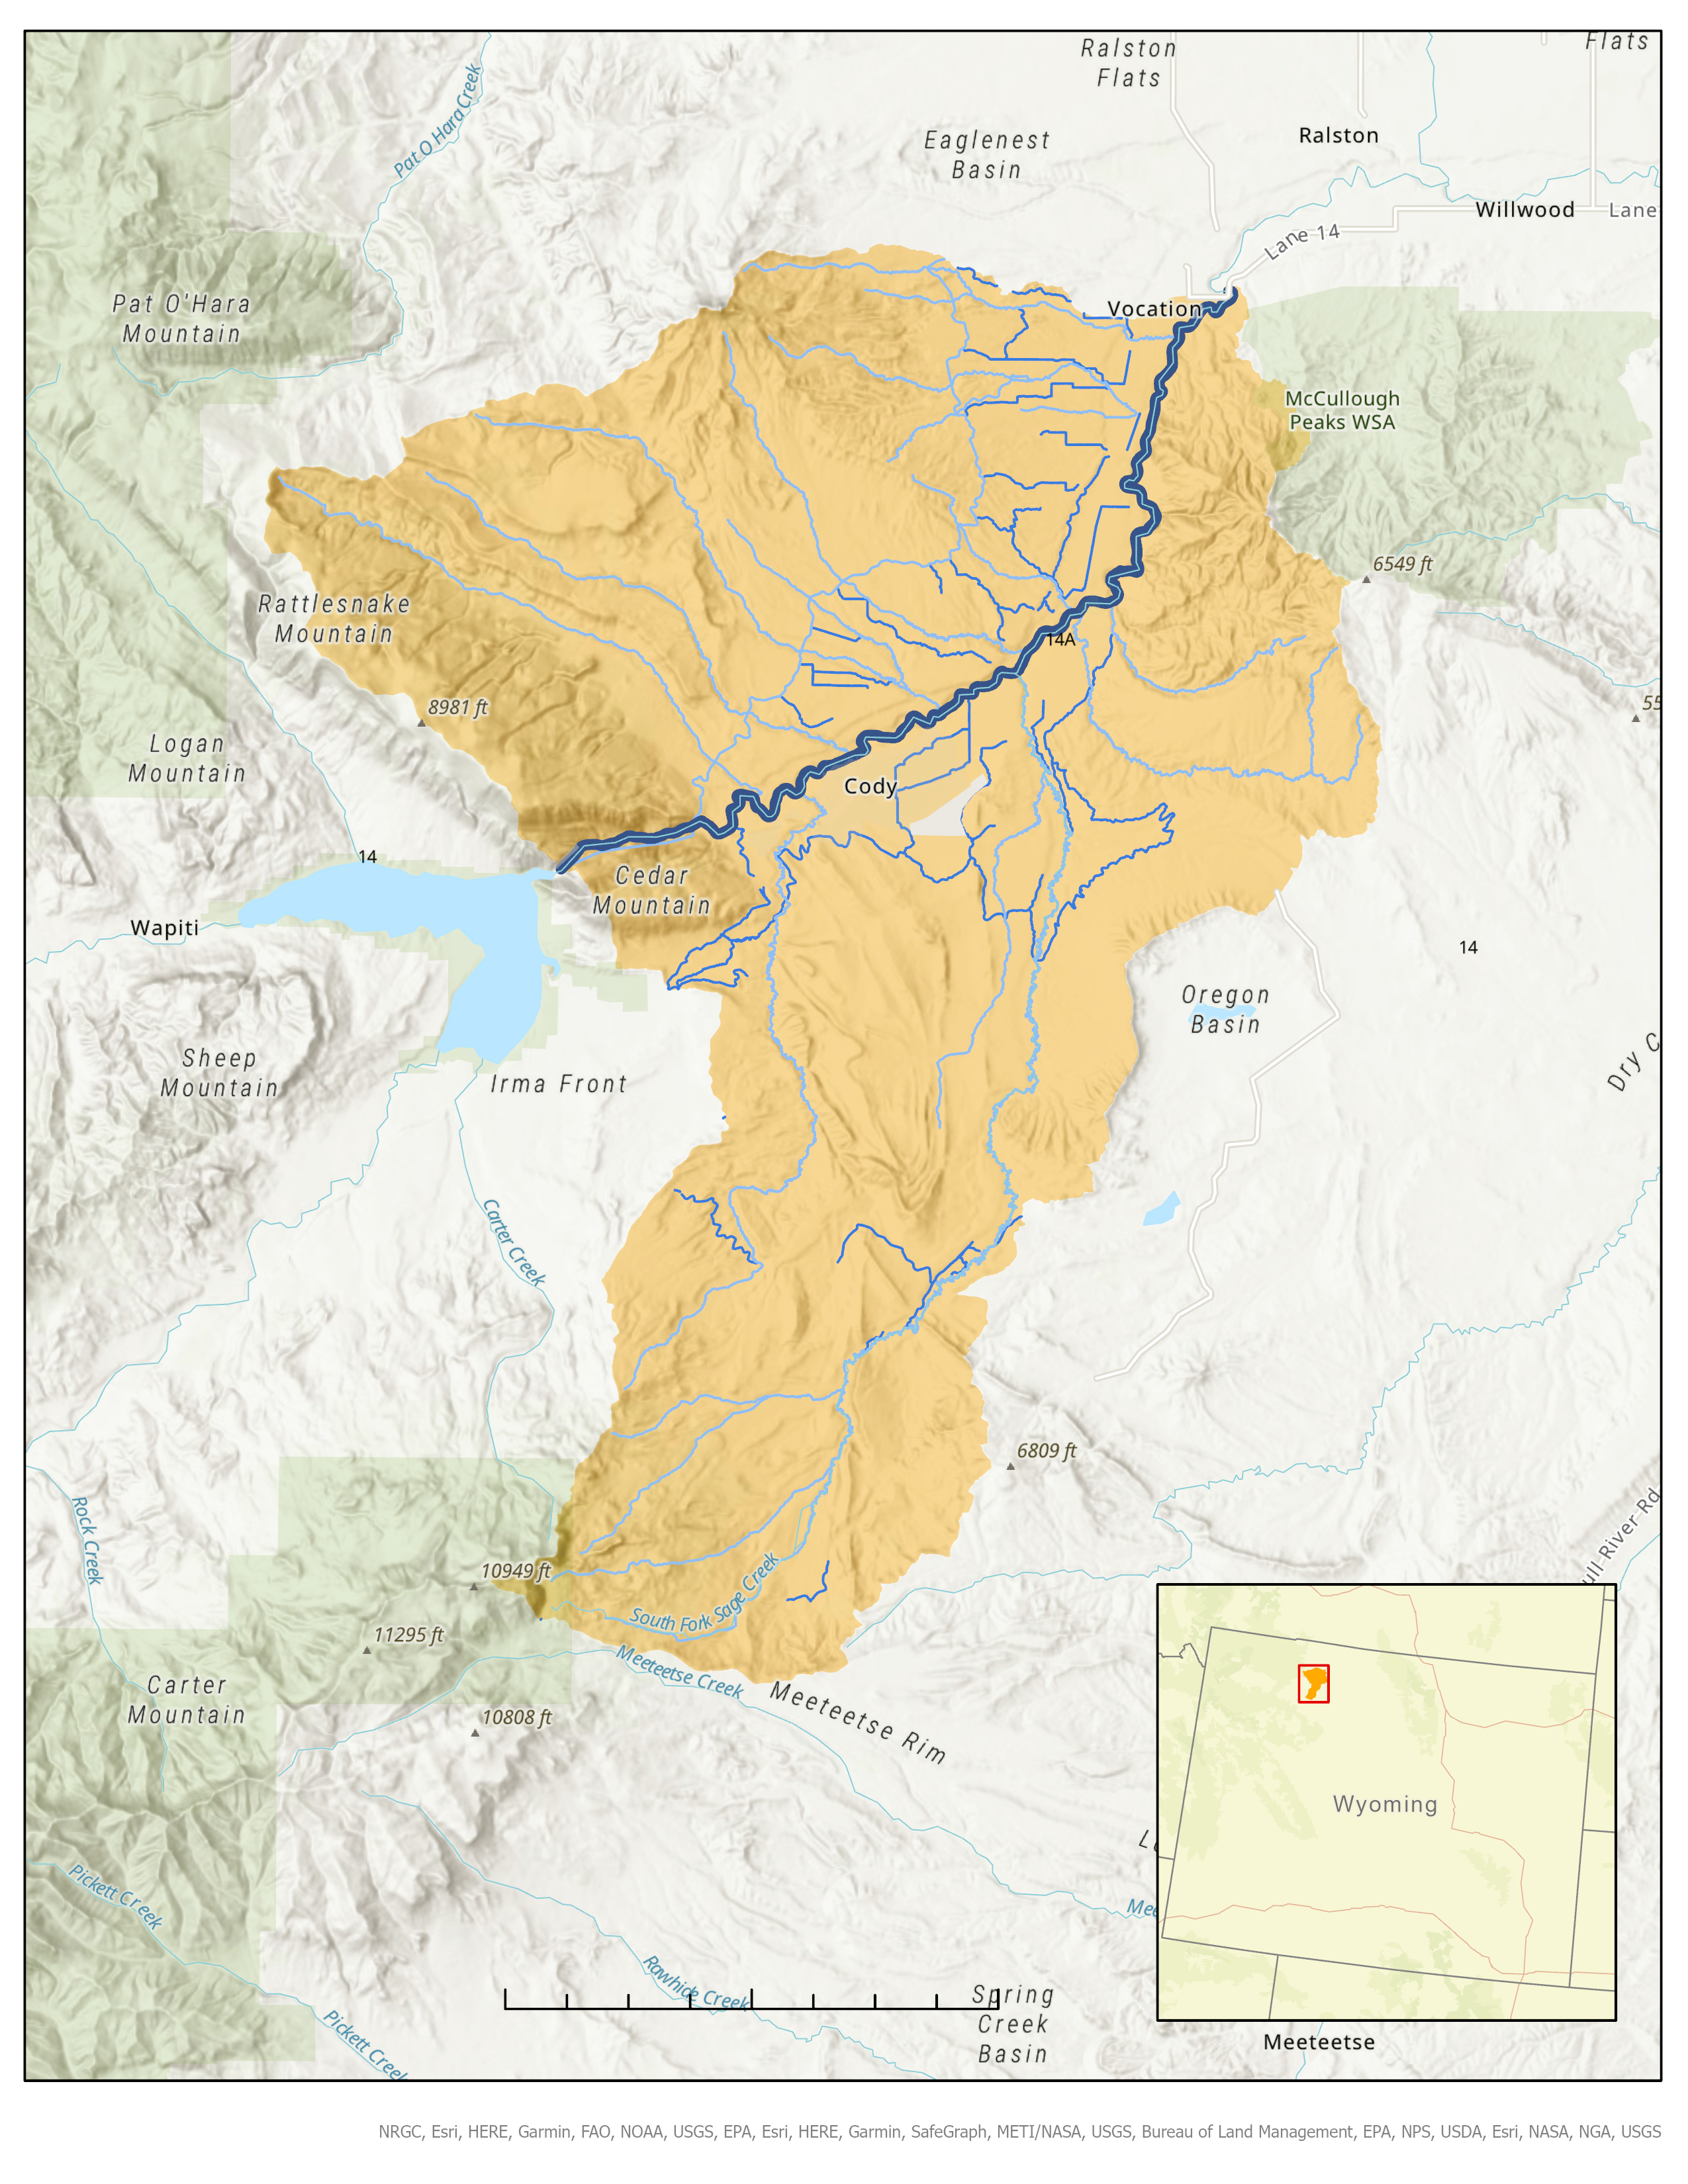


Project Location
Study Area
  Shoshone River
    Buffalo Bill Dam to Willwood Dam
    Tributaries & irrigation canals feed into the river
  Surrounded by mountains
  Annual precipitation: 10.5in
Study Period
  Jan. 2019 – Oct. 2021
    While USGS operated a water monitoring station
Shoshone River
Streams
Canals
Watershed Area
Willwood Dam
2.5
0
5
10 Miles
Basemap Citation: NRGC, Esri, HERE, Garmin, FAO, NOAA, USGS, EPA, Esri, Here, Garmin, SafeGraph, METI/NASA, USGS, Bureau of Land Management, EPA, NPS. USDA, Esri, NASA, NGA, USGS
Notes:
The study area for our project was the portion of the Shoshone River between the Buffalo Bill Dam and Willwood Dam. Several tributaries and irrigation canals feed into the river between the dams, transporting sediment that gets trapped behind Willwood Dam. This project aimed to investigate where sediment was entering the river to reduce the amount of sediment building up behind the dam.
The USGS operated a water monitoring station from January 2019 to October 2021, which is why we chose these dates for our study period. They installed two monitoring stations, one above and below Willwood Dam. For this project we used the USGS in situ gage data from the one above Willwood Dam.
-------------------Image Credits------------------------------
Images and figures created by the DEVELOP team
Basemap Citation: NRGC, Esri, HERE, Garmin, FAO, NOAA, USGS, EPA, Esri, Here, Garmin, SafeGraph, METI/NASA, USGS, Bureau of Land Management, EPA, NPS. USDA, Esri, NASA, NGA, USGS

Slide 3
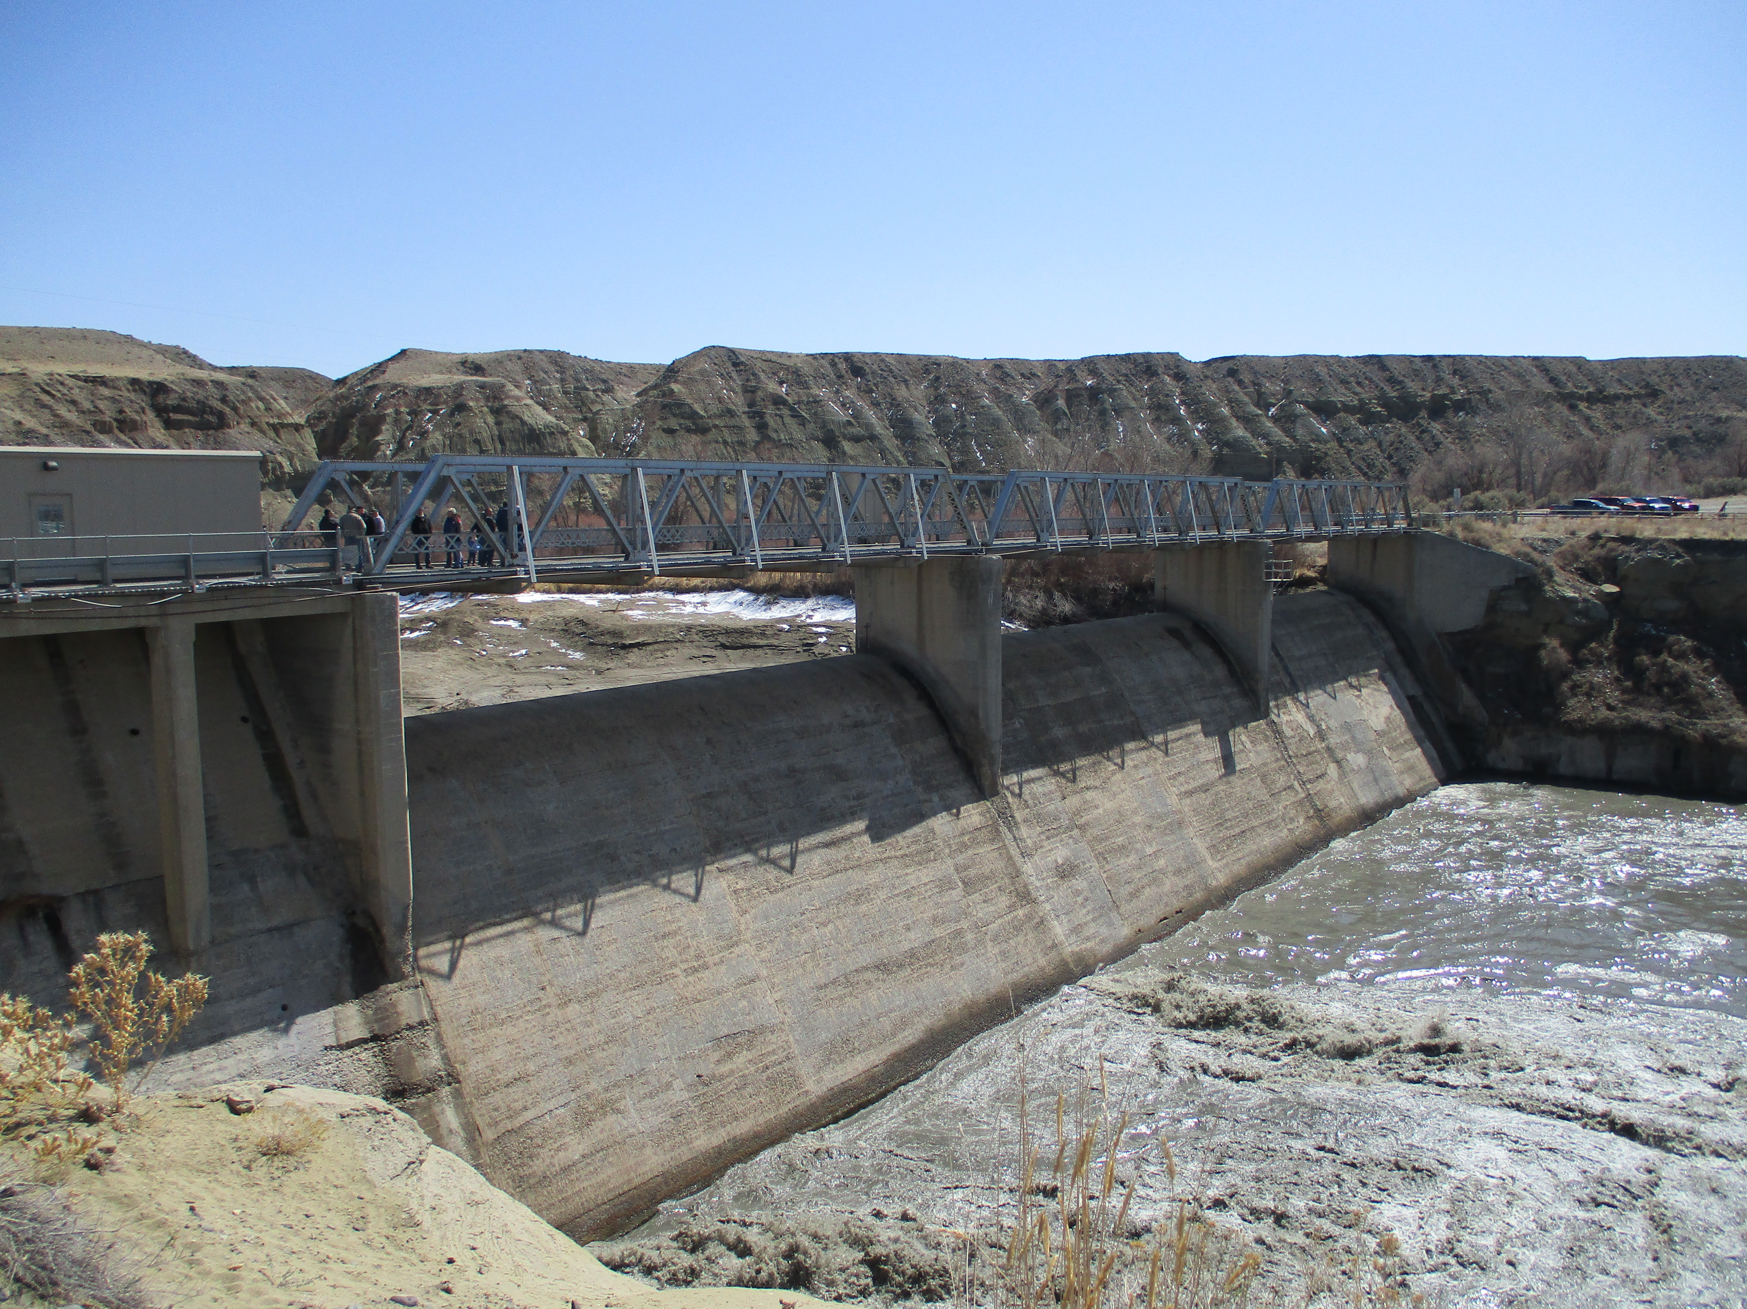
Historical Background
Sediments become trapped behind the Willwood Diversion Dam (WDD)
Heavily concentrated when released, impairs downstream water quality
2016 release prompted the creation of three working groups to address sedimentation in WDD
Image: Carmen McIntyre
Notes:
During routine dam repair operations, the sediment that has accumulated behind the dam gets released. In 2016, a routine repair operation at the Willwood Dam released tons of built-up sediment into the Shoshone River, polluting the river and killing thousands of fish. This release greatly concerned the communities that rely on the river for farming, recreation, and tourism. The 2016 release prompted the Wyoming Department of Environmental Quality (WYDEQ) to create the Willwood Working Groups to implement practices that reduce excess sediment into the Shoshone River.
------------------------------Image Credits ------------------------------
Photo obtained from Carmen McIntyre, used with permission

Slide 4
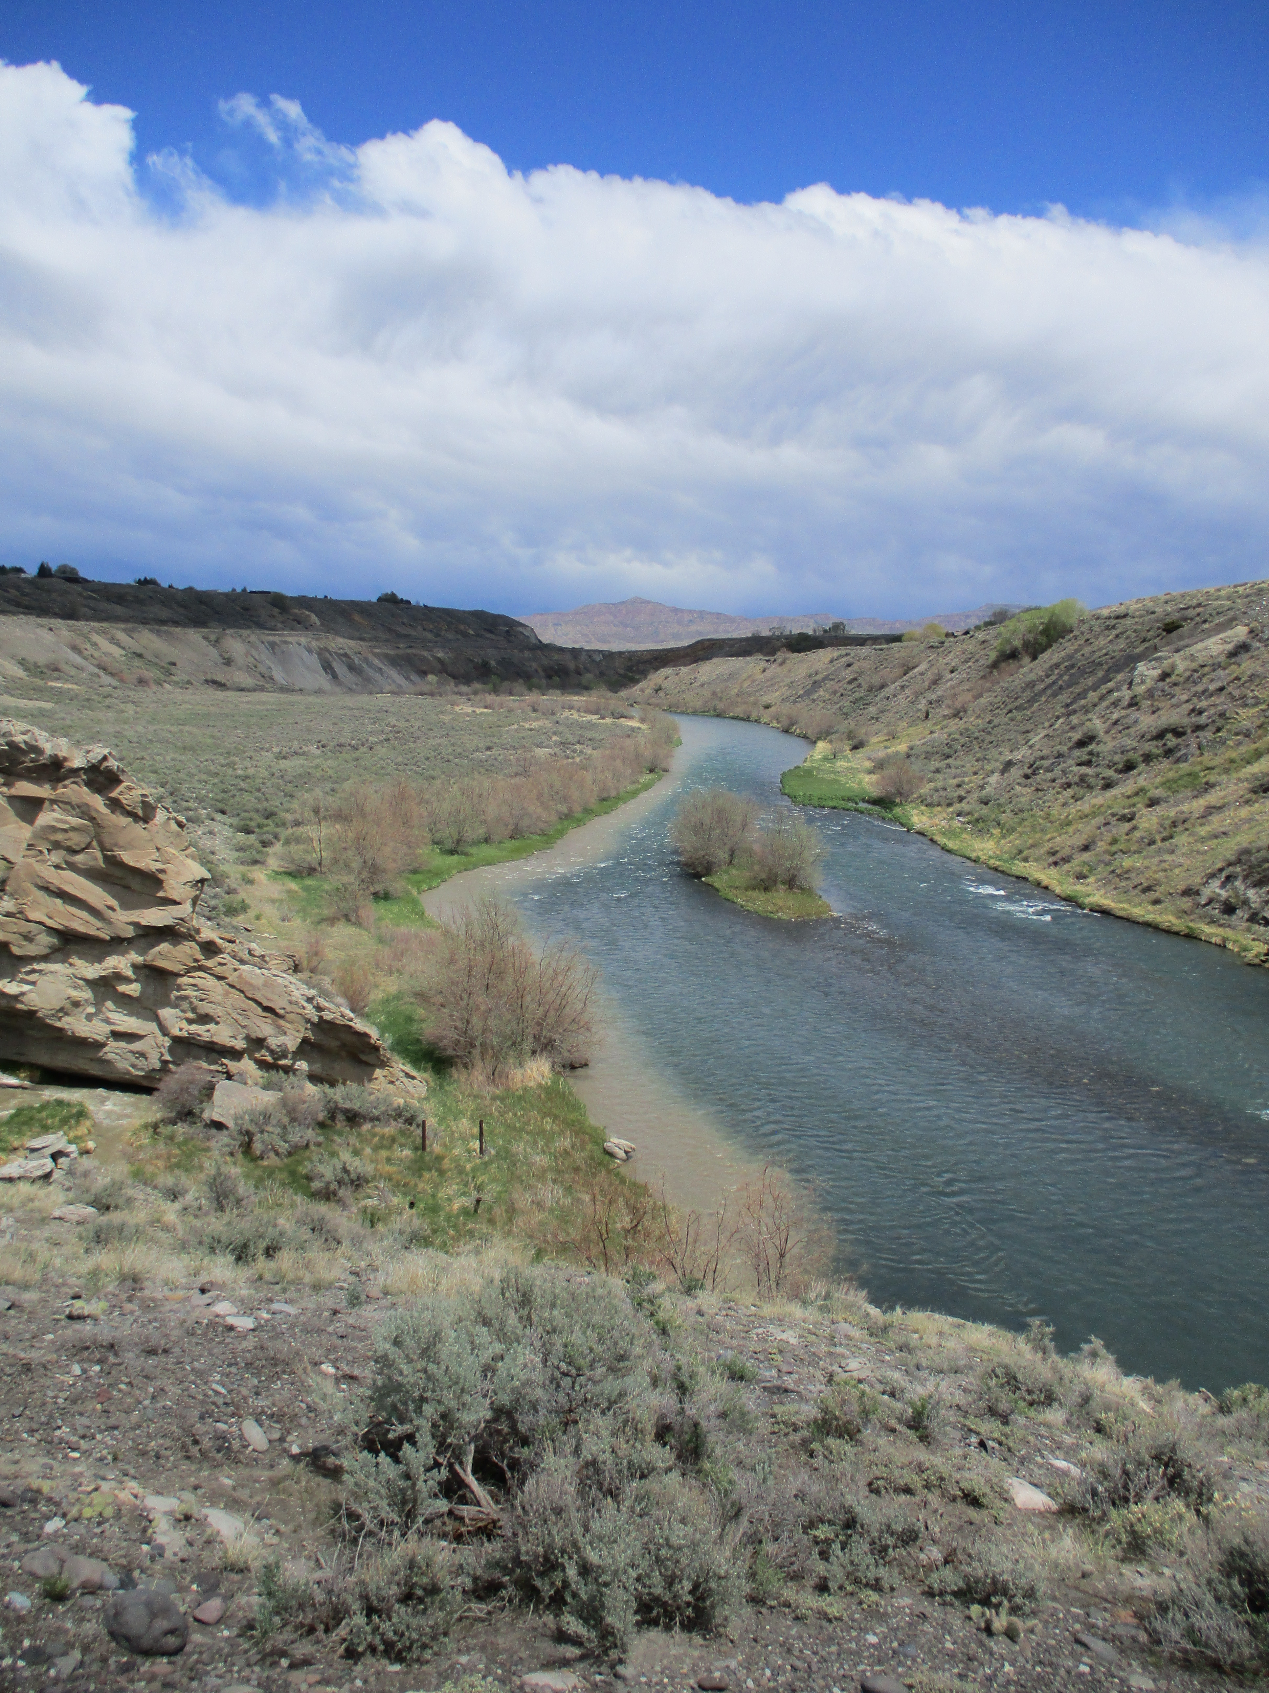
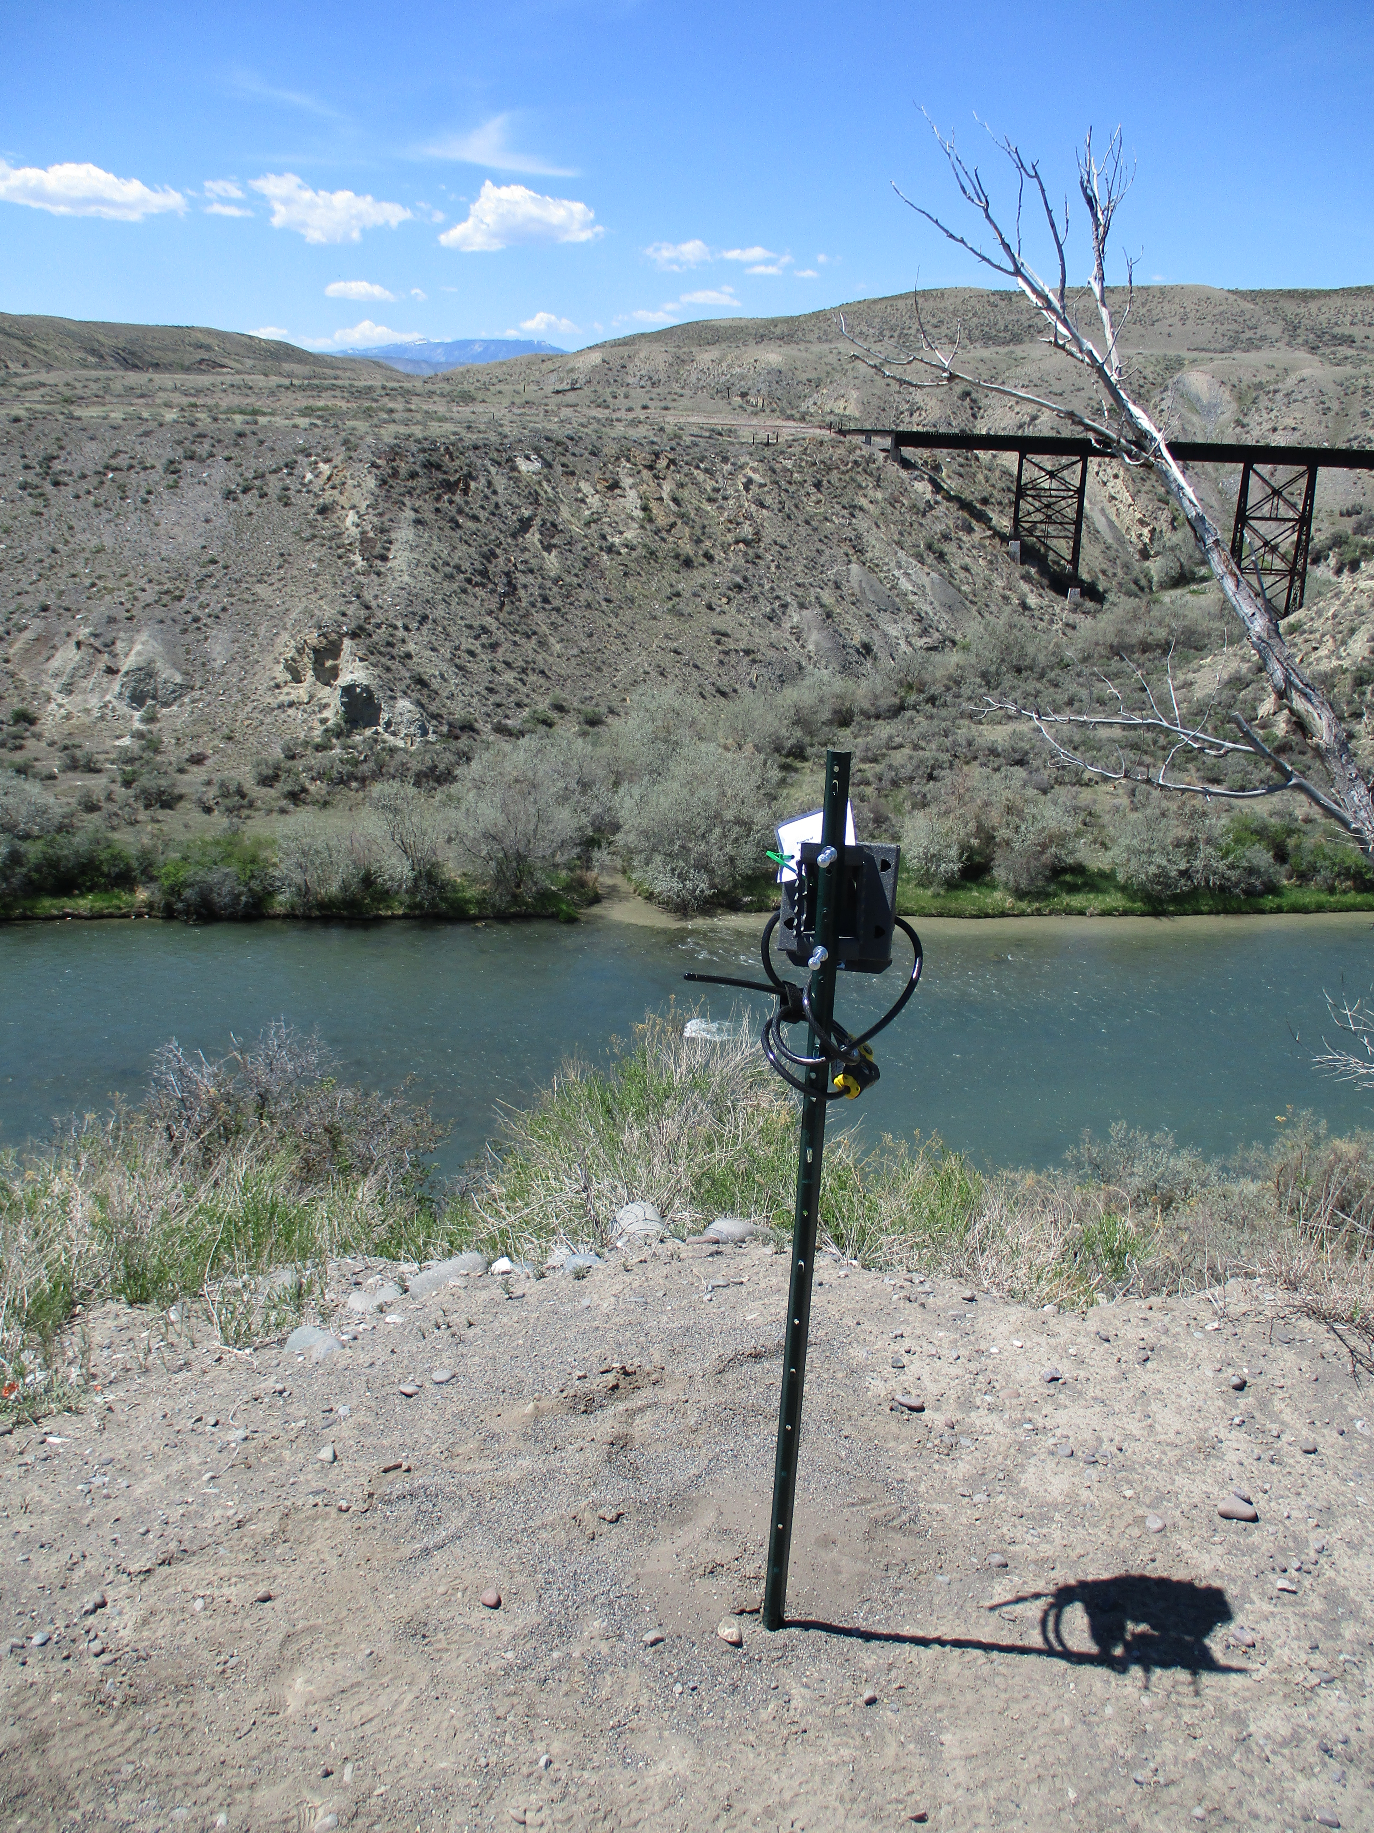
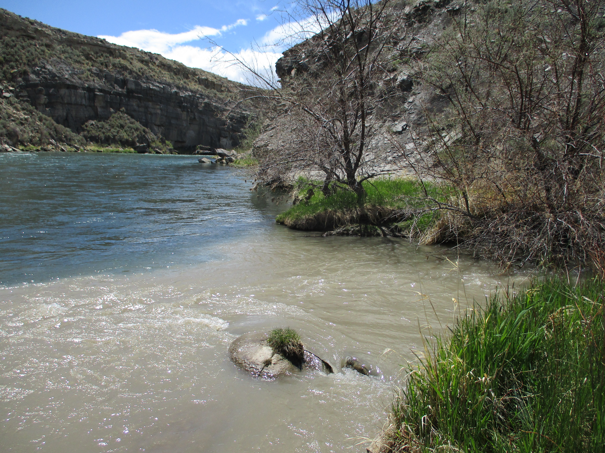
Project Partners
WY Department of Environmental Quality
Shoshone River Partners
USGS MT-WY Water Science Center
David Waterstreet
Carmen McIntyre
Jason Alexander
Watershed Protection Program Manager
Watershed Coordinator
Supervisory Hydrologist
Images: Carmen McIntyre
Notes:
This project partnered with David Waterstreet from the Wyoming Department of Environment Quality, Carmen McIntrye from the Shoshone River Partners, and Jason Alexander from the USGS Montana-Wyoming Water Science Center. David is the manager of the Watershed Protection Program, Carmen's the Watershed Coordinator with the Powell-Clarks Fork Conservation District and the chair of the Shoshone River Partners, and Jason is the supervisory hydrologist with the United States Geological Survey. WYDEC contracted with the USGS to install the monitoring stations to perform real-time monitoring of suspended sediment.
------------------------------Image Credits ------------------------------
Photos obtained from Carmen McIntyre, used with permission

Slide 5



Community Concerns
Ecological
Economic
Quality of Life
Fish spawning habitat
Aquatic insects
Rafting, angling, recreation
Irrigated agriculture
Community member recreation
Notes:
Elevated sediment levels from dam releases have several impacts on the community. The rapid increase in turbidity causes hypoxic conditions for fish and aquatic insects, leading to mass mortality events. These degrade the quality of the ecosystem and lead to economic losses for the industries that rely on fish populations such as commercial fishing charters. The dam also provides water for irrigation, supporting local agriculture. Since excess sediment buildup at the Willwood Dam hinders operations, it affects irrigated agriculture as well. Elevated sediment levels also impact community member recreation such as fishing or rafting.
------------------------------Image Credits ------------------------------
Logos obtained from PowerPoint

Slide 6
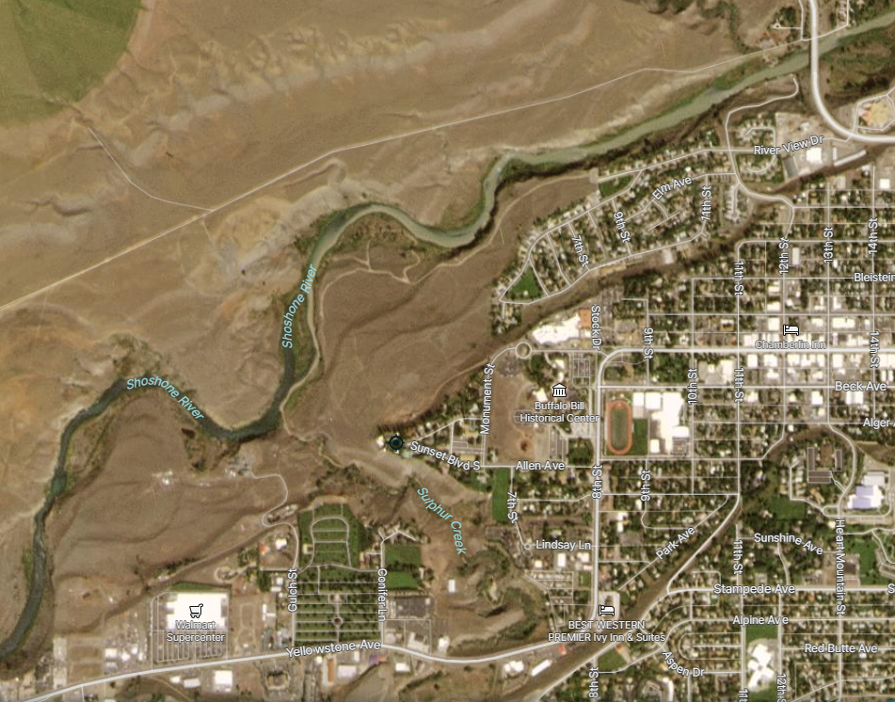
Why remote sensing?
Look at turbidity spatially
Identify sources of sediment to prioritize watersheds for BMPs
Estimate sediment input from inaccessible areas
Sediment joining the river from a tributary
Image: PlanetScope
Notes:
We leveraged remote sensing to address the partner and community concerns from elevated sediment levels. Remote sensing refers to data collected by instruments mounted on satellites or aircraft. If you’ve ever looked at the satellite layer in a maps app, you’re familiar with remote sensing data! Watershed managers have historically relied on in-situ turbidity data and time-lapse photography to identify tributaries contributing high amounts of sediment to the Shoshone River. These methods provide excellent quality data for specific locations but lack the ability to look at the whole river at once. Remote sensing presents a unique opportunity to look at turbidity spatially. Identifying tributaries with a high sediment load using remote sensing allows watershed managers to prioritize the implementation of best management practices (BMPs), such as stream restoration and riparian fencing. This can help identify sources of sediment in order for the partners to allocate their limited time and funding effectively.
-------------------Image Credits------------------------------
Image source PlanetScope (September 12, 2019)

Slide 7
Project Objectives
Create categorical sediment contribution maps indicating priority tributaries
Conduct precipitation analysis to better understand runoff events
Analyze which land cover types are correlated with high turbidity
Image: Carmen McIntyre
Notes:
The primary objective was to create a categorical sediment contribution map for contributing watersheds and tributaries along the Shoshone River. To accomplish this goal, the team used geospatial precipitation data and in-situ gage data to identify storm events that had the potential to increase sediment loading. The team supplemented the categorical map with a precipitation trends analysis and land cover analysis to consider the effects of these variables on sediment loading.
-------------------Image Credits------------------------------
Image of the Shoshone River provided by Carmen McIntyre, Shoshone River Partners.

Slide 8
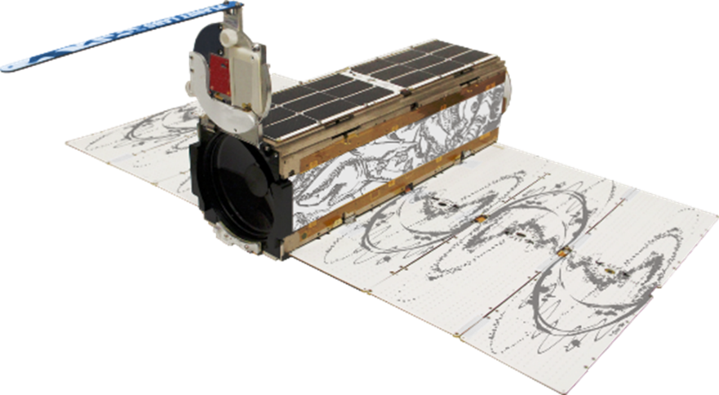
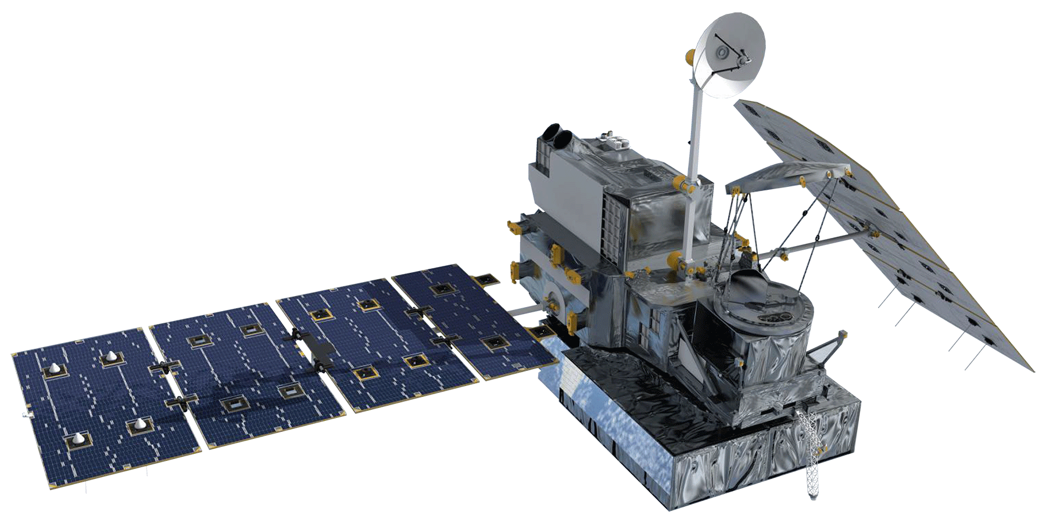
Earth Observations
PlanetScope
GPM IMERG
4 band (RGBn) imagery
3m resolution
Daily
Precipitation estimations
10km resolution
Daily
Images: NASA; Planet Labs PBC
Notes:
For our analyses, we used PlanetScope data to look at turbidity and NASA'S GPM IMERG for precipitation. PlanetScope consists of approximately 130 satellites that capture the entirety of Earth's surface every day. We chose this to investigate turbidity in the Shoshone River due to its high spatial (3m resolution) and temporal resolution.
GPM IMERG uses NASA's GPM satellite collection to estimate precipitation over Earth's surface. Although the spatial resolution was lower than PlanetScope's, the temporal resolution allowed us to look at precipitation on a daily basis.
------------------------------Image Information Below ------------------------------
•PlanetScope Image Credit: Planet Labs PBC used with permission
•GMP Imerg Image Credit: NASA (DEVELOPedia )
•Image Source: https://www.devpedia.developexchange.com/dp/index.php?title=List_of_Satellite_Pictures#/media/File:08_GPM.png

Slide 9
Sensing Turbidity
Light bounces off suspended sediment particles, increasing reflection
Change in reflection differs across the light spectrum
Images: Carmen McIntyre
Notes:
Turbidity is essentially a measure of light scatter. Remote sensing can measure turbidity because satellite imagery is able to pick up on the change in reflection. The change in reflectance depends on the concentration of suspended sediment though the amount of change in reflectance varies across the electromagnetic spectrum.
-------------------Image Credits------------------------------
Images of clear and turbid water provided by Carmen McIntyre, Shoshone River Partners.

Slide 10




Methods
Download
Trim & Merge
Turbidity Index
Extract & Analyze
Notes:
For our analyses, we downloaded PlanetScope images of the Shoshone River between the dams from January 2019 to October 2021. We then trimmed the satellite images to the Shoshone River by using a polygon shapefile created by tracing the river in ArcGIS Pro. We merged the trimmed satellite images together to create a holistic cutout of the river. We then had to sort out an equation that would meaningfully translate reflectance to turbidity. This involved calibrating reflectance with measured turbidity values collected by USGS. We’ll go more into detail on this step later. Finally, we extracted turbidity from spots along the river to try to determine spatial trends.
For the precipitation analysis, we downloaded GPM IMERG data for our study period. We compared daily precipitation estimates to mean daily turbidity collected from the USGS monitoring station above Willwood Dam.
------------------------------Image Credits ------------------------------
Icons obtained from PowerPoint

Slide 11
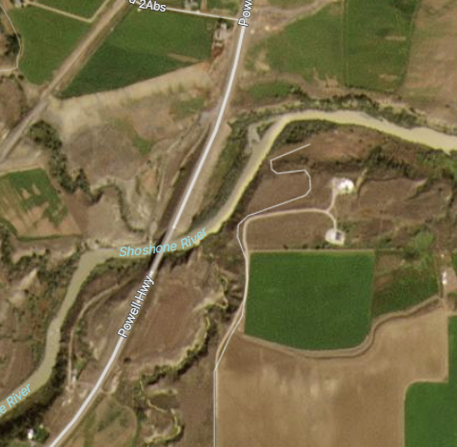
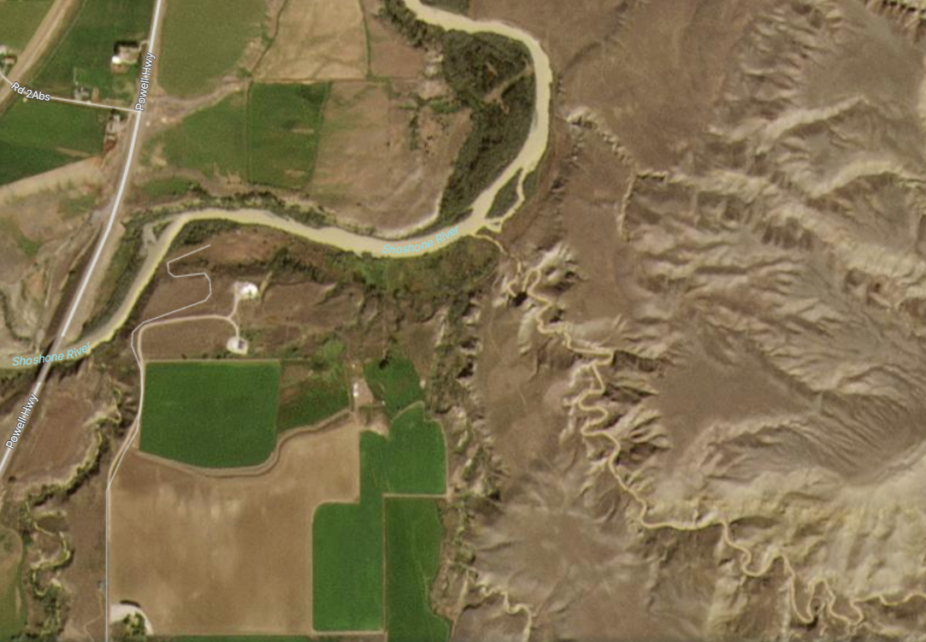
Results: Empirical Study
PlanetScope Imagery
Sulphur Creek
(Upper Watershed)
Dry/Homesteader Creek (Middle Watershed)
Penney Gulch
(Lower Watershed)
Notes:
To first verify the feasibility of using PlanetScope data to observe turbidity, we looked through the satellite data to see if we could identify any tributaries clearly contributing sediment. Using precipitation data and the USGS gage data, we identified dates of high precipitation and turbidity to narrow down our search.
Based on our empirical results, we found that Sulphur Creek, Dry/Homestead Creek, and Penny Gulch had the highest sediment loading following precipitation events. We then sought to verify these findings with established turbidity indices, or equations.
------------------------------Image Information Below ------------------------------
•Image Source: PlanetScope Images captured on September 12, 2019

Slide 12
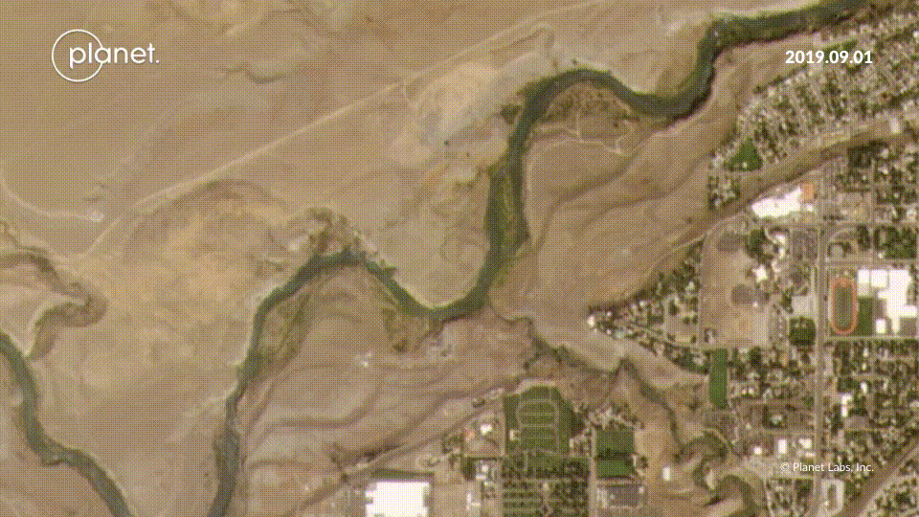
Sulphur Creek Example
PlanetScope Imagery
Notes:
As you can see here, there's a clear sediment plume coming in from Sulphur Creek. These images were taken in September 2019.
------------------------------Image Information Below ------------------------------
•Image Source: PlanetScope https://www.planet.com/stories/sulphur-creek-drainage-sep-12-2019-pRwTGmD4g

Slide 13
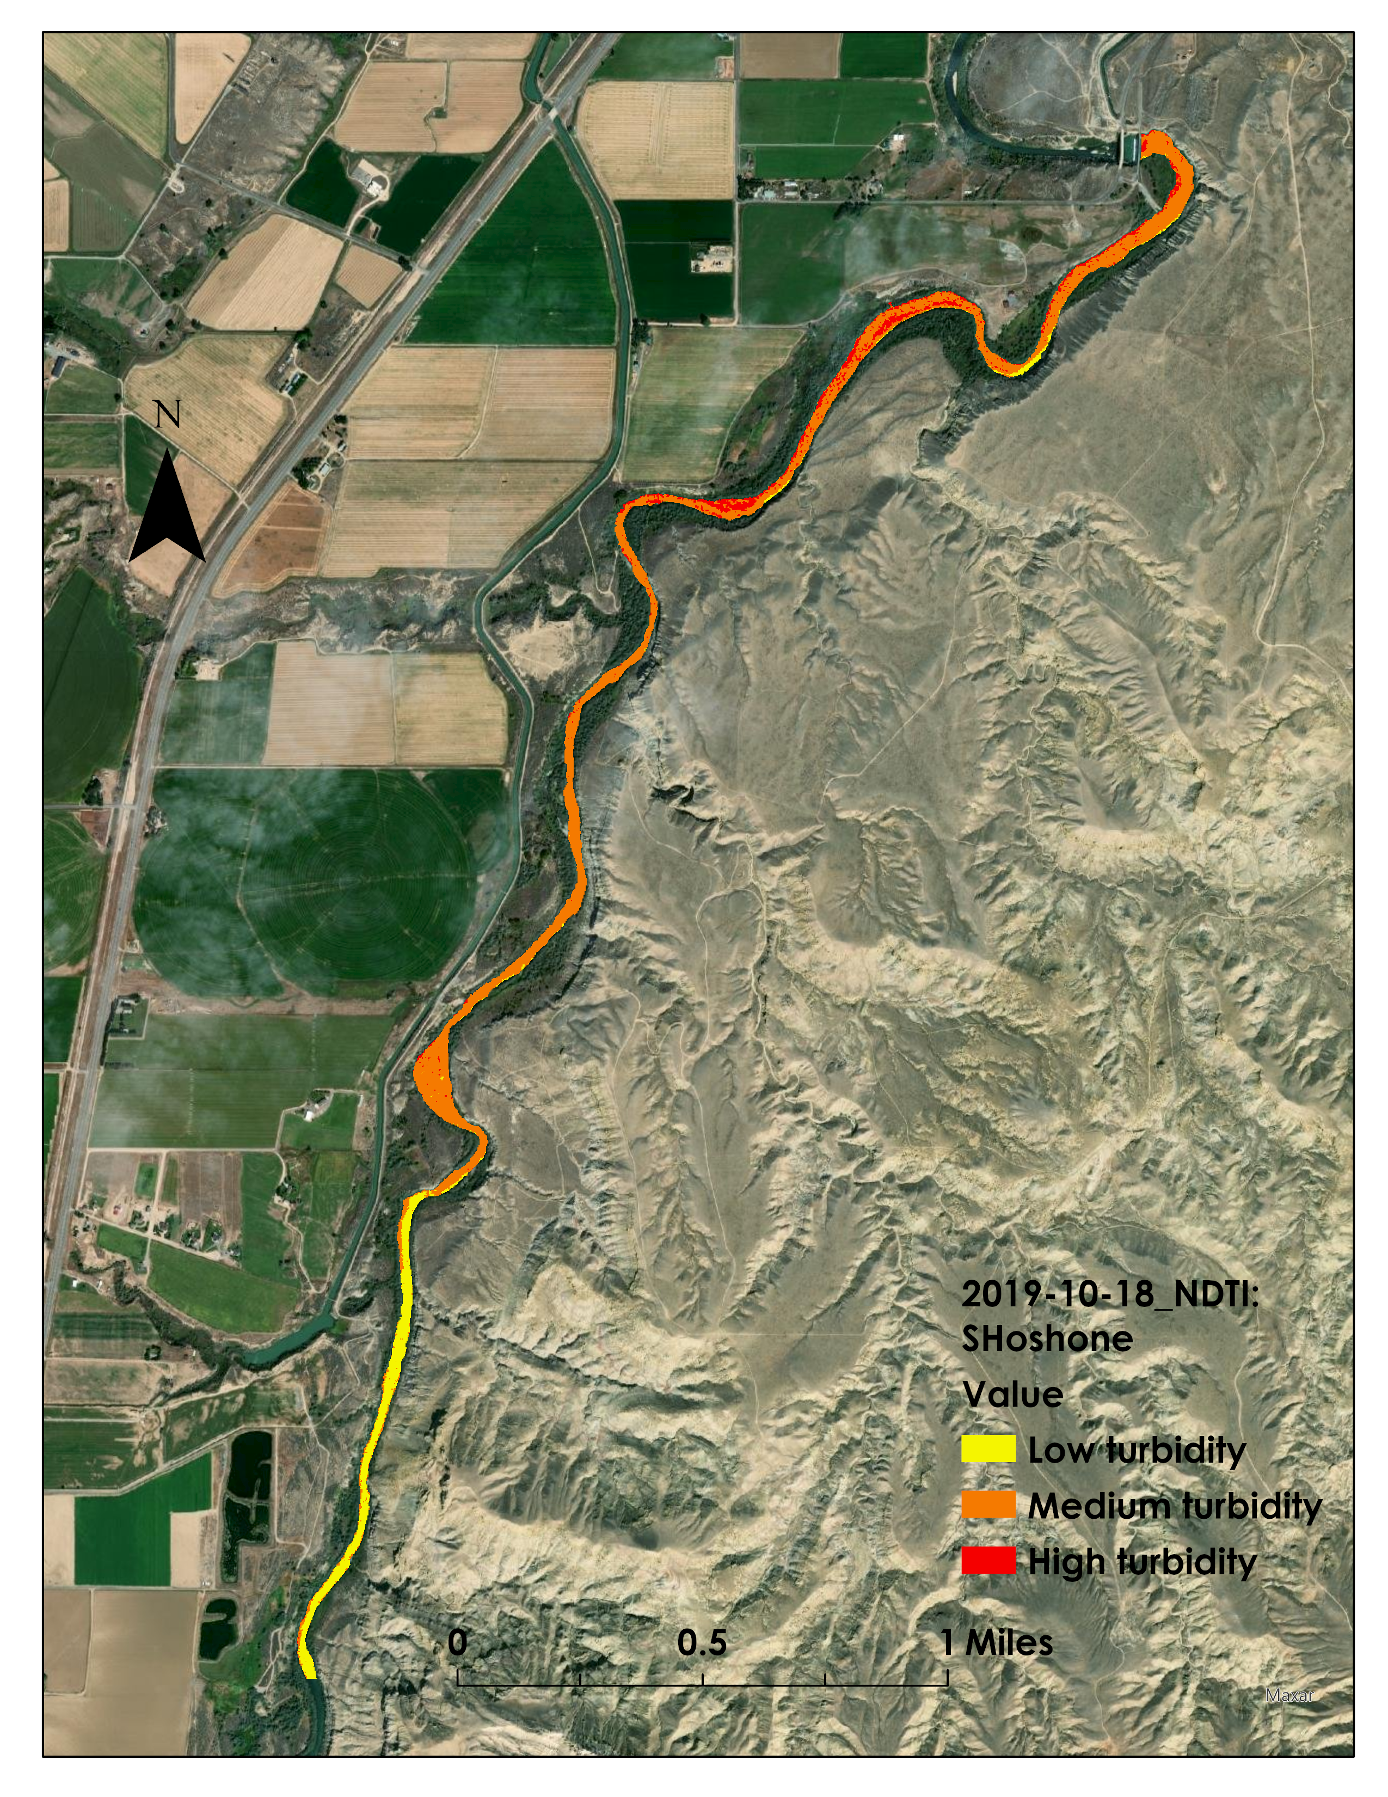
Results: Sediment Contribution Map
Turbidity change along part of the Shoshone River: Low, Moderate, High, based on a high storm day

Slide 14
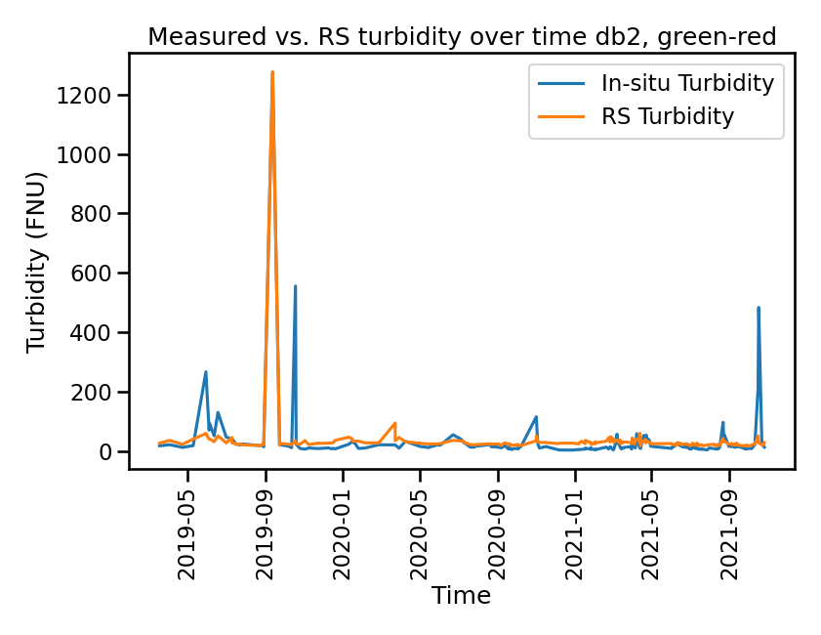
Results: Turbidity Calibration
Measured Turbidity vs. Remotely Sensed Turbidity
Calibrated reflectance to in-situ turbidity
T = green / (a + b * red)
  a = 0.0473
  b = - 0.165
  (r2 = 0.70)
Turbidity (FNU)
Time
NDTI = (Red – Green) / (Red + Green)
Notes:
Just looking at images can give really great spatial information about turbidity, however, it's also possible to go a step further and roughly quantify turbidity spatially. You can do this through an equation than relates reflectance to turbidity, however, since reflectance properties of sediment vary based on the local soils, it works best if you develop an equation specifically for your study area. We calibrated coefficients by using an optimization function to minimize the difference between calculated turbidity and turbidity measured at the USGS gauge around the same time as the image was taken. After testing multiple combinations of bands and equations, we found that a combination of red and green bands gave the best prediction of turbidity. Specifically green over a plus b times red where green and red are normalized to the total daily reflectance. This gave an r2 value of 0.70. It should be noted, however that even though this relationship did an excellent job of modeling the largest spike in turbidity, other high turbidity days were significantly underestimated.
We also used the Normalized Difference Turbidity Index (NDTI) which aims to provide a relative look at turbidity across a system without attempting to assign measurements.
-------------------Image Credits------------------------------
Images and figures created by the DEVELOP team

Slide 15
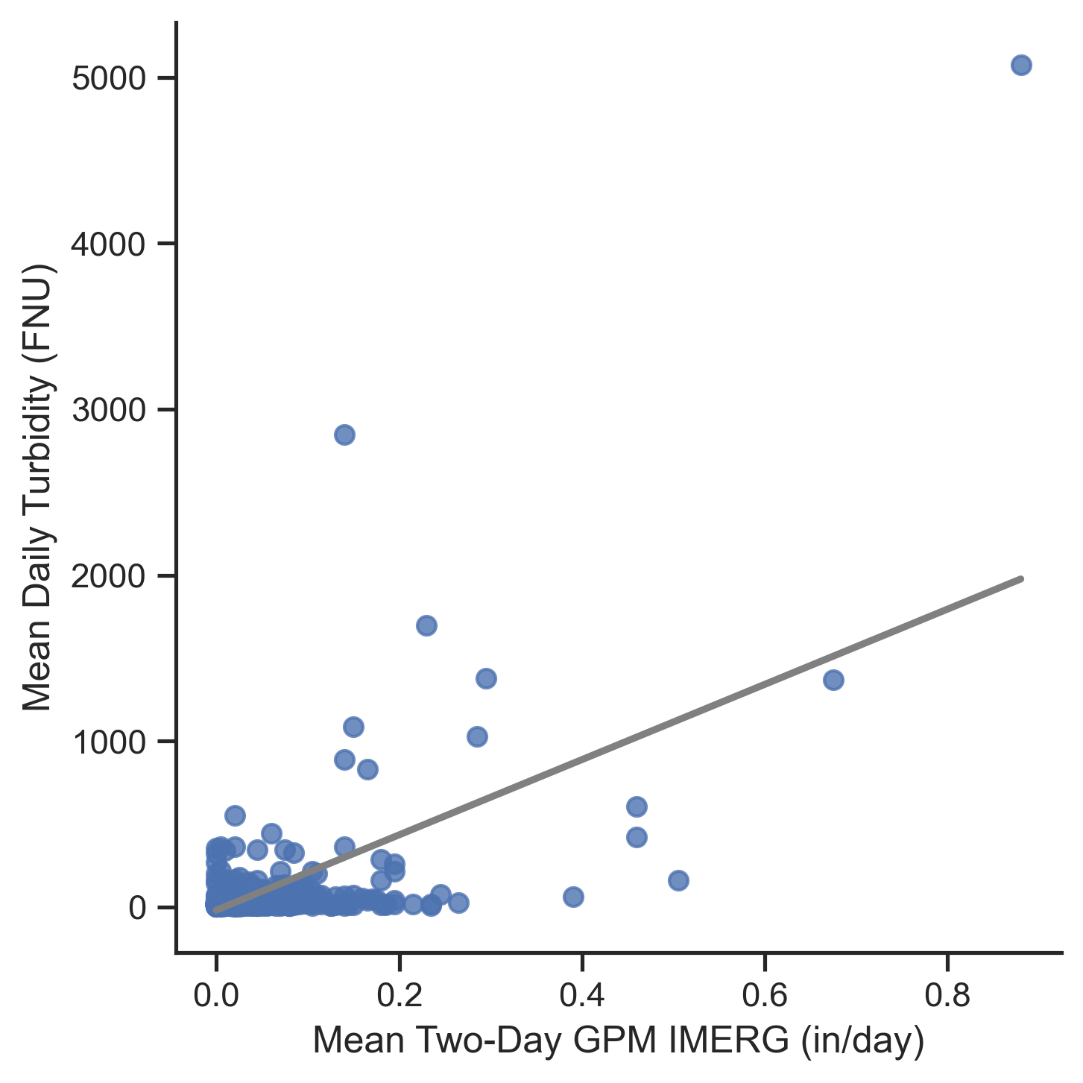
Results: Precipitation Analysis
GPM IMERG Averaging Time | R², without snowmelt influence (Apr to Oct) | R², entire study period
None | 0.37 | 0.34
Two-Day | 0.61 | 0.57
Three-Day | 0.59 | 0.56
r = 0.61
Notes:
We used GPM IMERG data for our precipitation data. This table shows the averaging time in days. We looked at the correlation between GPM IMERG data (in in/day) against the mean daily turbidity from the USGS monitoring station above the Willwood Dam. We filtered the study period to April through October to remove the influence of snowmelt. We found that the highest correlation occurred using a two-day mean on the precipitation data in this timeframe.
-------------------Image Credits------------------------------
Figures created by the DEVELOP team

Slide 16
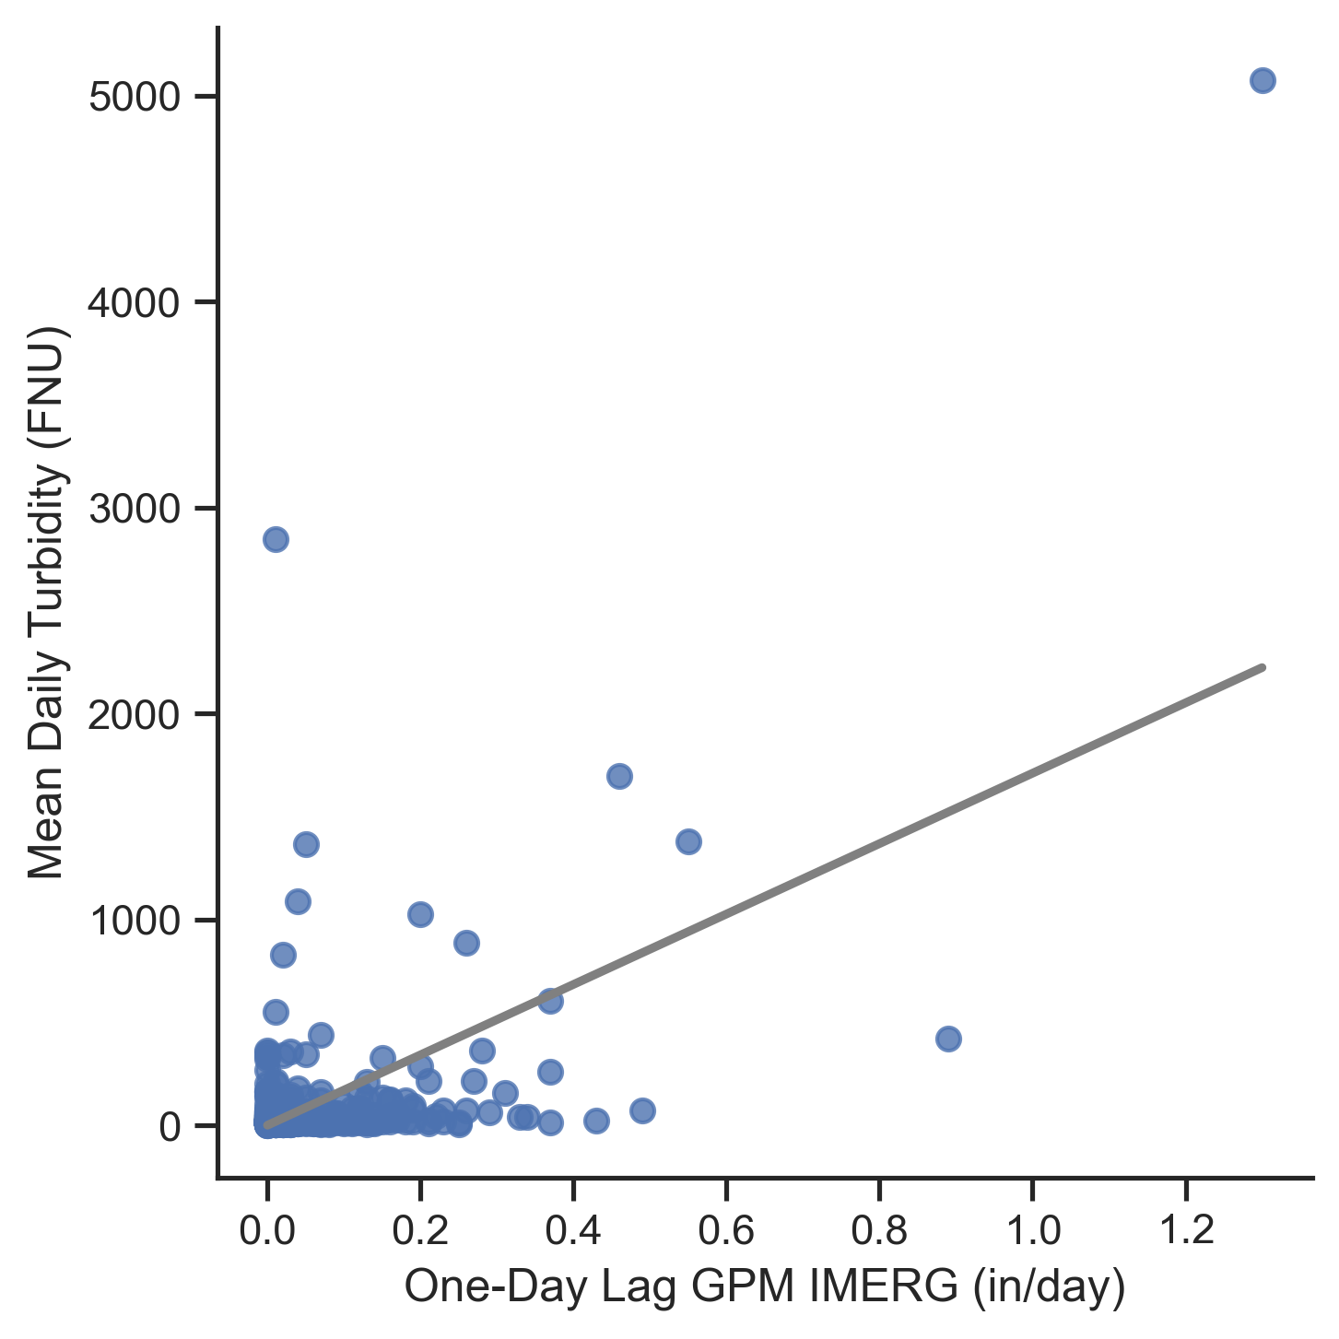
Results: Precipitation Analysis
GPM IMERG Lag Time​ | R², without snowmelt influence (Apr to Oct) | R², entire study period
One-Day | 0.59 | ​0.55
Two-Day | ​0.23 | ​0.22
Three-Day​ | ​0.10 | ​0.09
r = 0.59
Notes:
This table uses the same data as the previous slide, except we used a one-day, two-day, three-day time lag on the GPM data (in other words, using the previous day or day's measurements). We found the highest correlation when using a one-day lag between the months of April through October. This finding is consistent with a two-day mean having the highest correlation, as this indicates that sediment takes at least a day to be observed in the river following rainfall.
-------------------Image Credits------------------------------
Images and figures created by the DEVELOP team

Slide 17
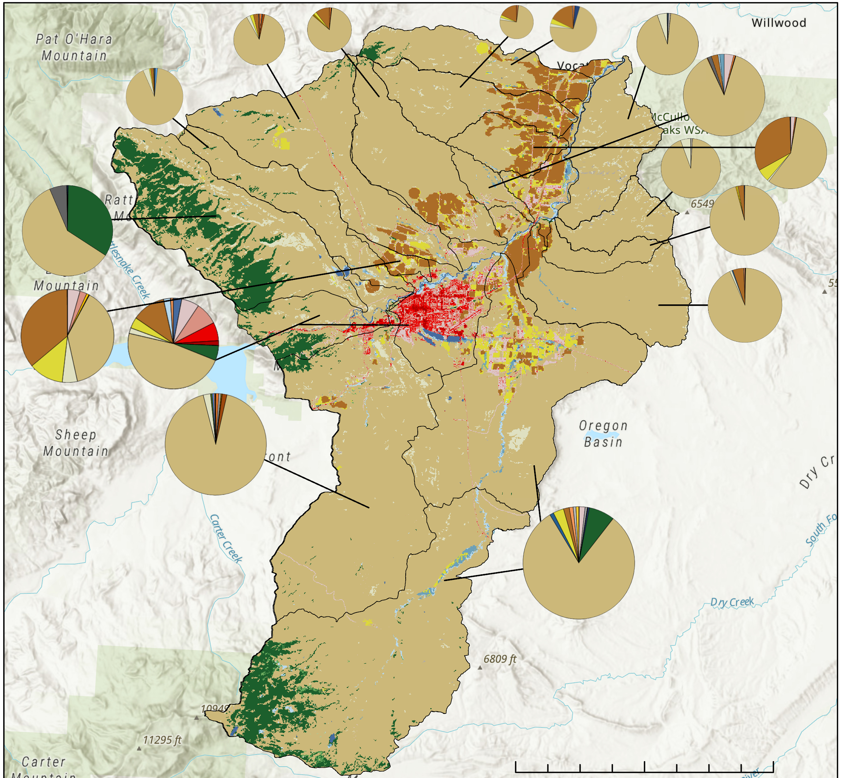
Results: Land Cover Analysis
Dominant land cover types are:
  Shrub/scrub
  Cultivated crops
Open Water
Developed, Open Space
Developed, Low Intensity
Developed, Med. Intensity
Developed, High Intensity
Deciduous Forest
Evergreen Forest
Shrub/Scrub
Hay/Pasture
Mixed Forest
Cultivated Crops
Herbaceous
Woody Wetlands
Emergent Herb. Wetlands
Barren Land
0
2.5
5
10 Miles
Basemap Citation: Esri, HERE, Garmin, SafeGraph, METI/NASA, USGS, Bureau of Land Management, EPA, NPS, USDA, Esri, NASA, NGA, USGS
Notes:
This map shows the sub-watersheds in the area with their land cover classification. We derived land cover types from the National Land Cover Dataset (NLCD). We found the majority of land cover types were shrub/scrub.
-------------------Image Credits------------------------------
Images and figures created by the DEVELOP team
Basemap Citation: Esri, HERE, Garmin, SafeGraph, METI/NASA, USGS, Bureau of Land Management, EPA, NPS, USDA, Esri, NASA, NGA, USGS

Slide 18
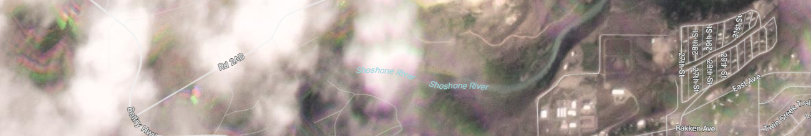

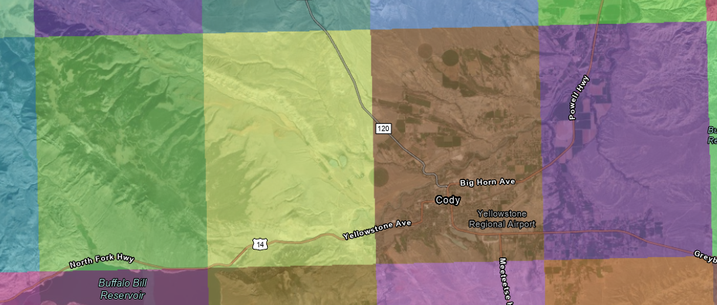
Limitations and Uncertainties
Often missed storm runoff events because of clouds
Spectral data quality
Spatial resolution of precipitation data (10km)
Notes:
During the analyses, we faced some limitations. We often missed information right after a rainfall event because it was still cloudy.
We faced challenges when working with the PlanetScope data, most notably the spectral data quality. We attributed bad data readings to the atmospheric corrections that Planet Labs makes to the images. It was also hard to pick up small plumes in the data even with its high spatial resolution.
GPM IMERG didn't have a high enough spatial resolution to analyze precipitation patterns at a sub-basin scale. Each colored rectangle on the righthand image shows the spatial extent of the image.
-------------------Image Credits------------------------------
Images obtained from PlanetScope data
Map Citation: GPM IMERG (2021), Esri, HERE, Garmin, SafeGraph, GeoTechnologies, Inc, METI/NASA, USGS, Bureau of Land Management, EPA, NPS, USDA, Earthstar Geographics

Slide 19
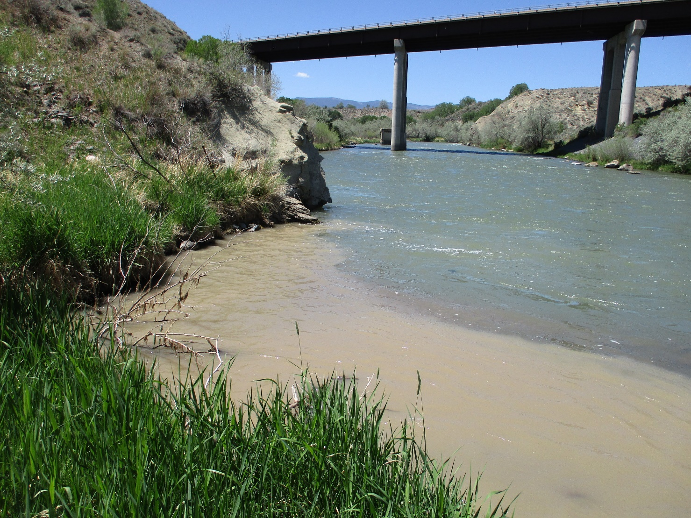
Conclusions
Remote sensing allows watershed managers to investigate sources of turbidity spatially
Sediment plumes from small tributaries were clearly visible on multiple days
PlanetScope data provided a spatial resolution suitable for looking at a small river, but the spectral resolution may have caused challenges with data analysis
Image: Carmen McIntyre
Notes:
This project showed the potential for high spatial and temporal resolution data such as planetscope to be used to look at turbidity spatially along small rivers. We were able to identify multiple plumes caused by tributaries with high turbidity joining the Shoshone river. This is relevant to watershed mangers looking to identify sources of sediment and would allow for targeted best management practices along watersheds contributing a high sediment load. While the high spatial and temporal resolution was helpful, the lower quality spectral signature caused issues finding a consistent relationship between turbidity and reflectance across the entire study period. A future term will be furthering this project by considering turbidity events caused by snowmelt runoff.
-------------------Image Credits------------------------------
Image of the Shoshone River provided by Carmen McIntyre, Shoshone River Partners.

Slide 20
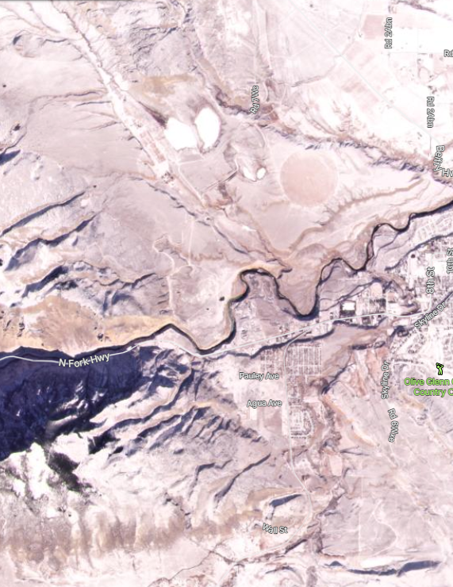
Future Work
Project will be continued during a 2nd term:
  Investigate turbidity during snowmelt season
  Soil Water Assessment Tool (SWAT) Hydrologic Model
  Quantitative turbidity
PlanetScope Imagery
Notes:
The second term of this project can expand on our findings and the limitations we encountered. The team will analyze the influence of large snowfall and melt events on sediment contributions during the snowmelt season (October through April). There is also a possible opportunity to explore precipitation patterns at sub-basin scale with a precipitation dataset that has a higher spatial resolution than GPM IMERG. The team will use the Soil Water & Assessment Tool (SWAT) to further explore sediment trends in the Shoshone River. An additional objective is to quantify the amount of sediment from each tributary. The anticipated end products will include snow cover analysis maps as well as quantitative sediment contribution maps.
-------------------Image Credits------------------------------
Image source Planet Explorer (January 2021)

Slide 21
A special thank you to our Science Adviser and Fellow:
Dr. Austin Madson (University of Wyoming, Assistant Professor)
Caroline Williams (NASA DEVELOP, Fellow)
We would also like to thank our project partners for their input and guidance:
David Waterstreet (WYDEQ)
Carmen McIntyre (WYDEQ, Shoshone River Partners)
Jason Alexander (USGS)
Thank you to the WyGISC department for hosting us!
Notes:
Once again, thank you so much for attending our presentation. Before we close, our team would like to give a huge thanks to our adviser, Austin, and our fellow, Caroline, as well as our partners David, Carmen, and Jason. We would also like to thank Austin and the WyGISC department for hosting us this term at the Pop-Up location! Thank you all for your contributions, and with that, we will open the floor for any questions.

Slide 22
Backup Slides

Slide 23
Sensing Turbidity
NDTI = (Red – Green) / (Red + Green)
Red
Spatial Turbidity Map
Legend
Green
Notes:
-------------------Image Credits------------------------------
Images of clear and turbid water provided by Carmen McIntyre, Shoshone River Partners.

Slide 24
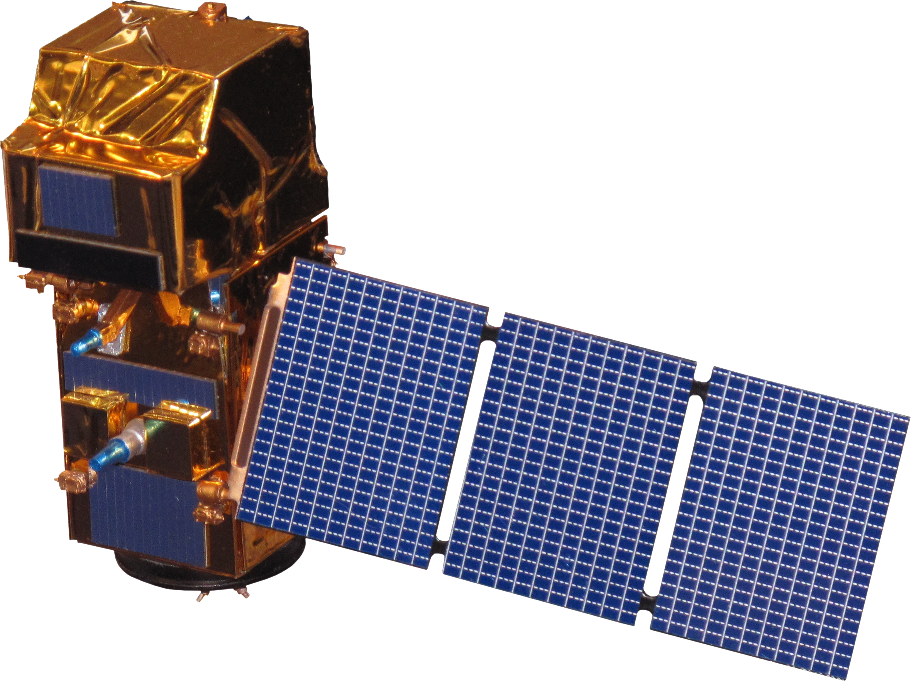
Earth Observations
PlanetScope
GMP IMERG
Sentinel-2 MSI
4 band (RGBn) imagery
3m resolution
Daily
Precipitation
8-band imagery
10m resolution
Images: NASA; ESA, Planet Labs PBC
Notes:
We used Sentinel-2 MSI data to extract turbidity values along the river.
------------------------------Image Information Below ------------------------------
•PlanetScope Image Credit: Planet Labs PBC, used with permission
•Image Source: https://www.flickr.com/photos/nasa2explore/12468114213/in/set-72157629601396498 (Public Domain, image processed in Word to remove background)
•GMP Imerg and Sentiel-2 MSI Source: DEVELOPedia

Slide 25
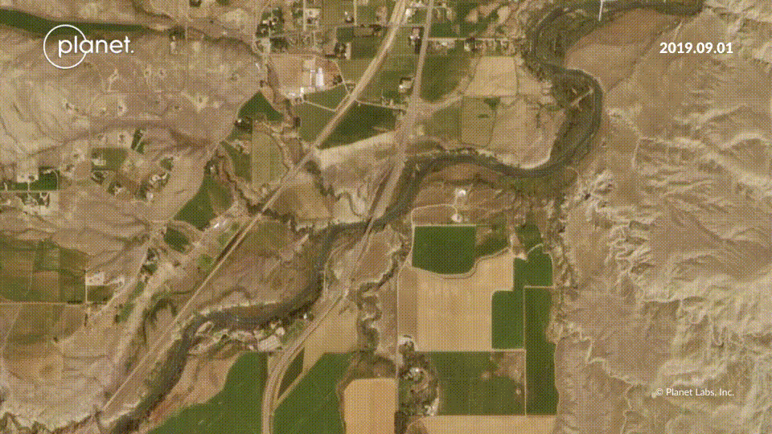
Results: Dry/Homesteader Creek
PlanetScope Imagery
Notes:
You can see where the sediment starts to enter the river at the orange arrow.
------------------------------Image Information Below ------------------------------
•Image Source: PlanetScope https://www.planet.com/stories/dry-homesteader-creek-sep-12-2019-7TDQniDVR

Slide 26
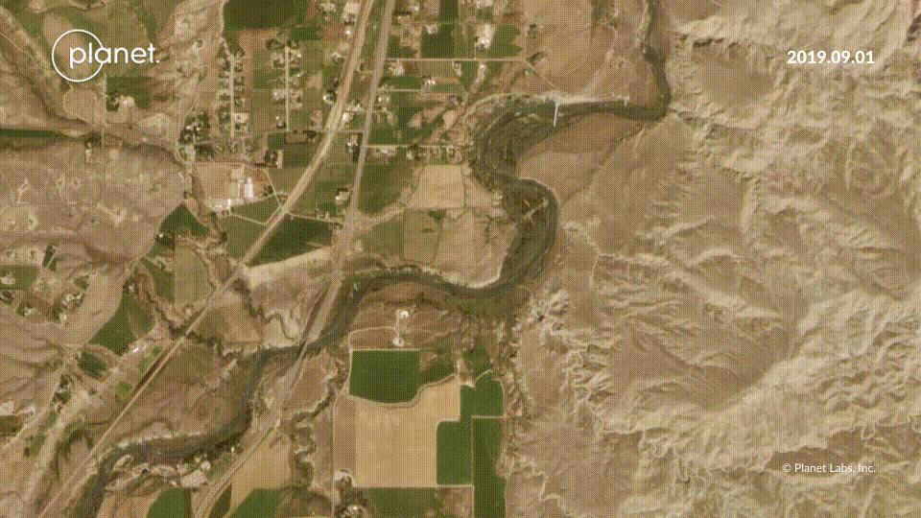
Results: Penney Gulch
PlanetScope Imagery
Notes:
You can see the sediment coming down from McCullough Peaks into the river.
------------------------------Image Information Below ------------------------------
•Image Source: PlanetScope https://www.planet.com/stories/penney-gulch-sep-12-2019-bO6NVmDVR

Slide 27
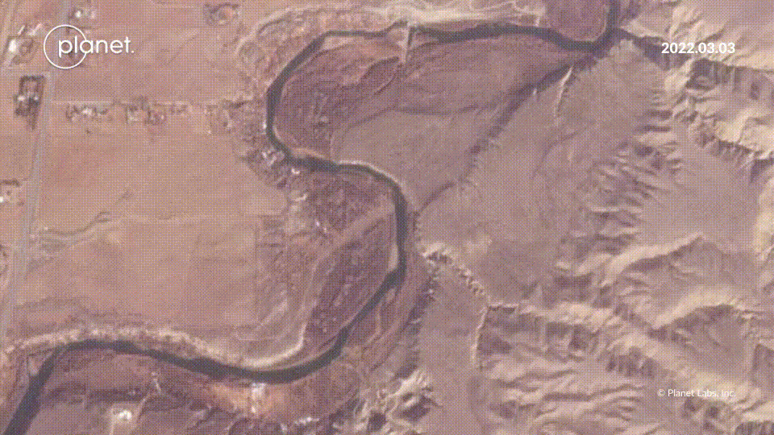
PlanetScope Imagery
Notes:
Penny Gulch in 2022 with clear sediment plume.

Slide 28
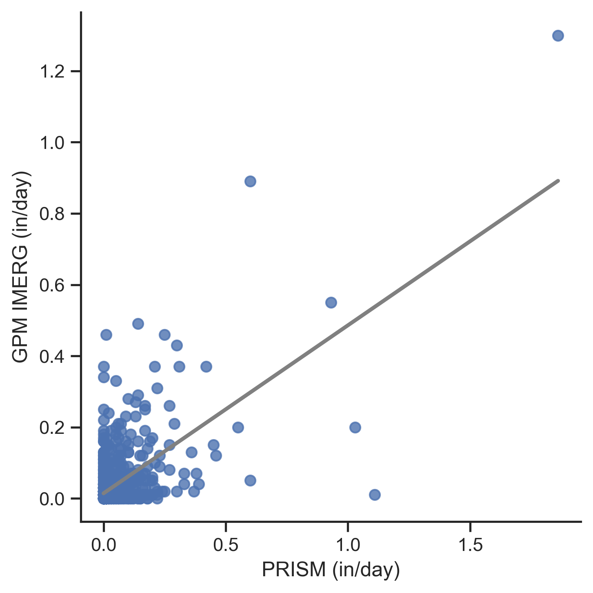
Results: Precipitation Analysis
GPM and PRISM are comparable
Notes:
GPM IMERG and PRISM data are comparable in this region.

