Slide 1
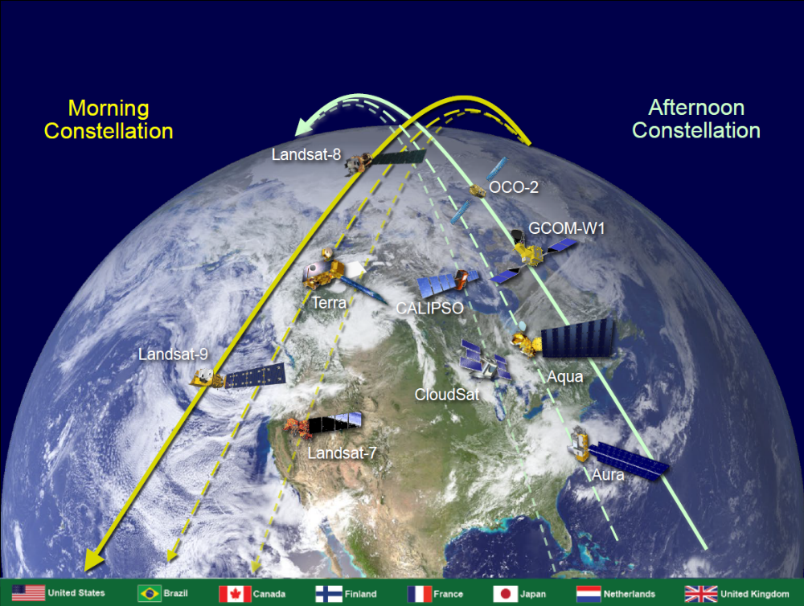
International Earth Science Constellation (ESC)
INTRODUCTION
INTRODUCTION
Michael J. Machado
Constellation Mission Operations Manager
Mission Validation and Operations Branch – Code 584
Earth Science Mission Operations (ESMO) Project – Code 428
NASA/Goddard Space Flight Center

Slide 2
Welcome
Welcome to all the members and invited guests of the Mission Operations Working Group (MOWG) of the International Earth Observing Constellations!
Special thanks to Mark Heigh, Cindy Leaper, Nancy Herndon, and Bill Guit for helping with this 5th Virtual MOWG meeting.
Thanks to everyone who is supporting in person
Appreciate those supporting the hybrid format at unusual hours due to being in a different time zone
Welcome to our guests and first-time attendees
THANK YOU as always for your support!
Notes:
Claire Parkinson (Aqua Project Scientist) is here to show Satellite Observations of Climate Change. This year Aqua marked a 15-year anniversary!
Some changes since last meeting (New faces or people returning):
Cheryl Yuhas is retiring; Greg Dell currently assigned as Program Executive
PJ Guske moved on: Mark Garcia new OCO-2 Project Manager
CALIPSO: Denis Perriot moved to a new position; Claude Audouy now head of the Application Mission Operation division; Franck Darnon took over as CALIPSO Mission Operations Manager
Landsat 9 attendees:
Don Dichmann here to observe and learn for LandSat 9 ascent planning
Del Jenstrom & Steve Pszcolka here to present Landsat 9
Flight Dynamics: Shane Stezelberger and Thomas Noyes
CARA: Dave Adams (Goddard Space Asset Protection Lead)
ESA: Kate Symonds
SNPP/S5P: Jose Davis & Bryan Mattfeld

Slide 3
Earth Science Mission Operations (ESMO)
External Matrix Support
FSW: Bob Lutz
FDF: Samuel Schreiber
CARA: Lauri Newman
CRMS: Matt Duncan (SpaceNav)
MOA: Russ DeHart
Project Manager
Wynn Watson
Deputy Project Manager – Operations
Jamie Pawloski
Deputy Project Manager – Technical
Eric Moyer
Deputy Project Manager – Resources
Tracy Parlate
Project Scientists
Earth Observing System (EOS) Senior Project Scientist & A-Train Project Scientist: Steven Platnick
Aqua: Claire Parkinson
Deputy - Lazaros Oreopoulos
Aura: Bryan Duncan
Deputy – Nick Krotkov
Terra: Kurt Thome
Deputy - Si-Chee Tsay
Deputy – Robert Wolfe
Project Admin
Selene Annadale
Diane Trakas
Project Support
Vickie Lopez
Ground Systems Manager
Shampa Wali
Ground Systems Deputy:
Phillip Caffo
Mission Directors / Managers
Aqua: Bill Guit
Aura: Bill Guit
Terra: Dimitrios Mantziaras
GPM/GEDI: Tony Scaffardi
ICESat-2: James Jaranyi &
Vacant
TSIS-1: Eric Moyer (acting)
POES/MetOP: Vacant
IT Security
Darnell Kemper
Chris Mishaga
EDOS: Terri Wood
Networks: Kevin Kranacs
Flight Dynamics
EOS Operations & Analysis Manager: Tiffany Hoerbelt
EOS Deputy: Becky Mesarch
Software Development (CCS): Tiffany Hoerbelt
Constellation Support
Mark Heigh
Earth Science Constellation Manager
Mike Machado
Notes:
Ask all teams for org charts

Slide 4
MOWG Charter
The Constellation mission teams
enable nearly simultaneous
science observations by
coordinating their operations and
cooperating with each other to
ensure the safety of the constellations.

Slide 5
Constellation History
A-Train Mission Operations Working Group (MOWG): Exploratory discussions between LaRC (John Stadler) and GSFC (Angie Kelly, Bill Guit and Lauri Newman) in 2002. Officially met for the first time in March 2003 – MOWG 20-Year Anniversary in March 2023!
Morning Constellation: Officially began with Landsat 7 (April 1999) and Terra (December 1999), followed by joint EO-1/SAC-C launch (November 2000)
Afternoon Constellation (A-Train): Began with the Aqua (May 2002) and Aura (July 2004), then PARASOL (December 2004), and joint CALIPSO/CloudSat launch (April 2006)
Later ESC missions followed:
  OCO (2010) and Glory (2011) launches failed
  GCOM-W1 (May 2012), Landsat 8 (February 2013), OCO-2 (July 2014), Landsat 9 (September 2021) successfully reached orbit
Formation of the C-Train:
  CloudSat exited A-Train on February 22, 2018
  CALIPSO exited A-Train in mid-September 2018
  C-Train operational orbit configuration achieved on November 1, 2018
More Constellation Exits
  Aqua begins free-drift, drag down approach in January 2022 with eventual constellation exit
  Terra executes Constellation Exit Maneuvers October 2022
Major Milestone Anniversaries:
  Landsat 8 10-years (February 11, 2023)
Notes:
As missions get older and use up fuel we need to help determine how the A-Train evolves; afternoon presentations will help show what is possible
TanSat launched above us and could join the A-Train
Landsat 7 investigates refueling and hope to overlap with Landsat 9

Slide 6
Significant Meeting Topics
NASA Headquarters Perspective
Terra, Aqua, Aura Drifting Orbits Workshop summary
Current State of the Missions
  Morning and Afternoon Constellations mission status including C-Train status
  Review Afternoon Constellation Inclination Adjust Maneuver (IAM) plans for 2023
  Updates to Aqua passing events with Constellation members
  Terra Constellation Exit Maneuver (CEM) series results
  Aqua/Aura/Terra (Earth Observing System) mission Perigee Lowering Maneuver (PLM) schedule including Aura CEM plan

Slide 7
Possible EOS In-guide Perigee Lowering Maneuver (PLM) Schedule
 | Sun | Mon | Tue | Wed | Thu | Fri | Sat
September 2023 | September 3 | 4 Holiday | 5 Aura CEM | 6 | 7 Aura CEM | 8 | 9
 | 10 | 11 | 12 | 13 | 14 | 15 | 16
 | 17 | 18 | 19 Aura PLM | 20 | 21 Aura PLM | 22 | 23
 | 24 | 25 | 26 Aura PLM | 27 | 28 Aura PLM | 29 | 30
October 2023 | October 1 | 2 | 3 Aura PLM | 4 | 5 Aura PLM | 6 | 7
 | 8 | 9 Holiday | 10 Aura PLM | 11 | 12 Aura PLM | 13 | 14
 | 15 | 16 | 17 Aura PLM | 18 | 19 Aura PLM | 20 | 21
 | 22 | 23 | 24 Aura PLM | 25 | 26 Aura PLM | 27 | 28
 | 29 | 30 | 31 | November 1 | 2 | 3 | 4
November 2023 | 5 | 6 | 7 Aqua PLM | 8 | 9 Aqua PLM | 10 Holiday | 11
 | 12 | 13 | 14 Aqua PLM | 15 Passivate Aura | 16 Aqua PLM | 17 | 18
 | 19 | 20 | 21 | 22 | 23 Holiday | 24 | 25
 | 26 | 27 | 28 Aqua PLM | 29 | 30 Aqua PLM | December 1 | 2
December 2023 | 3 | 4 | 5 Aqua PLM | 6 | 7 Aqua PLM | 8 | 9
 | 10 | 11 | 12 Aqua PLM | 13 | 14 Aqua PLM | 15 | 16
 | 17 | 18 | 19 Aqua PLM | 20 | 21 Aqua PLM | 22 | 23
 | 24 | 25 Holiday | 26 | 27 | 28 Aqua PLM | 29 | 30
 | 31 | January 1 | 2 | 3 | 4 Aqua PLM | 5 | 6
January 2024 | 7 | 8 | 9 Terra PLM | 10 Passivate Aqua | 11 Terra PLM | 12 | 13
 | 14 | 15 Holiday | 16 Terra PLM | 17 | 18 Terra PLM | 19 | 20
 | 21 | 22 | 23 Terra PLM | 24 | 25 Terra PLM | 26 | 27
 | 28 | 29 | 30 Terra PLM | 31 | February 1 Terra PLM | 2 | 3
Feb 2024 | 4 | 5 | 6 | 7 Passivate Terra | 8 | 9 | 10

Slide 8
State of the Constellations
Morning Constellation
  Landsat 8 and Landsat 9 are operating nominally in the Morning Constellation
  SAC-C stopped operations in August 2013
  EO-1 was decommissioned and passivated on March 30, 2017
  Landsat 7 lowered orbit in April 2022
  Terra lowered orbit in October 2022
Afternoon Constellation (A-Train & C-Train)
  Aura, GCOM-W1 and OCO-2 are operating nominally in the Afternoon Constellation with OCO-2 as the anchor (reference mission) for phasing
  PARASOL exited the A-Train in 2013
  CloudSat & CALIPSO operating in the C-Train (formed November 1, 2018)
  CloudSat Attitude Control Through Two Wheel Operations (ACT TWO) – C-Train formation flying to resume
  Aqua continues it’s free-drift, drag down approach
Successful cooperation through anomalies, passing events and Constellation Exits as mission orbits diverge
Notes:
CloudSat Anomaly - Sun-Point-Spin mode; Reaction Wheels & Cloud Profiling Radar (CPR) have been turned off; Return to Do-Op late June at earliest

Slide 9
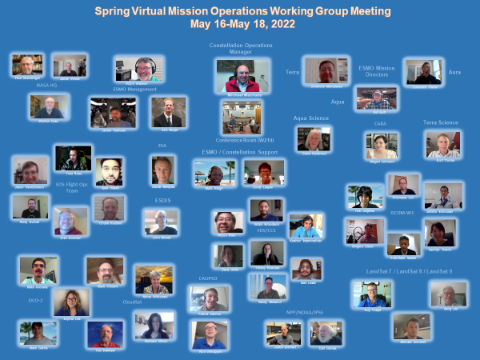

Slide 10
Since the last meeting . . .
  Aqua continues its free-drift, drag down approach and monitors passing events with Constellation members
  Landsat 9 spacecraft transition from NASA to USGS
  Terra successfully exited the Morning Constellation and continues to operate
  CloudSat has successfully executed maneuvers; anticipate resuming formation flying with CALIPSO
  Terra, Aqua, Aura drifting orbits workshop to identify unique science opportunities

Slide 11
Significant Events . . .
EVENT | DATE
2022 Spring MOWG Meeting (Virtual) | May 16-18, 2022
Aqua Crossing/Passing OCO-2 | May 17, 2022
Aqua Crossing/Passing Landsat 7 | June 30, 2022
Landsat 9 Spacecraft Transition to USGS | August 11, 2022
Aqua Crossing/Passing Terra | September 15, 2022
Aqua Crossing/Passing Landsat 9 | September 26, 2022
Aqua Crossing/Passing Terra | October 23, 2022
Terra, Aqua, Aura Drifting Orbits Workshop | November 1-2, 2022
2022 Fall MOWG Meeting (GSFC/Hybrid) | November 16-18, 2022
Notes:
Still need a sponsor for FALL MOWG and decide on location.

Slide 12
Potential Future MOWG Meetings . . .
Virtual and/or Hybrid
Past Locations
Boulder/Ft. Collins, CO
KAFB, Albuquerque, NM
France
GSFC, MD
Gilbert, AZ
Japan
JPL/Pasadena area, CA
KSC area, FL
LaRC/Norfolk area, VA
Dulles, VA
Sioux Falls, SD
Other Locations Discussed
Alaska Ground Station Facility
JSC, TX
Host desired location or Virtual?
Sponsors
CALIPSO/CNES
CALIPSO/LaRC
CloudSat/JPL
CloudSat/KAFB
ESMO missions/GSFC
GCOM-W1/JAXA
Landsat/NGIS
Landsat/USGS
OCO-2/JPL
OCO-2/OSC ATK
NGC
Notes:
Still need a sponsor for FALL MOWG and decide on location.

Slide 13
Action Items from Fall 2021 MOWG
# | Assignee | Description | Status / Due Date
2111-01 | Aqua Team | Document Orbital Debris Program Office email agreeing with Aqua approach for calculating apogee/perigee altitudes, semi-major axis, and eccentricity. | CLOSED / November 15, 2021
2111-02 | Aqua Team | Explain the difference between 2 plots in the Aqua Delta-CER package slide 42 – why is right plot more eccentric? | CLOSED / December 3, 2021
2111-03 | Constellation Management team | Develop Crossing Plan documents. Start coordination, communication 2 months prior to crossing. | CLOSED / April 29, 2022
2111-04 | Aqua Team | What Retrograde Maneuver capability does Aqua have? | CLOSED / February 1, 2022
2111-05 | All Teams | Teams provide (via CCS) a long ephemeris for the purpose of Terra Constellation Exit Planning. 1/1/2022 – 1/1/2024, 60s step size, include maneuvers and drag environment | CLOSED / February 28, 2022
2111-06 | Mike Machado | Send Constellation Operations Coordination Plan out for signatures | OPEN / December 15, 2021
2111-07 | Terra Team | Send Landsat 7 team (via CCS) a long ephemeris file spanning 1/1/2022 – 1/1/2023, 60s step size, include maneuvers and drag environment | CLOSED / December 31, 2021
2111-08 | MOWG Leads | Provide feedback for CCR#21 (New Cornerstone Mission) | CLOSED / December 17, 2021

Slide 14
Action Items from Spring 2022 MOWG
# | Assignee | Description | Status / Due Date
2205-01 | All Teams | Draft CCR to modify definitions for Constellation Status flag changes | OPEN / December 1, 2022
2205-02 | CCS Team | Update CCS to include Landsat 9 in the Morning Constellation | CLOSED /June 30, 2022
Table 2-5. Constellation Status Flag Definitions
FLAG | TYPE | ACTION | DEFINITION
RED | ZOE violations | Action is required immediately | An Alert ZOE violation has occurred.
YELLOW | Control Box violations | Action may be required, but not immediately | Does not qualify as RED, but a Control Box violation has occurred OR an Alert ZOE violation is predicted to occur during the next 5 days OR Mission has exited the Constellation.
GREEN | Nominal operations | No action is required | Does not qualify as RED or YELLOW. That is, the satellite is in its control box and no Alert ZOE violations have occurred or are predicted to occur during the next 5 days OR Mission has exited the Constellation.
Simplest option: add another “Or” phrase to the Yellow or Green category.
Recommendation
Mission continues to operate outside the Constellation and conduct Nominal Operations = Green

Slide 15
Meeting Logistics
Presentations
  Please e-mail your presentation updates to michael.j.machado@nasa.gov, and mark.t.heigh@nasa.gov
  All the presentations will be made available after the meeting. NOTE: The large file transfer service has been decommissioned. Distribution for select (international and interagency) members via Box. Office 365 OneDrive option for internal partners. Download instructions will be sent.
  Presentations will be recorded! Let us know beforehand if your presentations are “not for public view”.
Webex meeting information:
  See Agenda or email announcement for Webex meeting links
Group photo Ideas – On-site group photo planned. Virtual attendees, please send us a photo (selfie or group photo from a recent event). We can use these later to assemble into a MOWG photo collage!

Slide 16
ありがとうございます
Arigatou Gozaimasu
Merci
Thank you
Questions?
Notes:
Pronounce arigatou gozaimasu as ah-ree-gah-toh goh-zah-ee-mas.
State "arigatou gozaimasu."[4] This phrase essentially means "thank you very much."
You can use arigatou gozaimasu with people who have a higher status than you, including supervisors, family elders, teachers, and strangers or acquaintances who appear older than you.
You can also use this phrase to express formal or heartfelt gratitude to someone close to you.
In its non-romanized form, write 有難う 御座います.

Slide 17
Abbreviations / Acronyms List
  AFRL Air Force Research Laboratory
  AIRS Atmospheric Infrared Sounder
  ALI Advanced Land Imager
  AMSR-E Advanced Microwave Scanning Radiometer for EOS
  AMSR2 Advanced Microwave Scanning Radiometer 2
  ASTER Advanced Spaceborne Thermal Emission and Reflection Radiometer
  CA Conjunction Assessment
  CAM Command Authorization Meeting
  CEM Constellation Exit Maneuver
  CALIPSO Cloud-Aerosol Lidar and Infrared Pathfinder Satellite Observations
  CARA Conjunction Assessment Risk Analysis
  CARMA Conjunction Assessment and Risk Mitigation Automation
  CCR Configuration Change Request
  CCS Constellation Coordination System
  CNES Centre National d’Etudes Spatiales
  COVID-19 Coronavirus Disease 2019
  CRMS Collision Risk Management System
  CVT Constellation Visualization Tool
  DAM Debris Avoidance Maneuver
  DAS Debris Assessment Software
  DB Direct Broadcast
  DO-OP Daylight Only Operations
  EAR Export Administration Regulations
  EO Earth Observation
  EO-1 Earth Observing-1
  EOMP End of Mission Plan
  EOS Earth Observing System
  EROS Earth Resources Observation and
  Science
  ESA European Space Agency
  ESACCS European Space Agency Constellation Coordination System
  ESC Earth Science Constellation
  ESDIS Earth Science Data and Information System
  ESMO Earth Science Mission Operations
  ETM+ Enhanced Thematic Mapper Plus (Landsat 7)
  FAQ Frequently Asked Question
  FDS Flight Dynamics System
  FOT Flight Operations Team
  FMU Formatter Multiplexer Unit
  FSW Flight Software
  FY Fiscal Year
  GEDI Global Ecosystem Dynamics Investigation
  GCOM-W Global Change Observation Mission – Water
  GMT Greenwich Mean Time
  GS Global Survey
  GSFC Goddard Space Flight Center
  HIE High Interest Event
  HQ Headquarters
  IAM Inclination Adjustment Maneuver
  ISRO Indian Space Research Organization
  ISS International Space Station
  ITAR International Traffic in Arms Regulations
  JAXA Japan Aerospace Exploration Agency
  JPL Jet Propulsion Laboratory
  JPSS Joint Polar Satellite System
  JSC Johnson Space Center
  JSpOC Joint Space Operations Center
  KSC Kennedy Space Center
  LaRC Langley Research Center
  MetOp Meteorological Ops Satellite
  MLT Mean Local Time
  MMOD Micrometeorite Orbital Debris
  MOWG Mission Operations Working Group
  NASA National Aeronautics & Space Administration
  NET No Earlier Than
  NGAS Northrop Grumman Aerospace Systems
  NISAR NASA-ISRO Synthetic Aperture Radar mission
  NOAA National Oceanic and Atmospheric Administration
  OCO Orbiting Carbon Observatory
  OIIR NASA Office of International and Interagency Relations
  ORR Operational Readiness Review
  PLM Perigee Lowering Maneuver
  POC Point Of Contact
  PS Project Scientists
  RMM Risk Mitigation Maneuver
  RWA Reaction Wheel Assembly
  SAC-C Satellite de Aplicaciones Cientificas (Scientific Application Satellite)
  SC Spacecraft
  S5P Sentinel-5 Precursor
  SNPP Suomi National Polar-orbiting Partnership
  SSR Solid State Recorder
  SWIR Short Wave Infrared
  TBC To Be Confirmed
  TBD To Be Determined
  TES Tropospheric Emission Spectrometer
  TSIS Total and Spectral Solar Irradiance Sensor
  USGS U.S. Geological Survey
  WRS World Reference System

