Slide 1
Validation of Cryogenic Propellant Tank Self-Pressurization by Leveraging Reduced Order Modeling within Computational Fluid Dynamics Simulation
November 20, 2022
J. M. Brodnick – NASA, Fluid Dynamics Branch (MSFC-ER42)
H. Q. Yang – JSEG, Fluid Dynamics Branch (MSFC-ER42)

Slide 2
Background
  The Fluid Dynamics Branch within the Propulsion Systems Department at the Marshall Space Flight Center is currently supporting multiple programs in need of in-space cryogenic fluid management (CFM) analysis.
    Space Launch System (SLS) upper stages
    Commercial Lunar Payload Services (CLPS)
    Human Landing System (HLS)
    Nuclear Thermal Propulsion (NTP) systems
  Quantification of self-pressurization of propellant tanks has direct application to long-term storage of cryogenic propellants, a need for many current and future programs.
  As a result, a validation activity was started leveraging available ground test data.
  Predictions were made using Computational Fluid Dynamics (CFD) and a standard volume of fluid (VoF) model.
    Observed spurious velocities near the gas-liquid interface
    Long simulation durations due to low time step requirements
    Significant spatial resolution and simulation time was found necessary
  Predictions were also made using a hybrid CFD and reduced order modeling methodology where CFD was only used to explicitly calculate liquid flow field dynamics.
    Precluded any movement of the gas-liquid interface and alleviated time step requirements
    A subset of these results is presented herein

Slide 3
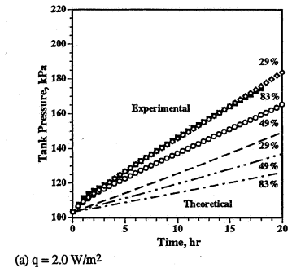
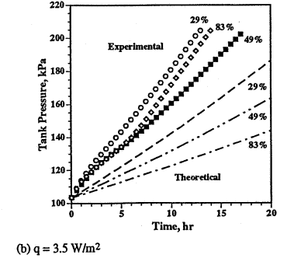
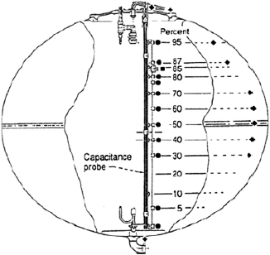
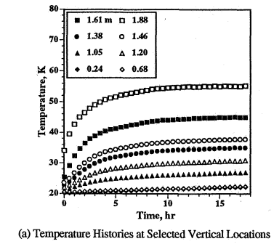
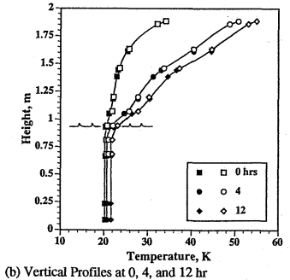
Experimental Setup
  Multiple tank self-pressurization tests were performed at the NASA Glenn Research Center K-site facility
  An insulated ellipsoidal tank was filled with liquid hydrogen and allowed to pressurize through heating
  Liquid level and heat flux sensitivities were studied
  Ullage pressure and axially varying temperatures in both fluid phases were the primary metrics used to quantify the self-pressurization process
Tank Configuration Illustration
(Temperature Sensor Locations Shown)
Reference:
Hasan M, Lin C, Dresar NV. Self-pressurization of a flightweight liquid hydrogen storage tank subjected to low heat flux. NASA TM 103804; 1991.

Slide 4
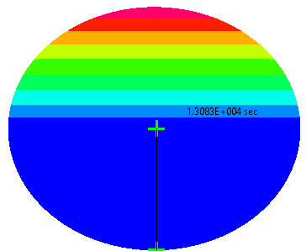

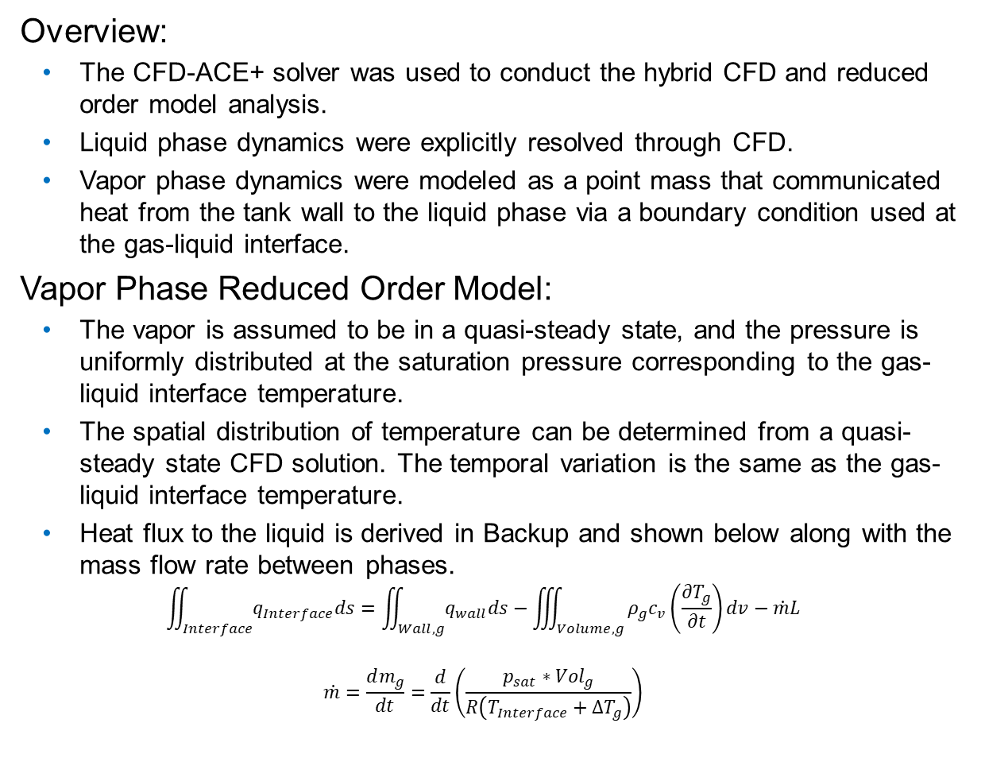



Modeling Methodology
Overview:
  The CFD-ACE+ solver was used to conduct the hybrid CFD and reduced order model analysis.
  Liquid phase dynamics were explicitly resolved through CFD.
  Vapor phase dynamics were modeled as a point mass that communicated heat from the tank wall to the liquid phase via a boundary condition used at the gas-liquid interface.
Vapor Phase Reduced Order Model:
  The vapor is assumed to be in a quasi-steady state, and the pressure is uniformly distributed at the saturation pressure corresponding to the gas-liquid interface temperature.
  The spatial distribution of temperature can be determined from a quasi-steady state CFD solution. The temporal variation is the same as the gas-liquid interface temperature.
  Heat flux to the liquid is derived in Backup and shown below along with the mass flow rate between phases.
  $$\iint_{Interface}^{ }{q_{Interface}ds}=\iint_{Wall,g}^{ }{q_{wall}ds}−\iiint_{Volume,g}^{ }{ρ_{g}c_{v}\left(\frac{∂T_{g}}{∂t}\right)dv}−\dot{m}L$$
  $$\dot{m}=\frac{dm_{g}}{dt}=\frac{d}{dt}\left(\frac{p_{sat}{∗Vol}_{g}}{R\left(T_{Interface}+∆T_{g}\right)}\right)$$
Illustration of Vapor Phase Thermal Stratification Analysis
$$q_{wall}$$
Vapor Phase Volume
$$T_{Interface,Initial}$$
(from test measurements)
Illustration of the Liquid Phase Self-Pressurization Analysis
$q_{Interface}$
(from reduced order model)
Liquid Phase Volume
$$q_{wall}$$

Slide 5
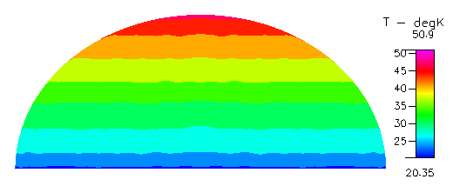
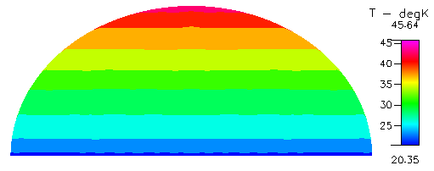
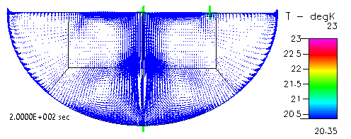
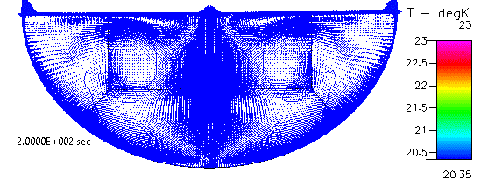


Simulation Results
  Temperature fields for the 49% fill level simulations are shown.
  The liquid temperature field was altered significantly if dynamics near the gas-liquid interface and forming the natural convection cell at the tank bottom were not well resolved.
Heat Injection: 3.5 W
Heat Injection: 2.0 W
Vapor Phase Analysis
(Final State Shown)
$$∆T_{ullage}=15 deg.$$
$$∆T_{ullage}=10 deg.$$
Liquid Phase Analysis
(Transients Shown)

Slide 6
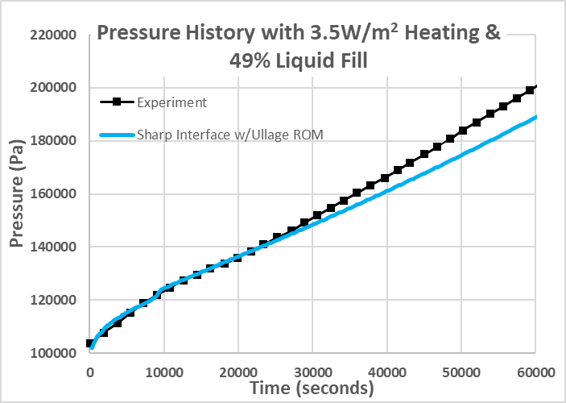
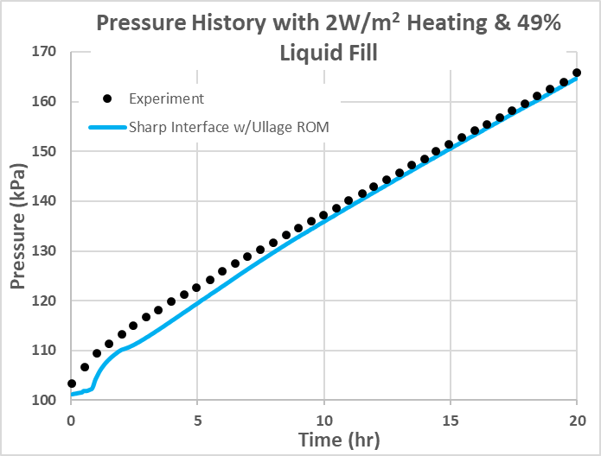
Simulation Results
  Ullage pressure transients for the 49% fill level simulations are shown.
  An initial transient was observed in both the experiments and simulations before approach to a constant pressure rise rate.
  Acceptable pressurization rates were predicted demonstrating successful validation of the modeling methodology for a range of engineering applications.

Slide 7
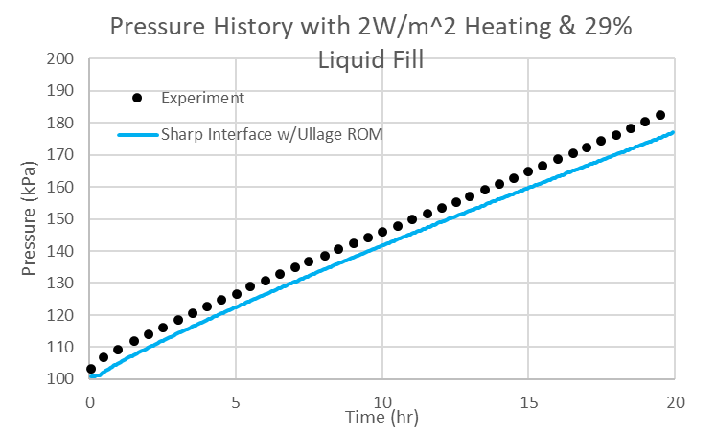
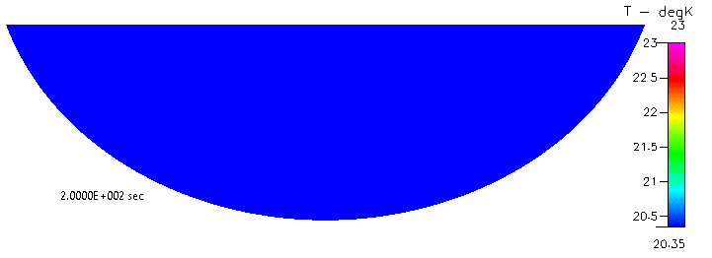
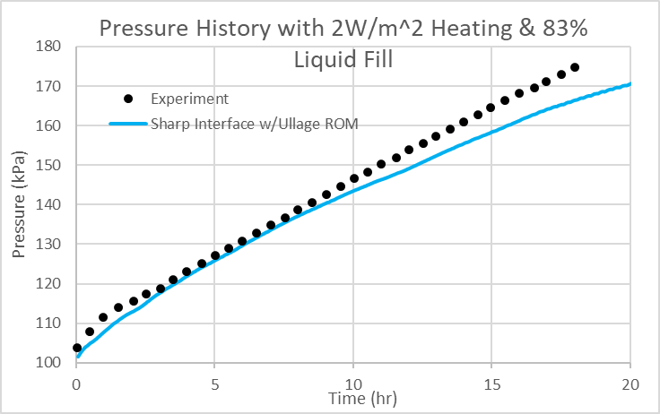
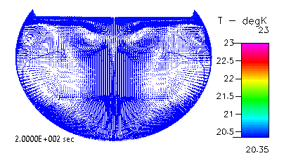
Simulation Results
  The natural convection flow path affected liquid temperatures differently based on fill level.
    29%: A single liquid flow path yielded nearly uniform temperature.
    83%: Distinct flow paths yielded temperature stratification.
  Reasonable agreement with the experimental tank pressurization was observed.
29% Fill Level with 2.0 W Heat Injection
(Velocity vectors not shown)
83% Fill Level with 2.0 W Heat Injection

Slide 8
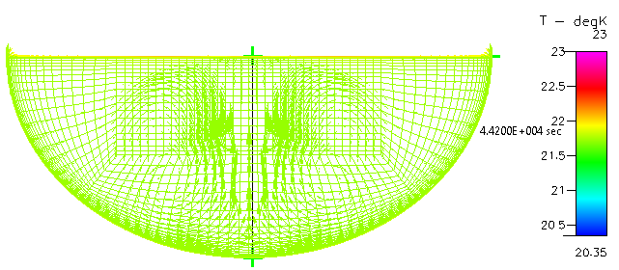
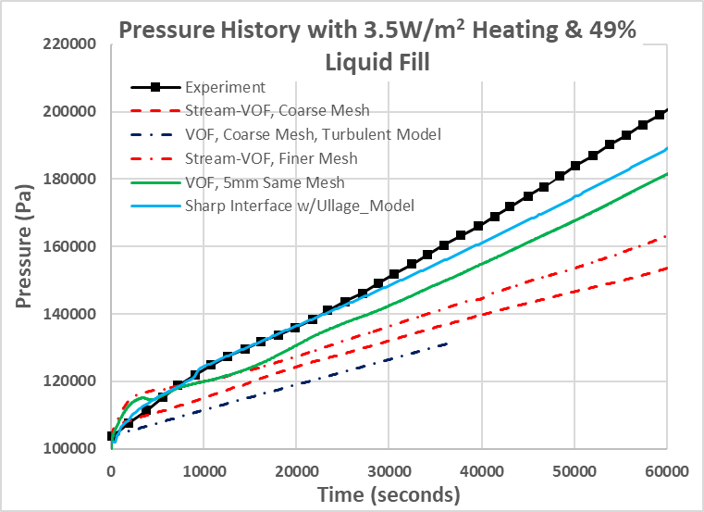
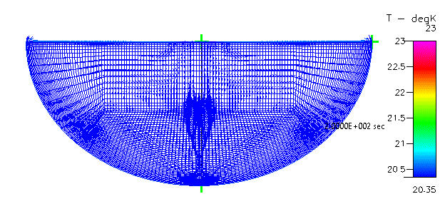
Comparisons to VoF Simulation Results
  Interface dynamics observed in VoF simulations prevented buildup of high gradient thermal stratification in the liquid phase along the gas-liquid interface.
  Increased spatial resolution necessitated reduced time steps in VoF simulations due to interface treatment.
  Overcoming these issues, VoF simulation results did yield an acceptable pressurization rate albeit at a greater cost.
    Pressurization transients also differed between the two methods of simulation.
VoF
(Final State Shown / Little thermal stratification)
Equivalent Spatial Refinement
Too much mixing near the interface
Spatial Refinement
Reduced Order Vapor Phase
(Transient Shown / Stratification is apparent)
Turbulent dissipation yielded excessive mixing in the liquid

Slide 9
Conclusion
  Validation of propellant tank self-pressurization was conducted using the CFD-ACE+ solver and a reduced order model of the ullage vapor.
    The modeling methodology promotes rapid assessment of self-pressurization.
  The chosen modeling methodology has multiple benefits over a standard VoF method for the subset of applications where fixed gas-liquid interfaces exist.
    Alleviated time step requirements
    Enabled increased spatial resolution with minimal impact to simulation duration
    Enforced gas-liquid interface position precluding numerically driven interface dynamics
  This work was used to demonstrate the critical physics for tank self-pressurization and numerical methodologies that may be used to best resolve those physics.
  The findings informed development and operation of production level CFD tools used in the Fluid Dynamics Branch at NASA Marshall Space Flight Center.
    Development of a sharp interface model in the branch’s production level CFD tools where both fluid phases are distinctly and explicitly represented in CFD is underway.

Slide 10
Backup

Slide 11
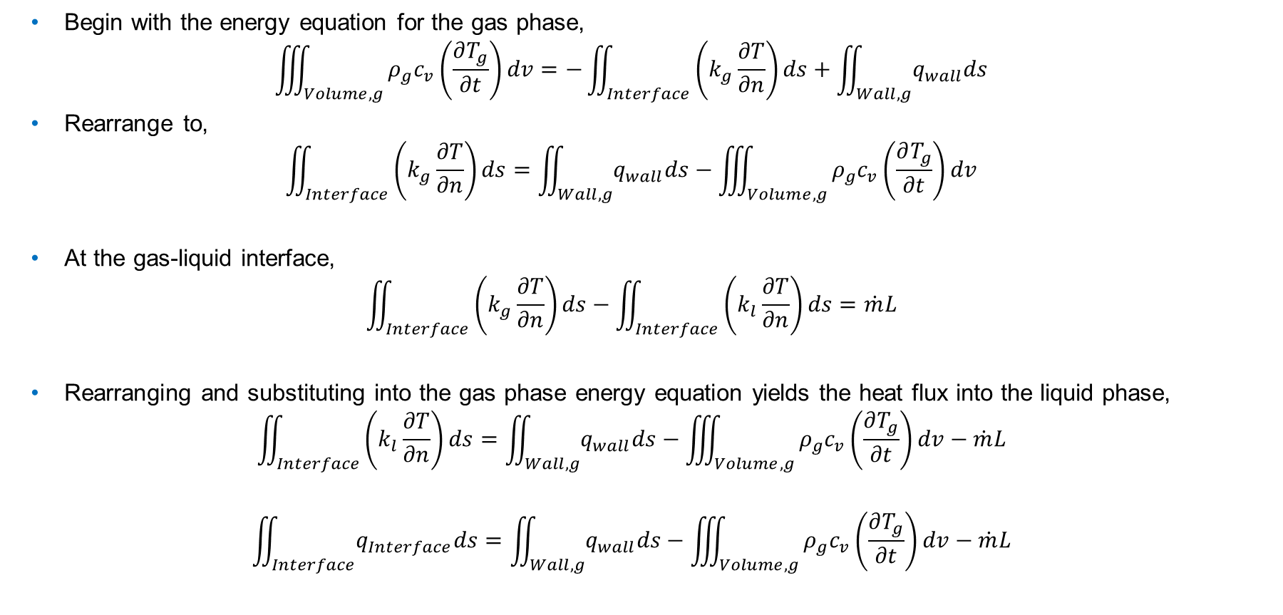
Derivation of Vapor Phase Model Heat Flux
  Begin with the energy equation for the gas phase,
  $$\iiint_{Volume,g}^{ }{ρ_{g}c_{v}\left(\frac{∂T_{g}}{∂t}\right)dv}=−\iint_{Interface}^{ }{\left(k_{g}\frac{∂T}{∂n}\right)ds}+\iint_{Wall,g}^{ }{q_{wall}ds}$$
  Rearrange to,
  $$\iint_{Interface}^{ }{\left(k_{g}\frac{∂T}{∂n}\right)ds}=\iint_{Wall,g}^{ }{q_{wall}ds}−\iiint_{Volume,g}^{ }{ρ_{g}c_{v}\left(\frac{∂T_{g}}{∂t}\right)dv}$$
  At the gas-liquid interface,
  $$\iint_{Interface}^{ }{\left(k_{g}\frac{∂T}{∂n}\right)ds}−\iint_{Interface}^{ }{\left(k_{l}\frac{∂T}{∂n}\right)ds}=\dot{m}L$$
  Rearranging and substituting into the gas phase energy equation yields the heat flux into the liquid phase,
  $$\iint_{Interface}^{ }{\left(k_{l}\frac{∂T}{∂n}\right)ds}=\iint_{Wall,g}^{ }{q_{wall}ds}−\iiint_{Volume,g}^{ }{ρ_{g}c_{v}\left(\frac{∂T_{g}}{∂t}\right)dv}−\dot{m}L$$
  $$\iint_{Interface}^{ }{q_{Interface}ds}=\iint_{Wall,g}^{ }{q_{wall}ds}−\iiint_{Volume,g}^{ }{ρ_{g}c_{v}\left(\frac{∂T_{g}}{∂t}\right)dv}−\dot{m}L$$

