Slide 1
Comparison of Entry Descent and Landing Aerodynamic Databases with Uncertainty Quantification Developed Using Machine Learning Techniques
T.J. Wignall
NASA’s Data Science Summit
November 15, 2022

Slide 2
Outline
  What are Aerodynamic Databases?
  What should our database cover?
  How is Uncertainty Quantification (UQ) Determined?
    Term-based UQ by inspection vs data-driven UQ
  Making the Comparison
    Plotting, model metrics, point density, and aerodynamic performance
  Final thoughts

Slide 3
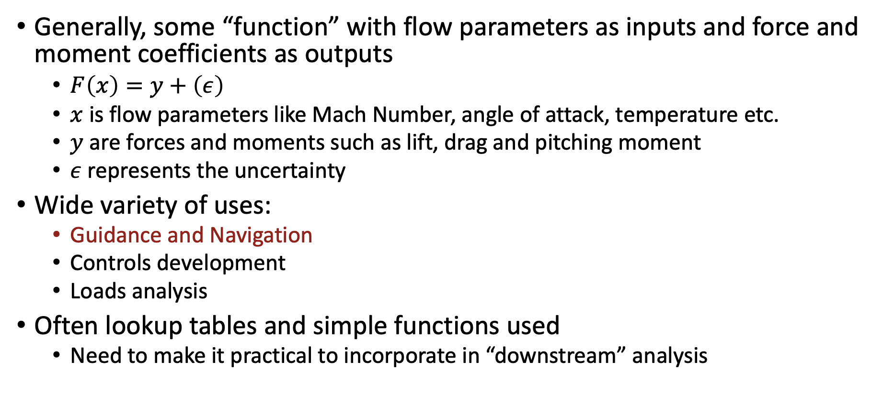
Aerodynamic Databases
Generally, some “function” with flow parameters as inputs and force and moment coefficients as outputs
  $F\left(x\right)=y+\left(ε\right)$
  $x$ is flow parameters like Mach Number, angle of attack, temperature etc.
  $y$ are forces and moments such as lift, drag and pitching moment
  $ε$ represents the uncertainty
Wide variety of uses:
  Guidance and Navigation
  Controls development
  Loads analysis
Often lookup tables and simple functions used
  Need to make it practical to incorporate in “downstream” analysis

Slide 4

Aerodynamic Databases: Orion
Database of interest today is simplified Orion EDL force and moment database used in trajectory analysis
Going to compare 4 models to Orion v0.60
Lift force
Drag Force
Velocity
$$α$$
Airflow
Angle of attack
Center of mass
Pitching moment

Slide 5
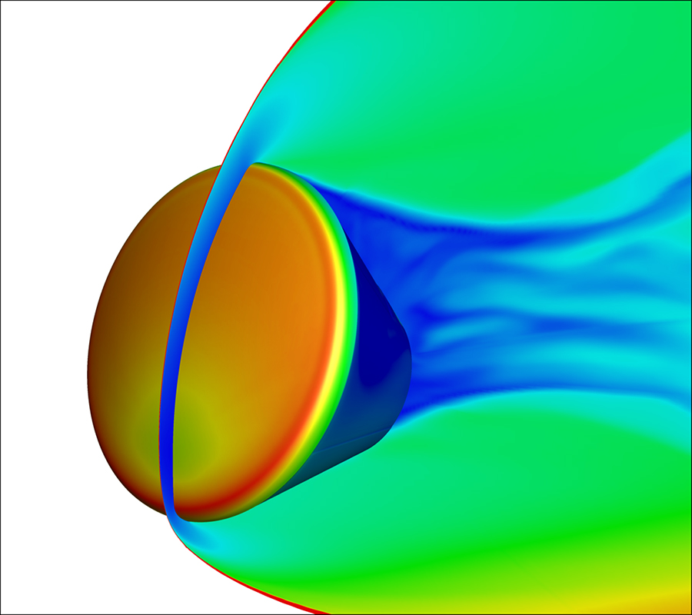
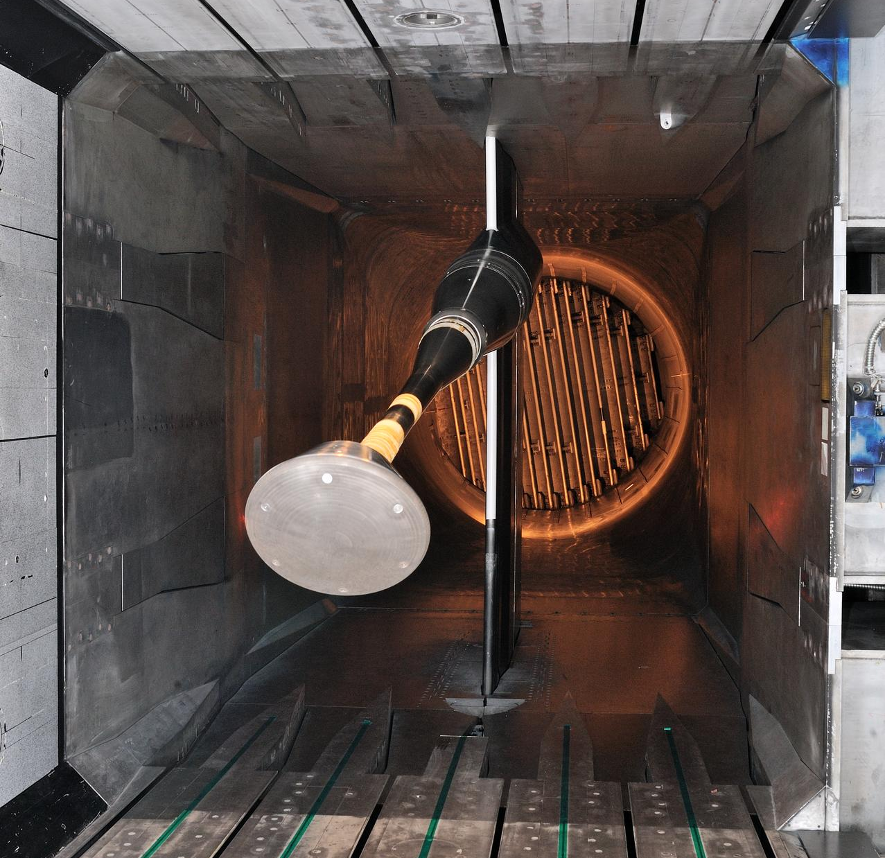
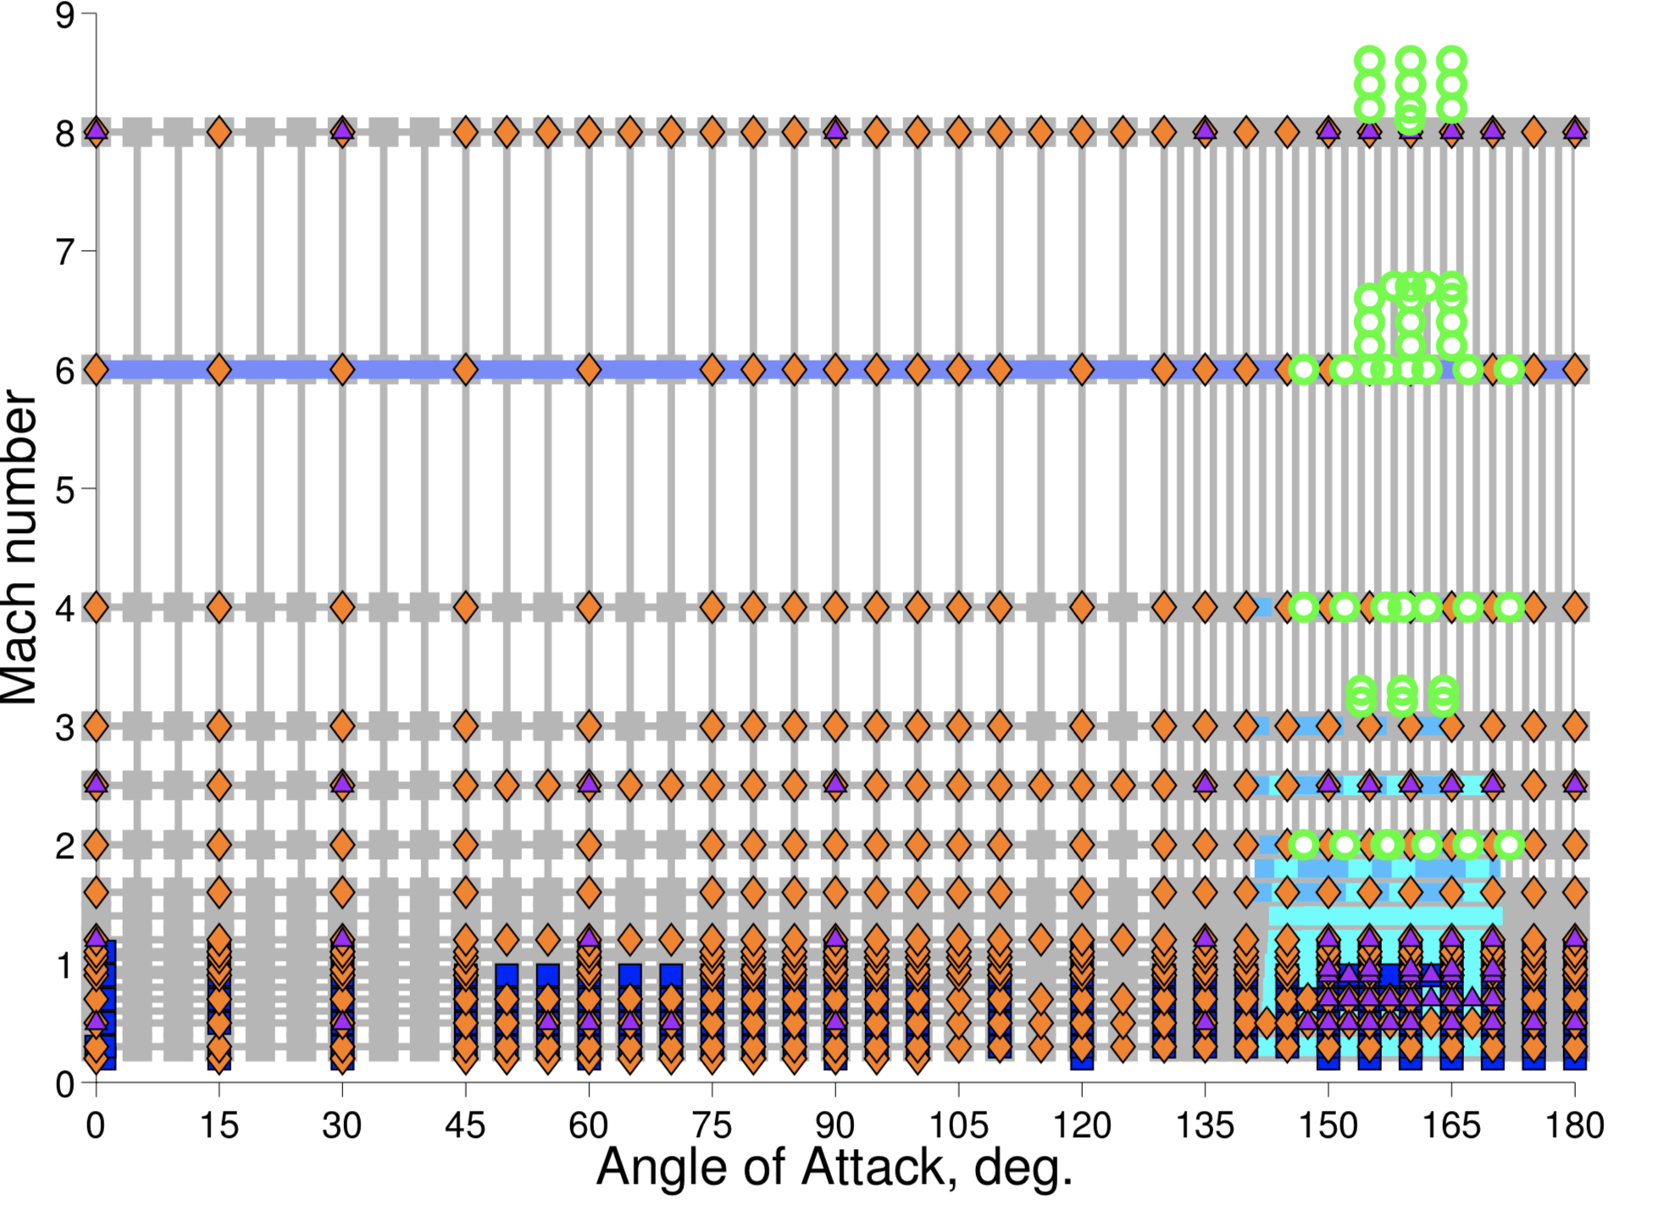
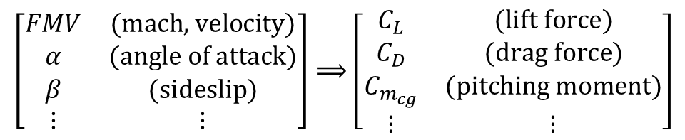
Aerodynamic modeling
DATA
ENGINEERING & MISSION DESIGN
1
2
3
AERO-DATABASE
$$\left[\begin{matrix}FMV & \text{(}\text{mach}\text{, }\text{velocity}\text{)} \\ α & \text{(}\text{angle} \text{of} \text{attack}\text{)} \\ β & \text{(}\text{sideslip}\text{)} \\ ⋮ & ⋮\end{matrix}\right]⟹\left[\begin{matrix}C_{L} & \text{(}\text{lift} \text{force}\text{)} \\ C_{D} & \text{(}\text{drag} \text{force}\text{)} \\ C_{m_{cg}} & \text{(}\text{pitching} \text{moment}\text{)} \\ ⋮ & ⋮\end{matrix}\right]$$
Image credits. 1: Chun Tang, NASA. 2: Sandra Gibbs, NASA. 3: Karen Bibb, NASA.

Slide 6
Aerodynamic modeling: 4 candidate models
*See talk later today for how we are adopting these methods for use in trajectory sims
Orion v0.60 Database
  State of the practice
  Term based UQ by inspection (assumes uniform distribution)
Polynomial
  6^{th-}Order Polynomial
Dropout Neural Network (NN)
  Standard feedforward NN
  4 hidden layers, each with 128 neurons, swish activation function
Structured Covariance Gaussian Network* (SCGN)
  Mean: 4 hidden layers, each with 16 neurons and tanh activation
  Covariance: 4 hidden layers, each with 32 neurons and tanh activation functions
Gaussian Process Regressor* (GPR)
  Squared Exponential Kernel, user defined observation noise
*To see how we are adjusting these for use in trajectory simulations see: Sampling Functions from Gaussian Processes and Structured Covariance Gaussian Networks talk later today by Nakamura-Zimmerer and Scoggins

Slide 7
Outline
  What are Aerodynamic Databases?
  What should our database cover?
  How is UQ Determined?
    Term-based UQ by inspection vs data-driven UQ
  Making the Comparison
    Plotting, model metrics, point density, and aerodynamic performance
  Final thoughts

Slide 8
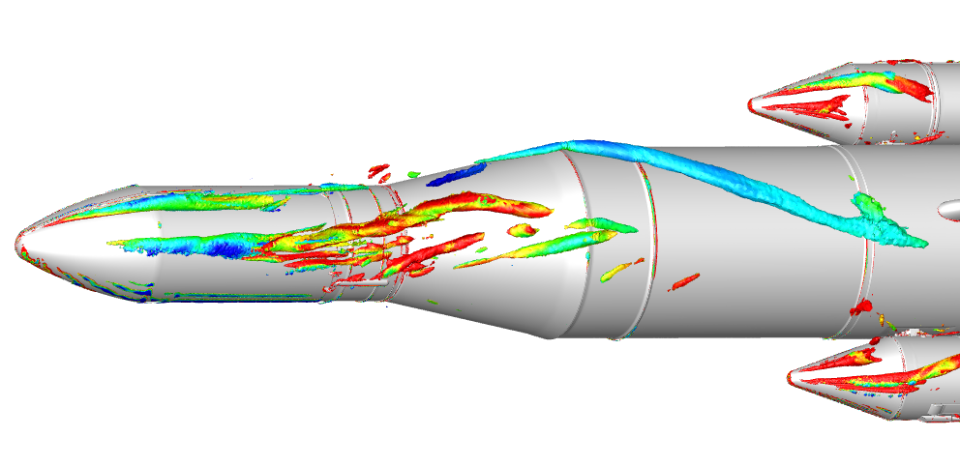
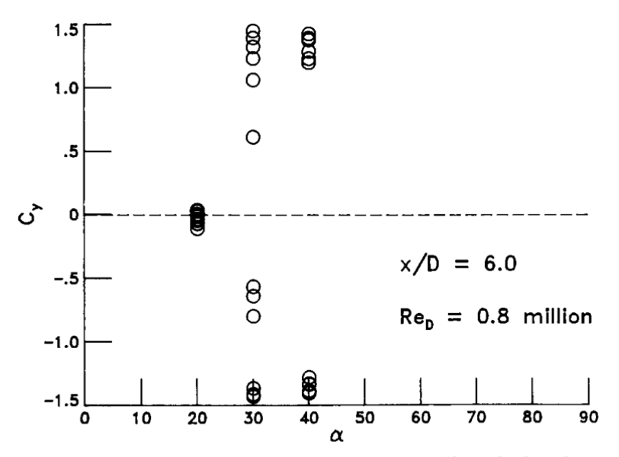
What should the database predict/cover?
Stable
Asymmetric Vortices
Moderately Stable
Starboard Vortex
Nominal value and uncertainty quantification
What do we mean by Nominal value?
  The value before you add any uncertainty
  Median or mean
What if your desired distribution is not unimodal?
  For example: Hysteresis, asymmetric vortices, Coandă Effect
  Still an open question
Thankfully, our aerodynamic data are “well behaved”
  Most models we’ve tried predict symmetric distributions with one peak
Isosurfaces of Q-criterion flooded by vorticity on the SLS¹
1. From Pomeroy, B. W., “NASA Langley Low-Speed CFD Contributions to the Space Launch System Program,” NASA Advanced Supercomputing (NAS) Division Advanced Modeling and Simulation (AMS) Series, May 19, 2022.
2. From Hartwich, Hall, and Hemsch, Navier-Stokes Computations of Vortex Asymmetries Controlled by Small Surface Imperfections. J. SPACECRAFT VOL. 28, NO. 2)
8
Effect of bimodal vortex behavior on side force coefficient for a 3.5-caliber tangent-ogive. ²

Slide 9
What should uncertainty cover?
How is the uncertainty going to be used?
Controls
  Designed on Confidence Interval tested on prediction interval
Loads
  Often focus on “worst cases”
    Primary concern is something like a 99.7 percentile prediction
Guidance and Navigation
  Use whole distribution of possible values
9

Slide 10

Guidance and Navigation UQ needs
Monte Carlo simulations using evaluations drawn from the distribution of possible values
  Want to evaluate the range of possible values
Prediction interval best covers this
  Want to evaluate the accuracy of the distribution
Altitude [km]
$α$ [deg]
time [s]
time [s]
time [s]
Trajectory simulation results from SCGN model*
10
*For more details: Sampling Functions from Gaussian Processes and Structured Covariance Gaussian Networks talk later today by Nakamura-Zimmerer and Scoggins

Slide 11
Outline
  What are Aerodynamic Databases?
  What should our database cover?
  How is UQ Determined?
    Term-based UQ by inspection vs data-driven UQ
  Making the Comparison
    Plotting, model metrics, point density, and aerodynamic performance
  Final thoughts

Slide 12
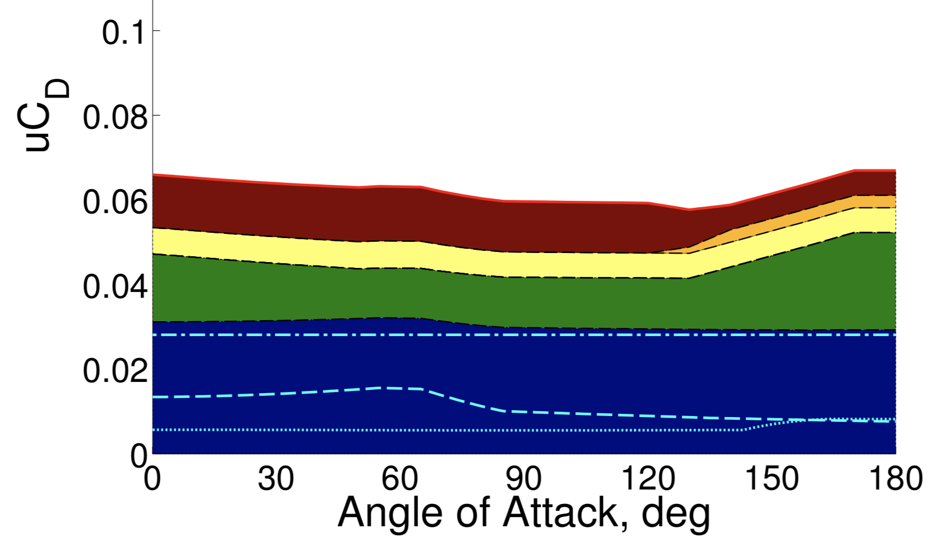
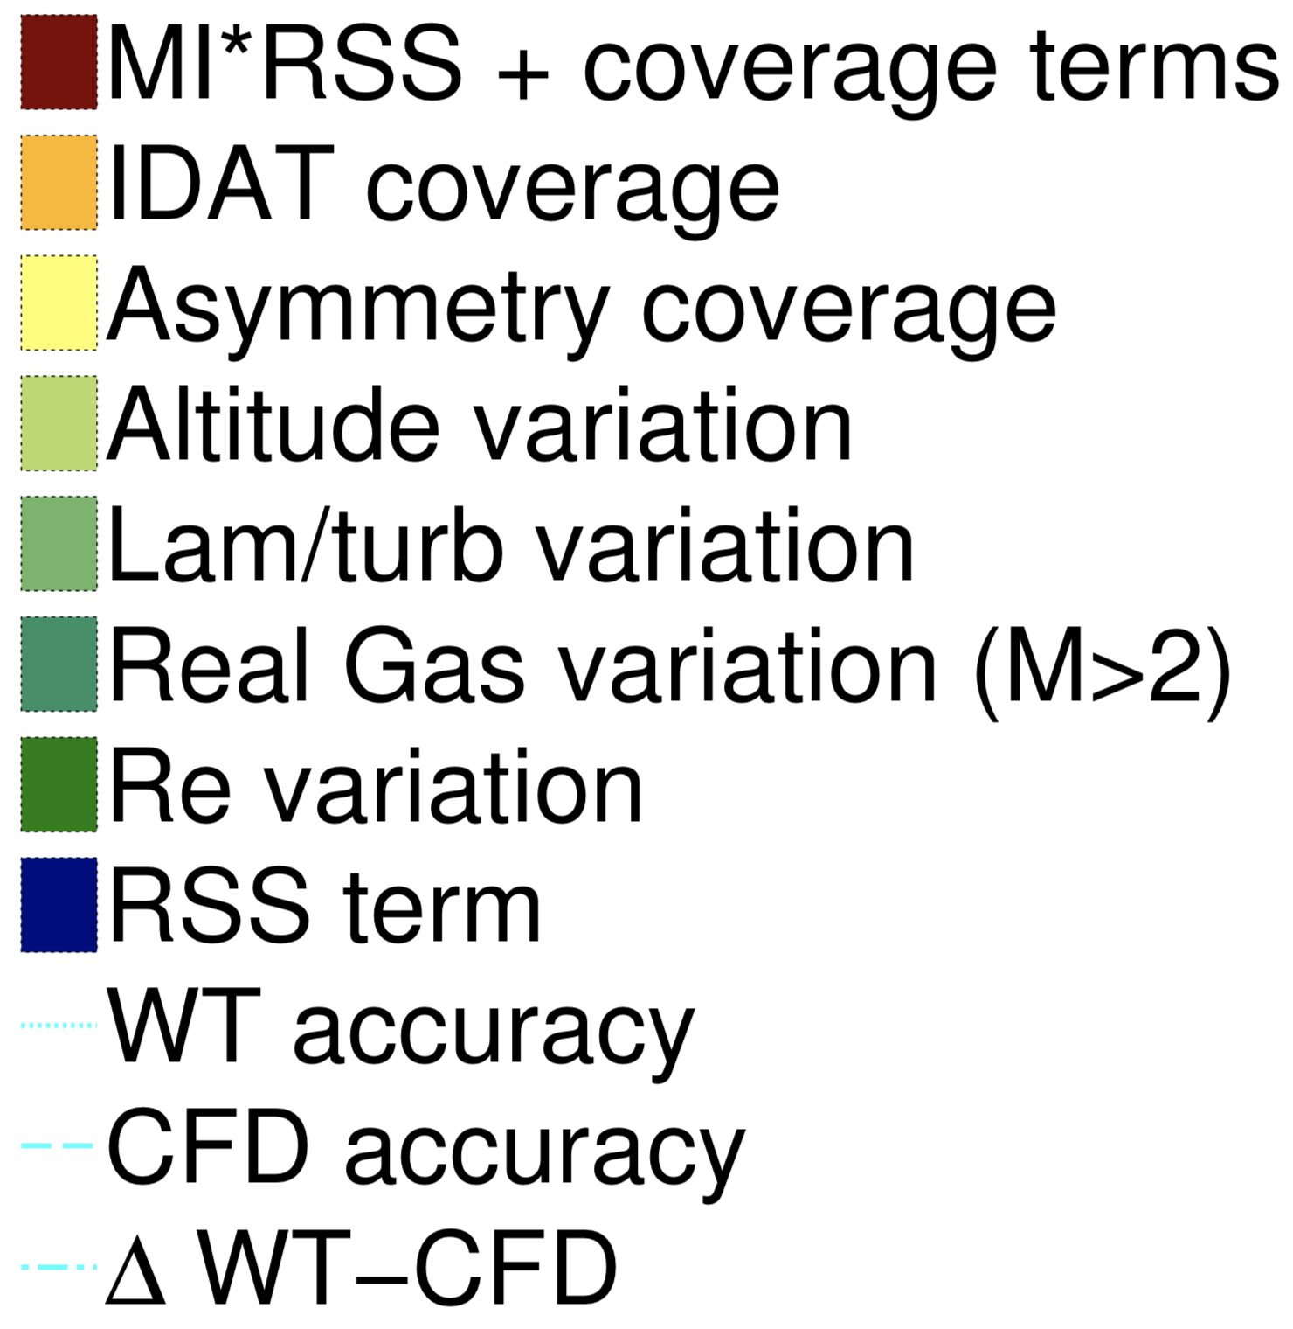
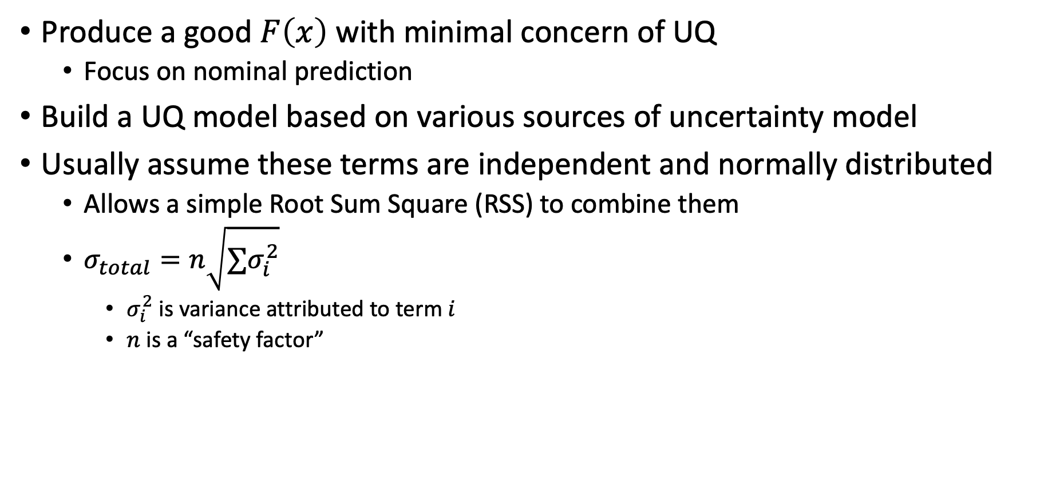

State of the Practice:
Term-based UQ by inspection
Produce a good $F\left(x\right)$ with minimal concern of UQ
  Focus on nominal prediction
Build a UQ model based on various sources of uncertainty model
Usually assume these terms are independent and normally distributed
  Allows a simple Root Sum Square (RSS) to combine them
  $σ_{total}=n\sqrt{∑σ_{i}^{2}}$
    $σ_{i}^{2}$ is variance attributed to term $i$
    $n$ is a “safety factor”
$$u_{C_{D}}$$
State of the practice: “UQ by inspection”
Development of the Orion crew module static aerodynamic database, part I: Hypersonic & part II: Subsonic/supersonic (Bibb et al., AIAA SciTech Forum, 2011a,b)

Slide 13
State of the Practice: Term-based UQ
Pros:
Can include known effects not included in data
Can gather data to target specific terms
Can independently adjust terms as new data is acquired
Cons:
Requires work to define each term
  Not always clear how to distinguish terms
Assumptions on shape of distribution
  Usually normal or uniform
Hard to make UQ models that are
targeted for specific regimes
$$u_{C_{D}}$$
State of the practice: “UQ by inspection”
Development of the Orion crew module static aerodynamic database, part I: Hypersonic & part II: Subsonic/supersonic (Bibb et al., AIAA SciTech Forum, 2011a,b)

Slide 14
Data-driven UQ
Pros:
Less work/faster
  Gives the ability to bring UQ into “where should we gather data”
Can cover things that were not being looked for
Cons:
Does not capture uncertainties not found in the data
Hard to separate noise in measurement from final uncertainty
Notes:
  While these methods can be combined, the best way to do so is still an open question
  Terms in ter- based UQ are derived from data

Slide 15
Outline
  What are Aerodynamic Databases?
  What should our database cover?
  How is UQ Determined?
    Term-based UQ by inspection vs data-driven UQ
  Making the Comparison
    Plotting, model metrics, point density, and aerodynamic performance
  Final thoughts

Slide 16
Making the Comparison
The limits of graphical comparison
Evaluation of nominal prediction
Evaluation of distribution

Slide 17





Graphical Comparisons
Data visualization is always going to be extremely useful
Visualization as the number of dimensions increases is difficult
If only 2D plots:
  Levels of inputs
  Number of outputs
  Number of models under consideration
  5,000+ plots for the database under consideration
Plotting can still help
  Remove poorly trained models
  Check critical conditions
FMV = 0.5
$$α=160°$$
$$C_{L}$$
$$C_{D}$$
$α$ [deg]
$$FMV$$

Slide 18
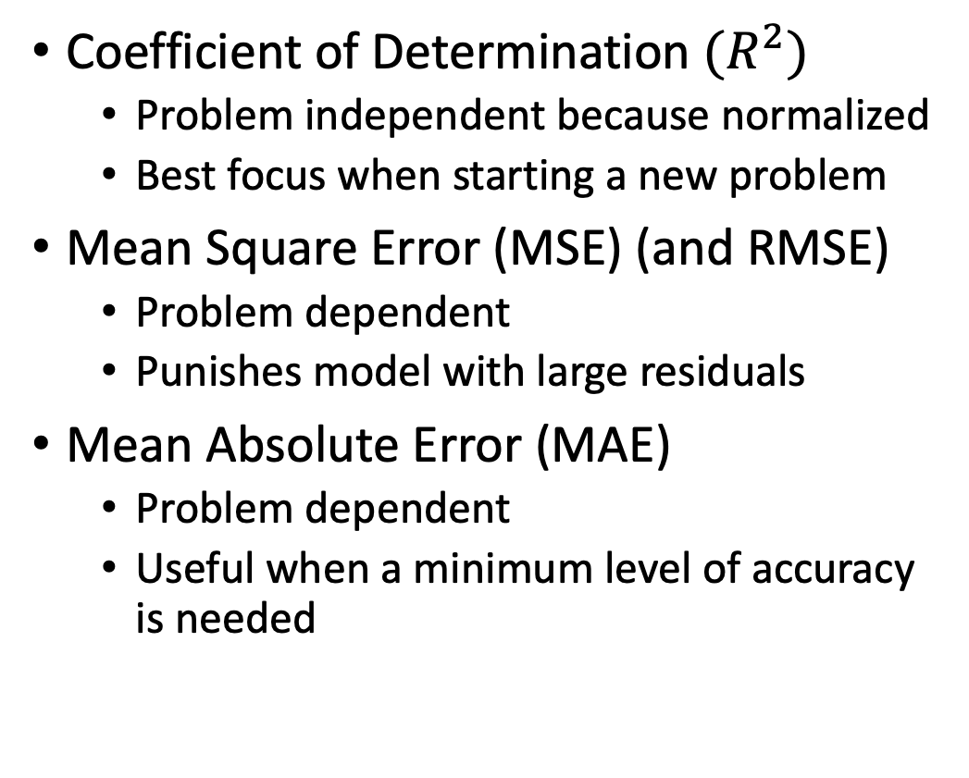
Nominal Metrics
Coefficient of Determination $(R^{2})$
  Problem independent because normalized
  Best focus when starting a new problem
Mean Square Error (MSE) (and RMSE)
  Problem dependent
  Punishes model with large residuals
Mean Absolute Error (MAE)
  Problem dependent
  Useful when a minimum level of accuracy is needed
Nominal Metrics on Predicting C_{D}
Model Name | R² | MSE | MAE
Orion v0.60 | 0.987904 | 0.001463 | 0.015295
Dropout NN | 0.980539 | 0.002354 | 0.031824
GPR | 0.989308 | 0.001293 | 0.019891
Polynomial | 0.951147 | 0.005909 | 0.053855
SCGN | 0.986672 | 0.001612 | 0.019879

Slide 19


Interval Metrics
FMV = 6.0
Pinball loss
  “MAE” at a given percentile
  Useful when a given percentile is important
Calibration
  Difference between the observed and expected Cumulative Distribution Function (CDF)
Sharpness
  Average variance
$$C_{m,cg}$$
$α$ [deg]
Calibration Curves for C_{m,cg}
Observed CDF
Expected CDF

Slide 20
Modifying Metrics
Metrics have an implicit bias of performance where data density is highest
Usually this corresponds to the region of most interest and is acceptable
What if this is not the case or the data are uniform?
Goes back to how the database is being used
Want highlight model performance where it is most important

Slide 21
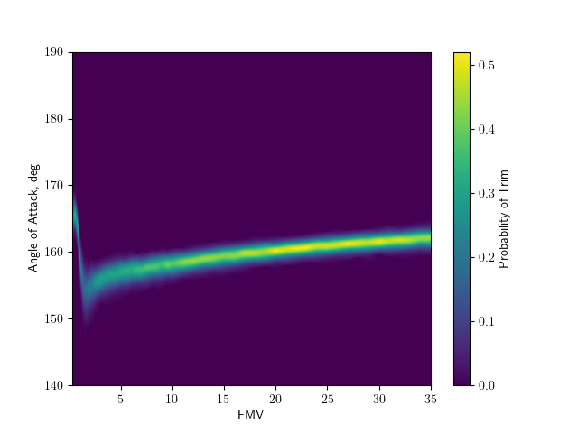




Weighting Performance
Identify where we want to stress performance
  During EDL, usually at a trim angle of attack
Modify metrics by using their weighted form
  WMSE, WMAE, weighted sharpness
Predicted Nominal Trim
Dropout NN
$α$ [deg]
$α$ [deg]
$$FMV$$
$$FMV$$

Slide 22
Final Thoughts
Traditionally Constructed Orion v0.60 database tends to preform best overall
SCGN tends to do best on interval metrics
Machine Learning methods not “tuned”
  Reasonable hyperparameters picked to focus on “how to compare”
Need to find a way to subdivide parameter space based on underlying physics
  While maintaining desirable behavior on the boundaries
Data-driven UQ not ready to replace UQ by inspection for final product
  Long term: a way to combine these should be developed
Data-driven UQ can be used during “data generation” to inform where to gather data
  Minutes to generate the 80% answer

Slide 23
Final Thoughts
Know your data/acceptable level of performance
Know what you care about/how the model will be used
Data-driven UQ is great until it is not
  Ad-hoc methods to include uncertainties not covered by the data
Numeric metrics only practical way to compare models
  Make sure they capture what you want them to capture
  Adjust them as needed for problem specific needs
    Weight regions of interest
    Collect more data where it’s needed

