Slide 1
BRYCE CANYON
Water Resources
Monitoring Vegetation Health and Water Availability in Bryce Canyon National Park for Drought Stress Mitigation Planning
Aaron Carr
Melanie Frost
Ashley Grinstead
Alissa Stark
Maryland – GSFC | Fall 2022

Slide 2

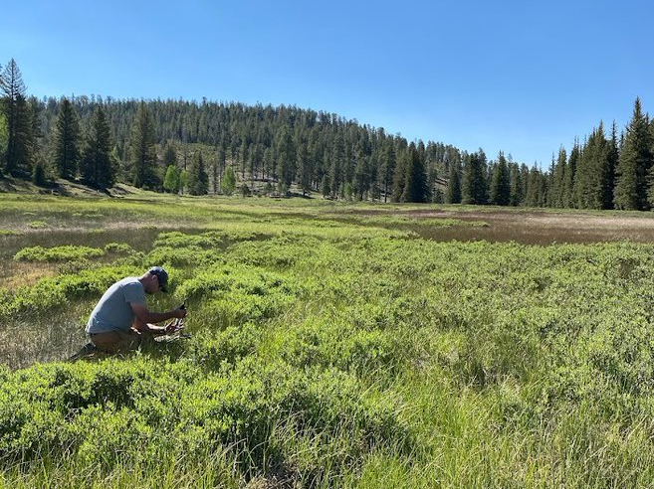
PARTNERS & OBJECTIVES
Partner: National Park Service, Bryce Canyon
  Tyra Olstad, Physical Scientist
Objectives:
  Apply sophisticated remote sensing techniques to:
    Detect springs, seeps, and groundwater-dependent ecosystems
    Examine changes in surface water presence and vegetation health
    Report changes in climate
  Create a framework for future applications
Image Credits: Public Domain & Tyra Olstad
Notes:
We partnered with the National Park Service in Bryce Canyon National Park to develop a groundwater-depended ecosystem monitoring framework. Sophisticated remote sensing techniques are not currently utilized by the partners to identify and monitor park hydrology and vegetation. Instead, they manually scour the landscape in Google Earth for indicative “green patches”, then verify their presence on foot. ArcGIS Pro is currently used to manage existing, albeit inaccurate, hydrologic and vegetation datasets. This project expanded their capability to monitor these systems with remote Earth observations, which included Landsat 8 and high-resolution PlanetScope imagery. The team used machine learning to predict and map the most likely places for mapped springs and seeps, visualized trends in the health of park vegetation, and charted climatic variables over time to investigate pervasive drought conditions. The fulfillment of these objectives will better inform partner management practices by improving their understanding of the location and status of these ecologically vital features in the park.
------------------------------Image Information Below ------------------------------
Image Credit: National Park Service
Image Source: https://en.wikipedia.org/wiki/National_Park_Service#/media/File:Logo_of_the_United_States_National_Park_Service.svg (public domain), extracted by user Smasongarrison
Image Credit: Tyra Olstad
Image Source: Provided by partner with permission to use.

Slide 3


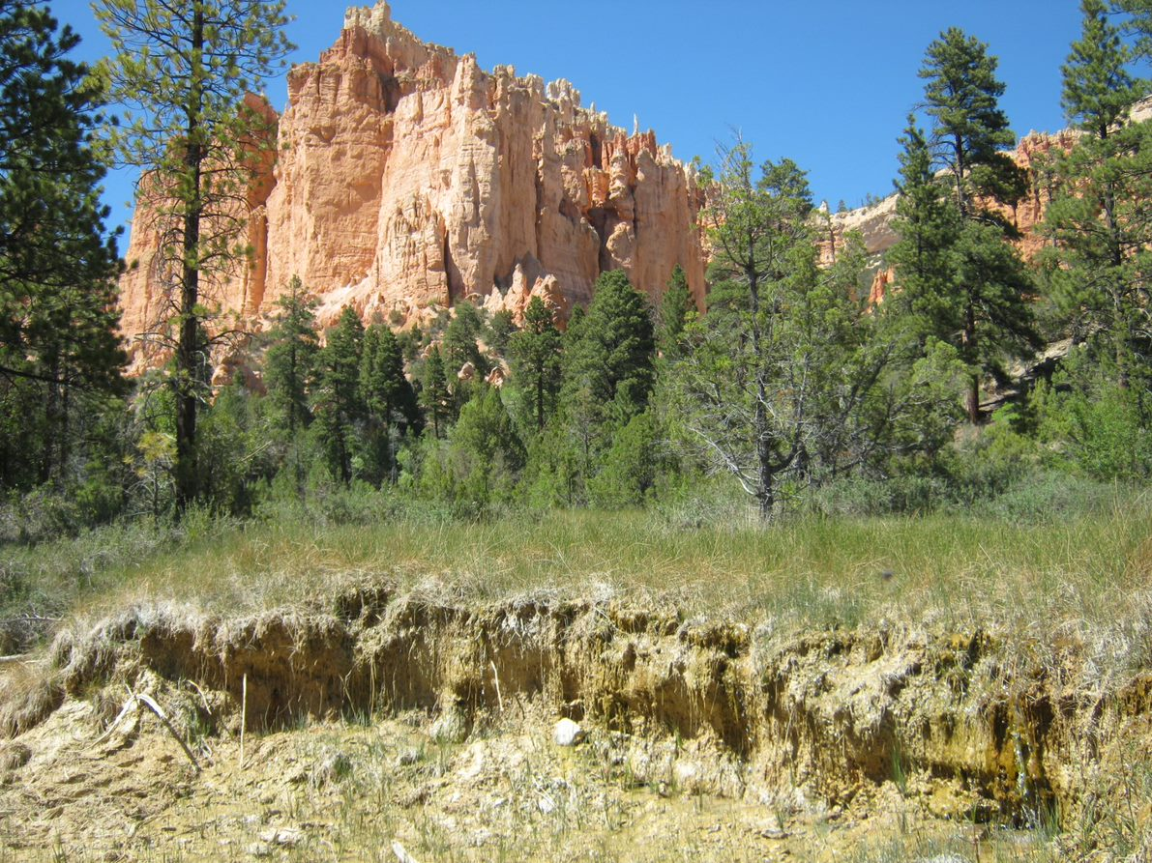

STUDY AREA & PERIOD
Bryce CanyonCity
12
Study Period: 2013–2022
Study Area: 35,835 acres
Tropic
Bryce Canyon
National Park
N
Yellow Creek spring in front of hoodoos
Image Credit: Tyra Olstad
0
5 Miles
Utah Geographical Resource Center
Notes:
Bryce Canyon National Park has an area of 35,835 acres and is located in southern Utah. The park sits at the top of the Paunsagunt Plateau and is split into three distinct ecosystem zones: the spruce/fir forest, the Ponderosa pine forest, and the pinyon-juniper forest. Bryce Canyon also boasts the highest concentration of irregular rock spires (“hoodoos”) and is one of the best locations for stargazing in the world. The park was declared an International Dark Sky Park in 2019, coinciding with a sharp increase in visitors to 2,594,904 in 2019.
------------------------------Image Information Below ------------------------------
Image Credit: Tyra Olstad
Image Source: Provided by partner with permission to use.
Image Credit: DEVELOP team
Image Source: Created by the NASA DEVELOP team

Slide 4
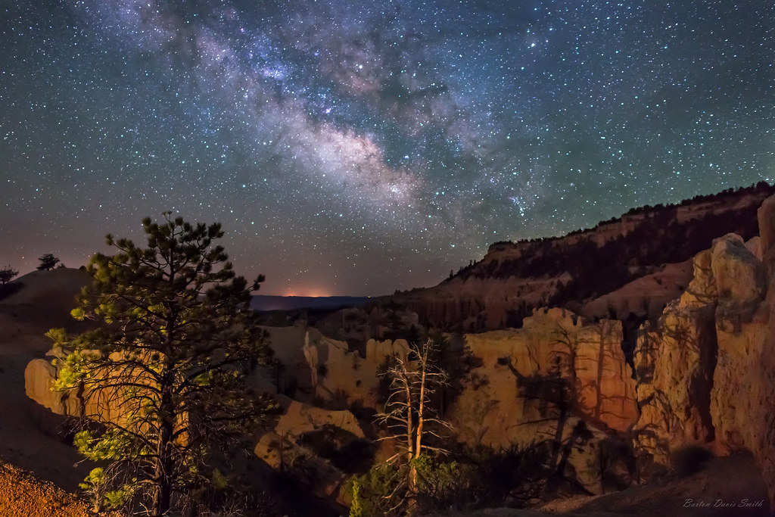
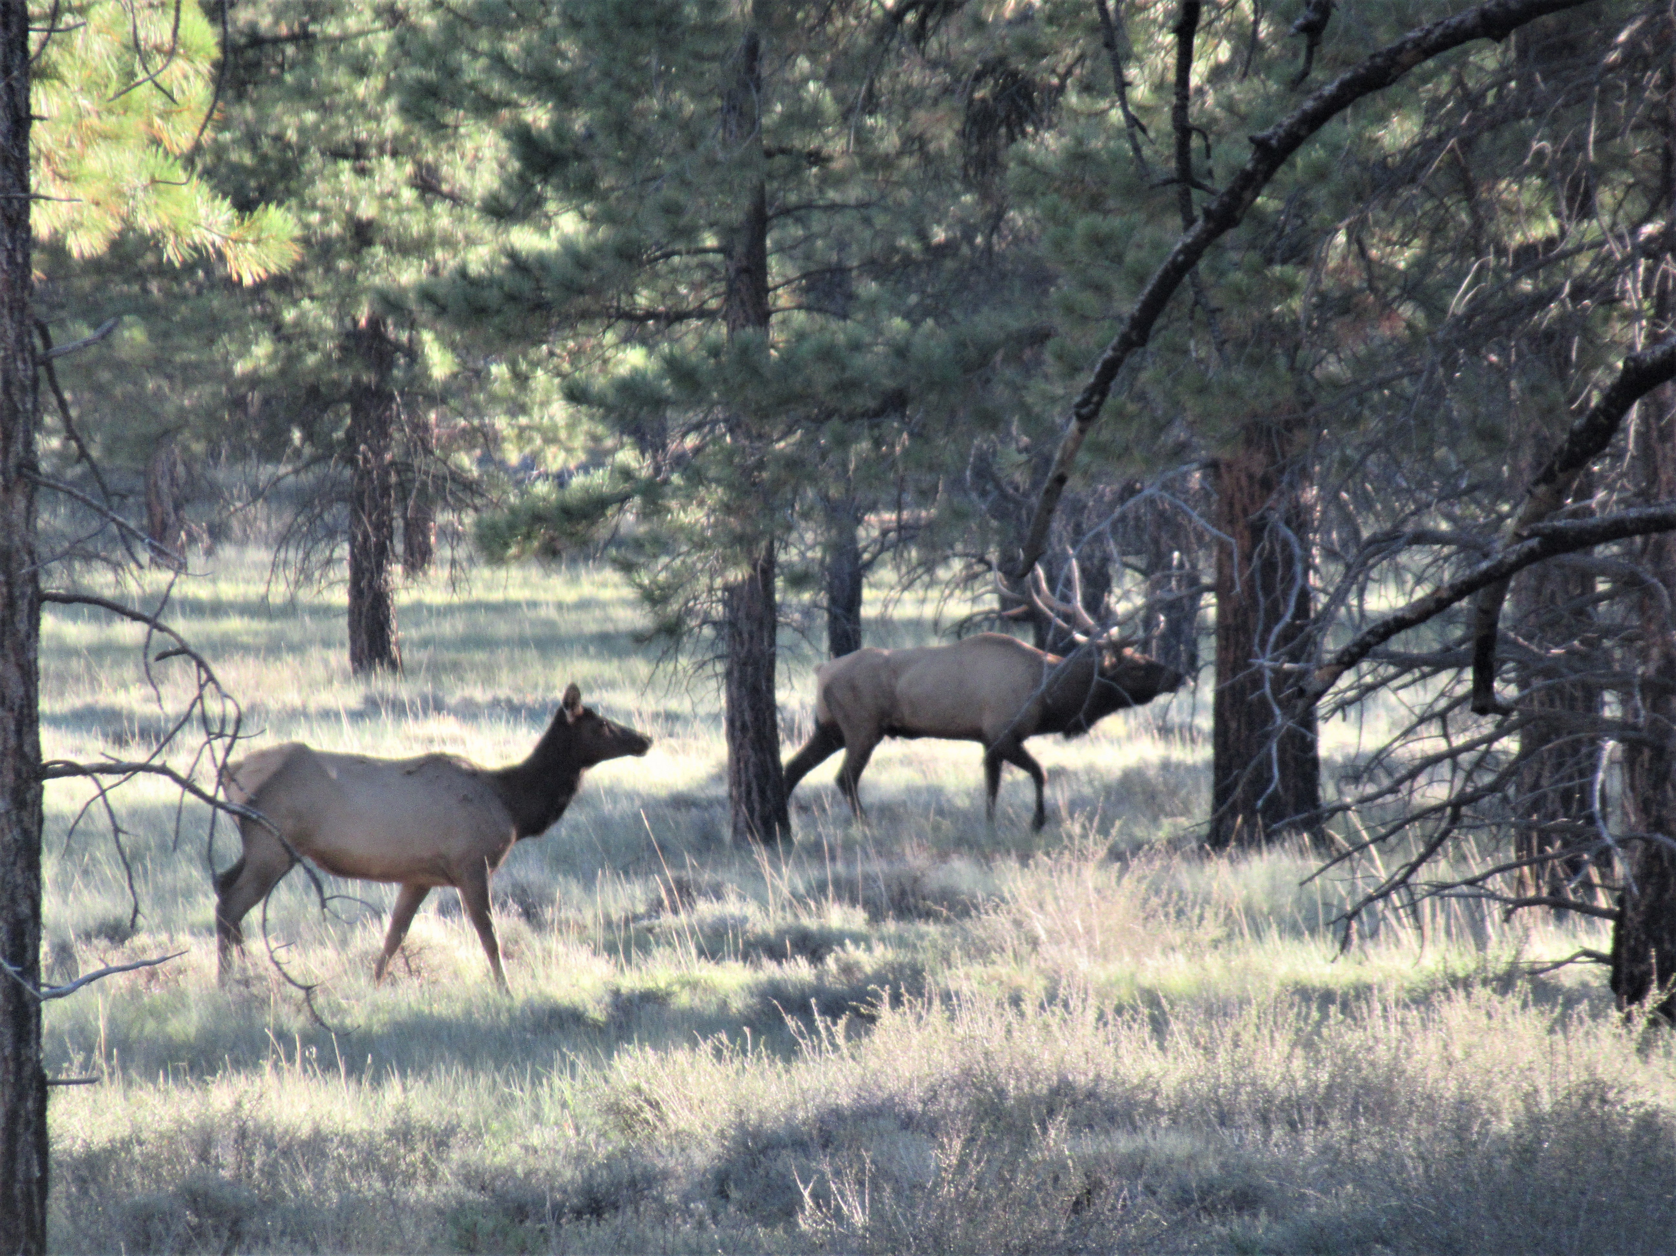
BACKGROUND INFORMATION
Groundwater Dependent Ecosystems
Unique species
Sensitive to changing climate
Image Credit: Barton Davis Smith
Park Tourism
Visitors increased from 890,676 in 2006 to 2,679,478 in 2018
Highest concentration of Hoodoos in the world
Designated Dark Sky Park in 2019
Image Credit: Tyra Olstad
Notes:
Bryce Canyon National Park is home to groundwater-dependent ecosystems (GDEs) that are threatened by a multidecadal drought and increased groundwater extraction due to a spike in tourism. These ecosystems contain unique species that are only found in areas where near-surface groundwater is present, such as aspen groves and fens. These species contribute to the high biodiversity found in Bryce Canyon, which boosts an ecosystem’s productivity and the services it provides to the park.
Groundwater dependent ecosystems (GDEs) are defined as communities that rely fully or partially on groundwater and become stressed in the absence of it (Gou et al., 2014; Orellana et al., 2012). GDEs provide structure and function for ecosystems in addition to valuable ecosystem services for humans, such as food production and water purification (Murray et al., 2006). Because of their sensitivity to change, these ecosystems are threatened by climate change and anthropogenic activities, such as drought and excessive groundwater pumping (Eamus et al., 2016). Only 19 states have implemented groundwater management legislation, and California is the only state in the United States to formally recognize GDEs in the Sustainable Groundwater Management Act (The Nature Conservancy, n.d.).
Bryce Canyon also boasts the highest concentration of irregular rock spires (“hoodoos”) and is one of the best locations for stargazing in the world. The park was declared an International Dark Sky Park in 2019, coinciding a sharp increase in visitors (2,594,904 people in 2019; National Park Service, 2022).
The terrain is very diverse, and groundwater discharge occurs in currently unpredictable locations. However, park staff have observed that GDEs often overlap sites of ground water expulsion. Therefore, this project aims to ultimately predict the location of springs and seeps as a proxy for GDEs, and to investigate the possibility of direct GDE detection.
------------------------------Image Information Below ------------------------------
Image Credit: Barton Davis Smith
Image Source: https://www.flickr.com/photos/bartman1958/35318101085 (Creative Commons, Attribution-NoDerivatives 4.0)
Image Credit: Tyra Olstad
Image Source: Provided by partner with permission to use.

Slide 5
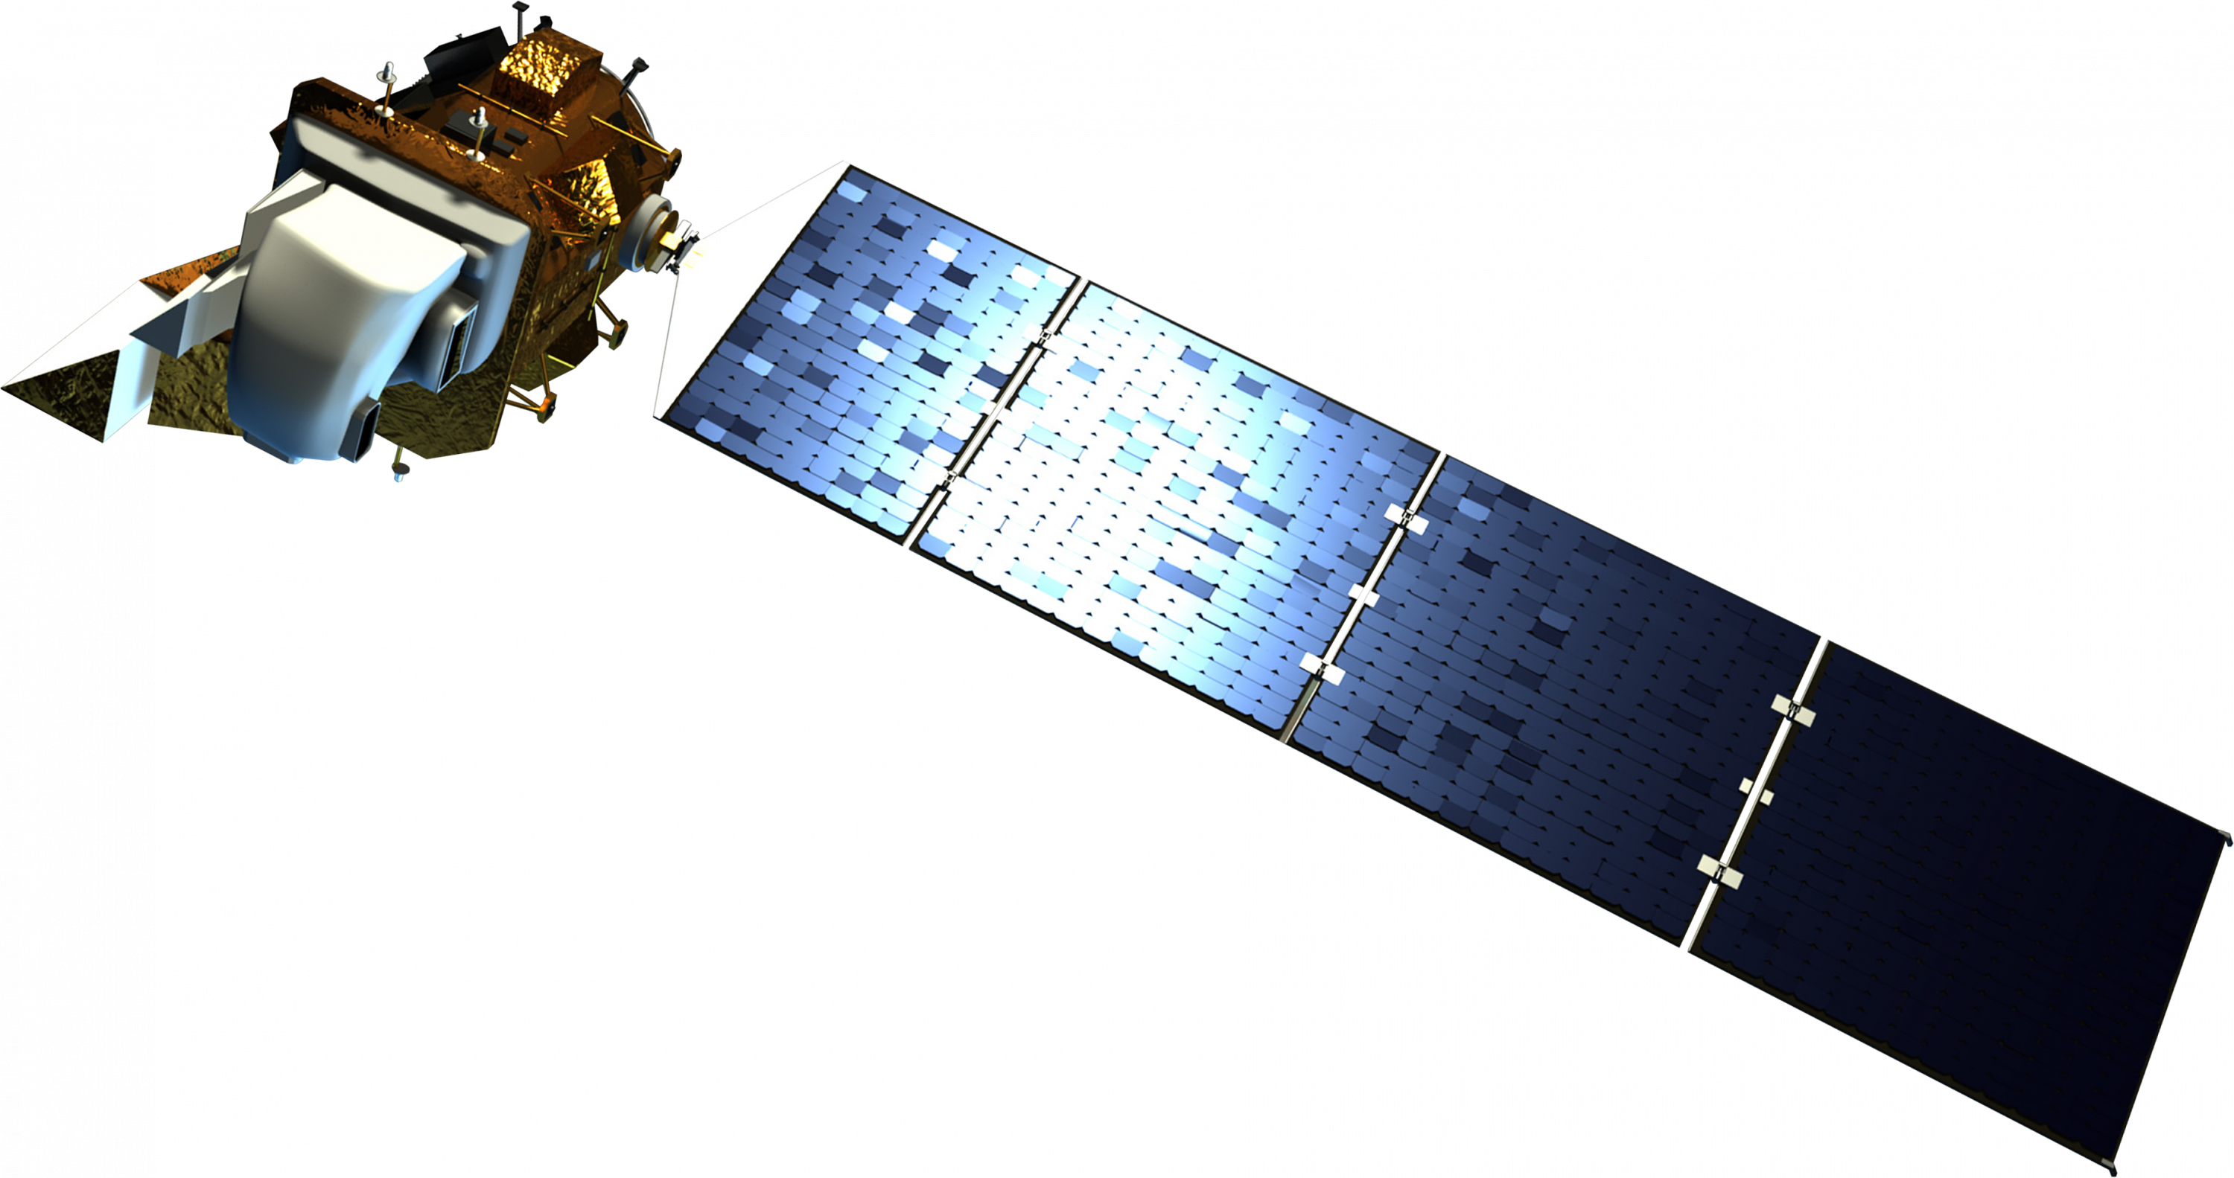
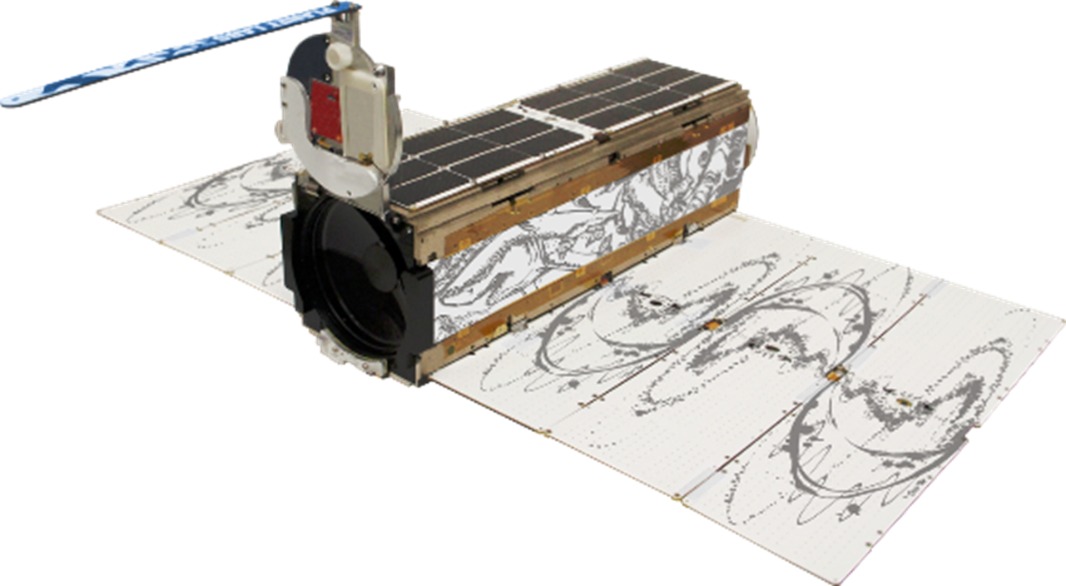
EARTH OBSERVATIONS
Landsat 8 OLI
PlanetScope DOVEs
Image Credits: NASA, Planet
Notes:
Our project utilized two Earth observations to sustain most of our end products: Landsat 8 Optical Land Imager and the PlanetScope DOVE constellation. We used 2013-2022 imagery from Landsat 8 OLI and 2017-2022 DOVE data to generate change maps of park-wide vegetation and create time series of health indicators. The DOVE cube satellite constellation provided a high spatial and temporal resolution useful in Bryce-wide analysis, but National Agriculture Imagery Program data was alternated to for spring and seep identification in our random forest. This model was supplemented with Utah Geologic Survey geologic data, aerial Utah Geospatial Resource Center LiDAR elevation data, and the US Department of Agriculture's SSURGO soil types. We used a dataset from the NPS of known springs and seeps as training data in the random forest. Lastly, our climatic time series analysis was enriched with modeled Western Land Data Assimilation System data and in-situ precipitation data from 1979 to present.
PLACEHOLDER add about LiDAR
------------------------------Image Information Below ------------------------------
•Image Credits for Satellite Renderings: NASA, Planet
•Image Sources: Spacecraft Icons | Science Mission Directorate (nasa.gov), Direct email from Planet

Slide 6



METHODOLOGY: NDVI & NDWI ANALYSIS
Using Annual May/April Imagery From:
PlanetScope DOVEs (PlanetExplorer)
How has vegetation and water changed in space?
Change Maps
2017 – 2022
Landsat 8 OLI
(USGS)
How have they changed over time?
Google Earth Engine
Time Series
2013 – 2022
NAIP Imagery
(USDA)
Are spring and seep NDVI/NDWI values statistically unique?
Direct Detection
2018
Notes:
Our first two objectives, which were to detect GDEs, springs, and seeps and to understand the presence and change of park vegetation and surface water, were initially addressed through a pair of difference indices. The Normalized Difference Vegetation Index and Normalized Difference Water Index are two indicators for detecting the presence and health of these features. We ordered 3-meter resolution PlanetScope imagery for the dry-season in April or May for 2017-2022, which is an ideal time for high NDVI contrast between consistently-watered GDEs and stressed vegetation. However, NDWI was found to be inapplicable as surface water was not detectable in our imagery so we focused on NDVI. We masked shadows caused by hoodoos and cliff features in Bryce Canyon with a random forest model, and we also masked out clouds and snow when necessary in the PlanetScope and Landsat imagery's built-in quality flags. NDVI statistics were then extracted from the imagery over the whole of Bryce Canyon and at 73 points of known springs and seeps to generate vegetation health time series. We were then able to investigate for a distinct NDVI signal associated with the presence of known springs and seeps, but direct detection was disproven through statistical tests. Landsat 8 OLI provided 30-meter imagery of a similar criteria prior to 2017 and to the present. These data were either uploaded into or pulled from Google Earth Engine, where change maps and general trend analyses were created by calculating the difference between our periodic values.

Slide 7
METHODOLOGY: Predictive Modeling
NDVI
Evapotrans-piration
NDWI
Groundwater-Dependent Ecosystem?
Land Surface Temp
Elevation
Soil Moisture
Slope
Distance to Geological Formations
Notes:
The team ran Machine Learning models: random forest classification and maximum entropy models using ArcGIS Pro 3.0.2 and inputs of various remote-sensed radiation, topographic variables, and climatological variables. The variables considered were
Soil Moisture (to 40cm), Evapotranspiration, Surface Temperature (all from WLDAS)
Elevation (from LIDAR provided by NPS but from UGRC)
Slope (calculated from LIDAR elevation)
NDVI (from NAIP 2021, USDA)
NDWI (from NAIP 2021, USDA)
Distance to geological features (from UGS and altered by NPS) and fault lines (from UGS)
Distance to soil type boundaries (from the USDA’s SSURGO)

Slide 8
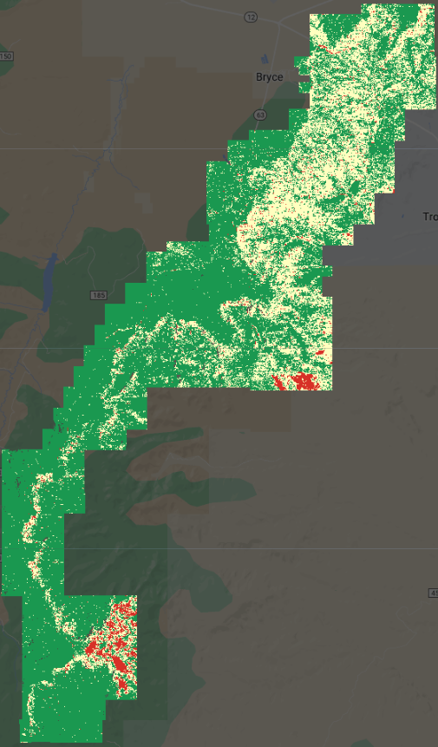

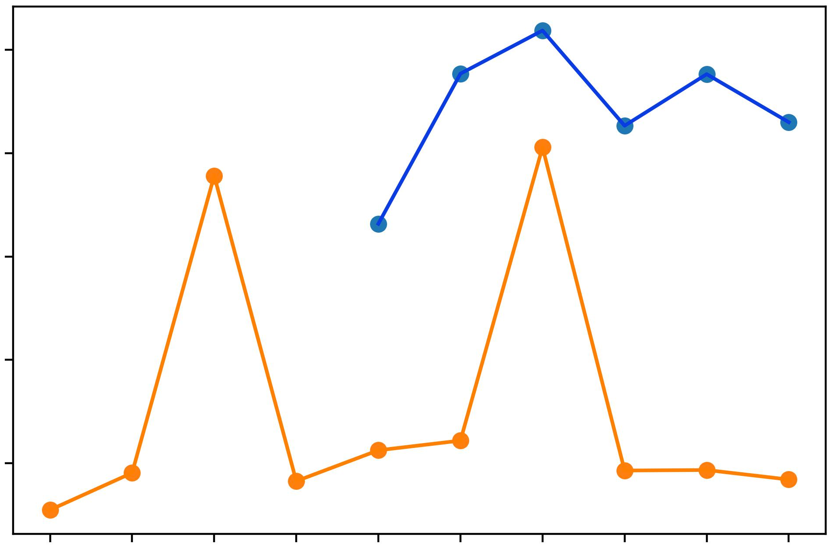
Bryce Canyon
NDVI Change
Planet, 2017 to 2022
RESULTS: Vegetation Change
Bryce Canyon Average NDVI
Planet & Landsat, April/May 2013–2022
N
0.35
PlanetScope
Landsat
0.30
NDVI
0.25
0.20
+ 1 to + 2
0.15
+ 1 to – 1
- 1 to – 2
2013
2014
2015
2016
2017
2018
2019
2020
2021
2022
0
5 Miles
Year
Google Earth Engine
Notes:
The first use of our data was to determine temporal changes in vegetation health through the use of NDVI. We did so both through time series and change maps with both PlanetScope and Landsat imagery.
Landsat estimated NDVI values lower than PlanetScope, but both showed the same general trends between 2017 and 2022. 2019 was a common peak NDVI year as observed by both OLI and the DOVEs.
Spatially, the most extreme decreases in vegetation health from 2017 to 2022 have occurred in the southeast and east corners of the park. These areas both fall below the upper plateau, and areas above the rim have generally seen the healthiest increases in vegetation. The edge of the rim and northern portion of Bryce Canyon persist as areas of minimal vegetation change. However, the upper plateau has experienced the largest improvement in vegetation well-being between 2017 and 2022. Overall, vegetation health increased in 38 square kilometers of the park which is over four times the amount of area that experienced decline during the same time period.

Slide 9
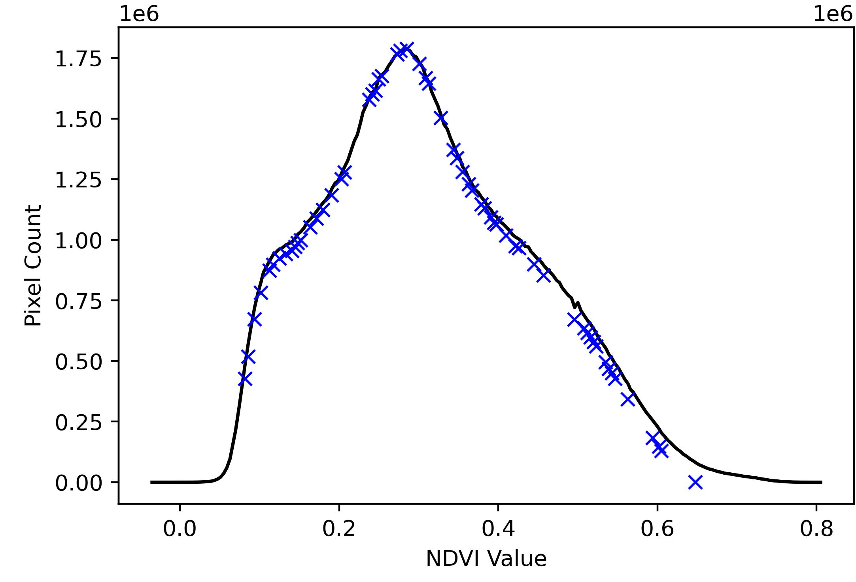
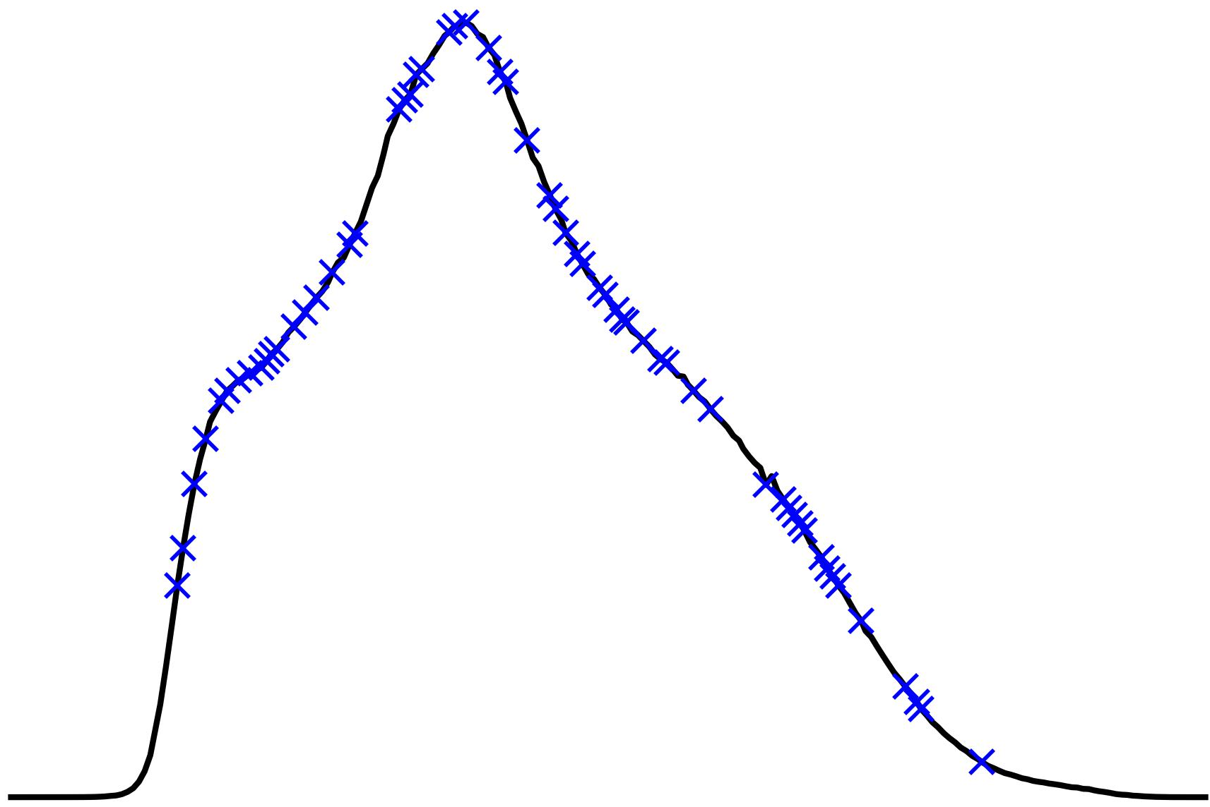
RESULTS: Detection with NDVI
Bryce Canyon NDVI Histogram
Planet, 05/14/2022
1.75
1.50
Known Spring/Seep
Bryce Canyon NDVI Table
6 Annual April/May Images, 2017–2022
1.25
Overall Mean | Springs & Seeps Mean | Z-Score | P-Value
0.322 | 0.287 | -0.271 | 0.787
Pixel Count (1e6)
1.00
0.75
0.50
Two-Tailed Z-Test
H_{o}: µ = µ_{o}
H₁: µ ≠ µ_{o}
0.25
0.00
0.0
0.2
0.4
0.6
0.8
0.0
0.2
0.4
0.6
0.8
NDVI
Notes:
After assessing vegetation health on a park-wide scale, we then considered the use of NDVI in directly detecting springs and seeps. We found that the values of NDVI at known springs and seeps area appeared randomly distributed along the Bryce Canyon NDVI histogram. These images were selected during April or May, as at this time of year GDEs are being consistently watered by subsurface water and all other vegetation is stressed by low precipitation. GDEs were hypothesized to have been most perceivable against contrasting stressed vegetation, but this was not the case. A two-tailed Z-test confirmed this, and provided a probability value of 79% that the overall NDVI mean is equal to that of the mean springs & seeps. Because NDVI is too similar at springs and seeps against the rest of the landscape, it could not be used as a single detector for their presence. We then moved on to the random forest and entropy models to determine other reliable indicators of their occurrence.

Slide 10
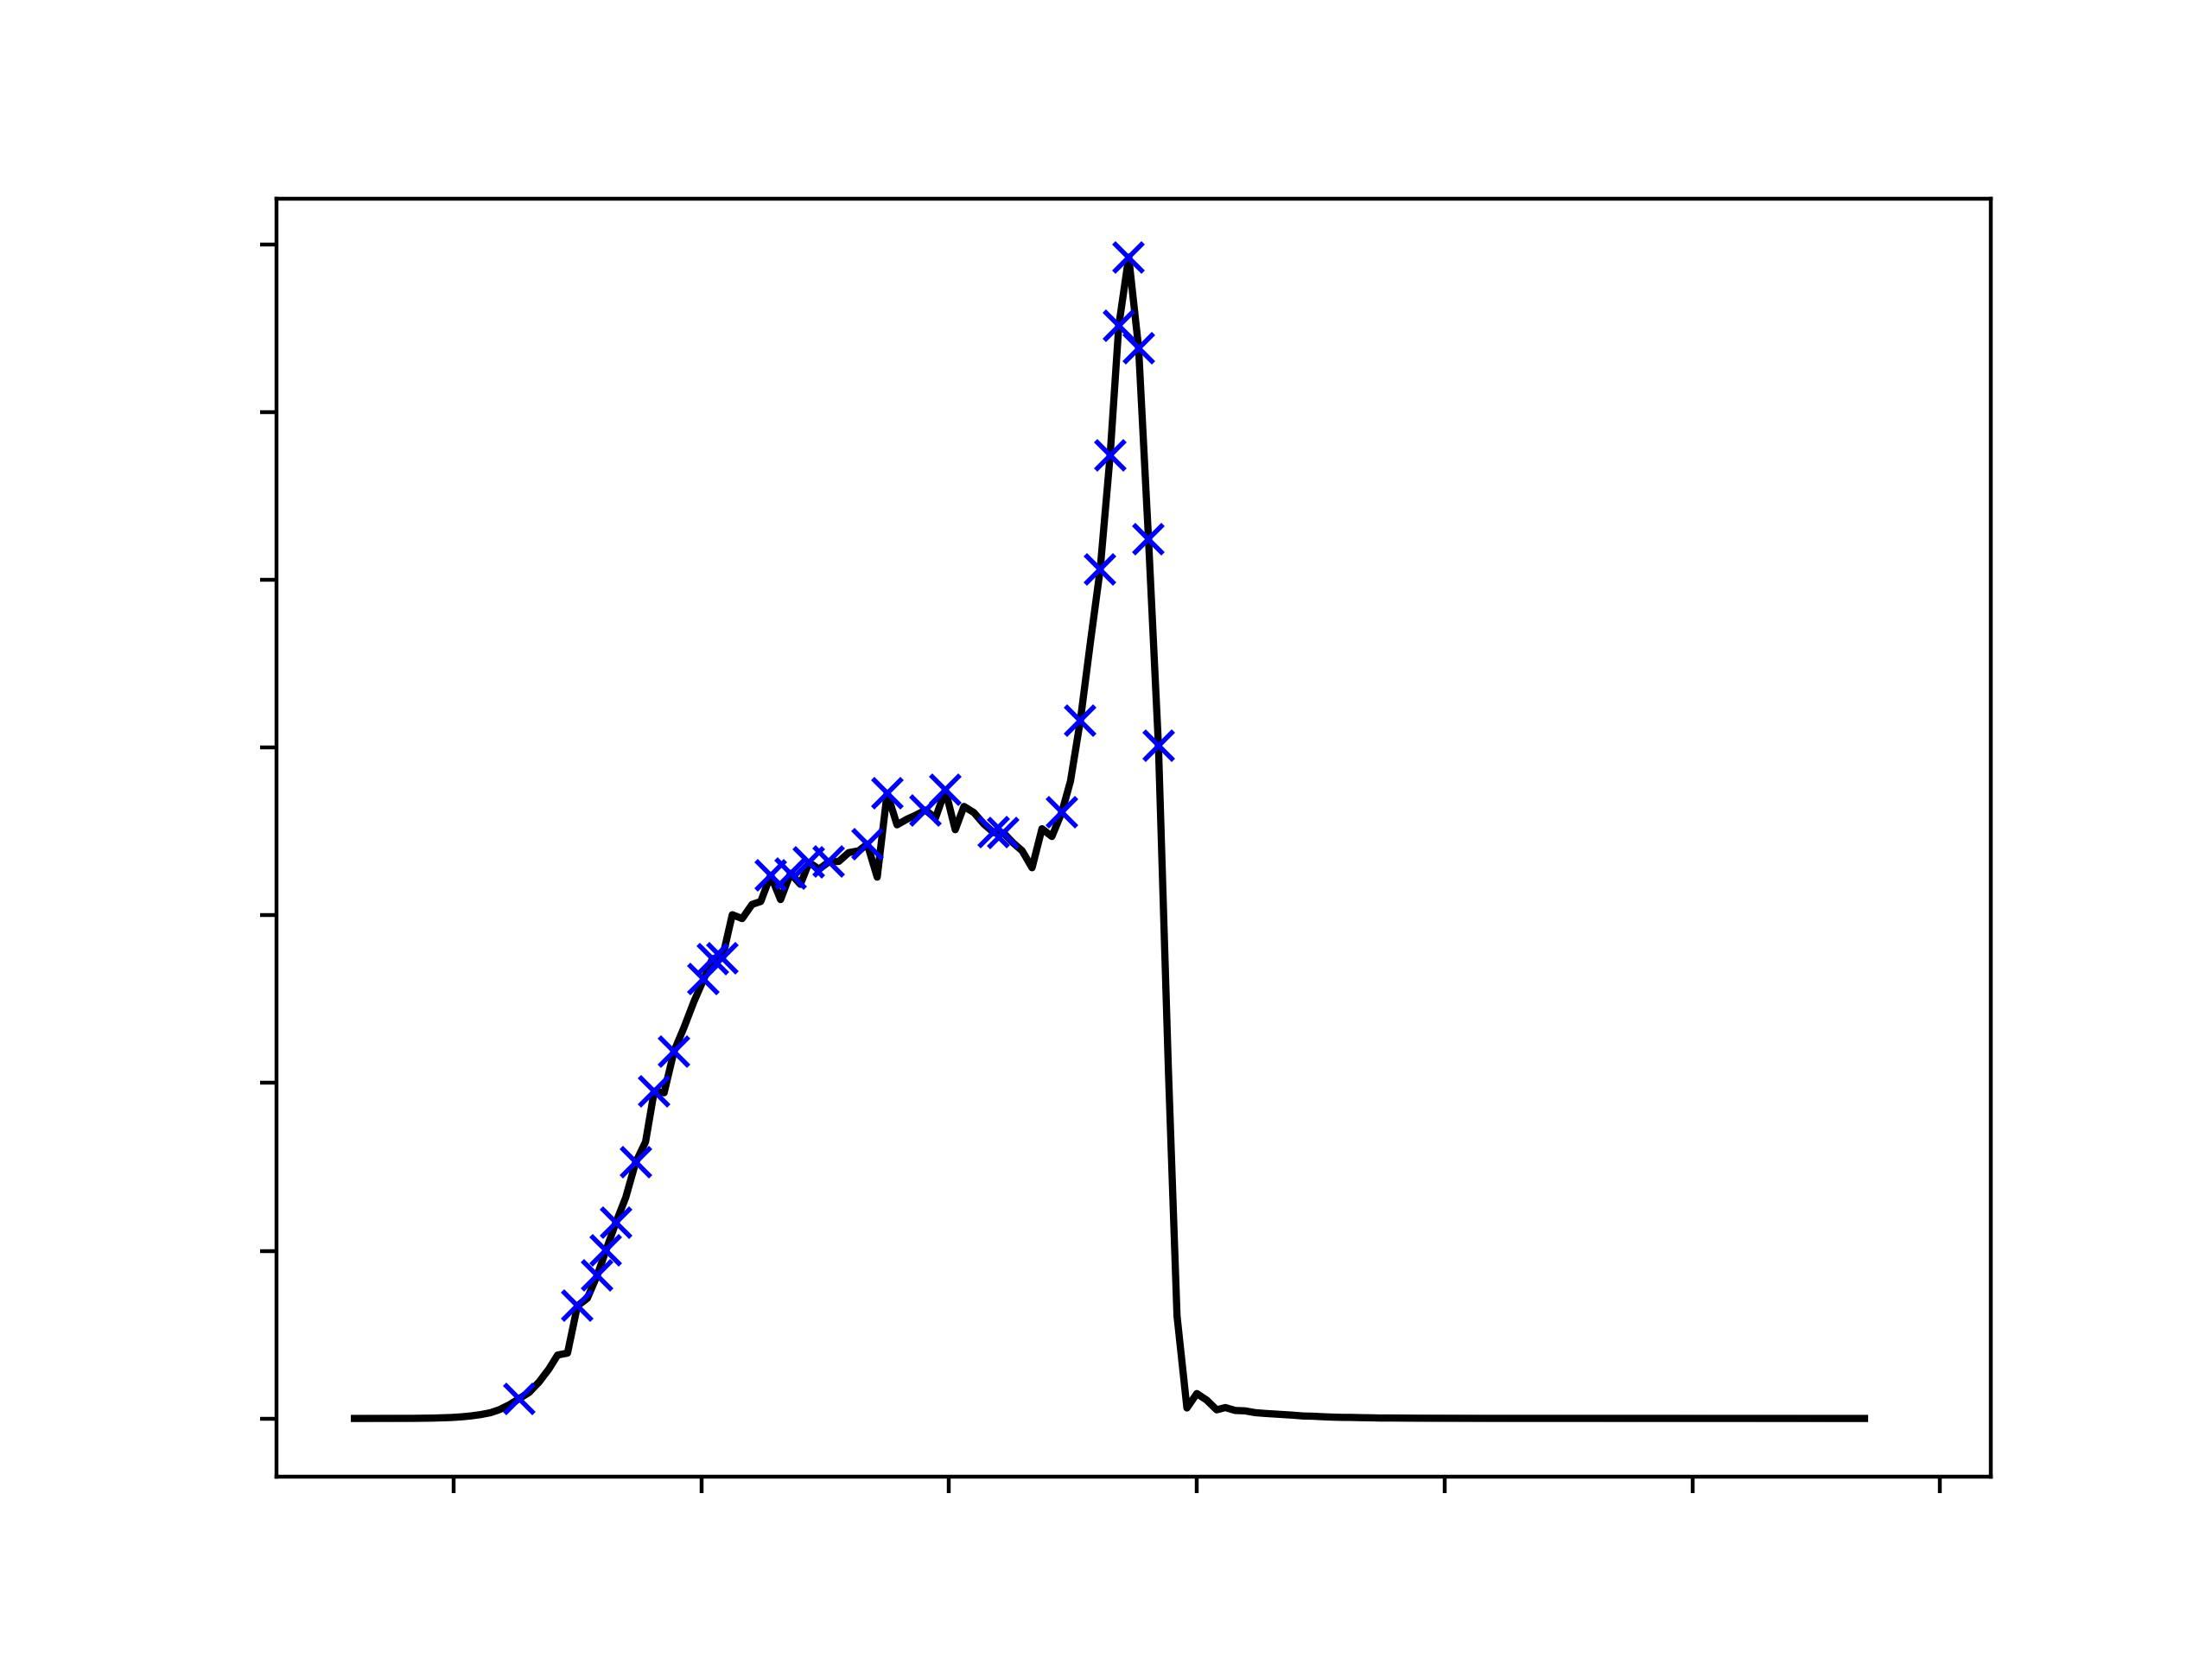
Results: NDWI Surface Water & Change
Bryce Canyon NDWI Histogram
NAIP, 08/06/2018
1.75
Known Spring/Seep
1.5
1.25
1.0
Pixel Count (1e7)
0.75
0.5
0.25
0.0
-0.6
-0.4
-0.2
0.0
0.2
0.4
0.6
NDWI
Notes:
NDWI was tested on the highest resolution imagery that we had, which was 0.6-meter NAIP imagery. The histogram for NDVI values for the entire park were all under 0 and we found that the values of NDWI at known springs and seeps area appeared randomly distributed along the histogram. This did not make sense because if there was surface water in the park, the NDWI values would show up positive and closer to 1. Trying out NDWI for PlanetScope imagery was a bust since if NDWI values could not be detected for high resolution NAIP imagery, it would definitely not be detected for 3-meter PlanetScope imagery. When clicking around the values for NDWI, it seemed like some shadows and bare soil came up as positive while other values came up as negative. Overall, NDWI proved to be unreliable for detecting the locations of springs and seeps and since there seemed to be no surface water detected, change maps were not produced.

Slide 11
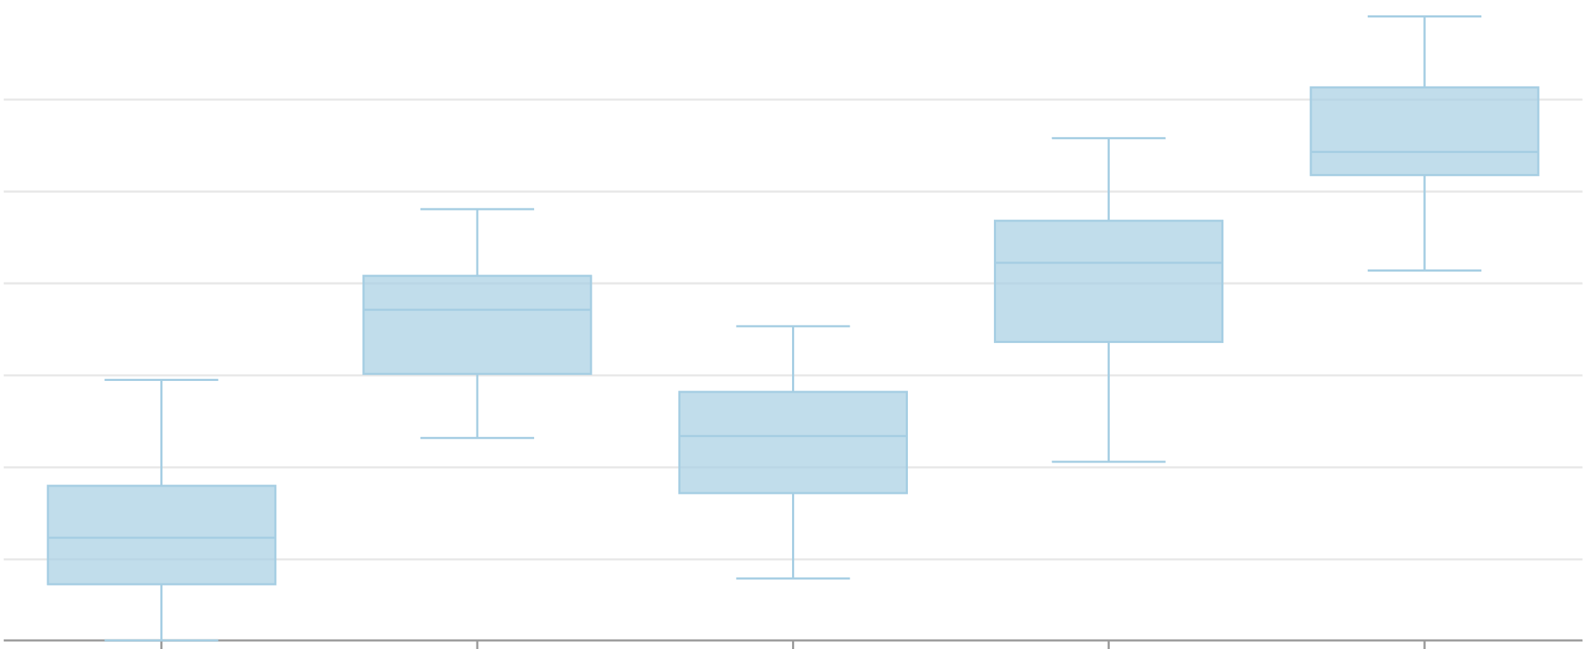
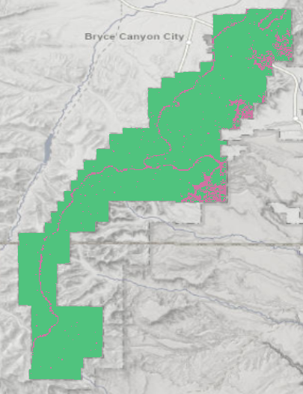
Results: Random Forest Model
1.8
1.7
1.6
Importance
1.5
1.4
1.3
Elevation
Distance to Geologic Formation
Distance to Soil Boundary
NDVI
Slope
Distribution of Variable Importance
Validation Classification
 | Seep/Spring (observed) | Not Seep/Spring (observed)
Seep/Spring (predicted) | 56% | 92%
Not Seep/Spring (predicted) | 44% | 8%
0
5 Miles
UGRC , UGS, USDA
Notes:
Used 73 identified Seeps and Springs and 1000 randomly-generated points as negative cases
Did Random Forest Classification Analysis in ArcGIS Pro 3.0.2. Random Forest randomly selects portions of the dataset and creates a decision tree from the data. We programmed the model to do this 100 times, then the algorithm makes the best decision tree from the different runs.
Final Model included Slope, Elevation, NDVI (from NAIP 2021, USDA), distance to geological features, and distance to different soil types (from the USDA’s SSURGO)
Most important were Slope, NDVI, distance to geological features, distance to soil type boundaries, elevation
Training Accuracy was 0.89, Testing Accuracy was 0.86, with 10% of points excluded from training.
Although the final model had a 86% testing accuracy, the output prediction map is not especially useful as there are too many points to be able to investigate on foot and no clear priority for which points are most likely to be GDEs

Slide 12
Results: Maximum Entropy Model
N
N
N
Predicted Probability of Seep or Spring
0.90 to 1.00
0.75 to 0.90
0.90+
0.50 to 0.75
0
3 Miles
0.00 to 0.50
UGRC , UGS, USDA
90% Seep or Spring Locations
Image Credit: DEVELOP Team
0
5 Miles
UGRC , UGS, USDA
Probability of Seep or Spring Location
Image Credit: DEVELOP Team
Notes:
Maximum Entropy (presence only) models assume that there are more likely points in unidentified areas. The model gives 50% of known seeps and springs a probability of 90% or more
Model run in ArcGIS 3.0.2
Darker purple = more likely to be seep or spring
Included same variables as the Random Forest Model
Many of the 90% and above locations are located in the Yellow Creek area
------------------------------Image Information Below ------------------------------
Image Credit: DEVELOP team
Image Source: Created by the NASA DEVELOP team

Slide 13
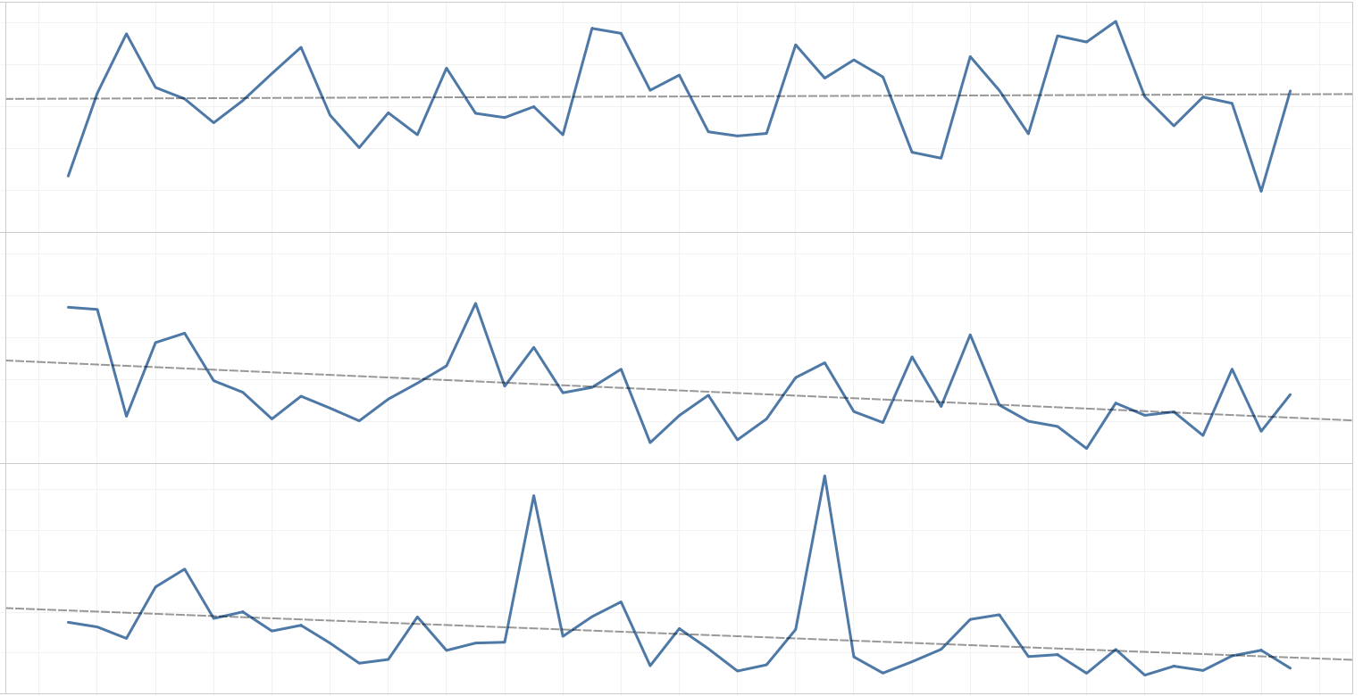
RESULTS: Precipitation Time Series
40K
Rainfall (mm/yr)
30K
20K
10K
0K
40K
30K
Snowfall (mm/yr)
20K
10K
0K
1000
800
Snow Sublimation
(mm/yr)
600
400
200
0
1980
1985
1990
1995
2000
2005
2010
2015
2020
Notes:
Rainfall increased about 25 mm per year, or about 1,000 mm since 1979
Snowfall decreased about 310 mm per year or about 13,000 mm since 1979
Snow Sublimation decreased about 5 mm per year or 230 mm since 1979
All variables from WLDAS model

Slide 14
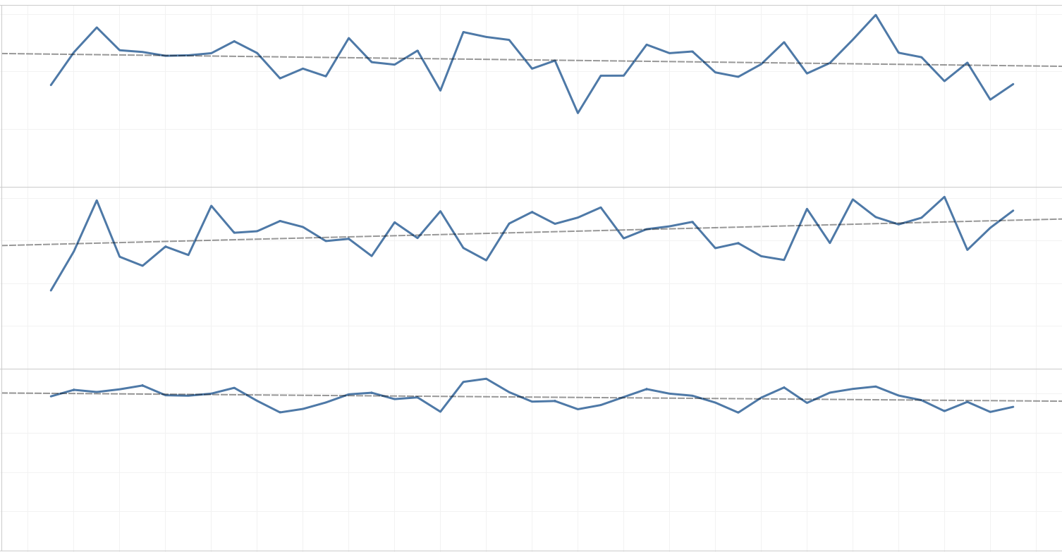
RESULTS: Climatic Time Series
150M
100M
Evapotranspiration (mm/day)
50M
0M
8
6
Land Surface Temp (C)
4
2
0
0.20
0.15
Soil Moisture (m/m)
0.10
0.05
0
1980
1985
1990
1995
2000
2005
2010
2015
2020
Notes:
Evapotranspiration decreased 240 kg/day per year or about 10,000 kg since 1979
Land Surface Temp increased 0.025 degrees Celsius per year, or 1.1 degrees since 1979
Soil Moisture (0-40 cm below the surface) did not statistically significantly change (at the 0.05 level) year to year
All variables from WLDAS model

Slide 15
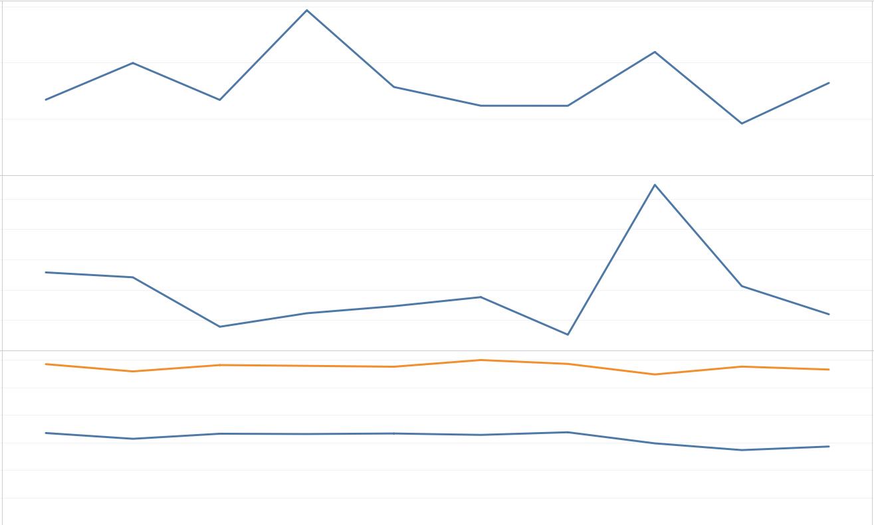
RESULTS: In Situ Time Series
30
20
Precipitation
(in/year)
10
0
10
8
6
Snow Depth
(in)
4
2
0
50
40
Max/Min Temp
(F)
30
20
10
0
2012
2013
2014
2015
2016
2017
2018
2019
2020
2021
Notes:
In Situ Data is similar to WLDAS modeled data, with precipitation peaks in 2015 (rainfall) and 2019 (snowfall), and a dip in 2020
High 2019 Snow Depth driven by Feb 2019 snow depth averaging 47" and topping at 65.98"
Trends are not as clear, with outlier months potentially skewing the data.
- Precipitation is down an average of .36 inches per year
- Snow Depth increasing 0.08 Inches per year
- Max Temperature decreasing by 0.1 degrees Fahrenheit each year
- Min temperature changes nto statistically significant
All variables from WLDAS model

Slide 16
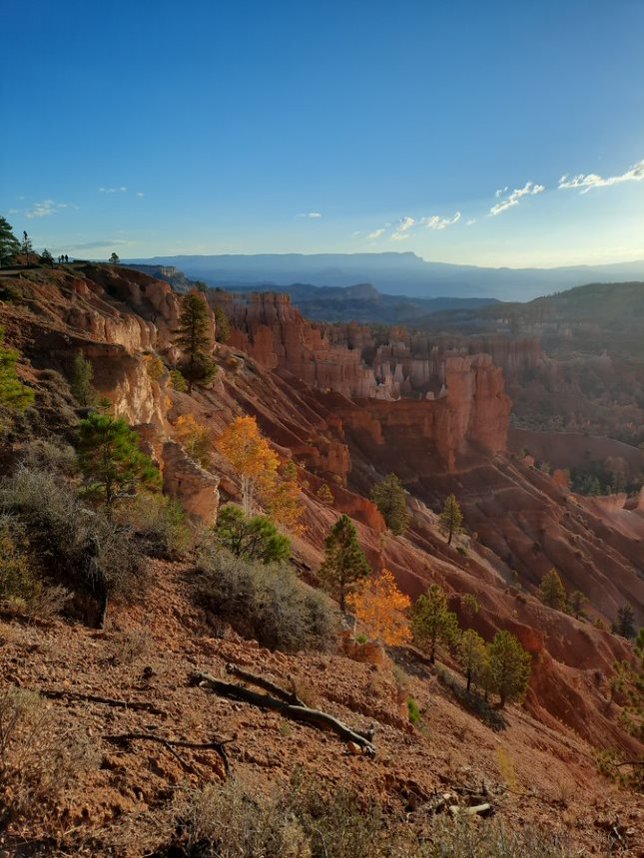
CONCLUSIONS
NDVI and NDWI alone are not a reliable indicator of spring and seep presence
Maximum Entropy model predicted the probability of where springs and seeps were located
Snowfall and snow sublimation has decreased since 1979, but rainfall has remained relatively consistent
A slope in Bryce Canyon covered in autumn foliage.
Image Credit: Tyra Oldstad
Notes:
At the end of this project, the team learned that multiple factors are needed for detecting springs and seeps in Bryce Canyon National Park. NDVI is helpful for informing the effect of climatic trends in terms of vegetation health overall in the park and for the random forest model, but not for detecting the springs and seeps alone. NDWI was supposed to be used to detect the presence of surface water and to demonstrate surface water change in Bryce Canyon but was not applicable to our specific project due to two possible reasons: the springs and seeps are too small for how course the imagery resolution is, or the region is too arid for the index since there is great contrast between shadows and bare soil. The team believes that NDWI could be used in future studies that use higher resolution imagery. Maximum Entropy model was able to predict the probability of where springs and seeps were located based on environmental variable inputs. 2019 was also a year of high snowfall and low rainfall, suggesting a particular importance of the former in contributing to park vegetation health.
------------------------------Image Information Below ------------------------------
Image Credit: Tyra Olstad
Image Source: Provided by partner with permission to use.

Slide 17

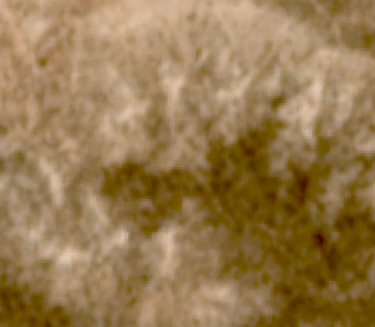
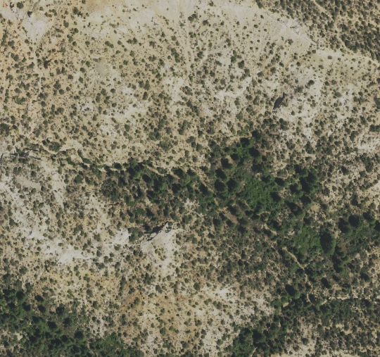
FUTURE WORK
Request and collect aerial thermal imagery
  Groundwater discharge may have a distinguishable temperature in thermal imagery
Utilize park stratigraphy
  Geologic factors may be a reliable indicator of spring and seep occurrence
Use different machine learning/statistical approaches
Utilize high evapotranspiration importance through OpenET
Landsat
PlanetScope
NAIP
Notes:
Bryce Canyon National Park is host to many unique features, and perceiving these features from orbit is no easy task. Although GDEs and hydrologic systems are ecologically impacting to Bryce Canyon, their size makes it difficult to identify and monitor them from orbit. Therefore, future teams should seek new methods of identification outside traditional indices and bands. For example, drone or aerial thermal imagery may be requestable for groundwater discharge identification. Groundwater is at a more constant temperature than surface water, so it may be distinguishable in colder months. NDWI use is limited due to the shallowness, turbidity, and thinness of existing discharges, but a thermal signature should be more recognizable. Park geology may be another reliable indicator of spring and seep occurrences. Our partner has observed that groundwater discharge often occurs along fault lines and/or above an impermeable layer in the Straight Cliffs formation. With more developed geologic data, future teams may be able to interpolate suitable spots for springs and seeps to occur. Finally, according to the Random Forest model, evapotranspiration from WLDAS was favored out of all of the input variables. OpenET could be a great resource for 30-meter modeled evapotranspiration data but must be contacted early for access to data in a reasonable amount of time. The team this term contacted OpenET during week 4 and unfortunately did not get full access to the API until week 8.

Slide 18
Partner
  Tyra Olstad (National Park Service, Bryce Canyon)
Science Advisor
  Sean McCartney (NASA Goddard Space Flight Center, Science Systems & Applications, Inc.)
Fellows
  Carli Merrick (NASA Goddard Space Flight Center, Science Systems & Applications, Inc.)
  Nicole Ramberg-Pihl (NASA Goddard Space Flight Center, Science Systems & Applications, Inc.)
Additional Support
  Dr. Jessica Erlingis (NASA Goddard Space Flight Center & University of Maryland)
Notes:
Thank you for your attention and attendance today. We would like to recognize and thank our present fellow, Carli Merrick, and science advisor, Sean McCartney, for their always-present guidance, as well as Nicole Ramberg-Pihl for establishing the project. We would also like to sincerely thank our partner at the National Park Service, Tyra Olstad, for her enthusiasm and informativeness throughout the term. Lastly, we also want to thank Dr. Jessica Erlingis for her collaboration in generating and delivering WLDAS data. We will now take any questions.

