Slide 1
LCRD Experiment Program

Slide 2
Agenda
LCRD Mission Overview & Architecture
LCRD Development & Activation Summary
LCRD Experiment Program Overview
LCRD Experiment Portfolio
LCRD Current Status

Slide 3
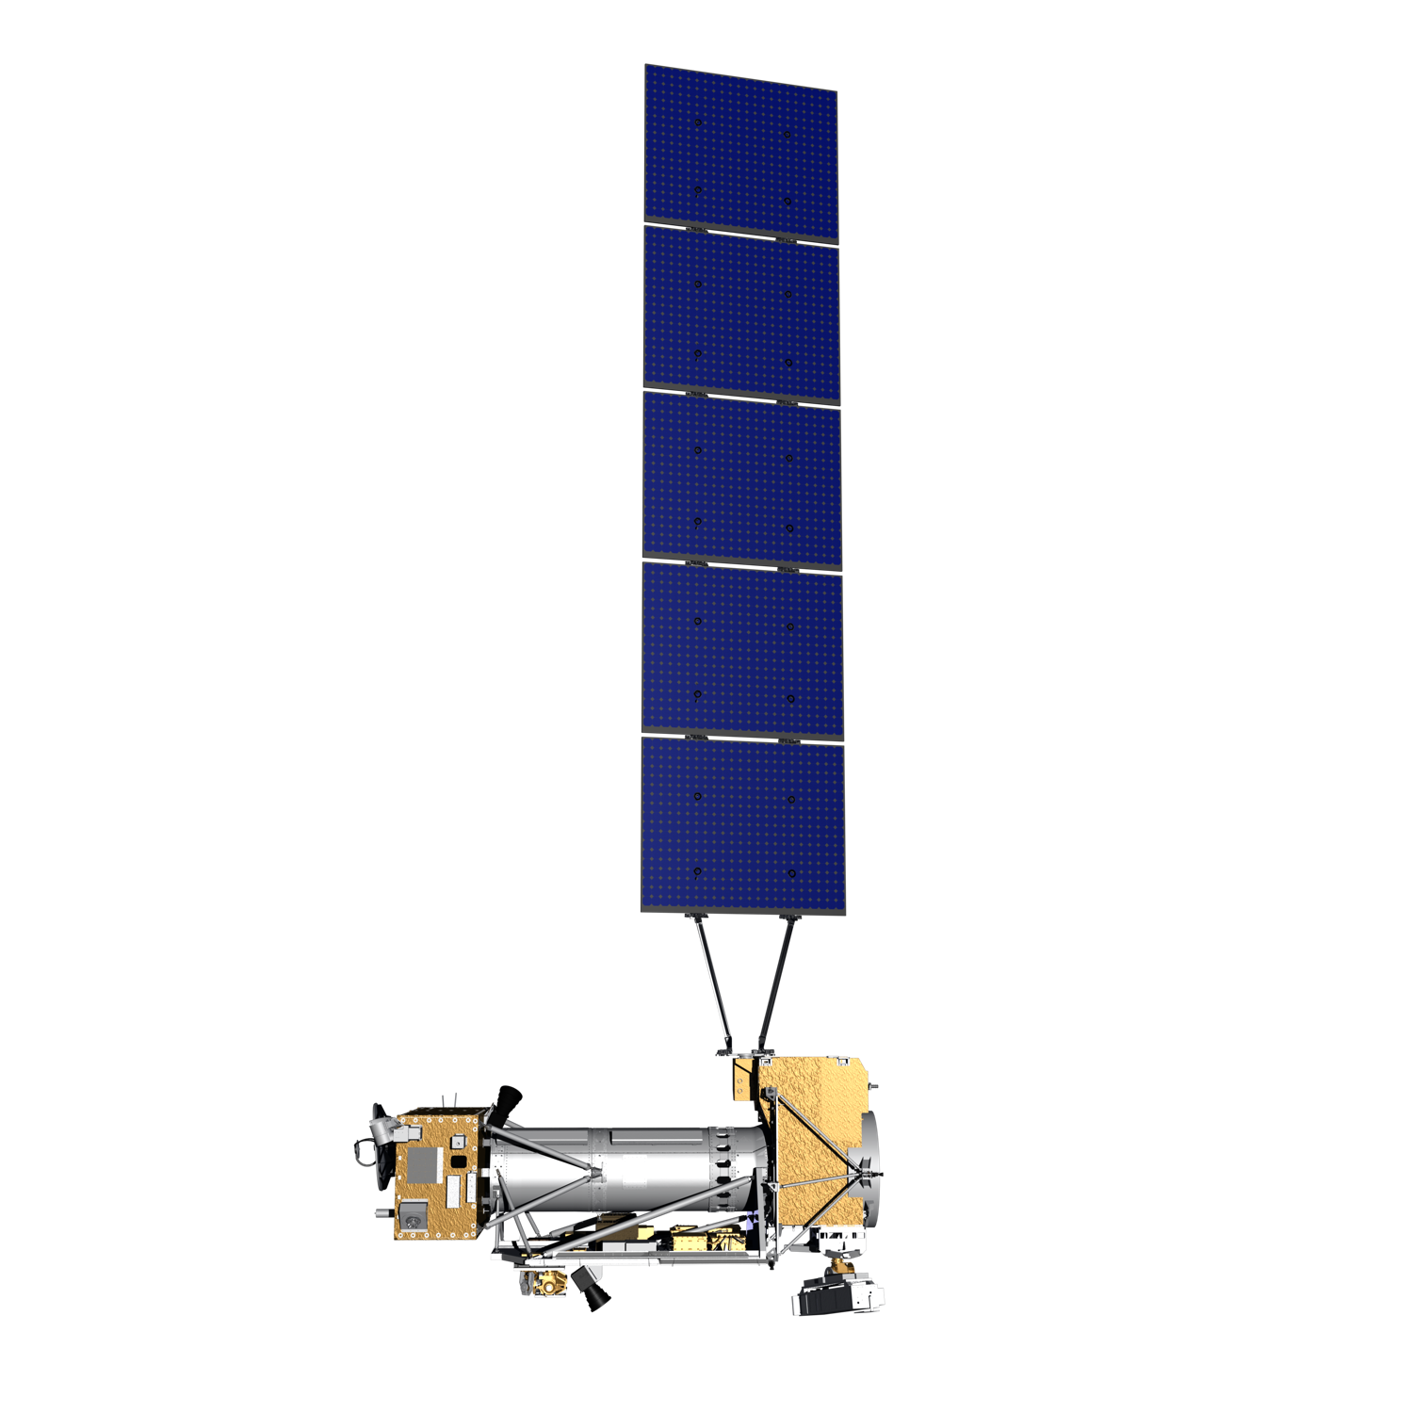
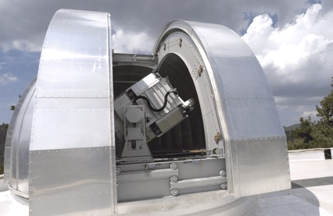
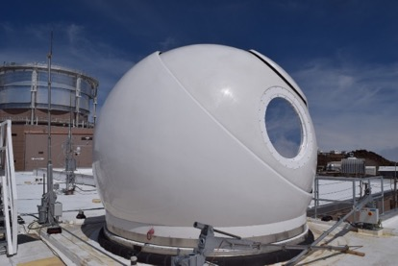
LCRD Mission Overview
Demo Description:
A minimum two-year flight demonstration (goal of five years) to advance optical communications technology toward infusion into deep-space and near-Earth operational systems while growing the capabilities of industry sources.
Objectives:
Demonstrate bidirectional optical communications between geosynchronous Earth orbit (GEO) and Earth
Measure and characterize the system performance over a variety of conditions
Develop operational procedures and assess applicability for future missions
Provide an on-orbit capability for test and demonstration of standards for optical relay communications
Anticipated Benefits:
A reliable, capable and cost-effective optical communications technology for infusion into future operational systems
Jet Propulsion Laboratory’s (JPL) Table Mountain Facility (OGS1)
Photo credit: NASA & GSFC Conceptual Image Lab
OGS-2 - Haleakala, Hawaii.

Slide 4
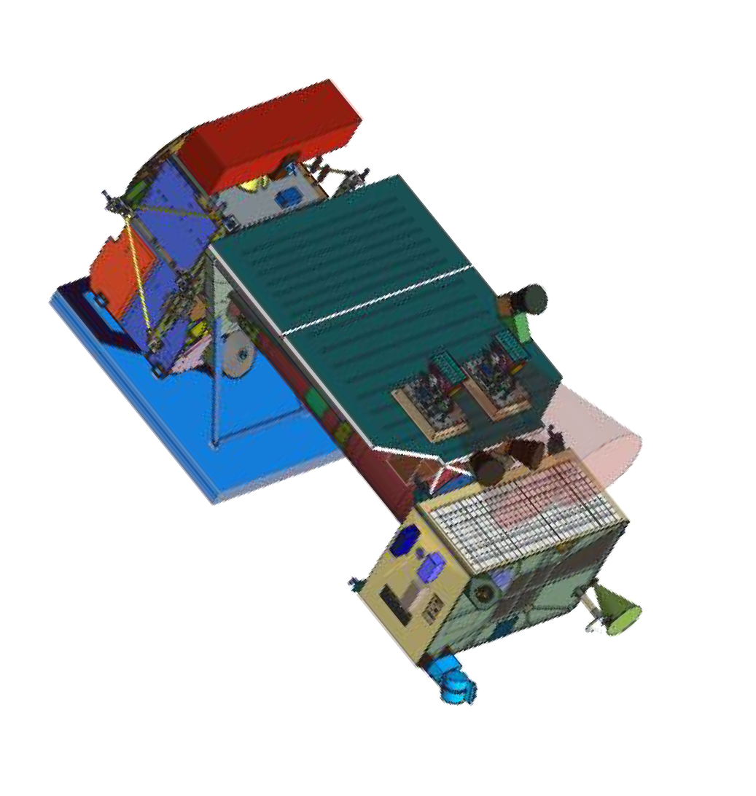


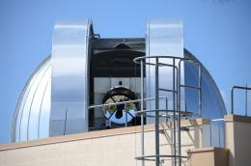








Mission Architecture
LCRD Flight Payload
on STPSat-6
Optical Link
Optical Link
Satellite T&C,
Ranging
High Data Rate System
STPSat-6 Antenna and Ground Equip. (SAGE)
Table Mountain, CA
Hawaii
Optical Ground Station 2
Optical Ground Station 1
Space Network/WSC
LMOC Extension
LCRD Mission
Ops Center (LMOC)
STPSat-6 Satellite Ops Center (SSOC)
GSFC
White Sands, NM
Space Network/WSC

Slide 5
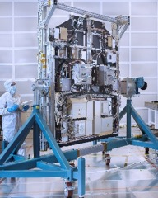
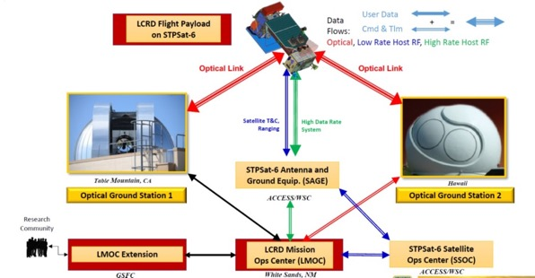
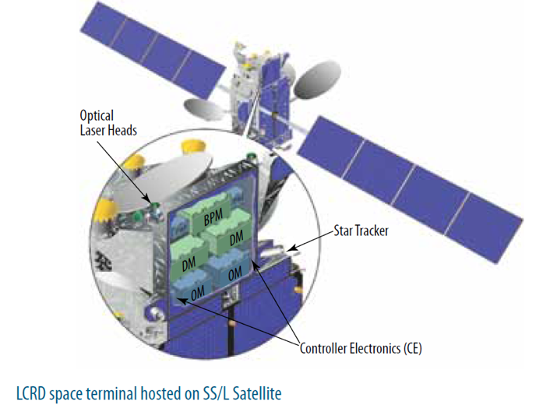
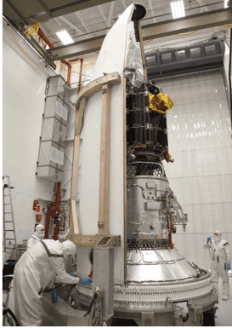
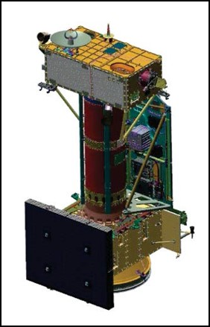
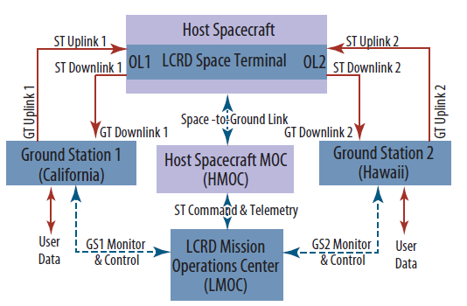
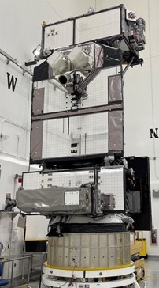
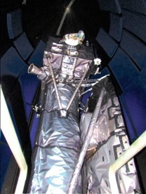
Development Leading to Launch
8/2011
LCRD SELECTED
3/2013
MDR/SRR
LCRD Payload
1/2020
PAYLOAD DELIVERY
TO SPACEVEHICLE
12/2016
CDR
7/2015
D-PDR
9/2013
LLCD Launch
6/2011
LCRD Proposed
10/2013
PDR
11/2019
PSR
5/2021
ORR
12/7/2021
LAUNCH
STPsat-6 Configuration
LCRD on STPsat-6
STPsat-6 in the Atlas V Fairing
5

Slide 6
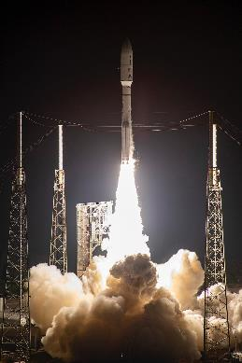
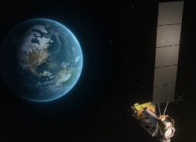
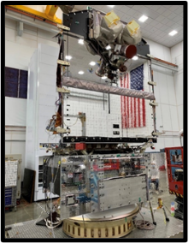
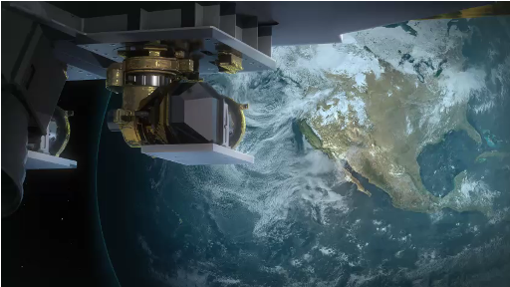
LCRD Inflight Activation Timeline
Dec 7, 2021 at 5:19am
Launch from Kennedy Space Center on a ULA Atlas V hosted by U.S. Air Force’s STPSat-6 satellite
Jan 12, 2022
Successfully powered on in orbit
Jan 19, 2022
Acquired first optical link with Optical Ground Station OGS-2 in Hawaii
Jan 27, 2022 – “First Light achieved”
Both LCRD payload terminals at GEO achieved bi-directional laser communication individually with both Optical Ground Stations.
February 2022
Completion of Flight Modem calibrations, link/service characterizations
March-April 2022
Optical – to – Optical links and services testing
June 10, 2022
Beginning for 2 years of experiments

Slide 7
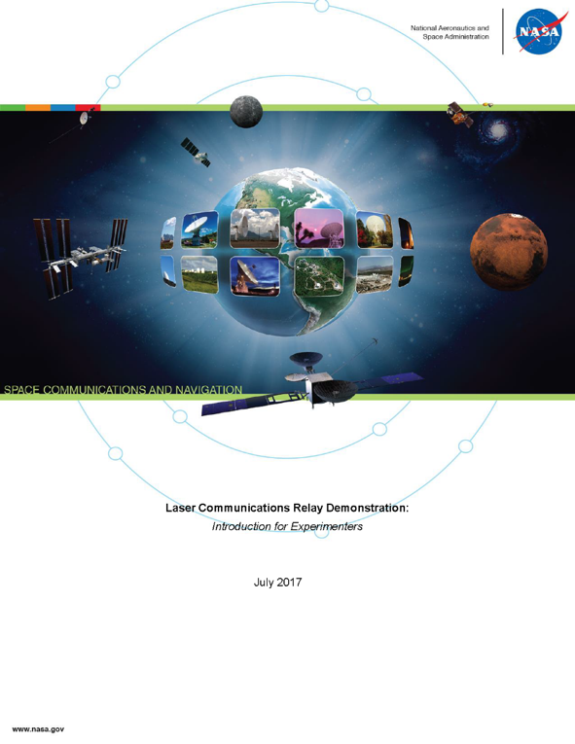
LCRD Experiment Program
The LCRD Experiment program began on June 10, 2022 and will run for 2 years
Initial experiments will demonstrate technology readiness for operational optical communications systems
  Laser Communications Link and Atmospheric Characterization
  Relay Operations
  Optical-based Networking Services
Other experiments under development include:
  Development of operations efficiency (handover strategies, more autonomous ops, etc.)
  Planetary/Near-Earth Relay scenarios (additional delays, reduced data rates, non-continuous trunkline visibility)
  Low Earth Orbit (LEO) - real or simulated
  User-to-User Relay
  Direct Uplink/Downlink
  Commercial applications
LCRD Introduction for Experimenters document describes experiment types as an introduction for the Guest Experimenter Program
7

Slide 8
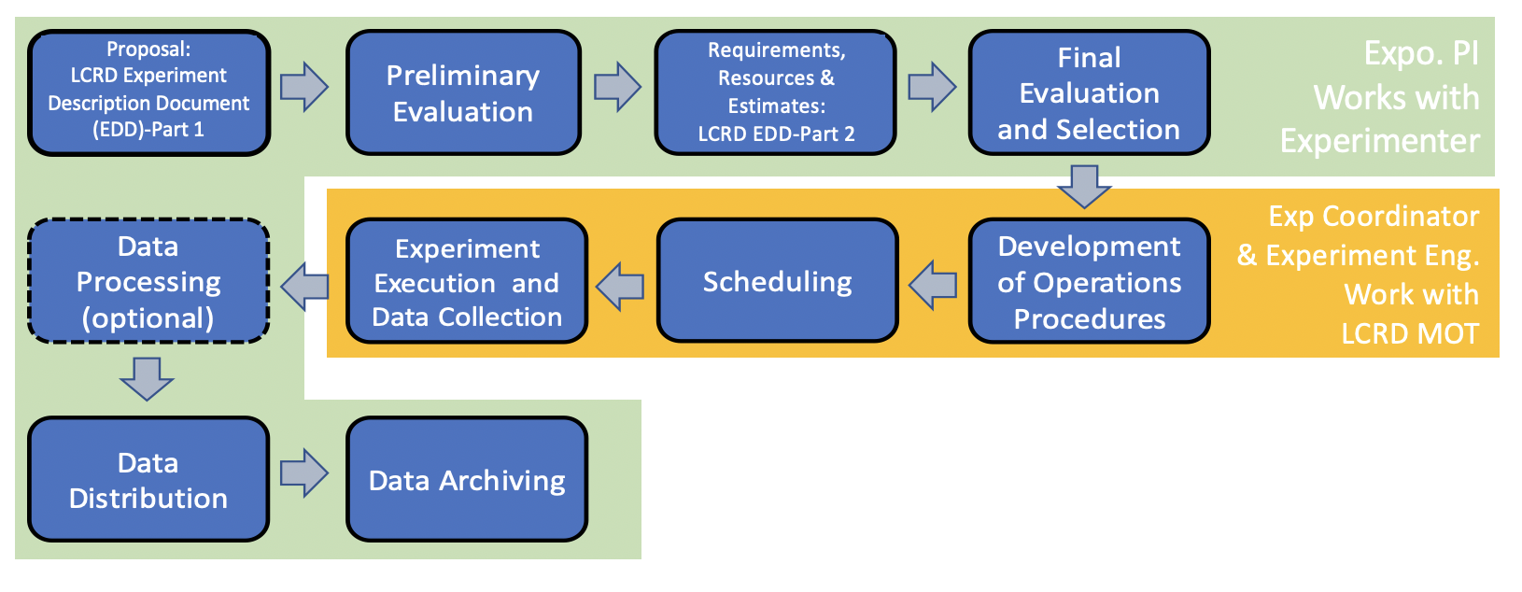
LCRD Experiment Coordination Process

Slide 9
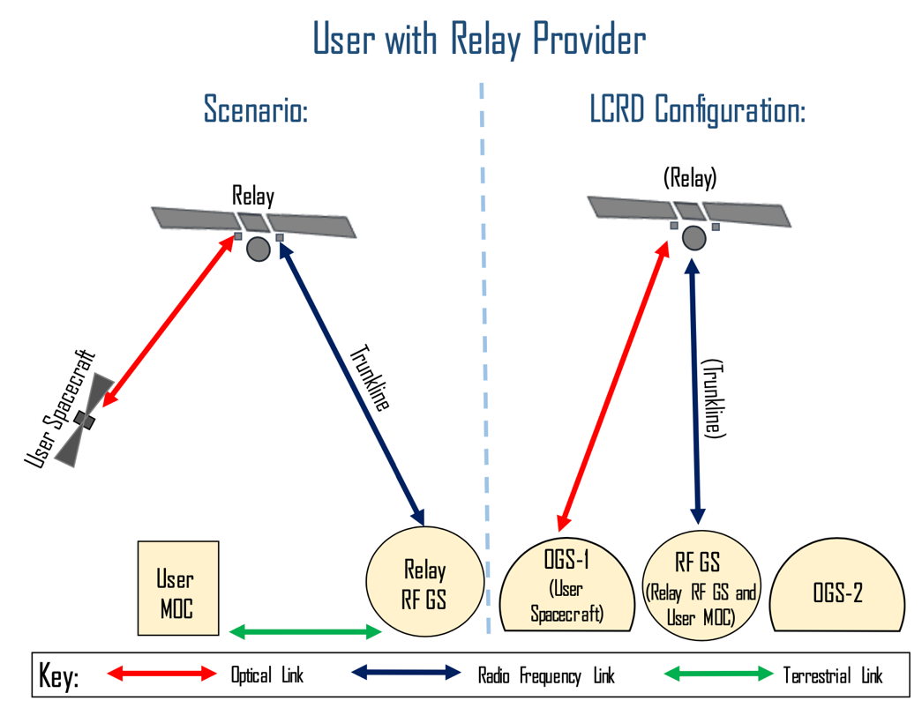
Sample Experiment Configuration
LCRD can be configured to simulate a user spacecraft communicating via a relay spacecraft to the ground
On left (Operational Scenario): user spacecraft employs an optical link to communicate with the relay spacecraft, and the relay spacecraft uses an RF link to exchange data with the ground station
On right (LCRD System configuration): One of the optical ground stations functions as the user spacecraft, using its user element simulators to generate and receive user data
The LCRD flight segment functions as the relay spacecraft. The RF link between the HBRF and RF ground station simulates the trunkline, and the LCRD RF ground station employs its UMS to function as the User MOC
Further configurations available in the LCRD Introduction for Experimenters

Slide 10
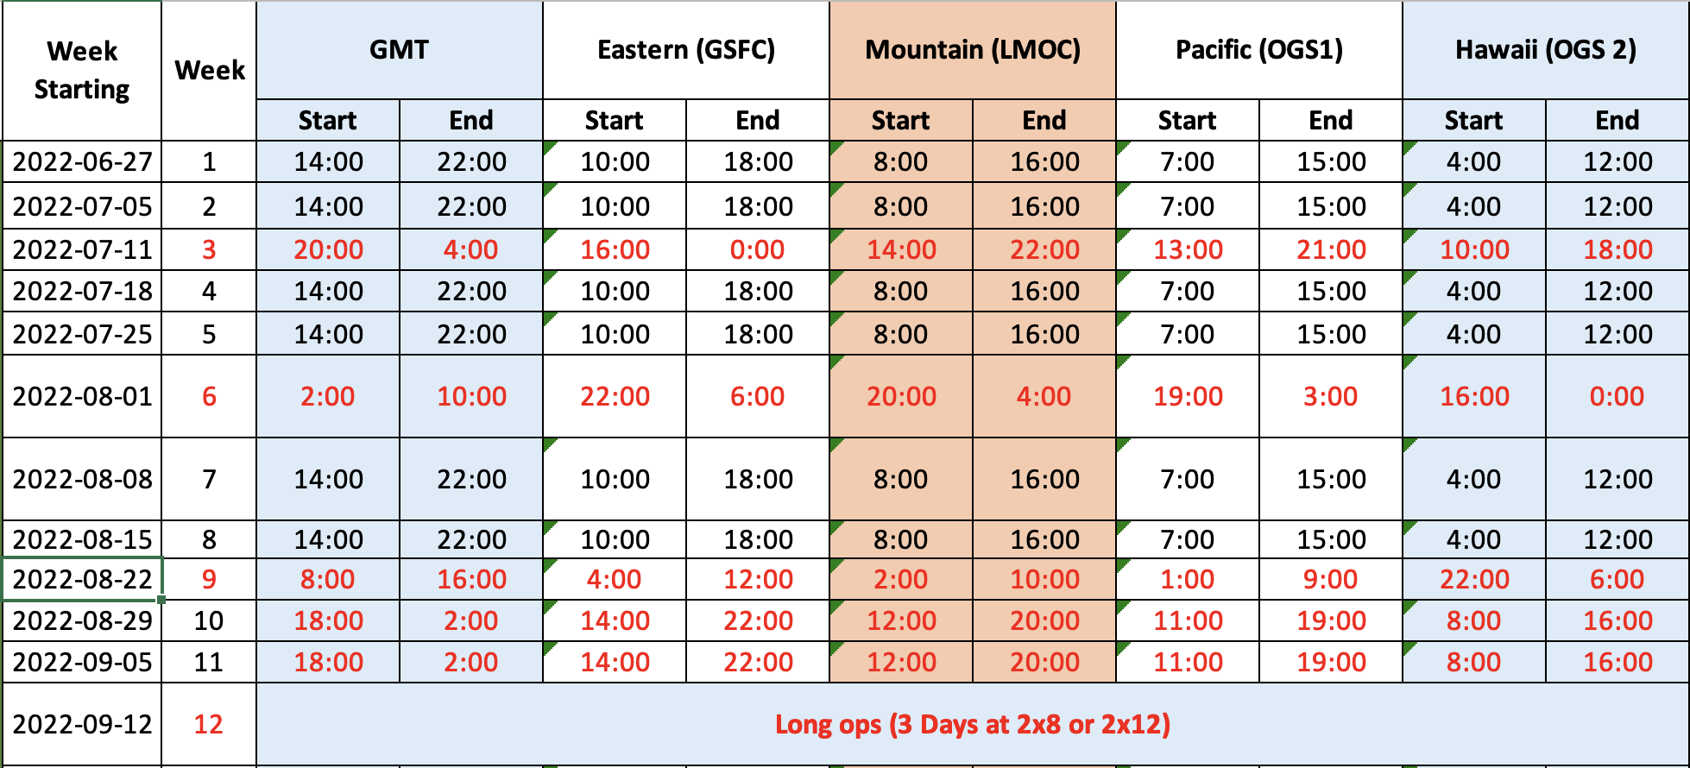
LCRD Operational Hours Procession
Nominal Operational Hours
  8 Hours per day, 5 days per week
  8AM – 4PM, Mountain Time
  Monday – Friday
Shifted hours
  12-week cycle, which repeats 8 times during the experiment program
  Every third week, ops processes forward by 6 hours
  On week 9, will complete procession around the clock
Weeks 10 – 11
  Optimized for afternoon – dusk operations at OGS1
Long Ops
  3 days of the week
  2 shifts x 8 hours or 2 shifts by 12 hours, depending on planned experiments
Schedule Status
  Reviewed and approved by all stakeholders – Investigator team, operations team, WSC, OGS1 and OGS1
  Start times for all weeks in experiment program are identified and socialized with team members

Slide 11
LCRD Experiment Portfolio
Operational Pathfinder
Characterization
Networking
Uplink Fade Modelling
Adaptive Link Rates
Atmospherics at Optical Ground Station (OGS-2)
Novel multi-mode receiver test
Machine Learning for Bit Decoding
Deep Learning for Data rate reduction
Large File Transfer
Balloon terminal
Laser Guidestar
Data services using optical comm
Disruption/Delay Tolerant networking
Navigation: Using the optical comm beam to aid orbit determination
Planetary delay and low optical power simulation
Relay comm with LEO terminals
Comm with alternate ground terminals
Optical Comm in the atmosphere
Optical Comm in the presence of clouds
Pointing, Acquisition and Tracking (PAT)
Link Budget Verification and Validation
Off-nominal network Configurations
Variable Beacon
FEC and Interleaver Parameter study
Partnerships
NASA
&
Co-I
Commercial
OGA/
University
Qty: 10
Qty: 21
Qty: 14
Total Experiment Quantity: 45

Slide 12
LCRD Experiment Status
Current Status: The 2-year LCRD experiment program began on June 10, 2022
Running optical comm experiments 4 - 5 days per week
Current experiments include communications performance in presence of the atmosphere and optical data service loopback and relay tests utilizing OGS1 (Wrightwood, CA), OGS2 (Haleakala, HI) and the RF ground station (White Sands, NM)
Upcoming experiments include Delay/Disruption Tolerant Networking (DTN), Orbit Determination aided by optical communications beam, and Low Earth orbit (LEO) terminal communications
Accepting proposals from guest experimenters!
https://esc.gsfc.nasa.gov/projects/LCRD

