Slide 1
November 2022 eddie J. Paddock eddie.paddock@nasa.gov
832-628-9671
84 South Project Description With Initial Validation Report
Lunar surface Terrain Modeling & visualization
JSC’s Simulation and Graphics Branch

Slide 2
Background and Project Description
Background:
  Lunar Reconnaissance Orbiter (LRO) surface digital elevation map (DEM) data is available in the public domain (PGDA - High-Resolution LOLA Topography for Lunar South Pole Sites (nasa.gov)); however, it is not readily usable for visualization without specialized processing.
  The 84 South Project attempts to process the DEM data to provide manageable polygonal terrain models of the 84 and 87 South Latitude of the Moon in OBJ formatted models of the South Pole cap along with the 13 Artemis landing regions at manageable resolutions and file sizes.
Project Description
  Simulation and Visualization teams have created 3D models that represent the terrain of the lunar south pole (below the 84S parallel including 13 potential early Artemis mission landing regions of interest – see next slide)
  The project is composed of three phased releases:
    87 South Cap at 100 meters per pixel (mpp) with 6 landing regions at 5 mpp (November/2022 time frame)
    84 South Cap outer ring at 100 mpp with 7 additional landing regions at 5 mpp (December/2022 time frame)
    Terrain exporter tool release for configurable 84 South locations and resolutions (February/2023 time frame)
  These Lunar Surface Models can be used in many publicly available viewing tools and/or custom simulations
  South Pole rendered lighting conditions would need to be configured independently with tools like JPL’s SPICE
  Initial validation of models and tools has been performed
    See pages at the end of this presentation for this initial validation description

Slide 3
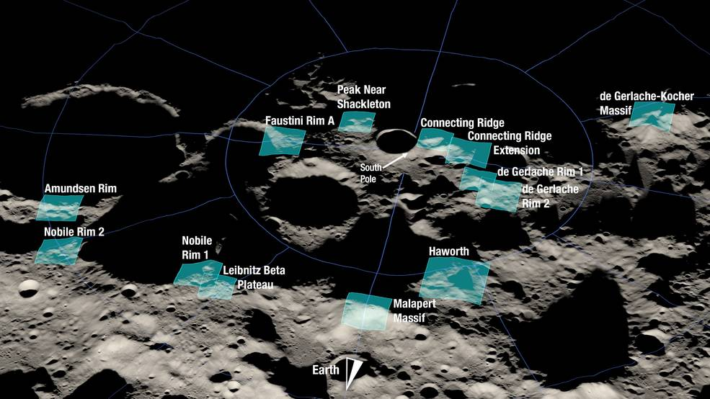
Artemis Landing Regions of Interest for 87S and 84S
Figure 1: 84 South Artemis Landing Regions
87 South
Faustini Rim A
Peak Near Shackleton
Connecting Ridge
Connecting Ridge Extension
de Gerlache Rim 1
de Gerlache Rim 2
84 South
de Gerlache-Kocher Massif
Haworth
Malapert Massif
Leibnitz Beta Plateau
Nobile Rim 1
Nobile Rim 2
Amundsen Rim

Slide 4
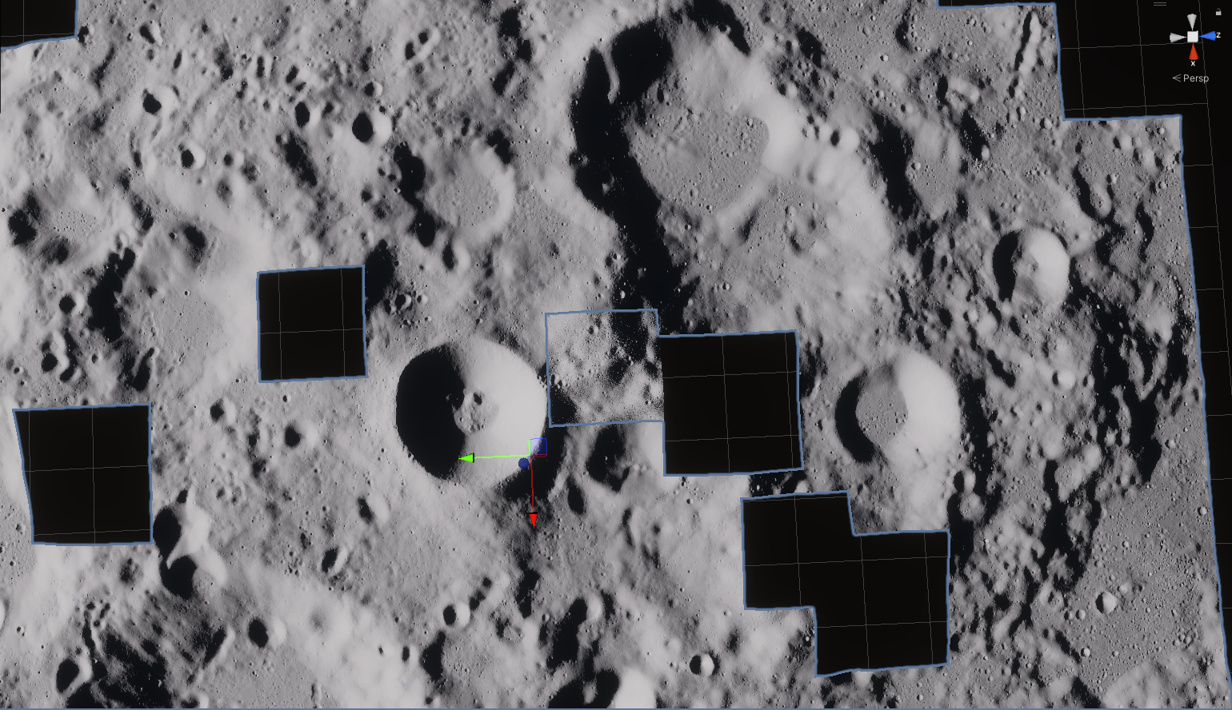
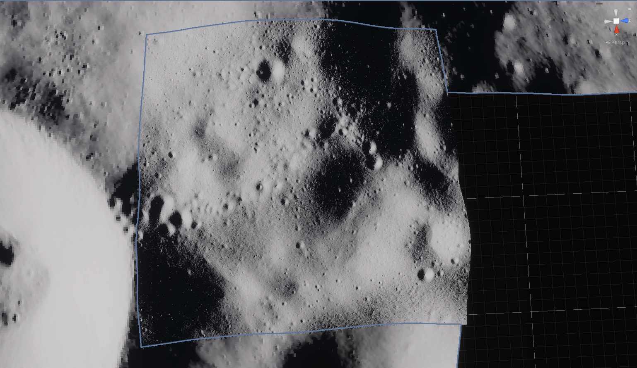
87S and 84S Models (Phase 1 & 2)
Figure 2: Unity game engine view of 87S at 100mpp with cut out of 6 landing regions with inserted 5 mpp Connecting Ridge model
Figure 3: “Zoomed in view ” of Figure 2
100 mpp 84/87 Cap models will have “cut out” models of landing regions with separate 100 mpp and 5 mpp “fill in” models for custom resolution setup
With lunar surface models, user will be able to:
  Render the 84/87 South lunar terrain models (OBJ formats) via publicly available rendering tools
    84/87 Caps at 100 mpp plus 13 Artemis landing regions at 5 mpp
  Integrate terrain models into lunar simulations with user added lighting conditions

Slide 5
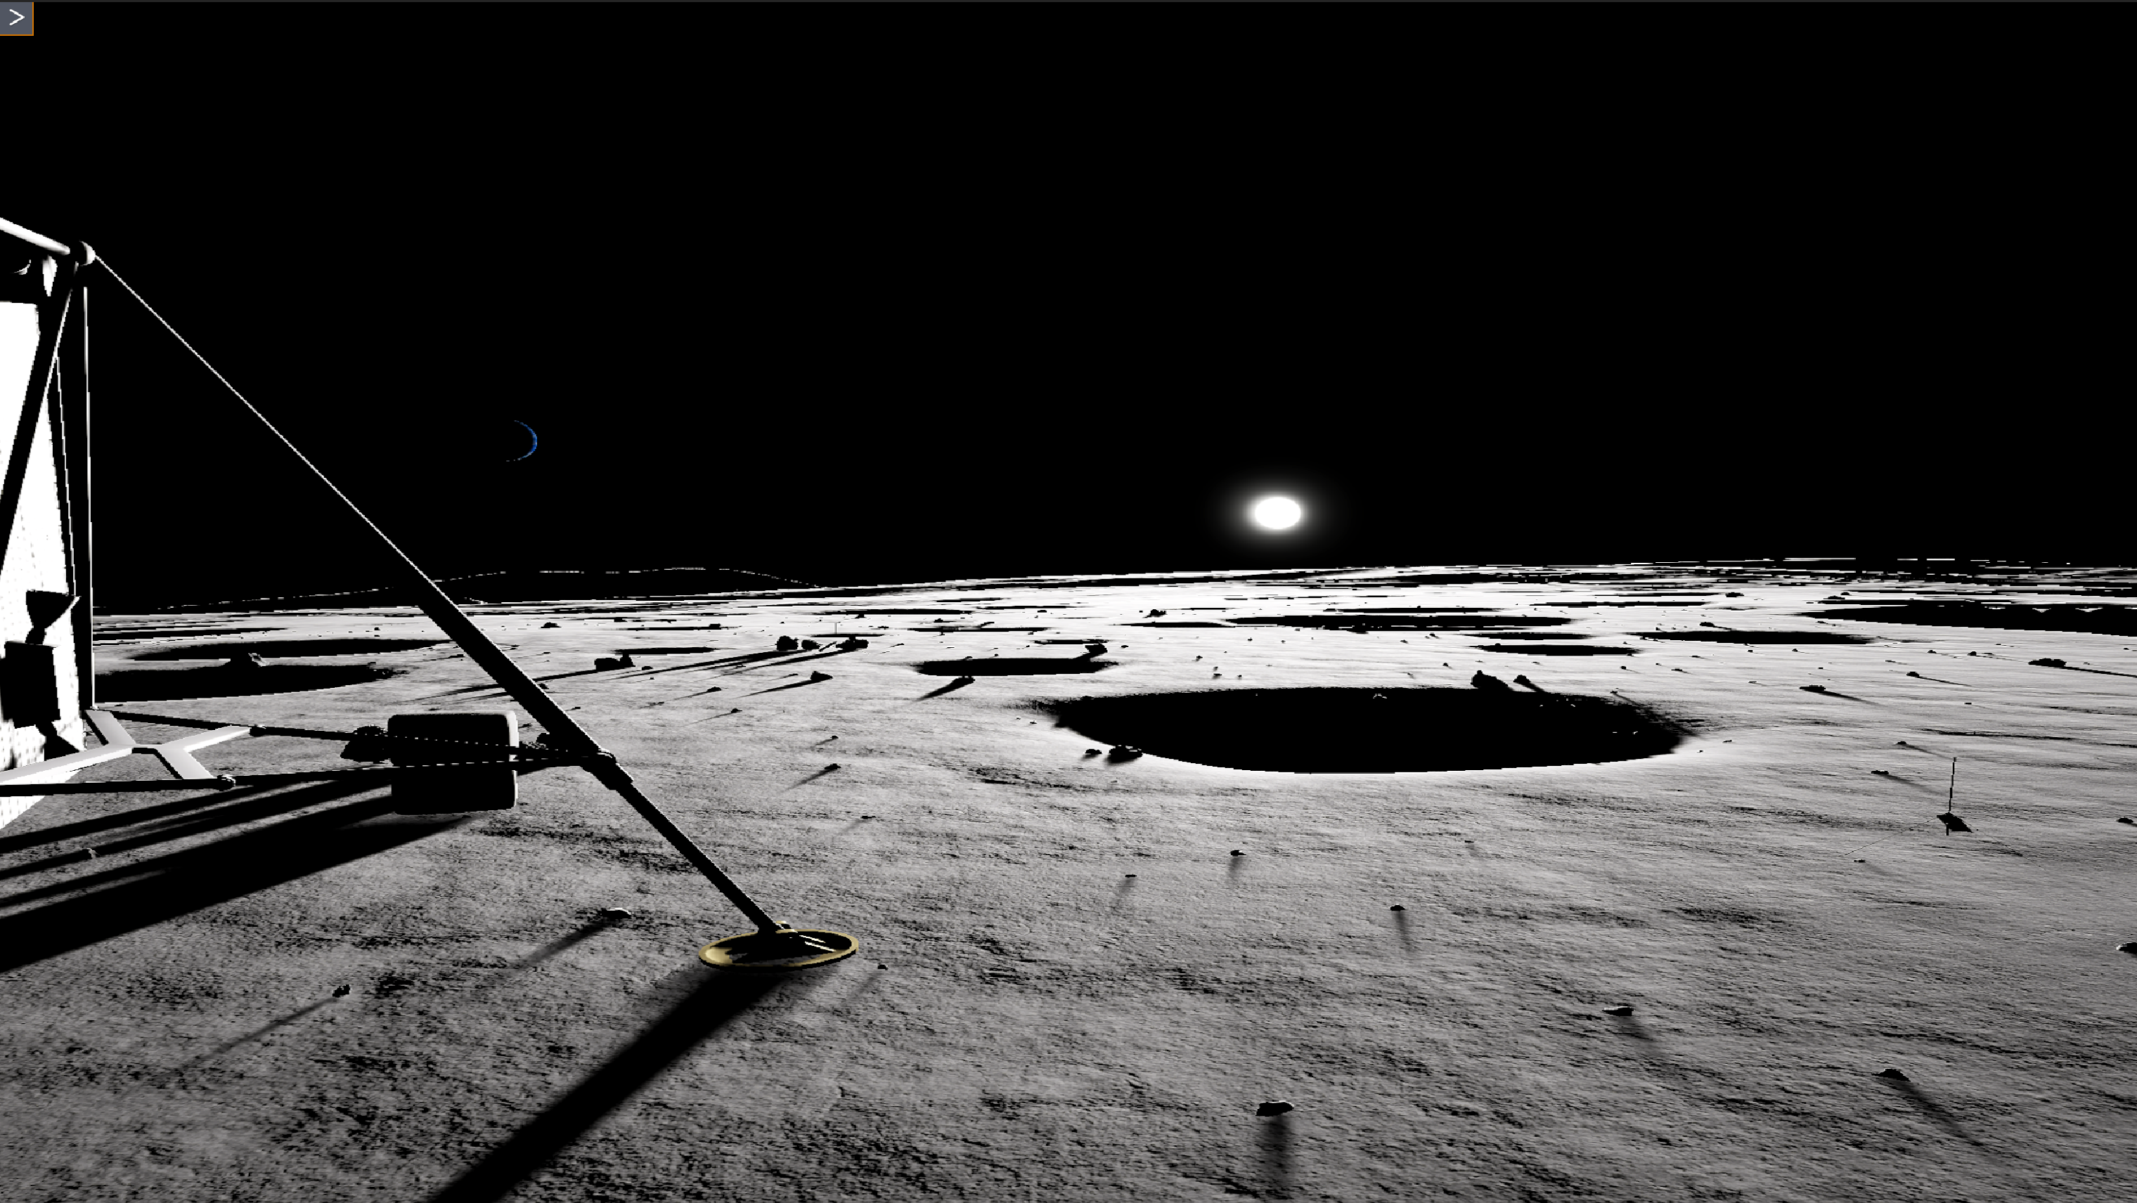
84S Exported Models (Phase 3)
Figure 4: Lunar Assets for VR Assessments (LAVA) VR Tool, with Sun/Earth set up at specific azimuth and altitude defined by SPICE ephemeris for a date and location (lighting not included in models)
With phase 3, users can export terrain at specified regions with higher resolutions, and run custom simulations with surface views

Slide 6
Initial Validation
84 South Model Validation Process
  Validation of the terrain model and DEM data processing
    Compare virtual model generated images to LROC images (See following pages)
    Compare LLA/XYZ trigonometry math referenced back to Digital Elevation Map (DEM) vertices (See following pages)
  Release IEEE conference validation paper and 84S Model Description and Validation Document (this document)
    Will be included with model package
  Release a NASA-STD-7009 Credibility and Appropriate Use document
    Will be included in model package and will describe model/tool fidelity, validation limitations, risks and accredited use
  Further validation is planned with JSC’s Astromaterials Research and Exploration Science (ARES) Division (XI)

Slide 7
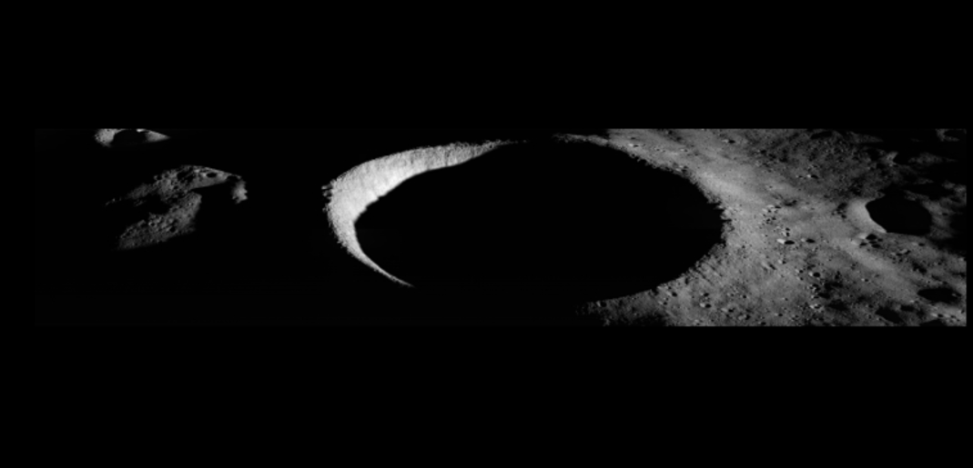
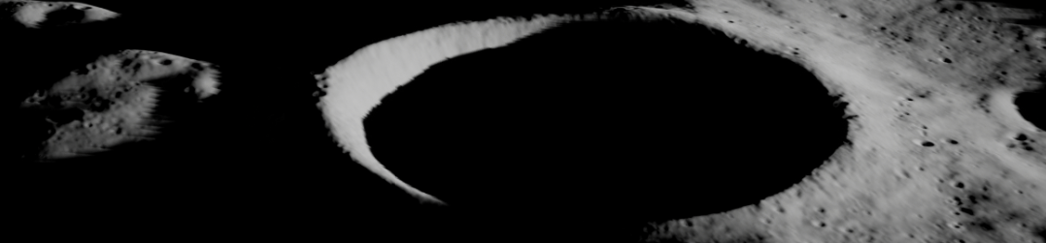
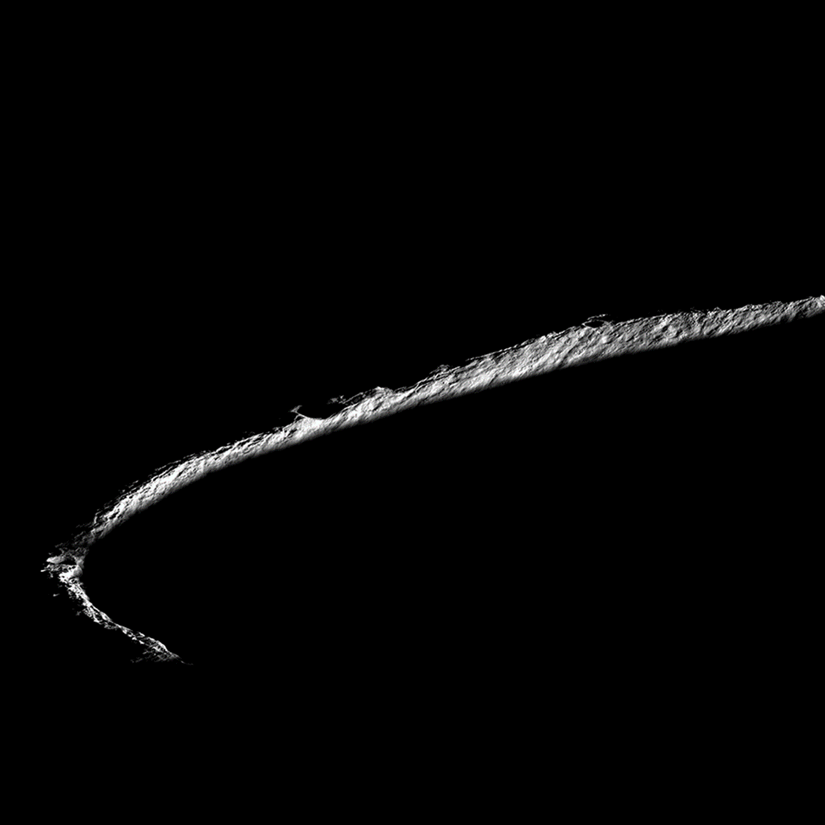
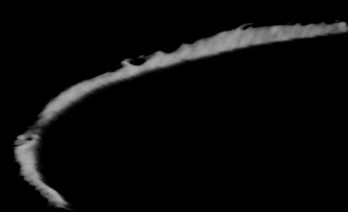
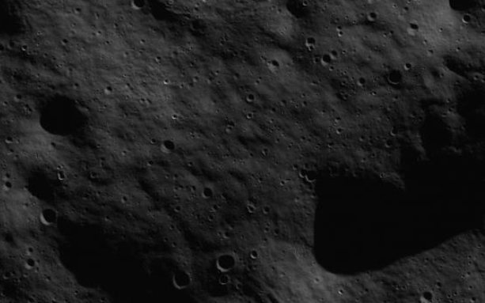
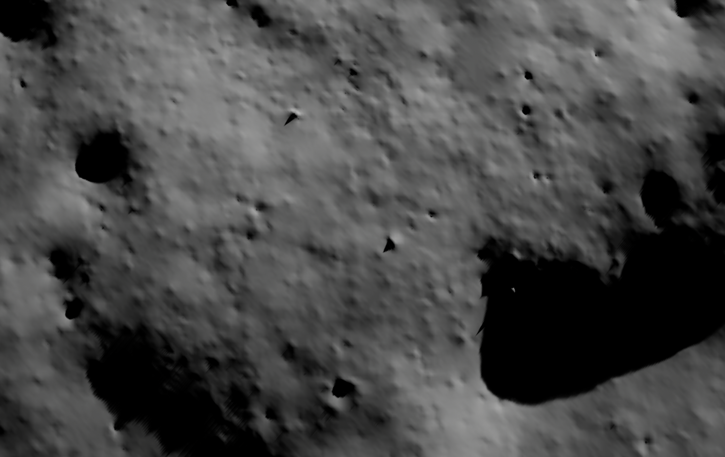
Validation – Virtual Images Compared to LROC
LROC Images
84 South Models Rendered in Unreal Game Engine with
Matching Camera & Sun Light Source for Comparisons
Figure 5: NAC M1195011983, was captured on 2015-08-23 T 23:31:55 UTC and displays an illuminated view of Shackleton crater. The solar azimuth and elevation shown in this image are 68.97° and 0.84°, respectively.
Figure 6: NAC M1224655261, was captured on 2016-08-01 T1:46:34 UTC and features a low sun elevation of 0.86° and solar azimuth of -152.83°.
Figure 7: NAC M103870068RE, “Connecting Ridge”, was captured on 2009-8-2 T 16:33:20 UTC with a solar azimuth and elevation of 38.75° and -0.23°, respectively.

Slide 8
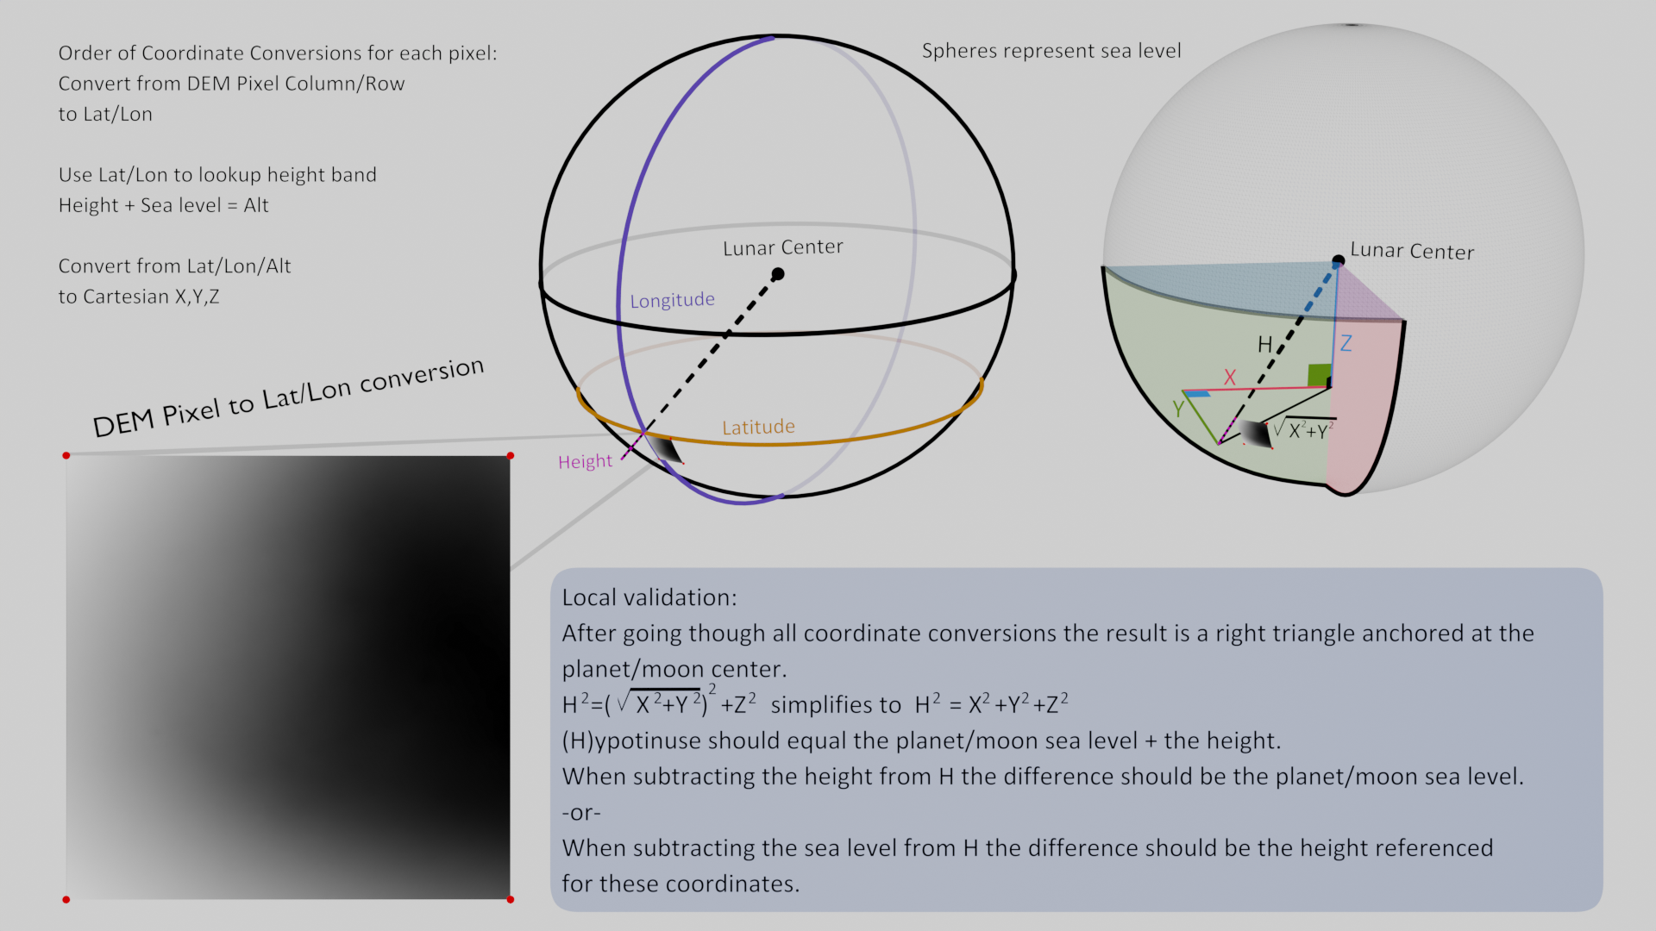
Validation of GDAL/Blender DEM Processing
Figure 8: Comparison of LLA/XYZ trigonometry math referenced back to Digital Elevation Map (DEM) vertices

