Slide 1
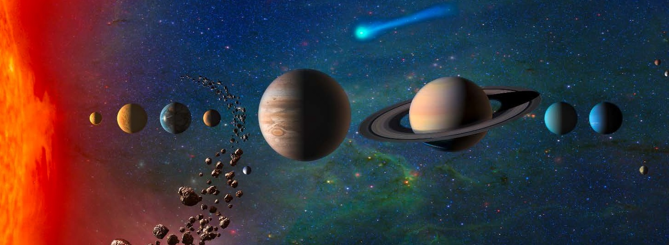
HEATSHIELD for EXTREME ENTRY ENVIRONMENT TECHNOLOGY (HEEET) and 3D Woven TPS Readiness for Outer Planet Probe Missions
M. Gasch¹, J. Monk¹ , H. Alpert and E. Venkatapathy¹
¹NASA Ames Research Center, Moffett Field, CA 94035, USA.

Slide 2
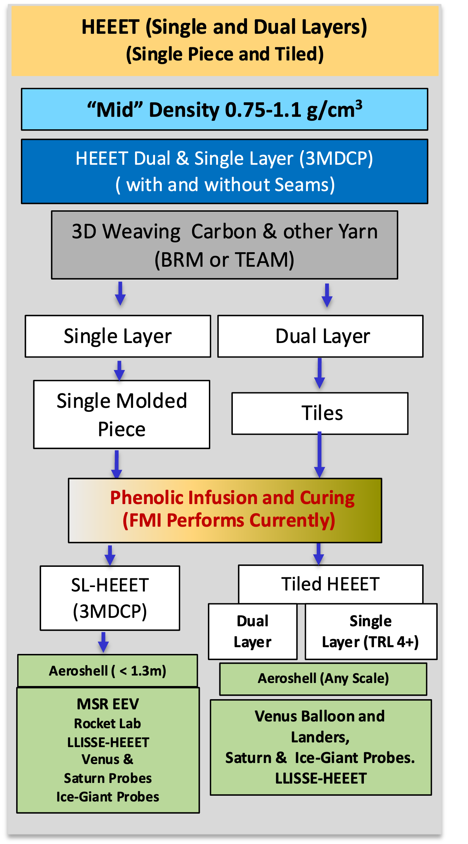
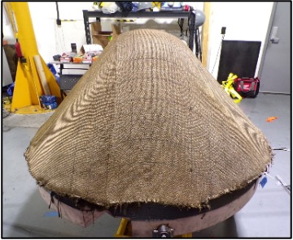
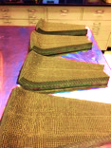
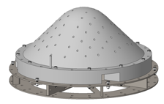
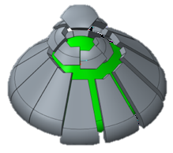
Background – Dual Layer HEEET vs Single Layer 3MDCP
There are now heatshield technology options for for Giant Planet in situ probes as well as for Aerocapture missions – options are scalable but with some limitations (environment, diameter and thickness)
3D Weaving
The 3D woven Family of materials
Dual Layer HEEET and Single Layer 3MDCP
  3MDCP = 3(D) Mid-Density Carbon Phenolic is the Insulation Layer from HEEET dual layer weave
Both Dual Layer HEEET and 3MDCP have predictable response in arcjet testing
  Stagnation @ 3600 W/cm2 and 5.3 atm,
  AEDC H3 at 1200 W/cm2, 2.9 atm and 4000Pa shear
The scalability challenges and limitations they place on developers have been addressed in previous presentations ( Ref: there are 5 )
HEEET (2 layer) and 3MDCP (lighter insulating layer) are both capable of supporting Giant planet missions
  HEEET can support any diameter (Ref 1, 4) and mission constraints due to weaveable thickness have been addressed in Ref 1
  3MDCP seamless design targets dia < 1.3 m. due to max weave width of ~80-inch. Ice Giant Mission constraints due to woven thickness limitations is explored in Ref 2, 3, 6.
  We are ready to support Saturn Probe mission NF-5 proposals and UOP flagship study with the two TPS options
  Options to relax mission constraints are being evaluated
Forming & Infusion
Infusion
Machining
Final Machine & Integration
Integration & Final Machine

Slide 3
TPS Lead Times are Long
In addition to weave size and thickness constraints, proposal teams need to be aware of the long lead items related to 3D weaving. In particular:
  Schedule for loom set up and weaving
  Molding/forming and infusion
  Integration onto an aeroshell or structure for development testing and then flight
The following is an estimated schedule for 3D woven TPS manufacturing.
  It is critical that mission teams plan on engaging heatshield related vendors prior to the beginning of phase B so that procurement can be initiated when Phase B funding arrives (i.e. have SOW’s and quotes in place ready to award)
Phase A
6-8 months
Establish SOWs and Gather Quotes
Looms exist for Dual Layer HEEET and 3MDCP weaving, however, set up and weaving are long lead items and
therefore, TPS procurement needs to be initiated at least 2 years prior to CDR.

Slide 4
Sustainability of HEEET and Single Layer 3MDCP TPS
Two vendors are certified to weave TPS preforms for NASA: one for DL HEEET and another for 3MDCP
  MSR EES has currently baselined 3MDCP as the heatshield
    MSR Weaving to be completed in 2023 – 300m of material loaded on the loom, additional 200m available and should be woven
    Mission launches in 2027
One vendor certified to resin infuse TPS for NASA: FMI
By 2023, all weaving activity will be completed and by 2024 all resin infusion will be completed by FMI for DFly & MSR
There is a real risk to TPS sustainability by the time a Saturn Probe or Flagship UOP mission would need the capability
  Between 2023 and beginning of Phase B for Saturn Probe mission (if selected) or a Flagship mission, there is a gap around 4 or more years
In order to safeguard against atrophy of 3D Woven and PICA TPS which will be needed for Outer/Giant Planet missions, it is important NASA maintains awareness through annual assessments of the external TPS manufacturing capabilities
  From raw materials to weaving to molding/forming , resin infusion – all aspects of S-of-the-A TPS manufacturing needs to be assessed for atrophy to assure that all companies involved are mission ready
If risks are identified, it will be important to work with HQ to retire the risks and ensure all TPS options (3D Woven and PICA) are available for future missions
  Recommendations:
  OPAG to identify the importance of 3D Woven and general TPS Sustainability and recommend NASA HEEET/3MDCP/PICA Team to monitor and assess manufacturing industrial base and make recommendations to SMD-PSD to ensure the capability is ready to support NF-4/5 as well as Flagship missions.
  OPAG to recommend SMD fund to weave out remaining 3MDCP dry weave to support future OP missions to reduce risk during long lead procurements / loom set up in Phase B
  3D Woven TPS is an enabling TPS, developed for Outer Planet in-situ missions
Notes:
It is an interesting question about what the risk is to TPS manufacturing. I know its too late for this presentation but it would be useful to develop a 5 x 5 risk matrix for TPS atrophy. I think the risk to 3D weaving is likely relatively low. Both BRM and TEAM now have industry unique looms that they are unlikely to get rid of. The risk may more be that some DoD or other customer comes in and wants to use the loom, making it less accessible when NASA needs it. The larger risks maybe blended yarn sustainability, and this one is hard to characterize. Schappe has been around awhile and has some pretty unique capabilities so the likelihood of it going away feels pretty low (although the consequence is pretty high). Given FMIs shift to C/C work for DoD, infusion and fiberform sustainability maybe more of an issue.

Slide 5
References
Venkatapathy, E., “Recent Advances in Ablative TPS in the U.S. for In-situ Exploration of Giant Planets,” In Situ Exploration of the Giant Planets II Workshop, July, 2022, Laurel, MD. (Talked about single and dual layers)
Monk, J., et al., “Uranus Probe Entry and Descent Mission Concept,” In Situ Exploration of the Giant Planets II Workshop, July, 2022, Laurel, MD. (used Single layer in the evaluation)
Hannah, A., et al., “A TPS Design Analysis of Entry Probe Delivery from Orbit for Ice Giant Missions,” In Situ Exploration of the Giant Planets II Workshop, July, 2022, Laurel, MD. (for dual and single layer of HEEET)
Venkatapathy, E., et. al., “Next Generation Thermal Protection Systems for Outer Planet Missions,” https://www.hou.usra.edu/meetings/OPAG2021Aug/eposterindex.cfm, OPAG Sept., 2021. (TPS aspects of Ice Giant Aerocapture and Saturn Probe)
Venkatapathy, E., et al., “Entry System Technology Readiness for Ice-Giant Probe Missions,” Space Sciences Review, 2020. ( All about HEEET)
Prabhu, D., “Exploration of Atmospheric Entries at Saturn, Uranus & Neptune with HEEET as Heatshield TPS,” Intl. Conf. on Flight Vehicles, Aerothermodynamics, Re-entry Missions & Engineering – FAR 2019, Monopoli, Italy. (Only dual layer HEEET)

Slide 6
Backup

Slide 7
Advocacy Sought from OPAG for the Next Generation of Ablative TPS to Enable Ice-Giant Aerocapture and Enhance Saturn Probe Mission
Saturn Probe
Saturn mission designers are generally interested in shallow entries with lower g-loads (around 50g’s), which saves science instrument development schedule and qualification costs.
Shallow entries result in higher heat-loads, in the range of 150 kJ/cm² – 300 kJ/cm², an order of magnitude higher than Venus or Sample Return missions, in the ~20 kJ/cm² range.
To enable Saturn probe missions, TPS must offer mass efficient thermal protection in order to meet science mass requirements.
Heatshield:
While DL-HEEET offers robust protection it could require ~50% of the mass of the entry system.
Recent analysis shows Saturn Probe missions could benefit from the use of single-layer HEEET (3MDCP) which potentially offers a 30% - 50% mass savings over DL-HEEET.
Backshell:
Both PICA and C-PICA can meet thermal protection requirements for the backshell. However, C-PICA is more mass efficient with 30% - 50% mass savings compared to PICA. Every kg of mass reduction for the backshell helps with stability and results in ~3 times overall mass savings.
Aerocapture to Achieve “Faster and Better” Science for Ice Giant Missions
An aerocapture mission will require a mass efficient TPS that can handle extreme heat-load, ~ 100 kJ/cm2 – 500 kJ/cm2. Such as TPS can enable:
Reduced trip time by ~ 4- 8 years (30% -50%), compared to propulsive 12 – 17 years
Improved science payload mass to accommodate probe(s) and lander
To assess the TPS choices and and associated mass, a wide range of conditions were evaluated: entry velocities that will reduce the trip by 4 – 8 years (approach velocities of 8, 14, 18 and 22 km/s, for an entry mass of 2200 kg and for aeroshell diameters of 3, 4 and 5 m).
In order to achieve aerocapture with a blunt body, the geometry chosen was the well studied.
The optimized (and patented) geometry can provide L/D of 0.6 but for the current study it was limited to 0.44
For every geometry, approach velocity, the undershoot and overshoot aerocapture trajectories were determined around Neptune that reaches Triton.
Heatshield:
While DL-HEEET is applicable across the entire aerocapture design space, it is heavy with TPS mass fractions between 22% and 67%
For cases where heat-flux is > 1500 W/cm², use of SL-HEEET on the wind-side and C-PICA on the lee-side of the heat-shield results in lowest mass.
  SL-HEEET is more mass efficient for all cases but it is not as efficient as PICA or Conformal PICA for heat-flux < 1500 W/cm².
For all cases where the peak heat-flux is < 1500 W/cm², Conformal PICA is the most mass efficient due to its more insulative nature compared to PICA. C-PICA is less expensive and also more compliant making it very attractive for large diameter aeroshells
C-PICA and SL-HEEET can lower the TPS mass fraction by a factor of (3 – 4) compared to DL-HEEET. (5%-20%) TPS mass fraction range makes aerocapture Ice Giant missions very attractive
Use of SL-HEEET (3MDCP) with C-PICA can result in significant mass savings and provide additional opportunities for enhanced mission science. We seek OPAG support and advocacy to demonstrate the TPS architectures.
Notes:
Matt: In 2 min here is what I would suggest highlighting:
A more efficient TPS compared to HEEET – Dual Layer – Can enable Ice-Giant Aerocapture mission and Saturn Probe missions, with a much more efficient TPS can consider higher latitude or heading orientation different that pro-grade equatorial for better science.
HEEET single layer as well as Conformal PICA are much more efficient derivatives. So, the completion of their development is much simpler and low cost.
The overall mass fraction benefit makes these developments very attractive and hence we seek OPAG”s support and advocacy

