Slide 1
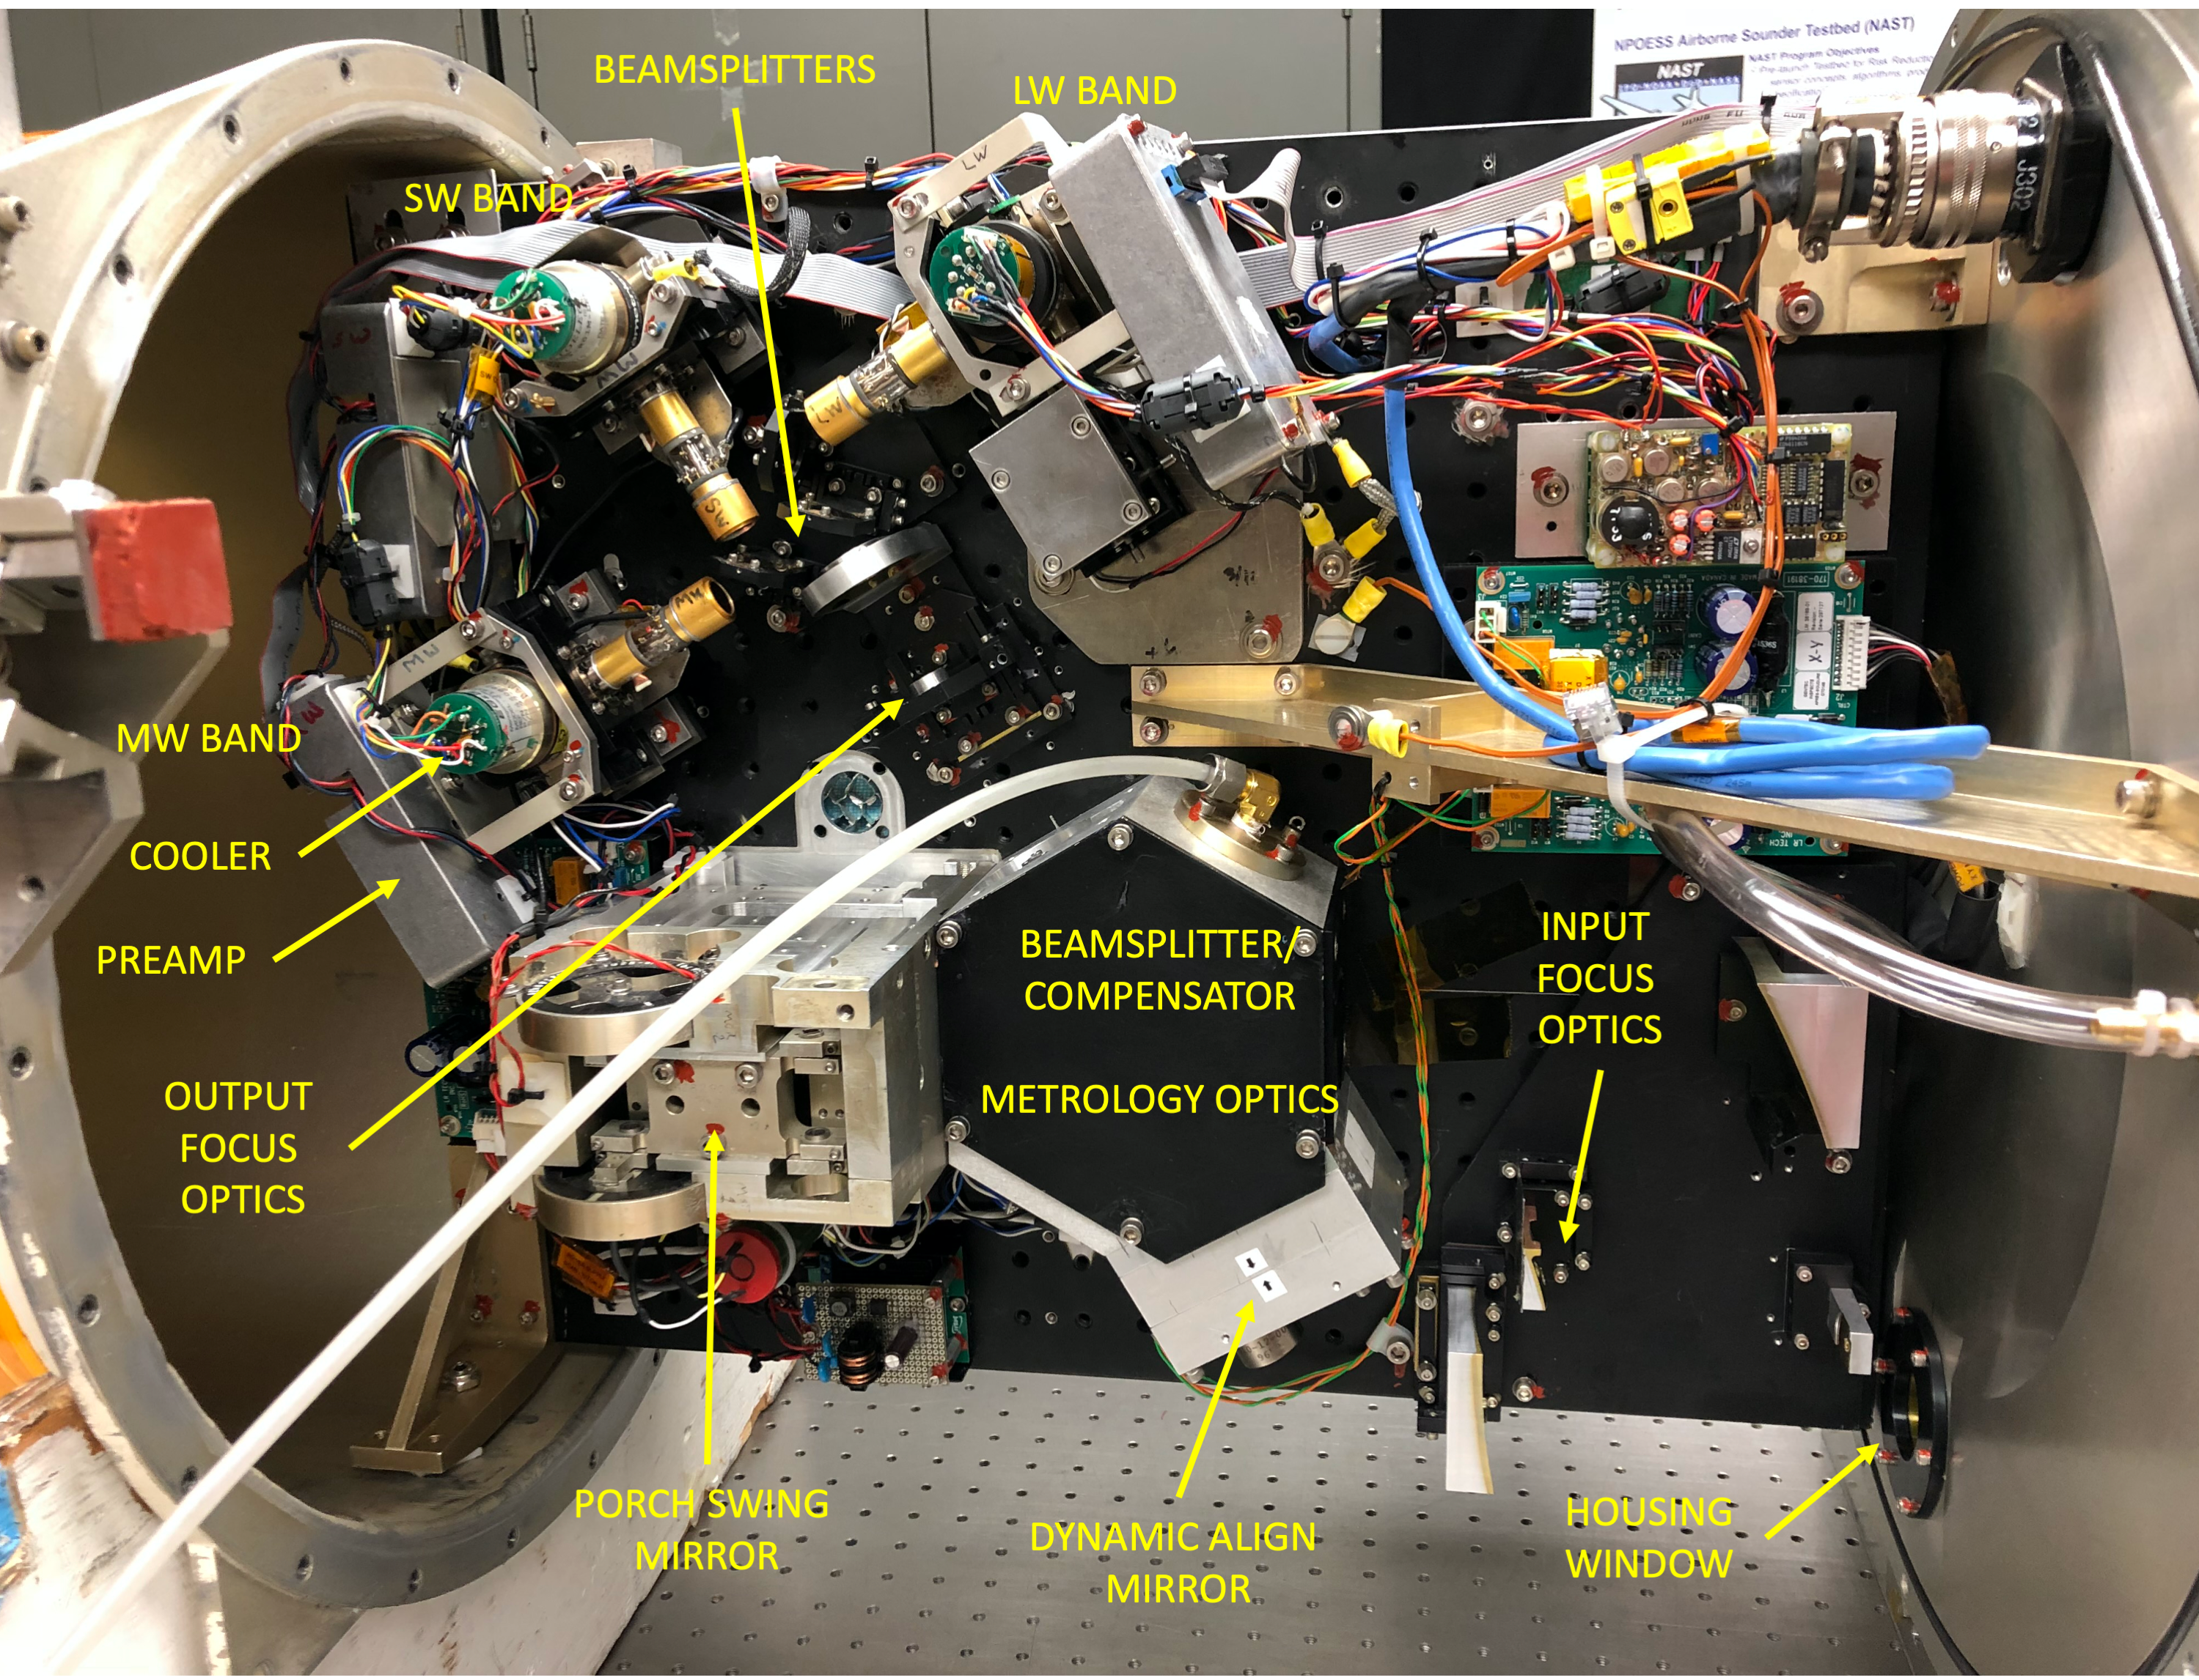
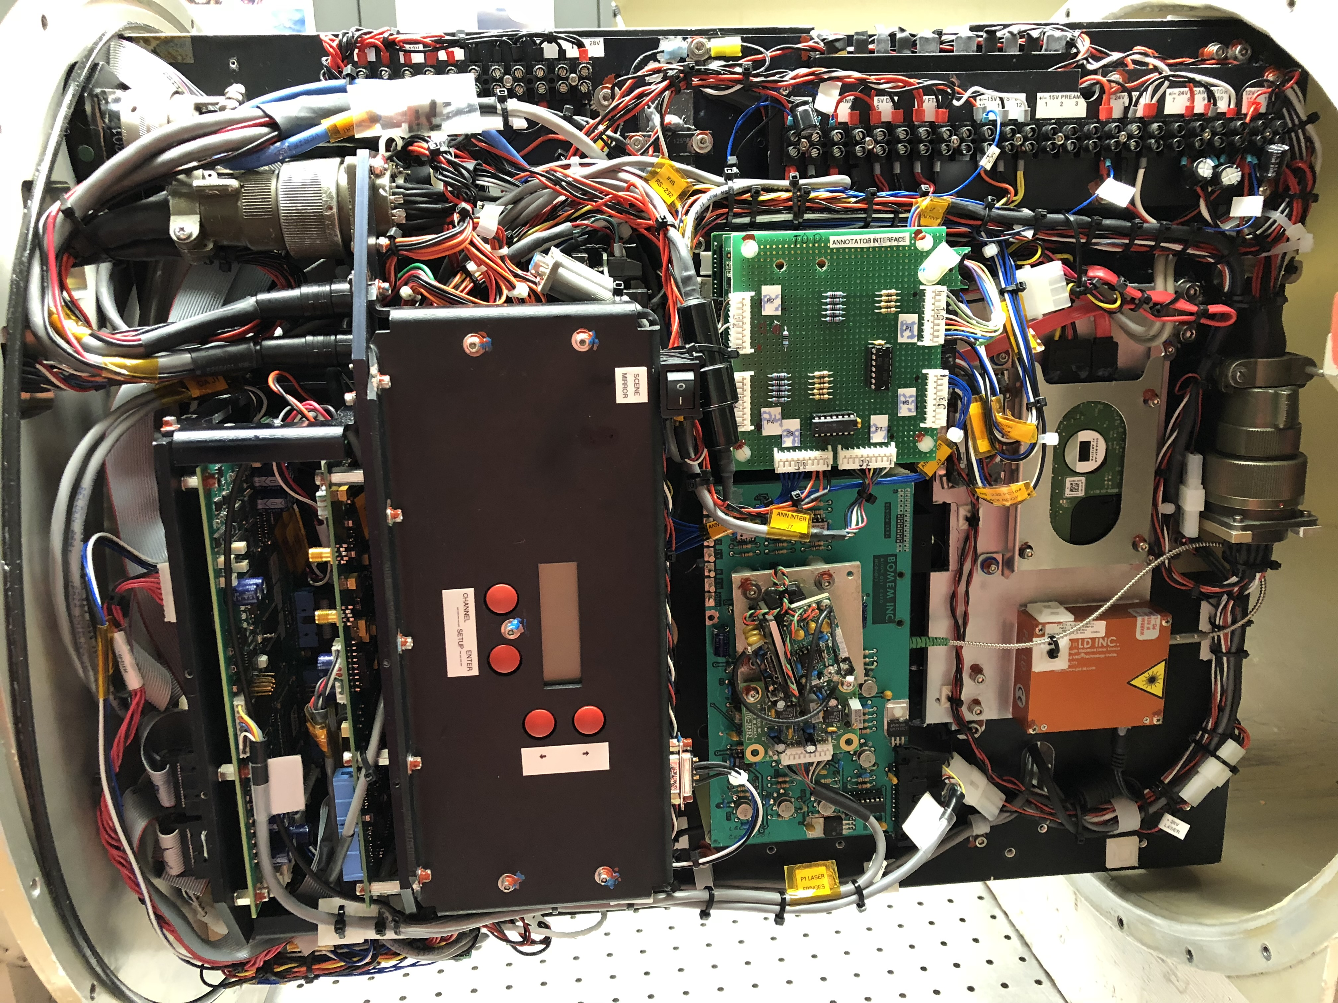
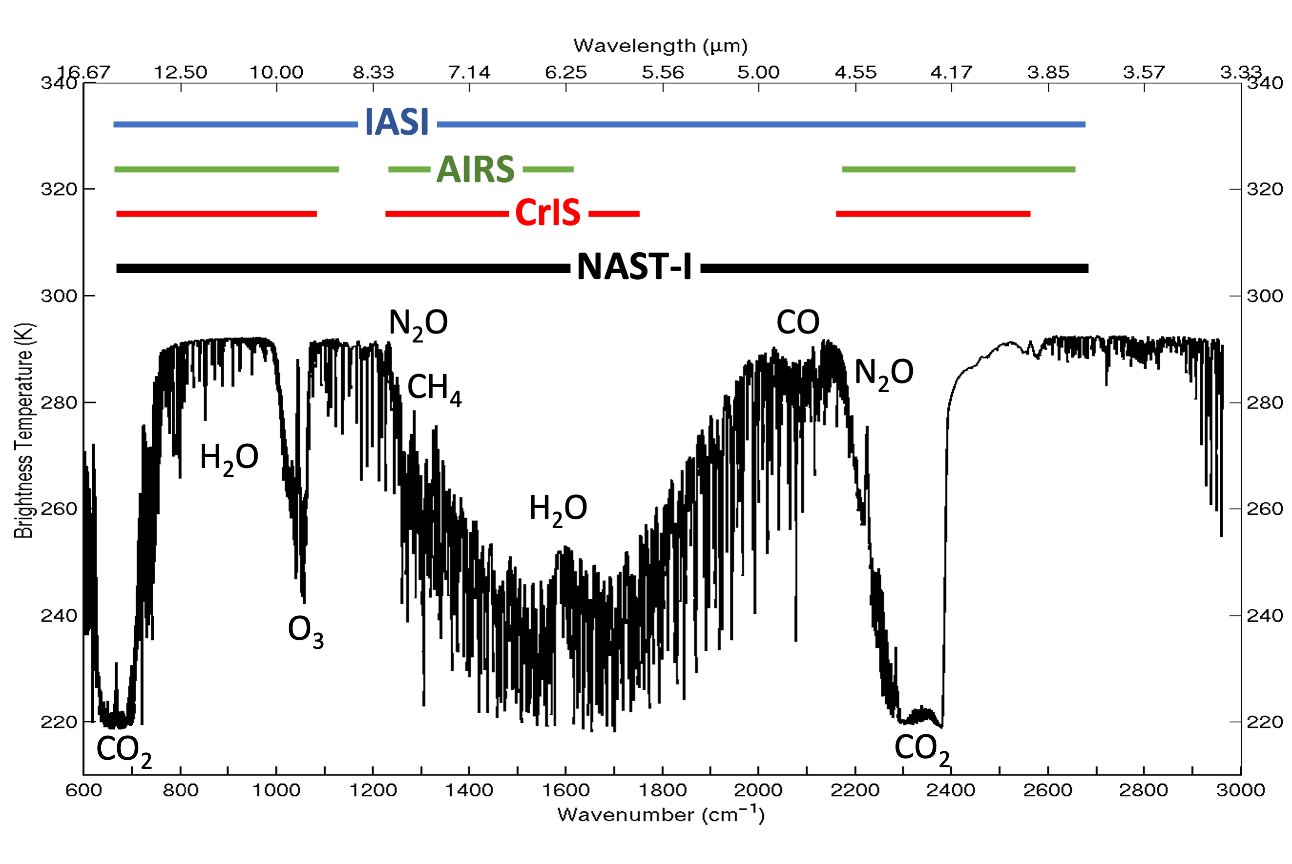
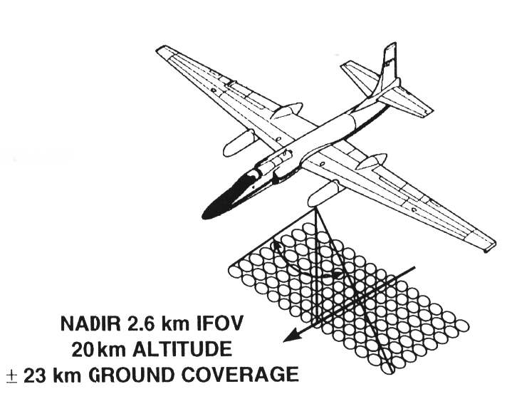
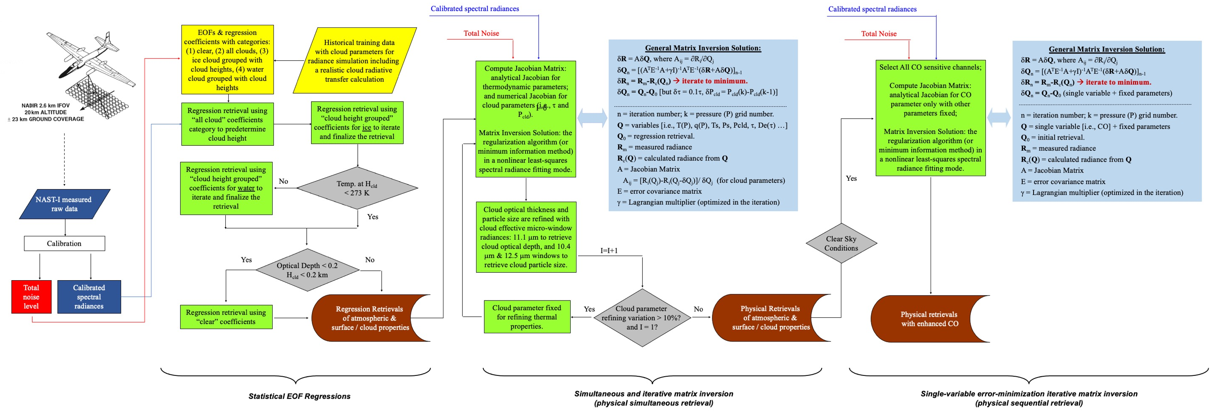
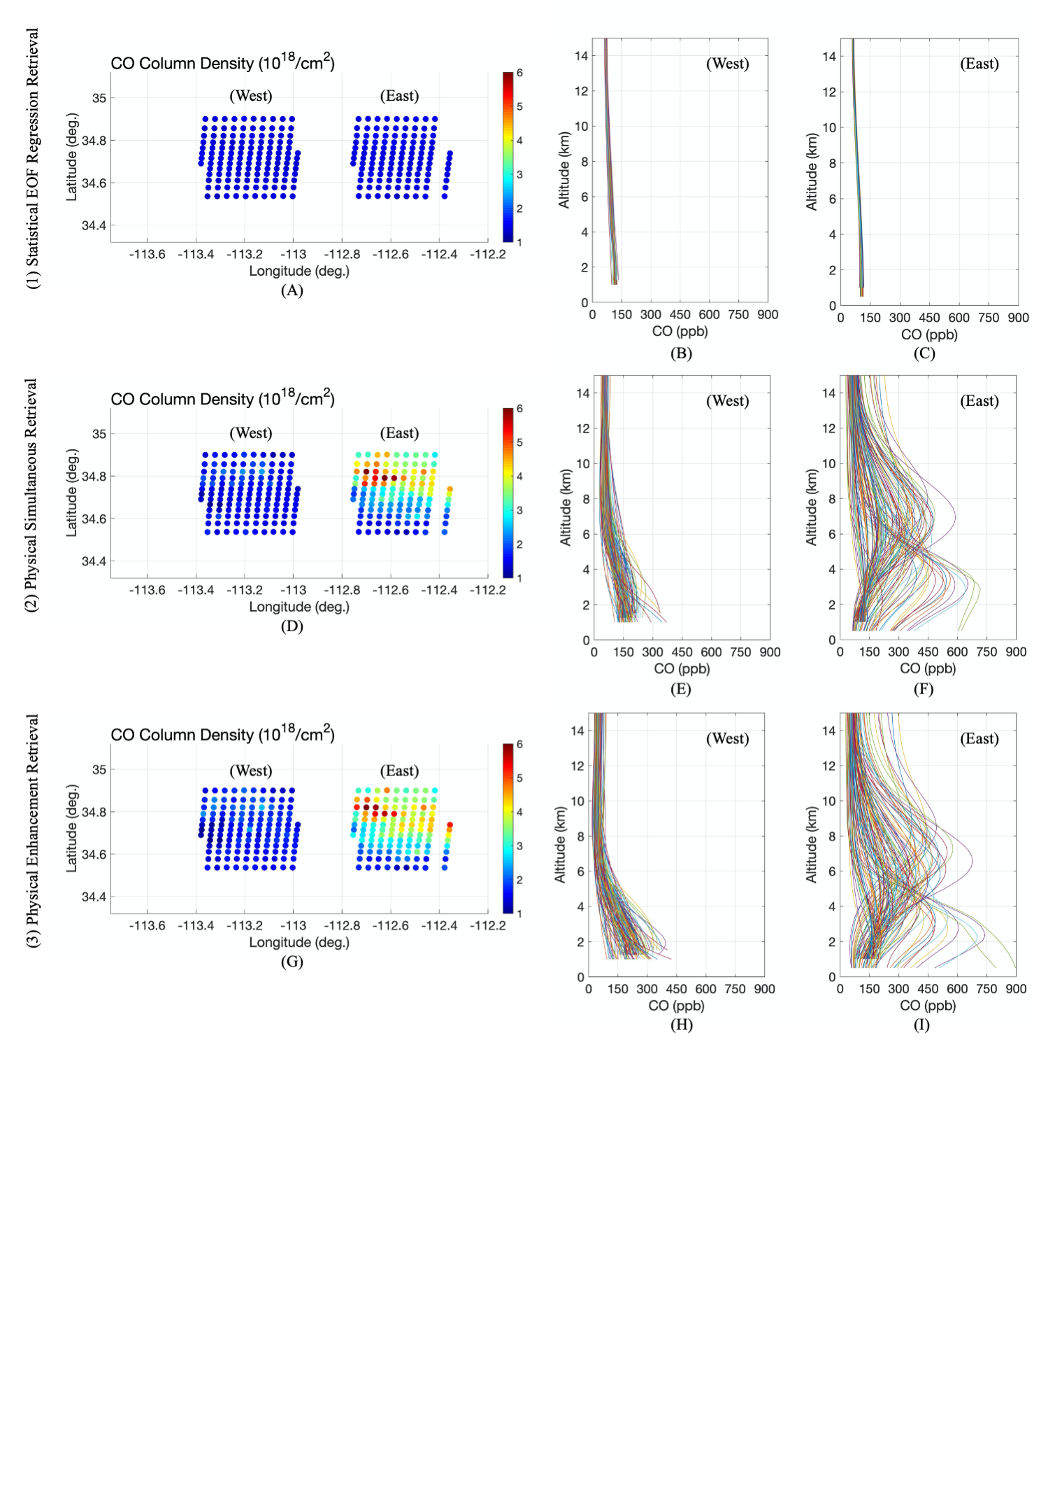
Wildfire-Induced CO Plume Observed during FIREX-AQ Experiment (1)
Daniel K. Zhou, Allen M. Larar, Xu Liu, and Xiaozhen Xiong
NASA Langley Research Center, Hampton, VA 23681
A22C-1679
Introduction
The Fire Influence on Regional to Global Environments and Air Quality (FIREX‑AQ) field campaign was conducted during August 2019 to investigate the impact of wildfire and biomass smoke on air quality and weather in the continental United States. Ultra-spectral resolved infrared measurements contain information about tropospheric carbon monoxide (CO) and ozone (O₃), as well as other trace species. A methodology of retrieving these tropospheric trace species from such remotely sensed spectral data has been developed and validated for the National Airborne Sounder Testbed-Interferometer (NAST‑I). NAST‑I CO and O₃ measurements from the recent FIREX‑AQ field campaign are presented herein and used to estimate wildfire plume age. Results show enhanced CO plume evolution and transport away from fire ground site, and its plume age associated with the plume distance in both vertical and horizontal directions from the wildfire location, as enabled by the moderate-vertical and high-horizontal resolution obtained from the NAST‑I remotely sensed IR spectrometer onboard NASA ER‑2 aircraft. This study advances our knowledge of fire-induced plume with its evolution and age in 3-dimensional space.
NAST-I: Brief Description and Objectives
NAST-I was developed in 1997-1998; refurbished in 2009 & 2016.
NAST-I Sensor Characteristics:
Michelson interferometer (FTE).
~8500 spectral channels, ~650-2800 cm⁻¹ at 0.25 cm⁻¹ spectral resolution.
Spatial resolution ~130 m/km flight altitude.
Radiances ~0.5 K absolute accuracy with 0.1 K precision.
Aircraft Accommodation:
ER-2 wing super pod
PROTEUS underbelly pod
WB-57 underbelly pallet.
NAST-I Field Campaigns:
  Before AIRS launch (<2002): 9 missions collecting geophysical field state characterization for satellite remote sensing system risk mitigation (sensors and algorithms).
  After AIRS launch (>2002): 13 missions for advanced satellite remote sensor Cal/Val (e.g., Aqua AIRS, MetOp IASI, & SNPP/JPSS CrIS), and airborne science.
  The most recent field campaign: FIREX-AQ (August 2019).
NAST-I spectral coverage encompasses all satellite IR sounders with a higher (or equivalent) spectral resolution and higher spatial resolution.
NAST-I Level 2 Data Processing & CO Retrieval Demo
NAST‑I CO retrieval progression through
statistical EOF regression (left panel),
physical simultaneous retrieval (middle panel), and
CO physical sequential retrieval (right panel)
from relatively clean (upwind, or west) and polluted (downwind, or east) regions near Sheridan fire on August 21, 2019.

