Slide 1
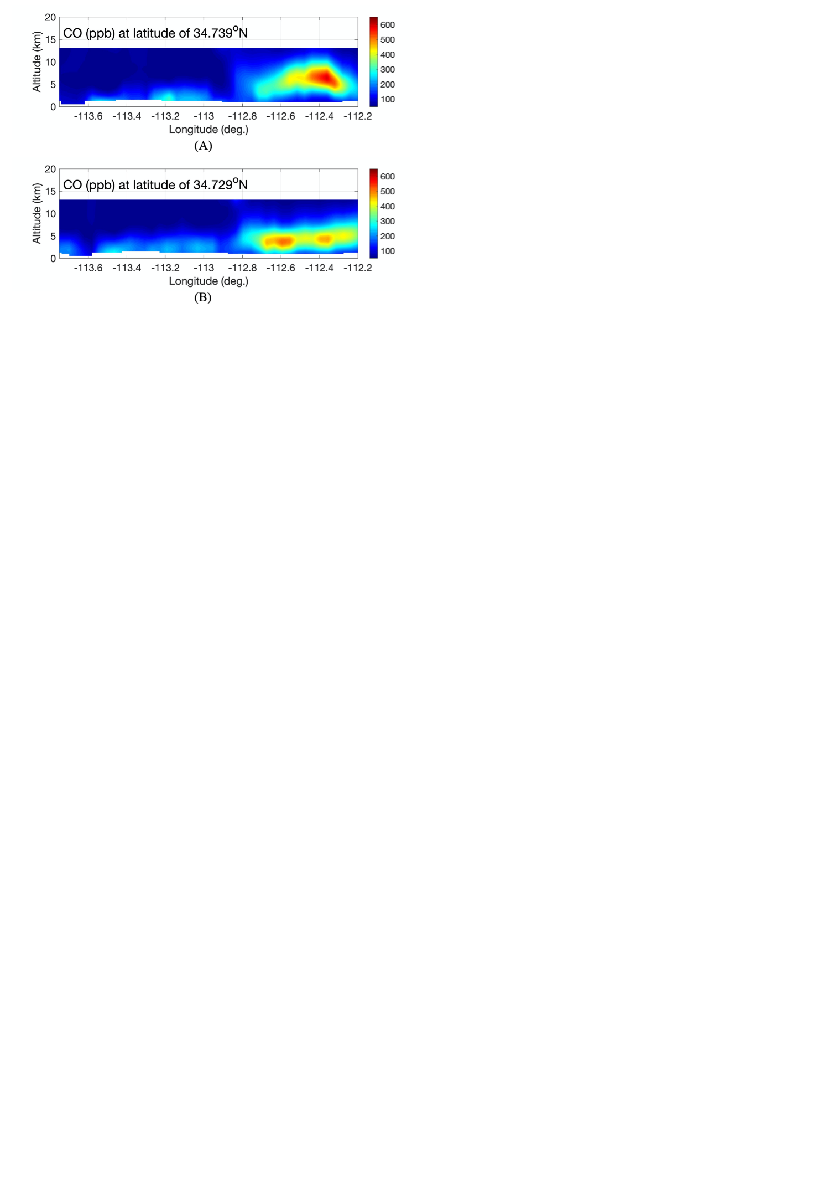
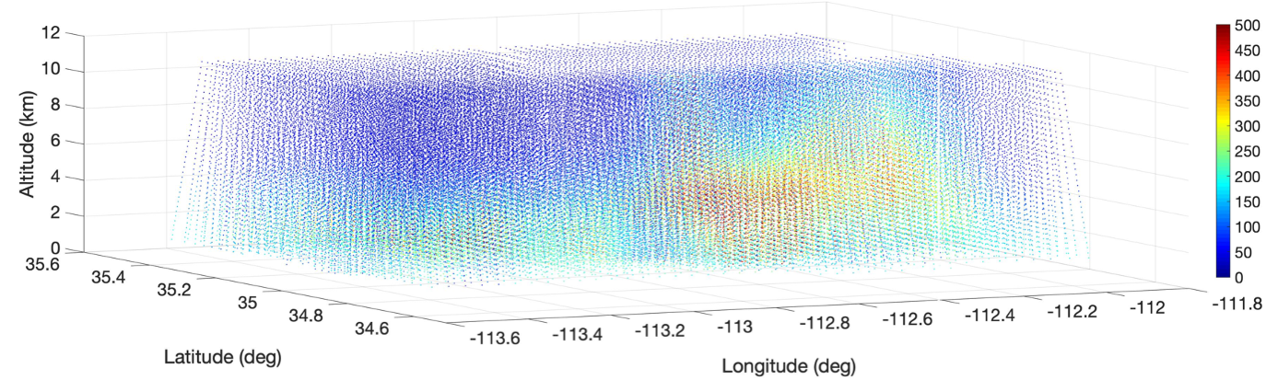
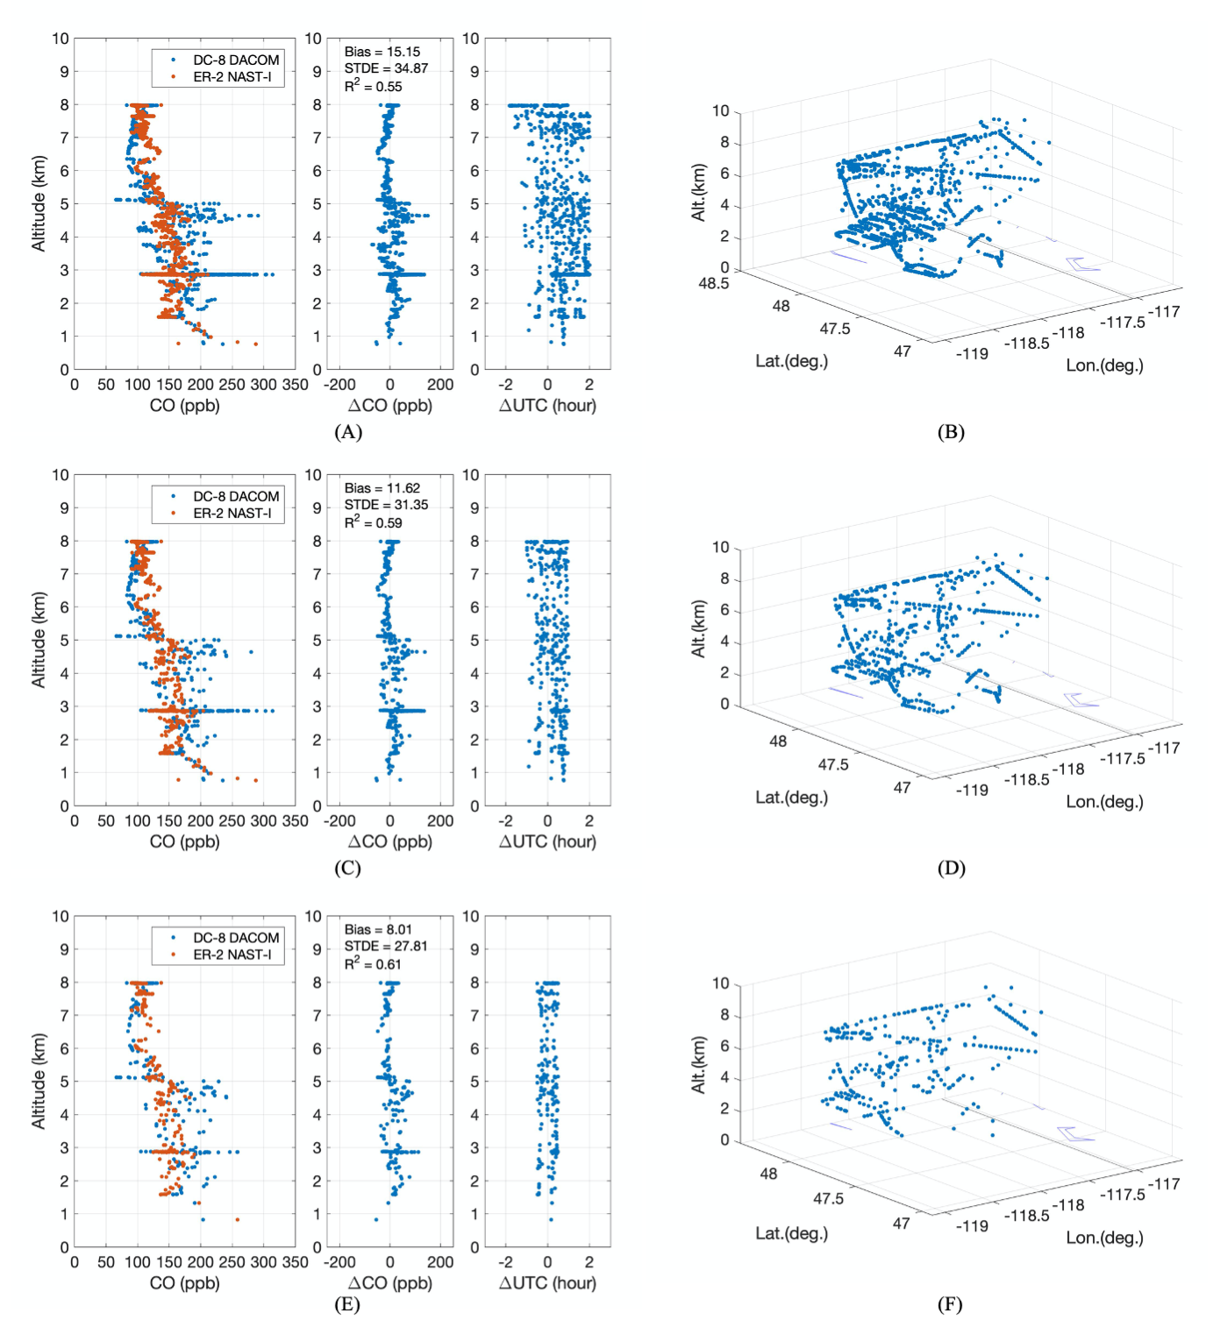
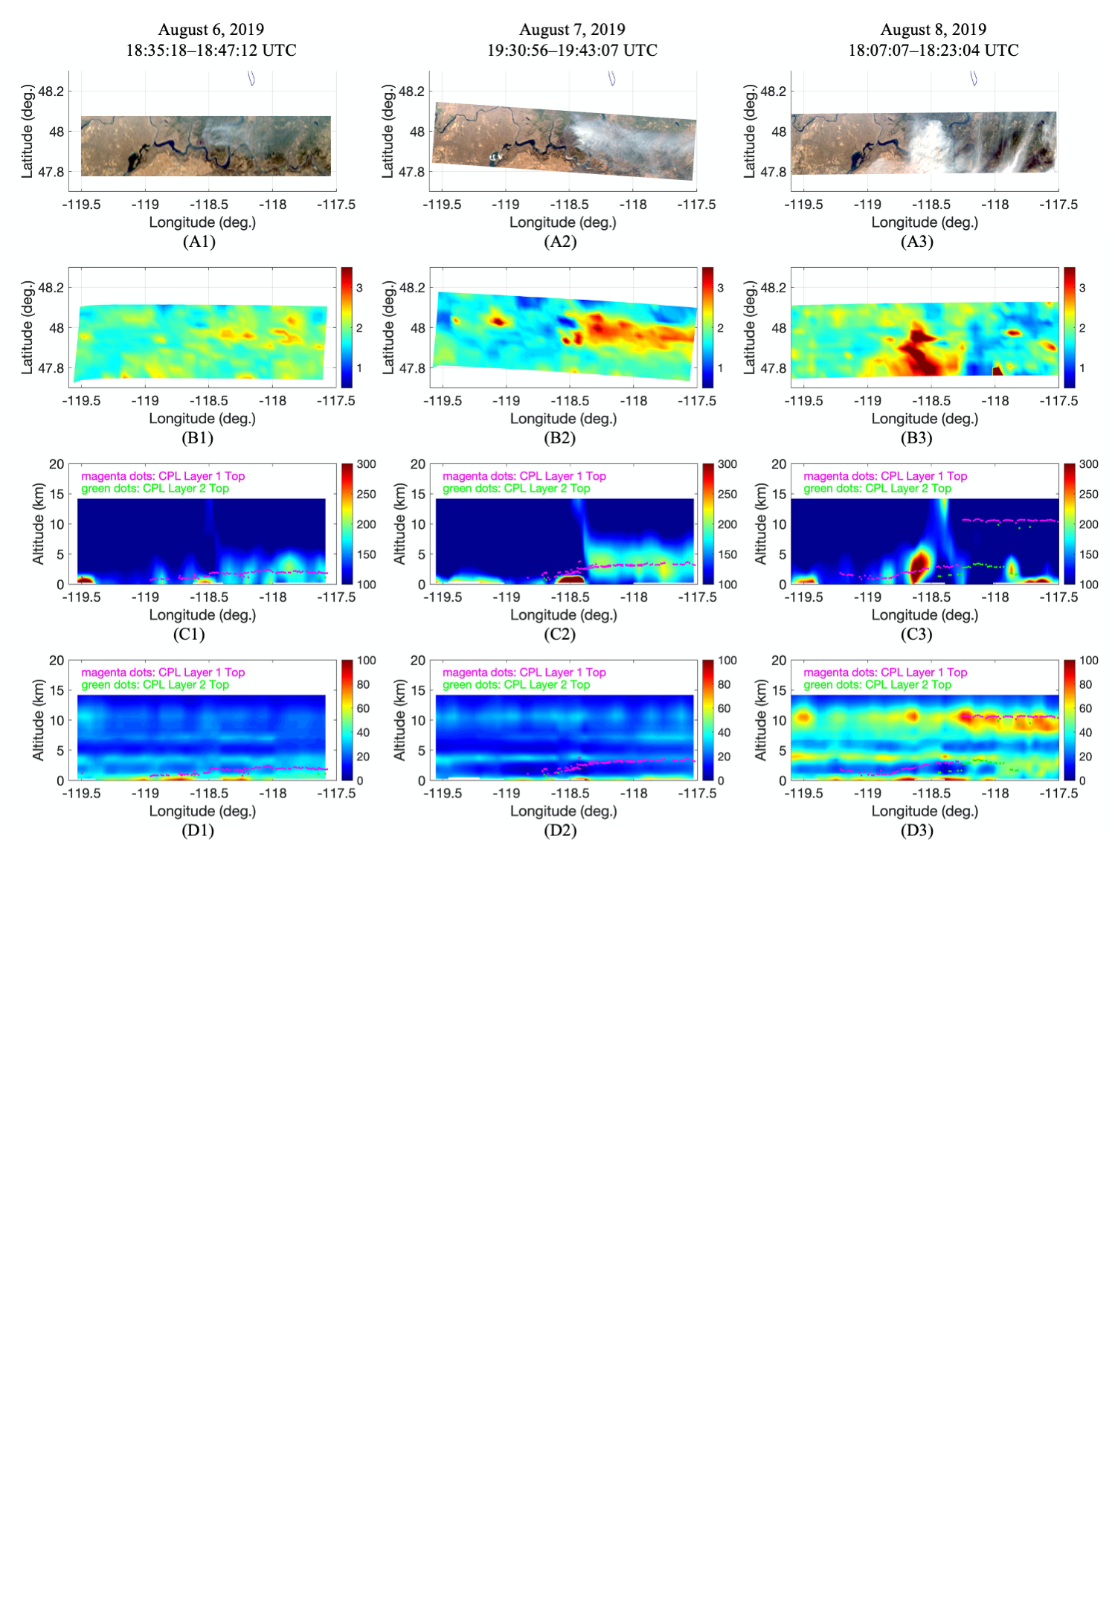
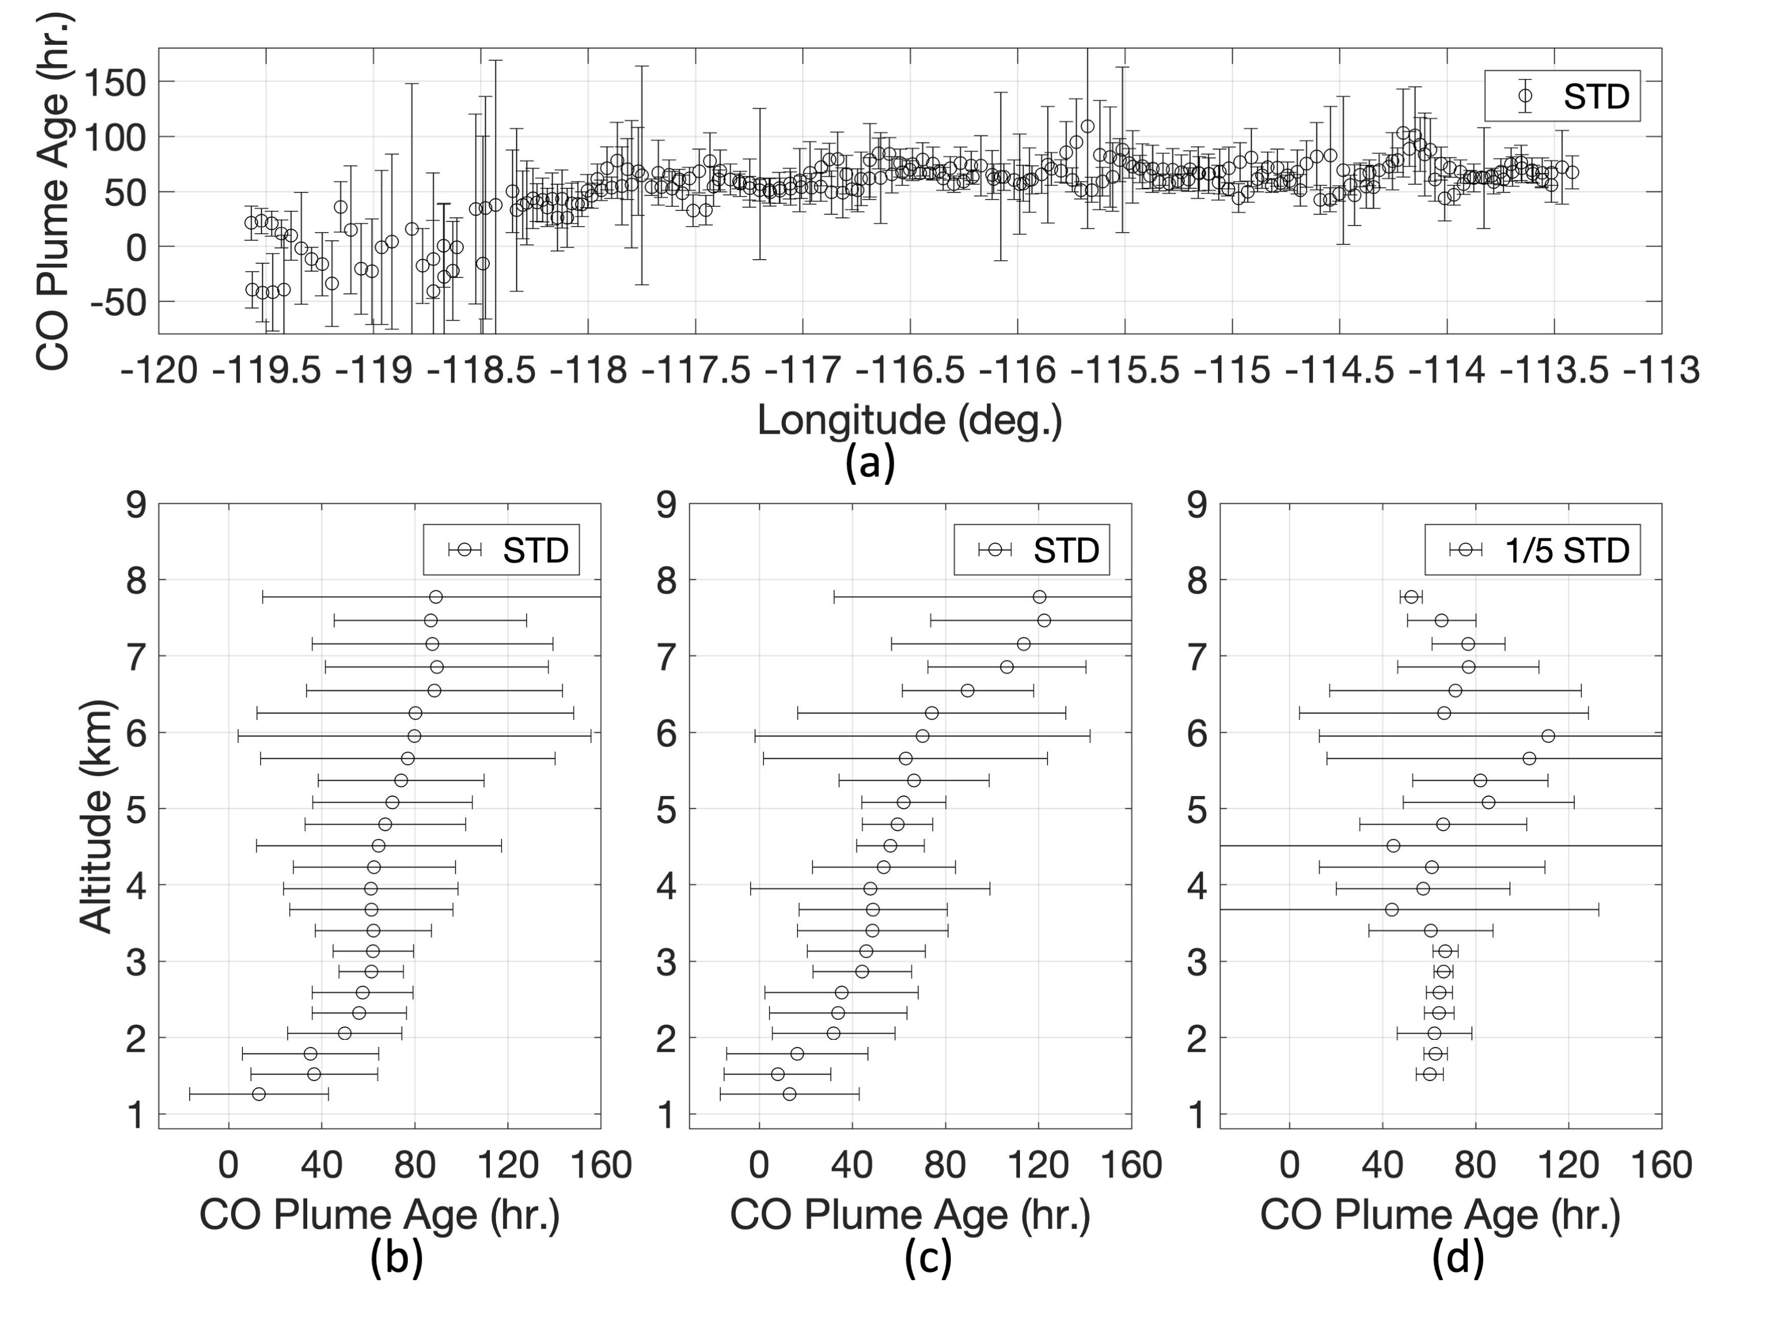
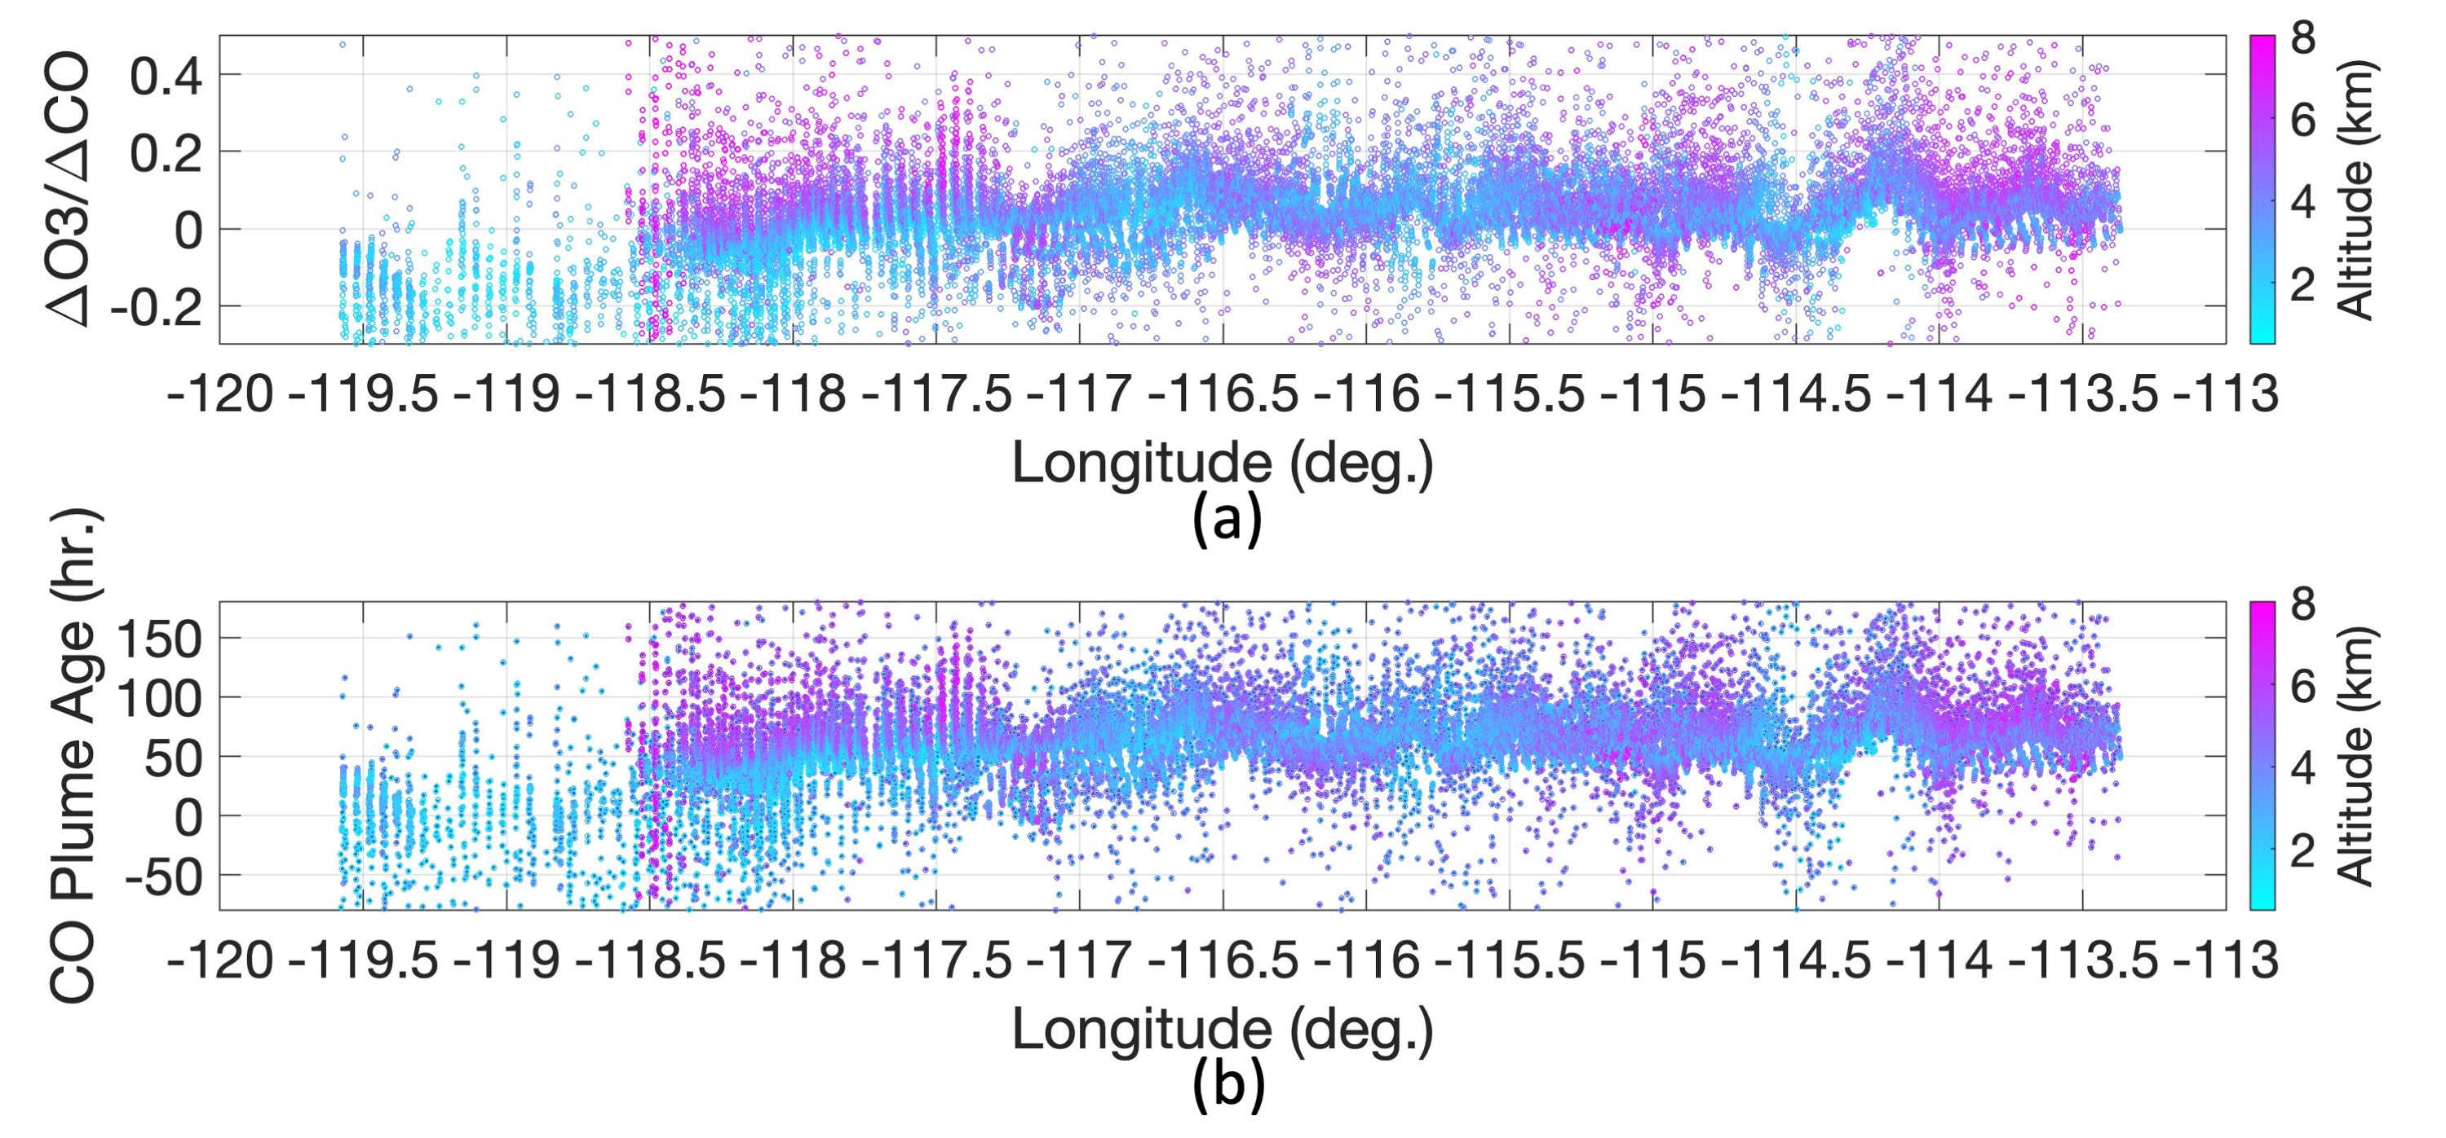
Wildfire-Induced CO Plume Observed during FIREX-AQ Experiment (2)
Daniel K. Zhou, Allen M. Larar, Xu Liu, and Xiaozhen Xiong
NASA Langley Research Center, Hampton, VA 23681
A22C-1679
Sheridan Fire Induced CO Distribution and Evolution
NAST‑I three-dimensional CO (ppb) distribution shows the plume evolution and transport near the Sheridan fire ground location (34.80º latitude, ‑112.85º longitude) from August 21, 2019.
CO time-evolution shown in its vertical profile cross sections up- and down-wind of the Sheridan fire location (about 140 km) from (A) 23:28:13–23:39:37 UTC of August 21, 2019, to (B) 00:38:35–00:49:24 UTC of August 22, 2019. (A) and (B) are about 70 minutes apart.
CO Retrieval Evaluation
Williams Flats Fire Induced CO Plume Progression
Inter-comparison between DACOM (smCO_{D}) and NAST‑I (CO_{N}) from August 6, 2019: (A) smCO_{D} and CO_{N} comparison with statistical parameters of bias, STDE, and R², and associated ∆UTC is less than ±2 hours, (B) data locations (near Williams Flats fire). (C) and (D) are the same as (A) and (B) but with associated ∆UTC less than ±1 hour; and (E) and (F) are the same as (A) and (B) but with associated ∆UTC less than ±0.5 hour.
Williams Flats fire progression from August 6 (left column), to August 7 (middle column), then to August 8 (right column). (A) eMAS true-color imageries, (B) CO column density (10¹⁸/cm²), (C) CO vertical profile (ppb) cross section with CPL layer top, and (D) the relative humidity vertical profile (%) cross section with CPL layer top.
Wildfire CO Plume Age Estimation
Conclusion
Wildfire plume age is estimated using O₃ and CO data based on an empirical relationship derived from in-situ measurements*. A positive relationship is found between the △O₃/△CO ratio and plume age. For this case study of wildfire plume age, we have chosen the ER‑2 sorties over the William Flats fire and the extended downwind area from August 7, 2019, as the ER-2 sorties have ~450 km downwind flight leg segments.
*D. A. Jaffe and N. L. Wigder, “Ozone production from wildfires: A critical review,” Atmospheric Environment, 51, 1-10 (2012).
Wildfire induced CO plumes, in conjunction with their evolution and transport, are readily identified with NAST‑I measurements.
NAST‑I retrieval ability is demonstrated showing the contrast between nominal atmospheric background and fire-induced elevated CO profiles.
NAST‑I remotely-sensed CO is evaluated by favorable inter-comparisons with the DACOM in-situ CO measurements which show a positive agreement.
Plume characterization correlation between CO and smoke-dust detected by the CPL and eMAS is assessed and presented a good correspondence.
Plume age estimation in a 3-d high-spatial-resolution adds critical temporal information of the fire-induced plume, demonstrating the capability of an ultraspectral remote sensor with a higher spectral and spatial resolution to monitor CO and O₃ and its advantage of giving broader spatial and temporal assessment by rapidly covering a large field of observation.
(a) Plume age distribution along the longitude. Plume age distribution along the altitude: (b) all data shown from (a), (c) data from longitude less than ‑117.0º (near fire location), and (d) data from longitude greater than ‑117.0º (further away from fire location.
△O₃/△CO distribution along the longitude within the fire-induced plumes, and (b) estimated plume age distribution

