Slide 1
ANOPP2 Mission Analysis Tool (AMAT)
Leonard V. Lopes and Stephen A. Rizzi
NASA Langley Research Center

Slide 2
Outline
UAM Noise-Power-Distance Prediction Process
Prediction of single source noise hemisphere
Collecting source noise hemispheres to define flight event
Modification of hemispheres for V&V
Propagation of noise to ground and metric calculation
ANOPP2 Toolchain: AARON, ARMIT, ASOFT, AMPIT, AMAT
AMAT Examples
Calculation of NPD during level flyover (Mode L)
Calculation of OASPL (dBA) during approach (Mode A)
Calculation of 1/3rd Octave SPL along line on ground (Mode L)
Conclusion

Slide 3
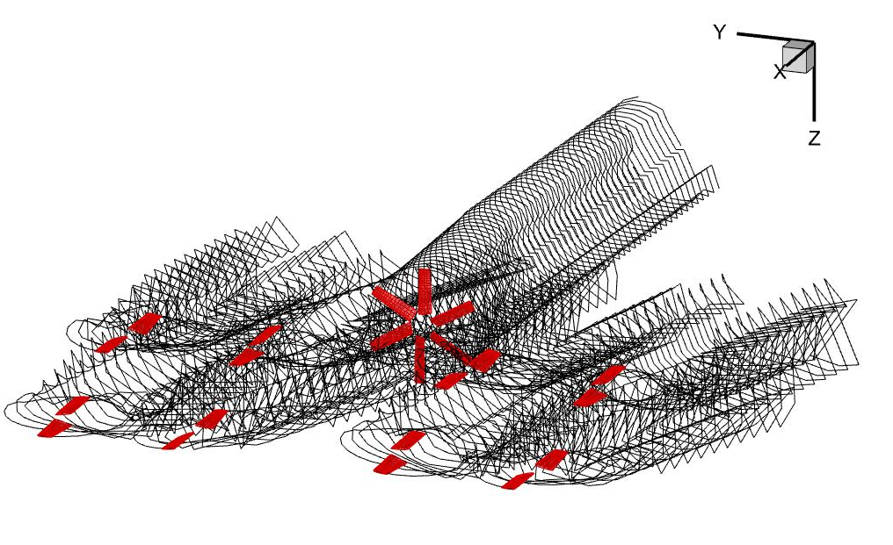
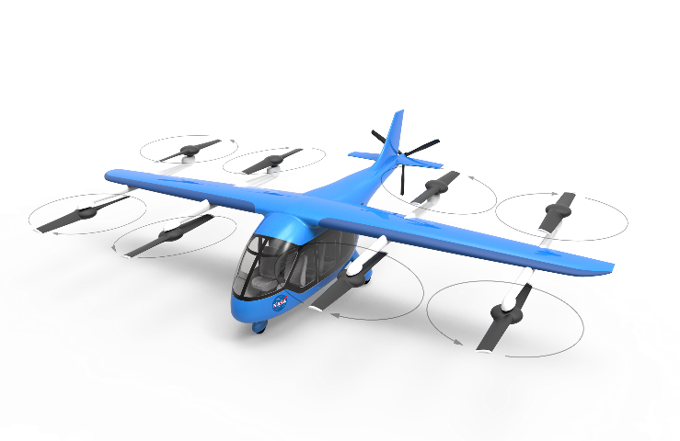
UAM NPD Prediction Process
UAM source noise prediction requires mid- to high-fidelity aerodynamics
Aerodynamics affects blade dynamics and rotor performance
Blade dynamics and rotor performance affect aerodynamics
The aerodynamics are affected by flight condition and trim state
Similar flight conditions may result in significantly different aerodynamics
There may exist many trim states capable of the same flight condition
Vehicle Concept
Flight Conditions
Aerodynamic Assessment
Trim State
Aerodynamic
Computation

Slide 4
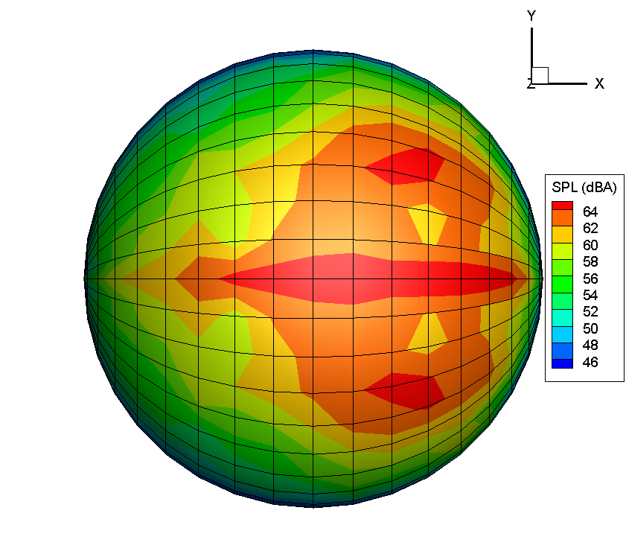
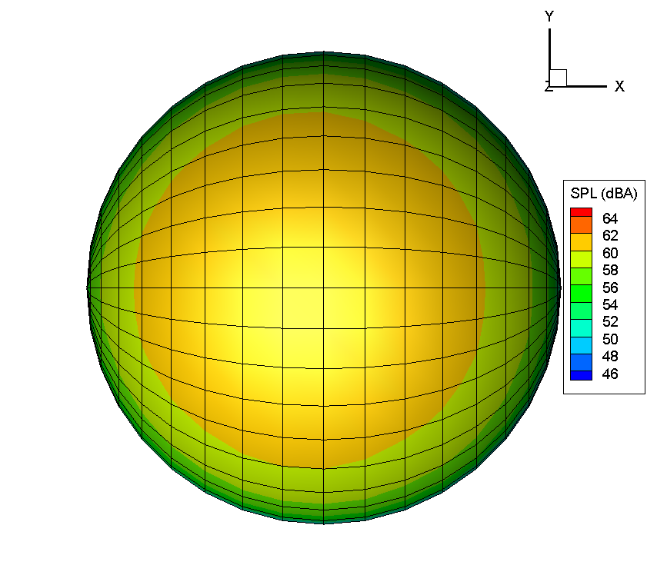
Single Source Noise Hemisphere
Many different sound sources on vehicle
Tonal noise source: deterministic (from rotating/moving blade volume and surface pressures)
Broadband self-noise source: stochastic (from turbulent boundary layer and related phenomena)
Blade vortex interaction (BVI) : included in tonal noise sources
Blade wake interaction (BWI): stochastic (from turbulent self wake ingested by rotor or from rotor-rotor interaction)
Turbulence ingestion noise (TIN) : surrounding turbulence environment ingested (e.g. nearby buildings)
Electric motor noise: significant tonal noise in the mid-frequency range (annoying for listeners)
Each flight condition and trim state results in a unique aerodynamic assessment
Capability of aerodynamics and acoustics is evolving, multiple iterations of same assessment as tools improve
Leads to a large database of aerodynamic assessments and source noise hemispheres that is ever-evolving
Currently Available
Not Yet Available
Version 1, 2, 3…. of
Aerodynamic Assessment
Source Noise Hemispheres
Aerodynamic Assessments
Source Noise Hemispheres

Slide 5
Flight Event
Flight event is defined as one or more flight conditions at emission times
Start with a database of source noise hemispheres for each flight condition and trim state
Flight event can be a simple flyover, climb, or approach at many altitudes (h)
Each hemisphere run at many different altitudes
Each hemisphere run at level flyover, approach, and takeoff
Can also be a complex vehicle maneuver
Several hemispheres selected to coincide with flight path’s required flight conditions
Source Noise Hemispheres for
Flight Condition and Trim State
Level Flyover
Approach
h
Takeoff
Maneuver

Slide 6
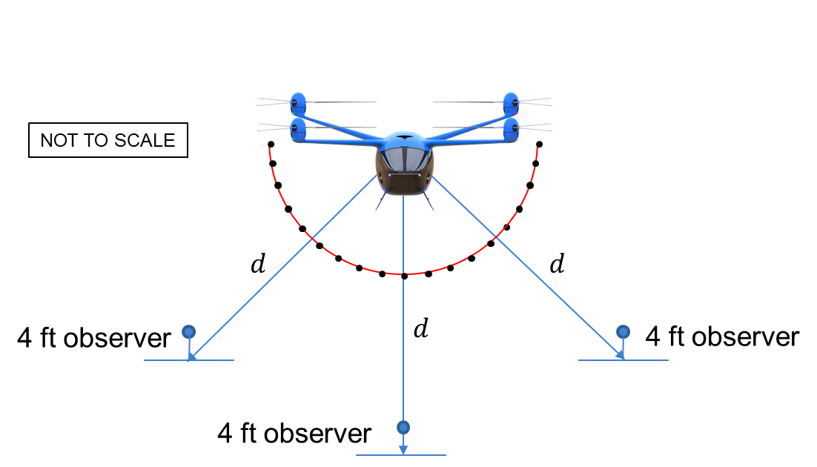
V&V
Modification of the source noise hemisphere is critical for analysis
Replace entire hemisphere with noise at a single point (eliminates source interpolation)
Eliminate all azimuthal angles other than 0°
Eliminates azimuthal interpolation and simulates fixed wing source flyover event
Select on azimuthal angles of -45°, 0°, 45°
Simulates rotorcraft source flyover event
Modified ‘hemisphere’ is used in propagation as if full noise hemisphere
-45°
0°
45°

Slide 7
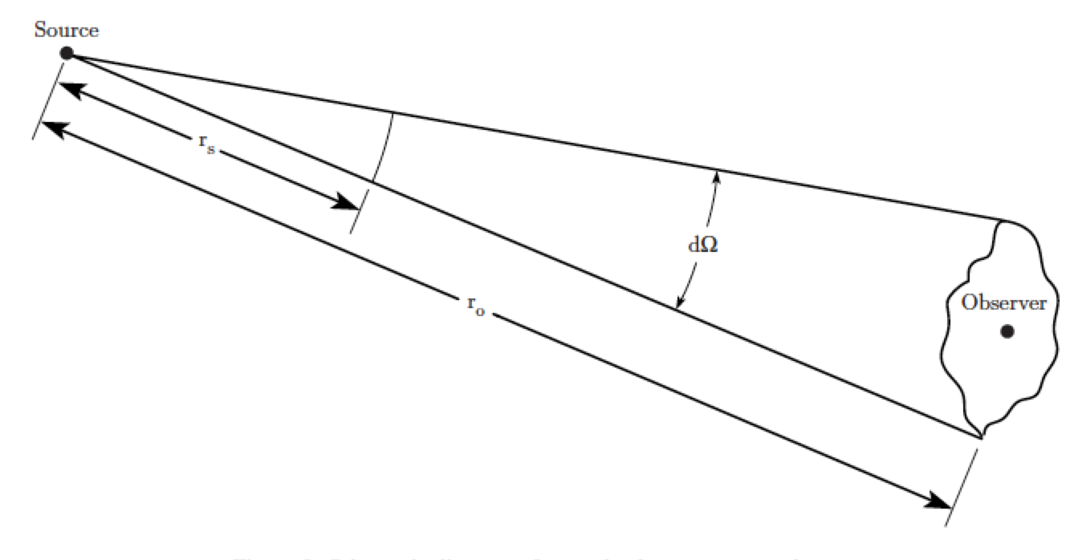
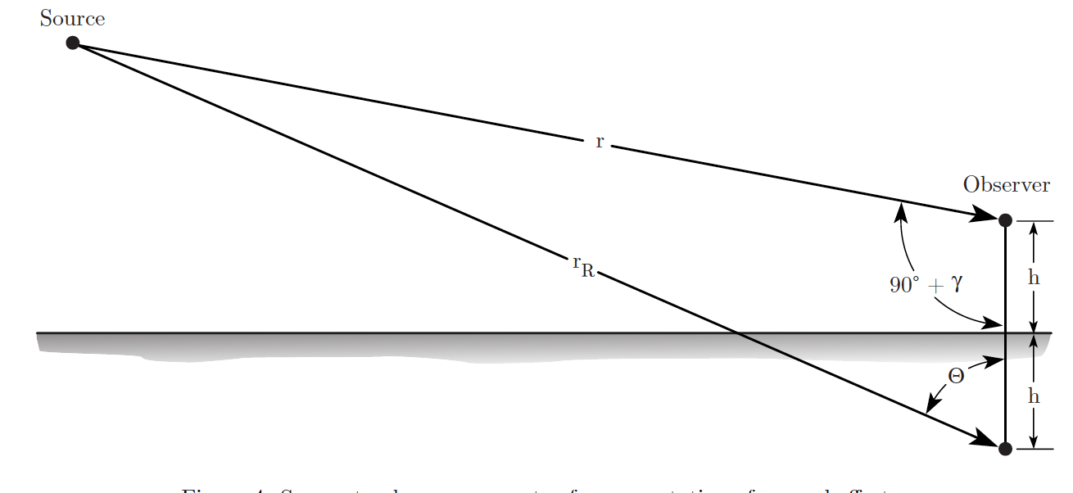
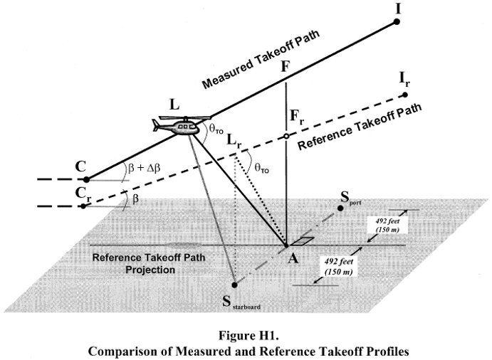
Propagation
Each combination of hemisphere, flight path, and observer
Given time history of noise hemisphere, calculate noise at one or more ground observer positions
Source noise hemisphere may be 1/3rd octave band SPL, NBS, or PSD
Account for spherical spreading
Account for atmospheric absorption (several models)
Account for ground effects
Account for different emission angles (due to ground)
Layered atmosphere (not required for NPD generation)
Called many times for each vehicle NPD database
Also leveraged for certification assessment

Slide 8
Outline
UAM Noise-Power-Distance Prediction Process
Prediction of single source noise hemisphere
Collecting source noise hemispheres to define flight event
Modification of hemispheres for V&V
Propagation of noise to ground and metric calculation
ANOPP2 Toolchain: AARON, ARMIT, ASOFT, AMPIT, AMAT
AMAT Examples
Calculation of NPD during level flyover (Mode L)
Calculation of OASPL (dBA) during approach (Mode A)
Calculation of 1/3rd Octave SPL along line on ground (Mode L)
Conclusion

Slide 9
ANOPP2
ANOPP2 is a multifaceted program used to perform noise calculations
ANOPP2 is composed of three components
Common framework that can be used for fine-grained control
Does require writing a user code in Fortran, C++, or Python
Because of its complexity, using the framework directly has steep learning curve
Functional modules perform a specific acoustic calculation and require the framework
Tools focus on the user’s application by reducing available capability are reducing the learning curve
ANOPP2
Tools
Framework
Functional Modules

Slide 10
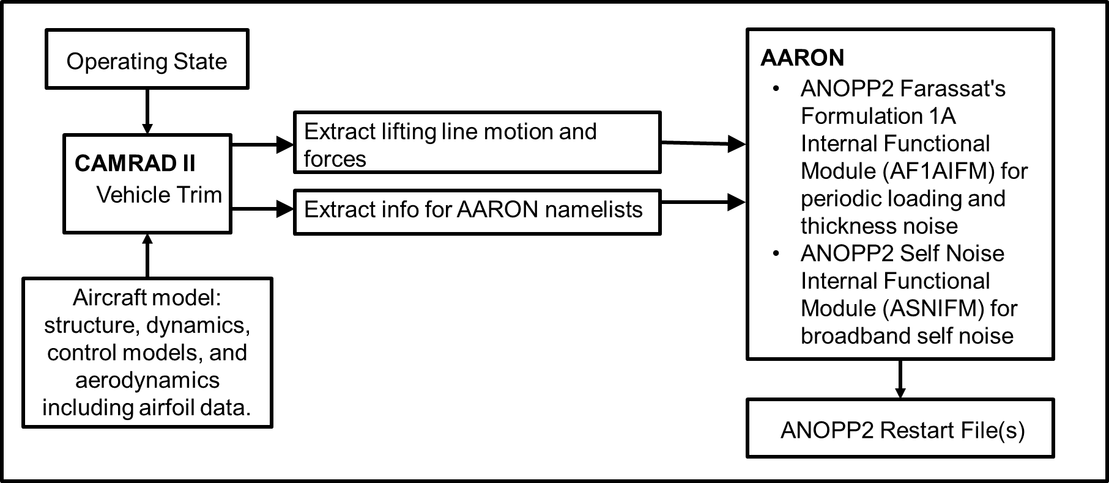
AARON
ANOPP2 Aeroacoustic ROtor Noise (AARON)
Comprehensive analysis using CAMRAD II for vehicle trim and lifting-line motion and forces
The ANOPP2 Farassat Formulation 1A Internal Functional Module (AF1AIFM) for tonal noise
The ANOPP2 Self-Noise Internal Functional Module (ASNIFM) for broadband noise
Exports ANOPP2 restart file containing single source noise hemisphere (all noise sources)
Broadband Self Noise
Tonal Noise
Optional
CFD coupled aerodynamics

Slide 11
ARMIT, ASOFT, AMPIT
ANOPP2 Restart Metadata Insertion Tool (ARMIT)
Metadata are additional information (other than noise) on hemisphere
Attaching metadata allows for organization and hemisphere selection
ARMIT allows for including any type of metadata to source noise hemispheres
ANOPP2 Source Observer Filtering Tool (ASOFT)
V&V for source noise hemispheres is important in order to trust results
We can limit the noise hemisphere to a particular azimuth angle(s)
Examples 0° (fixed-wing mode) or -45°, 0°, 45° (helicopter mode)
ASOFT allows the study of directionality on far-field noise
ANOPP2 Message Passing Interface (MPI) Tool (AMPIT)
Source noise and propagation computations can take a long time
Leveraging computational resources reduced the time significantly
AARON and AMAT leverage AMPIT to significantly reduce computation time on the order of the number of processors available
Not To Scale

Slide 12
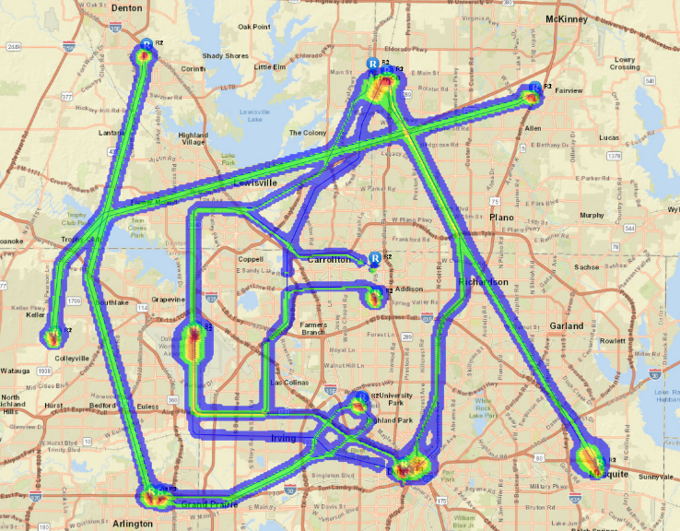
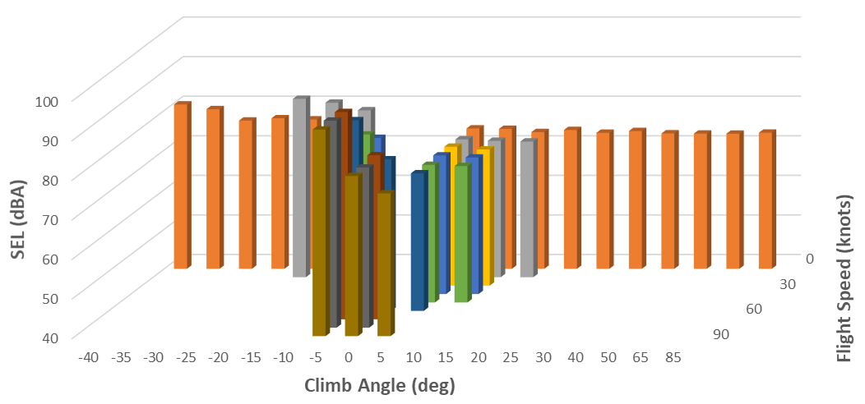
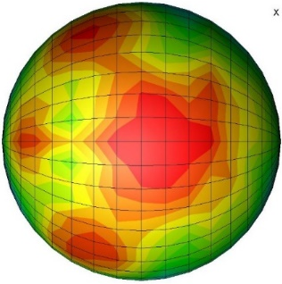
AMAT
Single vehicle noise predictions feed into community noise impact assessment
Source noise hemispheres of various vehicles under various flight conditions are fed into design tool
Environment impact (AEDT) simulates many different flight paths and accumulates to assess noise over large area
Noise from entire airport is simulated and community impact assessed
ANOPP2’s Mission Analysis Tool (AMAT)
Command line tool that wraps the ANOPP2 Straight Ray Propagation Internal Functional Module (ASRPIFM)
Takes a source noise hemisphere and flies under various flight conditions
Doppler shift, spherical spreading, atmospheric absorption, ground effects
Records data required by AEDT for community impact assessment
AMAT
AEDT
Source Noise Prediction
CAMRAD II
OVERFLOW
Source Noise
Integrated Acoustic Metric Data
SPL [dB]
ANOPP2

Slide 13
Outline
UAM Noise-Power-Distance Prediction Process
Prediction of single source noise hemisphere
Collecting source noise hemispheres to define flight event
Modification of hemispheres for V&V
Propagation of noise to ground and metric calculation
ANOPP2 Toolchain: AARON, ARMIT, ASOFT, AMPIT, AMAT
AMAT Examples
Calculation of NPD during level flyover (Mode L)
Calculation of OASPL (dBA) during approach (Mode A)
Calculation of 1/3rd Octave SPL along line (Mode L)
Conclusion

Slide 14
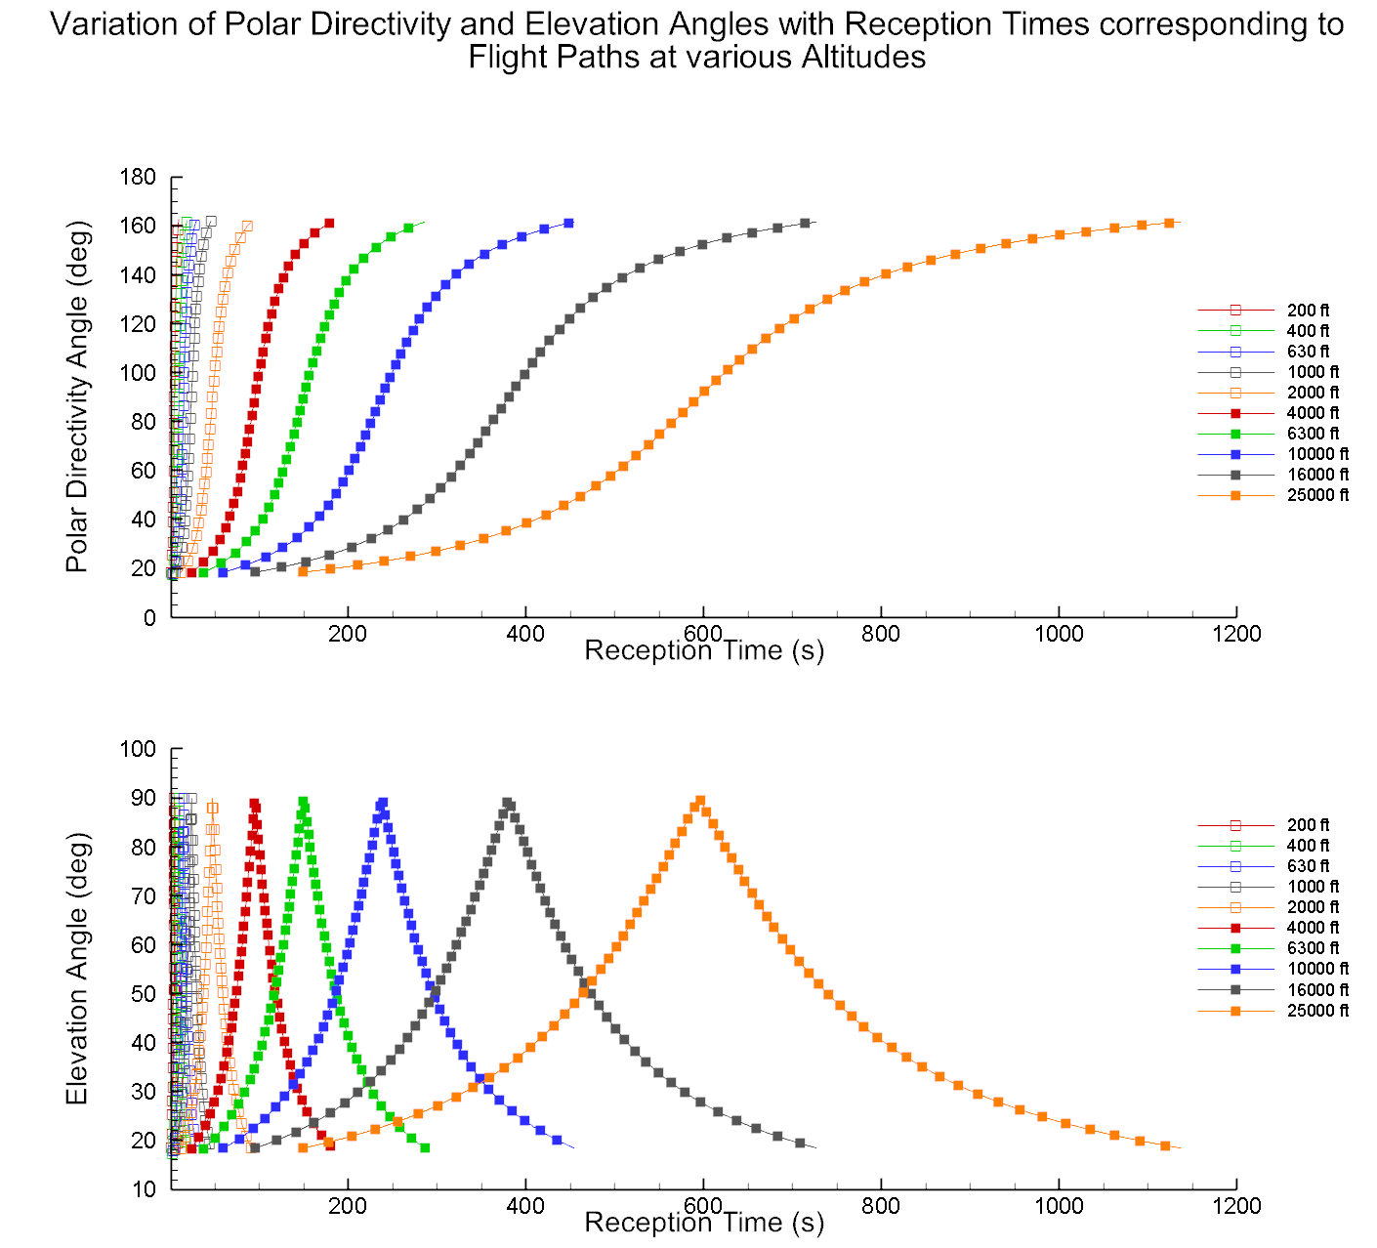
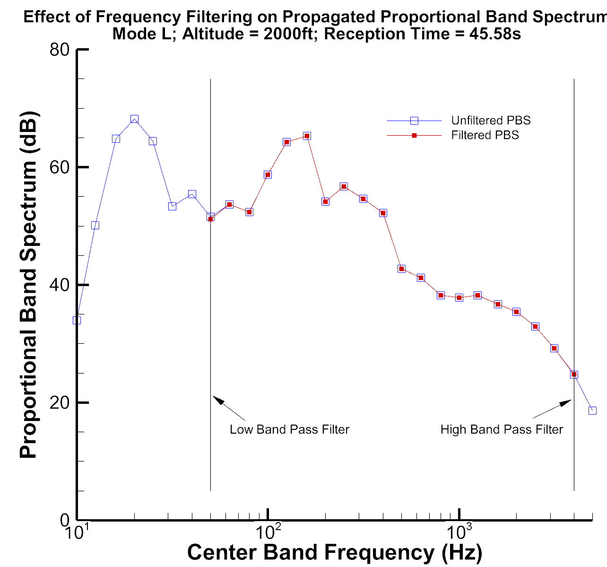
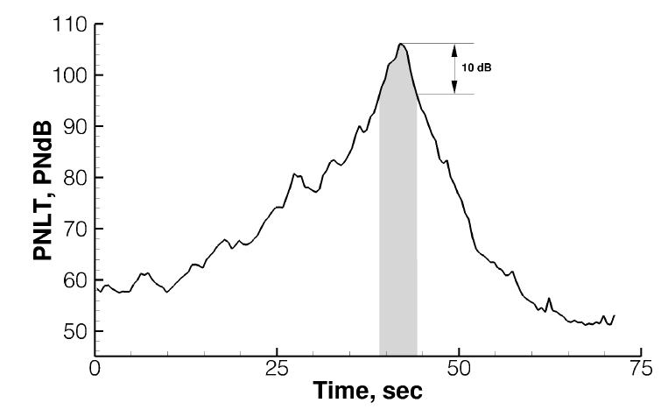
Namelist Input File
AMAT input file includes 2 parts
Single namelist: short list of settings/options
Flight path and source specifications: source selection, mode, velocity, source hemisphere files
lossless (no absorption)
SAE ARP 866a
ANSI S1 26 1978
ANSI S1 26 2014
ICAO6 1978
Broadband Self Noise
Tonal Noise
&AmatConfiguration
Absorption flag (on/off, model)
Ground settings (on/off, model)
Flight path and simulation settings
Metadata settings
Frequency filter settings
/
Noise source selection (F1A only, etc.)
Mode
Velocity and source hemisphere file
Hard/Soft/No Ground
Flow Resistance
Level Flyover
Approach
Duration of flight event
h
Takeoff
Maneuver

Slide 15
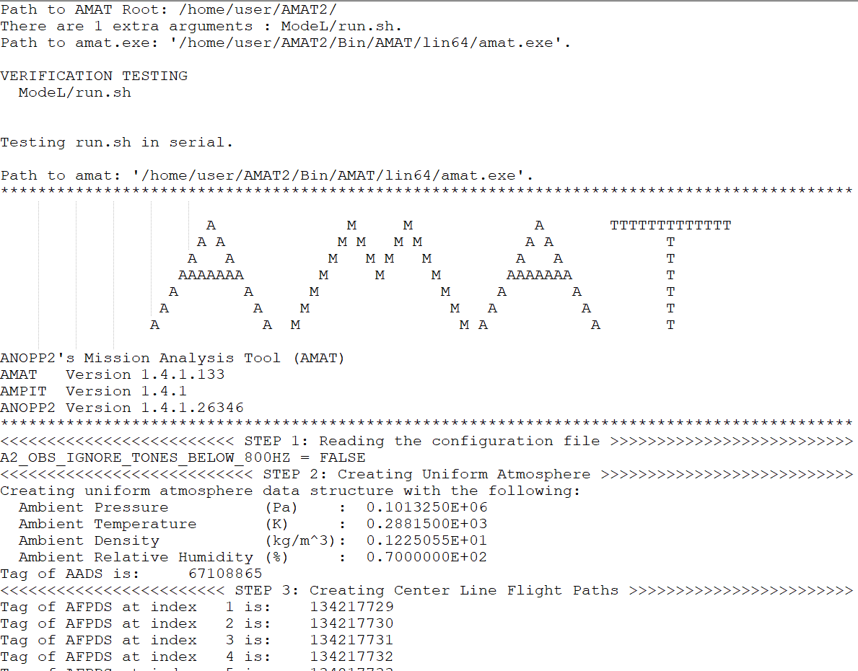
Command Line Output
+ Series of Tecplot formatted files of metadata and predictions

Slide 16
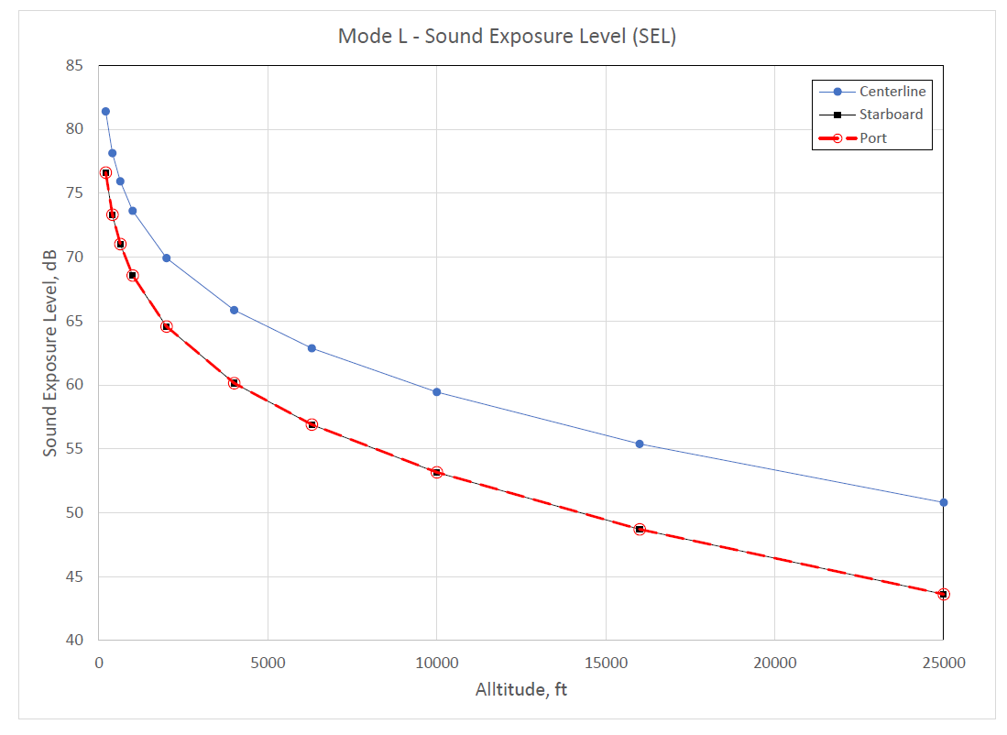
1) Calculation of NPD during level flyover (Mode L)

Slide 17
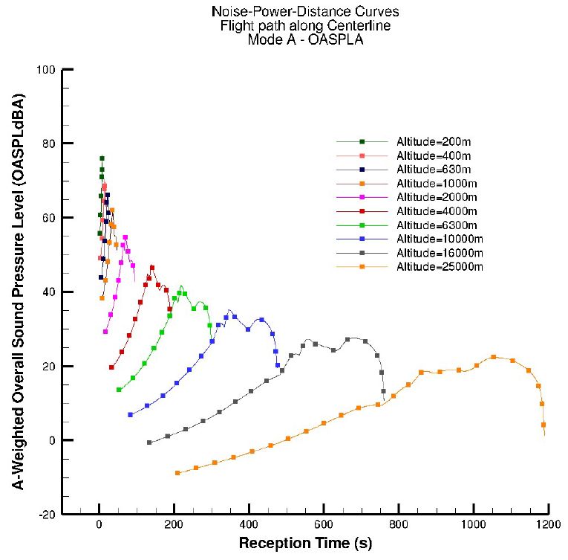
2) Calculation of OASPL (dBA) during approach (Mode A)

Slide 18
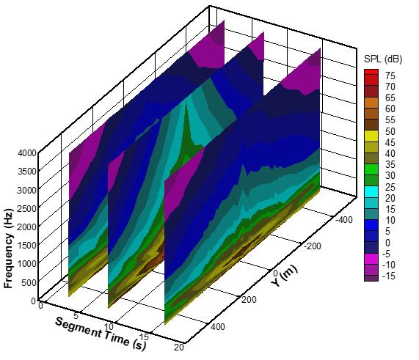
3) Calculation of 1/3rd Octave SPL along line (Mode L)

Slide 19
Conclusion
UAM vehicle noise requires suite of tools chained together
ANOPP2 provides suite of tools for different pieces of the noise assessment puzzle
Examples have been demonstrated showcasing the ANOPP2 Mission Analysis Tool (AMAT), which provides the far-field propagation portion of the tool chain

