Slide 1
Data Management and Best Practices
Michael Shook
NASA Langley Research Center
Hampton, VA

Slide 2
About Me
BS in Atmospheric Science from University of Kansas in 2012
10 years experience in data processing and data management for NASA suborbital field campaigns
8+ field airborne field campaigns

Slide 3
What is Data Management?
Process of organizing, maintaining, and preserving data for future users

Slide 4
The problem(s)
Trying to compare nice, gridded satellite or model data to airborne or ground data
Someone else wants to copy your model run

Slide 5
Goal: Make your data FAIR
Findable
Accessible
Interoperable
Reusable
https://www.go-fair.org/fair-principles/
Wilkinson et al. 2016, Scientific Data https://doi.org/10.1038/sdata.2016.18

Slide 6
Findable
There is a place (and only one place) for other people to find your data
  Can be a shared drive, figshare.com, or a NASA data center (DAAC)
  Has a DOI or other unique identifier for public data
Your data has metadata
  Includes units, contact info, lat/lon, model parameters, etc.
  Found with the data (in a header or readme)
  Identifies what data it’s describing (if separate from the data)
  Searchable for public data

Slide 7
Accessible
Make the data easy to acquire once it’s been found
Choose a format that is free to use and widely accepted
If possible, use a standard/convention for your format
  HDF: HDF-EOS or HDF-GEOMS
  netCDF: CF convention
  Text/CSV: ICARTT

Slide 8
Interoperable
Make your data easy to combine with other data
  Use community-standard terms
  If possible, use a standard naming convention (like CF Convention or NASA’s upcoming Standard Names for Atmospheric Composition)

Slide 9
Reusable
Include all the information needed to reproduce the data
Describe any changes (detailed version history)
Explain the permissions for the data

Slide 10
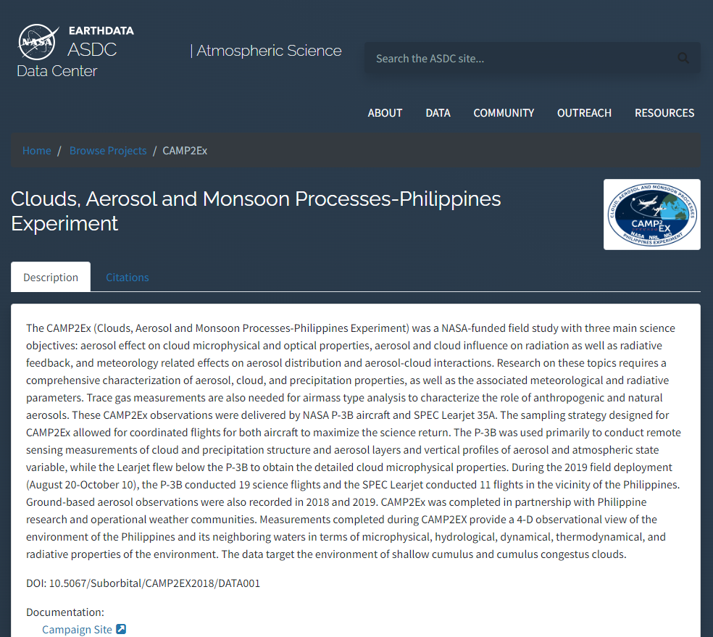
Example
“NASA aircraft CO data Philippines”
Findable
  Search using Google or EarthData Search
  Has a DOI
Accessible
  “Get Dataset” button
  Data is in text/ICARTT format
Interoperable
  Variables are described using a standard naming convention
Reusable
  Data is available without restriction
  Revision history

Slide 11
Version Control
Git is most common
“Saves for your saves”
Can be used locally (just on your own computer) or with a team online (e.g., GitHub)
Not just for code!

Slide 12
Questions?

