Slide 1
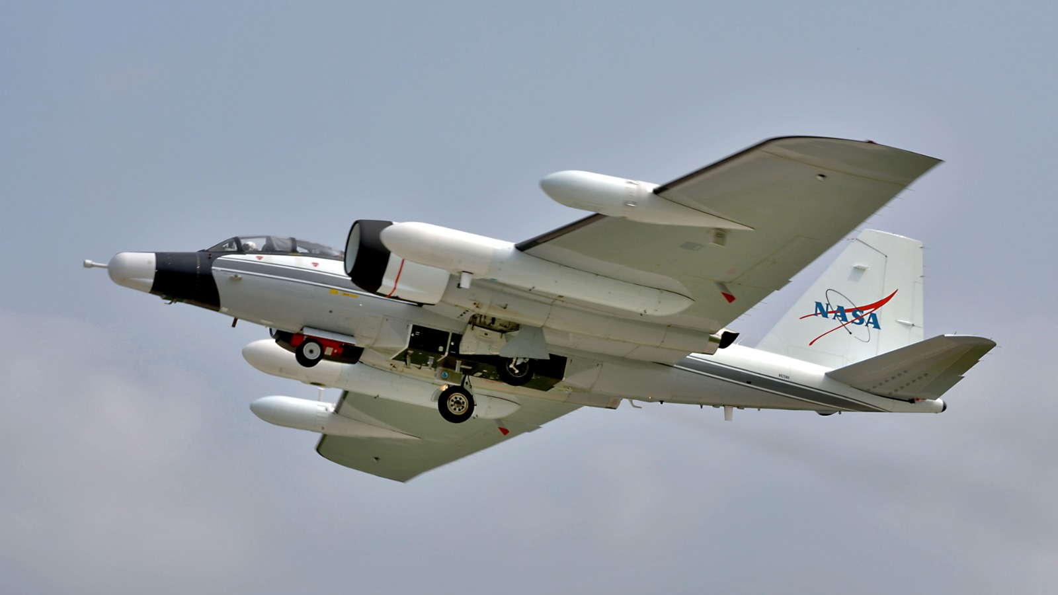



Microphysical Observations of the Asian Tropopause Aerosol Layer (ATAL): Preliminary ACCLIP Results
Matthew D. Brown^{1, 2}, Michael Shook¹, James C. Wilson³, and Luke D. Ziemba¹
¹Chemistry and Dynamics Branch, NASA Langley Research Center, Hampton, VA 23681
²Science Systems and Applications, Inc., Lanham, MD 20706
³Department of Mechanical and Materials Engineering, University of Denver, Denver, CO 80210

Slide 2
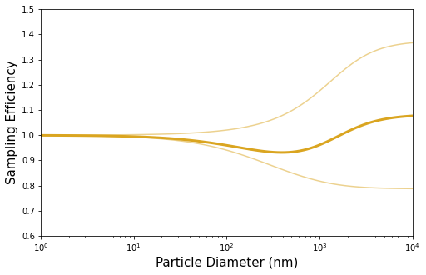
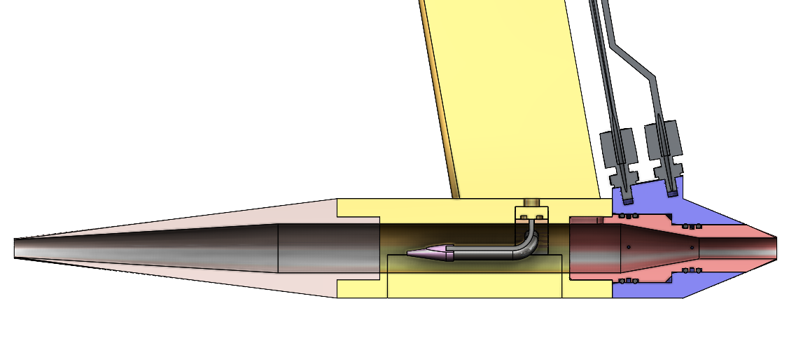
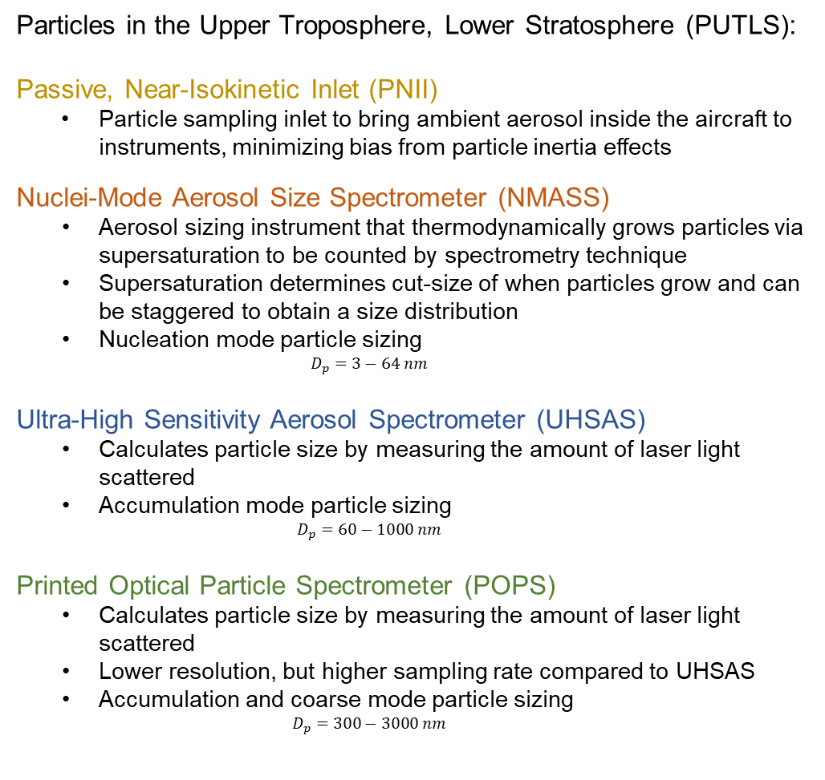
PUTLS Overview
Particles in the Upper Troposphere, Lower Stratosphere (PUTLS):
Passive, Near-Isokinetic Inlet (PNII)
  Particle sampling inlet to bring ambient aerosol inside the aircraft to instruments, minimizing bias from particle inertia effects
Nuclei-Mode Aerosol Size Spectrometer (NMASS)
  Aerosol sizing instrument that thermodynamically grows particles via supersaturation to be counted by spectrometry technique
  Supersaturation determines cut-size of when particles grow and can be staggered to obtain a size distribution
  Nucleation mode particle sizing
    $$D_{p}=3−64 nm$$
Ultra-High Sensitivity Aerosol Spectrometer (UHSAS)
  Calculates particle size by measuring the amount of laser light scattered
  Accumulation mode particle sizing
    $$D_{p}=60−1000 nm$$
Printed Optical Particle Spectrometer (POPS)
  Calculates particle size by measuring the amount of laser light scattered
  Lower resolution, but higher sampling rate compared to UHSAS
  Accumulation and coarse mode particle sizing
    $$D_{p}=300−3000 nm$$
NMASS
UHSAS
POPS
1 10 100 1,000 10,000 (D_{p}, nm)
1
2
1
2

Slide 3
ACCLIP Science Objectives and Motivation
Quantify variability in UTLS particle size distribution associated with the Asian Summery Monsoon
Calculate optical properties of the Asian Tropopause Aerosol Layer (ATAL) and assess model representation
Identify pathways for ATAL aerosol to reach the stratosphere

Slide 4
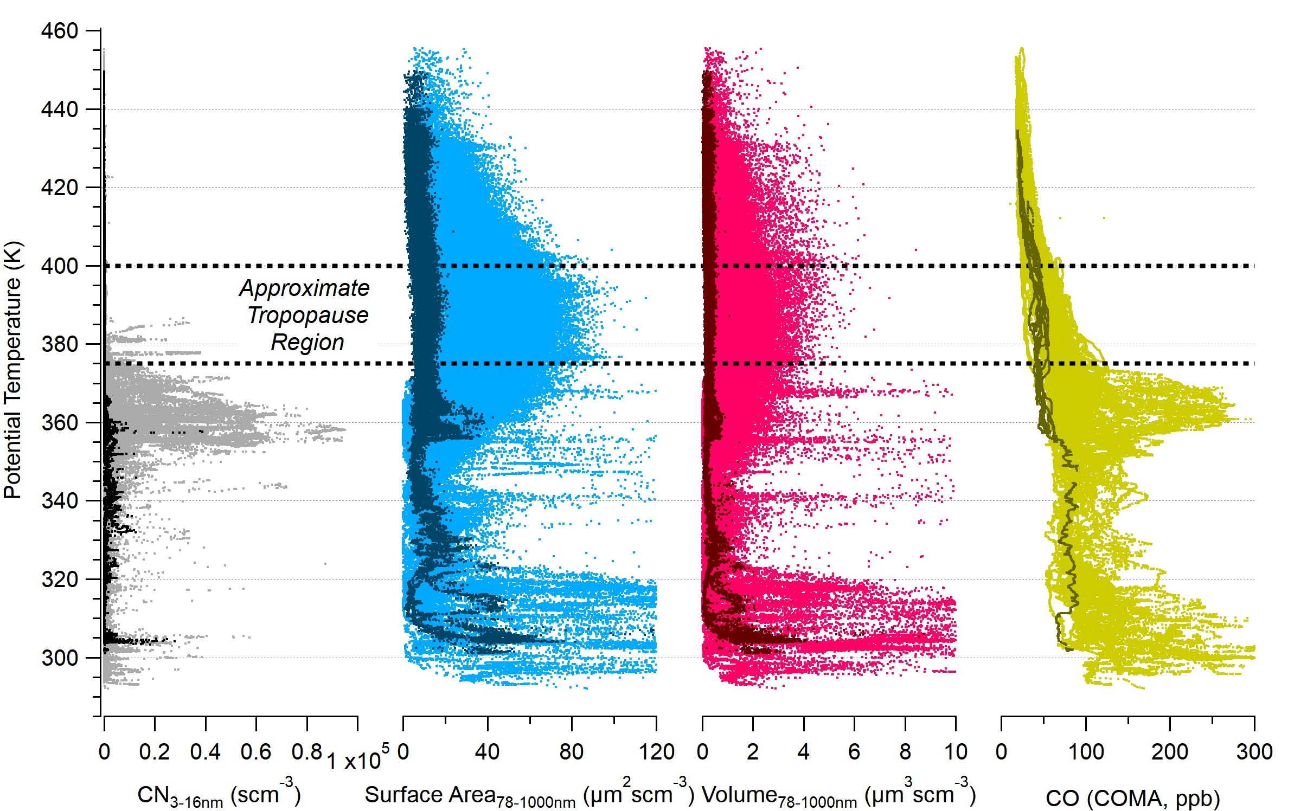
ACCLIP PUTLS Measurements
Dark = Houston Flights (RF1 + RF2) Light = Osan Flights (RF3 – RF17)
ACCLIP profiles characterized by 3 generally decoupled regimes:
  Surface Pollution
  High number concentrations in the FT/UT from ‘new’ convection
  ATAL
Significant loadings compared to profiles from Houston

Slide 5
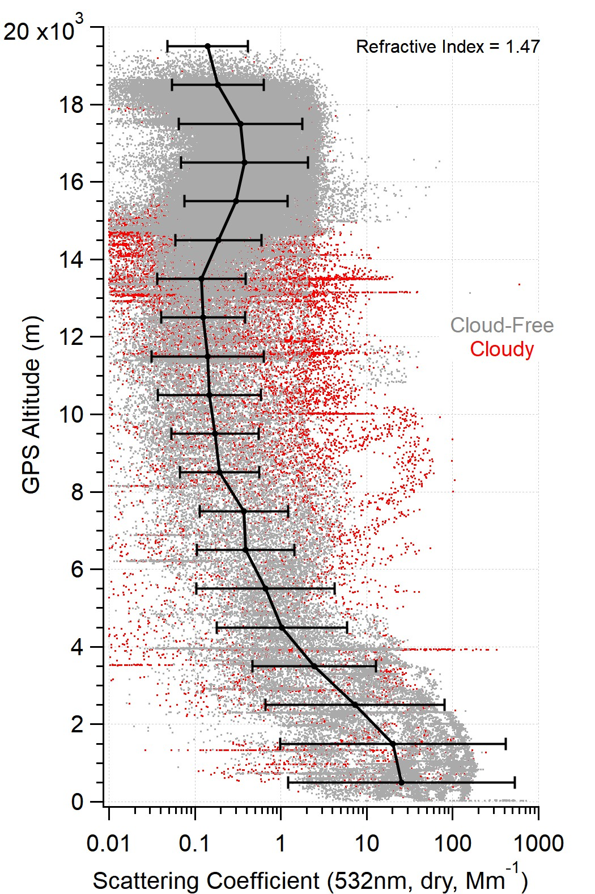
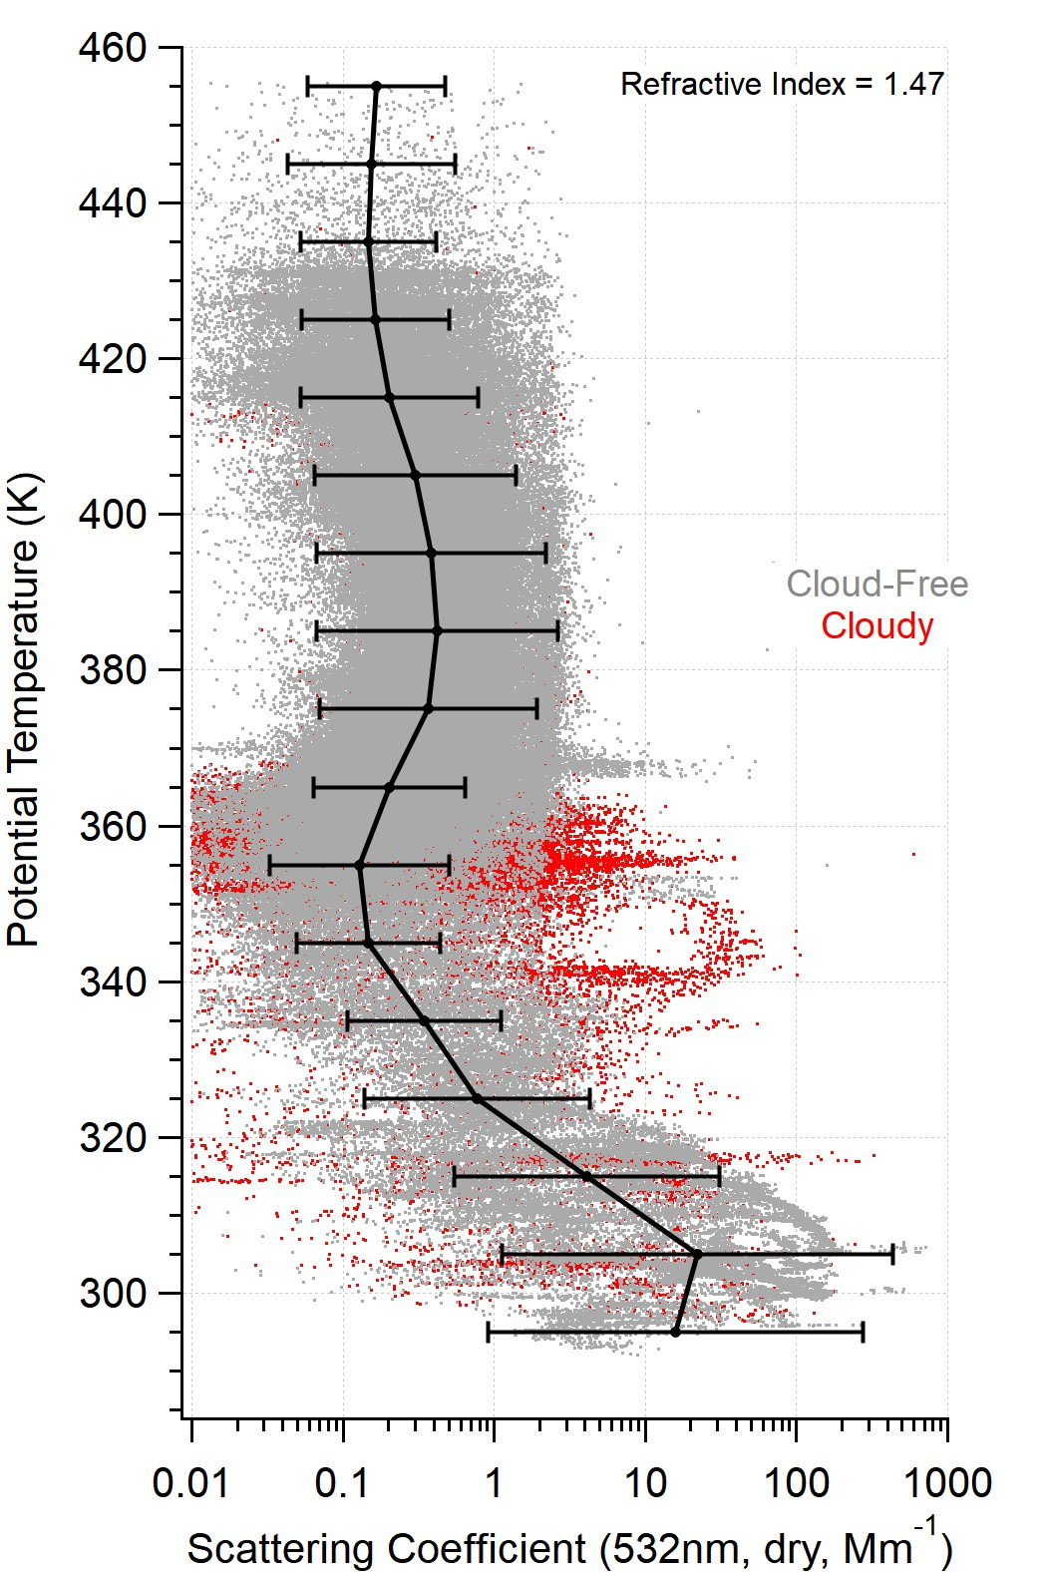
ACCLIP PUTLS Measurements: Calculated Scattering
Scattering coefficients were calculated from UHSAS size distributions:
  Mie Theory
  Purely scattering particles, n = 1.47
  Dry RH
  Cloud-free conditions
  at Ambient T/P
  Plotted at 1Hz and as binned geometric mean/std

Slide 6
ACCLIP PUTLS Measurements: Tropopause Identification
Descending profiles only
Altitude change > 2.0 km
Thermal tropopause height quantified using WMO definition:
  Lowest altitude when lapse rate < 2°/km
  If lapse rate is then > 3°/km, a second tropopause is identified
  corroborated with profile minimum temp.
N = 42

Slide 7
ACCLIP PUTLS Measurements: Calculated Dry Scattering
binned median (25th / 75th)
ATAL peak broadly surrounds thermal tropopause
Peak median (75th) scattering observed at 750m below tropopause
Scattering generally NOT correlated with CO, H₂O or SO₂

Slide 8
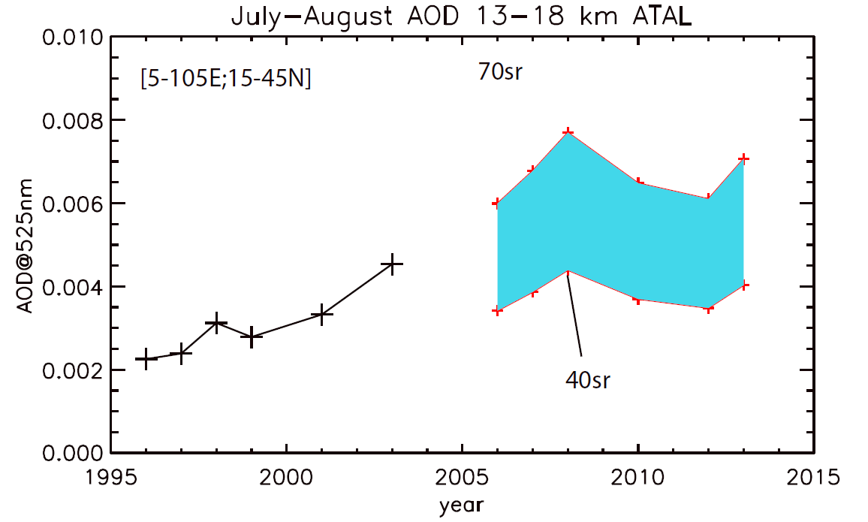
ACCLIP PUTLS Measurements: Calculated ATAL Optical Depth
0.0043 75th
0.0024 50th
0.0013 25th
2022
AOD calculated for ATAL only
32% of AOD is ABOVE the Tropopause height
ACCLIP obs. at low-end of satellite record

Slide 9
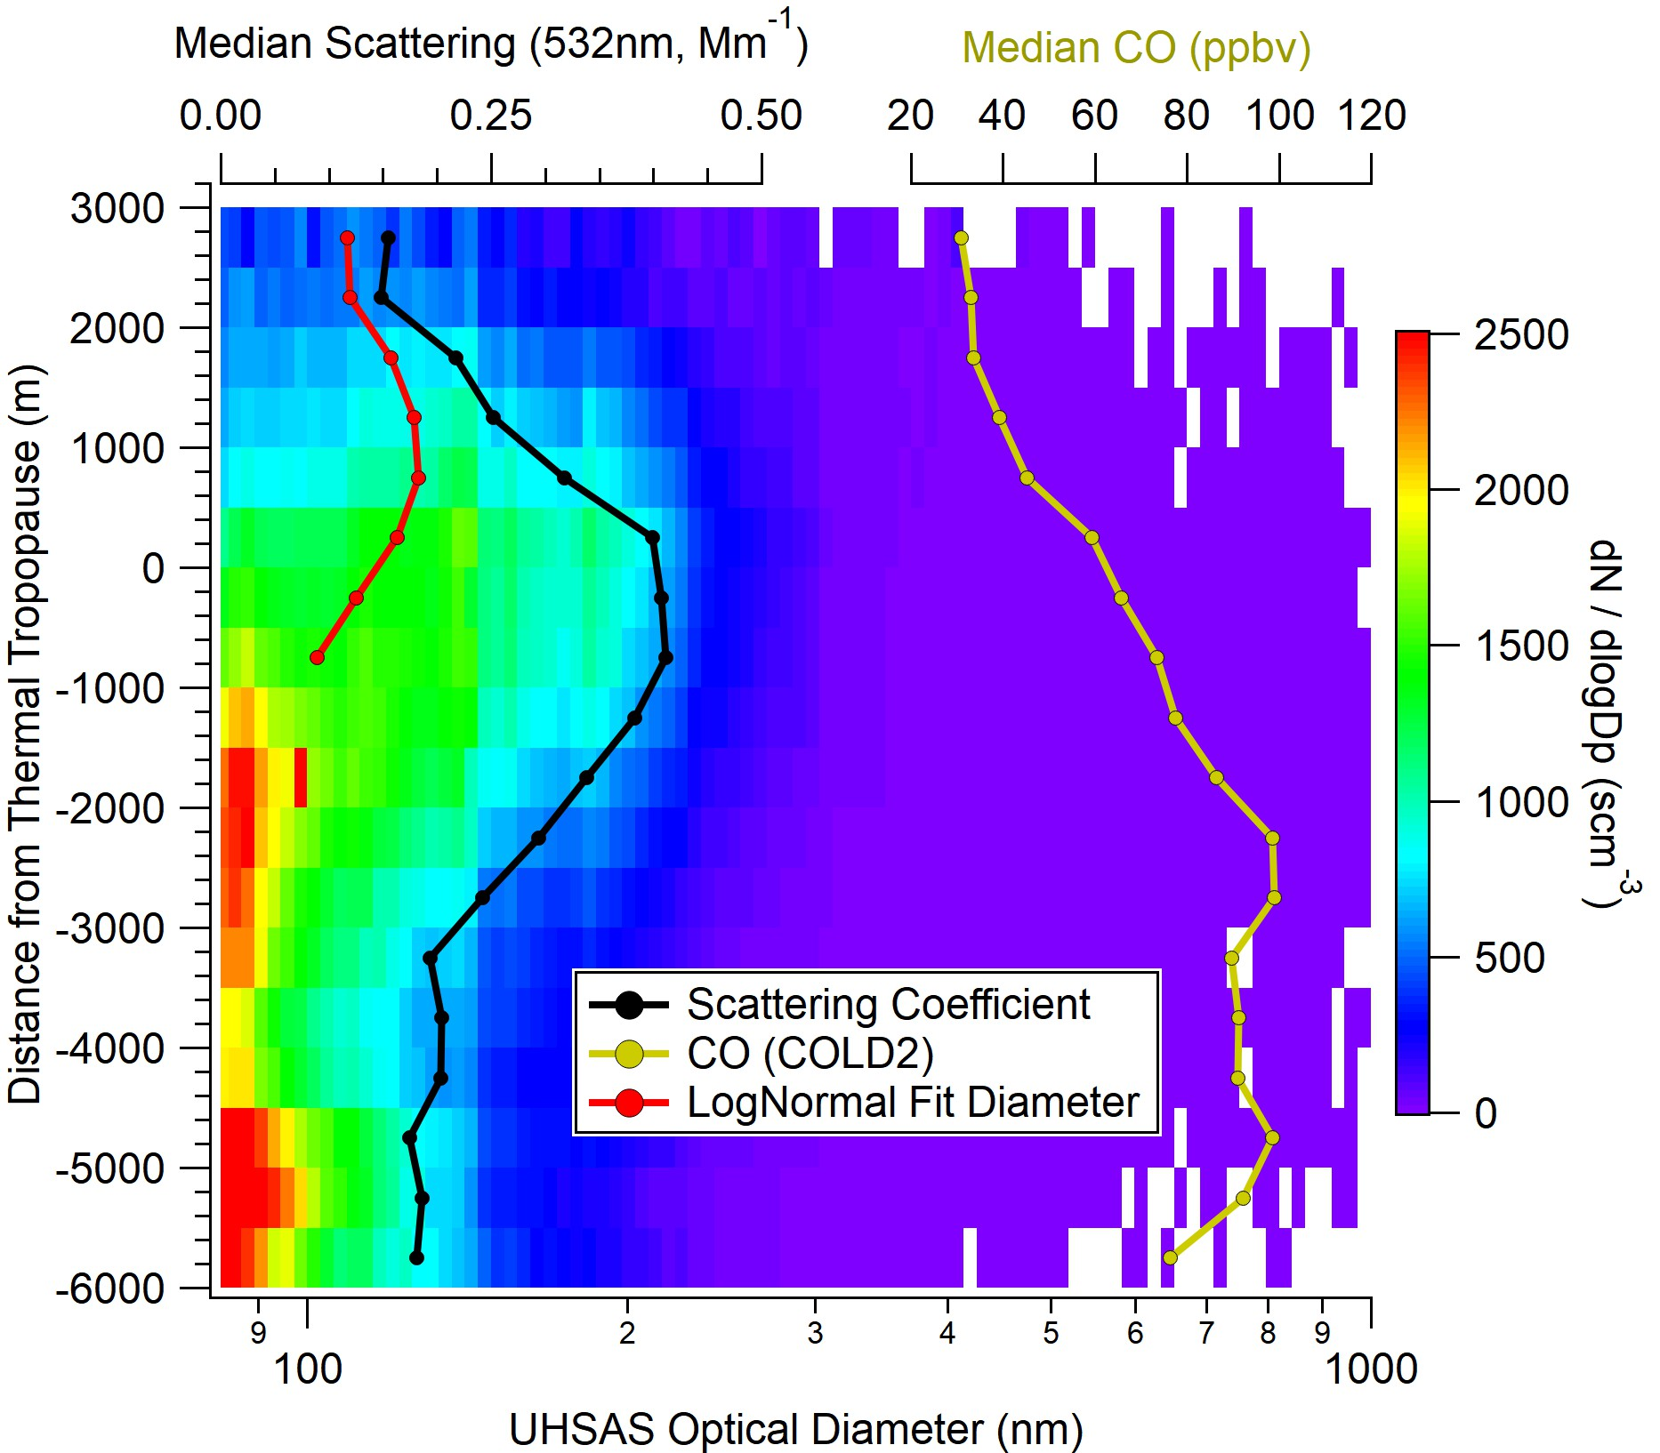
ACCLIP PUTLS Measurements: ATAL Size Dependence
Peaks in CO correspond with increased concentrations of smaller particles (and NMASS)
No obvious CO peak coincident with ATAL scattering
Size mode peaks at 750m ABOVE tropopause, decreases into the stratosphere

Slide 10
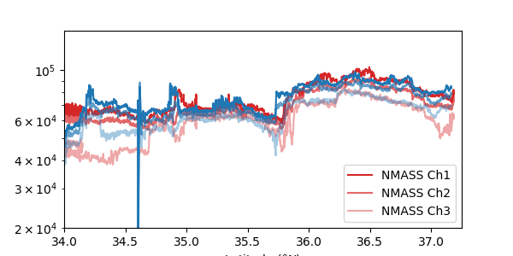
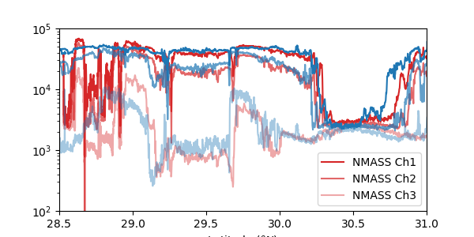
ACCLIP PUTLS: G-V Intercomparison, Aug-19 & Aug-25 2022
Concentration (#/scc)
Concentration (#/scc)
Altitude ~ 14.6 Kft
Upper Tropospheric air, where channels are largely converged
Altitude ~ 13.4 Kft
Large dynamic features captured, comparing well throughout concentration range
** Generally good agreement for NMASS
** Statistics and sizing will be compared more rigorously so datasets can be used together

Slide 11
ACCLIP PUTLS: Conclusions………………….Future Work
Ultrafine particles from fresh(er) convective outflow are observed in the UT decoupled from the ATAL
The ATAL was distinctly observed as a region of increased particle surface area, volume, and scattering coefficient
ATAL particles are distributed broadly across the thermal tropopause:
  AOD = 0.0013 – 0.0043 (25th-75th percentile)
  32% of AOD is above the tropopause height
ATAL mode diameter is largest above the tropopause, decreases with height into the stratosphere
Lack of CO correlation suggests a secondary source
Finish post-mission calibrations and corrections
Implement composition-dependent UHSAS size calibration and Mie-theory calculations using PALMS/SP2
Explore spatial variability in ATAL loading
Compare with model, satellite, balloon sondes

