Slide 1
Data Stewardship and NASA Data Catalog
Information, Data, & Analytics Services (IDAS)

Slide 2
Contents
Defining Data Stewardship
Overview of Federal and NASA Data Strategy
Data Stewardship Updates
Overview of NASA Data Catalog
NASA Data Catalog Demonstration

Slide 3
Defining Data Stewardship
WHAT IS DATA STEWARDSHIP?
The management of an agency’s data standards and collection of practices that empower employees to access and share clean and reliable data in a timely and secure way, enabling them to achieve their mission, center and project objectives
WHAT IS A DATA STEWARD?
Operationalizes practices and leverages principles defined by the data community to establish standards, promote data literacy, and ensure implementation and compliance of data policies

Slide 4
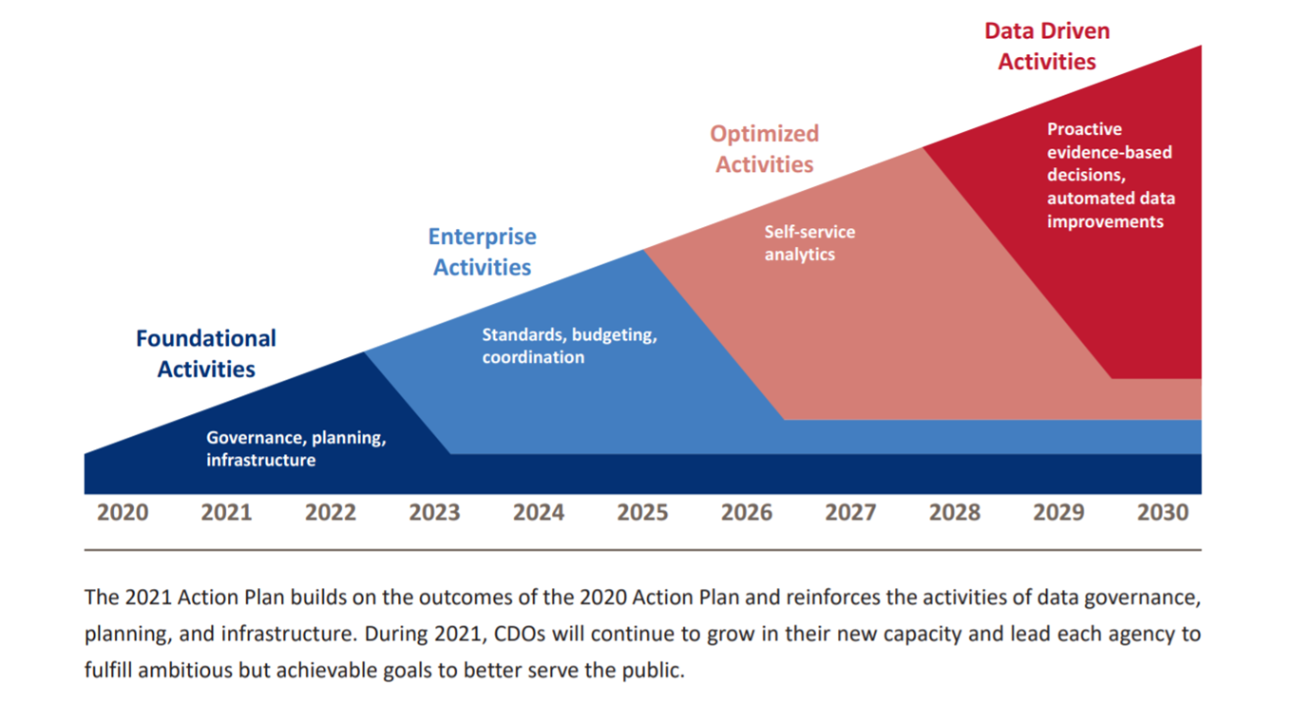
The Federal Vision
Leveraging Data as a Strategic Asset
We are here
The Federal Data Strategy (FDS) provides a 10-year vision for how the Federal Government will accelerate the use of data to deliver on mission, serve the public, and steward resources while protecting security, privacy, and confidentiality.

Slide 5
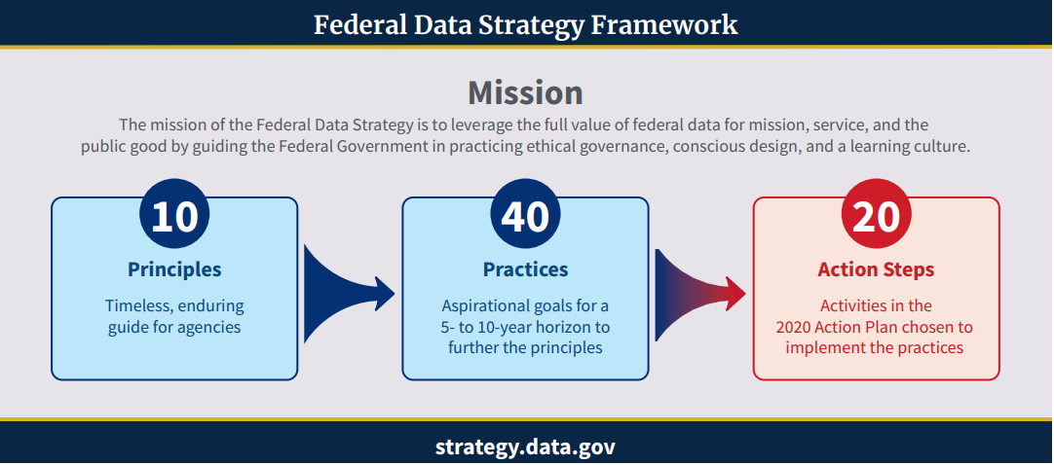
The Federal Vision
The Federal Data Strategy encompasses 10 principles, 40 practices and 20 action steps to realize this mission.
Data Stewardship is a core component of this strategy as it is specifically highlighted under the ethical governance principle and fuels all of the 40 practices that will need to be realized across the government.
In fact, if all of the 40 practices are realized it will “improve the government’s approach to data stewardship.”
To meet this strategy NASA needs to prioritize the governance, planning and infrastructure of agency data.
Link to framework: https://strategy.data.gov/assets/docs/2020-federal-data-strategy-framework.pdf

Slide 6
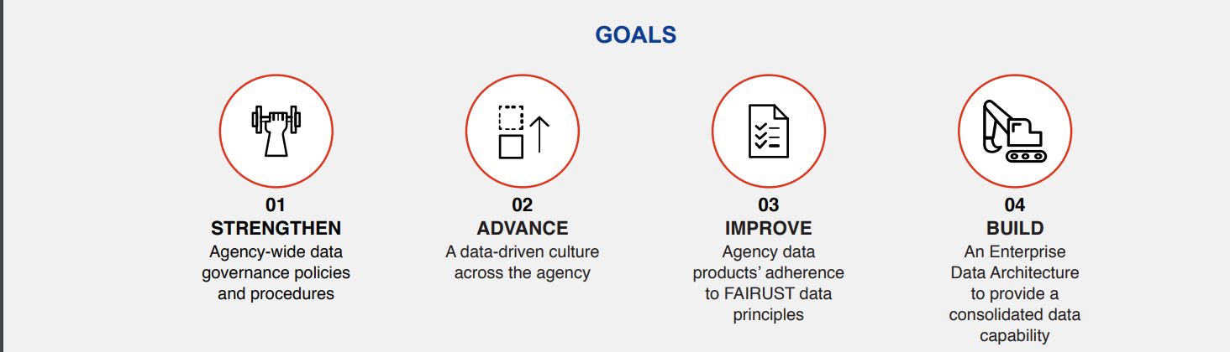
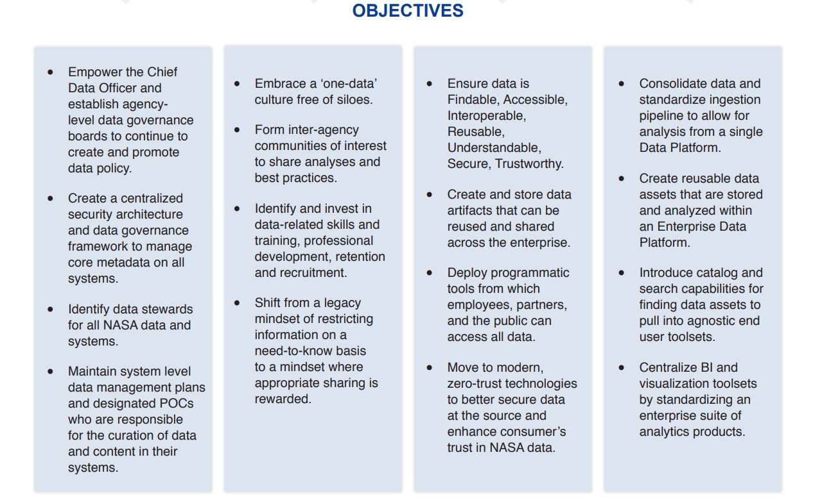
NASA’s Response
NASA’S DATA STRATEGY
In response to the Federal Data Strategy, NASA has developed their own enterprise-wide data strategy with four core goals and corresponding objectives that describe a vision for becoming a data-driven organization.
NASA views strengthening data governance and advancing data-driven culture as core goals to achieve its vision.
To help meet these goals, IDAS is establishing a service for Data Stewardship.

Slide 7
Data Stewardship Community of Practice
33 data stewards
82 data sources
766 datasets cataloged
175 community members

Slide 8
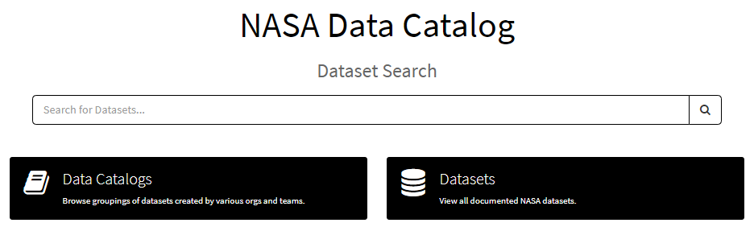
NASA Data Catalog​
Challenge:
NASA data exists in siloes within disparate data systems and is often not Findable, Accessible, Interoperable, and Reusable (FAIR) for data users.
Federal strategies, mandates, policies, and legislation require agency compliance
Approach:
Spark transformational culture shift toward “Data Stewardship”
Standardize process and database that effectively allows for secure, modernized data discovery, sharing, reuse, reporting, and collaboration
Integrate with Enterprise Data Platform (EDP) and various other NASA systems in automating the ingestion of data assets into catalog
Solution:
System for data stewards to document and manage metadata representing all data assets throughout NASA, regardless of domain, platform, or organizational affiliation: Enterprise Data Catalog and Agency Data Inventory
Impact:
Complete catalog and inventory of all NASA data assets that more effectively ensures FAIR data, advances data stewardship culture, and provides a thorough strategic and technical understanding of the NASA data environment​
Effectively comply with Federal Data Strategy and Public Law 115-435 via Agency Data Inventory​
Evolving to meet emerging needs of Data Stewardship CoP

Slide 9
NASA Data Catalog Demonstration
NASA Data Catalog​

