Slide 1
Human Contribution to Safety:
Human Performance is Not Just About Error
Jon Holbrook, PhD
Cognitive Scientist
National Aeronautics and Space Administration

Slide 2
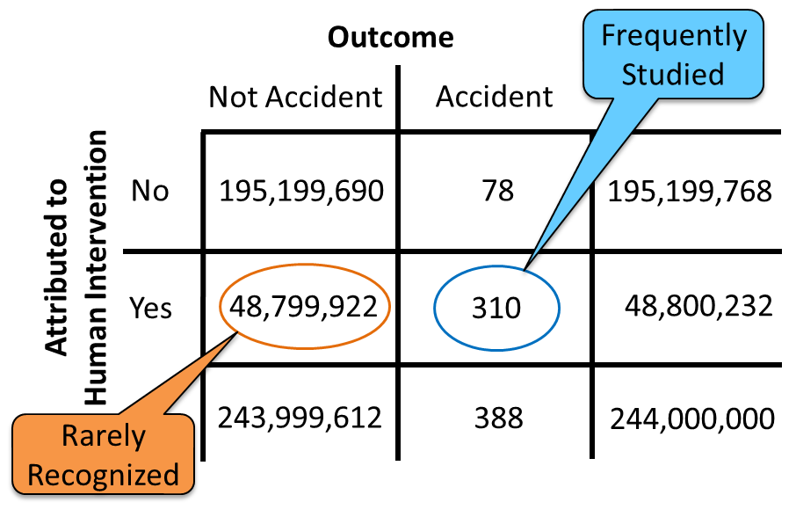
Errors Aren’t Representative of Human Performance
Human error has been implicated in up to 80% of accidents in civil and military aviation¹
Pilots intervene to manage aircraft malfunctions on 20% of normal flights²
World-wide jet data from 2007-2016³
  244 million departures
  388 accidents
Learn more: Holbrook, J. (2021). Exploring methods to collect and analyze data on human contributions to aviation safety. In Proceedings of the 2021 International Symposium on Aviation Psychology. https://aviation-psychology.org/wp-content/uploads/2021/05/ISAP_2021_Proceedings_FINAL.pdf
(1) Weigmann & Shappell, 2003; (2) PARC/CAST, 2013; (3) Boeing, 2017

Slide 3

The Mind is a Successful Adaptive System
?
Natural selection produces computational systems that solve adaptive problems reliably, quickly, and efficiently, but those systems are functionally specialized.
“Discovering the design of the mind is easier when evolutionary biology tells us what we might find” (Cosmides & Tooby, 2013).
Image credit (left image): Creative Commons Attribution-Share Alike 3.0 Unported license

Slide 4

Consequences of Focusing on Human Error
When the only data that are available are about human failure, then data-driven designs only consider that humans fail.
RO
ER
R
Designs intended to “protect” the system from “error-prone” humans can design-out the capability for humans to effectively intervene/adapt, which is a far more common behavior.

