Slide 1
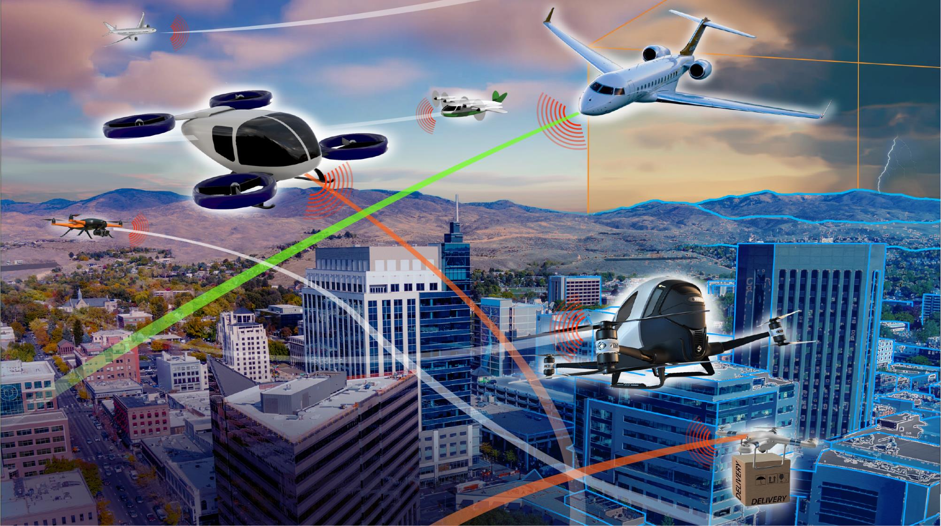

Digital Flight
A Cornerstone Capability of Sky for All
Proposed Research into a New Cooperative Operating Mode to Complement VFR and IFR
November 2022
Release approval 20220017143

Slide 2
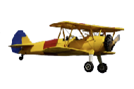


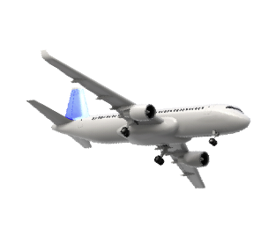
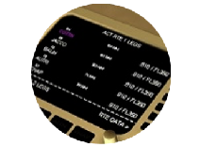
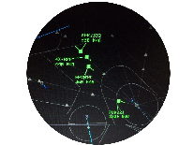
20th Century Evolution of Operating Modes
Origins of Visual Flight Rules (VFR)
Origins of Instrument Flight Rules (IFR)
Flexibility
Access
See and
Avoid
“Airways”
Increased
Collision Risk
Visual Separation
“Airway”
Traffic
Control
(ATC)
Radio
Navigation
Flexibility
Access
Procedural Separation
The Future of
Aviation Mobility is:
Radar
Surveillance
Voice Communications
Radar
Separation
Capacity
Flexibility
Access
Global
Precision Navigation
Advanced
Avionics
Traffic
Management Automation
Capacity
Flexibility
Access
Data
Communications
Initial Trajectory-Based Operations

Slide 3
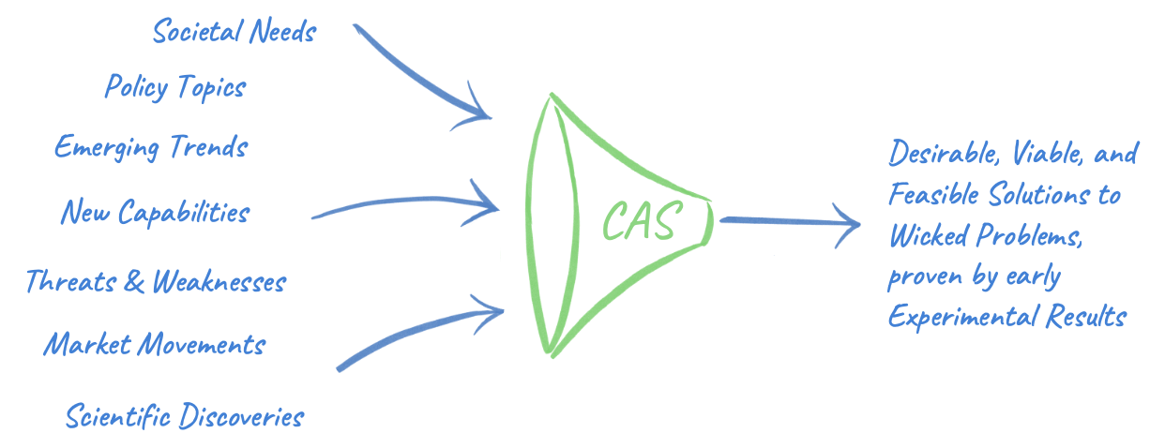
Convergent Aeronautics Solutions (CAS) Project
Thinking differently to revolutionize aviation
Release approval 20220017143
Explores the unknown – Converges disciplines & industries – Advances disruptive concepts
Convergent Aeronautics Solutions
CAS Project is sponsoring exploratory research on Digital Flight to assess Desirability, Viability, and Feasibility
Aviation Lens
Imagine desirable aviation futures
Explore the most difficult, problems of aviation
Discover pathways to overcoming barriers
Test these pathways via vanguard experiments
Incubate transformative change in aviation
Emerge new strategic thrusts in ARMD

Slide 4
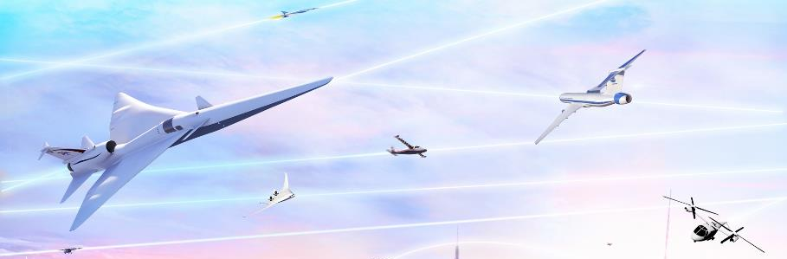
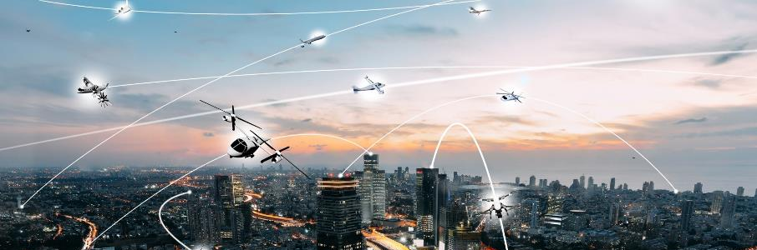
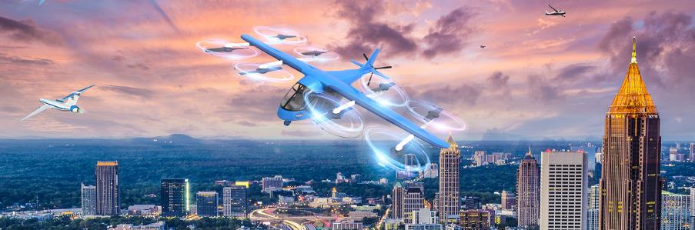
Limitations of Current Operating Modes
VFR and IFR:
Not adaptable to greater flight diversity
Not scalable to high tempos & density
Not suited to self-piloted aircraft
Not ensuring operational predictability
Not conducive to regional growth
“New and adapted flight rules and procedures will be required to efficiently manage these increasingly dynamic operations of differing priority and types.”
Airbus and Boeing, 2020
IFR: Instrument Flight Rules
VFR: Visual Flight Rules

Slide 5
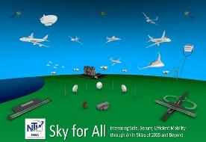

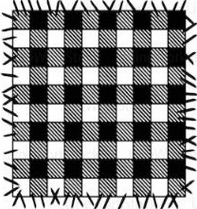
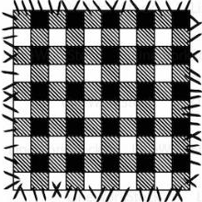
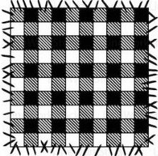
Emerging Patchwork of Operating Modes
Approach: Common New Operating Mode
IFR
Harmonization through Digital Flight
Common operating mode
Serving unique market needs
IFR or DFR
DFR for UML 4+
Airline / Bus. Aviation
“Reduced operating costs”
UML 4+
UML 4+
Sky for All
Mid-21st Century Vision
Achieve Scalable Secure Digital Aviation System
Assure Safety as Operations Diversify & Grow
Design for Sustainability & Resiliency
Enable Equitable Access for Diverse Ops
Enhance Quality of Life
Promote and Empower Operator Mobility
Transform Existing Aviation Ecosystem
ETM + DFR
Urban Air Mobility
“Dense / complex urban ops”
ETM
VFR / IFR
High Altitude Ops
“Cooperative separation”
VFR, IFR, or DFR
Emergency Air Svcs
“All Weather Safe Response”
IFR or DFR
IFR
Larger UAS
“Seamless integration in the NAS”
VFR / IFR
VFR, IFR, or DFR
Digital Flight Rules (DFR) & Digital Information Ecosystem
VFR, IFR, or DFR
Regional Air Mobility
“Community-friendly regional travel”
VFR / IFR
Part 107, UTM
General Aviation
“Simplified Vehicle Operations”
Part 107, UTM + DFR
Small UAS
“Beyond visual line of sight”
Transformation Accumulation
Evolution of proven capability
Maturity to serve needs & risk targets
UAS: Unmanned Aircraft System
UTM: UAS Traffic Management
ETM: Upper Class E Traffic Management
UAM: Urban Air Mobility
UML: UAM Maturity Level

Slide 6
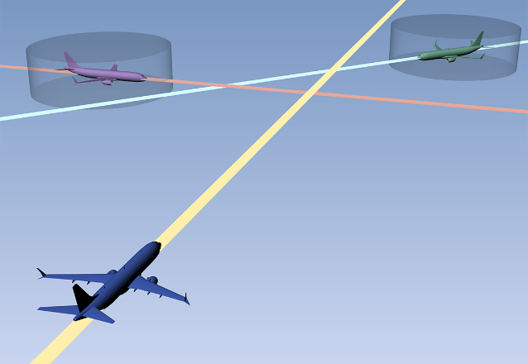
Exploring “Digital Flight”
Digital Flight (DF):
A proposed cooperative operating mode
  in which flight operations are conducted by reference to digital elements, with the operator ensuring flight-path safety through cooperative practices and self-separation enabled by digital technologies and automated information exchange
Digital Flight Rules (DFR):
Regulations that would govern sustained Digital Flight operations
as an alternate means of separation in VMC and IMC, in lieu of employing visual procedures (VFR) or receiving ATC separation services (IFR)
Proposed to be applicable to all airspace user categories (i.e., new entrants and incumbent operators) and accepted in potentially all airspace classes
Designed to be compatible with the emerging concepts of UTM, UAM, and ETM. Could serve as the mature-state operating mode in each of these concepts and other similar derivatives (xTM).
ATC: Air Traffic Control
IMC / VMC: Instrument / Vishal Meteorological Conditions
xTM: Extensible Traffic Management

Slide 7







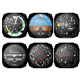


Consider a Potential Third Operating Mode
Flight by Visual Reference
Visual Flight
Flexible
Scalable
Pilot sees and avoids
Distributed decision-making
No centralized coordinator
Very limited intent sharing
Cooperative procedures and rules
Limited to no dependence on technology or ATC
Pilot
Flight by Reference to Digital Information
Proposed: Digital Flight
Operator (with automation) is the separator
Distributed decision-making
No centralized coordinator
Required intent sharing
Encoded cooperative practices
Technology-dependent separation
Cooperative with Air Traffic Management
Flexible
Scalable
Predictable
Accessible
Decision-Maker
Operator
Automation
Operating
Environment
Flight by Reference to Instruments and ATC Services
Instrument Flight
ATC is the separator
Federated/centralized decision-making
Centralized coordination via ATC approval
Intent sharing with ATC
Heavily dependent upon human decision-making
Predictable
Accessible
Pilot
ATC

Slide 8



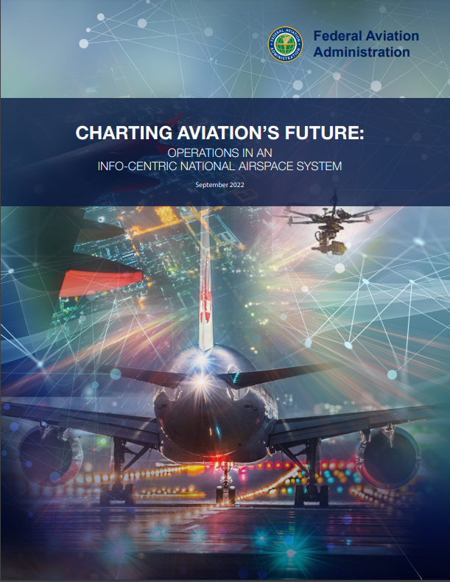
Digital Flight Elements
Essential Elements
Digital Information Connectivity and Services | Maintains a digital model of the operating environment for use by decision-making automation Shared situation awareness Current and Future State Traffic, environment, constraints Must meet integrity criteria
Shared Traffic Awareness | Maintains awareness of relevant traffic for use in conflict management Aircraft state, flight path intent, navigation performance
Cooperative Practices | Governs the behavior of DFR operations to ensure harmonized use of the airspace
Separation Automation | Automates the separation function in flight path management Tool for detecting and resolving conflicts while conforming to constraints
Cooperative Practices
Essential Elements
Digital Information Services and Connectivity | Maintains a digital model of the operating environment for use by decision-making automation Shared situation awareness Current and future state Traffic, environment, constraints Must meet integrity criteria
Shared Traffic Awareness | Maintains awareness of relevant traffic for use in conflict management Aircraft state, flight path intent, navigation performance
Cooperative Practices | Governs the behavior of DFR operations to ensure harmonized use of the airspace
Separation Automation | Automates the separation function in flight path management Tool for detecting and resolving conflicts while conforming to constraints
Digital Flight
Digital Information Services & Connectivity
Shared Traffic
Awareness
Separation Automation
https://www.faa.gov/sites/faa.gov/files/Charting-Aviations-Future-Operations-in-ICN_0.pdf

Slide 9


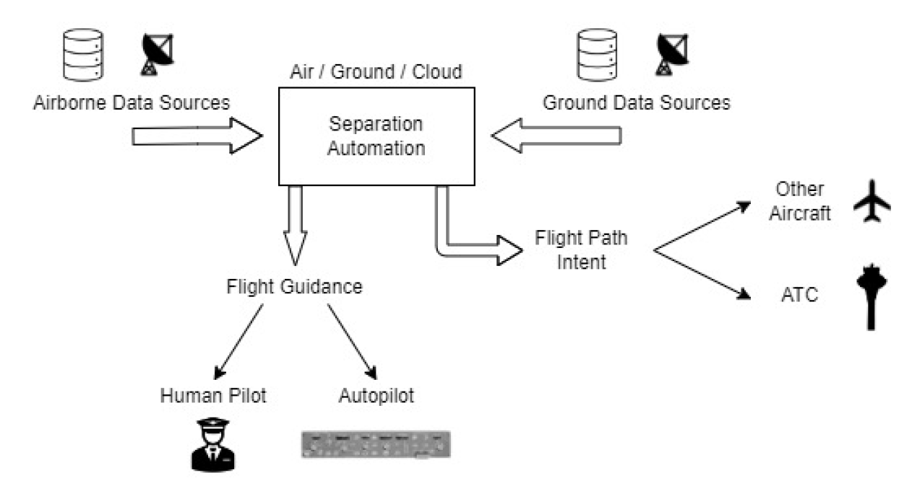


Architecture Flexibility
Separation automation may be
  Provided by the operator or by a third party
  Based in the air, ground, the cloud, or a combination
    Self-Provision
    Services Provision
    Location of automation
    and decision-making

Slide 10








Current View of Digital Flight Principal Capabilities
Operator Self-Separation
Cooperative Conflict Management
Adaptive Pairwise Separation
Right-of-Way / Burden Electronically Determined
Time-Critical Maneuvers Coordinated
Computed Resolution
Coordination Rules
Higher 4D Nav. Performance Shared
DFR
Smaller
Separation Criteria
Higher 4D Nav. Performance Shared
DFR
DFR
Larger
Separation Criteria
Detected Conflict
Coordination Rules
Has Right-of-Way
Lower 4D Nav. Performance
Shared or Assumed
Conflict Prevention
Hazard Avoidance
VFR
IFR
DFR
Current
DFR
Current
Burdened
Lateral Performance
Vertical Performance
Along Path Performance
Predicted
Predicted
DFR
Collaborative Utilization of Constrained Resources
Self-Organization & Sequencing
Self-Regulation of Density & Operational Complexity
Lower Density
Terminal
Airspace
Flow management assigns RTA to #3
#1
IFR
Shared
destination
and ETA
#2
IFR
DFR
#3
Optimized route with self-separation producing dependable future state (actual time of arrival = RTA)
Current
All DFR
No Central Coordinator
Predicted
All DFR
Higher Density

Slide 11

Candidate Digital Flight Cooperative Practices
Share and Update Intent
Navigate with Intended Precision
Take
Timely
Action
Respect Established Operating Procedures
To Be Determined
Ensuring harmonized use of the airspace
Apply Pair-Appropriate Separation
Coordinate
with ATC in Controlled Airspace
Join in Appropriate Flow Management
To Be Determined
Respect
VFR and IFR Aircraft
Text
Respect
Intent When Changing Intent
Respect
Right-of-Way Among DF Aircraft
Coordinate Maneuvering Among DF Aircraft
Avoid Active
Protected Airspace
To Be Determined

Slide 12
Candidate Digital Flight Cooperative Practices
Cooperative Practice | Intended Effect
Share and Update Intent | Increase predictability, efficiency, stability, and safety
Take Timely Action
Respect Intent When Changing Intent | Minimize disruption to existing operations
Respect VFR and IFR Aircraft
Navigate with Intended Precision | Increase airspace capacity; reduce actionable conflicts
Apply Pair-Appropriate Separation
Respect Right-of-Way Among DFR Aircraft | Distribute separation burden; increase safety
Coordinate Maneuvering Among DFR Aircraft
Coordinate with ATC in Controlled Airspace | Facilitate airspace integration; minimize controller workload; minimize disruptions
Join Appropriate Flow Management
Avoid Active Protected Airspace
Respect Established Operating Procedures

Slide 13
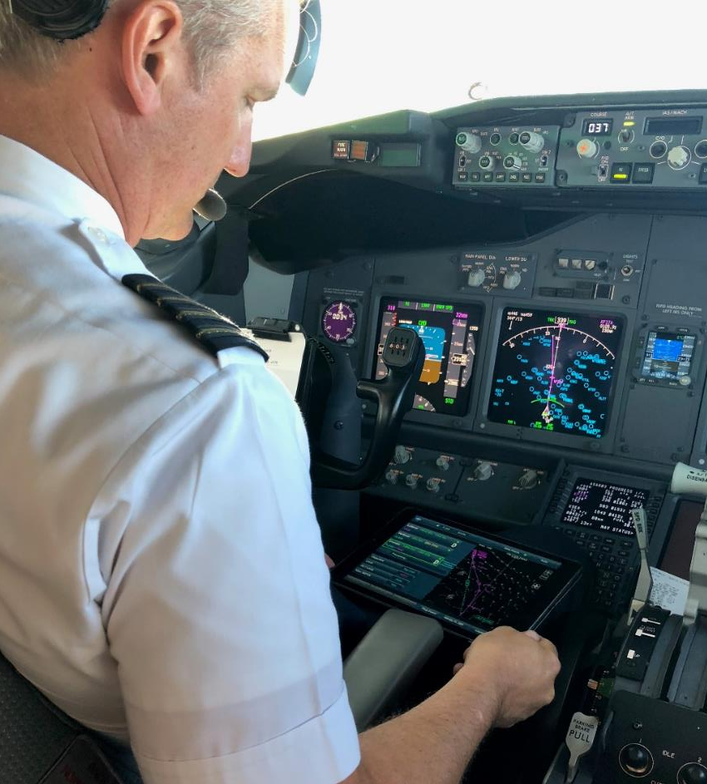
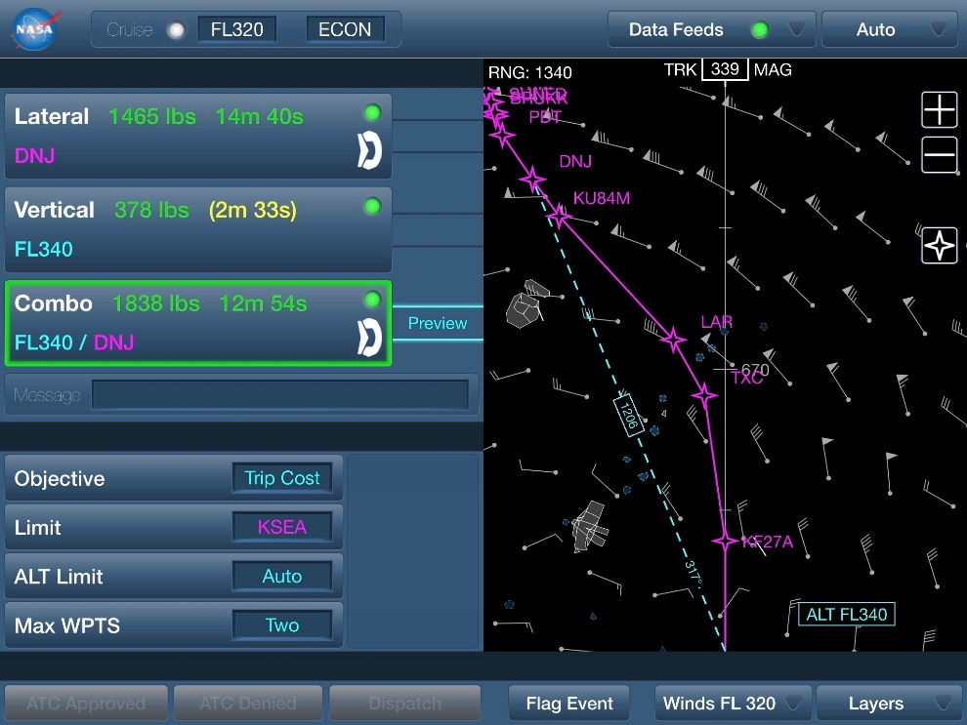

NASA Tech is Already Building Toward Digital Flight
TASAR: Traffic Aware Strategic Aircrew Requests
NASA technology for flight optimization
Validated in airline operations
Now commercially available
DF

Slide 14






Digital Flight Community Engagement
NASA Convergent Aeronautics Solutions (CAS) Project
Exploring the Desirability, Viability, and Feasibility of Digital Flight
Industry Workshops Identified Critical Barriers…
… and Paths Forward / “Chisels”
Safety & Certification of Autonomous Systems
Concept Communication
    Describe the DF concept in greater detail to reduce identified uncertainties
Stakeholder Engagement
    Engage with key stakeholders to communicate concept and get input on desired DF policy
Modelling, Simulation, and Analysis
    Conduct studies to quantify performance and
    safety impacts resulting from DF
Technology Demonstration
    Define and conduct real-world demonstrations of DF capabilities
Integration
with VFR and IFR
Regulation Lead Time and Complexity
Unambiguous Responsibilities
Technology and Data Link Maturity
Avoiding Impact on Non-DF Cost and Operations
Viable Implementation Path
Business Case Viability

Slide 15
Digital Flight: A Path Forward
DFR
Continuing Innovation
Starting the S-Curve
of Digital Flight
Accelerated Adoption
Services Expansion
Increasing Complexity
DFR Regulations Development
Benign Applications
Standards Development
Compliance Development
DF
Operational
Credit
Applications under IFR
Performance R&D
Critical Infrastructure
Capability Maturation
Applications under VFR
DF Community Building
Early Applications
Information Services

Slide 16





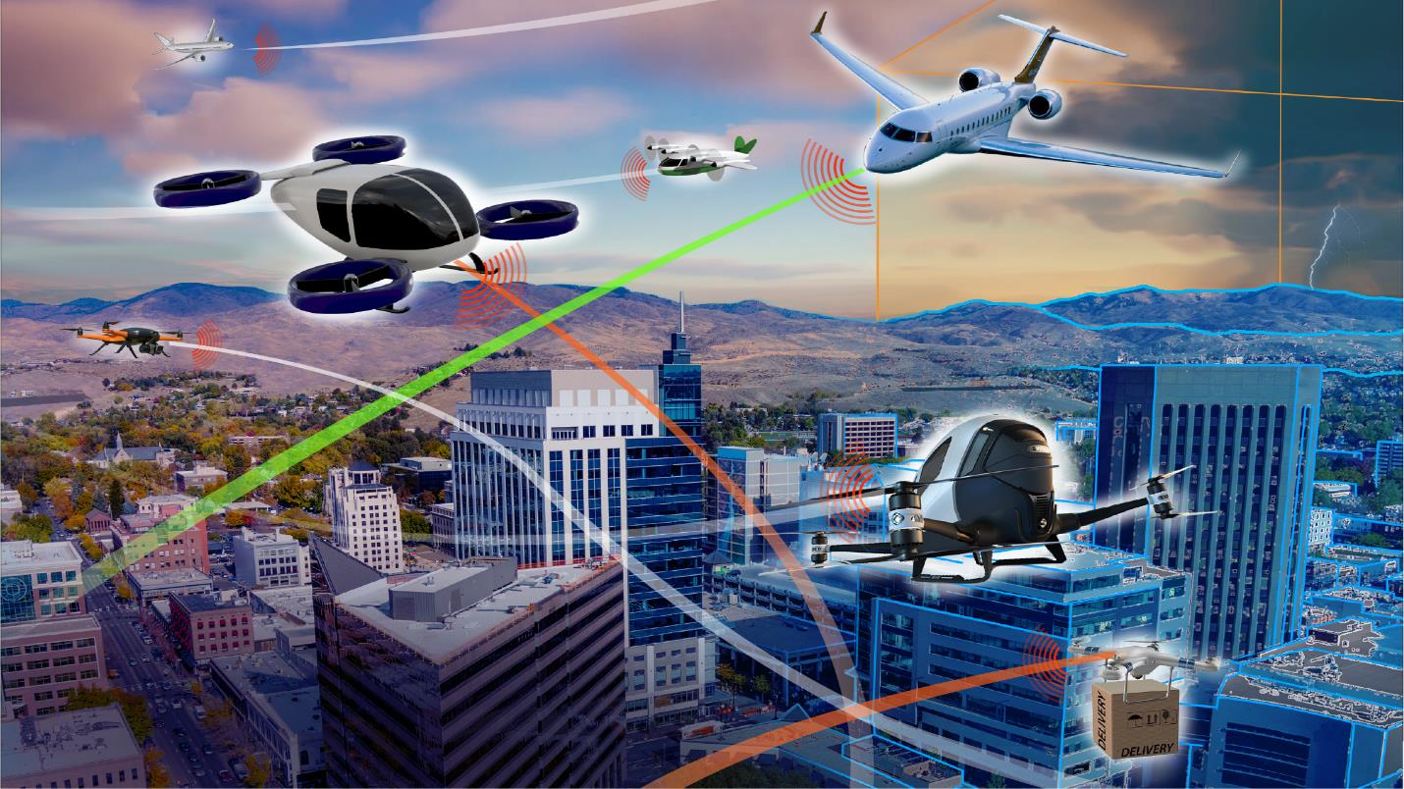
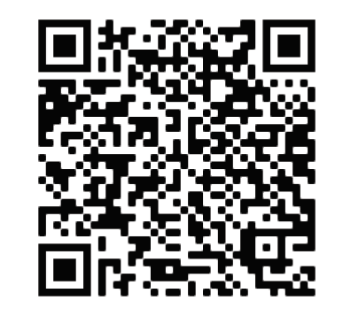
Digital Flight: Exploring the Desirability, Viability, and Feasibility
Thank You!
Andrew.R.Lacher@nasa.gov
David.Wing@nasa.gov
Wes.Ryan@nasa.gov
Use this QR code to access a NASA publication describing Digital Flight in greater detail.

Slide 17
Backup Charts

Slide 18
Operator Self-Separation
Primarily focuses on traffic separation but includes all hazards
  E.g., Weather, terrain, obstructions, protected airspace
Applies cooperative practices
Remains “well clear” from VFR (digitally)
Remains greater than IFR separation mins from IFR traffic
  Communicates intent to ATC
Computed Resolution
Detected Conflict
Conflict Prevention
Hazard Avoidance
Current
DFR
Predicted

Slide 19
Cooperative Conflict Management
Right-of-Way / Burden Electronically Determined
Time-Critical Maneuvers Coordinated
Distributes the burden of separation provision among themselves
Shares airspace with minimal impact
Applies cooperative practices
Shares intent with other DFR operations
  Enables early detection of potential conflicts
  Reduces unnecessary maneuvers
Avoids creating conflict when changing intent
Follows DFR right-of-way rules
Coordinates maneuvers when appropriate
  Explicit maneuvers requires communications
Coordination Rules
DFR
Coordination Rules
Has Right-of-Way
Current
Burdened
Predicted
DFR

Slide 20
Adaptive Pairwise Separation
Higher 4D Nav. Performance Shared
Automation enables tailoring separation criteria to specific situation
  VFR – Greater than well clear
  IFR – Greater than IFR separation standards
  DFR – Tailored
Derived from information sharing
  Intent
  Navigation precision (self-proclaimed commitment to intent)
Enables reduced DFR v DFR separation
  Higher traffic density
DFR
Smaller
Separation Criteria
Higher 4D Nav. Performance Shared
DFR
Larger
Separation Criteria
Lower 4D Nav. Performance
Shared or Assumed
VFR
IFR
DFR
Lateral Performance
Vertical Performance
Along Path Performance

Slide 21
Collaborative Utilization of Constrained Resources
Terminal
Airspace
Directly engages with strategic conflict management (e.g., demand capacity balancing, traffic synchronization)
  Capacity-limited resources
  Enabled by time-based flow management
Shares and updates intent
Conforms to scheduled times
Continues to self-separate through cooperative conflict management
Flow management assigns RTA to #3
#1
IFR
Shared
destination
and ETA
#2
IFR
DFR
#3
Optimized route with self-separation producing dependable future state (actual time of arrival = RTA)
Current
Predicted

Slide 22
Self-Organization & Sequencing
Creates order from distributed interactions
  Shared operational objective (e.g., sequencing and spacing to land)
  Without central authority
  Similar to VFR @ uncontrolled airfields
Adheres to cooperative procedures which establish priority
  Enabled by information sharing
All DFR
No Central Coordinator

Slide 23
Self-Regulation of Density & Operational Complexity
Lower Density
Applies appropriate mitigations to ensure traffic volume remains at a safe scale
Ensures that self-separation remains feasible
  Not simply a max count of aircraft in a sector
  Not dependent upon human workload
All DFR
Higher Density

