Slide 1
Subsonic Single Aft Engine (SUSAN)
Flight Deck Experiment
Throttle and Engine Display Concepts

Slide 2
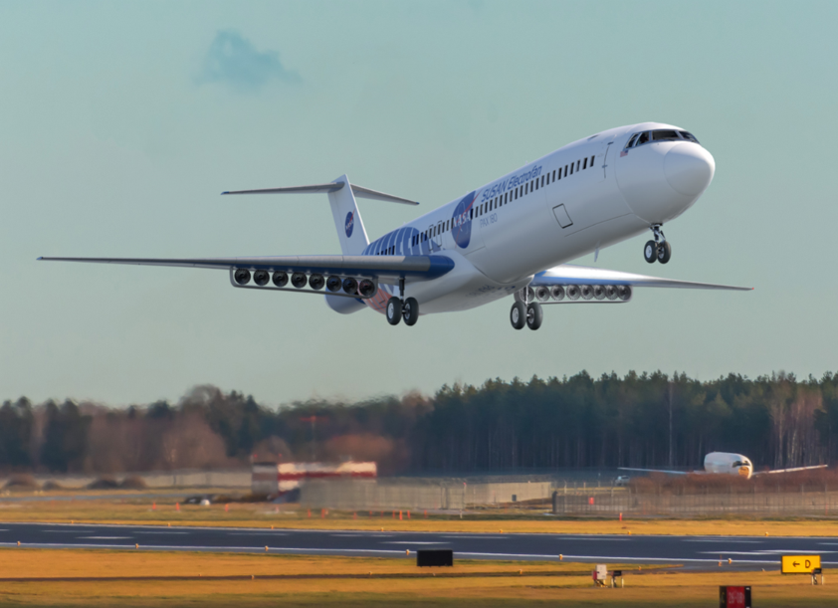
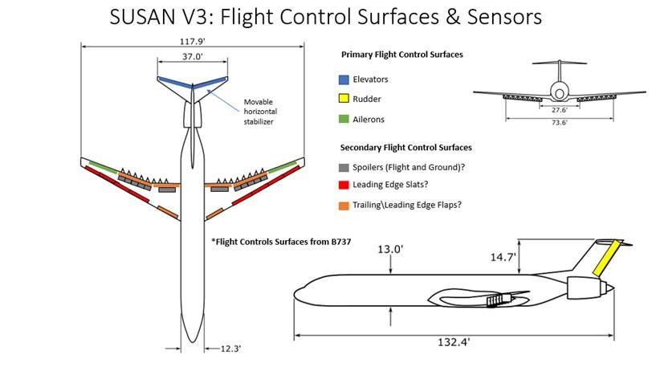
SUSAN Concept V3.1
1 Fuel-burning turbofan on tail
16 electric engines on wings
Electric engines have single use, backup/emergency batteries

Slide 3
Two Research Questions
How many throttle handles are needed for SUSAN?
    1, 2, or 3 throttle handles
How should the hybrid-electric propulsion state be displayed to the flightcrew?
    All electric engines thrust displayed
    Total thrust of all engines on a wing displayed

Slide 4
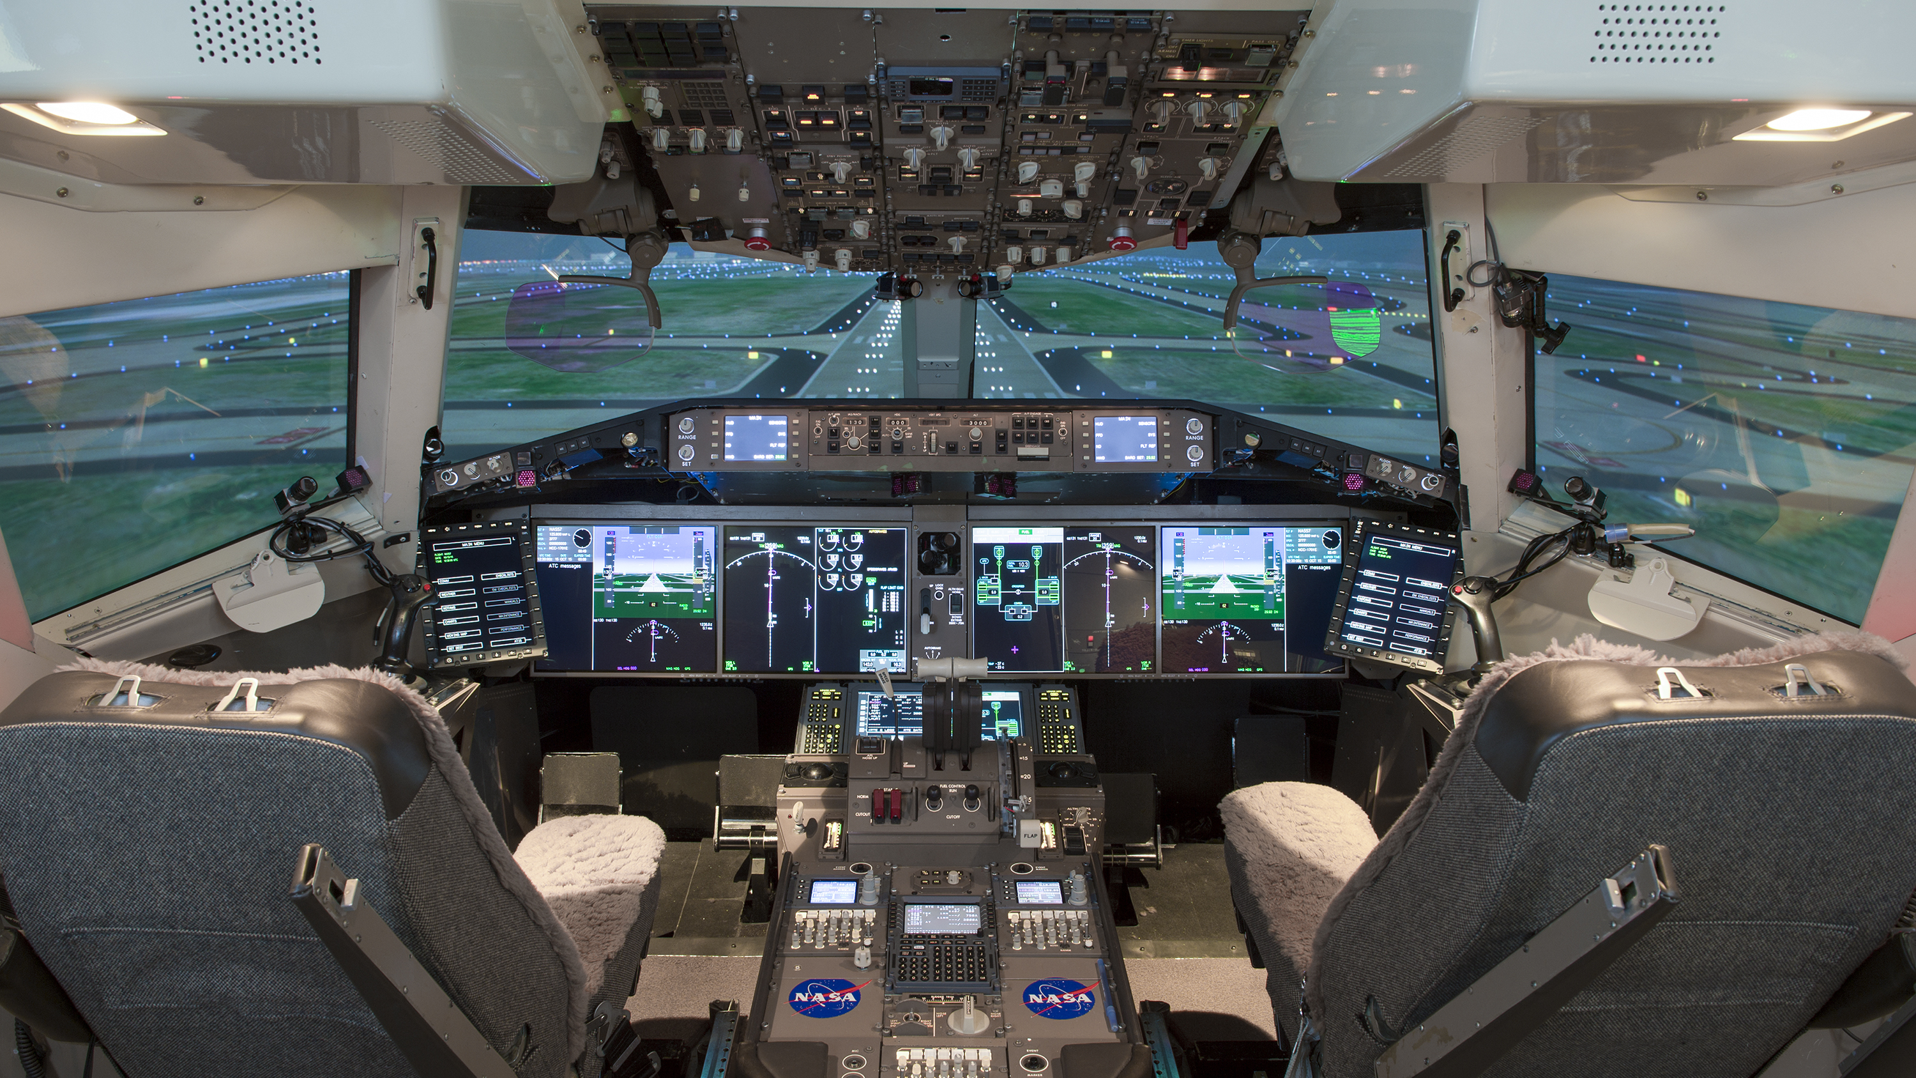
Photo Credit: NASA

Slide 5
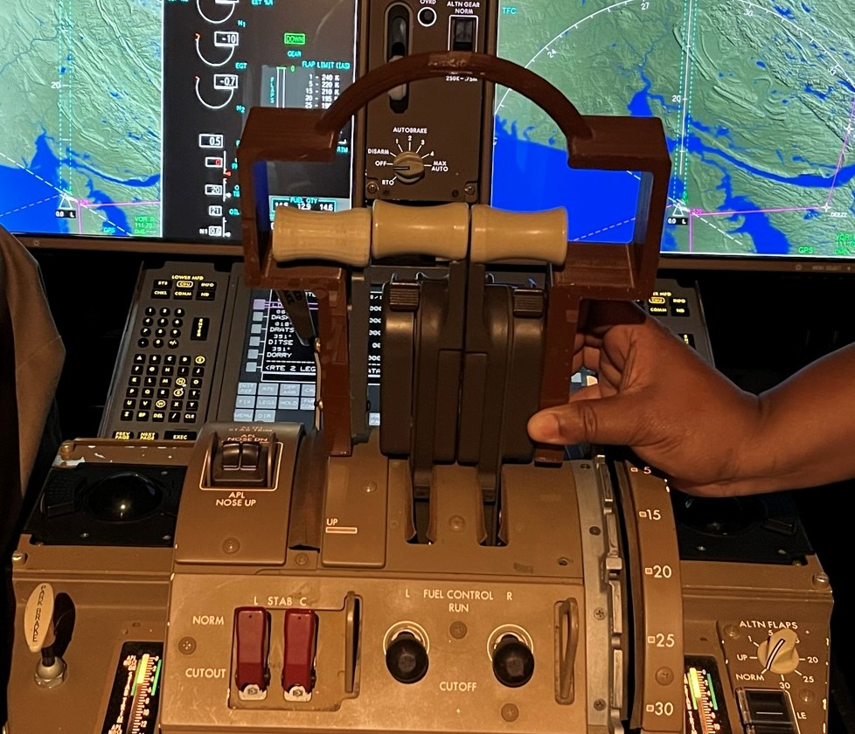
Research Flight Deck (RFD)
Throttle Change for SUSAN
#1 #2 #3
Single throttle:
  Only #2 throttle was used
  Button press to switch between turbine and electric engine thrust control
Dual throttle:
  #2 controls turbine
  #3 controls electric engines
Triple throttle:
  Same as Dual throttle but added throttle #1
  #1 added for only the Triple throttle
  #1 mechanically linked to #3
Photo Credit: NASA

Slide 6
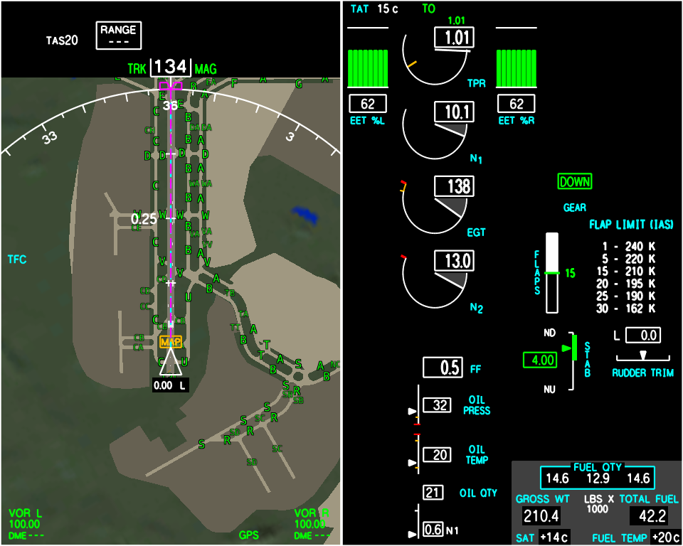
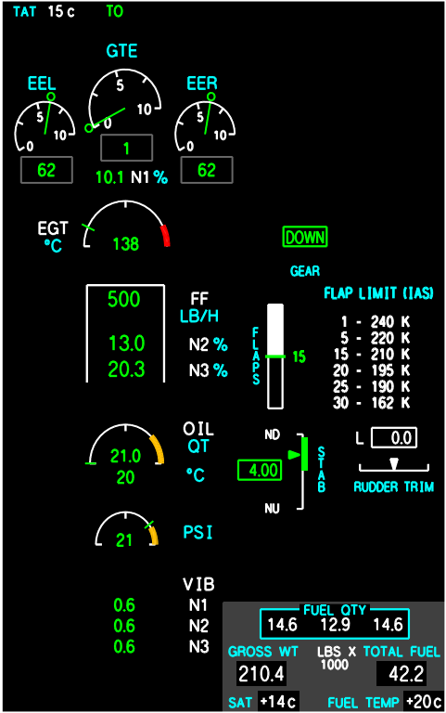
‘Bars’ Engine Display Concept
‘Dials’ Engine Display Concept

Slide 7
Commercial Pilot Participants
9 flightcrews; 18 pilots in the NASA Langley Research Center (LaRC) Research Flight Deck (RFD)
From 3 commercial airlines (each paired Captain and First Officer were from the same airline)
Flightcrews’ hours
  Captains: 16,500 mean (6,800 median)
  First Officers: 9,300 mean (7,000 median)
Flightcrews’ ratings
  15 with Airbus (A319/A320/A321)
  8 with Boeing (B737/B757/B767/B777)

Slide 8
Scenarios
Nominal
  New York (KJFK) to Denver (KDEN) Takeoff to cruise
  Landing KDEN from cruise to gate with 150 knot tailwind at altitude
Off-nominal KDEN to Albuquerque, NM (night, overcast, visibility ¼ mile, thunderstorms in the vicinity of KDEN)
  1 electric engine failed on takeoff (bus fault resulted in complete loss)
  4 electric engines failed on climbout (main generator failed)
  Fuel-burning engine failed on takeoff (divert back to airport)
  Fuel leak enroute (divert possibilities stress emergency battery life)
  Bird strike (flock) on takeoff, loss of all electric engines on one wing
  Partial loss of turbine engine at cruise (engine limit)
  Thermal failure resulted in loss of all electric engines at cruise

Slide 9
Experiment Matrix: Crew vs Event
B1 = ‘Bars’ engine display, 1 throttle
D2 = ‘Dials’ engine display, 2 throttles
EE = electric engine
# | Event | Event Description | 1 | 2 | 3 | 4 | 5 | 6 | 7 | 8 | 9
1 | 1 | Normal TO | B1 | D2 | B3 | D1 | B2 | D3 | B1 | D2 | B3
2 | 2 | Normal Land | B1 | D2 | B3 | D1 | B2 | D3 | B1 | D2 | B3
3 | 3 | 1 EE Fail | B1 | D2 | B3 | D1 | B2 | D3 | B1 | D2 | B3
4 | 4 | 4 EE Fail | B1 | D2 | B3 | D1 | B2 | D3 | B1 | D2 | B3
5 | 5-1 | Turbine Engine Fail | B1 | D1 | D1 | D1 | B1 | B1 | B1 | D1 | D1
6 | 5-2 | Turbine Engine Fail | D2 | D2 | B2 | D2 | B2 | D2 | D2 | D2 | B2
7 | 5-3 | Turbine Engine Fail | B3 | B3 | B3 | B3 | D3 | D3 | B3 | B3 | B3
8 | 6 | Thermal Fail | B1 | D2 | B3 | D1 | B2 | D3 | B1 | D2 | B3
9 | 7 | Birdstrike | B1 | D2 | B3 | D1 | B2 | D3 | B1 | D2 | B3
10 | 8 | Turbine Partial Loss | B1 | D2 | B3 | D1 | B2 | D3 | B1 | D2 | B3
11 | 9 | Fuel Leak | B1 | D2 | B3 | D1 | B2 | D3 | B1 | D2 | B3

Slide 10
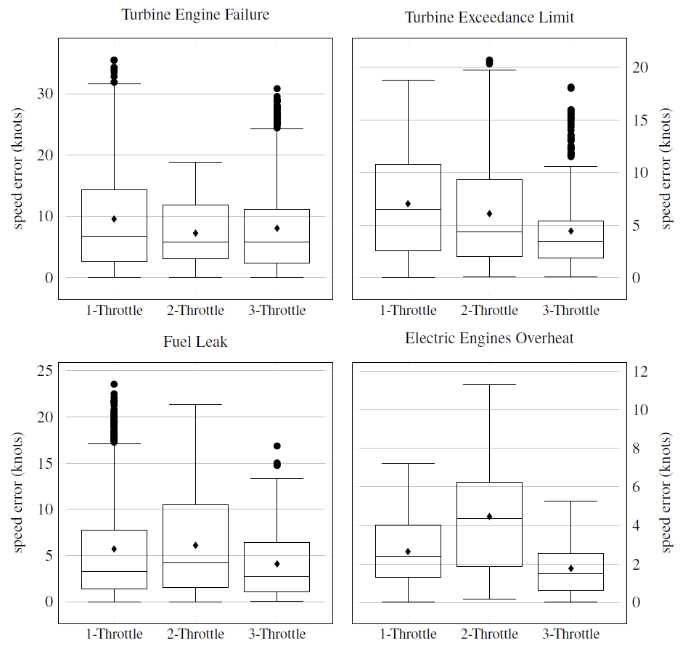

Slide 12
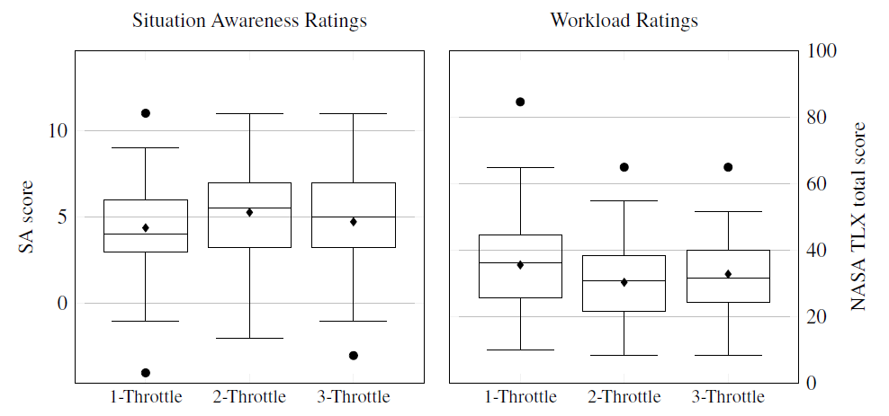

Slide 13
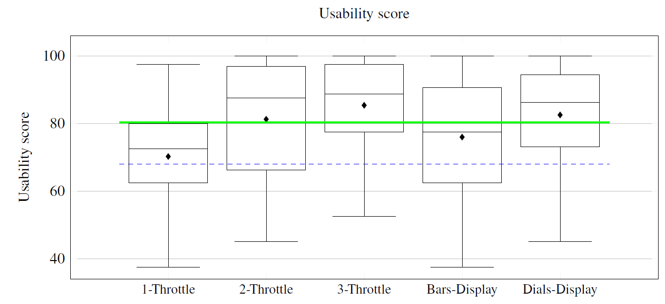
80.3 excellent
68.0 good design

Slide 14
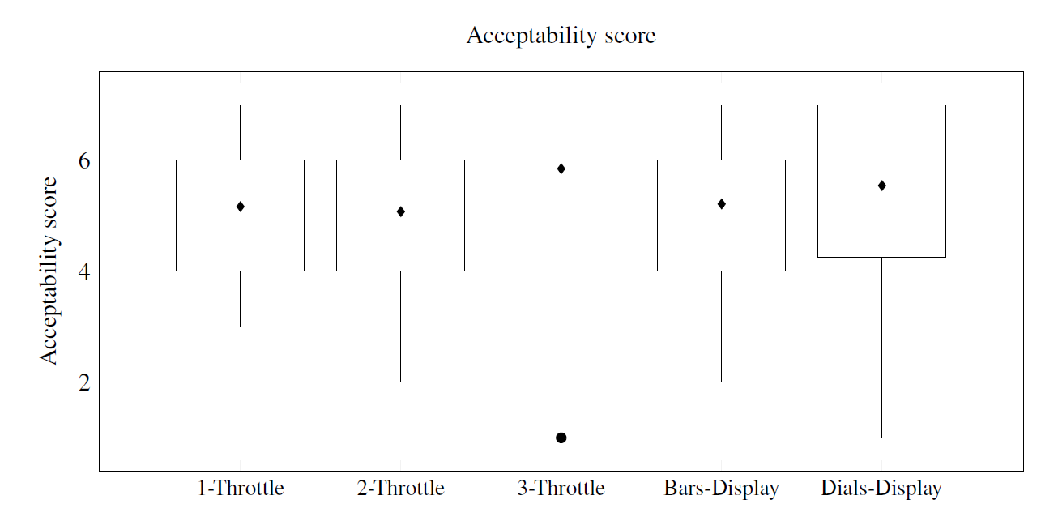
1 – very unacceptable; 4 – average; 7 – very acceptable

Slide 15
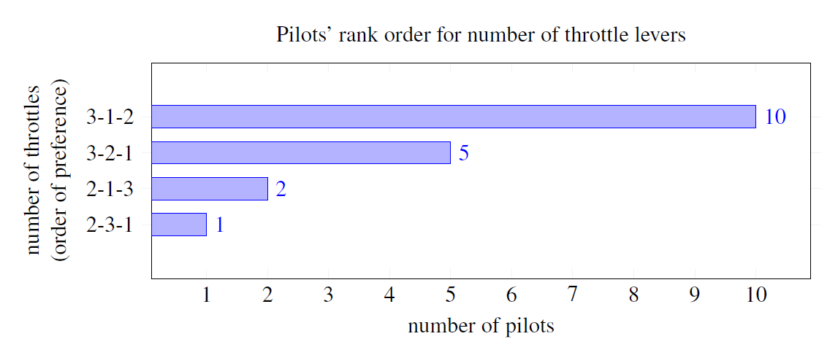

Slide 16
Throttle Results
Single throttle with ability to trim the thrust on the left and right side
  A single throttle with ability to break out the left/right throttles in emergency
  A single throttle with a knob that twists for trim
  Back-driven throttle is desired
3 throttle levers is intuitive; follows their training
2 throttle levers could work
  Concern that in an emergency, pilots revert to previous twin engine training
  Would need to make the 2 throttles tactilely different

Slide 17
Engine Display Results
Both Bars and Dial displays were adequate
All pilots preferred the bars presentation of electric engines
  Gives info about all engines
  Bars are visually distinct from turbine
  Would like percent power (vs EPR) for turbine combined with bars (i.e., combine the bars for electric engines with dials display of turbine engine)
Need to display charge left to avoid total thrust loss
A time and range remaining for single/emergency use batteries
Integrate FMS path with emergency use battery required for route

Slide 18
Pilot Concerns for Electrified Aircraft
Thermal runaway/battery fires (787 entry into service issues; UPS flight 6 fire)
Is 30 min emergency battery life enough? (need better model of battery drain). Can rechargeable batteries charge on idle descent?
Want to have control when to engage emergency batteries
Degraded performance during hot day: 90 deg day, on tarmac at JFK for over an hour
Lightning strike to a battery

Slide 19
Questions?

