Slide 1

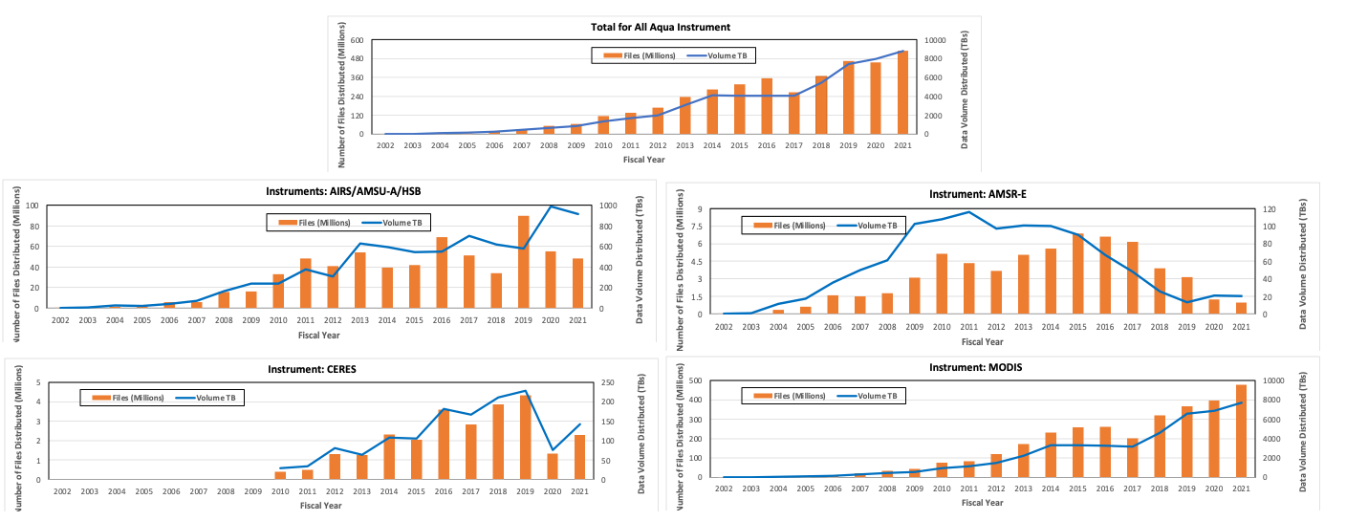
Quantitative Metrics from 20 Years of Aqua Data Usage
AGU Paper Number: IN41A-07
Lalit Wanchoo^{1,2} (lalit.wanchoo@nasa.gov), Dany Turcios^{1,2} (dany.x.turcios@nasa.gov), Jeanne Behnke² (jeanne.behnke@nasa.gov)
¹ ADNET Systems, Inc., 7515 Mission Drive, Suite A100, Lanham, MD 20706, ² NASA GSFC, Code 423, Greenbelt, MD 20771
Introduction
NASA’s Aqua one of the flagship satellite carries six Earth-observing instruments (Table 1) that have collected data for over 20 years. NASA’s Earth Science Data and Information System (ESDIS) Project makes these data, along with derived products, available to worldwide data users. Since the launch of Aqua on May 4, 2002, more than 10,000 data products have been archived and distributed by NASA-funded Distributed Active Archive Centers (DAACs) that are part of NASA’s Earth Observing System Data and Information System (EOSDIS). Raw data (level 0) is processed at full instrument resolution to other higher levels products to provide more useful parameters and data formats. A description of product levels is given in Table 2 and Table 3 lists the NASA’s EOSDIS DAACs that are responsible for archiving and distributing of EOS Aqua mission data. At the end of the 2019 Fiscal Year, about 3,000 Aqua data products constituted almost 20% of the entire EOSDIS data archive volume (6 PB out of approximately 34 PB of total EOSDIS archive), and 6 PB of Aqua data were distributed to over half-a-million public users worldwide.
Number of Data Products Archive
The number of Aqua data products has increased every year over the last 20 years (Figure 3). More than 3,000 Aqua data products are currently archived by all EOSDIS DAACs. The increase in data products during 2011 is due to addition of CERES data to the ESDIS Metrics System (EMS) along with the reprocessing of MODIS data that led to the creation of new MODIS data products. Also, the increase in data products in 2019 is due to additional MODIS data products produced by LAADS.
Aqua Data User Characterization
The Aqua data user community has evolved significantly since the start of the mission, and the number of users downloading Aqua data has grown from approximately 100 in FY 2002 to close to 400,000 in FY 2021. Figure 6 illustrates the distribution of Aqua data to more than 5.5 million users from the United States and foreign countries over the last 20 years. A majority of Aqua data was downloaded by U.S. users, 93% of whom downloaded Level 2 and Level 3 data products (Figure 7). Figure 8 shows that Aqua data were downloaded by world-wide users.
Table 1: Aqua Instruments Names
Table 2: Data Product Level Definitions
Purpose
By categorizing the Aqua data products and their distribution, we can get a quantitative assessment of Aqua data usage. NASA’s ESDIS Project has collected archive, distribution, and user information from EOSDIS data users since May 2002 when public distribution began right after on-orbit commissioning. These metrics are available through the ESDIS Metrics System (EMS). EMS information is stored in a relational database from which quantitative metrics of Aqua data were retrieved and analyzed for this study.
The purposes of this study are to: 1) perform a comprehensive investigation of the 20-year trend in the archive and distribution of Aqua data products; 2) identify and characterize data product usage over the last 20 years; and 3) identify and characterize the global user community for these data.
Reference: EarthData Website, https://earthdata.nasa.gov/collaborate/open-data-services-and-software/data-information-policy/data-levels
Table 3: EOSDIS Distributed Active Archive Centers for Aqua Data
Aqua Data Distribution
EOSDIS DAACs provide free access to all data in the EOSDIS collection to worldwide data users and constantly evolve services to make discovering and accessing these data as simple and efficient as possible. The volume of Aqua data distributed has steadily increased over the 20 years of the mission, as shown in Figure 4. Since the launch of Aqua, more than 55 Petabytes (PB) of Aqua instrument data have been distributed to worldwide data users. The majority of these data are from the MODIS instrument, which are distributed by NASA’s LAADS DAAC and LP DAAC (Figure 4). Figure 5 shows that most distributed data products are higher level products (Levels 1-4), indicating that there is more usage of derived geophysical parameters than of the lower level radiance parameters. Also, these figures show the increased usage of higher-level products over time, which indicates enhanced data quality.
Archive Aqua Data
NASA DAACs store data products that they produce or that they receive and facilitate the distribution of these data products to end users. This means that the total EOSDIS data archive volume is distributed over multiple DAACs. On a daily basis, EOSDIS DAACs process an average of more than 100 Gigabytes (GB) of Level 0 Aqua data from all five instruments to produce more than 1,500 GBs of Level 1 through Level 4 data products. The 20 years of the Aqua mission have seen the addition of new products and multiple reprocessing of all Aqua data, which further increases the Aqua data archived by the DAACs. Figures 1 and 2 show how the DAACs have been achieving Aqua data over 20 years, with most of these data being Level 1 and Level 2 data from the AIRS/AMSU-A/HSB and MODIS instruments. Over 98% of all Aqua data is archived at five DAACs: 1) ASDC (CERES), 2) GESDISC (AIRS/AMSU-A/HSB), 3) LP DAAC (MODIS), 4) LAADS DAAC (MODIS), and 5) OB.DAAC (MODIS). Aqua data are archived and made available to users through various distribution services at their respective DAAC.
Figure 4: Yearly Aqua Instruments Data Distribution by EOSDIS
Figure 8: Worldwide Number of Users Downloading Aqua Data (FY 02 to FY 21)
Summary
Figure 9 shows how the archiving and distribution of Aqua data have evolved over last 20 years. A comparison of FY 2002 and FY 2021 data metrics shows the following: 1) From only a few hundred data products, the Aqua archive has grown to more than 4,000 data products, 2) The distribution of Aqua instrument data has grown from 68 Terabytes (TB) to 2.5 PB per FY, and 3) The number of users downloading data has grown from about 100 to 400,000, with data being distributed globally. This global distribution of Aqua data is possible due to NASA’s open data policy, which ensures that these data are freely distributed. These metrics for Aqua data and data distribution provide insight to the innovation and work of EOSDIS DAACs in managing the growth of the Aqua data archive and facilitating the efficient distribution of these data. EOSDIS DAACs continue to provide guidance for the requirements of future data systems that will be needed to effectively and efficiently handle increasing amounts of data produced by Aqua as well as on-going and future Earth science missions.
Acknowledgments
Lalit Wanchoo and Dany Turcios contributions to this study were funded through the Science and Exploration Data Analysis (SESDA IV) GSFC NASA contract No: 80GSFC17C0003 C and Jeanne Behnke’s contributions to this study were made as a part of her employment by NASA.

