Slide 1
LISA EDUT PROGRAM
Status
November 17, 2022
SEAN BRENAN | Lead Design Engineer
SAM BONELLI | Design and AI&T IPTL Lead
ANDREW SACCO | Chief Systems Engineer
BRIAN VANRENSSELAER | Program Manager

Slide 2
Agenda
Mission Overview
Assembly Hardware
STM Telescope Design
STM Telescope Status
EDU1 M1 Status
Path Forward

Slide 3
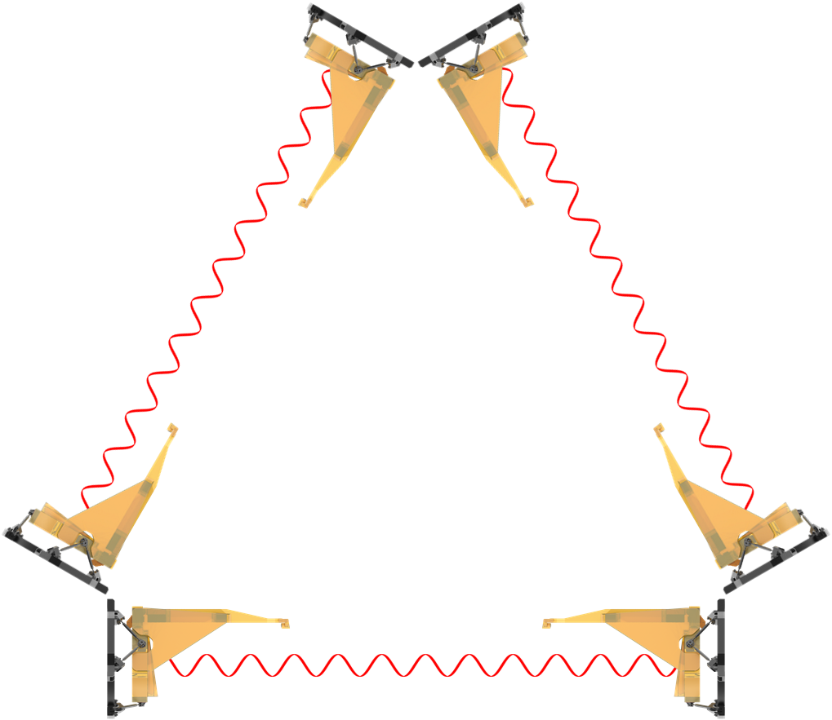
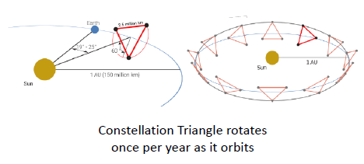
Mission Overview
Flight Mission Design
Three satellites in an equilateral triangle formation with arm lengths of ~2.5 million kilometers.
Any two arms of this triangle represent a Michelson type interferometer.
Gravitational waves deform space-time and can be detected as a change in the length of the interferometer arms (~ 10 pm/Hz^{1/2}).
Baseline 4 year lifetime + 6 years goal
Each spacecraft has 2 telescopes that transmit and receive simultaneously and are in the optical path between the pairs of free-floating test masses at the end of each arm.
SC-1
~2.5 million km
Heliocentric Orbit
SC-2
SC-3
Behind each telescope is an optical bench with a laser at 1064 nm and a free floating test mass.
The much longer baseline spacing between test masses and the quiet environment in space will allow the LISA Mission to measure much lower frequency gravitational waves than LIGO

Slide 4
LISA Assembly Hardware
All assembly hardware was designed, developed, and demonstrated in ~15 months
Extensive cross-functional collaboration enabled success of LISA STM build
  Developed assembly hardware with continuous feedback from metrology, optics, design, manufacturing, and assembly
  Feedback from all stakeholders allowed team to optimize:
    Reach-in-access for assembly and metrology
    Line-of-sight and clearance for optical paths
    Adjustability of hardware
    Process and assembly flows
  Performed extensive assembly technology development
  Iteratively improved hardware through assembly analyses and repeated reviews with stakeholders
  Several months of demonstrations were performed to de-risk critical activities

Slide 5
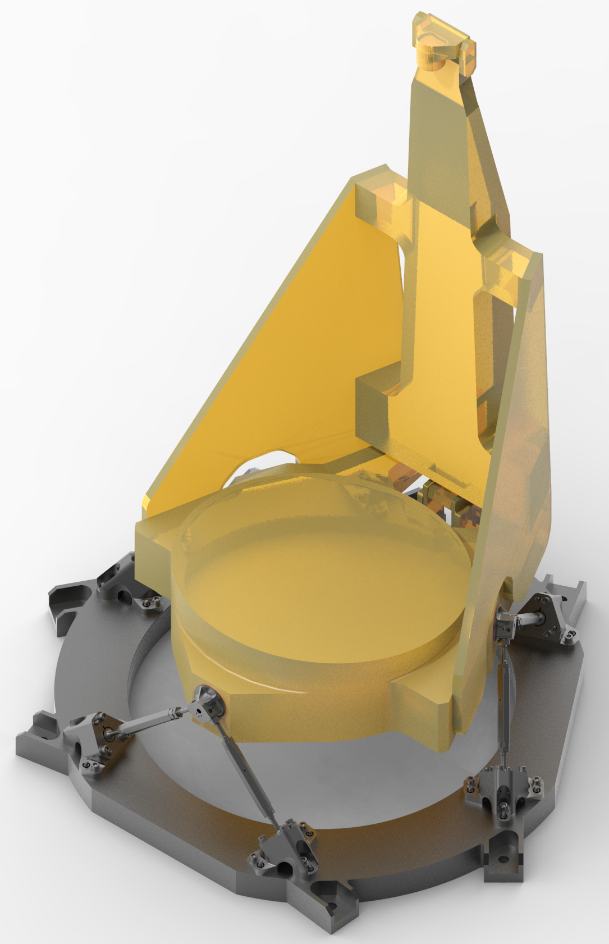
LISA STM Telescope Design
The Structural Thermal Model (STM) is intended to demonstrate thermal stability of the all-glass structural design of the LISA relay telescope
Design is optimized to maintain picometer-level-stability across entire thermal operating envelope
Mirrors are held in the assembly to extremely precise tolerances, exceeding the mechanical assembly requirements needed for an imaging telescope
All optics are fixed in place. There is no optical adjustment possible after assembly.
Simplified Model of L3Harris all Glass Design STM unit (uncoated)

Slide 6
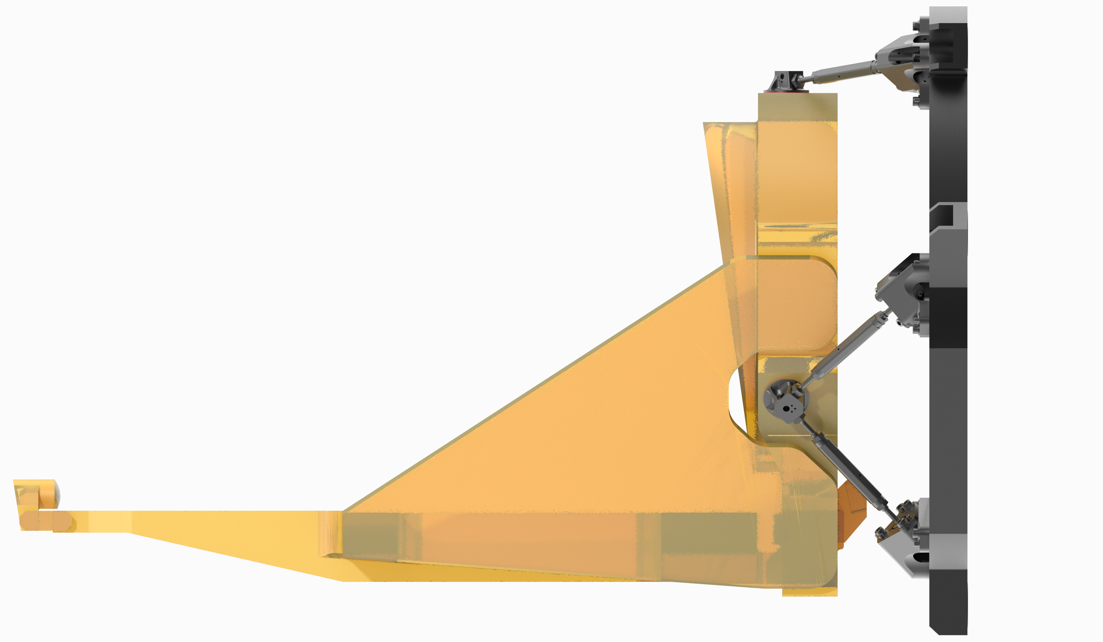
LISA STM Status
STM assembly successfully completed
  Demonstrated nearly flawless machining of complex Zerodur® parts; all meet or exceed design specifications
  Components fixtured, aligned, and assembled with micron-level accuracy
  Assembled 0.5m x 0.4m gussets to a positional accuracy better than 25 microns
  Successfully demonstrated build process with
  minimal-to-zero redesign or process changes required
Structural Thermal Model (STM) Status
  FEM simulations - Complete
  Structural model assembly - Complete
  TVAC testing - In progress
  Random vibration testing & sine burst testing - Up next
  Stability testing (post delivery by NASA partners at University of Florida) - Feb./Mar. 2023
STM Assembly complete and entering TVAC/Vibe testing phase
ZERODUR® is a registered trademark of Schott Glass Technologies

Slide 7
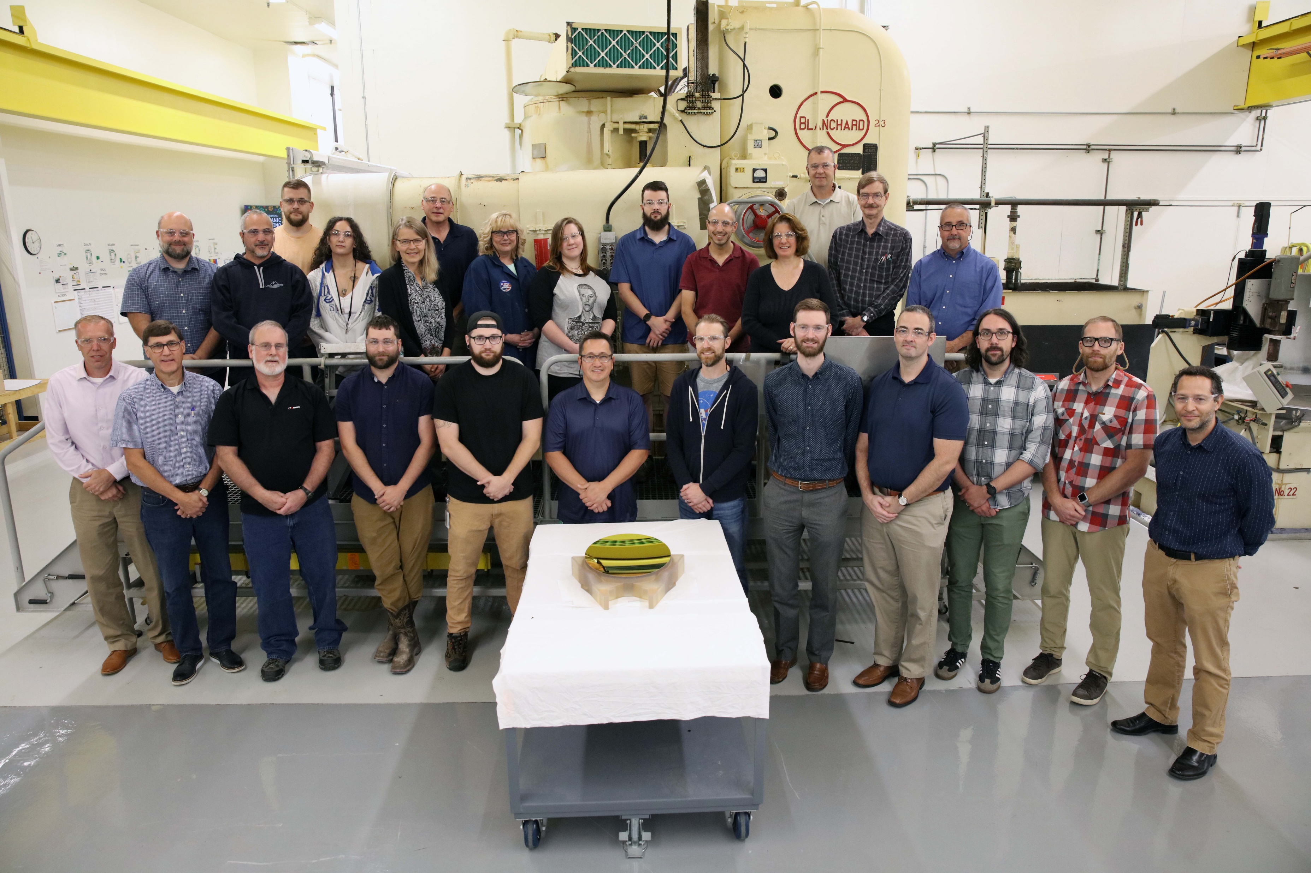
LISA EDU1 M1 Completed
EDU1 M1 has completed its fabrication and optical testing
  Zerodur® blank machined with optical surfaces ground, polished, smoothed and figured at L3Harris
  Acid etching completed by Corning Inc. and L3Harris
  Gold coating applied by Viavi Solutions Inc.
Design incorporates structural elements for rigidity/strength, light-weighting for mass reduction and features/interfaces allowing for integration to telescope
Final surface figure of 6.0 nm RMS achieved
Surface roughness of 2Å RMS achieved
  Over 15 µm to 227 µm periods
Optic ready for integration into the EDU1 telescope
ZERODUR® is a registered trademark of Schott Glass Technologies

Slide 8
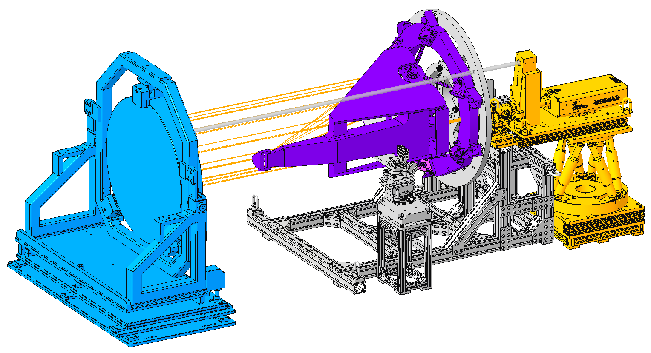
LISA EDU Telescope Path Forward
Optical telescope build and test (EDU1 and EDU2)
  Assembly of optical telescopes
  Wavefront error and boresight performance measured in horizontal configuration
    Illumination from the small pupil against auto collimating flat
    High resolution 1.064 micron wavelength interferometer
  TVAC and Sine Burst/Random Vibration Testing
    Hot cure followed by 4 cycles from -10°C to +38°C with 12 hour dwell at plateaus
    Sine burst loading up to 40 g’s
  Deliver to GSFC or ESA for stability testing: EDU1 7/2023, EDU2 3/2024

Slide 9
Gregory Coons
Contracts Manager
L3Harris Technologies
400 Initiative Drive
Rochester, NY 14606
(Office) 585-269-5816
Gregory.Coons@L3Harris.com
Brian VanRensselaer
Program Manager
L3Harris Technologies
400 Initiative Drive
Rochester, NY 14606
(Office) 585-269-6266
Brian.VanRensselaer@L3Harris.com

