Slide 1
Feasibility Study of a Multi Tilt-rotor Aircraft as the Artemis Lunar Training Vehicle
2023 AIAA SciTech Forum
TF-13, General Topics in Transformational Flight
January 26, 2023
Jing Pei, Atmospheric Flight Entry Systems Branch, NASA LaRC
Dr. Jared Grauer, Dynamic Systems and Controls Branch, NASA LaRC
Luke Miller, Flight Dynamics Branch, NASA LaRC
Jason Welstead, Aeronautic Systems Branch, NASA LaRC
Han Woong Bae, Navigation Guidance & Controls Branch, NASA MSFC
This material is a work of the U.S. Government and is not subject to copyright protection in the United States.

Slide 2
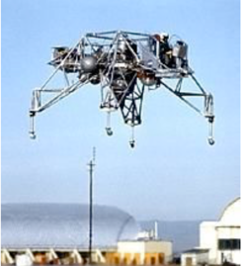
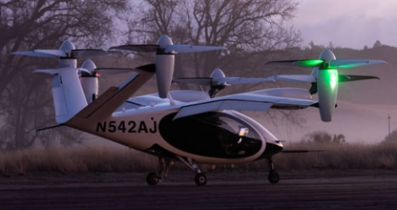
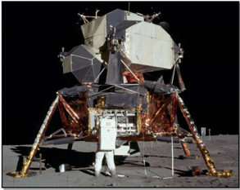
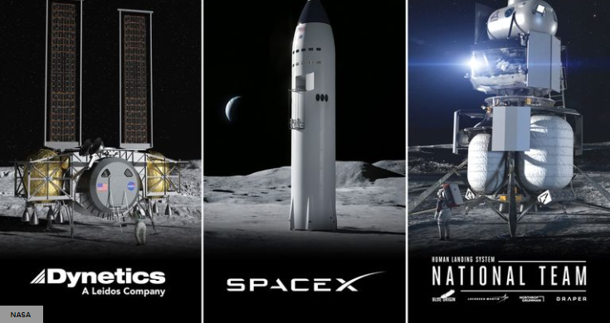
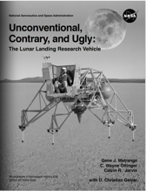
Motivation
LLRV to LLTV
Apollo
eVTOL Production Aircraft [1]
[1] www.nasa.gov
Crew must have a thorough understanding of control response, control power, and the unique physics of flight in the lunar environment of vacuum and 1/6 gravity, primarily the relationship between flight deck angle (thrust vector) and linear acceleration.
Tilt-rotor configurations allows decoupling between vehicle flight path and attitude. Able to replicate the ratio of tilt angle to linear acceleration as what a vehicle would experience on the lunar surface
In-Flight Trainer (IFT) Candidate
Positive Training
Artemis
Neil Armstrong: “I felt very comfortable – I felt at home. I felt like I was flying something I was used to and it was doing the things that it ought to be doing…”
Donald "Deke" Slayton, then NASA's astronaut chief, “said there was no other way to simulate a moon landing except by flying the LLTV”.
Notes:
Make a statement disclaimer on using the Joby image throughout this presentation

Slide 3
Background and Challenges
Background
Apollo Lunar Module (LM) had auto-land capability.
All six Lunar landings were performed manually!
This phase of flight is the most critical and involves the greatest risk to crew and mission.
HLS manual landing capability is an Artemis crew safety requirement.
Positive Training
Challenges
The manual lunar landing is a dynamic, skills-based task that requires a high level of sensorimotor coordination.
No fixed or motion-based sim can replicate psychological stressors.
No reset button, actual propellant limitations, real-world consequences.
Crew must be trained to monitor all automated systems and manually fly at any point in the flight profile in order to safely land the HLS.
Apollo LM Pilots were initially shocked at how much the LM had to bank to achieve the desired velocity profile.
Without adequate training, the crew is at maximum risk.
X
5
4
3
2
1
 | 1 | 2 | 3 | 4 | 5
Likelihood
With proper training
X
Consequence
Per NASA crew Office
Notes:
Emphasize manual landing capabilities

Slide 4
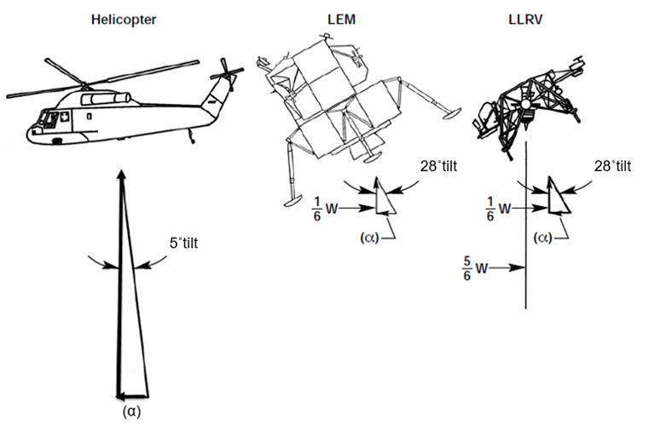
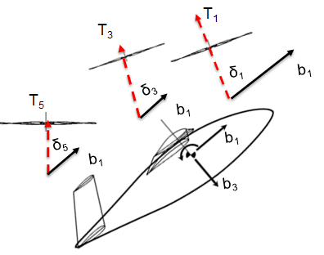
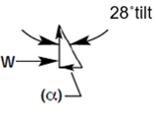
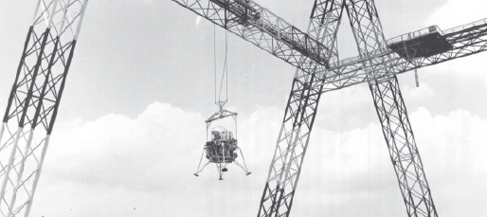
Emulating Lunar Gravity
(Lunar Excursion Module)
(Lunar Landing Research Vehicle)
Credit: LLRV Monograph
W
Goal: Solve for rotor thrust and gimbal angles such that ratio of tilt to translational accel is the same as LEM and LLRV.
Langley LLRF
(Lunar Landing Research Facility)

Slide 5
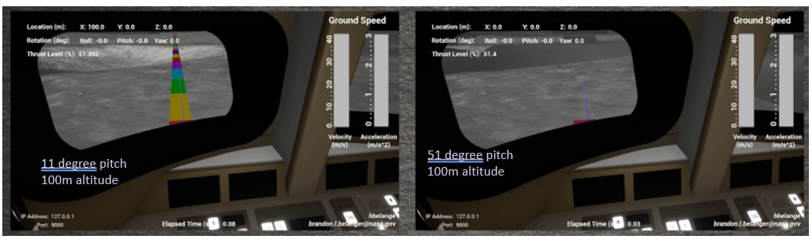
Bank Angle Animation Cockpit View

Slide 6
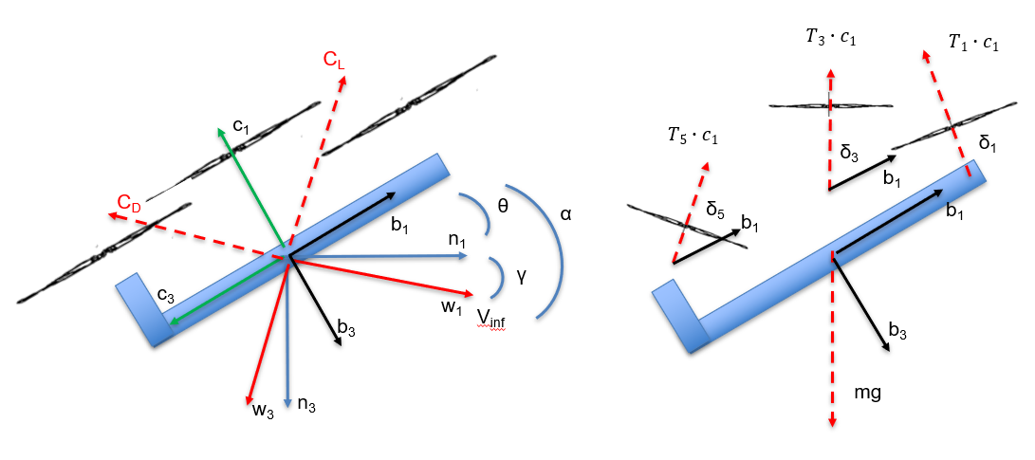
Notional Tilt Rotor Configuration

Slide 7
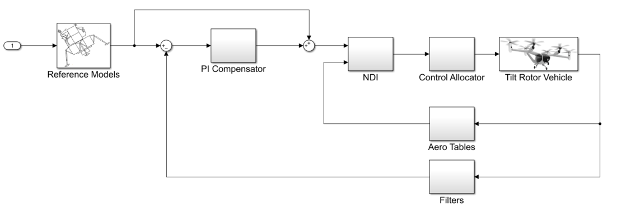
Nonlinear Dynamic Inversion (NDI) Control Architecture
Pilot Input
HLS lander model (any provider’s design)
Requires a good aero model
How do we make the tilt-rotor behave like the HLS vehicle?
Lander reference model block represents closed-loop lander dynamics (GN&C + airframe).
Ability to rapidly swap out the lander reference model.
Allows for evaluation of multiple lander designs without affecting flight control architecture.

Slide 8



Notional Artemis Lunar Training Vehicle (ALTV) Training Profile
Wingborne Flight to Profile start
Lunar Simulation Mode
Transition to Optimal Lunar Lander Profile Start
Enable Lunar Lander
Control Modes
Match lunar landing trajectory states at low gate, then switch over to lunar simulation mode
Pilot allowed to take over manually at any point along the trajectory
Apollo Low Gate Start (500 ft)
Requirement: IFT needs to be able to simulate the dynamics and trajectories of any current or future vehicle concepts
Transition to
Wingborne

Slide 9
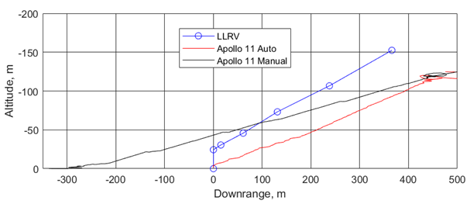
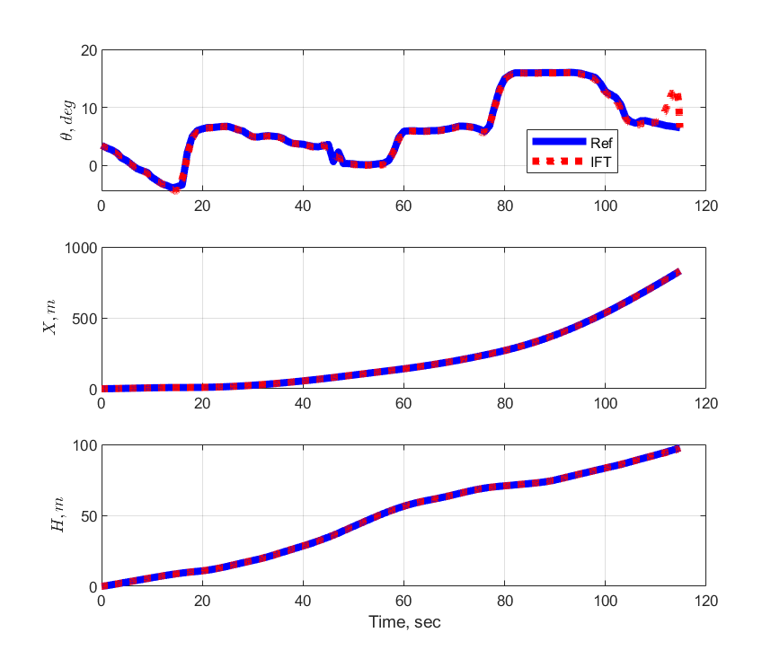
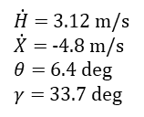
Following the Apollo 11 Trajectory
Apollo 11 P66 entry conditions (as flown)
$\dot{H}$ = 3.12 m/s
$\dot{X}$ = -4.8 m/s
$θ$ = 6.4 deg
$γ$ = 33.7 deg
[2] Kluever, E. E., Mallick, L, D., Matranga, J. G., “Flight Results with a Non-aerodynamic, Variable Stability, Flying Platform”. Society of Test Pilots. Vol. 8.2. 1966
[3] Bennett, V. F., “Apollo Lunar Descent and Ascent Trajectories”. NASA TM X-58040. March 1970

Slide 10
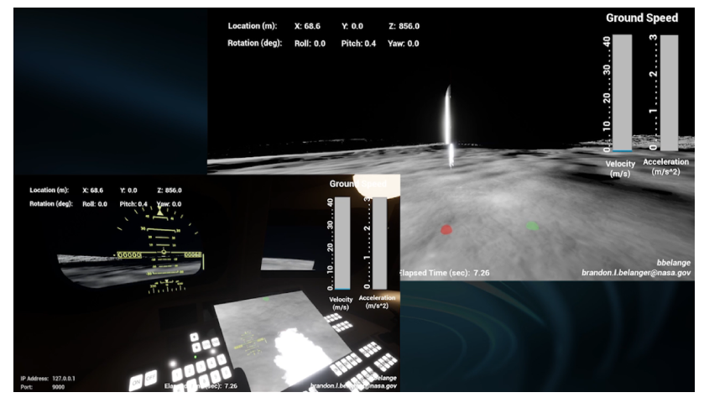
Notional Lunar Starship Manual Redesignation

Slide 11
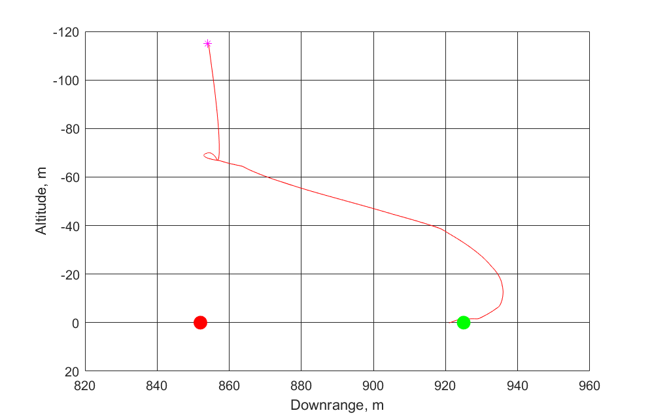
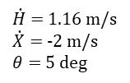
Notional Lunar Starship Manual Redesignation with ALTV
Lunar Simulation Manual Control Entry Point
Auto Landing Site
$\dot{H}$ = 1.16 m/s
$\dot{X}$ = -2 m/s
$θ$ = 5 deg
Redesignated Landing Site

Slide 12
Summary and Discussion
Study explored the viability of leveraging current technology in the field of eVTOL vehicles as a potential candidate for the Artemis Lunar Training Vehicle
Rotor gimbal capability is the key that allows for decoupling of attitude and flight path → required for simulating the ratio of deck angle to linear acceleration in Lunar g
Model-following control architecture enables IFT to simulate different lander concepts subjected to its own physical capabilities
Gentleness of the Apollo approach trajectories allows for the IFT concept to simulate them to a great extent (~ last 120 seconds)
Future Artemis missions likely involves more aggressive maneuvers with rapid descent rates and large flight path angles
Resulting in large aero forces, VRS phenomenon, complex rotor aero interference effects at large AoA → pushing the operating enveloped of the typical eVTOL design → severely restrict the training profile (replicate ~ last 15 seconds, mostly vertical descent → question: still worth having a custom trainer?)

