Slide 1
Coupled Reactor Multiphysics and Mass Scalability Assessment for Crewed Megawatt-Class NEP System Architectures
JANNAF December 2022 Conference Presentation
Presented by: Corey Smith
Supported by: Dennis Nikitaev, Matthew Duchek, Kelsa Palomares, DV Rao
December 5th, 2022

Slide 2
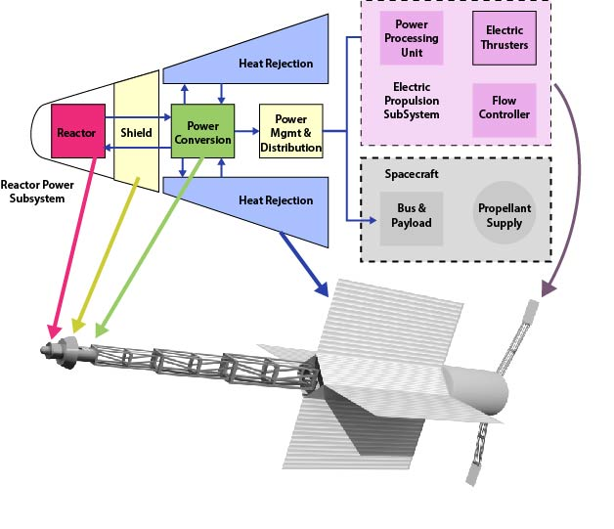
Agenda
Introduction and Objectives
  NEP System Overview
  Key Performance Parameters (KPPs)
  Modeling Objectives
Scalability Assessment Methodology
  Coupled Reactor Modeling Methodology
  Reactor Loop Options
Reactor Scalability Results
  High-Temperature Gas Reactor (HTGR)
  Liquid Metal Reactor (LMR)
  Heat Pipe Reactor (HPR)
  Reactor Option Comparison at 1200 K and 1400 K

Slide 3
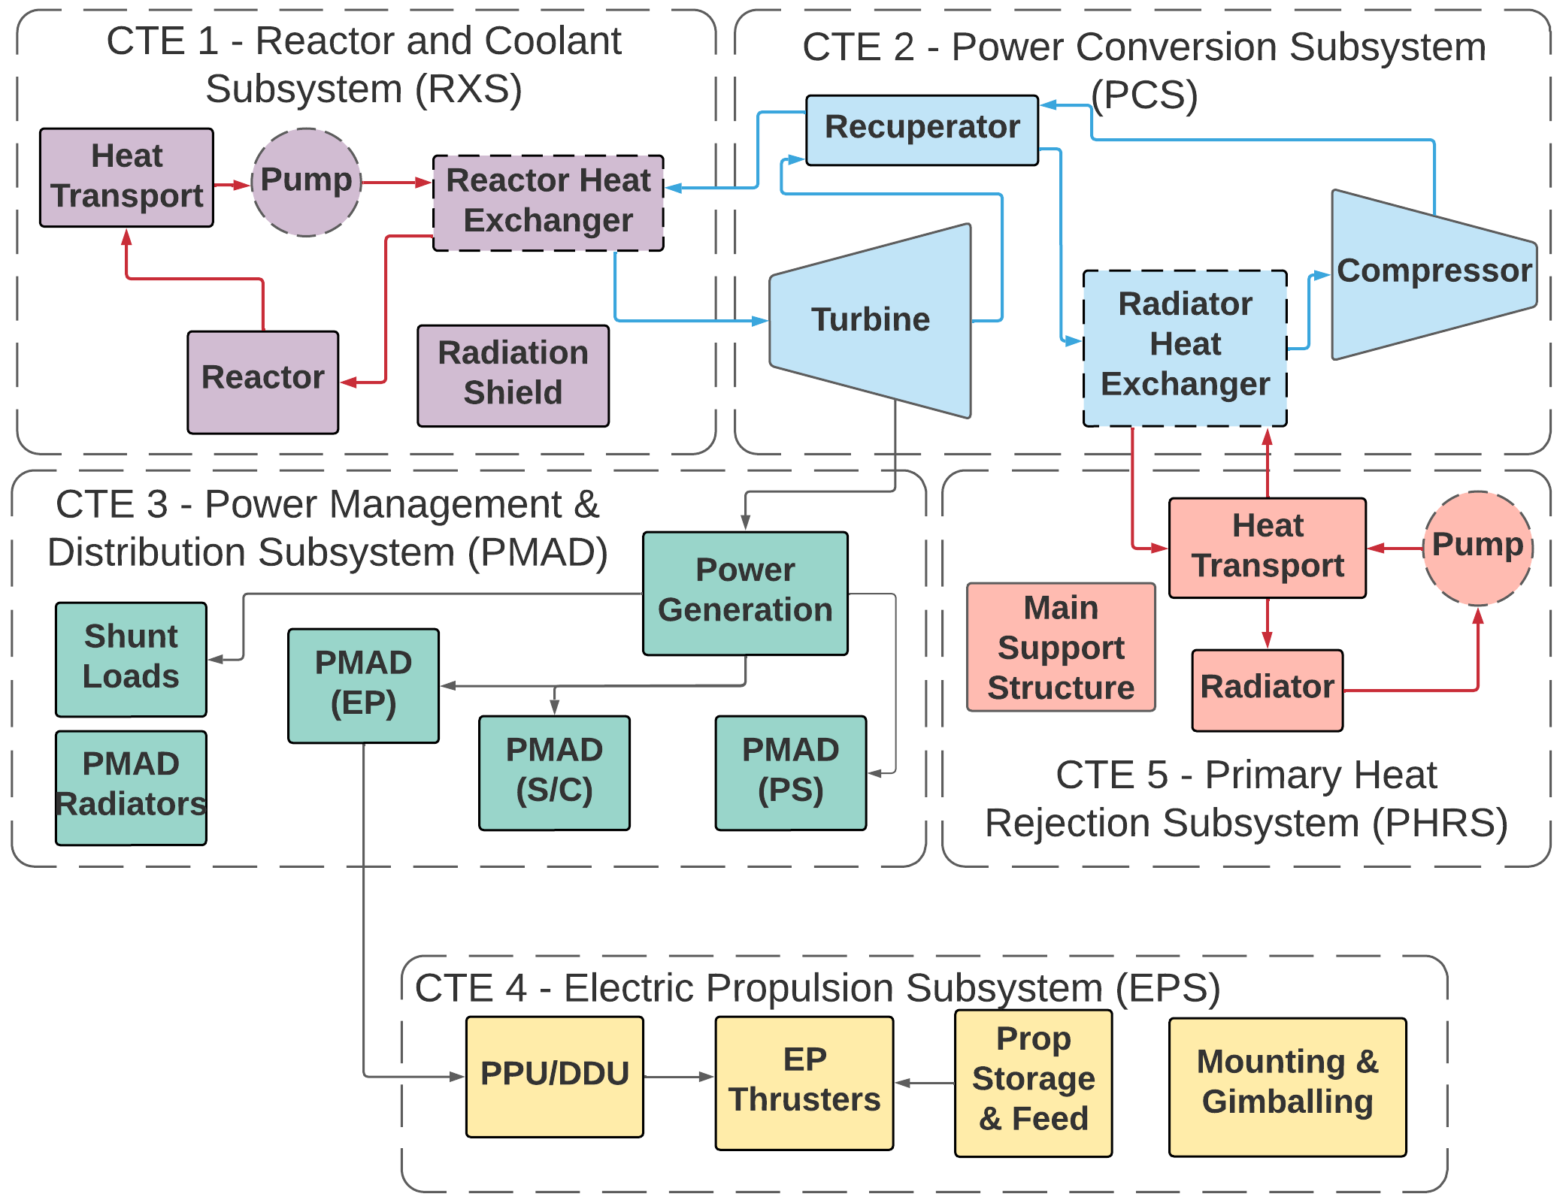
NEP System Overview
  Nuclear Electric Propulsion (NEP) systems are one of the primary technologies capable of enabling crewed and cargo missions for cislunar and interplanetary missions
  NEP systems are divided into 5 Critical Technology Elements (CTEs)
  Reactor and Coolant Subsystem (RXS)
  Power Conversion Subsystem (PCS)
  Power Management and Distribution (PMAD)
  Electric Propulsion System (EPS)
  Primary Heat Rejection System (PHRS)
  Each CTE is further divided into assemblies and subcomponents
    Depending on CTE design decisions, some components of the figure are not required to enable the complete system
  Technology selections & optimization should be performed on the system level

Slide 4
CTE-1 Key Performance Parameters (KPPs) [6]
To characterize the ability for an NEP system to enable cislunar and interplanetary missions, the electric power output and mass quantities for the entire spacecraft are utilized
  Specific mass, or α_{e}, is the ratio of these two quantities (in units of kg / kW_{e})
  In this work, α refers to the specific mass with respect to thermal power (kg / kW_{th}) since the system efficiency for each test case is unknown without additional knowledge about the PCS
The RXS CTE yields one of the largest contributions to α, thus significant analyses must be performed to determine which reactor choice will allow for optimization of this term
KPP | Threshold | Target | Rationale
Power Conversion Inlet Temperature (PCIT) / Reactor Exit Temperature | 1200 K | 1400 K | High temperature enables higher efficiency and lower system mass.
CTE-1 Specific Mass (α_{e}) | 6.0 kg / kW_{e} | 4.5 kg / kW_{e} | Based on SME input.
KPP | Range |  | Rationale
Total Thermal Power | 5 – 8 MW_{th} |  | Corresponds to a 2 MWe system with 25-40% efficiency.
Burnup | 30 – 48 MW_{th}-yr |  | Based on 6-year operational life.
Radiation Limits | Neutron Fluence: 10¹² n/cm² Gamma Dose: 100 kRad |  | Radiation limit at the spacecraft side of the shield.

Slide 5
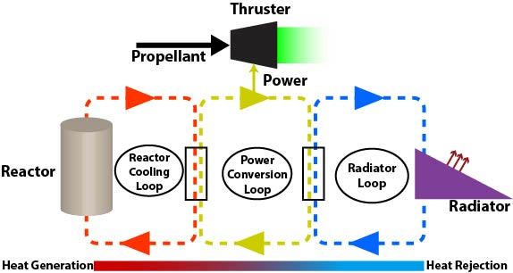
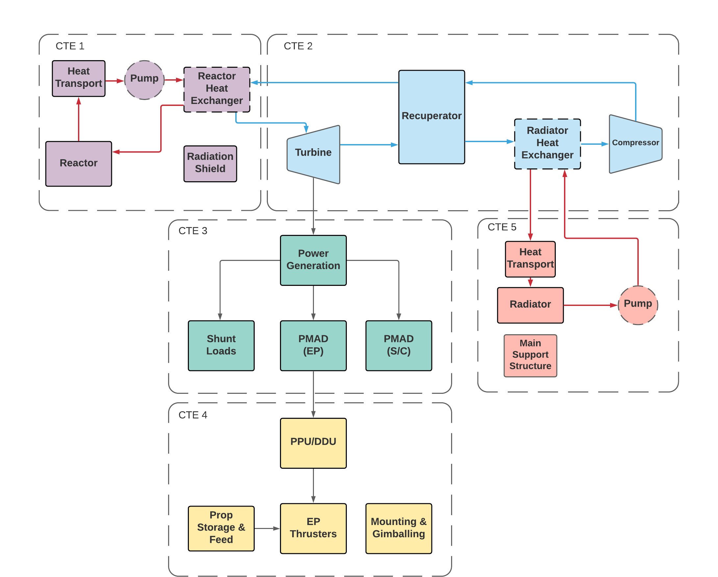
Reactor Modeling Objectives
Create a flexible and user-friendly modeling suite for analyzing the physical phenomenon for CTE-1
  Extensibility to different working fluids and geometry
  External shield sizing algorithm
  Optional heat exchanger for HPRs and LMRs, optional pump included for LMRs
Implement a coupled reactor mass model based on system geometry and desired performance metrics
  Perform core sizing based on thermal hydraulics by scaling to finite reactor calculations from a unit cell approach
  Incorporate radial/axial reflectors, shields, and reactor pressure vessel
Create case-specific neutronics scripts through input generators and compare with high fidelity point designs
  Input generators available in Serpent and OpenMC

Slide 6
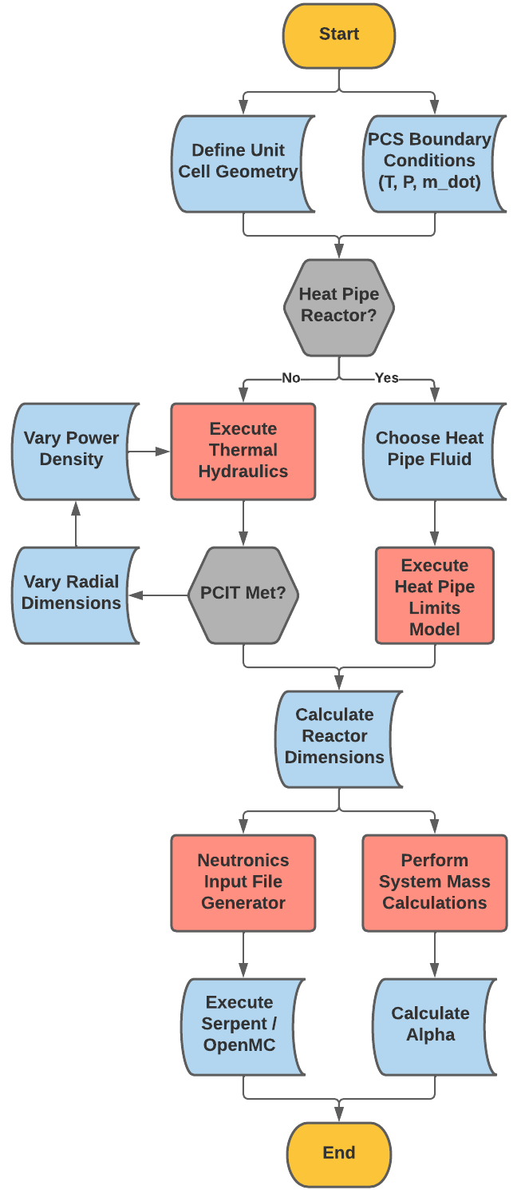
Coupled Reactor Modeling Methodology
Reactor thermal hydraulics, mass calculations, and neutronics are coupled into a single methodology to account for all relevant physics
  Thermal Hydraulics
    HTGR / LMR: Varies per unit cell mass flow rate, number of unit cells, and thermal power density until a desired reactor exit temperature is reached
    HPR: HP limits-based approach to assess the heat throughput per HP. Inputs include the fraction of total throughput and the wall temperature to PCIT ΔT
  Neutronics
    SERPENT or OpenMC input files are generated per case based on thermal hydraulically converged dimensions
  Mass
    Volume calculations based on converged number of core unit cells and dimensions of the axial / radial reflectors, external shields, and pressure vessel
    Various subcomponents (I&C, structural support, etc.) are calculated using empirical correlations from the SP-100 project [15]
Bounding conditions from the PCS model (temperature, pressure, flow rate) are used as inputs and convergence criteria for the reactor T/H sequence.

Slide 7
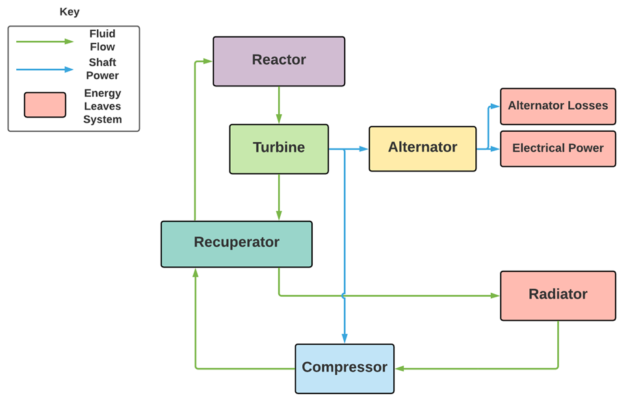
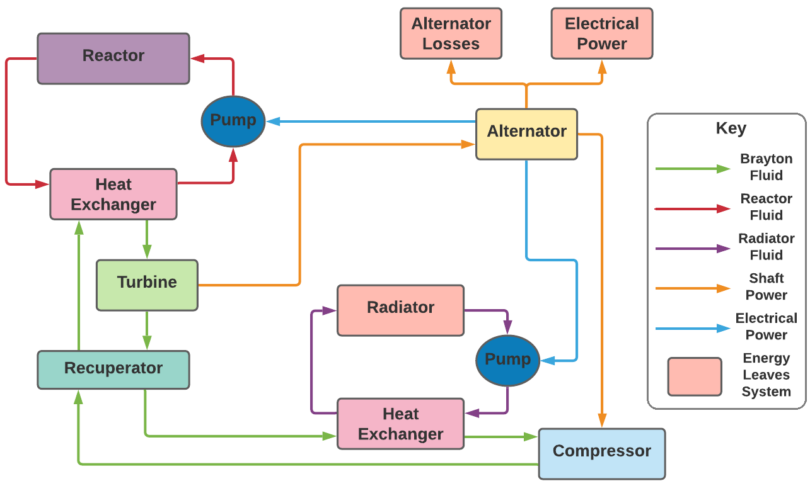
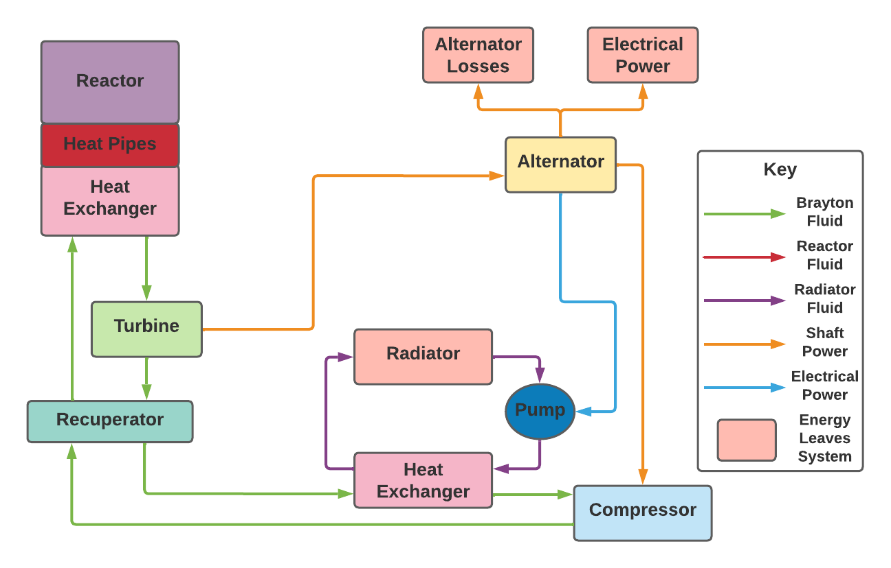
Reactor Loop Options
To increase the efficiency of the PCS and decrease system mass, various working fluids can be used in the reactor loop
  Single loop: Noble Gases (i.e., He, Xe, He-Xe, He-Ar, etc.) or Supercritical CO2
    72% He – 28% Xe mixture is currently under investigation by the SNP project
  Separate loop: Liquid Metals (i.e., Na, K, NaK-78, Li) or Heat Pipes
System mass dependent on working fluid configuration and heat rejection exit temperature
  Radiator size is also dependent on the amount of heat rejection needed
Single Loop HTGR
Triple Loop LMR
Triple Loop HPR

Slide 8
HTGR / LMR Subcomponent Cooling Model
Pressure vessel flow and overall mass model to incorporate system pressure and temperature conditions on thickness requirements
  Added the PV thermal hydraulics approach to inform pressure drop and enthalpy gain on the core periphery
Contains a momentum, frictional, and area change pressure drop map across the entire reactor loop based on first-order equations
  Physics-based sizing pressure losses:
    In-core cooling channels
    Annular pressure vessel flow
  Contraction pressure losses:
    Inlet nozzle to the pressure vessel flow
    Inlet plenum to in-core cooling channels
    Exit plenum to exit nozzles
  Expansion pressure losses:
    Pressure vessel flow to inlet plenum
    In-core cooling channels to exit plenum
Input Variables | Friction | Momentum | Area Change
In-Core Flow Channels | X | X
PV Annular Cooling Channel | X | X
Ducting (PCS to RXS / RXS to PCS) | X | X
Reactor Plena |  |  | X
Inlet / Outlet Nozzles |  |  | X
Inclusion of this model has reduced uncertainty in the pressure in various locations within the RXS and with the PCS interface.

Slide 9
HTGR Reactor Scalability Assessment
Legacy reactor concepts have proposed using performant gases to directly cool the reactor and to serve as the power conversion working fluid
  JIMO/Prometheus project down-selected away from heat pipe and pumped liquid metal reactors to focus on direct gas-cooled
The reactor unit cell used in this scalability assessment is proprietary, thus it has been removed from this presentation
Currently, Helium-Xenon (He-Xe) mixtures are being investigated as the main working fluid for the reactor and PCS
  72% He, 28% Xe to yield 40 g/mol
  Past work investigated and removed sCO₂ from the trade space
Key parameters for scalability assessment:
  Inputs: Total mass flow rate, inlet pressure / temperature, and PCIT
  Outputs: Pressure drop, reactor mass, external shield mass, total thermal power / power density, pressure vessel thickness / mass
Input Parameter | Parameter Range
Mass Flow Rate | 5 – 100 kg/s
Inlet Temperature | 700 – (PCIT-100) K
Inlet Pressure | 2 – 5 MPa
PCIT | 1200, 1400 K

Slide 10
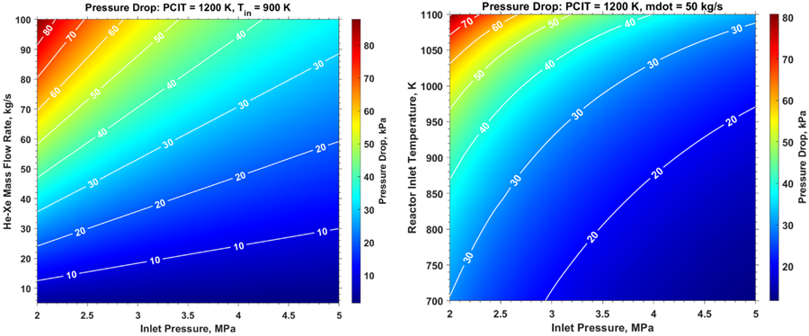
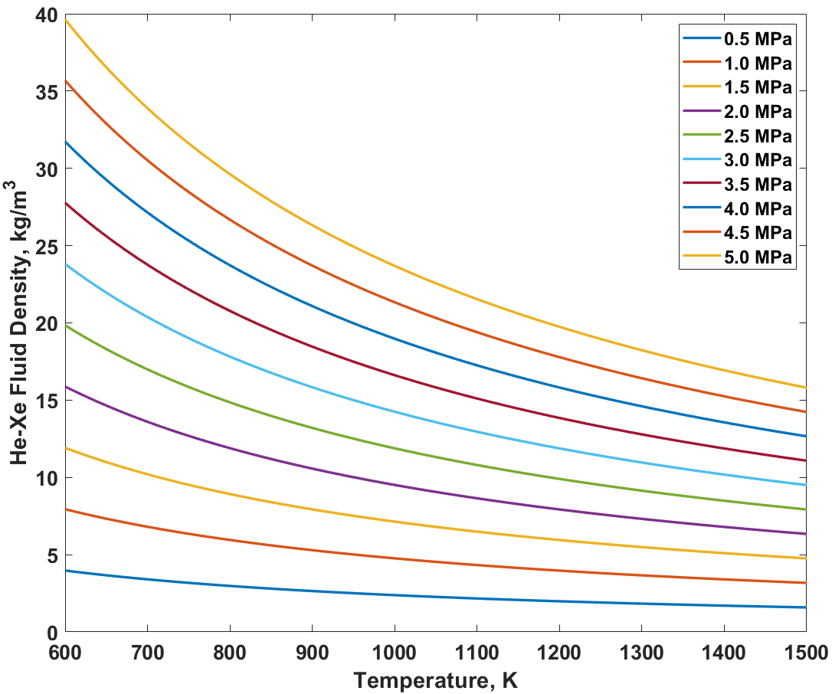

HTGR Pressure Loss Sensitivity Assessment
Perturbations of the four main PCS boundary conditions provide an understanding of how the pressure loss varies across a wide sweep of operating conditions
Key observations:
  Reactor pressure drop is strongly correlated to the inlet pressure’s impact on the fluid density
  As fluid pressure increases, frictional and momentum pressure losses significantly decrease
  Pressure drop increases as:
    Inlet pressure decreases
    Mass flow rate increases
    ΔT decreases
    PCIT increases
While higher gas pressure leads to lower pressure losses, a thicker pressure vessel is required. Reactor inlet conditions are heavily dependent on the exit conditions of the primary heat rejection system (radiators).

Slide 11
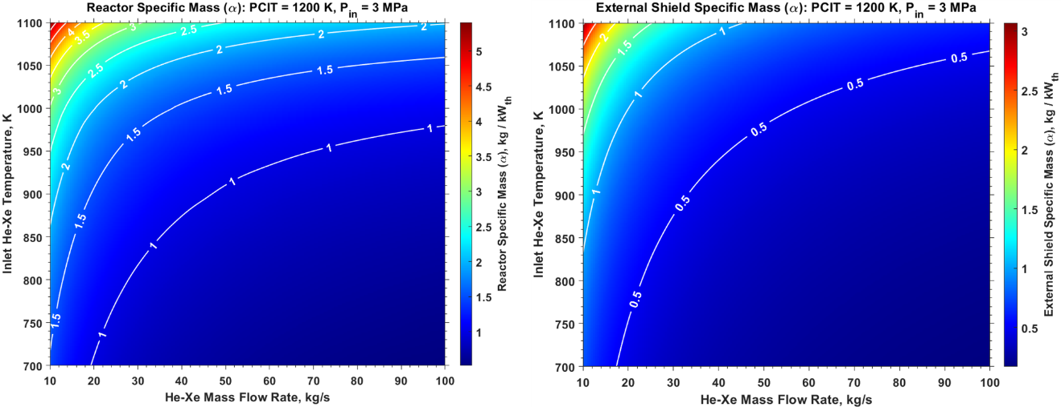
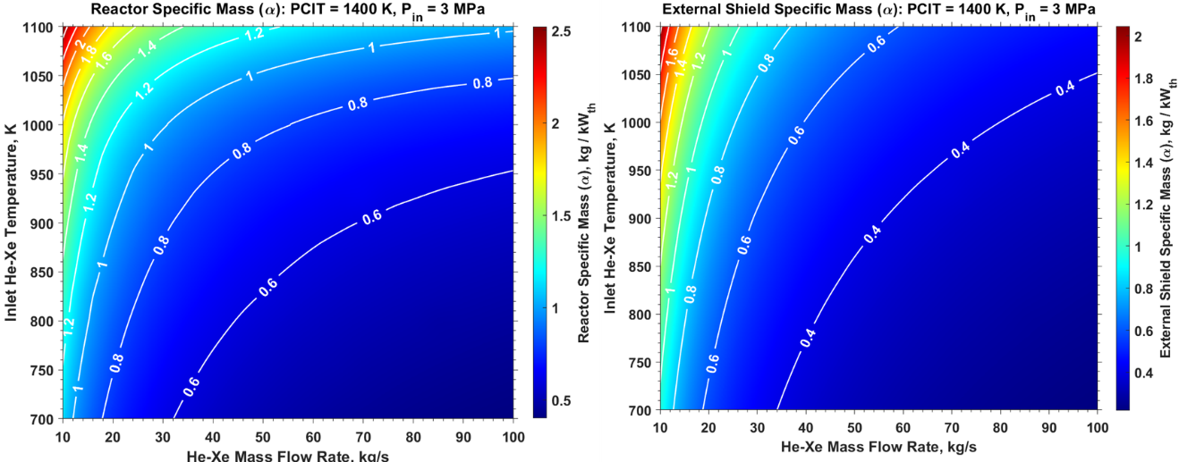

HTGR Scalability Results
Key Observations:
  Mass flow rate increase and / or inlet gas temperature decrease will decrease reactor α due to the thermal power increase ($Q=\dot{m}ΔH$) and change in required number of unit cells
  Inlet gas temperature decrease will also reduce the temperature of the pressure vessel, allowing for a smaller thickness
  Increasing the PCIT will yield a smaller reactor geometry due to enhanced in-core thermal hydraulics, but a thicker pressure vessel will be required
  Large reactor ΔTs will cause extreme thermal stresses on the fuel and other key subcomponent materials
  System efficiency will decrease as mass flow rate increases, may also require additional PCS components

Slide 12
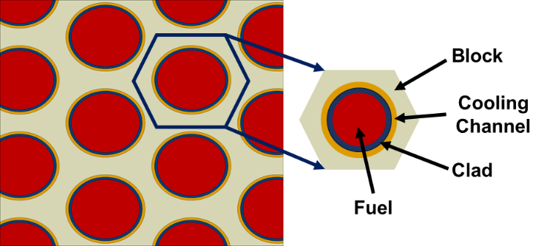
LMR Reactor Scalability Approach
Pumped lithium reactors were investigated during the SP-100 project due to their promising fluid properties, including high boiling point (~1600 K)
  Pumped liquid metal offer several thermal hydraulic advantages, including low pressure losses and excellent thermophysical properties
  Corrosivity and chemical reactions with several in-core and primary loop components is a concern
Key inputs and outputs to this scalability assessment are akin to the gas-cooled reactor option, but the reactor inlet / outlet temperature are driven by the heat exchanger conditions
  Inputs: Total mass flow rate, inlet pressure, PCIT, and reactor ΔT
  Outputs: Pressure drop, reactor mass, external shield mass, total thermal power / power density, pressure vessel thickness / mass
This technology option is currently de-emphasized by the SNP project’s NEP Technology Maturation Plan (TMP)
Input Parameter | Parameter Range
Mass Flow Rate | 5 – 100 kg/s
Reactor ΔT | 30 – 60 K
Inlet Pressure | 1.5 – 4.5 MPa
PCIT | 1000 – 1500 K
This option is included in this work to provide a metric for comparing the results of HTGRs and HPRs while providing backbone results in case LMRs reach a high enough TRL.

Slide 13
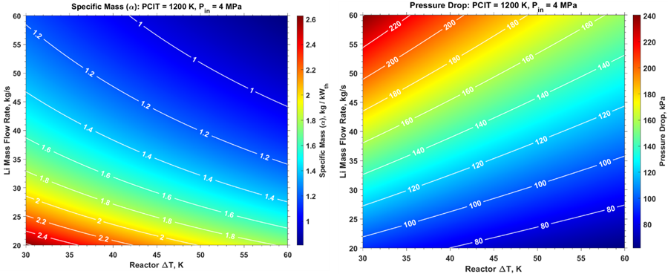
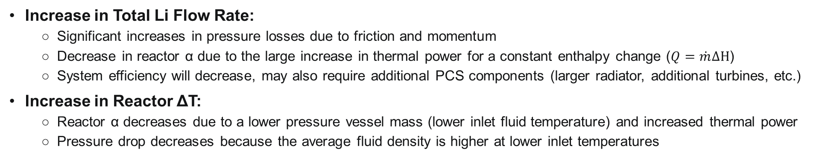
Lithium LMR Results
Increase in Total Li Flow Rate:
  Significant increases in pressure losses due to friction and momentum
  Decrease in reactor α due to the large increase in thermal power for a constant enthalpy change ($Q=\dot{m}ΔH$)
  System efficiency will decrease, may also require additional PCS components (larger radiator, additional turbines, etc.)
Increase in Reactor ΔT:
  Reactor α decreases due to a lower pressure vessel mass (lower inlet fluid temperature) and increased thermal power
  Pressure drop decreases because the average fluid density is higher at lower inlet temperatures

Slide 14
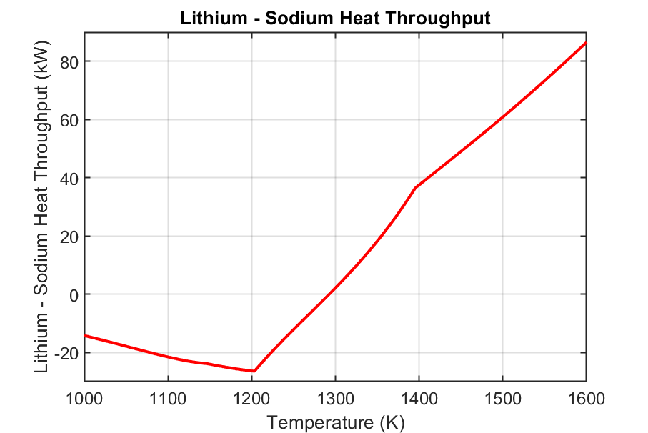
HPR Limits-Based Thermal Hydraulic Modeling
The current code suite allows for sodium and lithium working fluids for the heat pipes
  Code flags allow the user to either choose the fluid or have the code determine which performs better
  Potassium and NaK are options, but their operational regime is below NEP reactor operating conditions
Choosing the correct working fluid is contingent on the operational temperature of the reactor and the heat exchanger requirements
  Sodium provides better performance than lithium up to ~1300 K
  Operating the reactor heat pipes above 1400 K with lithium will yield the smallest core configurations, but concerns over the fuel and moderator operating temperatures are present
Sodium
Lithium
Sodium to Lithium Transition

Slide 15
HPR Scalability Assessment
Key observations from the HTGR and LMR results will translate to the HPR since the PCS boundary conditions are still imposed through the heat pipe heat exchanger
  Specifically output trends for PCIT, He-Xe mass flow rate, and inlet gas temperature / pressure
In this assessment, a proprietary reactor geometry from Los Alamos National Laboratory (LANL) has been used to perform scaling studies
  Geometry specifications have been omitted from this presentation and report
Input Parameters:
  PCIT, K
  HX Inlet Temperature, K
  HX Inlet Pressure, MPa
  Mass Flow Rate, kg/s
  Heat Pipe ΔT (Wall Temperature – PCIT), K
  Heat Throughput Factor (Percent of Maximum Throughput)
Key Outputs:
  Reactor Mass, kg
  External Shield Mass, kg
  Total Thermal Power, MW_{th}
  Number of Fuel/Moderator Heat Pipes
$${\dot{Q}}_{PCS}=\dot{m}(h\left(P_{in},PCIT\right)−h\left(P_{in},T_{in}\right))={f_{HP}(N}_{FHP}∗Q_{FHP,lim}+N_{MHP}∗Q_{MHP,lim})$$
Input Parameter | Parameter Range
Working Fluids | Sodium, Lithium
Mass Flow Rate | 9 – 35 kg/s
HX Inlet Temperature | 725 – 1100 K
HX Inlet Pressure | 1 – 3.1 MPa
PCIT | 1150, 1200, 1400 K
HP Throughput Factor | 0.4 – 1.0
HP ΔT | 0 – 200 K

Slide 16
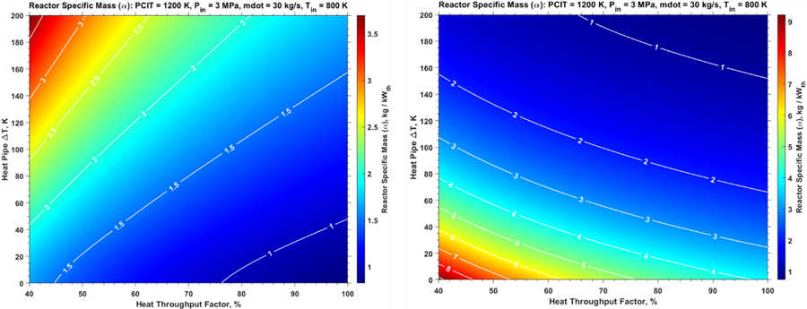
HP ΔT and HP Factor Sensitivity
Increase in Heat Pipe ΔT:
  For Na, reactor α increases since the heat throughput performance per heat pipe will decrease rapidly after 1200 K
  For Li, reactor α will decrease at the same PCS operating conditions because each heat pipe can handle more heat throughput
  Break-even performance between the two fluids can be observed around ΔT = 100 K as mentioned previously
  Thermal power does not vary since the code converges on this output through the PCS operating conditions
Increase in Heat Throughput Factor:
  α decreases since the amount of heat transport per heat pipe will increase, leading to fewer required unit cells for both fluids
  Approaching 100% efficiency is not desirable to avoid cascading heat pipe failures, most designs operate between 40 – 70%
Sodium
Lithium

Slide 17
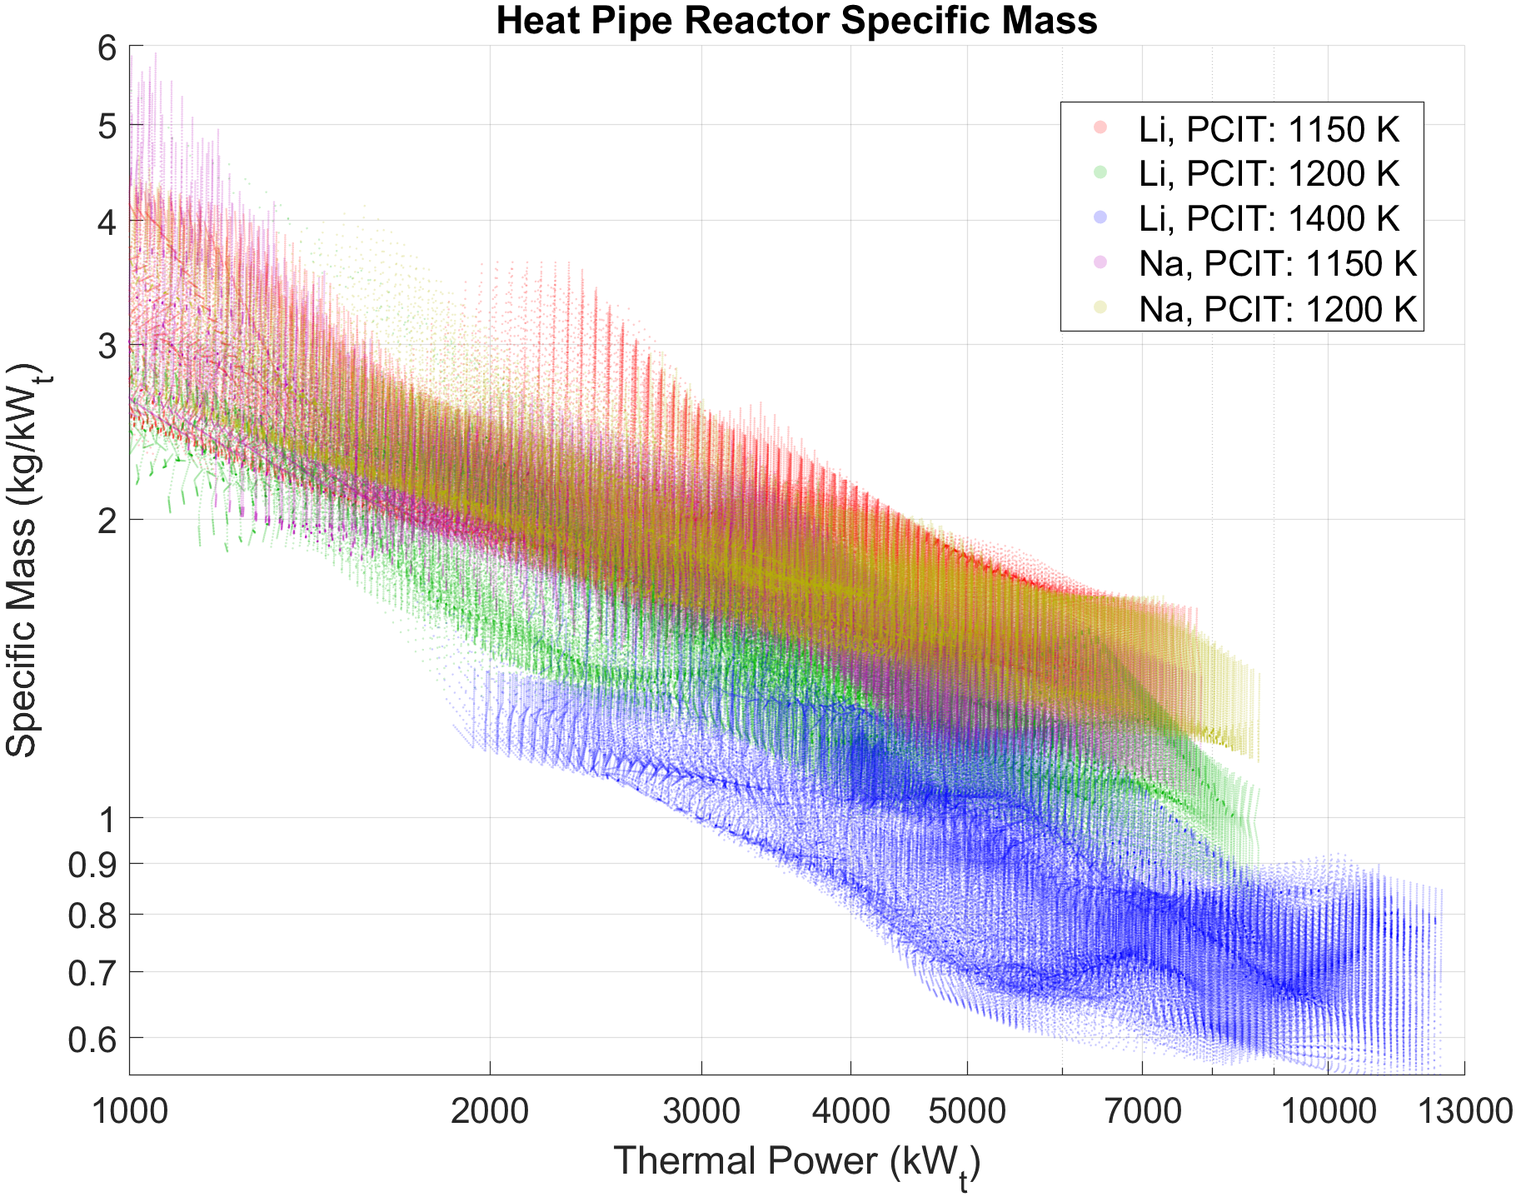
HPR PCIT Comparison Data
PCIT increase and use of lithium allows for minimization of the specific mass due to increased heat pipe performance at higher temperatures.

Slide 18
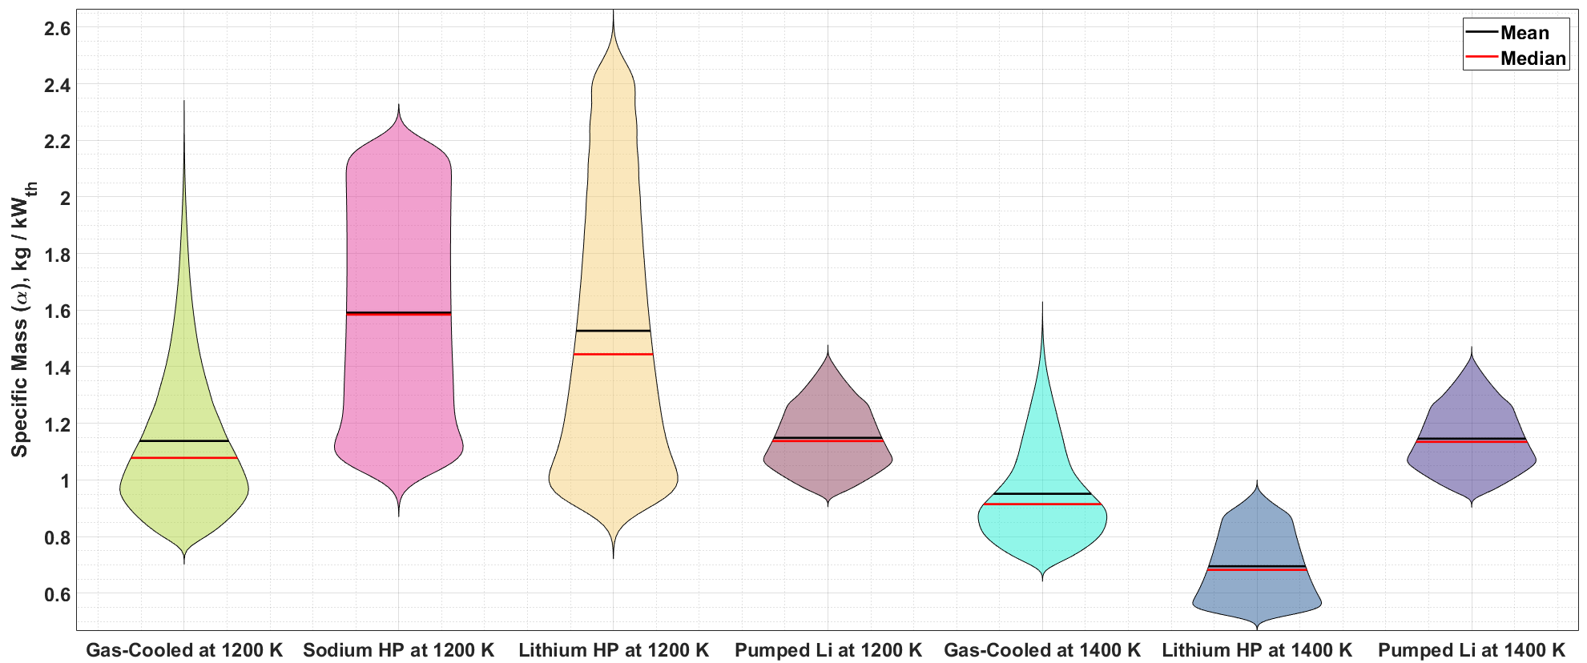
Violin Comparison Plots
All reactor options at each specific PCIT cover a similar range of reactor α’s. Increasing PCIT yields an overall decrease in α for all reactor options, but this choice would require higher fuel and moderator temperatures for the entire mission length.

Slide 19
References
[1] K. A. Polzin, A. K. Martin, A. Curran, R. Myers and M. Rodriguez, "Strategy for Developing Technologies for Megawatt-class Nuclear Electric Propulsion Systems," in International Electric Propulsion Conference, Boston, MA, 2022.
[2] D. Buden, "Summary of Space Nuclear Reactor Power Systems," in Symposium on Space Nuclear Power and Propulsion, Albuquerque, 1993.
[3] S. S. Voss, "SNAP Reactor Overview," Air Force Weapons Laboratory, Kirtland Air Force Base, 1984.
[4] K. Polzin, "NEP Reactor Technical Interchange Meeting," 2021.
[5] NASA Mars Transportation Assessment Study, "Nuclear Electric Propulsion (NEP)-Chem 1.2 Design," 2020.
[6] M. Duchek, W. Machemer, C. Harnack, M. Clark, A. Pensado, K. Palomares, K. Polzin, A. Martin, F. Curran, R. Myers, M. Rodriguez, D. Rao, R. Dyson and R. Scheidegger, "Key Performance Parameters for MW-Class NEP Elements and Their Interfaces," in ASCEND Conference, Las Vegas, 2022. .
[7] J. Ashcroft and C. Eshelman, "Summary of NR Program Prometheus Efforts," Knolls Atomic Power Laboratory, Niskayuna, 2006.
[8] B. Zohuri, Heat Pipe Design and Technology: Modern Applications for Practical Thermal Management, Switzerland: Springer Cham, 2016.
[9] National Aeronautics and Space Administration, "Nuclear Electric Propulsion Technology Maturation Plan," 2022.
[10] V. Patel, "Temperature Profile in Fuel and Tie-Tubes for Nuclear Thermal Propulsion Systems," in Nuclear and Emerging Technologies for Space Conference, Albuquerque, 2015.
[11] R. T. Berringer and A. A. Bishop, "Pressure Drop, Flow Distribution and Mixing Studies for a Model Heterogeneous Reactor Vessel," Westinghouse Electric Corporation, Pittsburgh, 1959.
[12] D. Nikitaev, C. D. Smith and K. Palomares, "Comparison of Convective Heat Transfer Correlations and Their Application to Nuclear Thermal Propulsion," in Nuclear and Emerging Technologies for Space Conference, Cleveland, 2022.
[13] D. Rao and M. Blood, "Queen Bee and Empress Reactor Designs," Los Alamos National Laboratory, 2021.
[14] D. Nikitaev, C. D. Smith, M. Duchek, C. Harnack and W. Machemer, "Heat Pipe Heat Exchanger for Nuclear Electric Propulsion Power Conversion System," in ASCEND Conference, Las Vegas, 2022.
[15] A. C. Marshall, "RSMASS-D Models: An Improved Method for Estimating Reactor and Shield Mass for Space Reactor Applications," 1997.
[16] S. A. Wright and R. J. Lipinski, "Pin-Type Gas Cooled Reactor for Nuclear Electric Propulsion," in American Institute of Physics, Albuquerque, 2003.

Slide 20
Questions?
Corey Smith corey.d.smith@ama-inc.com

Slide 21
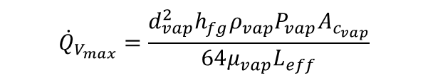

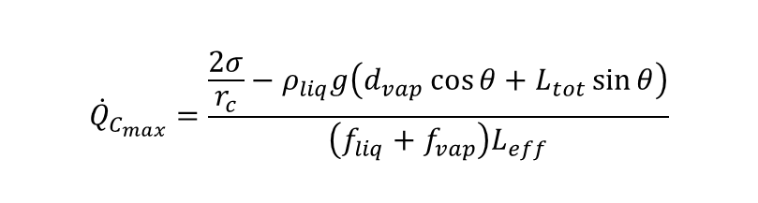

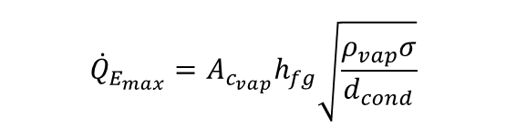
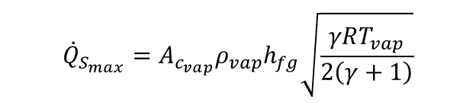
Heat Pipe Limits Model
Heat pipes are governed by operability limits which dictate the maximum heat transferred from the heat source [2-9].
$${\dot{Q}}_{V_{max}}=\frac{d_{vap}^{2}h_{fg}ρ_{vap}P_{vap}A_{c_{vap}}}{64μ_{vap}L_{eff}}$$
$${\dot{Q}}_{S_{max}}=A_{c_{vap}}ρ_{vap}h_{fg}\sqrt{\frac{γRT_{vap}}{2\left(γ+1\right)}}$$
$${\dot{Q}}_{E_{max}}=A_{c_{vap}}h_{fg}\sqrt{\frac{ρ_{vap}σ}{d_{cond}}}$$
$${\dot{Q}}_{C_{max}}=\frac{\frac{2σ}{r_{c}}−ρ_{liq}g\left(d_{vap}\cos{θ}+L_{tot}\sin{θ}\right)}{\left(f_{liq}+f_{vap}\right)L_{eff}}$$
$${\dot{Q}}_{B_{max}}=\frac{\frac{2βσ}{r_{n}}}{1+\frac{βL_{eff}μ_{liq}}{Kh_{fg}A_{c_{wick}}ρ_{liq}}}$$
$$β=\frac{2πL_{evap}k_{{wick}_{eq}}T_{vap}}{h_{fg}ρ_{vap}\ln{\frac{d_{HP−in}}{d_{vap}}}}$$
Li can transport 5X the heat of Na, but at a higher temperature.

Slide 22
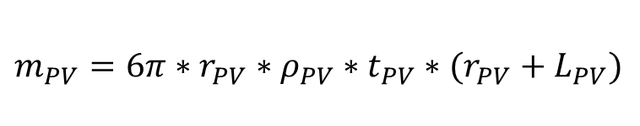
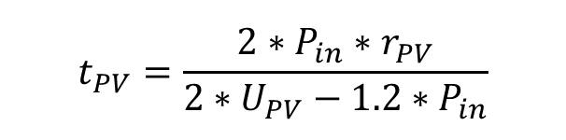
Pressure Vessel Sizing Calculator
Single layer pressure vessel (PV) thickness is calculated using the operating pressure of the reactor, hoop stress, and the ultimate strength of the chosen material
Operating of the temperature is complex to solve, so current iterations of the model rely on user inputs for the PV operating temperature
  Material strength varies significantly with temperature, leading to increased PV thickness
Available materials:
  Inconel 718
  Al 7050
  Ti-6Al-4V
  W
  Mo
  Mo30W
$$t_{PV}=\frac{2∗P_{in}∗r_{PV}}{2∗U_{PV}−1.2∗P_{in}}$$
$$m_{PV}=6π∗r_{PV}∗ρ_{PV}∗t_{PV}∗(r_{PV}+L_{PV})$$
This algorithm is used for HTGR and LMR test cases. HPRs do not require a pressure vessel due to low operating pressure of the reactor subsystem.

Slide 23
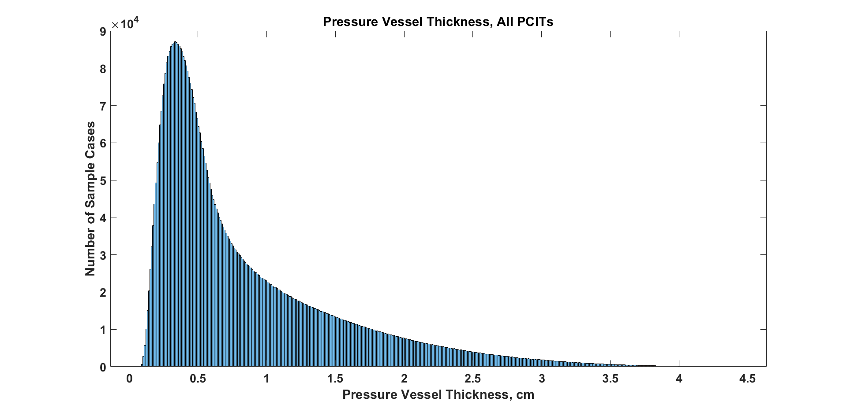
Pressure Vessel Sizing Results
While the mean and median of the distribution are less than 1 cm, the case-specific results will depend on inlet gas temperature and operating pressure.

Slide 24
Final Reactor Modeling Suite
Gas-Cooled Reactor Capabilities
  Simple and complex (Empress-based) reactor unit cells with high-fidelity mass calculations
  Pressure vessel sizing methodology based on operating temperature and material properties
  Pressure losses incorporated in the inlet / outlet nozzle, plena, and pressure vessel annular flow channel
Heat Pipe (HP) Reactor Capabilities
  Limits-based modeling approach with user-set dimensions for the heat pipe and corresponding unit cells
  Variable operating temperature limits for sodium and lithium to increase the per HP heat throughput
  Complete integration into the HP heat exchanger (HX) suite for parametric and point design assessment
Pumped Liquid Metal Reactor Capabilities
  Simple pin-in-block reactor unit cells with annular flow channels
  Capable of running with sodium, lithium (preferred option), and eutectic NaK
  Project down-selection have made this option less viable compared to gas-cooled and heat pipe options

