Slide 1
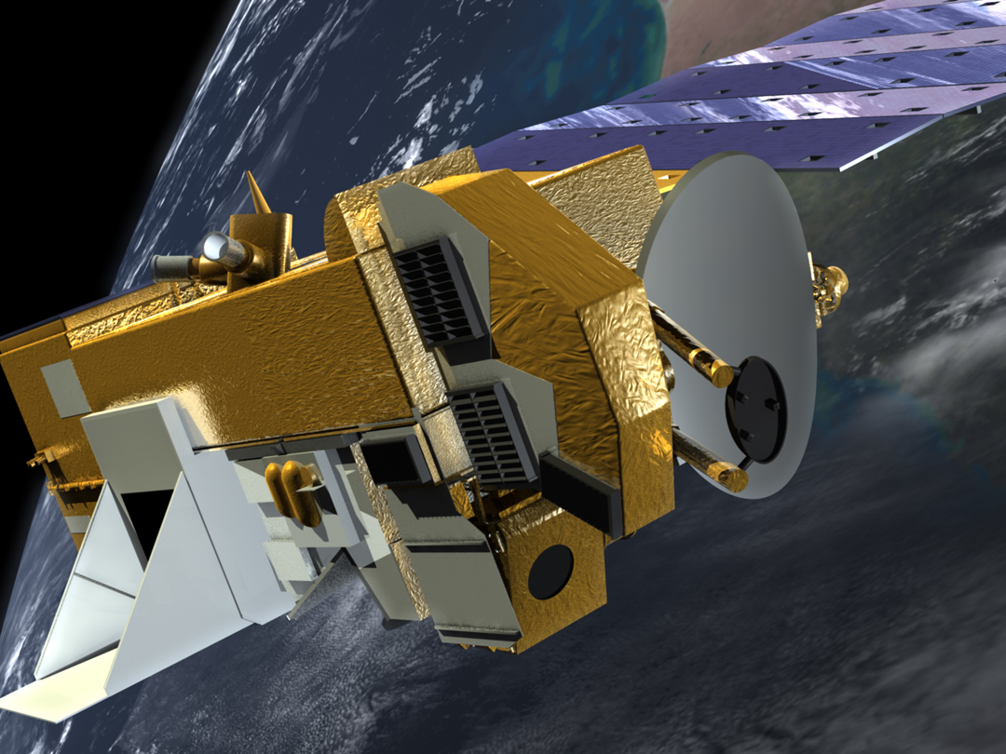
Mission Status for
Earth Science Constellation MOWG Meeting
(Hybrid)
EOS Aura
Bill Guit
Aqua Mission Director - Code 584/428
Mission Validation and Operations Branch
Earth Science Mission Operations Project
NASA/Goddard Space Flight Center
William.J.Guit@nasa.gov
November 16, 2022

Slide 2
Topics
Mission Summary
Spacecraft Subsystems Summary
Recent Activities
Planned Activities
Propellant Usage & Lifetime Estimates
Overall Summary
Additional Slides:
  Spacecraft Maneuvers & Ground Track History
  Conjunction Assessment
  Data Capture & Ops Error Statistics
  Extended Mission Plans

Slide 3
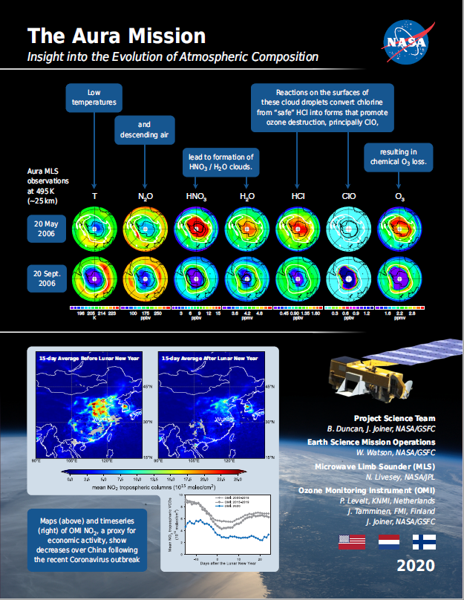
EOS Aura Mission Summary
(Updates since May 2022 MOWG in blue)
07/15/04: Launch
  6-Year Design Life
09/30/10: End of Prime Mission Review
09/18/15: 2015 Mission Extension Senior Review Proposal Panel Report
03/03/17: Senior Review Proposal #5
03/03/20: Senior Review Proposal #6
07/10/20: Senior Review Earth Science Subcommittee Presentation
  ‘Excellent’ Science Overall Finding
10/01/20: NASA HQ Senior Review Guidance Letter
  Extends Ops through at least FY23
  Response to letter included updated Phase F Plan and EOMP status (03/30/21)
02/01/22: ESMO Annual Review #15
07/15/22: Aura 18-Year Anniversary

Slide 4
Aura Extended Mission Timeline
TODAY
2021
2022
2023
2024
2025
2026
Q1
Q2
Q3
Q4
Q1
Q2
Q3
Q4
Q1
Q2
Q3
Q4
Q1
Q2
Q3
Q4
Q1
Q2
Q3
Q4
Q1
Q2
Q3
Q4
Senior Review Cycle
2020 SR: FY21 – FY23
2020 SR: FY24 – FY26
2023
SRP
Spacecraft
& Instrument Activities
MLT & Beta Angle Drift
Fuel Threshold
IAMs
No more IAMs,
continue DMUs to maintain ~705 km altitude
CEMs / PLMs
IAMs
IAMs
INST Off
Passivate
Power Threshold
Meetings
& Milestones
Aura
CER
KDP-F
Aqua
20-Years
Aura
20-Years
DR
DRR
Senior Review Funding (Approved)
SRP – Senior Review Proposal
INST Off – Power down instruments
Senior Review Funding (Preliminary Guideline)
CER – Constellation Exit Review
Passivate – Spacecraft passivation
IAMs – Spring Inclination Adjust Maneuvers
DR – Decommissioning Review
IAMs – Fall Inclination Adjust Maneuvers
KDP-F – HQ Key Decision Point to proceed with Phase F
NOTE: Activity & Milestone dates dependent on spacecraft performance
(i.e., fuel and power limitations)
CEMs – Constellation Exit Maneuvers
DRR – Disposal Readiness Review
PLMs – Perigee Lowering Maneuvers

Slide 5
Aura Spacecraft Subsystems
(No changes since May 2022 MOWG Meeting)
Command & Data Handling (CDH) – Nominal
  Formatter Multiplexer Unit (FMU) / Solid State Recorder (SSR) Anomaly
    Initial symptoms occurred December 4-18, 2007
    Newest symptoms started in January 2017 and remain active (impacting S-Band HK data capture)
Communications (COMM) – Nominal
  Transmitter-B Reflected Power Anomaly (10/17/17, 01/05/18)
Electrical Power System (EPS) – Nominal
  Array Regulator Electronics (ARE) Anomalies:
    Solar Panel Connector Anomaly – ARE-3C (01/12/05) – loss of 11 strings
    MMOD Strike – ARE-5A (3/12/10) – loss of 6 strings
  ARE Degradation (due to aging):
    ARE-1A (3/12/10, 11/5/11), ARE-1C (7/14/17, 12/22/17), ARE-2A (8/24/19), ARE-2C (8/18/17),
    ARE-4A (9/23/14, 12/8/14), ARE-4C (6/6/19), ARE-5A (4/25/13), ARE-5C (9/27/12, 2/4/13), and
    ARE-6A (9/14/13)
  Estimated that Aura has lost 33 strings of solar cells out of a total of 132 strings (~75.0% remain)
Flight Software (FSW) – Nominal
Guidance, Navigation & Control (GN&C) – Nominal
Propulsion (PROP) – Nominal
Thermal Control System (TCS) – Nominal
All subsystems configured to primary hardware

Slide 6
Recent Activities (May 2022 – October 2022)
(Updates since May 2022 MOWG in blue)
COVID-19 Response & Impacts
  Followed NASA / GSFC response framework
    Moved back into GSFC Stage 1 on 05/01/22
    No longer in a mandatory telework posture
    2+ years of Mission Operations in GSFC Stage 2, 3, or 4 status
  Operations teams were successful in minimizing on-site presence to only essential personnel
  Met mission requirements and performed critical activities with most of the staff working remote (i.e., maneuver monitoring & anomaly response)
  6-Month Experimental Period for the Return to Work and Future of Work at GSFC. Mid-May thru mid-December.
Stage 2
Stage 3
Stage 4
Stage 3
Stage 2
Stage 1
03/16/20
03/18/20
03/24/20
07/20/20
06/07/21
05/01/22
GSFC Transition Dates

Slide 7
Recent Activities (May 2022 – October 2022)
(Updates since May 2022 MOWG in blue)
0 Spacecraft Bus Anomalies
0 Instrument Anomalies
  0 Microwave Limb Sounder (MLS) Anomalies
  0 Ozone Monitoring Instrument (OMI) Anomalies
7 Spacecraft Maneuvers
  7 Drag Make-up Maneuvers (DMUMs #155 – 161)
    Routine: 05/12/2022, 6/2/22, 7/20/22, 9/8/22, 10/5/22, 10/26/22 and 11/10/2022
    0 Risk Mitigation Maneuvers (RMM)
  0 Inclination Adjust Maneuvers (Last IAM was #79 on 3/16/2022)
0 Instrument Maneuvers
  MLS Yaw #17 (Moon Scan) – 03/20/22
19 High Interest Events (HIEs) (Tiers 1-4) As of 10/31/22
  19 Tier 3 Events (T3) – Maneuver options planned and screened
  0 Tier 4 Events (T4) – Maneuver executed
  Additional details in back-up slides

Slide 8
Recent Activities (May 2022 – October 2022)
(Updates since May 2022 MOWG in blue)
Aqua / Aura Maneuver Working Group (MWG)
  Re-prioritized to focus on Retrograde Maneuver (RM) capability development for Constellation Exit Maneuvers (CEMs) and Perigee Lowering Maneuvers (PLMs) schemes.
    To be completed by January 2023
  Aura Lifetime and Decommissioning Analyses
    08/17/2022: FDS completed updates to Aura lifetime analyses (plots and tables)
    10/12/2022: FDS delivered 2022 Updated Analysis for Aura Decommissioning
  Aura Inclination Adjust Maneuver (IAM) Planning
    No further IAMs are being planned for Aura
  Aura Drag Make Up Maneuver (DMUM) Planning
    Aura will continue to perform DMUMs until CEMs and PLMs (Aug-Sep 2024)
  Propulsion Performance Monitoring
    FOT and flight dynamics team routinely monitors maneuver performance
    No performance issues

Slide 9
Recent Activities (May 2022 – October 2022)
(Updates since May 2022 MOWG in blue)
Aura Electrical Power System Power Working Group
  Aura Battery Depth-of-Discharge (DoD) Testing
    FOT currently performing Battery DoD Tests like what Aqua performed
      Aura DoD Test #1 (20%) – 08/25/2022
      Aura DoD Test #1 Results Review – 08/31/2022
      Aura DoD Test #2 (23%) – 09/15/2022
      Aura DoD Test #2 Results Review – 09/21/2022
      Aura DoD Test #3 (25%) – 09/29/2022
      Aura DoD Test #3 Results Review – 10/05/2022
      Aura DoD Test #4 (28%) – 10/13/2022
      Aura DoD Test #4 Results Review – 10/19/2022
      Aura DoD Test #5 (31%) – 11/03/2022
      Aura DoD Test #5 Results Review – 11/15/2022
    Aura DoD Testing overall performance review scheduled for 11/15/2022 with Northrop Grumman on-site at GSFC

Slide 10
Recent Activities (May 2022 – October 2022)
(Updates since May 2022 MOWG in blue)
TES Laser End of Life (EOL) Testing [since instrument decommissioning on 01/31/2018]
  Phase 2 testing alternates leaving Laser A or B ON for extended durations and characterize performance every 6 months
  Previous Phase 2 Testing:
    Round 1 (November 2018), Round 2 (April 2019), Round 3 (October 2019), Round 4 (November 2021), & Round 5 (June 2022)
  Phase 2, Round 5 Testing:
    3 days of test commanding (06/20/2022, 06/22/2022, & 06/24/2022)
    Testing included characterizing Laser B and turning it OFF, then turning Laser A ON and characterizing
    Neither laser was responsive during the testing which was not unexpected
    JPL Laser SMEs will look to conduct one last set of test (Round 6) in early 2023 to wrap up the EOL tests

Slide 11
Planned/Completed Activities
(Updates since May 2022 MOWG in blue)
EOS Automation (EA) – automation of routine operations – Completed
  Complete the necessary FOT processes for 2-OCE EOS online operations
Summer/Fall 2022: Maneuver Working Group (MWG) – Re-prioritized
  Retrograde Maneuver (RM) capability development (CEM / PLM schemes)
Summer/Fall 2022: FDS Lifetime Analysis Updates – Delivered 10/12/2022
  Updates to incorporate Spring IAM performance and new solar flux predicts
Fall 2022: Aura End of Mission Plan (EOMP) Updates (Rev E) – Pending HQ direction
  Updates to DAS inputs, lifetime analysis, and reliability assessment
Fall 2022: Earth Science Constellation (ESC) MOWG – Today’s Presentation
  Present mission status and upcoming activities
Fall 2022: ESMO Decommissioning/Passivation Peer Review (#2) – WG Formed
  End of Mission activity planning and spacecraft passivation sequence development
Mid-to-Long-Term Plans:
  January 2023: ESMO Annual Review (#16)
  March 2023 Senior Review Proposal for Aura
    Include updated Aura EOMP (Rev E) and mission lifetime performance statuses
  Fall 2023: Potential Termination of EOS Missions (Aura, Aqua and Terra)
    DRAFT Aura Decommissioning Maneuver Schedule on next slide

Slide 12
Aura Fall 2023 Potential Decommissioning
Maneuver Schedule
Sunday | Monday | Tuesday | Wednesday | Thursday | Friday | Saturday
27 AUG | 28 | 29 | 30 | 31 End of Science | 1 SEP | 2
3 | 4 Holiday | 5 CEM #1 | 6 | 7 CEM #2 | 8 | 9
10 | 11 | 12 | 13 | 14 | 15 | 16
17 | 18 | 19 PLM #1 | 20 | 21 PLM #2 | 22 | 23
24 | 25 | 26 PLM #3 | 27 | 28 PLM #4 | 29 | 30
1 OCT | 2 | 3 PLM #5 | 4 | 5 PLM #6 | 6 | 7
8 | 9 Holiday | 10 PLM #7 | 11 | 12 PLM #8 | 13 | 14
15 | 16 | 17 PLM #9 | 18 | 19 PLM #10 | 20 | 21
22 | 23 | 24 PLM #11 | 25 | 26 PLM #12 | 27 | 28
29 | 30 | 31 Back-up | 1 NOV | 2 Back-up | 3 | 4
5 | 6 | 7 | 8 | 9 | 10 | 11

Slide 13
Collision Risk Management System (CRMS)
Process Improvements
ESMO has developed ground system capabilities to autonomously identify and develop maneuver options to assist in Risk Mitigation Maneuver (RMM) / Debris Avoidance Maneuver (DAM) planning
Developed in response to an increased number of predicted close approaches with orbital debris and operational satellites
  More High Interest Events (HIEs) had led to more effort to plan mitigation maneuvers
  Concern is that updates to the US Air Force Space Fence will significantly increase the size of the Space Catalog
Key CRMS capabilities include:
  User defined collision risk thresholds
  Maneuver optimization for conjunctions with multiple secondary objects
EOC is operating with CRMS Release 10.0 (ORR 6/22/2022)
  CRMS R11 targeted for release in March 2023
ESMO developed MOCA CONOPS in support of CARA Devolution initiative
  Completed Parallel Ops test phase in Fall 2019 (09/26/19)
  09/01/2021: MOCA CONOPS updated to adhere to the NASA Interim Directive (NID)
  05/12/2022: Final ESMO MOCA CONOPS signed off

Slide 14
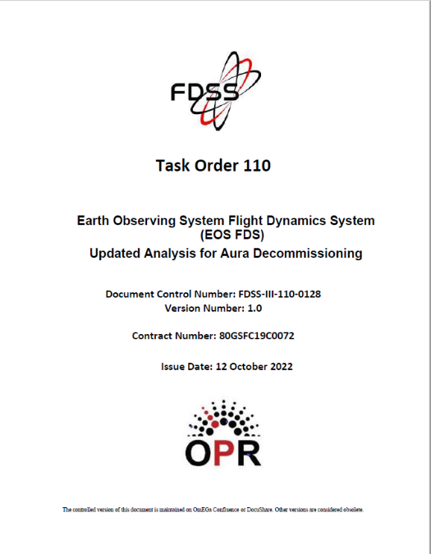
Aura Propellant Usage
(Analysis Updated October 2022)
2006: Initial Aura lifetime fuel analysis
2008: Detailed Aqua & Aura lifetime analysis
  Presented to MOWG and at Aura End of Prime Mission Review in Sep 2010
2012 (September): Initial Aura Decommissioning Plan
2013 (August): Updated Decommissioning Plan
  Included updated Constellation Exit Plan
2014 (September): Updated Decommissioning Plan
2015 (September): Decommission Plan Update Postponed
  Postponed to evaluate long-term plan and decommissioning maneuvers
2016 (January): Updated Decommission Plan (v1.2)
  Included hypothetical MLT drift analysis with LS-8
2017 (October): Updated Decommission Plan (v1.0)
2018 (July): Updated Decommission Plan (v1.0)
  Summer IAM required update to document and IAM Plans
2018 (November): Updated Decommission Plan (v2.0)
  Updated definitive fuel usage & predicted solar flux levels
  Updated propellant estimates for IAMs w/ RWAs & DMUs
2019 (July): Updated Decommission Plan (v1.0)
  Update definitive fuel usage & predicted solar flux levels
2020 (November): Updated Aura Lifetime Analysis
2021 (January): Updated Decommission Plan (v1.0)
  Updated report with definitive fuel usage & predicted solar flux levels
2021 (July): Updated Aura Lifetime Analysis
2021 (December): Updated Aura Lifetime Analysis
2022 (February): Updated 2021 Decommission Plan (v1.0)
  Updated report with definitive fuel usage & predicted solar flux levels
  Updated propellant estimates for CEMs & PLMs
2022 (October): Updated 2022 Decommission Plan (v1.0)
  Updated report with definitive fuel usage & predicted solar flux levels
Final will be produced 60 days before start of decommissioning
Additional details in back-up

Slide 15
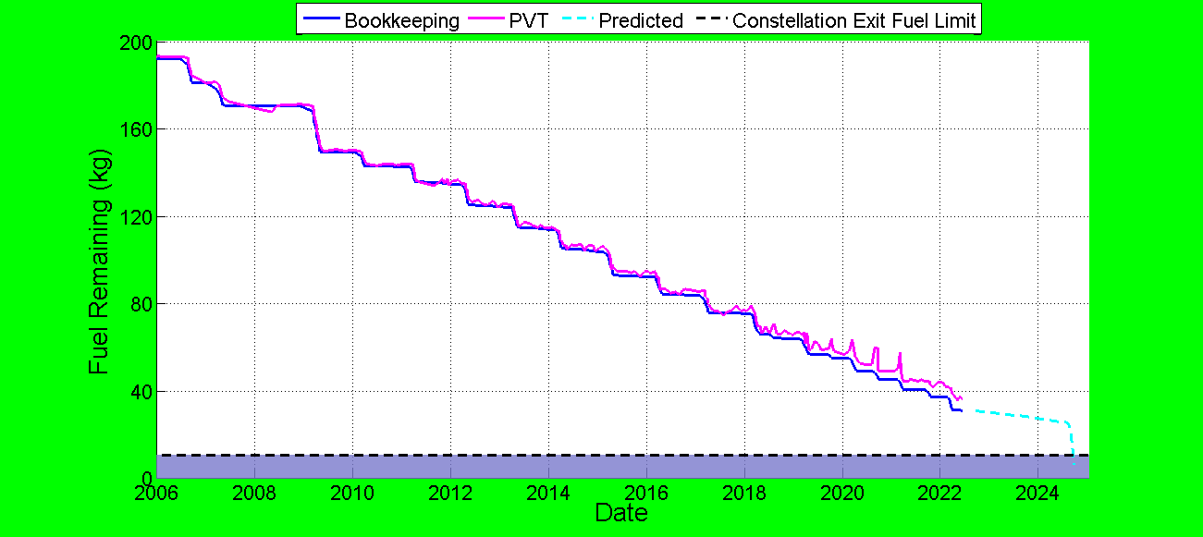
Fuel Usage: Actual & Predicted
(Lifetime Fuel Usage – Updated August 2022)
Constellation Exit and
Perigee Lowering
(Aug - Sep 2024)
Spring 2022
3 IAMs
10.7 kg Constellation Exit Fuel Limit

Slide 16
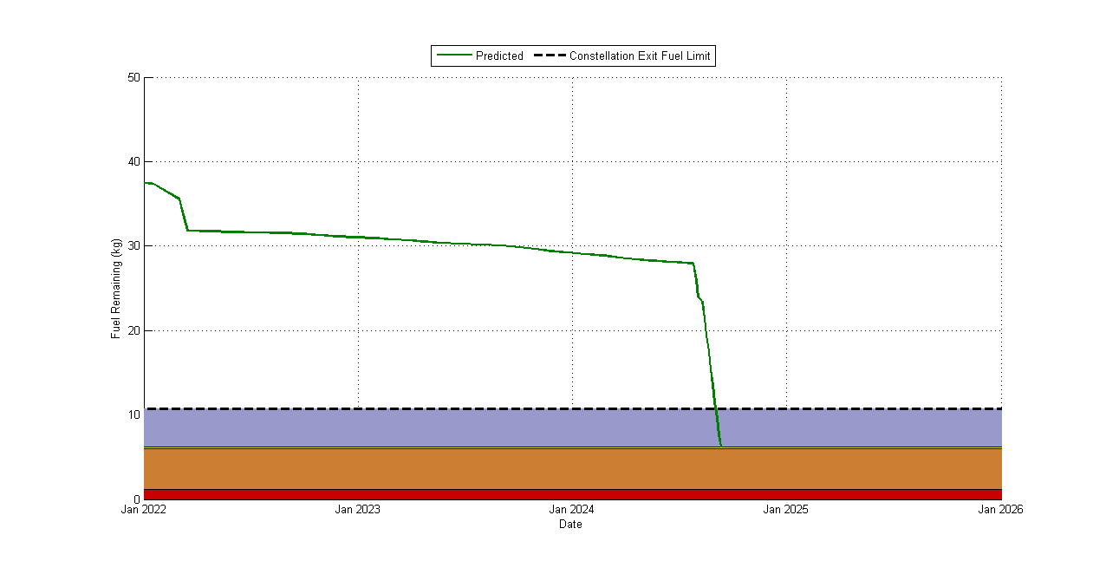
Aura Predicted Available Fuel
(Analysis Updated December 2021)
Available Fuel
Constellation Exit Fuel Limit (10.7 kg)
2022 Spring IAM Series
Fuel required to perform ~4.4 km constellation exit (4.51 kg)
RMM fuel buffer (0.19 kg)
Uncertainty in EOL fuel measurements (Estimate) (4.8 kg)
Unusable fuel in the propulsion system (1.2 kg)
Constellation Exit and Perigee Lowering Maneuvers (August - September 2024)

Slide 17
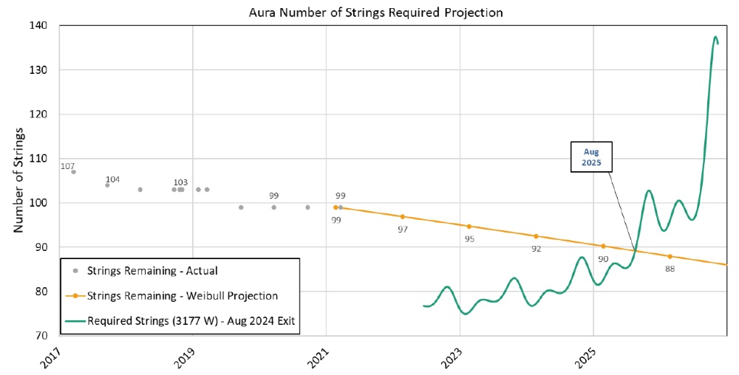
Aura Power Generation Predictions
(Analysis Updated October 2022)
Power Generation limit predicted to be reached in August 2025
Minimum Required Power for Loads and Battery Charging is 3177 W
Power Margin = 0 W when the Solar Array strings required equals the Solar Array strings remaining. Projected to occur with ~90 strings remaining and about 32.5° Beta Angle

Slide 18
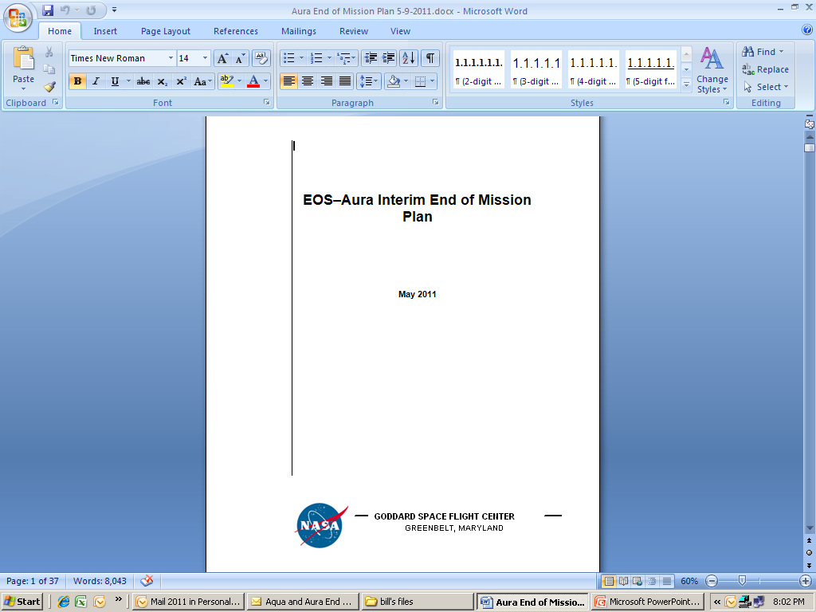
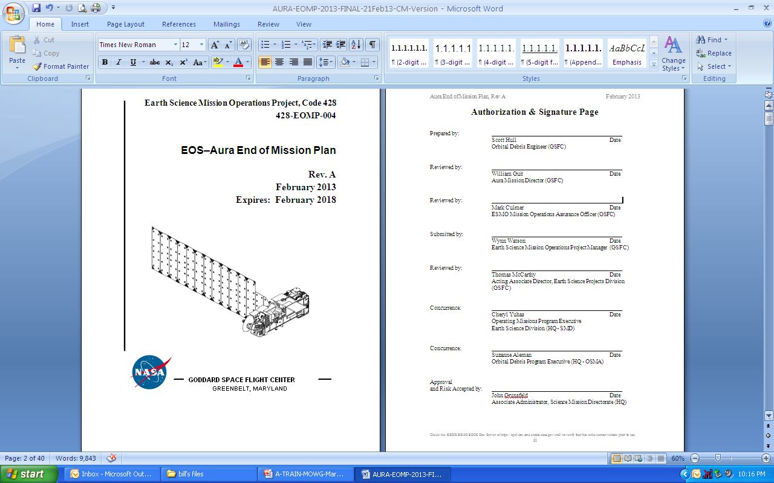
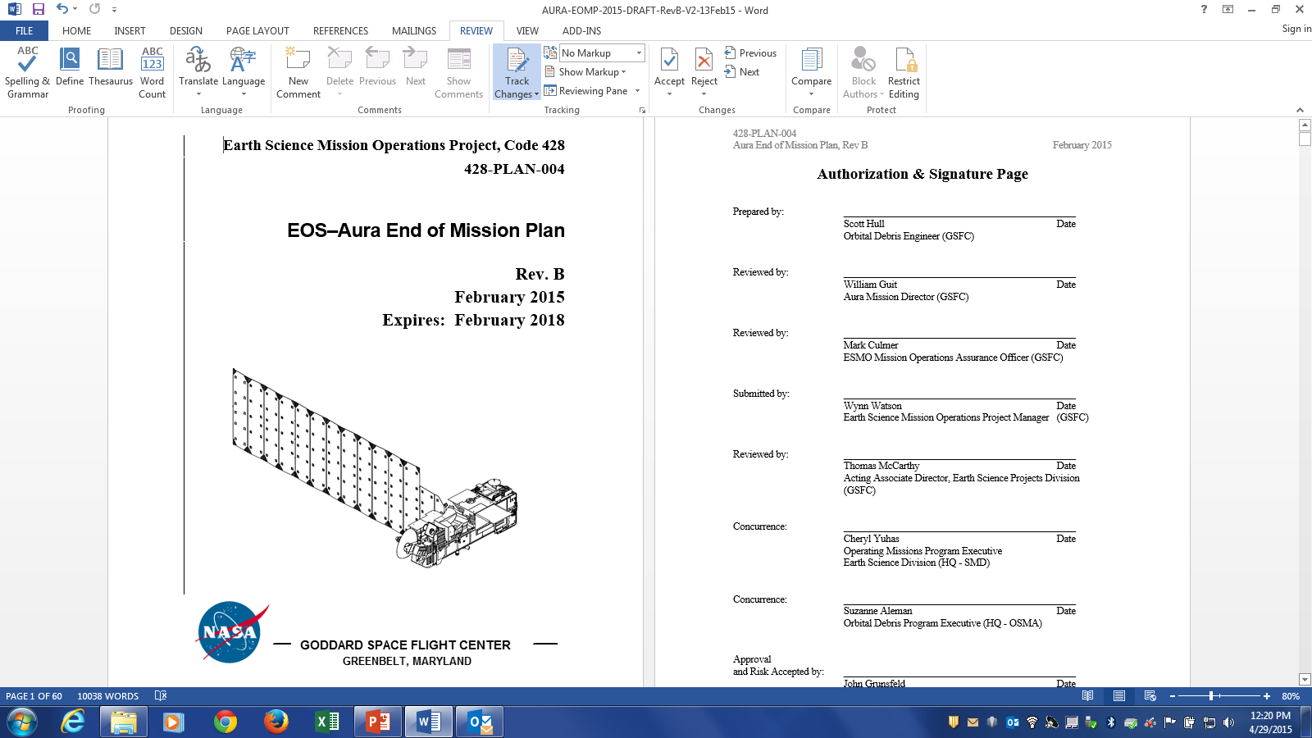
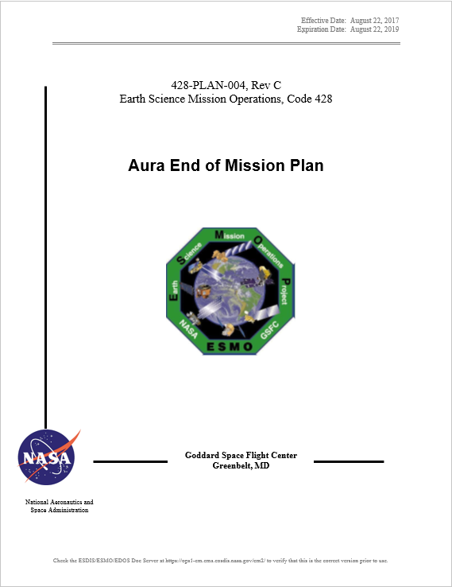
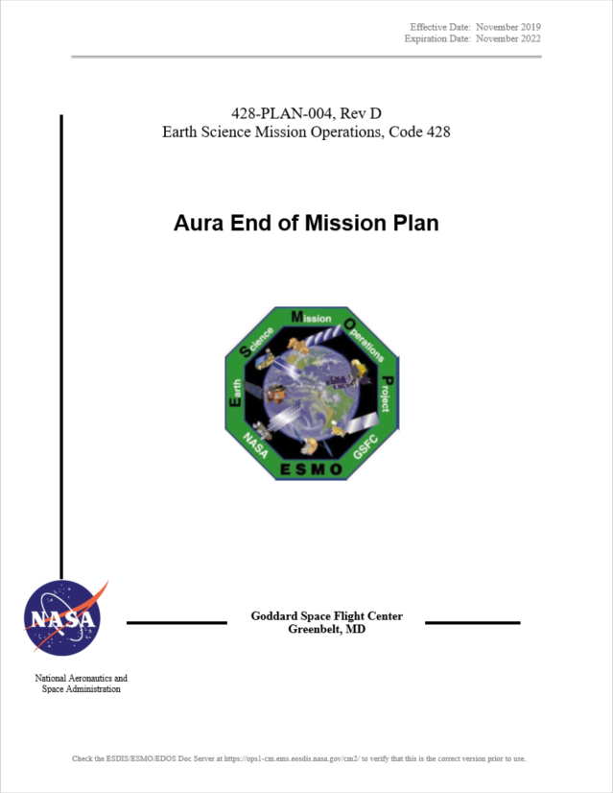
Aura End of Mission Plan (EOMP)
(No changes since May 2022 Virtual MOWG)
Initial draft February 2009
Produced the first “Interim” End of Mission Plan (EOMP) in May 2011
  Approved by NASA HQ July 2011
Produced EOMP Rev A: February 2013
  Waivers were approved in May 2013
Produced EOMP Rev B: February 2015
  Updated Lifetime Estimate
Produced EOMP Rev C: August 2017
  Lifetime and Reliability estimates as of December 2016
Produced EOMP Rev D: November 2019
  Lifetime and Reliability estimates as of October 2019
  Signatures completed in March 2021
  Aura EOMP Rev D expires in November 2022
Content Synopsis:
  Safely exit the A-Train Constellation
  Passivate Aura to the extent possible for uncontrolled reentry
  Aura has five (5) approved waivers for passivation
    Pressurant Passivation, Large Object Collision Probability, Small Object Collision Probability, Orbital Lifetime (30-Year), and Re-entry Risk (Un-controlled)
Final will be produced 60 days before End of Mission

Slide 19
Summary
Spacecraft Status – GREEN
Instrument Status – GREEN
  HIRDLS: Chopper Stalled 03/17/2008 – Not collecting science data
  MLS: Operating Normally –
    01/04/2022: GHz Mirror Electronics (GME-B) Anomaly (Recovered 01/04/2022)
    03/26/2022: Receiver-2 (R2) Out-of-Limits Violation (PLL Voltage Update on 03/28/2022)
  OMI: Operating Normally
    03/20/2022: OMI IAM Warm Restart (Recovered 03/21/2022)
  TES: Instrument Decommissioned on 01/31/2018
Data Capture/L0 Processing Status – GREEN
  SSR Data Capture to 10/31/2022: 99.9957515+ %
Ground Systems – GREEN
  Upgrade OS/COTS to adhere with Agency Security Configuration Standards
  Maintain IT security posture by patching all components per cadence presented in ESMO Patch Management Plan (either monthly, bi-monthly or quarterly).
Flight Operations Automation:
  06/24/2022: FOT Automation Status – 2-OCE Operations Concept Review (OCR)
    06/30/2022: Test Readiness Review (TRR)
    07/11/2022: Start of 8-Week Test Period, Weekly Follow-ups
    09/01/2022: Operations Readiness Review (ORR) – Currently in operations

Slide 20
Questions?

Slide 21
Additional Charts
Maneuvers & Ground Track History
Orbital Trends
Aura Conjunction Assessment
High Interest Events (HIEs)
Data Capture & Operations Errors
Extended Mission Plans
(Analysis Updates)

Slide 22
Orbit Maintenance
Mission Requirements: Perform Drag Make-Up Maneuvers (DMUMs) to maintain Ground Track Error (GTE) with respect to the World Reference System (WRS-2)
  Requirement: +/-20 km as measured at the Descending Node
To meet coincident viewing requirements, Aura’s initial ground track was offset from Aqua’s by one WRS path plus 25.4 km
  Aura was maintained -5.4 to -45.4 km west of Aqua until late 2007
  Since May 8, 2008, a new control box, +/- 10 km from a +18 km (east) offset of the Aqua WRS-2 path is used to maintain MLS-CALIPSO viewing request
Control Box Excursions: To date there have been 4 control box excursions
  3 on +10km front-side: 9/5/12 - 9/6/12, 03/23/15 - 04/17/15, and 12/31/21 - 01/11/22 (increase in drag)
  1 on -10km back-side: 2/12/13 to 3/13/13 (drop in drag after DMUM on 1/16/13)
161 Drag Make-up (DMU) maneuvers have been performed to date:
  07/19/2012: DMUM # 43 No Yaw Slew Maneuver (NYS) #1
  Last maneuver 11/10/2022 (DMU #161) – Next DMU (#162) planned for 12/8/2022
  Variation in performance from –6.7% (cold) to +5.3% (hot)
To date a total of 79 Inclination Adjustment Maneuvers (IAMs) have been performed:
  Last maneuvers completed on 03/02/22 (IAM #77), 03/09/22 (IAM #78), and 03/16/22 (IAM #79)
  No more IAMs planned for the remainder of the mission
  Variation in performance from -7.2% (cold) to +3.5% (hot)

Slide 23
WRS Ground Track Error (GTE)
(As of October 1, 2022)
May 8, 2008
Re-Phase Maneuver

Slide 24
WRS Ground Track Error (GTE)
(As of October 1, 2022)

Slide 25
Aura Averaged MLT @ Ascending Node
(As of October 1, 2022)

Slide 26
Aqua/Aura Mean Local Time (MLT)
@ Ascending Node (As of October 01, 2022)
Aqua
Aura
Upper Mission Limit (14:00:00)
Spring 2022
IAMs
Lower Mission Limit (13:30:00)

Slide 27
Aura Predicted Beta Angle
(With Yearly Inclination Maneuvers) (As of April 10, 2022)

Slide 28
Aura Conjunction Assessment High Interest Events (HIEs)
2022 | Jan | Feb | Mar | Apr | May | Jun | Jul | Aug | Sep | Oct | Nov | Dec | Total
T3 | 1 | 3 | 4 | 4 | 4 | 5 | 3 | 2 | 5 |  |  |  | 31
T4 | 0 | 0 | 0 | 0 | 0 | 0 | 0 | 0 | 0 |  |  |  | 0
Total | 1 | 3 | 4 | 4 | 4 | 5 | 3 | 2 | 5 |  |  |  | 31
  2017: 19 CARA HIEs – 16 required significant action (T2-T4)
  2018: 16 CARA HIEs – 16 required significant action (T2-T4)
  2019: 15 CRMS HIEs – 15 required significant action (T2-T4)
  2020: 10 CRMS HIEs – 3 required significant action (T4)
  2021: 12 CRMS HIEs – 1 required significant action (T4)
  2022: 31 CRMS HIEs – 0 required significant action (T4)
  Last 10 HIE details include:
  07/06/2022: CA vs. 31337 at 08:44:32 GMT – DAMs planned, and maneuvers screened (T3)
  07/07/2022: CA vs. 33666 at 18:28:39 GMT – DAMs planned, and maneuvers screened (T3)
  07/23/2022: CA vs. 22546 at 01:06:20 GMT – DAMs planned, and maneuvers screened (T3)
  08/19/2022: CA vs. 36916 at 17:15:38 GMT – DAMs planned, and maneuvers screened (T3)
  08/23/2022: CA vs. 40493 at 23:18:33 GMT – DAMs planned, and maneuvers screened (T3)
  09/07/2022: CA vs. 42316 at 10:25:15 GMT – DAMs planned, and maneuvers screened (T3)
  09/11/2022: CA vs. 40493 at 11:26:49 GMT – DAMs planned, and maneuvers screened (T3)
  09/13/2022: CA vs. 37506 at 17:10:17 GMT – DAMs planned, and maneuvers screened (T3)
  09/15/2022: CA vs. 42283 at 01:17:40 GMT – DAMs planned, and maneuvers screened (T3)
  09/30/2022: CA vs. 35591 at 19:48:39 GMT – DAMs planned, and maneuvers screened (T3)
Tier 1 – Notify (email/phone), Tier 2 – Conduct Briefing,
Tier 3 – Plan Maneuver, Tier 4 – Execute Maneuver
NOTE: In 2019 the EOS missions transitioned from CARA HIE statistics to CRMS based HIE statistics

Slide 29
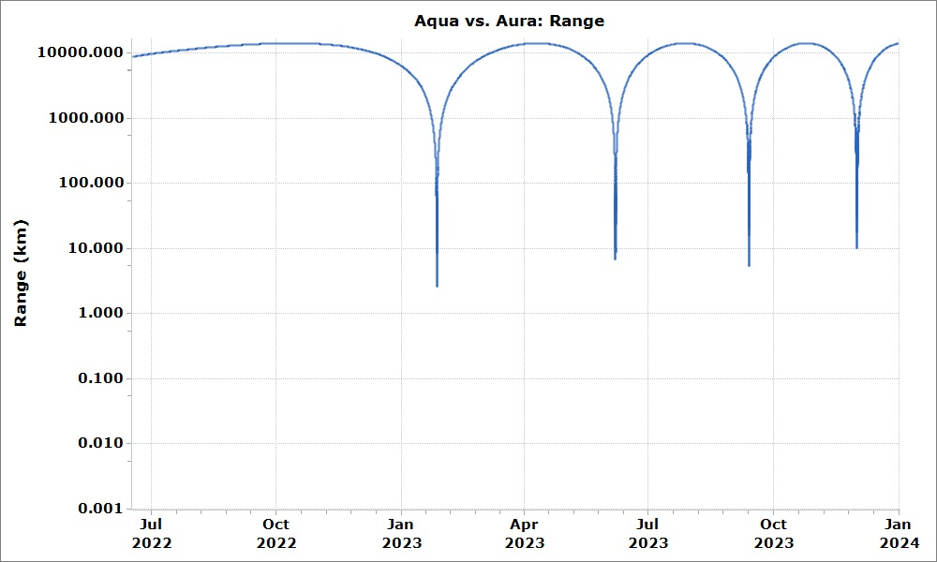
Aqua/Aura Range Prediction
(As of June 2022)
Passing
June 2023
Passing
December 2023
Passing
January 2023
Passing
September 2023
Uses June 2022 Aqua and Aura ephemerides for range predictions.

Slide 30
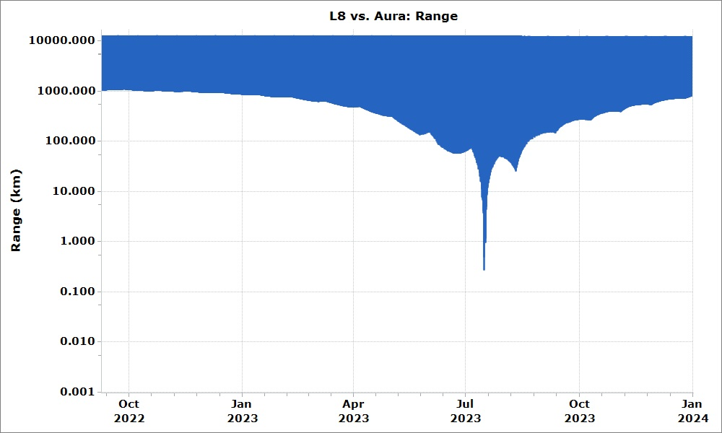
LS-8/Aura Range Prediction
(As of September 2022)
Uses September 2022 Landsat-8 and June 2022 Aura ephemerides for range predictions.
Crossing
July 2023

Slide 31
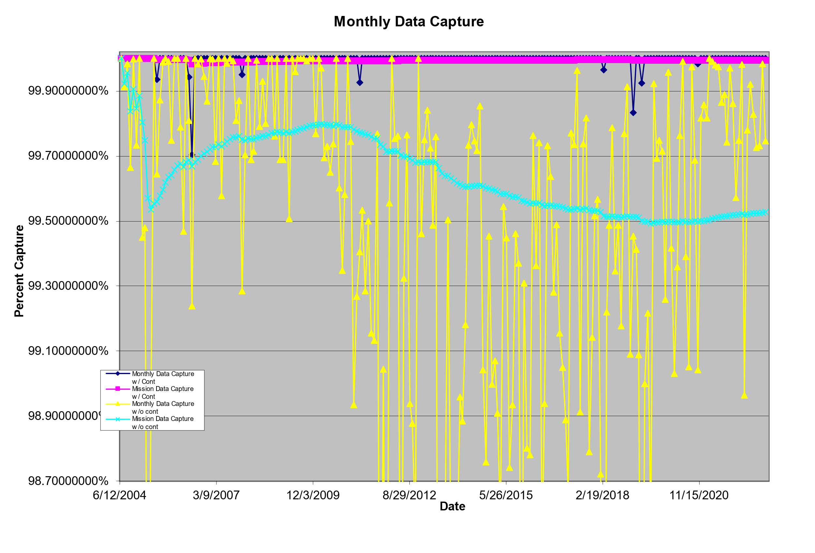
  Monthly Data Capture
  SSR Data Capture to 09/30/2022: 99.99557515%
37 months with no data losses
83 months with no data losses
SSR Anomaly (2007)
FOT Ops Errors
(2011, 2018, & 2019 (2))
EDOS Ops Error (2005)
Alaska Station Issues
(2020 & 2022)
Norway Communication
Outages (2006)
Mission Capture Req. = 95%

Slide 32
SSR Data Losses – 2022
Last Data Loss: February 2022 (Ground Station Issues)
January: None
February: Data Loss #1074 on DOY 034 (February 3rd, 2022)
  Late schedule changes followed by ground station issues resulted in 12 minutes 51 seconds of OMI loss
March thru April: None
May thru October: None

Slide 33
Operational Errors
(18-Months: April 2021 – September 2022)
Aura: 41 Months since last operational error (April 2019)
3+ years of Aura FOT Error Free Operations

Slide 34
Extended Mission

Slide 35
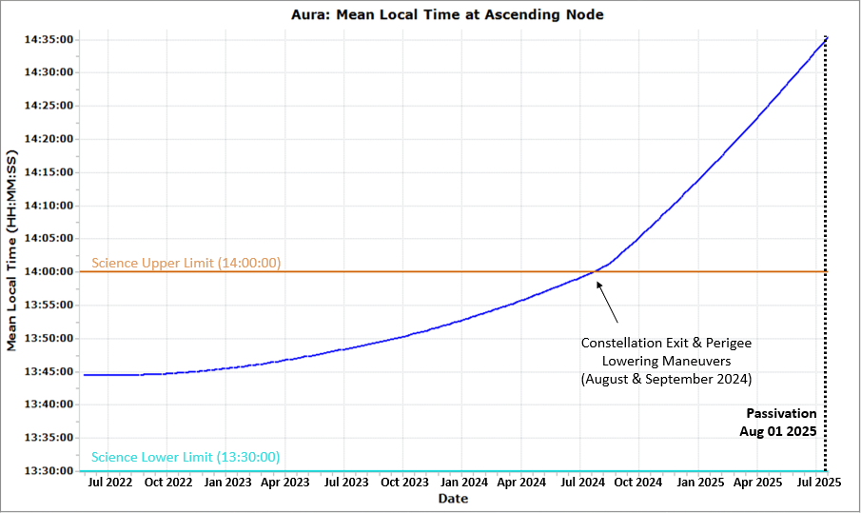
Aura Mean Local Time (MLT) at ascending Node
(MLT Plan - Updated August 2022)
August 2025: Mission ends due to insufficient power generation.
August 2024: Aura could begin executing orbit lowering maneuvers to a new position to fly below the A-Train constellation of satellites. Two other satellites, CloudSat and CALIPSO, have already exited the A-Train and continue to take observations below the A-Train.
Today:
Drift ~0 min.
August 2024:
Drift ~15 min.
Spring 2022 Inclination Adjust Maneuver Series (IAMs) performed to minimize MLT drift (< 1 hour) through the end of the mission with the objective to maintain science-quality data collection.

Slide 36
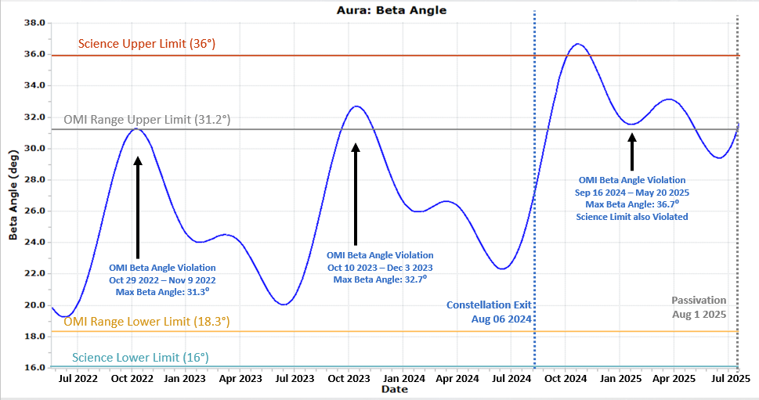
Aura Predicted Beta Angle
(Analysis Updated August 2022)

Slide 37
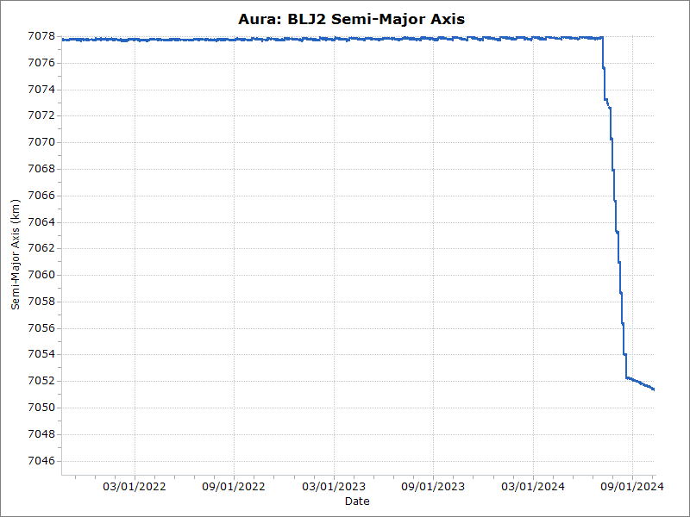
Aura Predicted Semi-Major Axis
(Analysis Updated December 2021)
CEMs
July
2024
PLMs
August – September 2024
Semi-Major Axis
Constellation: 7077.7 km ± 0.3 km

Slide 38
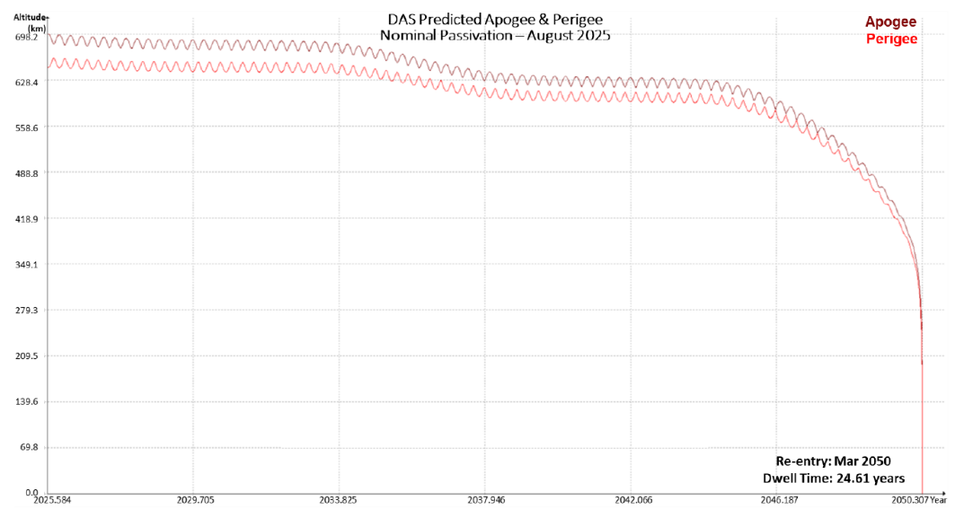
Aura Predicted Re-entry
(Updated October 2022 – April 2022 DAS Solar Flux File)
Apogee
Perigee
- NEEDS UPDATING -
Reentry: Dec 2050
Dwell Time: 24.61 years

Slide 39
Abbreviations / Acronyms List
  ARE – Array Regulator Electronics
  BLJ2 – Brouwer-Lyddane mean elements
  CA – Conjunction Assessment
  CALIPSO – Cloud-Aerosol Lidar and Infrared Pathfinder Satellite Observations
  CARA – Conjunction Assessment Risk Analysis
  CDH – Command & Data Handling
  CEM – Constellation Exit Maneuver
  ΔCER – Delta Constellation Exit Review
  COMM – Communications
  CONOPS – Concept of Operations
  COTS – Commercial-Off-The-Shelf
  CRMS – Collision Risk Management System
  DAM – Debris Avoidance Maneuver
  DAS – Debris Assessment Software
  DMUM – Drag Make-up Maneuver
  DR – Decommissioning Review
  DRR – Disposal Readiness Review
  EA – EOS Automation
  EDOS – EOS Data Operations System
  EOC – EOS Operations Center
  EOL – End of Life
  EOMP – End of Mission Plan
  EOS – Earth Observing System
  EPS – Electrical Power System
  ESC – Earth Science Constellation
  ESMO – Earth Science Mission Operations
  FDS – Flight Dynamics System
  FMU – Formatter Multiplexer Unit
  FOT – Flight Operations Team
  FSW – Flight Software
  FY – Fiscal Year
  GCOM-W – Global Change Observation Mission - Water
  GHz – Gigahertz
  GME – Gigahertz Mirror Electronics
  GMT – Greenwich Mean Time
  GNC – Guidance Navigation & Control
  GSFC – Goddard Space Flight Center
  GTE – Ground Track Error
  HIE – High Interest Event
  HIRDLS – High Resolution Dynamics Limb Sounder
  HK – Housekeeping
  HQ – Headquarters
  IAM – Interface Adapter Module
  IAM – Inclination Adjustment Maneuver
  INST – Instruments
  KDP-F – Key Decision Point to proceed with Phase F
  kg – kilogram
  km – kilometer
  L0 – Level-Zero
  LS – Landsat
  m – meters
  MLS – Microwave Limb Sounder
  MLT – Mean Local Time
  MMOD – Micrometeorite Orbital Debris
  MOCA – Mission Operations Conjunction Assessment
  MOWG – Mission Operations Working Group
  MWG – Maneuver Working Group
  NASA – National Aeronautics & Space Administration
  NID – NASA Interim Directive
  NYS – No Yaw Slew
  OCE – Operations Control Engineer
  OCO-2 – Orbiting Carbon Observatory-2
  Ops – Operations
  OMI – Ozone Monitoring Instrument
  ORR – Operational Readiness Review
  PLL – Phase-locked Loop
  PLM – Perigee Lowering Maneuver
  PROP – Propulsion
  PSR – Pre-Ship Review
  PVT – Pressure Volume Temperature
  R2 – Receiver 2
  RM – Retrograde Maneuver
  RMM – Risk Mitigation Maneuver
  RWA – Reaction Wheel Assembly
  SOH – State of Health
  SR – Senior Review
  SRP – Senior Review Proposal
  SSR – Solid State Recorder
  TCS – Thermal Control System
  TES – Tropospheric Emissions Spectrometer
  TRR – Test Readiness Review
  US – United States
  W – Watts
  WRS – World Reference System

