Slide 1
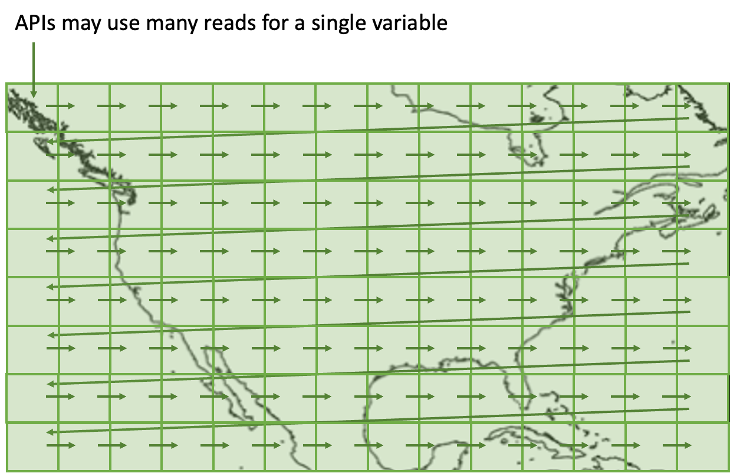
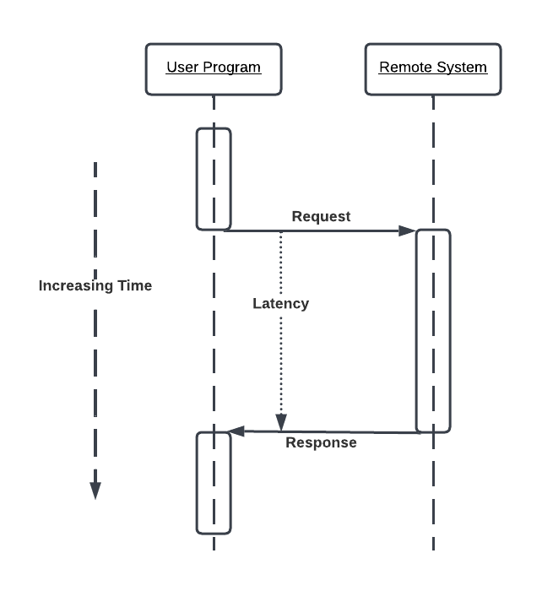
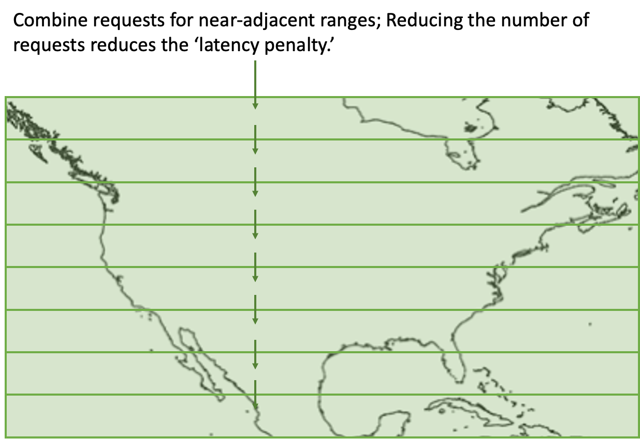
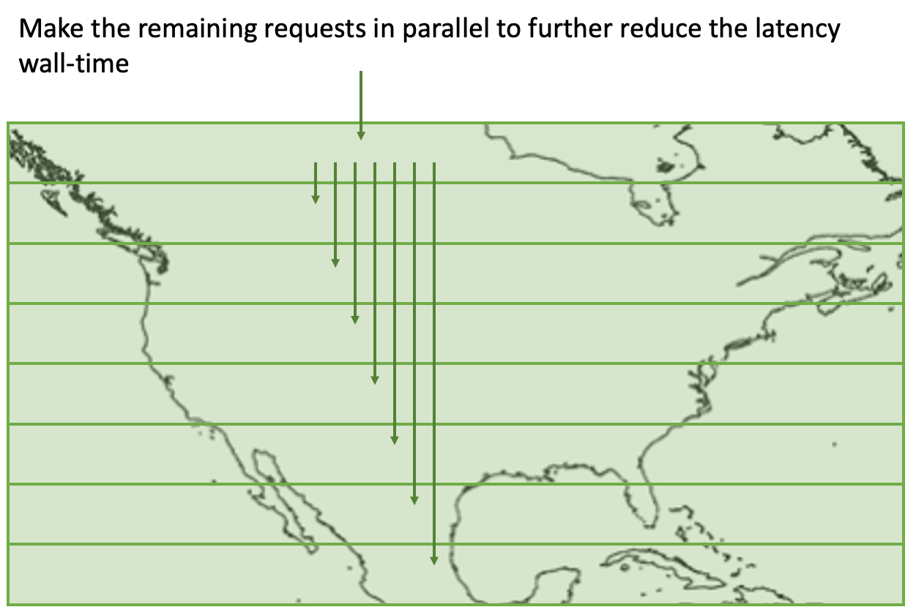
Performance optimization of legacy HDF5 data for Web Object Stores
IN22C-0325
Why bother with legacy data?
Older data are important – access to data spanning decades
New data are often 'older' – the file structures were designed years ago
What is latency?
Latency, in this context, is the time the User Program has to wait for the Remote System to respond to the request from the User Program.
What makes these data 'hard' to use?
Originally designed for use with small, but relatively expensive, disk drives.
Files were 'optimized' to use as little space as possible.
Disk drives relatively low-latency favored small 'chunks' of data.
These small chunks enabled data compression (reduce file size)
The chunks made it possible to read portions of the file (read
only the needed chunks)
But along comes the cloud...
Now storage is cheap(er) but access latency is longer
How much longer? A typical SSD latency is between
0.08 and 0.16 ms while S3's latency is between
100 and 200 ms, at least 1,000 times longer,
But S3 has very high transfer rates, so if we can reduce
the effective latency of S3, performance will be improved.
Graphics credit: James Gallagher, THG
The SuperChunk algorithm
To work with legacy data, do not reformat!
Software can combine adjacent 'chunks' into one request
These 'superchunks' transfer much more data in one shot
Fewer transfers == lower cost from latency
This technique is used in combination with...
Parallel transfers – often used with I/O operations
HTTP caching – used to improve web performance
Authentication – optimizations
How much faster?
Data access times, seconds
Data | existing chunk layout | merge adjacent chunks
SSMIS - 2.6MB | 39.3 | 17.3
Actual improvement varies - in the above 17 chunks were combined into 3. For datasets with larger numbers of smaller chunks, performance improvement is greater.
Related work
Management Library Performance-A Neuroscience Use Case. In The 2019 International Conference for High Performance Computing, Networking, Storage, and Analysis (Poster session).
Pfander, I., Johnson, H. and Arms, S., 2021, December. Comparing Read Times of Zarr, HDF5 and netCDF Data Formats. In AGU Fall Meeting Abstracts (Vol. 2021, pp. IN15A-08).
Signell, R., Jelenak, A., Readey, J., 2020, February. “Cloud-Performant NetCDF4 / HDF5 Reading with the Zarr Library”
https://medium.com/pangeo/cloud-performant-reading-of-netcdf4-hdf5-data-using-the-zarr-library-1a95c5c92314, (search “medium netcdf zarr”)
Graphics credit: Patrick Quinn, Element 84
James Gallagher*, Patrick Quinn†, Nathan Potter*, Dan Holloway*, Sam Lloyd*, Kodi Neumiller*, Kent Yang§ *OPeNDAP, †Element 84, §THG. Correspondence: jgallagher@opendap.org

