Slide 1
Small Satellite Aerocapture Concepts for Future Interplanetary Missions
Rohan Deshmukh
Analytical Mechanics Associates, Inc.
Atmospheric Flight and Entry Systems Branch
NASA Langley Research Center
rohan.g.deshmukh@nasa.gov
January 26th , 2023
Co Authors: Angela Bowes (NASA Langley) and Soumyo Dutta (NASA Langley)
2023 AIAA SciTech Forum
GNC-34/AFM-20 Entry, Descent, and Landing GN&C Technology VI - Aerocapture
This material is a work of the U.S. Government and is not subject to copyright protection in the United States.
Notes:
Add copyright on title slide.

Slide 2
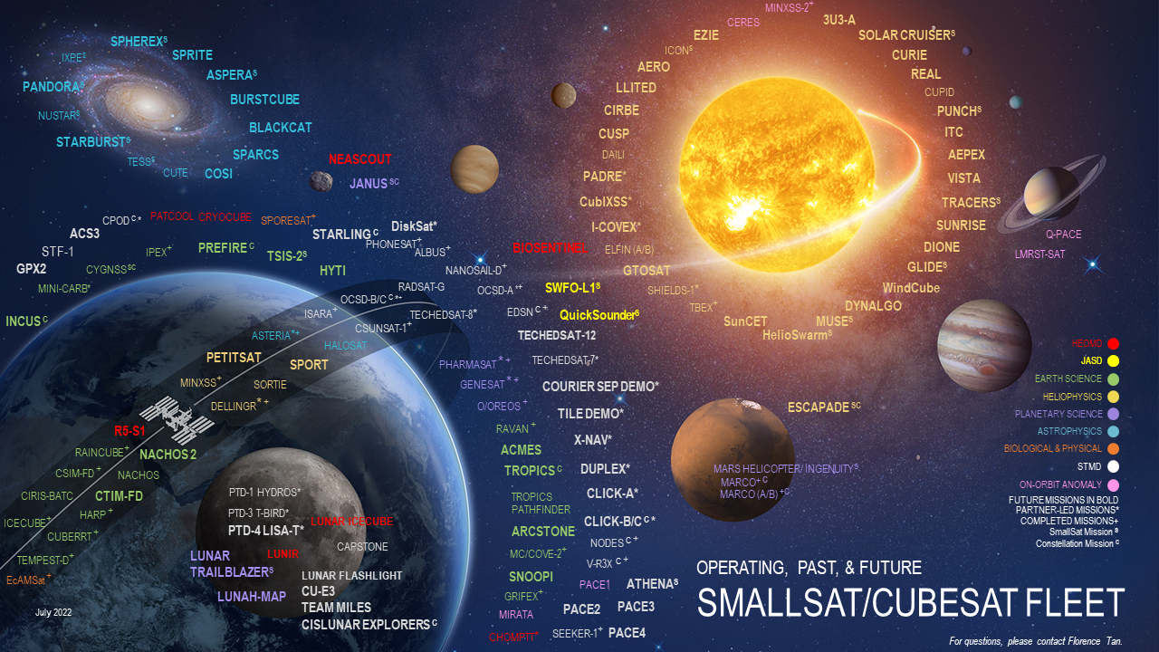
Recent proliferation of Small Satellite missions
Desire for interplanetary mission sets; challenges with achieving orbit insertion
Can aerocapture technology be utilized to enable Small Satellite mission sets?
Image Credit: https://s3vi.ndc.nasa.gov/cubesatfleet/
Notes:
So no NASA presentation is not complete with a cool graphic. I’ll start the motivation for this paper based on this beautiful graphic that visualizes the various NASA-affiliated current, past, and future small satellite missions. The figure not only continues to get populated each year I check but serves to illustrate a recent paradigm shift in mission design being small satellites. The figure also illustrates the desire for interplanetary missions to destinations, like Mars and Venus. A critical engineering challenge in enabling such mission sets is orbit insertion where traditional satellite means of insertion may not scale down to the small satellite level. So the question that this paper seeks to investigate is can aerocapture technology be utilized to enable small satellite mission sets?

Slide 3
Outline
Overview
SmallSat Aeroshell Design
Aerocapture Flight Envelope Analysis
Monte Carlo Simulations
Study Findings
Suggestions for Future Work
Note: All aerocapture trajectory generation and analysis was conducted using Program to Optimize Simulated Trajectories II (POST2), developed at NASA Langley Research Center
Notes:
This paper presents results from a STMD-funded project in Summer of 2021 that served to investigate this question. There were a few papers presented at other conferences that go into details on some of the technical analysis conducted. This presentation serves to provide a summary of the study findings. It will start of with a brief overview of the problem, provide key results from downscaling efforts of deployable decelerator technology, aerocapture flight envelope analysis, and monte carlo simulations, and conclude with a summary of the key findings, and suggestions for future work.

Slide 4
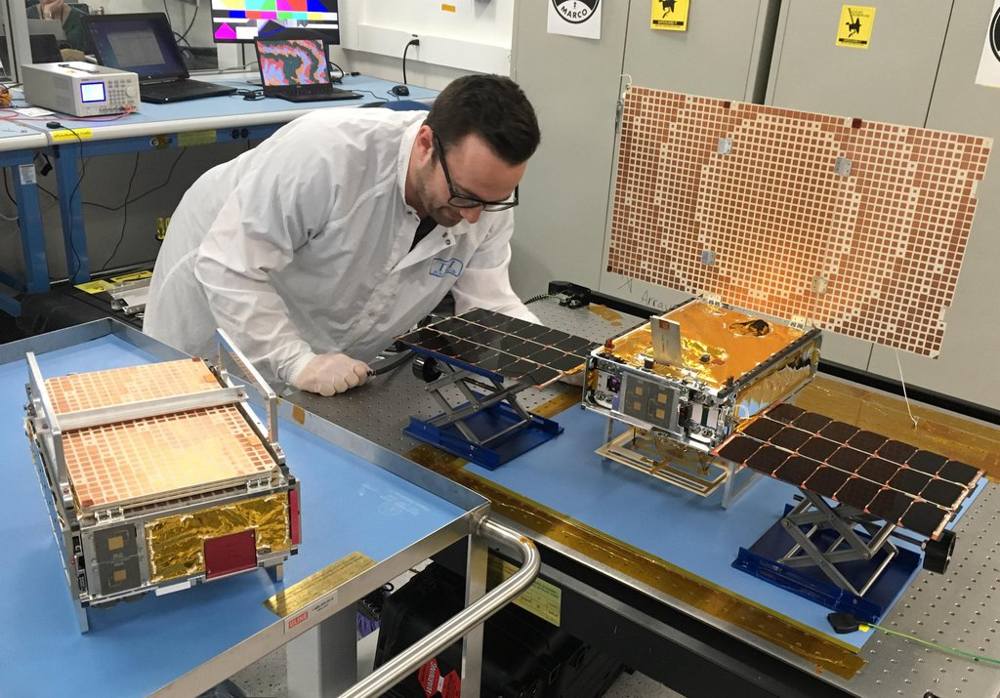
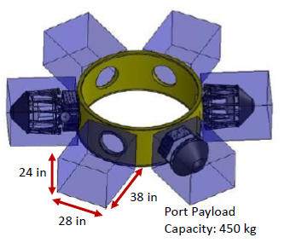
Small Satellites (SmallSats)
Miniaturized lower-cost satellites that launch as secondary payloads
  Payload adapters impose unique requirements to the design of SmallSats
NASA investments in SmallSats
  Policies on requiring secondary payload rideshare opportunities [1]
  Achieve science missions with SmallSats [2]
  Utilize SmallSats in interplanetary missions [3]
Stowed
Deployed
Image Credit: https://www.jpl.nasa.gov/images/pia22319-both-marco-spacecraft
Notes:
Small satellites are miniaturized versions of traditional satellites that utilize commercial-off-the-shelf components and launch as secondary payloads as ways to reduce mission cost. As secondary payloads, SmallSats must adhere to payload adapter requirements such as those depicted in this figure. Prior to launch, SmallSats must stow into a compact configuration and after launch must deploy into their operation configuration such as depicted in this figure of MarCO. NASA has current ongoing investments in SmallSats that serve to promote the utilization of them whenever possible, including interplanetary missions. Consequently, mission designers are starting to take the exit onto the SmallSat expressway.

Slide 5
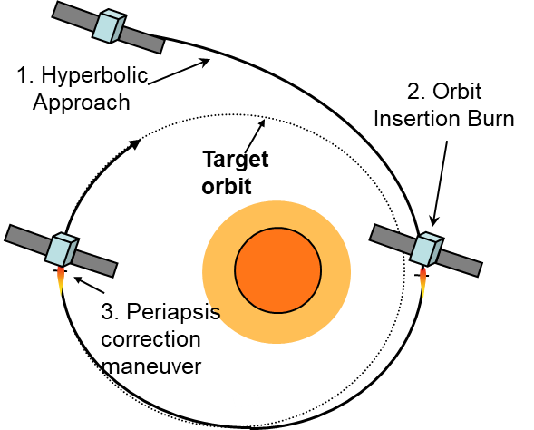
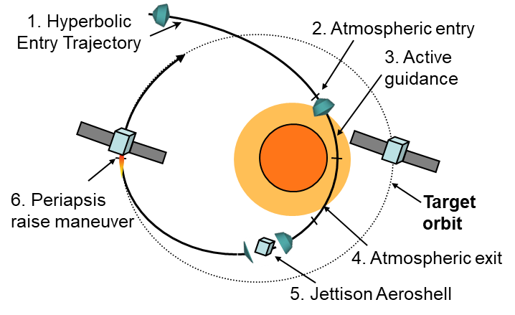
How to achieve interplanetary orbit insertion
Interplanetary missions require high ΔV maneuvers
  Rideshare integration with primary payloads may not guarantee desired orbit
  High propellant mass fraction for chemical propulsion
  Long insertion time associated with electric propulsion
Atmospheric drag can be used to quickly achieve high ΔV maneuver via aerocapture
Aerocapture
Fully Propulsive
Image Credit: M.M. Munk, and T.R. Spilker, “Aerocapture Mission Concepts for Venus, Titan and Neptune”, 6th International Planetary Probe Workshop, Atlanta, GA, 2008.
Notes:
Interplanetary mission require high delta-v maneuvers for orbit insertion about the planetary body of interest. Downscaling of size and mass associated with SmallSats makes planning of these maneuvers difficult. A few potential options do exists but they either do not guarantee the desired orbit, are not mass feasible, or take too long to transfer to the desired orbit. The atmosphere of the destination can be utilized to provide the change in velocity needed to capture from a single and quick drag pass through a technique known as aerocapture. Figures above show a conops comparison between aerocapture and fully-propulsive alternative. Aerocapture has been widely studied in the literature and might be well-suited for SmallSats.

Slide 6
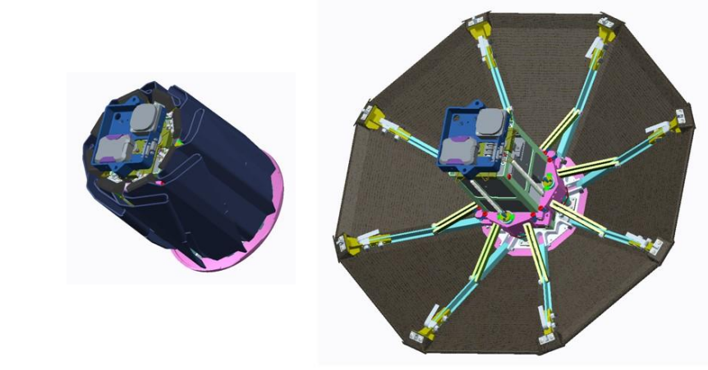
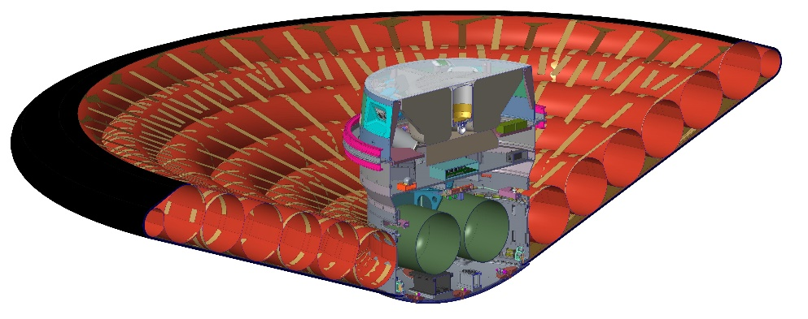
Aerocapture Technology Application for Small Satellites
Deployable aeroshells are well conceived for secondary payload requirements
  Deployables can compactly stow during launch and deploy prior to entry
  Requirements will influence the deployed diameter achieved
Deployable Aeroshell Technology
  Mechanically -> ADEPT
    SmallSat platform aerocapture studies [4]
    Sounding rocket tests of SmallSat-sized variant [5]
  Inflatable -> HIAD
    Nov 2022 flight test of 6m variant
    Limited analysis for downscaling to SmallSat-sized variant [6]
Stowed and fully mechanically deployed configurations of 3U CubeSat form-factor of Adaptable Deployable Entry Placement Technology (ADEPT) Sounding Rocket-One Flight Experiment
Image Credit: https://arc.aiaa.org/doi/pdf/10.2514/6.2019-2896
Deployed view of fully-inflated 6m diameter Low-Earth Orbit Flight Test of an Inflatable Decelerator (LOFTID).
Image Credit: NASA
Notes:
The aerocapture technology associated with deployable aeroshells is well suited for secondary payload missions where the aeroshell can compactly stow during launch and deploy prior to entry. Mechanical deployment and inflatable deployment mechanism have been investigated with two sets of aeroshell platforms being ADEPT and HIAD, respectively. Although both platforms have been envisioned for large diameter configurations to support human-scale Mars missions, there has been some efforts in downscaling the platforms for SmallSat mission sets. Such a mission set for ADEPT has been both studied and flight-tested such as the 3U configuration shown in the figure above. Despite flight-testing of the HIAD platform, there has been limited analysis for its application for SmallSat mission sets. Consequently, an effort was conducted in this project to investigate such a configuration.

Slide 7
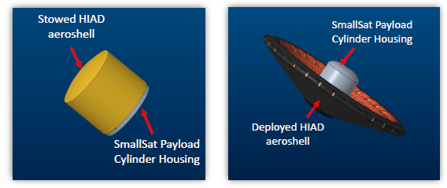

SmallSat HIAD Aeroshell - Design
Downscaling conducted using engineering models developed for LOFTID
  Detailed analysis can be found in Mann et al. [7]
  70° sphere-cone w/ deployed diameters: 1.5m, 2m, 2.5m
1.5 m Diameter HIAD
Diameter: 33 cm/ 13 in
Height: 30 cm/ 11.81 in
2 m Diameter HIAD
Diameter: 44 cm/ 17.3 in
Height: 40 cm/ 15.75 in
2.5 m Diameter HIAD
Diameter: 55 cm/ 21.7 in
Height: 50 cm/ 19.67 in
Diameter
Height
Diameter (m) | Mass (kg) | Area (m²) | Ballistic Coefficient (kg/m²)
1.5 | 61 | 1.767 | 19
2 | 85 | 3.142 | 15
2.5 | 111 | 4.909 | 13
< 38 INCH >
< 38 INCH >
< 38 INCH >
< 38 INCH >
< 38 INCH >
< 38 INCH >
< 28 INCH >
< 28 INCH >
< 28 INCH >
< 24 INCH >
< 24 INCH >
< 24 INCH >
Notes:
The approach taken for downscaling HIAD was to utilize engineering models developed for LOFTID. Details on the downscaling can be found in the Small Satellite Conference paper written by Shelly Mann. The resulting design configurations achieved include 1.5m, 2m, and 2.5m variants. The figure on the left shows the stowed configuration in the standard secondary payload adapter. The figure on the right shows both the stowed and deployed configurations with cylindrical region for housing SmallSat payload. The table provide a summary of the aeroshell mass and ballistic coefficient (BC) achieved with each configuration.

Slide 8
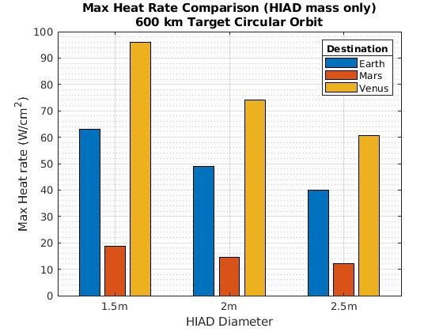
SmallSat HIAD Aeroshell - Heat Rate Trends
Applied Sutton-Graves heat rate model to aerocapture trajectories at Earth, Mars, and Venus with each configuration
  Estimate of aeroheating environment; interested in the trends
  Entry Velocity (km/s): 10.3 (Earth, Venus), 6 (Mars)
Trends
  Heat rate at Venus is ~1.5 times larger than Earth; ~5 times larger than Mars
  Increasing deployed diameter serves to reduce heat rates; greatest decrease seen for Venus
  Assuming 75 W/cm^2 HIAD flexible TPS heat rate limit, possible aerocapture HIAD designs for Mars, Venus, and Earth
Nose radius in Sutton-Graves calculations assumed to be 1/3 deployed diameter
Notes:
A critical metric in understand the efficacy of SmallSat aerocapture mission sets of the aeroheating environment. While having a lower ballistic coefficient due to lower entry mass is advantageous for reducing heating, reductions in nose radii associated with geometric downscaling lead to an increase in heating. To assess this trade-off, a Sutton-Graves convective heat rate model is applied to aerocapture trajectories at Earth, Mars, and Venus with each HIAD configuration to estimate the aeroheating environment and understand trends. The figure on the right shows a comparison of the heat rates. What the trends show are elevated heating environment for Venus and a reduction in heat rate with diameter for each destination. Comparing the values to a upper heat rate limit dictated by TPS material suggests possibility of aerocapture HIAD designs at Mars, Venus, and Earth.

Slide 9
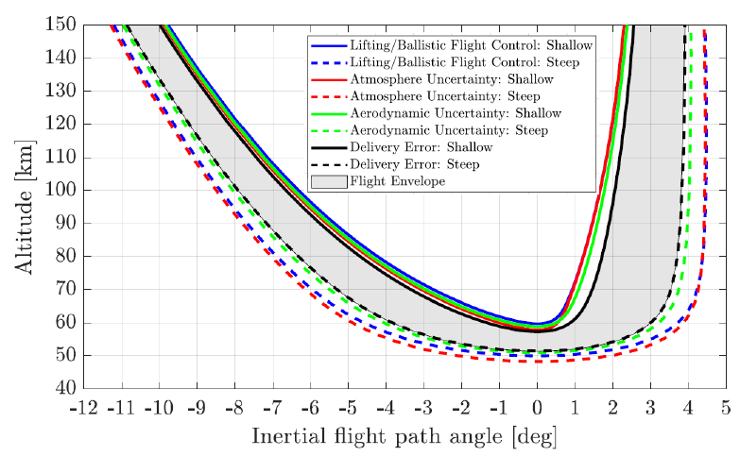
Aerocapture Flight Envelope - Overview
Goal: Understand the design-space to identify potentially feasible SmallSat HIAD aerocapture mission concepts at Venus, Earth, and Mars
Tool: Aerocapture Flight Envelope
Methodology: Parametrization of lifting and ballistic trajectories by L/D and BCR (ballistic coefficient ratio)
Detailed analysis can be found in Joshi et al. [8]
Envelope Width (deg)
Exit
Entry
Illustration of the aerocapture flight envelope. Individually apply ±3σ trajectory dispersion sources and solve for steep/shallow trajectories that achieve desired orbit using upper/lower control bounds. Most restrictive trajectories defines the flight envelope.
Notes:
With potential SmallSat HIAD geometries identified, the next step in the analysis is to identify feasible SmallSat aerocapture mission concepts at each destination from a controllability perspective. During aerocapture, trajectory dispersions serve to reduce the guidable trajectory-space. The aerocapture flight envelope can be utilize to visualize this. Figure on the right shows a sample flight envelope where the blue lines show the bounds of the controllable aerocapture trajectory-space with no dispersions applied, commonly known as the corridor width. Individually applying 3-sigma level dispersions associated with atmosphere, aeroshell aerodynamics, and delivery error serves to influence the size of the trajectory-space. The most restrictive bounds qualitatively defines the flight envelope, with its width quantitatively defining the control margin. Details on the analysis can be found in the Small Satellite conference paper by Jack Joshi but the general idea is to parameterize the trajectories by L/D (for lifting) or BCR (for ballistic) and ballistic coefficient compatible with SmallSat HIAD designs.

Slide 10
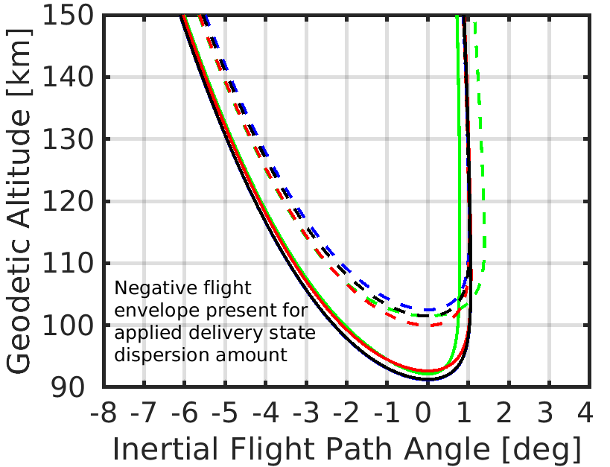
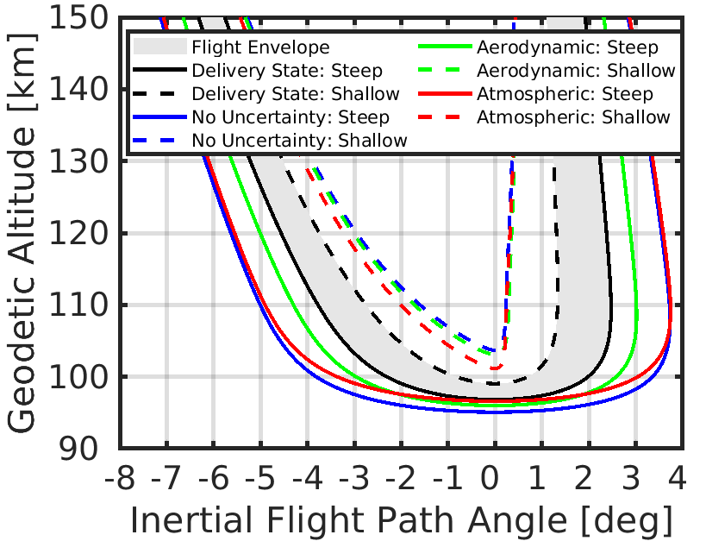
Aerocapture Flight Envelope - Venus
Lifting HIAD aeroshell needed to produce positive flight envelope
Ballistic (20 BCR, BC = 25 kg/m²)
Lifting (0.25 L/D, BC = 25 kg/m²)
Each parametrized vehicle design had an entry velocity of 11.5 km/s targeting a 300 km circular orbit
Notes:
Here we will show a comparison of the flight envelopes for Venus with a full set of the envelopes found in the paper. The left plot shows a lifting SmallSat HIAD configuration with a moderate L/D capability of 0.25 can produce a generous and positive flight envelope. For the ballistic configuration even with a very large BCR capability of 20, the flight envelope is negative indicating potential inability of control choice for overcoming the largest set of trajectory dispersions (insert crying Jordan meme).

Slide 11
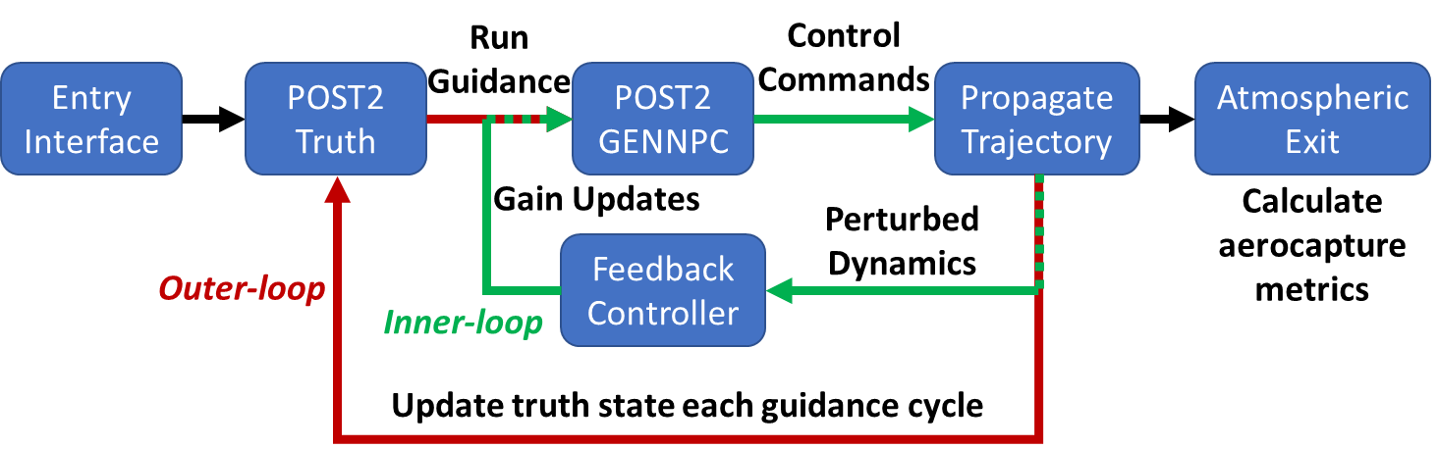
Monte Carlo Simulations
Provided quantitative insight into qualitative trends presented in flight envelope assessment
Ran Monte Carlo simulations using generalized numerical-predictor corrector (GENNPC) module built into POST2 [9]
  Outer-loop: truth trajectory model with dispersions applied
  Inner-loop: nominal trajectory model that optimizes bank angle to minimize apoapsis error using NPC routine
Notes:
To provide further insight into the trends seen in the flight envelope assessment, Monte Carlo simulations are run. The Programs to Optimize Simulated Trajectories II is utilized to conduct this analysis with its generalized numerical-predictor module. At a high-level, the module works using an outer-inner loop setup shown in the left figure. The outer-loop instance of POST2 serves as the truth model where trajectory dispersions analyzed in the previous section are applied. At each guidance cycle, it spawns a separate instance of POST2 that acts as a numerical predictor-corrector that optimizes the bank angle to minimize the apoapsis error. This recursive calls of inner-loop of POST2 are conducted until the trajectory reaches atmospheric exit wherein aerocapture orbit insertion metrics are computed.

Slide 12
Monte Carlo Simulations
Analyze lifting SmallSat HIAD design
Use post-aerocapture 99th percentile total ΔV statistic to provide estimate of propellant mass requirements
Planet | Time from Entry to Exit (min) | Dissipated Velocity (km/s) | Capture Rate | 99th %-tile Burn Cost (m/s) | Propellant Mass (kg) | Propellant Mass Fraction (%)
Earth | 12.6 | 3.6 | 100% | 178 | 13.05 | 8.7%
Mars | 21.4 | 2.5 | 100% | 147 | 10.82 | 7.2%
Venus | 17.3 | 4.25 | 100% | 189 | 13.81 | 9.2%
Aerocapture enables rapid orbit insertion for SmallSat missions
Aerocapture reduces SmallSat orbit insertion ΔV requirements on the order of km/s to order of m/s
Propellant mass allocations constitute less than 10% of total entry wet mass
Notes:
8001 Monte carlo cases are run on the lifting SmallSat HIAD designs identified in the previous section. Figure on the left shows histogram of the total post-aerocapture delta-v and corresponding statistics. The delta-v is used to provide an estimate for propellant mass allocation needed. The results show that aerocapture can significantly reduce orbit insertion delta-v requirements on the order of km/s to the order of m/s leading to requiring less than 10% of the total entry mass being allocated to propellant.

Slide 13
Study Findings
Downscaling of aeroshell geometries for secondary payload provided a unique challenge for high aeroheating environments
  Smaller nose radii + flexible TPS limits design-space
  HIAD designs provide potential design considerations that alleviate these challenges while enabling generous payload mass to be delivered to orbit via aerocapture
Aerocapture flight envelope assessment indicated lifting flight control with modest L/D provided sufficient control margin for SmallSat HIAD aerocapture trajectories at Venus, Earth, and Mars
At each destination, Monte Carlo simulations indicated 100% capture success rate with results demonstrating the enabling potential of aerocapture technology for SmallSat missions

Slide 14
Future Work
Further TPS analysis with higher-fidelity aeroheating models can help further refine the TPS mass fractions and SmallSat payload mass estimates at each destination
Further investigation into lifting HIAD configurations is warranted given preliminary results indicating need for technology
Trade studies between ADEPT and HIAD SmallSat aeroshell designs to further understand advantages/disadvantages of each type of deployable aerocapture aeroshell technology

Slide 15
References
National Aeronautics and Space Administration, “Evolved Expendable Launch Vehicle (EELV) Secondary Payload Adapter (ESPA) Secondary Payload Rideshare,” 2019. Space Mission Directorate Policy Document SPD-32.
Tan, F., and N., K., “NASA Science Mission Directorate SmallSat Coordination Group: State of NASA Science with SmallSats,” 35th Annual Small Satellite Conference, Logan, UT, 2021.
National Aeronautics and Space Administration, “NASA Small Spacecraft Strategic Plan,” 2019.
Cassell, A et al., “ADEPT: A Mechanically Deployable Re-Entry Vehicle System Enabling Interplanetary CubeSat and Small Satellite Missions,” 32nd Annual AIAA/USU Conference on Small Satellites, 2018.
S. Dutta et al., “Adaptable Deployable Entry and Placement Technology Sounding Rocket One Modeling and Reconstruction,” Journal of Spacecraft and Rockets, Vol. 59, No. 1, 2022, pp. 236–259.
et al., S. H., “Low Cost Innovative Atmospheric Entry Probes Combining CubeSat and HIAD Technologies,” International Planetary Probe Workshop 13, 2016.
et al., S. M., “Small Satellite-sized Hypersonic Inflatable Aerodynamic Decelerators for Interplanetary Science Missions,” 36th Small Satellite Conference, August 2022.
et al., J. J., “Flight Envelope Assessment of SmallSat Aerocapture Trajectories at Venus and Mars,” 36th Small Satellite Conference, 2022.
A.W etl al., “Enabling Thread Safety and Parallelism in the Program to Optimize Simulated Trajectories II,” 2023 AIAA SciTech Forum, Jan 2023.

Slide 16
Acknowledgements
This study was funded by the NASA Space Technology Mission Directorate. Authors would like to acknowledge the contributing work done by 2021 NIFS Summer Interns: Melis Grace (U. Colorado), Shelly Mann (Old Dominion), Daniel Engel (U. Illinois), Danny Nguyen (U. Colorado), and Jack Joshi (U. Illinois). Authors would also like to thank contributions from: Karl Edquist (NASA Langley), Jamshid Samareh (NASA Langley), Michelle Munk (NASA Langley), and Jannuel Cabrera (NASA Langley).

Slide 17
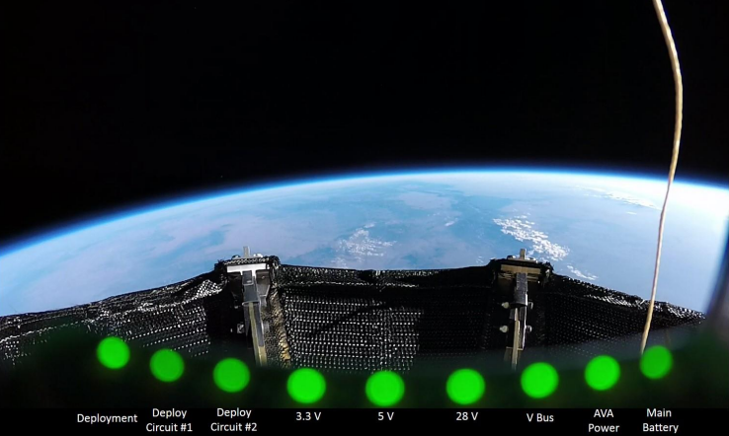
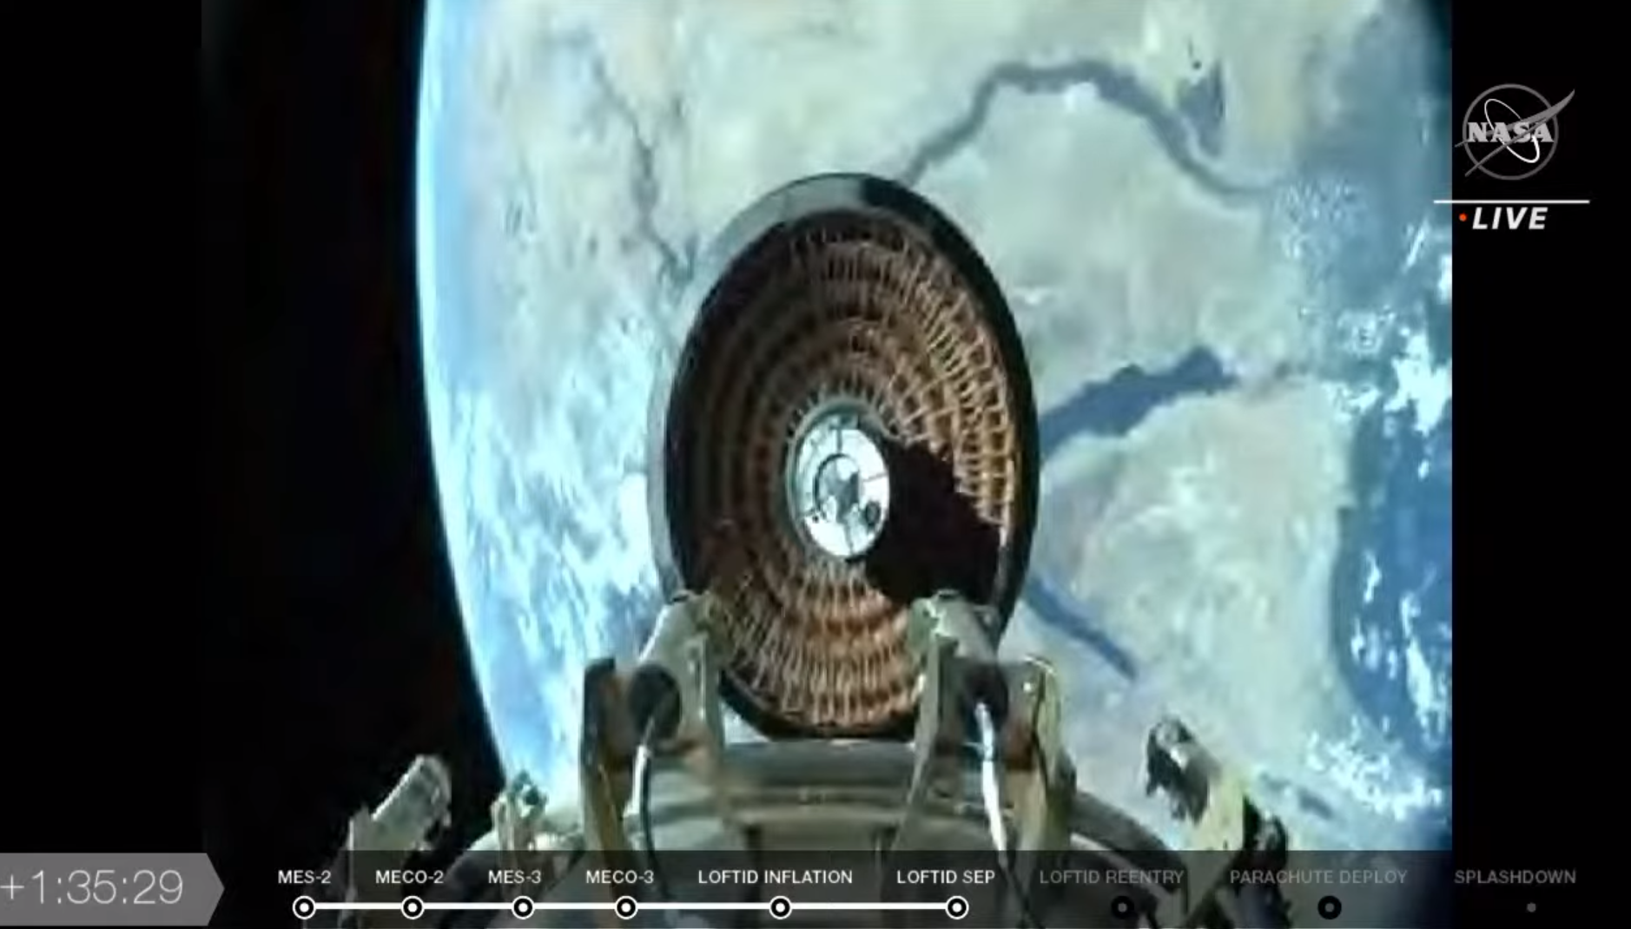
Questions?
OH WORD?
NICE DAY FOR ATMOSPHERE SURFING
Image Credit: Cassel A., “ADEPT Sounding Rocket One Flight Test Overview”, AIAA Aviation Conference 2019, Dallas, TX.
Image Credit: NASA TV

Slide 18
Backup

Slide 19
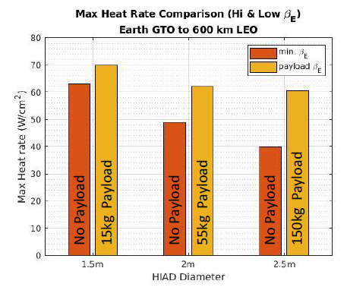
SmallSat HIAD Aeroshell - Heat Rate Trends
Investigate how SmallSat payload mass affects heat rate trends
  Payload mass added to HIAD mass to increase entry mass
    15kg -> CubeSat, 55kg -> Microsatellite, 150kg -> Minisatellite
  Present trends based on GTO to LEO transfer via aerocapture at Earth scenario
Trends
  Adding payload mass leads to increase in peak heat rate (larger ballistic coefficient)
  Larger diameter configurations have larger payload margin based on TPS heat rate limit
    Better suited for lowering peak heat rate and larger payload masses
  Trends generally follow for different destinations
Payload Margin
24
19
25
30
15
13
White numbers are the ballistic coefficient (kg/m^2).
Notes:
The addition of SmallSat payload mass may affect the heat rate trends. Three sets of SmallSat payload masses are investigated with the results of an Earth aerocapture scenario shown in the figure. Again, we are interested in the trends. The trends suggest increasing payload mass increases ballistic coefficient and the max heat rate. Using a larger diameter configuration is advantageous in providing both margin and lowering heat rate for larger payload masses. These trends generally follow for Mars and Venus.

Slide 20
Aerocapture Flight Envelope - Summary
Lifting SmallSat HIAD designs are desired for robustness to trajectory dispersions
  The large BCR may be too difficult to physically achieve for ballistic designs
Flight envelopes are unique to each planetary destination
  Severity of trajectory dispersions vary at each destination
  Flight envelopes provide a qualitative metric at visualizing each dispersion’s effect on the guidable trajectory-space
  Can vary depending on entry conditions, targeted orbit, and entry mass (e.g. ballistic coefficient)
Results presented are not comprehensive but provide a potential tool for SmallSat mission designers to utilize in conceptual analysis
Notes:
A general summary for the flight envelope results is shown on this chart. Lifting trajectories are identified to be more desirable than ballistic trajectories. A small amount of L/D is shown to produce much more controllability than even a very large BCR value that might be difficult to physically implement. While the affect of aerocapture trajectory dispersions are unique to each planetary destination, the aerocapture flight envelope can be a useful tool for mission designer in conceptual analysis.

Slide 21
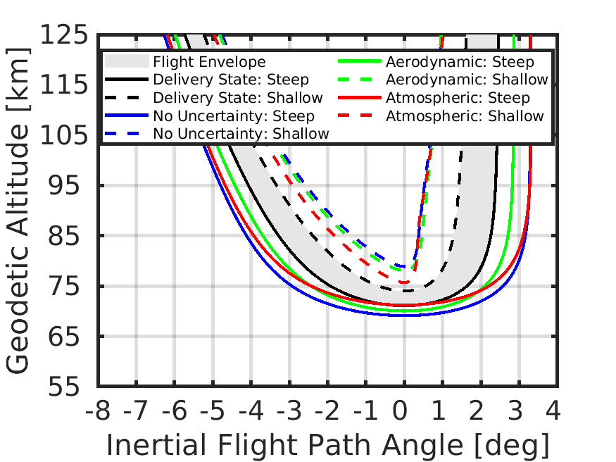
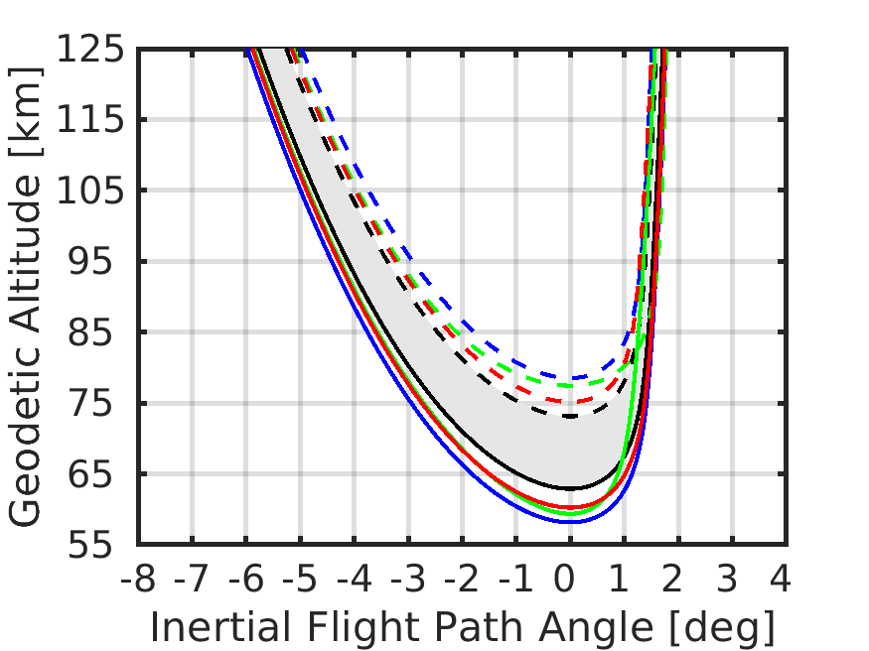
Aerocapture Flight Envelope - Earth
Lifting and ballistic HIAD aeroshell produce positive flight envelope
Note: decreasing BCR may lead to significant reduction or elimination of flight envelope
Lifting (0.25 L/D, BC = 25 kg/m^2)
Ballistic (20 BCR, BC = 25 kg/m^2)
Each parametrized vehicle design has an entry velocity of 11.5 km/s targeting a 500 km circular orbit

Slide 22
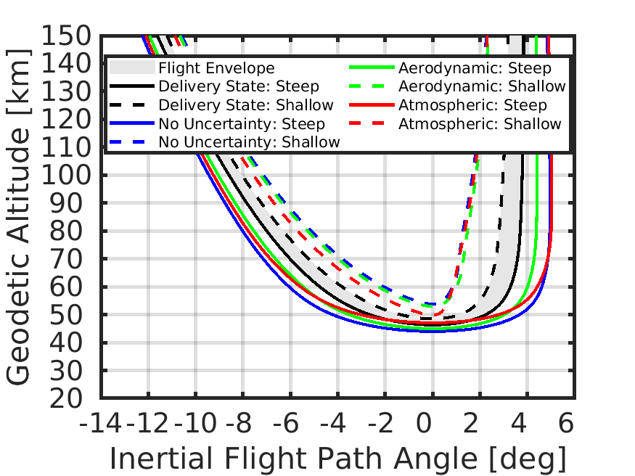
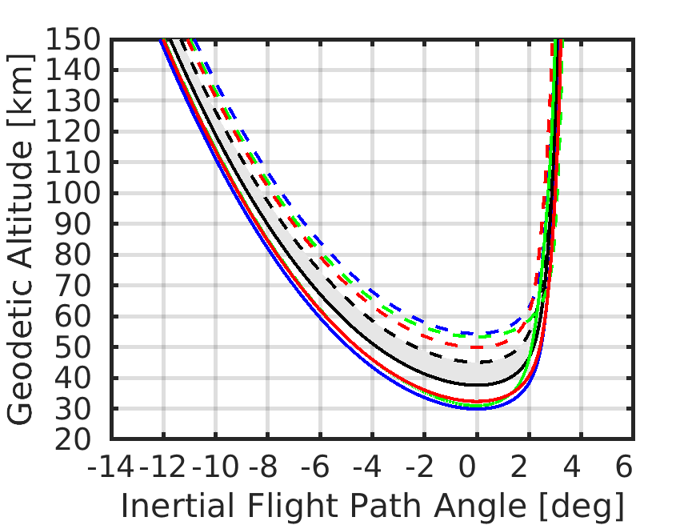
Aerocapture Flight Envelope - Mars
Lifting and ballistic HIAD aeroshell produce positive flight envelope
Note: decreasing BCR may lead to significant reduction or elimination of flight envelope
Lifting (0.25 L/D, BC = 25 kg/m^2)
Ballistic (20 BCR, BC = 25 kg/m^2)
Each parametrized vehicle design has an entry velocity of 6 km/s targeting a 400 km circular orbit

