Slide 1

Structural Sizing of a Transonic Truss-Braced Wing
Erin Anderson, Alana Cardona, and Brian Mason
Structural Mechanics and Concepts Branch
NASA Langley Research Center, Hampton, VA
AIAA Science and Technology Forum and Exposition
Structures, Structural Dynamics & Materials Conference
January 23-27, 2023
This material is a work of the U.S. Government and is not subject to copyright protection in the United States.
Notes:
2.14.18: RD Chief Engineers will serve as the review board for the Research Review Forums (RRF).
The RRFs are also intended to assist/assure that Branch Heads are well aware of the milestones and status of work under their responsibility, and for BHs to gain the perspective of what other branches are dealing with, with regard to milestones/technical work.

Slide 2
Outline
Introduction
Global Finite Element Model
Stiffener Modeling
Optimization
Conclusions

Slide 3

Introduction
Background
  Accurate and fast finite element model (FEM) generation is an expected part of the modern aircraft design process
  A FEM that can be modified quickly is necessary for sizing optimization
Objectives
  Assess approaches to rapidly model complex composite layup designs
  Develop a model for a transonic truss-braced wing (TTBW) and size laminates using optimization
Wing
Jury Strut
Main Strut
A proposed TTBW aircraft concept
Notes:
Finite element modeling is part of all modern design processes
Increasingly complex designs may require frequently iterated FEMs. Approximated approaches may recover some of the time cost of early, frequent modeling
This study investigated a global wing model for a Transonic Truss-Brace Wing. We propose an alternative method of modeling stiffeners in a composite aircraft FEM, use of this method in a sizing optimization

Slide 4
Global finite element model

Slide 5
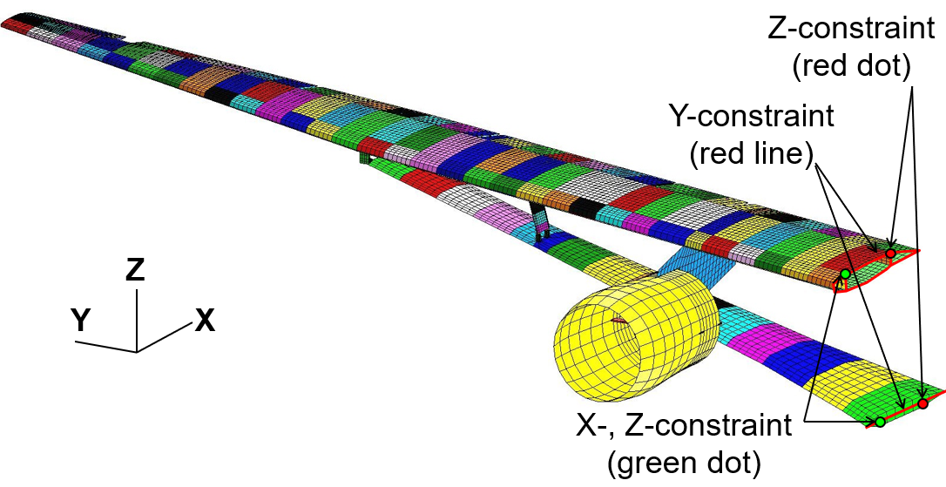
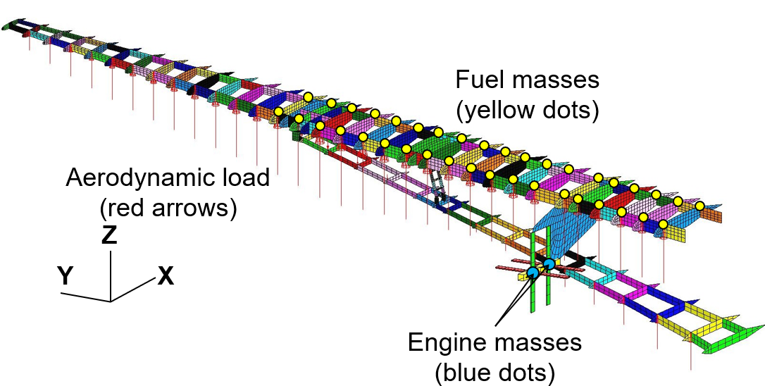
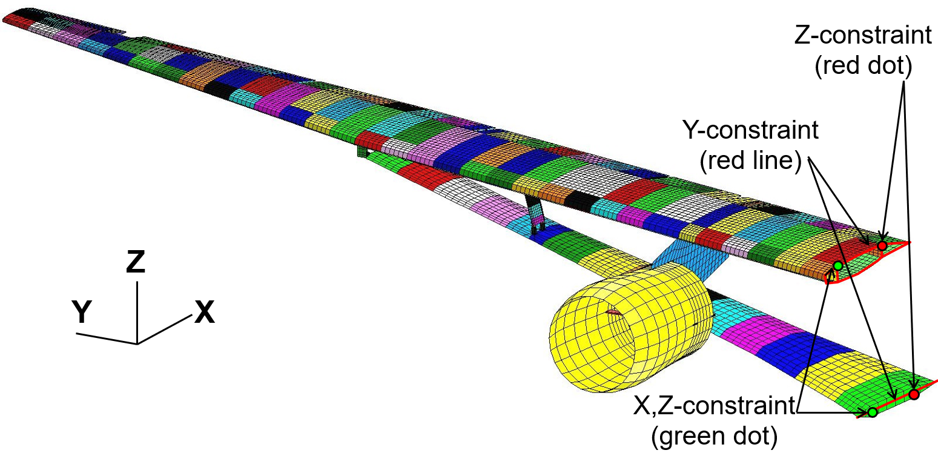
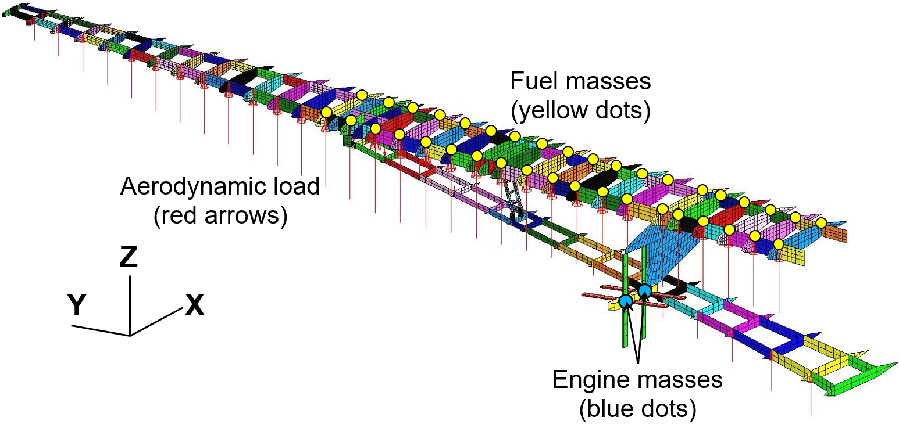
Finite Element Modeling
FEM of wing, main strut, jury strut, and engine nacelle with boundary conditions
Same FEM with covers removed and mass and aero loads
A global FEM of an example TTBW wing and struts
Subjected to a -1-g gust loading and +2.5-g climb loading
Global FEM for stiffener modeling approaches and base FEM for optimization efforts
Notes:
This is the global model we worked with; it includes detailed modeling of the wing, main strut, and jury strut. One the left is the full model shown with cover panels, and on the right the covers are removed to show ribs
This model was meshed using Conceptual Design Workshop and MSC/PATRAN for analysis using MSC/NASTRAN
The model consists of 16,935 shell (quadrilateral and triangular) elements, 807 beam elements, 66 point masses, and 15,322 nodes

Slide 6
Stiffener modeling

Slide 7
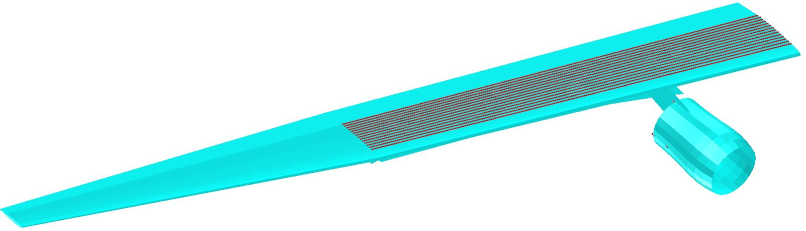
Finite Element Modeling: Stiffener Modeling
Commonly, stiffeners are modeled as individual beam elements
Models must be constructed to accommodate beam elements
Design evolutions frequently drive modifications to stiffener properties and locations
Changing individual elements is time consuming; other methods of modeling stiffeners are desired
Beam stiffeners
The global wing model shown here contains over 1400 beam elements in the region of interest
Notes:
The most familiar way of modeling stiffeners is to model them explicitly as beam elements
For this model, 1400 beam elements are required to accomplish this
Wing geometry changes might drive re-meshing, which would require properties and positions of all 1400 beam elements to be modified
Likewise, geometries must be meshed to accommodate beam spacing, resulting in a mix of triangular and quad elements
Without these accommodations, meshes can be much simpler

Slide 8
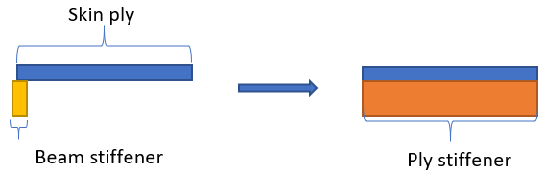
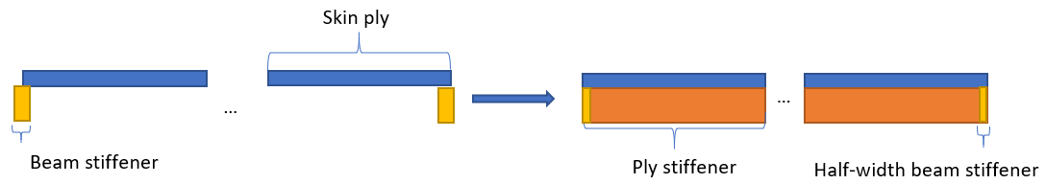
Stiffener Modeling Approaches
Beam stiffener
Composite smeared layer (CSL)
  A beam stiffener can be “smeared” into an added composite ply layer
  Applying this approach across a panel results in reduced stiffness at the edge elements
Hybrid
  Half-width beam elements can be added to edge elements to recover edge stiffness lost in CSL approach
Skin ply
Beam stiffener
Ply Stiffener
Beam stiffener and equivalent CSL ply stiffener
Skin ply
Beam stiffener
Ply Stiffener
Half-width beam stiffener
Hybrid equivalent with half-width edge beams
Notes:
One alternative to modeling stiffeners on a composite model explicitly as beams is to add a ply layer to the skin layup and “smear” the stiffener across this layer
This Composite Smeared Layer is assigned the material properties of the beam stiffener weighted by the volumetric ratio between the beam and the smeared layer
Unaltered, this approach leads to reduced stiffness at edge elements where an adjacent stiffener should be. To recover this stiffness, half-width beam elements can be added, depending on desired fidelity

Slide 9
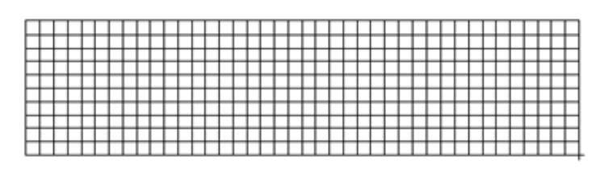
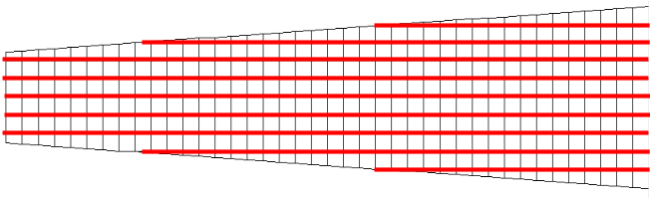
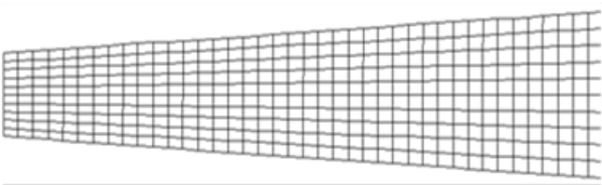
Stiffener Modeling Approaches: Example Cases
Two example geometries to explore CSL approach
  A rectangular panel
  A trapezoidal panel
Each example case was modeled and analyzed with
  Beam element stiffeners
  CSL stiffeners
  Hybrid stiffeners
Notes:
Before employing the CSL approach or the hybrid approach of CSL stiffeners and half-width beams to the global model, we created two proof of concept example cases.
A simple rectangular panel, where the beam-reinforced model and the CSL-reinforced models used the same mesh
And a trapezoidal panel, where the beam-reinforced model was modified to accommodate the beam elements and the CSL and Hybrid models were meshed without modification

Slide 10
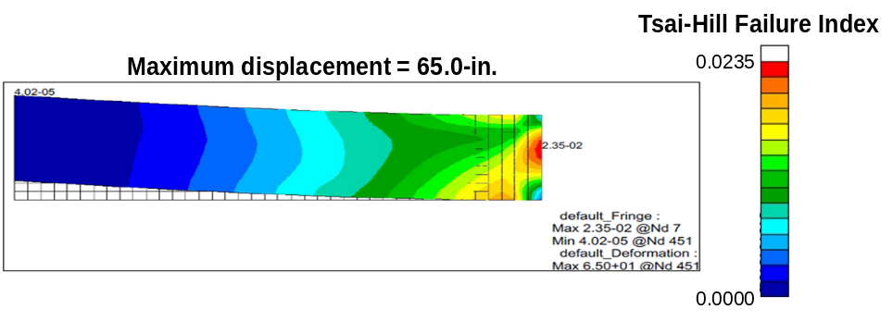
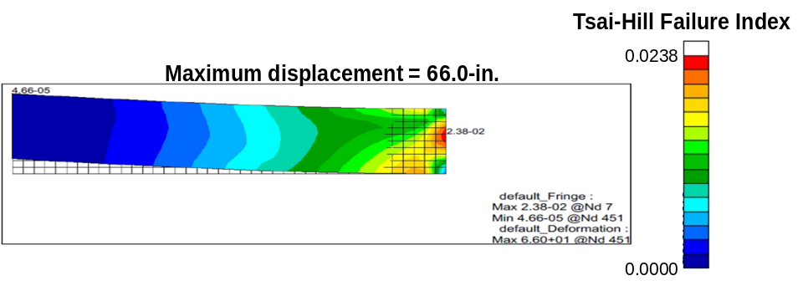
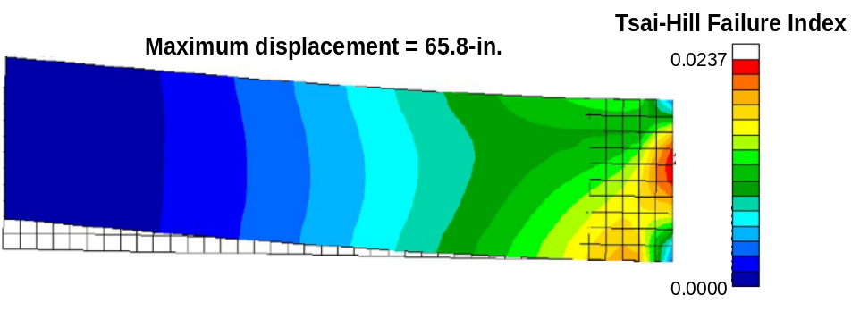
Stiffener Modeling Approaches: Example Case Results
Tsai-Hill failure index
Tsai-Hill failure index
Maximum displacement = 65.0 in
0.00235
Maximum displacement = 66.0 in
0.00238
0.00
0.00
Beam-reinforced results
CSL-reinforced results
Maximum displacement = 65.8 in
Tsai-Hill failure index
0.00237
Clamped Edge
250 lbs
Loading Scenario
Hybrid-reinforced results
0.00
Model | Maximum displacement, in. | Displacement difference to beam baseline, % | Maximum Tsai-Hill failure index | Failure index difference to beam baseline, %
Rectangular panel beam-reinforced | 65.0 | - | 0.0235 | -
Rectangular panel CSL-reinforced | 66.0 | +1.54 | 0.0238 | +1.28
Rectangular panel hybrid-reinforced | 65.8 | +1.23 | 0.0237 | +0.85
Notes:
Each model was loaded with a 250-lb load distributed at the tip and clamped at the opposite edge
Both the CSL and Hybrid models performed well, with displacements and failure indices coming within about 2% of the beam baseline model
Both of these metrics were improved in the Hybrid reinforced model, which brought the reported max failure index to within 1% of the baseline

Slide 11
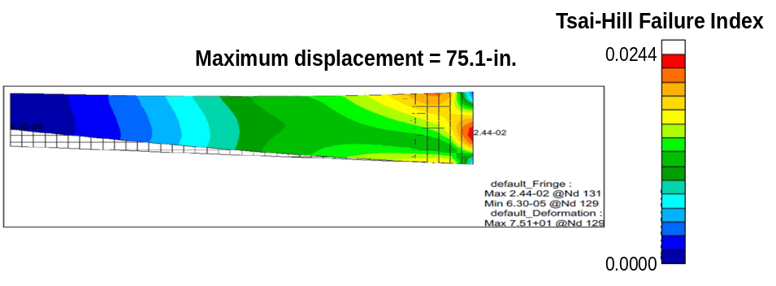
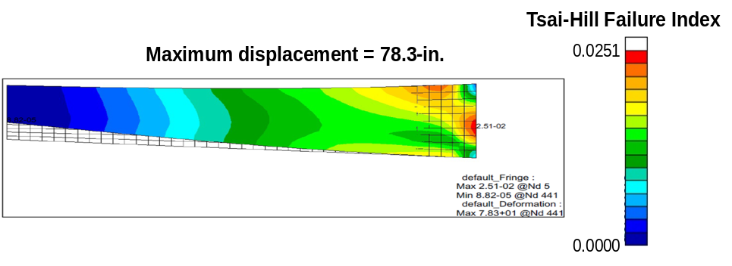
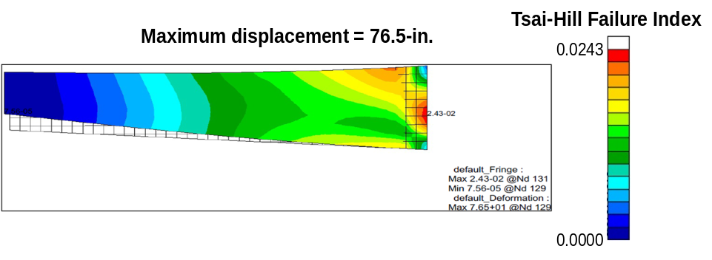
Stiffener Modeling Approaches: Example Case Results
Tsai-Hill failure index
Tsai-Hill failure index
Maximum displacement = 75.1 in
0.0244
Maximum displacement = 78.3 in
0.0251
0.00
0.00
Beam-reinforced results
CSL-reinforced results
Maximum displacement = 76.5 in
Tsai-Hill failure index
0.0243
Clamped Edge
250 lbs
Loading Scenario
Hybrid-reinforced results
0.00
Model | Maximum displacement, in. | Displacement difference to beam baseline, % | Maximum Tsai-Hill failure index | Failure index difference to beam baseline, %
Tapered panel beam-reinforced | 75.1 | - | 0.0244 | -
Tapered panel CSL-reinforced | 78.3 | +3.99 | 0.0251 | +2.87
Tapered panel hybrid-reinforced | 76.5 | +1.86 | 0.0243 | -1.64
Notes:
We did the same for the trapezoidal panel.
The CSL-only approach resulted in a 4% difference in displacement and a 3% difference in failure index
These were reduced to 2% differences when the Hybrid approach was employed.
This may be due to the more complex geometry of the trapezoidal panel versus the rectangular panel

Slide 12
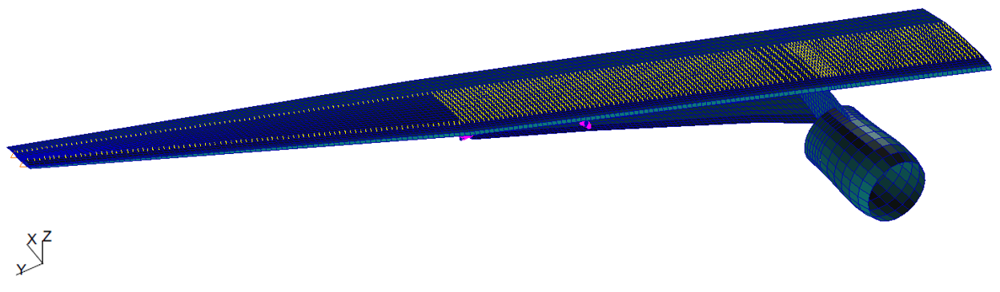
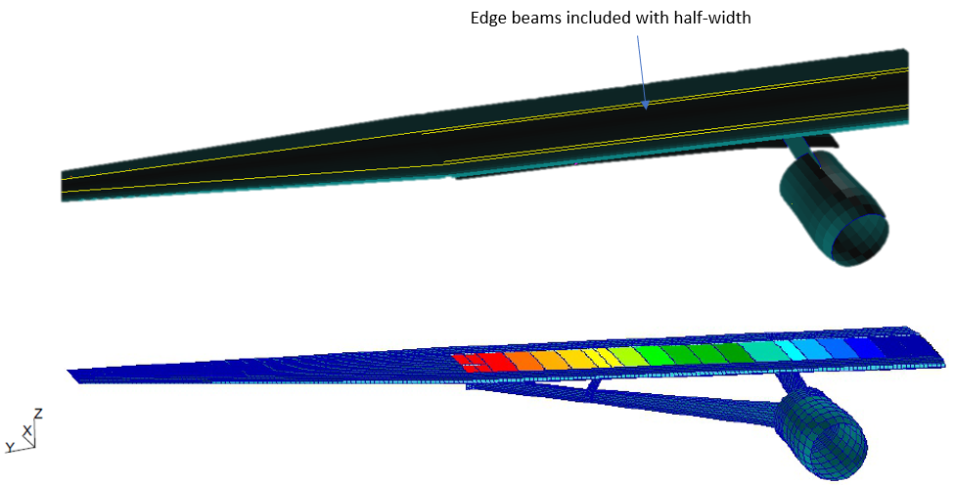
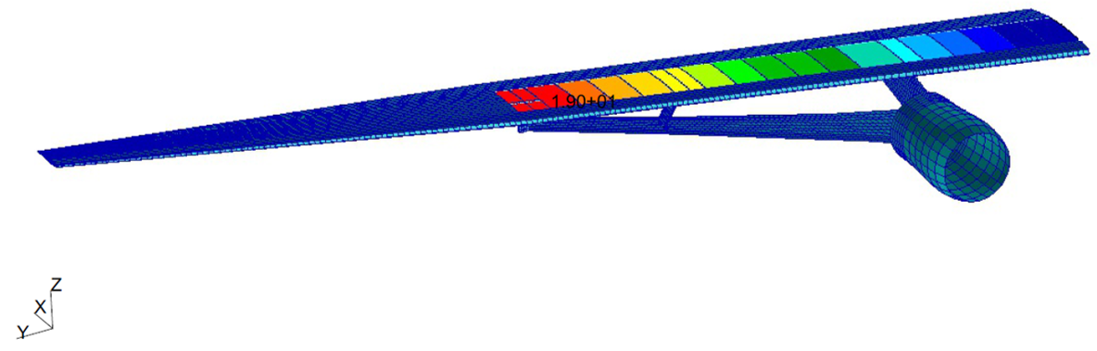
Integration Into Global Model
CSL and hybrid approaches yield displacement and failure index results within 4% of beam approach
The global FEM was modified into three models: beam-reinforced, CSL-reinforced, and hybrid-reinforced
Edge beams included with half-width
Beam-reinforced baseline model
Hybrid-reinforced model
(beam elements shown above and CSL property regions indicated by color below)
CSL-reinforced model
(CSL property regions indicated by color)
Notes:
Given the success of the example cases, we integrated both the CSL-only and Hybrid approaches in the global model geometry
Here we have the baseline beam model, with its 1400 beam elements
These are reduced to the equivalent CSL elements shown below – each colored section represents a group of CSL layers with the same properties
On the right is the Hybrid model. The image on top shows the locations of the half-width beam elements. The image below shows the CSL elements, property groups are again indicated by color

Slide 13
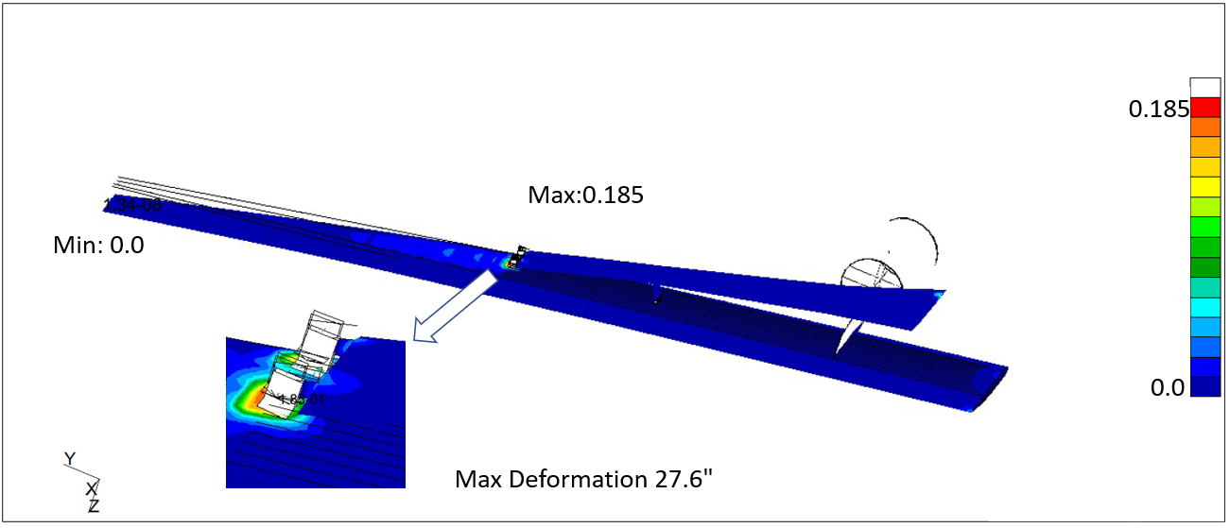
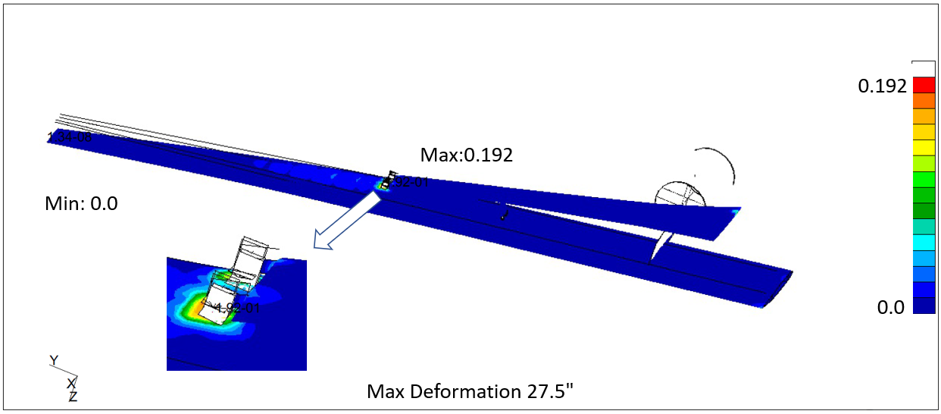
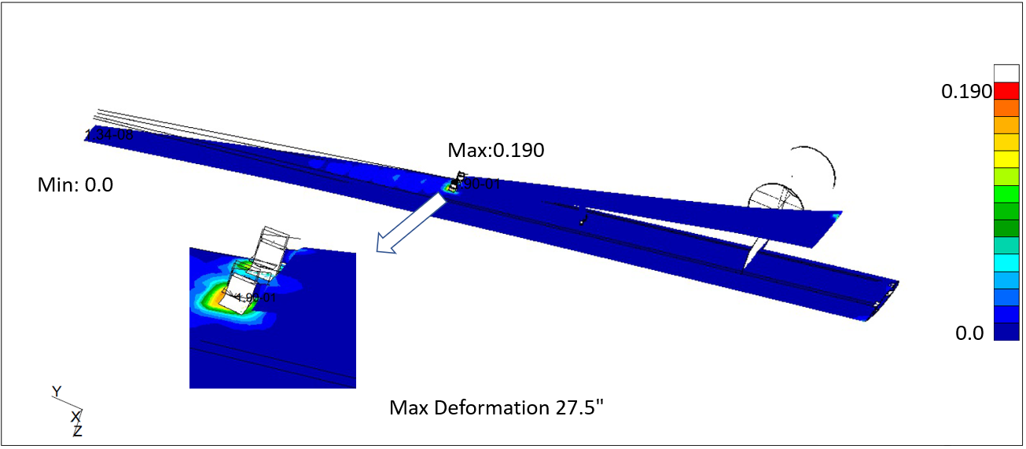
Global Model Results +2.5-g climb load
Tsai-Hill failure index
Tsai-Hill failure index
Maximum displacement = 27.6 in
0.185
Maximum displacement = 27.5 in
0.192
Max =0.185
Max =0.192
0.00
0.00
Beam-reinforced
CSL-reinforced
Maximum displacement = 27.5 in
Tsai-Hill failure index
Global TTBW model version | Maximum displacement, in. | Displacement difference to beam baseline, % | Maximum Tsai-Hill failure index | Failure index difference to beam baseline, %
Beam-reinforced | 27.6 | - | 0.185 | -
CSL-reinforced | 27.5 | -0.36 | 0.192 | +3.78
Hybrid-reinforced | 27.5 | -0.36 | 0.190 | +2.70
0.190
Max =0.190
0.00
Hybrid-reinforced
Notes:
Here we have the results of the three global models – the beam-reinforced baseline, the CSL-reinforced model, and the Hybrid-reinforced model. We’ve flipped the model upside down for these images to show the location of the maximum failure index
The differences in displacement less than half a percent for both models.
The Hybrid model performs slightly better than the CSL-only model for failure index.
Given the rectangular geometry of the reinforced area of the global model and the similar performance of the CSL and Hybrid approaches, the CSL approach was integrated into an optimization model in the next section

Slide 14
optimization

Slide 15
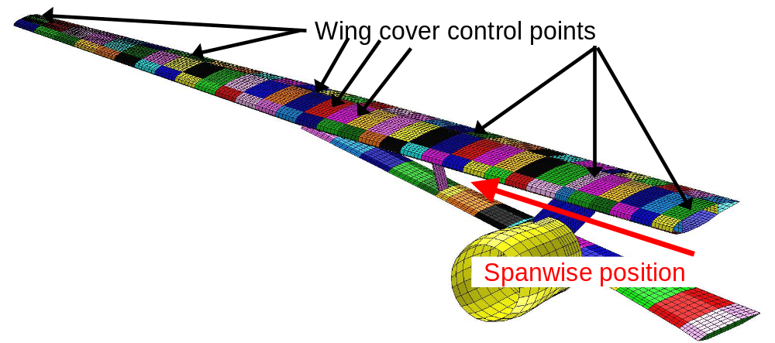
Integration into Optimization Model and Sizing
Sizing for laminate thickness performed using
LS-OPT
Wing divided into bays consisting of upper and lower covers, spars, and ribs
Layups in each bay were assigned a repeating quasi-isotropic stack ([45/-45/0/90])
  Design variables n0, n45, and n90 represent the number of individual 0°, +/-45°, and 90° plies
  Minimum value of n0, n45, n90 determines number of complete stacks
  Remaining plies placed in middle of layup
Thicknesses assigned at user-defined control points, vary linearly between these points
  Use of 21 control points reduced the scope of the problem from 465 design variables to 63
-1-g gust load case and +2.5-g climb load cases
Wing cover control points
Spanwise position
Global FEM and optimization control points
Notes:
We performed an initial sizing study for laminate thickness using the software LS-OPT
All composite layups were assigned at repeating quasi-isotropic stack
The wing was divided into bays consisting of the upper and lower covers, spars, and ribs in a region
Design variables n0, n45, and n90 were assigned to each section, representing the number of zero degree, 45 degree, and 90 degree plies
To initialize the optimization, composite stack thicknesses were assigned to wing covers at control points, where a user-defined known thickness can be assigned directly. Thickness between these points was assigned as a scaled percentage of adjacent control points
Using this method, the 21 control points reduced the scope of the problem from 465 design variables to just 63

Slide 16
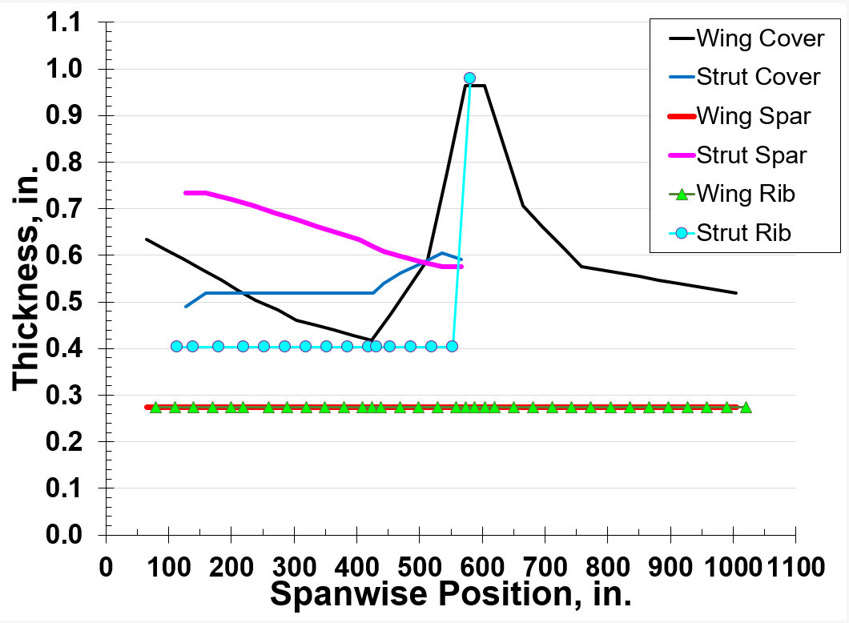
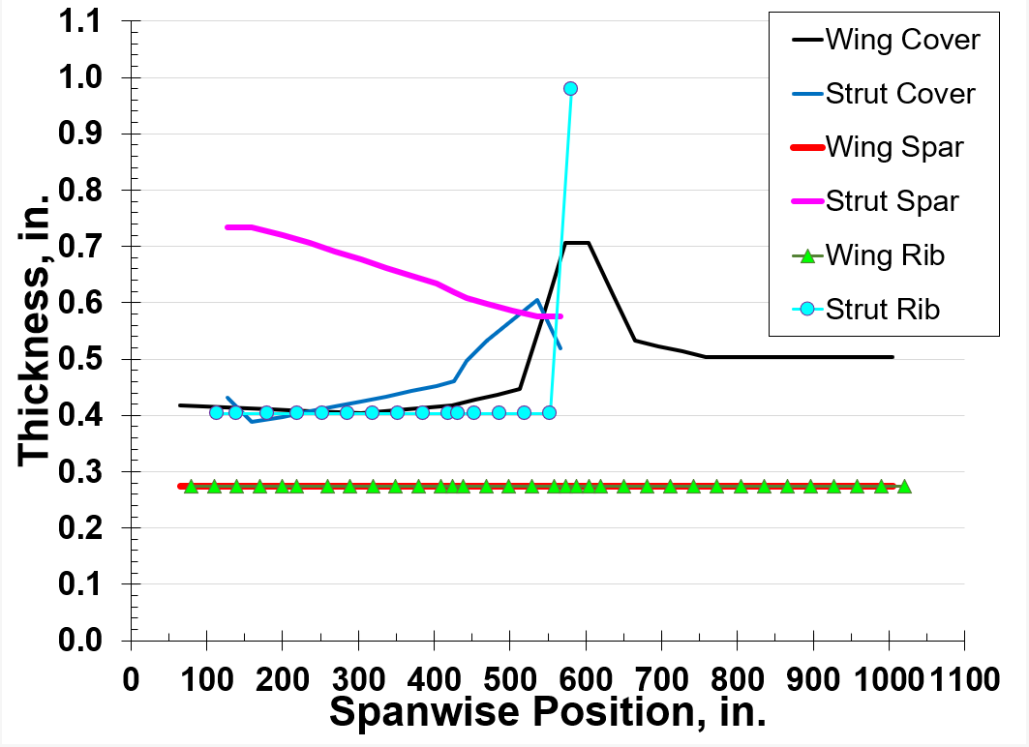
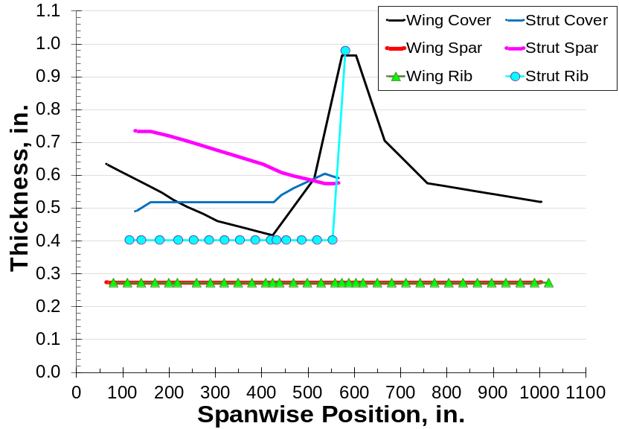
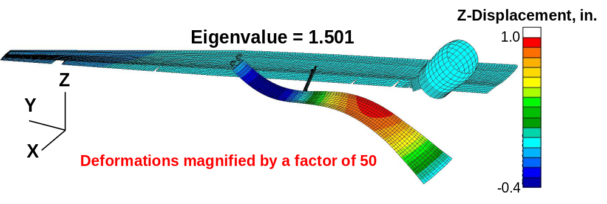
Structural Sizing Results
Unstiffened design
CSL-reinforced design
Two sizing studies
  Unstiffened design
  CSL-reinforced design
The CSL-reinforced model indicated a weight-savings
of 19.7% over an unstiffened design
The critical constraint was buckling under a +2.5-g climb load case
Largest
reduction
Mode shape of CSL-reinforced global TTBW
Notes:
The results of the optimization are shown in the two plots here
Laminate thicknesses for Covers, Spars, and Ribs are plotted against their spanwise position for a weight optimized wing, subject to buckling and strength constraints
The reinforced design used the CSL method, as discussed in the previous section.
This optimization indicates that a reinforced design may yield a weight savings of as much as 19.7%
The critical constrain for these designs proved to be buckling under a positive 2.5 g load associated with climb
The relevant lowest eigenvector is plotted here for the CSL-reinforced composite model.
Note that the deformations are magnified by a factor of 50 here for clarity

Slide 17
Concluding Remarks
Composite smeared layer (CSL)-reinforced and hybrid-reinforced modeling approaches produce results for deflection and failure index within
4% beam-reinforced modeling approach results
CSL-reinforced approach was integrated into a global model for sizing
and optimization
Results from the CSL-reinforced design optimization for strength and buckling indicate expected reduction in weight compared to an unreinforced design

Slide 18

QUESTIONS?

