Slide 1

Validating uPSP with Transducers
M. Shaw-Lecerf¹, E.L. Lash¹, D. Murakami¹, N. Roozeboom¹, J. Li², Paul Bremner³
¹NASA Ames Research Center
²Metis Technology Solutions, Inc.
³AeroHydroPLUS
AIAA SciTech Forum, January 23-27, 2023
Sponsor: NASA Aerosciences Evaluation and Test Capabilities (AETC) Portfolio Office
This material is declared a work of the U.S. Government and is not subject to copyright protection in the United States.
Notes:
00:30
Hi and thanks for listening.
My name is Marc Shaw-Lecerf, I am an Aerospace Engineer at NASA Ames Research Center.
I will be presenting an approach for validating Unsteady Pressure-Sensitive Paint Data with pressure transducers.
I would like to thank my co-authors Lara Lash, David Murakami, Nettie Roozeboom, Jie Li, and Paul Bremner, and
I would also like to thank the NASA AETC Portfolio Office for supporting this work.

Slide 2
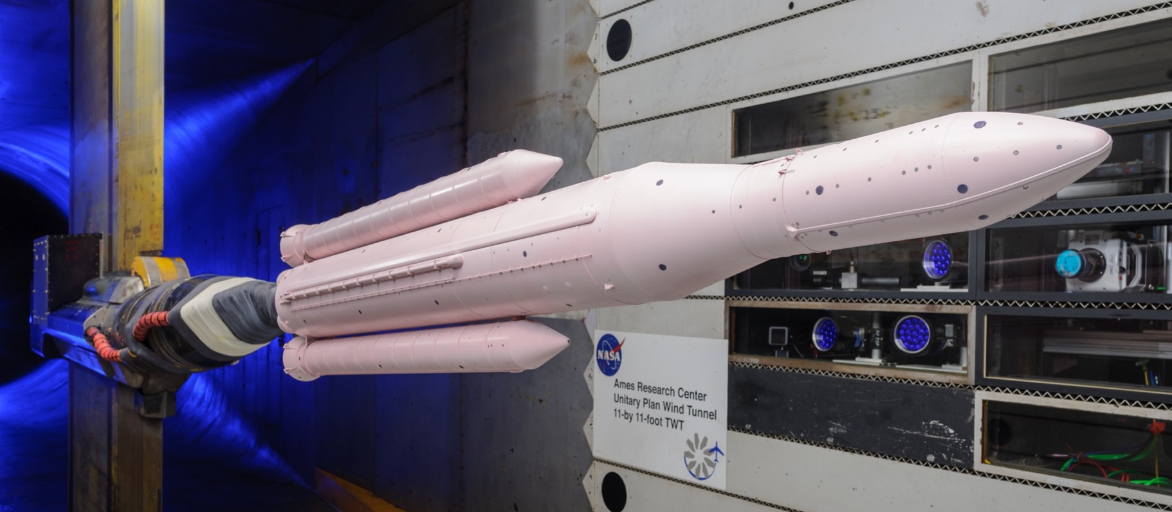
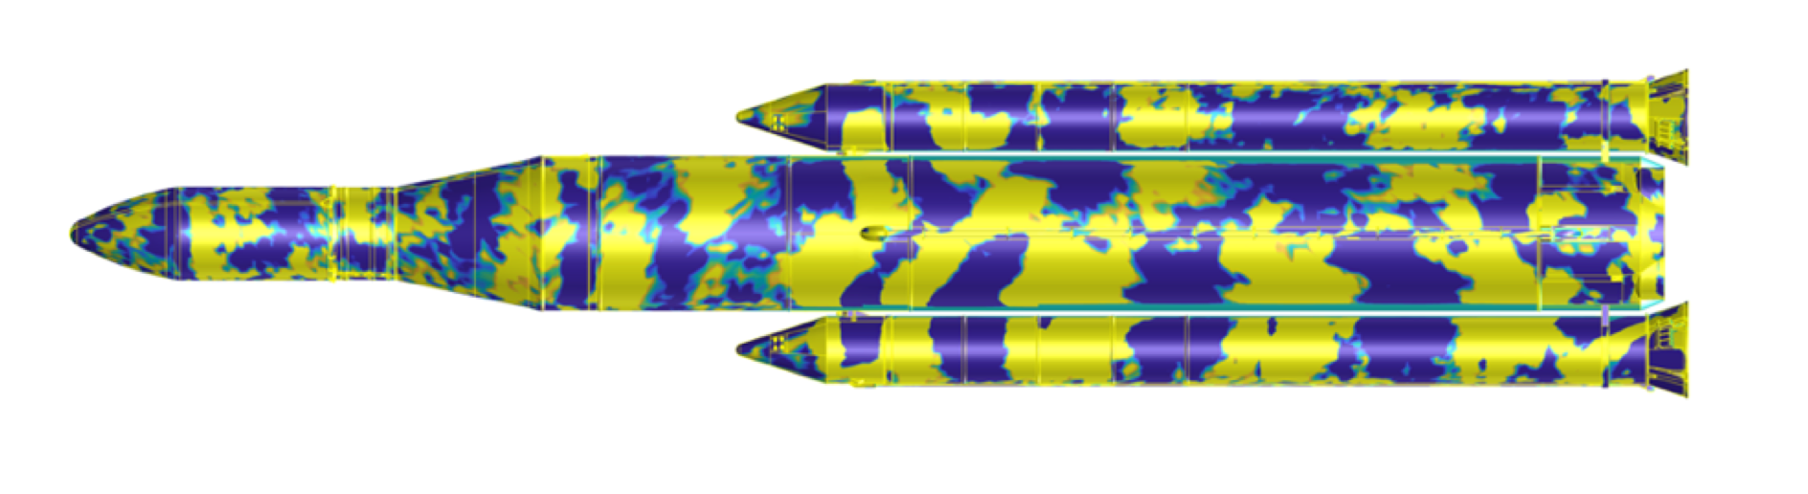
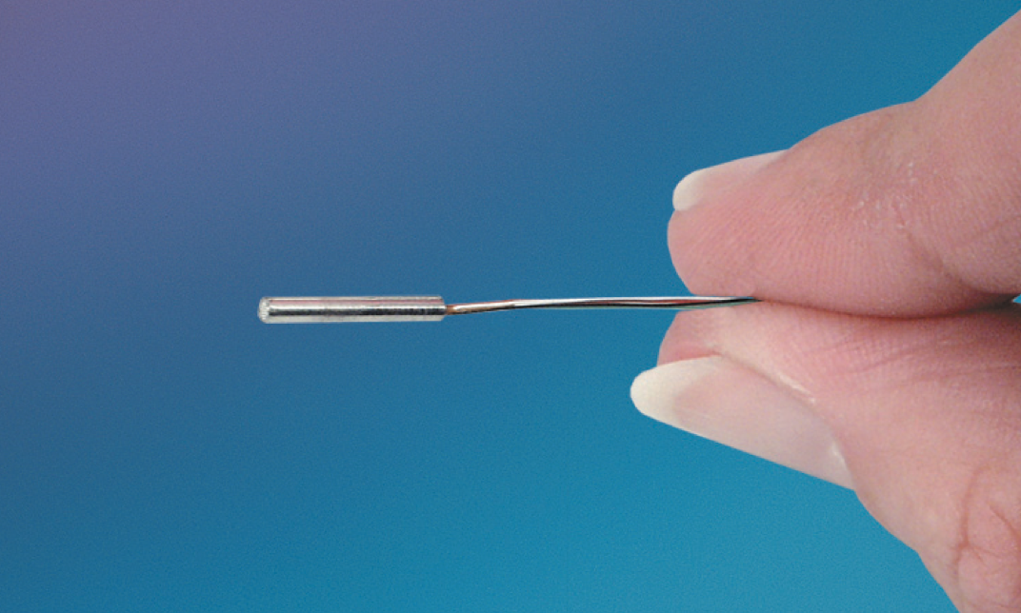
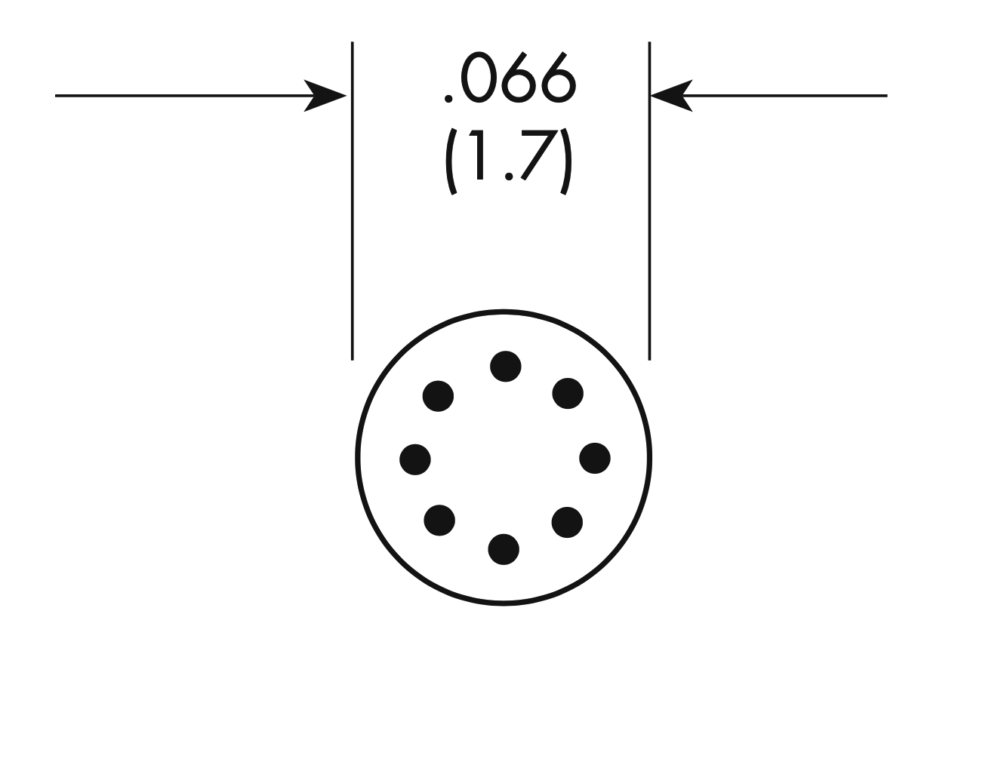
On-body unsteady aero at NASA Ames
Unsteady pressure-sensitive paint (uPSP)
[AIAA-2022-0141]
Validation is crucial for practical use!
Miniaturized pressure transducers (PT)
“🍎”
Independent measurement source;
“Gold Standard”
[Reproduced with permission from Kulite Semiconductor Products, Inc.]
“🍊”
Notes:
00:30
(01:00)
This work is motivated by the toolkit we have at NASA Ames for measuring on-body unsteady aerodynamic effects.
Our unsteady pressure-sensitive paint system has demonstrated cutting-edge capability to visualize full-body surface pressure fluctuations, but validation is crucial for its practical use.
Our traditional, "gold standard" technique is to use surface-mounted miniaturized pressure transducers.
So, we would like to use transducers as a means of verifying UPSP data ... but they are fundamentally different sensing mechanisms and are good at different things.
This presentation is essentially going to be an effort to compare "apples" to "oranges."

Slide 3
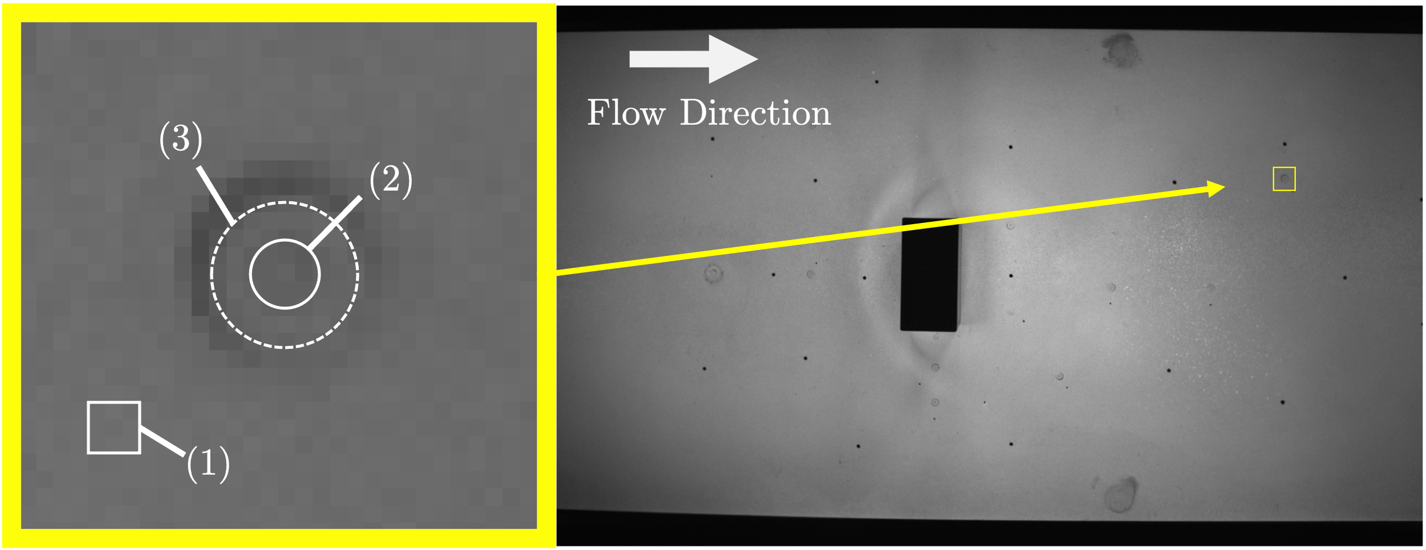
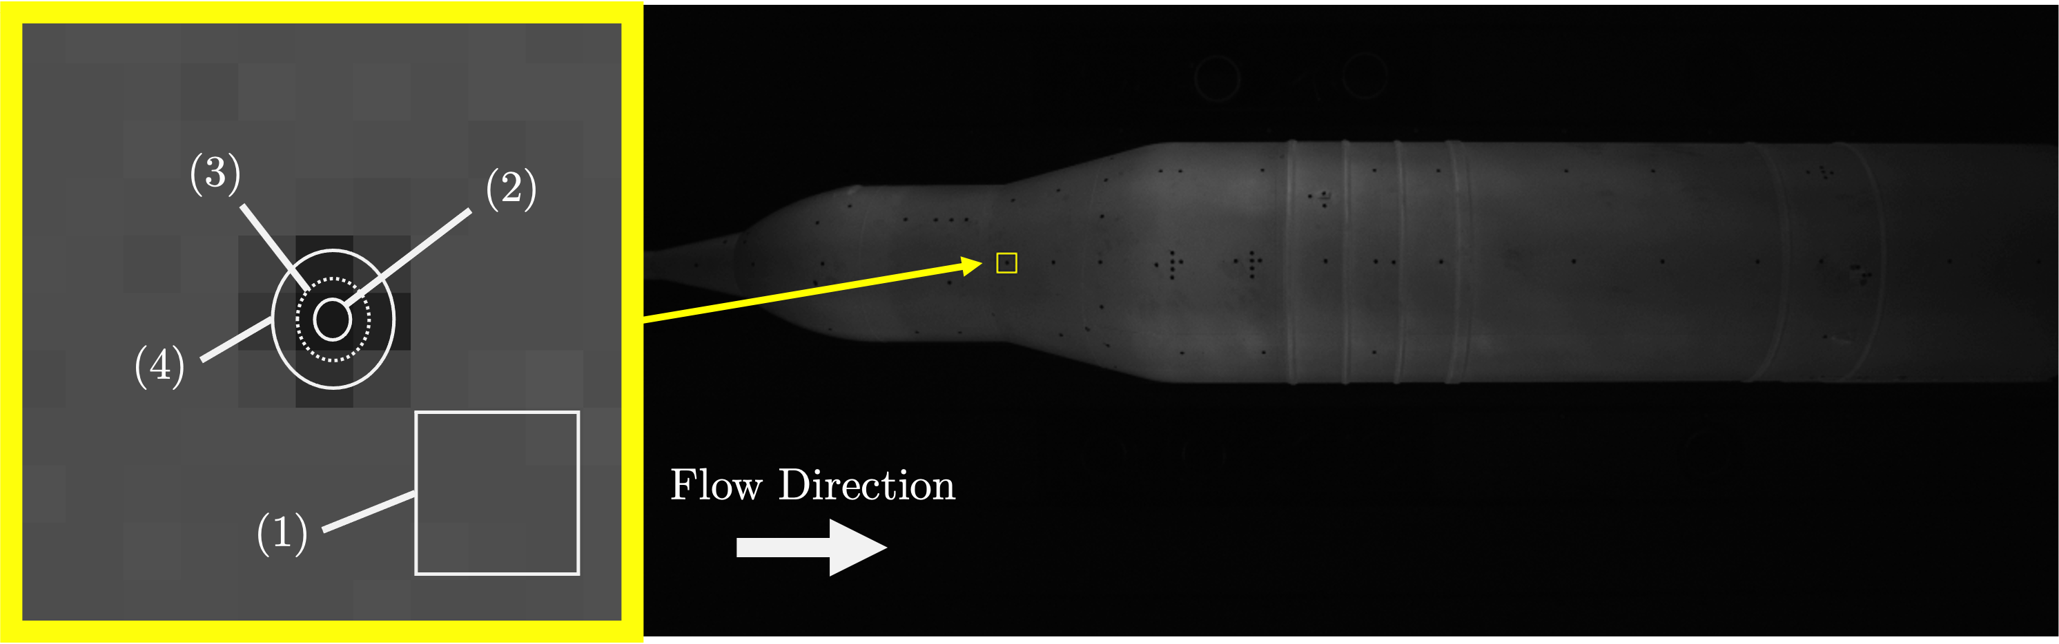
Comparing 🍎’s and 🍊’s
(2022)
Block-on-Plate
Ames FML
PT head ~ 10 px
(2017)
SLS AUAT
Ames 11-FT TWT
PT head ~ ½ px
Notes:
00:30
(01:30)
To illustrate how different PT and uPSP datasets are …
side-by-side of two uPSP high-speed camera frames from two different wind tunnel tests.
The PT size relative to camera pixels varies widely between the two tests. In particular, much lower spatial resolution relative to transducer size in the 11-ft TWT.

Slide 4
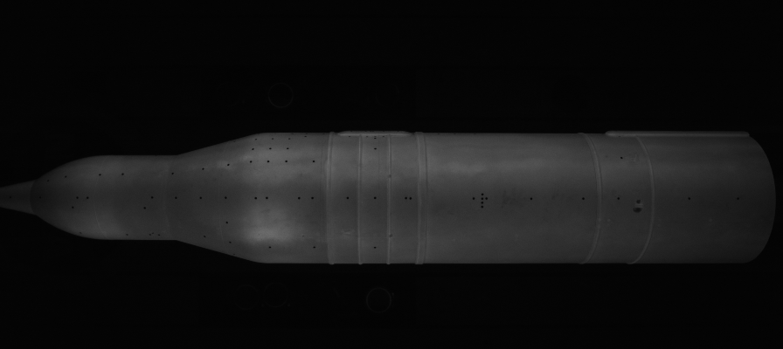
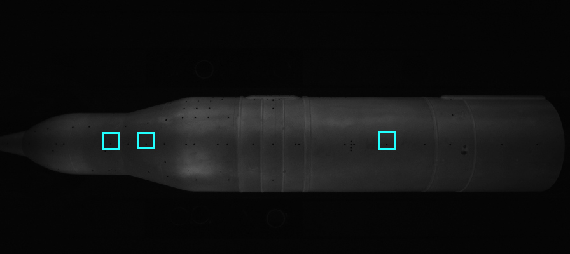
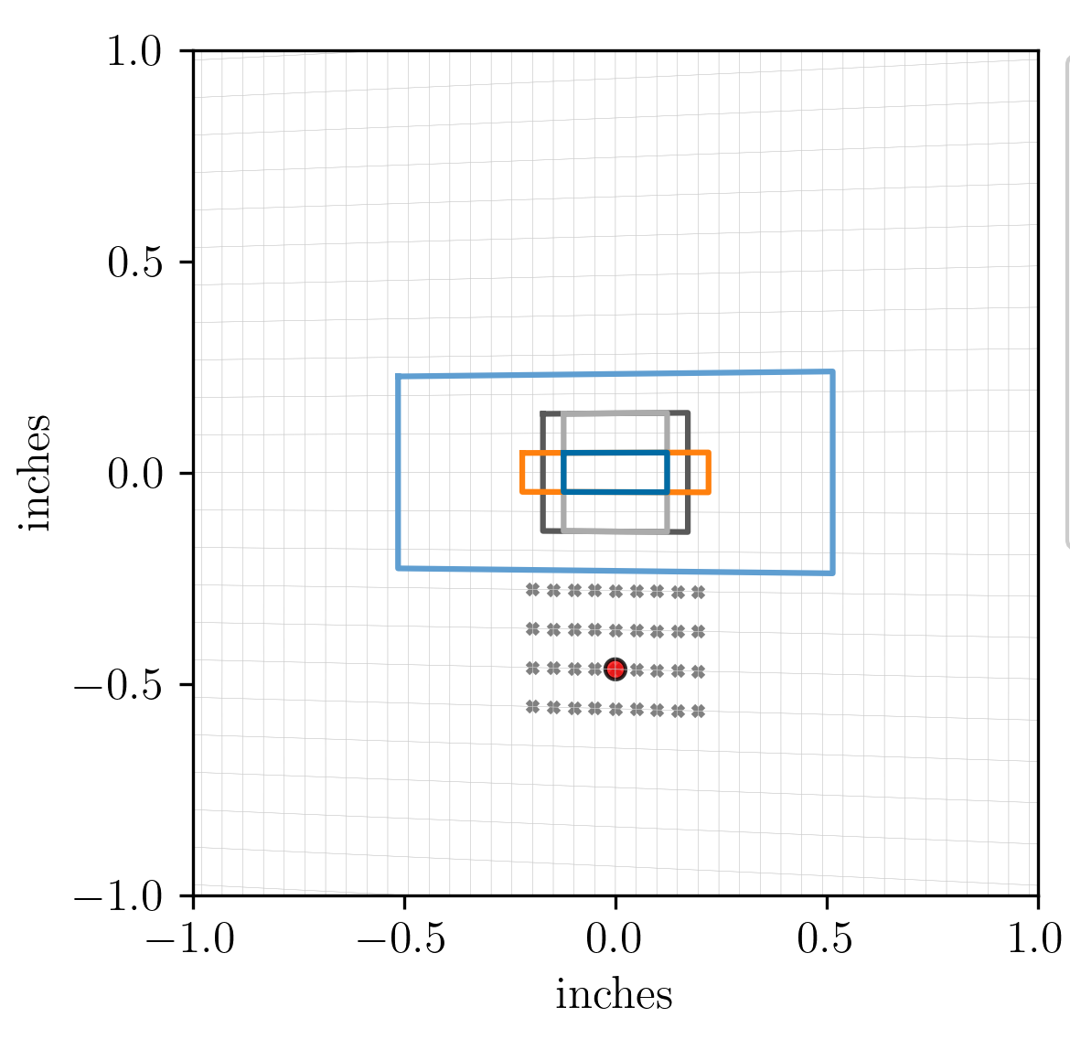
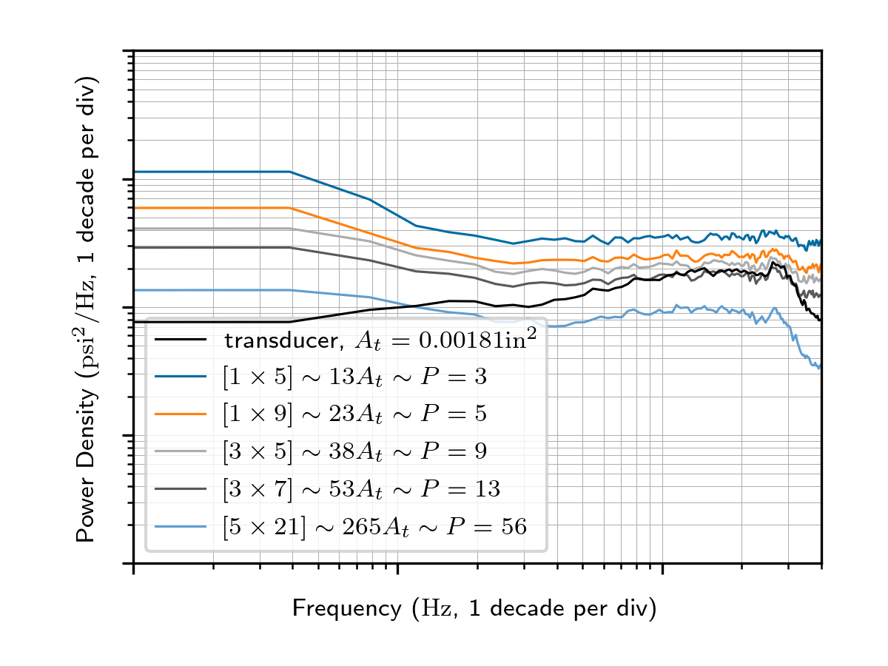
Which comparison is “correct?”
Power Spectral Density (PSD)
VT signal = average
of values at each grid point
“Virtual Transducer”
selection areas
PT head (to scale)
Notes:
01:00
(02:30)

Slide 5
Proposed VT correction method
1. Form (2) VT areas; assume
Flow field fully correlated
Simplified noise model
3. Check correlation assumption
Use (pairwise) time series cross-corr.
Cam. noise annihilated
Remainder: cross-corr. @ zero lag
Plot in VT averaging neighborhood
PT
2. Then,
“Residual” camera noise
Notes:
01:00
(03:30)

Slide 6
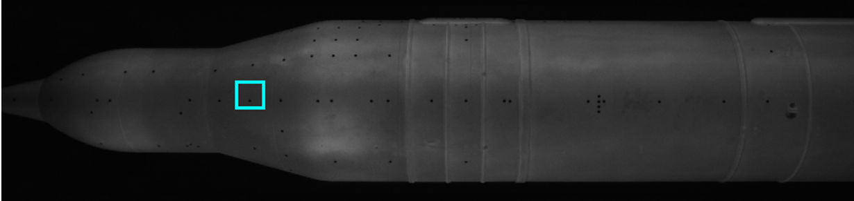
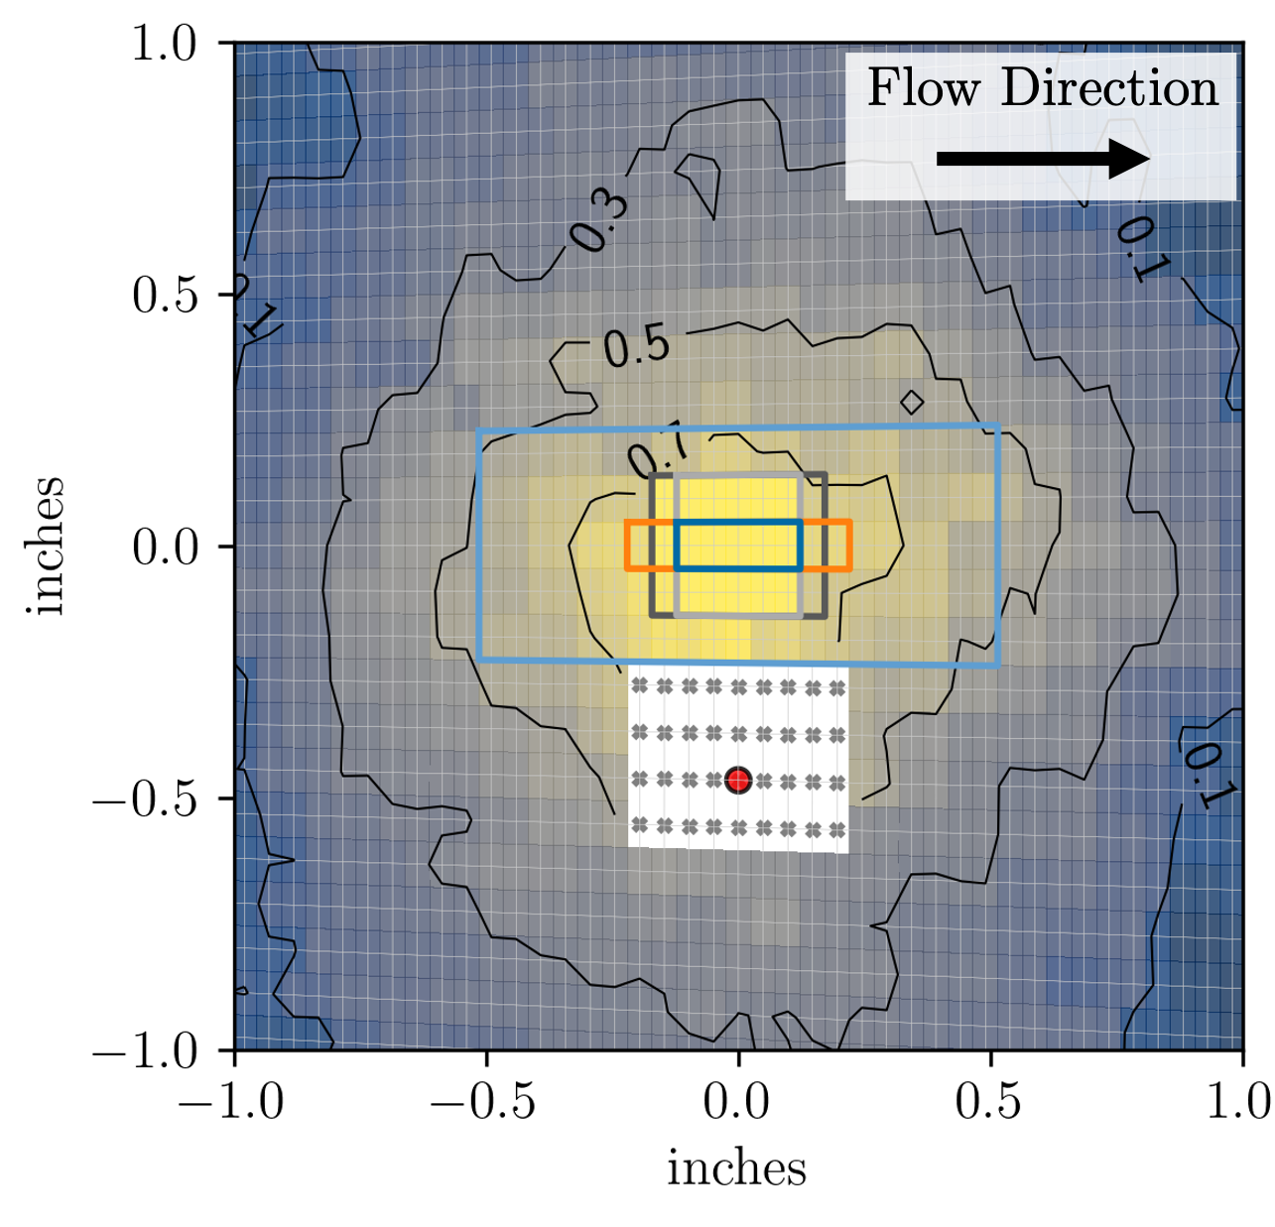
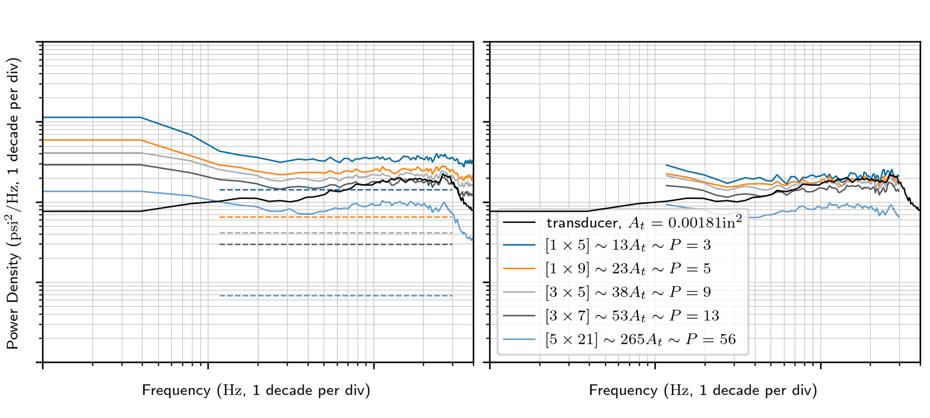
Results (2017 SLS AUAT, Ames 11-ft)
Band-passed
cross-correlation map
(each grid pt w/ VT center pt)
Before
After
Bandpass
PT head (to scale)
Notes:
01:00
(04:30)

Slide 7
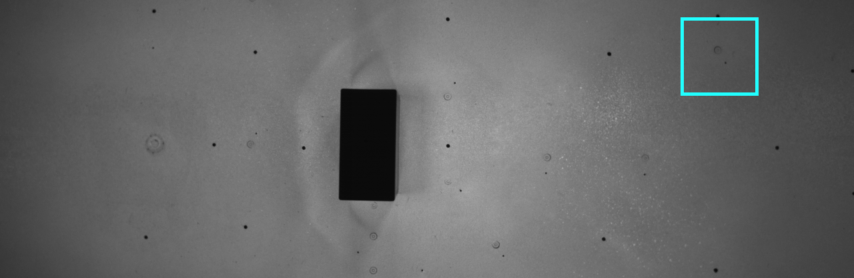
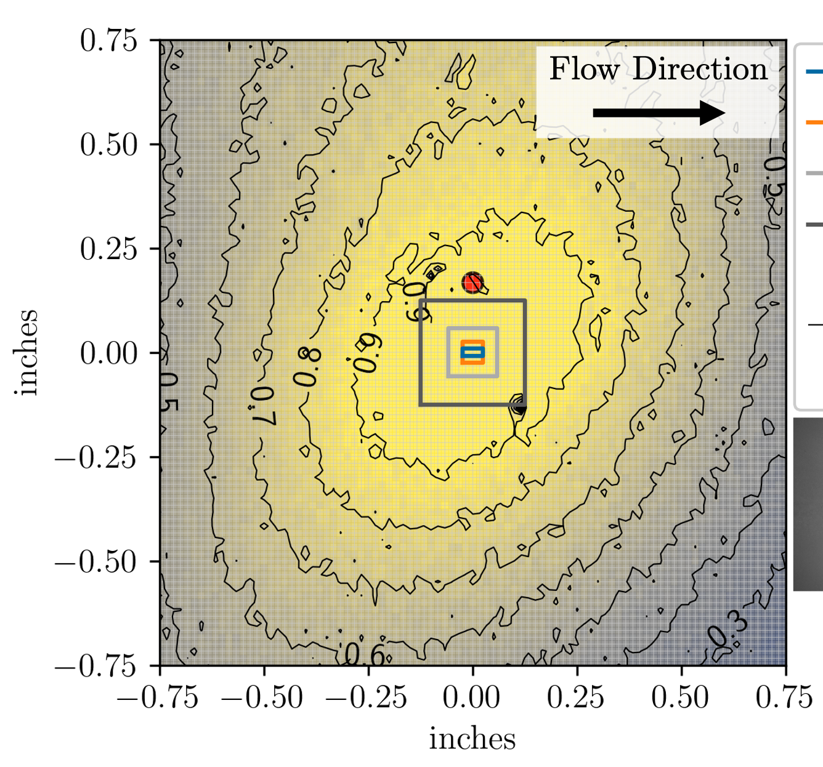
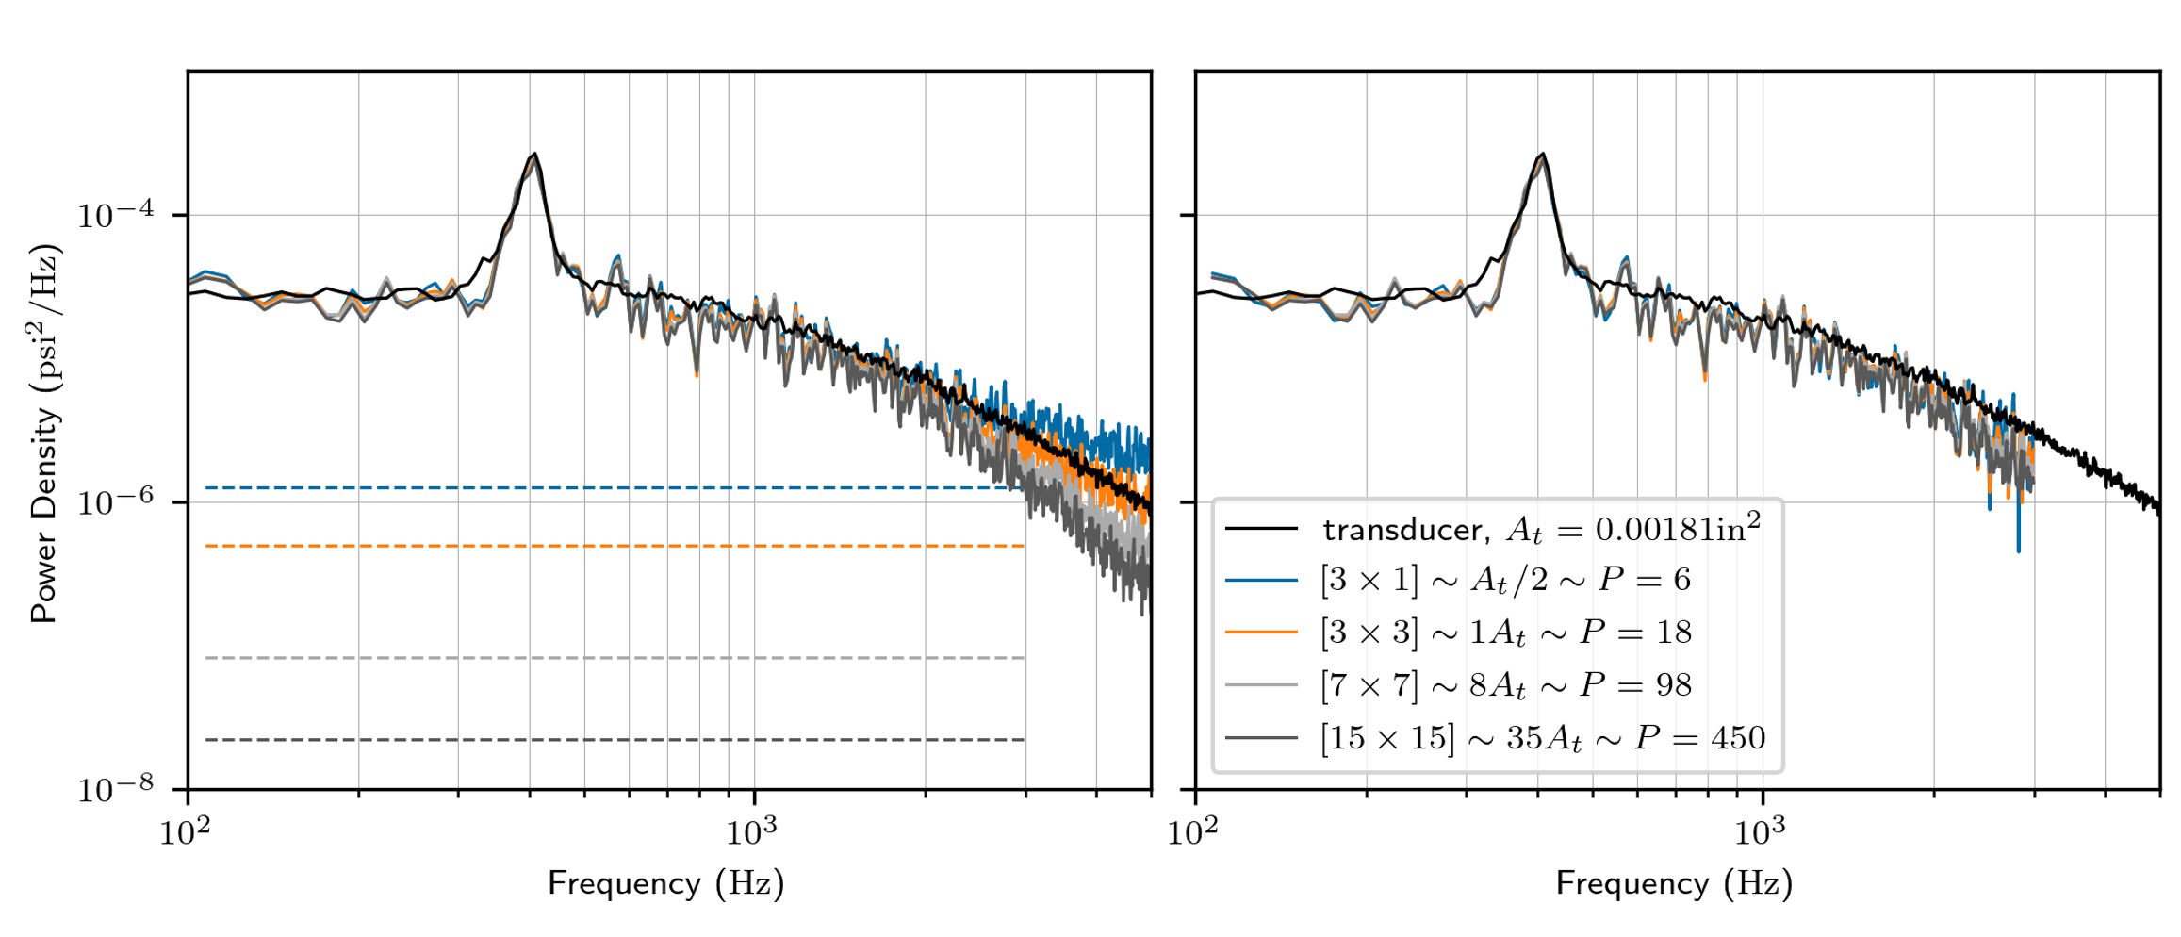
Results (2022 Block-on-Plate, Ames FML)
Band-passed
cross-correlation map
(each grid pt w/ VT center pt)
Bandpass
Before
After
PT head (to scale)
Notes:
00:30
(05:00)

Slide 8
“Global” VT vs. PT comparison
Compare many transducers + several test conditions
Procedure
  Compute surface map of VT RMS with noise correction
  Compare PT to avg. of VT RMS at neighbor grid points
Notes:
00:30
(05:30)

Slide 9
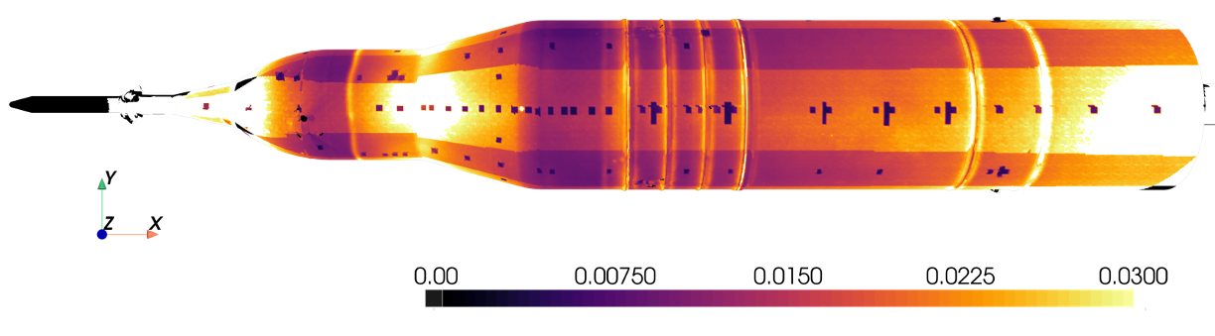
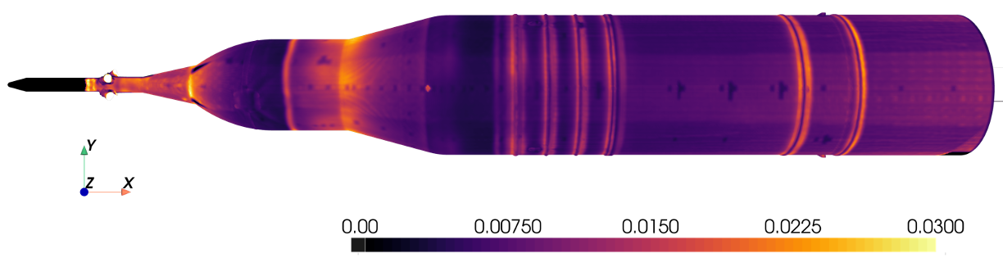
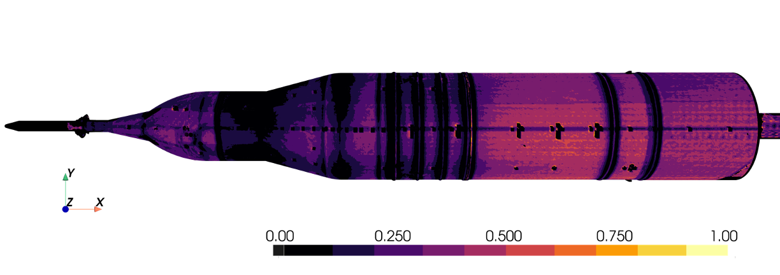
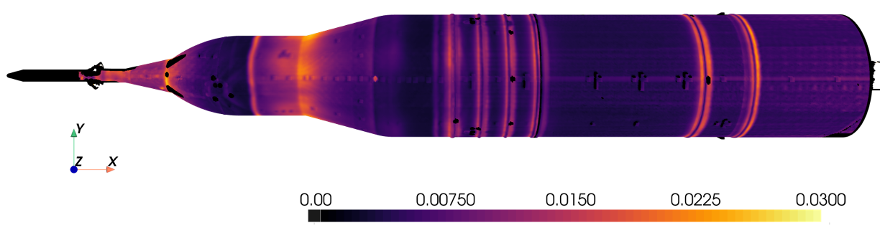



VT RMS ΔCp surface map
…“Bands” = lower camera noise in 2x coverage areas
(A) Original
(B) Area-Averaged
…Bands visible w/ lower SNR
(Bandpassed) $RMS ΔC_{p}$
Relative Diff, |C – B|/B
(C) Area-Averaged – [Residual Noise]
(Bandpassed) $RMS ΔC_{p}$
…Bands (mostly) mitigated
(Bandpassed) $RMS ΔC_{p}$
Notes:
01:00
(06:30)

Slide 10
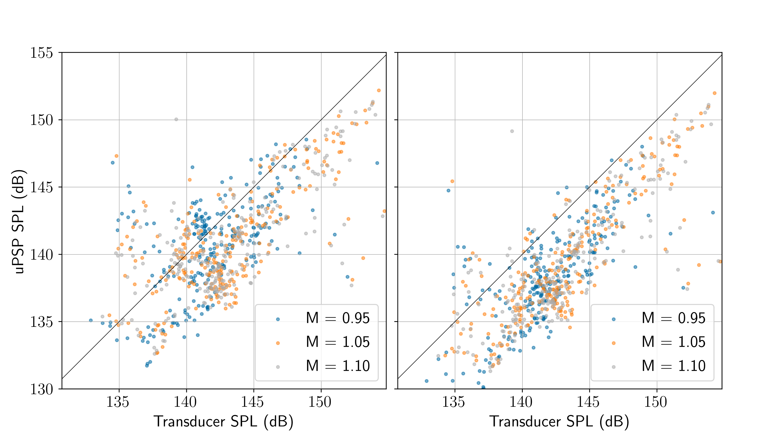
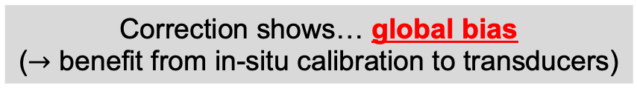
uPSP vs. Transducers (2017 AUAT)
Correction shows… global bias
($→$ benefit from in-situ calibration to transducers)
Before
After
~2-5 dB lower than transducers
Notes:
01:00
(07:30)

Slide 11
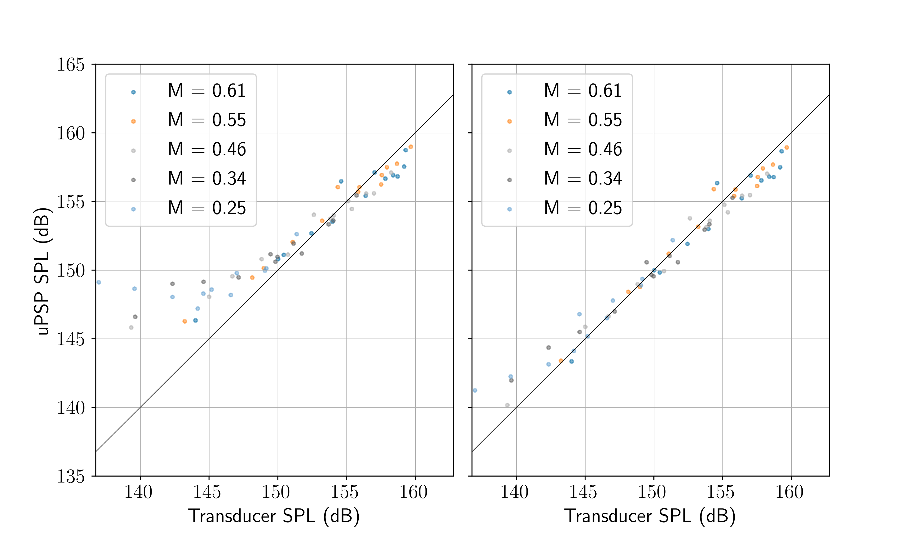
uPSP vs. Transducers (2022 FML)
Correction shows … good agreement with transducers
Before
After
Notes:
00:30
(08:00)

Slide 12
Conclusion
Estimate residual camera noise in uPSP VT signals
  Use two overlapping area averages
  Assume flow is correlated; check w/ cross-correlation map
NASA Ames uPSP system validation takeaways
  2022 FML Block-on-Plate: good agreement
  2017 11-ft SLS AUAT: systematic dB error
Notes:
01:00
(09:00)

Slide 14
Thank you to those supporting this work
NASA Aerosciences Evaluation and Test Capability (AETC)
Space Launch System (SLS) Program
ARC Personnel
  Fluid Mechanics Laboratory Staff
  NAS Division Staff
  UPWT Staff

Slide 15
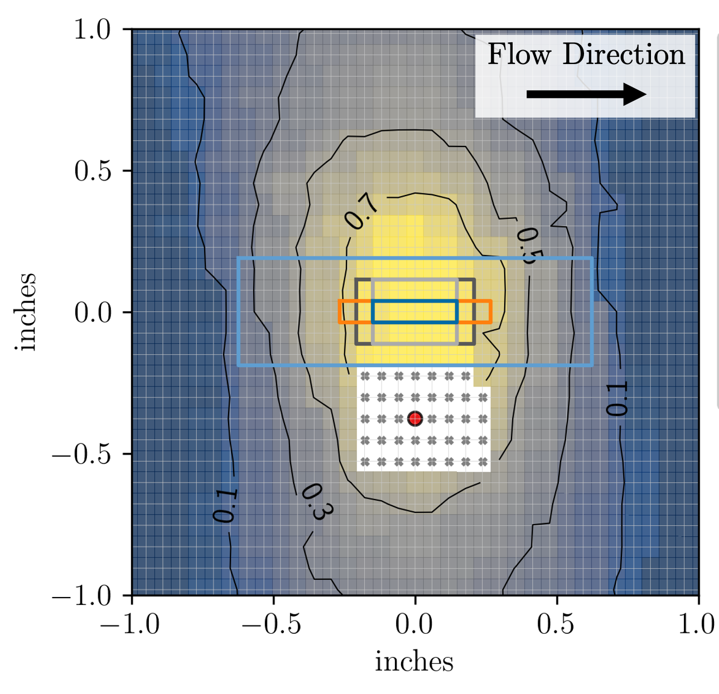
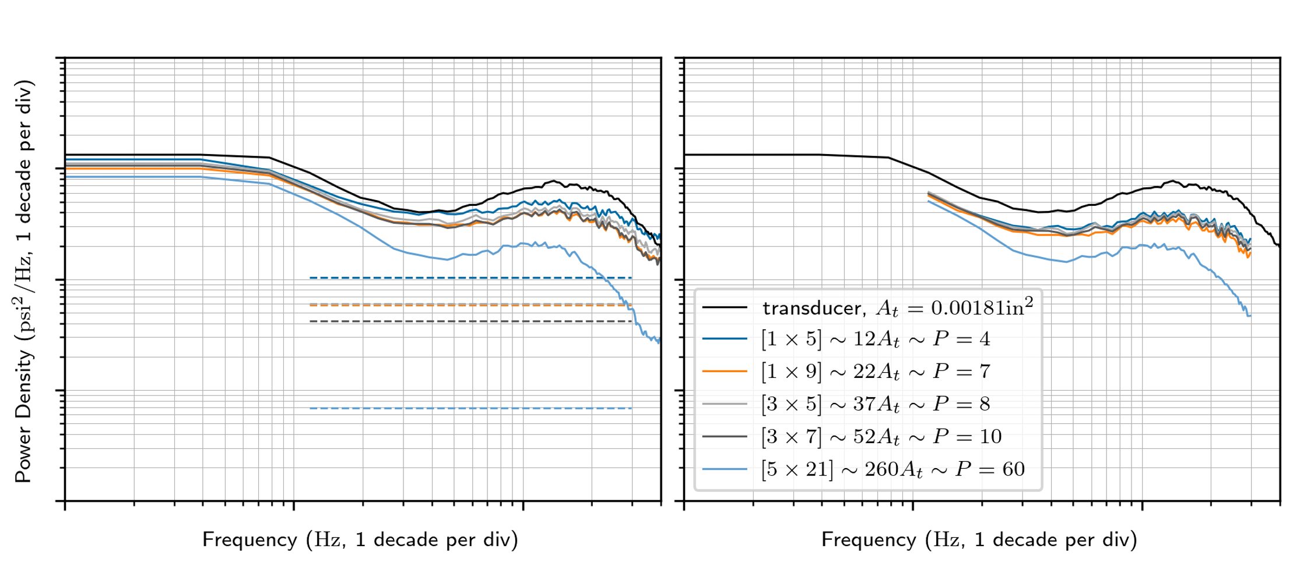
Results (2017 SLS AUAT, Ames 11-ft)
Band-passed
cross-correlation map
(each grid pt w/ VT center pt)
Bandpass

Slide 16
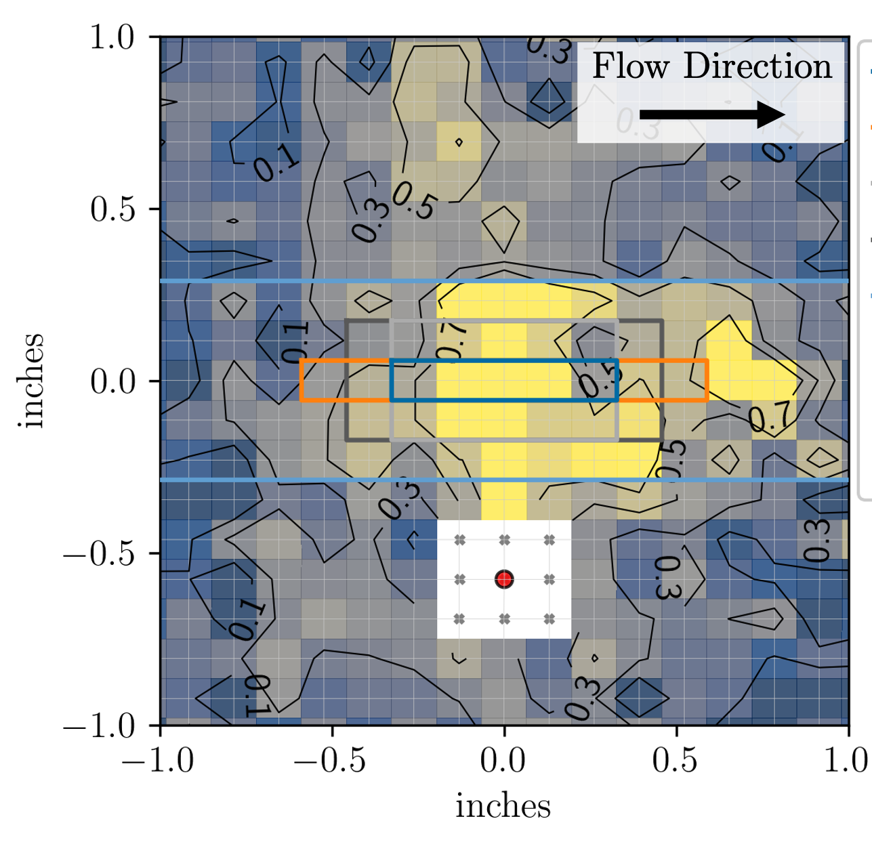
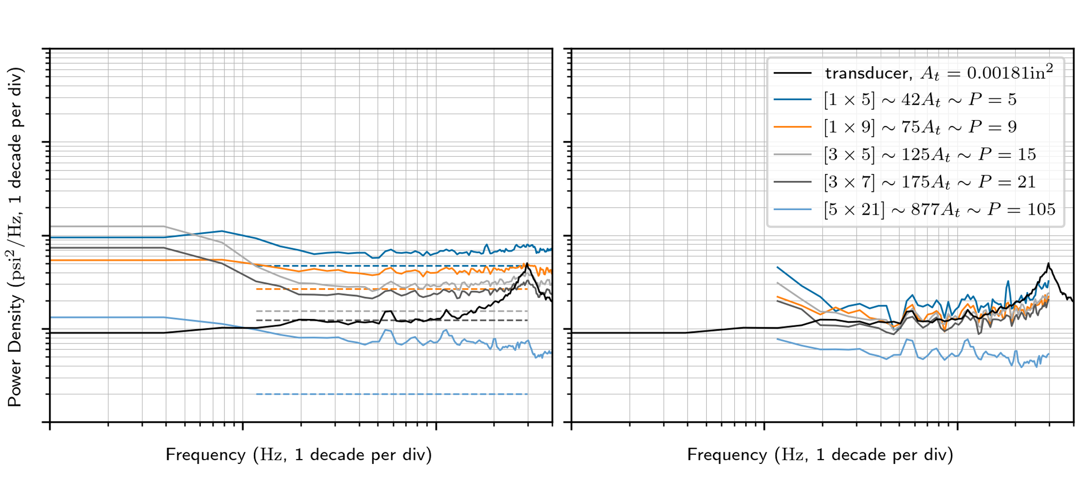
Results (2017 SLS AUAT, Ames 11-ft)
Band-passed
cross-correlation map
(each grid pt w/ VT center pt)
Bandpass

Slide 17
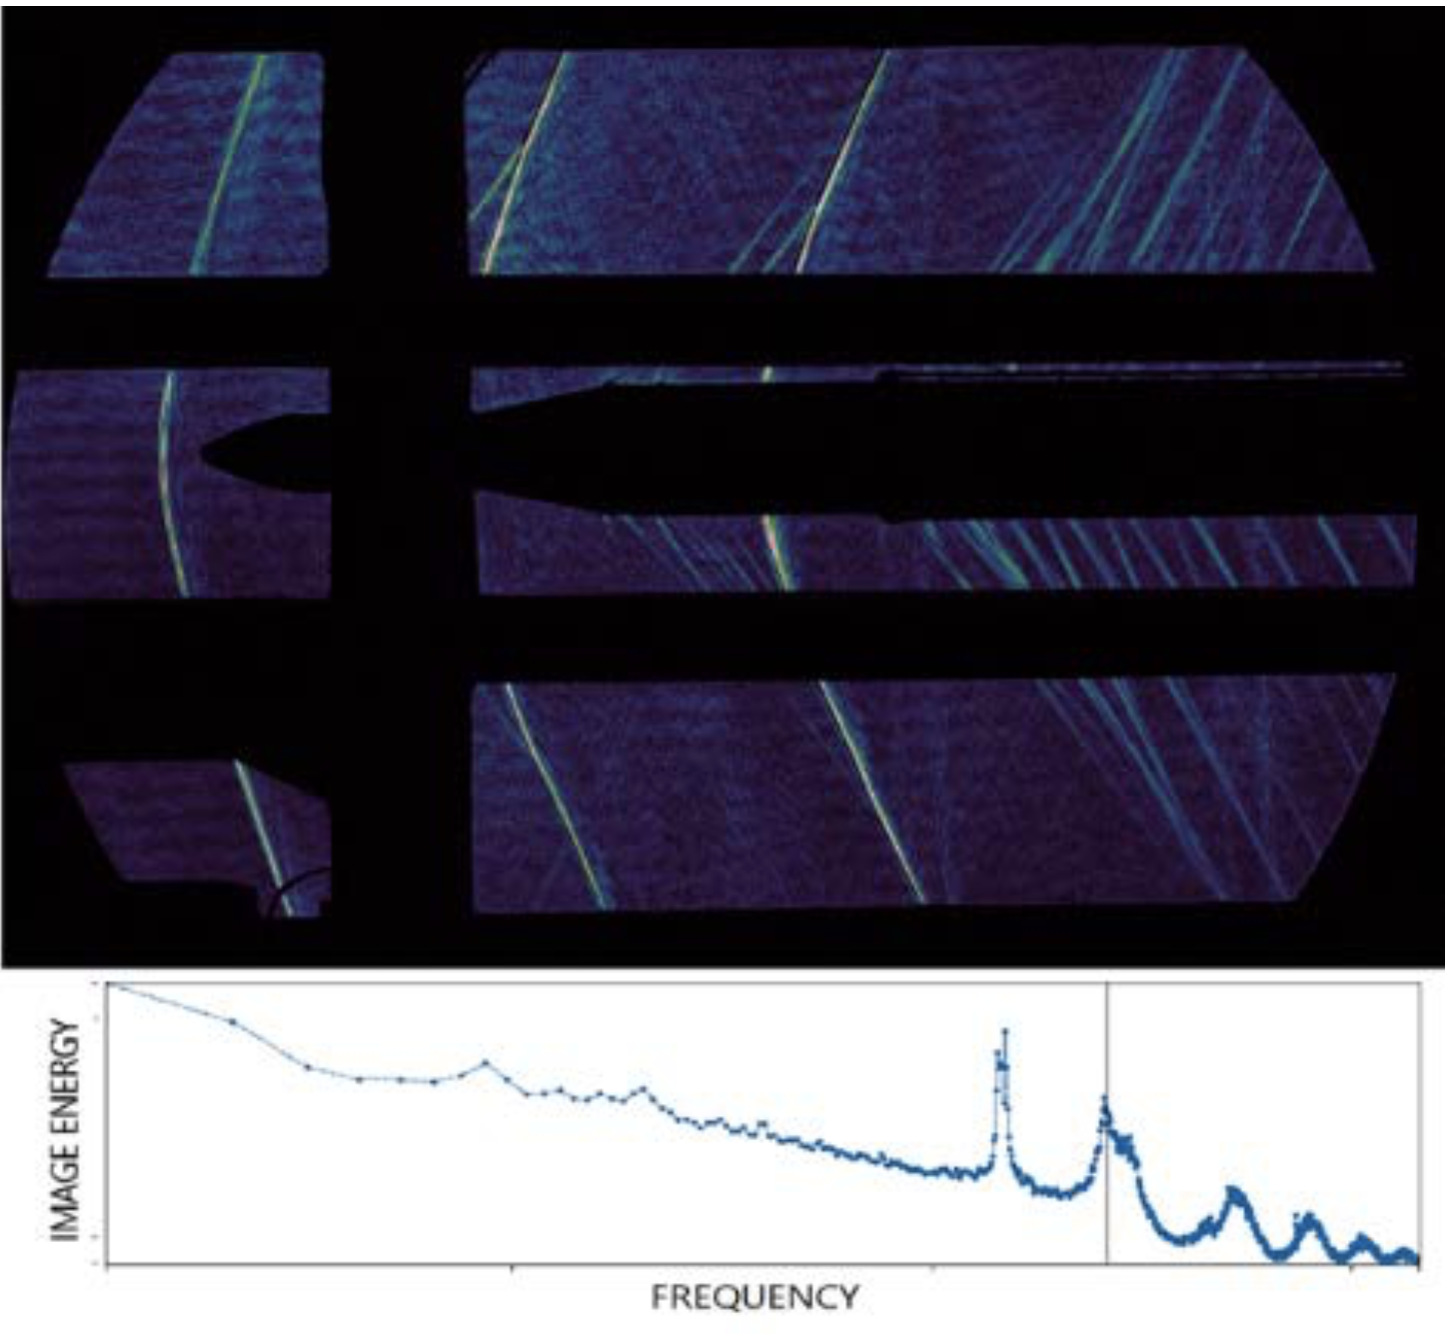
Unsteady aero “toolkit” at NASA Ames
Miniaturized pressure transducers
High-speed shadowgraph
Reproduced with permission from Kulite Semiconductor Products, Inc.
AIAA-2019-3299
Unsteady pressure-sensitive paint (uPSP)
AIAA-2022-0141

Slide 18
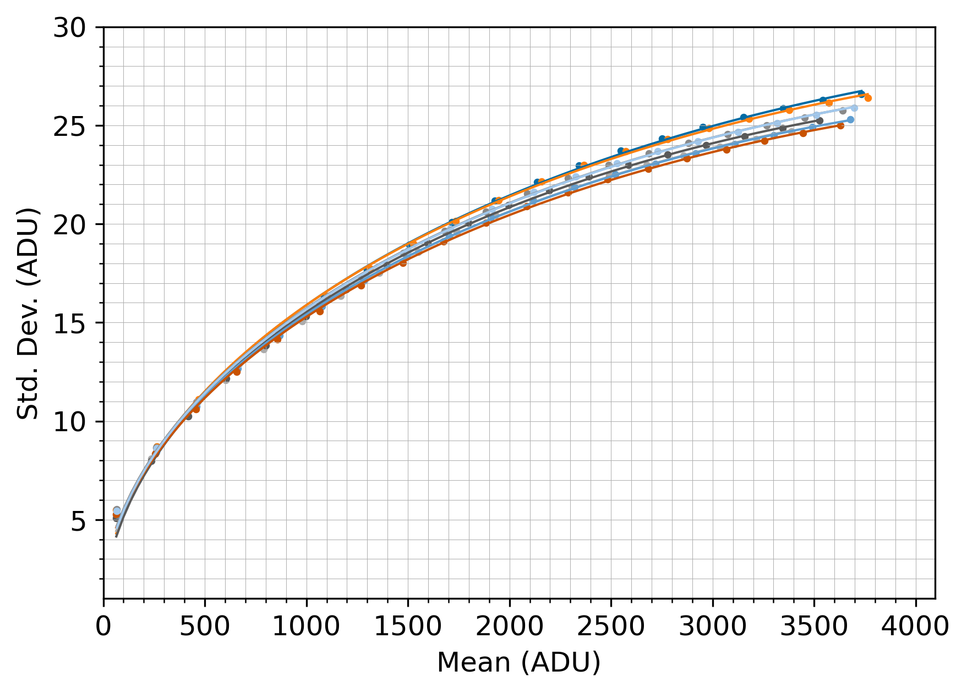
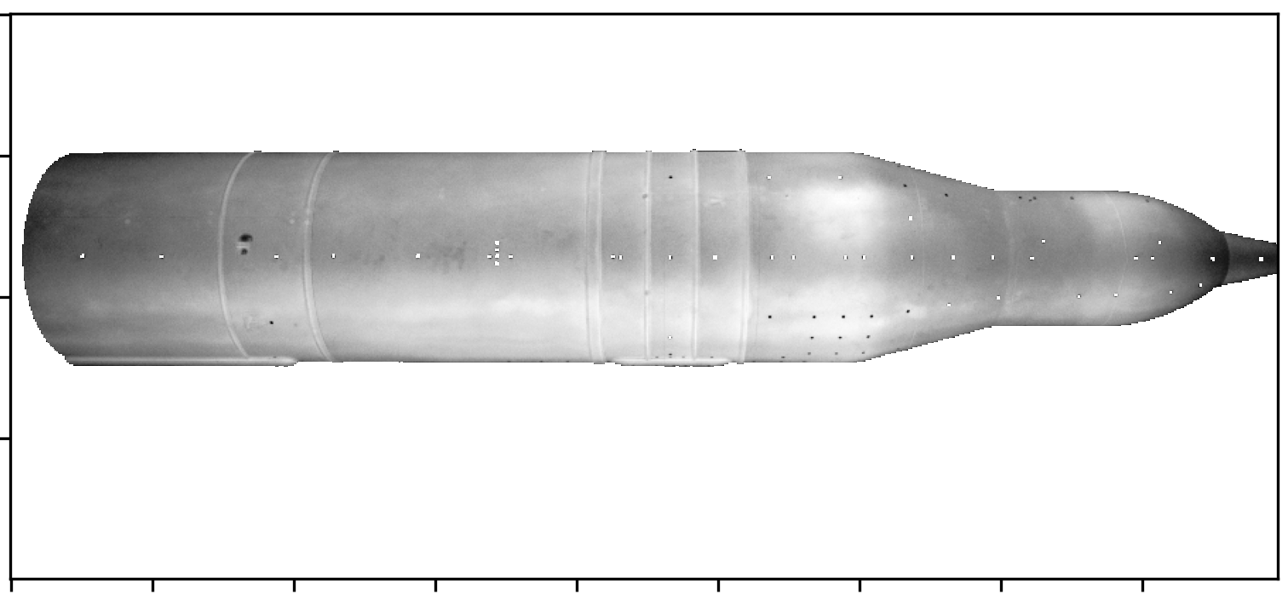
Challenge for uPSP: camera noise
Noise characterization for (8) high-speed cameras
Hypothesis: operating in shot noise-dominated range of sensor
(1st frame, [200, 670] ADUs)

Slide 19
Proposed VT correction method
Consider two area-averaged uPSP signals ,
(Painted) surface point
Assumptions
Flow field fully correlated in averaging area
Simplified camera noise model (~ shot noise)
  Uncorrelated pixel-to-pixel
  Identical variance @ each pixel
Transducer

Slide 20
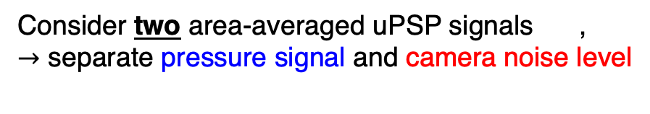
Proposed VT correction method
Consider two area-averaged uPSP signals ,
$→$ separate pressure signal and camera noise level
(Painted) surface point
Transducer
“Residual” camera noise

Slide 21
Proposed VT correction method
Consider two overlapping areas, and assume:
Flow field fully correlated in averaging area
Simplified camera noise model (~ shot noise)
PT
“Residual” camera noise

Slide 22
But surface pressure may not be fully correlated!
Analyze pairwise time series cross-correlation
  Camera noise annihilated
  Remainder ~ cross correlation function @ zero lag
  Build map of this value in VT averaging neighborhood
Qualitative metric (for now…)

