Slide 1
Testing Capabilities and Needs for Fission Space Nuclear Systems-Engine Ground Testing
JANNAF December 2022
Lindsey Holmes
Vice-President, Advanced Projects
Analytical Mechanics Associates
December 7, 2022
Notes:
Please fill in the appropriate TDN numbers and POCs as specified.

Slide 2
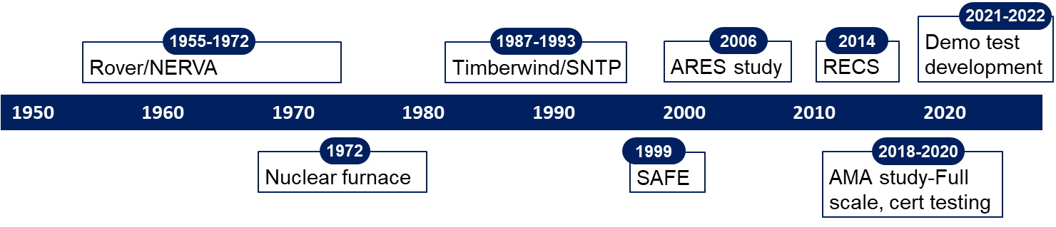
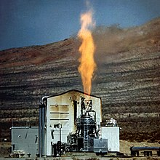
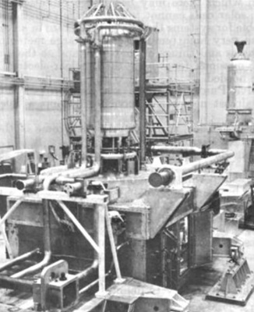
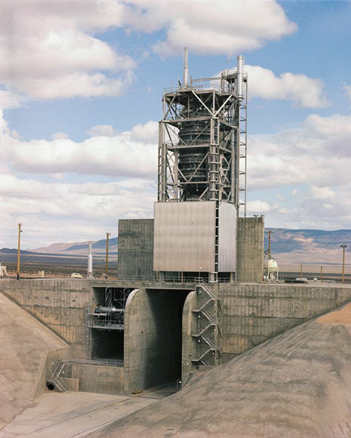
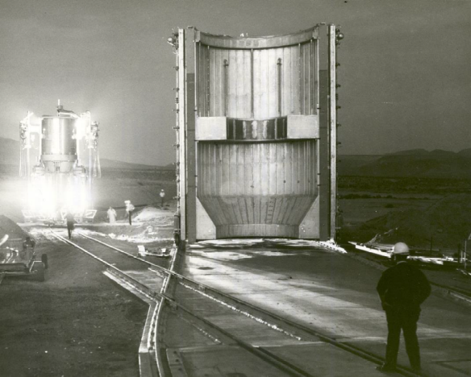
1955-1972, Rover/NERVA: Tested 22 HEU reactors and engines in multiple open-air test stands
  Test Cell A and C utilized for nozzle-up reactor tests
  Engine Test Stand 1 (ETS-1): Only NTP engine test stand, tested XE’ nozzle-down with 28 restarts, 3 hrs 48 min total duration. Estimate to rebuild $FY22 ~$850M (exhaust processing not included)
  Nuclear Furnace (NF-1): first demonstration of hydrogen exhaust scrubbing, albeit low power and low flow rates
1987-1993, Timberwind/SNTP: Planned for “real-time” exhaust scrubbing, EIS for NNSS approved but program cancelled prior to construction
1999-present: Multiple engine testing concepts proposed (see next slide) including demonstrating/testing in space. Recurring challenges: Cost, schedule and regulatory approval
Kiwi-A Test Fire
Nuclear Furnace (NF-1)
Engine Test Stand 1
(ETS-1)
Shielded Engine Test Compartment for ETS-1

Slide 3
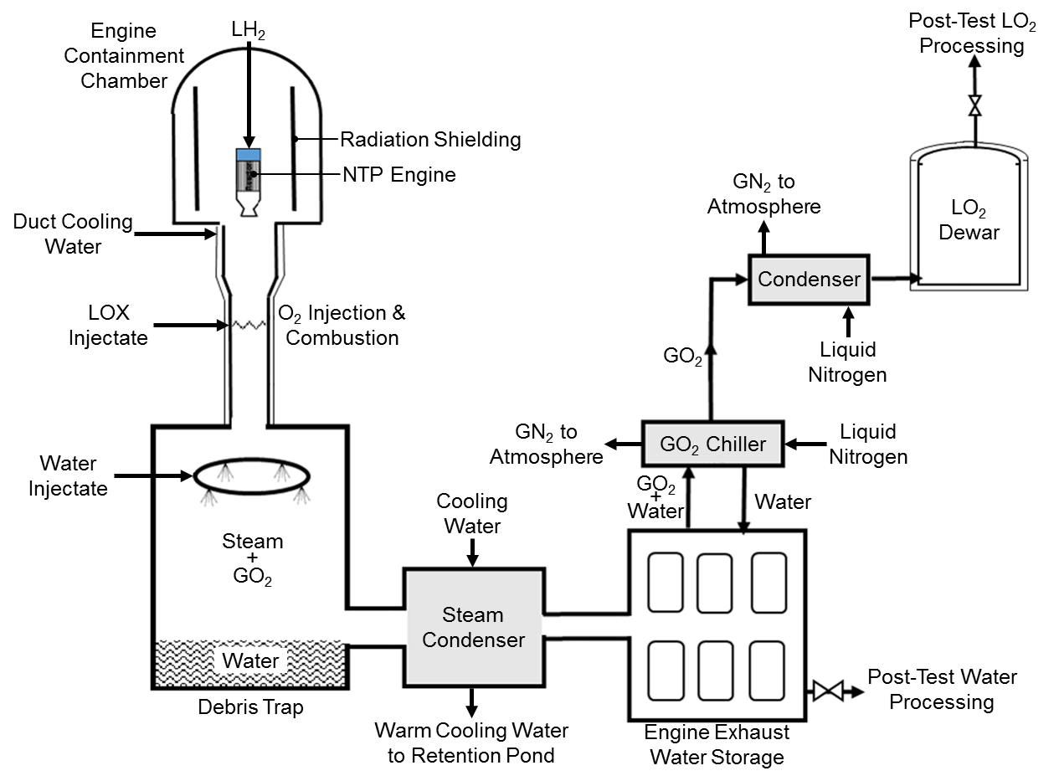
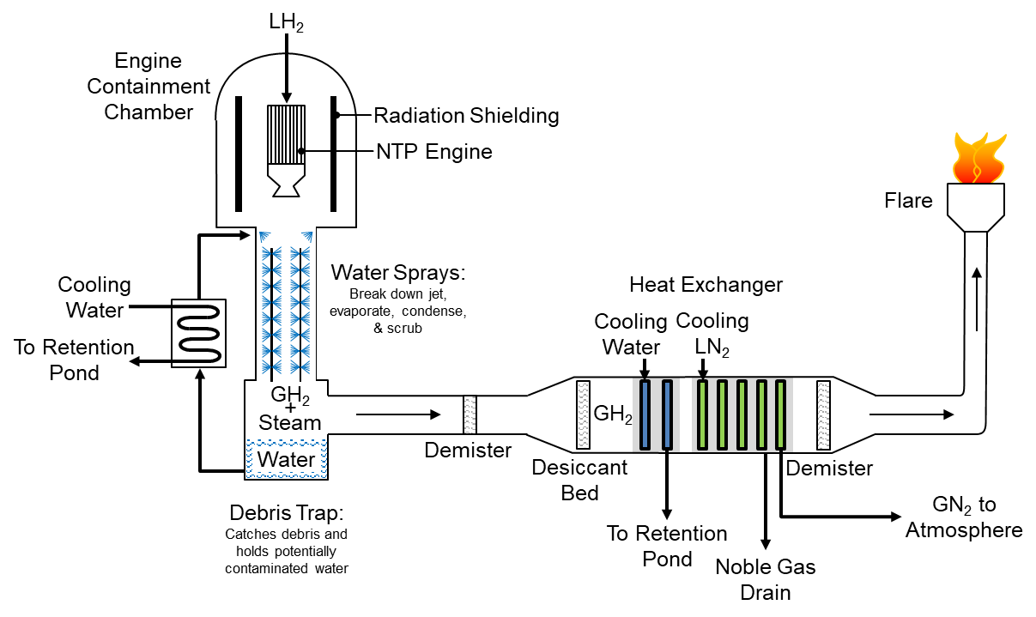
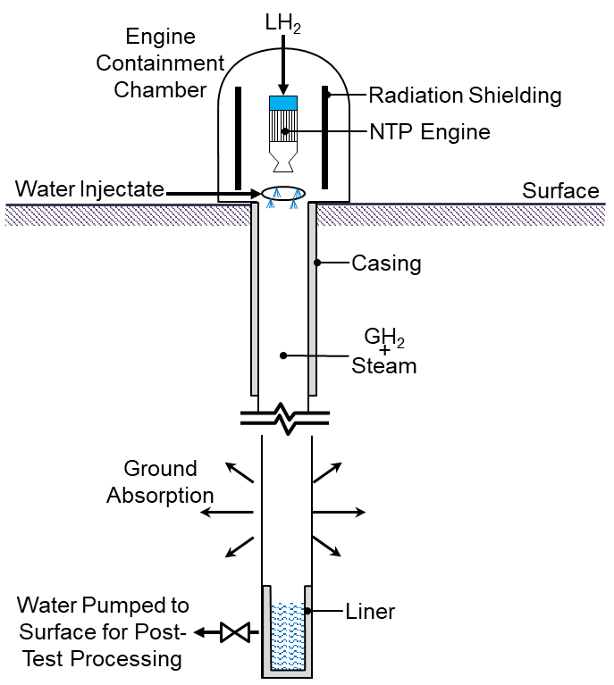
NTP Engine Exhaust Processing Concepts
Increased regulations post-NERVA require additional safety measures—numerous concepts have been proposed
Rocket Exhaust Capture System (RECS)
Engine hydrogen exhaust is burned at high temperatures with oxygen and produces steam to be cooled, condensed, and collected for controlled processing and disposal
Real-Time Processing
Engine hydrogen exhaust is injected with water to break down, evaporate, condense and cool. Noble gases removed via cryo cooler and hydrogen flared.
Subsurface Active Filtration of Exhaust (SAFE) / Borehole
Relies on permeability of soil to absorb and filter engine exhaust. Borehole dewatered and post-test processed
RECS
Real-Time
SAFE / Borehole
Post-Run Capture System (PRCS)
Hydrogen exhaust is flared through vents, sensors monitor the exhaust, if excessive fission products present, engine shuts down and remainder of exhaust is captured for decay or processing
PRCS
Numerous variations on concepts
MOAR SAFE: SAFE with exhaust flared until excessive fission product detected, then exhaust redirected to borehole
PRCS with real-time processing of cool-down exhaust
PRCS with higher back-pressure (different nozzle configuration) to allow for full exhaust capture
Accumulation Tanks

Slide 4
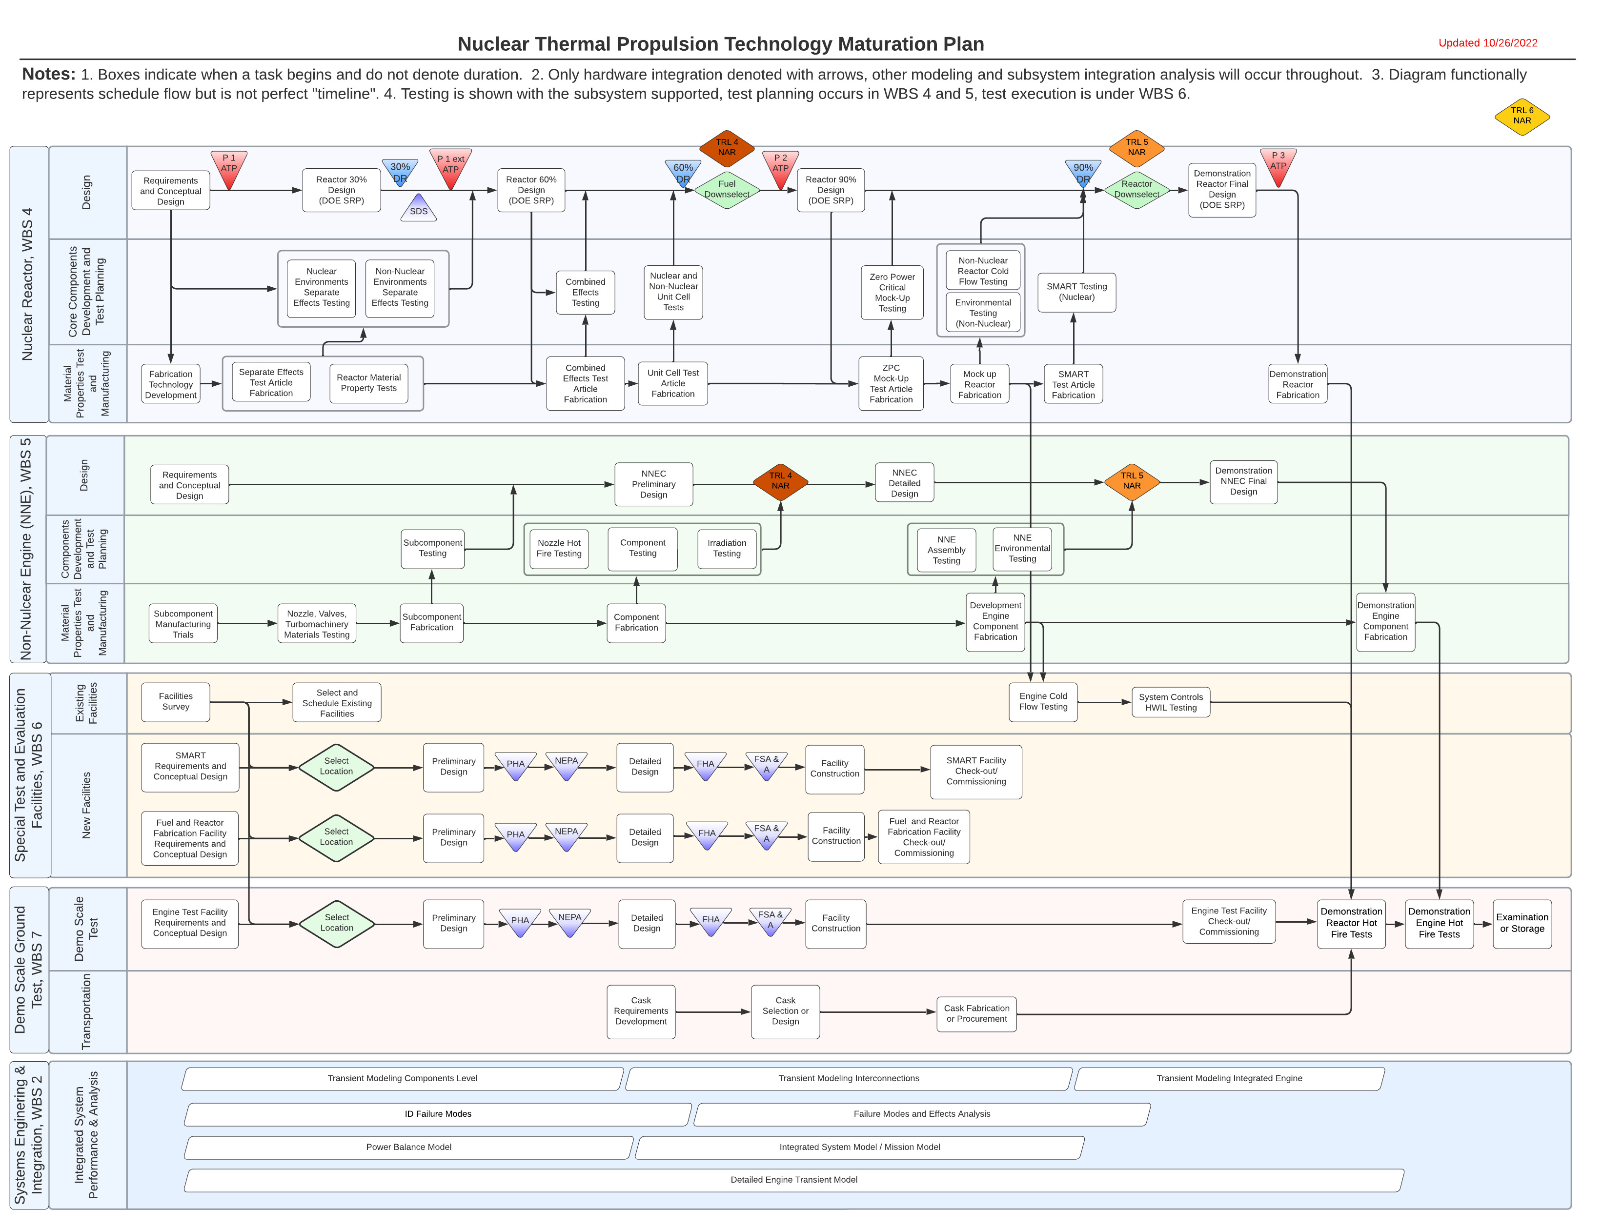
Manufacturing, testing, M&S, PIE, and design iterations will be required to mature reactor and engine designs—Requires manufacturing, test, and inspection facilities and equipment
Reactor and Engine Testing

Slide 5
Potential Facilities for NTP Technology Maturation
Reactor Storage & Transport
Certified Casks
On-site Casks
New Certified Casks
INL Storage
NNSS Storage
Reactor
Reactor
Examination
INL HFEF
INL IMCL
ORNL IMET
ORNL IFEL
Argonne IML
INL AL
INL SPL
INL FASB
INL EML
MIT Nuclear Reactor Lab
EMAD
Higher Temp Capabilities
Reactor Nuclear Testing
ACRR
HFIR
OSTR
OSURR
MITR-II
ATR
FBR
MURR
NBSR
PSBR
PULSTAR
TAMU NSC
Other University Facilities
TREAT
ZPPR
NCERC
DAF
Other Irradiation Facilities
SMART
Reactor Non-Nuclear Testing
CFEET
HHEAT
NTREES
ORNL I&C Testbed
Industry Facilities
Mock-up Cold Flow TBD
Mockup Environmental TBD
Hardware-in-the-Loop
Reactor
Fabrication
& Assembly
GRC
MSFC
LANL
INL
ORNL
LaRC
Ames
Univ of Tennessee
Univ of S Carolina
NNSS
Fuel Fab
Component Fab
USNC NASA SBIR, High Temp
Fuel/ Reactor Fab
Reactor Assembly
Engine Test Facilities (ETF)
Water
Power
TCC
Test Stand
AI&T
ETF System Test Facilities
SSC
E-Complex
INL Demo Test
NSS Demo Test
Structure
Exhaust System
GN2 System
GHE System
Firex System
Propellant System
Test Cell
ETF System
Shops
TBD
Potable Water System
Electrical Power System
Data Systems
HVAC Systems
Test Water System
Water Retention Pond
TBD
Integrated Engine
Assembly
INL, TBD several options
NNSS, TBD several options
TBD-Sprung Structure
NNE
Assembly
Testing
MSFC
SSC
Industry Facilities
Engine
NNE
Assembly
MSFC
SSC
Industry Facilities
Govt Provided, Existing, Operational Facility
NNE Fabrication
Vendor Facilities
Govt Provided, Existing Facility Requiring Mods
Govt Provided, New Facility
Contractor Provided, Existing Facilities
NNE Component
Testing
MSFC Test Facility 116
MSFC CDA
SSC
OSTR
Sandia Irradiation
MSFC Hot Cell
Other irradiation facilities
ORNL I&C Testbed
Industry Facilities
Hardware-in-the-Loop
Contractor Provided New/Modified Facility
TBD
NNE Storage & Transport
TBD

Slide 6
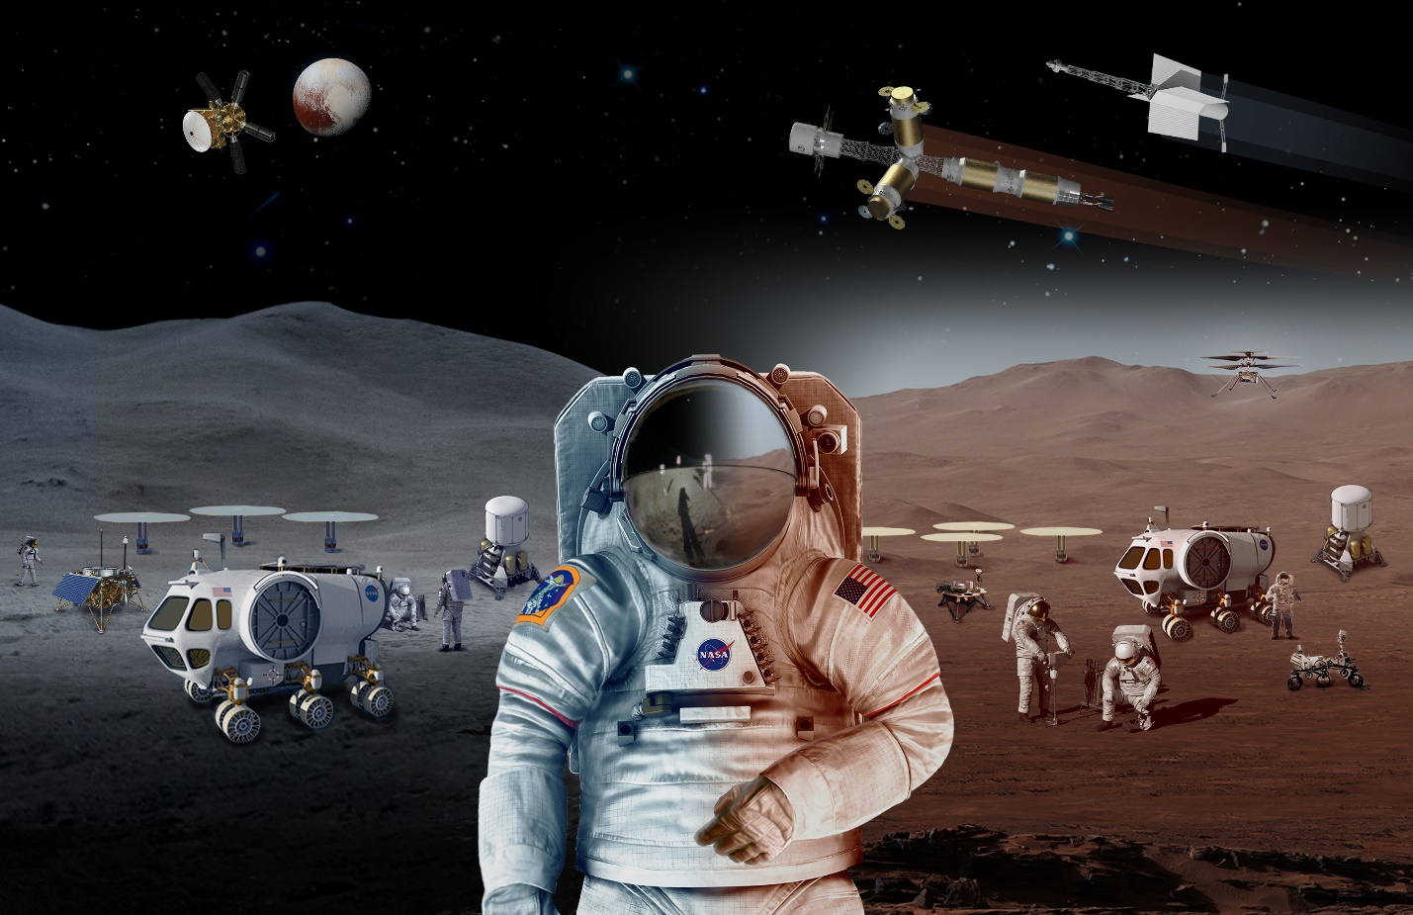
Lindsey Holmes
lindsey.m.holmes@ama-inc.com

Slide 7
Acronyms
ACRR = Annular Core Research Reactor (Sandia)
ALARA = As low as reasonably achievable
ALB = Analytical Laboratory
ATR = Advanced Test Reactor (INL)
CFEET = Compact Fuel Element Environmental Test
DAF = Device Assembly Facility
EIS = Environmental Impact Statement
EMAD = Engine Maintenance Assembly and Disassembly Facility
EPA = Environmental Protection Agency
FASB = Fuel and Applied Science Building
FBR = Fast Burst Reactor (White Sands)
GRC = Glenn Research Center
HFEF = Hot Fuels and Examination Facility
HFIR = High Flux Isotope Reactor (ORNL)
HHEAT
IFEL = Irradiated Fuels Exam Lab
IMCL = Irradiated Materials Characterization Lab
IMET = Irradiated Materials Lab (ORNL)
IML = Irradiated Materials Lab (Argonnee)
INL = Idaho National Lab
LANL = Los Alamos National Lab
LaRC = Langley Research Center
MFC = Materials and Fuels Complex
MITR-II = Massachusetts Institute of Technology
MSFC = Marshall Space Flight Center
MURR = University of Missouri Research Reactor
NBSR = NIT Research Reactor
NCERC = National Criticality Experiments Research Center
NNE = Non-nuclear engine
NNSS = Nevada National Security Site
NTREES = Nuclear Thermal Rocket Element Environmental Simulator
ORNL = Oak Ridge National Lab
OSTR = Oregon State TRIGA Reactor
OSURR = Ohio State University Research Reactor
PBR = Penn State Breazeale Nuclear Reactor
PRCS = Post Run Capture System
PULSTAR = North Carolina State University Reactor
RECS = Rocket Exhaust Capture System
SAFE = Subsurface Active Filtration of Exhaust
SMART = Subscale Maturation of an Advanced Reactor Test
SPL = Sample Prep Lab
SSC = Stennis Space Center
TAMU NSC = Texas A&M University Nuclear Science Center Reactor
TCC = Test Control Center
TREAT = Transient Reactor Test Facility (INL)
TRIGA = Training, Research, Isotopes, General Atomics
ZPPR = Zero Power Physics Reactor

