Slide 1
Effects of dose error and sample size on sonic boom dose-response curves
Will Doebler, Aaron Vaughn, Nathan Cruze, Kathryn Ballard, Jonathan Rathsam, and Pete Parker
183rd Meeting of the Acoustical Society of America
Nashville, TN
December 6, 2022
2pNS3

Slide 2
Outline
Quesst Mission
Brief info on previous NASA sonic boom community noise flight tests
  Noise dose error
  Dose-response modeling results
Simulation experiment to assess impact of dose error and number of survey participants on dose-response models
  Set-up
    Population model
    Dose experimental design
    Injecting dose error
  Modeling approach
  Simulation results
Dose error mitigation strategies
  Simulation extrapolation, regression calibration, Bayesian methods, data cloning
Summary
Notes:
I will first quickly brief NASA Quesst Mission in case you missed earlier talks. Then I will briefly show some information from previous NASA sonic boom community noise flight tests. Then the main portion of the presentation is a dose-response simulation experiment to assess and quantify the impact of dose error and number of participants on dose-response models. Putting the simulation in context with recent work on the topic, this simulation is directly applicable to the X-59 community responses tests and it also uses slightly more complex modeling techniques than simple logistic regression, which is commonly used in the literature.
I’ll conclude by briefing some dose error mitigation techniques.

Slide 3
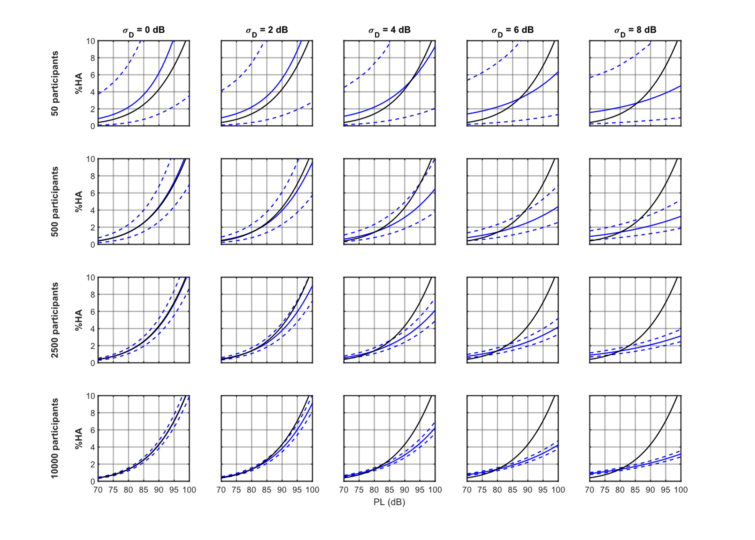
Key Takeaways: Noise Dose Error Effect
Noise dose error (uncertainty) in sonic boom community noise surveys can arise from many sources: e.g., sparse measurements and turbulence effects
Noise dose error causes attenuation or flattening of the slope
of dose-response models:
The attenuation cannot be alleviated by recruiting additional participants
Methods exist to correct the effects of error in the noise dose
No dose error
With dose error
True
Percent Annoyed
Modeled
Noise Dose (dB)
Notes:
These are the key takeaways from this talk. When noise doses are estimated in community noise surveys, there is error or uncertainty in the estimated doses for the survey respondents from many sources for example sparse acoustic measurements or effects of turbulence on sonic booms.
Traditional statistical modeling of these community noise surveys assumes there is no error in the noise dose.
However, error in measuring or estimating the noise dose causes the modeled dose-response curve to flatten and not match the true underlying population. This attenuation is not alleviated by recruiting additional participants, it just shrinks the confidence interval around the inaccurate attenuated curve. Also note that this attenuation does not have the same definition as acoustic attenuation of sound it’s just describing the slope reduction.
At the end of the talk, some methods will be briefed that we are looking into that can account and correct for the attenuation due to dose error.

Slide 4
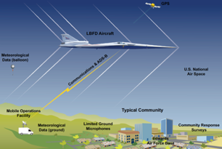
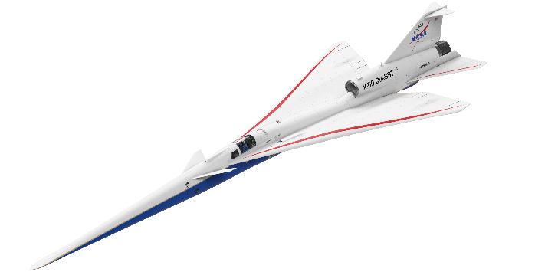
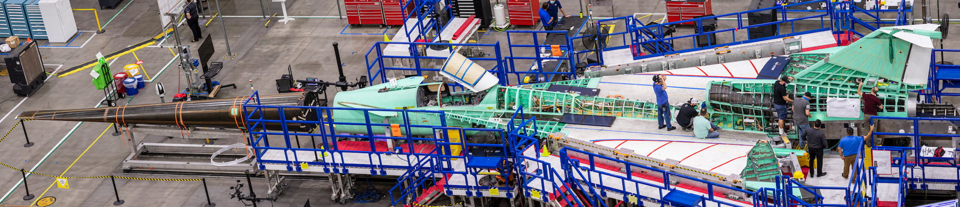
Quesst Mission: Goal is to provide dose-response data to regulators
Phase 1:
Construction, First Flights, and Planning
Phase 2:
Acoustic Validation
Phase 3:
Community Noise Testing
Notes:
NASA’s Quesst Mission has a goal of providing dose-response data to the FAA and ICAO for use in informing potential new noise certification standards for low-boom aircraft in supersonic cruise. It is broken into 3 phases. First is construction of the aircraft, its first flights and safe flight envelope expansion, and planning for the future phases. The second phase is acoustic validation where we ensure the X-59’s sonic thump has achieved its loudness goal and to validate our prediction tools. The last phase is flying the X-59 over up to 5 communities across the US for about one month, introducing community members to up to 6 sonic thumps per day. A longitudinal community noise survey will be administered to collect the perceptual response of the communities, and this noise dose versus perceptual response will be provided to the regulators.

Slide 5
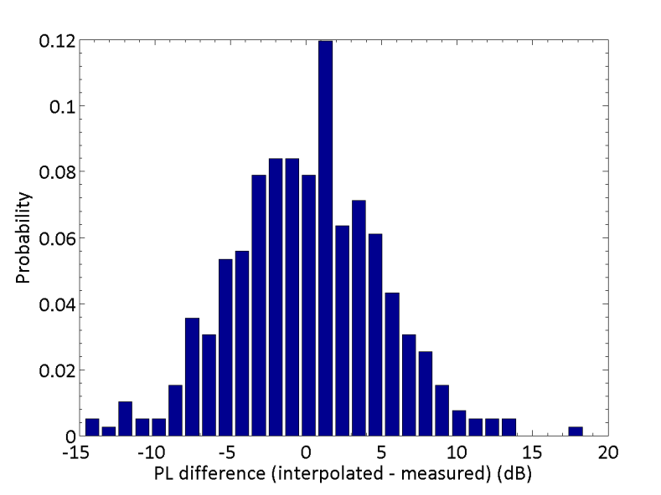
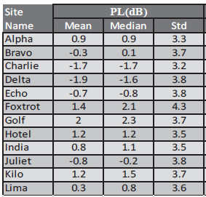
Previous low-boom flight test dose error
Small Community Test (1 sq. mi.)
  Edwards Air Force Base “WSPR”
  PL Error Standard Deviation: ~3.7 dB
Larger Community Test (10 sq. mi.)
  Quiet Supersonic Flights 2018
  PL Error Standard Deviation: ~4.9 dB
Standard deviation of difference between dose estimate and measured dose using a leave-one-out method:
Histogram of differences between dose estimate and measured dose using a leave-one-out method:
J. Page et al., NASA/CR–2014-218180
J. Page et al., NASA/CR–2020-220589/Volume I
Notes:
NASA has been preparing for the X-59 by administering smaller scale community noise flight tests. Two of these tests were the WSPR test over Edwards AFB and the QSF18 test in Galveston, TX. Members of each of these communities were recruited to participate in longitudinal sonic boom community noise surveys. A longitudinal survey differs from a cross-sectional survey where a participant is asked to respond once. In these tests, the participants were asked to respond to each sonic boom event.
These communities were instrumented with a sparse array of noise monitors, and an F-18 aircraft produced low-amplitude sonic booms by means of a special low-boom dive maneuver. A leave-one-measurement-out technique was employed to see how well the estimated doses matched the measured doses for each test. For the WSPR test the table shows the different noise monitors and the standard deviation of difference between the estimated dose and the measured dose. The dose error is about 3.7 dB on the Perceived Level scale. On the right are the results of a similar procedure for the QSF18 test. The QSF18 test had greater dose error at about 4.9 dB.
For future X-59 testing, it is anticipated that the dose error will be less than that of QSF18 due to the X-59 being in steady cruise flight rather than the QSF18 test where the aircraft is performing a special diving maneuver resulting in more variable loudness across the survey area. (Shane Lympany’s talk from the morning session goes into detail on this)

Slide 6
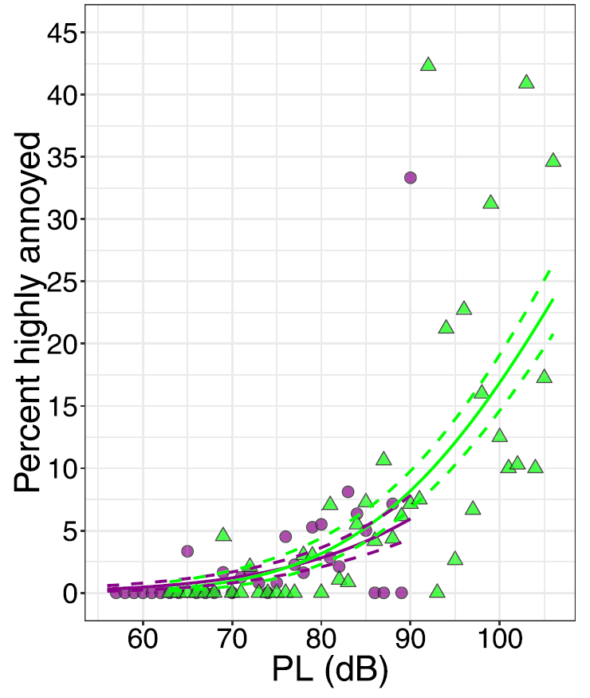
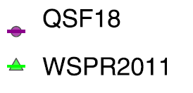
Previous model results assumed no dose error
Bayesian Multilevel Logistic Regression Model
  Shared slope
  Random intercept
Large Community Test
Small Community Test
J. Lee et al. J. Acoustical Soc. Am., 147:2222, 2020.
Notes:
The previous modeling efforts of the past dose-response tests are shown in the plot for the small and large community noise surveys. The dose is given in perceived level decibles and the response is given as the percentage of people highly annoyed. A Bayesian multilevel logistic regression model was used assuming the participants had the same slope or rate of onset of annoyance but a random individual intercept. The modeling approach assumes there is no dose error.
For X-59 testing, we wanted to understand the impact of dose error and number of participants. One way to do this is to set up a simulation experiment where the annoyance of the population is known exactly as well as the doses the population is subject to. The dose-response simulation we analyzed is outlined in the rest of the talk.

Slide 7
Simulated dose-response dataset with error overview
Goals:
  Assess impact of dose error on dose-response curves for future X-59 tests
  Assess impact of number of participants on dose-response curves for future X-59 tests
Approach:
  Generate dataset of simulated participants based on a known underlying population model
  Expose the simulated population to true doses and record their true responses
  Perturb the true doses to simulate dose error
  Fit models to the perturbed dose, true response data
  Assess the accuracy and precision of the models to the known underlying population model
    Vary the dose error
    Vary the number of participants
Next slides:
  Population model
  Dose schedule and error
  Modeling approach
  Results
Notes:
The goals of our simulation are to assess the impact of dose error and number of participants on dose-response curves for future X-59 community tests. The approach is to generated a dataset of simulated survey participants from a known underlying population annoyance model based on the QSF18 modeling results. We expose the participants to noise doses that we know exactly, and record their responses. The doses are then perturbed by additive normal error to simulate the dose error. We fit a multilevel logistic regression model to the perturbed dose, true response data and note how the model fit dose-response curve matches the known population dose-response curve. We vary the dose error and the number of participants to see how each impact the results.
We include realism when practical including the notional X-59 noise exposure schedule and participation and withdrawal rates from the previous sonic boom surveys. There are some limitations such as looking at only additive gaussian error with fixed variance. Each simulated participant receives the same true dose. And we do not include carry-over effects or other non-acoustic factors in the population model.
The next slides outline the population model, the dose schedule and error, the modeling approach, and the results of the simulation

Slide 8
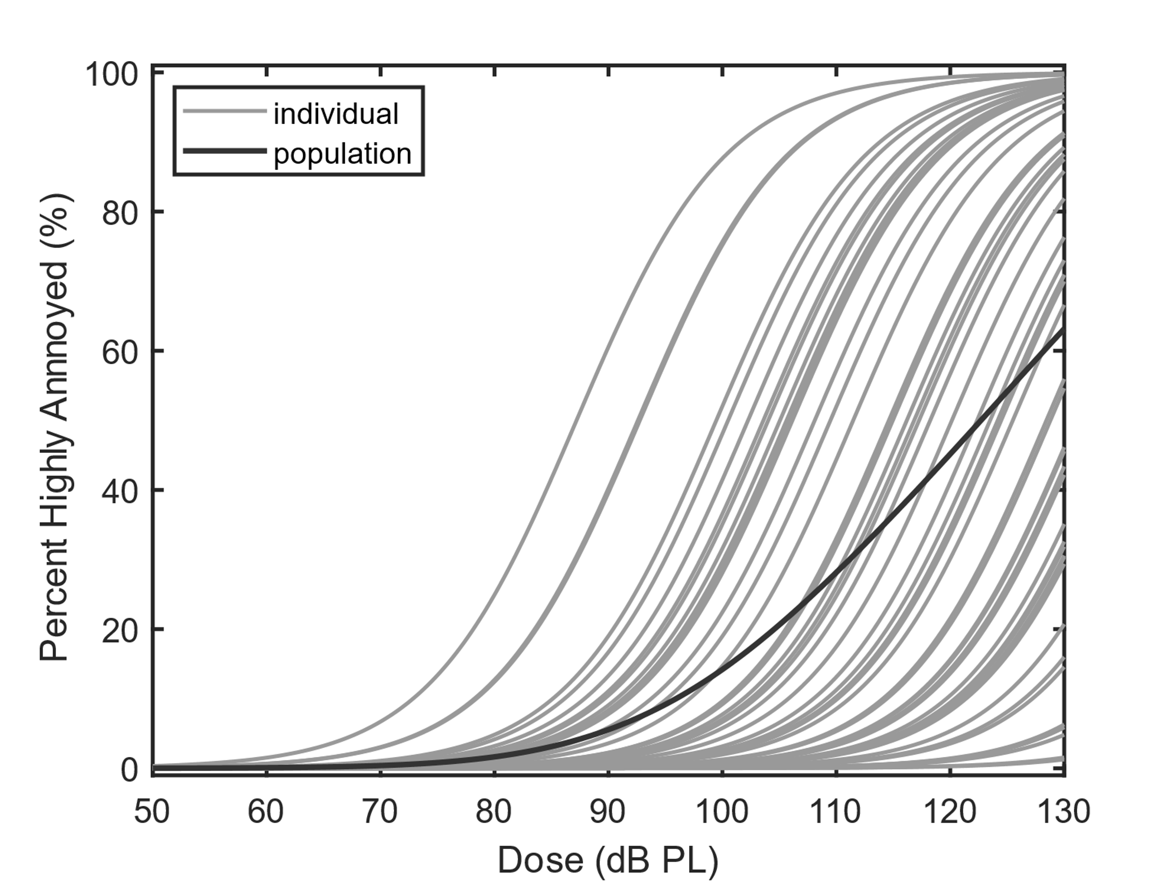
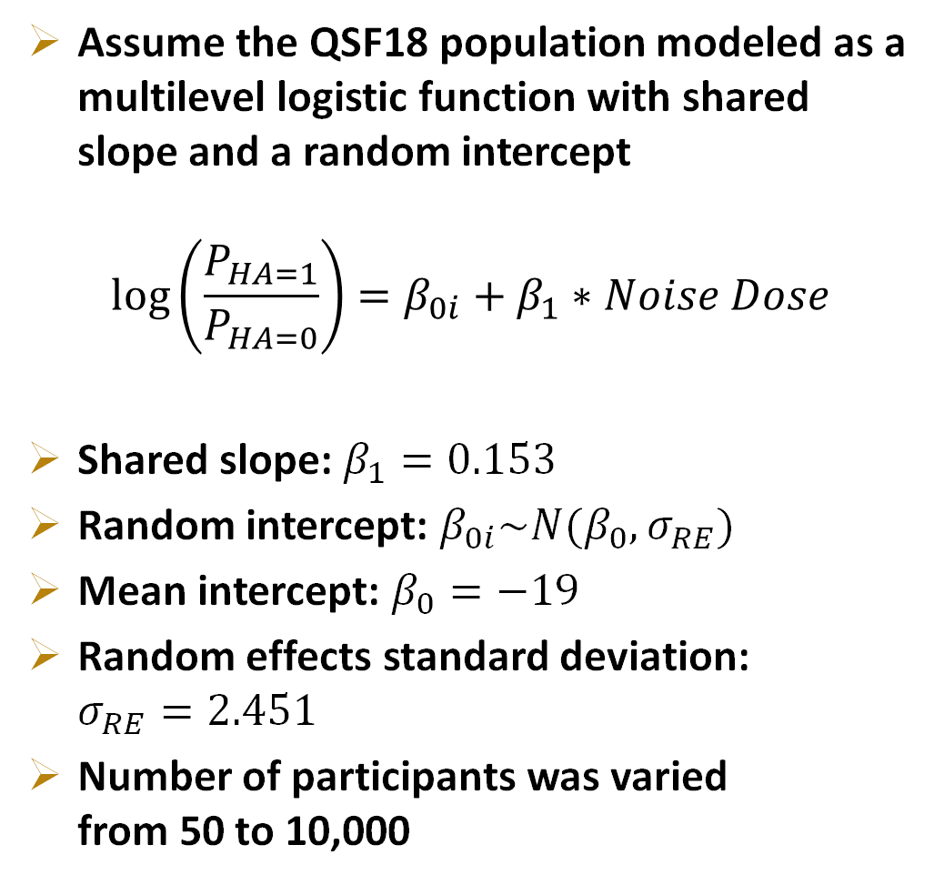
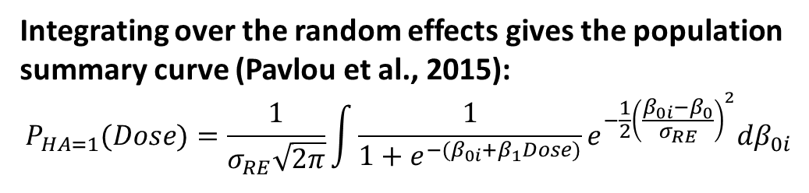
Simulated dose-response dataset: population model
Assume the QSF18 population modeled as a multilevel logistic function with shared slope and a random intercept
$$\log\left(\frac{P_{HA=1}}{P_{HA=0}}\right)=β_{0i}+β_{1}∗Noise Dose$$
Shared slope: $β_{1}=0.153$
Random intercept: $β_{0i}\sim N(β_{0},σ_{RE})$
Mean intercept: $β_{0}=−19$
Random effects standard deviation:
$σ_{RE}=2.451$
Number of participants was varied
from 50 to 10,000
Integrating over the random effects gives the population summary curve (Pavlou et al., 2015):
$$P_{HA=1}(Dose)=\frac{1}{σ_{RE}\sqrt{2π}}\int{\frac{1}{1+e^{−(β_{0i}+β_{1}Dose)}}e^{−\frac{1}{2}{\left(\frac{β_{0i}−β_{0}}{σ_{RE}}\right)}^{2}}dβ_{0i}}$$
Notes:
For the simulation population, we assume the model fit parameters from the QSF18 study using the multilevel logistic function that has a shared slope beta1 and a random intercept beta0 i. Each participant’s random intercept is a draw from a normal distribution of known mean and standard deviation. We run multiple simulations varying the number of participants from 50 to 10,000. To arrive at the population summary curve we use the integration method of Pavlou et al., which integrates over the random effects for a logistic function times a normal distribution of random effects. The gives the probability of observing high annoyance at a given dose.
As an example consider the leftmost S-shaped curve as an individual’s dose-response curve. Say that this participant is subject to a true dose of 85 dB. There is about a 50% chance the subject responds as highly annoyed to this dose. The response that is recorded in the simulated dataset is either a 0 or 1 based on the outcome of a random number generator simulating the 50/50 chance.

Slide 9
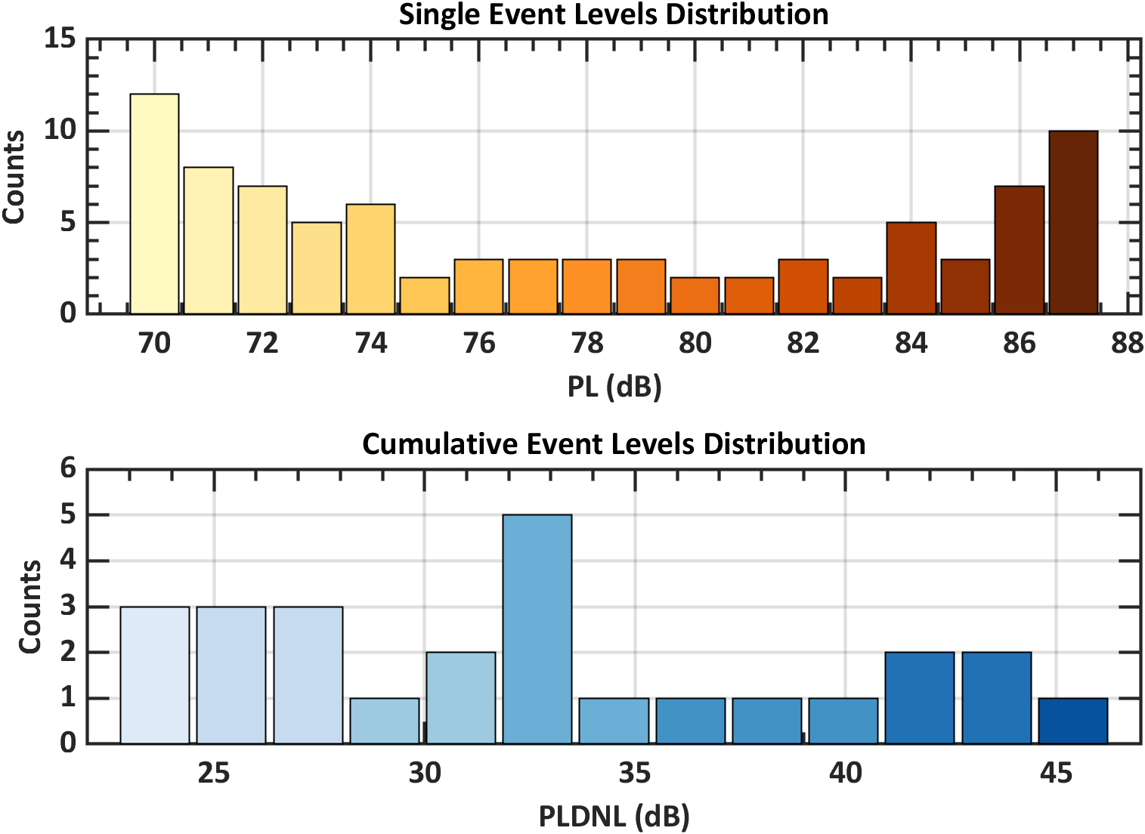
Simulated dose-response dataset: dose design and error
Each simulated participant is subject to 86 true doses
  True doses were perturbed by a draw from normal distribution with standard deviation of 2, 4, 6, or 8 dB.
Also created datasets for the cumulative noise dose
From J. Page et al., “Noise Exposure Planning Report,” Interim Contract Deliverable (2021).
Notes:
Now that the population model is defined, the simulated participants must be subject to known noise doses. The doses are the notional noise exposure schedule for the X-59 community response tests for single event or single flyover doses and also for cumulative event or daily summary doses. The participants respond to these true doses, and then the doses are perturbed by a draw from a normal distribution to simulate dose error. We varied the dose error from 2 to 8 decibels so that the observed dose error from WSPR and QSF18 are encompassed.

Slide 10
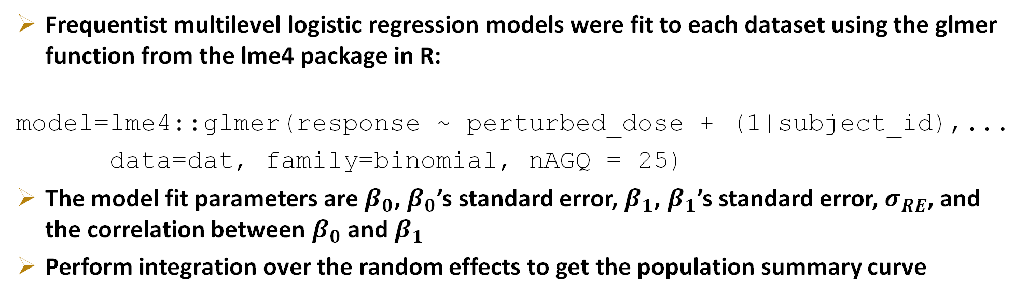
Simulated dose-response dataset: Model fitting
Example dataset
subject_id | boom | perturbed_dose | response
1 | 1 | 70 | 0
1 | 2 | 75 | 0
…
2 | 1 | 73 | 1
2 | 2 | 74 | 1
…
Frequentist multilevel logistic regression models were fit to each dataset using the glmer function from the lme4 package in R:
model=lme4::glmer(response ~ perturbed_dose + (1|subject_id),...
data=dat, family=binomial, nAGQ = 25)
The model fit parameters are $β_{0}$, $β_{0}$’s standard error, $β_{1}$, $β_{1}$’s standard error, $σ_{RE}$, and the correlation between $β_{0}$ and $β_{1}$
Perform integration over the random effects to get the population summary curve
Notes:
Here is an example of what the simple simulation datasets may look like. We keep track of the subject IDs the boom number, the perturbed dose, and the response highly annoyed or not. Then to each of these datasets we fit a multilevel logistic regression model with shared slope and random intercept in R using the glmer function from the lme4 package. The model outputs beta0 which is the intercept of the average participant, beta1, which is the shared slope, and the random effects standard deviation. These we can compare to the known population. The model fits also provide the standard errors and correlation that we use to bootstrap the confidence interval. Finally using these parameters we integrate over the random effects to get the final population summary curve that we can compare to the known population summary curve.

Slide 11
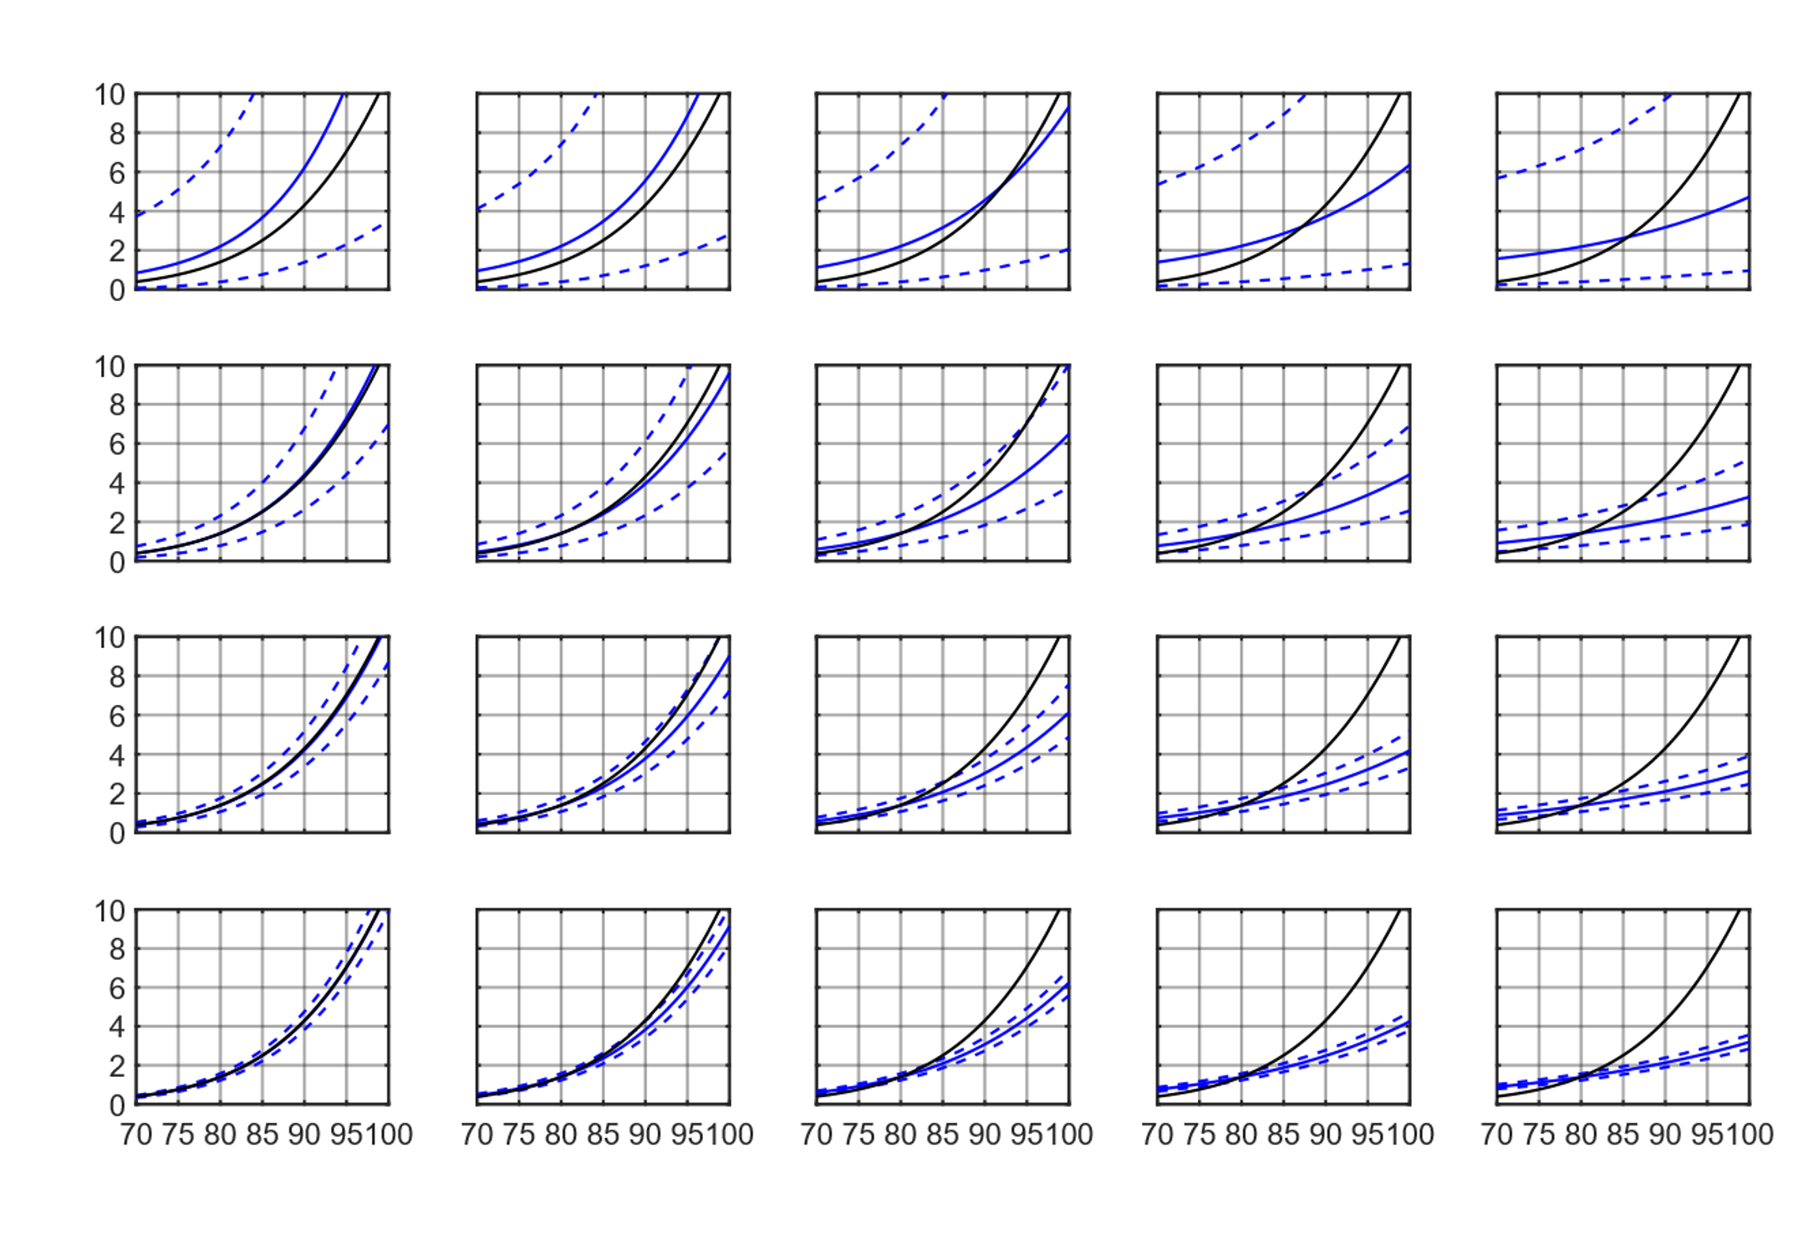
Simulation results: Effects of error and sample size
No Dose Error
2 dB Error SD
4 dB Error SD
6 dB Error SD
8 dB Error SD
True
50 Participants
Modeled
500 Participants
SD: standard deviation
Percent Highly Annoyed
2500 Participants
10000 Participants
Noise Dose, PL (dB)
Notes:
Here are the population summary results for the simulation dataset. Each plot shows the noise dose in decibels versus the percentage of people highly annoyed. As you move down the rows, the number of simulated participants increases from 50 to 10,000. The columns show the impact of increasing dose error. The black curve shows the true population summary curve, and the blue curve is the modeled result with its 95% confidence interval. When there is no dose error, by 500 participants, the modeled and true curve match quite well. As you continue to add participants the confidence interval decreases.
[remind people where WSPR 3.7 dB and QSF18 4.9 dB lie on this chart.
You can also see that as the dose error increases, the attenuation or flattening effect is visible regardless of the number of participants.

Slide 12
Simulation results: Effects of error and sample size
Improve accuracy by reducing dose error
No Dose Error
2 dB Error SD
4 dB Error SD
6 dB Error SD
8 dB Error SD
True
50 Participants
Modeled
500 Participants
Improve precision by increasing number of participants
Percent Highly Annoyed
2500 Participants
10000 Participants
Noise Dose, PL (dB)
Notes:
Thus, whenever possible, it is best to reduce the dose error to improve the accuracy of the dose-response curve. Adding participants does not fix the problem, it just reduces the size of the confidence interval about the inaccurate curve.
There are approaches to account for dose error in modeling that we are looking into, so another approach is to understand the dose error as well as possible if it is unable to be reduced.

Slide 13
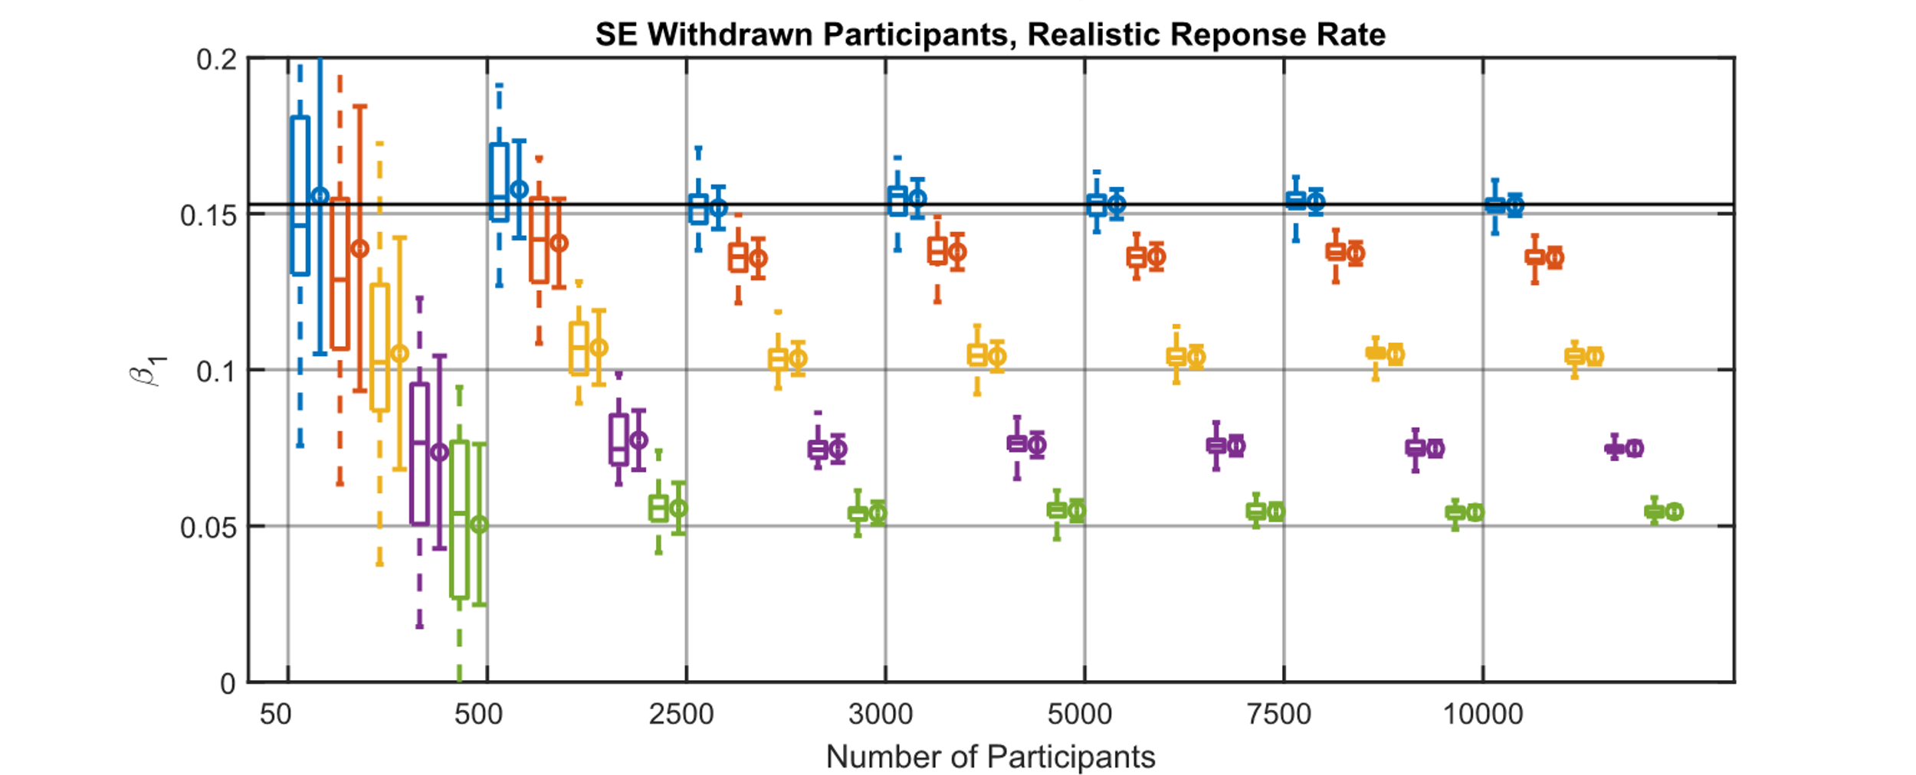

Slope term decreases linearly with increased dose error
Takeaway: under ideal conditions, it is possible to back-correct for impact of dose error
True $β_{1}$
Slope
Increasing Dose Error
50
500
2500
3000
5000
7500
10000
Number of Participants
Box and whiskers show data from 30 replicates
Dot and error bar show the mean and the standard deviation of the 30 replicates
Notes:
Another example result of the modeling is that the slope term decreases linearly with increasing dose error from 0 to 8 dB. The modeled slope term is shown in the plot for increasing numbers of participants. We replicated each condition 30 times, and all the modeled slope data are shown in the box and whisker plots and then we also plot the mean and standard deviation of the replicates to show how variable each replicate of the same condition was.
Because the slope term decreases linearly with increasing dose error, if you know the dose error standard deviation, you can back-correct or extrapolate to the 0 dose error condition. The other model parameters have similar simple relationships with increases in dose error. This is a principle of the simulation extrapolation approach to account for dose error, which is one technique we are looking into.

Slide 14
Ongoing work: researching methods to account for dose error
Simulation Extrapolation
(Carroll et al., 2006 Chapter 5)
  For known or estimated dose error, further perturb the doses and observe the effect on the model parameters. Extrapolate (“back-correct”) to the 0 dose error parameters.
Regression Calibration
(Carroll et al., 2006 Chapter 4 and Horonjeff, 2022 following this talk)
  Knowing or estimating the dose distribution and dose error distributions, compute the condition with 0 dose error
Bayesian Methods
(Carroll et al., 2006 Chapter 9; Xiang, 2020 and Doebler et al., 2022)
  Probabilistic modeling using estimated dose and estimated dose error variance to ascertain the true dose
Data Cloning
(Torabi, 2013)
  A Bayesian MCMC method using a likelihood corresponding to clones of the observed data yields maximum likelihood estimates
Notes:
We have ongoing work to apply and assess several methods that account for dose error in dose response modeling. I showed the principle of simulation extrapolation on the previous slide, but for this you have knowledge of the measured dose error fit your model. And then you further perturb the doses and fit the model again noting how the parameter change. This allows you to fit a line or function extrapolating to the 0 dose error condition.
Regression calibration is another technique where you have knowledge or estimate of the true dose distribution and the dose error distribution, which allows you to estimate the 0 dose error dose-response curve.
We’ve presented a Bayesian approach to accounting for dose error at a previous ASA meeting. The estimated doses and error are supplied as data, and the probabilistic model estimates the true dose.
Finally there is a data cloning approach, which uses clones of the data in its maximum likelihood estimate
If appropriate, these may be applied to X-59 dose-response data. The methods that correct for dose error are subject to errors themselves if the error distribution is mis-specified, so knowledge of the error distribution is also important.

Slide 15
Summary
NASA will soon be flying its X-59 over communities across the USA
A community noise survey will be administered to measure perception of X-59 sonic thumps
Error in the noise dose causes attenuation in dose-response curves
The attenuation is not alleviated by recruiting additional participants
There are modeling methods to account for dose error, which may be applied to X-59 community survey data
  Ongoing work assessing the methods on other datasets prior to X-59 testing
Notes:
In summary, we will soon be flying the X-59 for a series of longitudinal community noise surveys to low-booms or sonic thumps. We are interested in understanding and quantifying the impact of dose error on dose-response curves. We showed that the dose error attenuates or flattens the curves and that the flattening effect is not alleviated by recruiting more participants. Finally we have ongoing work to apply the methods that account for dose error to our dose-response datasets.

Slide 16
References
Carroll, R., Ruppert, D., Stefanski, L., and Crainiceanu, C. (2006). Measurement Error in Nonlinear Models: A Modern Perspective (2nd ed.). Chapman and Hall/CRC. https://doi.org/10.1201/9781420010138
Doebler, W. J., Vaughn, A. B., , Ballard, K. M., and Rathsam, J. (2022). Simulation and Application of Bayesian Dose Uncertainty Modeling for Low-Boom Community Noise Surveys. Proceedings of Meetings on Acoustics. https://doi.org/10.1121/2.0001592
Horonjeff, R. (2021). An examination of dose uncertainty and dose distribution effects on community noise attitudinal survey outcomes, The Journal of the Acoustical Society of America 150, 1691. https://doi.org/10.1121/10.0005949
Lee, J., Rathsam, J., and Wilson, A. (2020). Bayesian statistical models for community annoyance survey data. The Journal of the Acoustical Society of America, 147(4), 2222–2234. https://doi.org/10.1121/10.0001021
Pavlou, M., Ambler, G., Seaman, S., and Omar, R. Z. (2015). A Note on Obtaining Correct Marginal Predictions from a Random Intercepts Model for Binary Outcomes. BMC Medical Research Methodology, 15(59). https://doi.org/https://doi.org/10.1186/s12874-015-0046-6
Torabi, M. (2013). Likelihood Inference in Generalized Linear Mixed Measurement Error Models. Computational Statistics and Data Analysis, 57(1), 549–557. https:/doi.org/10.1016/j.csda.2012.07.018
Xiang, N. (2020). Model-Based Bayesian Analysis in Acoustics—A Tutorial. The Journal of the Acoustical Society of America, 148(2), 1101–1120. https://doi.org/10.1121/10.0001731

Slide 17

nasa.gov/quesst
william.j.doebler@nasa.gov

