Slide 1


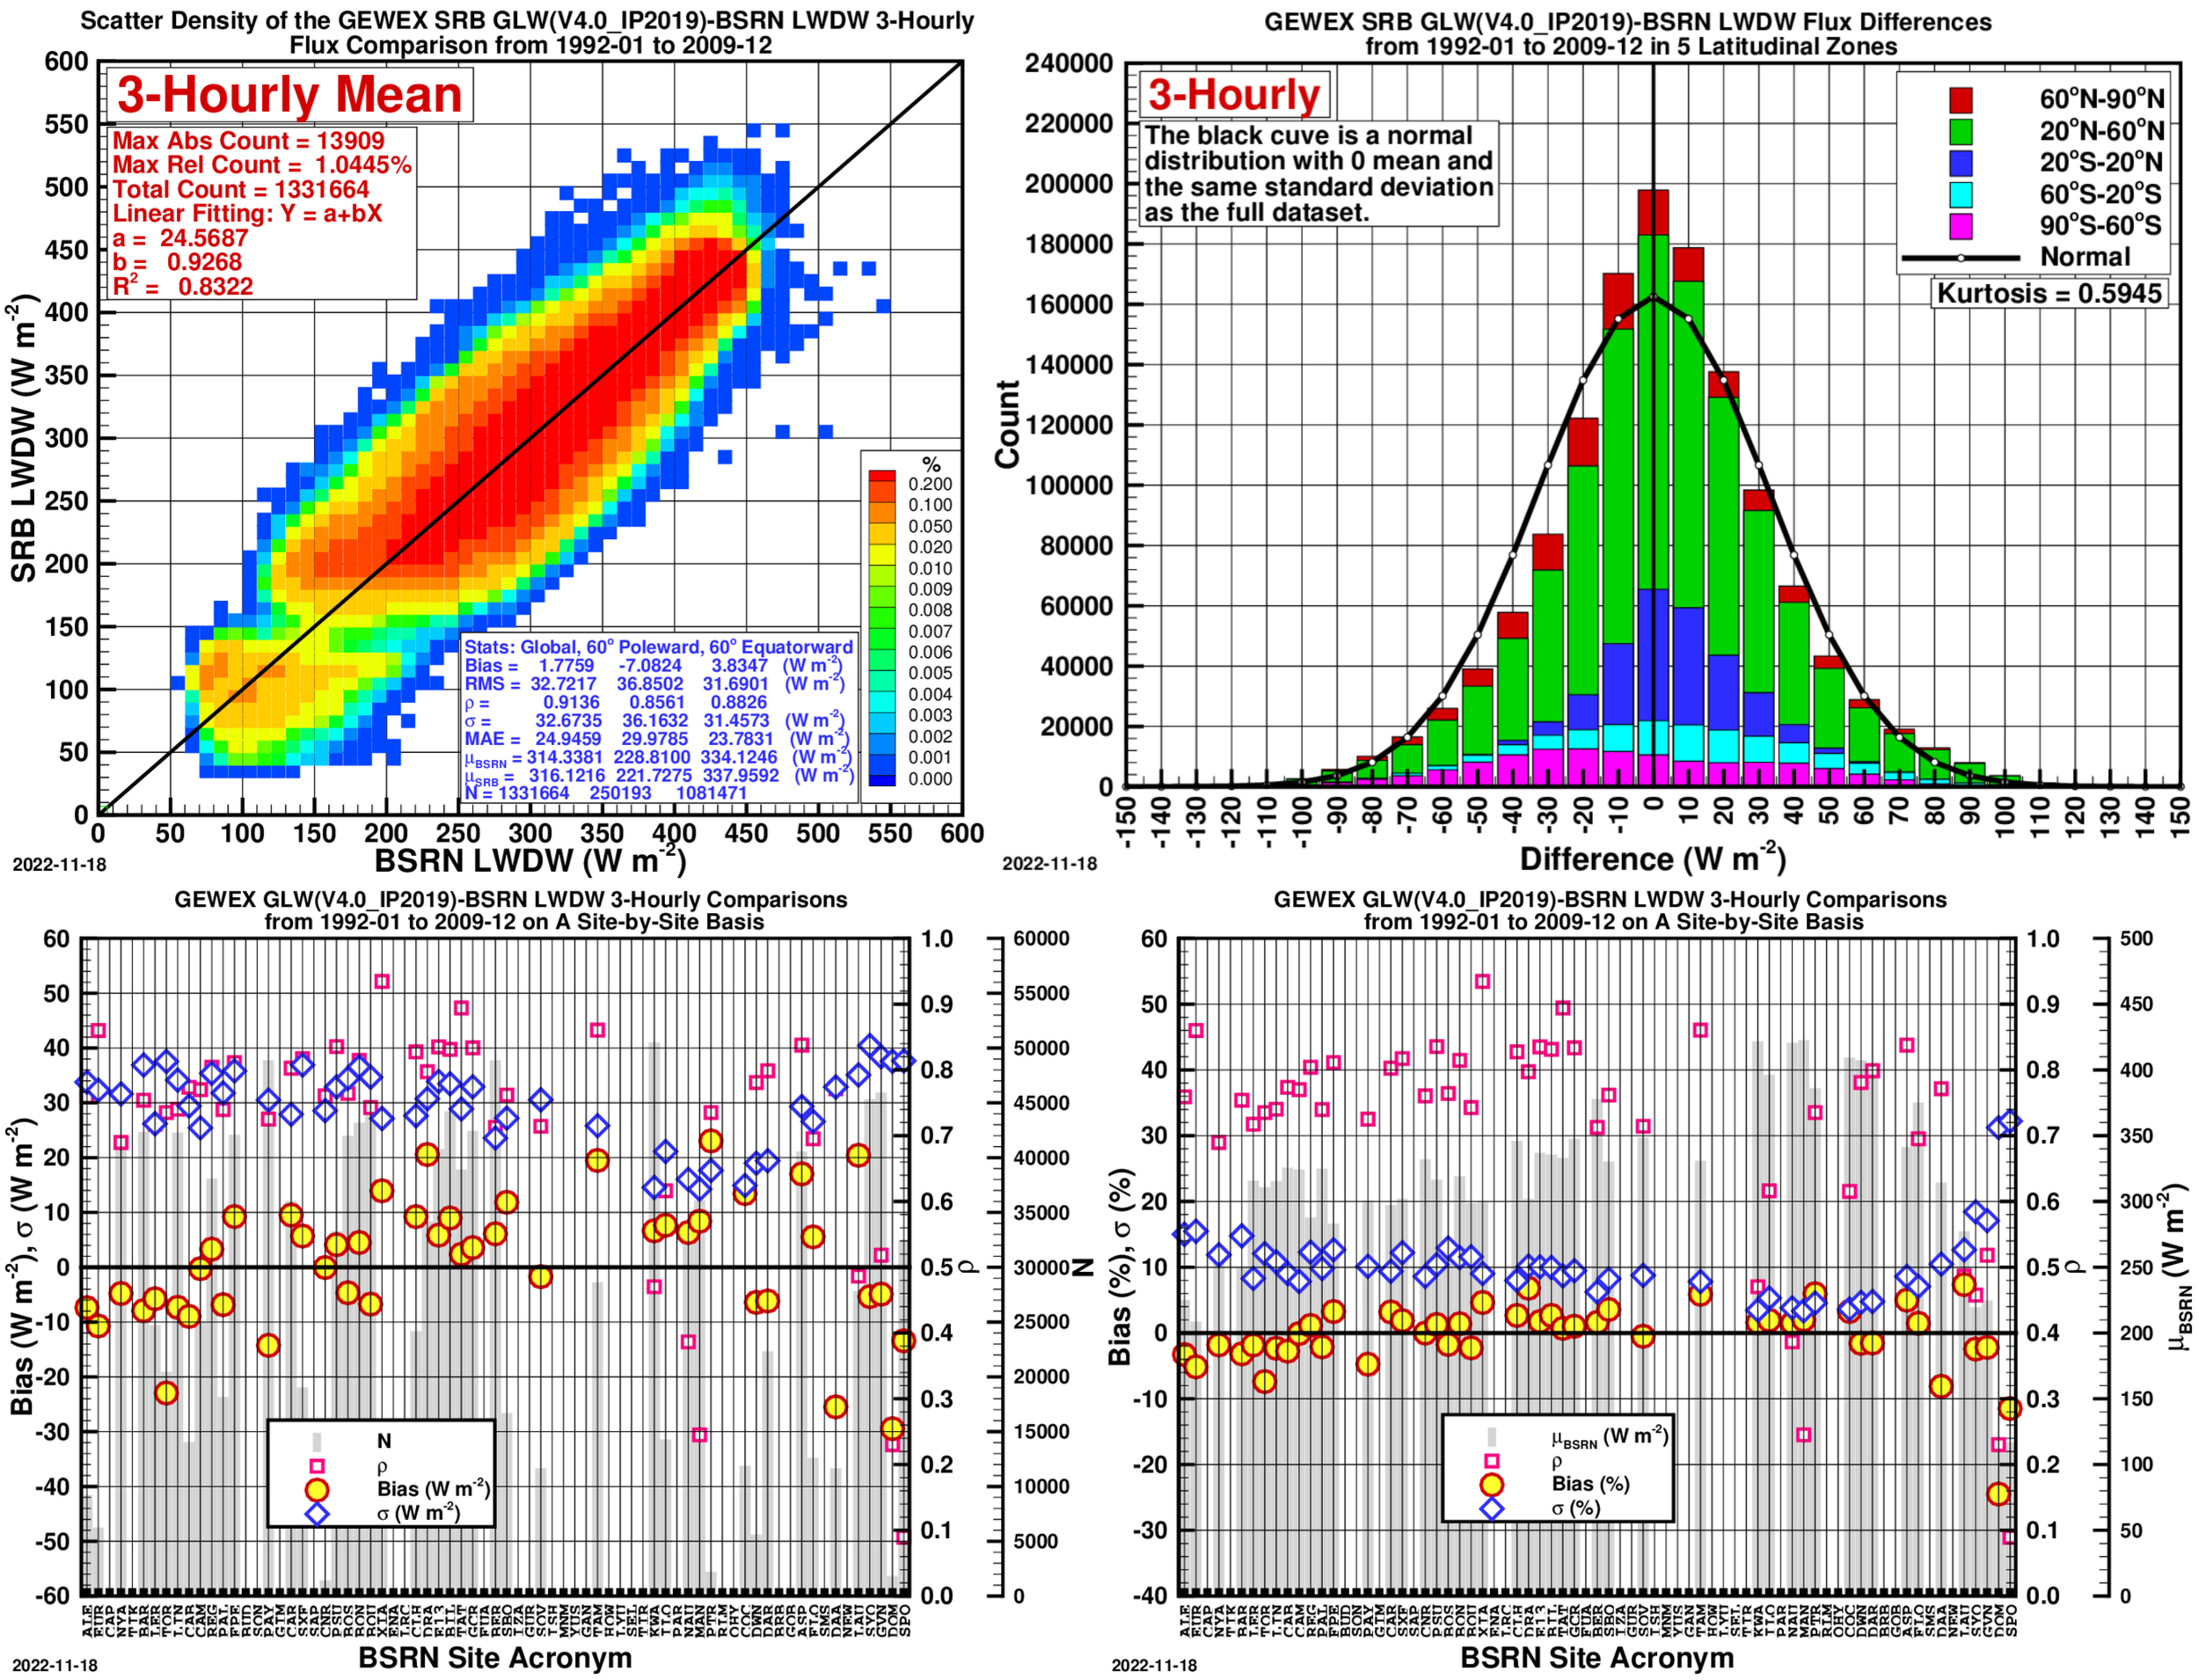
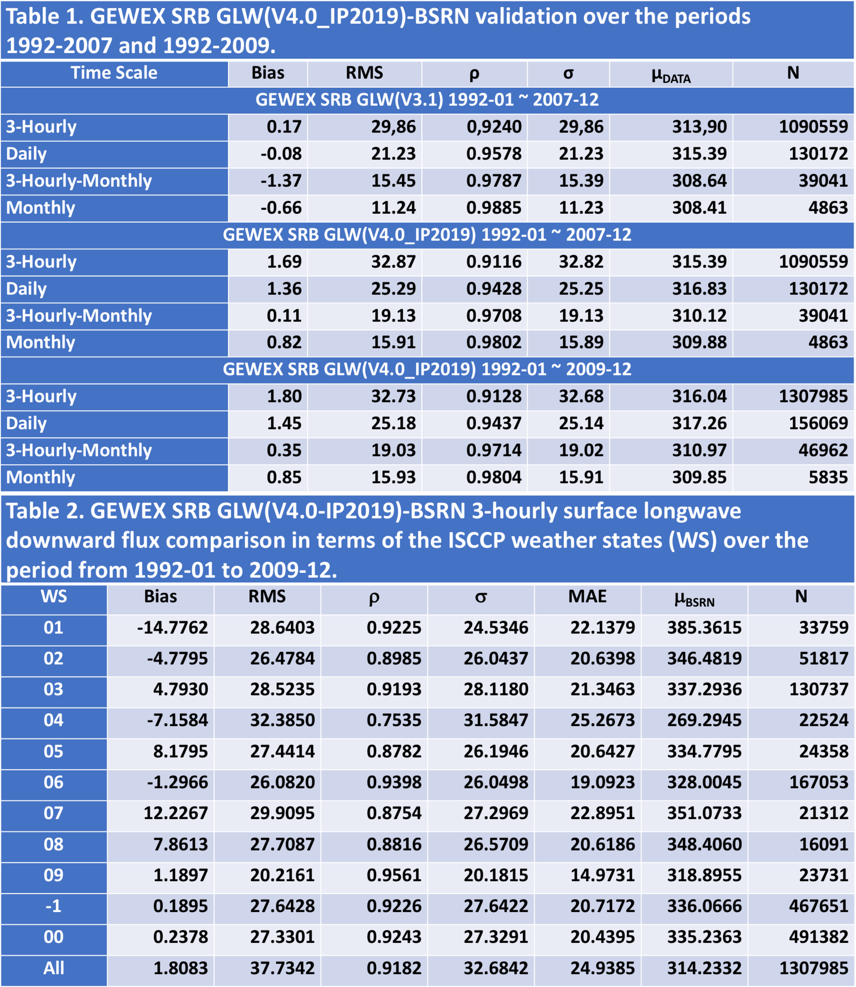
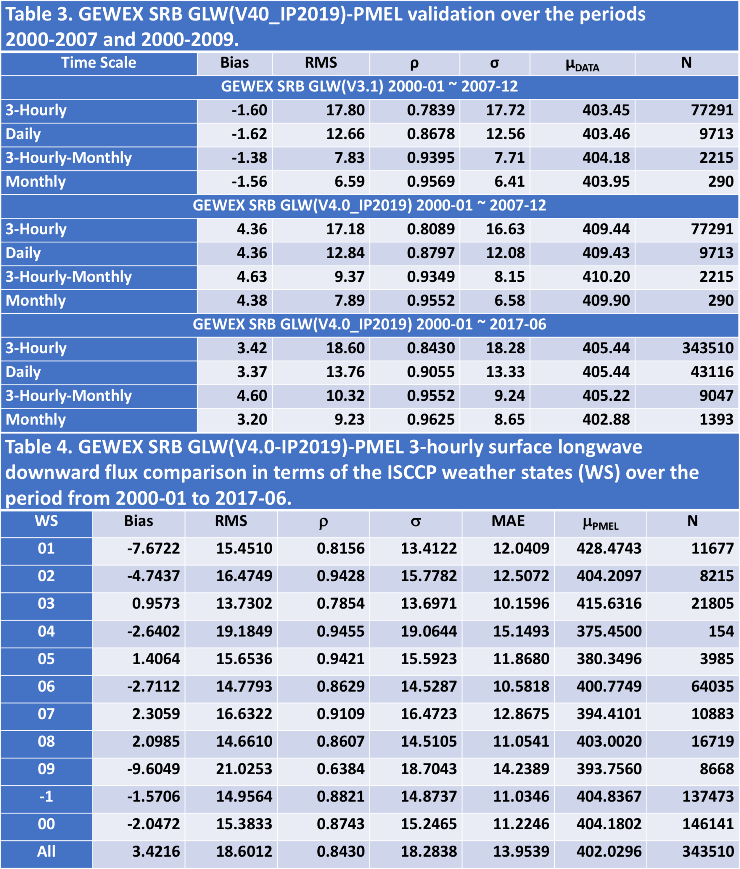
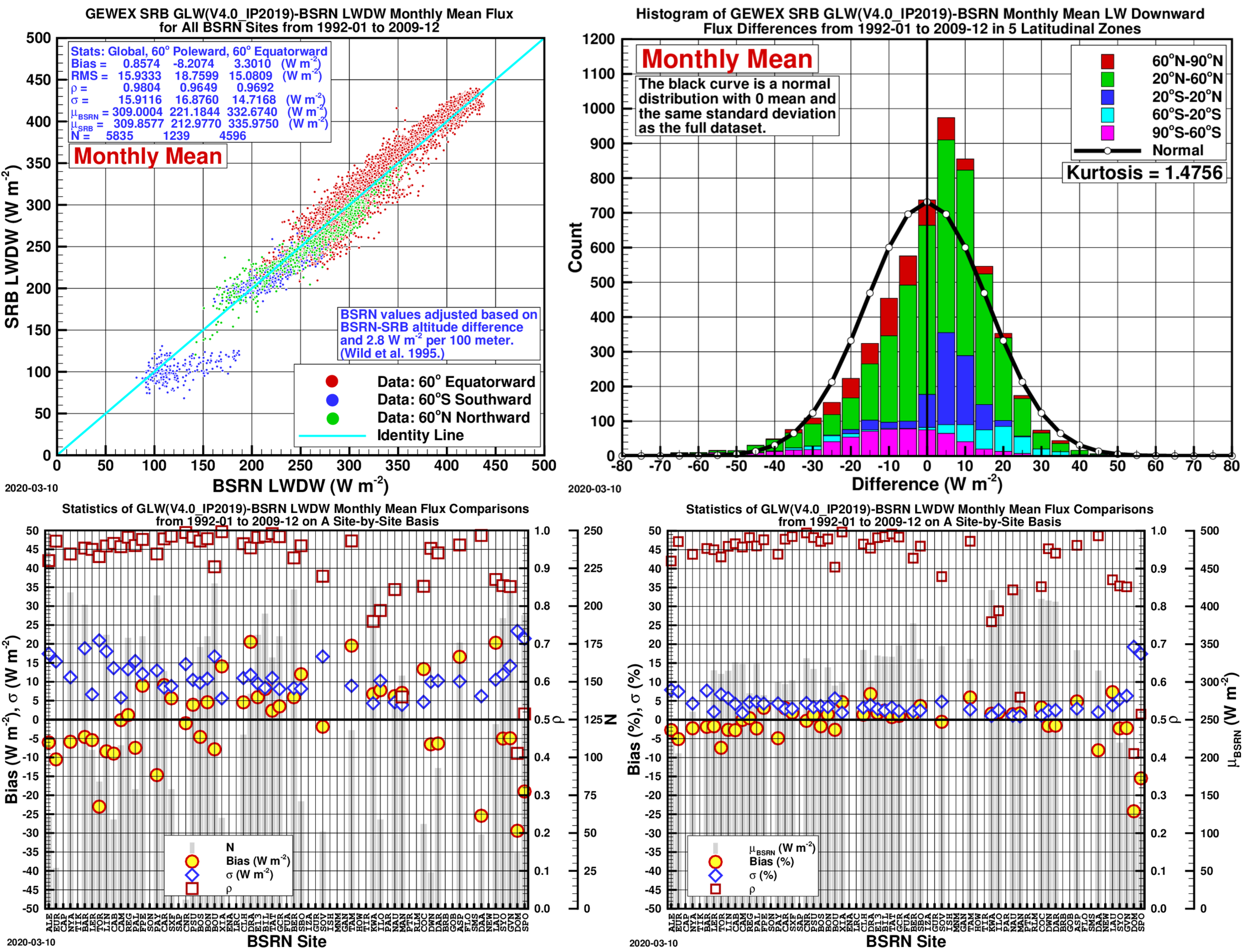
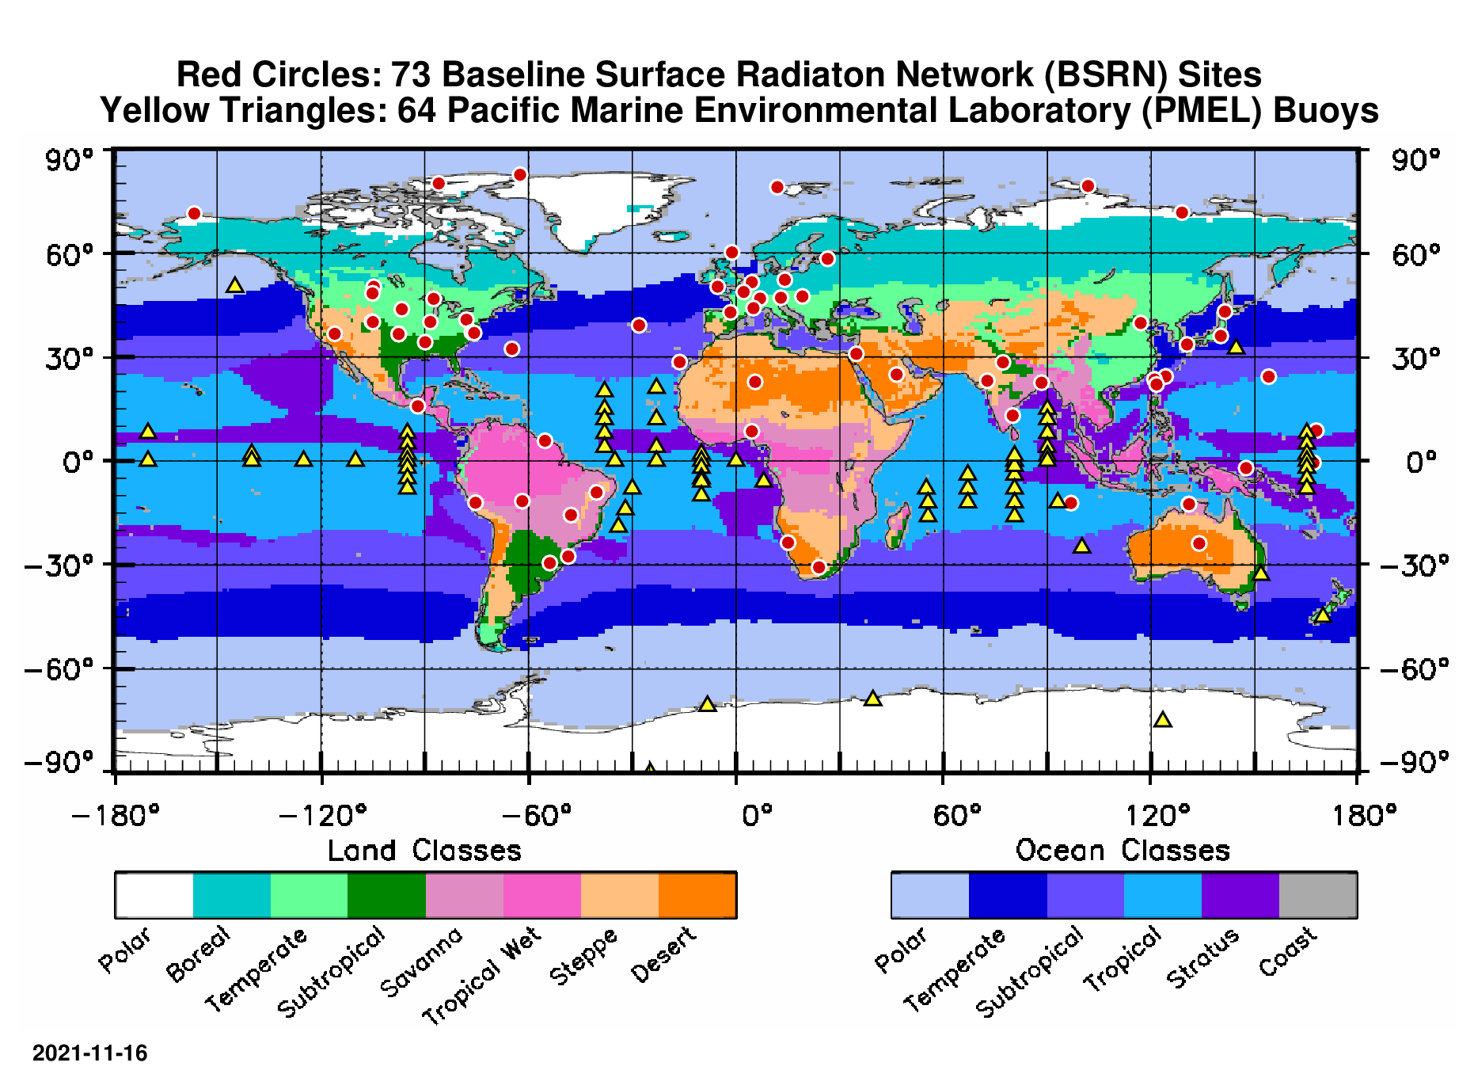
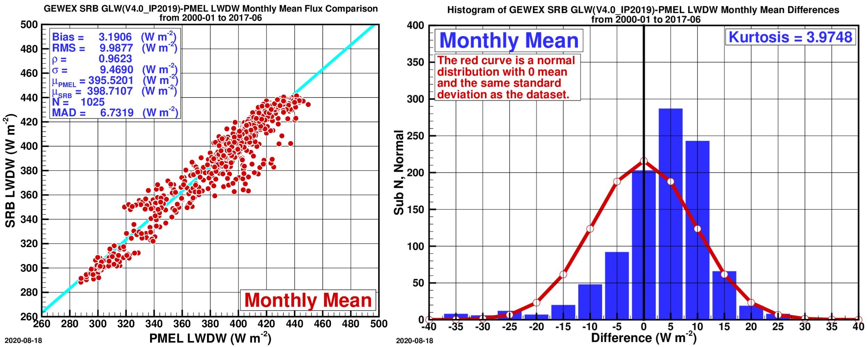
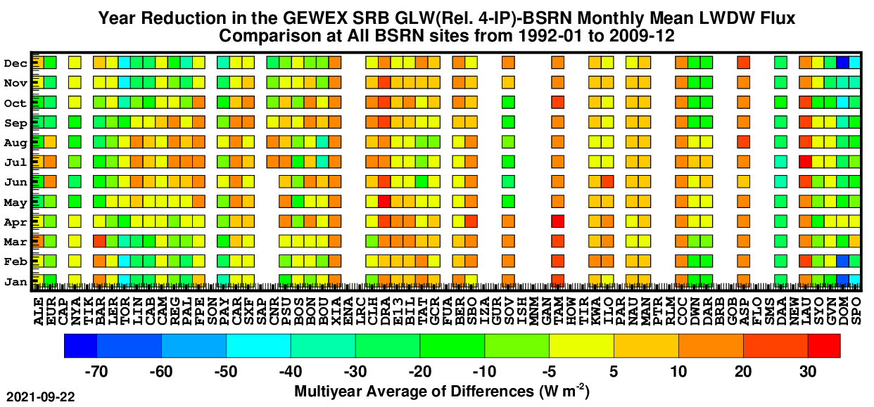
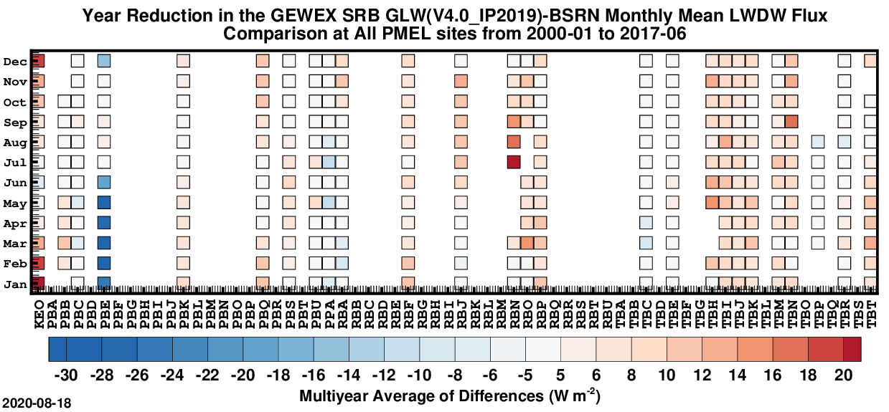
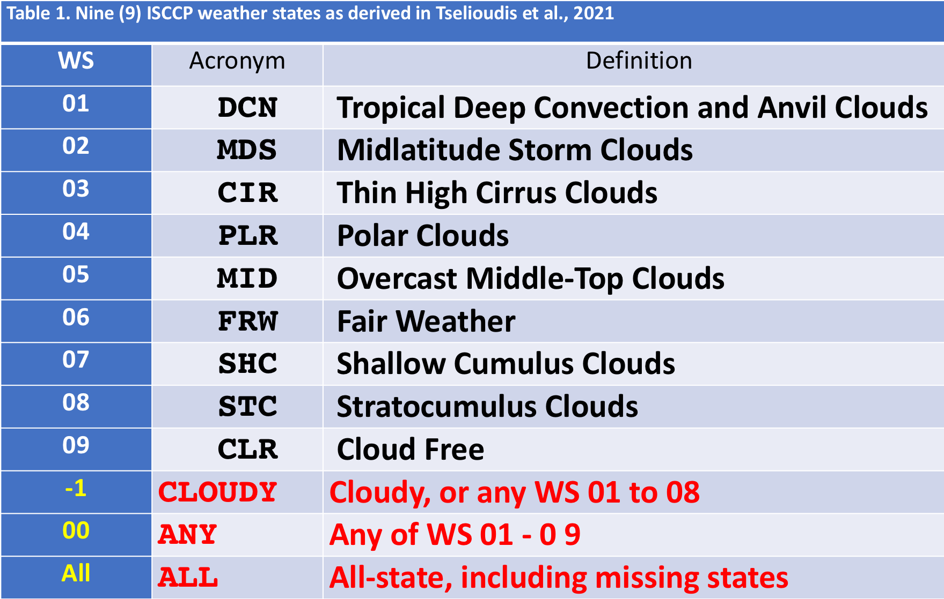
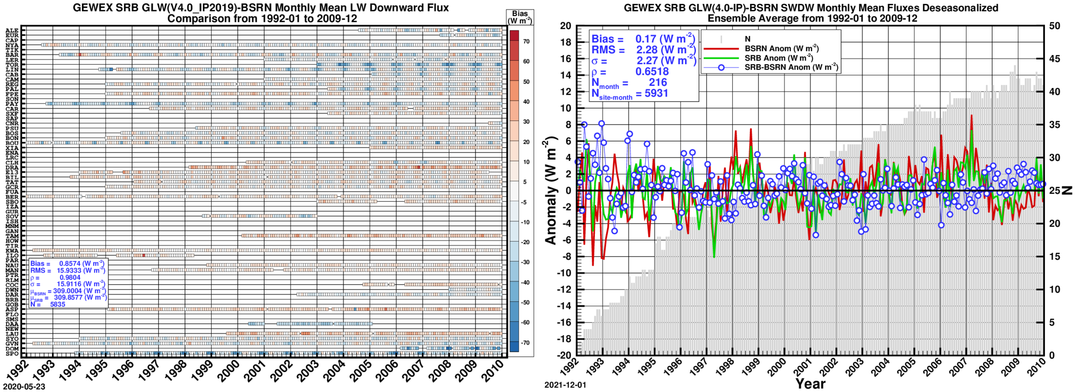
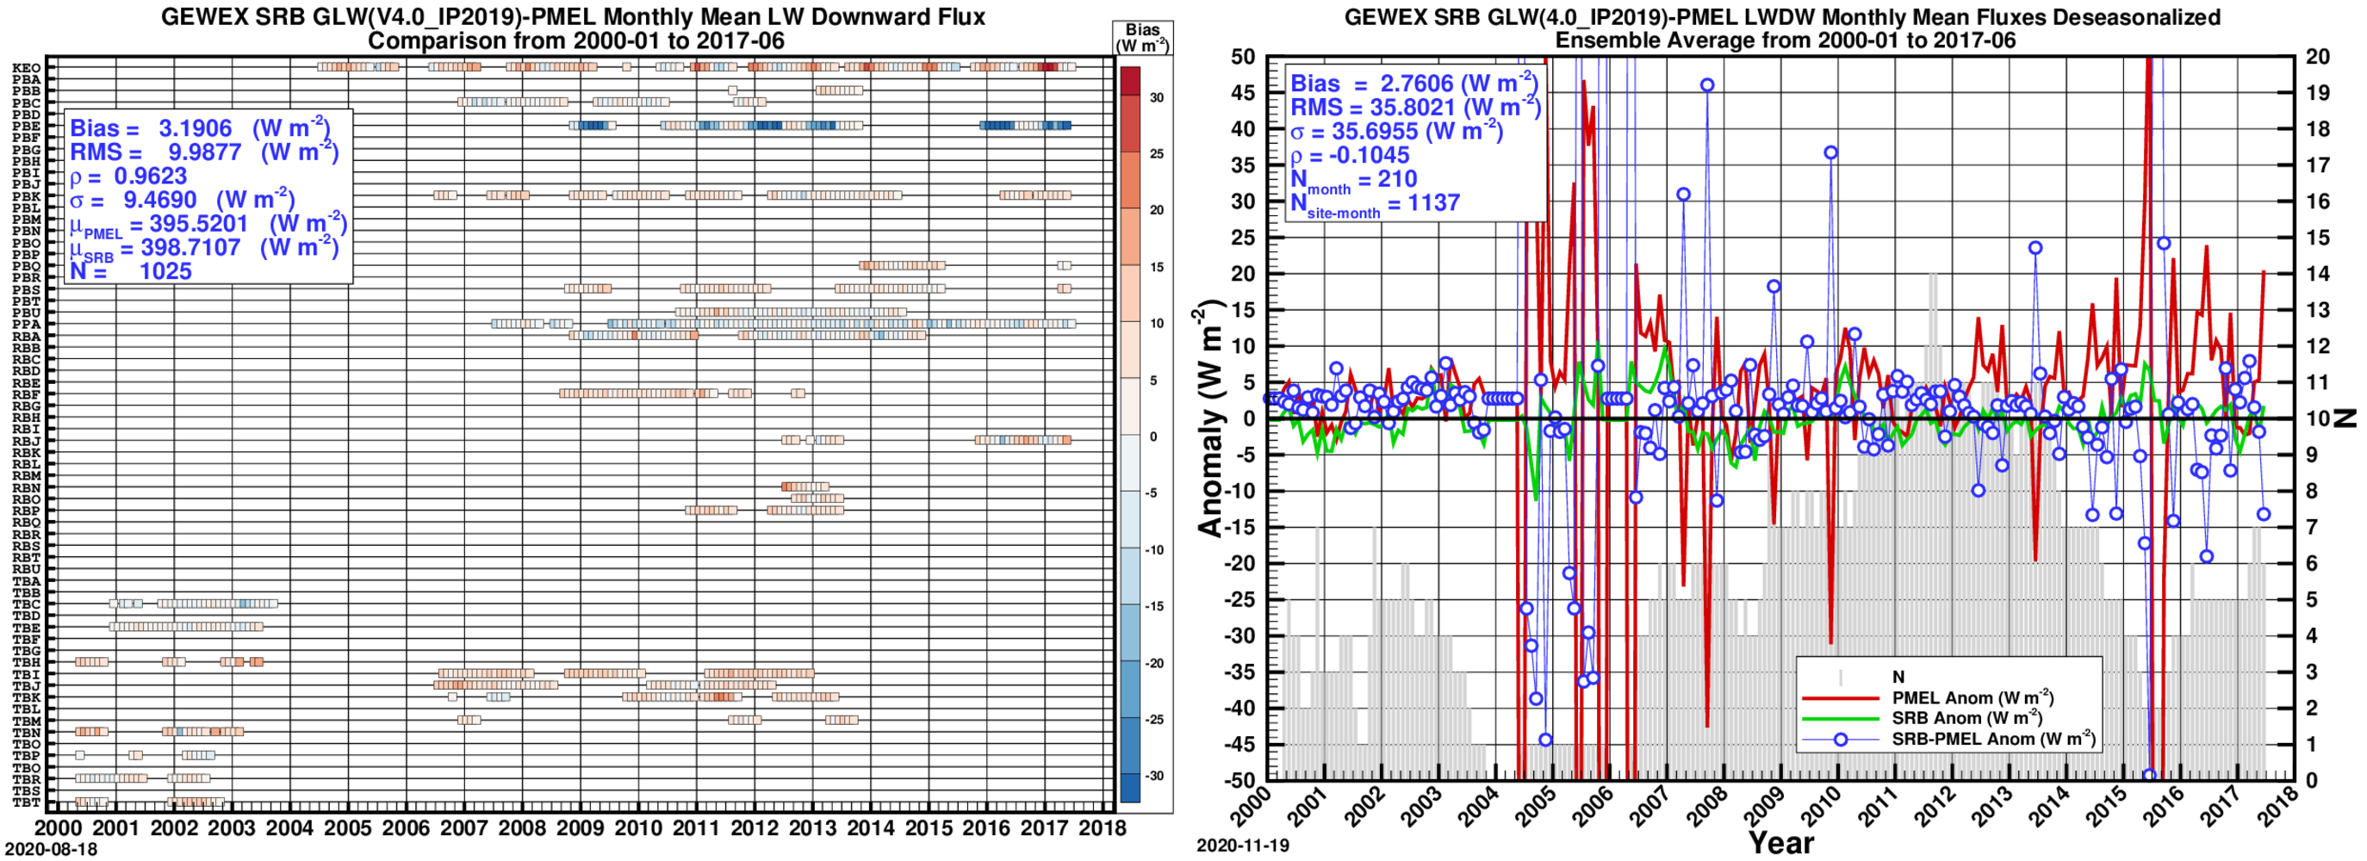
­The Surface Longwave Downward Fluxes of the NASA GEWEX SRB Release 4.0‑IP Products: Validation Against the Surface-Based BSRN and PMEL Observed Data
Taiping Zhang¹, Paul W. Stackhouse, Jr.², Stephen J. Cox¹ ,J. Colleen Mikovitz¹ 1. SSAI/NASA Langley Research Center; 2. NASA Langley Research Center
Paper No.: A55Q-1355
AGU 2022 Fall Meeting
Introduction
Comparison with the BSRN Land-Based Data
Since the NASA Global Energy Water Exchanges (GEWEX) Surface Radiation Budget (SRB) project released its 3rd version of products in 2010, the GEWEX Data Assessments Panel (GDAP) has been working on integrating various data products to address issues in the closing of the global energy and water cycles. The 4th version of the SRB products, Rel. 4.0-IP, has integrated data products from the cloud, aerosol, atmosphere, ocean surface, and land surface projects, coordinating within GDAP, to produce a long-term time series of TOA and surface radiative estimates. The Rel. 4-IP shortwave products span 34 years continuously from July 1983 to June 2017 on a quasi-equal-area 1° longitude by 1° latitude grid system. The longwave products are for land only from 1983-07 to 1987-12; for both land and ocean from 1988-01 to 2009-12; and ocean only from 2010-01 to 2017-06. The data are provided at 3‑hourly, 3-hourly-monthly, daily and monthly means. The ISCCP HXS clouds and radiances are the key cloud input of the current GEWEX SRB algorithms. In addition, the longwave algorithm has also made changes in cloud microphysical property, surface skin temperature input, surface emissivity, atmospheric profile, adding longwave aerosol optical properties, revising cloud overlap procedure, and so on. Details of changes in both inputs and algorithms are documented in a NASA Algorithm Theoretical Basis Document (ATBD). We have validated the surface longwave downward fluxes against the surface-based Baseline Surface Radiation Network (BSRN) and the Pacific Marine Environmental Laboratory (PMEL) buoy data. As of 2020, the BSRN archive has 12,116 site-months of observed records from 73 stations on all seven continents, and as of 2017, PMEL archive has 4389 buoy‑months of observed records from 64 buoys deployed in the tropics of Pacific, Atlantic and Indian Oceans. This paper presents how the SRB Rel. 4.0-IP surface longwave downward fluxes compare with these surface-based measurements and how the comparison statistics differ from that of Rel. 3.0.
The Surface-Based BSRN Sites and PMEL Buoys
Comparison with the PMEL Ocean-Based Data
Summary and Conclusions
The GEWEX SRB Rel. 4-IP longwave products span 1983-07 to 2009-12 over the land, 1988-01 to 2017‑06 over the ocean, which implies that the data cover both the land and ocean over the period from 1988-01 to 2009-12. The data are available as 3-hourly, 3-hourly-monthly, daily and monthly means on a quasi-equal-area 1º by 1º grid system;
The Rel. 4-IP longwave data overlap with that of Rel. 3.1 over the period from 1992-01 to 2007-12. Over the land, the biases are more or less the same, but Rel. 3.1 shows somewhat smaller standard deviations; over the ocean, comparison with the PMEL buoy data shows that Rel. 4-IP is about 6 W m⁻² larger than Rel. 3.1, and the 3-hourly and daily means show slightly smaller standard deviations;
Over the land, the longwave flux is most biased (-14.7 W m⁻²) under WS 1 (tropical deep convection and anvil clouds) and least biased (1.1 W m⁻²) under WS 9 (cloud free); over the ocean, the longwave flux is also most biased (-7.6 W m⁻²) under WS 1, but least biased (0.9 W m⁻²) under WS 3 (thin high cirrus clouds);
Over the ocean under all weather states, the standard deviations of the differences from observed data are significantly smaller than their land counterparts, though it should be noted that the PMEL buoys are deployed only in the tropical oceans while the land-based BSRN stations are located over a wide range of latitudes;
Over both the land and ocean, WS 6 (fair weather) is the most frequent weather state, as shown in Tables 2 and 4;
Thought not discussed here, the Rel. 4-IP top-of-atmosphere outgoing longwave radiation global annual mean is within 1.4 W m⁻² (0.6%) of both CERES SYN1deg and EBAF, and the longwave surface downward flux is within 1.8 W m⁻² (0.5%);
Meteorological inputs strongly affect longwave fluxes, future improvements in SRB longwave fluxes depend on improved meteorological input datasets.
References
Stackhouse, P.W., Cox, S.J., Mikovitz, J.C. and Zhang, T., 2018. GEWEX (Global Energy and Water Cycle Exchange Program) Surface Radiation Budget (SRB) Release 4 Integrated Product (IP4) Algorithm Theoretical Basis Document (ATBD) and Evaluation.
Tselioudis, G., Rossow, W.B., Jakob, C., Remillard, J., Tropf, D. and Zhang, Y., 2021. Evaluation of clouds, radiation, and precipitation in CMIP6 models using global weather states derived from ISCCP-H cloud property data. Journal of Climate, 34, 7311-24. DOI: 10.1175/JCLI-D-21-0076.1
Zhang, T., Stackhouse Jr., P.W., Cox, S.J., and Mikovitz, J.C., 2021. The uncertainty of the BSRN monthly mean Global 1 and Global 2 fluxes due to missing hourly means with and without quality-control and an examination through validation of the NASA GEWEX SRB datasets. J. Quant. Spectrosc. Radiat. Transf., 255, 107272. DOI: https://doi.org/10.1016/j.jqsrt.2020.107272
Contact Information
https://gewex-srb.larc.nasa.gov/
Dr. Taiping Zhang SSAI/NASA Langley Research Center One Enterprise Parkway, Suite 200 Hampton, VA 23666-5845 | E-mail: Taiping.Zhang@NASA.gov

