Slide 1

Performance Modeling of
Urban Air Mobility Vehicles to
Support Air Traffic Management Research
David Hartman, John Foster
NASA Langley Research Center
Christopher Hartman
Analytical Mechanics Associates, Inc.
AIAA SciTech, January 23rd, 2023
This material is a work of the United States Government
and is not subject to copyright protection in the United States.
Notes:
The title of this paper is "Performance Modeling of Urban Air Mobility Vehicles to Support Air Traffic Management Research"
My name is David Hartman and my co-authors are John Foster and Christopher Hartman

Slide 2
Motivation
Performance models for Urban Air Mobility (UAM) aircraft are needed to enable Air Traffic Management (ATM) research
Challenges:
  Existing performance modeling methods are not appropriate for UAM vehicles or operations
    UAM vehicles combine fixed-wing and rotorcraft characteristics
    UAM operation procedures in development stage
  Detailed UAM vehicle performance data and flight envelopes not readily available
Notes:
The emergence of Urban Air Mobility (UAM) vehicles has resulted in a need for flight performance models that enable comprehensive simulation-based research on air traffic management topics such as route structure, scheduling, and separation standards.
Successful performance modeling methods exist for a wide range of traditional aircraft designs.
However, the development of performance models for UAM vehicles can present several challenges:
First, existing performance modeling methods are not appropriate for UAM vehicles or operations,
This is because these vehicle often combine fixed-wing and rotorcraft performance characteristics and nominal operations and procedures for these aircraft are still being developed.
Another challenge has been the lack of available data capturing the detailed performance characteristics and unique flight envelopes of these aircraft.

Slide 3
Overview of Paper
Review of existing performance modeling methods
Description of three NASA UAM designs
Overview of how performance data was obtained
Description of the performance model structure
Simulation based on the performance model
Conclusions and suggestions for future work
Notes:
This paper includes a:
Review of existing performance modeling methods for fixed-wing and helicopter vehicles, with a focus on the popular Eurocontrol BADA models
Description of 3 NASA UAM designs and the representative mission they are sized for
Also included is an overview of how performance data was obtained
A description of the performance model structure that was chosen
An example from a simulation based on the performance model
And finally, some conclusions and suggestions for future work

Slide 4
Performance Models
“Performance Models” are used extensively in ATM systems analysis
  Airspace and procedure design, traffic separation, trajectory prediction, real-time and fast-time simulations
Models balance competing objectives:
  Maximize accuracy, minimize model complexity
  Complexity reduced via assumptions about:
    Operations and procedures
    Parametric models appropriate to vehicle and flight segment
Performance models include:
  Typical airspeeds, climb or descent rates, altitudes, and the associated fuel or battery power consumption.
Do not include vehicle dynamics
Are not supplied as an executable simulations
Notes:
Aircraft performance models are used in many areas of ATM systems analysis.
Applications include airspace and procedure design, traffic separation, trajectory generation and prediction, and real-time human-in-the-loop and fast-time simulations.
Performance models are typically constructed with the aim of balancing competing objectives, such as maximizing predictive accuracy with minimal model complexity.
This balance might be achieved in part by making assumptions about things like
-the way the vehicle will be operated and the procedures that will be followed
-As well as by fitting a parametric model with limited degrees of freedom to the performance variations of the vehicle. Often this regression will also have some assumed domain of applicability over a certain flight segment or vehicle configuration.
Performance models usually include details such as nominal airspeeds and climb or descent rates for typical segments of flight as well as fuel burn (or battery consumption)as a function of weight and altitude
Performance models typically do not include vehicle dynamics and are usually not provided as a stand-alone or executable simulation.

Slide 5
Performance Model Example: BADA
The EUROCONTROL Base of Aircraft Data (BADA) performance models are widely used
Several model families covering over 300 aircraft
Well-suited to modeling many aircraft
BADA Models employ category-specific performance equations
  BADA 3 and BADA 4: Fixed-wing aircraft
  BADA H: Traditional rotorcraft
Paper explains the limitations of existing models for UAM applications
Existing models are not sufficient for UAM performance modeling
Notes:
The EUROCONTROL Base of Aircraft Data (BADA) performance models are among the most widely used
Several BADA model families have been created covering over 300 aircraft types
Overall structure of models assumes operations and performance that are well-suited to aircraft currently in-use
BADA Models all employ category-specific performance equations suitable for the type of aircraft being modeled
For example:
BADA Family 3 and 4 are specific to Fixed-wing aircraft
BADA Family H to Traditional rotorcraft
The paper explains some of the limitations of these existing models as they pertain to modeling of UAM vehicles and operations, and concludes that the existing BADA model families aren’t appropriate for modeling UAM vehicles

Slide 6
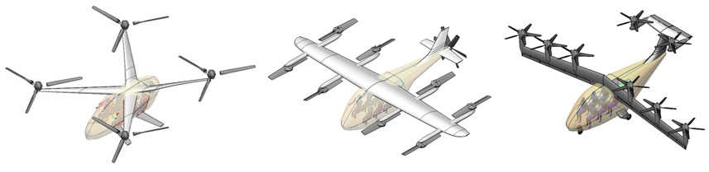
UAM Representative Vehicles
Performance data generated for 3 UAM designs developed by the NASA Revolutionary Vertical Lift Technology (RVLT) project
6-passenger vehicles all sized for same mission
Designed using NASA Design and Analysis of Rotorcraft (NDARC) software
Quadrotor | Lift+Cruise | Tiltwing
Fully Electric | Fully Electric | Turboelectric Hybrid
Notes:
In order to create our performance models, we needed UAM aircraft designs and performance data for each vehicle.
We selected 3 representative UAM vehicle designs developed by the NASA Revolutionary Vertical Lift Technology (RVLT) project.
These vehicles were all designed to carry 6 passengers and are sized to the same UAM mission using the NASA Design and Analysis of Rotorcraft (NDARC) software
Quadrotor, fully electric
Lift+Cruise, fully electric
Tiltwing, turboelectric

Slide 7
Obtaining Performance Data
Performance data from NDARC
MATLAB® used to manage NDARC sweeps
Includes broad range of payloads, altitudes, airspeeds, and flight modes
Figure illustrates unique performance trends
Quadrotor comparable to traditional helicopter
Lift+Cruise and Tiltwing are different from one another and from Quadrotor
Lift+Cruise and Tiltwing have typical airplane characteristics in fixed-wing flight mode
Unique performance trends illustrate challenge of fitting parametric model
Notes:
We used NDARC to generate our performance data for these aircraft.
MATLAB® scripts were used to manage the large number of NDARC sweeps and build a detailed performance database for each aircraft
Trim sweeps were computed over broad range of payloads, altitudes, airspeeds, and flight modes, including for accelerated flight and turns
Plots at right illustrate unique performance trends of each aircraft
Identical flight conditions
Unaccelerated, straight and level flight
Power consumption normalized by battery/fuel capacity
Quadrotor performance comparable to traditional rotorcraft
Lift+Cruise and Tiltwing are markedly different from one another and from Quadrotor
In fixed-wing flight mode, typical airplane characteristics are observed for Lift+Cruise and Tiltwing
Unique performance trends illustrate potential challenge of fitting a simple parametric model to these aircraft

Slide 8
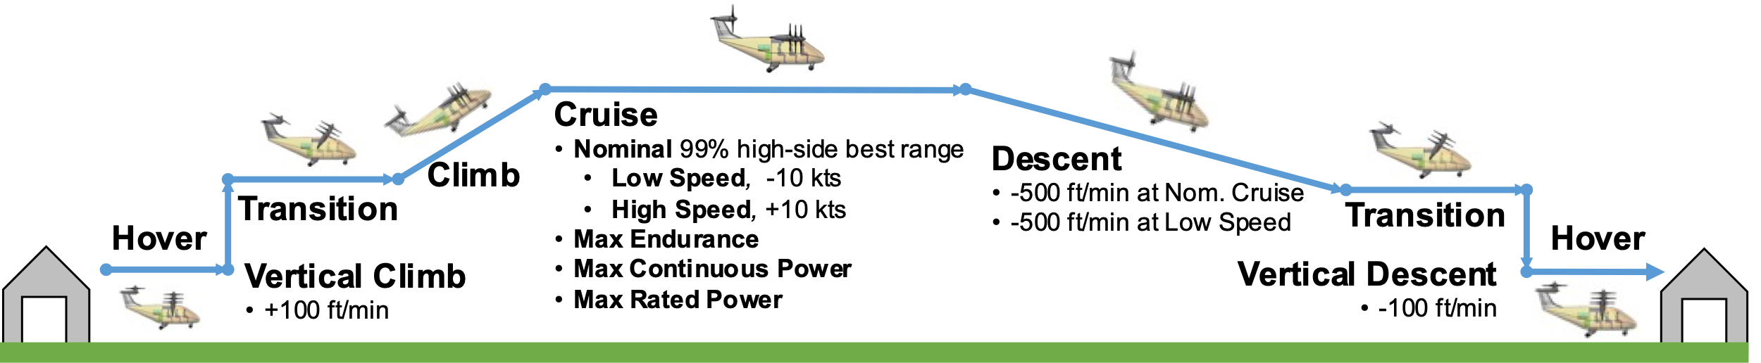
Performance Table Format
Model format is based on a performance table
  Similar format to BADA “Performance Table File” adapted to UAM flight
Provides accurate data for important flight segments
Mission segments included are illustrated below
Notes:
The disparate performance trends among UAM concepts led to the selection of a performance modeling approach comparable in format to the PTF tables provided with BADA models, adapted and expanded to suit UAM vehicle performance and operations.
This model structure was selected to support the goal of maximizing the relevance and accuracy of the model data provided to users for the most important flight segments.
The mission segments included in the performance tables were selected to capture vehicle performance during anticipated UAM flights.
The tables contain data that directly represents nominal operations based on analysis of the performance database generated using NDARC.
An overview of the segments included in the model is shown in this image and are discussed in further detail in the paper.
Important examples include hover, climb, nominal cruise, and nominal descent, and others that are included to provide additional performance details.

Slide 9
Flight Segments: Quadrotor Climb
Climb segment based on optimal Calibrated Airspeed (CAS) for best rate of climb at maximum power
Payloads:
  Low weight: 1 passenger
  Nominal weight: 4 passengers
  High weight: 6 passengers
Optimal airspeed is 49 knots CAS
Performance table for this segment shows rate of climb and power consumption (“fuel”) as function of altitude and payload
Notes:
To illustrate how flight segments were defined and analyzed, here is an example for the quadrotor ”climb” segment.
The Climb segment was based on finding an optimal Calibrated Airspeed (CAS) to achieve best rate of climb at max continuous power.
Payloads shown are for 1 passenger, 4 passengers, and the maximum of 6 passengers,
49 knots CAS selected based on “high weight” (6 passengers) payload.
The performance table for this segment shows the rate of climb that is achieved as well as battery consumption in MJ/hr for a range of altitudes and payloads.

Slide 10
Flight Segments: Nominal Cruise
Lift+Cruise with 6-passengers
Nominal Cruise defined by finding optimal CAS to achieve “99% high side” best range
Optimal cruise at 99 knots CAS
Performance table shows power consumption (“fuel”) as a function of altitude and payload
Notes:
Here’s another example, this time for the Lift+Cruise vehicle and the nominal cruise segment
The plot on the left shows range as a function of true airspeed, with altitudes from 0 to 12,000 feet shown
Nominal cruise is defined by finding the optimal calibrated airseed to achieve 99% high side best range
From this data, 99 knots calibrated airspeed was selected for cruise.
The performance data on the right shows power consumption as a function of altitude and payload as it appears in the performance table

Slide 11
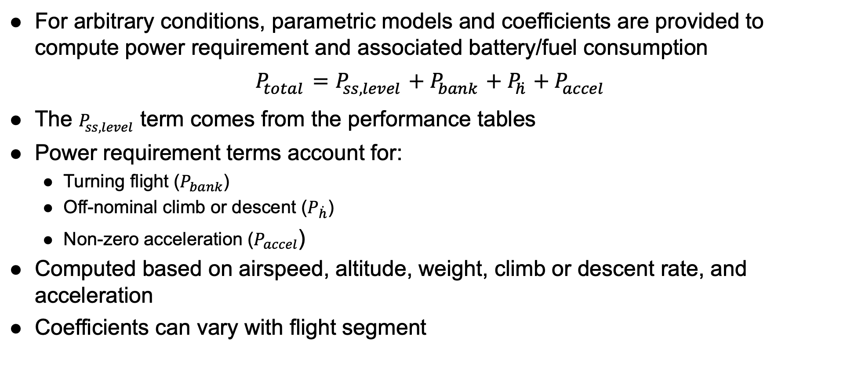
Performance Coefficients
For arbitrary conditions, parametric models and coefficients are provided to compute power requirement and associated battery/fuel consumption
$$P_{total}=P_{ss,level}+P_{bank}+P_{\dot{h}}+P_{accel}$$
The $P_{ss,level}$ term comes from the performance tables
Power requirement terms account for:
  Turning flight ($P_{bank}$)
  Off-nominal climb or descent ($P_{\dot{h}}$)
  Non-zero acceleration ($P_{accel}$)
Computed based on airspeed, altitude, weight, climb or descent rate, and acceleration
Coefficients can vary with flight segment
Notes:
For flight at arbitrary conditions not in table, parametric models and coefficients are provided to compute power requirement and associated battery/fuel consumption
$$P_{total}=P_{ss,level}+P_{bank}+P_{\dot{h}}+P_{accel}$$
The $P_{ss,level}$ term comes from the performance tables
Terms included account for
Turning flight $P_{bank}$
Off-nominal climb or descent $P_{\dot{h}}$
Non-zero acceleration $P_{accel}$
Each of these terms are computed based on airspeed, altitude, weight, climb or descent rate, and acceleration
The associated coefficients can vary with flight segment
Details are included in the paper

Slide 12
Simulation Example
A dynamic simulation was created to illustrate application of the model
Figures below are for a flight with a 37.5 nm cruise segment
Demonstrates the generation and analysis of realistic flight trajectories
Results illustrate differences between the vehicle’s performance
Notes:
In addition to the performance model, the paper discusses a dynamic trajectory simulation that was created as a proof-of-concept to illustrate an application of the model
Shown below is output for each aircraft executing a simple flight with a 37.5 nm cruise segment
It demonstrates that the model allows for the generation and analysis of realistic flight trajectories
Results illustrate some of the differences between the vehicles in terms of airspeed and power consumption
For example, we see that the Tiltwing completes the flight in only 23 min versus 29 for the Lift + Cruise and 31 for the quadrotor,
also we see a reflection of the quadrotor’s power consumption in cruise being the largest, while it is relatively efficient at slower speeds compared to the other aircraft, as expected.

Slide 13
Summary and Future Work
Paper discusses challenges facing UAM performance modeling and demonstrates methods for developing models for 3 UAM vehicles
Related paper [1] discusses an interface specification for UAM performance models to facilitate the creation of a database
Future work:
  Improved UAM aerodynamic modeling
  Development of better UAM performance model formats
  Better capture of performance-envelope limitations
Reliable performance models will serve an important role in ensuring the safety and efficiency of UAM.
[1] Hartman, D., Hartman, C., Foster, J., Morscheck F., Linke F., “An Interface Specification for Urban Air Mobility Performance Models to Support Air Traffic Management Research,” AIAA SciTech 2023 Forum (submitted for publication), January 2023.
Notes:
In conclusion, this paper discusses challenges facing UAM performance modeling and demonstrates methods for developing table-based models for 3 representative UAM vehicles
A proposed interface specification for interaction with the models is discussed in our related paper cited below, which is intended to facilitate the creation of a database of interoperable models
Future work:
Improved UAM aerodynamic modeling to inform the performance predictions that the performance models are based on
Development of better UAM performance model formats with improved parameterizations
Capture of performance-envelope limitations
Success of UAM depends on safety and efficiency. Reliable performance models will serve an important role in the continued development of the broader UAM ecosystem.
~~~
The successful growth of the UAM industry will depend on well-designed aircraft safely and efficiently integrating with ATM systems and regulations. Reliable performance models will serve an important role in the continued development of the broader UAM ecosystem, making continued progress in this area vital.

Slide 14
Acknowledgments
This work was funded by the NASA Air Traffic Management-eXploration (ATM-X) UAM Project.
The authors would like to extend thanks to our colleagues in the NASA RVLT Project for providing the original NASA UAM vehicle designs and for their assistance with the NDARC software.

