Slide 1


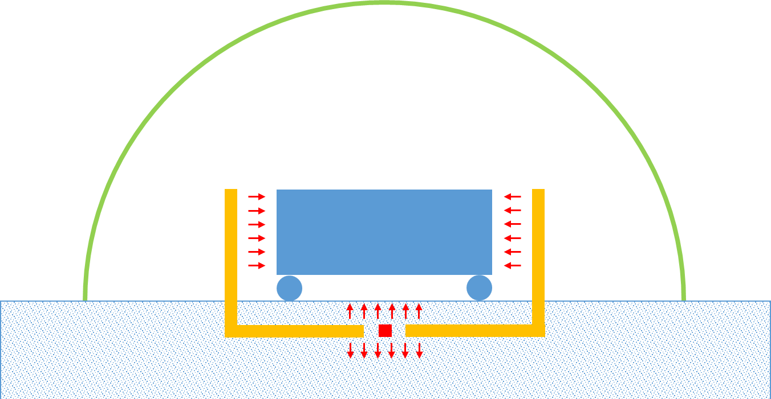
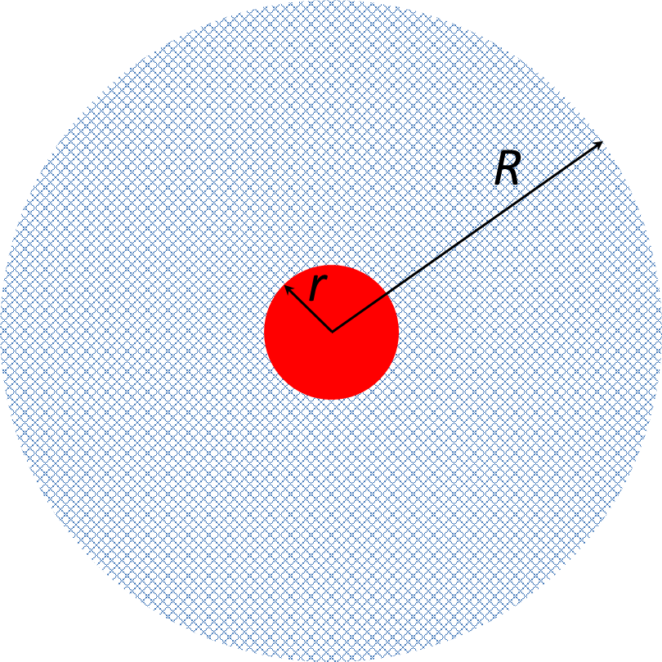
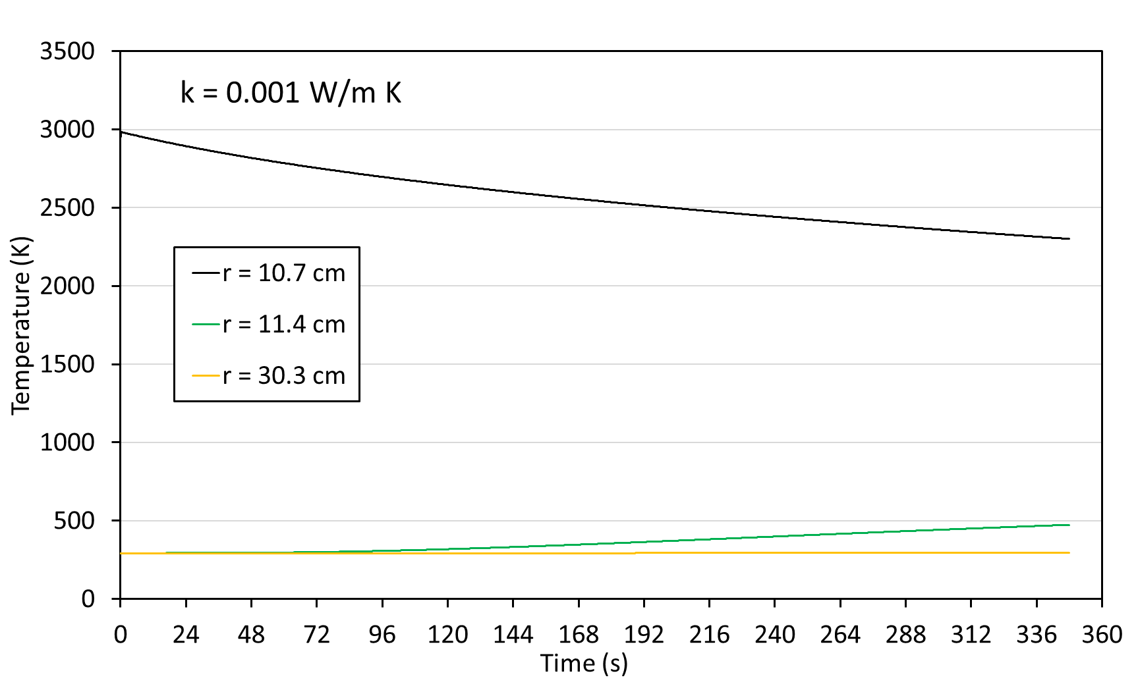
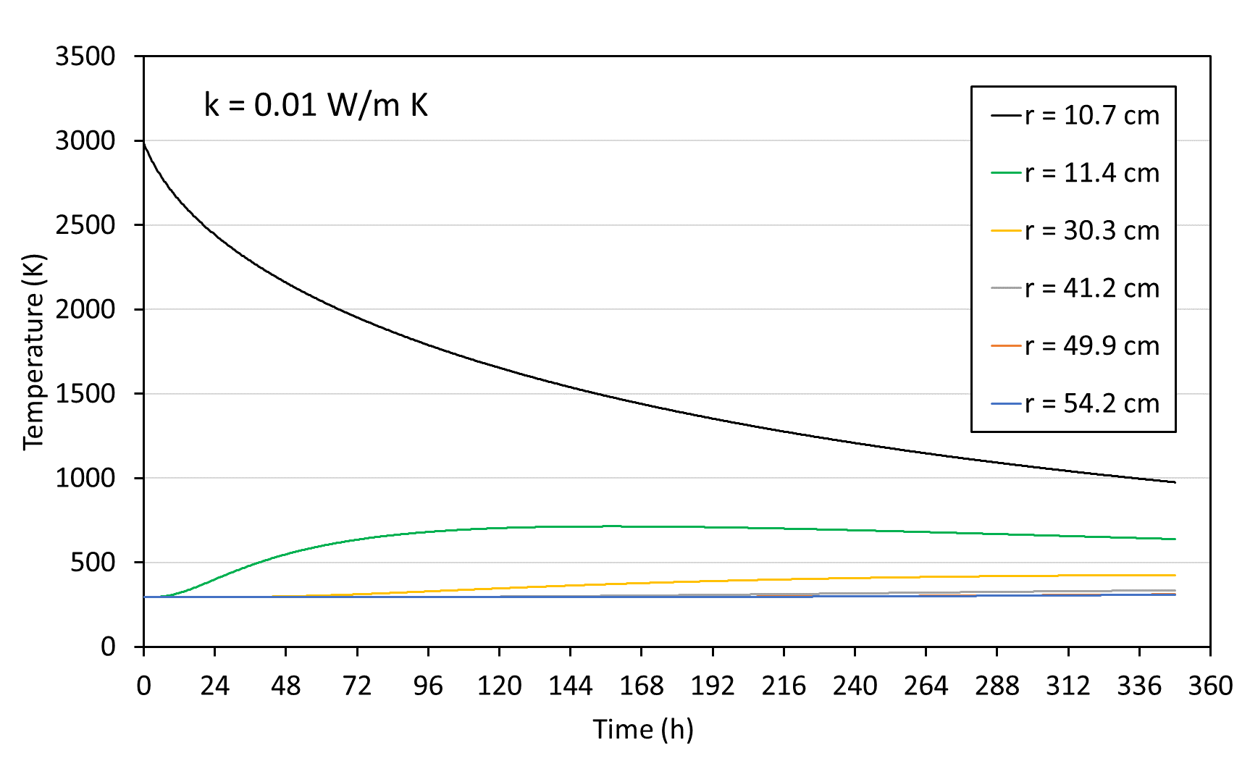

A Warm Garage for a Lunar Rover
Evgeny Shafirovich¹ and Steven L. Rickman²
¹Department of Aerospace and Mechanical Engineering, The University of Texas at El Paso
²NASA Engineering and Safety Center
Approach
Heat is generated by combustion of a highly exothermic reactive mixture.
The mixture remains hot for a long time because of the low thermal conductivity of regolith, 0.001 − 0.01 W/(m∙K), − great insulator!
The mixture pellets are placed in the surface layer of regolith and ignited.
The combustion forms condensed products and releases heat.
The heat slowly spreads to the surrounding regolith.
Heat is also transferred by heat pipes into radiant heating surfaces.
A greenhouse transmits sunlight during the day and decreases the radiative heat losses during the night.
Heat-generating Mixture
Combustion should generate heat but no gas. Example:
Ti/B (1:2 mole ratio) mixture; Ti + 2B → TiB₂
Specific energy: 4.0 MJ/kg (1.1 kWh/kg)
Easy ignition with a heated W wire
Adiabatic flame temperature: 3200 K
Product: solid TiB₂ (melting point: 3500 K)
Energy capacity of Ti/B mixture
1000 kg of regolith is heated by 12.5 kg of Ti/B mixture.
All generated heat is transferred to regolith, c_{p} = 500 J/(kg∙K).
The temperature of regolith will increase by 100 K.
Heat Transfer Estimates
A spherical model
Ti/B core (Ti/B mole ratio: 1:2, compacted to 70% relative density, ρ_{bulk} = 2445 kg/m³, m = 12.5 kg, r = 11 cm)
Regolith shell (ρ_{bulk} = 1500 kg/m³, m = 1000 kg, R = 54 cm)
Thermal conductivity of regolith: k = 0.001 W/(m∙K) and k = 0.01 W/(m∙K)
Initial temperature: 293 K
No heat loss from the outer surface
Software: Thermal Desktop SINDA/FLUINT (Cullimore and Ring Technologies)
Results:
k = 0.001 W/m K
Node Number | Radial Distance from Center (cm) | Temperature at 14.5 days (K)
127 | 10.7 | 2301
97 | 11.4 | 474
67 | 30.3 | 294
37 | 41.2 | 293
13 | 49.9 | 293
4 | 54.2 | 293
k = 0.01 W/m K
Node Number | Radial Distance from Center (cm) | Temperature at 14.5 days (K)
127 | 10.7 | 975
97 | 11.4 | 637
67 | 30.3 | 425
37 | 41.2 | 334
13 | 49.9 | 310
4 | 54.2 | 308
After 14.5 days the core lost 31% of the released heat at k = 0.001 W/(m∙K) and 77% at k = 0.01 W/(m∙K).
At 20 cm from the core surface, the temperature of regolith increased by 1 K at k = 0.001 W/(m∙K) and by 132 K at k = 0.01 W/(m∙K).
Conclusion
Heat generators based on gasless combustion of reactive mixtures could be installed directly in the surface layer of regolith.
Because of the low thermal conductivity of regolith, such generators would keep thermal energy for days and gradually supply heat to a rover/lander.
Acknowledgment
The material presented in this work is based upon the work supported by NASA under Grant #80NSSC20K0293.

