Slide 1




Thermodynamic Venting System (TVS) Augmented Injector Testing
NASA MSFC Advanced Propulsion Research and Technology Branch
Nicole Vaughn, Engineer, Presenter at AIAA SciTech 2023
Jonathan Stephens, Team Lead
Kevin Pedersen, Engineer
Travis Belcher, Engineer
NASA MSFC Systems Modelling and Simulation Branch
Cameron Hines, Engineer
NASA MSFC Spacecraft and Vehicle Propulsion Branch
Omar Mireles, Engineer
Yetispace Inc.
Noah Rhys, President
27 January 2023
Notes:
Hello, my name is Nicole Vaughn and I am an engineer at NASA’s Marshall Space Flight Center in the Advanced Propulsion Research and Technology Branch. Today, I am here to discuss our ongoing Thermodynamic Venting System (or TVS) Augmented Injector experiments in tank-to-tank transfer of cryogenic fluids.

Slide 2
Motivation
  NASA is laying the groundwork for human presence on the Moon, Mars, and other locations such as asteroids. Transportation infrastructure will be critical.
  Tank-To-Tank transfer of cryogens will be necessary for future on-orbit and deep space applications:
    Gateway
    Refueling of Reusable Vehicles
    In-Situ Resource Production and Distribution
    Long Duration Storage
  Technologies to enable cryogenic tank-to-tank transfers with minimal losses to boil off are desired
Notes:
With the current activity to return humans to the Moon and eventually to Mars, NASA is placing a big emphasis on transportation infrastructure and reusable vehicles. In order for a vehicle to be reusable, it needs to be refuellable, and many commonly used propellants are cryogenic, including methane, oxygen, and hydrogen. Being able to store these propellants for long durations and transfer them from tank-to-tank with minimal losses to boil off will be critical.

Slide 3
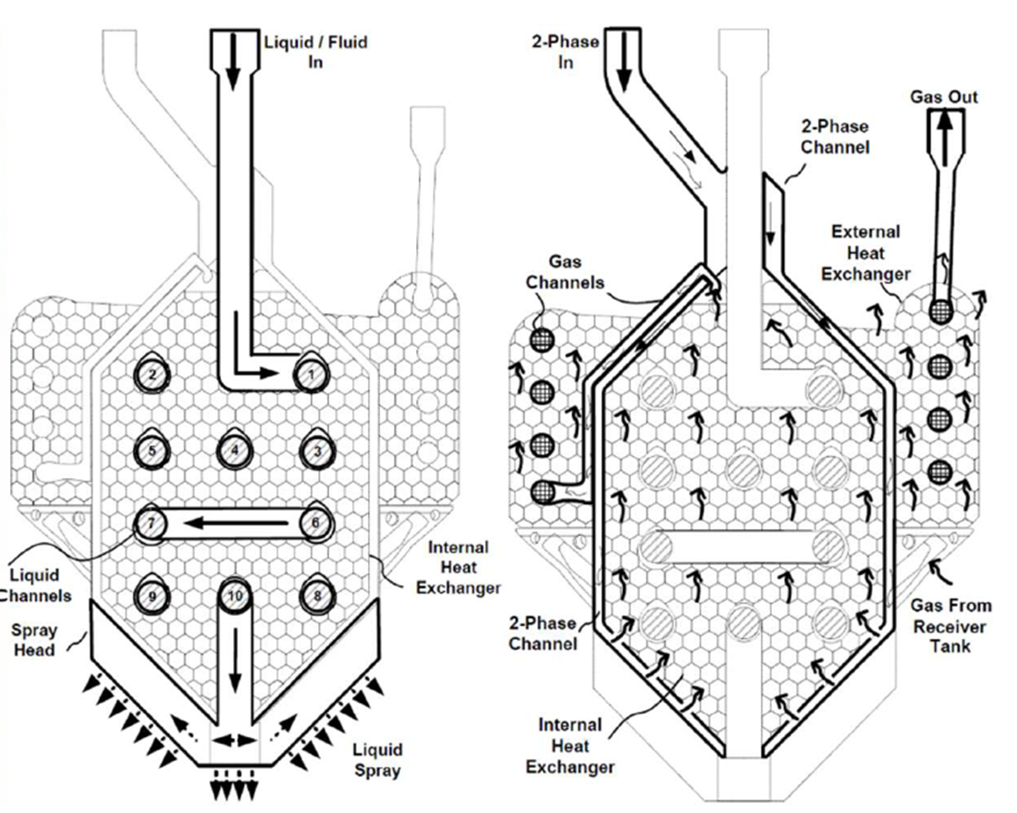
Overview of Injector Concept
Two Flow Paths
  Core Flow: LN2 to be transferred
  TVS Flow: Two-phase flow out of Joule-Thompson device
Heat Exchanger
  TVS flow subcools core flow
Condensation
  TVS flow chills exterior lattice, encouraging ullage condensation
Spray Pattern
  Core flow injects into tank via a series of spray holes
Notes:
One technology under development at Marshall is the TVS Augmented Injector. This concept features two fluid flow paths, a super cold two-phase fluid that has been isenthalpically expanded across a Joule Thompson device and the core flow of subcooled cryogen delivered from a bulk supply that will exit the injector via the spray. These flow will be physically separated, but experience heat exchanger in the interior portion of the injector. The two-phase TVS flow enters this lattice plenum area that the core flow spirals through on its way to the spray holes, the intention being that the core flow will be further subcooled by the TVS flow. Large sections of lattice on the exterior of the injector enshroud the final legs of the TVS flow, creating a large surface area of cold metal lattice to encourage tank ullage condensation.

Slide 4
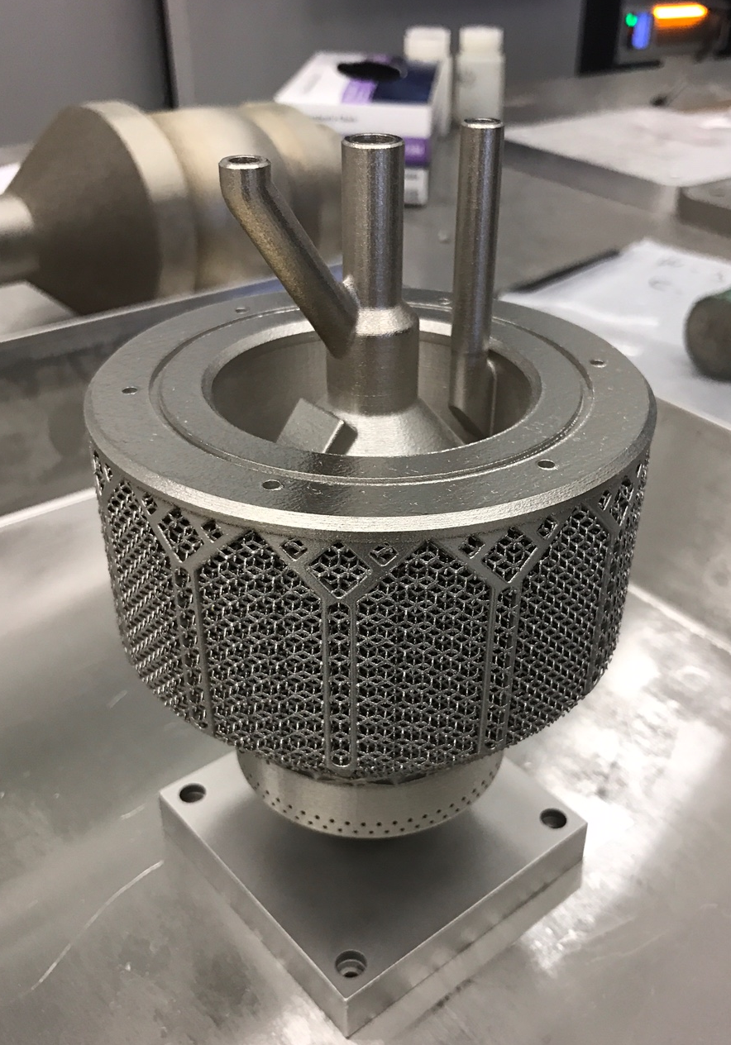
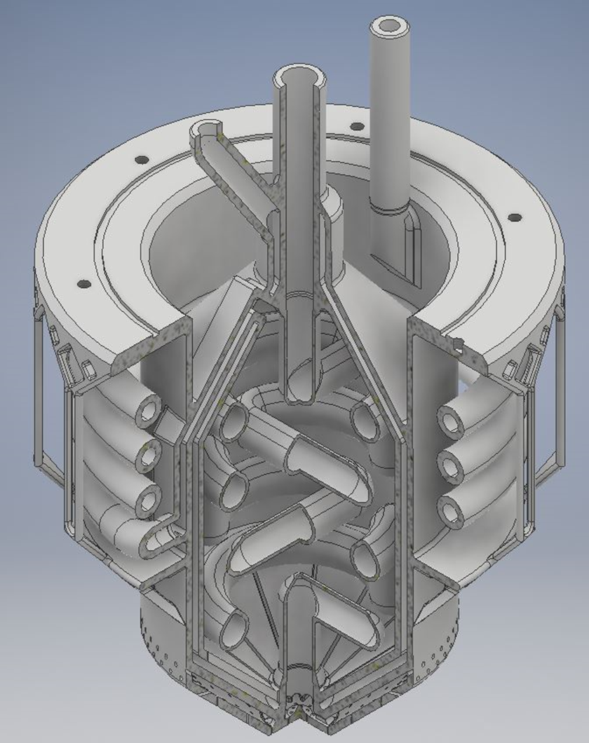
Previous Work
Concept originally patented by Jim Martin (MSFC Advanced Propulsion Research and Technology Branch) and Omar Mireles
Technology was demonstrated in 2018 with an Inconel V5 injector in thin-walled CRYOTE titanium tank in a vacuum chamber
Current injectors are printed with Laser Powder Bed Fusion (L-PBF)
Current Material: AlSi10Mg, selected for its lower density and relatively high thermal conductivity relative to Inconel 718
Earlier Version 4 TVS Augmented Injector printed from Inconel 718.
Notes:
This concept was originally envisioned by two MSFC engineers, Jim Martin and Omar Mireles. The injector was design such that it that could be additively manufactured using Laser Powder Bed Fusion. The Version 5 injector was actually printed from Inconel 718 and demonstrated in a thin-walled titanium tank in a vacuum chamber. The current iterations of these injectors are printed using Aluminum Silicon10 Magnesium powder. This material had a lower density than the Inconel, driving the weight down, and a higher thermal conductivity to aid in conduction between the flow paths.

Slide 5
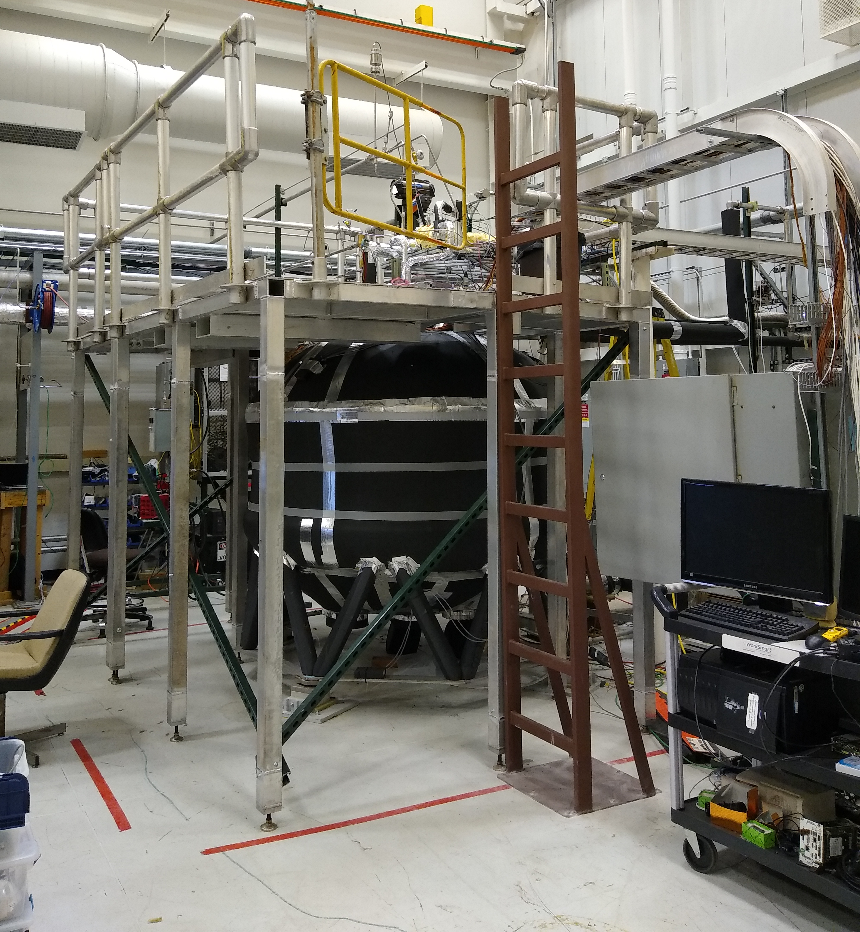
Experimental Facility
GN2 Supply
Heat Exchanger
LN2 Supply
(3000L)
JT Device
TVS Flow
Core Flow
Exhaust to Vacuum Pump
CTB2 Tank
Cryogenic Test Bed 2 (CTB2)
SS304L Tank with 3/8in walls
120ft^3 in Volume.
Notes:
The injectors in this work were tested in the Cryogenic Test Bed 2 (or CTB2) tank at Marshall Space Flight Center. This is a hefty stainless-steel tank with thick walls, approximately 3400L in volume. CTB2 has a lot of mass on its forward dome with multiple flanges and is not housed in a vacuum chamber, making it something of a “worst case scenario” for a tank-to-tank transfer test. A 3000L dewar located outside the building supplied liquid nitrogen for this test series but presented a bit of a problem in that it was not possible to completely fill CTB2 during any given test. Due to its large mass, most of the available LN2 was needed to chill the tank down, and the volume simply wasn’t there to do it from ambient conditions. Before each test day, the tank would typically be prefilled with approximately 300lbm of LN2 to allow it to chill overnight. The supply dewar could then be topped off before a testing attempt. A heat exchanger was plumbed into the gaseous nitrogen pressurant system on the supply dewar as well. This heat exchanger prechilled the GN2 before it entered the dewar ullage to keep the supply LN2 temperature from creeping up. This was a problem observed during early tests of the LN2 delivery system. In general, gaseous nitrogen would pass through the heat exchanger to pressurize the supply dewar. The LN2 would flow into the building and a small amount would tap off to undergo an isenthalpic expansion across a JT device to become a cold two-phase mixture that would become entirely gas by the time it exited the injector and be exhausted as waste. The rest of the LN2 would go to the core flow and inject into the tank.

Slide 6
Chill Methods
Charge-Hold-Vent
Vented Chill
Identify a “trigger point” temperature at which a no vent fill should be possible
Load a predetermined amount of LN2 into the receiving tank CTB2
Close Vent, allow tank to “soak” until pressure reaches a critical point and venting becomes necessary
Repeat steps 2 and 3 until trigger point temperature is achieved at consistent, measurable point on the tank wall
Proceed with a No Vent Fill
Identify a “trigger point” temperature at which a no vent fill should be possible
Begin flowing LN2 into the receiving tank with the vent open
Proceed with a No vent Fill once the trigger point temperature is achieved at consistent, measurable point on the tank wall
Notes:
Before a tank can begin to fill with a cryogen, it must be chilled to the point where the fluid won’t immediately boil away. This is commonly achieved by one of two methods: The Charge Hold Vent, or the Vented Chill.
.
.
.
.
Once the tank is chilled and LN2 begins to accumulate, we want to a achieve what is called a “No Vent Fill”. It’s unavoidable that some LN2 will boiloff during tank chilldown, but ideally that boiloff should be minimized during the chill and especially during the fill. This is why identifying the warmest possible “trigger point” is important. One the no vent fill begins, all the tank vents are closed and pressure is allowed to build as some fluid continues to boil. In a successful no vent fill, the pressure curve will eventually roll over as ullage collapses and condensation overcomes boiling. If that fails to happen, then the tank pressure rises until it approaches the supply pressure and the flow stalls. In theory, that is when the TVS system on the injector could be activated to recover from the stall by subcooling the core flow further and encouraging more condensation. Having the vent closed during the fill prevents any additional nitrogen from being lost to venting.

Slide 7
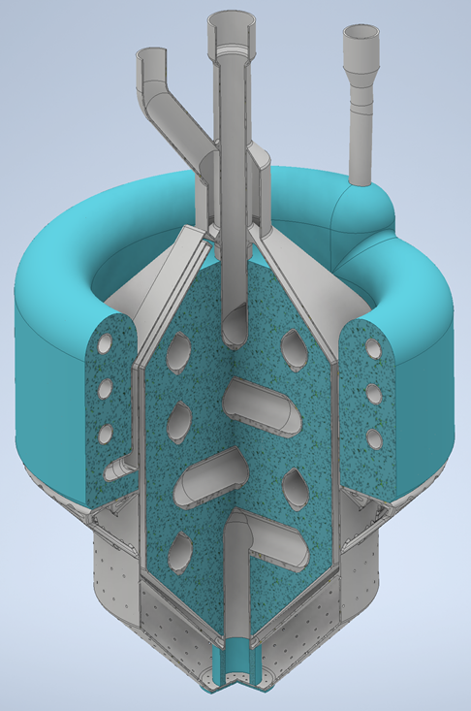
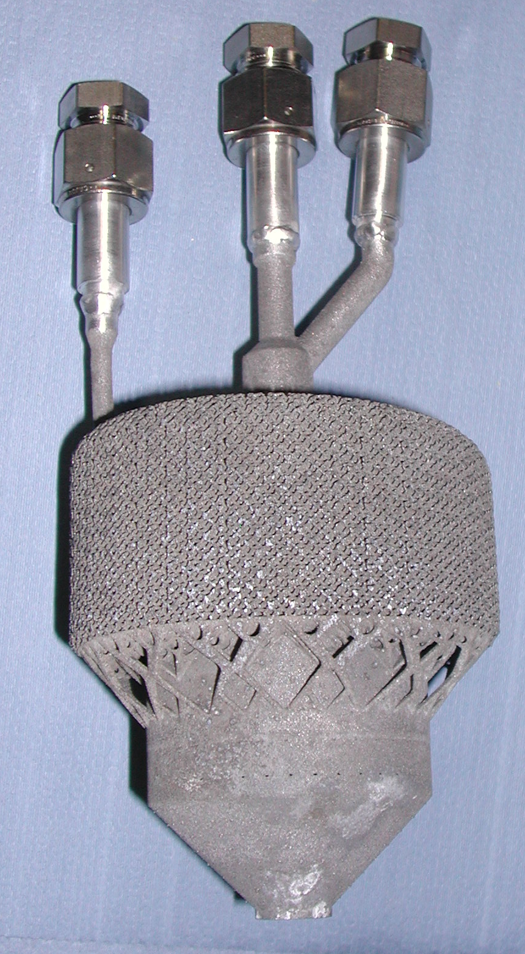
Version 5 (V5) Injector
Blue regions of CAD image indicate lattice
Heat exchange to cool core flow as it coils through central TVS “pool” of cold two-phase fluid
0.5mm thick walls to enhance interaction between the “hot” core flow and “cold” TVS flow
Exterior lattice encloses TVS flow to chill lattice and provide a lot of surface area for condensation of ullage
Spray entirely directed horizontal or downwards
Notes:
In total, there were four injectors tested during this test series. The first of which was an exact copy of the injector tested in 2018 but printed in aluminum instead of inconel.
.
.
.

Slide 8
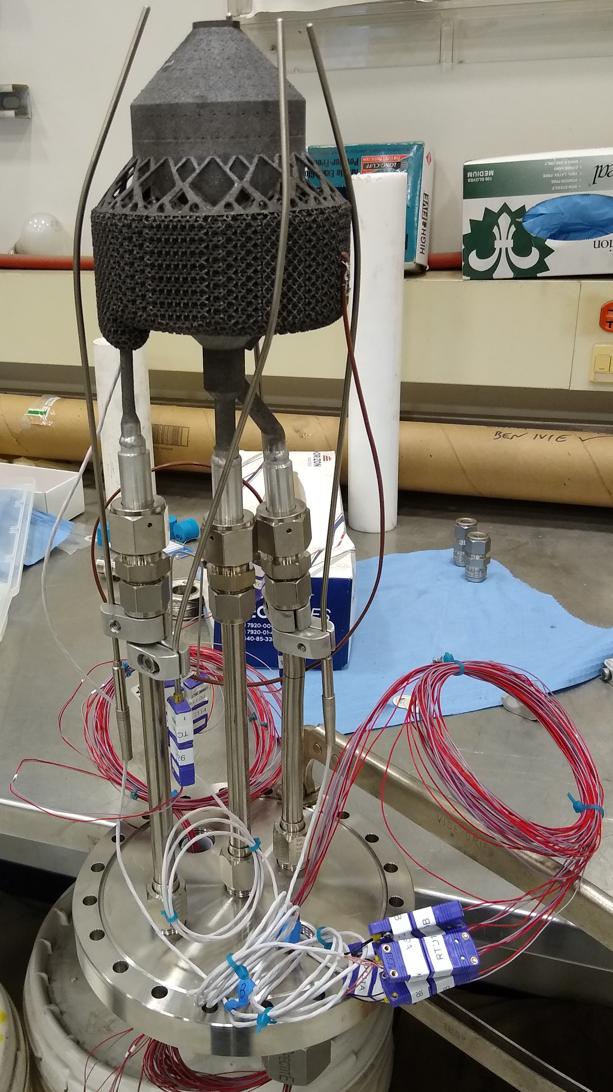
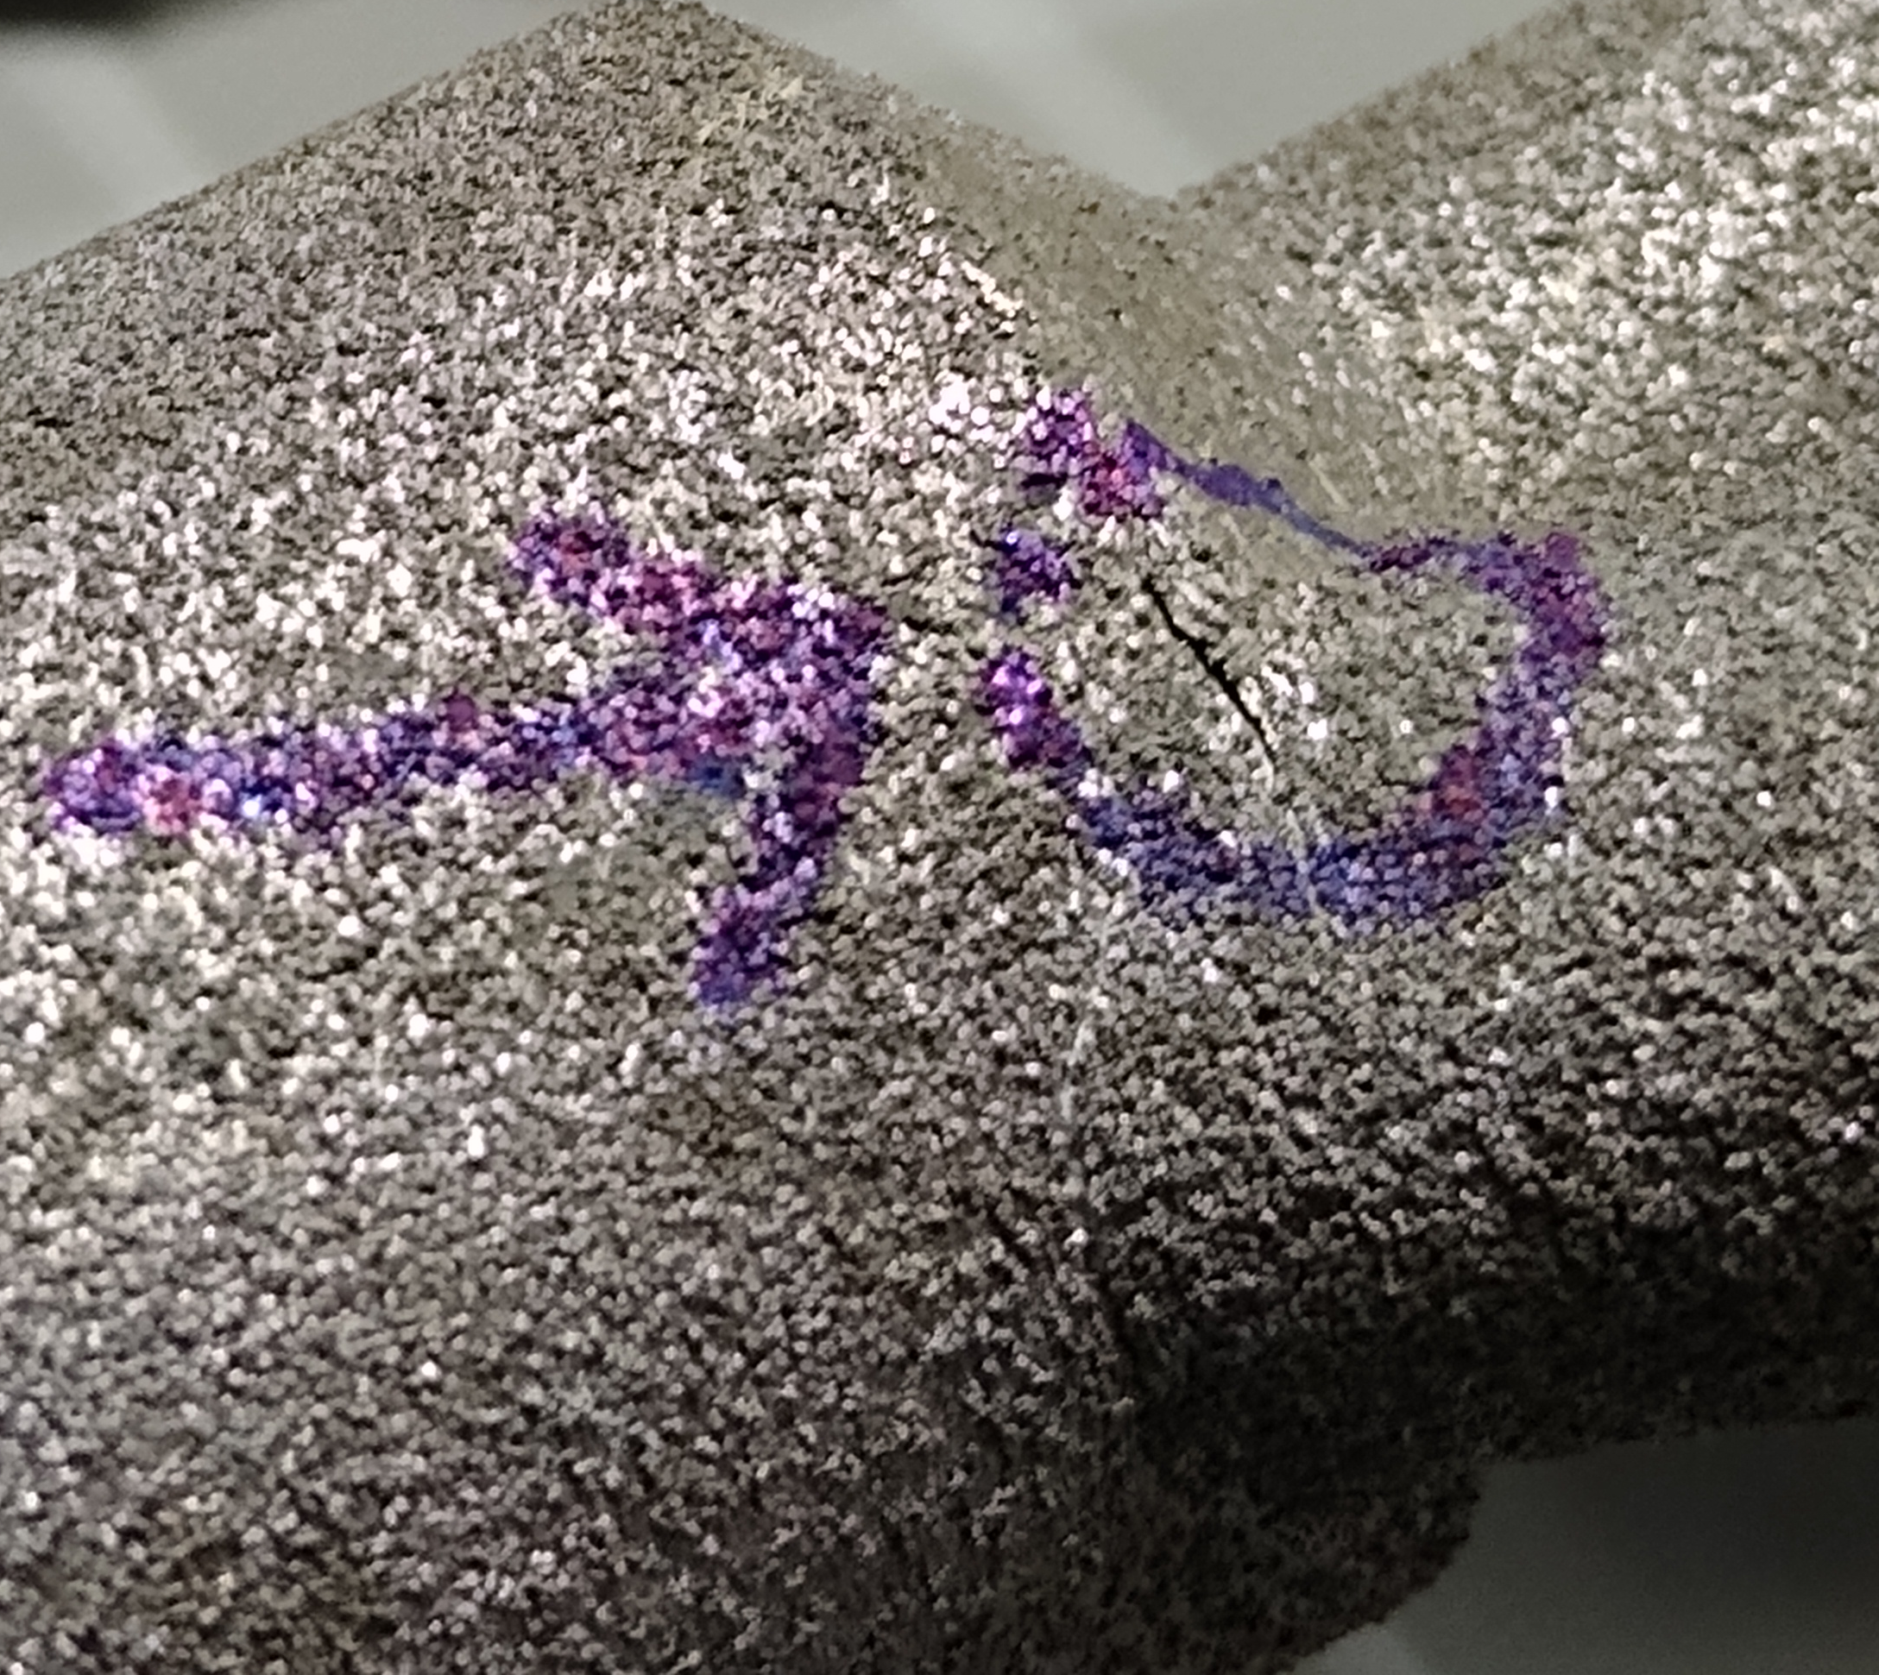
V5 Injector Testing
A very small leak was observed under the lattice during in initial checks, which was thought to be a result of print porosity.
The thin wall on the TVS inlet cracked at some point during testing.
Despite filling the tank with increasingly large “charges” CTB2 never chilled enough to warrant a no vent fill attempt using the Charge-Hold-Vent method.
During VC/NFV attempts, venting always became necessary due to high tank pressures. This was thought to be an issue of spray distribution for such a large and thick-walled tank.
The V5 was originally intended to be tested in a thin walled tank in a vacuum chamber.
The TVS system was not fully tested due to facility limitations in delivering subcooled LN2 to the JT device. After the injector cracked, no further tests were possible.
Notes:
Unfortunately, the V5 injector did not successfully chill or no vent fill the tank for a variety of reasons.

Slide 9
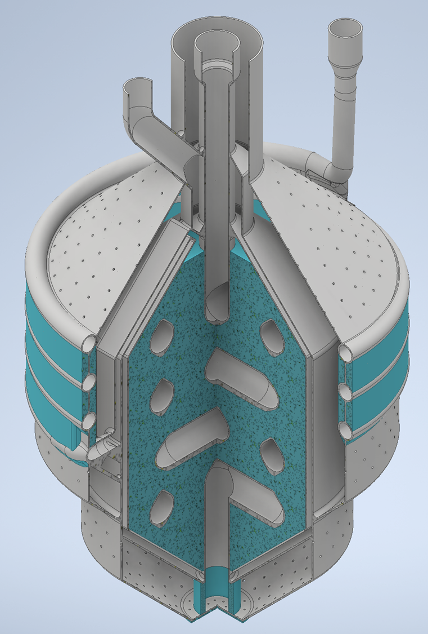
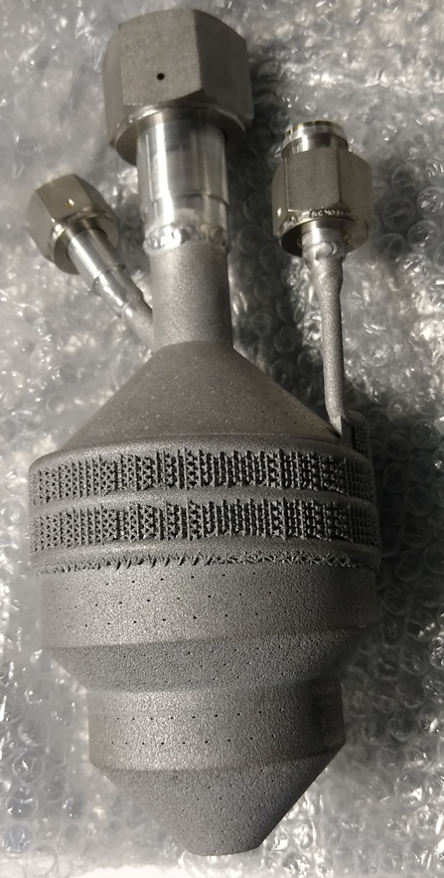
Version 6 (V6) Injector
Blue regions of CAD image indicate lattice
Heat exchange to cool core flow as it coils through central TVS “pool” of cold two-phase fluid
0.5mm thick walls to enhance interaction between the “hot” core flow and “cold” TVS flow
Exterior lattice encloses TVS flow to chill lattice and provide a lot of surface area for condensation of ullage
More spray holes than the V5 (approx. 3X the flowrate) with 1/3 of them oriented towards the upper dome
Notes:
The Version 6 injector was basically a modified V5 that addressed the spray pattern issue.

Slide 10
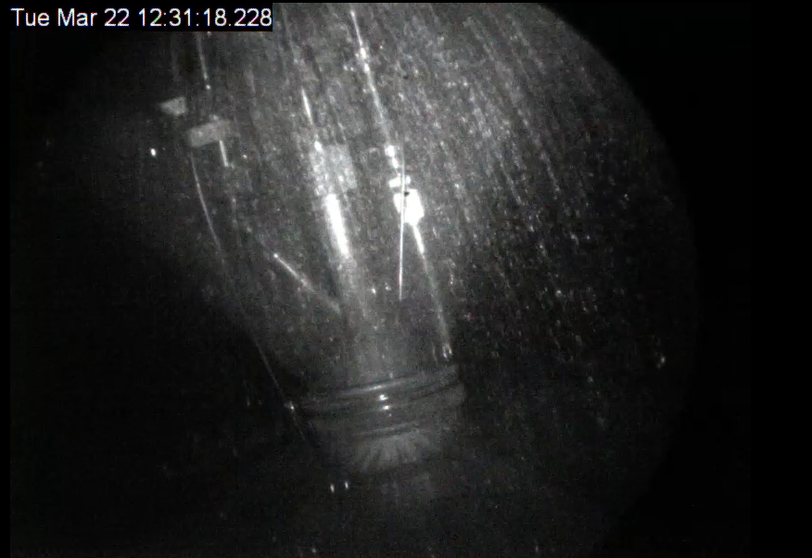
V6 In CTB2
Notes:
During testing there was a camera installed with a borescope to view the interior of the tank. This still from those videos give a sense of how much liquid was being sprayed onto the forward dome. This made a huge difference in our ability to chill down CTB2.

Slide 11
V6 Charge Hold Vent Comparison
Charge Hold Vent used a trigger point of 105K, can be compared with the Vented Chill data
Initial conditions were similar. The tank had been prechilled the day before each test and at the time of the test the fill level of CTB2 was within 2% of matching
The vented chill did require about 10K more degrees of cooling
 | Charge Hold Vent | Vented Chill
Tank Fill Level During Chill (Start to NVF) | 14.8% to 25.9 % | 12.6% to 40.48%
LN2 Accumulation in Tank During Chill (Measured by Load Cells) | 675 lbm | 1693 lbm
Total LN2 Transferred During Chill (Measured by Core Flowmeter) | 908 lbm | 2004 lbm
Total LN2 Lost to Venting During Chill | 233 lbm | 311 lbm
SD04 At Start of Chill | 132 K | 146K
SD04 Trigger Point Temperature | 104K | 105K
Time Taken to Chill | 2808 sec (~47 min) | 1313 sec (~22 min)
Notes:
Both the charge-hold-vent and vented chill methods have benefits and detriments. The charge hold vent if designed well will minimize the amount of cryogen lost to boiloff, but is slow and labor intensive. The vented chill will always result in more mass vented, but is operationally simple and time efficient.
.
.
.
.

Slide 12
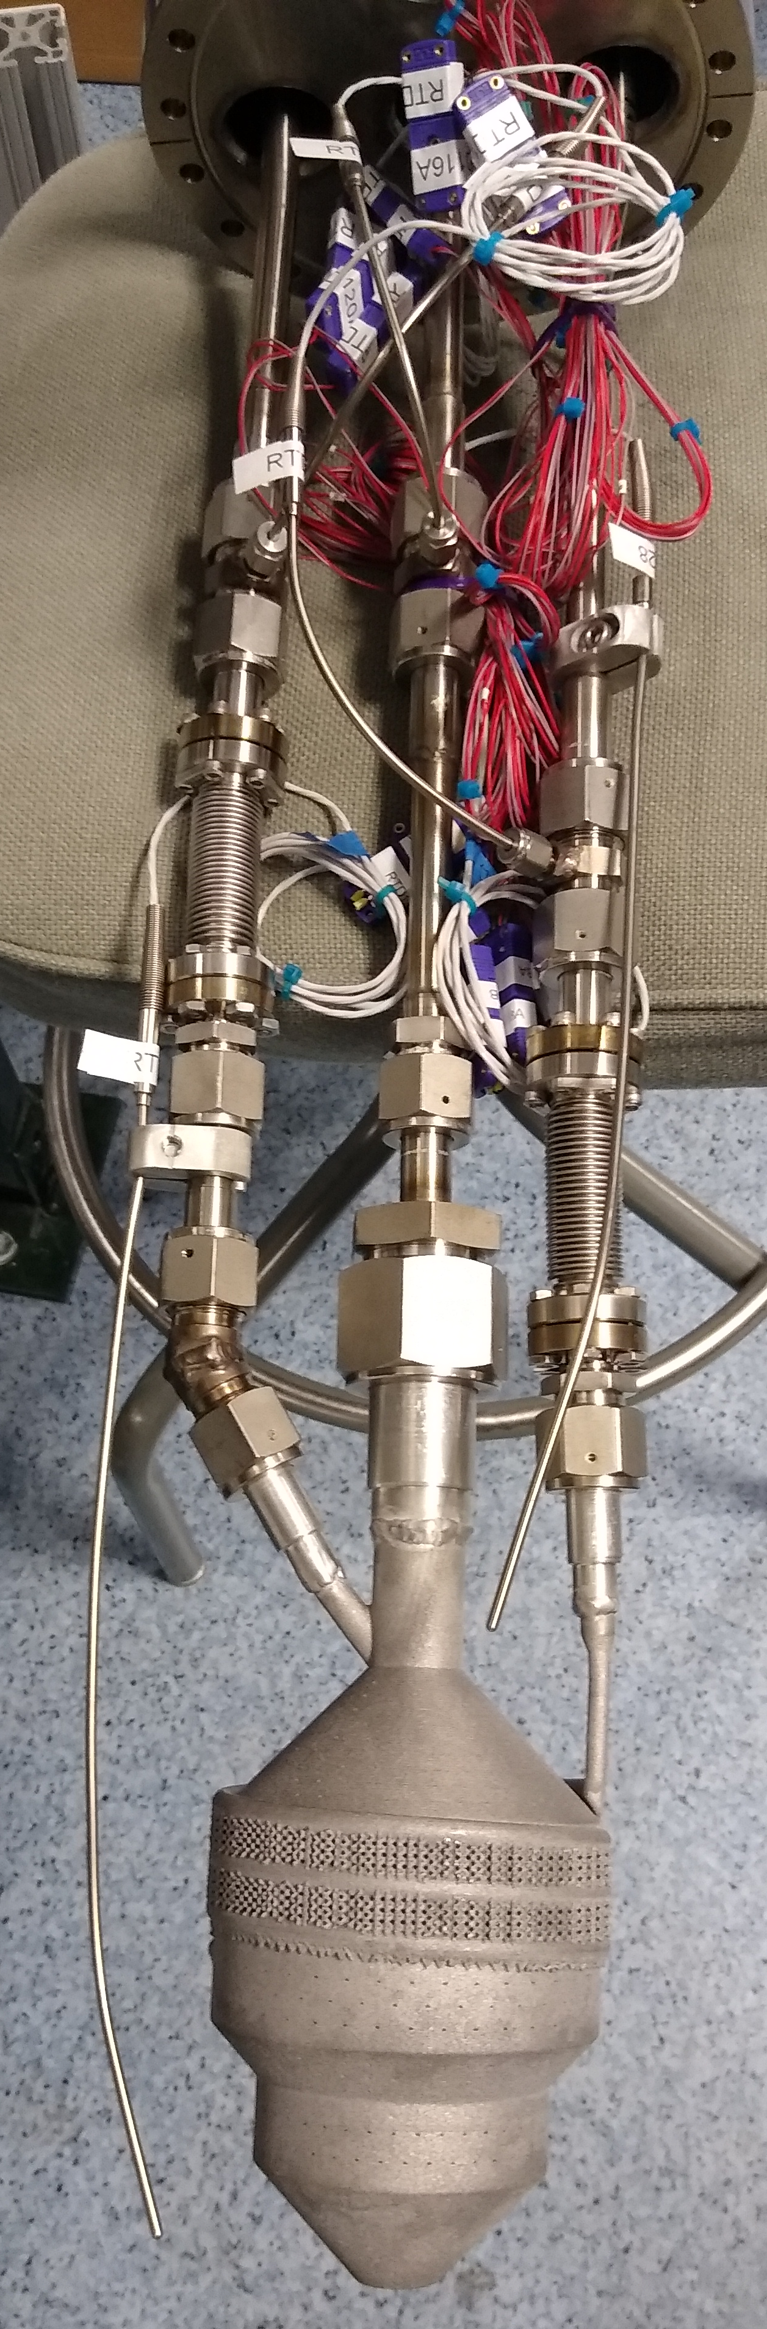
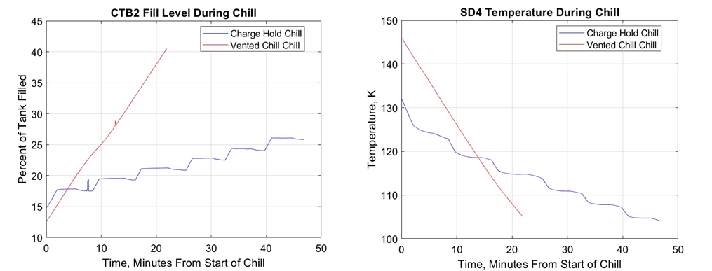
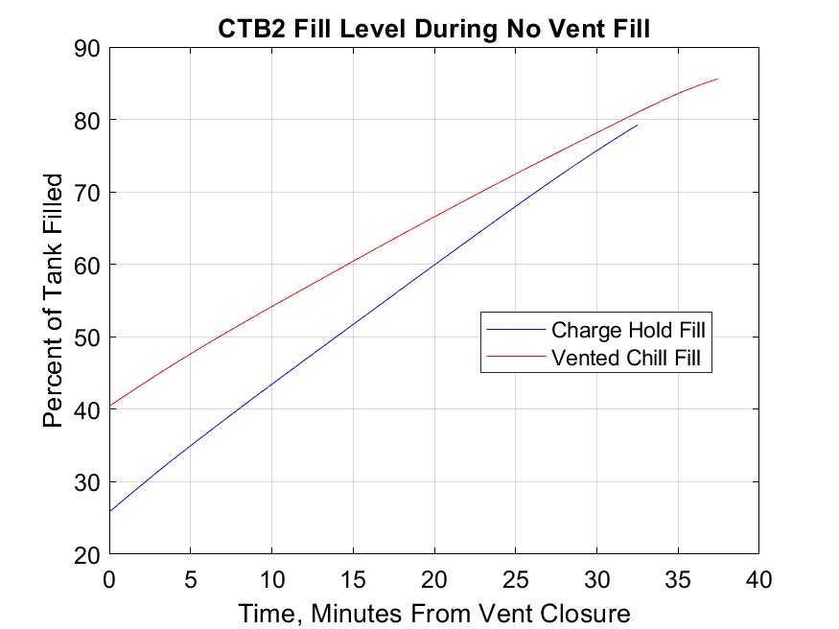
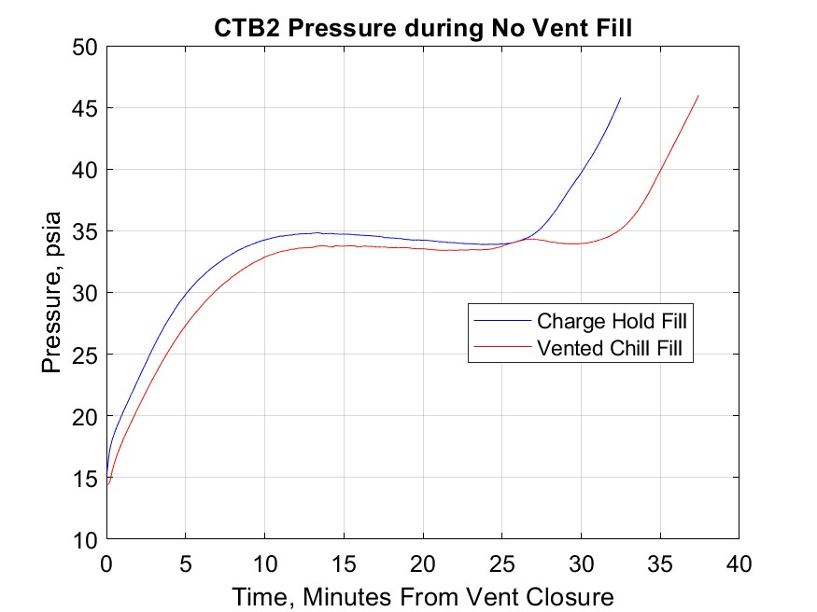
V6 Charge Hold Vent Comparison
Notes:
Here we have some graphical representations of the comparison between the two methodologies.
.
.
.
On the right we see an image of the V6 as it was installed in the tank.

Slide 13
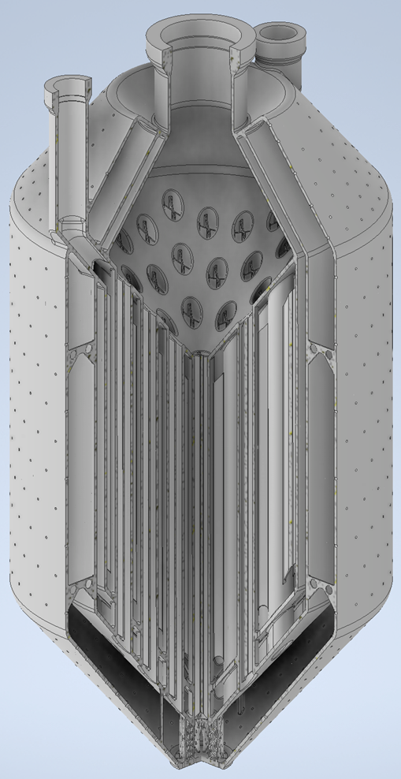
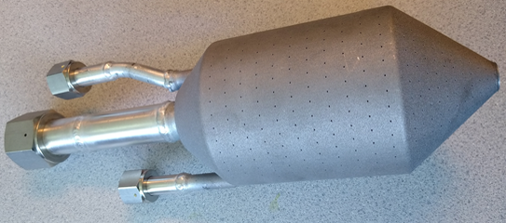
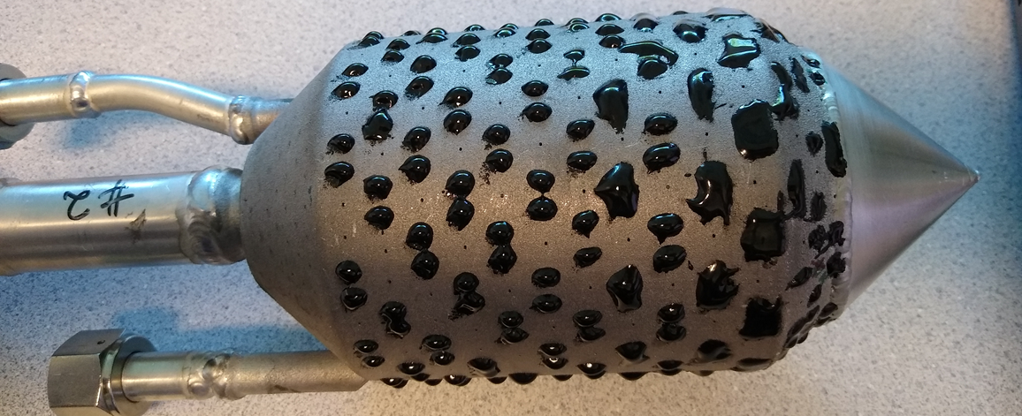
Shell and Tube Injector
No lattice except for support at nose region
Parallel flow heat exchanger between TVS and Core flows
1mm thick walls to address structural issues in previous injector
No dedicated exterior condensation surfaces
Spray holes on entire surface oriented in all directions initially. Nose cone and half of the spray holds on barrel section closed to bring flowrate down.
Notes:
For the third injection we tested, the shell and tube, the design diverged quite a bit from its predecessors.
.
.
.
Due to the limited supply volume of LN2, we had very short testing durations with the V6 injector, which had approximately three times the flowrate of the V5. The Shell and Tube as printed had an even greater flowrate from all of the additional holes. It was quickly determined that we needed to close up many of the spray holes and drive the flowrate down as our facility simply couldn’t handle the as printed flowrate. To do so, we welded a nose cone over the injector to eliminate downwards spray as it didn’t contribute much to tank chilling and used epoxy to close up approximately 2/3 of the holes on the barrel section. Only the upwards directed spray was left alone.

Slide 14
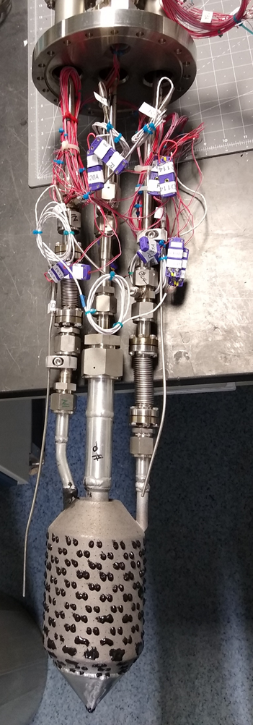
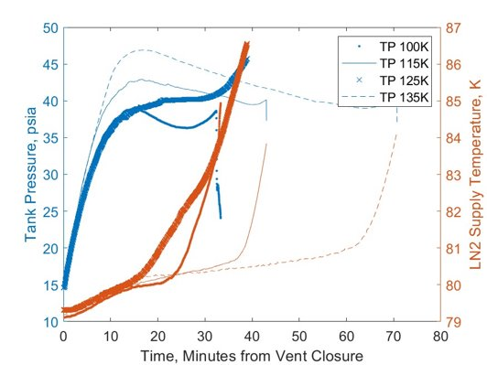
Shell in Tube Injector Testing
Four VC/NVF’s were completed with similar initial tank prechilling conditions using Trigger Points of100K, 115K, 125K, and 135K.
The 125K data is not entirely in family. The supply LN2 was warmer; thought to be a result of operator error. On the Core flow LN2 temperature plot, it is evident that the LN2 warmed immediately after lockup.

Slide 15
Lessons Learned and Future Work
Spray pattern has a significant impact on managing tank heat load
The No Vent Fill is highly sensitive to how subcooled the liquid being delivered to the core flow is
The aluminum printed parts could benefit from some additional processing post print to increase strength and reduce porosity
Wall thickness of less than 1mm introduce a greater risk of damage to a thermally cycling injector
Using prechilled pressurant on the dewars results in a more stable temperature in the LN2 supply
Condensation is likely a larger driver of ullage collapse than heat transfer to the core flow
Modifications are underway to facility to address limitations identified by this testing campaign (LN2 bulk supply volume in particular)
New injector design that focuses on ullage collapse, with post processing of printed part for strength
Demonstration of recovery from a stalled transfer with the TVS

Slide 16
Questions?
Nicole Vaughn, NASA MSFC ER64
nicole.m.vaughn@nasa.gov

