Slide 1

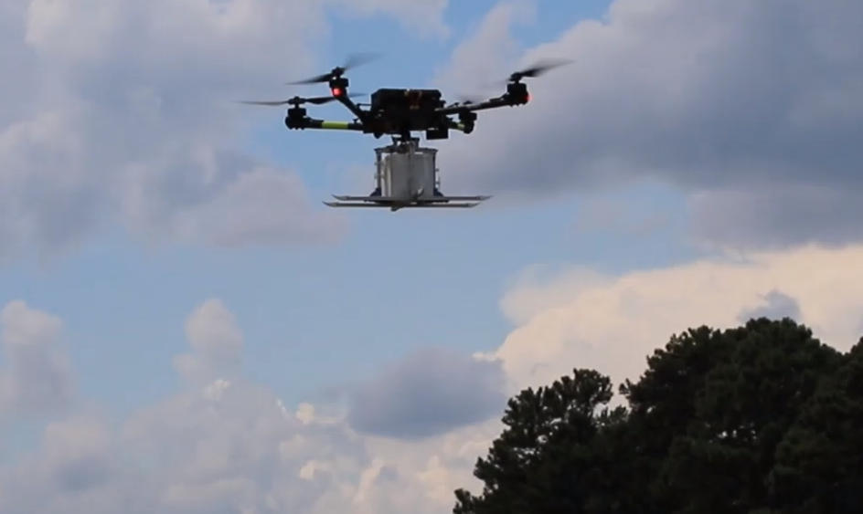
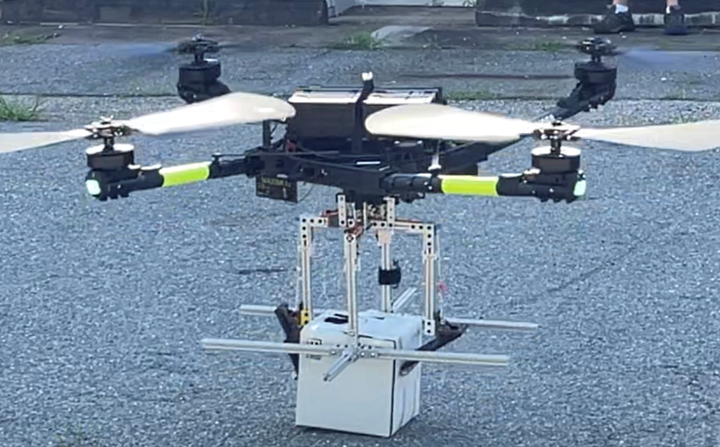


Tactical Fire Remote Sensing Advisory Committee
November 29th/30th 2022
Multi-aircraft Remote Emergency Response Assessment
Field Operations Package Delivery Mission Concept
sUAS Logistics Flight Demonstration
NASA Langley Research Center
NASA Academy

Slide 2
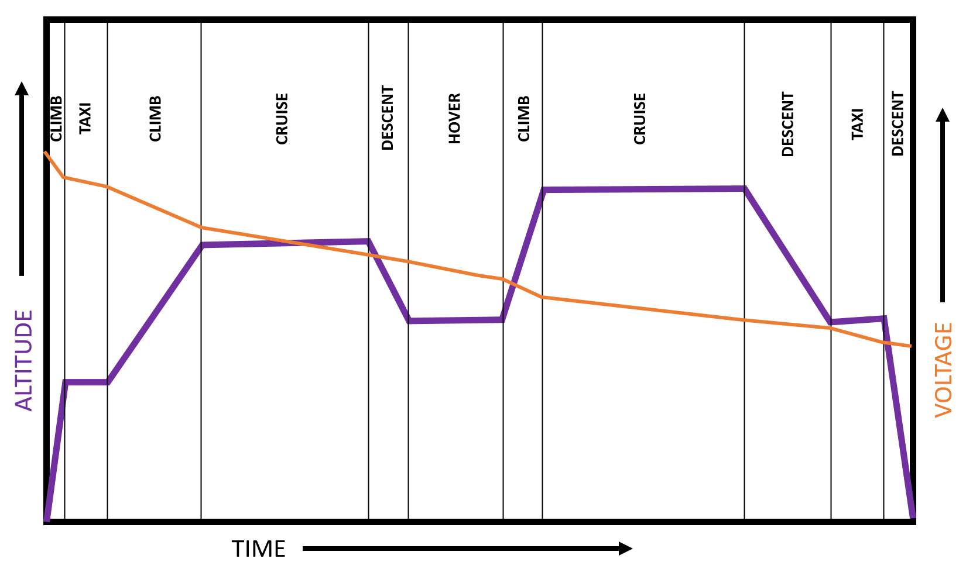
Mission Concept
Flight Performance
  Hover
  Climb/Descent
  Cruise/Taxi
  Wind Effects
  Altitude
  Min/Max Deliveries/Hour
Payload
  2.5 Gallon Cubinator

Slide 3
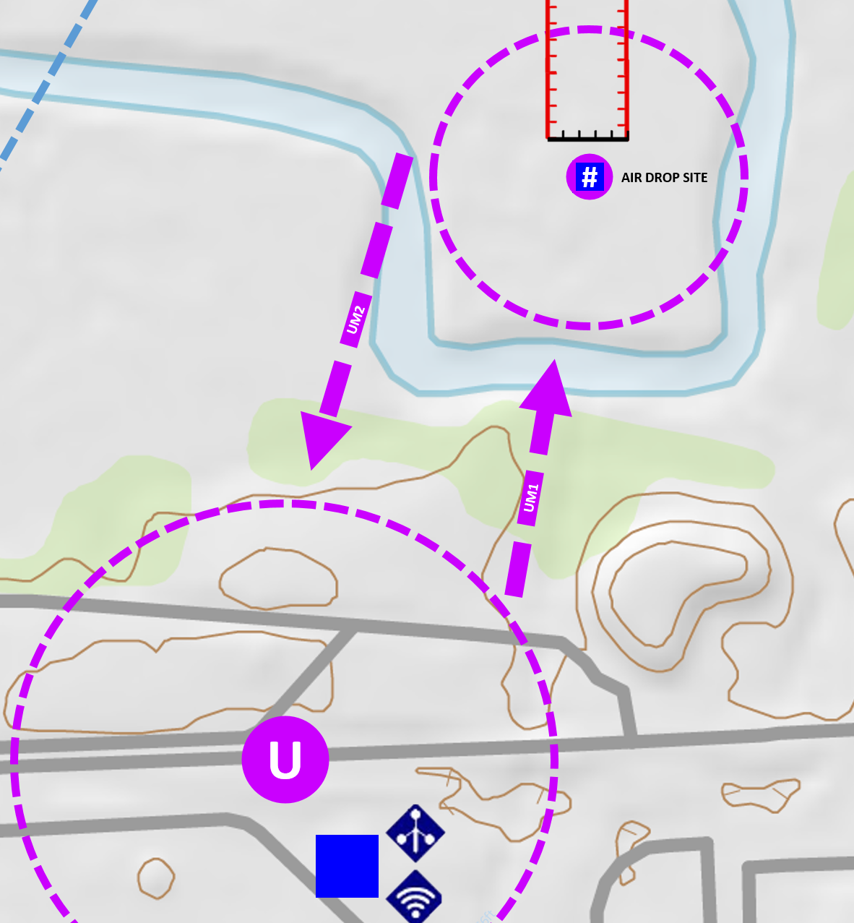
Operational Concept
Flight Planning
  Take Off and Landing Procedures
  UAS Drop Site Procedures
  Enroute Procedures
Navigation Modes
  VLOS
  EVLOS
  BVLOS
  m:N

Slide 4
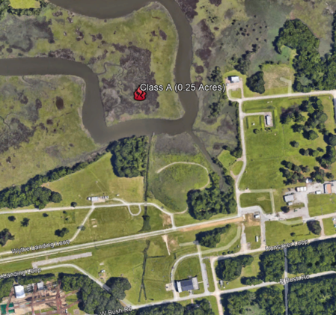
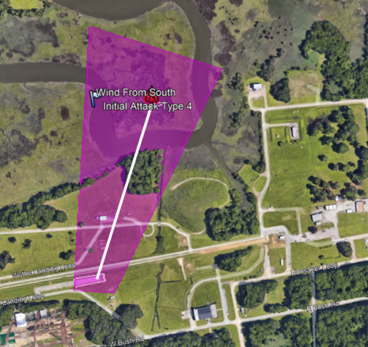
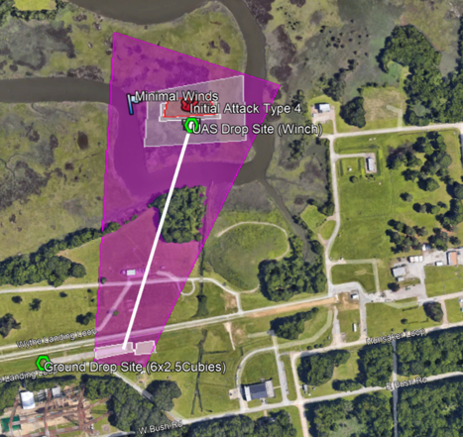
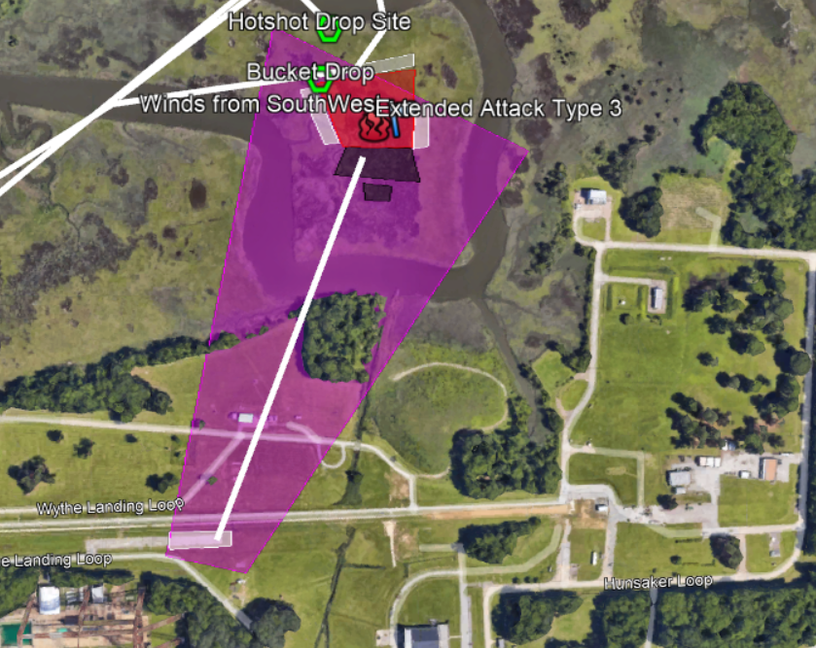
Concept Scenario
T0
T1
T2
T4
T0: Time Zero – Ignition Source
T1: Time 0-12 Hours – VLOS UAS Operations
T2: Time 12-24 Hours – BVLOS UAS Operations
T3: Time 24-36 Hours – VLOS UAS Operations and VFR Air Operations

Slide 5
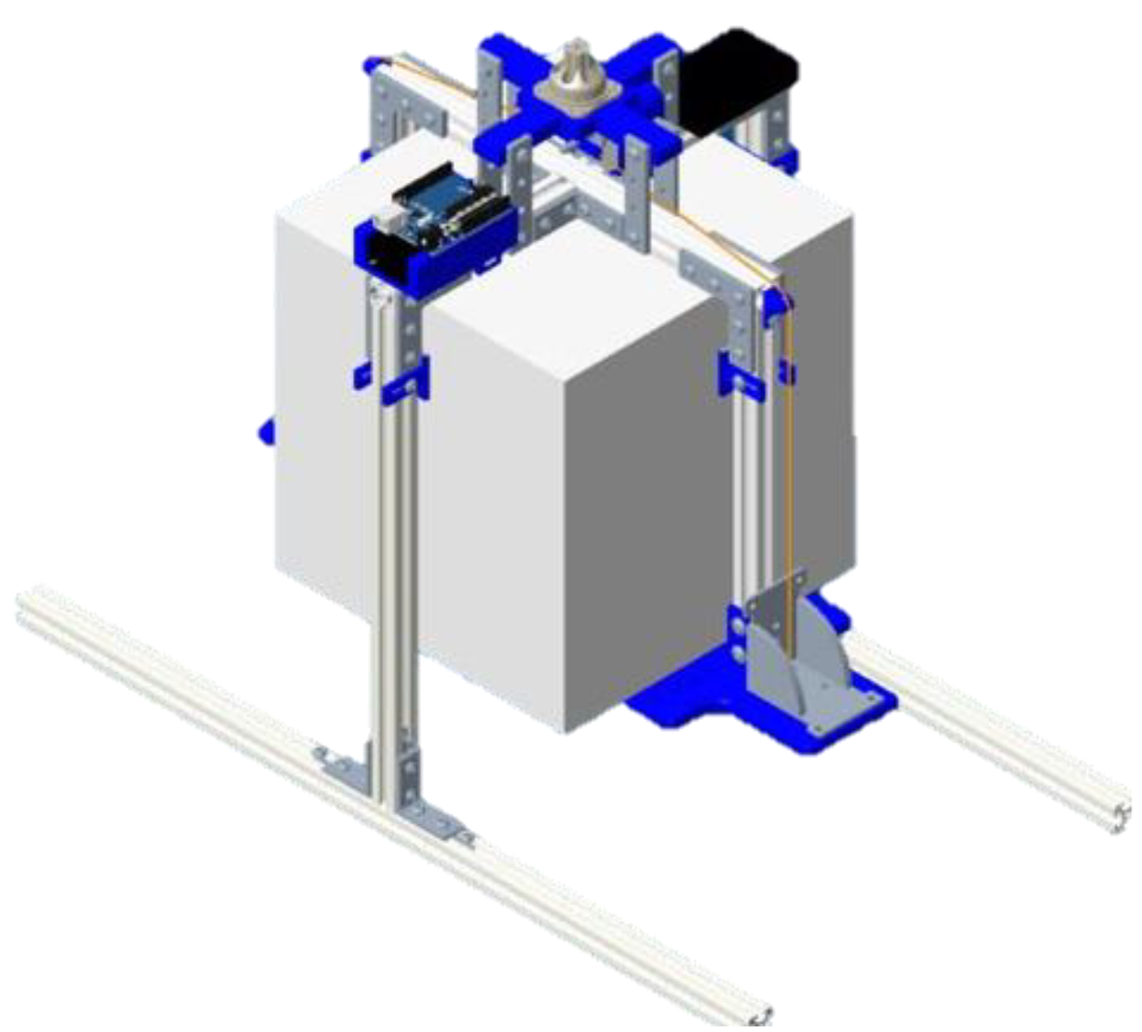
Automated Flight Capabilities
Crawl, Walk, Run
Level 1 – Payload Delivery (Focus of this presentation)
Level 2 – Waypoint Navigation Control
Level 3 – Collision Avoidance
Level 4 – Emergency Landing
Level 2-4 POC: robert.g.mcswain@nasa.gov

Slide 6
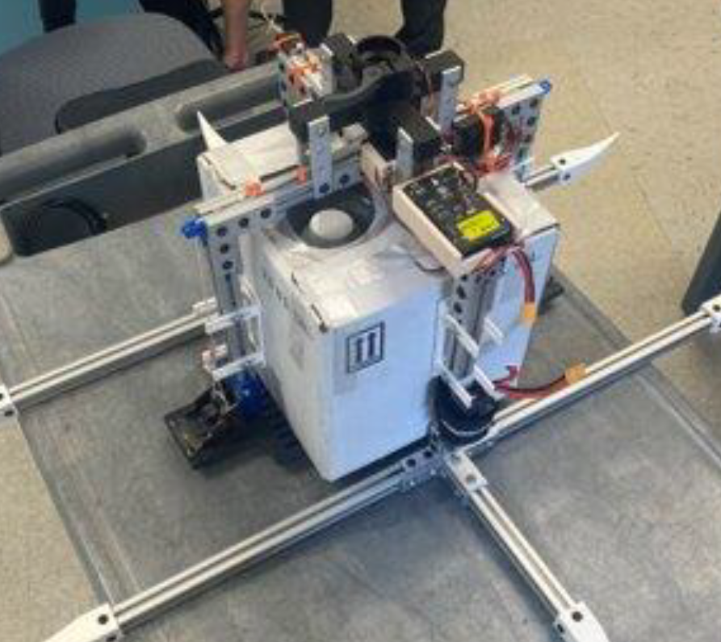
Payload Delivery Prototype
No Special Tools To Load
Simple Use Case
Remote Unload
6 weeks to Design, Build and Fly

Slide 7
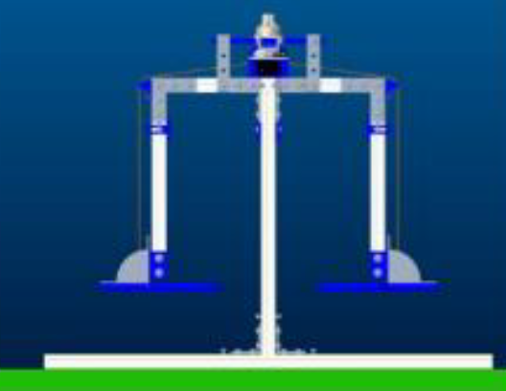
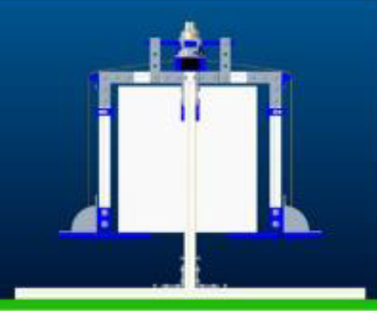
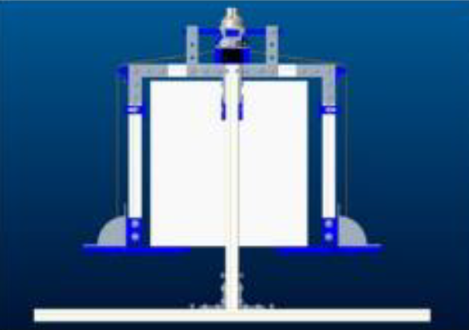
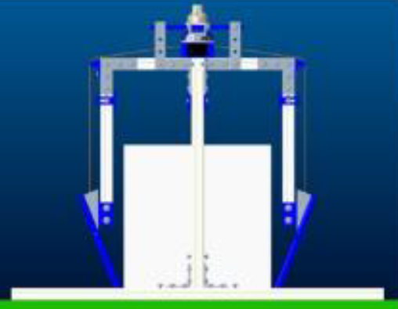
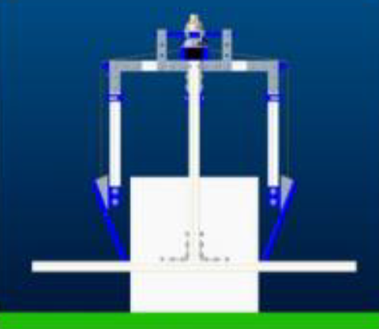
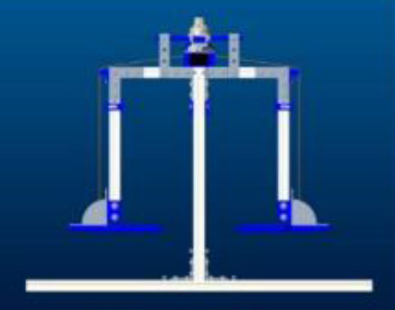
Prototype Deployment Process
Load Cubinator
Take Off
Land At Delivery Site
Release And Take Off
Land at Take Off Location

Slide 8
75
Flight Test Data Mission Performance
Gross Take Off Weight (lbs) | Flight Time (Hours) | Battery Capacity Recharged (A*Hours) | Average Amperage (A) | Maximum Flight Time No Reserve (Minutes) | Maximum Flight Time, 20% Reserve (Minutes) | Mission Speed (Kts) | Mission Distance (ft)
47.5 | .126 | 5.51 | 43.730 | 43.86 | 35.09 | 10 | 5415
47.5 | .127 | 5.69 | 44.803 | 42.85 | 34.28 | 10 | 5410
47.5 | .094 | 4.39 | 46.702 | 41.11 | 32.89 | 20 | 5429
57.5 | .127 | 7.15 | 56.299 | 34.10 | 27.28 | 10 | 5423
57.5 | .094 | 5.15 | 54.787 | 35.04 | 28.04 | 20 | 5437
67.5 | .127 | 9.16 | 72.126 | 26.62 | 21.30 | 10 | 5477
67.5 | .094 | 7.05 | 75.000 | 25.6 | 20.48 | 20 | 5459
75.7 | .127 | 11.51 | 90.630 | 21.19 | 16.95 | 10 | 5429
75.7 | .127 | 11.35 | 89.370 | 21.48 | 17.19 | 10 | 5439
Mission Altitude was 375ft MSL
75.7

Slide 9
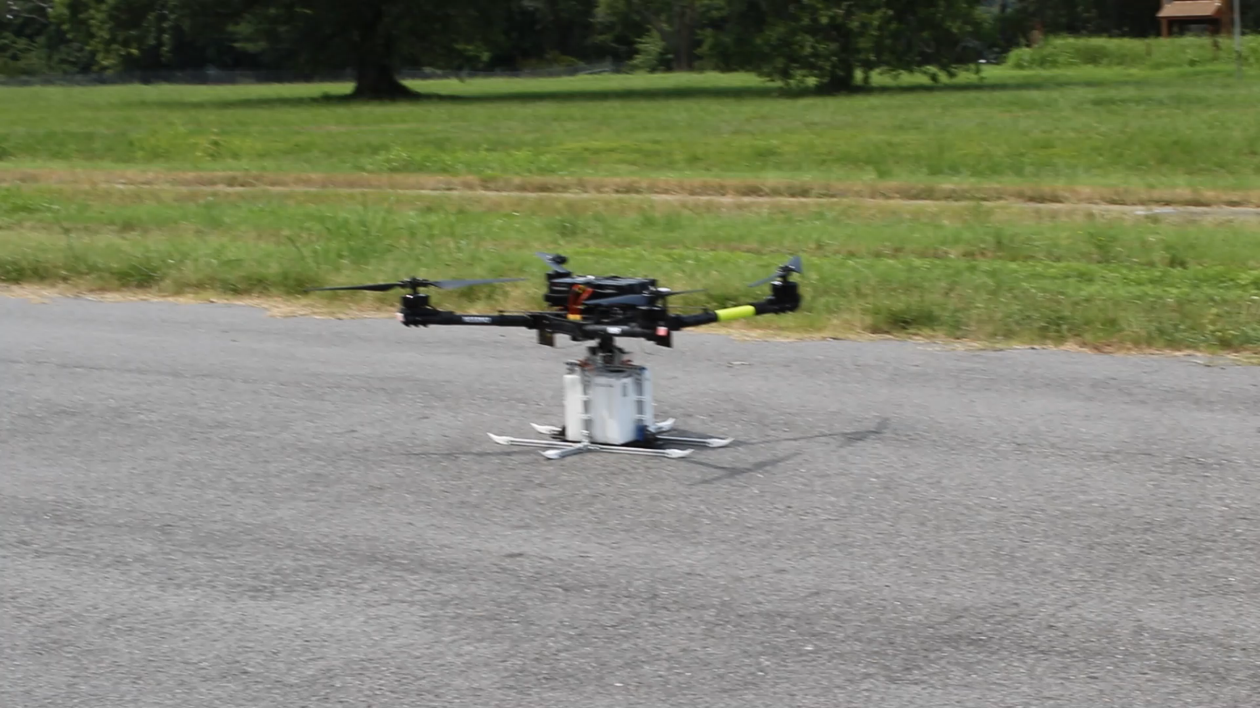
Flight Demonstration

Slide 10
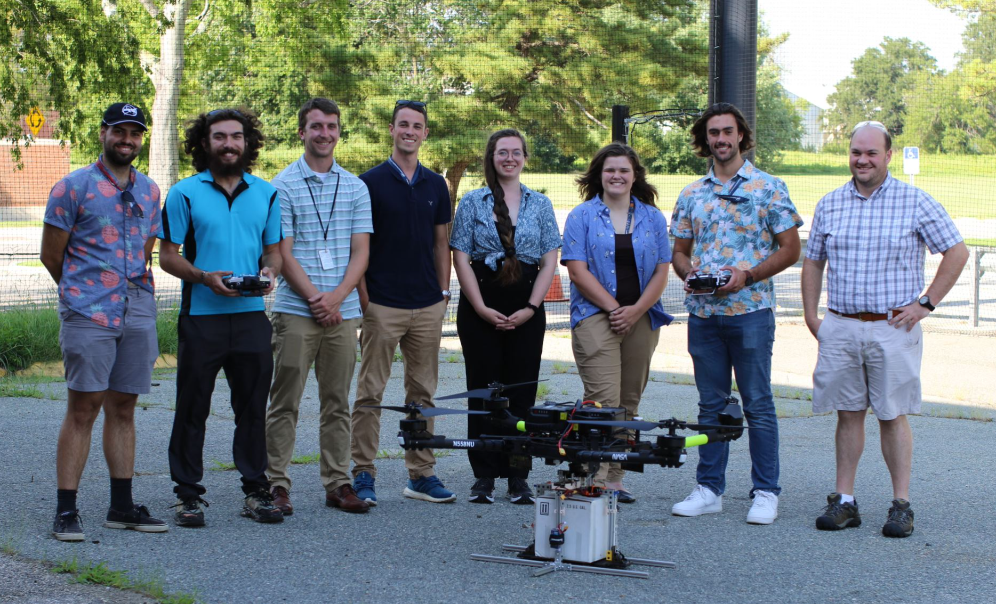
#Dronesforgood

