Slide 1
Updated noise dose range of NASA’s X-59 aircraft estimated from propagation simulations
Will Doebler and Alexandra Loubeau
NASA Langley Research Center
183rd Meeting of the Acoustical Society of America
Nashville, TN
December 6, 2022
2aNS7

Slide 2
Outline
Quesst Mission
Need for a noise exposure dose range in community response tests
Method for estimating the noise dose range of X-59 aircraft via propagation simulations
Assess the typical doses in the inner portion of the carpet
Computation of the X-59 single event sonic thump dose range
Computation of the daily dose range using the capable operational tempo of the X-59
Summary
Notes:
Here’s the outline of the talk. In case you just walked into the room I’ll brief NASA’s Quesst Mission. I’ll present the motivation for estimating a noise dose range for the community tests. Then I’ll present the simulation methods we used to estimate the dose range. We look at the X-59 sonic thump loudness in the inner portion of the carpet where predictions are most reliable. Finally I will show how the single event and cumulative or daily dose ranges were computed.

Slide 3
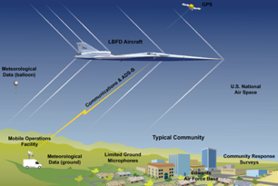
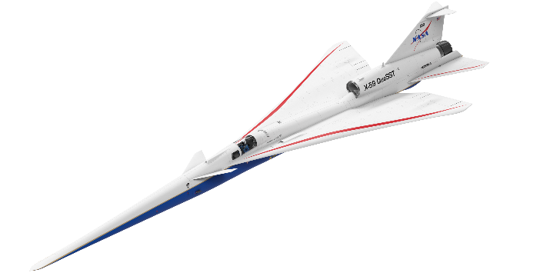
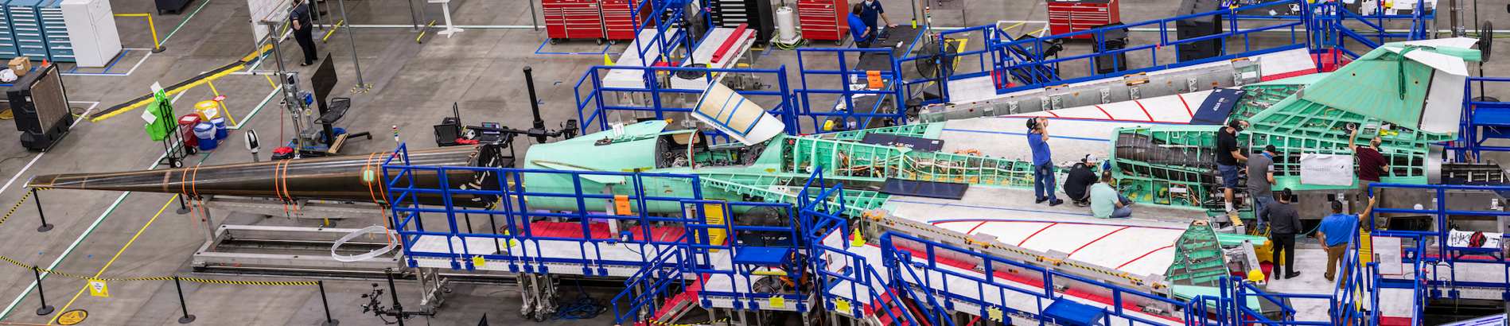
Quesst Mission: Goal is to provide dose-response data to regulators
Phase 1:
Construction, First Flights, and Planning
Phase 2:
Acoustic Validation
Phase 3:
Community Noise Testing
Notes:
As you’ve heard in the previous two talks, NASA’s Quesst Mission has a goal of providing dose-response data to the FAA and ICAO for use in informing potential new noise certification standards for low-boom aircraft in supersonic cruise. It is broken into 3 phases. First is construction of the aircraft, its first flights and safe flight envelope expansion, and planning for the future phases. The second phase is acoustic validation where we ensure the X-59’s sonic thump has achieved its loudness goal and to validate our prediction tools. The last phase is flying the X-59 over up to 5 communities across the US for about one month, introducing community members to up to 6 sonic thumps per day. A community noise survey will be administered to collect the perceptual response of the communities, and this noise dose versus perceptual response will be provided to the regulators.

Slide 4
Motivation for estimating the noise dose range
A noise dose range is needed for designing and planning the X-59 community response tests
  It is desirable to use the same noise dose range at each test site
X-59 trajectory and trim can be adjusted to produce a range of sonic thump levels
Simulated acoustic data is used prior to X-59 first flights to help with test planning
Response
Noise Dose
From Lee et al. in JASA, April 2020
Notes:
An pair of example dose-response curves are shown in the figure on the right. The data is from two of NASA’s previous risk reduction flight tests and community noise surveys. In this case, the noise dose is given in Stevens’ Perceived Level or PL, which has been shown to correlate well with human perception of sonic booms. The response is percent of people highly annoyed by a low-amplitude sonic boom.
While the X-59 has been designed to achieve a sonic thump of 75 dB, it would not be possible to create a dose-response curve if the X-59 flew at only one noise dose. The community noise surveys clearly need a range of doses to fill out the dose-response curves that the regulators need. There are various ways to change the noise dose of the X-59 including changing the altitude, Mach number, and position of control surfaces on the aircraft.
*click*
The X-59 is still under construction but will soon be flying. Until then we can estimate the dose range using propagation simulations of the aircraft in various trim states.

Slide 5
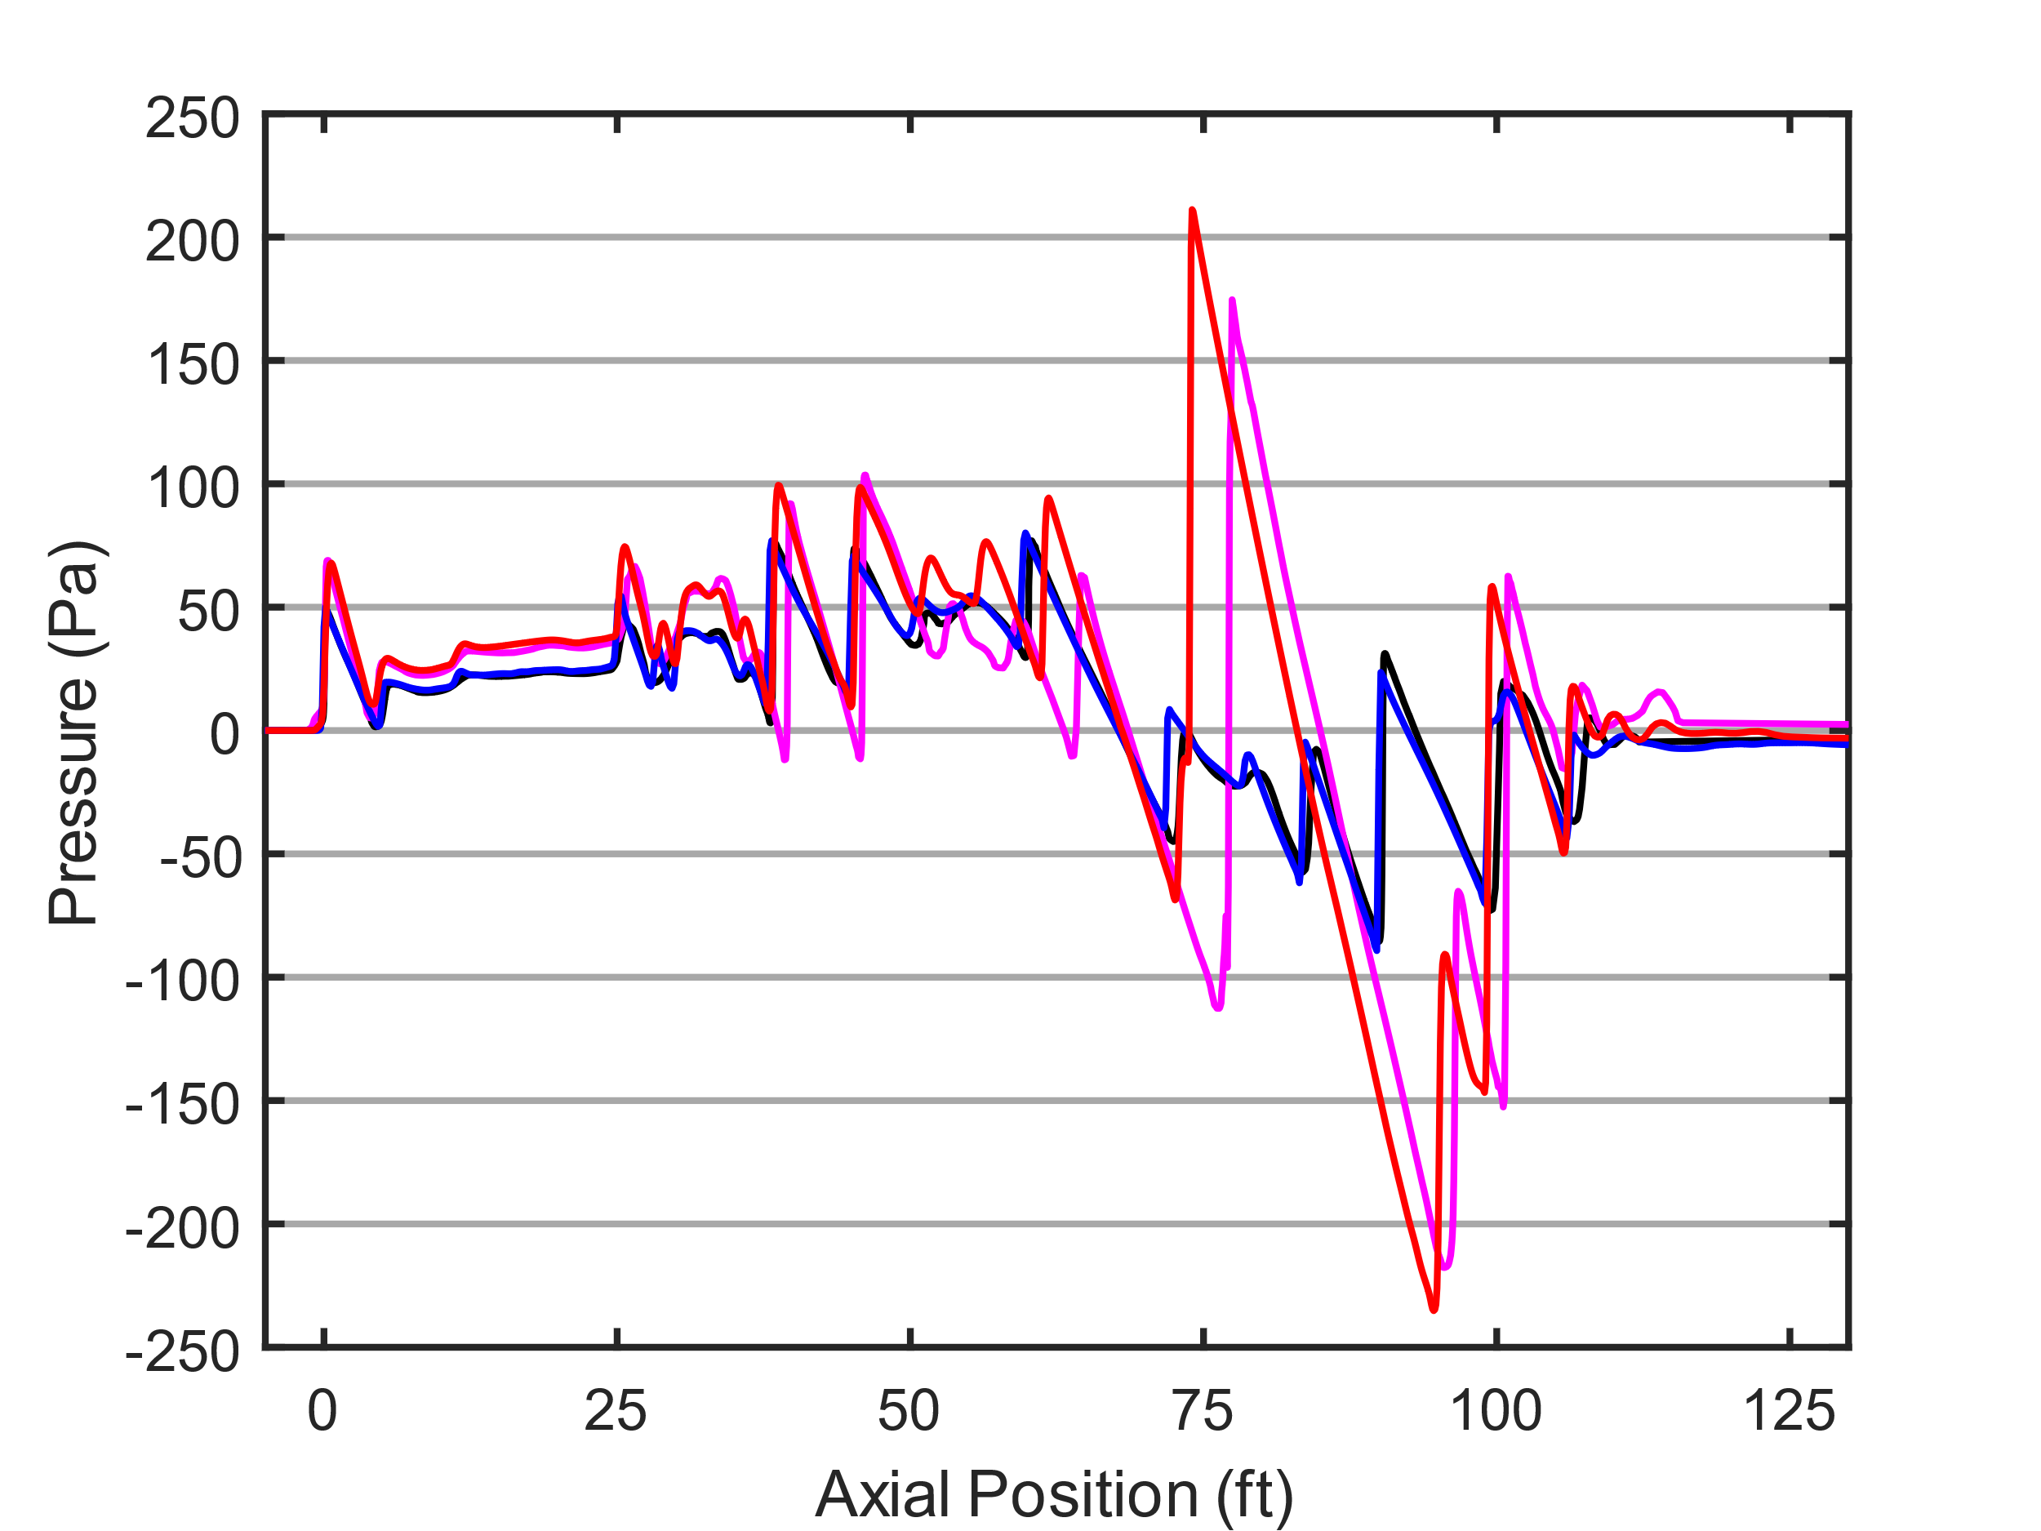
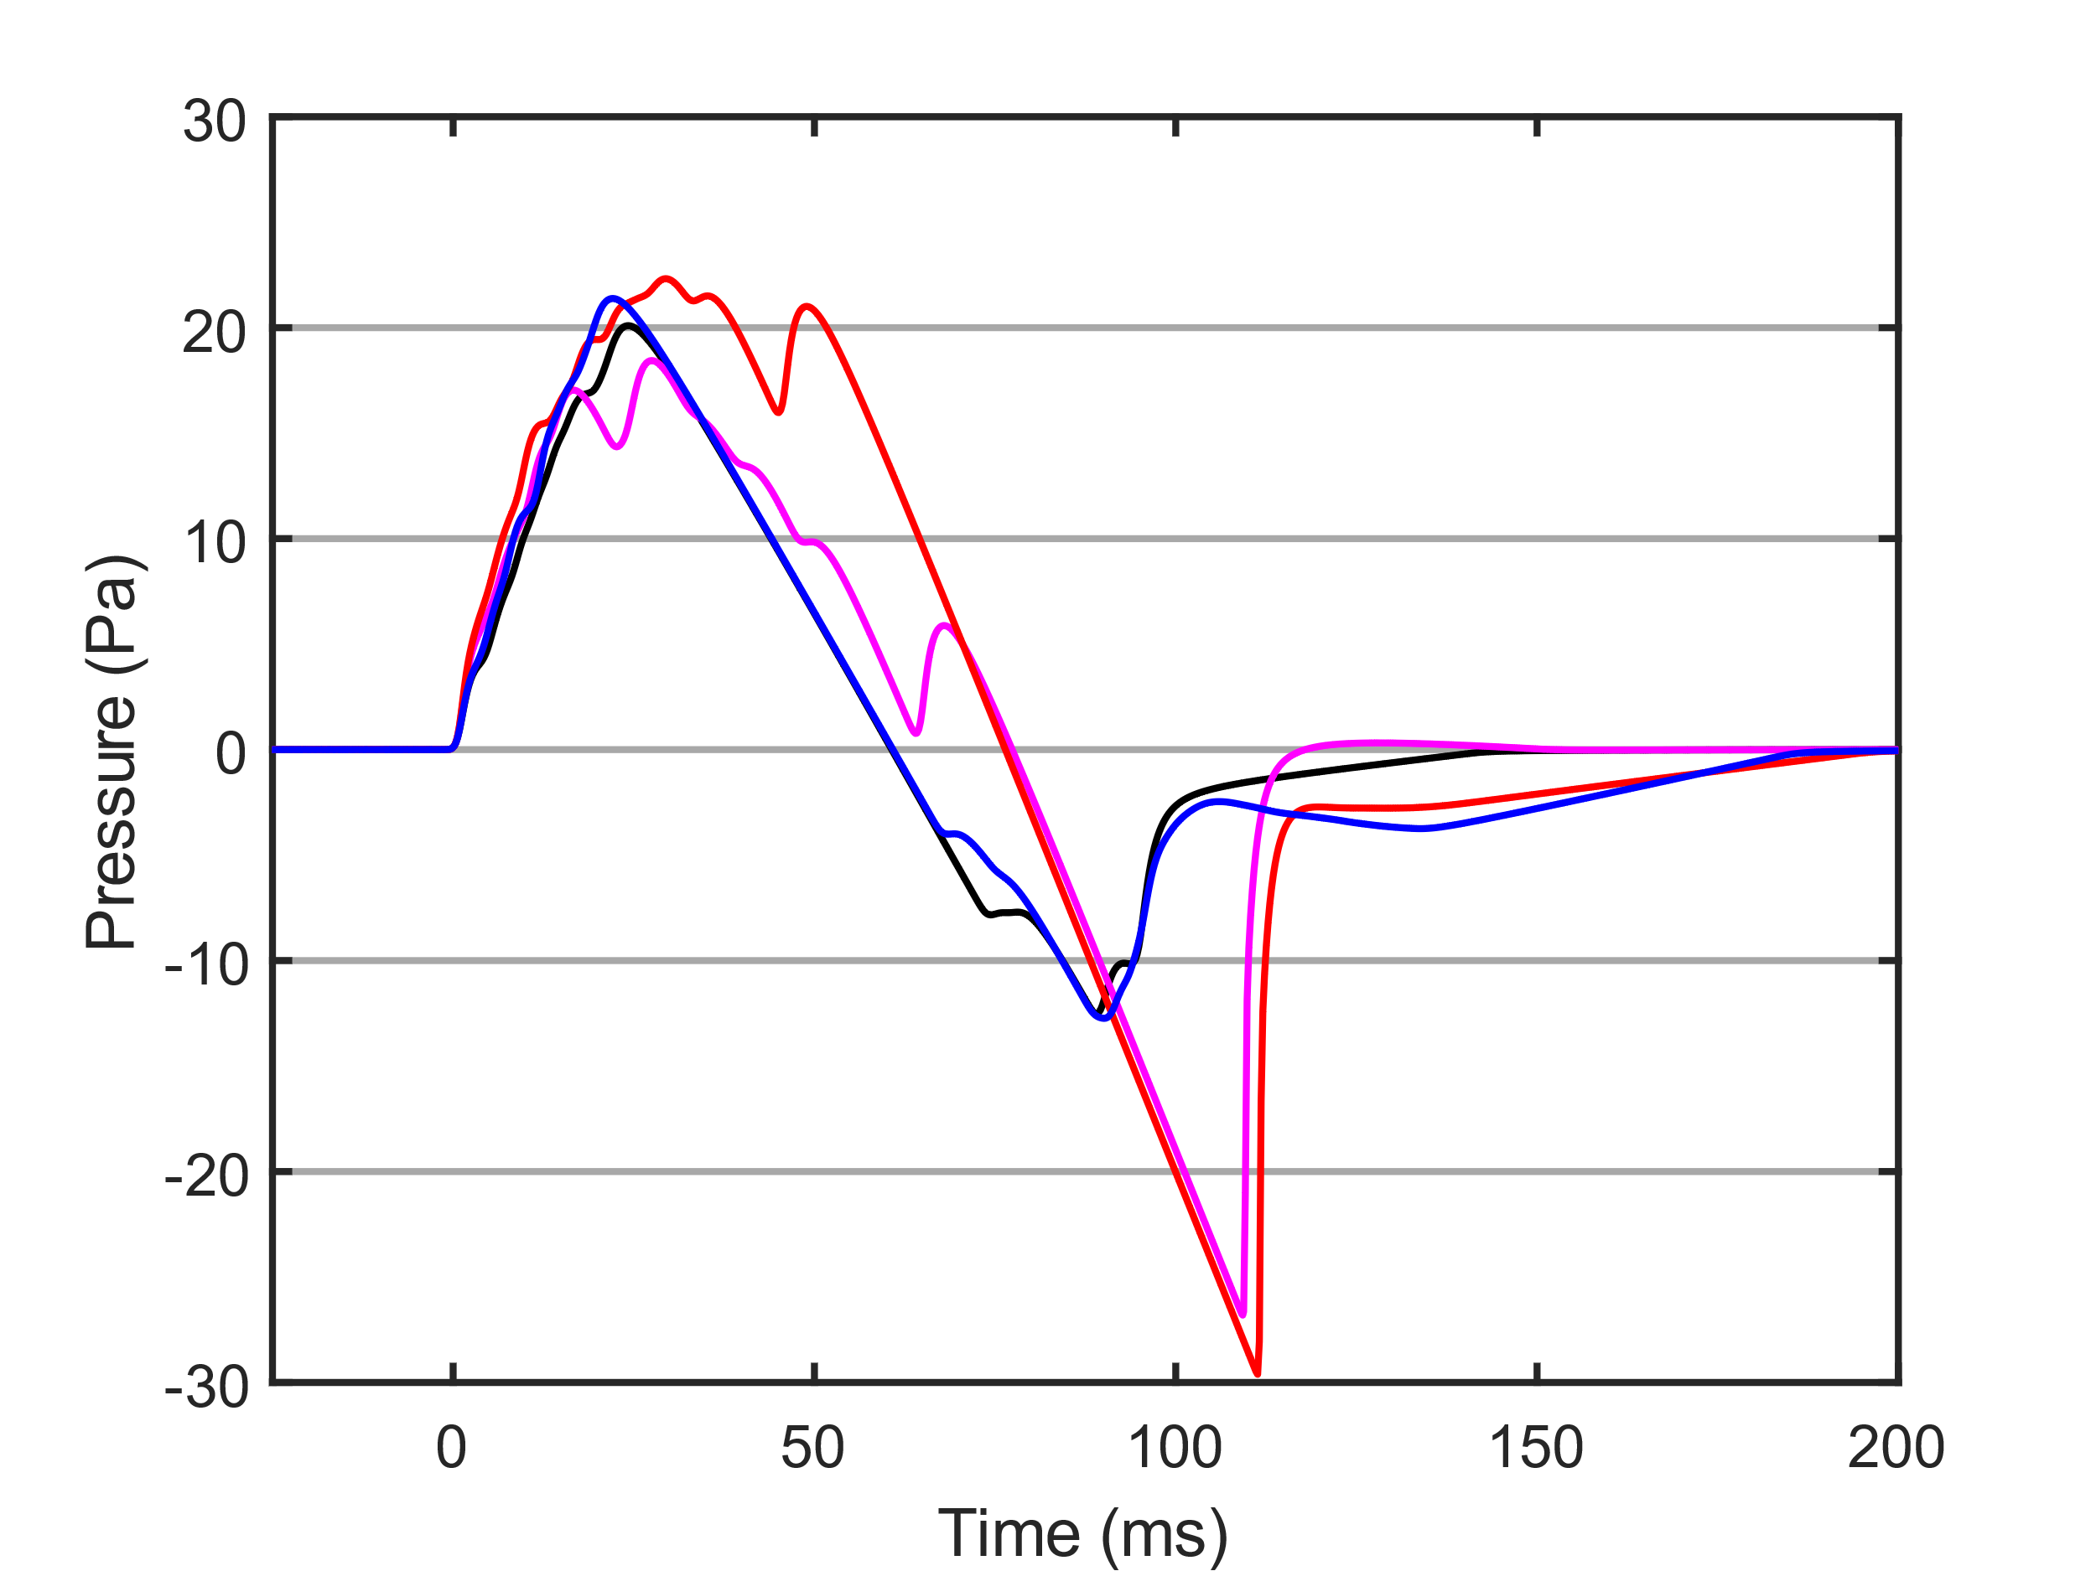
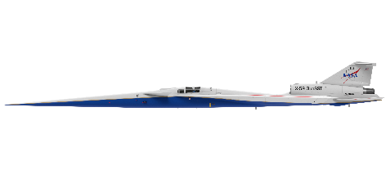
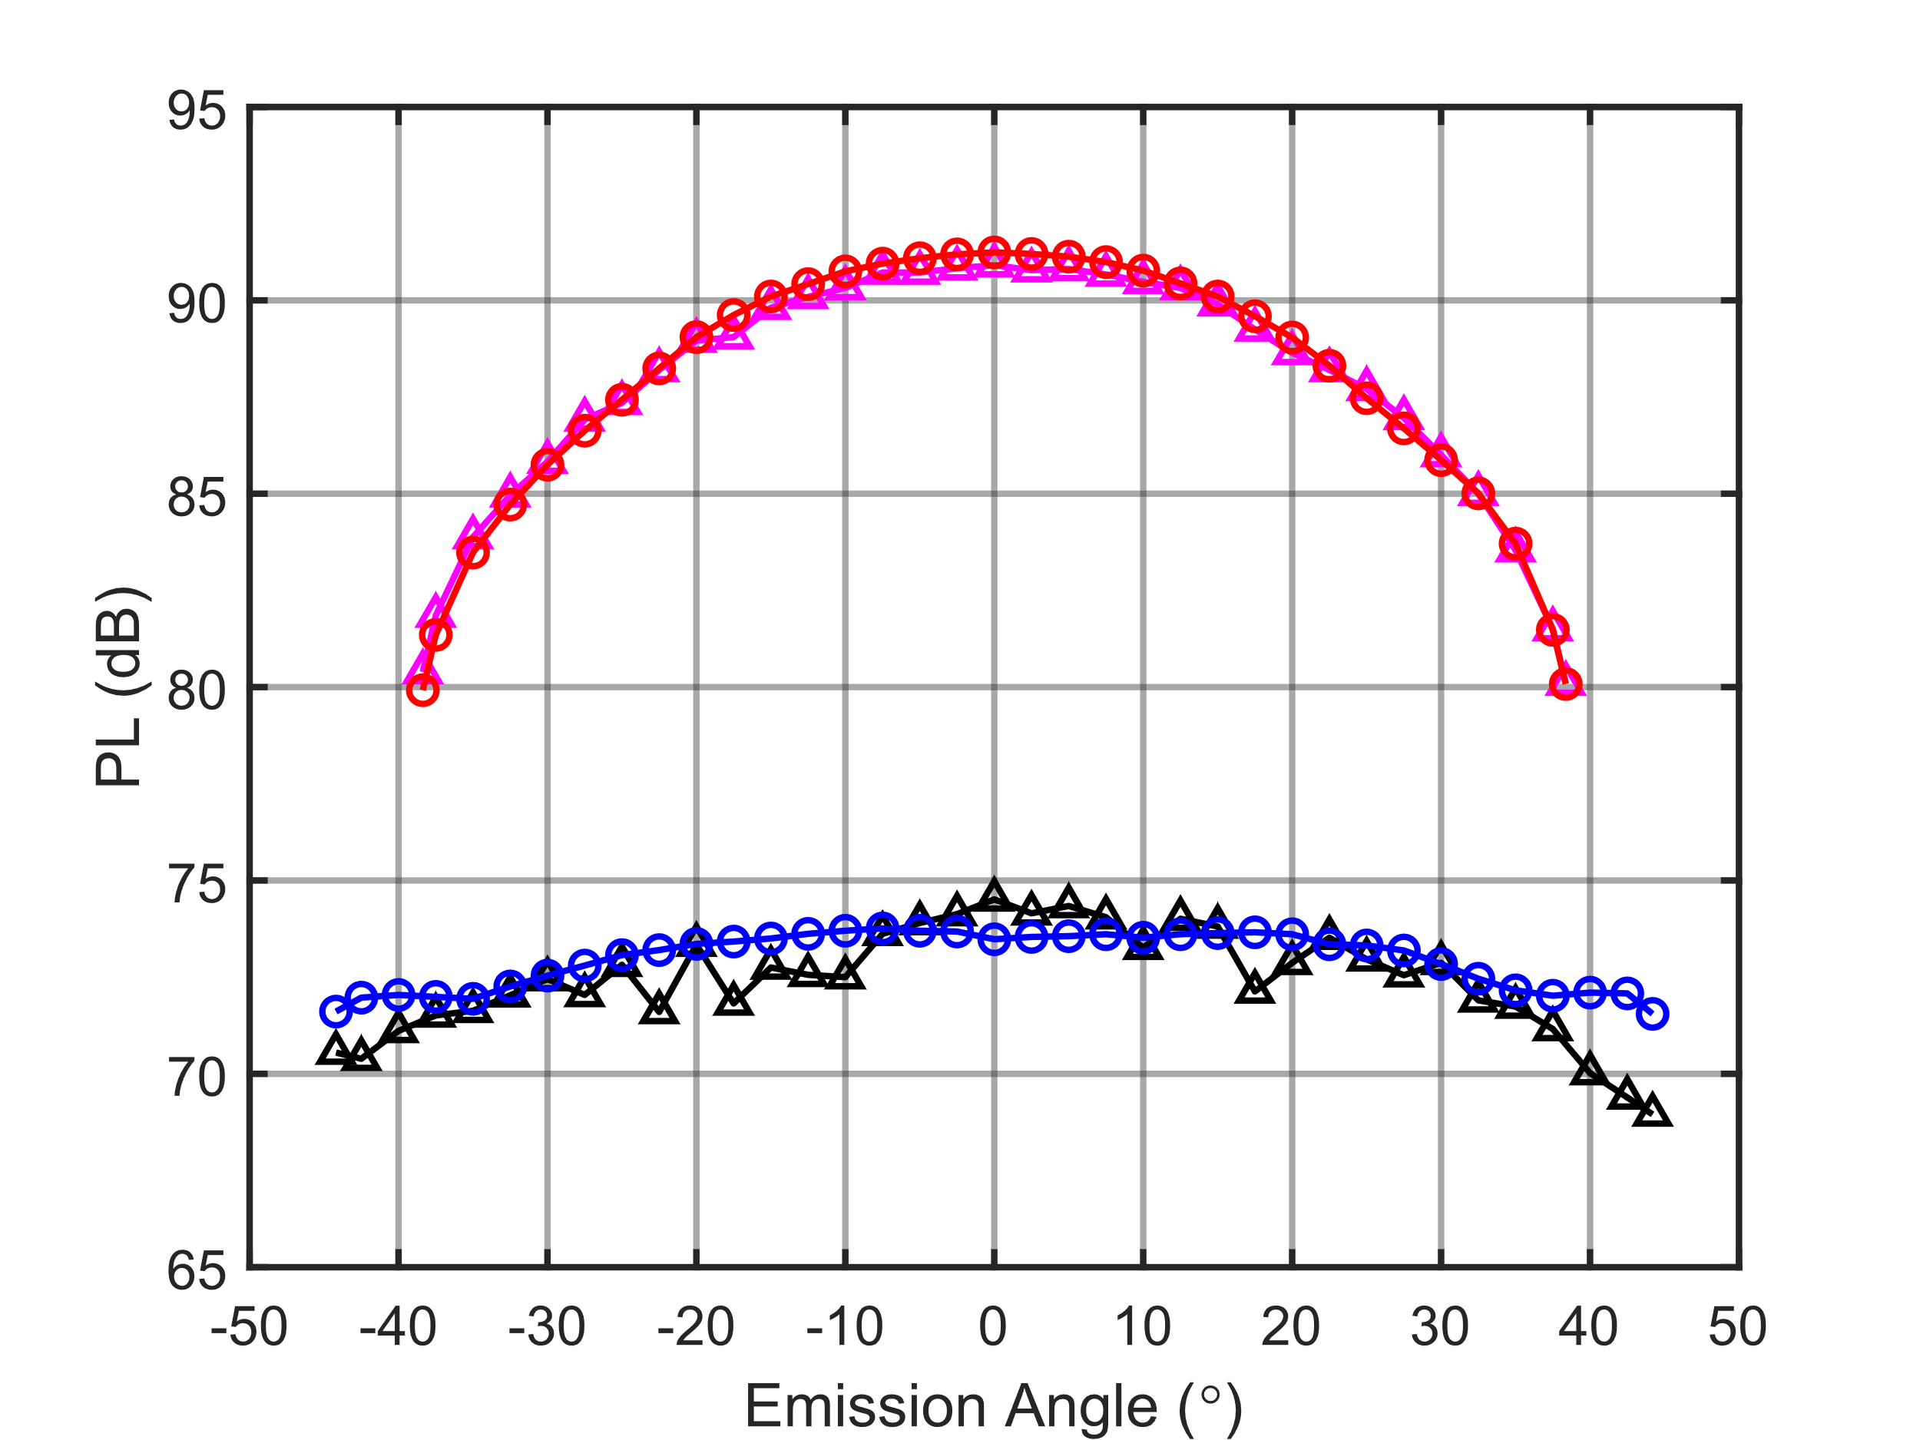
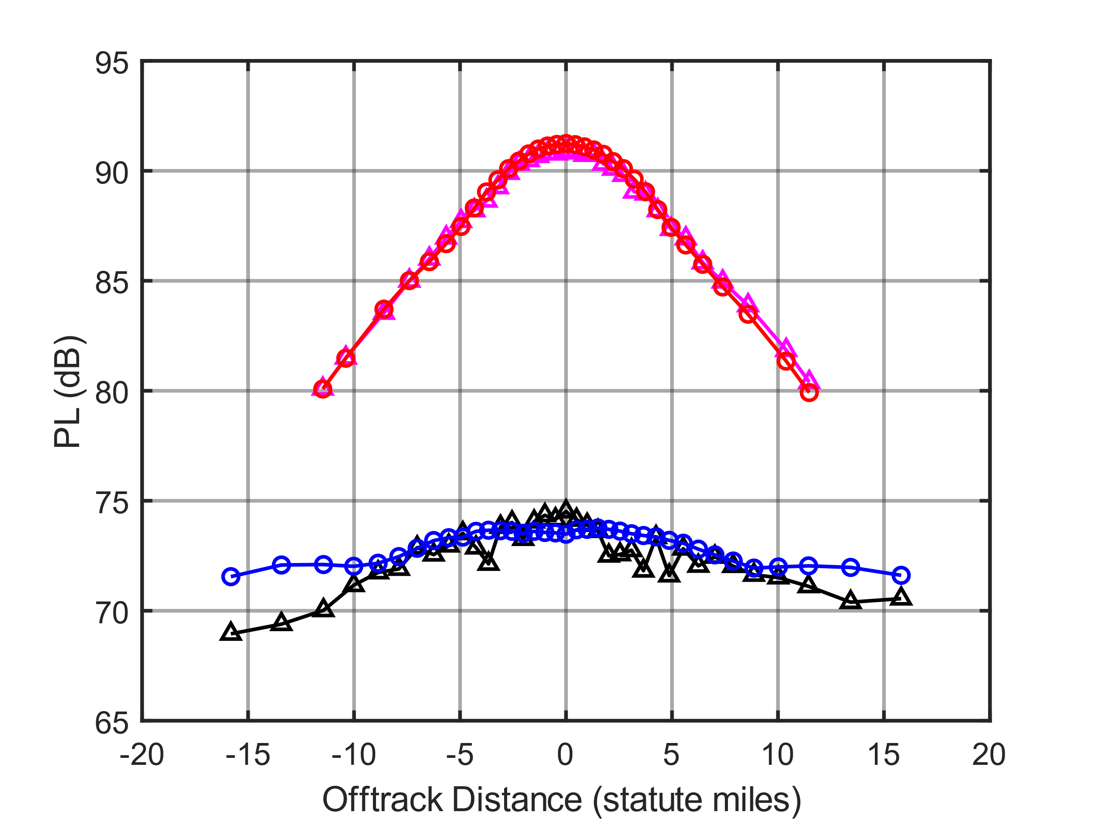
X-59’s min and max loudness¹ in a standard atmosphere²
Undertrack Nearfield Waveforms
Undertrack Ground Waveforms
FUN3D Max
Cart3D Max
FUN3D Min
Cart3D Min
2 CFD near-field pressure cylinders were produced
  Cart3D: inviscid
  FUN3D: includes viscosity
Min: 53,200 ft at Mach 1.4
Max: 43,000 ft at Mach 1.3
Near-field data were propagated through a standard atmosphere
Ground Loudness
1. M. Aftosmis et al., “Adjoint-Based Minimization of X-59 Sonic Boom Noise Via Control Surfaces,” AIAA 2021-3030; doi: 10.2514/6.2021-3030
2. ICAO 7488/3 temperature and pressure, no wind, and ISO 5878 Addendum 2 (0 to 8 km) ISO9613-1 Annex C (above 8 km) humidity profile
Notes:
Michael Aftosmis and the Cart3D team at NASA Ames developed an loudness minimization and maximization optimization routine given allowable control surface deflections, Mach number, and altitude of the X-59. They provided Cart3D near-field pressure data at the min and max loudness configuration at two degree azimuthal resolution, which are the black and magenta data on the plots on the right. Sriram provided the FUN3D solution at the same flight condition. The main difference between the two is that FUN3D code includes viscosity in its prediction.
The min loudness condition flies at Mach 1.4 at 53,200 ft. The max loudness condition flies at Mach 1.3 at 43,000 ft. The control surface deflection angles also differ, but you can read about their values in the paper.
The top left plot shows the near-field pressure for the min and max loudness configurations for both CFD solutions undertrack. The min-loudness waveforms in blue and black match pretty well for the two codes. The max loudness shocks near the rear of the aircraft differ somewhat in strength and position for the max loudness condition.
The top right figure shows what these waveforms look like after propagating through a standard atmosphere. Again the min loudness waveforms look fairly similar except the tail portion has slight differences. The max loudness looks fairly different in the front portion. However when you look at the differences in loudness on the ground, which are the bottom row of charts, the max loudness perceived levels match really well. The min loudness differ slightly, and the FUN3D solution is flatter across the carpet. The difference in the two plots on the bottom row is that the left plot is loudness as a function of acoustic ray emission angle, and the right plot is the loudness as a function of position on the ground laterally from undertrack.
Another difference to note is the carpet width difference between the min and max loudness. The max loudness is only about 23 statute miles wide while the min loudness is about 32 miles wide. This has implications for community testing in that fewer residents may be exposed to the max loudness overflights.

Slide 6
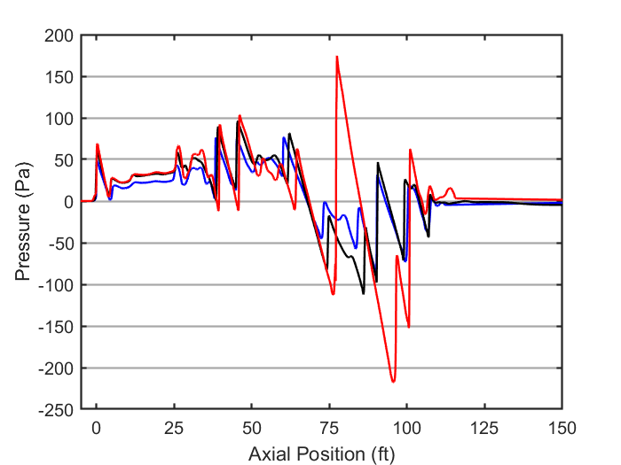
Propagation through realistic atmospheric profiles
PCBoom 7 for propagation
  Inputs
    Near-field pressure data
    4 aircraft cardinal headings
    19 geographical locations
    365 atmospheric profiles from 2017 at each location
      from Climate Forecast System Version 2 model
  Enhanced Burgers Solver
    Turbulence is not modeled
  Outputs
    Ground waveforms for every 2.5° emission angle
    Carpet width
X-59 Aircraft Heading
Cruise Trajectory
(Mach number and altitude)
Many Atmospheric Profiles
Nearfield Pressure
PCBoom 7 Propagation Model
Boom Waveforms
Exposure Region Size
Perception Metrics
Notes:
The standard atmosphere ignores the effects of wind and realistic temperature, pressure, and humidity profiles, so we used PCBoom to propagate the near-field data in order to estimate the real-world dose range. The inputs to PCBoom are the near-field pressure, information about the trajectory and heading, and 1 year of atmospheric profiles at 19 locations. The enhanced burgers module is used, which outputs ground waveforms for every emission angle that reaches the ground in the primary boom carpet. From these we compute sonic boom perception metrics and can compute the size of the exposure region, which is known as the carpet width.

Slide 7
Propagation and Computation Information
Embarrassingly Parallel
Propagation Simulation
  Parallelized over atmospheric profiles with MATLAB wrapper
  4 nearfields * 4 headings * 19 locations * 365 profiles = 110,960 carpets
    Each case takes a few seconds, depending on the carpet size
    Made possible by Lonzaga’s Enhanced Burgers¹
X-59 Aircraft Heading
Cruise Trajectory
(Mach number and altitude)
Many Atmospheric Profiles
Nearfield Pressure
PCBoom 7 Propagation Model
Boom Waveforms
Exposure Region Size
Perception Metrics
1. J. Lonzaga, “Recent enhancements to NASA’s PCBoom Sonic Boom Propagation Code,” AIAA 2019-3386; doi: 10.2514/6.2019-3386
Notes:
The simulation is nice because it is easily parallelized. We used 4 near-fields, 2 max and 2 min from different CFD codes. We had 4 aircraft headings, and at each location we propagate through 1 year of atmospheric profile data. In total, over 110 thousand carpets were generated. The latest version of PCBoom is much faster than previous version due to the Lonzaga implementation of the burgers equation.

Slide 8
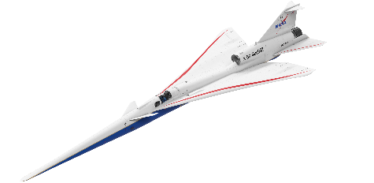

Analysis of Data within the Inner 40 km (25 s. mi) of Each Carpet
Definition of Inner Carpet
Isopemp on which boom data is available
Undertrack ray
Data included in inner carpet mean
40 km
Offtrack
distance (km)
-20
0
20
-20
0
20
-20
0
20
Case 1
Case 2
Case 3
|Both lateral cutoff distances| > 20 km
Carpet Width <= 40 km
One side of carpet < 20 km and Carpet Width > 40 km
Use the carpet edge on the narrower side as the anchor point. Compute mean of PL within 40 km of the anchored point
Compute mean PL for simulated ground data between ± 20 km
Compute mean PL for all simulated ground data
Notes:
*explain the animation and that the three cases are top-down views*
While we have the data for the full extent of the carpet, we are most confident in the predictions in the inner portion. Also, most of the carpets are at least 25 miles wide and we intend to recruit participants within this inner reliable boom carpet region within the X-59 test communities. As such we compute the mean value of the perceived level within this inner carpet. Here is how the inner carpet was defined for this study. There are 3 cases. Because we have perfect cruise trajectories, the sonic boom carpet for a single isopemp line shown as the blue curve characterizes the entire carpet. For case 1, centering on the undertrack ray landing position, both lateral cutoff rays are greater than 20 km from undertrack. In this case, compute the mean sonic boom loudness data from -20 to +20 km along the isopemp. For case 2, if the carpet is narrower than 40 km, we compute the mean PL of the entire carpet. For case 3, if one side of the carpet is less than 20 km, but the entire carpet is greater than 40 km across we use this edge anchoring approach and average from the short edge to +40 km laterally from the anchor.
Two other methods were investigated, which gave similar trends. This was chosen because it includes more data near the center of the carpet than the other methods.

Slide 9
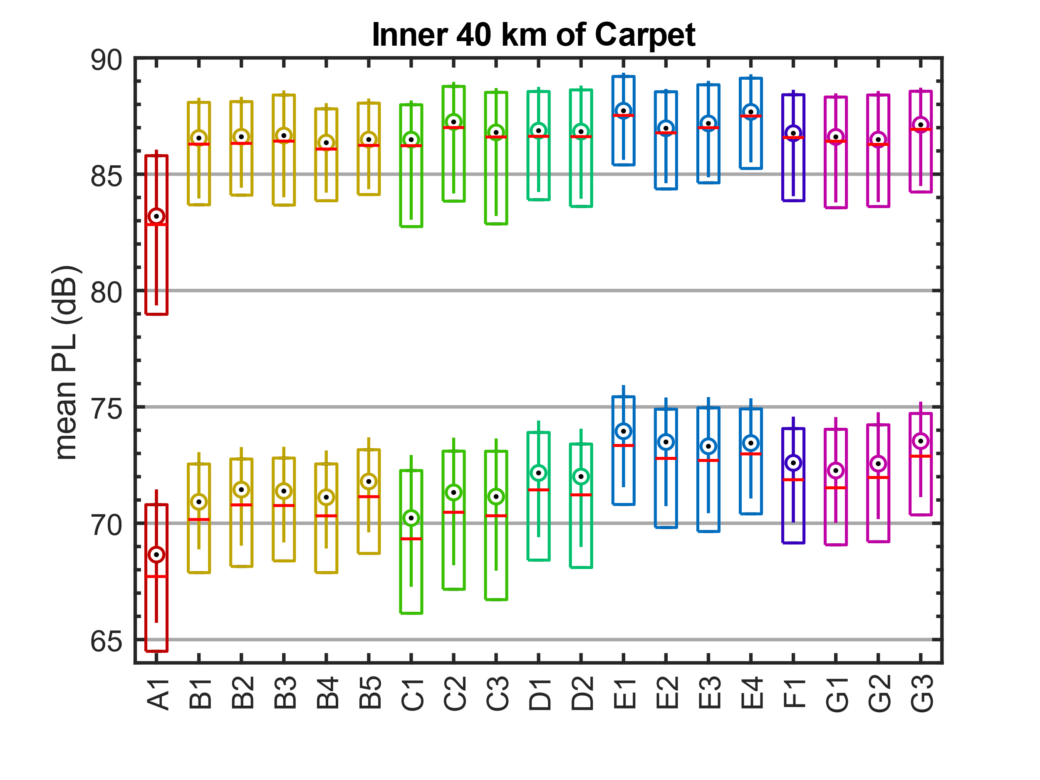
Statistics of the inner carpet mean PL
Inner Carpet
75th Percentile
Median
25th Percentile
Cart3D
FUN3D
Similar results with either near-field
Typical PL Dose Range: 72 to 86.7 dB
  Some locations may have higher or lower ranges
Location
Grouped by similar geographical region (colors)
Notes:
This is one of the takeaway charts from the talk. First we have the Cart3D results as the box plots and the FUN3D results as the compact style boxplot. The red line is the median value and the box extent is the 25th to 75th percentile of the inner carpet mean PL for 1 year of boom carpets at each location. The locations are grouped by similar geographical region. The Cart3D near-field results are about 1 dB lower than the FUN3D results, but overall the results match fairly well. Taking the mean value of the 19 medians on the chart results in a PL dose range of 72 to 86.7 dB, and some locations may have ranges that are slightly lower or higher.

Slide 10
Single event dose ranges of other metrics
X-59 was designed using the PL metric
6 metrics are being considered for the supersonic enroute noise certification standard
  A-weighted sound exposure level (ASEL)
  ISBAP = Indoor Sonic Boom Annoyance Predictor
 | Low (dB) | High (dB) | Range (dB)
PL | 72.0 | 86.7 | 14.7
ASEL | 57.6 | 72.5 | 14.9
BSEL | 74.1 | 83.8 | 9.7
DSEL | 77.6 | 84.2 | 6.6
ESEL | 68.9 | 80.4 | 11.5
ISBAP | 85.5 | 95.9 | 10.4
Notes:
While the X-59 was designed with PL in mind, there are 6 metrics in total that the ICAO is considering for use in its future supersonic aircraft noise certification standards. The additional metrics are 4 weightings of sound exposure level and the indoor sonic boom annoyance predictor. All of these correlate well with perception of sonic booms. Dose-response data for all of these metrics from the X-59 community tests will be provided to the regulators.
The dose ranges for each metric were computed using the process presented on the previous slide, and are shown in the table. It is interesting that some of the metrics like DSEL have a pretty small dose range. The narrow dose range may present a dose-response modeling challenge, although the metrics that have a narrower range tend also to be less affected by variability introduced by turbulence.

Slide 11
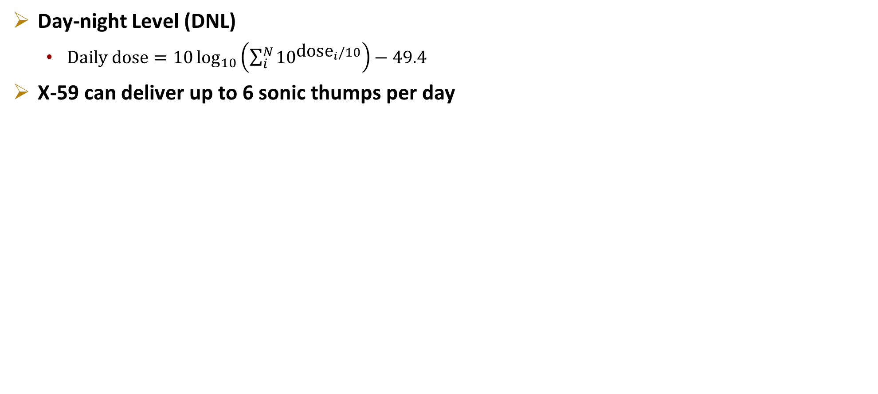
Cumulative daily dose for $N$ sonic thump events
Day-night Level (DNL)
  $\text{Daily} \text{dose}=10\log_{10}\left(\sum_{i}^{N}{10^{\text{dos}{\text{e}}_{i}/10}}\right)−49.4$
X-59 can deliver up to 6 sonic thumps per day
 | Low (dB) | High (dB) | Range (dB)
PLDNL | 22.6 | 45.1 | 22.5
ASELDNL | 8.2 | 30.9 | 22.7
BSELDNL | 24.7 | 42.2 | 17.5
DSELDNL | 28.2 | 42.6 | 14.4
ESELDNL | 19.5 | 38.8 | 19.3
ISBAPDNL | 36.1 | 54.3 | 18.2
Notes:
In addition to the single event metrics from the previous slide, cumulative daily dose-response data will be collected using the Day-night Level logarithmic summation approach. The X-59 can deliver up to 6 sonic thumps per day, so the High column in the table assumes the loudest single event dose is delivered 6 times in the DNL computation. The Low column assumes the X-59 flew just once over the community at its quietest single event level. You can see the cumulative dose range is a little larger than the single event dose range.

Slide 12
Summary
X-59 will soon be flown up to 6 times per day over up to 5 test sites across the USA
To design the noise exposure schedule a dose range is needed
Propagation simulations were conducted to estimate the dose range
  6 sonic boom perception metrics
  Single event dose
  Cumulative daily dose
Similar results regardless of CFD near-field
 | Low (dB) | High (dB) | Range (dB)
PL | 72.0 | 86.7 | 14.7
ASEL | 57.6 | 72.5 | 14.9
BSEL | 74.1 | 83.8 | 9.7
DSEL | 77.6 | 84.2 | 6.6
ESEL | 68.9 | 80.4 | 11.5
ISBAP | 85.5 | 95.9 | 10.4
 | Low (dB) | High (dB) | Range (dB)
PLDNL | 22.6 | 45.1 | 22.5
ASELDNL | 8.2 | 30.9 | 22.7
BSELDNL | 24.7 | 42.2 | 17.5
DSELDNL | 28.2 | 42.6 | 14.4
ESELDNL | 19.5 | 38.8 | 19.3
ISBAPDNL | 36.1 | 54.3 | 18.2

Slide 13

nasa.gov/quesst
william.j.doebler@nasa.gov

