Slide 1
Ground Winds Experienced During Artemis I
Pad Stays
Frank Leahy/MSFC
James Brenton/MSFC/Jacobs
Jake Williams/MSFC
NE DOLWG 12/07/22

Slide 2
Overview
Artemis I vehicle exposed to lengthy cumulative pad stay
  65 days for wet dress rehearsals (WDR)
  54 days for launch attempts (including Nicole)
  119 days total
Design case duration for fatigue
  Orion MPCV: 68 days
  SLS: 120 days
Design peak wind:
  80.7 knots at 132 ft level

Slide 3
Data
Pad 39B 1-min peak wind speed and direction obtained from KSC Weather Archive website
Upwind tower selected for the 132-ft level
Data post-processed to 5-min peak wind speed and direction to match design case
Design case:
  Distribution of 5-min peak winds and directions
    Orion MPCV: worst 60-day period (2/23/98 – 4/23/98)
    SLS: worst 120-day period (12/26/97 – 4/24/98)
  One knot speed bins and 30-degree direction bins
  From historical Pad 39B 60-ft database (1995 – 2007)

Slide 4
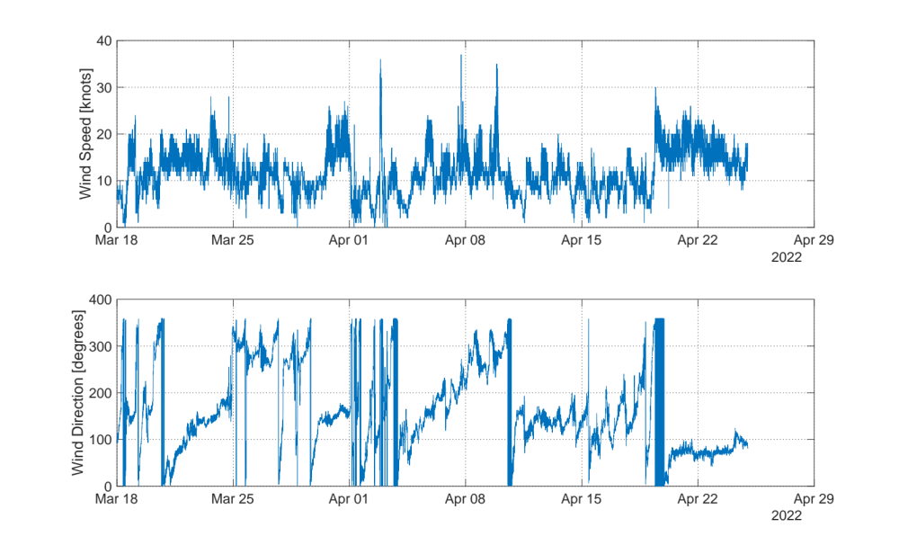
WDR Wind History (3/18 – 4/24)

Slide 5
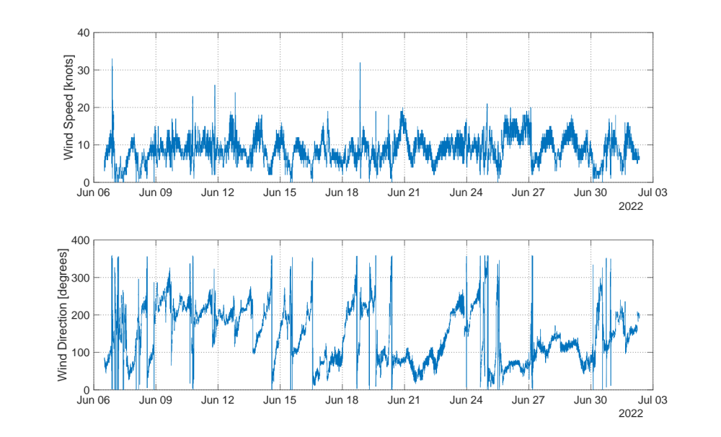
WDR Wind History (6/6 – 7/2)

Slide 6
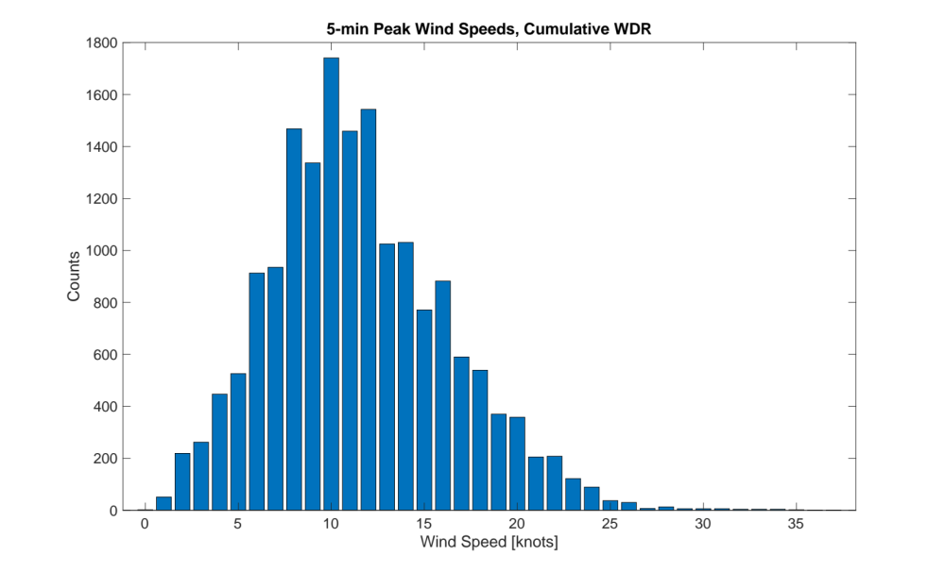
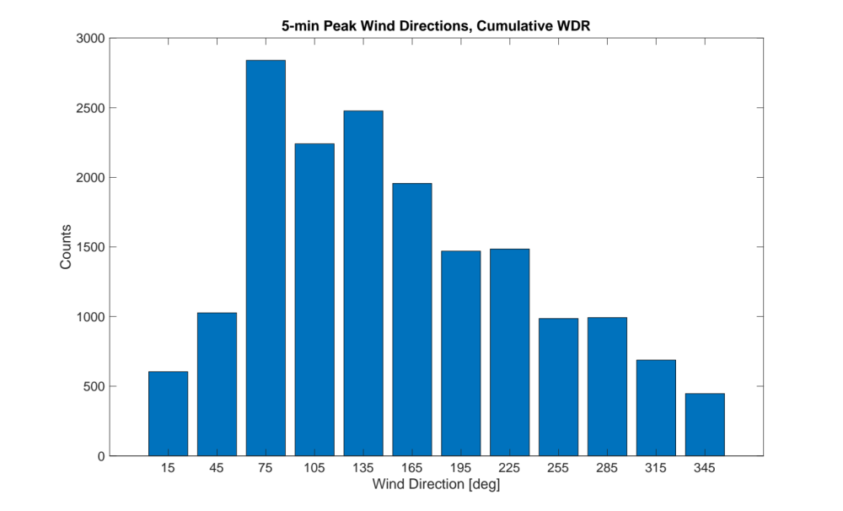
WDR Winds (3/18 - 4/24, 6/6 - 7/2)

Slide 7
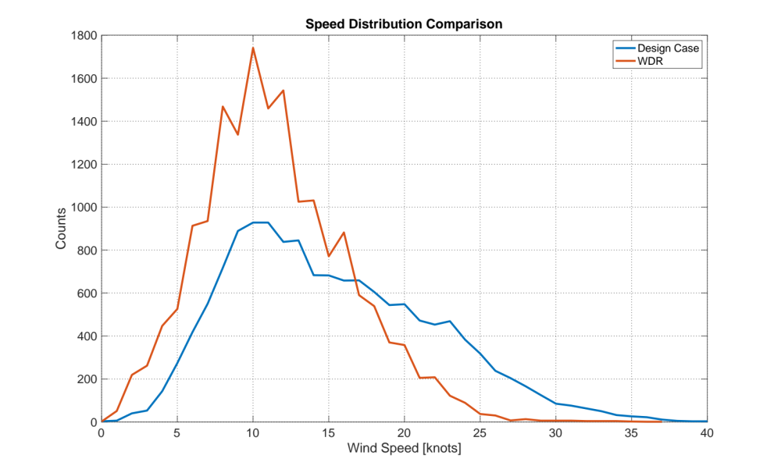
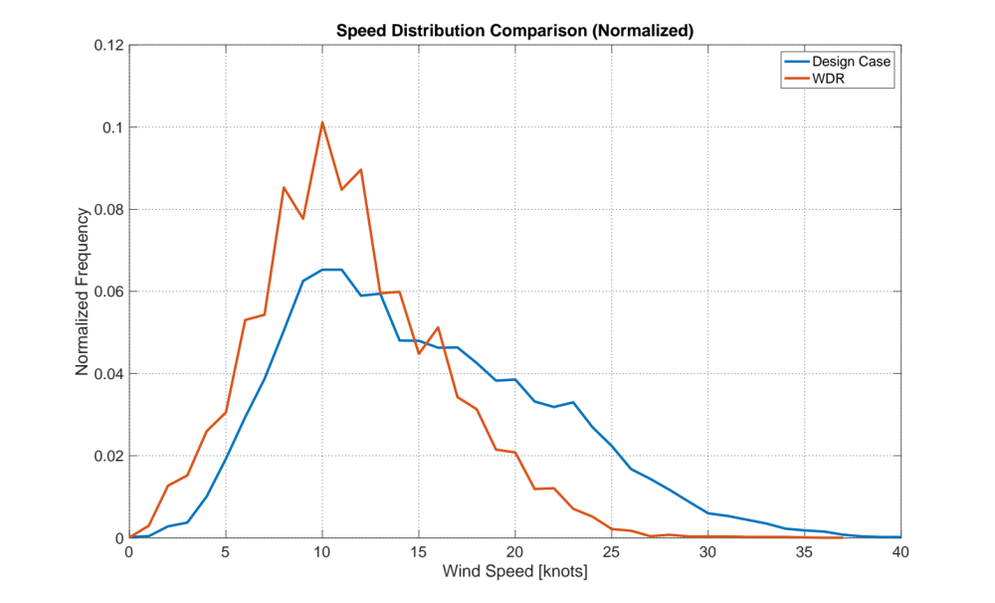
Wind Speed Comparison

Slide 8
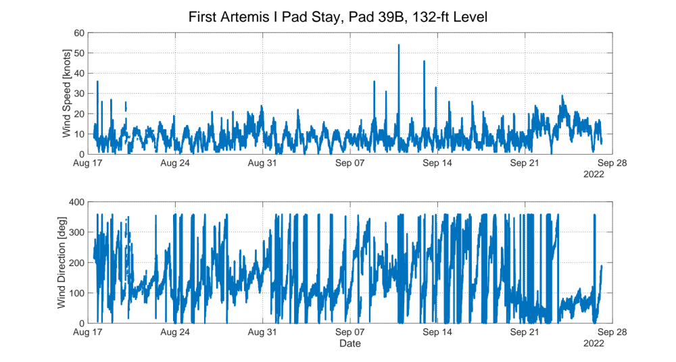
Pad Stay Winds for Initial Launch Attempts

Slide 9
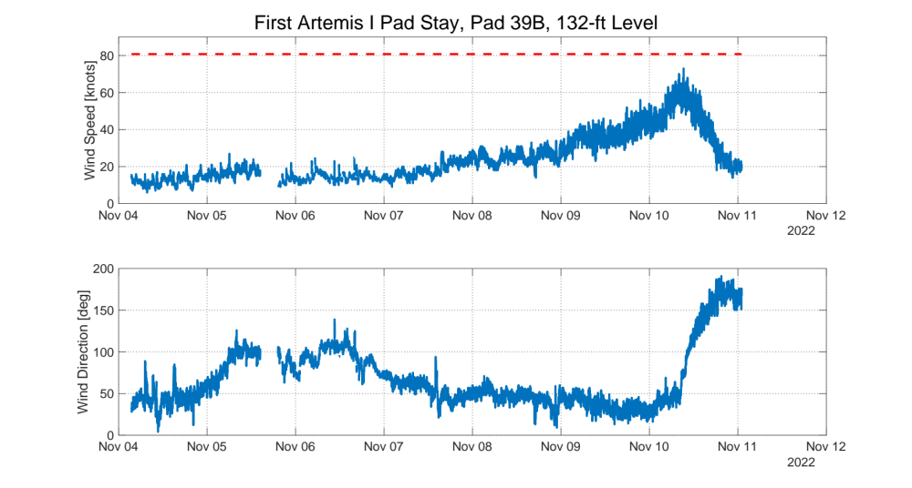
Pad Stay Winds for Last Launch Attempt (Hello Nicole)

Slide 10
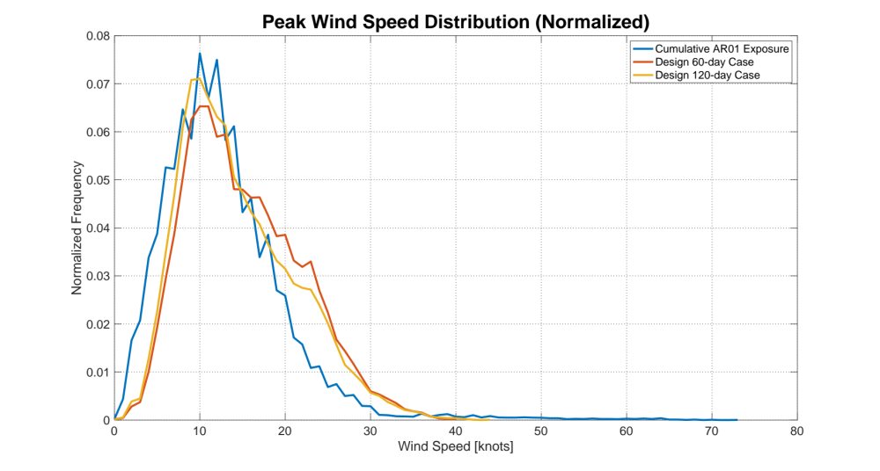
Wind Speed Distribution Comparison

Slide 11
Discussion
Ground winds during Artemis I pad exposure were used to assess fatigue life for hardware, including crew module/service module retention and release bolts, crew module longerons, and SLS elements and interfaces
Winds from pad exposure were more benign than design winds
  Effects from Nicole were over a relatively short duration
Peak design wind was never exceeded (contrary to some media reports)

Slide 12
Lessons Learned
Pad 39B structure includes 3 towers. Due to obstruction from the mobile launcher/vehicle and tower structure, it is important to select the upwind tower/sensor
Pad wind sensors during the Shuttle era were at the 60-ft level. Due to this, NASA design models (peak wind profile model, steady-state profile model, etc.) were anchored at the 60-ft level. These same models were used in SLS design assessments. There is no longer a 60-ft measurement at 39B. SLS structural load models require a 60-ft input. Lowest height at 39B is 132 ft. During Nicole, 132-ft measurements (or other heights) needed to be extrapolated to the 60-ft level using the peak wind model (not ideal). Solutions:
  Add a 60-ft sensor at 39B
  Modify loads model to accept different wind inputs/model
  Develop a better wind profile model for extrapolation

