Slide 1
Hot-wire Anemometry and Planned Test Entries
National Aeronautics and Space Administration
Andrew Leidy
Flow Physics & Control Branch
NASA Langley Research Center
Copyright 2022 United States Government as represented by the Administrator of the National Aeronautics and Space Administration.
No copyright is claimed in the United States under Title 17, U.S. Code. All Other Rights Reserved.

Slide 2
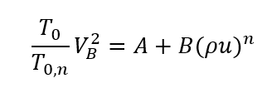
Introduction
Hot-wire anemometers are sensitive to mass flux and total temperature
Applications for hot-wire anemometry include
  Determining the flow quality within a facility
  Mapping the flowfield that is influenced by a model
    Mean flow distortion
    Boundary-layer instabilities & transition
It’s an especially important diagnostic if there is no line of sight
We use a constant temperature anemometer (CTA) at a high overheat & calibrate the wire using a modified King’s Law

Slide 3
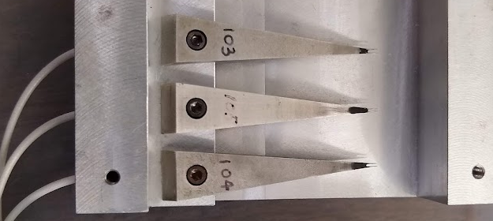
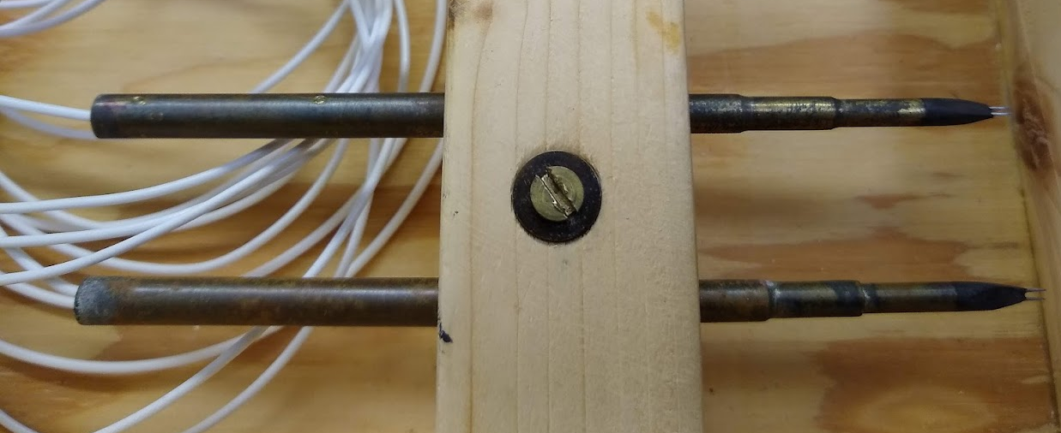
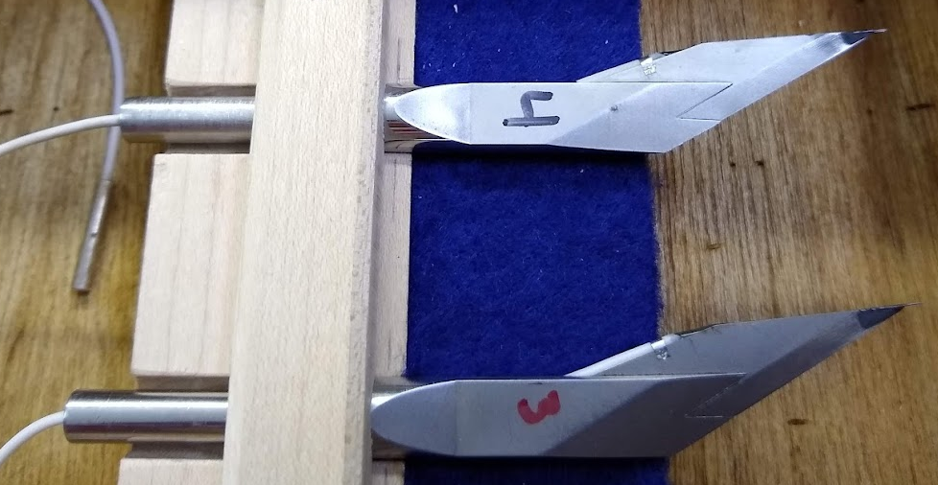
Types of Wire / Probes
Platinum-plated tungsten wires are used in the Mach 3.5 Supersonic Low Disturbance Tunnel (SLDT)
  Material is relatively strong with a high temperature coefficient
  Overheat brings the wire near the temperature limit
Platinum(90)-Rhodium(10) wires are used for Mach 6 testing
  Fulfills the temperature requirement, but the wire is relatively weaker
  Sold as Wollaston wire (Pt-Rd core is clad in silver)
Pt-Rd core
D=3.8μm
Ag Clad
Wollaston Wire
130 mm
100 mm
40 mm
Conventional freestream probes
Boundary-layer probes (blade)
Boundary-layer probes (wedge)

Slide 4
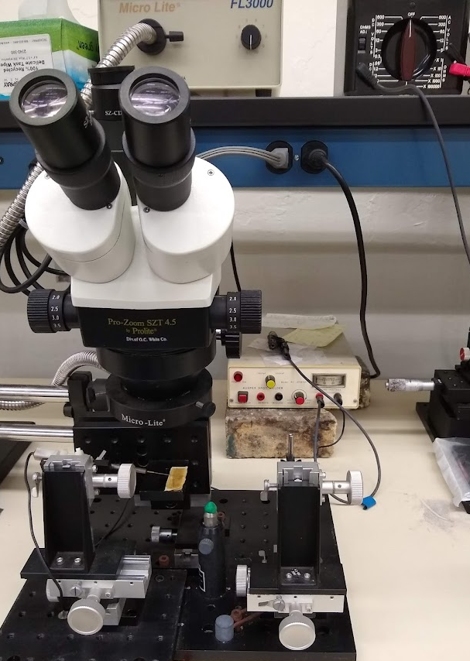
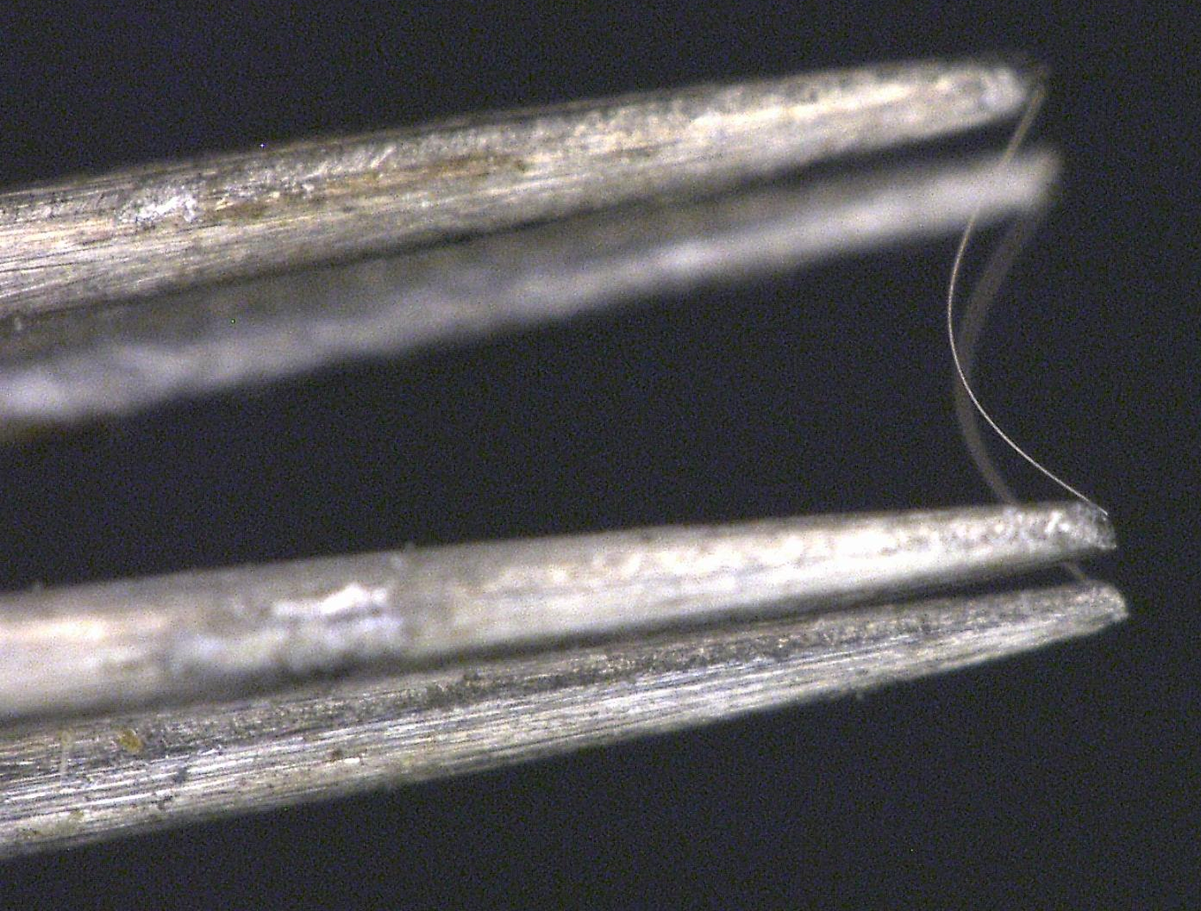
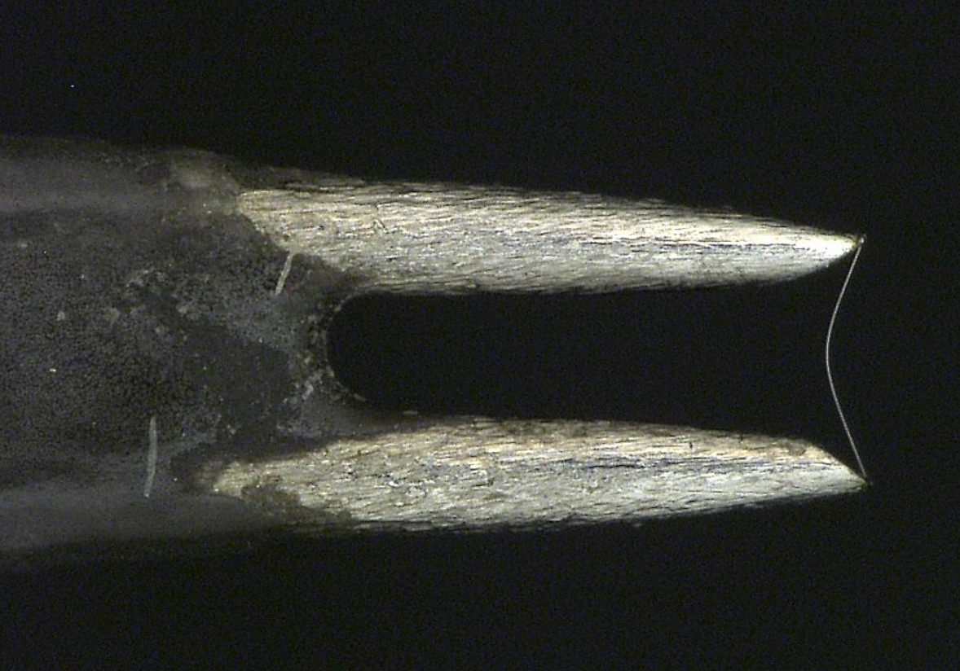
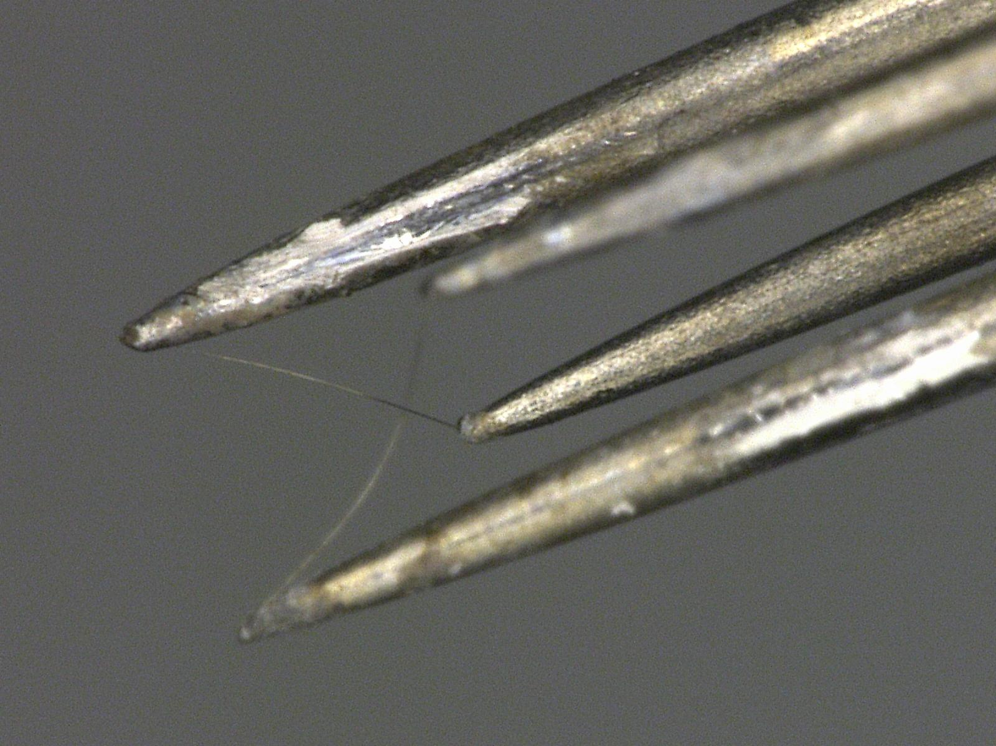
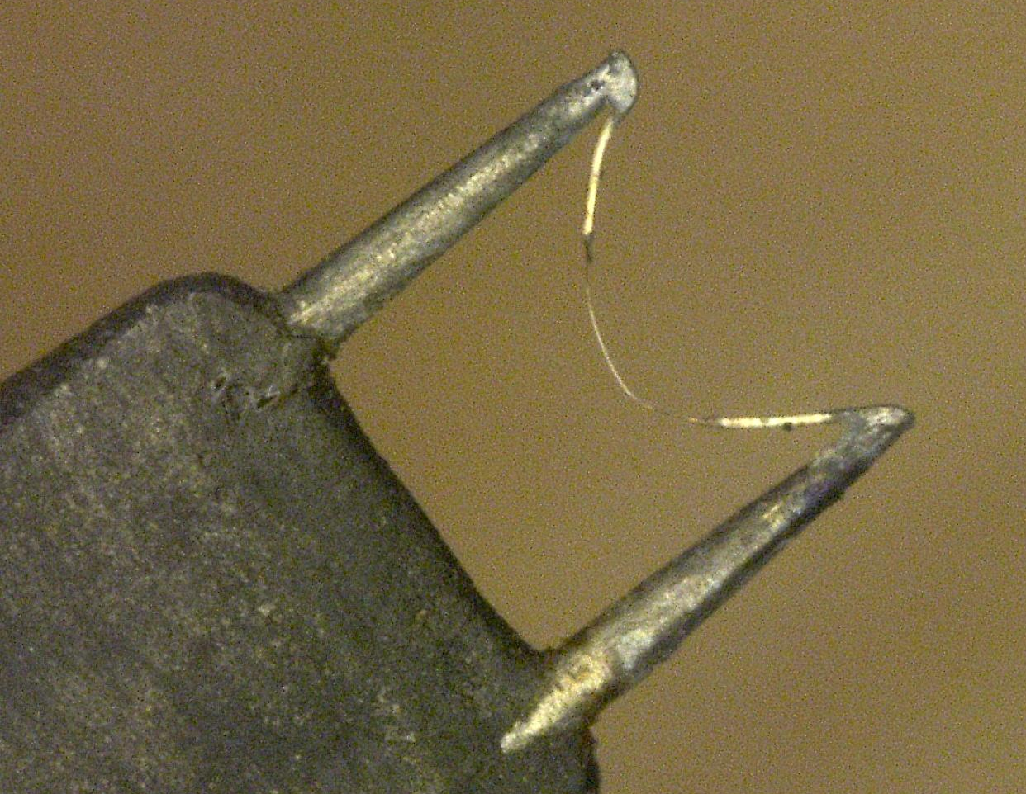
Attaching the Wire
Platinum-plated tungsten wires are spot welded to the prongs
Platinum Rhodium: 2 options
  Solder the Wollaston wire to the prongs, then etch (HNO3) the center to expose the Pt-Rd sensing element
  Etch the Wollaston first, then spot weld the Pt-Rd wire to the prongs
Dual wire
Spot welded
Hot-wire repair station
Platinum-coated Tungsten
Spot welded
Crosswire
Spot welded
Platinum-Rhodium
Soldered, then etched

Slide 5
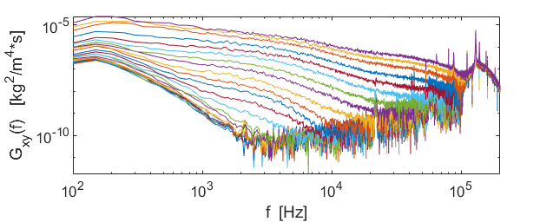
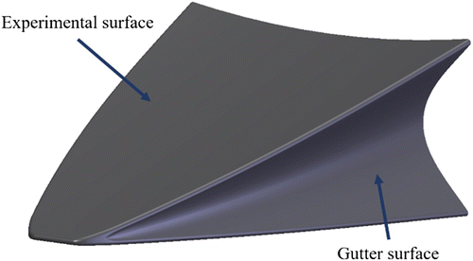
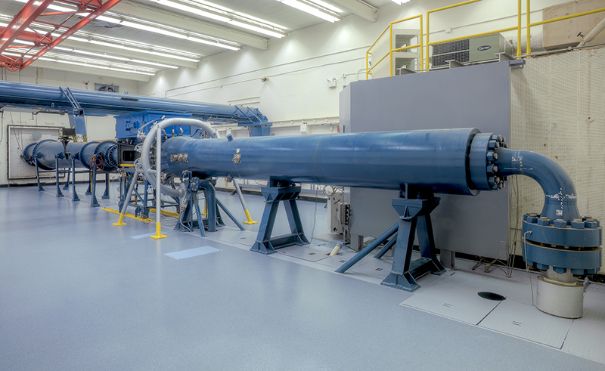
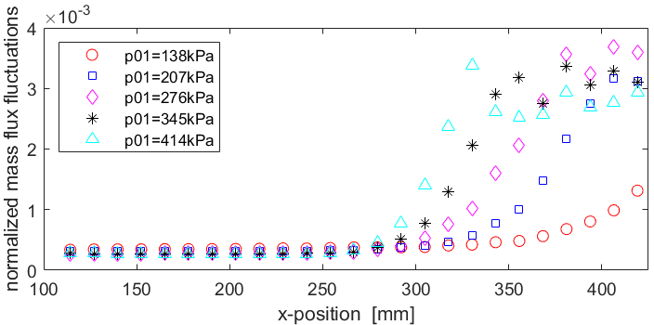
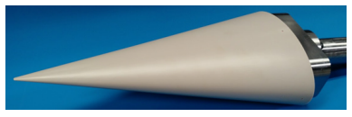
Mach 3.5 SLDT
Have both rapid-expansion and axisymmetric nozzle contours
Nozzle (and quiet core) are hidden from optical access
Hot-wire anemometers are regularly used to verify quiet flow
Off-body measurements are planned for the HIFiRE-5 and BOLT geometries
Bandwidth
≈150kHz
Incr. x
2
f noise
PSDs for
p0 = 207kPa
BOLT geometry
Quiet Threshold
Mach 3.5 SLDT
Centerline fluctuations at T0 = 319K
HIFiRE-5 geometry

Slide 6
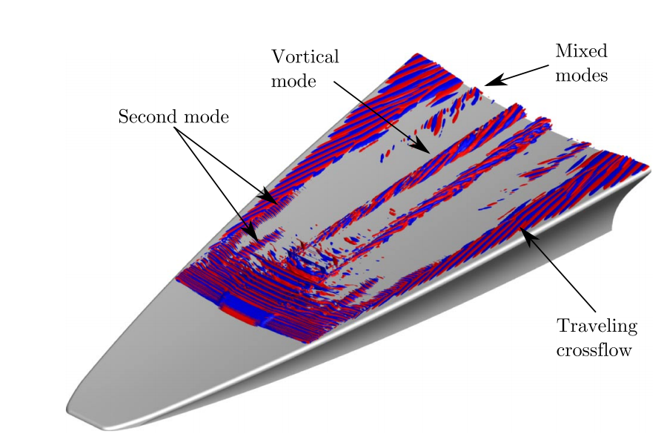
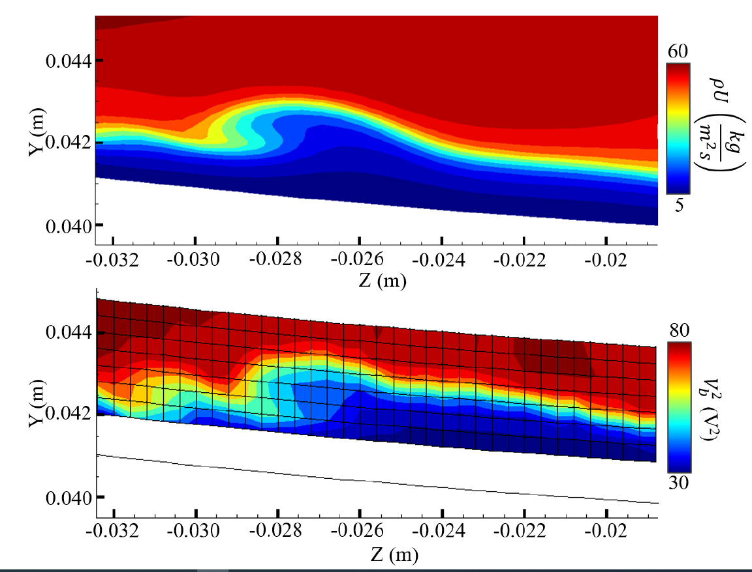
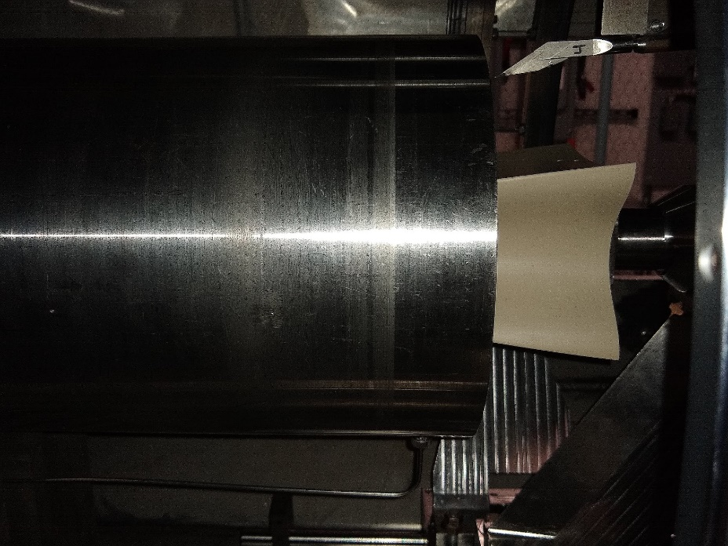
M6QT
Tunnel was built at LaRC and used in the 1990s (known as M6NTC)
Nozzle and settling chamber were sent to Texas A&M University and were brought online in the late 2000s
Hot-wire measurements are planned on a Long-BOLT model
Hot-wire
Probe
M6QT Nozzle
Long-BOLT
Model
Isosurface of streamwise velocity perturbation
Transition mechanisms identified (Knutson et al., 2019)
Top: Mass flux DNS (Johnston et al., 2021)
Bottom: Hot-wire bridge voltage (Kostak, 2022)
Long-BOLT within the M6QT nozzle

Slide 7
Concluding Remarks
Hot-wire measurements are still important for characterizing freestream flow quality and making flowfield measurements above a model
Different types of wire and probes are required depending on the application
The Mach 3.5 SLDT provides long runs, which are ideal for completing hot-wire surveys
Upcoming tests include the HIFiRE-5 and BOLT geometries in SLDT and the Long-BOLT geometry in the M6QT

