Slide 1

NASA Quesst Mission
X-59 Sonic Boom Test
Glenn Research Center 8’x6’ Supersonic Wind Tunnel
Presented by Mitchell Ahaus
Test Engineer, HX5 Sierra, NASA Glenn Research Center
Japanese Aerospace Exploration Agency, Tokyo, Japan
December 7th, 2022
Notes:
(DD) Would name & title be better than name and subject area? Engineer, not Engineering; Researcher, not Research?

Slide 2
Outline
8’x6’ Wind Tunnel Facility
X-59 Sonic Boom model hardware and support components
Instrumentation
Imaging Systems
Data Systems and Acquisition
Model Attitude and Position Correction
Data Results and Analysis
  Reference Runs
  RAM Position
  Humidity
  Repeatability
  Control Surface Deflections
  Angle of Attack
  Height
  Roll
  Mach
  Blade vs. Sting Comparison
  Uncertainty
Conclusion

Slide 3

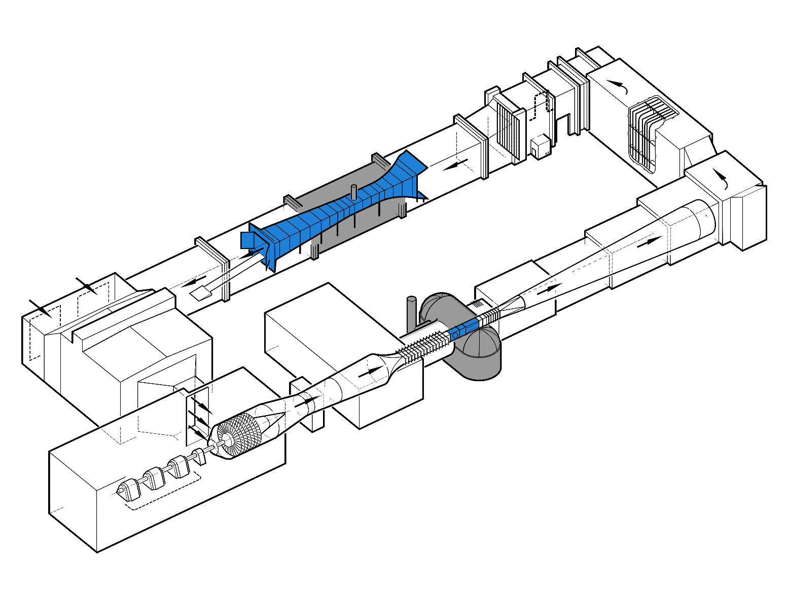
8- by 6-foot and 9- by 15-foot Wind Tunnel Complex
Continuous flow atmospheric closed-loop wind tunnel originally built in the 1940’s, with the first run occurring in April 1949.
Upgraded significantly over the years with addition of 9’x15’ Low Speed Wind Tunnel, transonic test section, acoustic dampening, flow straightening, and significantly improved data systems.
7 stage axial compressor is driven by three 29,000 hp electric motors which provide an 8’x6’ Mach range of 0.26 to 2.0.
Air exhaust Doors
Turn #2
9x15 LSWT flow cooler and straighteners
9x15 LSWT test section
Acoustic muffler
9x15 LSWT diffuser
Air intake Doors and
Turn #3
Turn #1
8x6 SWT diffuser
Air dryer
8x6 SWT test section and balance chamber
8x6 SWT flexible wall nozzle
8x6 SWT flow straighteners
Drive building: 87,000-hp
Graphics credit NASA GRC
Notes:
History
Built 1940’s
Quickly added Turn 1 concrete splitter
Still objectionable noise 5-mile radius
1950 added acoustic muffler, Turn 2, Baffles
1956 added return leg
8x6 also converted to transonic
1960’s 9x15 built
Originally hard wall for VSTOL, later acoustic treated
Two drive rigs
Specs
3-29000 hp motors
7-stage compressor
M 0.25-2
Open or closed loop
______________________________
Better idea of facility and its operation
Step through each area of the tunnel
Highlight capabilities and history
Above image as reference in following charts in lower lefthand corner; orient within tunnel loop
Random notes (just notes…not presentation words)
Tunnel designed and built mid 1940s; first tunnel run April 1949. Very shortly after the first tunnel run, the “87,000-hp bugle aimed at the heart of Cleveland” was encompassed with a concrete splitter, or “Turn 1”. Then, in January of 1950 during a 16-in ram jet test, the noise was still considered objectionable within a 5-mile radius. In august of 1950, the acoustic muffler, Turn 2, and acoustic baffles installation were completed. The facility ran in this configuration for another 5 years when in 1956, the tunnel loop was rounded out and the back-leg added. This introduced the ability to recirculate and reuse dry air to better increase supersonic testing efficiency while still maintaining that ability to run in a propulsion cycle (or open loop) to expels products of combustion when needed.
9x15 was designed and built in the late 1960s to sit in the 8x6’s return leg with the first 9x15 tunnel run occurring in 1969. Originally a hard-walled test section built for VSTOL research with the addition of the acoustic paneling added later for noise suppression. Currently most predominantly used for low air-speed aero-performance and acoustic testing with the use of two drive rigs: on being an approximately 5,000-hp drive rig for testing subscale high bypass ratio fans and the other being a 750-hp (per shaft) counter-rotating fan drive rig for open rotor or, unducted fan, testing.
Mach Number: 0.25 – 2.0 (191 – 1,534 mph)
Reynolds Number: 1.7 – 5.3 x 10⁶ / ft
Dynamic Pressure: 90 – 1350 psf
Total Pressure: 14.9 – 25.4 psia
Temperature: 60 – 220 °F
Open/Closed Loop

Slide 4
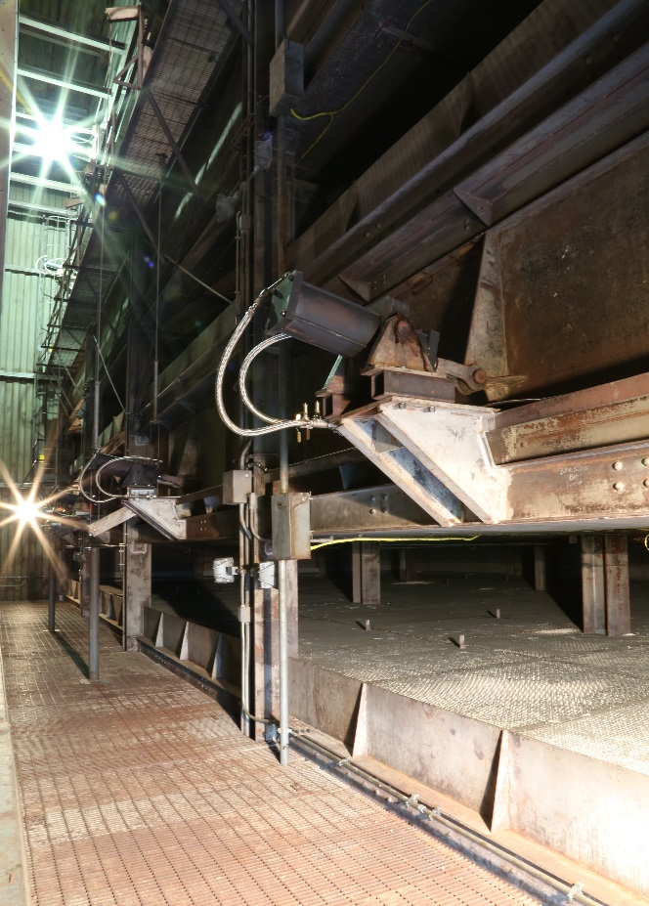
Air Dryer
Per tunnel standard operating procedures, supersonic air-on time is limited by availability of dry air. Air passes through 8-layers of desiccate beds to bring humidity down to calibration/customer requirement levels and retain full visibility in the test section.
During the X-59 Sonic Boom test air on time was somewhat limited by dry air availability at various stages of testing. Test time was maximized by optimizing the test matrix and model changes in real-time every night as well as testing on third shift which typically provides cooler and dryer air.
Dryer beds were reactivated on first shift each day to provide dry air for the next evening’s third shift run.
Air dryer beds upstream of compressor
Image credit NASA GRC
Notes:
Reactivation is the process of removing moisture from the dryer beds through heating.

Slide 5
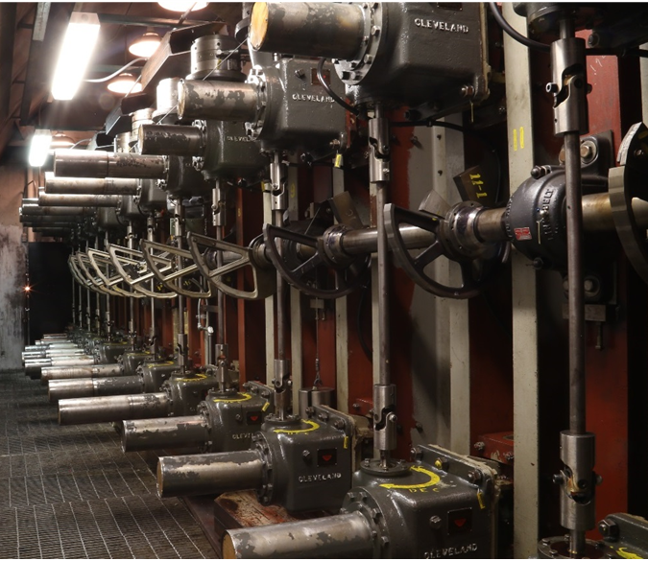
Flexwall
The flow speed in the supersonic test section of the 8’x6’ is controlled through compressor RPM and the position of the flexible wall nozzle upstream of the test section.
The flex wall position is typically set using flats on cams (shown) controlling a series of hydraulic motors which push the walls towards the flow creating a 2D nozzle. The flats on these cams ensure repeatability and are typically 0.03-0.04 below the round tenth of a Mach number between 1.3 and 2.0.
The 8’x6’ is calibrated and characterized based on these flats. The requirement for the X-59 model to test at M 1.40 necessitated a tunnel calibration prior to the sonic boom test.
The test conditions at Mach 1.36 and 1.47 represented nominal conditions for the 8’x6’ while the Mach 1.40 condition was off-nominal.
8’x6’ flexwall hydraulic motors
Image credit NASA GRC
Notes:
History
Built 1940’s
Quickly added Turn 1 concrete splitter
Still objectionable noise 5-mile radius
1950 added acoustic muffler, Turn 2, Baffles
1956 added return leg
8x6 also converted to transonic
1960’s 9x15 built
Originally hard wall for VSTOL, later acoustic treated
Two drive rigs
Specs
3-29000 hp motors
7-stage compressor
M 0.25-2
Open or closed loop
______________________________
Better idea of facility and its operation
Step through each area of the tunnel
Highlight capabilities and history
Above image as reference in following charts in lower lefthand corner; orient within tunnel loop
Random notes (just notes…not presentation words)
Tunnel designed and built mid 1940s; first tunnel run April 1949. Very shortly after the first tunnel run, the “87,000-hp bugle aimed at the heart of Cleveland” was encompassed with a concrete splitter, or “Turn 1”. Then, in January of 1950 during a 16-in ram jet test, the noise was still considered objectionable within a 5-mile radius. In august of 1950, the acoustic muffler, Turn 2, and acoustic baffles installation were completed. The facility ran in this configuration for another 5 years when in 1956, the tunnel loop was rounded out and the back-leg added. This introduced the ability to recirculate and reuse dry air to better increase supersonic testing efficiency while still maintaining that ability to run in a propulsion cycle (or open loop) to expels products of combustion when needed.
9x15 was designed and built in the late 1960s to sit in the 8x6’s return leg with the first 9x15 tunnel run occurring in 1969. Originally a hard-walled test section built for VSTOL research with the addition of the acoustic paneling added later for noise suppression. Currently most predominantly used for low air-speed aero-performance and acoustic testing with the use of two drive rigs: on being an approximately 5,000-hp drive rig for testing subscale high bypass ratio fans and the other being a 750-hp (per shaft) counter-rotating fan drive rig for open rotor or, unducted fan, testing.
Mach Number: 0.25 – 2.0 (191 – 1,534 mph)
Reynolds Number: 1.7 – 5.3 x 10⁶ / ft
Dynamic Pressure: 90 – 1350 psf
Total Pressure: 14.9 – 25.4 psia
Temperature: 60 – 220 °F
Open/Closed Loop

Slide 6
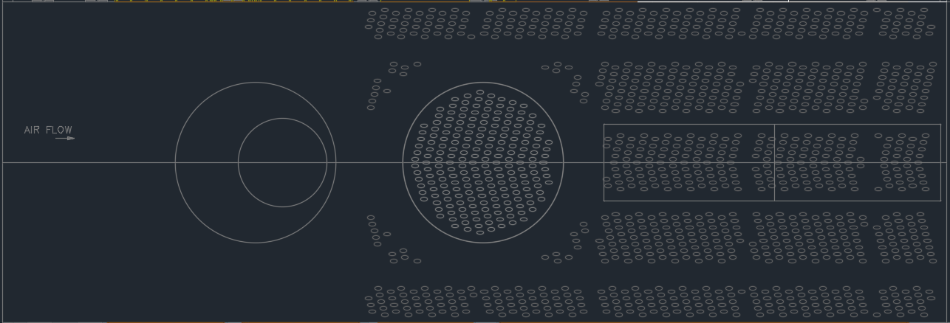
8’ x 6’ Test Section
The 8’x6’ test section is comprised of two parts. The upstream solid-walled “Supersonic Test Section” and downstream porous “Transonic Test Section”. The Transonic Test Section is useful for minimizing model shock reflections and was utilized for previous sonic boom testing.
Minor Mach fluctuations in the Transonic Test Section led to the Supersonic Test Section being utilized during the X-59 Sonic Boom Test. This was the first customer test in the Supersonic Test Section since the advent of the Transonic Test Section in 1956.
Supersonic Test Section
Transonic Test Section
8’x6’ Test Section
Graphics credit NASA GRC
Notes:
Tunnel was fully calibrated at the off-nominal Mach numbers and at the positions in question prior to testing.
Porosity holes are 1” diameter and were hand-drilled at a 60° angle to the air flow in a herringbone pattern as seen.

Slide 7
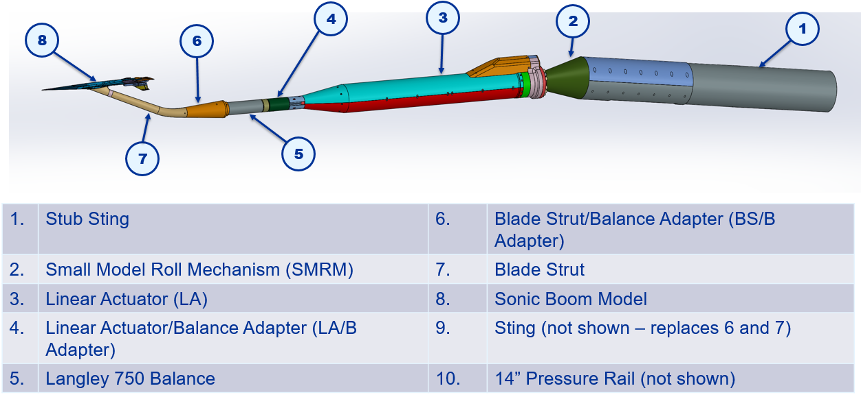
Hardware Stackup
Graphics credit NASA GRC

Slide 8
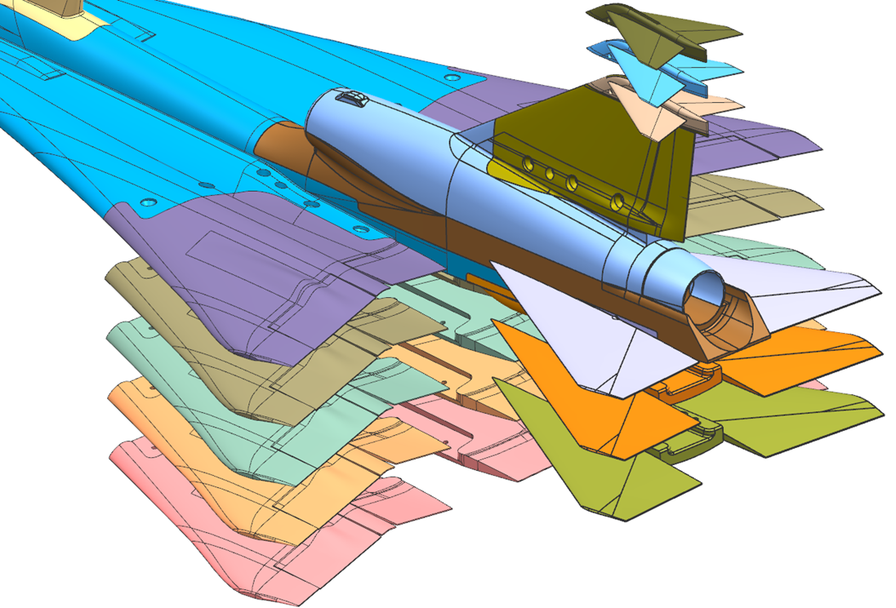
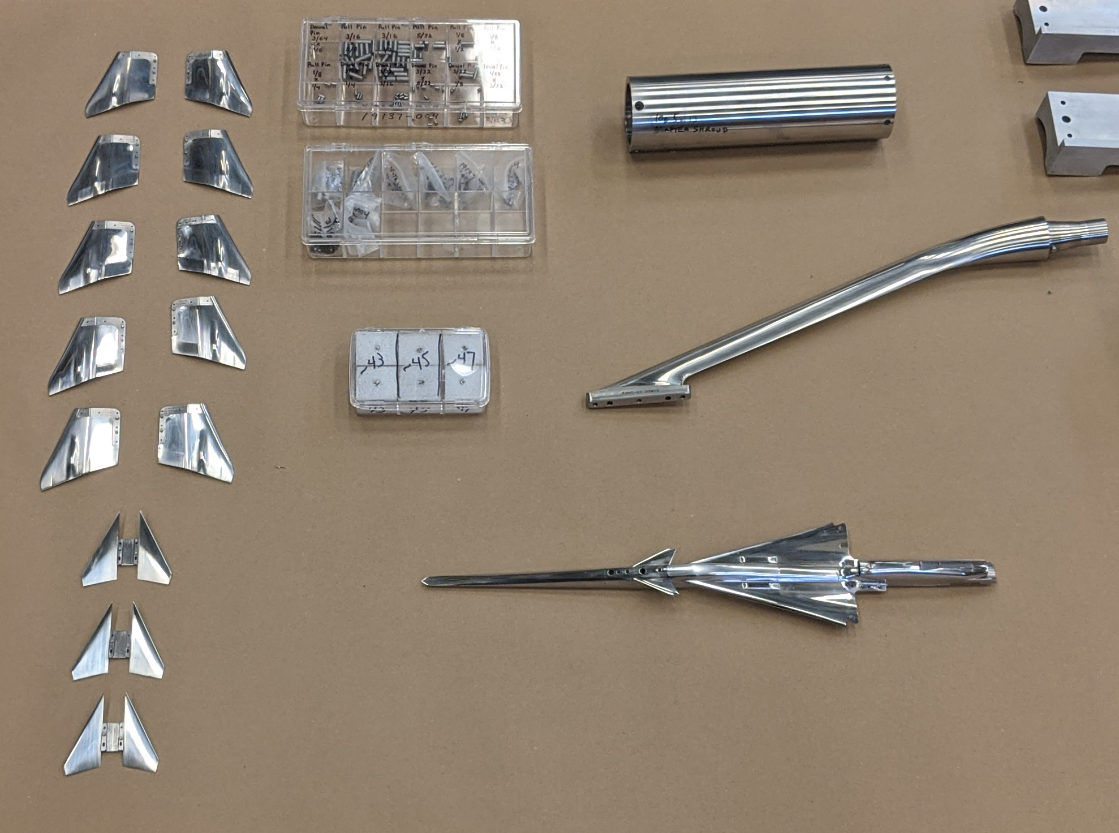
X-59 Sonic Boom Model
18.80” long 1.6212% scale model.
  2 mounting configurations
  5 wing configurations
  3 T-tail configurations
  3 Stabilator Configurations
Model Hardware Configurations
Graphics credit Tri Models Inc.
X-59 Sonic Boom model hardware upon arrival at 8’x6’
Image credit NASA GRC, NASA/TM-20220012155
Notes:
Wing configurations had varying ailerons and flaps

Slide 9
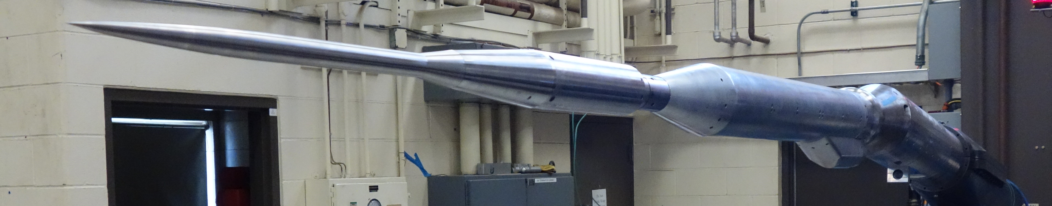
AS-2 Model
The AS-2 Model is an axisymmetric calibration body that was designed and built by Boeing in 2010.
The calibration body intended to produce a predictable and repeatable sonic boom signature.
Downstream end of AS-2 model is the same 8° male taper as the Blade Strut allowing for relatively simple model changes.
AS2 Model Installed in 8’x6’ Buildup Area
Image credit NASA GRC

Slide 10
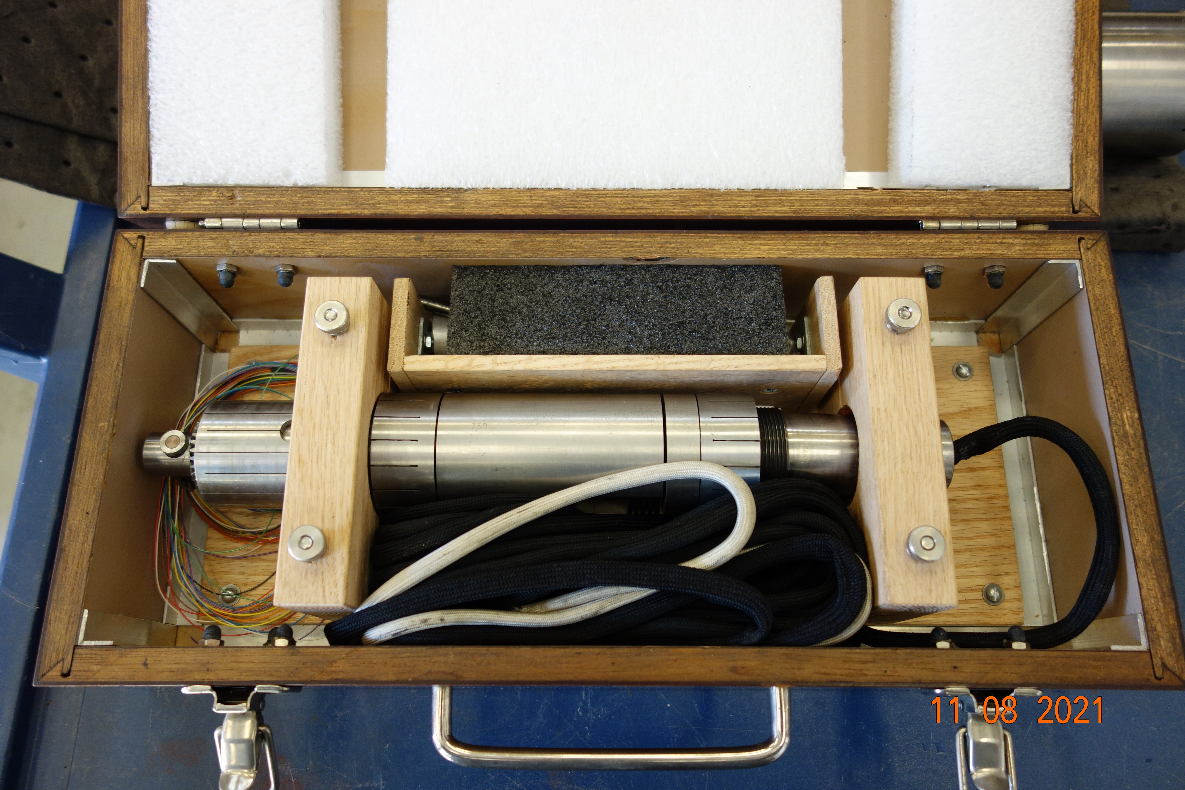
Langley 750 Balance
The 2.0” diameter Langley 750 balance was utilized to determine model attitude with both high accuracy and precision during testing.
The balance was oversized for the expected loads but allowed for margin to unstart loading conditions.
The overall stiffness of the balance was useful in decreasing overall deflection of the model relative to the larger support system.
The balance was calibrated immediately prior to the test.
Langley 750 balance in shipping box
Image credit NASA GRC

Slide 11
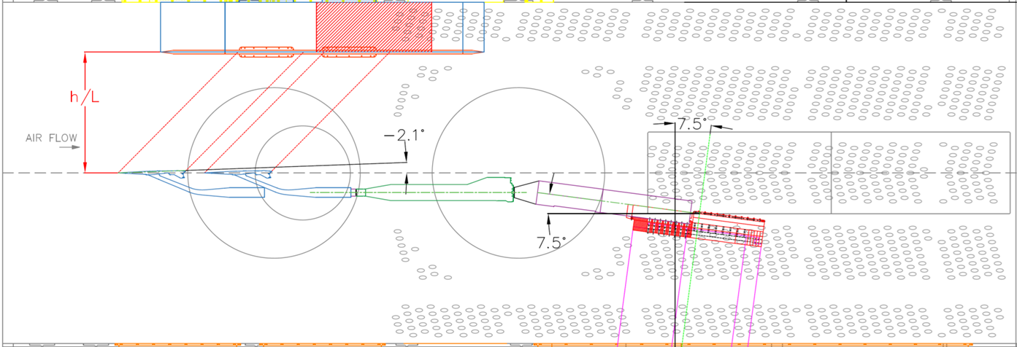
Linear Actuator
The Linear Actuator allowed for up to 24” of axial translation during testing.
The model would be moved from the aft most position forward over a typical range of 8” in what was known as an X Sweep. This movement allowed for spatial averaging of the boom signature resulting in a more accurate and useful signature average.
The Linear Actuator also allowed for optimal positioning of the model relative to the 14” rail mounted on the ceiling across all tested model heights.
Layout of model on tunnel centerline showing linear actuation limits
Image credit NASA GRC

Slide 12
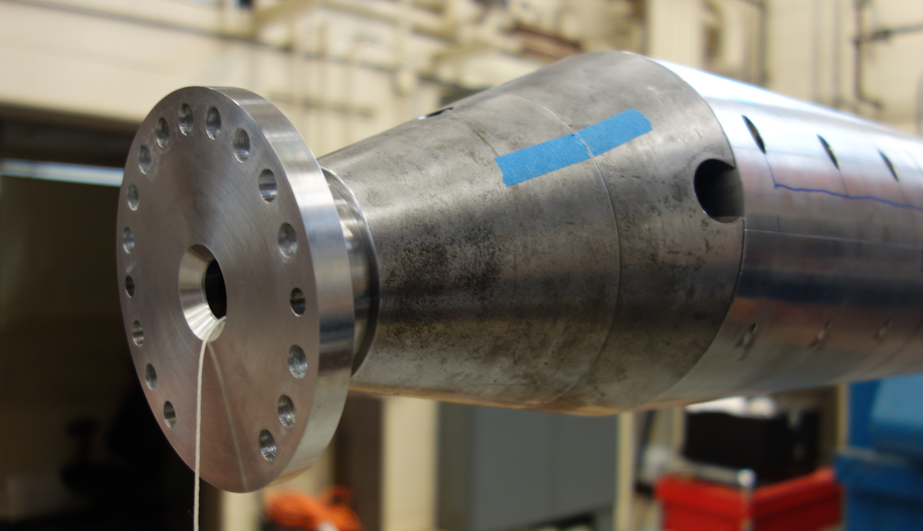
Ames Small Model Roll Mechanism (SMRM)
The SMRM allowed for rolling the model along the balance axis.
Test data was taken at 5° angle increments from 0° to 45° relative to the pressure rail on the ceiling.
Due to the offset from the blade strut, the SMRM angle did not directly equal the model roll angle relative to the pressure rail.
The model position relative to the pressure rail was calculated in real-time from the facility strut height, SMRM angle, Linear Actuator position, and balance feedback.
SMRM mounted in Stub Sting and with Linear Actuator taper flange installed on the left
Image credit NASA GRC

Slide 13
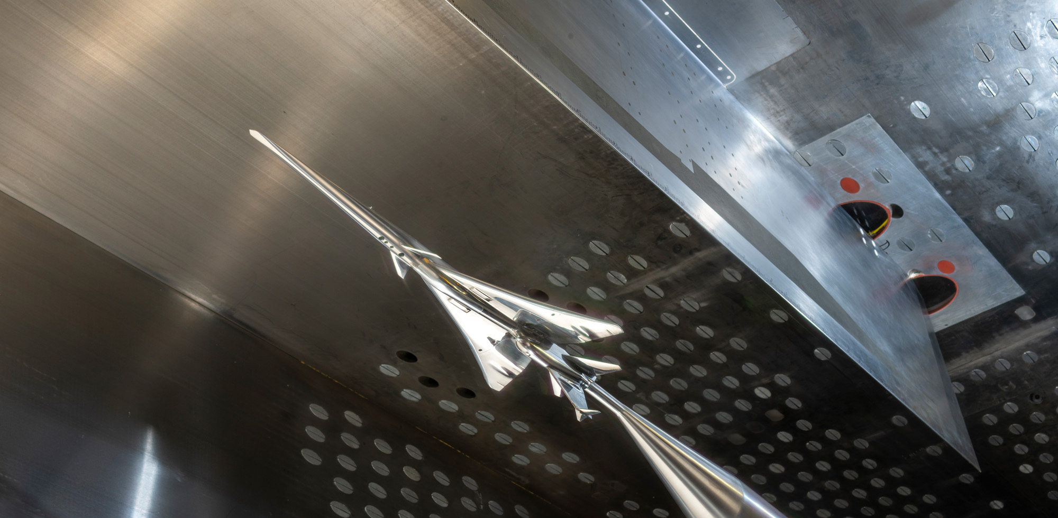
14” Pressure Rail
The main data resulting from this test was acquired from the 14” tall, 90” long pressure rail mounted on the ceiling of the 8’x6’ test section.
The pressure rail has 420 static pressure taps along a 66” instrumented length starting 18” from the leading edge of the rail.
It was of high importance when planning the test to position the model out of a region on the rail where shocks from the leading edge reflected off the tunnel walls and interfered with the model signature. This was known in advance of the test and observed in the data when said shock interference could not be avoided.
Ceiling mounted 14” rail behind sting mounted X-59 Sonic Boom Model
Image credit NASA GRC

Slide 14
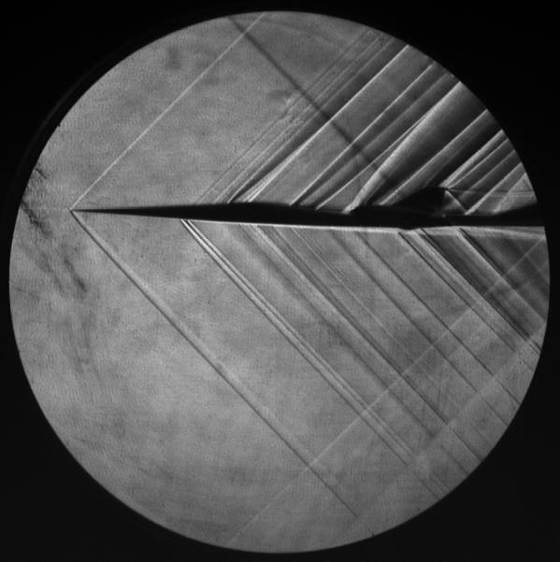
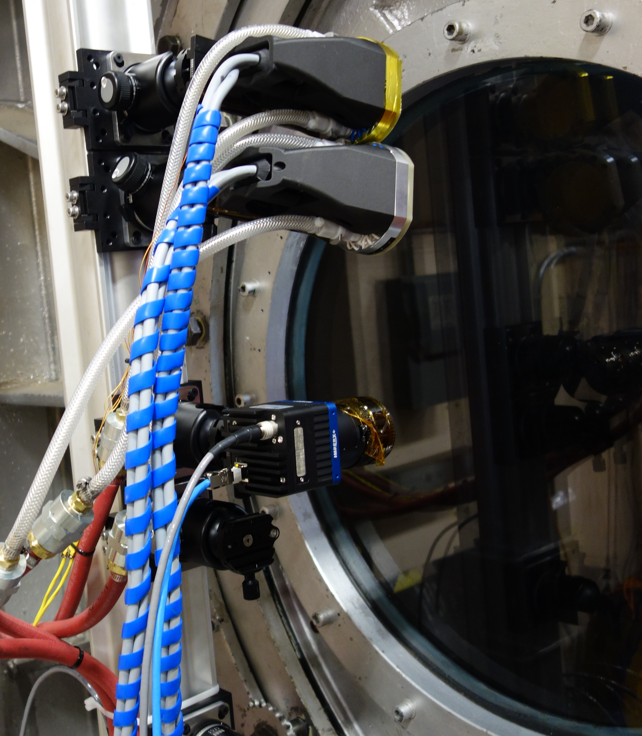
Imaging
Two different types of Schlieren were employed for this test.
Classical Schlieren was not originally a test objective but was setup and used early on to investigate unexpected data. It was later used to create the composite image as seen on the cover of Aviation Week Magazine.
Tomographic Background Oriented Schlieren (TomoBOS) images were taken with the goal of producing a 3D tomographic view of the airflow around the model. These images are still being processed.
Classical Schlieren composite image
TomoBOS camera setup outside of test section
Image credits NASA GRC

Slide 15
Data Systems and Acquisition
Steady state data were collected by utilizing the Collect Observe Broadcast Record and Analyze (COBRA) data system, the Optimus pressure monitoring system, and Electronically Scanned Pressure (ESP) mini-modules.
Data sampling durations varied depending on the type of run, but most of the data readings were recorded for 15 seconds during the standard X-sweeps.
Reference runs were completed regularly throughout testing. It was standard practice for a data run to use the most recent previously acquired reference run, but this could be changed to a later reference run if it was determined that run would provide a better correction.
COBRA samples at 12.5 Hz and provides real-time monitoring of pressure signatures to facility and customer displays. This allowed for easy recognition of any obvious issues that arose with specific ports or the data as a whole. On occasion, individual ports on the rail would report bad data and this could be easily flagged and ignored within COBRA until the issue could be investigated after shutdown.

Slide 16
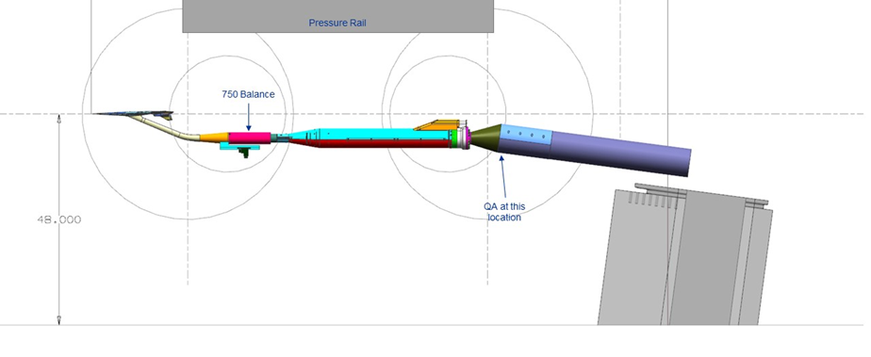
Model Attitude Correction
Knowing accurate model position was always a critical component of the test requirements.
Sting Deflection Theory uses Hooke’s law to model the support system and balance as a spring system.
During checkloads, known loads were applied at known locations and moments and forces were sensed at BMC.
There were only two direct feedback mechanisms for model attitude, the force/moment measurements from the balance and the angle output form the QA mounted on the stub sting.
Model attitude feedback components
Graphics credit NASA GRC

Slide 17
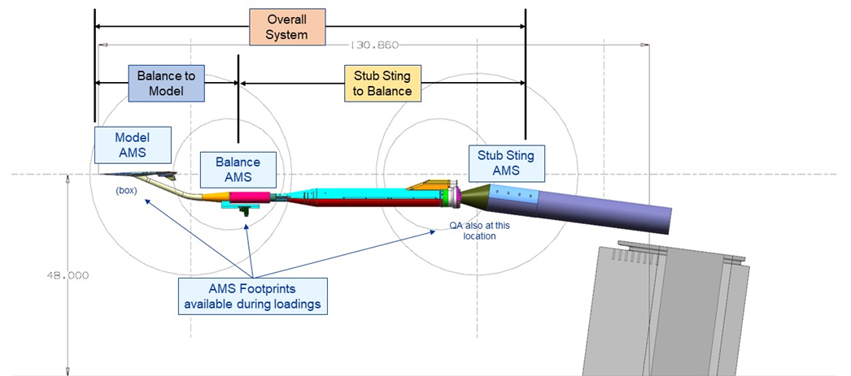
Model Attitude Correction
Deflections for the system ended up being considerably larger than a typical setup. The combination of the SMRM, Linear Actuator, and Blade Strut created a very long stackup.
The test requirements necessitated the deflections to be estimated using a two-system model.
During checkloading, loads were applied at two different axial locations on the model. The AMS, balance, and QA readings were recorded for a load set and the k-constants were calculated.
The model was then rolled 180° and the process was repeated, with the average of the two k-constants being used.
Model attitude system breakdown and component utilization
Graphics credit NASA GRC

Slide 18
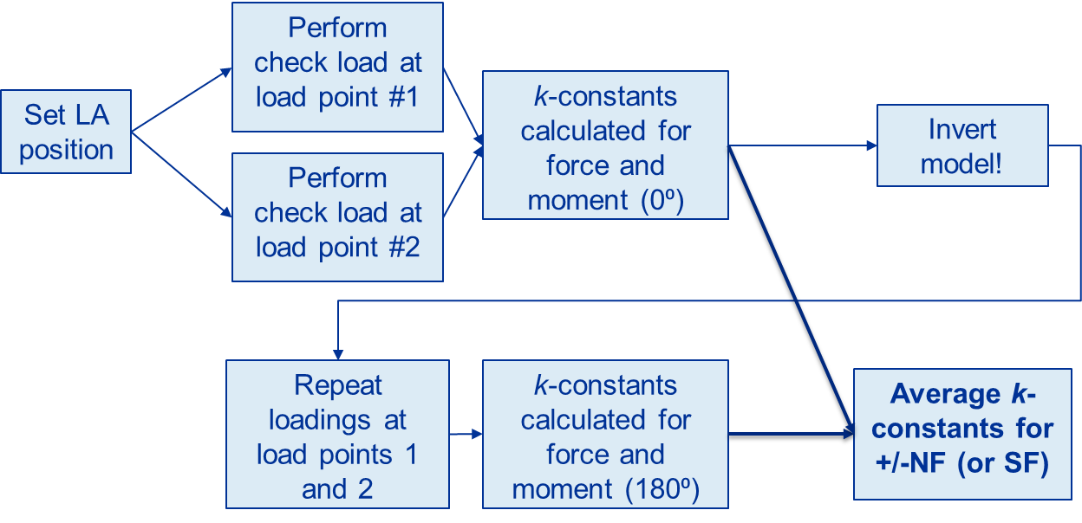
Model Attitude Correction
Process was repeated for three linear actuator positions and the k-constant was fit across the positions.

Slide 19
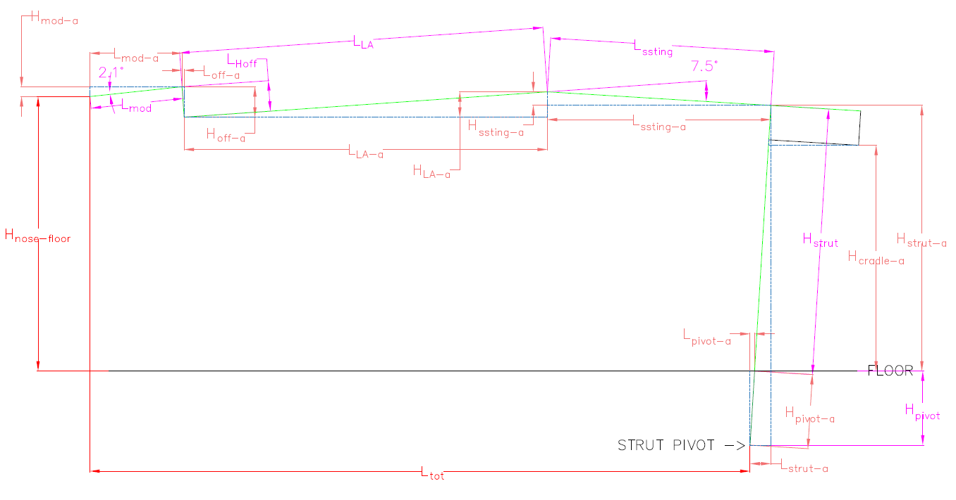
Model Position Corrections
An incremental approach was taken to go from the k-constants to true model position estimation.
For each of the four sub-components listed below, x, y, and z, positions were calculated through translations and Euler rotations.
All incremental positions were then summed and added to the initial tunnel station to get an estimated model nose position.
During testing, position control was automated by a continuous feedback control system. This control system self-adjusted after each Linear Actuator movement, greatly reducing settling time and model operator fatigue.
3
2
Incremental Components:
Strut Adjustment – Height and Pitch
Stub Sting (with Small Model Roll Mechanism) – Roll
Linear Actuator – Ram
Model nosetip (dependent on blade offset or sting configuration) – Constant Offset
4
1
Model position incremental component layout
Graphics credit NASA GRC

Slide 20
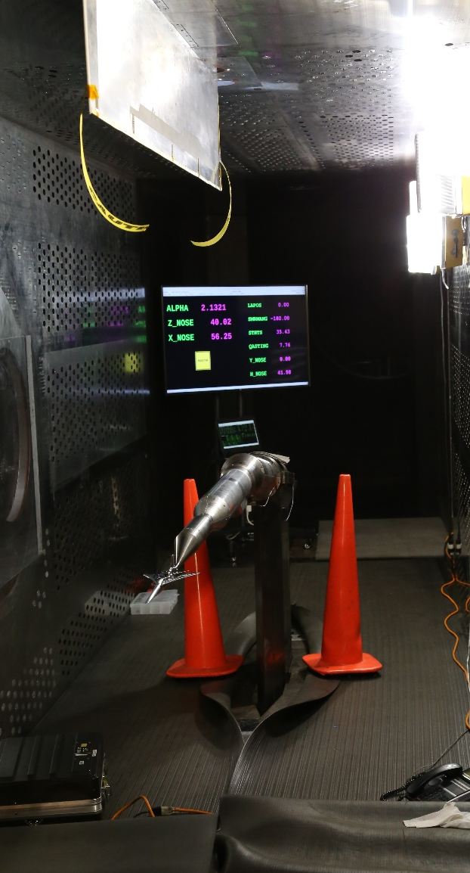
Model Position Corrections
Model position was verified in the tunnel at multiple strut heights and pitches, Linear Actuator positions, roll angles, and with different amounts of weight applied.
All three configurations (AS-2, Blade, and Sting) were checked.
X_NOSE (axial position) for all three configurations was always within 0.25” of measured tunnel station.
Z_NOSE (height above floor) was better for loaded measurements. For loaded positions,
  Blade Strut within ±0.15”
  Sting within ±0.30”
  AS2 within ±0.30” (unloaded only)
Test section model position verification setup
Photo credit NASA GRC
Notes:
AS-2 model was not loaded due to there not being a model block for AS-2.

Slide 21
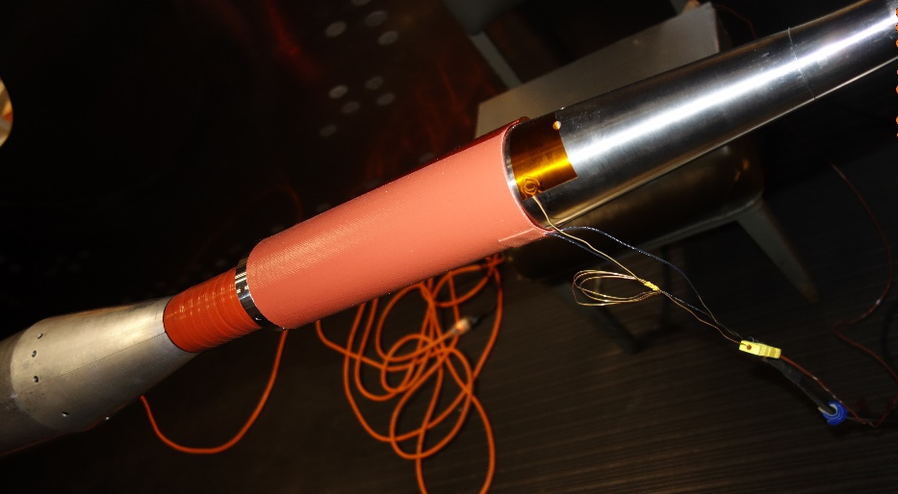
Balance Thermal Shift
During the first few nights of testing, it was discovered that there was a fairly large difference between room temperature and running temperature, as recorded by the balance.
Pre-run zero and post-run zero readings showed a difference of almost 10 lbf in NF. Ignoring this shift had a significant effect on the signature position.
A process of heat-soaking the balance prior to taking the pre-run zero reading greatly alleviated the problem.
Heat blanket covering balance can prior to run start
Photo credit NASA GRC

Slide 22
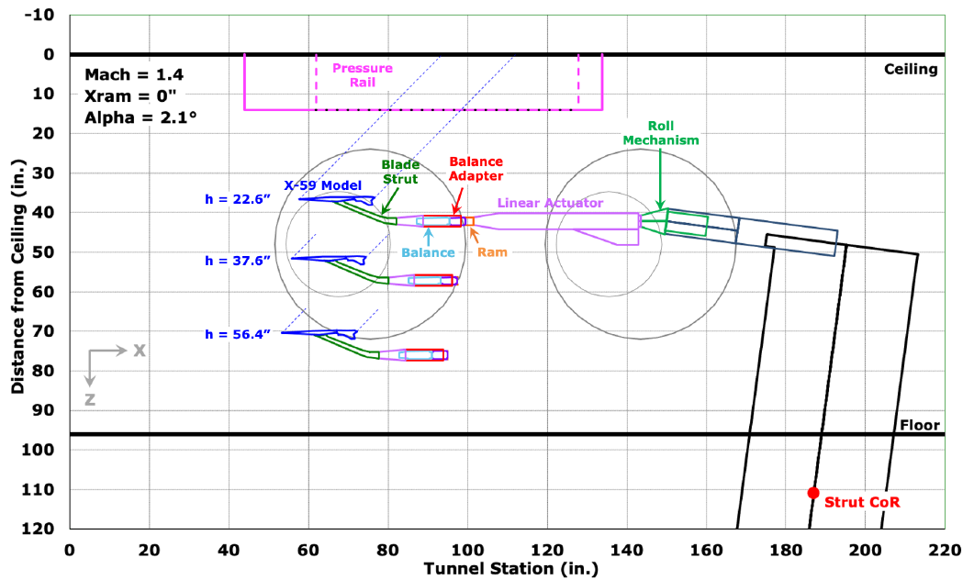
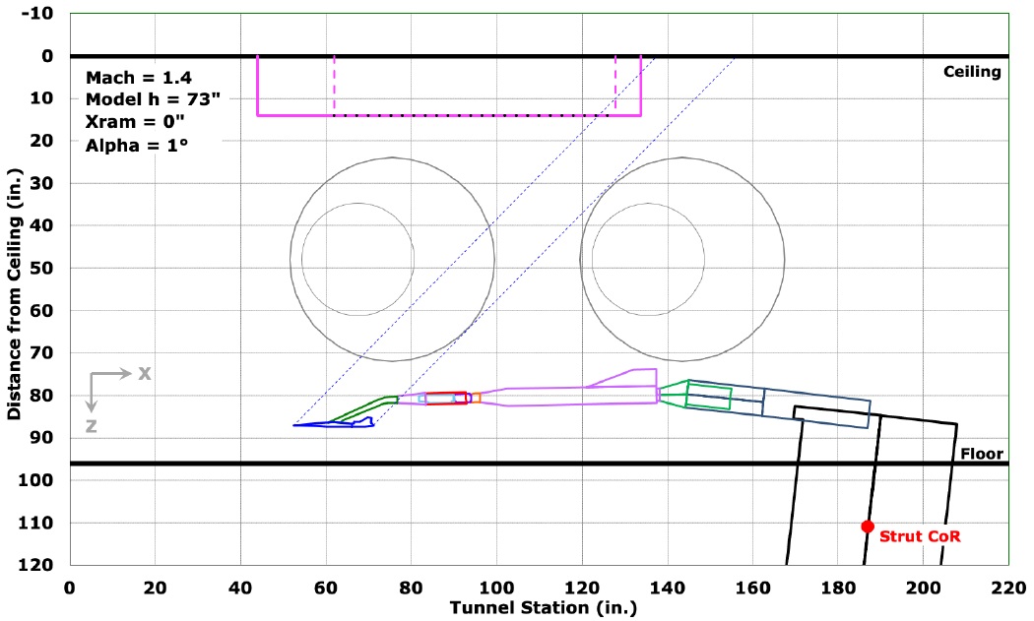
Model Positioning in Test Section
Model position relative to the 14” Pressure Rail was thoroughly investigated during test planning.
It was known that there is a section in the aft half of the rail where shocks from the leading edge of the rail would rebound off the tunnel wall and interfere with the model signature. It was prioritized to get as much data with the model out of this zone as possible.
Model heights were chosen as shown below from closest to the rail to furthest from the rail.
  h/L=1.2, h=22.6”
  h/L=2.0, h=37.6”
  h/L=3.0, h=36.4”
  h=73”, Roll=180° (Reference Run)
Top: Model Position at H/L of 1.2, 2, and 3.
Bottom: Reference run position
Graphics credit NASA/TM-20220012155

Slide 23
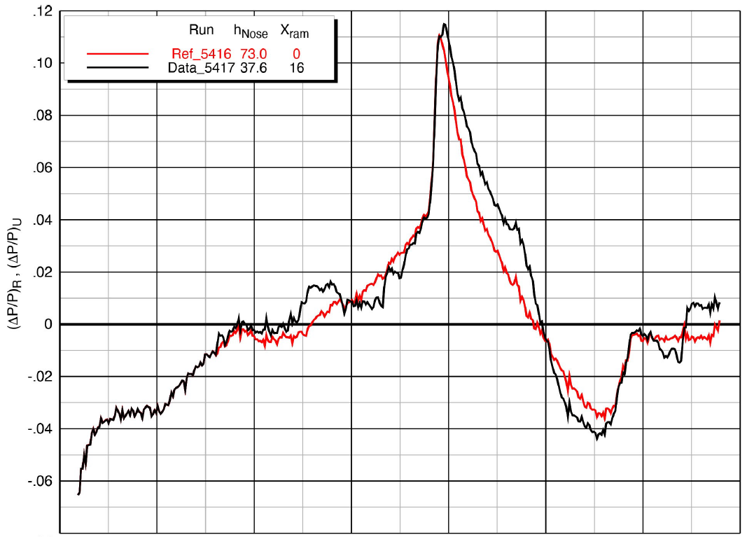
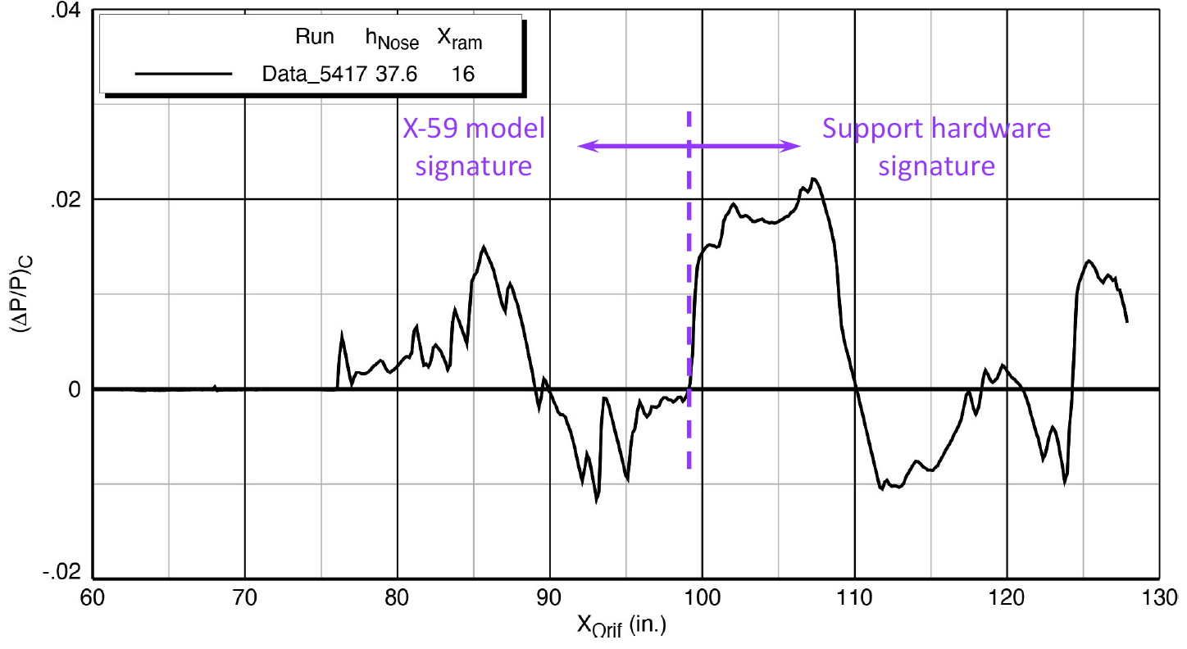
Results and Analysis – Reference Run
Reference and data run pressure signatures
X-59 blade model and support structure signature
Plot credit NASA/TM-20220012155
Notes:
Reference Runs were completed both before and after each data sweep.
The reference run signature provides a no-model signature that can be subtracted from the full model data signatures to provide the model-only signature.
SOP was to use a pre-data sweep reference run but this could be changed to use a post-data sweep reference if it was determined to provide a better output.
Each averaged pressure signature is comprised of 26 individual runs of data (25 steps of 0.32” of the linear actuator, about 2 pressure orifices)
The raw ΔP/P data is first corrected by subtracting the reference run signature
Linear Interpolation is used to align the 26 individual curves with each other after correcting for linear actuator position
At each X position, the value of the 26 curves is averaged
The average value across all 26 signatures at a specific X-position makes up the average signature point in a given SigSet
The large pressure increase around X = 99 corresponds to the start of the model support structure (specifically the transition to a circular support structure on the blade prior to the balance)

Slide 24
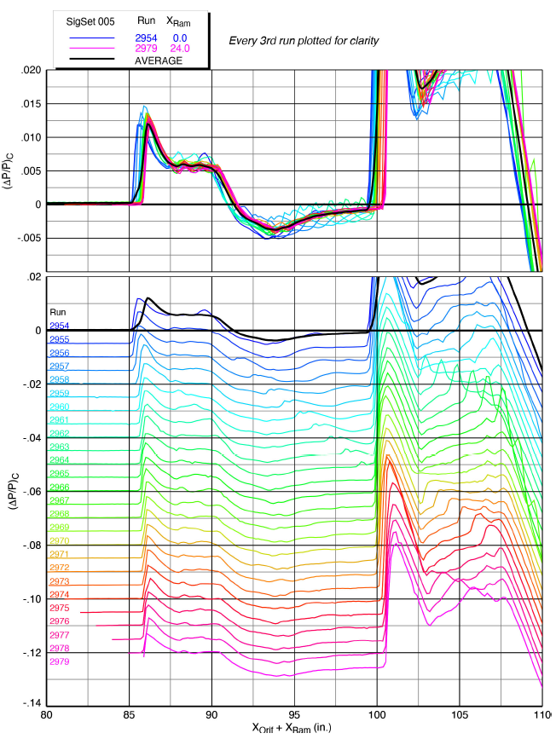
RAM Position Effects – AS-2
AS-2 was used to determine signature quality across the 14” rail and best practices for X-59 model data collection.
Signature collection across the entire 24” of the linear actuator span yielded an unexpected gradual pressure rise at the nose on the average signature.
This was determined to be due to a misalignment in the nose shocks as the linear actuator was translated across its entire span.
Something in the tunnel flow caused the nose shock to move during the translation.
Aligned AS-2 signatures, M 1.36, h/L =1.2
Plot credit NASA/TM-20220012155
Notes:
Averaged signature shows a gradual pressure rise, but individual signatures all yield a sharp rise.
The discrepancy was noted by the test team but additional investigation into the phenomena was outside the scope of the test.

Slide 25
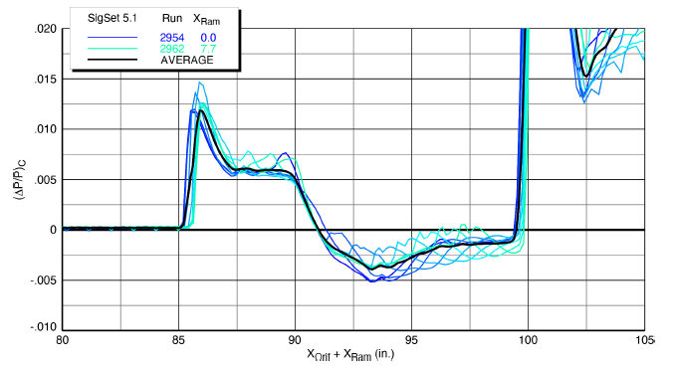
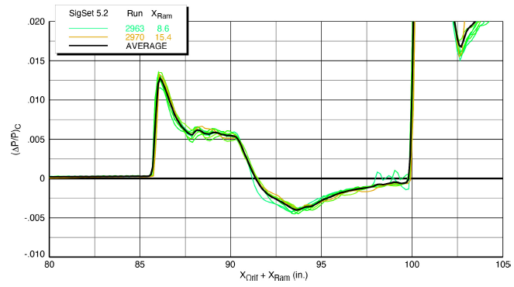
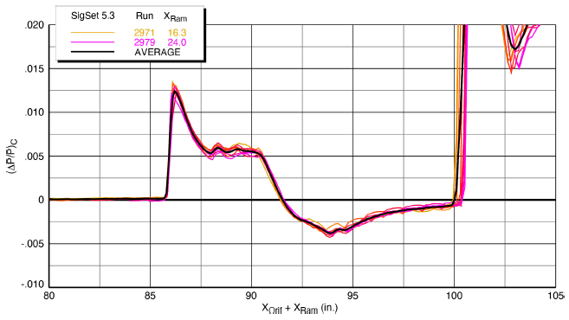
RAM Position Effects – AS-2
Further analysis showed that the misalignment was resulting primarily from signatures collected at the back of the rail. This lead to prioritizing data being collected from the forward end of the rail for the remainder of the test campaign when h/L was at 1.2.
X-Ram from 0”-8”, M 1.36, h/L =1.2
X-Ram from 8”-16”, M 1.36, h/L =1.2
X-Ram from 16”-24”, M 1.36, h/L =1.2
Plots credit NASA/TM-20220012155
Notes:
Significantly reduced scatter in the data can be seen when the linear actuator is extended from 8-16” and again from 16-24”.
All data indicates that there was sensitivity to the signature

Slide 26
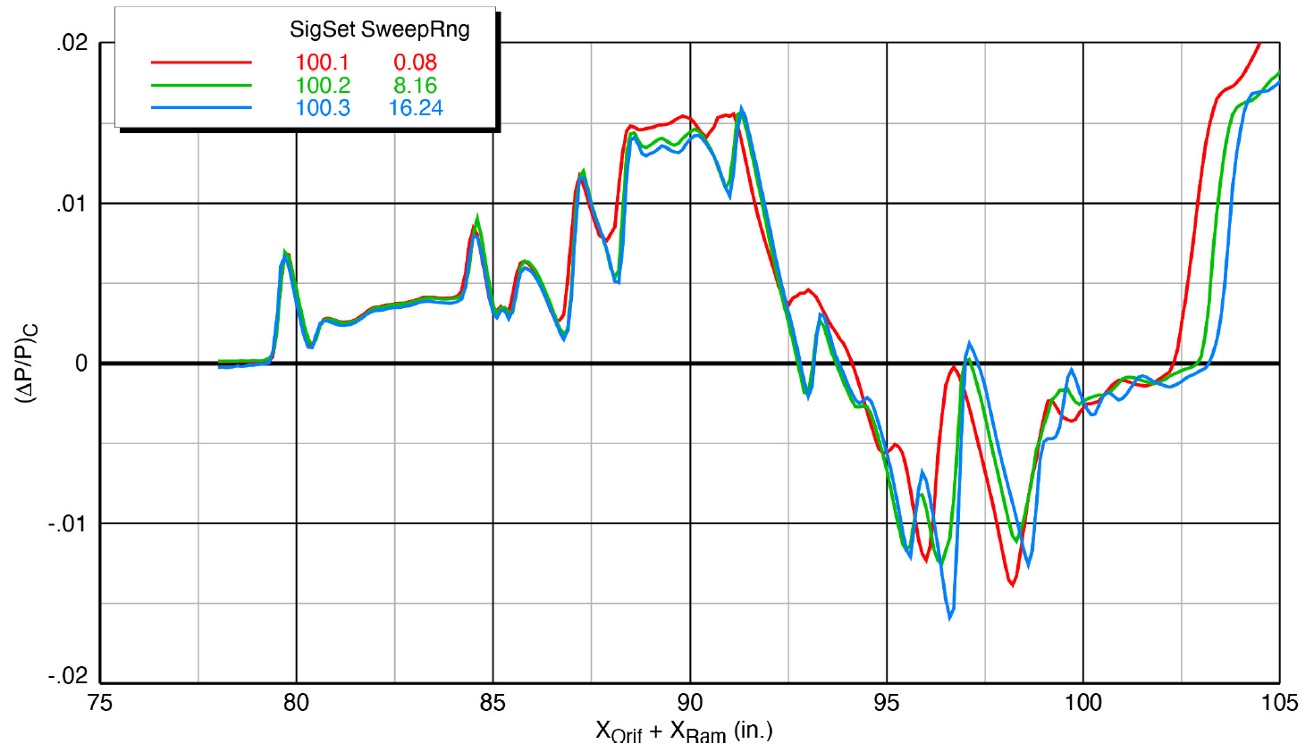
RAM Position Effects – X-59
Aligned signatures of sweeps from 0”-8”, 8”-16” and 16”-24”, M 1.40, h/L =1.2
Plots credit NASA/TM-20220012155
Notes:
Signature quality and repeatability is dependent on sweep range, and a preference was made for the forward half of the pressure rail at h/L of 1.2.
Red signature is from first third of the rail and clearly shows less consistent data signatures.

Slide 27
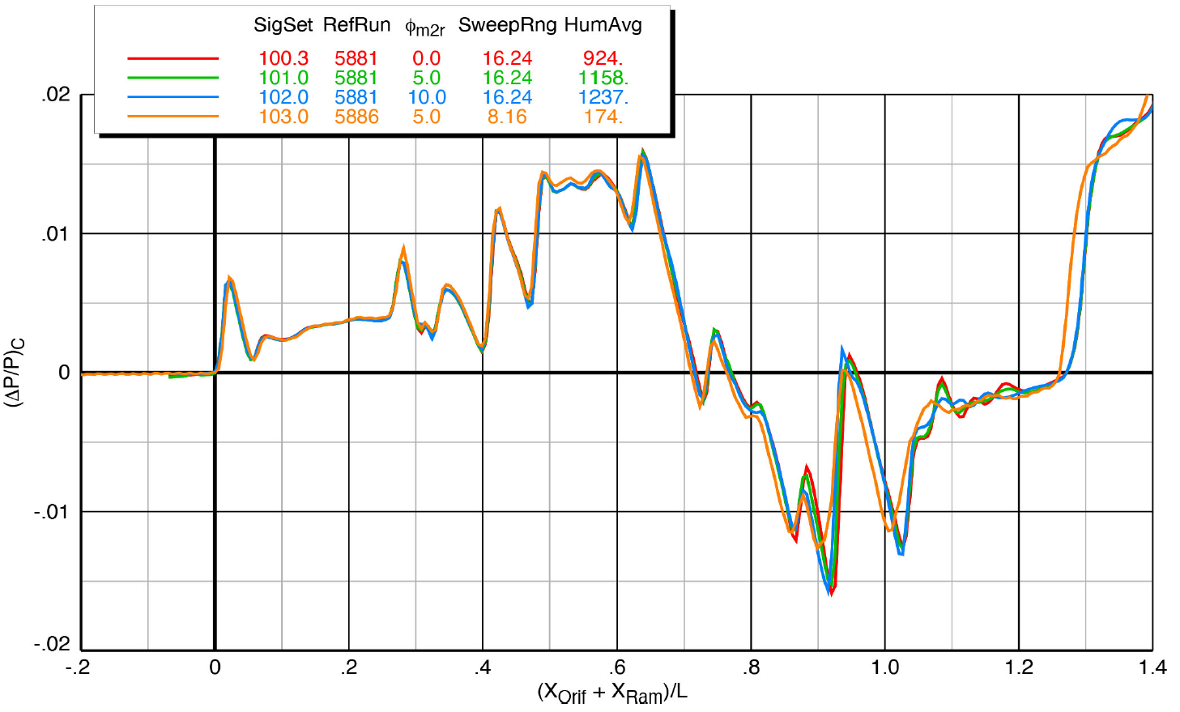
Humidity Effects – X-59 Blade
Aligned signatures of sweeps taken at significantly varying humidity levels, M 1.36
Plot credit NASA/TM-20220012155
Notes:
Previous testing had led to the belief that humidity had a significant impact on the boom signature, and previous sonic boom testing had focused on minimizing humidity and/or keeping it very low.
When accounting for all other variables as much as possible, the effects of humidity on signature data at the 8x6 was found to be minimal to nonexistent.
Model position, reference run applied, sweep increment and just about every other variable had a greater effect on the boom signatures than humidity.
Note: These sweeps were at varying angles of roll, but that does not invalidate the analysis regarding humidity.
During testing, following an investigation into humidity effects early on, humidity did not stop running until relative humidity reached a point that clouds began to form in the test section.
This is cause for shutdown following standard tunnel operating procedures.

Slide 28
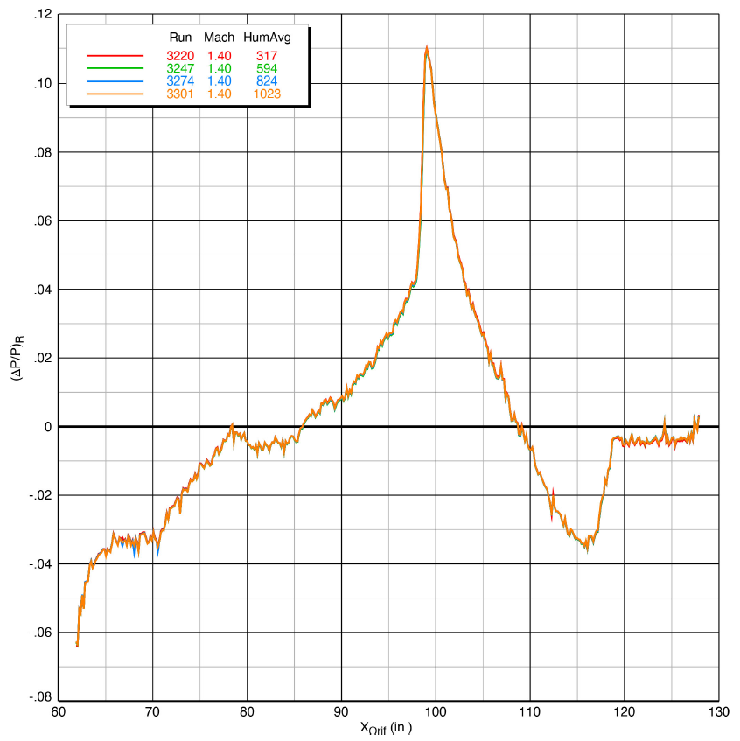
Reference Run Repeatability
Short-term repeatability of selected reference runs, M 1.40
Plot credit NASA/TM-20220012155
Notes:
Short-term repeatability was very good.

Slide 29
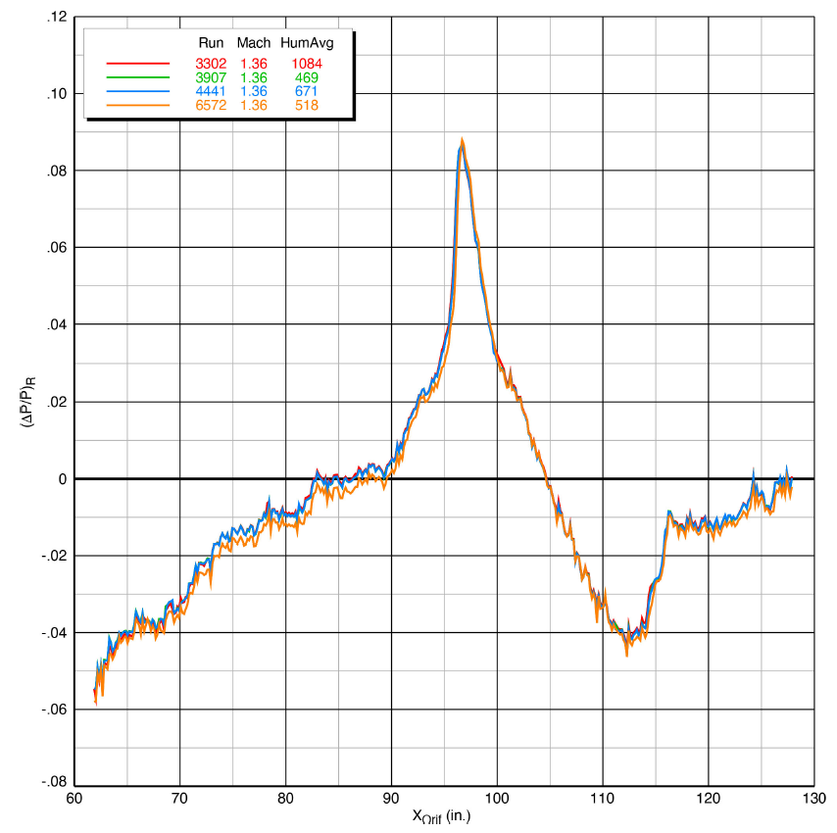
Reference Run Repeatability
Short- and long- term repeatability of selected reference runs, M 1.36
Plot credit NASA/TM-20220012155
Notes:
Repeatability over the short term was deemed to be very good by the test team. Long term repeatability was less consistent.
Plot shows repeats over the span of more than 3000 runs over about 3 weeks.
First three repeat extremely well with a significant shift over the first half and final quarter of the third reference run.

Slide 30
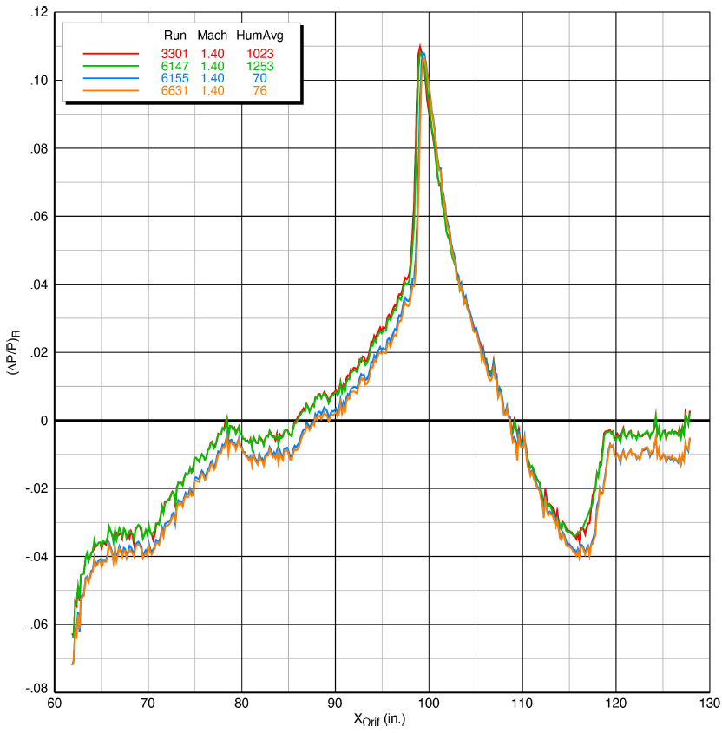
Reference Run Repeatability
Short- and long- term repeatability of selected reference runs, M 1.36
Plot credit NASA/TM-20220012155
Notes:
Long term repeatability was not particularly consistent for the duration of the test.
This plot shows four signatures with two very consistently repeating sets of reference runs. At this point it is unknown what would have caused this shift in reference run.
Differences in atmospheric conditions, changes in drive conditions, variable exhaust from central services and any number of other variables could have all potentially impacted the reference run repeatability over the long term.

Slide 31
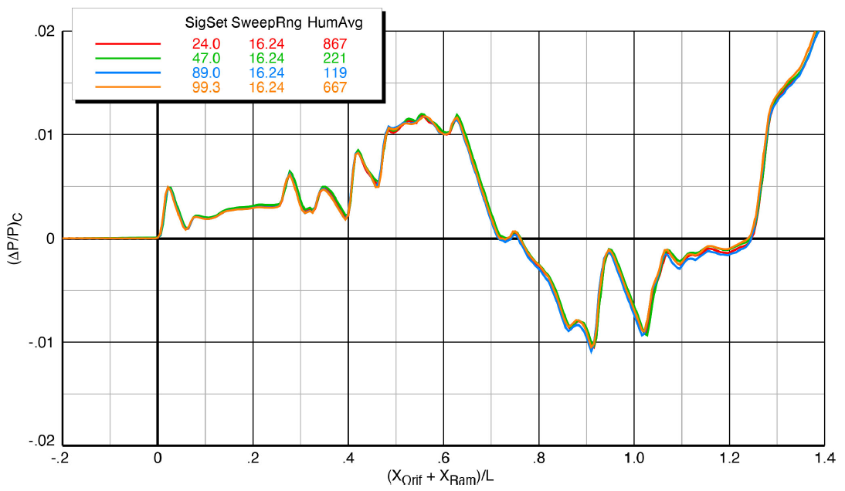
X-59 Blade Strut Repeatability
Long-term repeatability of selected X-59 Blade runs, M 1.40, h/L = 2.0
Plot credit NASA/TM-20220012155
Notes:
Similar to the reference run repeats, some boom signatures repeated extremely well, while others were not as consistent.
Causes for inconsistencies in repeatability is not currently known.
On occasion, applying different reference runs helped correct the signature and repeatability improved significantly, however this was not a consistent factor.
All repeats were completed using the same sweep ranges, h/L, Mach, AoA, and Roll Angle.

Slide 32
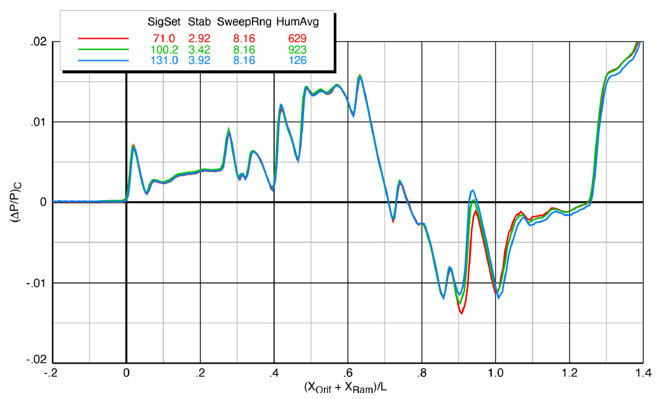
Control Surface Deflections - Stabilator
Effects of stabilator deflections, Blade Strut, M 1.40, h/L = 1.2
Plot credit NASA/TM-20220012155
Notes:
Stabilator runs were all completed in the blade strut configuration to keep the support structure from significantly interfering with the signature.
Stabilator effects were seen near the end of the model signature as expected.
Repeatability was fairly consistent although there were times that signatures were shifted as seen in previous plots.

Slide 33
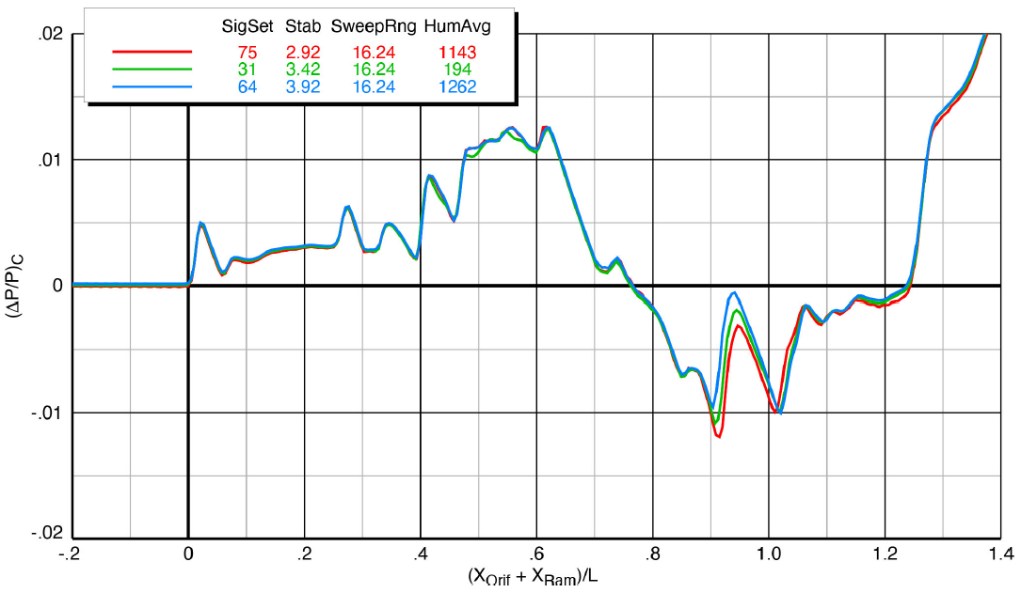
Control Surface Deflections - Stabilator
Effects of stabilator deflections, Blade Strut, M 1.40, h/L = 2.0, α = 2.4°
Plot credit NASA/TM-20220012155

Slide 34
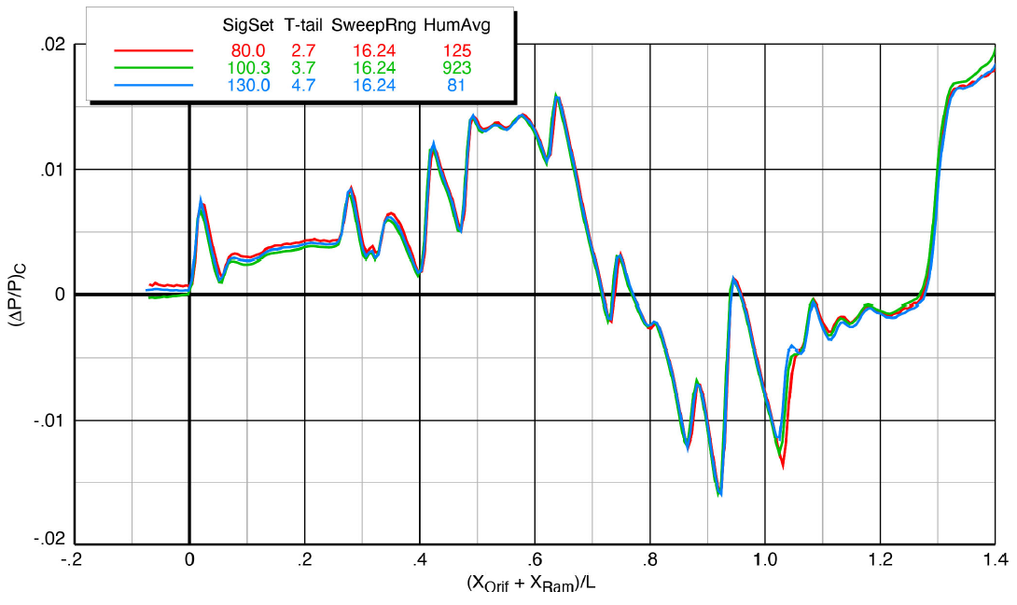
Control Surface Deflections – T-tail
Effects of T-tail deflections, Blade Strut, M 1.40, h/L = 1.2
Plot credit NASA/TM-20220012155
Notes:
T-tail runs were all completed in the blade strut configuration to keep the support structure from significantly interfering with the signature.
T-tail effects were seen at the absolute end of the model signature as expected.
Repeatability was not as consistent over the span of T-tail deflection runs. The sample size of the t-tail runs was fairly small however so repeatability inconsistencies could not be ignored as easily.
First plot shows good consistency across runs while second shows what looks like a overall shift in one of the signatures.

Slide 35
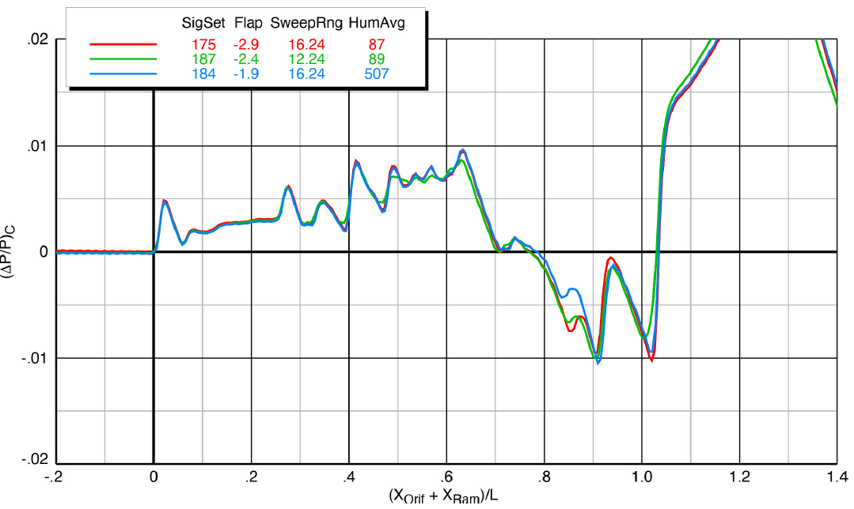
Control Surface Deflections – Flaps
Effects of flap deflections, Sting, M 1.40, h/L = 2.0
Plot credit NASA/TM-20220012155
Notes:
-2.9° and -2.4° flap deflections appear to make a minor difference in the resultant signature, however the impact of the -1.9° flap is significantly greater.
Not all flap configurations were run with the blade strut configuration. This was due to there appearing to be significant interference with the blade strut signature and the flap signature, thus eliminating the signatures usefulness.
Once this was determined, the final flap configuration was skipped.
The effects decreased rapidly as the height was increased.

Slide 36
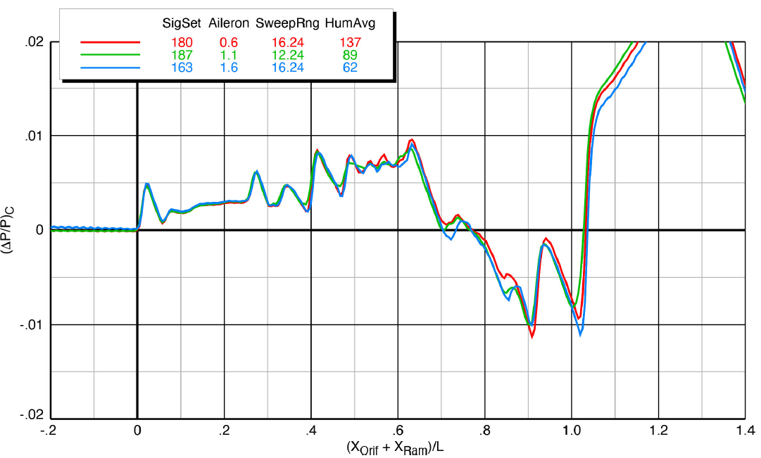
Control Surface Deflections – Ailerons
Effects of aileron deflections, Sting, M 1.40, h/L = 2.0
Plot credit NASA/TM-20220012155
Notes:
Aileron deflections appeared to have a similar impact as the flaps did, and were seen in the same region.
The same conclusion over the use of the blade strut was accepted with the ailerons and only two sets of the ailerons were run with the blade strut.
The effects of the ailerons decreased rapidly as the height was increased.

Slide 37
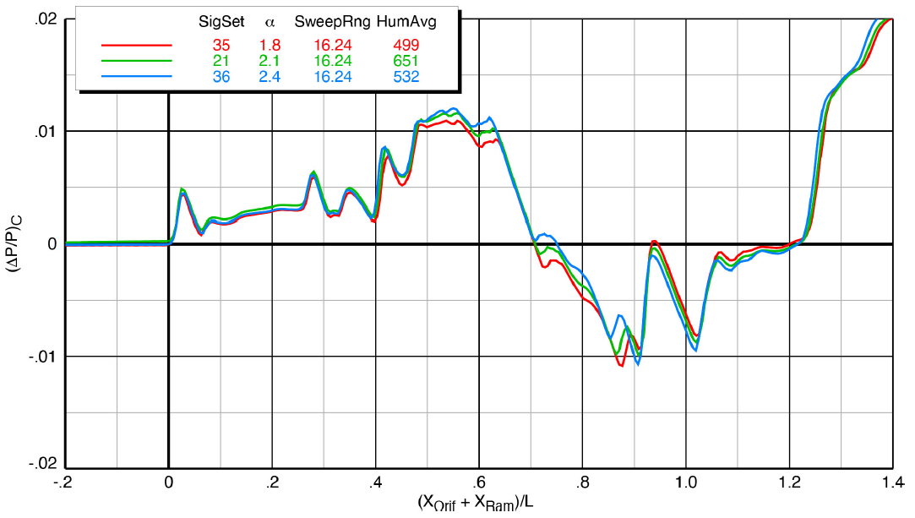
Effect of Angle of Attack
Effects of AoA, Blade Strut, M 1.36, h/L = 2.0
Plot credit NASA/TM-20220012155
Notes:
Angle of attack effects are most prominent around the lifting surfaces (wings, stabilator, and t-tail) as expected. This was seen consistently.
Repeatability around the nose was fairly consistent.

Slide 38
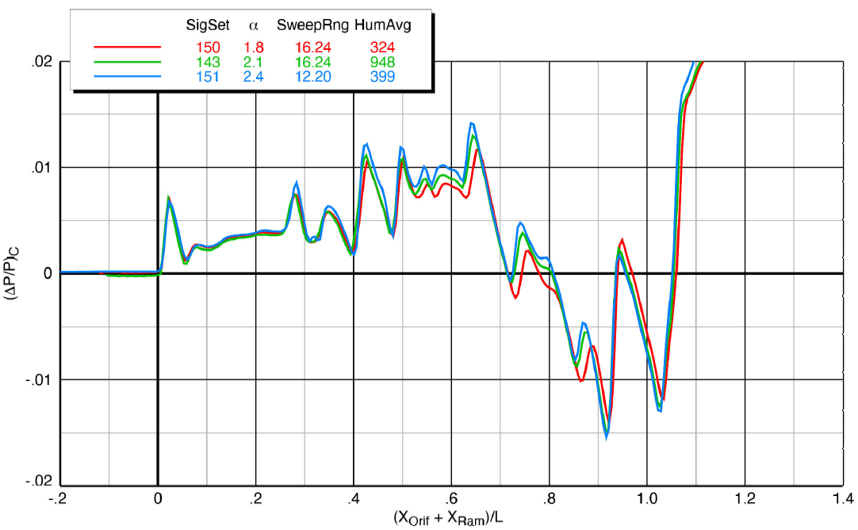
Effect of Angle of Attack
Effects of AoA, Sting, M 1.40, h/L = 1.2
Plot credit NASA/TM-20220012155
Notes:
Angle of attack effects are most prominent around the lifting surfaces (wings, stabilator, and t-tail) as expected. This was seen consistently.
Repeatability around the nose was fairly consistent.

Slide 39
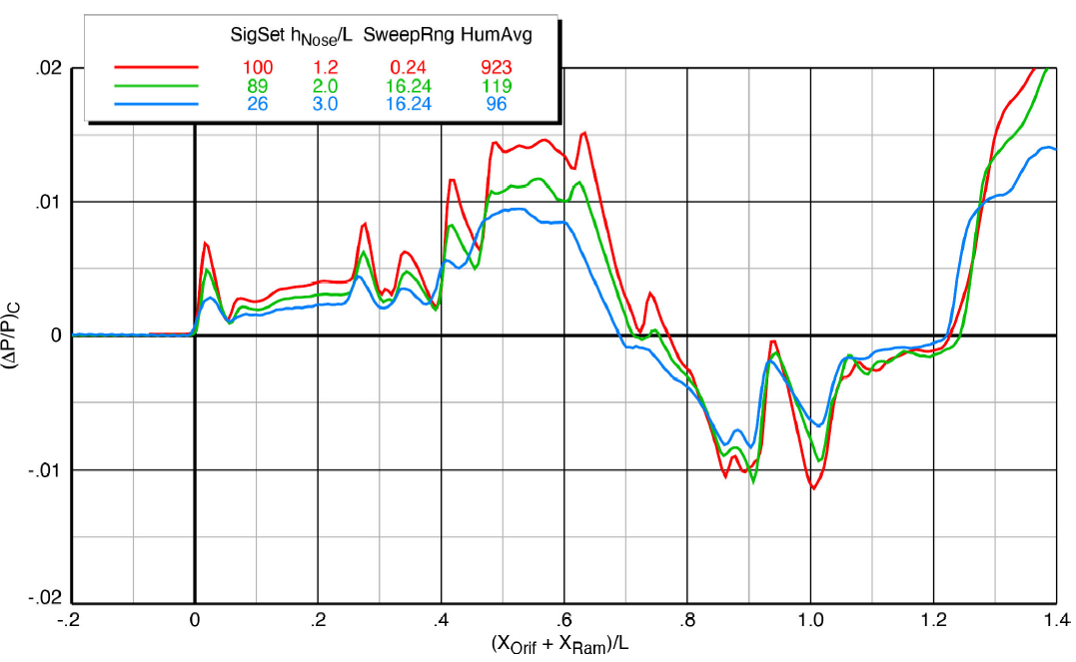
Effect of Height
Effects of Height, Blade Strut, M 1.40
Plot credit NASA/TM-20220012155
Notes:
Changes in height have a significant impact on overall signature strength. Increasing height showed signature ageing in every case as evidenced by the dramatic decrease in overall pressure differential.
Shock locations were still fairly consistent with minor overall shifting.

Slide 40
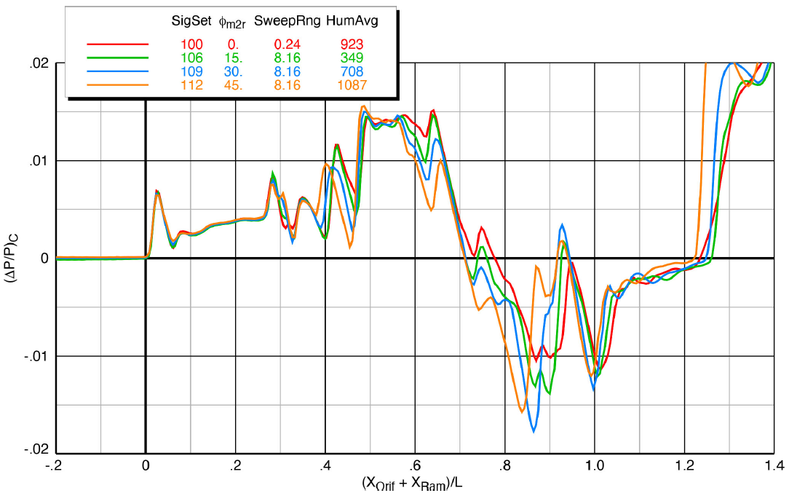
Effect of Roll Angle
Effects of roll every 15°, Blade Strut, M 1.40, h/L = 1.2
Plot credit NASA/TM-20220012155
Notes:
Roll angles sweeps were completed at every 15° for Mach 1.36 and 1.47, but were completed for every 5° for Mach 1.40.
Signatures were fairly consistent at the front of the model and tended to decrease around the middle of every signature. The results of the blade strut also become apparent in the middle of the signature.
However, at the rear of the model around the tail model features and shock interactions complicate the signature and it is fairly difficult to deduce anything but general statements about the effects of roll on boom signature.

Slide 41
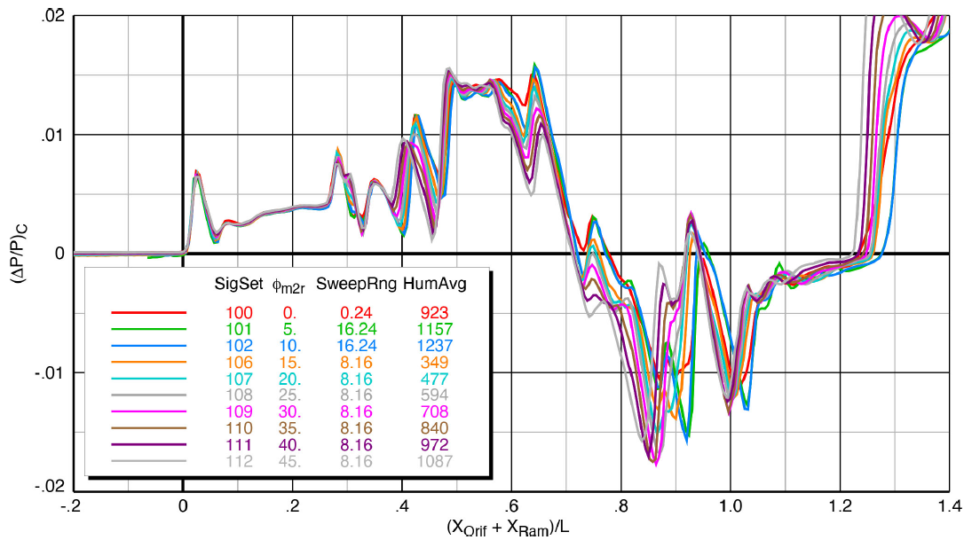
Effect of Roll Angle
Effects of roll every 5°, Blade Strut, M 1.40, h/L = 1.2
Plot credit NASA/TM-20220012155

Slide 42
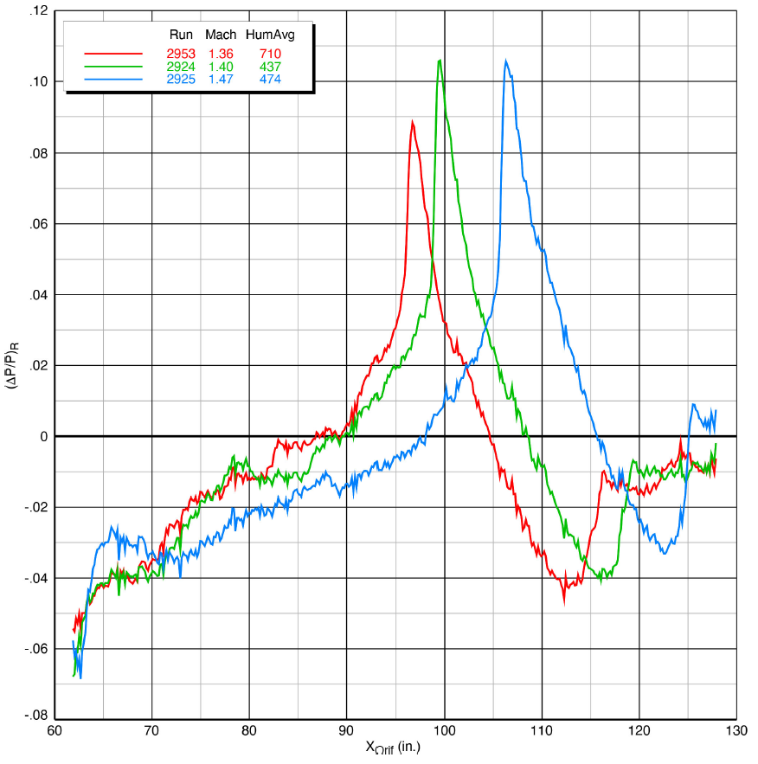
Effect of Mach Number – Reference Runs
Reference run comparison of different Mach numbers
Plot credit NASA/TM-20220012155
Notes:
The trend of the shocks moving back with increase in Mach is expected and seen clearly here.
The difference shock magnitude between the different Mach’s is not entirely understood. One would expect the magnitude to continue increasing from 1.40 to 1.47 as it does from 1.36 to 1.40.
This difference was consistent across reference and data runs.

Slide 43
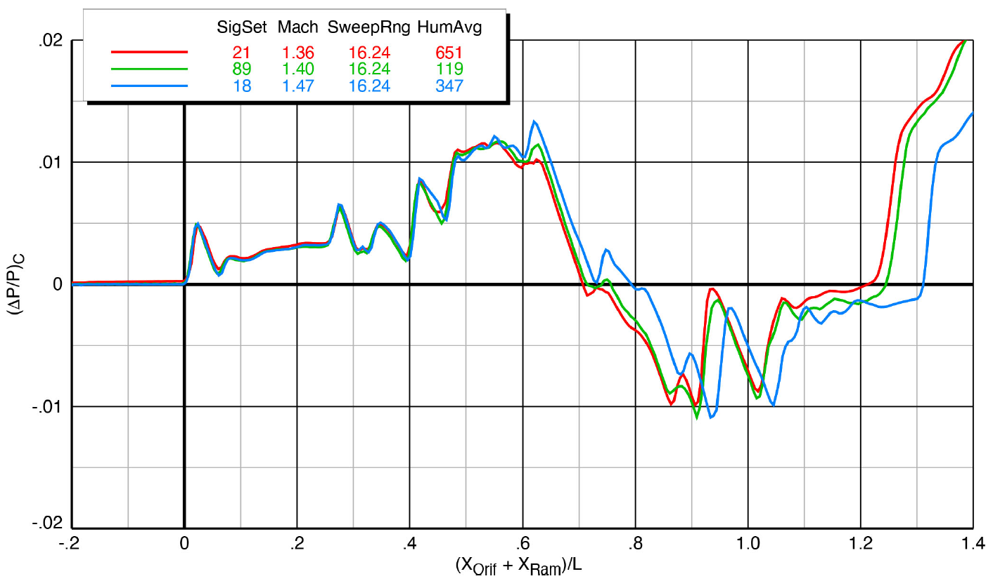
Effect of Mach Number - Blade
Effects of Mach, Blade, h/L = 2.0
Plot credit NASA/TM-20220012155

Slide 44
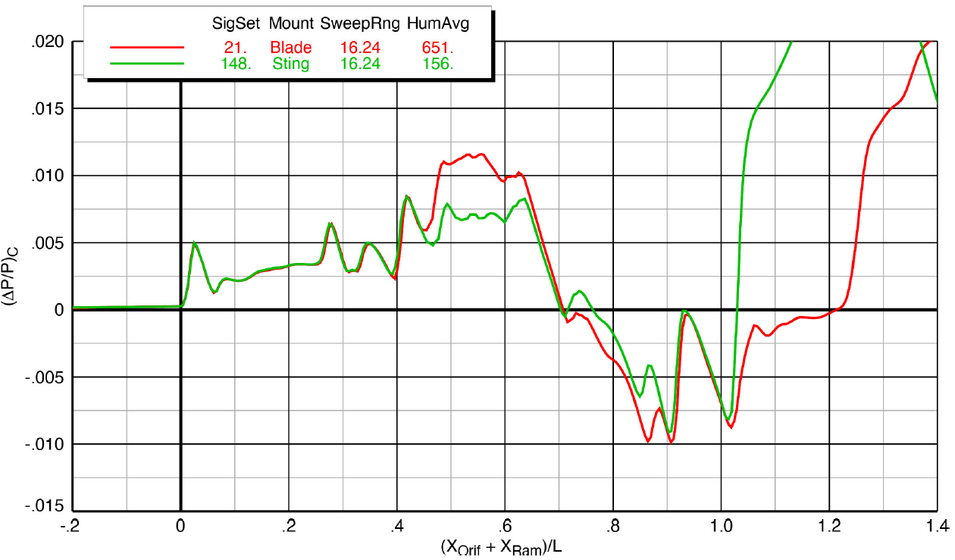
Blade Strut vs. Sting Mount Comparison
Blade Strut vs Sting, Mach 1.36, h/L = 1.2
Plot credit NASA/TM-20220012155
Notes:
Tradeoffs have to be made with any wind tunnel model. For the X-59 Sonic Boom test, one of those tradeoffs was how the model was mounted in the tunnel.
In order to generate as complete of a dataset as possible, the sting and blade configurations were used in conjunction with each other to more accurately look at specific parts of the aircraft.
Significant differences can be seen in the middle of the signature where the blade mounts to the model as well as further after where the engine inlet is covered with the sting. Further back the sting effects take over with the terminal pressure rise aft of the model position 1.

Slide 45
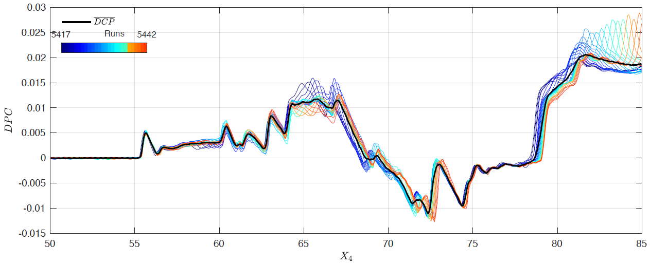
Uncertainty
Three sources of uncertainty were quantified.
  Time-averaged reference runs
  Time-averaged data runs
  Spatially-averaged data runs across linear actuator positions
Uncertainty for a given SigSet combines the three sources shown above.
A 2σ confidence bound can be applied to a given SigSet to show a 95% confidence interval.
While this bound implies a normal distribution, the low sample size cannot confirm this assumption.
Grand mean and individual signatures of SigSet 89
Plot credit NASA/TM-20220012155
Notes:
Sources of uncertainty are meant to compare sigsets within the test, not across tests. Uncertainty due to tunnel calibration, facility instrumentation or other external factors are not considered.
The three sources are quantified and then added together to get an overall uncertainty.

Slide 46
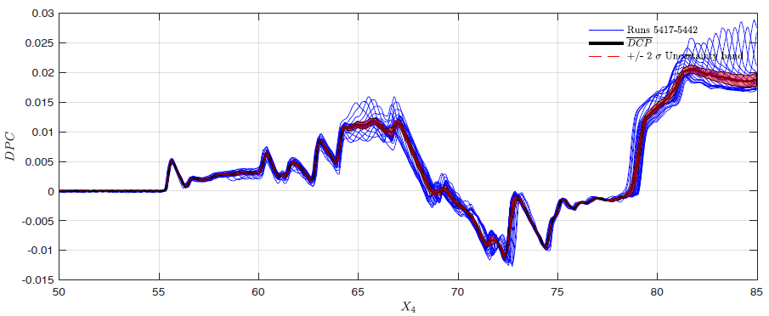
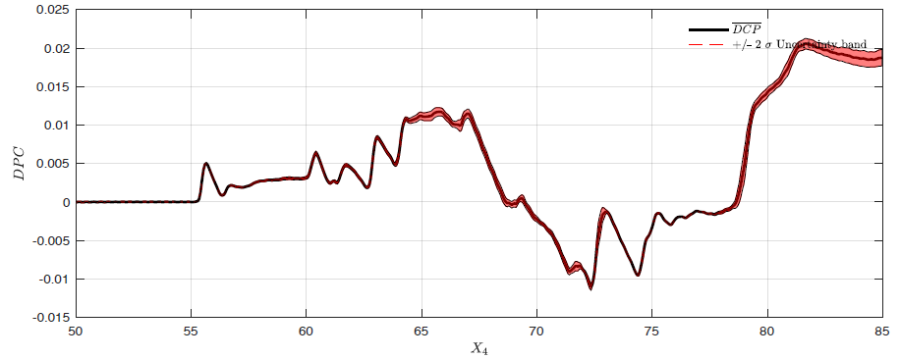
Uncertainty
Top: Uncertainty Bounds with individual signatures of SigSet 89
Bottom: Uncertainty bounds of SigSet 89
Plot credit NASA/TM-20220012155
Notes:
Sources of uncertainty are meant to compare sigsets within the test, not across tests. Uncertainty due to tunnel calibration, facility instrumentation or other external factors are not considered.
The three sources are quantified and then added together to get an overall uncertainty.

Slide 47

Thank you to all the project and task leaders, research test teams, CFD teams, 8’x6’ facility personnel, and hardware manufacturers that made the GRC 8’x6’ X-59 Sonic Boom Test possible.
More in-depth explanation of all information presented can be viewed in NASA TM-20220012155. Special thanks to all authors of that TM including principal researcher and first author Don Durston.
QUESTIONS?
Notes:
Over the course of nearly 6 weeks, 196 spatially averaged sonic boom pressure signatures were recorded in the GRC 8’x6’ Wind Tunnel.
The test data provides insight into the near-field sonic boom characteristics across a wide range of variable flight and control surface deflections situations.
Repeatability was generally very good with some exceptions. The data shows clearly the expected trends nearly all the time, although some outliers have to be ignored.
Test data will be used to validate CFD code, compare to JAXA test data, and compare to flight test signatures.

Slide 48
EXTRA SLIDES

Slide 49



RAM Position Effects – X-59
The same process was completed for the X-59 model at h/L of 2.0. Again, the first third of the rail yielded inconsistent data, but unlike at h/L of 1.2, this was also observed in the final third of the sweeps with X sweep of 16”-24”. The clearest signatures at h/L = 2.0 were collected from X sweep of 16”-24”. The pressure ratio is lower overall as expected.
X-Ram from 0”-8”, M 1.40, h/L =2.0
X-Ram from 8”-16”, M 1.40, h/L =2.0
X-Ram from 16”-24”, M 1.40, h/L =2.0
Plots credit NASA/TM-20220012155
Notes:
The first and third sweeps show a rearward shift in the signature, but it is not uniform over the length of the sweep.
The nose position varied around 0.5” across the signature
The middle and aft portion of the signature varied up to 1”
The reasons for the non-uniform shifting and elongation are not well understood, but it is likely to due with the unpredictable nature of interference between the rail and model shocks.

Slide 50



RAM Position Effects – X-59
Similar results can be observed with the X-59 model. Far more consistent data were collected from the front two-thirds of the rail at h/L = 1.2.
X-Ram from 0”-8”, M 1.40, h/L =1.2
X-Ram from 8”-16”, M 1.40, h/L =1.2
X-Ram from 16”-24”, M 1.40, h/L =1.2
Plots credit NASA/TM-20220012155

Slide 51

X-59 Blade Strut Repeatability
Short- and long- term repeatability of selected X-59 Blade runs, M 1.40, h/L = 2.0
Plot credit NASA/TM-20220012155
Notes:
Repeatability was not always consistent.

Slide 52

X-59 Sting Repeatability
Short- and long- term repeatability of selected X-59 Sting runs, M 1.40, h/L = 2.0
Plot credit NASA/TM-20220012155

Slide 53

X-59 Sting Repeatability
Short- and long- term repeatability of selected X-59 Sting runs, M 1.40, h/L = 2.0
Plot credit NASA/TM-20220012155
Notes:
No obvious trends were found regarding long-term repeatability within signatures. Some signatures repeated very well while others showed minor to moderate deviations.

Slide 54

Control Surface Deflections – T-tail
Effects of T-tail deflections, Blade Strut, M 1.40, h/L = 2.0
Notes:
3.7° T-tail signature appears to be shifted up around 70% the length of the model, and it stays shifted up for the remainder of the signature.
The cause is not currently known.

Slide 55

Effect of Roll Angle
Effects of roll every 15°, Sting, M 1.40, h/L = 1.2
Plot credit NASA/TM-20220012155

Slide 56

Effect of Roll Angle
Effects of roll every 5°, Sting, M 1.40, h/L = 1.2
Plot credit NASA/TM-20220012155

Slide 57

Effect of Mach Number - Sting
Effects of Mach, Sting, h/L = 1.2
Plot credit NASA/TM-20220012155

