Slide 1
A Technology Maturation Plan for the Development of Nuclear Electric Propulsion
Space Technology Mission Directorate
Technology Demonstration Mission Program
Space Nuclear Propulsion Project
Adam Martin, Kurt Polzin, Francis Curran, Roger Myers, Mitchell Rodriguez | Dec. 6, 2022

Slide 2
Outline
The SNP NEP Team
A Brief History of Nuclear Electric Propulsion
NEP/Chem Hybrid Propulsion System
Comparison of NTP and NEP-Chem for a Human Mars Mission
Current Status of NEP According to Recent Independent Reviews
Nuclear Electric Propulsion (NEP): Subsystem Categorization
SNP Assessment of Current State of the Art for NEP
NEP System Integration Model (NEP-SIM)
Initial Key Performance Parameters (KPPs)
Technology Maturation Plan (TMP) – Technical and Programmatic Approach
Summary

Slide 3
The SNP NEP Team
  SNP Core Team:
  Adam Martin (MSFC-ER64), NEP Lead
  Andy Presby (GRC-MA00), GRC PM for Space Fission Propulsion
  Mitchell Rodriguez (MSFC-ED04)
  Kurt Polzin (MSFC-EE05), SNP Chief Engineer
  Frank Curran, MZNBLUE (formerly of LeRC [GRC] and SAIC)
  Roger Myers, R Myers Consulting (formerly of LeRC [GRC] and Aerojet Rocketdyne)
  Partners:
  Analytical Mechanics Associates: Matthew Duchek, POC (coupled mission / system modeling)
  GRC: Rodger Dyson (Power Conversion), Robert Scheidegger (PMAD)
  LANL: DV Rao (Reactor / Power Conversion)
  Aerospace Corp.: Jeff Laube, POC – Technical expertise and review
  LaRC: Julia Cline, William Doggett – In-space Servicing, Assembly, and Manufacturing (ISAM)

Slide 4
A Brief History of Nuclear Electric Propulsion
Nuclear Electric Propulsion (NEP) systems use a fission reactor to power electric thrusters for spacecraft propulsion. The high specific impulse of the electric thrusters (thousands of seconds) coupled with the large amounts of energy that can be extracted from a nuclear reactor offer the potential of significant spacecraft mass reductions compared with purely chemical propulsion systems for missions with large Dv requirements.
There have been only three NEP missions to date:
  1965 - SNAP-10A (US, AEC-USAF): The only US space reactor. UZrH_{x} fueled, liquid metal cooled (NaK), thermoelectric (TE) power conversion, 30 kW_{th}, 0.5 kW_{e}, Cs-Ion thruster propulsion (8.5 mN thrust, duration < 1 hour)
  1987 - Kosmos 1818 and Kosmos 1867 (USSR): Topaz reactors, liquid-metal cooled, thermionic power conversion, Hall Effect Thrusters
Other US NEP and/or Nuclear Electric Efforts:
  1963-1969 – SNAP-8 (AEC-NASA): UZrH_{x} fueled, liquid metal cooled (NaK), Mercury Rankine cycle power conversion, 0.6 - 1 MW_{th}, ground tested only
  1983-1994 – SP-100 (DoE, NASA): Design study (some limited hardware development). HEU-UN fueled, liquid metal cooled (Li), TE power conversion, 2.4 MW_{th}, 100 kW_{e}
  2003 – 2005 – Prometheus / JIMO (NASA, DoE): Jupiter Icy Moons Orbiter Flight Project. HEU-UO₂ fueled, direct gas cooled closed Brayton cycle power conversion (He-Xe), ~200 kW_{e}, Xe-Ion and Hall thruster propulsion

Slide 5
NEP/Chem Hybrid Propulsion System
Recent studies* have explored the possibility of using a NEP/Chem hybrid propulsion system, an NEP system combined with a chemical propulsion stage, for human missions to Mars.
The chemical stage (likely using LOx-CH₄ as the propellant) performs the high-thrust required for climbing out of and dropping into planetary gravity wells.
The NEP stage provides the balance of the Dv required to complete the mission.
Results of analyses to date indicate that NEP/Chem hybrid vehicles can provide mission profiles comparable to Nuclear Thermal Propulsion (NTP) systems (i.e. comparable trip-times and launch mass requirements) with smaller, lower-temperature reactors.
*
  GRC-COMPASS: S.R. Oleson, et. al., Compass Final Report: Nuclear Electric Propulsion (NEP)-Chemical Vehicle 1.2, NASA Glenn Research Center, Cleveland OH (Sep 2021), TM-2021-0017131
  AR: T. Kokan, et. al., Nuclear Electric Propulsion / Chemical Propulsion Hybrid Human Mars Exploration Campaign: From Start to Steady-State, AIAA ASCEND 2021, Las Vegas NV (Nov. 2021), AIAA-2021-4013
  AMA: M. Ducheck, et. al., Hybrid NEP-Chemical Vehicle and Propulsion Technology Study for Crewed Mars Missions, 68th JANNAF Propulsion Meeting, Virtual (June 2021)

Slide 6
Comparison of NTP and NEP-Chem for a Human Mars Mission
Parameter or Configuration | NTP | NEP
Reactor Temperature (K) | ~ 3,000 | 1,200 – 1,500
Reactor Power (MW_{th}) | 250 - 500 | 5 - 16
Reactor Power Ramp Duration | Minutes | Hours - Days
Required Operational Lifetime | Hours | Years
Reactor Cooling | Open-Cycle (cooled by Propellant) | Closed-Cycle
Chemical stage (LOx-CH₄) required | No | Yes

Slide 7
Current Status of NEP According to Recent Independent Reviews
2020 - NASA Engineering and Safety Center (NESC) study findings:
    “The majority of critical technologies for both NEP/Chem and NTP systems are relatively immature….”
    “TRLs [technology readiness levels] in the literature are often overestimated”
    “The majority of critical technologies for NEP/Chem and NTP systems are at a relatively high level of advancement degree of difficulty (AD² > 4) for maturation, requiring a dual development approach.”
    “The proper assessment of baseline TRL and AD² values and the estimation of requirements and resources required for advancement have been consistent issues for NEP and NTP.”
    “Non-advocate reviews should occur at the start of a technology program and at all key milestones.”
2021 - National Academies of Science, Engineering, and Medicine panel report findings:
  “Developing a MW_{e}-class NEP system for the baseline mission [opposition-class Mars mission, 2039 launch date] would require increasing power by orders of magnitude relative to NEP system flight- or ground-based technology demonstrations.”
  “Subscale in-space flight testing of NEP systems cannot address many of the risks and potential failure modes associated with the baseline mission NEP system. With sufficient M&S [modeling & simulation] and ground testing, including modular subsystem tests at full scale and power, flight qualification requirements can be met by the cargo missions that will precede the first crewed mission to Mars. Fully integrated ground testing may not be required.”
  “As a result of low and intermittent investment over the past several decades, it is unclear if even an aggressive program would be able to develop an NEP system capable of executing the baseline mission in 2039.”

Slide 8
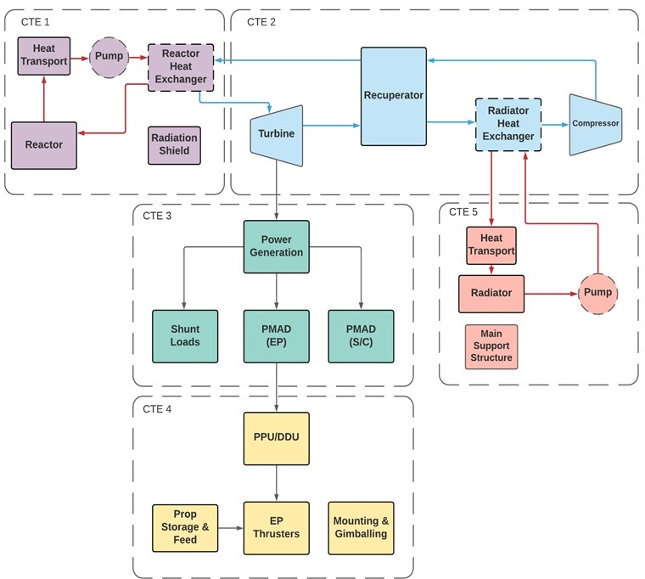
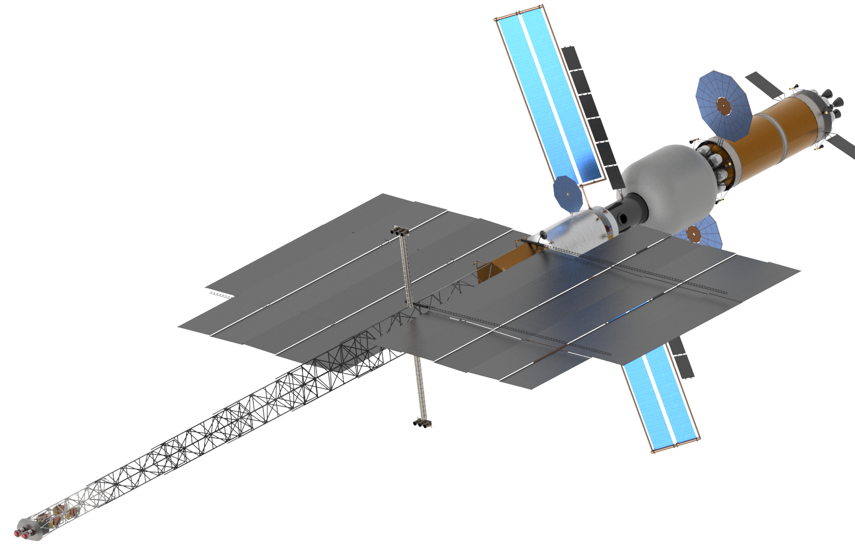
Nuclear Electric Propulsion (NEP): Subsystem Categorization
  NEP uses heat from a nuclear reactor to produce electricity that powers electric thrusters. The NEP system has been categorized into five Critical Technology Elements (CTEs):
    CTE 1: Reactor and Coolant Subsystem (RXS)
    CTE 2: Power Conversion Subsystem (PCS)
    CTE 3: Power Management & Distribution (PMAD) Subsystem
    CTE 4: Electric Propulsion Subsystem (EPS)
    CTE 5: Primary Heat Rejection Subsystem (PHRS)
CTE 5
CTE 4
Note: This block diagram is illustrative. Not all items shown may be needed; some needed items may not be shown.
CTE 2
Example NEP-Chem Configuration
CTE 3
CTE 1

Slide 9
SNP Assessment of Current State of the Art for NEP
  From December 2020 through April 2021, Technical Interchange Meetings (TIMs) were held with numerous government and industry Subject Matter Experts (SMEs) to assess the state of development of NEP technologies, identify specific, high-confidence, viable NEP system design options, and develop an understanding of the tasks required to mature critical technologies. TIMs were held on the following topics:
    Nuclear Reactor
    Power Conversion
    Power Generation, Power Management and Distribution (PMAD)
    Electric Propulsion
    Thermal Management
    In-Space Assembly
  SNP personnel collected additional information through one-on-one meetings with many SMEs.
  Technologies for each NEP subsystem were assessed in terms of Technology Readiness Level (TRL) and Advancement Degree of Difficulty (AD²).

Slide 10
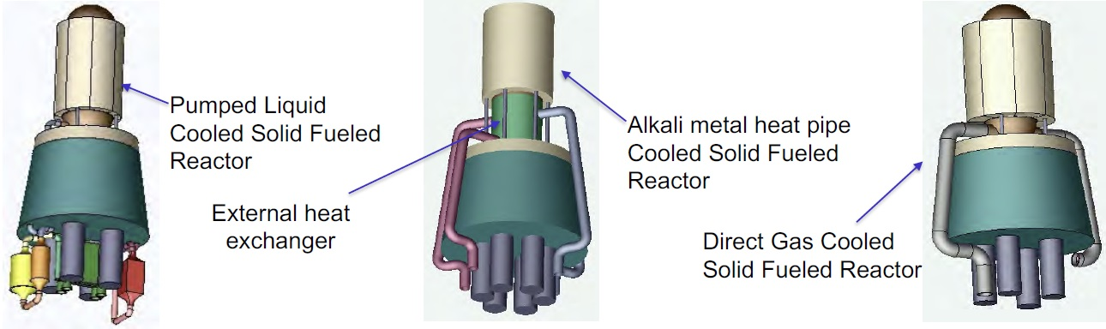
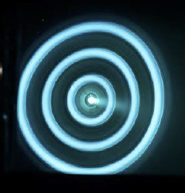
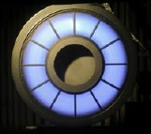
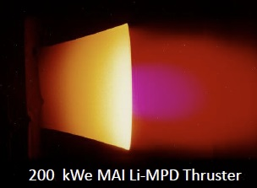
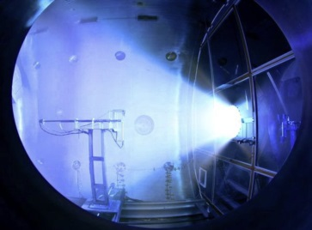
Examples of NEP System & Technology Options Considered
  Reactor Configuration / Coolant Options
    (a) Pumped Liquid Metal Reactor
    (b) Heat-Pipe Cooled Reactor
    (c) Gas Cooled Reactor
  Power Conversion System
    Closed Brayton Cycle (CBC) Engine
    Rankine Cycle Engine
    Magnetohydrodynamic (MHD) Conversion
    Alkali Metal Thermal Electric Conversion
    Thermionics and Nuclear Batteries
  Electric Propulsion System / Propellant
    (a) Hall Thruster / Xe
    (b) Annular Ion Engine / Xe
    (c) Magnetoplasmadynamic Thruster (MPD) / Li
    (d) VASIMR / Ar
(a) (b) (c)
(a) (b) (c) (d)

Slide 11
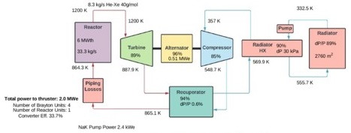
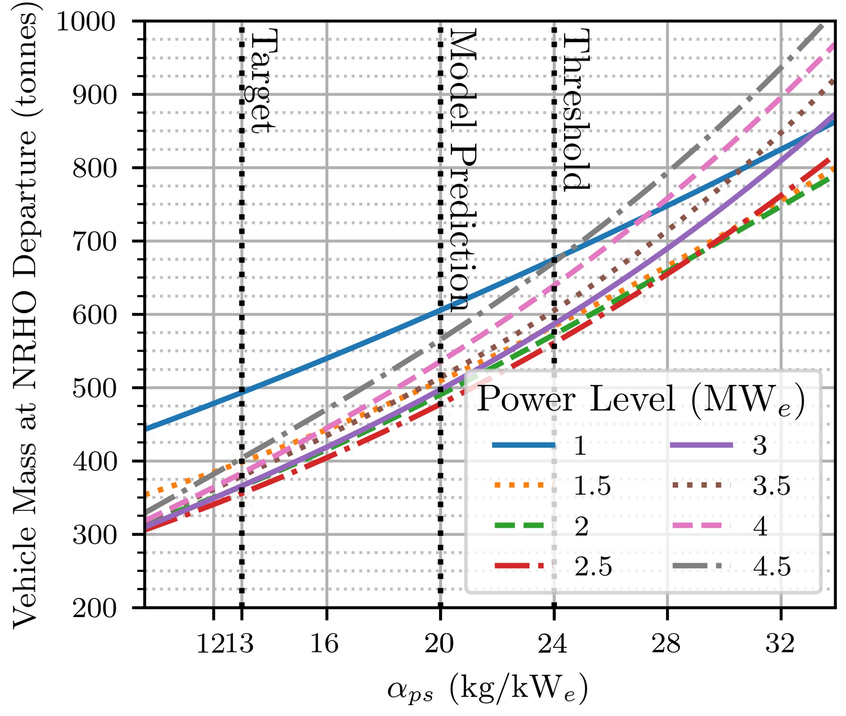
NEP System Integration Model (NEP-SIM)
Over the last two years, Analytical Mechanics Associates (AMA) has been developing an NEP System Integration Model for SNP. The results of the NEP-SIM are used as an aid in guiding technology investment and program management. The model has been used to set system-level Key Performance Parameters (KPPs) that will be used to assess program milestones.
The NEP-SIM: a flexible thermodynamic and mass model that can be used to quickly assess a wide range of configurations, working fluids, and power levels. It allows for optimized point designs and broad sensitivity analyses, and is now being modified to permit transient analysis. It includes:
Thermodynamic cycle model: Solves for steady state solution with a wide range of temperatures and fluid choices. Components are easily configurable and can be independently updated.
Component mass model: Combination of first principles physics-based scaling, published relationships, and point designs, integrated with the thermodynamic model for analyses and optimization routines.
Mission model: Capable of sweeping across power level and I_{sp} at a given α_{ps}*, or with variable α_{ps} at a given power level for a defined set of technology choices. Predicts the effect of α_{ps} on the vehicle mass and mission closure.
Transient Analysis: Quasi-transient model in development now; will be developed into a true transient model over the coming year.
*α_{ps} is the power-system α, including CTE-1, 2, 3, and 5 (i.e. exclusive of the EPS)

Slide 12
Initial Key Performance Parameters (KPPs)
  The initial set of KPPs, based on the system modeling and SME assessments made to date are summarized here:
Parameter | KPP value
Power system α (kg/kW_{e}) [consists of CTEs 1, 2, 3, and 5] | 24 (threshold), 13 (target)
Total electric propulsion thrust (N) | 65-120
Electric propulsion efficiency and I_{sp} (s) | Efficiency and I_{sp} required to close mission dependent on electric propulsion system choice
Nominal mission duration (hours) | 25,000
CTE 1 power output (MW_{th}) | 5-16
CTE 1 outlet/CTE 2 power conversion inlet temp (K) | 1200 (threshold), 1400 (target)
CTE 2 power output (MW_{e}) | 2-4
CTE 4 Thruster life-time (hours) | 21,000-35,000 (depends on electric propulsion system choice)
CTE 2 outlet/CTE 5 inlet temp (K) | 550-750
CTE 5 outlet/CTE 2 compressor inlet temp (K) | 325-500

Slide 13
Technology Maturation Plan (TMP) – Technical Approach
  SNP has drafted a Technology Maturation Plan (TMP) based on inputs provided by the technical community.
  The plan is based on developing and maturing the technologies that support an order of 1 MW_{e} electric propulsion capability.
  The primary goal of the TMP is to build and test hardware at relevant conditions (i.e. temperatures, power-levels, etc.) and demonstrate the achievement of Key Performance Parameters (KPPs) to inform a potential down-select between NTP and NEP for the human Mars mission.
  Lower performance options may be preferable to those with the higher performance based on manufacturability, operability, testability, cost, industry alignment, and other related investments.
  Complementary modeling efforts will be undertaken within the CTEs as adjuncts to hardware demonstration and to inform Failure Modes and Effects Analyses (FMEA).
  A parallel system-level modeling effort (already underway), anchored to test data as it becomes available, will continuously refine the KPPs to provide guidance to the project on the technology maturation effort.
  Technology maturation solutions should take advantage of recent and ongoing multi-agency investments and, where feasible, advance a strategy that aligns with industry participation.

Slide 14
Technology Maturation Plan (TMP) – Programmatic Approach
  This TMP was written to directly address the issues with past NEP efforts that were identified in the NESC and National Academies reports.
  The TMP proposes milestone-driven schedules for the specific technologies considered. TMP milestones were chosen to assure that TRL advancement has occurred when the milestones are met.
  The plan embodied within the TMP will demonstrate advancement of NEP component technologies and CTEs (subsystems) to TRL 4 and then TRL 5 within 4 years of program start.
  Non-Advocate Reviews (NARs) will be held at major decision points in the schedule and to make final determination of TRL advancement.
  Technologies not explicitly included in the TMP can still be proposed and considered. It was not possible for the SNP team to develop a TMP that included all possible technologies.
    Any technology not in the TMP that is proposed by an offeror must include a maturation plan calling out specific milestones that demonstrate advancement of those technologies progressively through TRL 4 and TRL 5. The proposed milestones and schedules must be justified and supported with the same rigor and to the same standards as found in this TMP.

Slide 15
Nominal Technology Selections in the TMP
  Based on the TIMs and discussion with SMEs, a number of down-selects were made by SNP for the TMP. These down-selects were made based on assessments of a combination of TRL and AD². In some cases, down-selects were made to one technology option, when the TRL/AD² of alternatives was deemed excessively low/high. Where no discrimination based on TRL/AD² was possible, two options were retained.
  CTE-1 (RXS):
    Gas Cooled or Heat Pipe Cooled Reactor
    UN or UO₂ fuel with conventional fuel form
  CTE-2 (PCS):
    Closed Cycle Brayton with He-Xe working fluid. (Supercritical CO₂ was considered but not selected based on materials concerns and system modeling that showed it offered no system-level advantages over He-Xe¹)
  CTE-3 (PMAD):
    AC power transmission, f ~ 2 kHz, V ≤ 1,000 V_{ac}
  CTE-4 (EPS):
    Hall Thruster, Xenon propellant, 100 kW_{e} – 250 kW_{e} per thruster
    MPD Thruster, Lithium propellant, 500 kW_{e} – 1 MW_{e} per thruster
  CTE-5 (PHRS):
    Liquid Metal (LM) pumped-loop trunk with heat pipe-based radiator panels
¹ R. Dyson et al., “Nuclear Electric Propulsion Brayton Power Conversion Working Fluid Considerations”, Nuclear and Emerging Technologies for Space (NETS) Conference, American Nuclear Society, Cleveland, OH, May 2022.

Slide 16
Summary
Drafting of a Technology Maturation Plan (TMP):
  At the direction of NASA STMD, and in response to the findings of recent reviews by the NESC and the National Academies on the state of nuclear propulsion technology for human Mars missions, SNP has developed a TMP to guide the advancement of MW class NEP technology to TRL 5.
  The TMP contains milestone-driven schedules for the advancement of all critical technologies required for a MW-class human Mars mission.
  Technical milestones are hardware focused and set at relevant parameter values (power levels, temperatures, etc.) to insure that real technology advancement is demonstrated.
  The milestones will be confirmed (or modified if necessary) by non-advocate review panels and all advancement claims will be accepted only after full non-advocate review (NAR).
Future Work:
  Complete full review of TMP (including NAR) in early 2023
  Initiate NEP development according to the TMP, if funding becomes available.
  SNP is also pursuing cost-sharing partnerships with other NASA projects and government agencies to advance NEP technology.

