Slide 1

Low-cost Quantification of Fluid Flow Parameter Sensitivity
using Reduced-order Modeling
Harley Hanes¹, Michael W. Lee², Donya Ramezanian³, Ralph C. Smith¹
¹North Carolina State University, ²NASA Langley Research Center, ³University of Southern California
AIAA SciTech Forum
01/25/23

Slide 2
Overview
Sensitivity analysis using Morris screening
Boundary penalty method for Galerkin Reduced-order Model (ROM)
Lid-driven cavity test problem
Sensitivity analysis of ROM with boundary penalty
Conclusions and future work

Slide 3
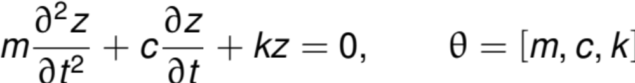
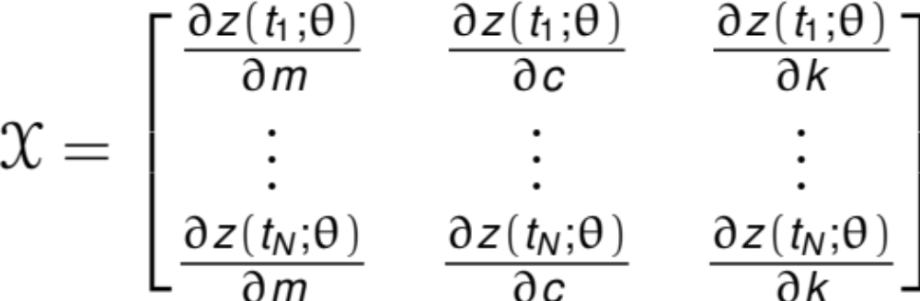

Sensitivity Analysis Quantifies Influence of Parameters
Sensitivity analysis quantifies variation in outputs apportioned to variation in parameters
Spring Equation:
Uses:
Optimize performance
Focus data collection
Reduce model complexity
Reduced model exists

Slide 4
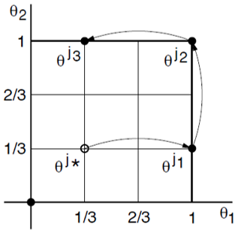
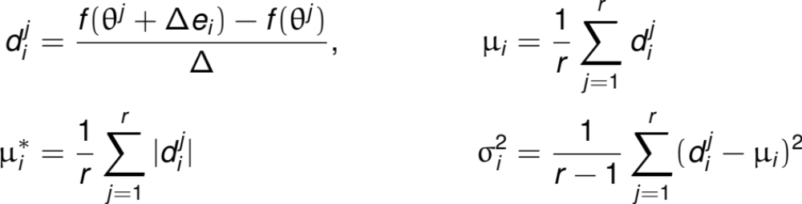
Morris Screening Averages Derivative Approximations
Method: Morris screening averages derivative approximations
We test sensitivity of incompressible flow problem
R. C. Smith, Uncertainty Quantification: Theory, Implementation, and Applications, SIAM, Philadelphia, 2014.
.

Slide 5
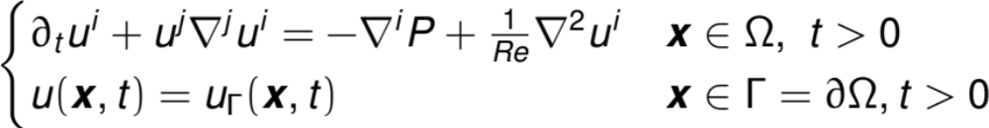


Solving Navier-Stokes is Computationally Expensive
Consider the incompressible Navier-Stokes Equations,
Goal: Quantify sensitivity of turbulent solutions to and
Problem: Direct numerical solutions (DNS) are computationally expensive
Solution: Develop a reduced-order model (ROM) adjusting and

Slide 6

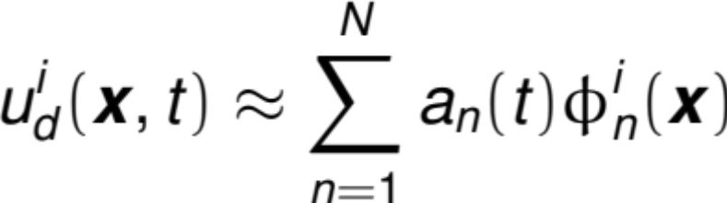
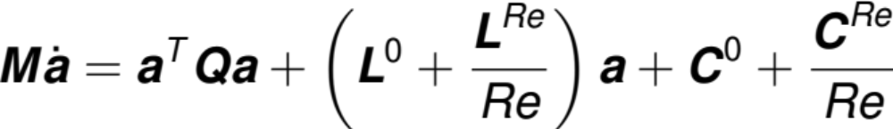
POD-ROMs Simplify PDEs into ODEs
Mean-reduce snapshot data,
Assume separation of variables and compute first $N$ POD modes,
Apply Galerkin projection of Navier-Stokes to construct ODE,

Slide 7
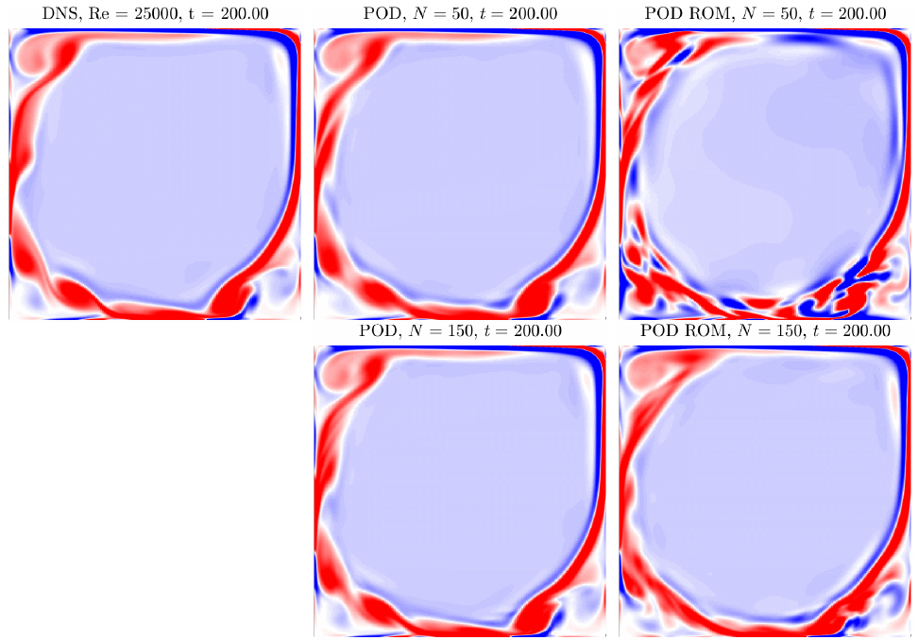
POD-ROMs are Effective for a Lid-Driven Cavity
M. Lee. (2020). On Improving the Predictable Accuracy of Reduced-order Models for Fluid Flows. PhD thesis, Duke University.
.

Slide 8
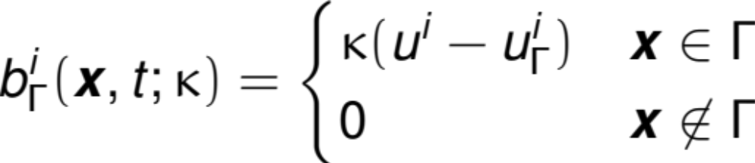
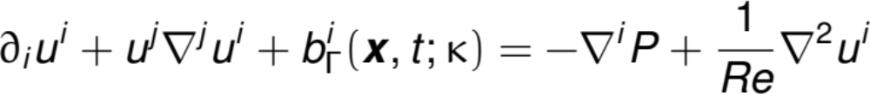
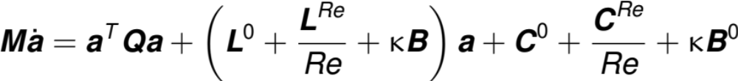
Penalties Define Boundary Conditions in a POD-ROM
Problem: Galerkin POD-ROMs do not explicitly control boundary conditions
Solution: Adding boundary penalties
New ODE for modal coefficients,

Slide 9


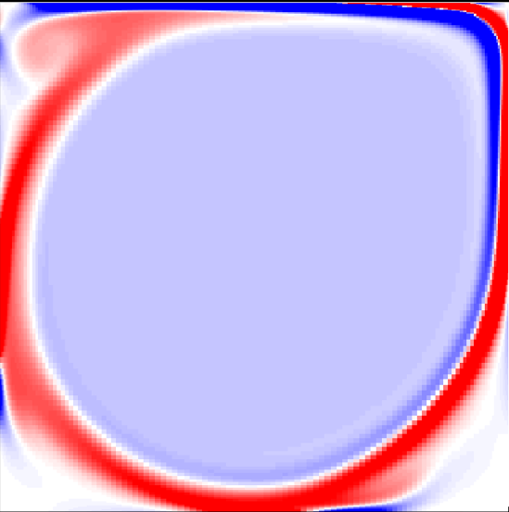
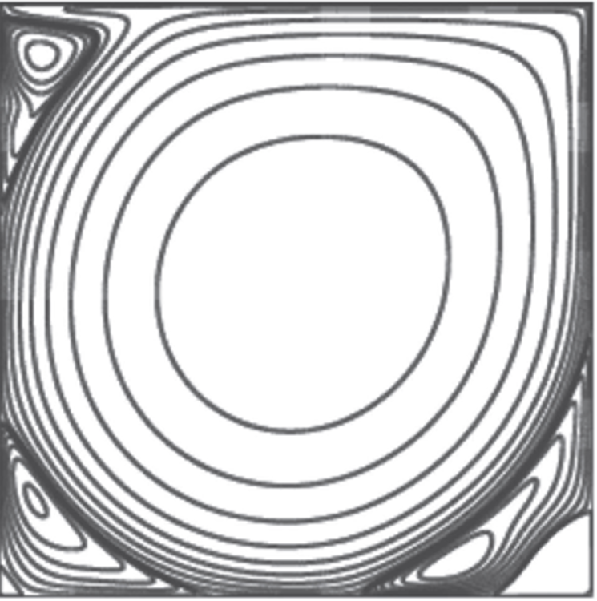

Two Common Lid-Driven Cavity Boundary Conditions
Regularized:
Unregularized:
New Boundary:
M. Lee. (2020). On Improving the Predictable Accuracy of Reduced-order Models for Fluid Flows. PhD thesis, Duke University.
Nuriev, A.N. et al. (2016). Bifurcation analysis of steady-state flows in the lid-driven cavity. Fluid Dynamics Research, 48.
.
Notes:
Both models use homogeneous Dirichlet boundary conditions except for top which rotates,

Slide 10
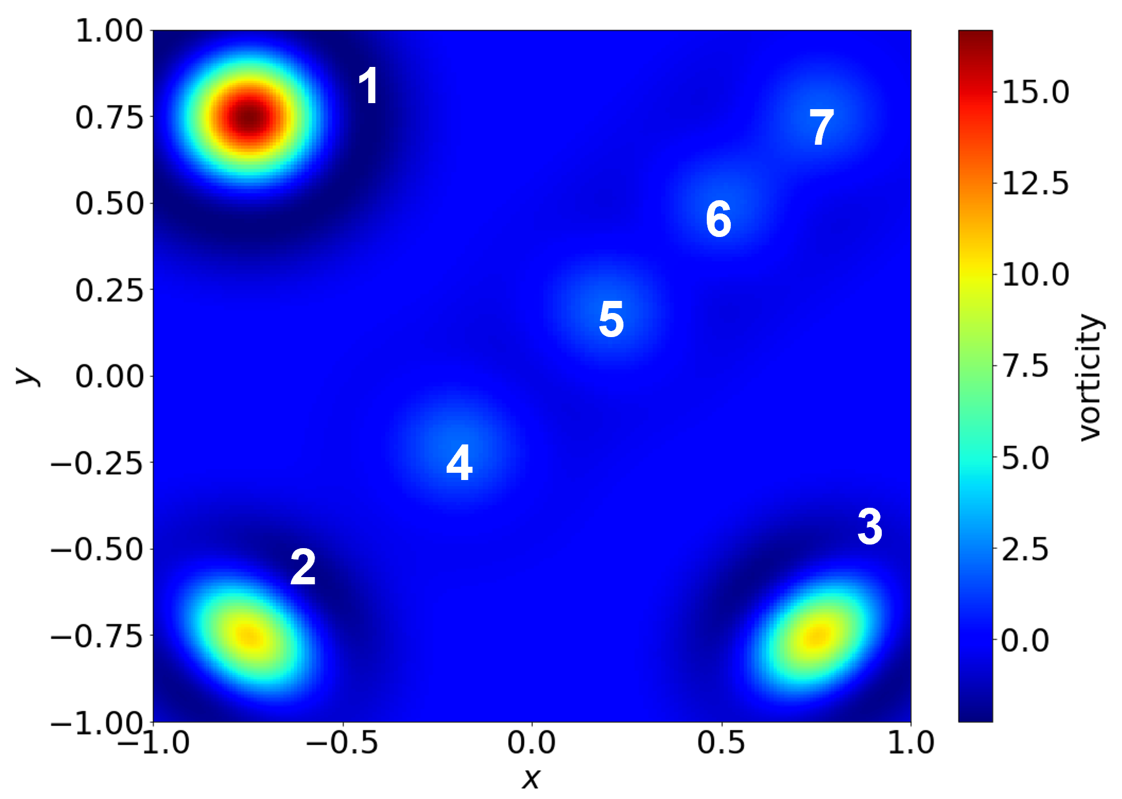
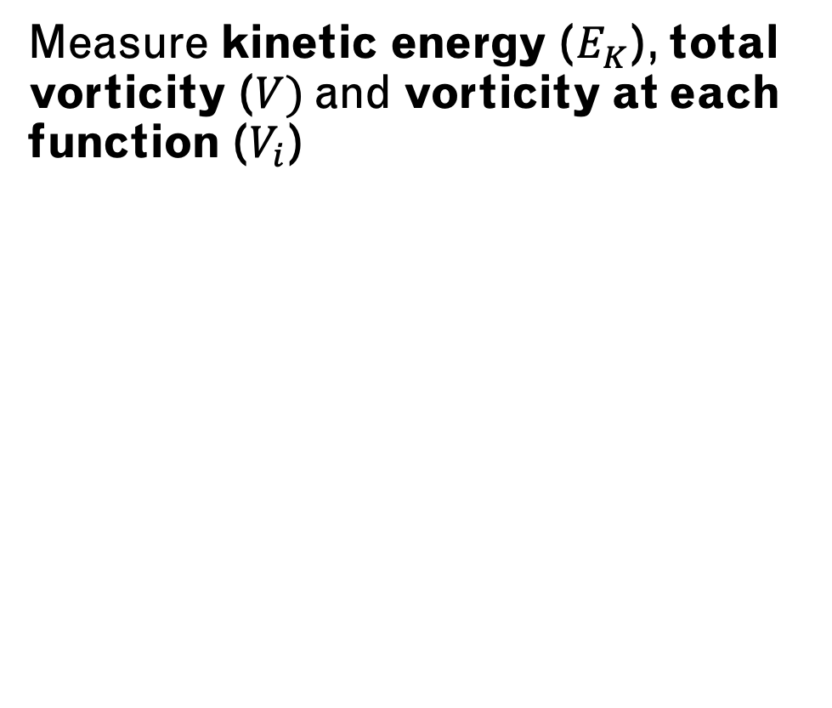
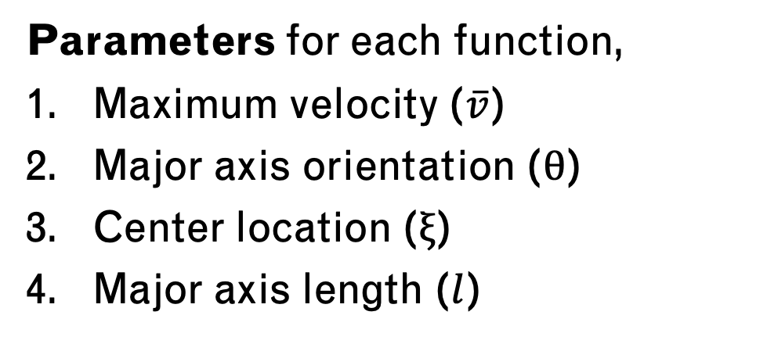
Mean Reduction Method
Classify flow into three regions,
High vorticity eddies (1-3)
Low velocity flow (4-5)
Main rotational flow (6-7)
Parameters for each function,
Maximum velocity ($\overline{v}$)
Major axis orientation ($θ$)
Center location ($ξ$)
Major axis length ($l$)
Measure kinetic energy ($E_{K}$), total vorticity ($V)$and vorticity at each function ($V_{i}$)

Slide 11
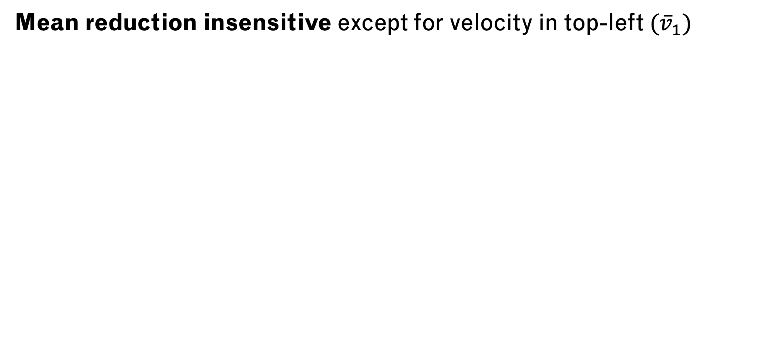
Sensitivity of Local Vorticities to all Parameters
Mean reduction insensitive except for velocity in top-left $({\overline{v}}_{1})$
Notes:
Only left side of flow ($V_{1}$, $V_{2}$) is sensitive to parameters

Slide 12
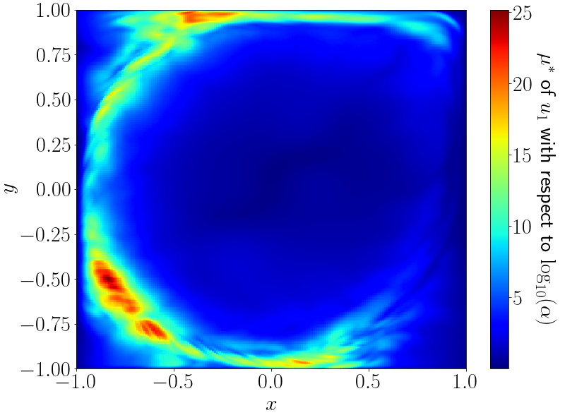
Sensitivity of X-Velocity to Boundary Condition
Most Sensitive: left-side turbulent areas
No sensitivity in top corners

Slide 13
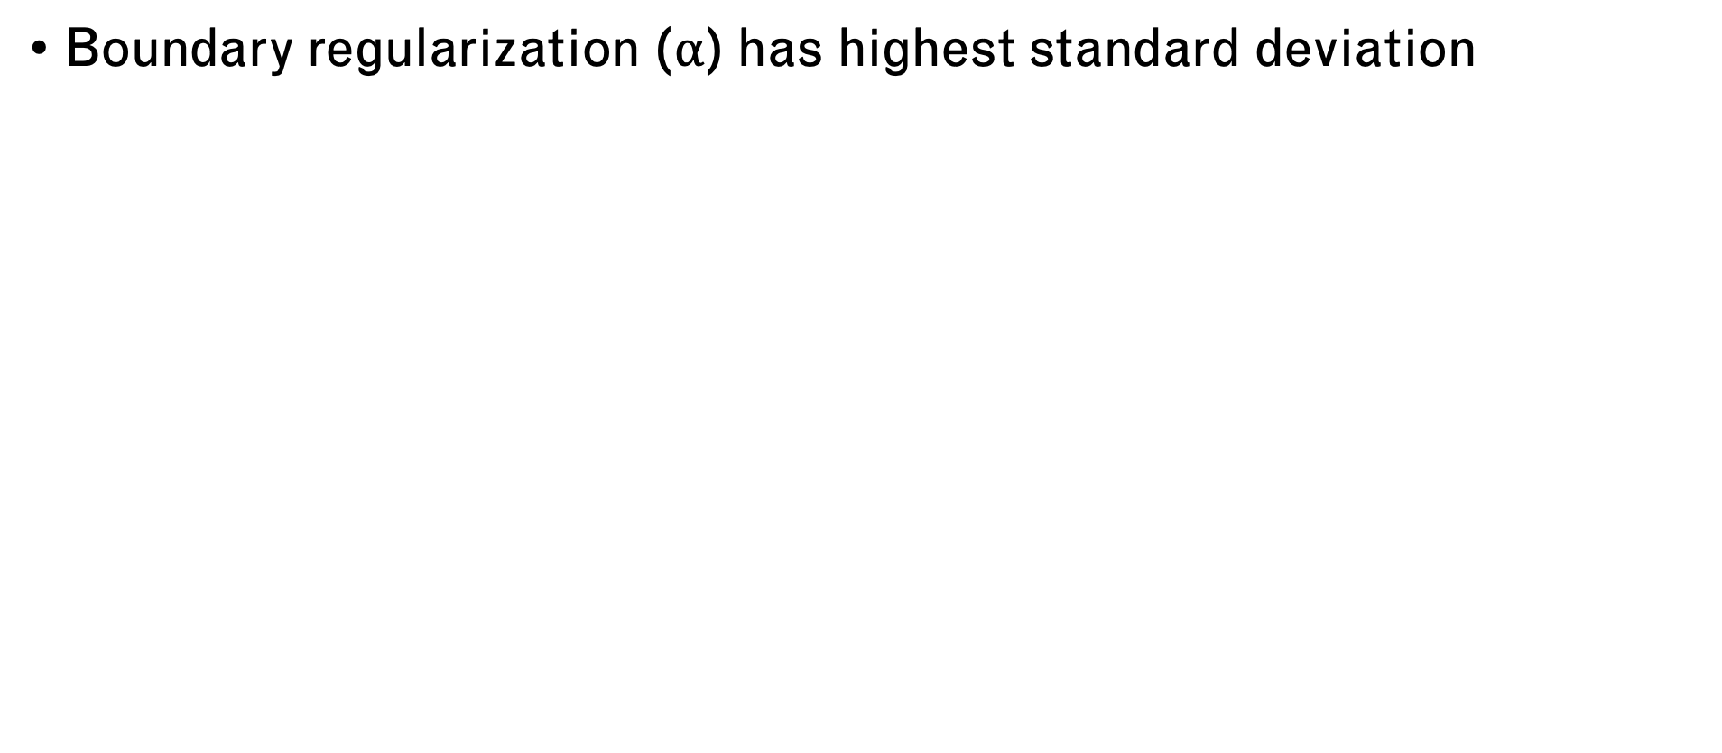
Scaled Absolute and Standard Deviation Sensitivities
Top-left mean reduction $({\overline{v}}_{1})$ is most sensitive parameter
Boundary regularization ($α$) has highest standard deviation
Notes:
Top-left mean reduction $({\overline{v}}_{1})$ is most sensitive parameter: except for vorticity in top-right ($V_{7}$)

Slide 14
Conclusions
Boundary penalties allow sensitivity analysis of boundary conditions in POD-ROMs
Sensitivities agree with comparisons of lid-driven cavity boundary conditions
Mean decomposition is sensitive only near changing boundary
Boundary penalties cannot quantify sensitivity in stable areas of POD basis

Slide 15
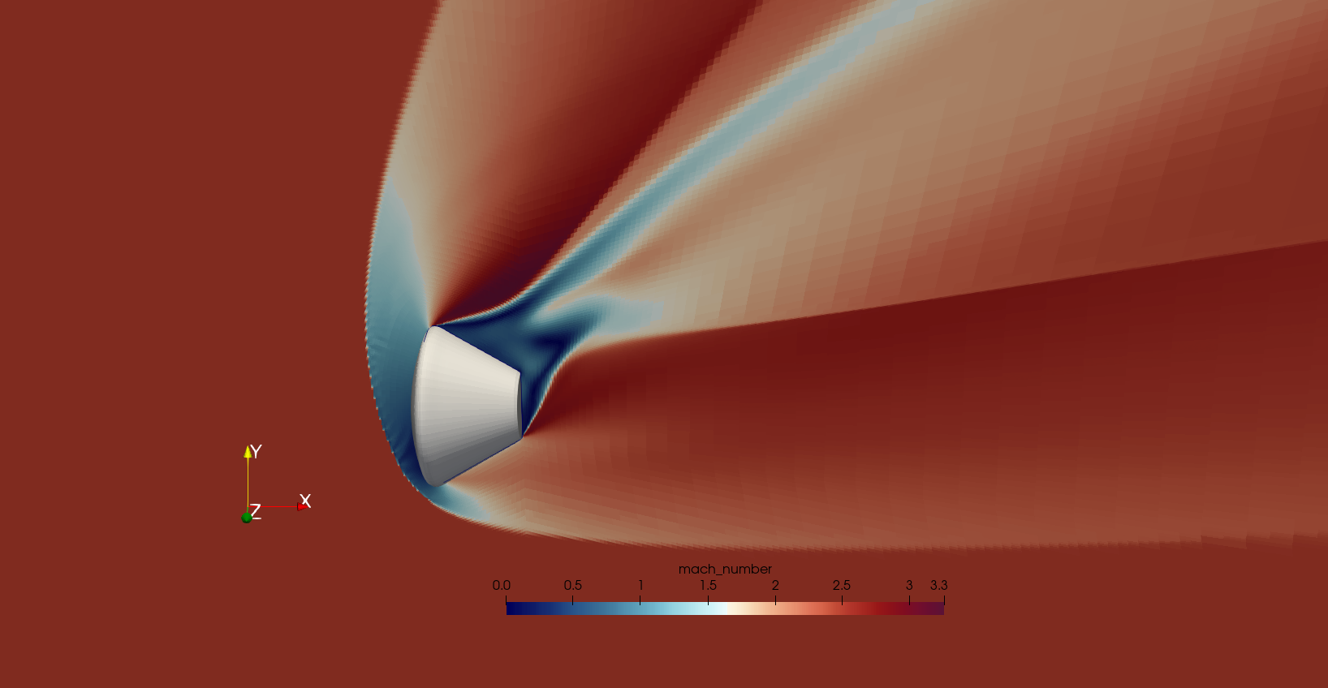
Future Work
Finding: Boundary penalty effectively quantifies sensitivity to boundary conditions
Next Step: Measure Orion lander sensitivity to surface roughness with boundary penalty
Notes:
POIs: Surface roughness of each lander panel
Significance:
QOIs: Lift/ drag coeff

