Slide 1
Silicon Photonic Transceiver for Spacecraft Navigational Lidar
Nathan Dostart
NASA Langley Research Center
SPIE Photonex, Dec. 7, 2022

Slide 2
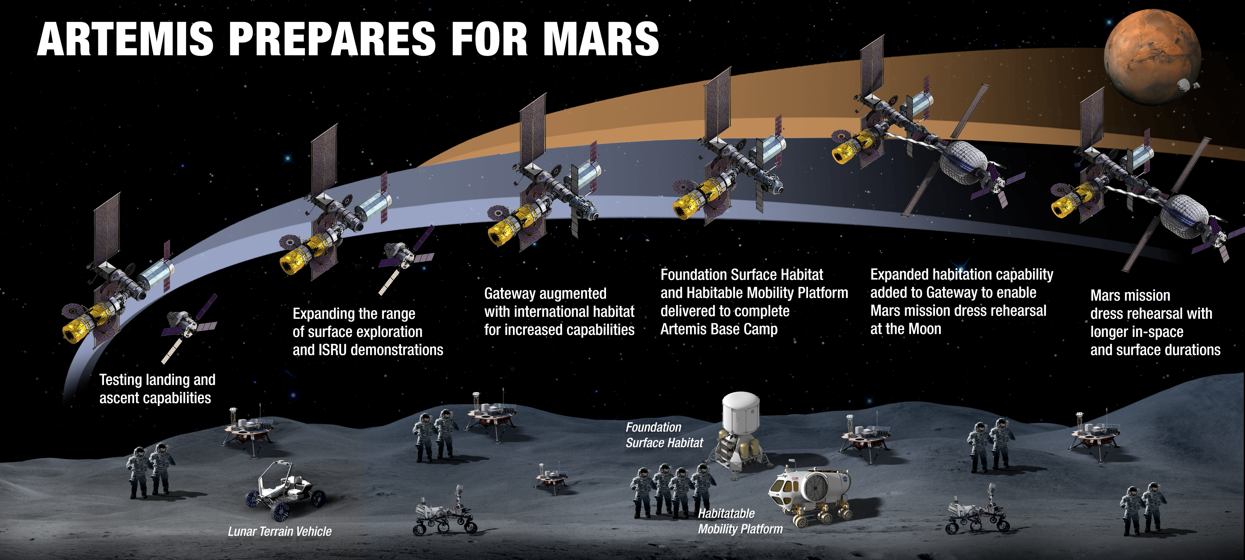
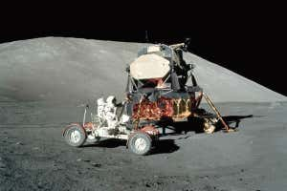
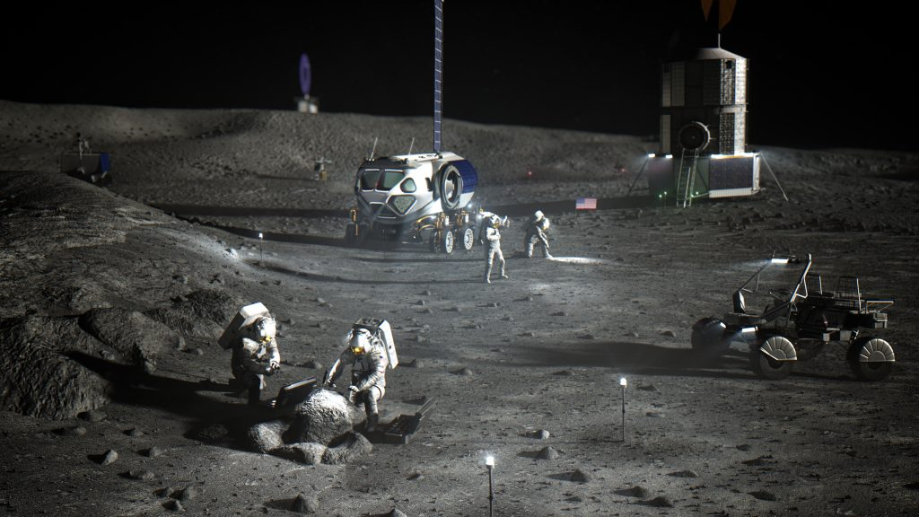
NASA Moon to Mars
NASA is planning for sustained human presence on the Moon and Mars
Operational lunar and Martian bases need periodic resupply, multiple landers
New/improved sensors need to land payloads in close proximity (<1 km) and with high precision (< 100 m)

Slide 3
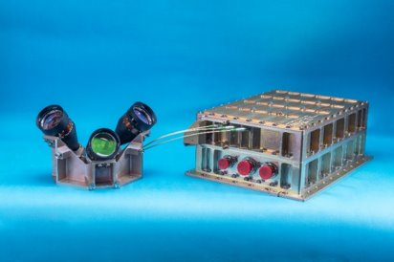
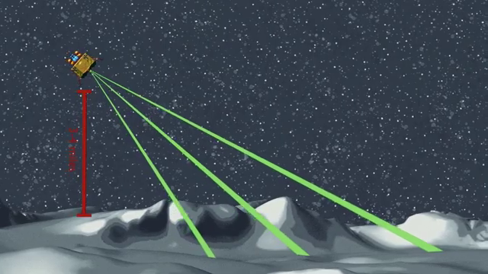
Navigation Doppler Lidar Enables Moon to Mars
Navigation Doppler Lidar (NDL)
  Frequency-modulated continuous wave (FMCW) lidar system
  1550 nm, fiber-optic system
NDL measures spacecraft attitude, velocity, and altitude during descent
  <1 cm/s velocity resolution, ~10 cm range resolution
  >5 km operational range
Precise measurements enable reduced landing uncertainty
Small size allows for redundancy, supports small landers
2 NDL units flying to the moon in 2023

Slide 4
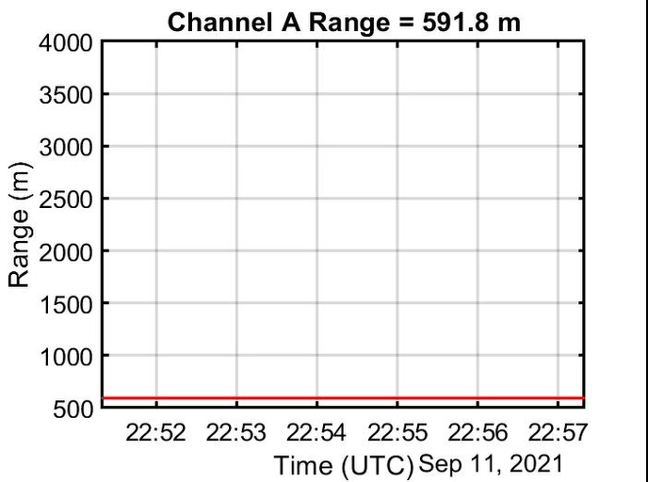
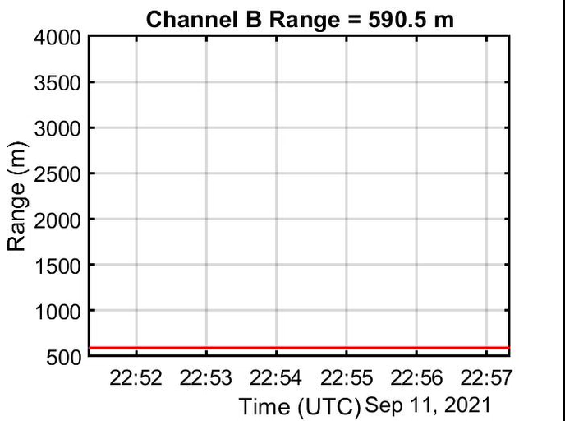
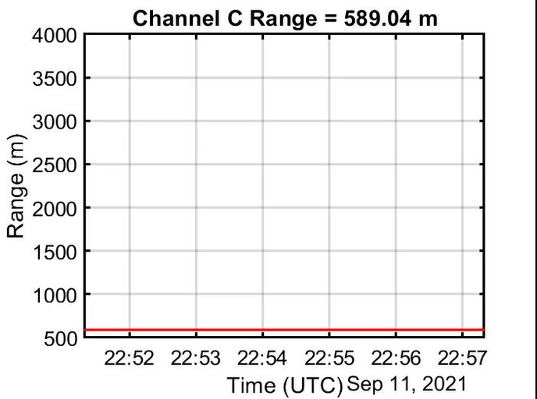
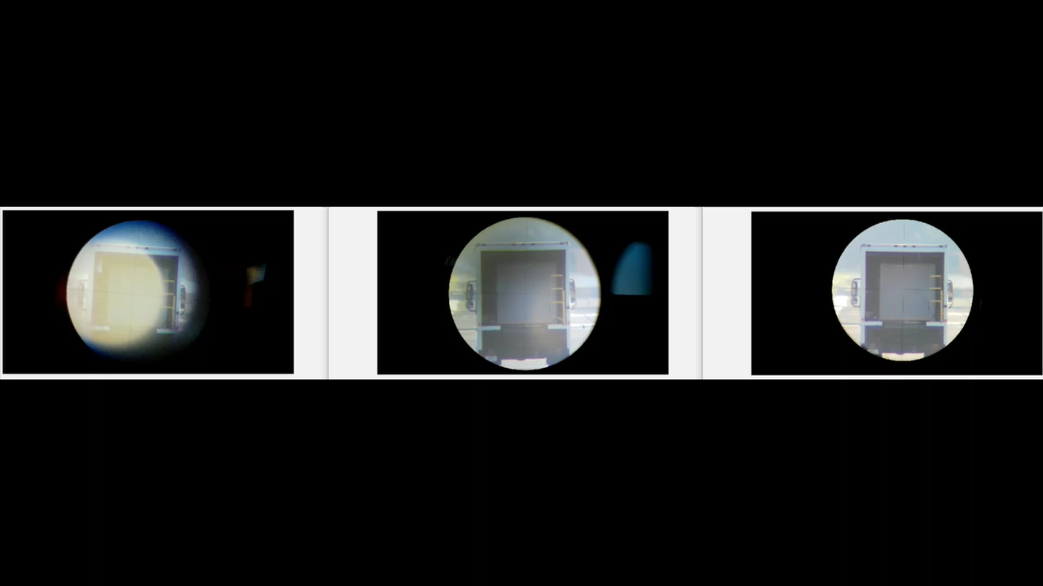
NDL In Action

Slide 5
NDL Operational Schematic
FMCW for range/velocity measurements
3 channels allow for vectorial position/velocity
NDL Flight Units
Seed
Freq. Mod.
Amp.
3x
Tele.
PBS
1:3
LO Tap
Up Ramp
Down Ramp
Dwell
PD
BS
PD
1:3
f_{Opt}
Transmit Path
LO Path
Return Path
Transmit
Return
Het. Freq.
Delay
Doppler
f_{RF}
LO – Local Oscillator
BS – Beam Splitter
PD – Photodiode
PBS – Polarizing Beam Splitter
t

Slide 6
NDL Next Generation
Incorporate many components into silicon photonic PIC including
  Modulator
  LO tap
  Balanced receiver
Use liquid crystal multi-angle beam steering to reduce channel count
Reduced system size, more robust to environment, low assembly complexity, improved performance (hopefully!)
Transmit Signal
LO
Return Signal
LO – local oscillator
LCBS – liquid crystal beam steering
BS – beam splitter
PD - photodiode
SiP PIC
Seed
Freq. Mod.
LO Tap
PD
BS
Gen 1 PIC
PD
Tele.
Circ.
Amp.
LCBS

Slide 7
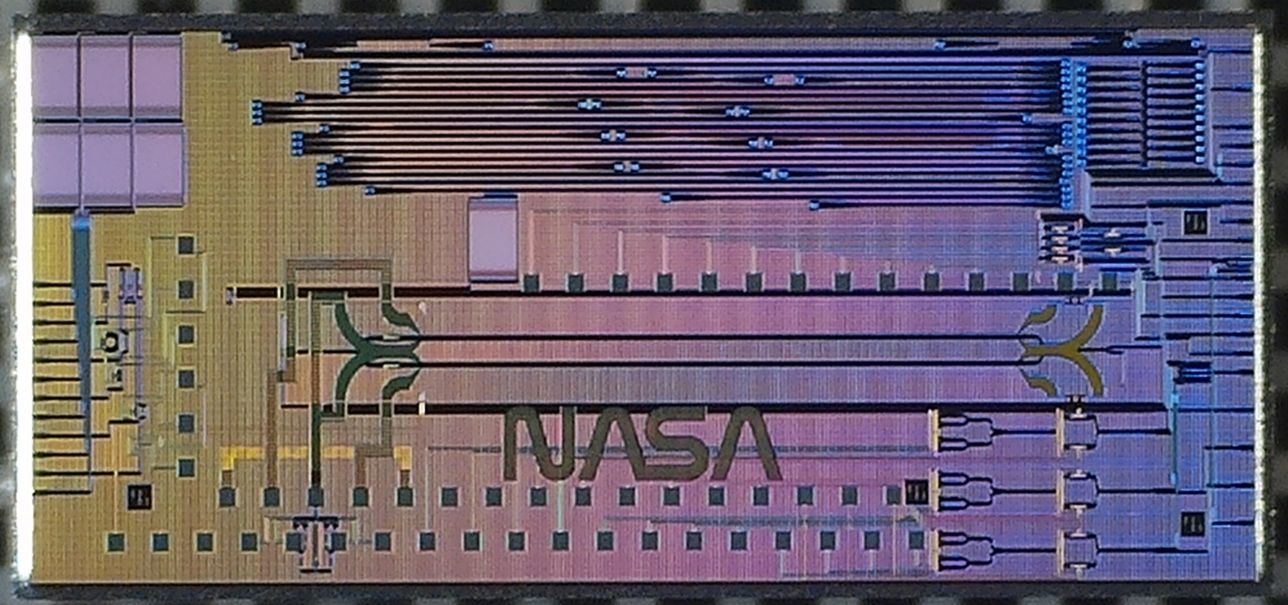
Gen. 1 PIC and Packaging – Open Top

Slide 8

Gen 1 PIC Overview
Alignment Loop
MZM for evaluation
4x balanced receivers
Single LO input
PIC
Mach-Zehnder Modulator
90:10 Tap
Y-split
Y-split
Y-split
BS
PD
RX4
PD
BS
PD
RX3
PD
BS
PD
MZM
RX2
PD
BS
PD
RX1-3
RX1
RX4
PD

Slide 9
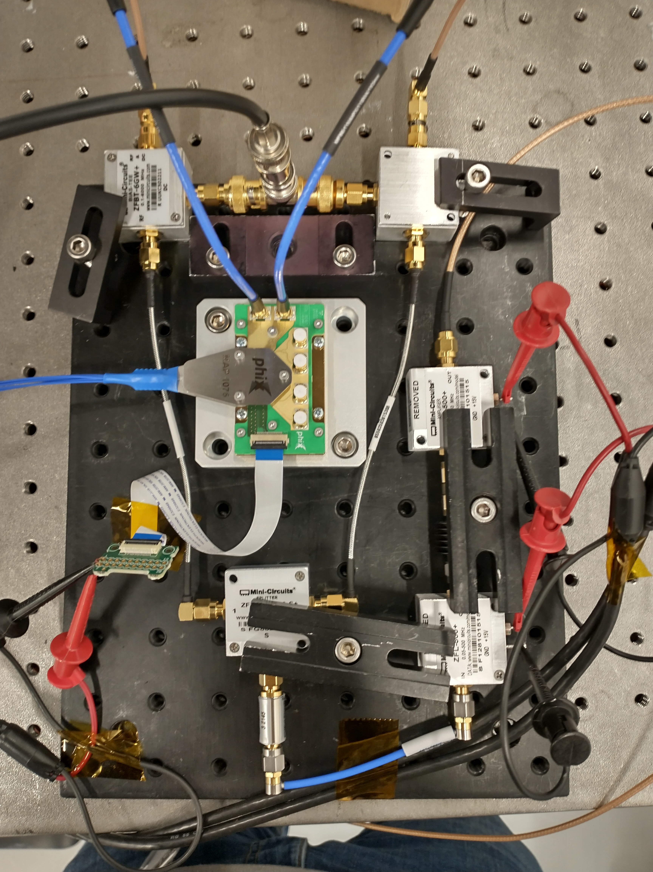
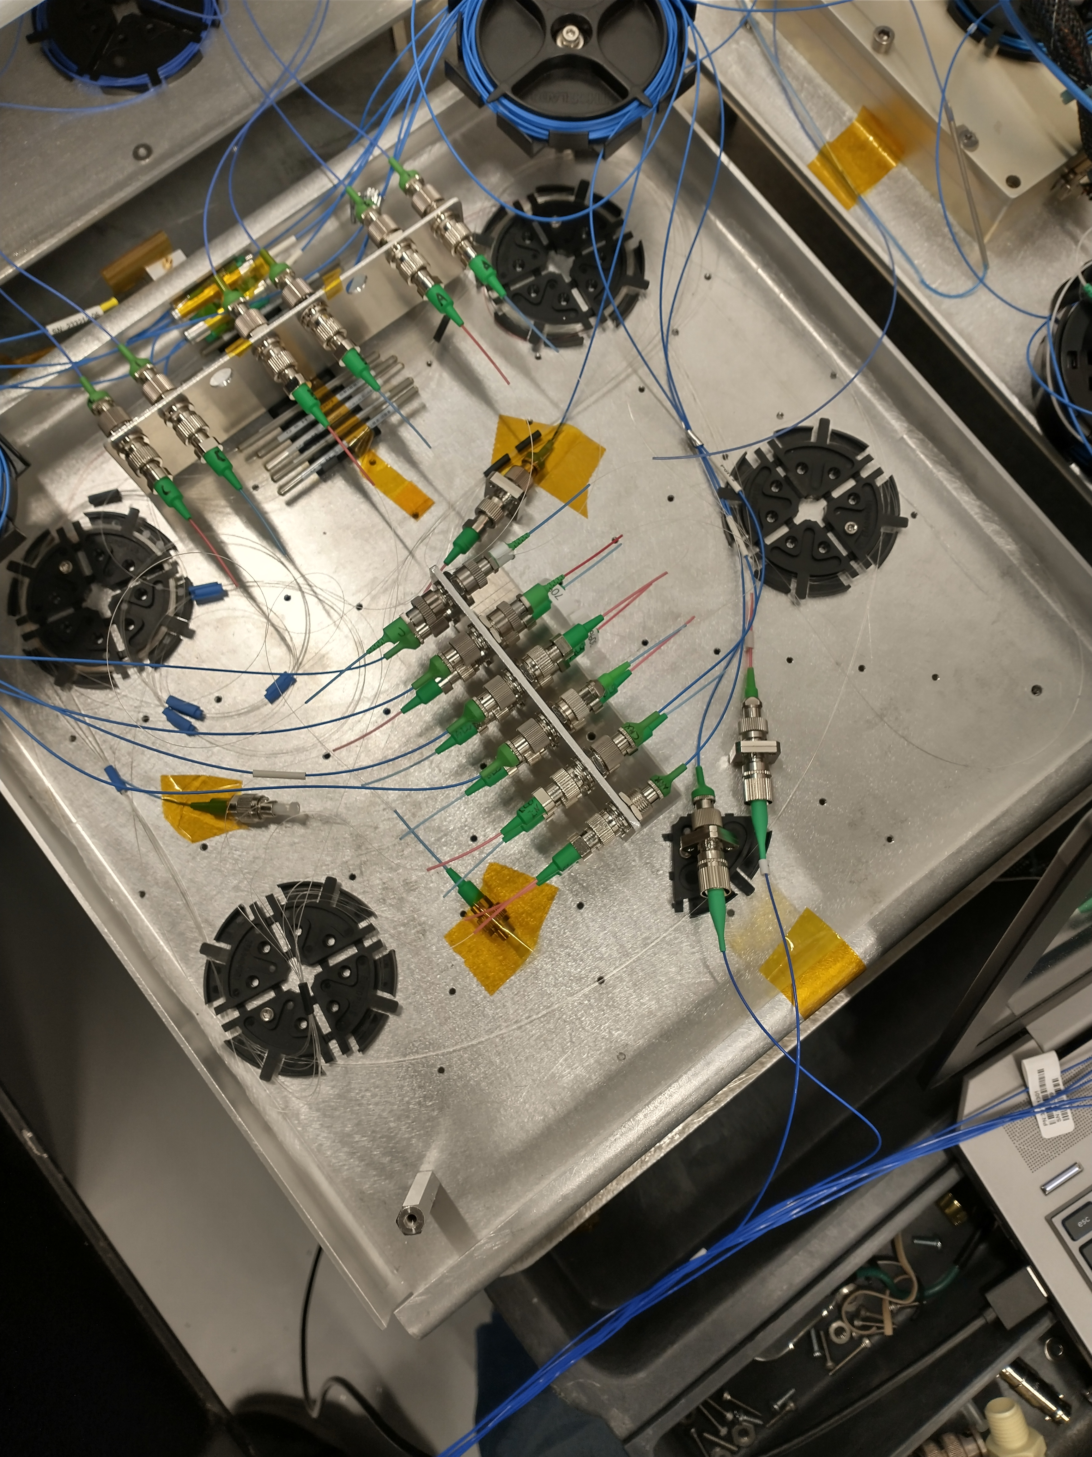
PIC Receiver Demo with NDL
Breadboard receiver with PIC
  PIC PDs with off-chip bias tees, RF amps, filter
Use NDL test unit for lidar measurement
  Beam on belt sander provides ~6 MHz Doppler frequency

Slide 10
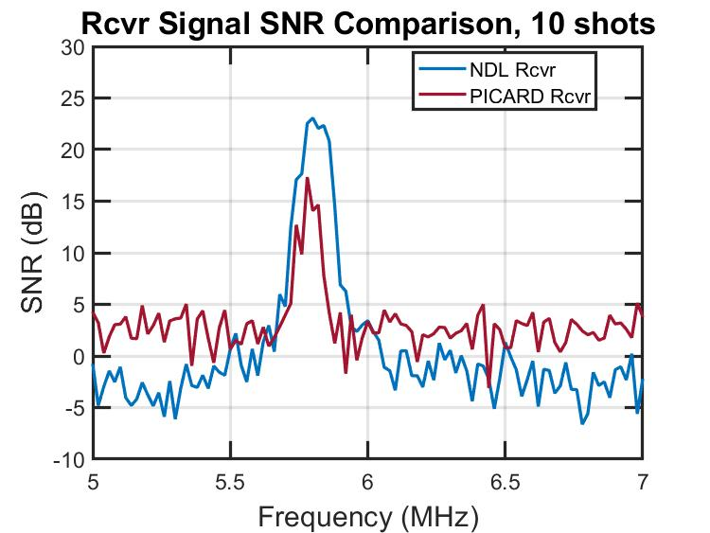
Receiver Measurements – The Bad News
~10 dB SNR drop
Partially explained by 5-6 dB estimate of total coupling loss
  Targeted/expected 3 dB, unknown cause for excess loss
More testing planned, current receiver non-optimal

Slide 11
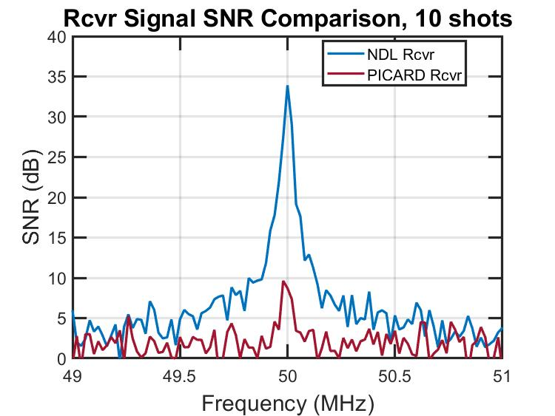
Receiver Measurements – The Good News
~25 dB additional common mode noise suppression
Existing spurs on NDL system require digital filtering, can cause measurement issues
  Imperfect synth modulation imprints 50 MHz spurs on LO
Improved common mode rejection improves NDL performance

Slide 12
Future Work
Signal power drop higher than expected
  Further characterization required to identify source of loss
  Improved coupling efficiency
Modulator characterization and revised design for single sideband operation
Hermetic package with in-package receiver electronics
Space-qualification/environmental test campaign -> TRL 6

Slide 13
Summary
Developed open-top silicon photonic PIC for space-based lidar system
Initial version showed reduced SNR but improved common mode rejection
Demonstration with existing lidar system
Further development focusing on
  Incorporating more functionality on the PIC
  Hermetic packaging and environmental testing for space qualification

Slide 14
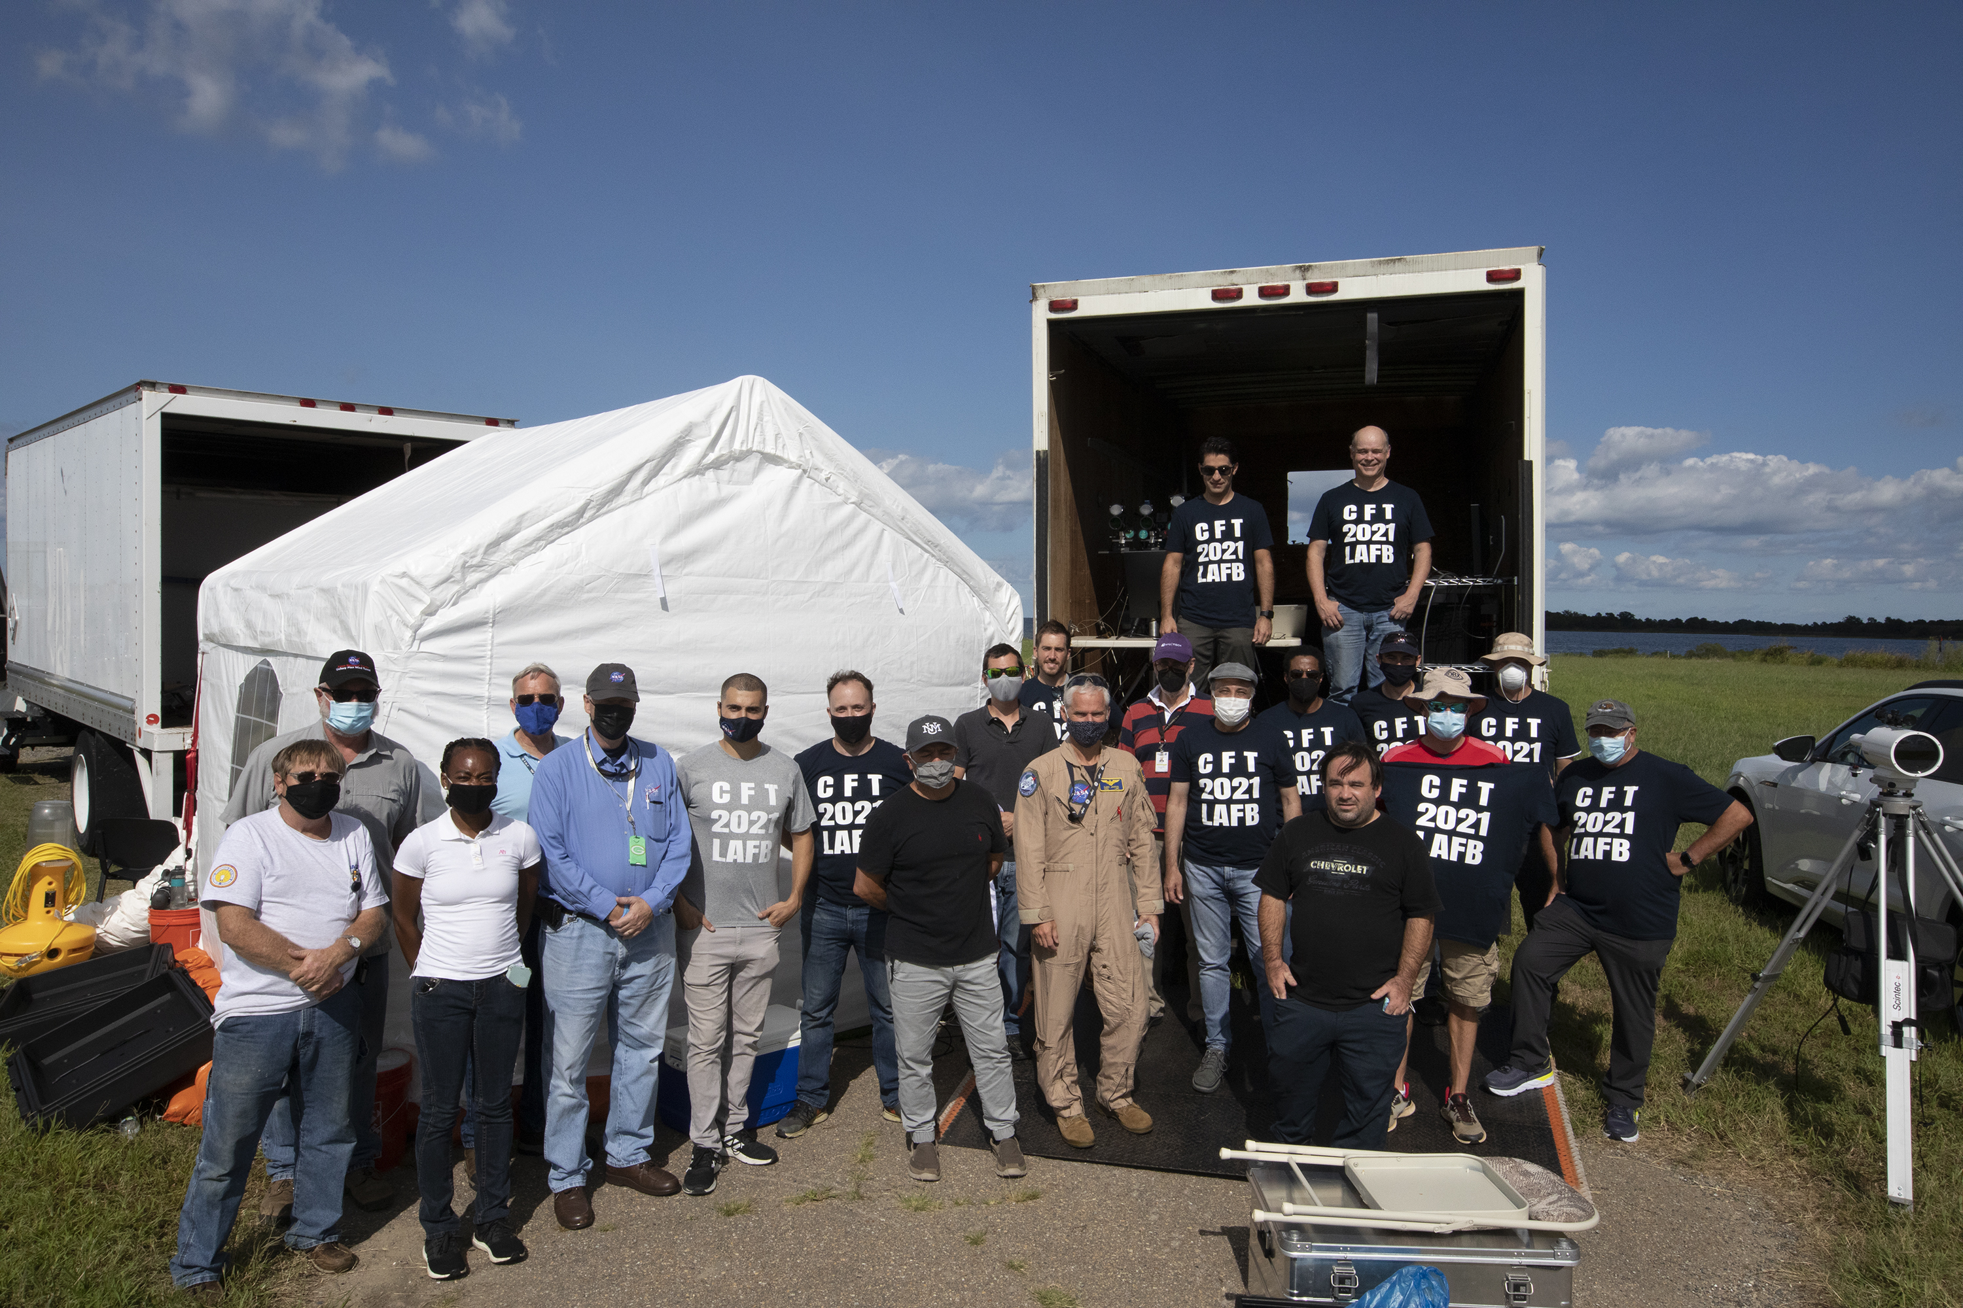
Thanks to the NDL Team
Keep an eye out for us on the Moon in 2023!

