Slide 1

Quantifying Emergent Fluid Dynamics Using Reynolds-Interpolated Fluid Reduced-Order Models
Chris Edwards¹, Michael W. Lee², Donya Ramezanian³, Ralph C. Smith¹
¹North Carolina State University, ²NASA Langley Research Center, ³University of Southern California
SciTech 2023
Jan. 25, 2023

Slide 2
Overview
Motivation
General approach
Derivation and comparison of methods
  Spanning Reduced-order Model
  Basis Concatenation
  Basis Interpolation
Conclusion

Slide 3
Motivation
Planetary entry, descent, and landing
Uncertainty Quantification (UQ):
  Bayesian Markov Chain Monte Carlo techniques
  Requires numerous model evaluations O(10⁴)
High-Fidelity computational fluid dynamics (CFD) simulations are computationally expensive –> Reduced-order Models (ROMs)
Parametric ROMs:
  Goal: Accurately simulate fluid physics at parameter points not included in the reference data

Slide 4
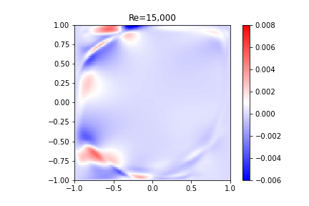
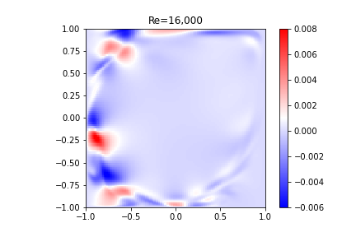
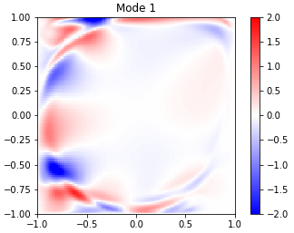
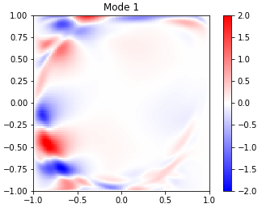
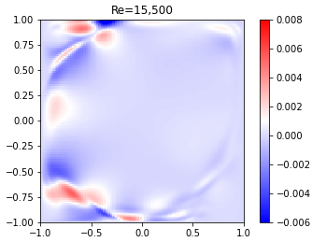
General Approach
Collect high-fidelity data at few parameter points (Reynolds no.)
Extract coherent structures (POD)
Use reduced-order model to predict flow physics at any intermediate parameter point

Slide 5
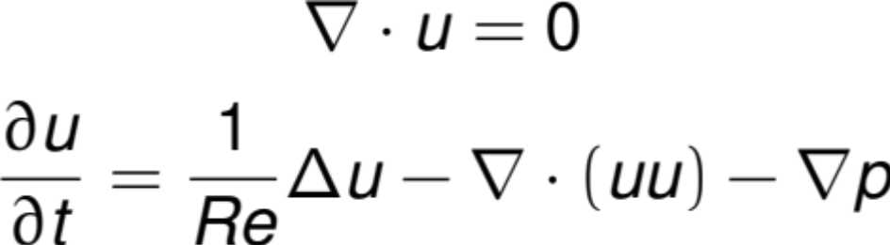
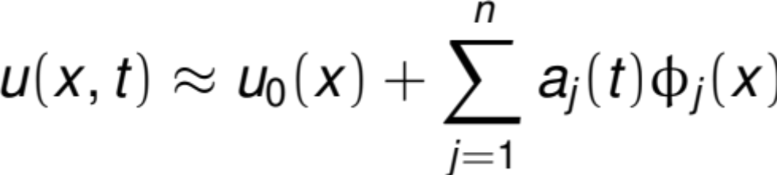

Incompressible ROM Formulation
Consider the incompressible conservation equations:
Linearly decompose the velocity field:

Slide 6



Incompressible ROM Formulation
Assume satisfies the boundary conditions
Galerkin projection yields (matrices defined in paper):
Pressure term vanishes where
Matrices are not Reynolds-dependent
Orthonormal modes make the identity matrix

Slide 7



Methodology: Spanning ROM
High-fidelity Data: Snapshots from different parameter points (Reynolds no.)
…
Form collection of snapshots
Extract coherent structures (POD)
Construct Reduced-Order Model (ROM)
Use ROM to predict flow physics
at any intermediate parameter point

Slide 8
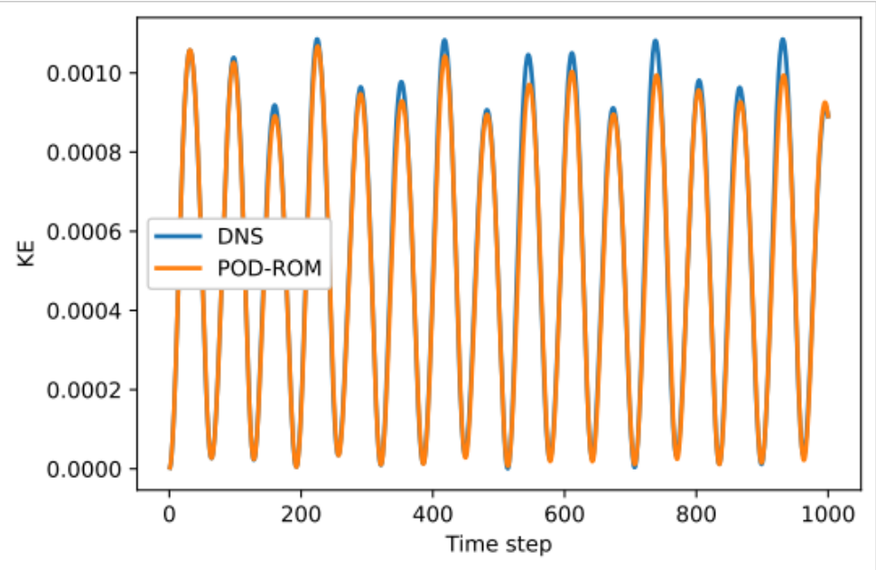
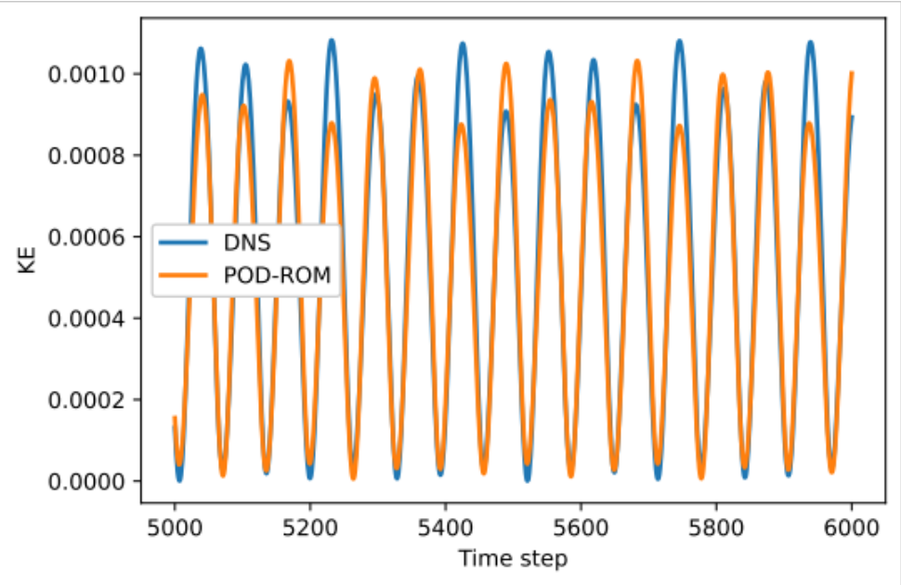
Results: Spanning ROM
Snapshots from Re = [15k | 16k | 17k | 18k]
ROMs at Re = [15.5k | 16.5k | 17.5k]
Bifurcation at Re=15.5k is well captured
First iterations, Re = 15.5k
Final iterations, Re = 15.5k

Slide 9
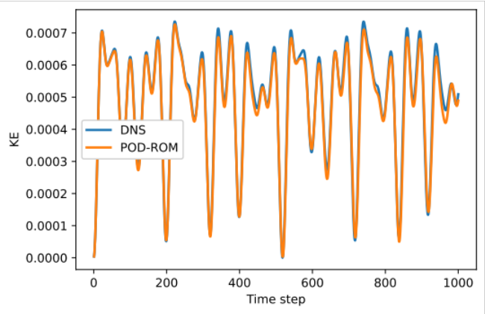
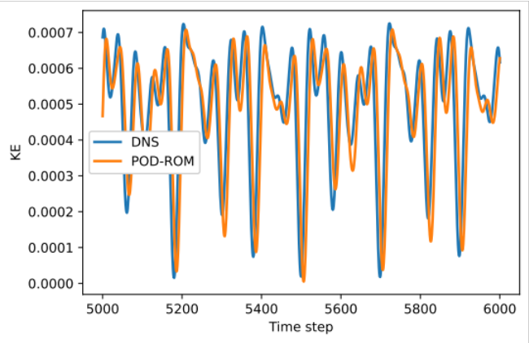
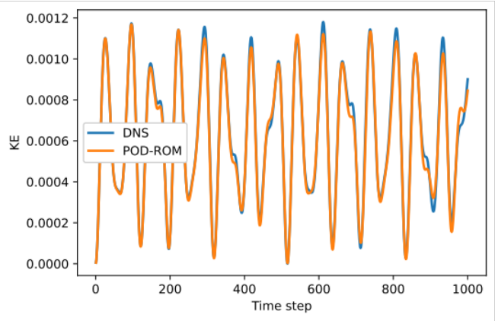
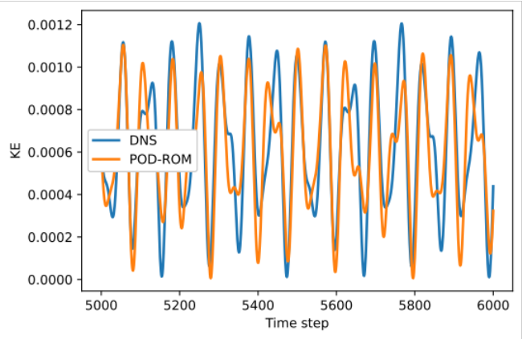
Results: Spanning ROM
ROM Solution is stable with high snapshot parameter resolution
First iterations, Re = 16.5k
Final iterations, Re = 16.5k
Snapshot Re = [15k | 16k | 17k | 18k]
First iterations, Re = 16k
Final iterations, Re = 16k
Snapshot Re = [15k | 16.5k | 18k]

Slide 10



Methodology: Basis Concatenation
High-fidelity Data: Snapshots from different parameter points (Reynolds no.)
…
Extract coherent structures (POD)
Concatenate POD bases
Construct Reduced-Order Model (ROM)
Use ROM to predict flow physics
at any intermediate parameter point

Slide 11
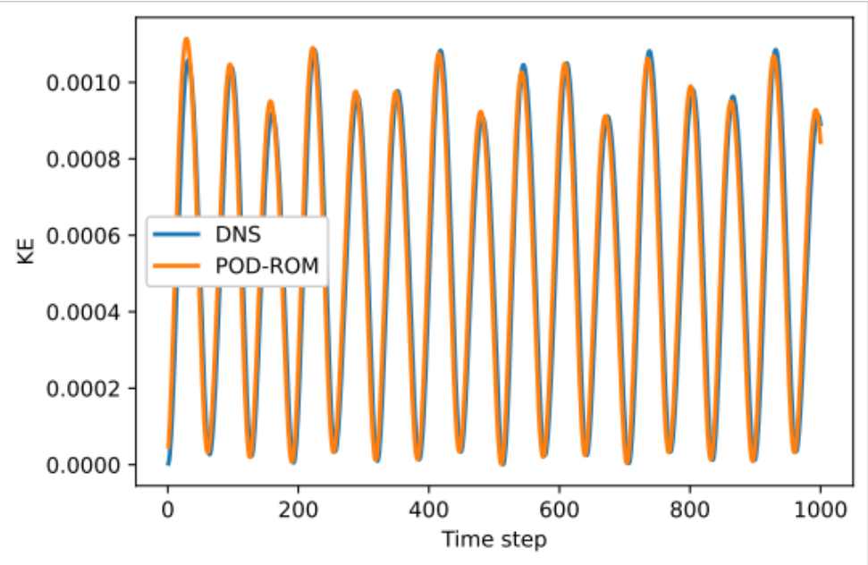
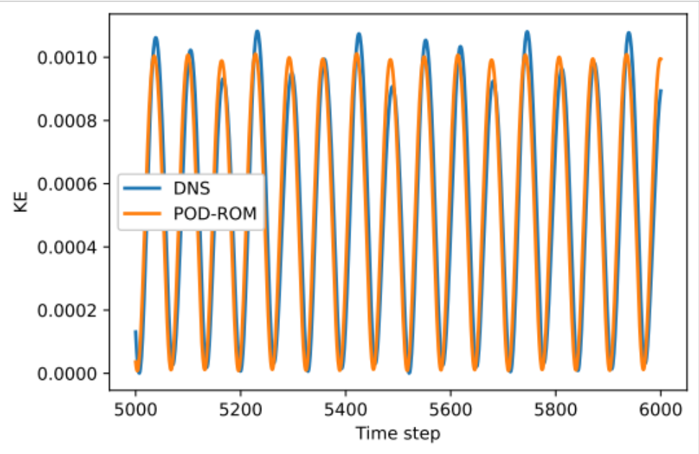
Results: Basis Concatenation
Snapshots from Re = [15k | 16k | 17k | 18k]
ROMs at Re = [15.5k | 16.5k | 17.5k]
Bifurcation at Re=15.5k is well captured
First iterations, Re = 15.5k
Final iterations, Re = 15.5k

Slide 12
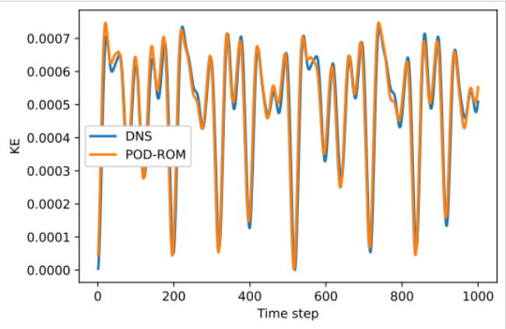
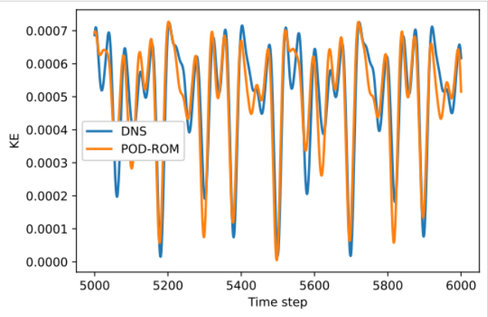
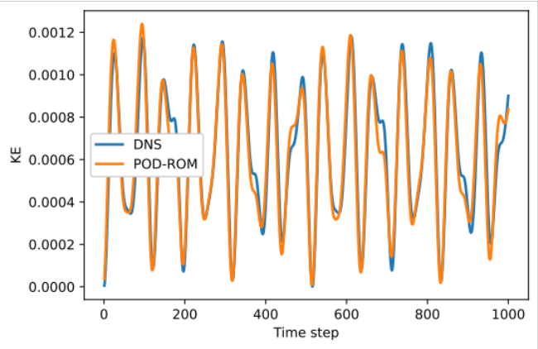
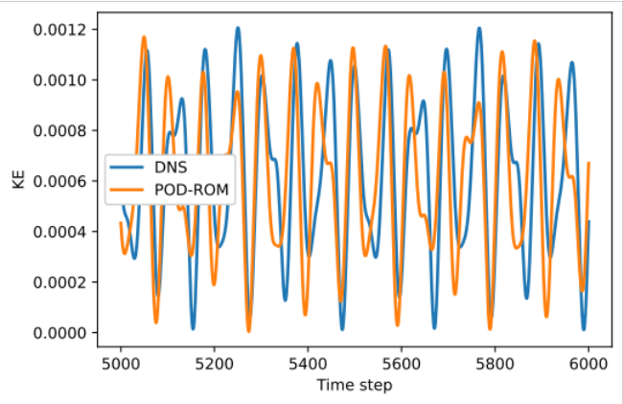
Results: Basis Concatenation
Less accurate than Spanning ROM
First iterations, Re = 16.5k
Final iterations, Re = 16.5k
Snapshot Re = [15k | 16k | 17k | 18k]
First iterations, Re = 16k
Final iterations, Re = 16k
Snapshot Re = [15k | 16.5k | 18k]

Slide 13
Methodology: Basis Interpolation
High-fidelity Data: Snapshots from different parameter points (Reynolds no.)
…
Extract coherent structures (POD)
Interpolate Bases
Univariate Interpolation
Multivariate Interpolation
Construct Reduced-Order Model (ROM)
Use ROM to predict flow physics
at any intermediate parameter point

Slide 14
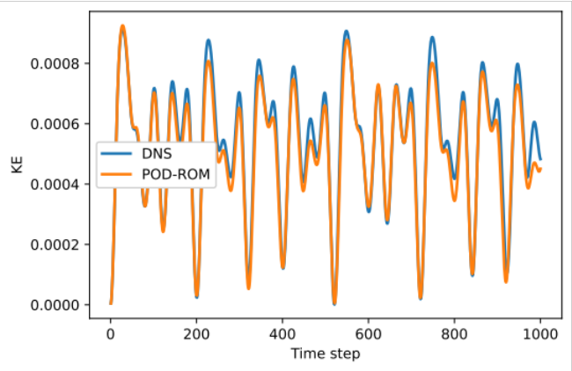
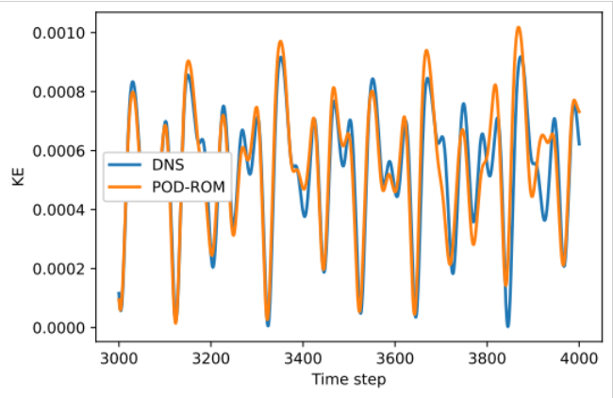
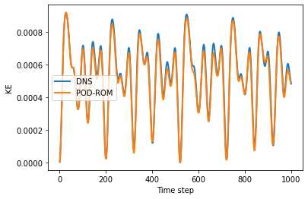
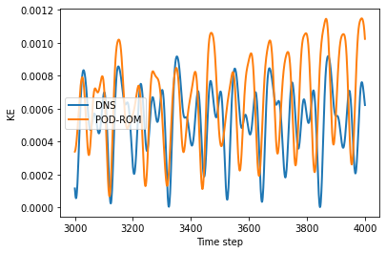
Results: Basis Interpolation
General Basis interpolation more stable
First iterations, Re = 17k
Final iterations, Re = 17k
General Interp. Re = [16k | 17.5k]
First iterations, Re = 17k
Final iterations, Re = 17k
Univariate Interp. [16.5k | 17.5k]

Slide 15
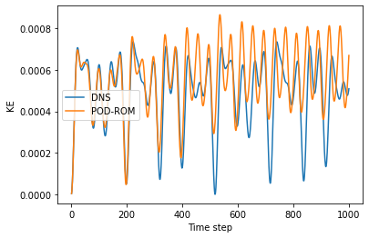
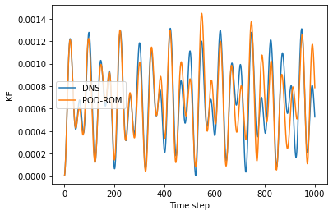
Results: Basis Interpolation
[15.5k | 17.5k] Univar. Basis Interp., Re = 16.5k
2 Univariate Interpolation ROMs
  Different target Re
  Same Re separation
ROM performance decreases as disparity in relative size of bases increases
[16.5k | 18.5k] Univar. Basis Interp., Re = 17.5k

Slide 16
Comparison of Methods
 | Spanning ROM | Basis Concat. | Univar. Basis Interp. | Gen. Basis Interp.
stability | needs high resolution | needs high resolution | unpredictable | needs high resolution
mode creation cost | high | mid | mid | mid
small basis | yes | no | yes | yes
handles implicit parameters | no | no | yes | yes
Overall Performance | best | good | unpredictable | good

Slide 17
Conclusion
We can inexpensively and accurately simulate flow physics at intermediate Reynolds numbers using only high-fidelity data from other Reynolds numbers
  Bifurcations can be captured with high snapshot resolution near critical point
  Changes in dominant frequencies can be captured
Will next extend to multiple parameters:
  Computational concerns will limit the effectiveness of Spanning and Basis Concatenation ROM techniques for moderate and large sized bases
  General Basis Interpolation naturally extends with multivariate interpolation

