Slide 1
NASA Langley Research Center
Supersonic and Hypersonic
Testing Capabilities
Michael DiFulvio, Branch Head
Karen Berger, Langley Aerothermodynamics Laboratory
Aaron Fuchs, 8-Ft High Temperature Tunnel
Hubert Senter, Scramjet Test Complex
Roger Wagner, 4ft Supersonic Unitary Plan Wind Tunnel

Slide 2
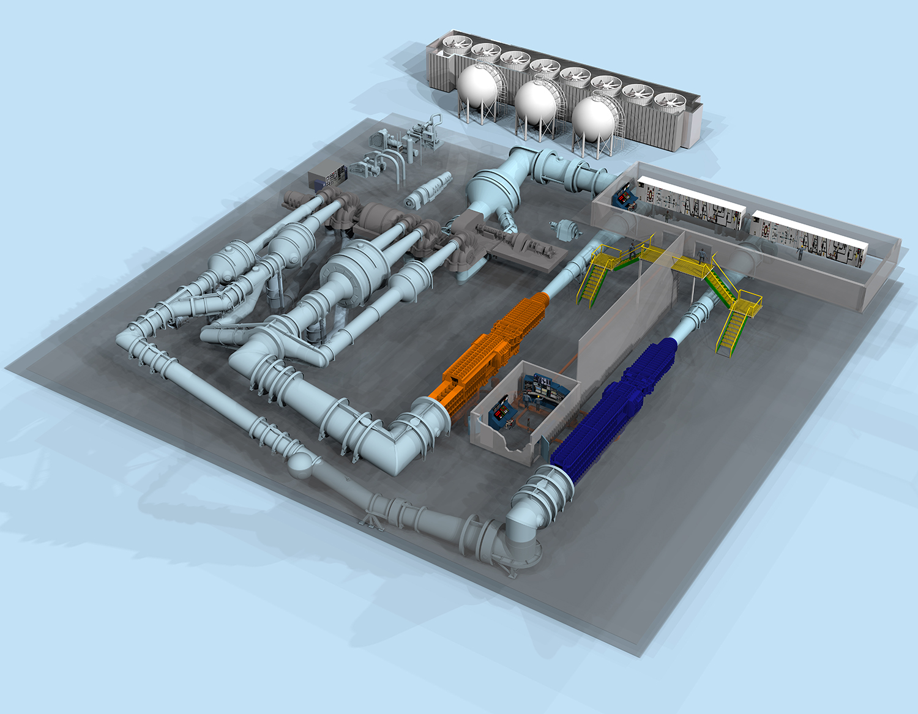

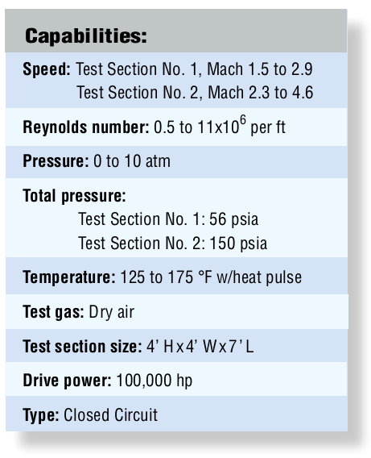
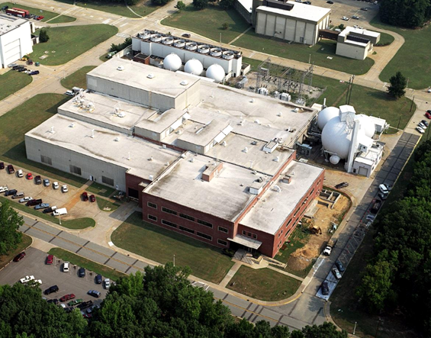
4ft Supersonic Unitary Plan Wind Tunnel - 4ft UPWT
Mach
LaRC NTF* & TDT**

Slide 3
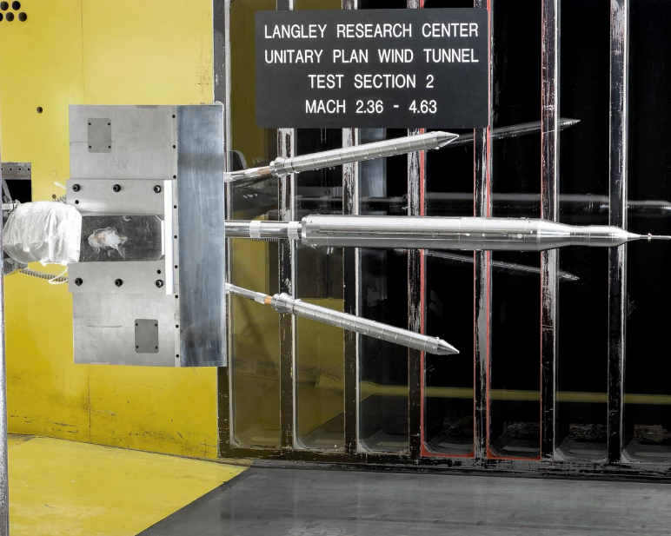
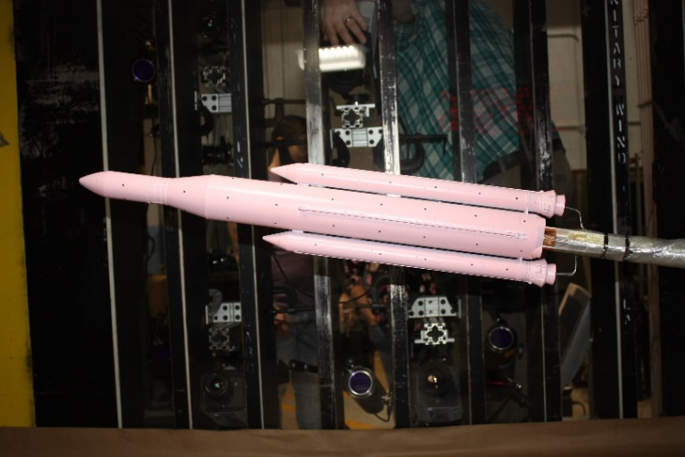
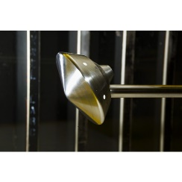
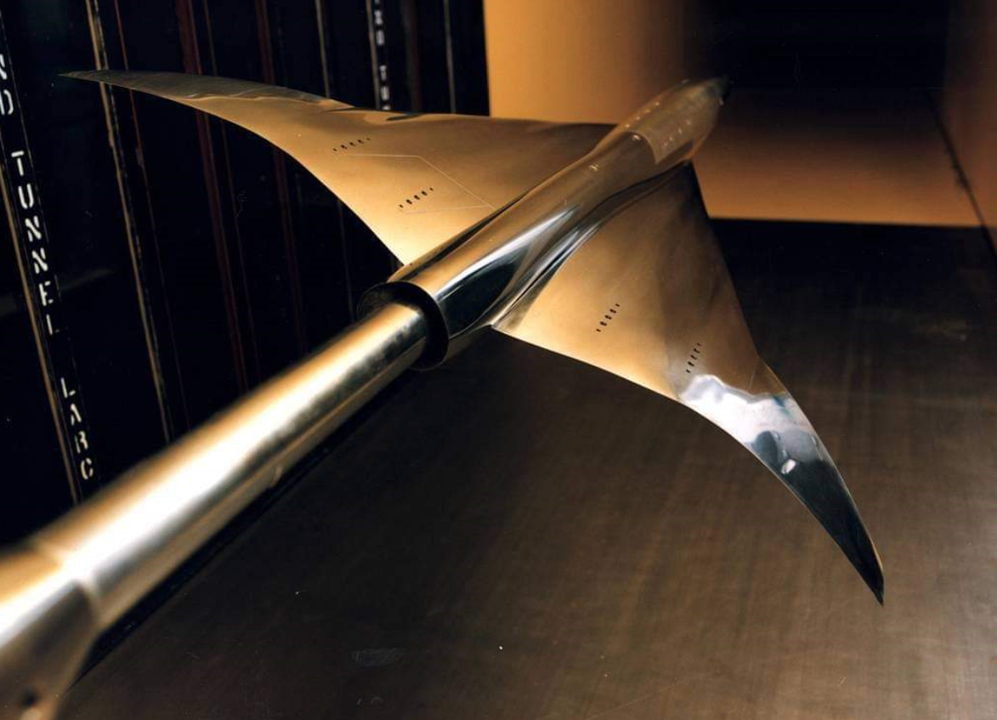
4ft UPWT - Test Types / Features
Closed-circuit, continuous-flow, variable-density supersonic tunnel
  Two 4-ft by 4-ft by 7-ft test sections
  Real-time customer data access; classified capable
Typical tests include
  Force and moment, surface pressure measurements, flow visualization, on & off surface flow patterns,
  Jet effects, dynamic stability, model deformation, global surface & off-body flow measurements, heat transfer
  Propulsion simulation system

Slide 4
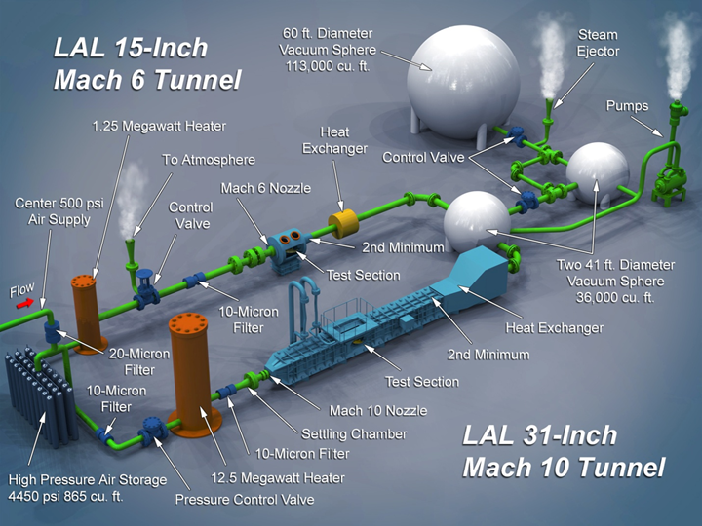

Langley Aerothermodynamic Laboratory – LAL
31-Inch Mach 10 Tunnel and 15-Inch Mach 6 High Temperature Tunnel
 | 31” Mach 10 | 15” Mach 6 High Temp
Mach Number | 10 | 6
Gas | Air | Air
Unit Reynolds Number | 0.25 - 2.1x10⁶/ft | 0.5 - 8.0x10⁶/ft
Pressure (psi) | 150 - 1450 | 100 – 550
Temperature (ºF) | 1300 - 1320 | 400 – 810
Angle of Attack (deg) | ± 45 | -10 to +50
Yaw Angle (deg) | ± 10 | ± 10
Run Time | 2 min | 90 sec
Runs per Day | 5 – 8 | 4 – 8
Test Section | Closed Jet | Open Jet
Tunnel Core Size | 14 x 14 in | 9 - 14 in

Slide 5
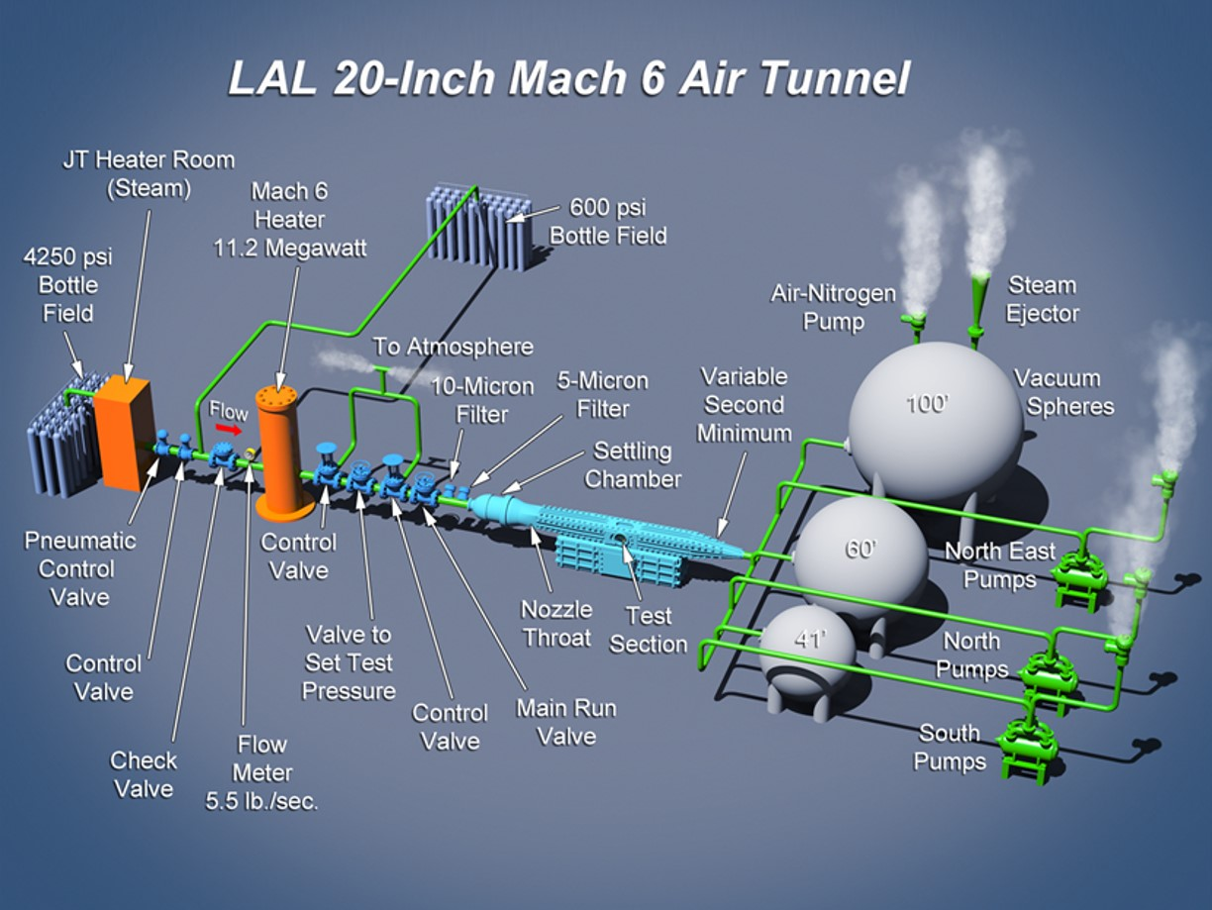
Langley Aerothermodynamic Laboratory – LAL
20-Inch Mach 6 Tunnel
 | 20” Mach 6
Mach Number | 6
Gas | Air
Unit Reynolds Number | 0.5 - 8.3x10⁶/ft
Pressure (psi) | 30 - 475
Temperature (ºF) | 410 – 475
Angle of Attack (deg) | -5 to + 50
Yaw Angle (deg) | ± 10
Run Time | 5 min
Runs per Day | 8 – 12
Test Section | Closed Jet
Tunnel Core Size | 14 x 14 in

Slide 6
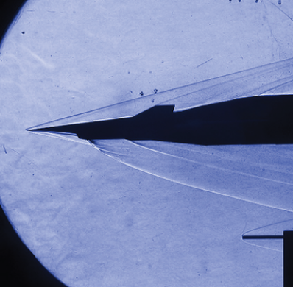
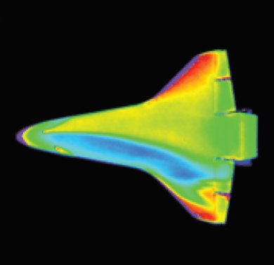
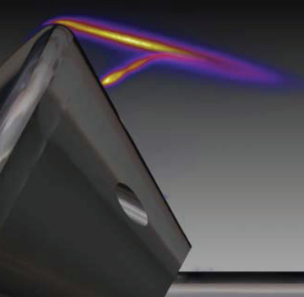
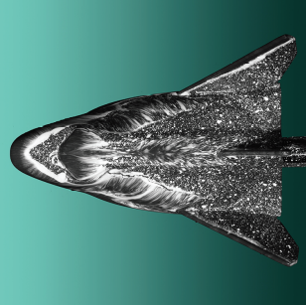
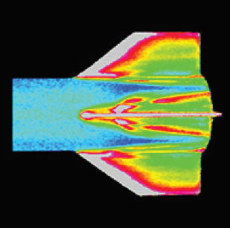
Langley Aerothermodynamic Laboratory – LAL Test Types / Features
Benefits
Flexibility | Run-by-run decisions
Productivity | - Fast paced - multiple runs/day, - Near real-time data reduction, - Ideal for parametric screening and benchmarking computational codes
Security | Proprietary, ITAR, classified testing
Capability | Demonstration of new/innovative test techniques and instrumentation
Model Fabrication | In-house rapid/inexpensive phosphor thermography model fabrication
Test Techniques
Static Aerodynamics | Force and Moment Strain Gage Balances
Discrete Pressure | ESP, Druck, Kulite, PCB
Global Pressure | Pressure Sensitive Paint
Discrete Temperature | Thermocouple, Thin Film, Thin Skin
Global Temperature | Phosphor Thermography, Infrared, Temperature Sensitive Paint
Discrete Heat Flux | Schmidt-Boelter, Atomic Layer Thermopile
Surface Diagnostic | Oil Flow Visualization
Flow Field Diagnostics | Schlieren, Planar Laser-Induced Fluorescence, Focused Laser Differential Interferometry

Slide 7
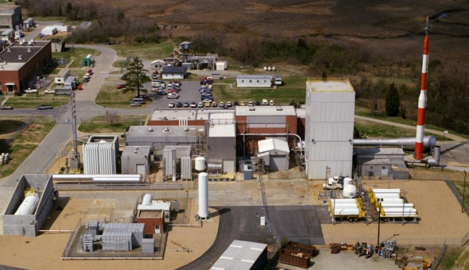
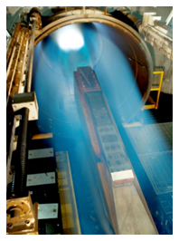
8-Ft. High Temperature Tunnel – 8ft HTT
Largest hypersonic aerothermal test facility in the US
  One of two calibrated facilities in this speed range
Facility tied to NASA’s premier hypersonic CFD team
  Mach 3, 4, 5, 6, 7
  20,000 – 120,000 ft. altitude
  True flight enthalpy (temperature up to 3600°R)
Matched flight conditions for
Hyper-X, HyFly, X-51
New Mach 6, water cooled, nozzle in design & fabrication
X-51

Slide 8
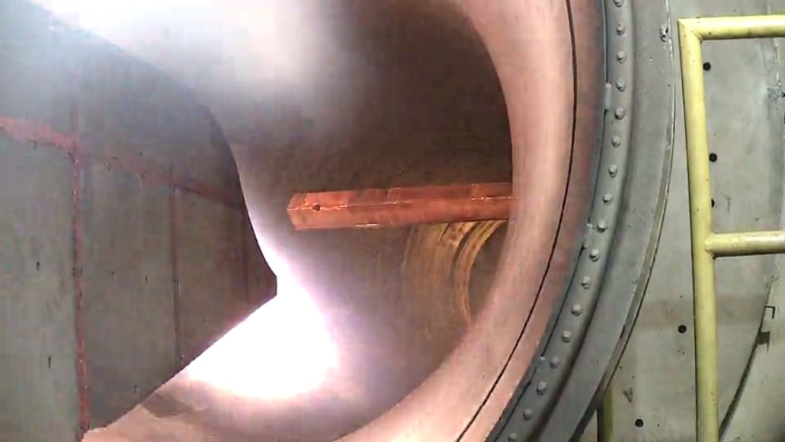
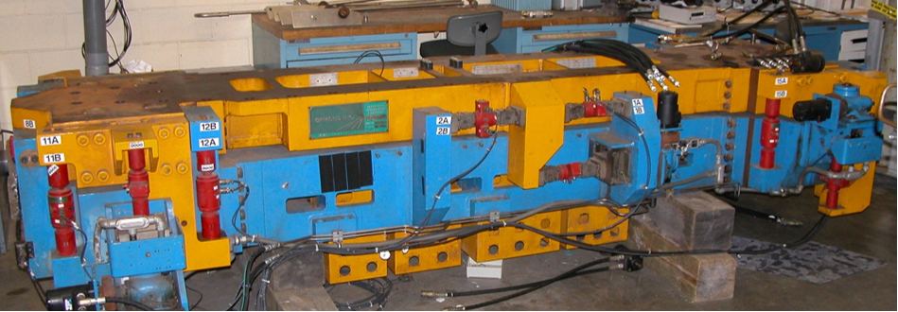
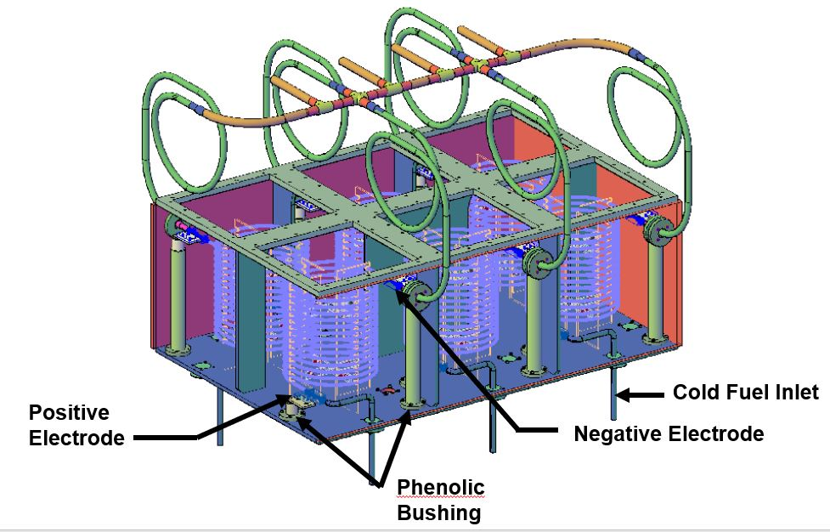
8-Ft. High Temperature Tunnel – 8ft HTT Test Types / Features
Test Features:
Propulsion Testing
  Ignition testing
  Operability testing
Material/Structure Testing
Force Measure System (FMS) data
Jet fuel delivery system
  Heated fuel delivery system
  Chilled fuel delivery system
Visual data
  IR imaging (high speed and low speed)
  Photogrammetry
  Engine diagnostic imaging
Radiant preheat lamps
Engine diagnostic imaging
Force Measurement System
6 – Coil JP fuel heater

Slide 9
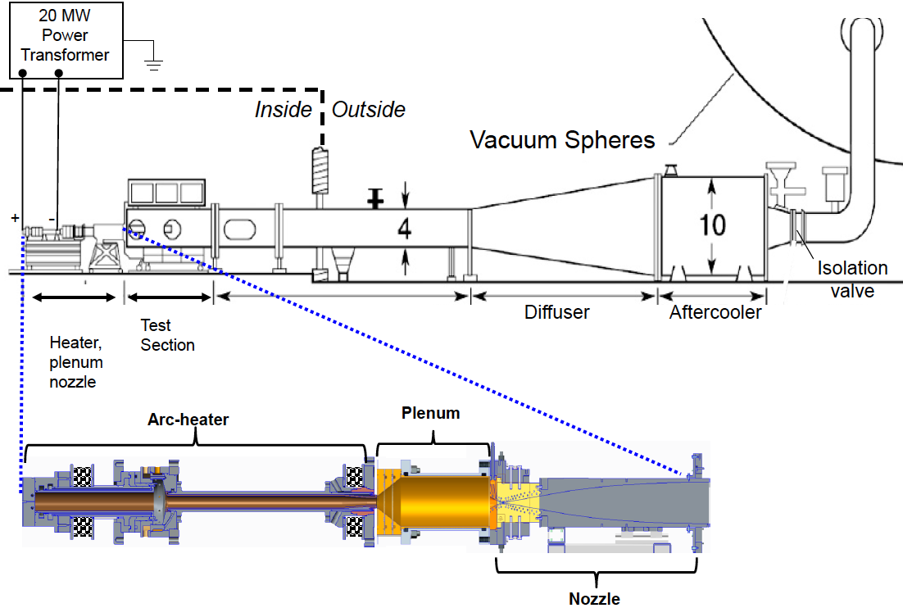
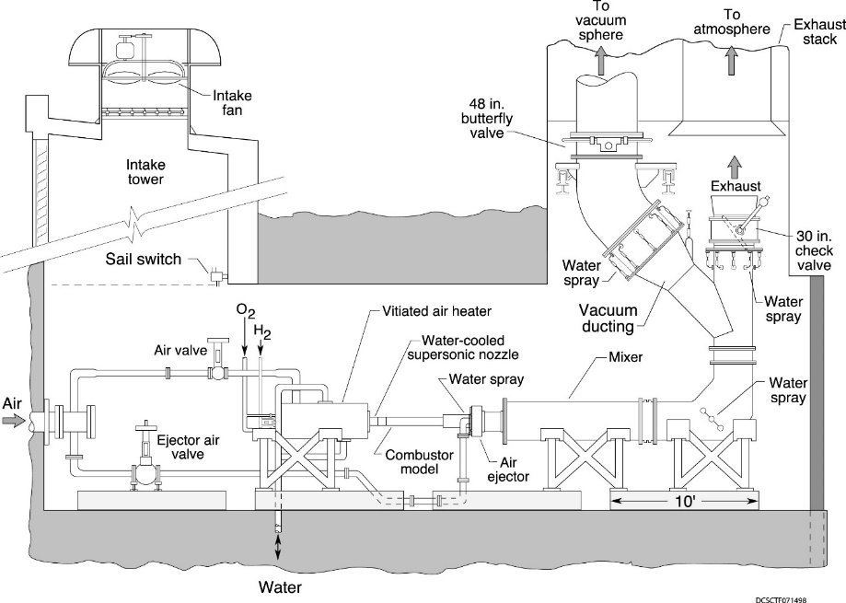
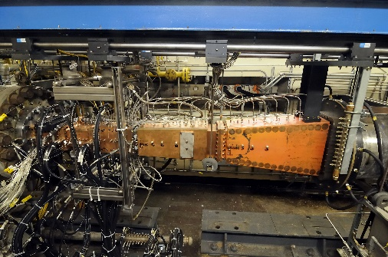
Scramjet Test Complex – STC
Arc-Heated Scramjet Test Facility (AHSTF) and Direct-Connect Supersonic Combustion Test Facility (DCSCTF)
 | AHSTF | DCSCTF
Simulated Flight Mach Number | 2.2 – 8 | 3 – 7.5
Gas | Dry Air | H₂-Air combustion products with O₂ replenishment
Flight Reynolds Number | 0.035 - 2.2x10⁶/ft | 2.0 - 8.0x10⁶/ft
Total Pressure (psia) | 675 | 115 – 500
Total Temperature (°R) | 2000 - 5200 | 1600 – 3800
Nozzle Exit (in.) | M2.2: 10 x 10 M3.5: 10 x 10 M4.7: 11.17 x 11.17 M6.0: 10.89 x 10.89 | M2.0: 1.52 x 3.46 M2.7: 1.5 x 6.69
Run Time | 30 sec – 5 min | Up to 15 min
Runs per Day | 5 – 10 | 4 – 8
Test Section | Open Jet | Direct Connect
AHSTF
DCSCTF

Slide 10
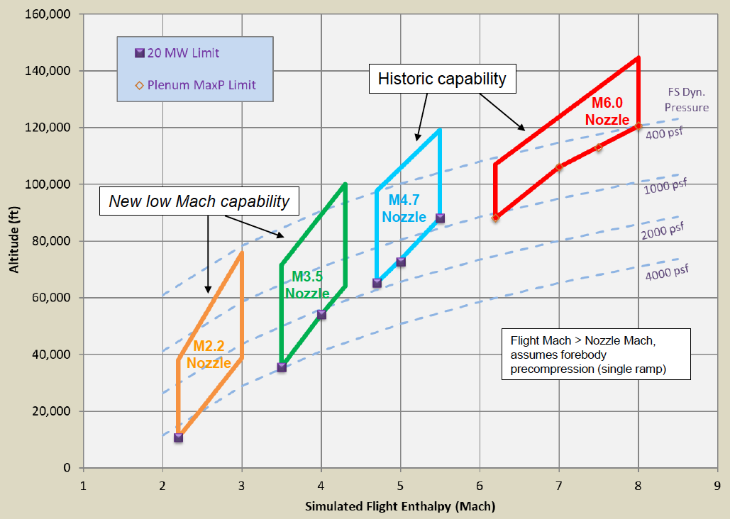
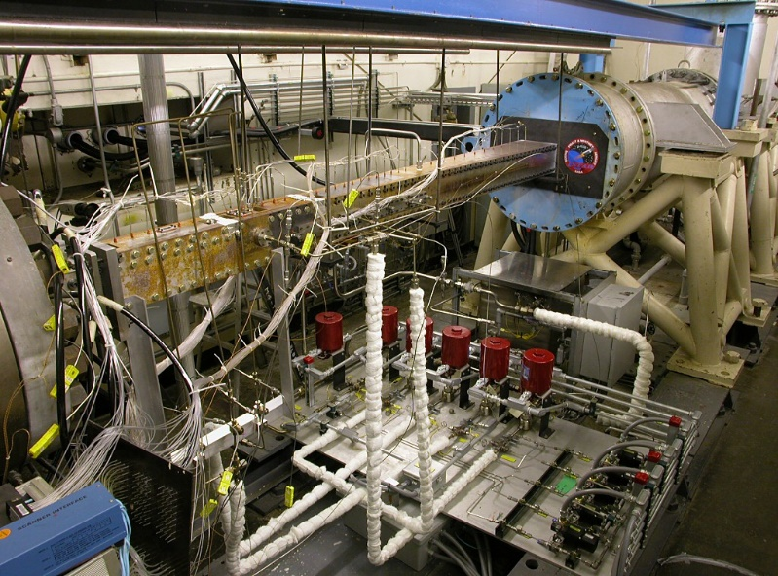
Scramjet Test Complex – STC Test Types / Features
AHSTF
High-enthalpy 1X-scale test facility used for integrated scramjet flowpath development and performance evaluation (partial forebody, inlet, isolator, combustor, partial nozzle)
Test gas heated via electric arc (creates small amount of NO contaminant)
Low back pressure for altitude simulation provided by four 60’ vacuum spheres
Liquid and gaseous fuel delivery systems
A large pool of pressure transducers, temperature sensors, heat flux gages, and flow rate meters available
Optical access for Schlieren, IR, and NO PLIF techniques
Proprietary, ITAR, classified testing available
AHSTF test envelope
DCSCTF
High-enthalpy 1X-scale test facility used for developing and testing scramjet isolator/combustor flowpaths (fuel injection, mixing, flameholding, combustion, heat release and thermal choking)
High-pressure air heated via hydrogen combustion with oxygen replacement, simulating isolator inlet conditions for flight at Mach 3.0 to 7.5
No test cabin; isolator/combustor is bolted directly to the facility nozzle
Liquid and gaseous fuel delivery systems
A large pool of pressure transducers, temperature sensors, heat flux gages, and flow rate meters available
Proprietary, ITAR, classified testing available
Test article installed in DCSCTF

