Slide 1



Classifying Aircraft using Velocity Data with Support Vector Machines and Likelihood Ratio Tests
Logan Dihel, Chester Dolph, Henry Holbrook
National Aerospace and Space Administration
Sandip Roy
Washington State University
AIAA SciTech, January 23-27, 2023
Published by the American Institute of Aeronautics and Astronautics, Inc., with permission.
1
Notes:
Hello everyone. My name is Logan Dihel. I’m a master’s student in Electrical Engineering at Washington State University, and I just completed an internship with NASA Langley in computer vision. I’d like to my NASA Mentor Chester Dolph and my thesis advisor Sandip Roy for their guidance throughout this research, along with my colleague Henry Holbrook for organizing the datasets used in this work. This presentation highlights methods to classify aircraft from radar data and investigates how data from flight controllers can be used to train classifiers.

Slide 2
Outline
Motivation
Methodology
  Overview, Metrics, Classifiers, Training Data Sources
Datasets
  Radar Dataset, Flight Controller Dataset
Results
  Metric Performance, Difficulties, and Comparison to Prior Work
Conclusions
Notes:
Here’s a brief outline of this presentation. I will cover motivation, methodology, the datasets, results, and conclusions.

Slide 3
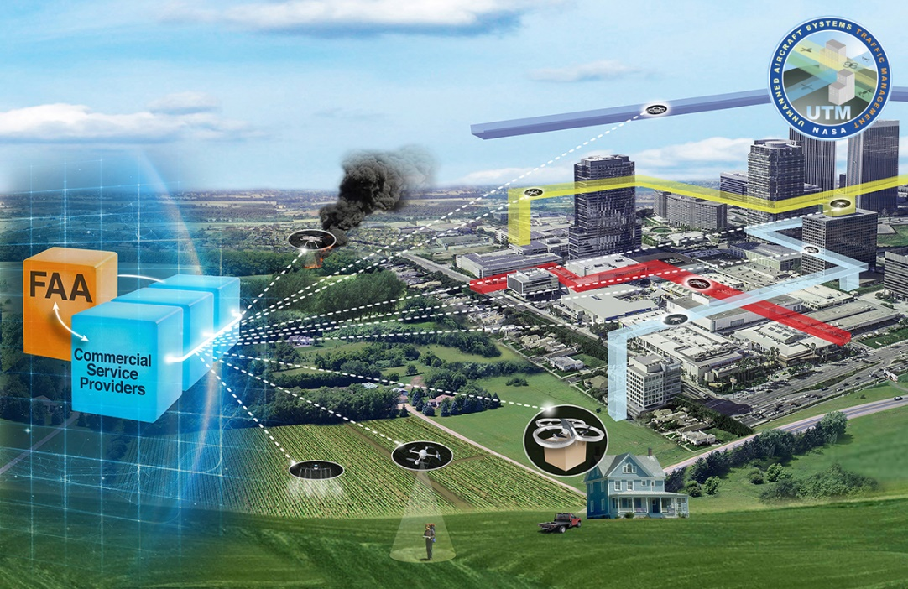
Motivation
sUAS Airspace Integration
  Urban Air Mobility
  Urban Traffic Management
  Advance Aircraft Mobility
sUAS Security Threats
  Gatwick Airport, 2018
  Lee Correctional, 2022
  Delayed Sports Events
https://nari.arc.nasa.gov/utm2021tim
Notes:
Why is classifying aircraft important? First, there are many technologies that rely on the ability to detect and classify aircraft such as small unmanned aerial systems. Second, sUAS present a threat to airports, prisons, and sports venues. For these reasons, it is important to detect and classify aircraft quickly.

Slide 4
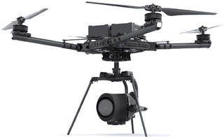
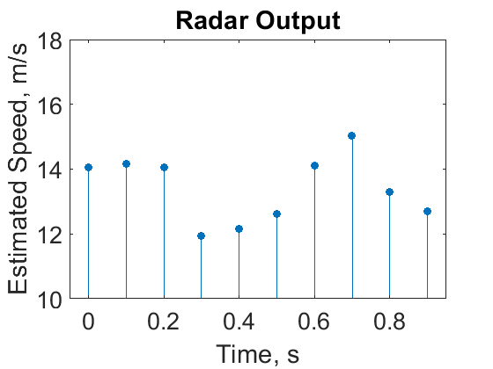
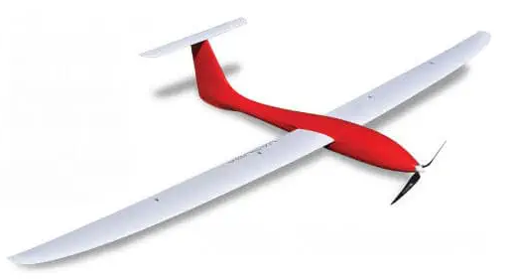
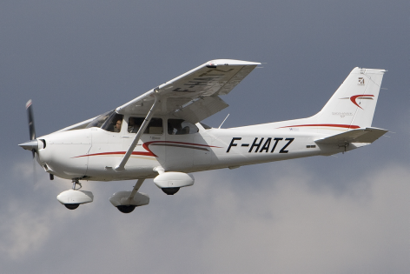
Methodology - Overview
Objective: quickly identify aircraft from radar data
Which metrics?
What type of classifier?
Metrics
Classifier
How to train classifier?
Notes:
The objective of this research is to quickly identify aircraft from radar data. To classify aircraft, we start with an estimated velocity signal from the radar, convert the signal to a metric, and a classifier identifies which type of aircraft the metric most likely belongs to. In this work, the three types of aircraft are multi-rotor sUAS, fixed wing sUAS, and general aviation, or GA plane. Three important questions to ask are which metrics do we use?, what type of classifier do we use?, and how do we train the classifier?

Slide 5






Methodology – Metrics
Which metrics should be used?
Average Speed
  sUAS should fly slower than GA plane
Smoothness-based Metrics
  Smaller aircraft should have more fluctuations in velocity tracks due to their smaller mass
  Novel: Log Variance of Absolute Change in Speed
  Novel: Log Variance of Relative Change in Speed
Notes:
Let’s start with metrics. The most basic metric is average speed. This metric was quite effective, with 96% accuracy from 1-second of radar data. Another approach is to use smoothness-based metrics, such as the two novel approaches presented in this work. We will show later why these novel approaches are poor at classifying aircraft from radar data.

Slide 6
Methodology – Classifier
What type of classifier should be used?
Support Vector Machine (SVM)
  Can classify using multiple metrics
  Commonly used for classification [1], [2]
Likelihood Ratio Test Classifier (LR)
  Best for single metric classification
  Well documented in probability theory
  Easy to implement on low-cost microcontroller
[1] Holbrook, H., Garrett, P., Behari, N., Dolph, C., Morris, C., and Szatkowski, G., “Aerial Object Trajectory Classification by Training on Flight Controller Data and Testing on Radar Generated Tracks,” AIAA SciTech Forum, 2022. https://doi.org/10.2514/6.2022-0496
[2] Dolph, C., Szatkowski, G., Holbrook, H., Morris, C., Ticatch, L., Malekpour, M. R., and McSwain, R., “Aircraft Classification Using RADAR from small Unmanned Aerial Systems for Scalable Traffic Management Emergency Response Operations,” AIAA AVIATION 2021 FORUM, 2021. https://doi.org/10.2514/6.2021-2331, URL https://arc.aiaa.org/doi/abs/10.2514/6.2021-2331.15
Notes:
Second, what type of classifier should be used? We use both a Support Vector Machine and a Likelihood Ratio Test Classifier. The SVM is commonly used to identify aircraft in literature. Likelihood Ratio Tests are an alternative approach that is best for classifying aircraft using only a single metric.

Slide 7
Methodology – Training Data Sources
How should the classifiers be trained?
Train with Radar Data
  Less data available, more expensive to collect
  59 tracks, 0.48 hours of data, 3 aircraft
Train with Flight Controller Logs [1]
  Readily available, less expensive to acquire
  274 tracks, 34.69 hours of data, 7 aircraft
  Potential issue: training classifier with a different data source than classifier is tested
[1] Holbrook, H., Garrett, P., Behari, N., Dolph, C., Morris, C., and Szatkowski, G., “Aerial Object Trajectory Classification by Training on Flight Controller Data and Testing on Radar Generated Tracks,” AIAA SciTech Forum, 2022. https://doi.org/10.2514/6.2022-0496
Notes:
Finally, how should the classifiers be trained? The straightforward approach is to train the classifiers with radar data, which are less abundant and expensive to collect. An alternative approach is to train the classifiers with flight controller logs, as they are readily available and less expensive to acquire than radar data. Training a classifier with flight controller logs but testing with radar data raises a potential issue which we will discuss later.

Slide 8
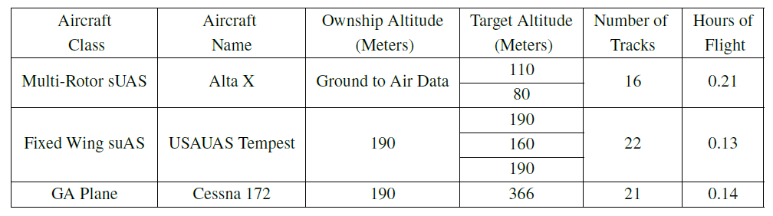
Radar Dataset – Summary
  Radar dataset is used to test the classifiers
  59 tracks, 0.48 hours of data, 3 aircraft
Notes:
Two datasets were used in this work. One from an Echodyne radar, and another from flight controllers which were mounted on aircraft during flight tests. The radar dataset consisted of 59 total tracks, totaling about 30 minutes of data across three aircraft.

Slide 9
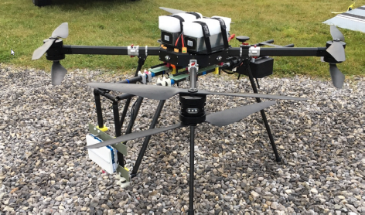
Radar Dataset – Aircraft Used
Radar mounted on BFD 1400-SE8 when sensing the Tempest and Cessna
Radar on ground when sensing Alta X
BFD 1400-SE8
Alta X
USAUAS Tempest
Cessna 172
Notes:
The Echodyne radar estimated velocity between 9 and 10 times per second. When sensing the fixed wing sUAS and GA plane, the radar was mounted on the BFD multi-rotor sUAS. When sensing the multi-rotor sUAS, the radar was stationary on the ground.

Slide 10
Flight Controller Dataset – Summary
  Only used for training the classifiers
  274 tracks, 34.69 hours of data, 7 aircraft
Notes:
The flight controller dataset is much larger than the radar dataset, with 274 tracks totaling over 34 hours of data across seven different aircraft. The flight controller logs for each aircraft were resampled to 10 Hz to match the radar dataset.

Slide 11
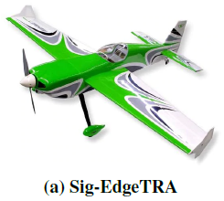
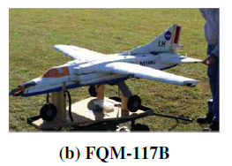
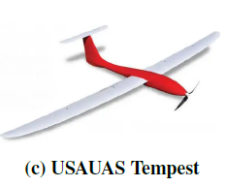
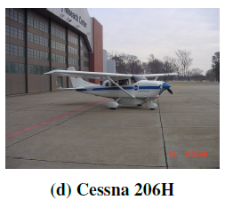
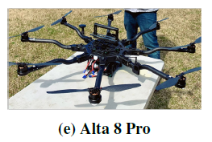
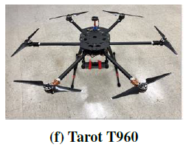
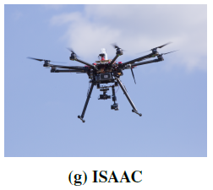
Flight Controller Dataset – Aircraft Used
Fixed Wing sUAS
  Sig-EdgeTRA
  FQM-117B
  USAUAS Tempest
GA Plane
  Cessna 206H
Multi-Rotor sUAS
  Alta 8 Pro
  Tarot T960
  ISAAC
Notes:
Of the seven aircraft, three were multi-rotor sUAS, three were fixed wing sUAS, and one was a GA plane. It should be noted that the GA plane used in the flight controller dataset is not the same as the GA plane used in the radar dataset.

Slide 12
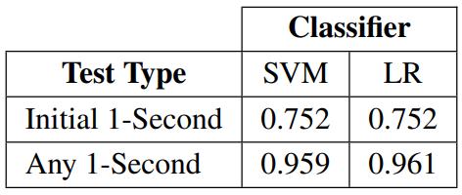
Results – Avg Speed, Train with Radar
Train classifiers with Average Speed from radar data, and test classifiers with radar data
10-Fold Cross Validation was used
Initial 1-Second: test on the first second of observed track data
Any 1-Second: test on any particular 1-second interval within the track data
Better Performance
Notes:
Throughout the results section, two types of tests were used. The first tests the classifiers with the initial 1-second intervals from the radar tracks. This test shows the performance of the classifiers when the radar first detects the aircraft. Because there were only 59 radar tracks in the dataset, we also considered testing over any particular 1-second interval from within the radar tracks. This slide uses average speed to train and test classifiers with radar data. When testing over the initial 1-second interval of radar data, the SVM and Likelihood Ratio Test classifiers achieved about 75% accuracy. When the classifiers were tested over any particular 1-second interval, the classifiers achieved 96% accuracy.

Slide 13
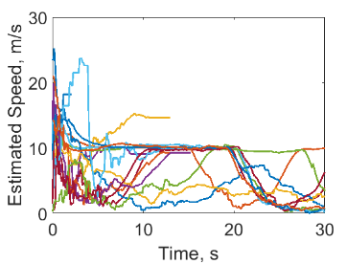
Difficulties with Testing over Initial Interval
Multi-Rotor Estimated Speed
Estimated Average Speed is larger at beginning of radar tracks
Echodyne radar uses a Kalman filter to estimate average speed
Notes:
So why did classification accuracy drop from 96% to only 75% when testing over the initial 1-second interval? The estimated speed of the aircraft quickly decreased after the aircraft was initially detected. So, the classifiers were trained using data with lower average speed than they were tested on, resulting in lower classification accuracy. The sudden drop in estimated speed may be due to the nature of the Kalman Filter used in the Echodyne radar: as more data is collected the radar obtains a better estimate for average speed.

Slide 14
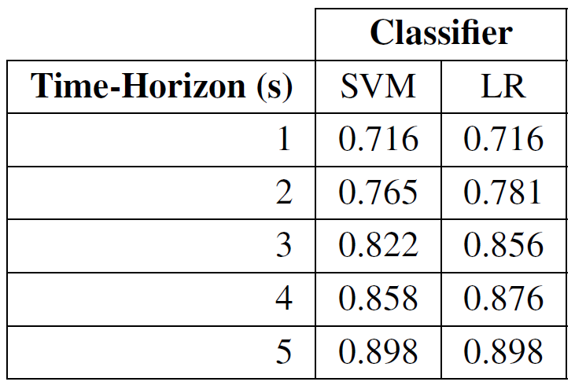
Results – Avg Speed, Train with FC (1/2)
Train classifiers with Average Speed from flight controller logs, and test classifiers with Initial T-second Interval of radar data
Classifiers perform better with more data
SVM and LR performed similarly
Notes:
This slide uses average speed from flight controller logs to train the classifiers. When testing over initial T-second intervals in the radar data, the SVM and Likelihood Ratio classifiers performed similarly, and their performances increased with a longer time-horizon, from 72% up to almost 90%.

Slide 15
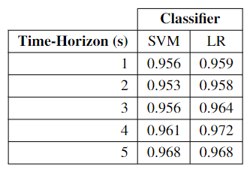
Results – Avg Speed, Train with FC (2/2)
Train classifiers with Average Speed from flight controller logs, and test classifiers with Any T-Second Interval of radar data
SVM and LR performed similarly
Better performance than testing on initial intervals
Notes:
When testing over any particular T-second interval, both classifiers had about 96% accuracy, which is higher than the previous test. Again, longer time-horizons had higher classification accuracy.

Slide 16
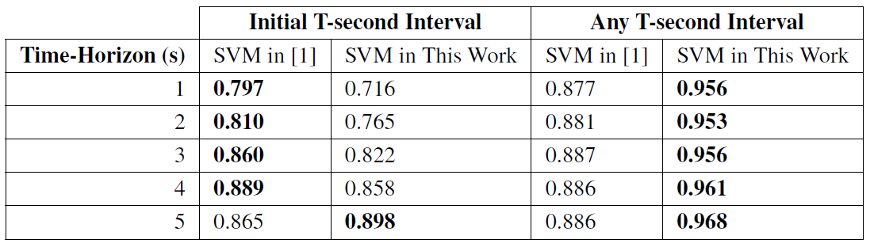
Results – Comparison to Prior Work
Comparison of SVM using only Average Speed to prior work
  Prior work used a 13-metric SVM, trained on flight controller logs, tested on radar data. One of these metrics was Average Speed.
[1] Holbrook, H., Garrett, P., Behari, N., Dolph, C., Morris, C., and Szatkowski, G., “Aerial Object Trajectory Classification by Training on Flight Controller Data and Testing on Radar Generated Tracks,” AIAA SciTech Forum, 2022. https://doi.org/10.2514/6.2022-0496
Notes:
This slide shows a comparison to prior work by my co-author Henry Holbrook. In the prior work, a 13-metric SVM was trained on flight controller logs and tested on radar data. We wanted to see whether a classifier trained with only average speed would perform similarly. We found that the prior work was more robust to the increase in the initial estimated speed in the radar data; however, the prior work had lower accuracy when testing over any particular T-second interval.

Slide 17
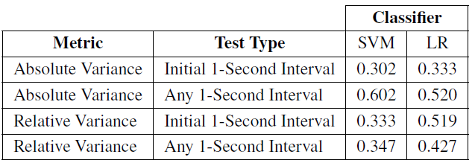
Results – Smoothness, Radar to Radar
Train classifiers with Smoothness Metrics from radar data, and test classifiers with radar data
Smoothness metrics had lower accuracy than Average Speed
Notes:
This slide shows the performance of the novel smoothness metrics. Regardless of the test, the novel smoothness metrics had lower accuracy than average speed.

Slide 18
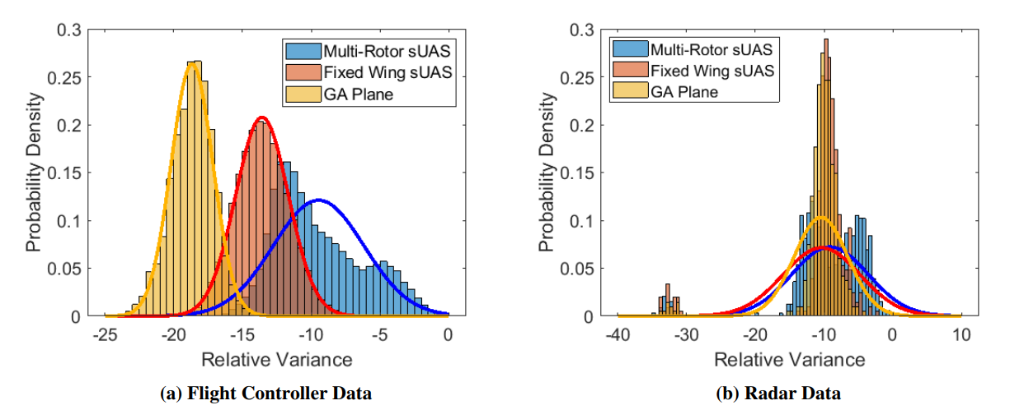
Results – Smoothness, Radar to Radar
Smoothness metrics did not map from FC data to radar data
Notes:
So why did we include the novel smoothness metrics in this presentation if they performed so poorly? Originally, the smoothness metrics were designed to classify aircraft from flight controller logs, which had a distribution shown on the left. When these metrics were applied to radar data, the distributions changed their parameters and had slightly more overlap, decreasing the classification accuracy as shown on the right. The distributions changed because the smoothness metrics depend on the sensors and filters used to estimate the velocity of the aircraft. The smoothness metrics teach a valuable lesson: metrics designed for one data source will not always map to another data source. In future work, it should be determined whether metrics map from training data to testing data appropriately before a classifier is trained and tested with different data sources.

Slide 19
Conclusions
Average Speed achieves up to 96% accuracy
  Train with radar data, 1 second time horizon
  Train with FC logs, 1 second time horizon
  Performed better than 13-metric SVM in [1] over any particular T-second interval, worse over short initial intervals
Novel smoothness metrics are poor classifiers
  When training and testing classifiers on different data sources preprocessing techniques may be required
[1] Holbrook, H., Garrett, P., Behari, N., Dolph, C., Morris, C., and Szatkowski, G., “Aerial Object Trajectory Classification by Training on Flight Controller Data and Testing on Radar Generated Tracks,” AIAA SciTech Forum, 2022. https://doi.org/10.2514/6.2022-0496
Notes:
In this presentation, we showed that both the SVM and Likelihood Ratio classifiers could classify aircraft with 96% accuracy, regardless of whether they were being trained from flight controller logs or with radar data. An SVM using only average speed performed better over any T-second interval but worse over short initial intervals when compared to a 13-metric SVM used in prior work. Additionally, we showed that the smoothness metrics were poor classifiers over this dataset, and more generally, that training and testing classifiers on different data sources may require additional dataset preprocessing techniques such as feature scaling and normalization.

Slide 20

Thank You!
Please direct questions to
logan.dihel@wsu.edu
chester.v.dolph@nasa.gov
Notes:
Thanks for listening to this presentation. If you have any questions, comments, or concerns, please direct questions to Logan Dihel or Chester Dolph. Thank you!

