Slide 1

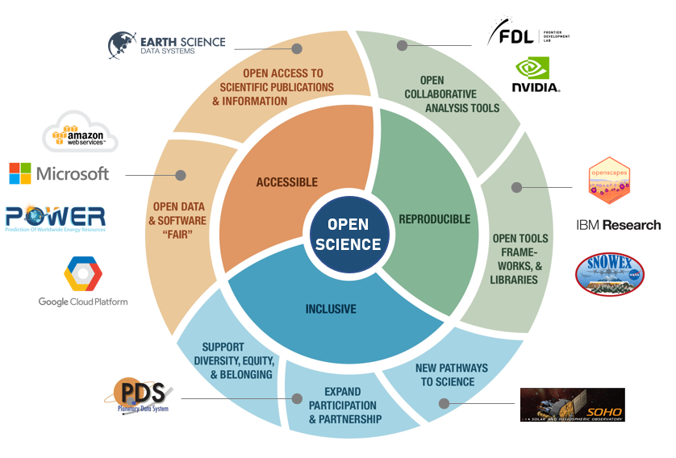

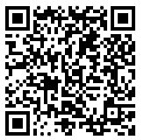

Fostering Open Science through
Public-Private Partnerships
Elizabeth Fancher (Barrios Technology)
Rahul Ramachandran (NASA)
Contact: elizabeth.m.fancher@nasa.gov
Background
AWS Success Stories
The lack of formal collaboration mechanisms often hinders open knowledge transfer between government agencies and private industries. NASA’s Interagency Implementation and Advanced Concepts Team (IMPACT) seeks to address these challenges by establishing NASA Space Act Agreements (SAAs) as non-reimbursable research partnerships with the private sector. One example is with the Amazon Web Services (AWS) Sustainability Initiative and AWS Open Data Sponsorship Program.
Discover these new NASA datasets on RODA:
NASA Prediction of Worldwide Energy Resources (POWER)
NASA/ USGS Europa Controlled Observations
NASA Exchange Global Daily Downscaled Projections (NEX-GDDP-CMIP6)
NASA SOHO/LASCO Comet Challenge
2022 Workshops and Training Events:
    NASA Openscapes Champions Cohort
    SnowEx Hackweek 2022
    ESDS Machine Learning Capacity Working Group
Methods
The agreement between NASA and AWS centers around the collaboration theme of discovery, access and use of high-value NASA science datasets and has two research goals:
Cloud-based Data Discovery
  Provide AWS cloud storage resources to NASA scientists within the Open Data Sponsorship Program.
  Provide users the ability to discover high-value cloud-optimized NASA datasets within the Registry of Open Data on AWS (RODA).
  Capacity Building
  Provide cloud compute resources to support NASA workshops that enable a transformation in data access and use of cloud-computing resources.
Next Steps
Continue to engage with other public-private partnerships (Google, Microsoft, IBM Research, and NVIDIA) to build a broader network of technical experts to explore the discovery, access, and use of high-value NASA science datasets on the cloud.
Investigate new ways to demonstrate “success” using data and compute resources collocated on the cloud.
Explore new opportunities in cloud technologies that enable and accelerate open science.
Partnership activities serve as convergence accelerators - “use driven” collaborations that benefit both parties.
Acknowledgements
Open Science image is based on a similar image created by Ramachandran, et al., and published in "From Open Data to Open Science." Earth and Space Science
AWS Open Data Sponsorship Team
Learn More at our Website!
Image credit: NASA, AWS, Microsoft, FDL, NVIDIA, GCP, IBM Research, Openscapes, and Flaticon.com,

